Slide 1






Experimental Investigation of Rotor Model with Blowing Jets
Elijah Greenfield
Emerson Moser, Parisa Footohi, Sergey Shkarayev
Micro Air Vehicles (MAV) and ASTEROIDS Laboratory
University of Arizona Aerospace and Mechanical Engineering Department

Slide 2
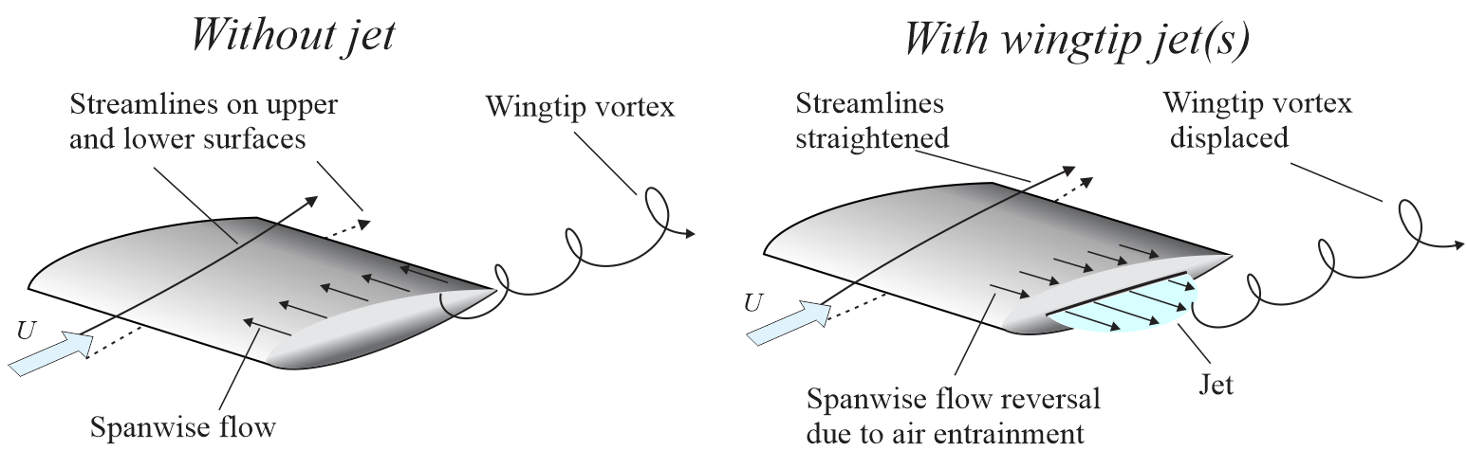
Motivation
Study the dynamic stall effects both with and without a perturbing jet
Study formation of vortices at different points along blade’s path
Reduce tip-vortex interaction in rotor blade
Applicable for rotorcraft not only on Earth, but also Mars and beyond
Notes:
-Passive vs. active flow manipulation
-Wing tip effects
-Entrainments and vortex offset
-Ingenuity shoutout – why this could be beneficial for Mars atmosphere

Slide 3
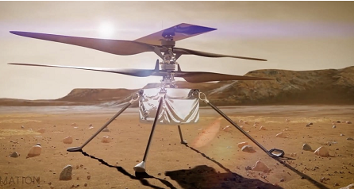
Drones and Helicopters on Mars
In 2021, the Ingenuity Mars Helicopter performed first 2-min flight
Need to explore the aerodynamics of rotor blades in Martian conditions, characterized by low density and high Mach numbers
Research objective of the present study is to investigate active flow control methods in a rotor model by using particle image velocimetry
Total mass 1,700 g
Batteries 270 g
Rotor 850 g
2,800 RPM, Mach 0.7
No payload
Notes:
-Ingenuity was a proof of concept: rotorcraft can work on other planets
-Very small, high RPM, no payload.
-For more extensive missions need to ensure rotors (and system) are capable of withstanding conditions
-Low density atmosphere necessitates high RPM, high Mach at tip
-Use PIV to study effect of active flow control

Slide 4
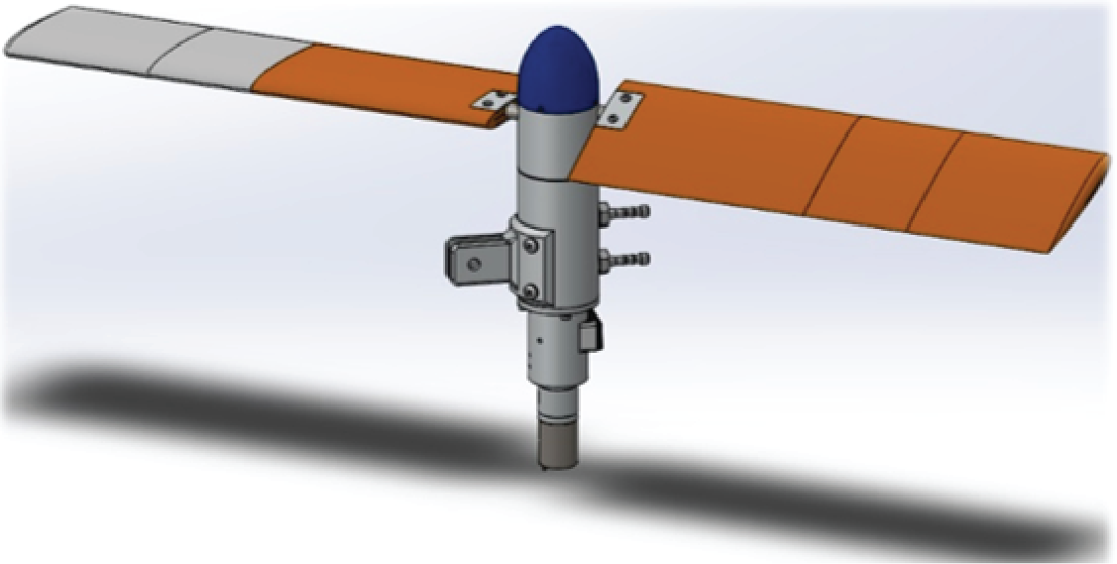
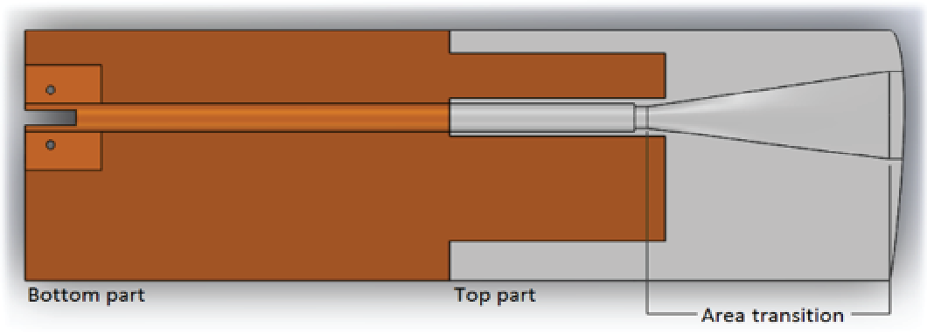
Experimental Model
Rotor assembly was mounted at a 6° angle of attack with respect to the freestream
Air chambers and slots at the blade tips guide pressurized air jets
Jets push vortex core further out of blade’s path
Airfoil: | NACA 0012
Blade span: | 0.3459 m
Blade chord: | 0.1 m
Notes:
-Two blade NACA 0012 rotor
-Separate pressure reservoir for each blade, same supply split for our testing
-Supply is routed through a channel at the quarter chord, which transitions to a rectangular slot at the wing tip
-Model is mounted to a fixture, so the blades and fixture can have separate angles relative to the freestream

Slide 5
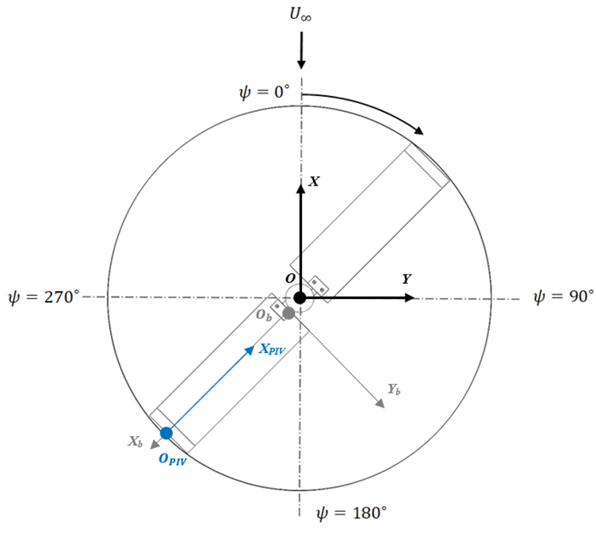
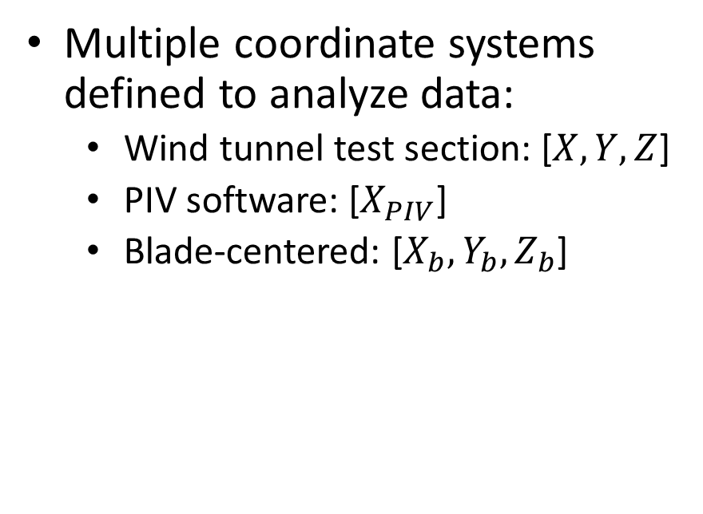
Coordinate Axes
Multiple coordinate systems defined to analyze data:
  Wind tunnel test section: [$X, Y, Z$]
  PIV software: [$X_{PIV}$]
  Blade-centered: [$X_{b}, Y_{b}, Z_{b}$]
Notes:
-Measurements taken at four angles with respect to freestream
-Data transformed to blade-centric coordinate system to stay consistent regardless of azimuthal angle

Slide 6
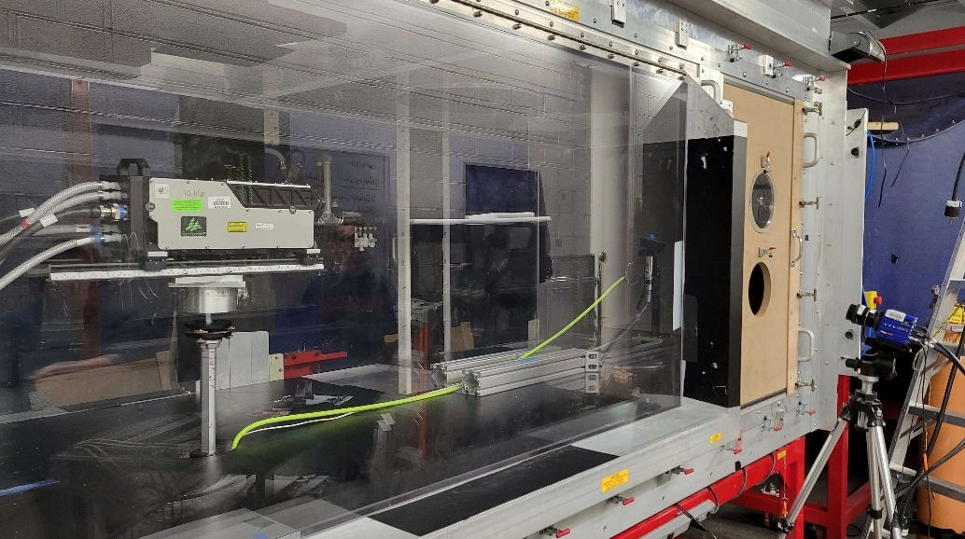
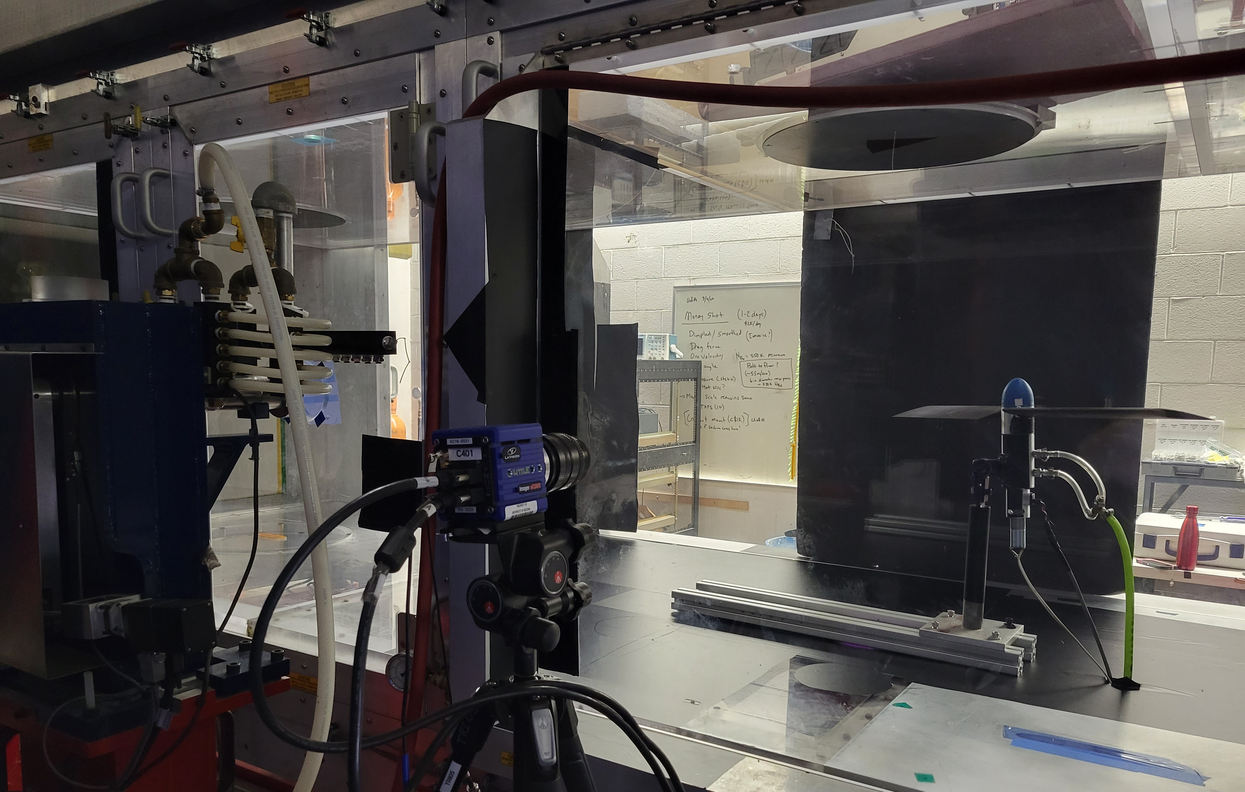
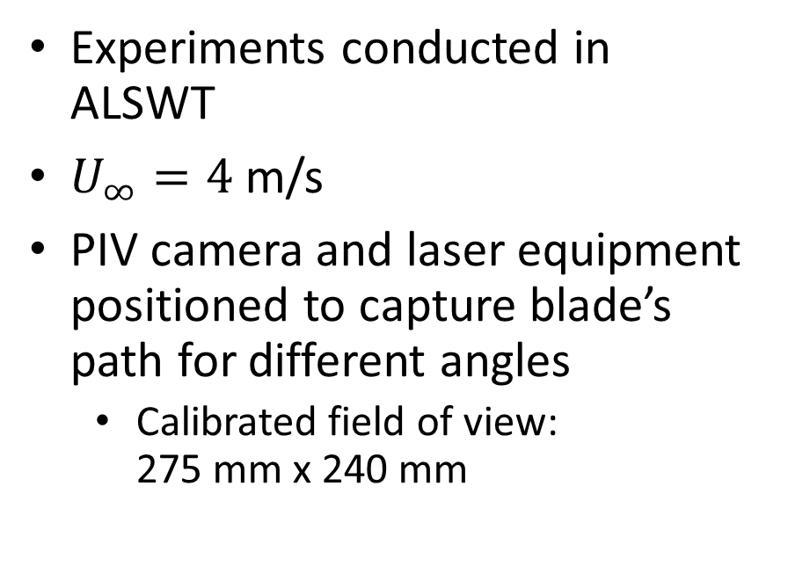
Facility and Setup
Experiments conducted in ALSWT
$U_{∞}=4$ m/s
PIV camera and laser equipment positioned to capture blade’s path for different angles
  Calibrated field of view: 275 mm x 240 mm
Notes:
-Campaign in Arizona Low Speed Wind Tunnel
-4 m/s freestream velocity
-In the picture, you can see our class IV laser mounted downstream of the rotor in the wind tunnel, with the camera facing perpendicular to the laser in front of the wind tunnel
-The setup in the campaign this semester was improved by removing an offset angle of the camera to the laser

Slide 7
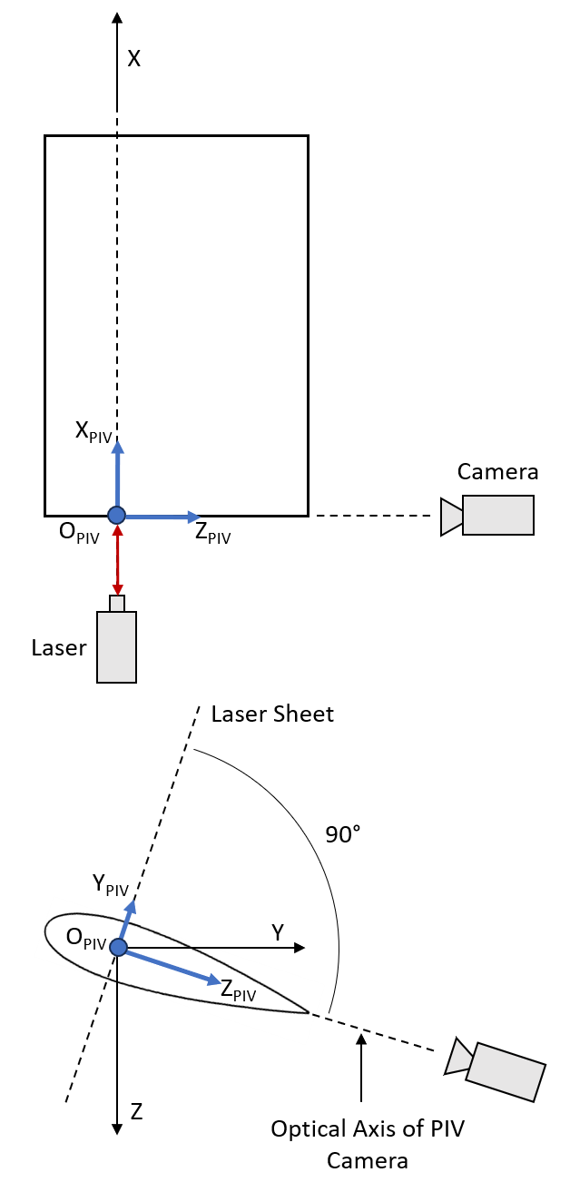
PIV
LaVision Particle Image Velocimetry (PIV) system used with DaVis 8.3.0 software
  Phase-locked 2D PIV
Illuminate seeded particles in flow with laser
  Spanwise plane, d/c = 0.25
Capture movement with high-speed camera
Notes:
-Used Particle Image Velocimetry to collect data
-PIV works be “seeding” reflective particles into the flow in the wind tunnel
-A laser and camera are then set to trigger to collect an image pair with known time between images
-By comparing the particle placement in the images, the flow velocity can be characterized
-PIV coordinate system is relative to the blade pitch, so the camera’s optical axis is aligned with TE of blade for each case; laser sheet perpendicular to chord line centered at quarter chord where jet is

Slide 8
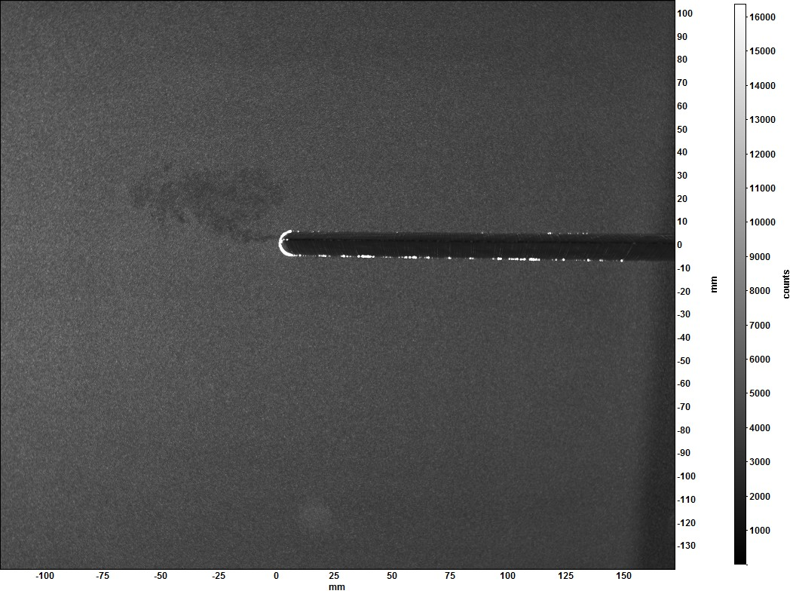
Results
Horizontal particle motion captured and with PIV equipment
Postprocess velocity vectors to obtain average velocity profiles
  Averaging of 100 recorded and processed PIV image pairs
  Postprocessing uses a 16x16 pixel interrogation window
Baseline and jet cases
Notes:
-White particles in background are seeder particles in the flow
-Glow along bottom edge is the laser
-Jet can be seen coming out of blade tip
-Tracks particle movement to get velocity

Slide 9
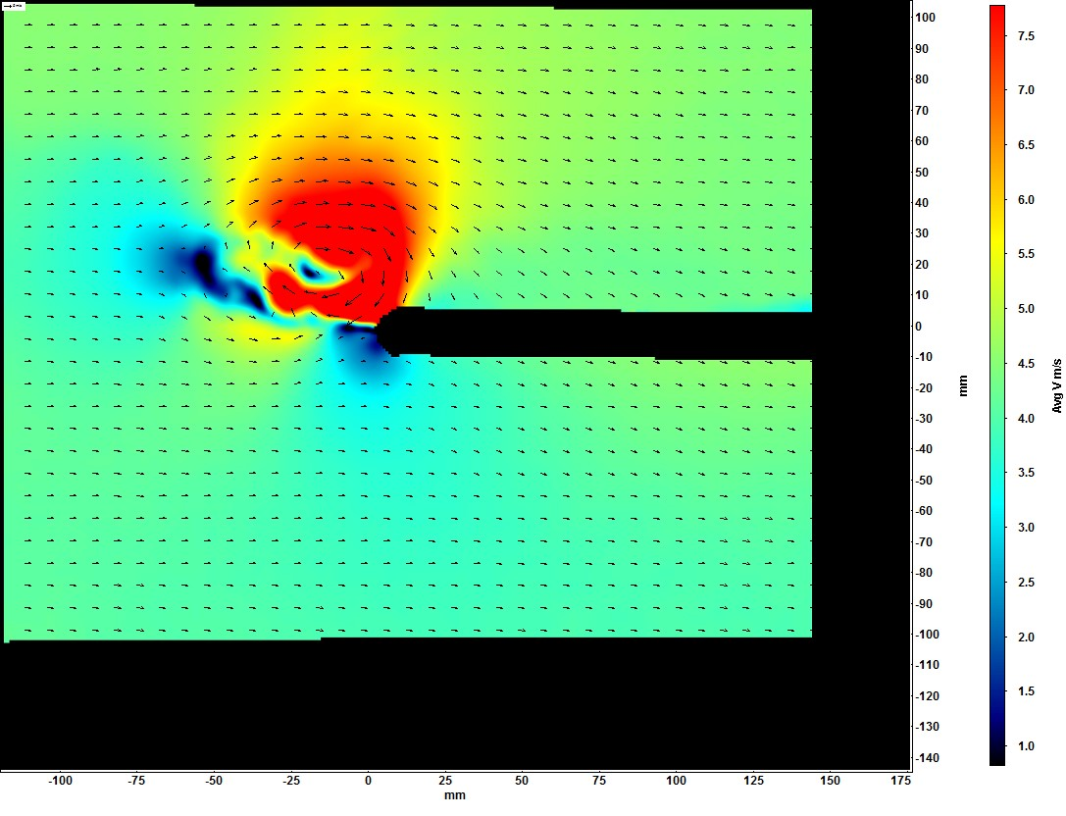
Results
Horizontal particle motion captured and with PIV equipment
Postprocess velocity vectors to obtain average velocity profiles
  Averaging of 100 recorded and processed PIV image pairs
  Postprocessing uses a 16x16 pixel interrogation window
Baseline and jet cases
Notes:
-Turns into velocity map like we see here
-Jet clearly seen in vectors
-Arrows show circulation of vortex

Slide 10
Results
Spanwise velocity profile plotted at 2 mm above blade surface
Compare jet to baseline case
Spike at blade tip where vortex and/or jet accelerates flow
Can see entrainment of flow as the jet activates and reverses spanwise flow
Notes:
-Can compare baseline to jet cases to see how tip jet affects velocity over the blade
-Our results show clear differences between the baseline case with no jet opposed to the tip jet turned on
-Jet is able to reverse flow over the top of the blade, even when faced against freestream.

Slide 11
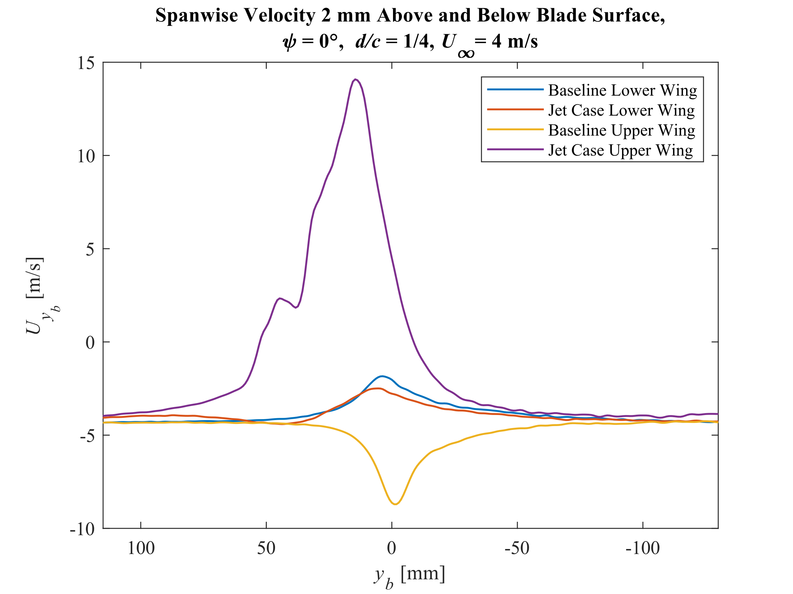
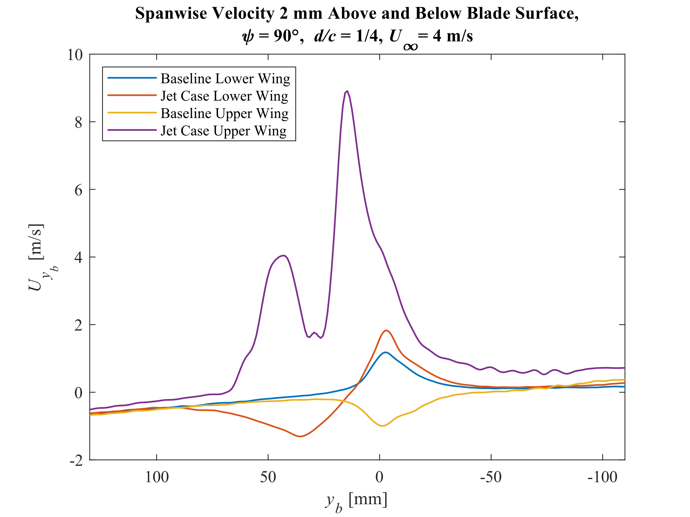
Results
Notes:
-For the 0° case, the difference from the baseline to the jet measurement is about twice the magnitude as it is for any other case
-Jet blowing much harder than freestream, so is able to completely reverse the behavior exhibited by the baseline.
-Difference in the baseline and the jet case for the lower surface is almost negligible
-Both vortex and jet have same entraining behavior, result in air on lower surface moving outwards regardless of jet presence

Slide 12
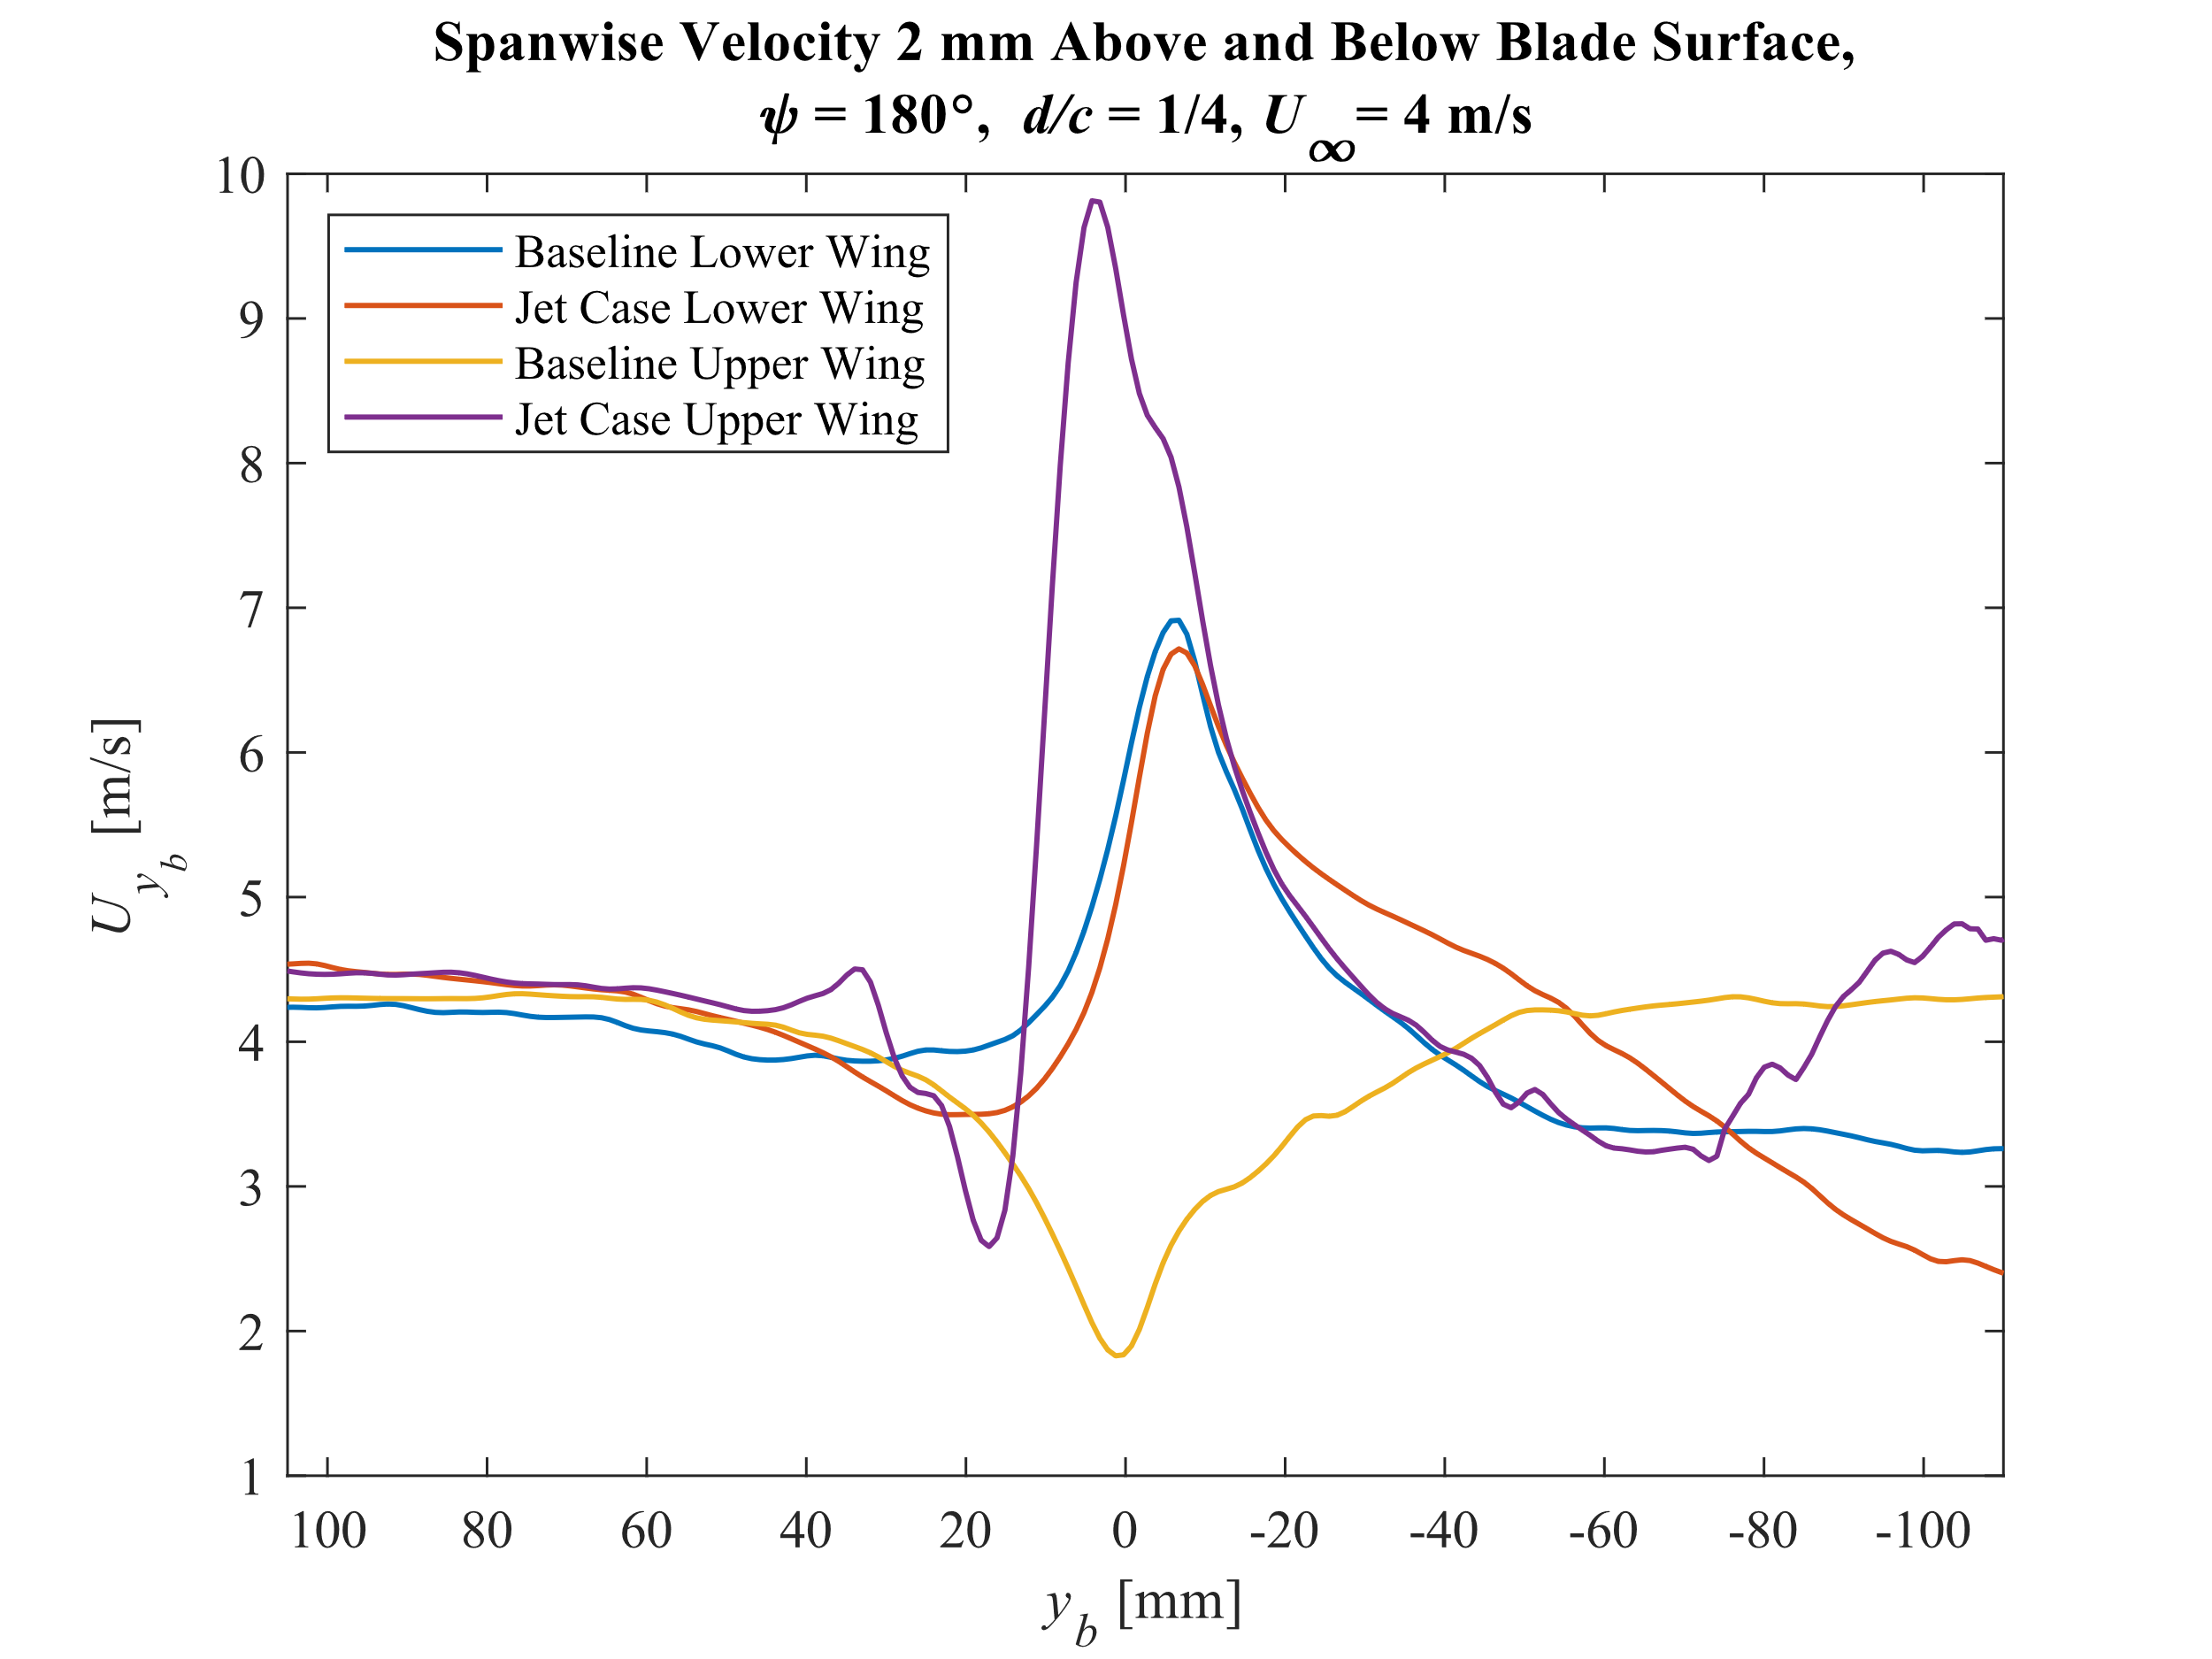
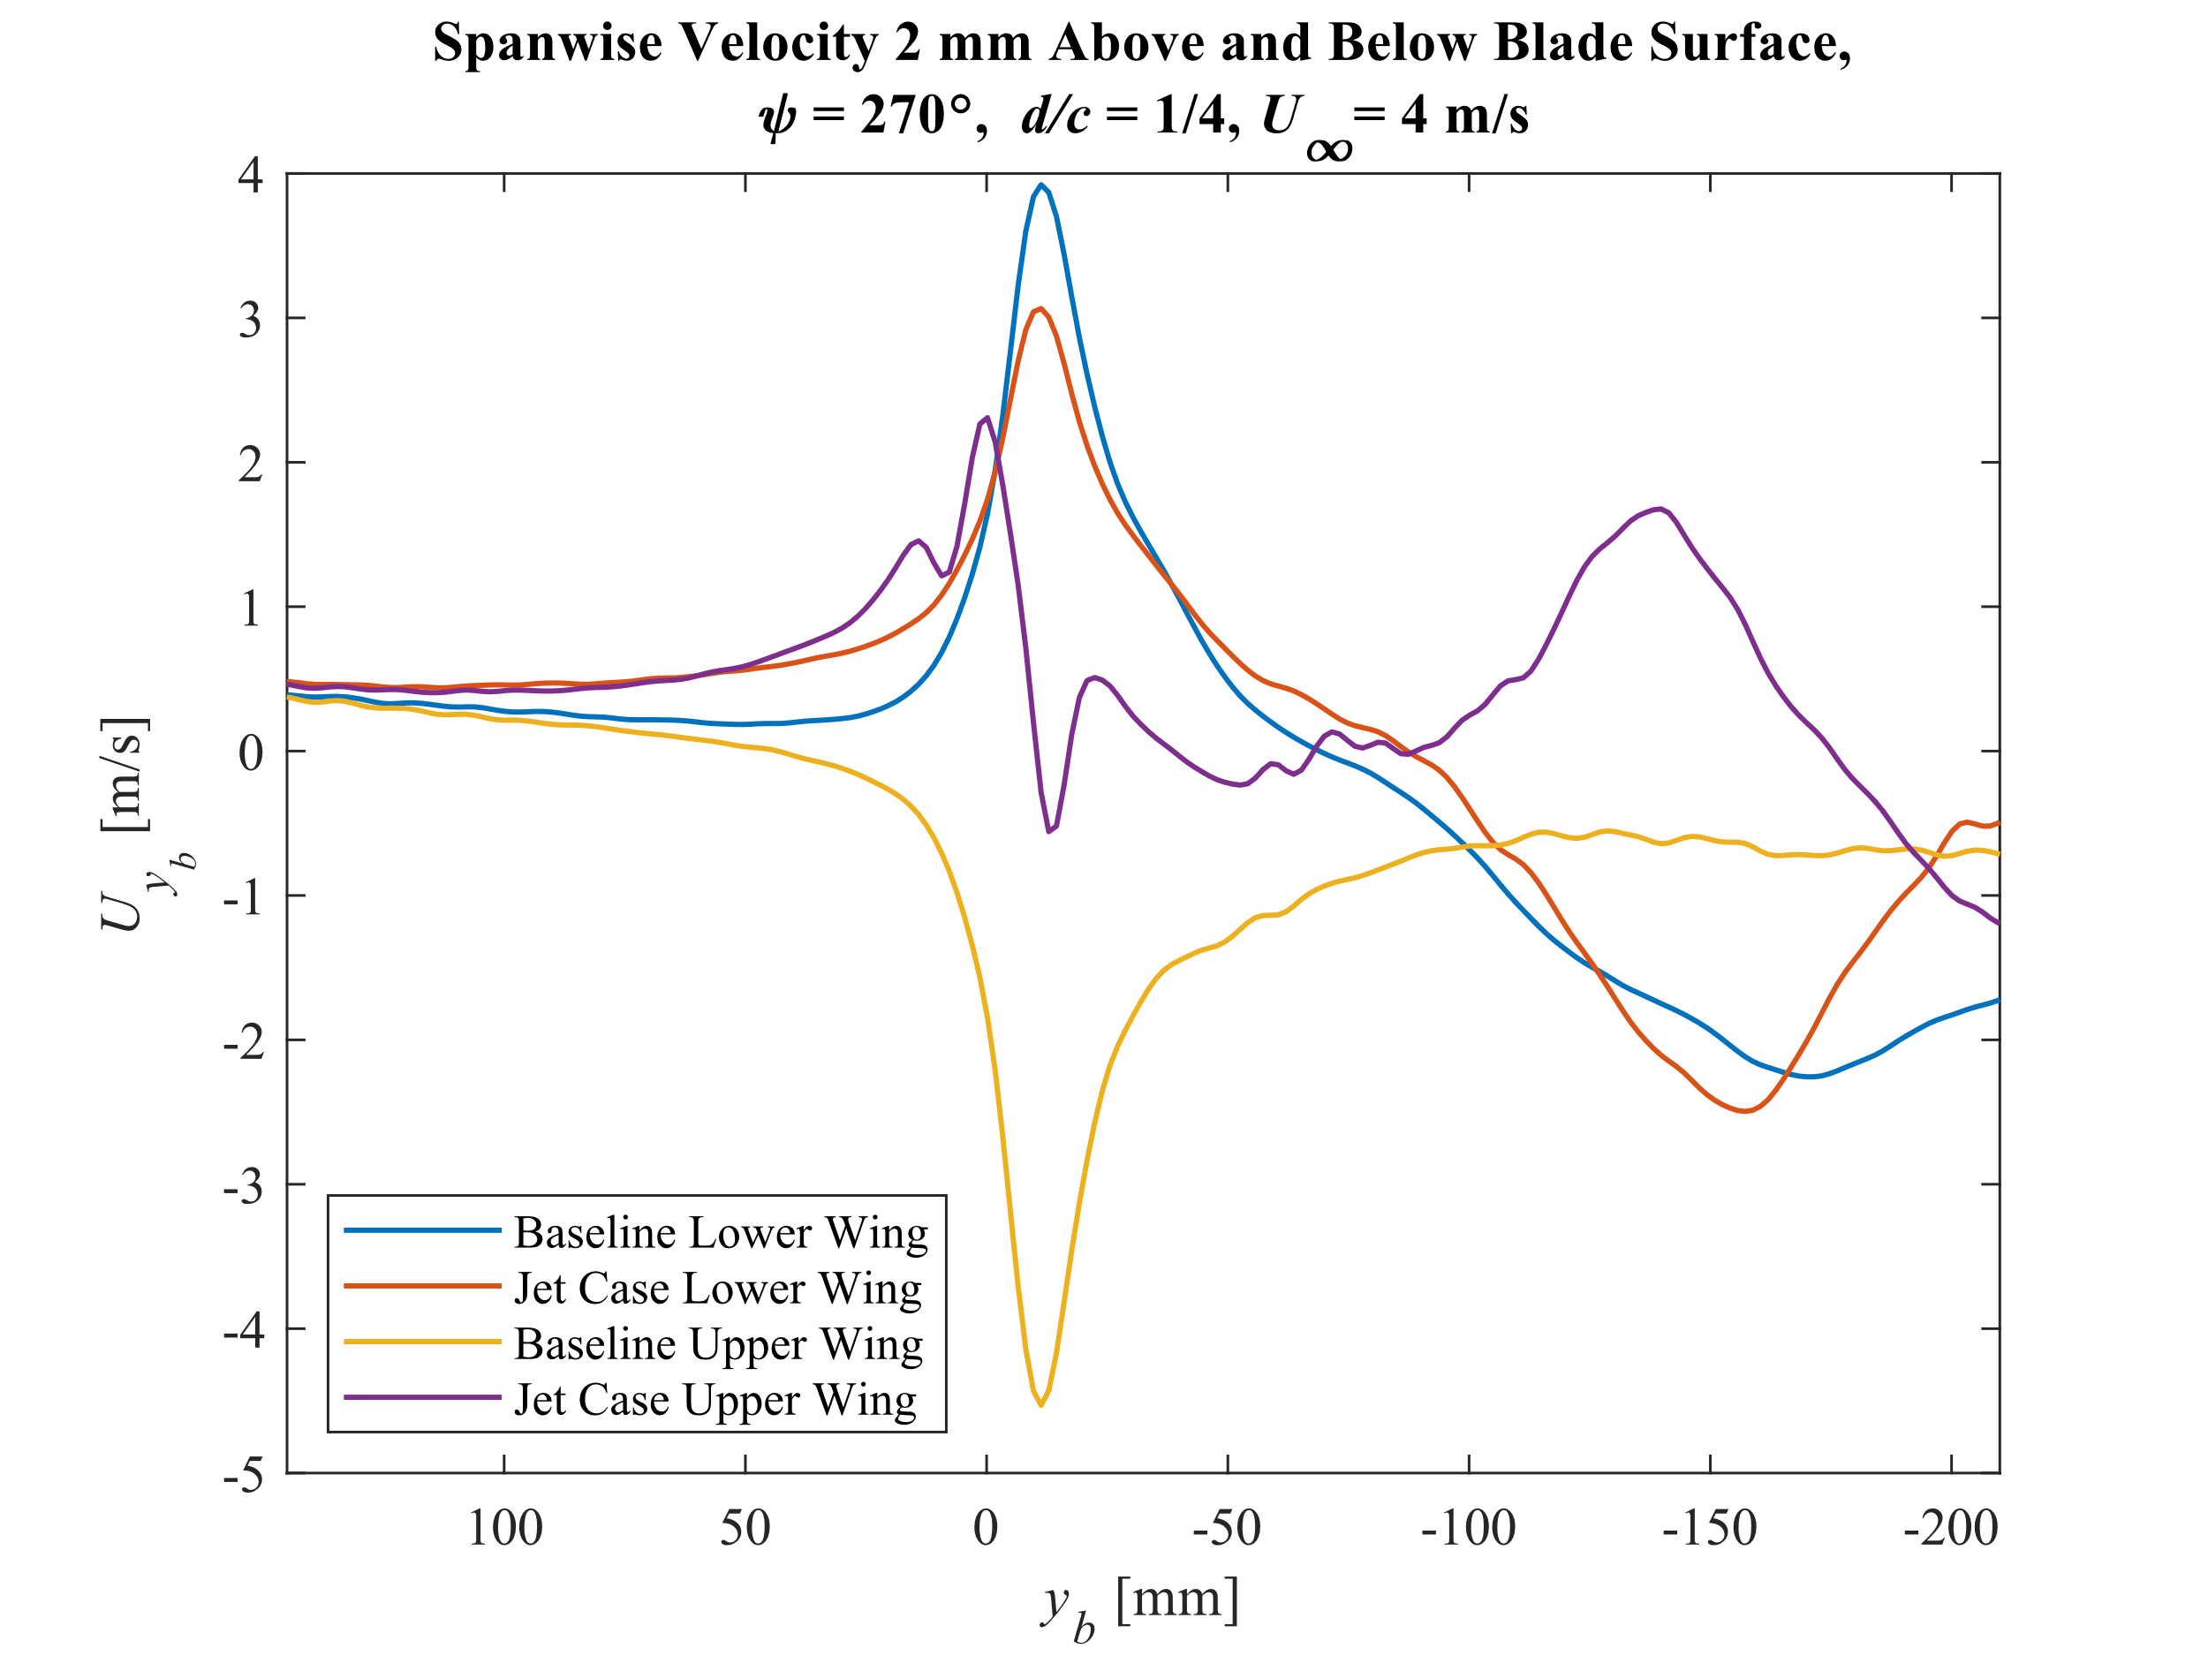
Results
Notes:
-This slide shows the 180° and 270° test cases. You can see that for the 270° test case, there are peaks further along the span of the blade
-The secondary peaks are likely interaction of the blade with the freestream, as the blade is going against the freestream at this angle
-Could also be interference from the wake of the previous blade traveling through the flow

Slide 13
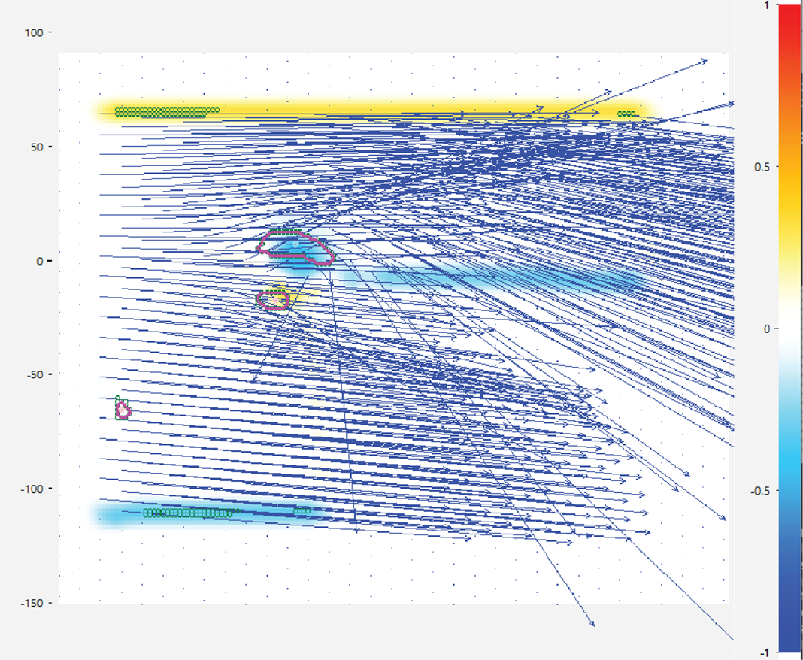
Vortex
Use local Galileo transformation to isolate patterns in velocity field
Outlines vortex core if magnitude of circulation exceeds threshold
Tip jets move center outwards and upwards, reducing performance impact
Notes:
-Vortex software used to identify vortex cores and see how tip jet perturbs them
-Uses local Galileo transformation to isolate regions with significantly larger circulation magnitude, mark as vortex
-Preliminary results indicate tip jets shift vortex core outwards and upwards in flow

Slide 14
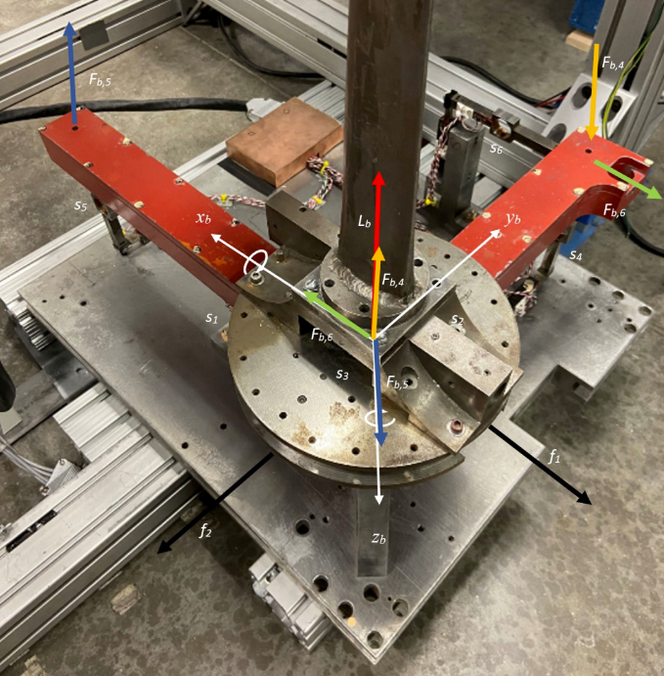
Force Balance
Used to obtain measurements of lift, drag, and moments
Kasari Force Balance relates voltage-based strain readings to real-world forces
Notes:
-Beyond wind tunnel testing, static testing using our Kasari Force Balance also helps determine the impact of the wingtip jet
-This balance includes six strain gauges, which output voltage readings read by LabView
-Using known masses and distances, namely the vectors shown on the red arms in the image, we can derive the force and moment acting on the model for given sets of strain voltage
-These undergo a coordinate transformation to give the forces at the base of the mounting pylon or relative the rotor itself

Slide 15
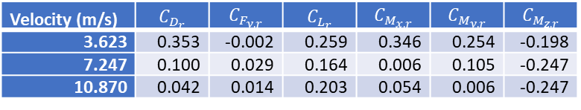
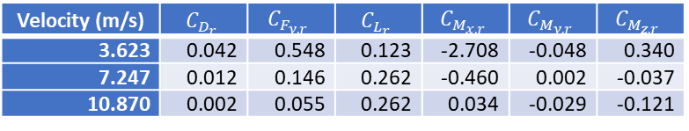
Force Balance Results
Preliminary results show strong impact from the presence of the jet
More experiments needed to confirm calibration
Velocity (m/s) | $$C_{D_{r}}$$ | $$C_{F_{y,r}}$$ | $$C_{L_{r}}$$ | $$C_{M_{x,r}}$$ | $$C_{M_{y,r}}$$ | $$C_{M_{z,r}}$$
3.623 | 0.042 | 0.548 | 0.123 | -2.708 | -0.048 | 0.340
7.247 | 0.012 | 0.146 | 0.262 | -0.460 | 0.002 | -0.037
10.870 | 0.002 | 0.055 | 0.262 | 0.034 | -0.029 | -0.121
Coefficients of forces and moments on the rotor, no jet
Velocity (m/s) | $$C_{D_{r}}$$ | $$C_{F_{y,r}}$$ | $$C_{L_{r}}$$ | $$C_{M_{x,r}}$$ | $$C_{M_{y,r}}$$ | $$C_{M_{z,r}}$$
3.623 | 0.353 | -0.002 | 0.259 | 0.346 | 0.254 | -0.198
7.247 | 0.100 | 0.029 | 0.164 | 0.006 | 0.105 | -0.247
10.870 | 0.042 | 0.014 | 0.203 | 0.054 | 0.006 | -0.247
Coefficients of forces and moments on the rotor, jet
Notes:
-The results form using the force balance also show clear impact when comparing the jet on and no jet case
-More experiments are needed to confirm calibration as the results aren’t super consistent, but initial results can be seen on the right
-The velocity associated with each case is the radial velocity at the wingtip associate with a 100, 200, and 300 RPM of the rotor motor

Slide 16
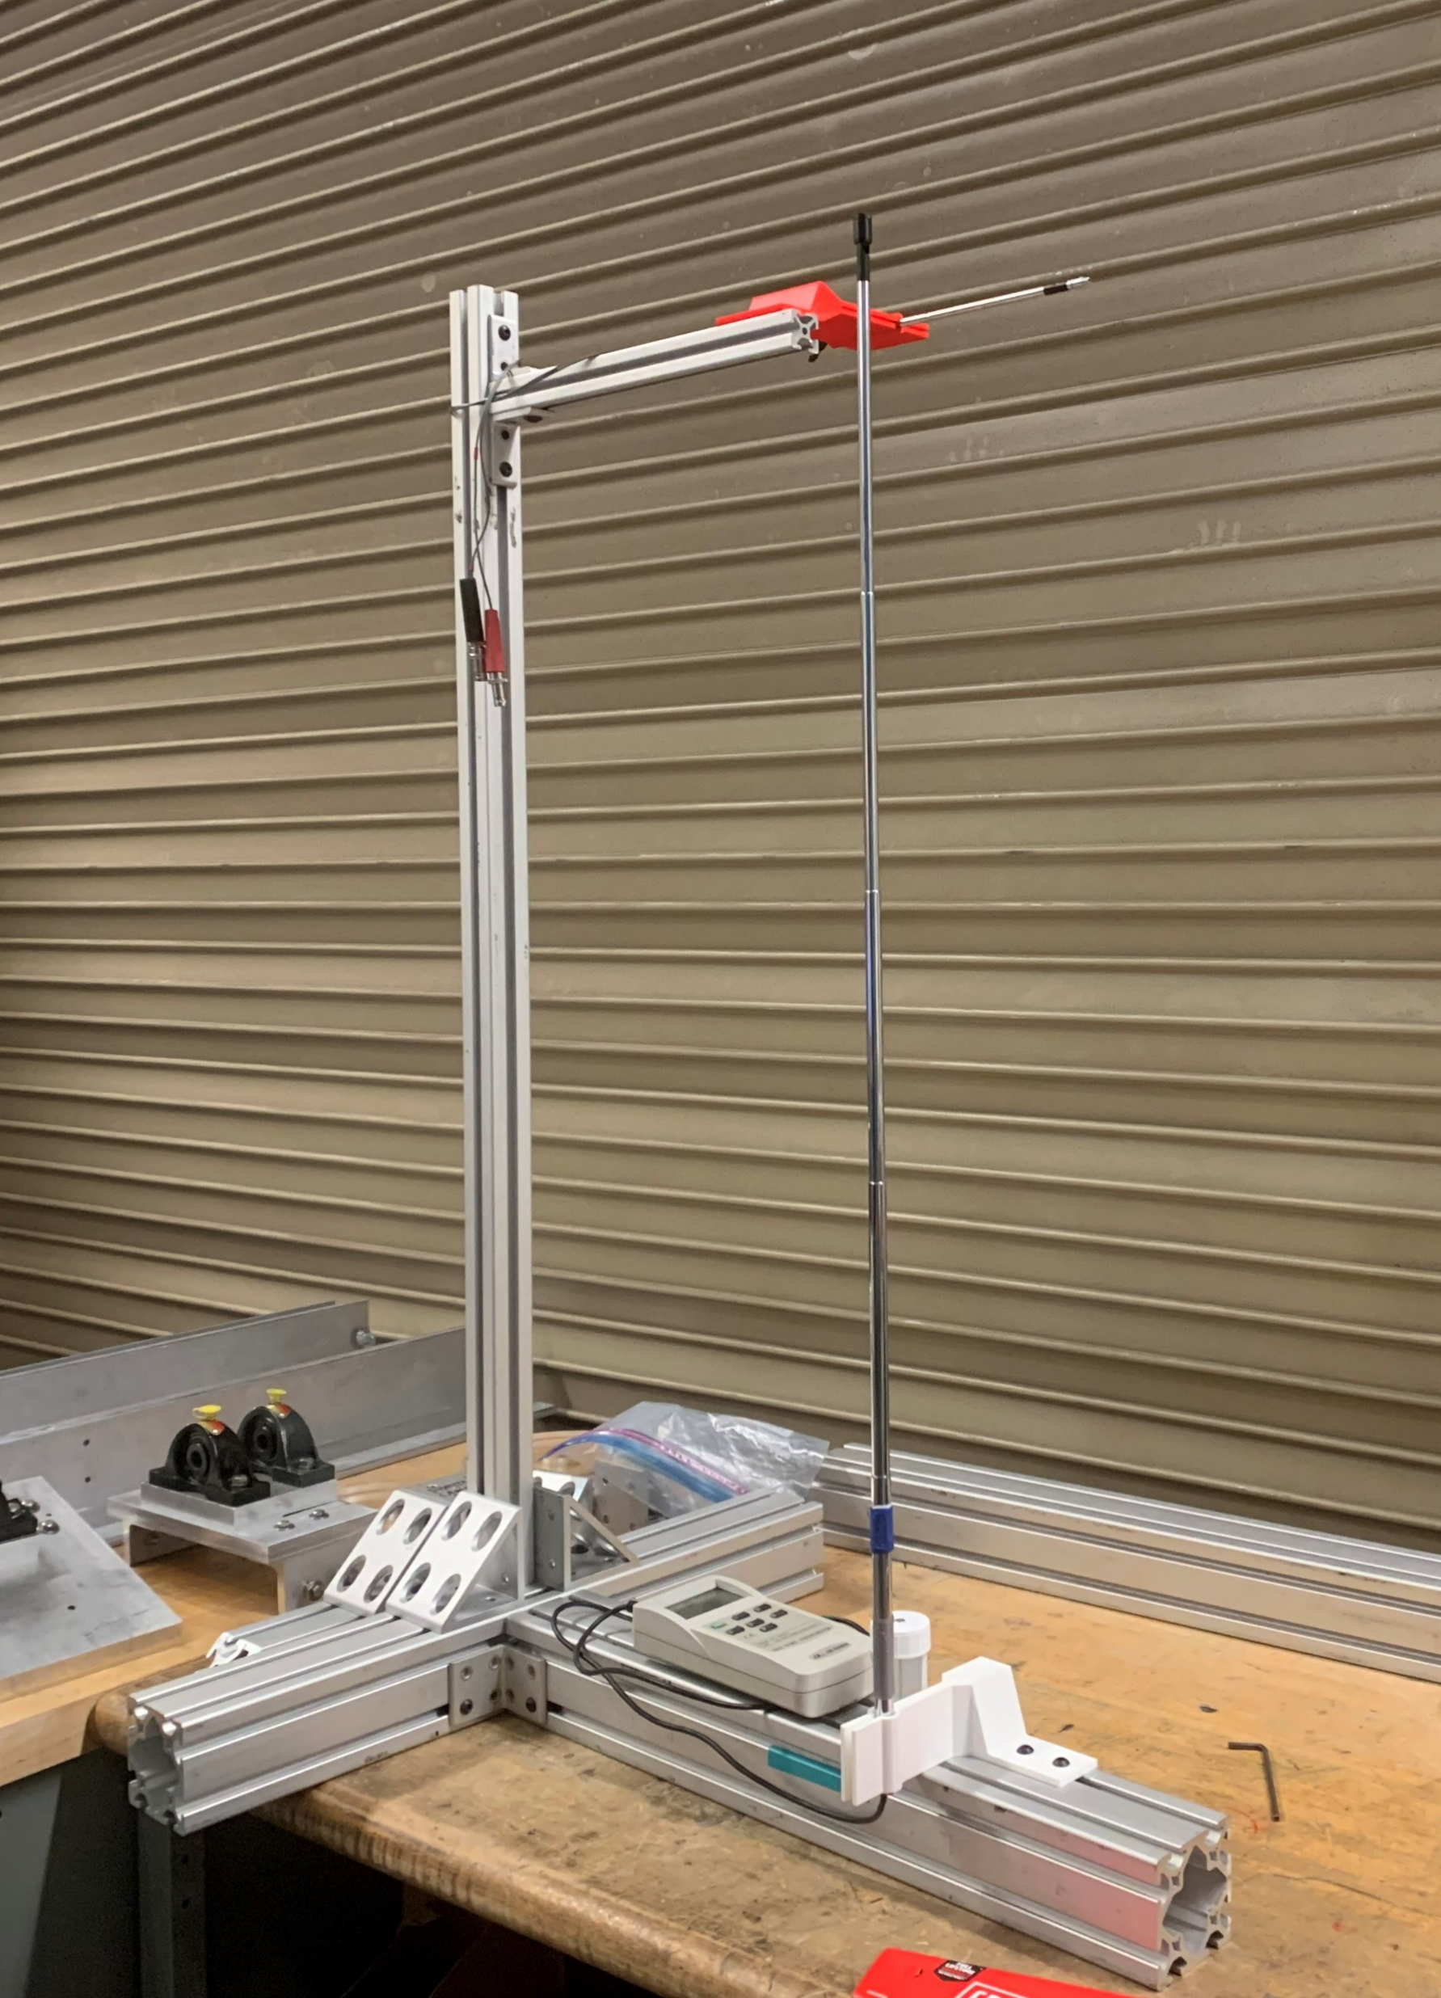
Next Steps
Measure velocity profile of tip jet
  Hand held anemometer hot wire
  2D hot wire “X” probe
Confirmation of measured forces
Continued vortex identification
Notes:
The next step for this research is to create a velocity profile of the tip jet
The picture to the right shows a test fixture that supports to anemometer hot wire measurement probes
By displacing the probes from the wingtip forward and backward and left and right, we hope to better characterize the direct contribution of the jet
The sensors used are a hand held anemometer hot wire probe (supported by the white 3d-printed mount) and a 2D constant temperature anemometer hot wire “X” probe
Also continue force-balance verification and vortex identification

Slide 17
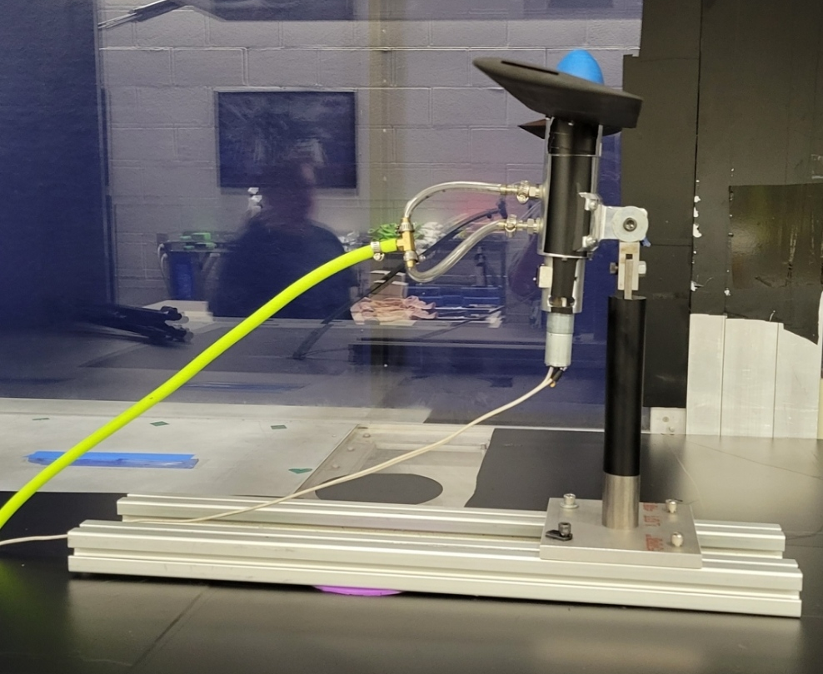
Thank you!

