Slide 1
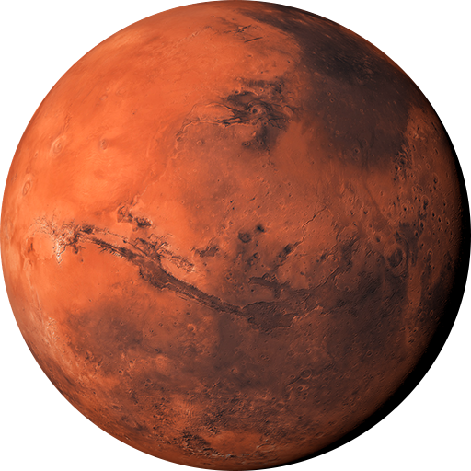
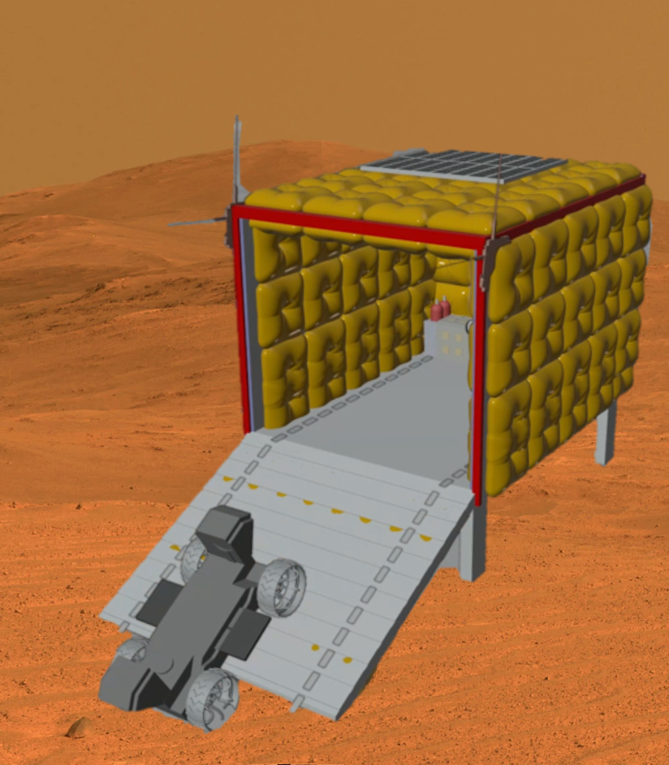
Inflatable Shelter for Extraterrestrial Protection
Andrea Torres, Anna Dinkel & Jekan Thangavelautham

Slide 2
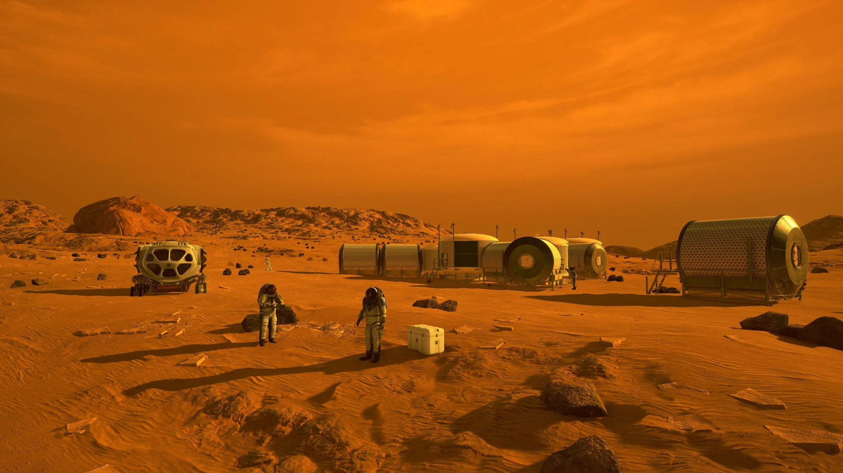
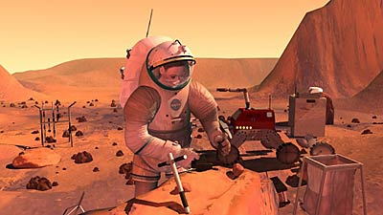
Introduction and Motivation
NASA Anticipates human presence on Mars by the 2030’s:
    Launch costs for large and heavy space vehicles are excessively expensive.
    The Martian environment poses significant challenges.

Slide 3
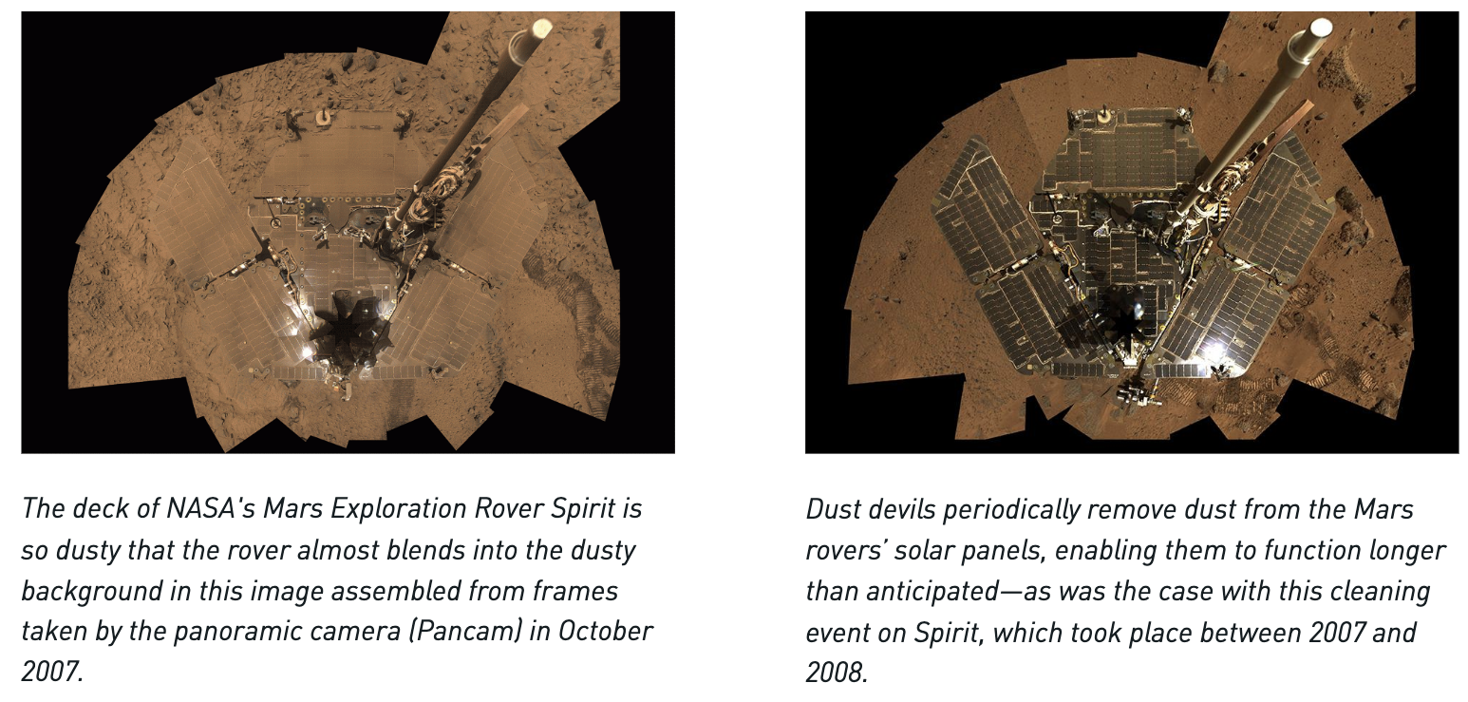
Martian Environment
Dust Challenges
Continent-Sized Dust Storms.
Negative Impact on Solar Power
Negative Impact on Machinery

Slide 4
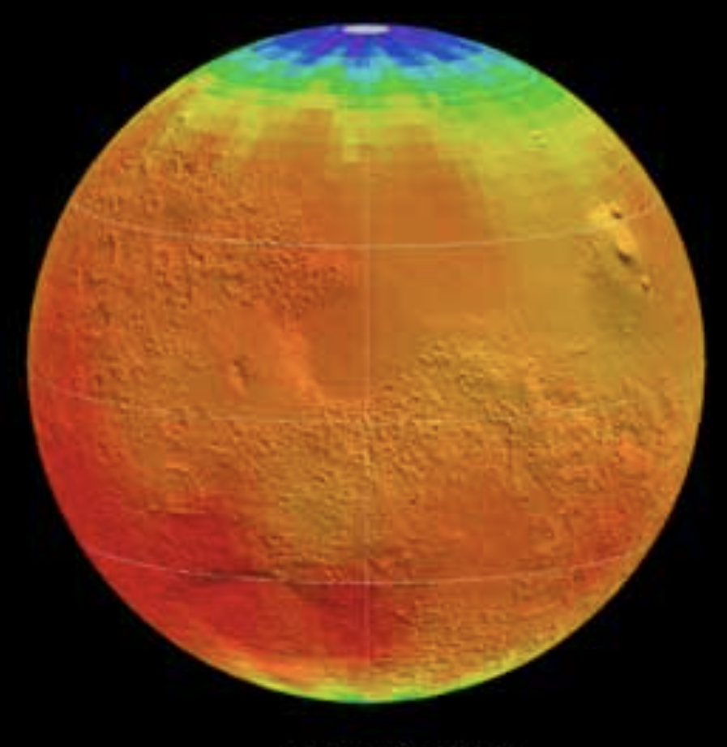
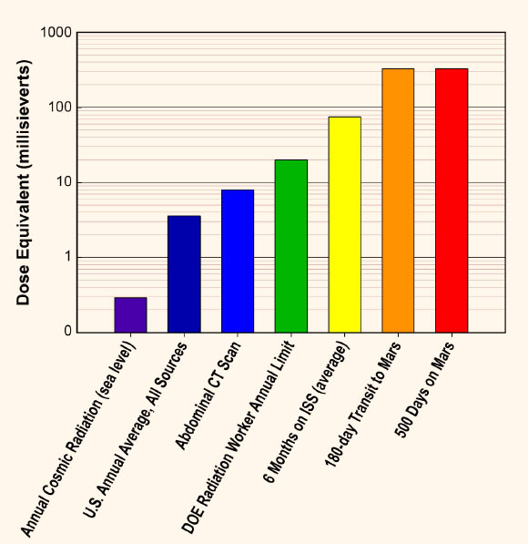
Martian Environment
Temperature & Radiation
Temperature Fluctuations Ranging from -153 ℃ to 20℃
Radiation Exposure to 8 rads per year.

Slide 5
Mission Objectives
Fulfill NASA’s vision of human exploration on Mars by the 2030s.
Address challenges posed by extreme Martian conditions such as dust, dust storms, temperature fluctuations, and radiation.
Increase lifespan of Exploration Vehicles.
Lower mission costs through innovative and efficient technology solutions.
Advance understanding of Martian surface and prepare for potential colonization.

Slide 6
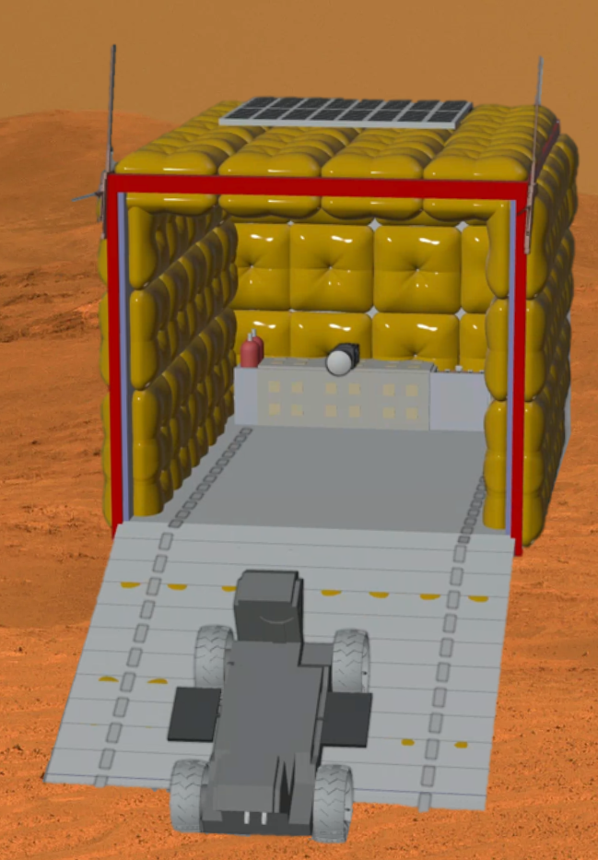
Proposed Solution
Develop an Inflatable Shelter that provides Robust protection against Martian dust storms, radiation and temperature fluctuations
This shelter will serve as a “garage” for rovers, enabling them to continue functioning optimally in extreme conditions

Slide 7
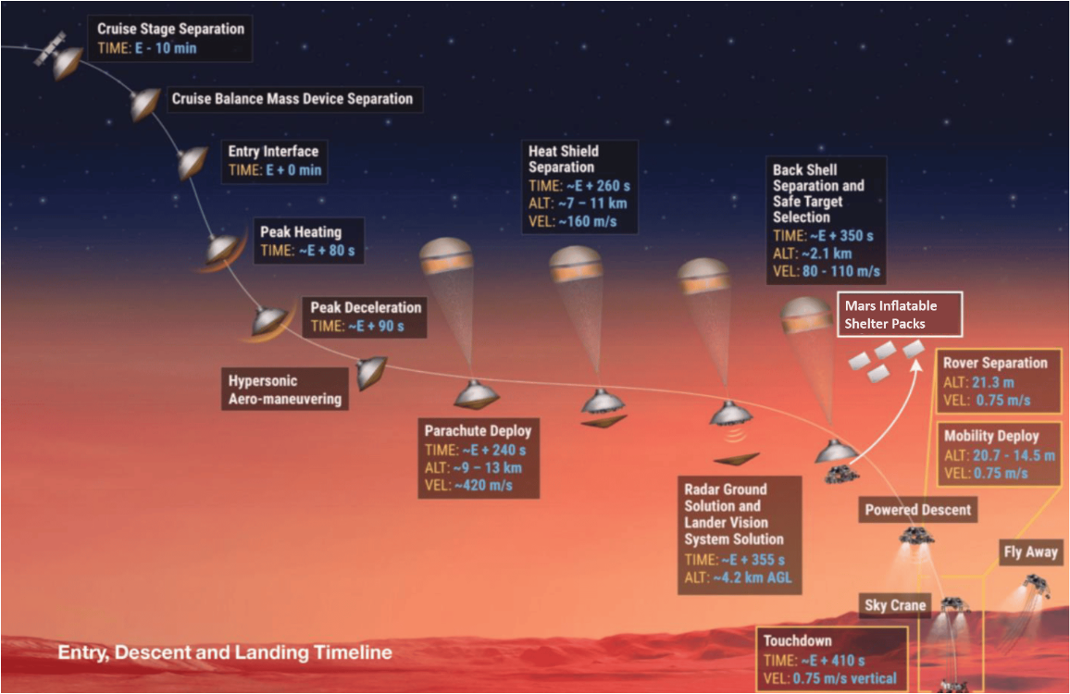
Landing - Concept of Operations
Shelter packs deployed during parachute descent
Multiple packs deployed surrounding flagship landing site

Slide 8
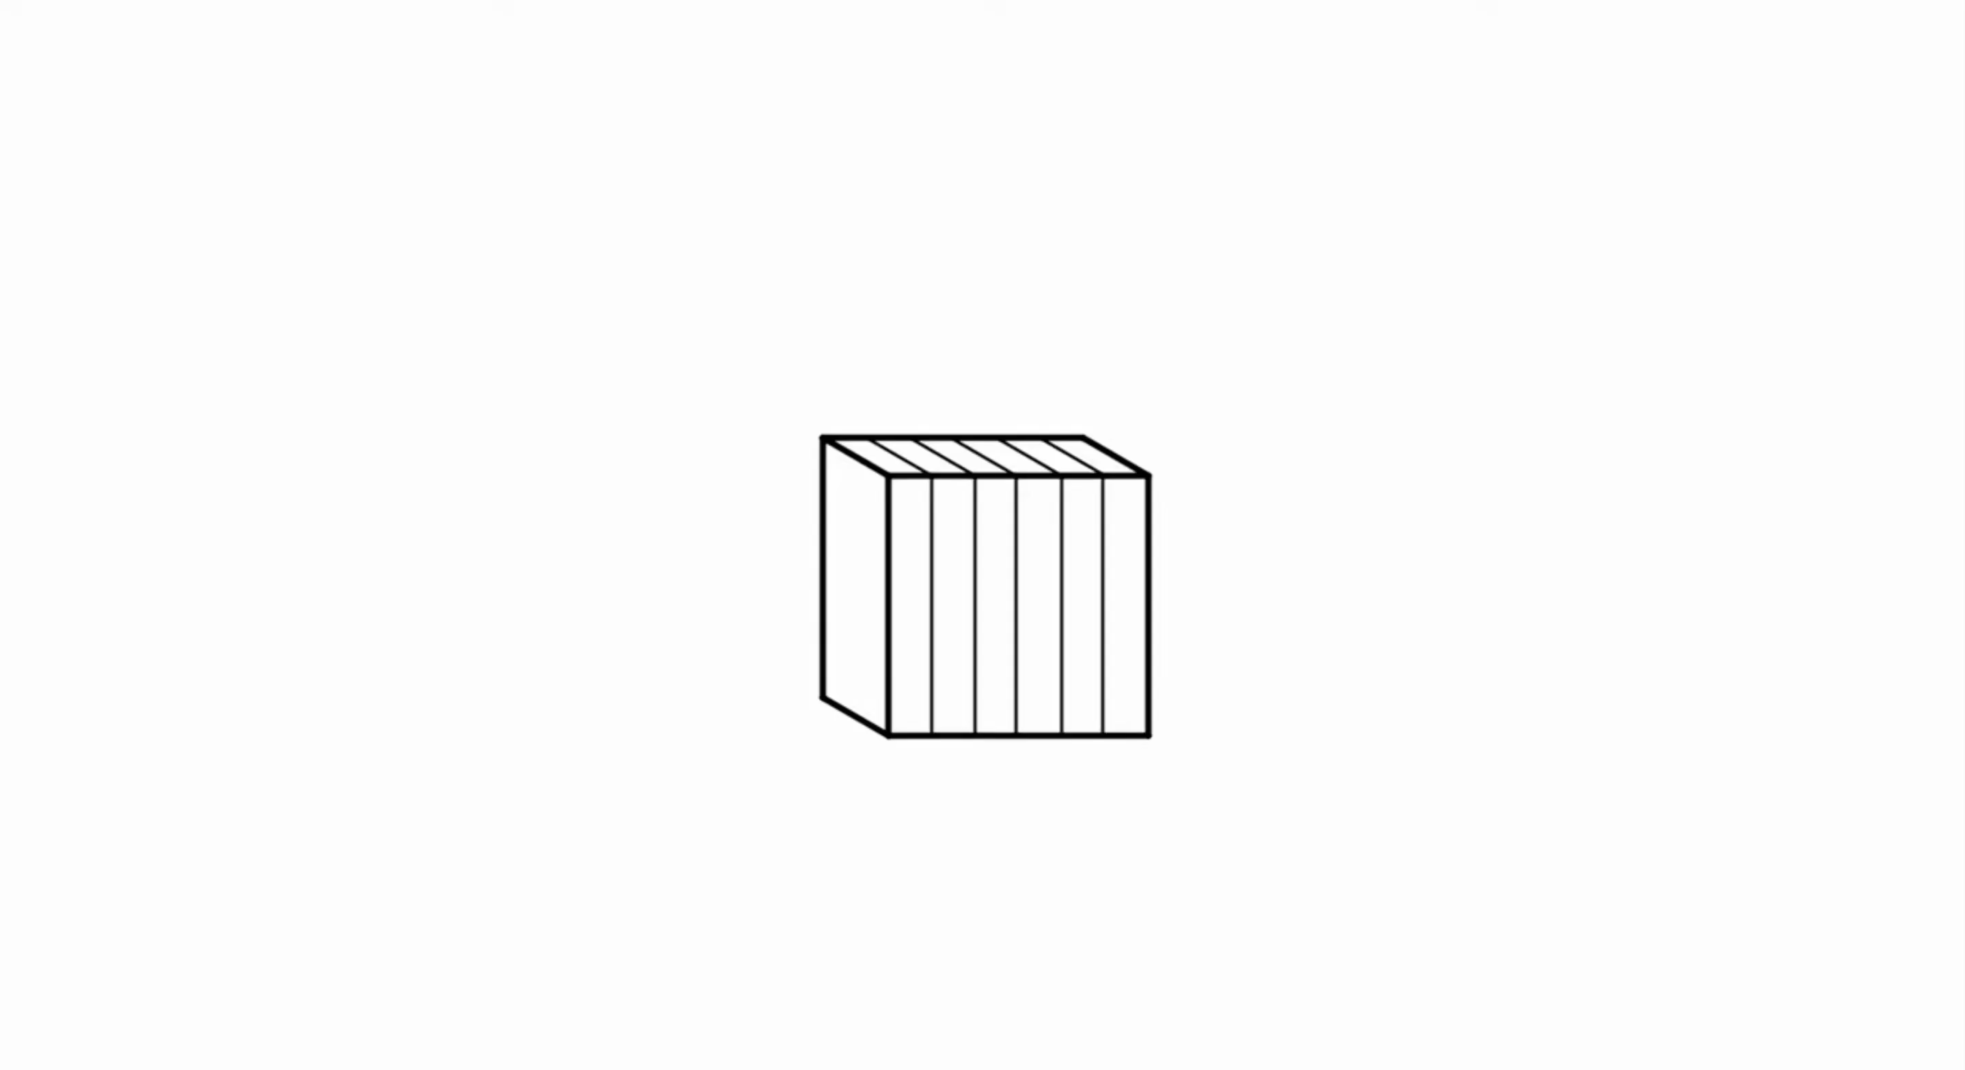
Deployment - Concept of Operations

Slide 9
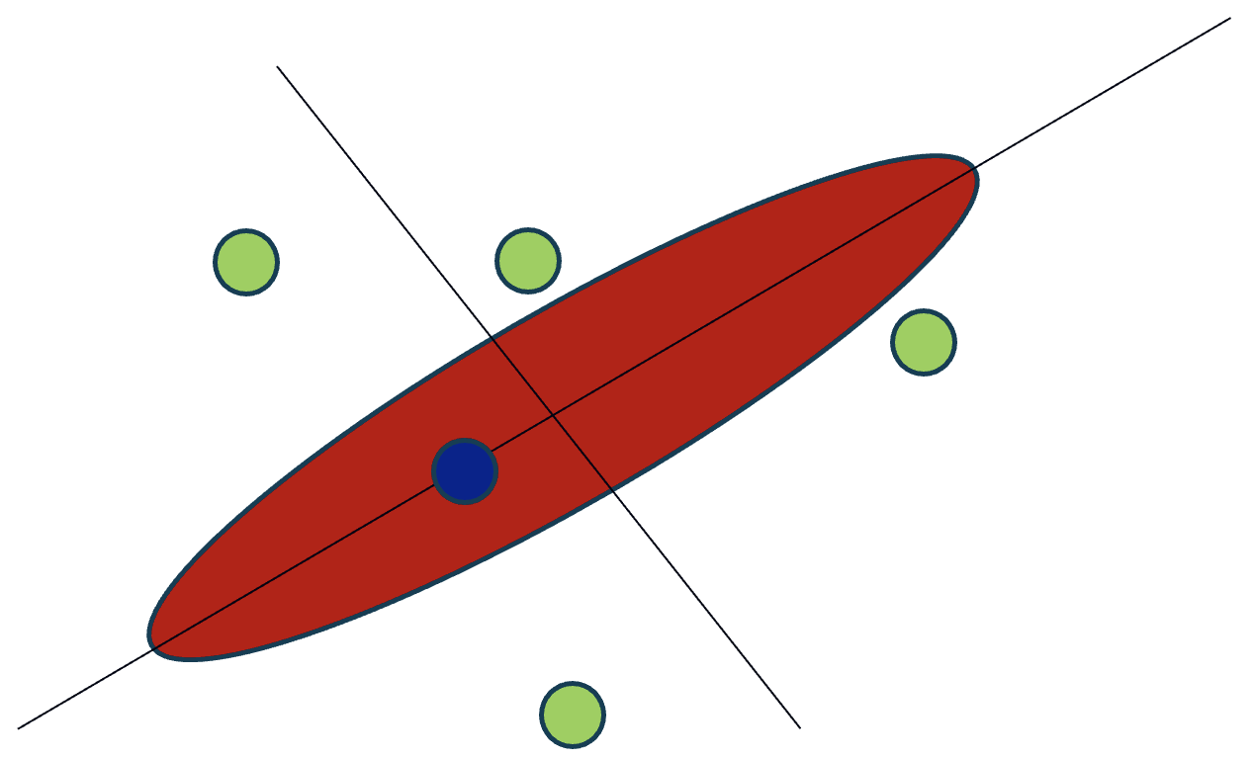
Shelter Pack Deployment Around Landing Site
Shelter packs distributed around flagship mission
Intended to provide mission support
Potential for tackling extreme environment exploration

Slide 10
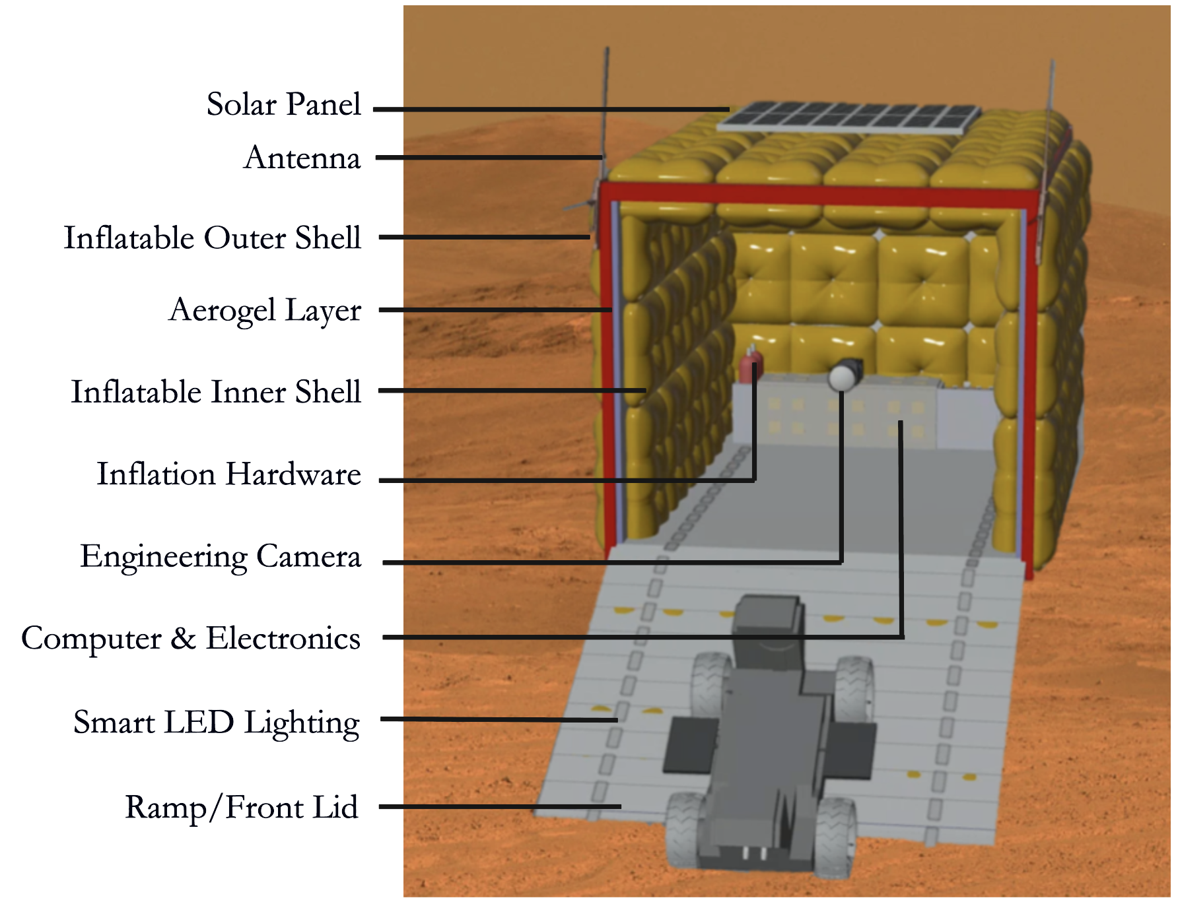
System Design

Slide 11
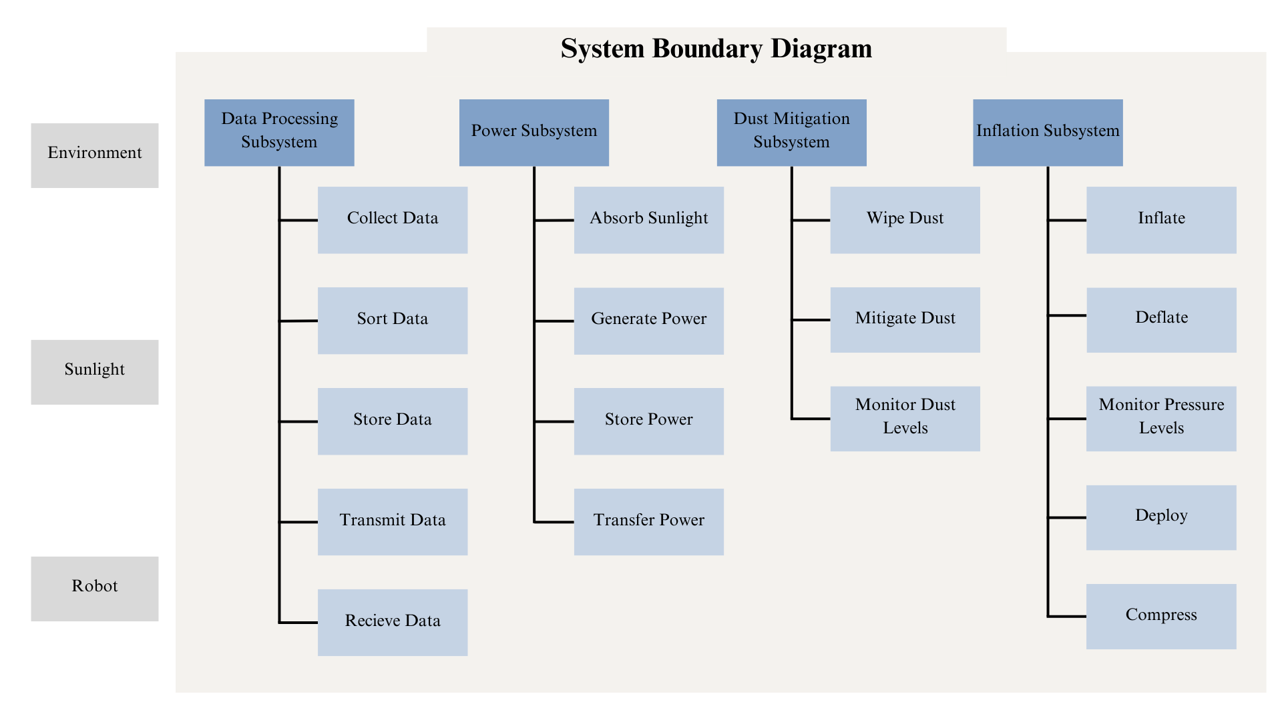

Slide 12
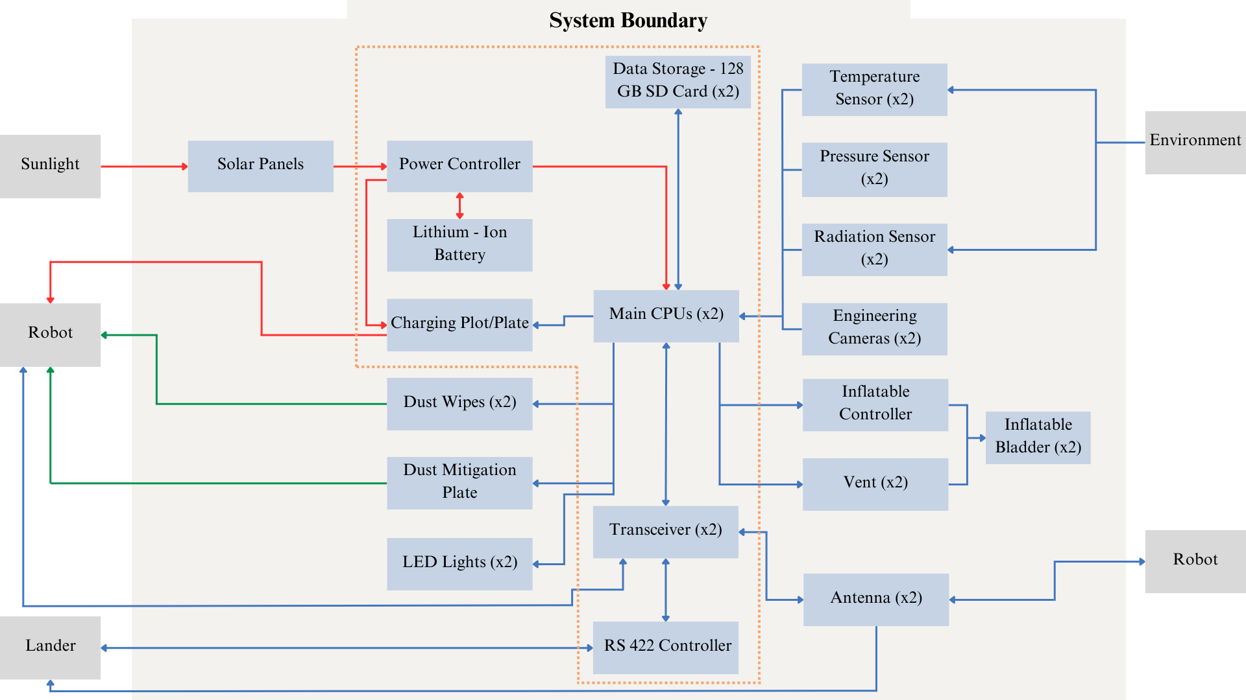
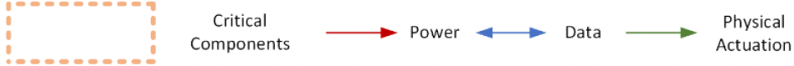
System Block Diagram

Slide 13
Risk Mitigation
Pressure loss in wheels:
    Redundant Internal Structure
    Multiple Layers of Vectran
Door Malfunction:
    Dual Door Access
Leak or Puncture:
    Pressure Redistribution
    Supportive bladder System
Sensor Malfunction:
    Multiple Sensors
Dust Entry:
    Cleaning Brushes
    Electromagnetic Dust Shield
 | Pressure Loss in Wheels
 |  | Door Malfunction
 | Leak or Puncture
 |  | Sensor Malfunction |  | Dust Entry
Likelihood
Severity

Slide 14
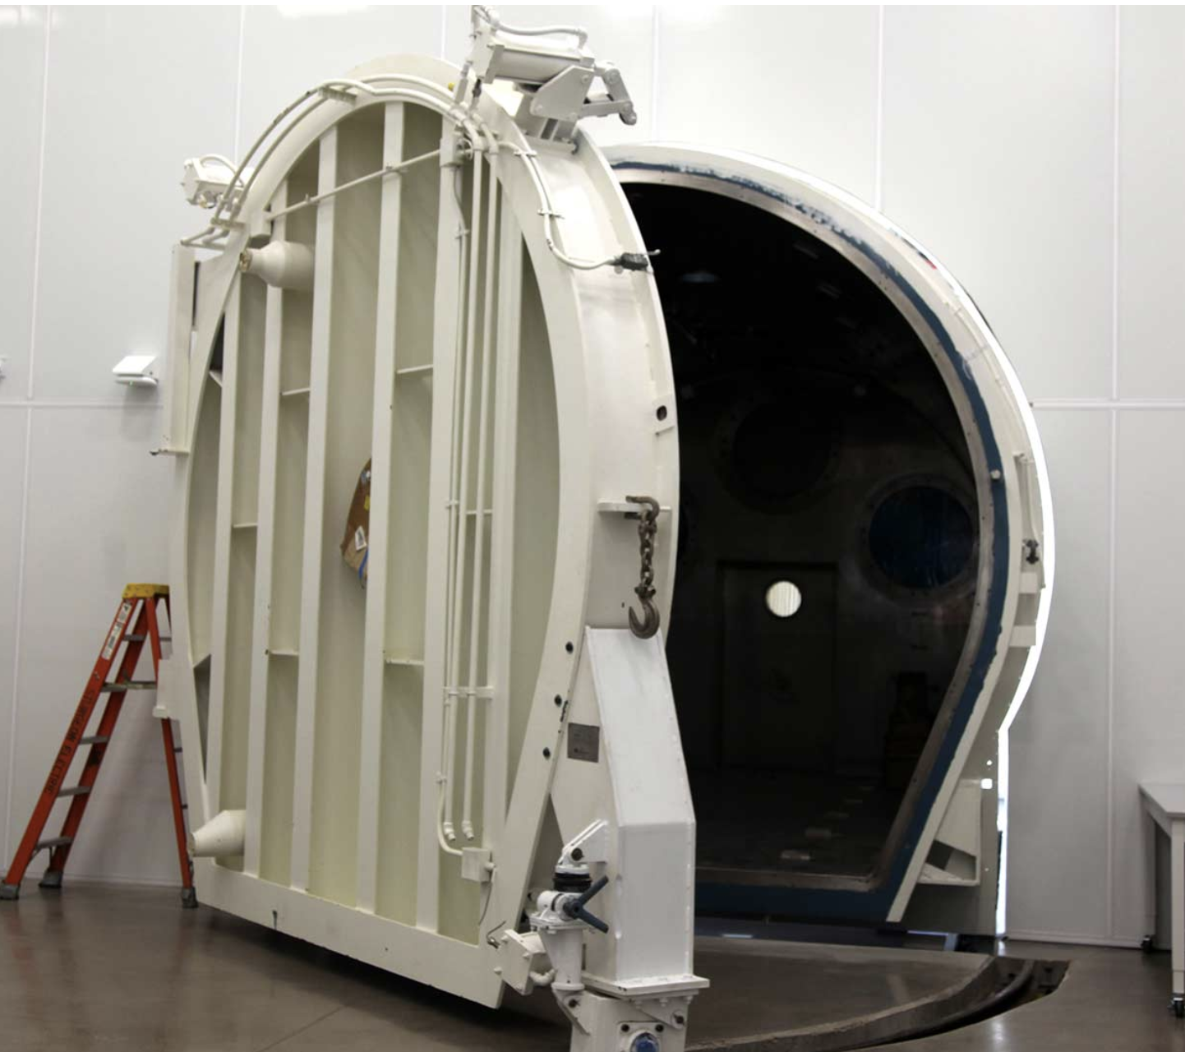
Conclusion
Future Work
Enhanced Rover Protection
Efficient Design
Exploration Foundation
Thermal Simulations
Thermal Vacuum Testing

Slide 15
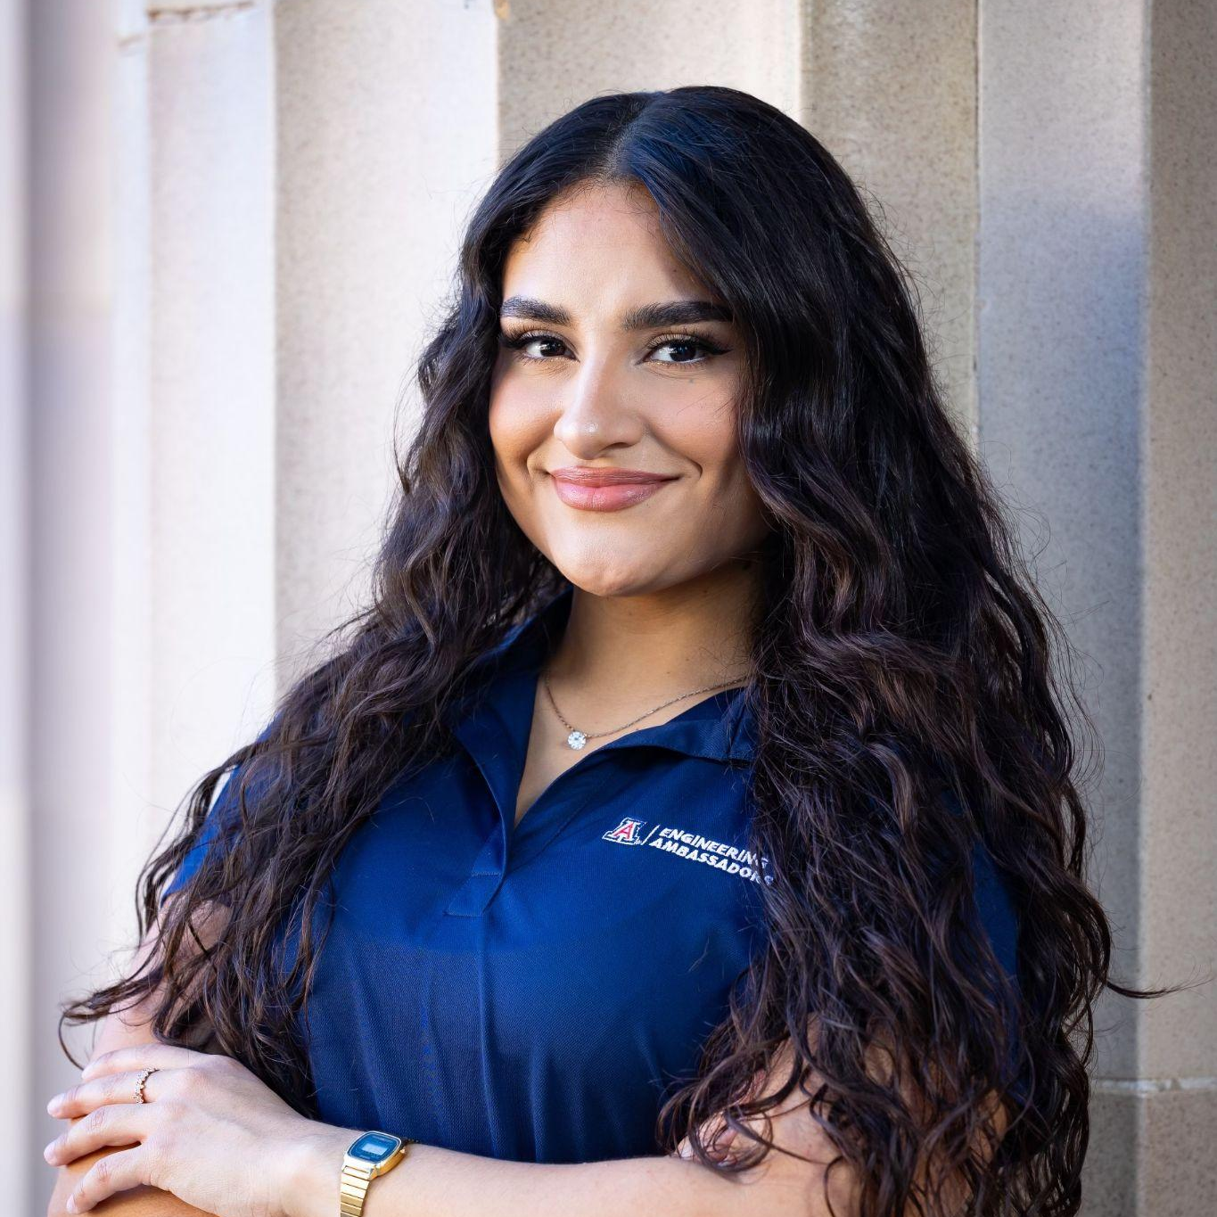
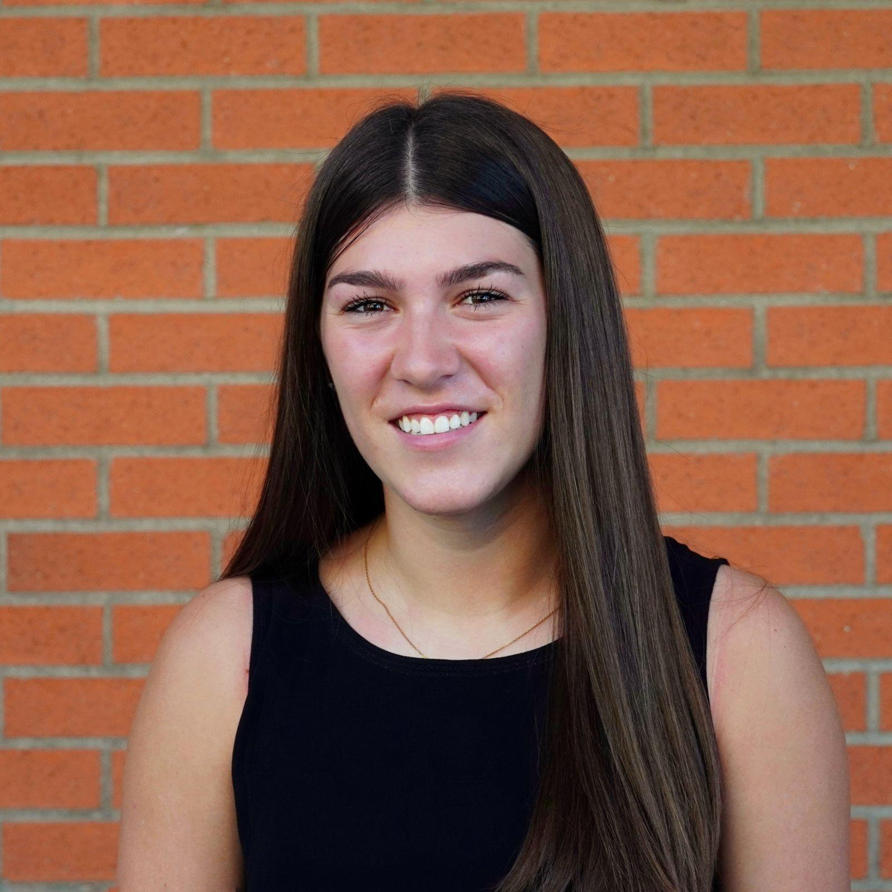

Thank you!
Andrea Torres is a third year Systems Engineering student with a minor in Industrial Engineering and Spanish at the University of Arizona. As an undergraduate researcher for the ASTEROIDS Laboratory, she contributes to the development of an expandable protection unit for extraterrestrial explorers. In the future, she plans to achieve her Master’s Degree in Space Systems Engineering, and aspires to work as a Systems Engineer in the space industry.
Anna Dinkel is a graduate student at the University of Arizona studying Aerospace Engineering with a focus on dynamics and controls. She is a graduate research assistant at the Space and Terrestrial Robotics Laboratory where she studies extraterrestrial robotics and inflatables. She leads teams of graduate and undergraduate students in inflatable and expandable space systems engineering projects and hopes to continue in her career as a space systems engineer.
Jekan Thanga has a background in aerospace engineering from the University of Toronto. He worked on Canadarm, Canadarm 2, and the DARPA Orbital Express missions at MDA Space Missions. Jekan obtained his Ph.D. in space robotics at the University of Toronto Institute for Aerospace Studies and did his postdoctoral training at MIT's Field and Space Robotics Laboratory. He is an Associate Professor and heads the Space and Terrestrial Robotic Exploration Laboratory and the NASA-funded ASTEROID Center in Formation at the University of Arizona. He is an advocate and leader in implementing Diversity, Equity and Inclusion programs in aerospace research. He is the Engineering Principal Investigator on the AOSAT I CubeSat Centrifuge mission. Jekan and his team of students have co-authored more than 200 technical publications, won the Popular Mechanics Breakthrough Award in 2016 for proposing the SunCube FemtoSat, won a Best Paper Presentation Award at AMOS 2019 for the Early Warning Constellation to Detect Incoming Meteor Threats, finalists for the NASA 2020 BIG Competition, and winners of the 2021 NASA RASCAL Competition.

Slide 17
References
Bridenstine, Jim. "NASA Proclaims Human Exploration of Mars Is on the Horizon." SciTechDaily, 21 July 2020,
https://scitechdaily.com/nasa-proclaims-human-exploration-of-mars-is-on-the-horizon/.
Kendall, Anthony. "Giving Future Human Space Explorers the Credit They’re Due." The Space Review, 31 Oct. 2005, www.thespacereview.com/article/483/1.
Lorenz, Ralph. “Attack of the Martian Dust Storms." Smithsonian National Air and Space Museum, Smithsonian Institution, Spring 2022,
https://airandspace.si.edu/air-and-space-quarterly/spring-2022/attack-martian-dust-storms.
"Mars Facts." NASA, NASA Science, https://science.nasa.gov/mars/facts.
"Mars: First Radiation Measurements from Planet’s Surface." Sci.News, 19 Dec. 2013, www.sci.news/space/science-mars-radiation-measurements-surface-01629.html.
"Mars Warming Sparks Global Warming Debate." Spaceflight Now, 18 July 2001, https://spaceflightnow.com/news/n0107/18marswarm/.
Rodriguez, Paola. "New $85 Million Home for UA's Space Institute Unveiled." Arizona Public Media, 7 Apr. 2023,
https://news.azpm.org/p/newsc/2023/4/7/215527-new-85-million-home-for-uas-space-institute-unveiled/.
Williams, Matt. "Why Going to Mars Is a Bad Idea." Phys.org, Science X, 8 Nov. 2016,
https://phys.org/news/2016-11-bad-mars.html#:~:text=Over%20the%20course%20of%20about,(8%20rads)%20per%20year.

