Slide 1




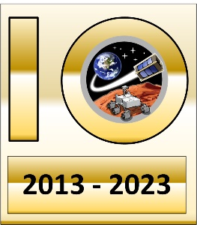
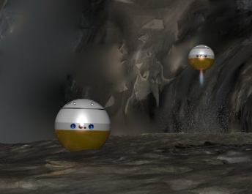
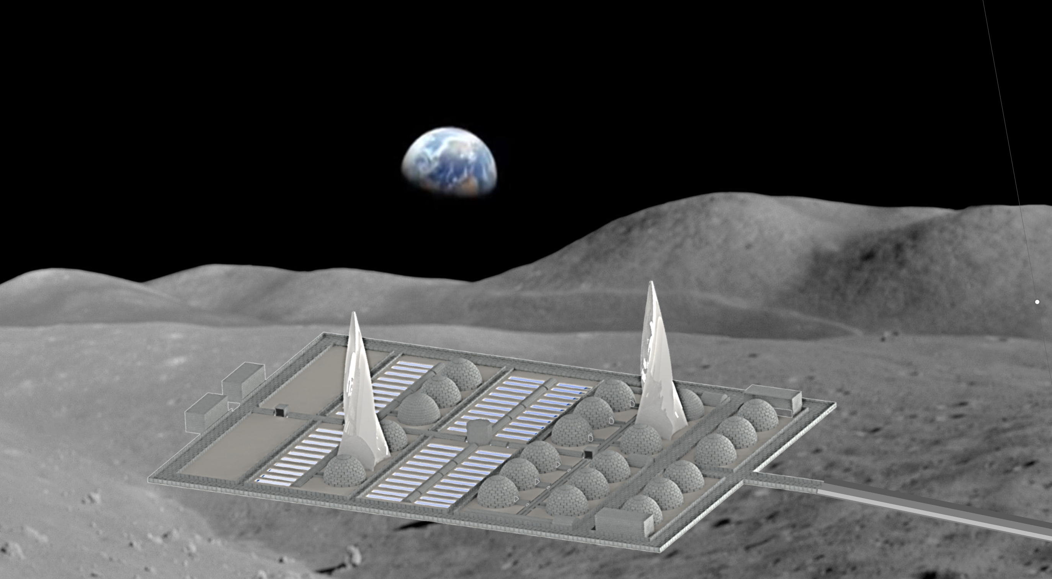
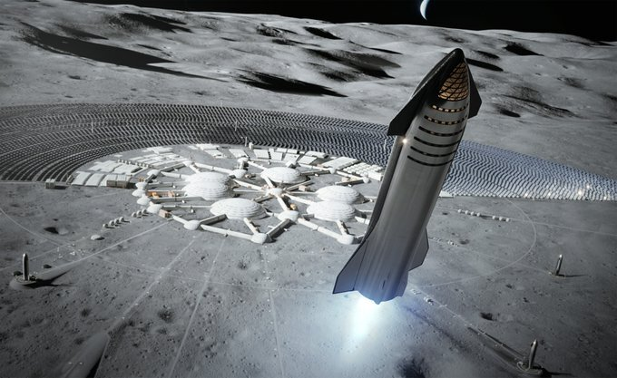
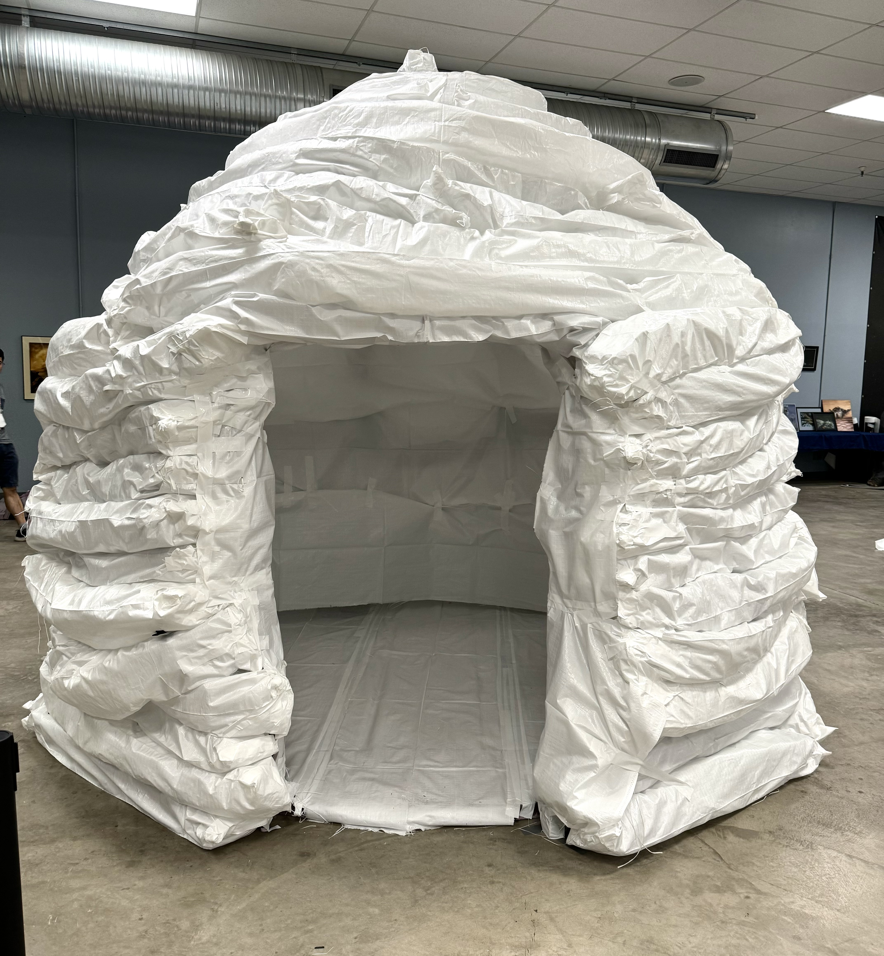
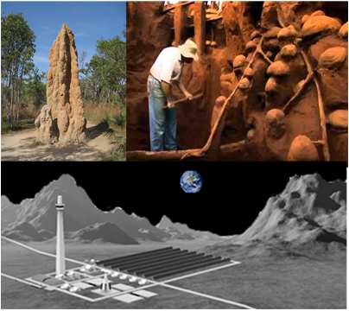
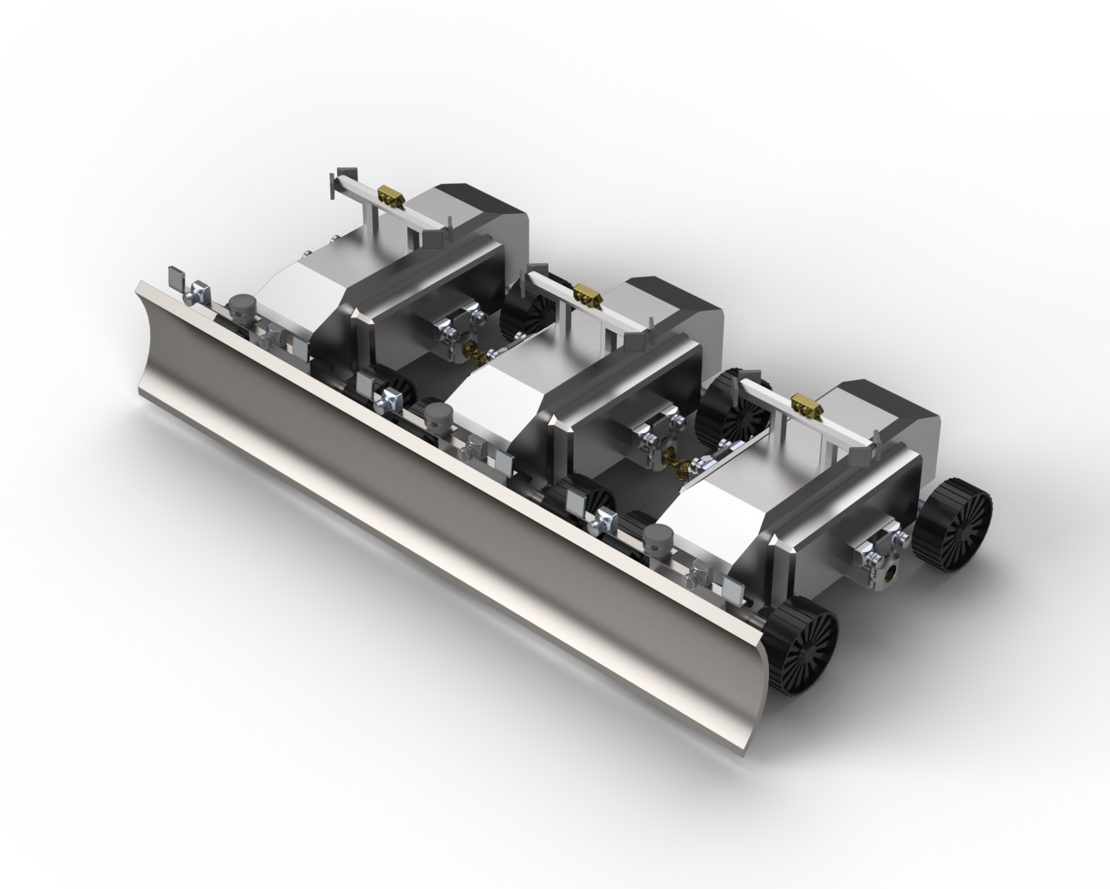
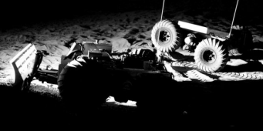
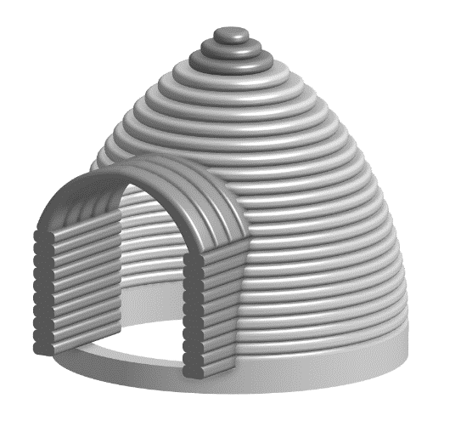
Machine Learning Algorithms for Handling Lunar Base Emergencies.
Sivaperuman Muniyasamy^{1,} Dr Jekan Thangavelautham¹
¹Space and Terrestrial Robotic Exploration (SpaceTREx) Laboratory
¹Aerospace and Mechanical Engineering,
University of Arizona

Slide 2
Outline
Motivation
Challenges
Objectives
Approach
Results and Discussions
Conclusion and future work
Notes:
This is my outline presentation. Fire in Space sounds like a very rare event. However, history tells us that we shouldn’t ignore the fire in human space flight missions.

Slide 3
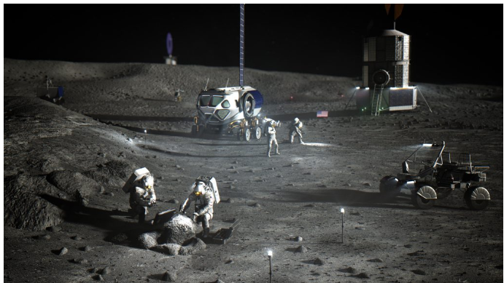
Motivation
Artemis Mission:
Return humans to the Moon.
Potential need for “Semi-Permanent” Structures on the lunar surface
Autonomous robots: Day-to-day and off-nominal operations and of lunar base.
Lunar Base Concept (NASA)

Slide 4
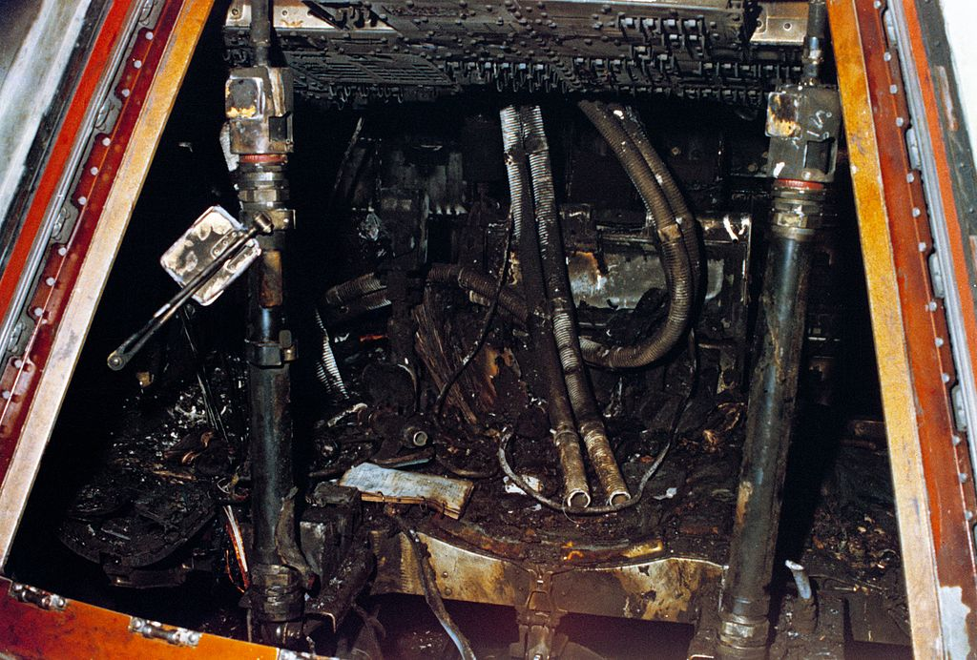
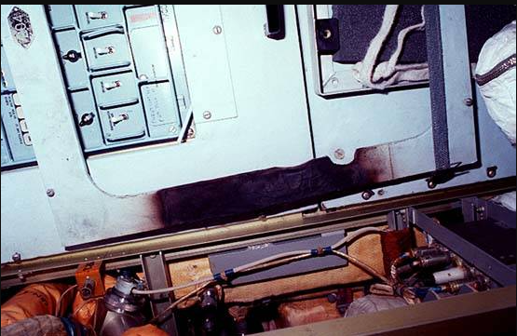
Motivation
Apollo 1 [1]
Mir space station fire on Feb. 24, 1997 [1]
  Solid Fuel Oxygen Generators (SFOG)
  Caused by latex working glove material inadvertently introduced into the canister.
A charred panel in the Kvant-1 module (NASA)
Apollo 1 (NASA)
Notes:
We know all about the Apollo 1 fire accident in the 1960s. Three astronauts lost their lives.

Slide 5
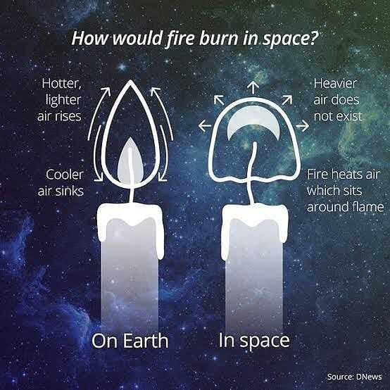
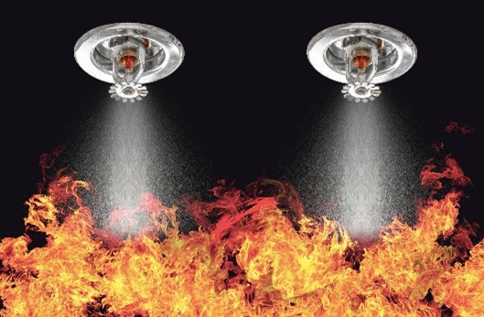
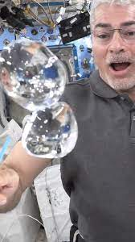
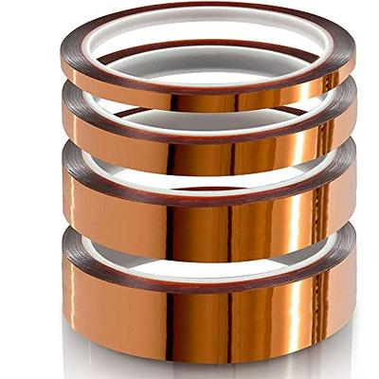
Challenges
Fire in Microgravity (DNews)
Sprinkler System
Kapton
Unpredictable environment inside the lunar base

Slide 6
Challenges
Challenges in fire extinguishing by astronauts
  Hazardous combustion product
  Visibility and quick response
Depressurization may not be a viable option in all cases
  May accelerate the fire propagation near depressurization valves and may permanently damage the valves.
  Astronauts stuck inside the pressurized chamber.
  What if there is an explosion inside the pressurized chamber?
Robots can be agile and quickly put out fire at an early stage of fire spread

Slide 7
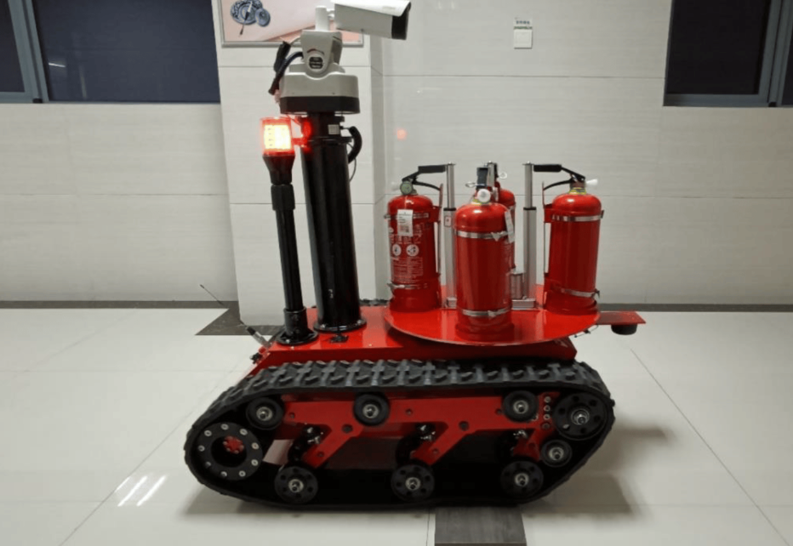
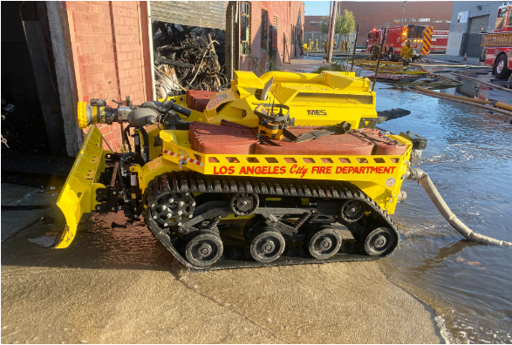
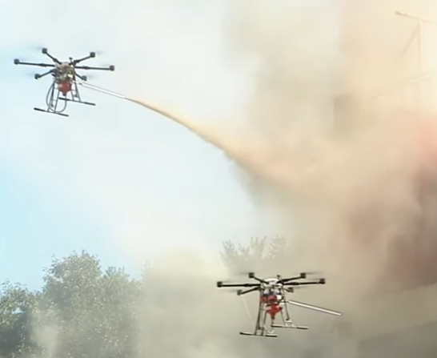
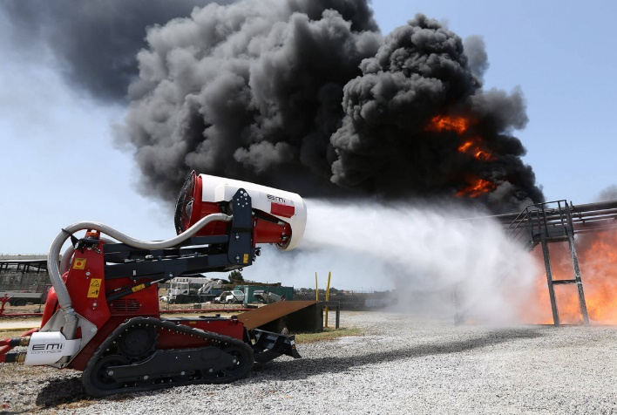
Related Work
Fire Fighting Robots
Indoor Fire fighting robot[7]
Fire fighting robot with Blades to clear the obstacles[2]
Fire fighting drones[3]
Fire fighting robot with cannon water system[2]
Small and compartment fire
Large scale fire

Slide 8
Objectives
To design and develop a SMART(Scalable Mobile Autonomous Robotic Tech) architecture for end-to-end lunar base operations utilizing
  A network of small robots for
    Site preparation and Infrastructure Construction and Lunar Operations
  A sensor network (with Smart sandbags and sensors) for
    Situational awareness
    Communication
    Navigation
  A distributive network (Tile network) for
    Heavy computing, Scheduling, and Monitoring the lunar operations

Slide 9
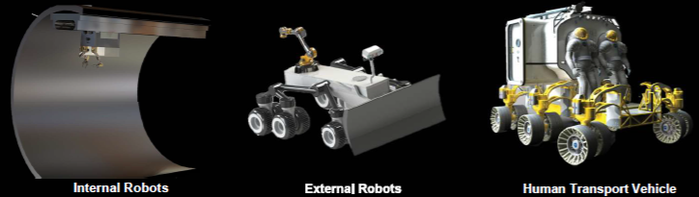
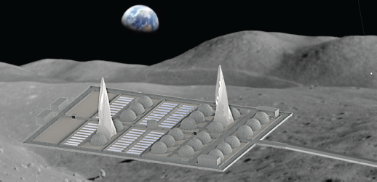
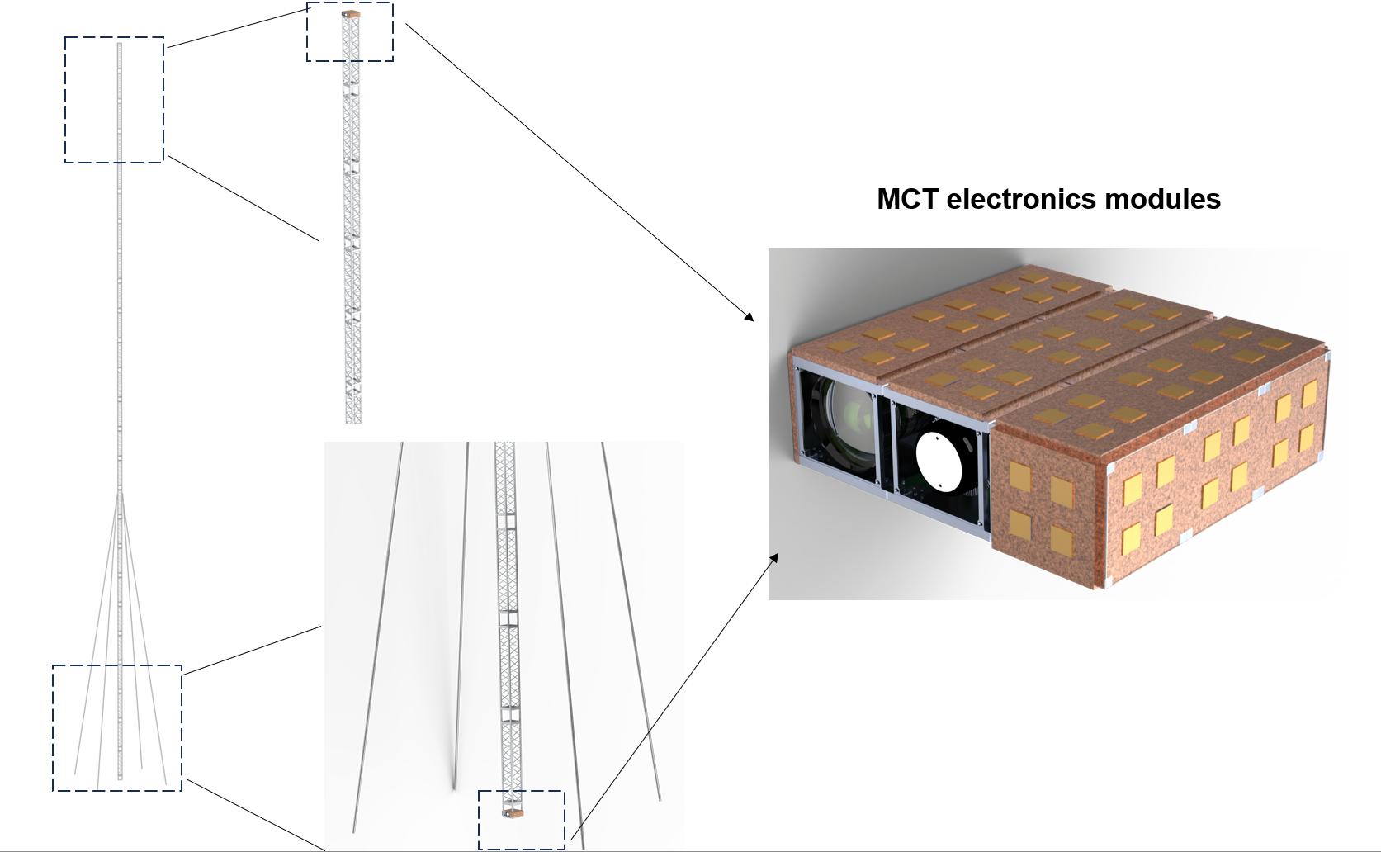
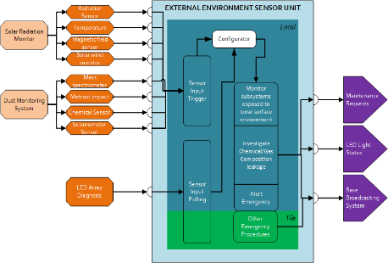
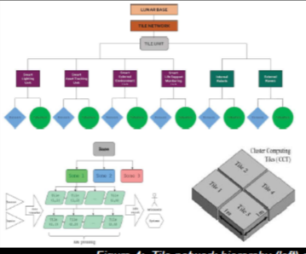
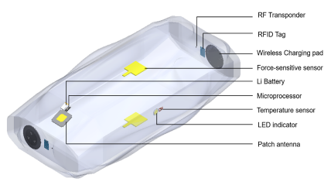
Approach
SMART(Scalable Mobile Autonomous Robotic Tech) Architecture
Lunar Base
Mobile Control Towers
Smart Blocks
Smart Sensors
Smart Computing Units

Slide 10
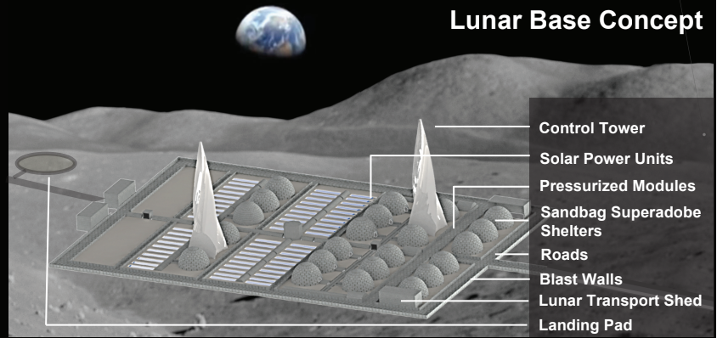
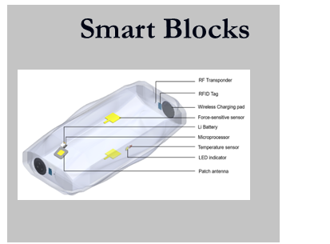
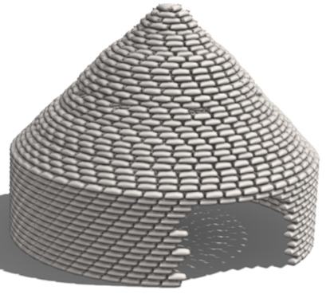
Approach
Lunar Base Concept
Sandbag Superadobe Shelter

Slide 11
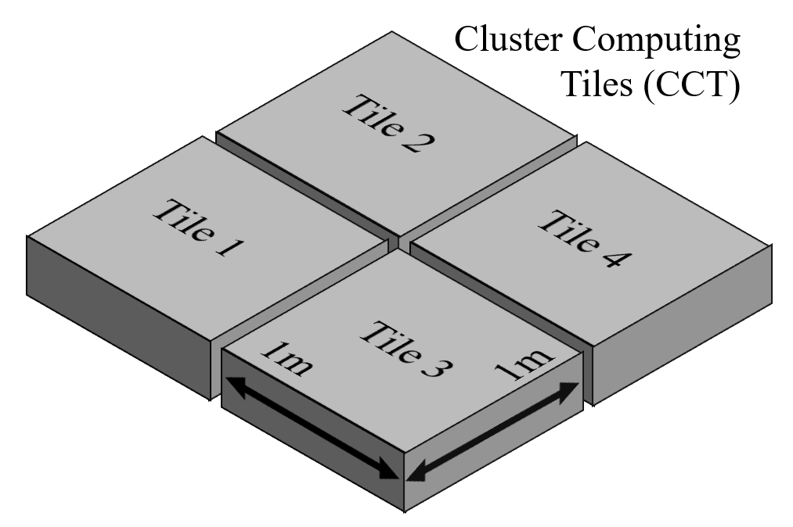
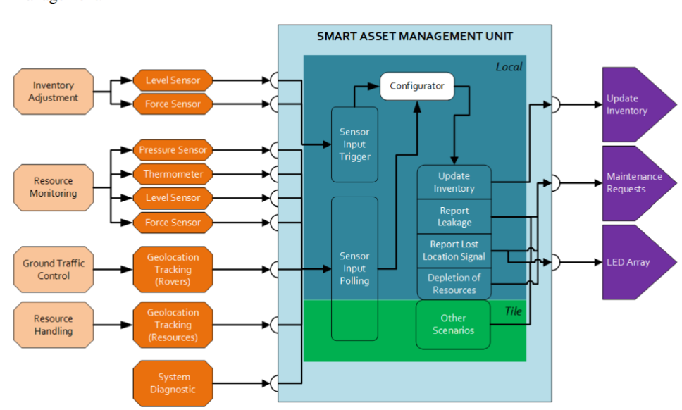
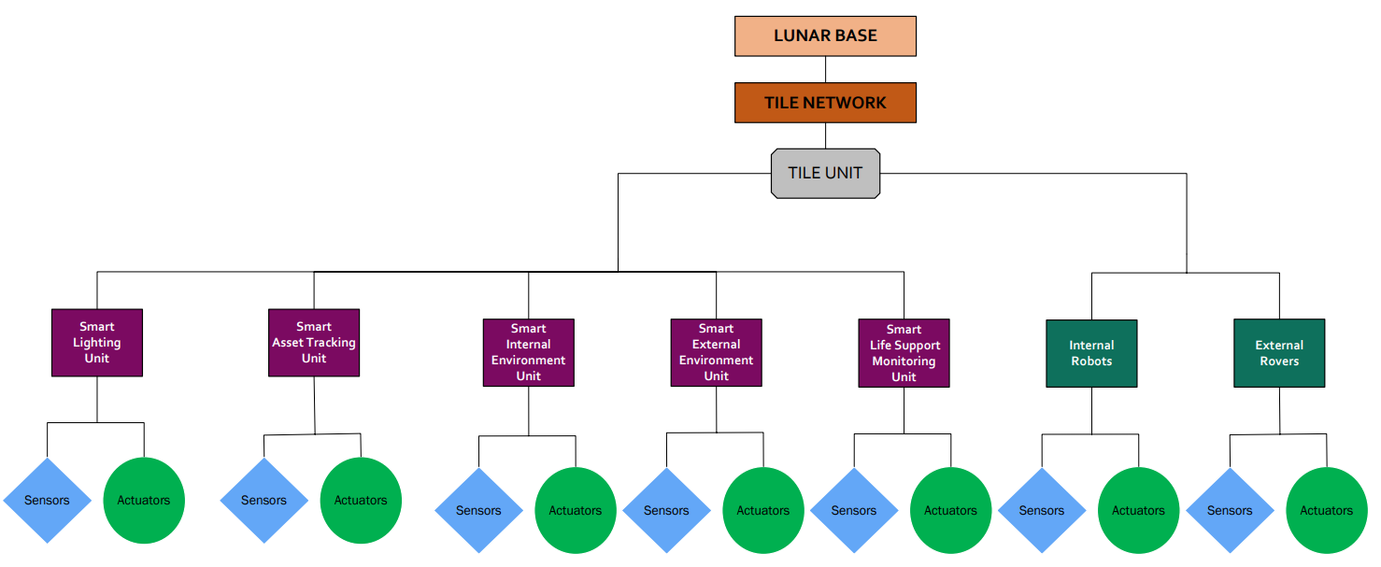
SMART Architecture for Lunar Base Applications
Smart systems for situational awareness
Lunar Base Hierarchy
Smart Sensor Unit

Slide 12
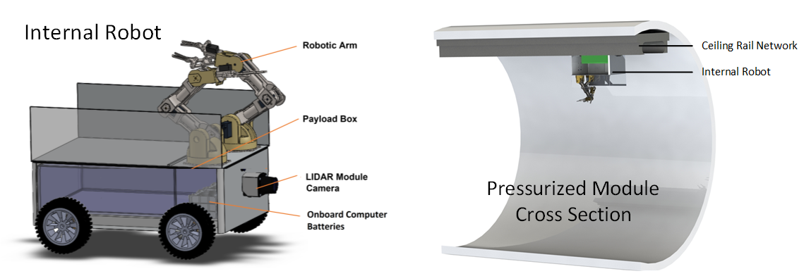
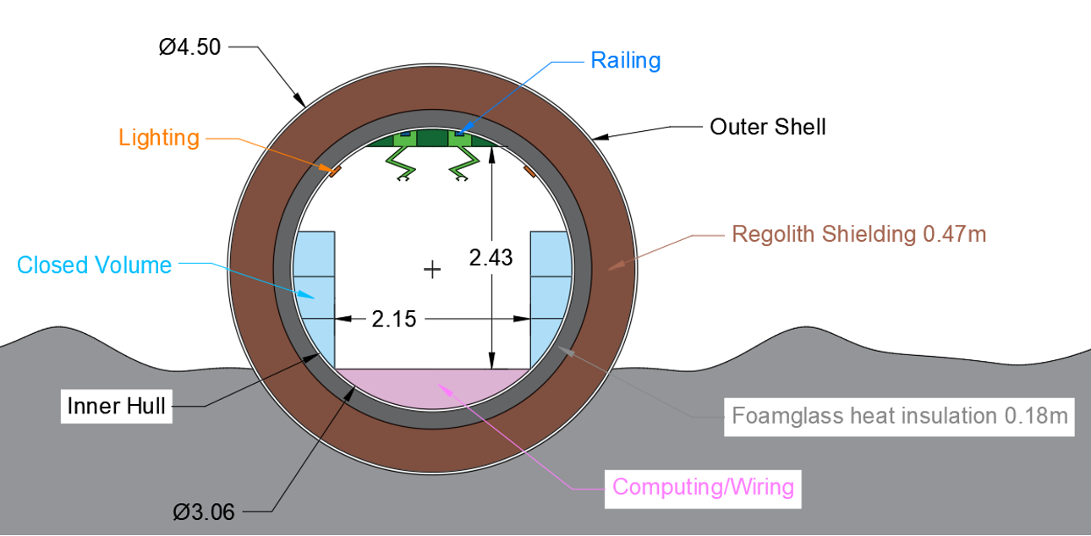
Internal Robots
Fleet of Interior autonomous robots moving along the pressurized chamber ceiling.
Interior Robot Design (upside down)
Interior Robot Placement
The internal robot railing (green) is on the top of the cylinder ceiling. Measurements are in meters.
Robots can travel faster without interfering with astronauts.

Slide 13
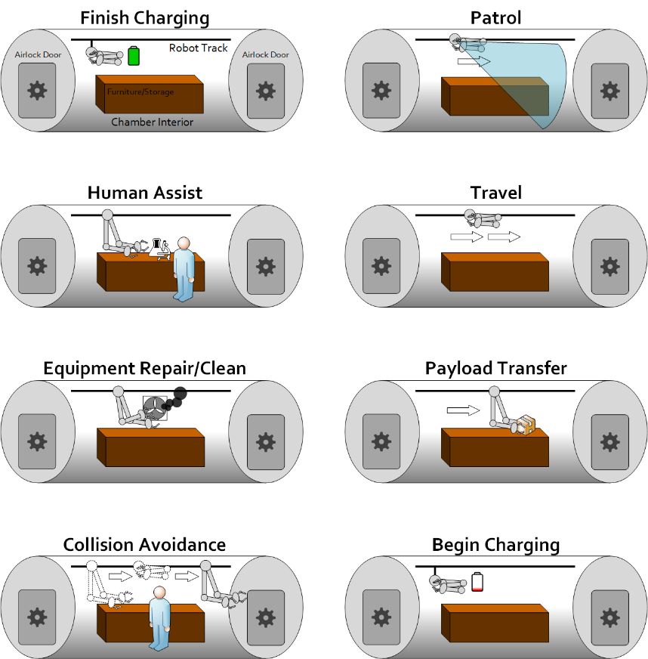
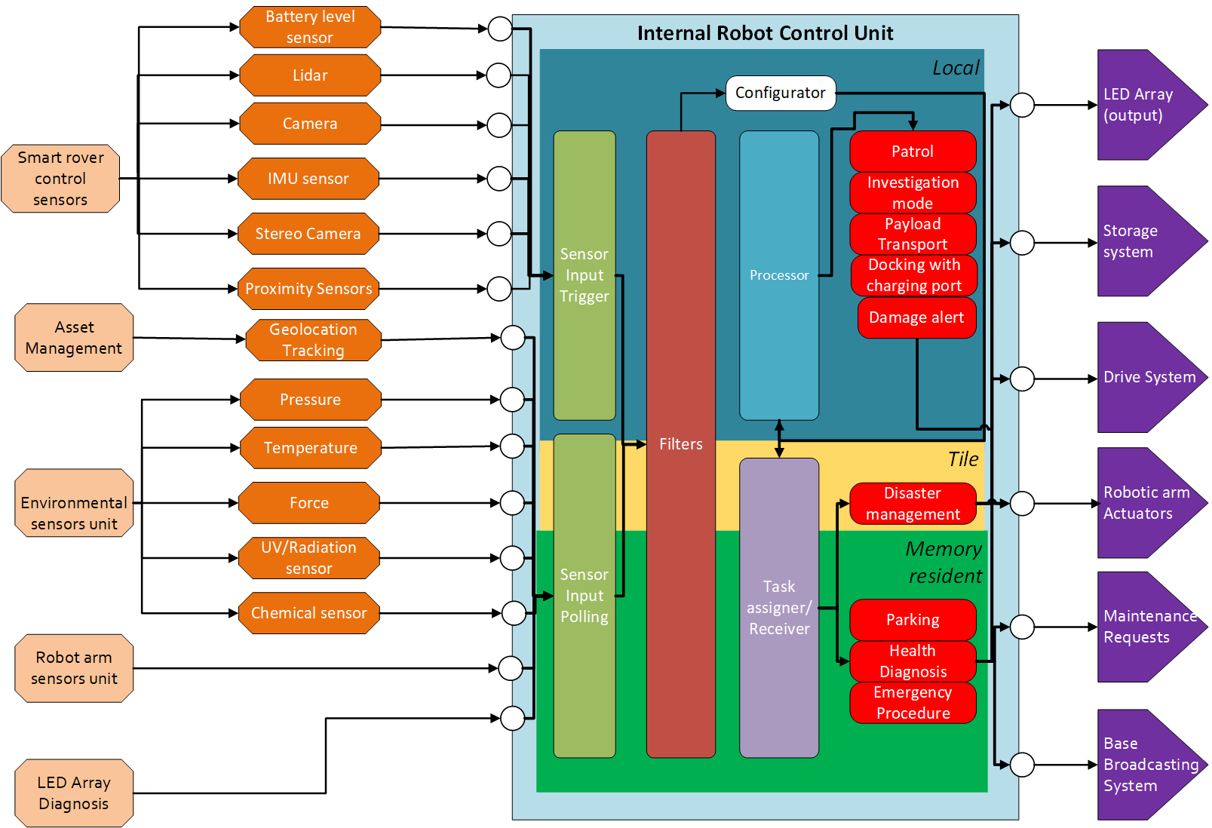
Internal Robots
Internal Robot connects with distributed cluster computing tiles
Triggers
Radio frequency signals
Optical commands
Modes
Idle
Human gestures
External system commands
Robot internal timer
Robot battery monitor
Collision avoidance sensors
Load/Unload payloads
Move
Human assist
Patrol
Charging
Maintenance
Upgrade/Repair self
Upgrade/Repair peers
Upgrade/Repair base
…
Autonomous robot operation
Modes
Robot functions illustration
Small robots leverage smart systems for handling routine, complex and computationally heavy operations
Internal Robot Control Unit

Slide 14
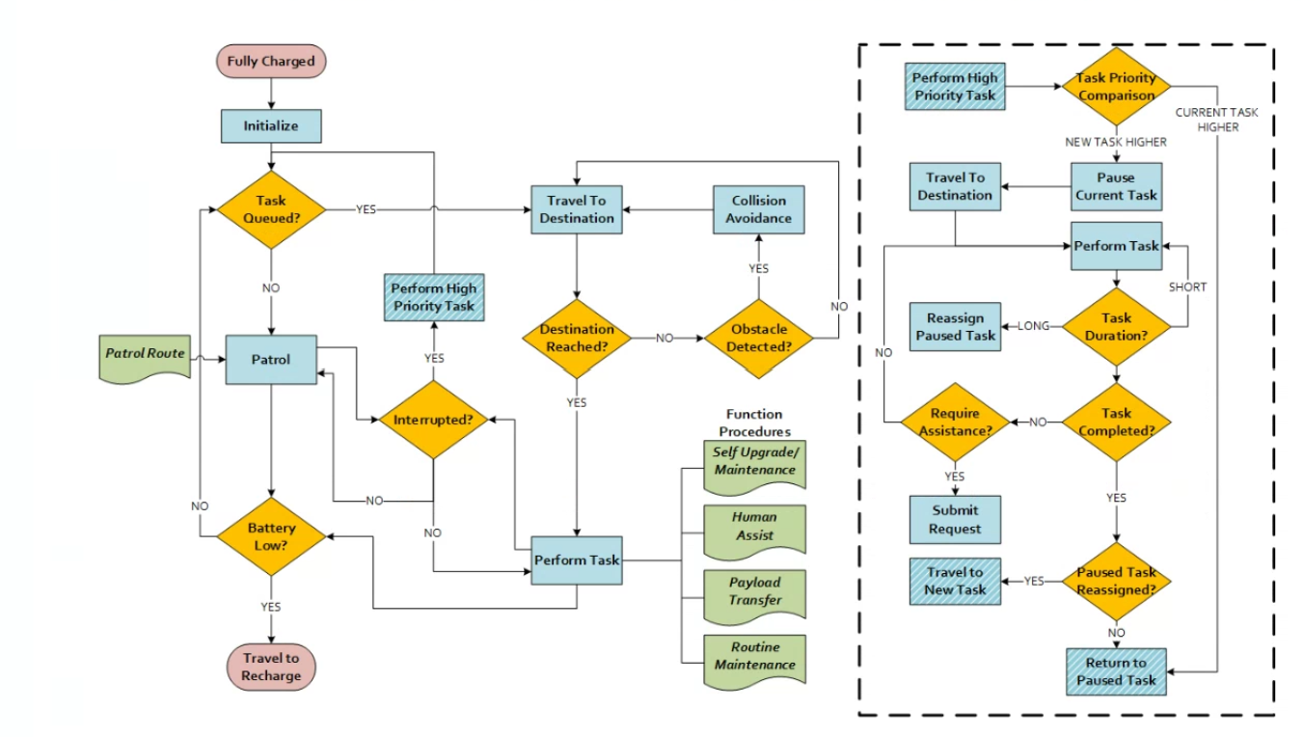
Block diagram of Robot Control
Robot Task Planning and Execution

Slide 15
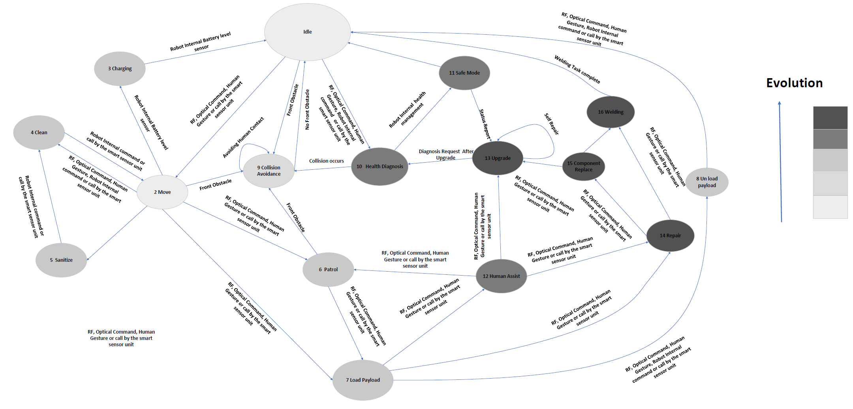
Finite State Machine
Internal robot control using FSM

Slide 16
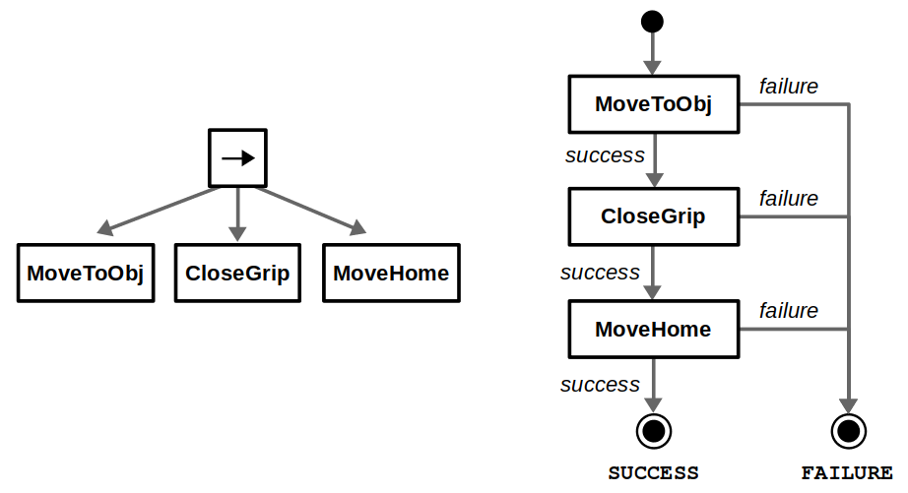
Behavior Tree
Internal robot control using Behavior Tree
Used in gaming industry and game engines like unity and unreal engine to control AI characters behaviors.
States are represented by the action nodes
Behavior Tree (Left) FSM (Right)

Slide 17
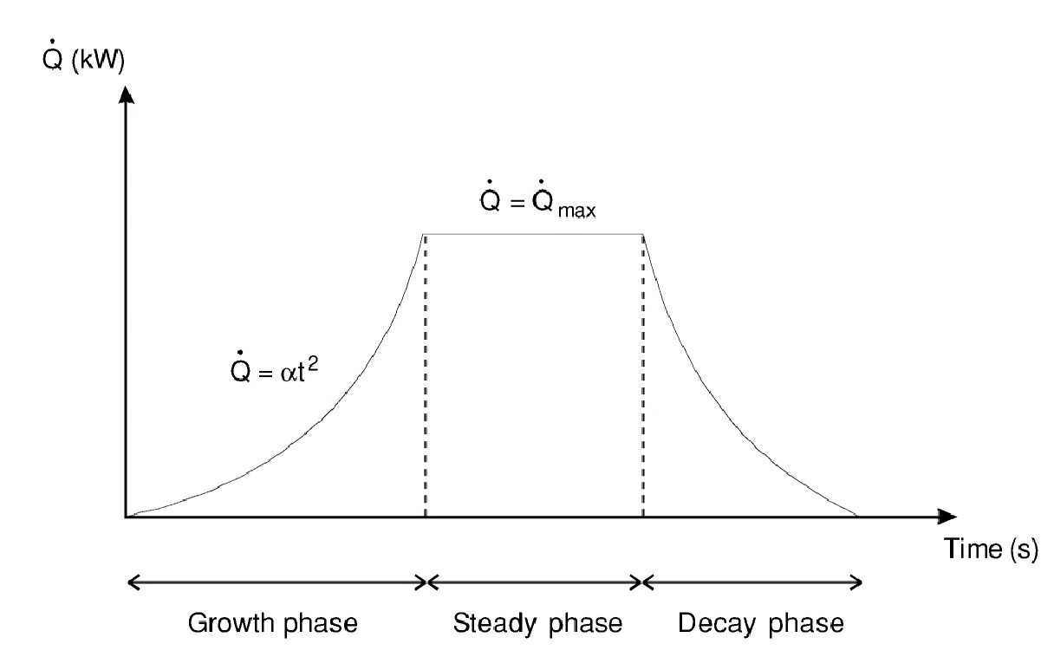
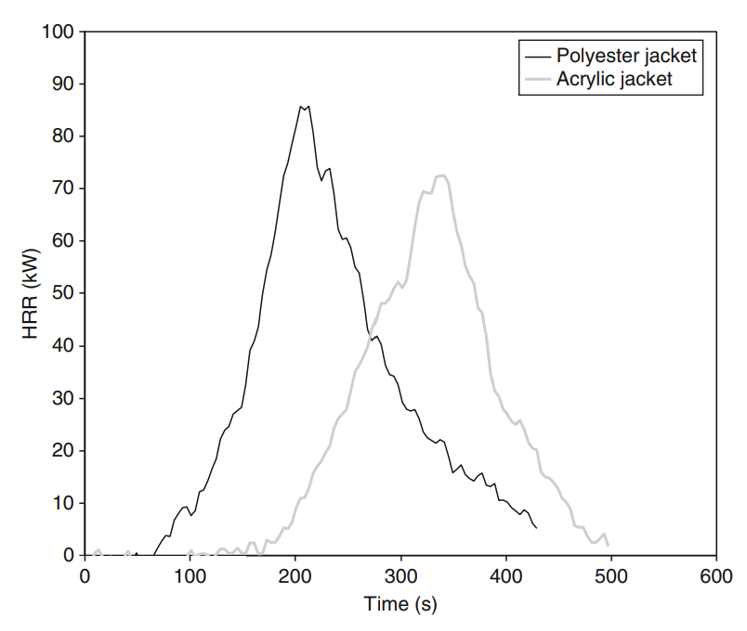
Fire Model
t² growth fire model
A high-fidelity fire model can be utilized for predicting fire profile
Heat release rate profile from the experiments
Heat release rate profile

Slide 18
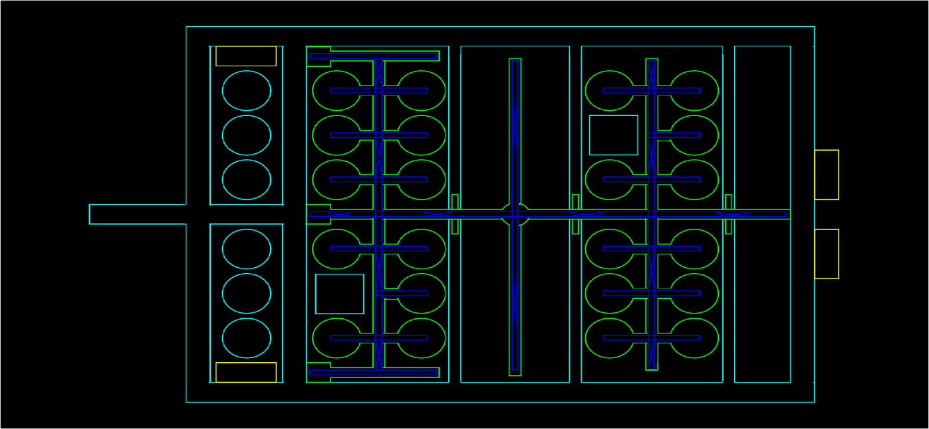
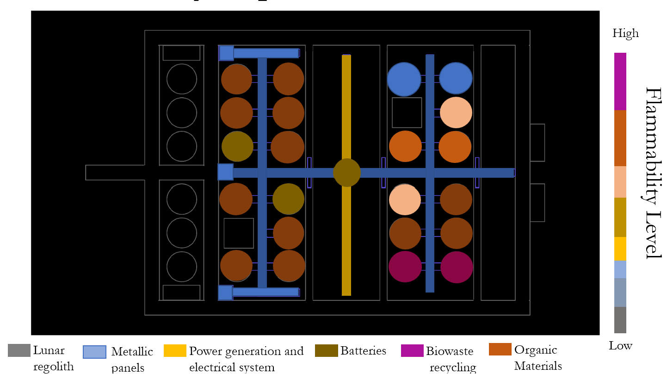
Lunar Base Software
Internal Robot Track
A snapshot showing the lunar base layout of the software visualizer.
The flammability map inside the lunar base
A software is developed to simulate various lunar base operations

Slide 19
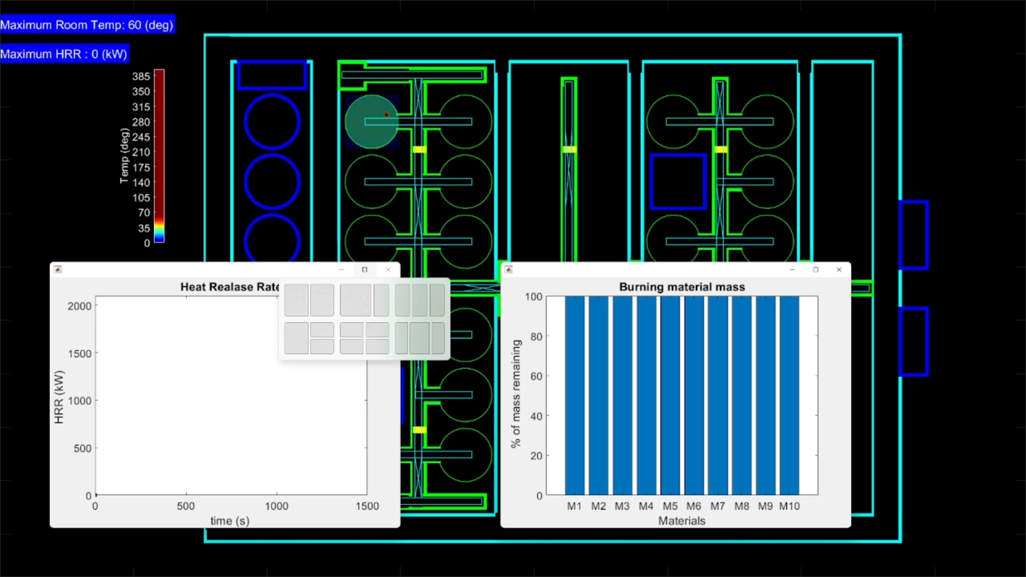
Fire Scenario
Heat Release Rate
Burning Material Mass

Slide 20
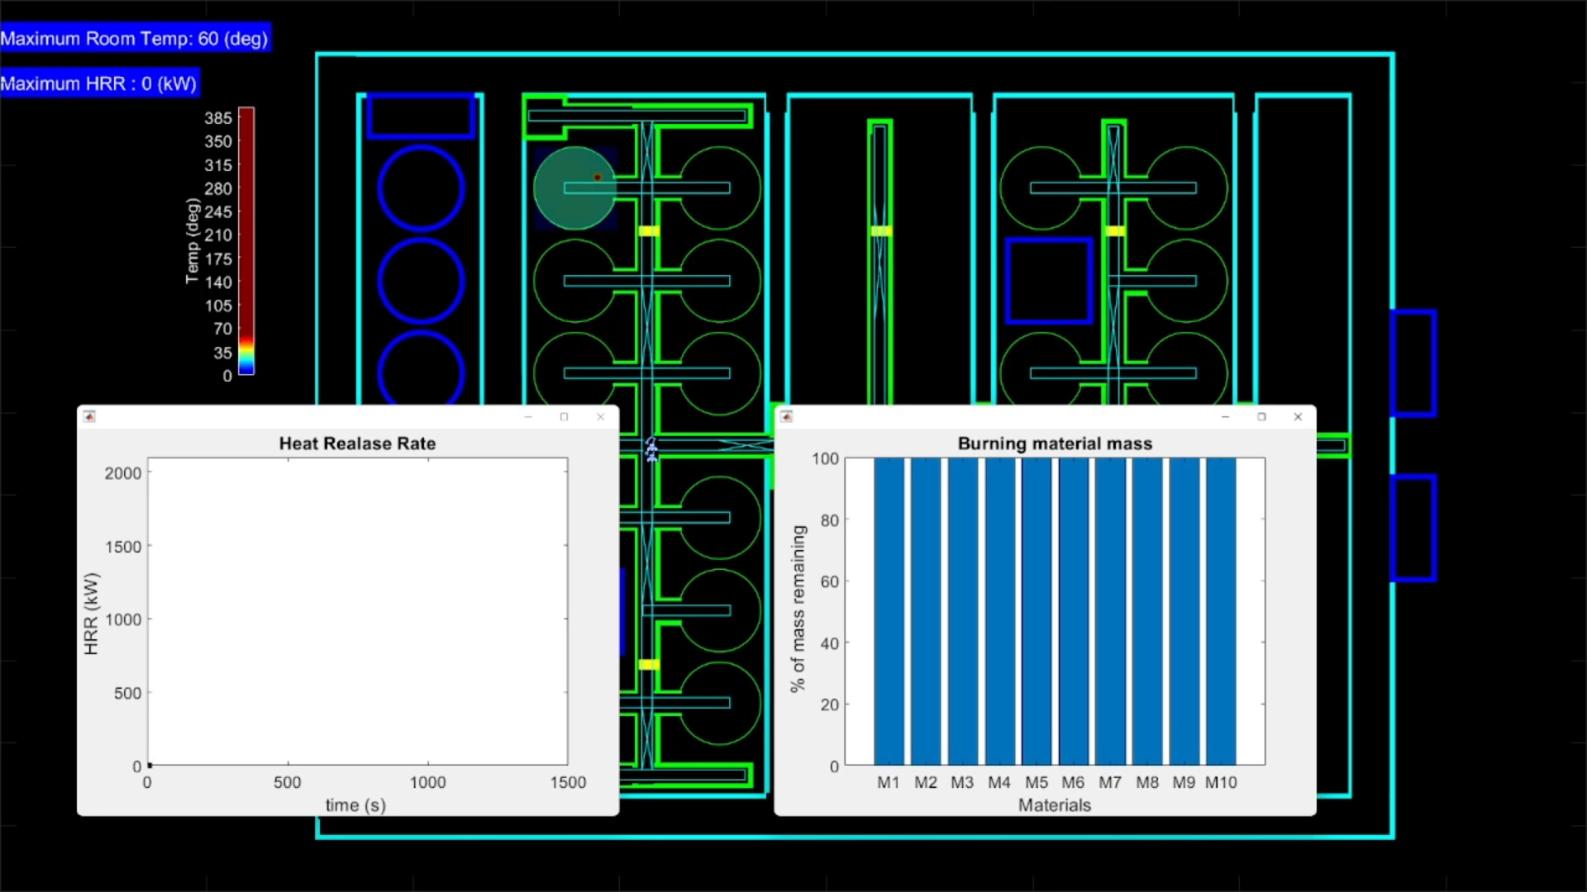
Single Robot Fire Fighting
Heat Release Rate
Burning Material Mass

Slide 21

Multiple Robots Fire Fighting
Heat Release Rate
Burning Material Mass

Slide 22
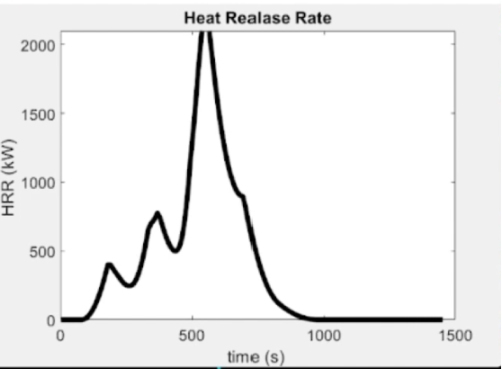
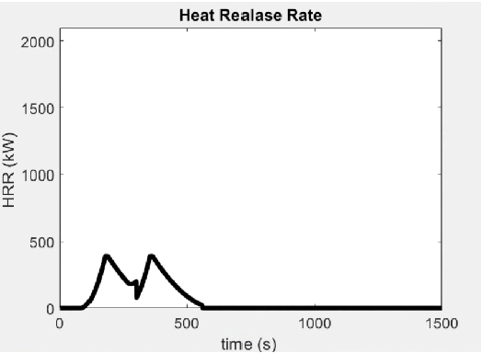
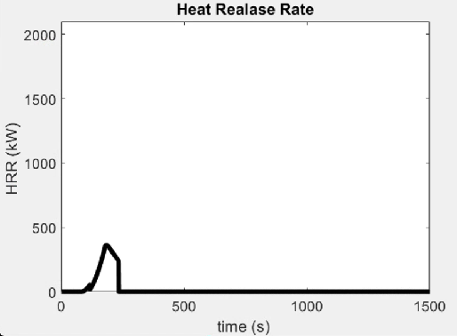
Results and Discussion
a) Without firefighting
b) Single robot firefighting
c) Multiple robot firefighting
Multi-robot fire fighting is promising

Slide 23
Conclusion and Future Work
A network of robots enables scalable autonomous operation of the lunar base.
Fire fighting with multiple robots is more promising than a single robot.
The high-fidelity fire model will be implemented using the distributive network to find out the optimum number of robots needed for firefighting using AI/ML techniques.
  Physics informed neural network
  GOAP
  BID
  Gen AI
Modular and specialized firefighting robots will be considered to see what strategy is advantageous under what conditions.

Slide 24
References
[1] Guibaud, Augustin, et al. "Fire safety in spacecraft: Past incidents and Deep Space challenges." Acta Astronautica 195 (2022): 344-354. 10.1016/j.actaastro.2022.01.021
[2] Captain, S. (2020, April 3). Firefighting drones extinguish 10-story blaze in China demonstration. DroneDJ. Retrieved April 29, 2023, from https://dronedj.com/2020/04/03/firefighting-drones-extinguish-10-story-blaze-china/
[3]. Thermite®. THERMITE® | Howe & Howe Technologies. (n.d.). Retrieved April 29, 2023, from https://www.howeandhowe.com/civil/thermite
[4] JSC 29353B flammability configuration analysis for spacecraft ... - NASA. (n.d.). Retrieved April 29, 2023, from https://ntrs.nasa.gov/api/citations/20150020937/downloads/20150020937.pdf
[5] Kim, H.J. and Lilley, D.G., 2002. Heat release rates of burning items in fires. Journal of propulsion and power, 18(4), pp.866-870.
[6] Hurley, M.J., Gottuk, D.T., Hall Jr, J.R., Harada, K., Kuligowski, E.D., Puchovsky, M., Watts Jr, J.M. and WIECZOREK, C.J. eds., 2015. SFPE handbook of fire protection engineering. Springer.
[7] Li, Sen, et al. "An Indoor Autonomous Inspection and Firefighting Robot Based on SLAM and Flame Image Recognition." Fire 6.3 (2023): 93.
[8] Olson, S. L., and Paul Ferkul. "Evaluating material flammability in microgravity and martian gravity compared to the nasa standard normal gravity test." 42nd International Conference on Environmental Systems. 2012.

Slide 25
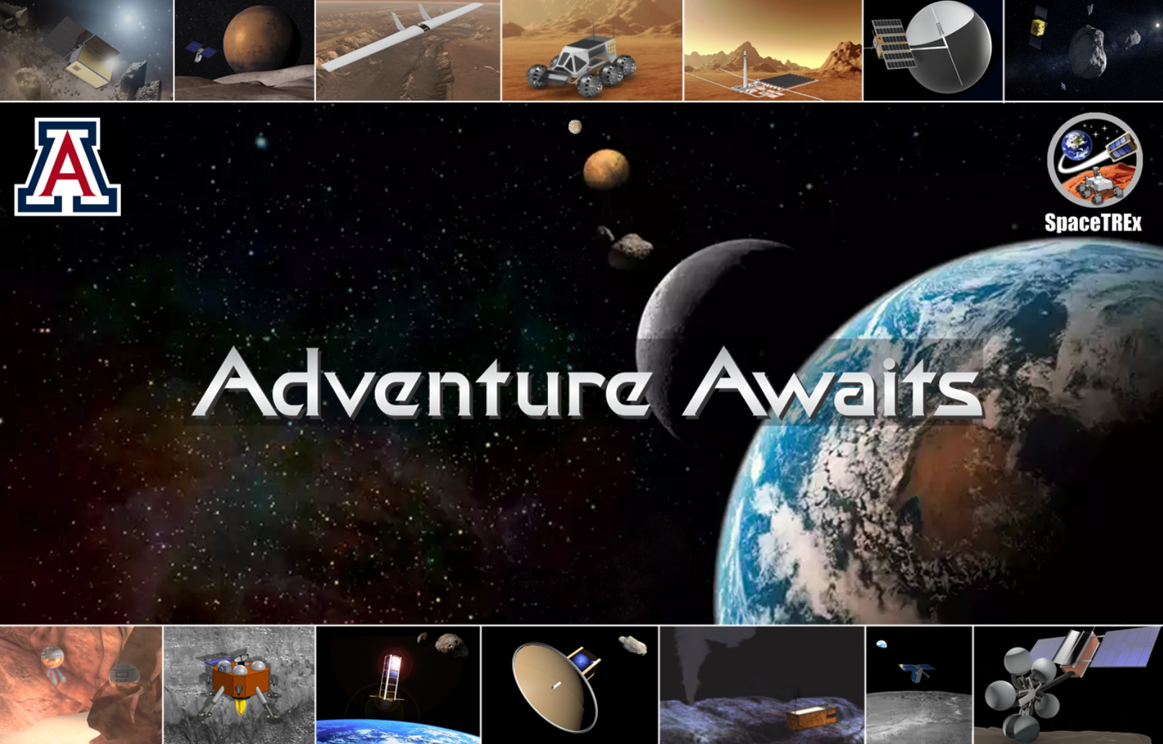
Thank You!

Slide 26
Any Questions ?

