Slide 1

Overview of CADRE Flight Software Developed using the F Prime Flight Software Product Line
Aadil Rizvi, FSW Engineer, NASA/JPL
© 2024 California Institute of Technology. Government sponsorship acknowledged.

Slide 2
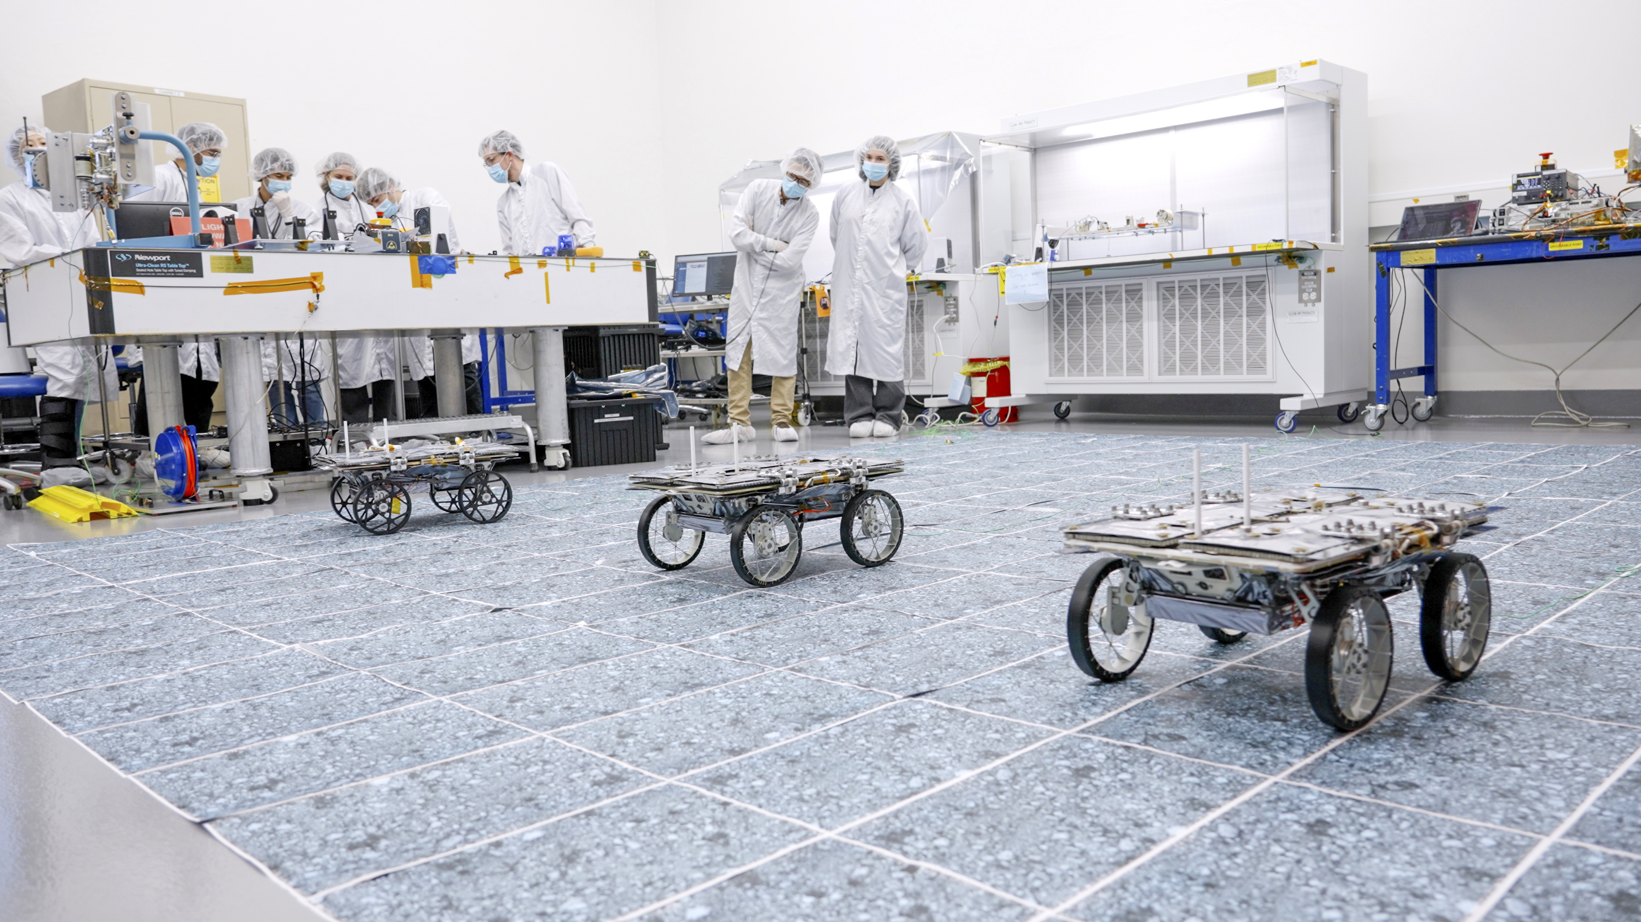
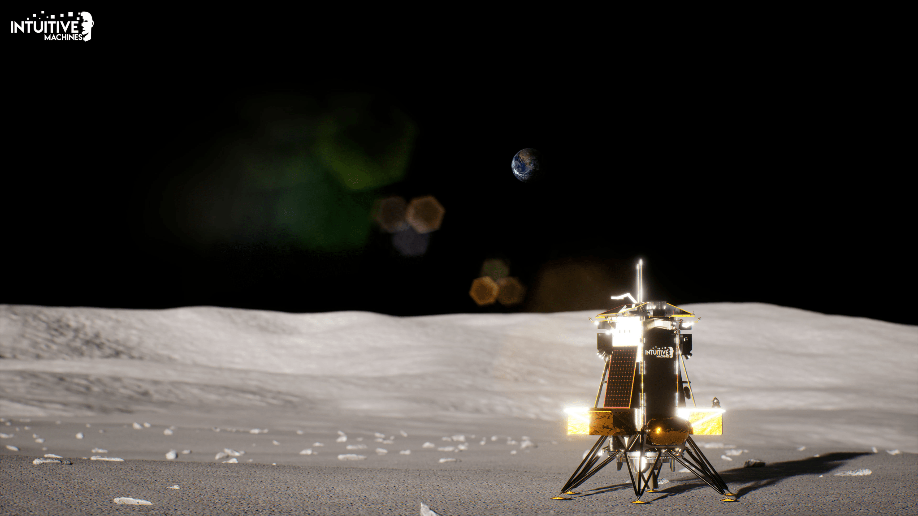
Introduction
CADRE (Cooperative Autonomous Distributed Robotic Exploration)
Network of small rovers that will work together to explore the Moon autonomously
Demonstrate multi-agent autonomy
3 rovers, 3 deployers and a base station
Launch date: early 2025 - 2026 Intuitive Machines (IM) - 3

Slide 3
CADRE Flight Software (FSW) Overview
Executes on ModalAI VOXL platform, Linux OS
Uses the open-source F Prime Product Line (https://fprime.jpl.nasa.gov)
Leverages inheritance from Mars Helicopter for VOXL platform
Integrates JPL developed autonomy software libraries into F’ components
A rover deployment executes on each rover platform while a separate base station deployment executes on the base station
Each agent can communicate with each other via a mesh network radio (MNR)

Slide 4

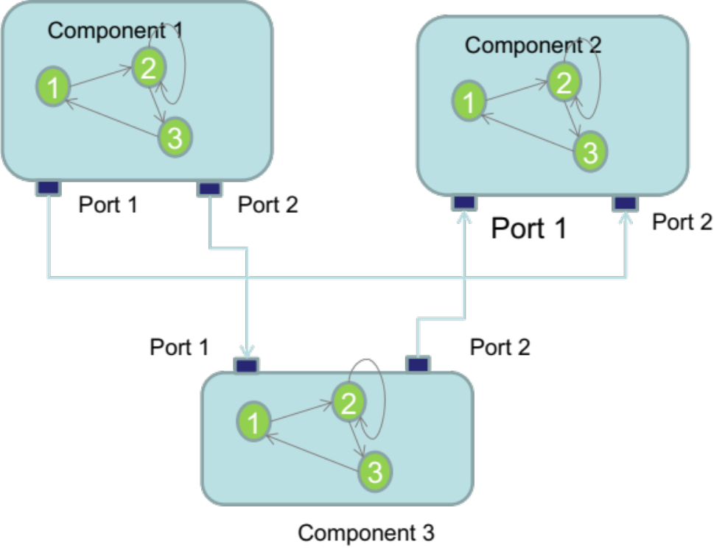
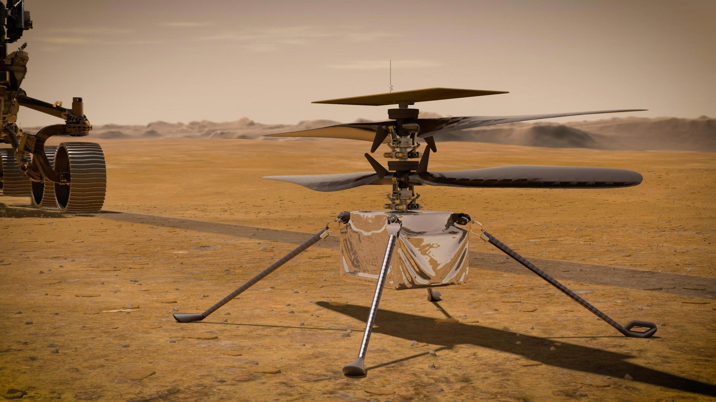
F Prime Product Line
https://fprime.jpl.nasa.gov
Open-source software framework for the rapid development and deployment of embedded systems and spaceflight applications

Slide 5
CADRE Hardware Components
BASE STATION
ROVER (x3)
IM LANDER INTERFACE
GPR
SACA
VOXL
MNR
STEREO CAMERA PAIR (x2)
VOXL
MNR
DEPLOYMENT MOTORS
UWB
MOBILITY MOTORS
UWB
FPGA
FPGA
PRTS
HTRS
PWR
PRTS
HTRS
PWR
SUN S
IMU

Slide 6
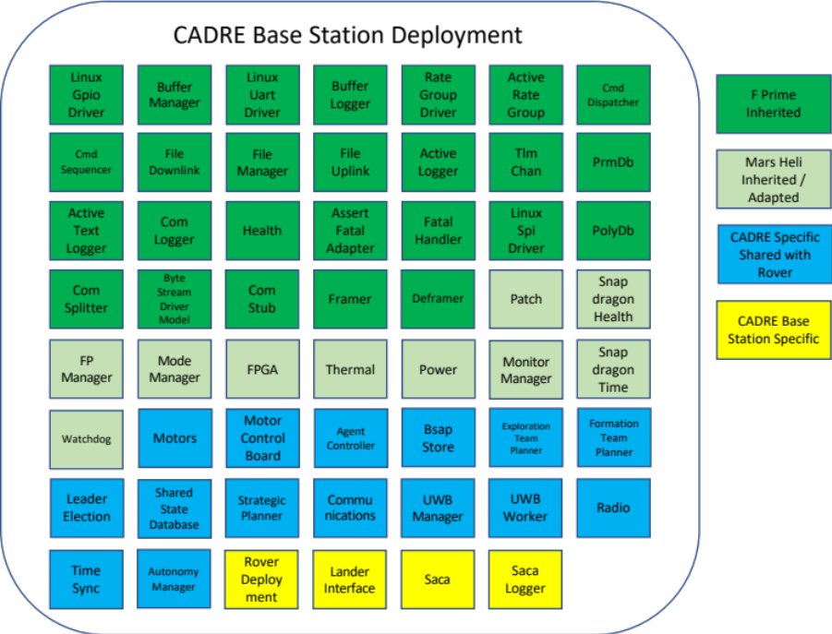
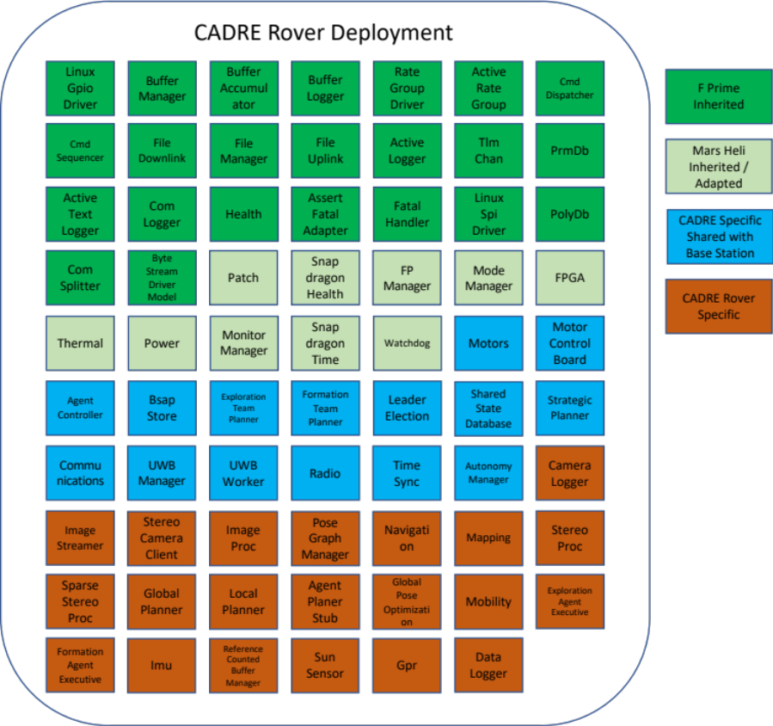
CADRE Flight Software (FSW) Components

Slide 7
CADRE FSW Component SLOC (Source Lines of Code)
Base Station Deployment
Rover Deployment
SLOC
SLOC
29412
29412
22020
14786
14786
7378
8257
7021
F Prime Inherited
Mars Heli Inherited / Adapted
CADRE Specific Shared with Rover
CADRE Base Station Specific
F Prime Inherited
Mars Heli Inherited / Adapted
CADRE Specific Shared with Base Station
CADRE Rover Specific
Total SLOC
59,833
Total SLOC
73,239
NOTE: SLOC count consists of F Prime component only hand-coded physical lines of code (i.e. no comment or blank lines). Other significant sources of code not
reflected in above SLOC count include surface mobility and autonomy libraries; comms, MCB driver, UWB driver, and other external libraries;
FPGA auto-generated register map, power voltage table; F’ auto-generated source code and unit test code; FPP source files; Linux kernel, OS,
configuration files and ground tooling.

Slide 8
CADRE FSW Autonomy – Formation Drive
Tasknet File
Autonomy Planning, Scheduling and Execution
Commands
Enable
Execute
Sync
Constraints
Power/thermal
Scheduling timeline
Formation Team Planner
Strategic Planner
Agent Controller
Shared State Database
Bsap Store
Formation Agent Executive
Trajectory waypoints
and drive times
Rover pose/location
Maps, obstacles
Sensor Inputs
Guidance, Navigation and Control Processing
Actuation
Outputs
Stereo Images
Images and
IMU data
Stereo Processing
Sparse Stereo Processing
Mapping
Global Planner
Mobility
commands
Mobility
IMU
Image Processing
Navigation
Local Planner
Motors
Motor Control Board

Slide 9
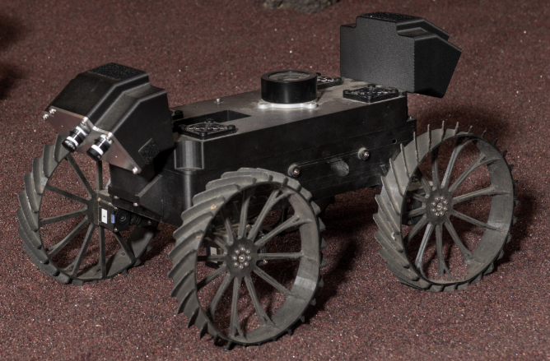
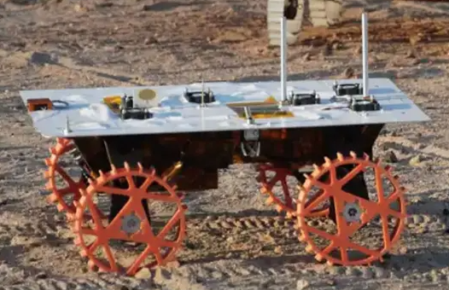
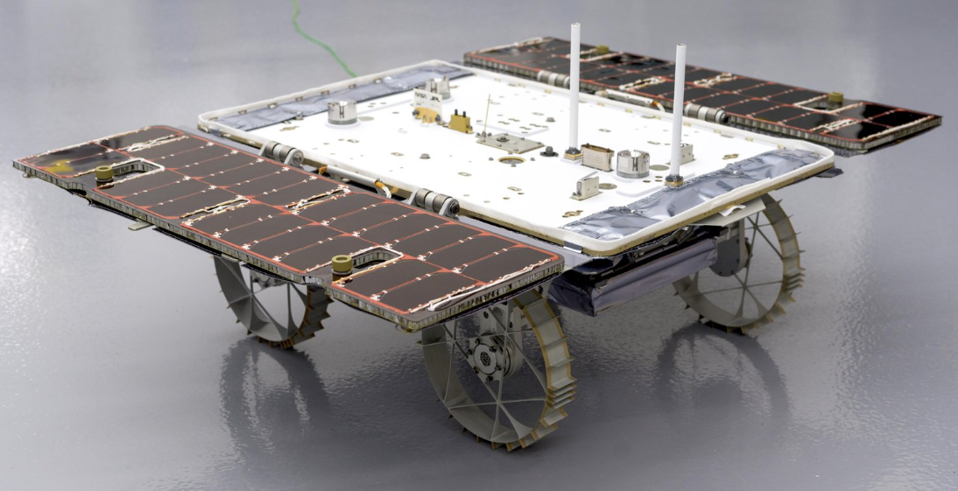
Testbed and Flight Integrated Deployment Testing
Dragon Farm
(12 VOXLs)
Mercury 7 Rovers
(3 rovers)
Demonstration Models
(2 rovers, 1 base station)
Flight Models
(3 rovers, 1 base station)
VOXL
Deployments Executed
Rover and base station
blkDrv deployments
Autonomy blkDrv
deployment
Sensor stub
deployment
Mercury7
rover deployment
Sensor stub
deployment
Rover and base station
flight deployments
Rover and base station
flight deployments
Integrated Testing GDS
F’ GDS
(uplink and downlink)
F’ GDS
(uplink and downlink)
RSVP lite (uplink)
F’ GDS
(uplink and downlink)
RSVP lite (uplink)
AMPCS (downlink)
F’ GDS
(uplink and downlink)
RSVP lite (uplink)
AMPCS (downlink)

Slide 10

Conclusion
CADRE is a large and complex F Prime FSW deployment with significant application software developed leveraging the framework and inheritance from Mars Heli.
The modularity of F Prime enabled deployment configurations for various test venues and helped perform targeted integrated testing for autonomy behaviors on more readily available test venues.
The F Prime product line’s ground tooling can be adapted for use with other ground data systems for compatibility while providing an out of the box light weight solution for integrated testing.
The successful testing and delivery of CADRE FSW underscores F Prime’s ability to enable large and complex software systems’ development by providing a reliable framework and architecture that’s extensible, adaptable and testable.

