Slide 1

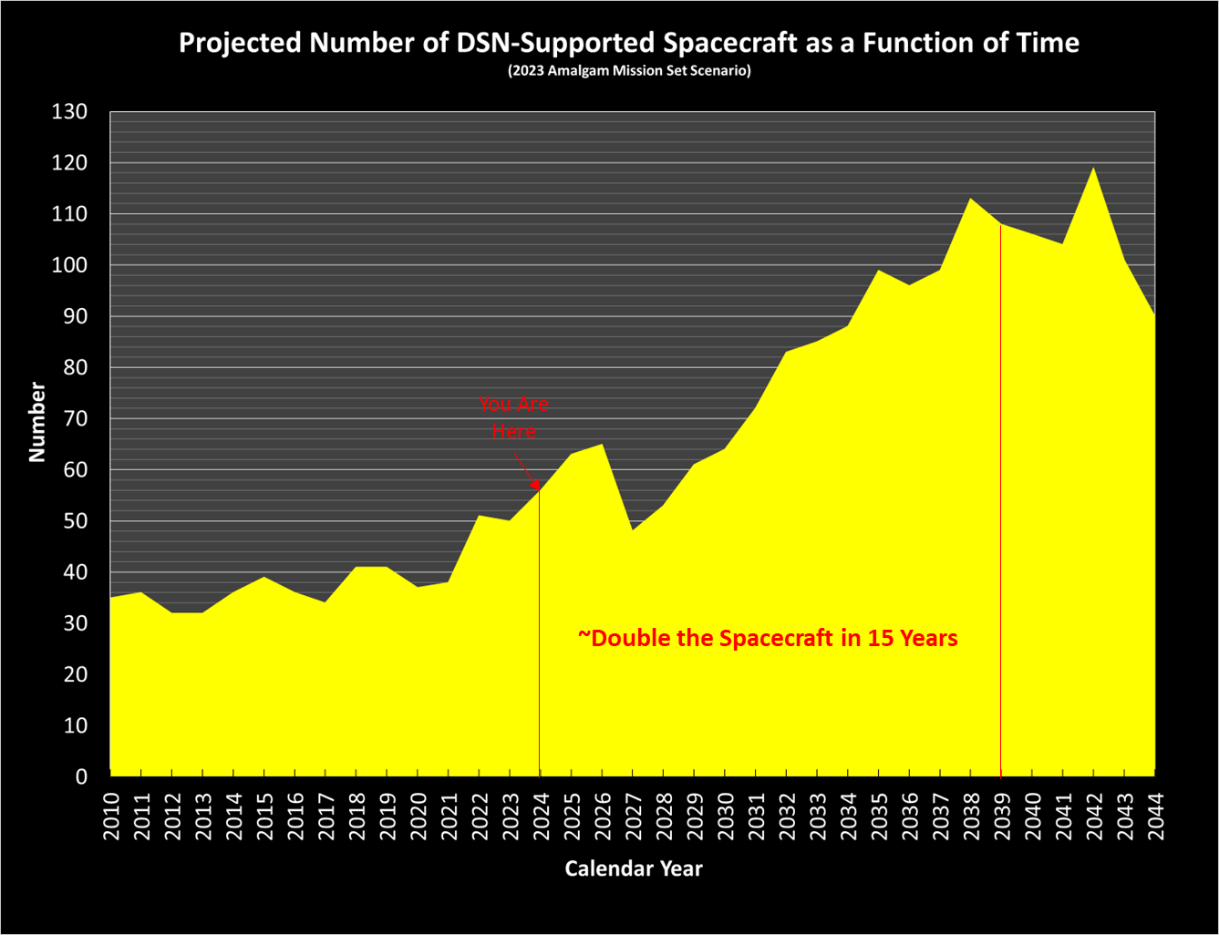
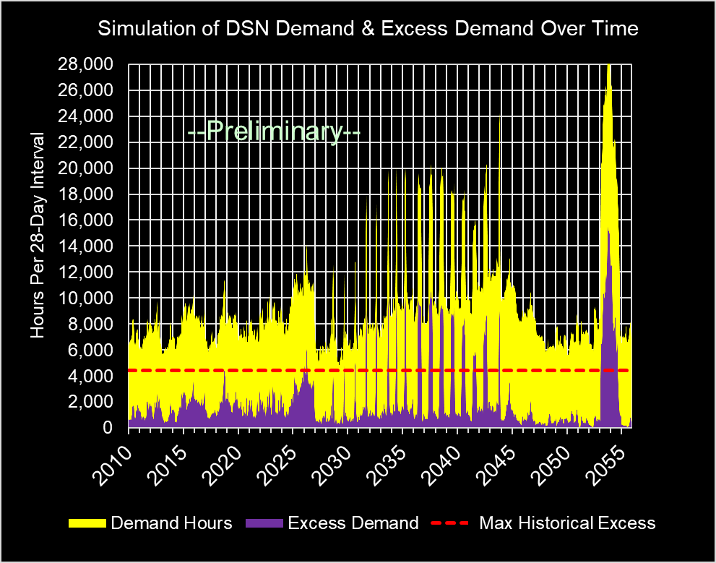
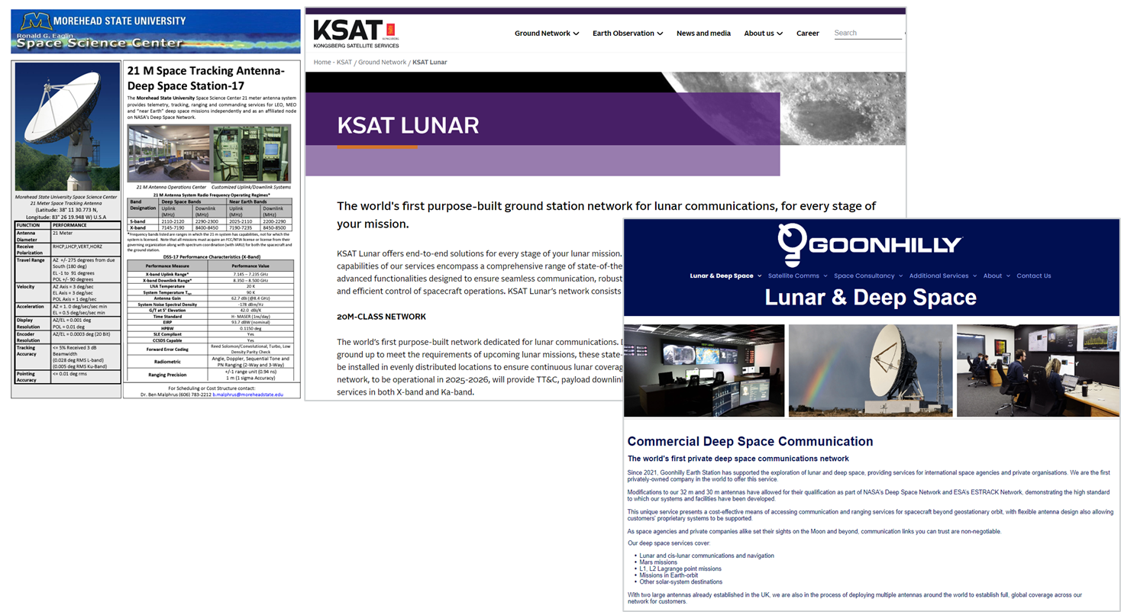
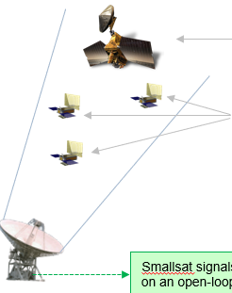
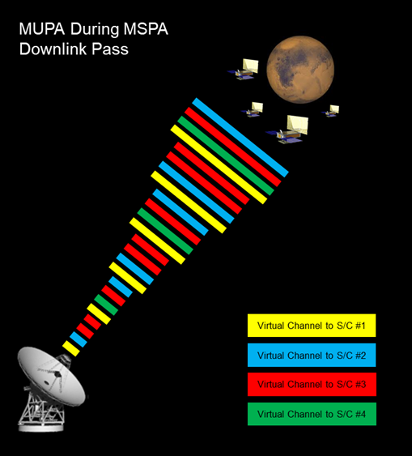
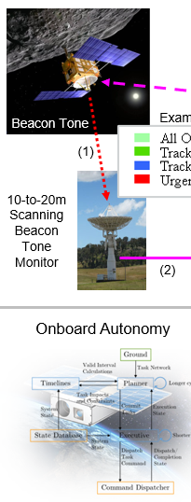
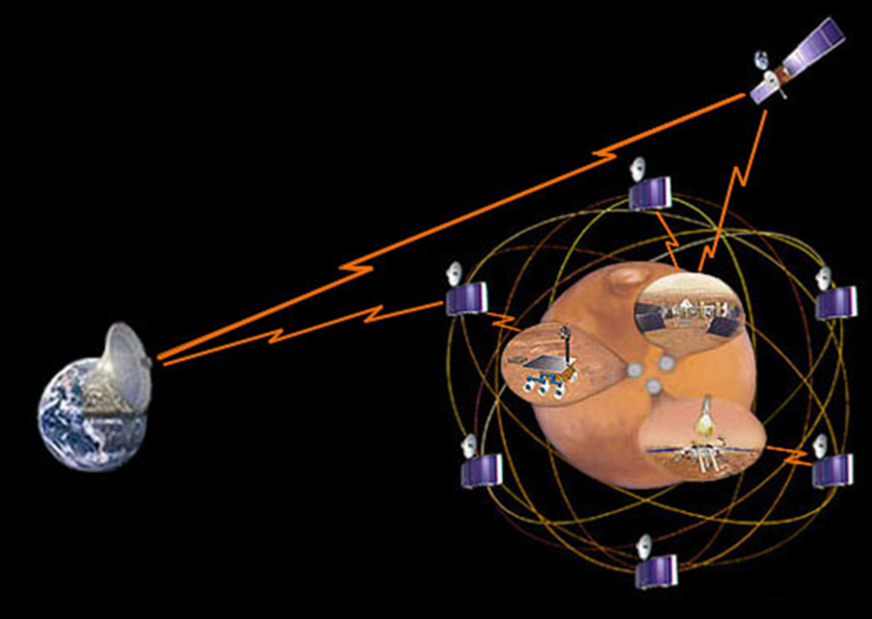
Future Deep Space Mission Communications Trends with Potential Implications for Smallsats
OMSPA
Douglas S. Abraham and E. Jay Wyatt
Jet Propulsion Laboratory, California Institute of Technology
Interplanetary Small Satellite Conference
University of Arizona, Tucson, AZ
April 30, 2024 – May 2, 2024
DTN
Copyright 2024 California Institute of Technology.
U.S. Government sponsorship acknowledged.

Slide 2
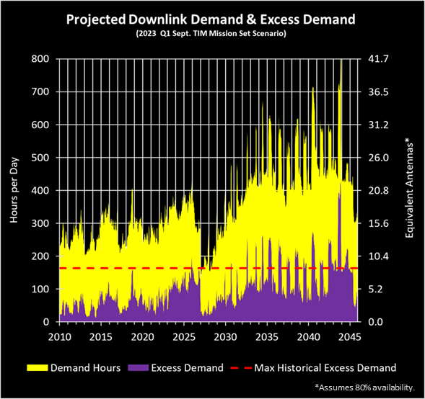
Key Future Mission Trends
Roughly double the spacecraft because: ~65% more missions in 15 years due to advent of human lunar exploration (involving multiple spacecraft elements) and more numerous robotic science missions (e.g., smallsats).
Excess demand spikes in future correspond to human exploration missions with multiple elements requiring 24/7 coverage and “hot” backups during mission-critical events.

Slide 3
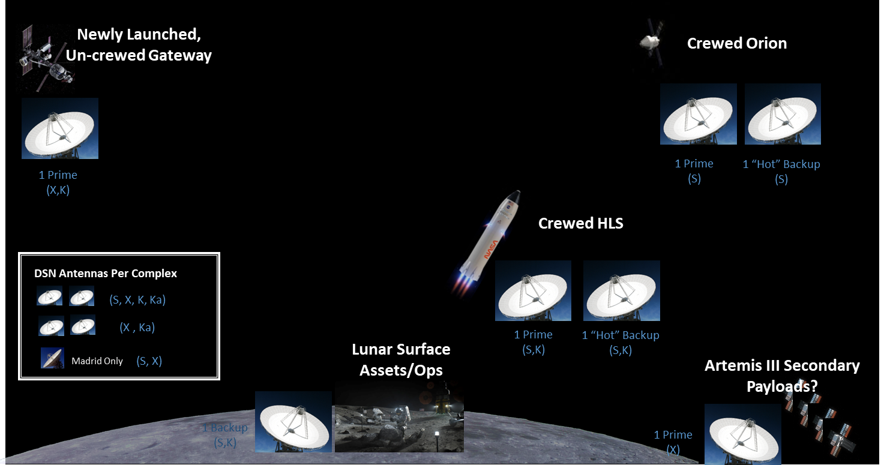
Artemis Mission Loading (1/2)
Artemis III Example
With just Artemis-3, the number of required antennas will likely exceed the number available at a DSN Complex. However, only a subset of those antennas have S- or K-band, leading to an even worse shortfall.

Slide 4
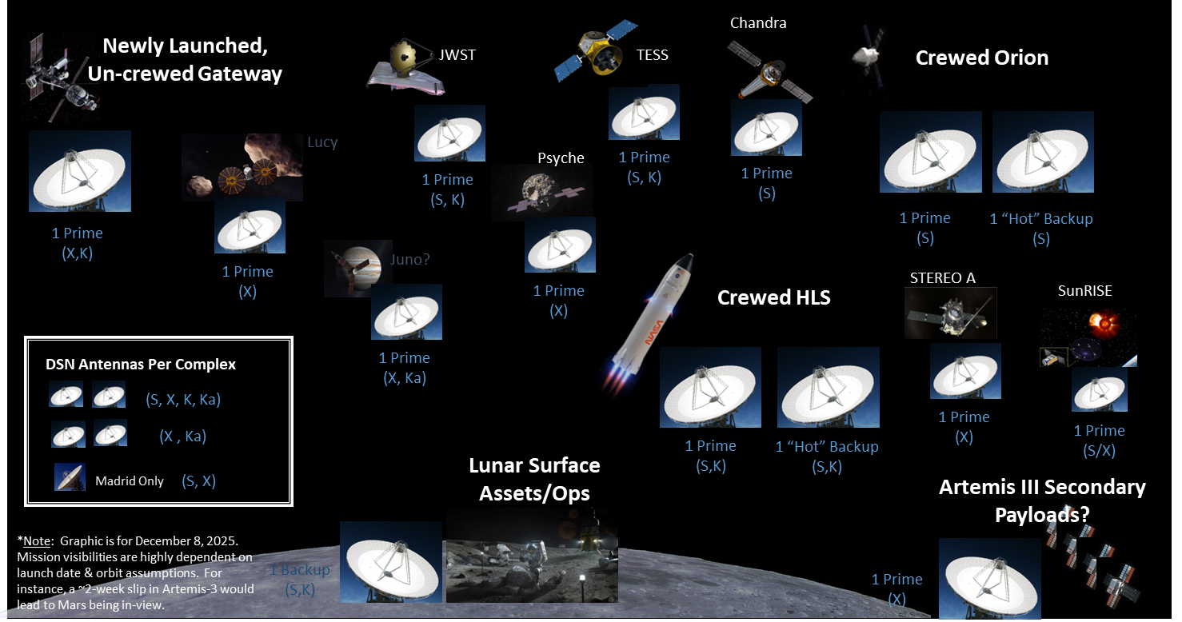
Artemis Mission Loading (2/2)
Artemis III with Missions in Same Sky View
Once the rest of the missions sharing the sky with Artemis-3 are added into the picture, the full extent of the potential DSN oversubscription can be readily visualized – hence, the large excess demand spikes during Artemis missions appearing in the earlier excess demand plot.

Slide 5
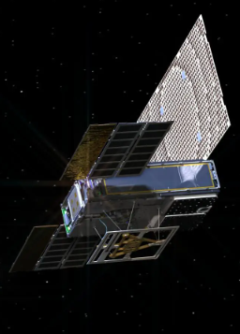
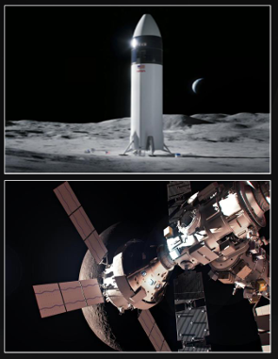
Loading Implications for Smallsats
>$10M
>$10B + Human Lives
But, deep space smallsats really need large ground antennas since they don’t have the mass, power, and volume to sport powerful transmitters or large antennas.
There are 5 emerging developments that may help.
Scheduling Priority
The cost information contained in this document is of a budgetary and planning nature and is intended for informational purposes only. It does not constitute a commitment on the part of JPL and/or Caltech.

Slide 6
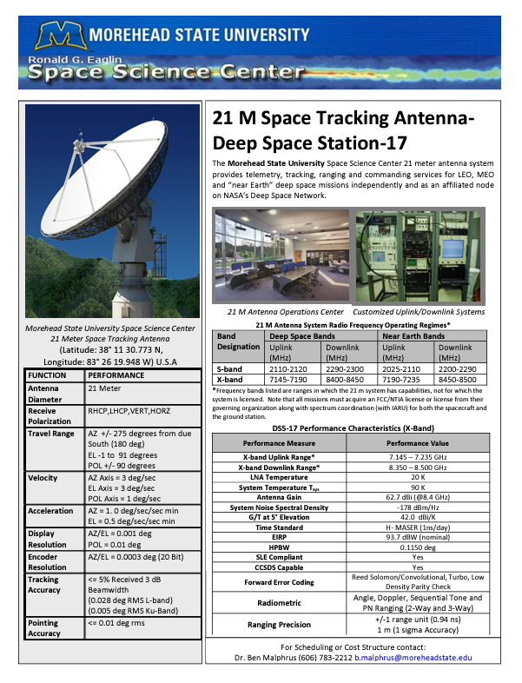
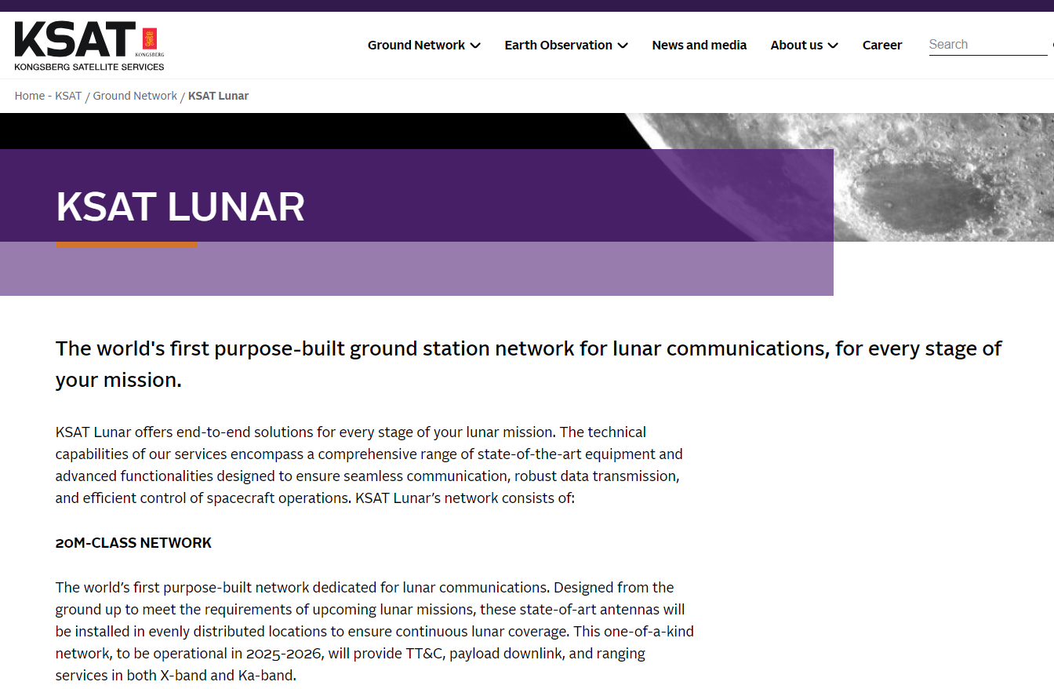
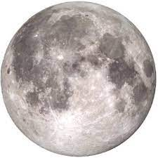
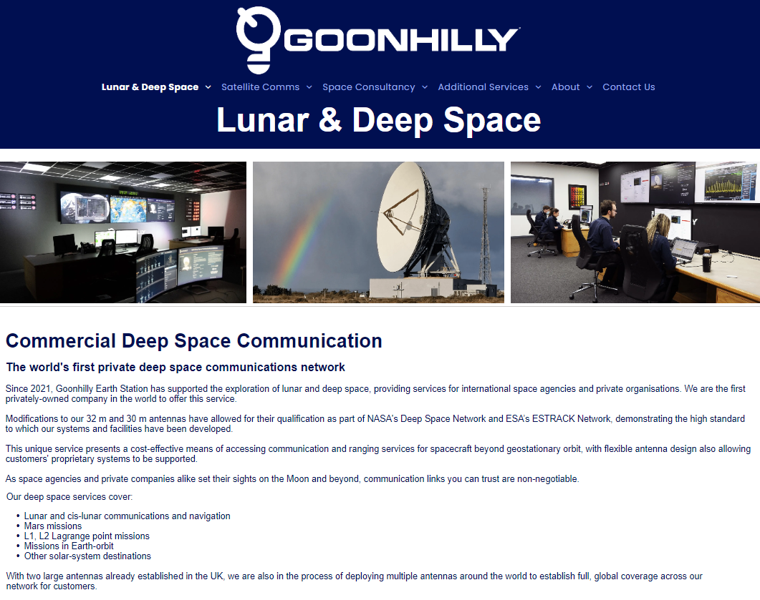
Emerging Developments Relevant to Smallsats (1/5)
University and Commercial Ground Station Providers
*
*Supports beacon tones and DTN (pilot service).
A growing number of university and commercial entities with 20m-class ground stations may be available to support deep space smallsats.

Slide 7
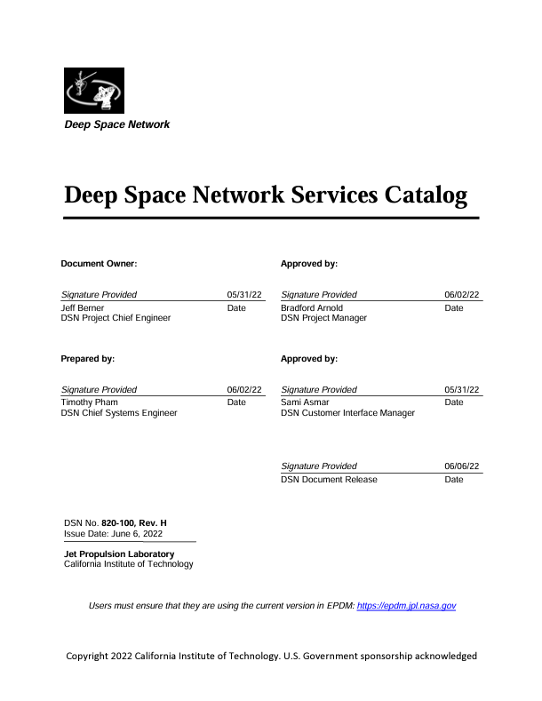
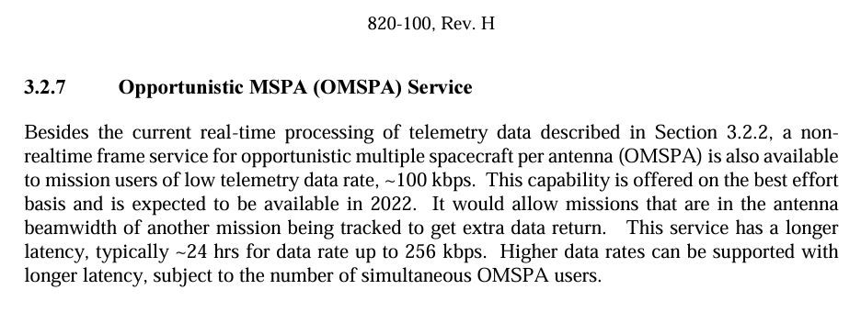
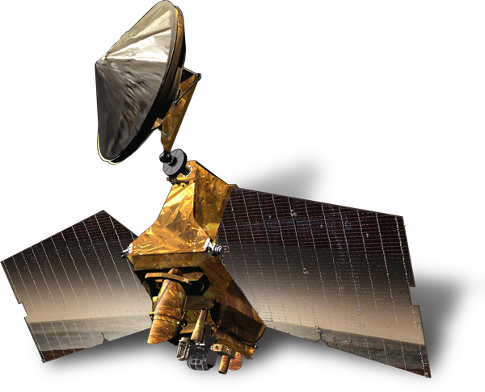
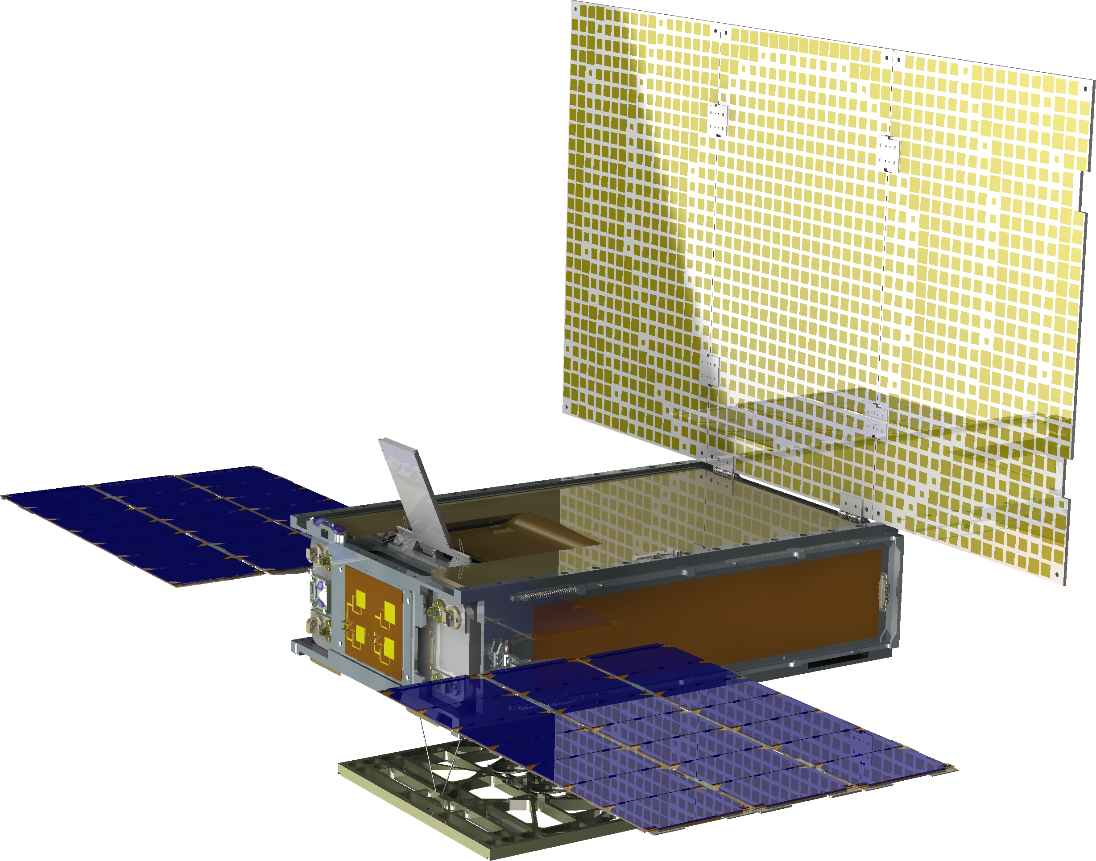

Emerging Developments Relevant to Smallsats (2/5)
DSN Introduction of OMSPA Service
New Opportunistic Multiple Spacecraft Per Antenna (OMSPA) Service
Traditionally scheduled TT&C pass
Primary Advantage: Enables large antenna availability to smallsats without conflicting with high-priority users.
In-beam smallsats make opportunistic use of the already scheduled antenna pass for downlink.
Telemetry frames delivered non-real time via same path as traditional telemetry.
Smallsat signals captured on an open-loop recorder.
DSN software receiver demodulates & decodes.

Slide 8
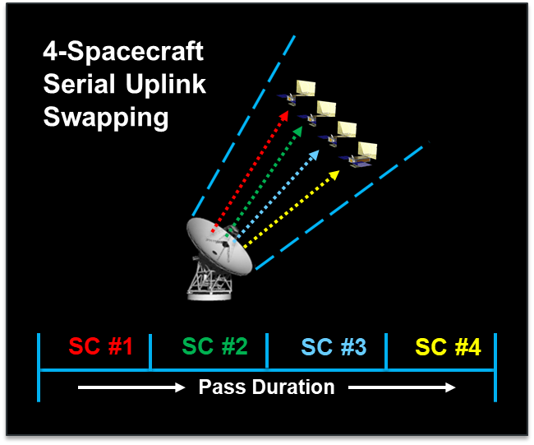

Emerging Developments Relevant to Smallsats (3/5)
MUPA Technology Efforts
Sequentially Shared Uplink During MSPA Downlink
Time-Multiplexed Uplinks During MSPA Downlink
Only fraction of a pass available to each spacecraft for uplink commanding & 2-way Doppler & ranging.
MUPA will enable near-simultaneous uplink and simultaneous 2-way Doppler & ranging over the entire pass duration, facilitating more efficient antenna usage.

Slide 9
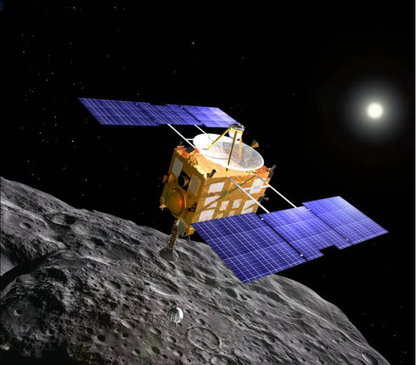
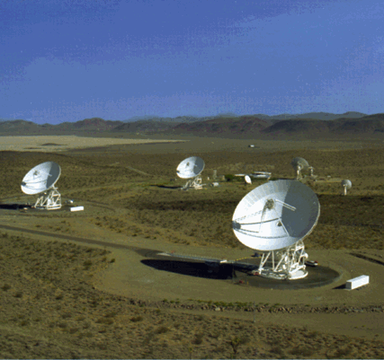

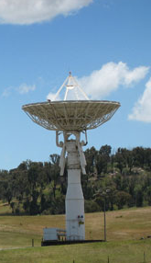
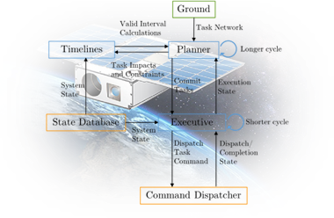
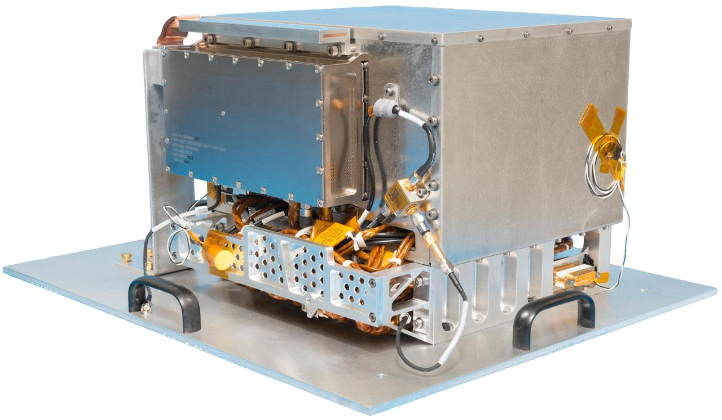
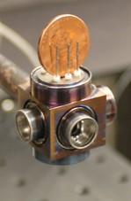
Emerging Developments Relevant to Smallsats (4/5)
Spacecraft-Initiated Operations
Spacecraft only “phone home” when they need to, reducing 34m & 70m loading.
BioSentinel recently demonstrated beacon tone operations on the MSU 21m antenna.
Initiation of Spacecraft-Requested Communications Session
Beacon Tone
Example Tones
(5)
(1)
10-to-20m Scanning Beacon Tone Monitor
Mission Operations Center
DSN Scheduling
(4)
(2)
(3)
Deep Space Network
Onboard Autonomy
More autonomous spacecraft with smaller more stable atomic clocks could further foster the above “phone home” paradigm.
Deep Space Atomic Clock
Toward a Next Gen CSAC
Onboard situational analysis for tone decisions.
Stable clocks for onboard navigation in lieu of coherent 2-way Doppler & ranging.

Slide 10

Emerging Developments Relevant to Smallsats (5/5)
Delay/Disruption Tolerant Networking (DTN)
DTN is a suite of protocols that enable data to transfer from source to destination through two or more connecting paths more efficiently, reliably, and securely.
Already adopted by flight projects such as ISS, KPLO, and PACE.
Provides for improved ground-based data mgmt.
Facilitates a more uniform flow of data through communications “bottlenecks.”
Facilitates secure communications across relay assets operated by diverse entities.
Among other things, it handles:
Unplanned outages and delays.
Data traverses split across multiple pathways.
Data rate mismatches between path segments.

Slide 11
In Summary
Human lunar exploration missions and large robotic missions may lead to periods when DSN antenna demand will exceed supply.
5 emerging developments may help smallsats contend with these excess demand periods.
  Current: Emerging university and commercial ground station providers.
  Current: OMSPA, enabling downlink “in the background” using already scheduled in-beam antennas.
  Future: MUPA enabling traditional antenna-beam sharing (MSPA) work on the uplink at the same time as the downlink.
  Future: Beacon tones enabling robotic spacecraft to only “phone home” when needed; recently demonstrated by BioSentinel via MSU antenna.
  Current & Future: DTN facilitating more efficient, reliable, and secure source-to-destination data transfer across one or more relays.

