Slide 1
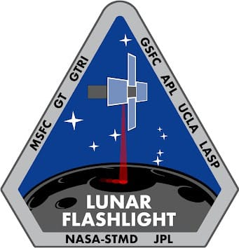

Lunar Flashlight: Propulsion System Challenges and Insights from a Lunar CubeSat Mission
Celeste Smith
April 30, 2024
Notes:
Hello, I’m Celeste Smith and this is Nathan Cheek and we’ll be presenting on the journey of the lunar flashlight propulsion system from launch through end of mission

Slide 2
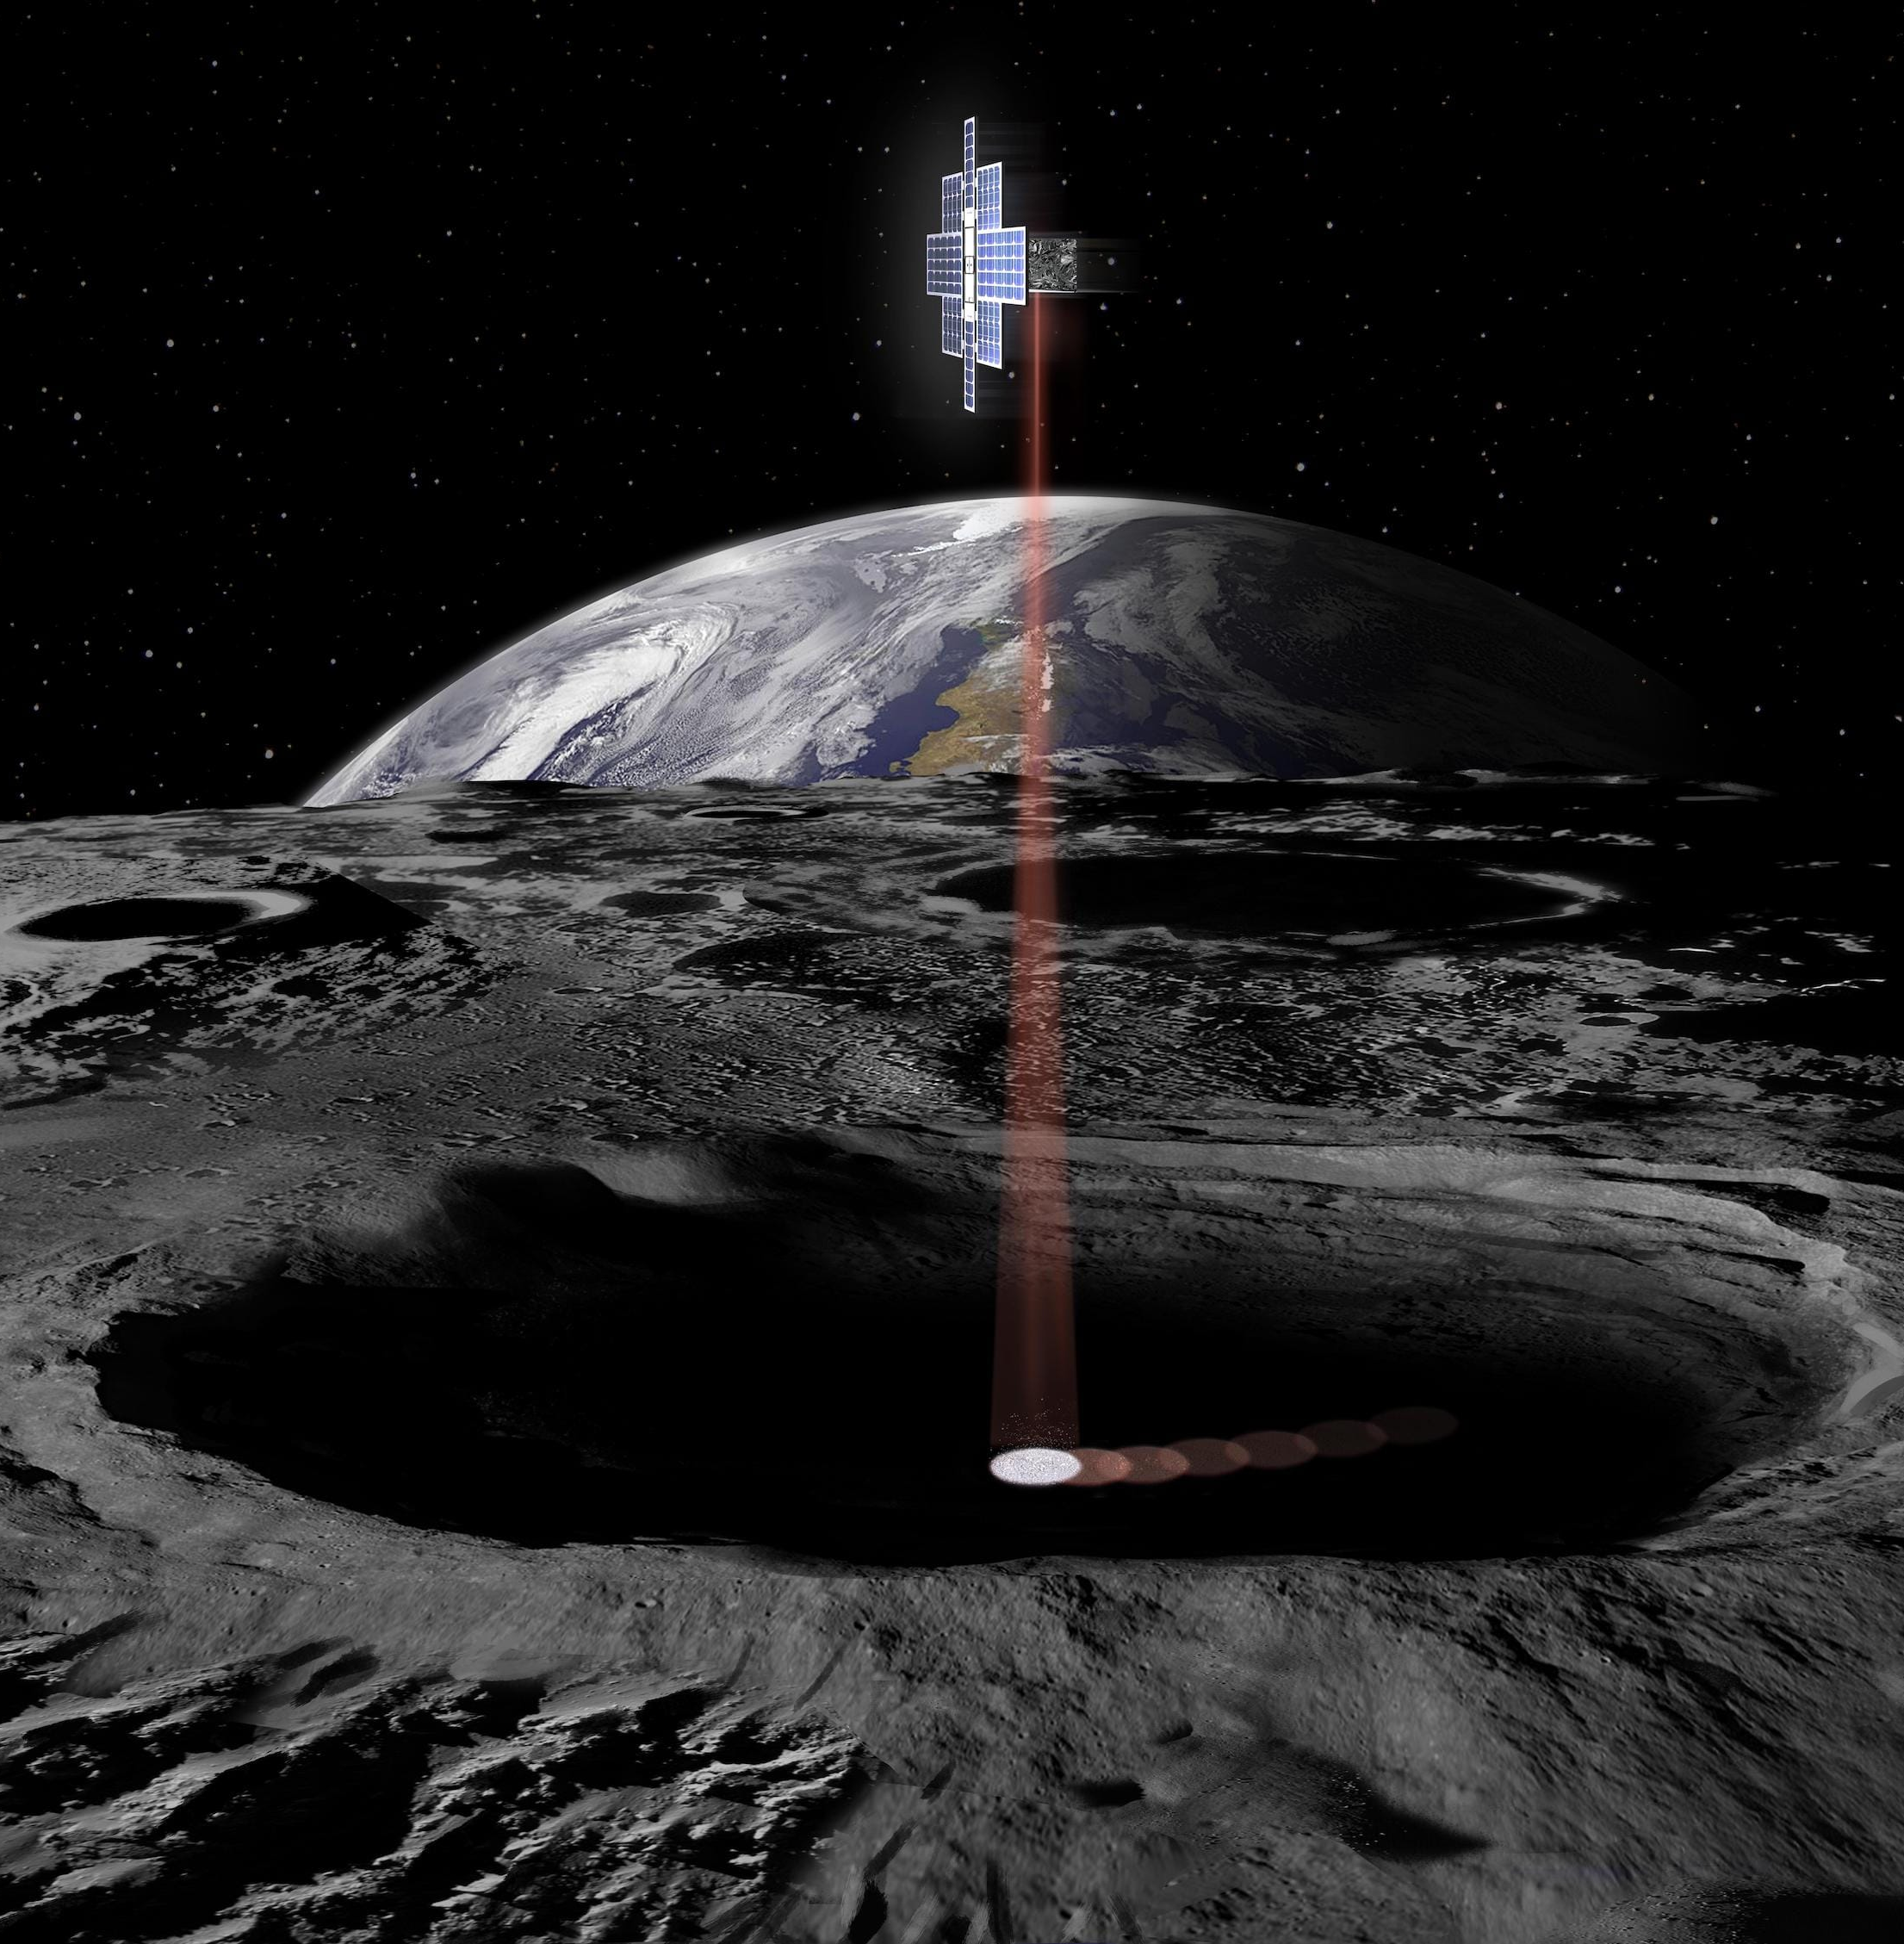
Lunar Flashlight Mission
Lunar Flashlight: Propulsion System Challenges and Insights from a Lunar CubeSat Mission
13 kg 6U CubeSat Tech Demo
Launched December 11, 2022 alongside ispace Hakuto-R M1 Lunar lander aboard a SpaceX Falcon 9
ASCENT green monopropellant propulsion system to perform maneuvers
Miniaturized infrared spectrometer used to detect surface water ice at the Lunar South Pole
New Sphinx flight computer and new version of Iris deep space radio
Notes:
Lunar Flashlight (LF) is a 6U CubeSat technology demonstration that was launched as a secondary payload alongside the ispace lunar lander on December 11th 2022
It demonstrated a propulsion system using ASCENT green monopropellant as an alternative to hydrazine, the prop system was planned to perform Trajectory Correction Maneuvers, Lunar Orbital Insertion, and reaction wheel desaturations
It also demonstrated miniaturized 4-point infrared reflectometry to detect surface water ice at the Lunar South Pole
And it demonstrated the new Sphinx flight computer as well as a new version of the Iris radio

Slide 3
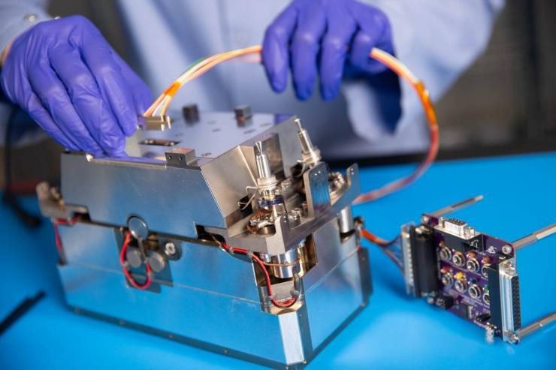
Lunar Flashlight Propulsion System Novel Technology
Lunar Flashlight: Propulsion System Challenges and Insights from a Lunar CubeSat Mission
ASCENT monopropellant vs Hydrazine
  Safer to store, handle, and use
  Less toxic byproduct
  Higher specific impulse
Additively Manufactured Titanium Manifold vs Tradition Manufacturing
  Reduced mass and complexity of part
  Allowed single continuous part
  Internal fluid passages routed without machining limitations
Notes:
Lunar Flashlight (LF) is a 6U CubeSat technology demonstration that was launched as a secondary payload alongside the ispace lunar lander on December 11th 2022
It demonstrated a propulsion system using ASCENT green monopropellant as an alternative to hydrazine, the prop system was planned to perform Trajectory Correction Maneuvers, Lunar Orbital Insertion, and reaction wheel desaturations
It also demonstrated miniaturized 4-point infrared reflectometry to detect surface water ice at the Lunar South Pole
And it demonstrated the new Sphinx flight computer as well as a new version of the Iris radio

Slide 4
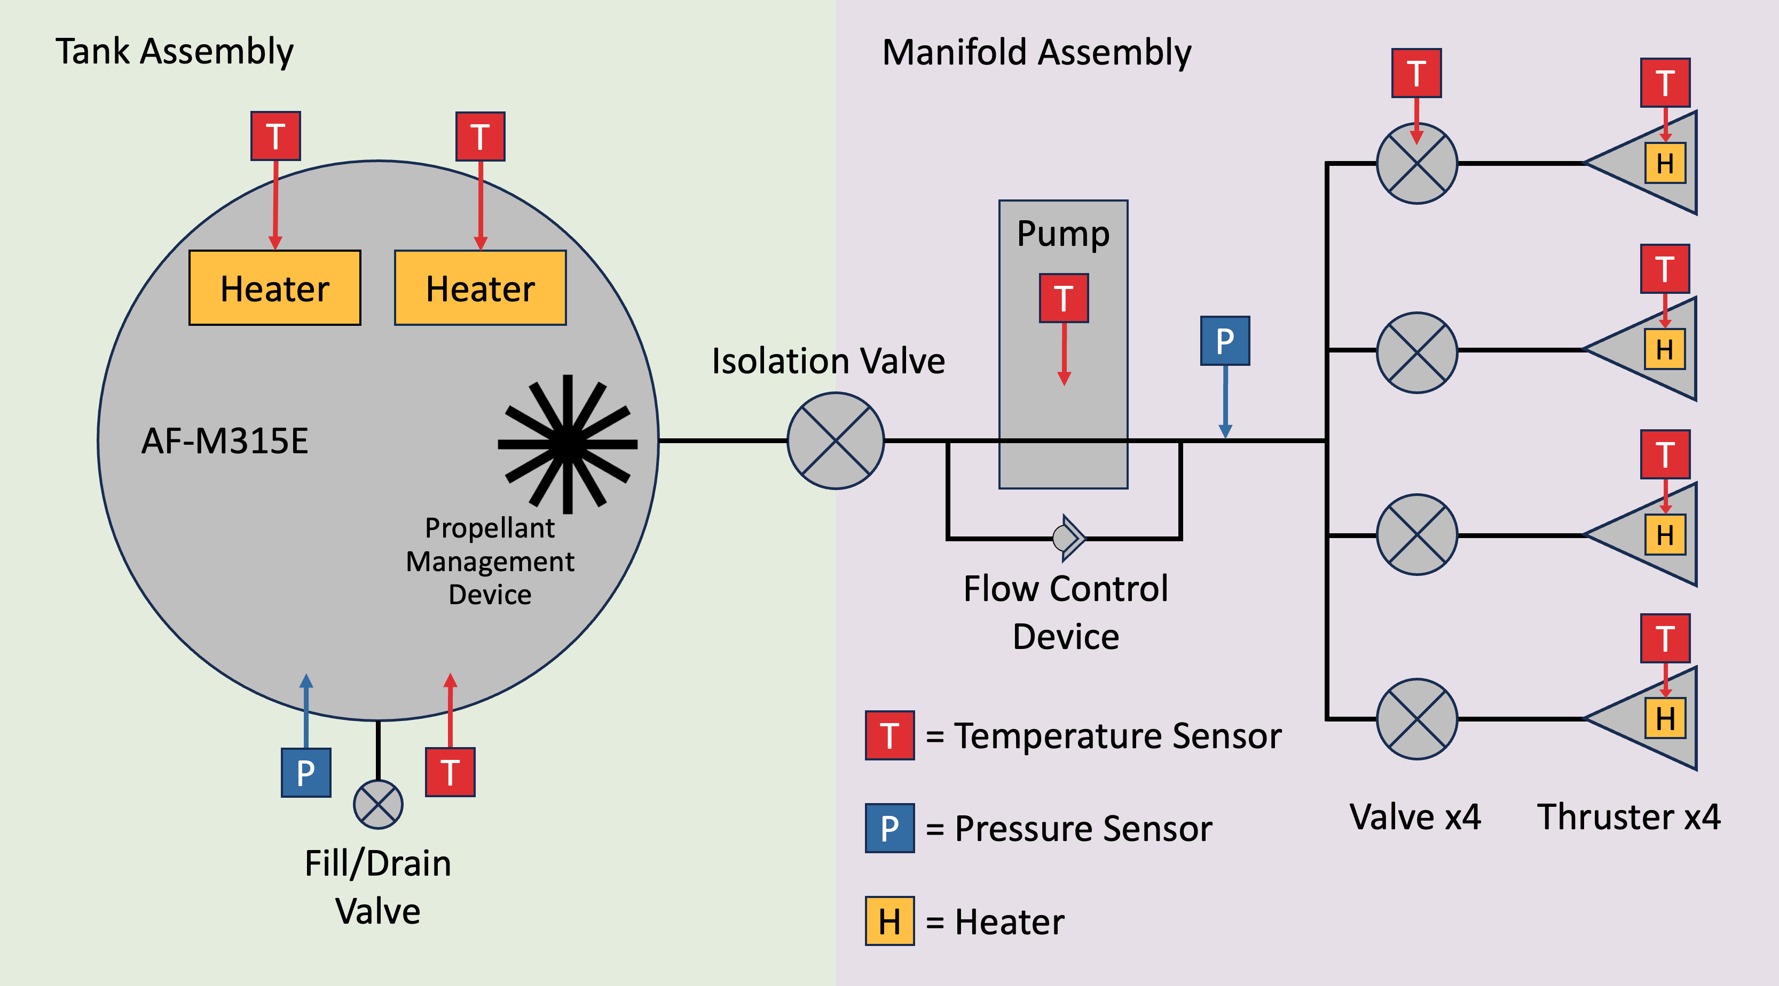
Lunar Flashlight Propulsion System (LFPS)
Lunar Flashlight: Propulsion System Challenges and Insights from a Lunar CubeSat Mission
Notes:
The Lunar Flashlight Propulsion System (LFPS) is composed of two main assemblies, a traditionally manufactured tank and an additively manufactured manifold. Both are constructed out of titanium.
The tank holds the ASCENT mono-propellent which is directed to the tank outlet in 0g with a propellant management device.
The isolation valve allows the tank to be segmented from the manifold.
This is a pump fed system so we have a pump on the manifold assembly along with a 3D printed flow control device that allows the fluid to recirculate. The manifold includes internal fluid lines made possible through additive manufacturing. A pressure monitor is included as well as four 100mN thrusters, each with their own valve. Each thruster also has a catalyst bed heater that heats the catalyst to start propellant combustion.

Slide 5
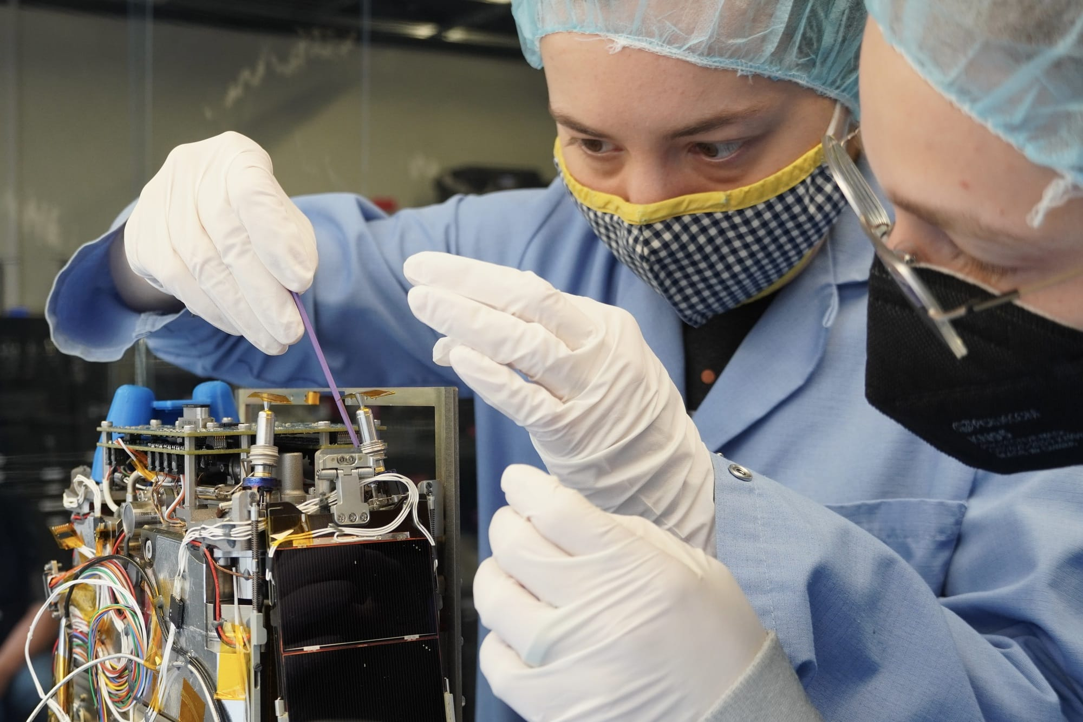
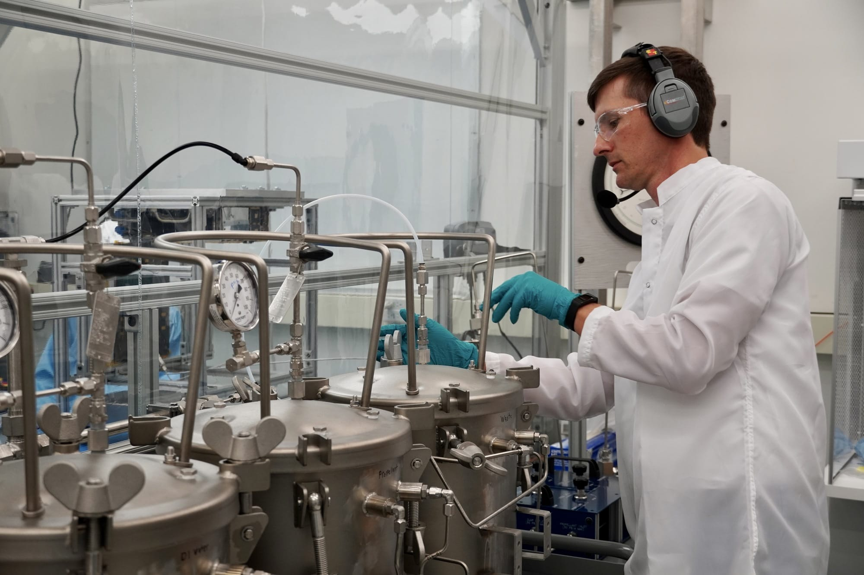
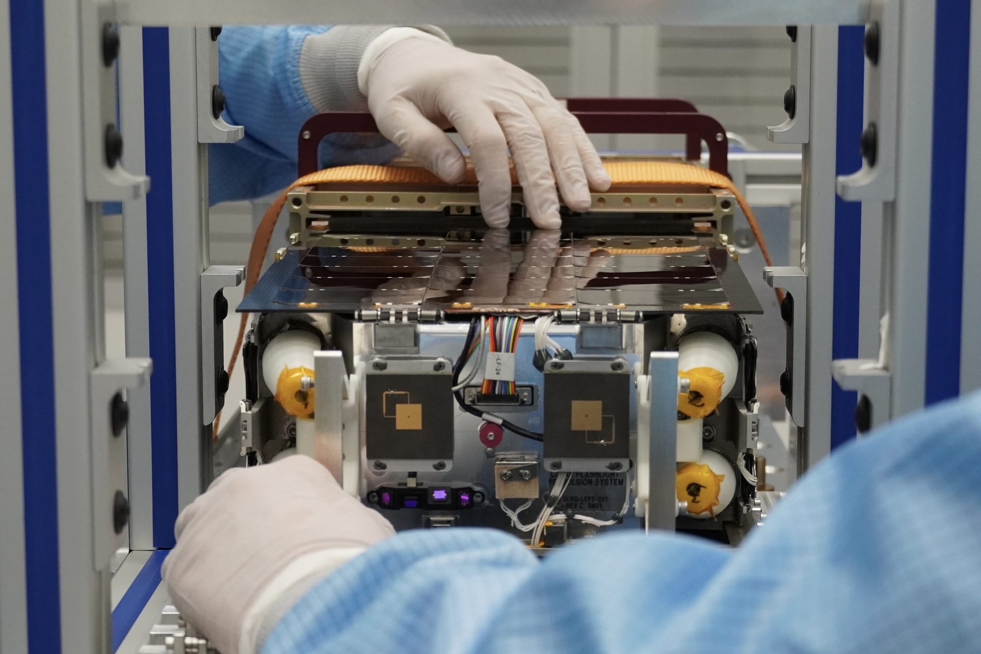
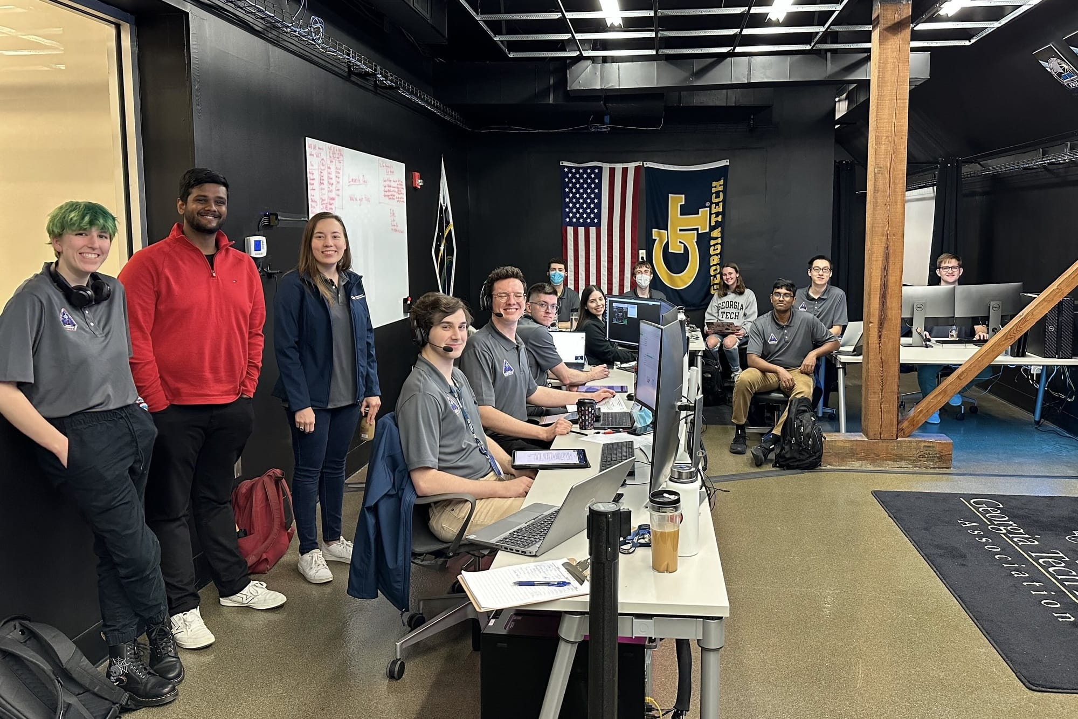
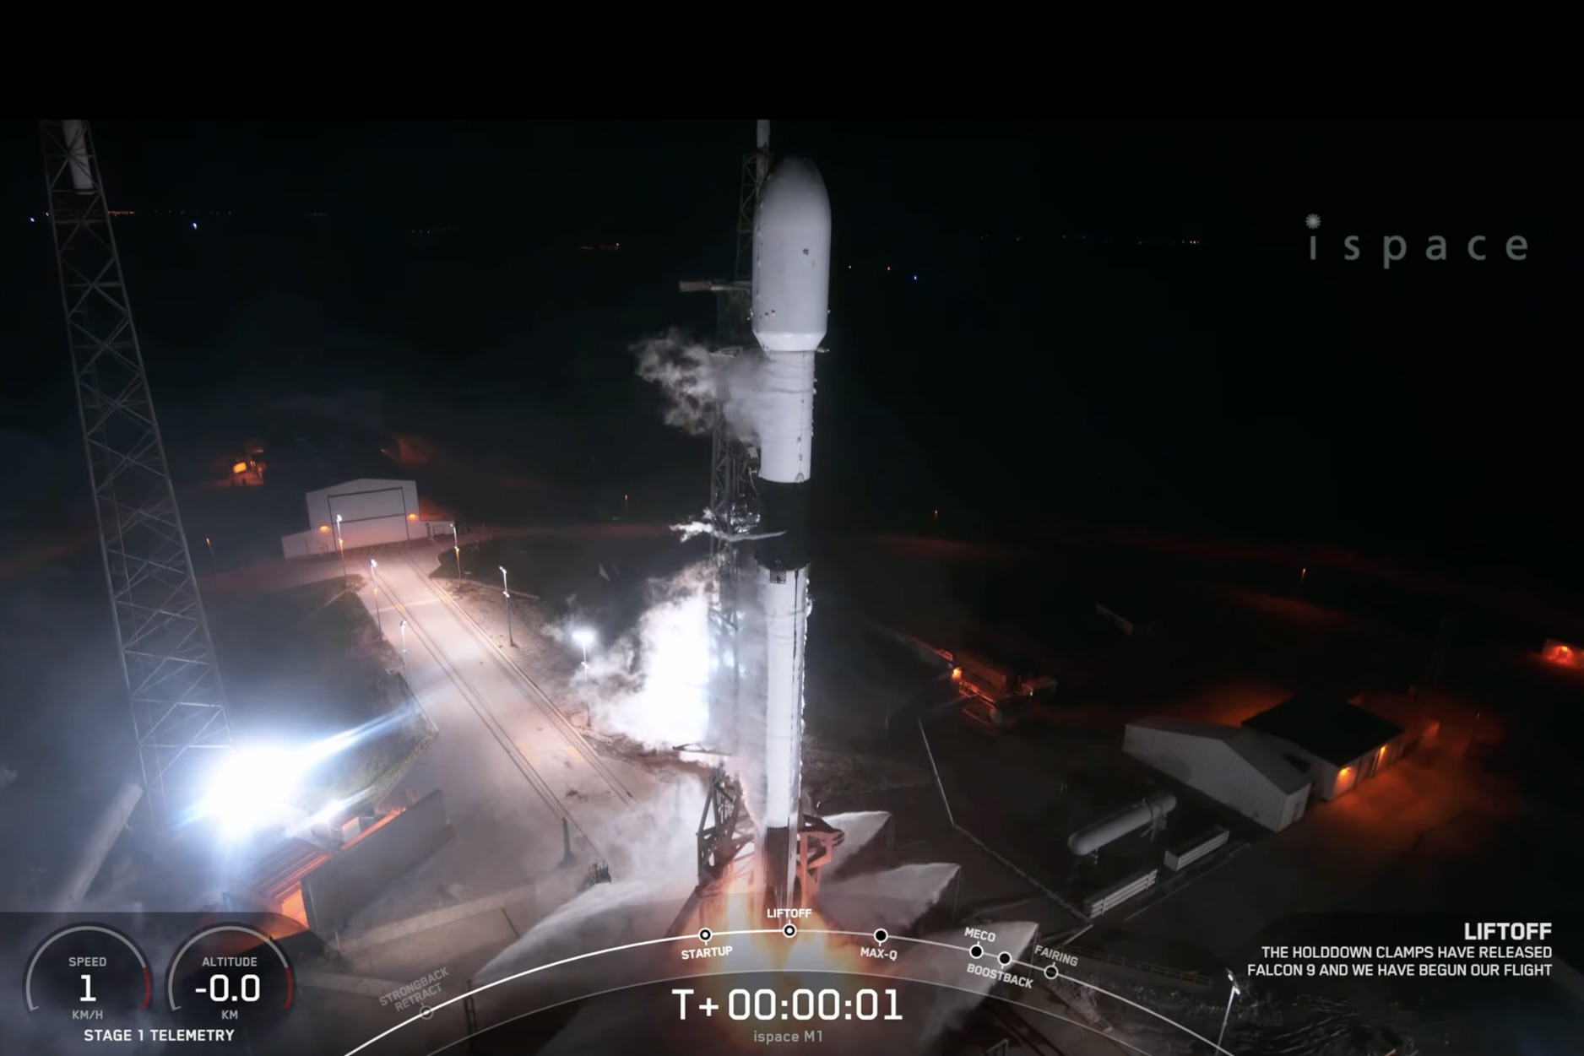
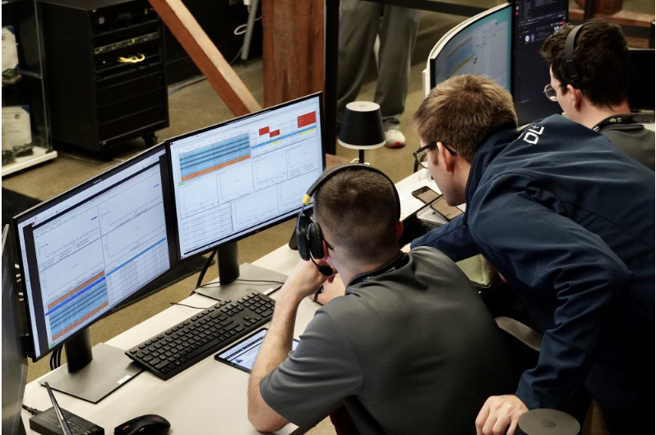
Successful Launch!
Lunar Flashlight: Propulsion System Challenges and Insights from a Lunar CubeSat Mission
Photo Courtesy of SpaceX
Notes:
So, with all the knowledge you need of the mission and system out of the way. We fueled the prop system at MSFC, installed it in the dispenser, and shipped LF to the cape to be strapped to a falcon 9. We’re going to start this story at launch.
We launched in the very early morning out of Cape Canaveral and soon after deployment had our first DSN pass in which we successfully established communication with the spacecraft and did a spacecraft health checkout. Following the spacecraft checkout and a couple propulsion system characterization and startup activities we attempted our first desaturation maneuver to dump the momentum the reaction wheels carried from initial tip-off.

Slide 6
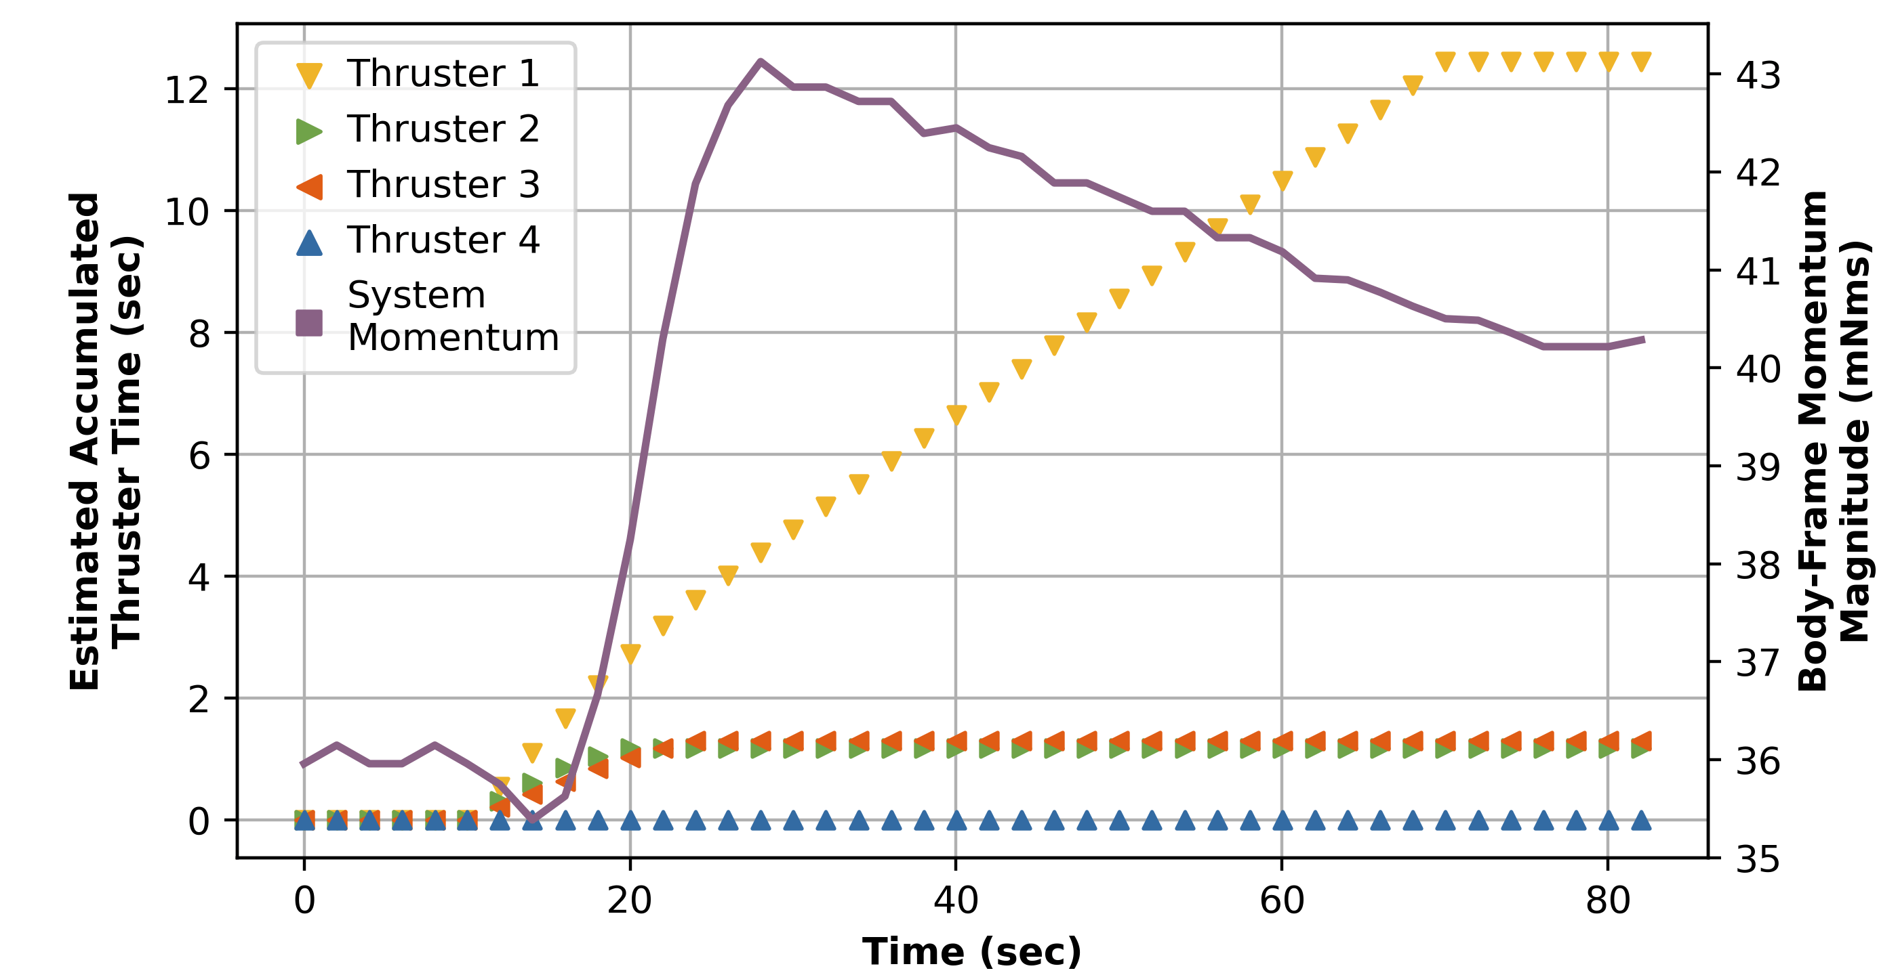
First Desaturation Maneuver: What Went Wrong?
Lunar Flashlight: Propulsion System Challenges and Insights from a Lunar CubeSat Mission
Notes:
Things didn’t go so well. We saw system momentum jump up, rather than down.
So, we looked closer, thruster 2 and 3 fired during the first 10 seconds, while thruster 1 kept firing until the 60 second timeout.
Clearly the thrusters fired, but why is momentum higher after the desaturation? Did we mix up thruster numbers or positions in the software? Are we getting the right thrust out of each thruster?
The ACS team told us the answer: momentum change corresponded to very little thrust coming from thruster 1

Slide 7
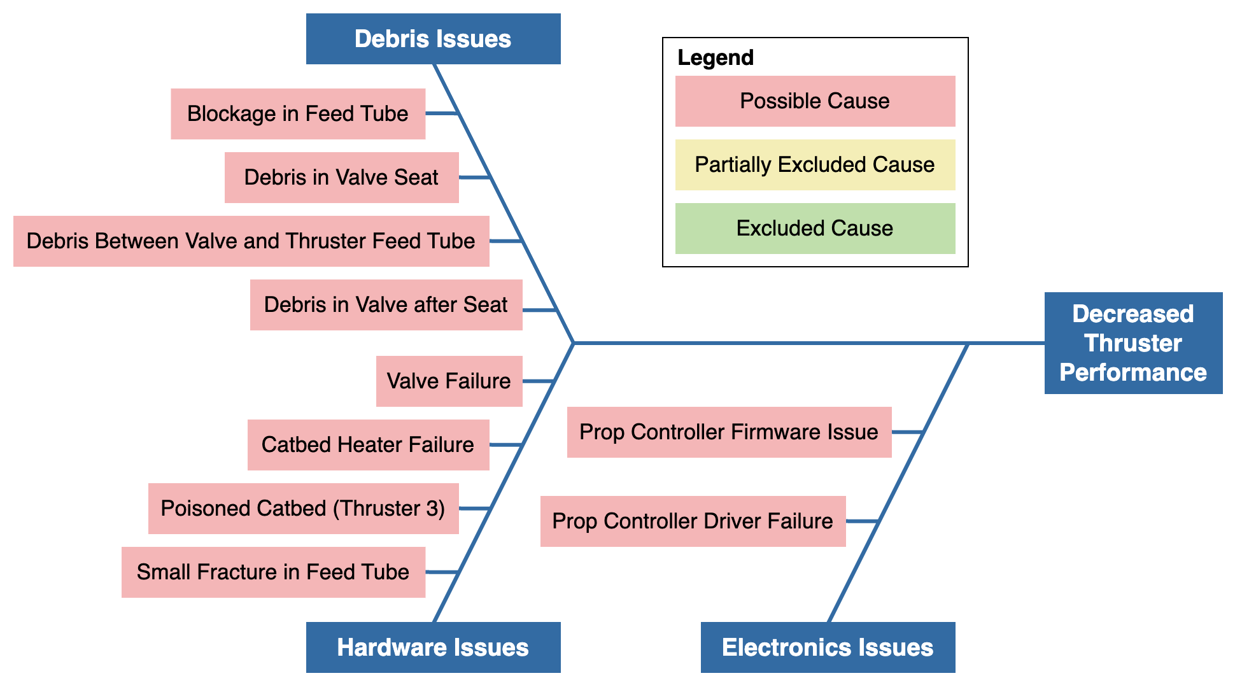
Initial Thoughts
Lunar Flashlight: Propulsion System Challenges and Insights from a Lunar CubeSat Mission
Notes:
We quickly started to investigate possible causes of low thrust. Causes were split into 3 main categories:
Debris issues
Hardware issues
Electronics issues
The prop system anomaly was the Ops team’s highest priority as we needed to start propulsive maneuvers as quickly as possible, thus just about every contact was dedicated to running prop tests. Along the way we saw decreased performance on thruster 3, and eventually thruster 2 as well.
With this fast-paced testing, we were able to quickly narrow down the list…

Slide 8
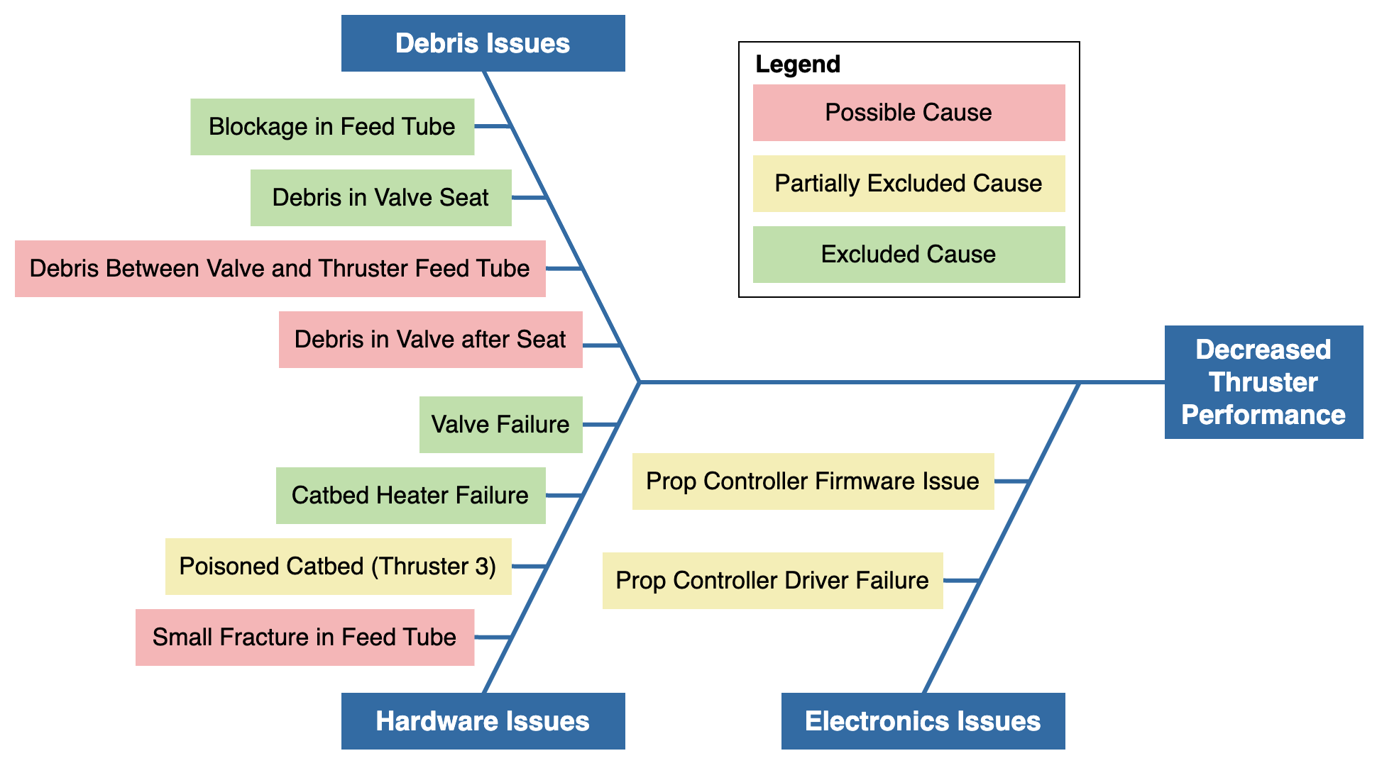
Initial Results
Lunar Flashlight: Propulsion System Challenges and Insights from a Lunar CubeSat Mission
Notes:
To narrow down the list we performed different tests. For example, one potential concern was voltage drop. Maybe the valves weren’t getting enough voltage to open consistently? We tested this by preheating, then turning off the heaters immediately before opening the valves, to make sure they got the highest possible voltage. No change.
Although we suspected FOD, we didn’t have enough info to pin down the location or source and we needed to consider all possible causes of low thrust

Slide 9

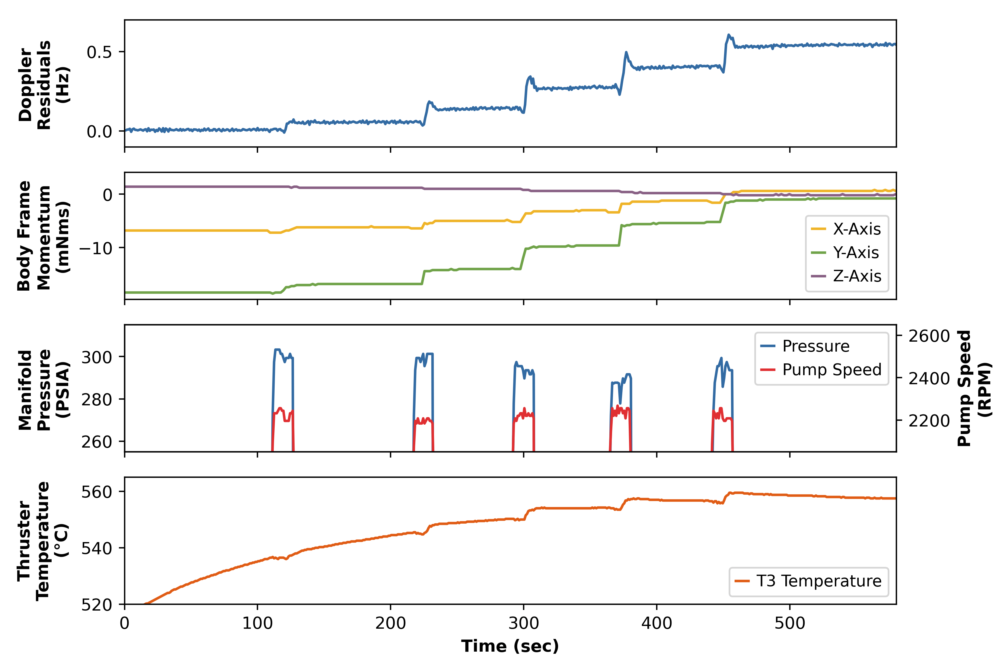


Thruster Characterization and Wake-Up Attempts
Lunar Flashlight: Propulsion System Challenges and Insights from a Lunar CubeSat Mission
Visualization of a Thruster Pulsing Sequence
  Timing
    Additional burn time
    Varied pulse lengths
  Temperature
    Catbed heater setpoints
    Tank heater setpoints
  Pressure
    Propellant pump speed
Notes:
While understanding the root cause is important, at this point in the mission, our highest priority was developing a way to get useful thrust out of the thrusters so we can get to the moon.
The knobs we could turn fell in to 3 categories.
Timing
We did longer burns on the thrusters with the hope that more flow would flush out debris like Krytox in the path, or that increased propellant flow would “wake up” the thruster
We also varied the pulse lengths on a recommendation from the manufacturer to improve the health of the thruster
Temperature
Tried running one thruster at a time, allowing the catbed to get hotter. This could reduce the viscosity of the propellent and potentially improved the health of the thruster
Pressure
Increased pressure to try to force more propellant flow
We were able to understand the results of testing in real time through tools developed by the Nav and ACS team to calculate thruster performance based on doppler and momentum changes. The prop team developed an interactive telemetry visualizer that combined all of this data together. The image on the right is an example of this visualizer corresponding Doppler residuals, body momentum, manifold pressure, and thruster temperature
At this point thruster 4 was the only nominally performing thruster
<Nathan> We were getting to know this propulsion system quite well, but we had one big question: …

Slide 10
So, how do we get to the Moon?
Notes:
With our current performance state, how do we get to the Moon?

Slide 11
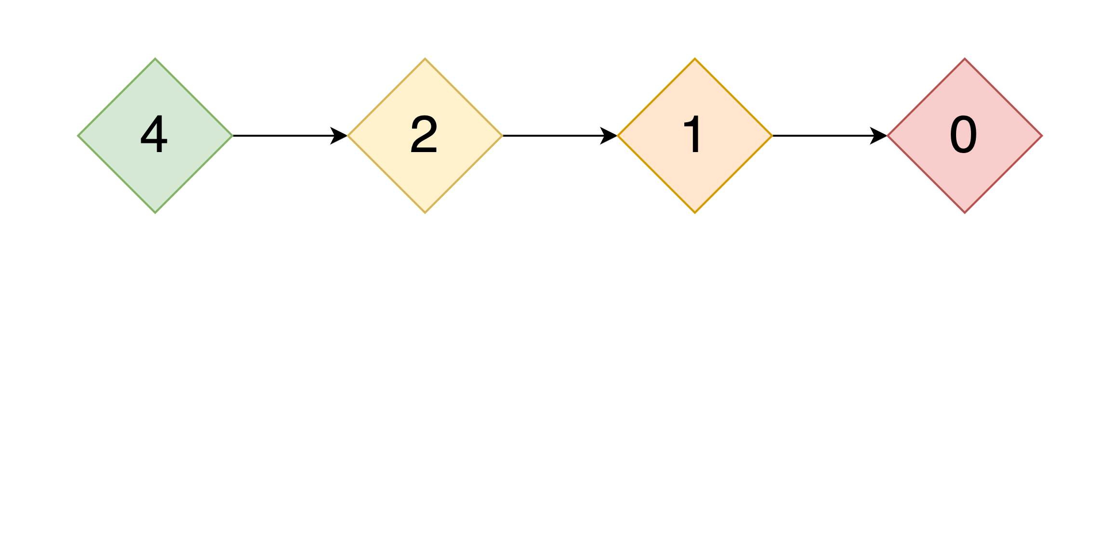
TCM Options
Lunar Flashlight: Propulsion System Challenges and Insights from a Lunar CubeSat Mission
How Many Working Thrusters?
Notes:
We needed a trajectory correction maneuver strategy. This depended heavily on the number of working thrusters
If each thruster was working well enough, even if they weren’t all at 100% <CLICK>, we could utilize our Attitude Control System’s closed-loop DeltaV algorithm
If we had two opposite thrusters producing a similar amount of thrust <CLICK>, we could do an open-loop command sequence, with lots of desats to remove momentum build-up
Otherwise <CLICK>, we could fire a single thruster at a time, rotating the spacecraft to limit momentum build-up
Finally <CLICK>, if we had no working thrusters, we would leave our lunar trajectory and eventually leave the Earth-Moon system

Slide 12
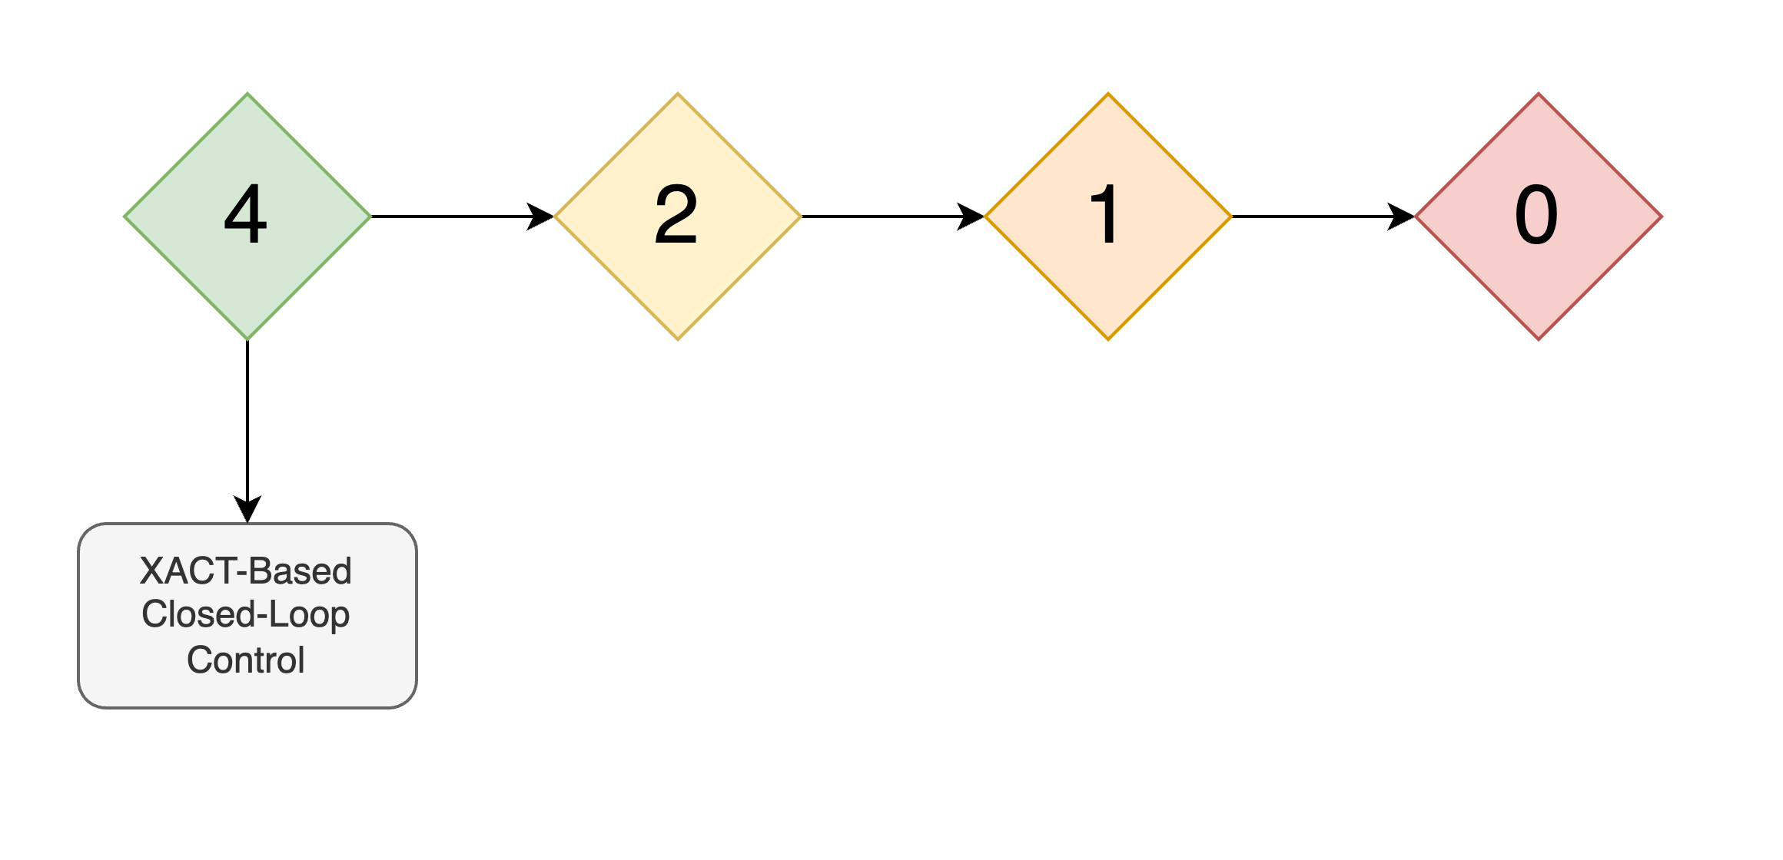
TCM Options
Lunar Flashlight: Propulsion System Challenges and Insights from a Lunar CubeSat Mission
How Many Working Thrusters?
Notes:
We needed a trajectory correction maneuver strategy. This depended heavily on the number of working thrusters
If each thruster was working well enough, even if they weren’t all at 100% <CLICK>, we could utilize our Attitude Control System’s closed-loop DeltaV algorithm
If we had two opposite thrusters producing a similar amount of thrust <CLICK>, we could do an open-loop command sequence, with lots of desats to remove momentum build-up
Otherwise <CLICK>, we could fire a single thruster at a time, rotating the spacecraft to limit momentum build-up
Finally <CLICK>, if we had no working thrusters, we would leave our lunar trajectory and eventually leave the Earth-Moon system

Slide 13
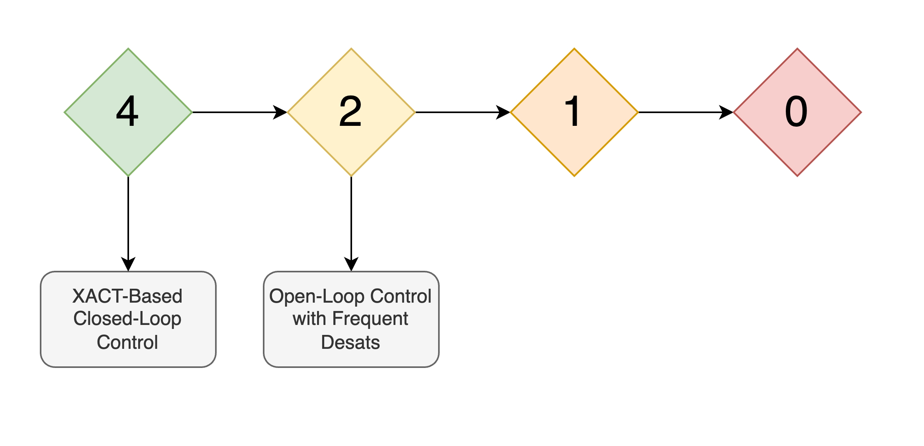
TCM Options
Lunar Flashlight: Propulsion System Challenges and Insights from a Lunar CubeSat Mission
How Many Working Thrusters?
Notes:
We needed a trajectory correction maneuver strategy. This depended heavily on the number of working thrusters
If each thruster was working well enough, even if they weren’t all at 100% <CLICK>, we could utilize our Attitude Control System’s closed-loop DeltaV algorithm
If we had two opposite thrusters producing a similar amount of thrust <CLICK>, we could do an open-loop command sequence, with lots of desats to remove momentum build-up
Otherwise <CLICK>, we could fire a single thruster at a time, rotating the spacecraft to limit momentum build-up
Finally <CLICK>, if we had no working thrusters, we would leave our lunar trajectory and eventually leave the Earth-Moon system

Slide 14
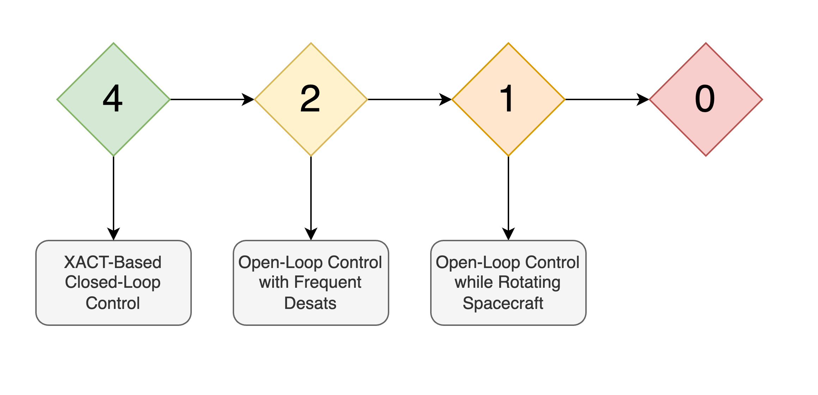
TCM Options
Lunar Flashlight: Propulsion System Challenges and Insights from a Lunar CubeSat Mission
How Many Working Thrusters?
Notes:
We needed a trajectory correction maneuver strategy. This depended heavily on the number of working thrusters
If each thruster was working well enough, even if they weren’t all at 100% <CLICK>, we could utilize our Attitude Control System’s closed-loop DeltaV algorithm
If we had two opposite thrusters producing a similar amount of thrust <CLICK>, we could do an open-loop command sequence, with lots of desats to remove momentum build-up
Otherwise <CLICK>, we could fire a single thruster at a time, rotating the spacecraft to limit momentum build-up
Finally <CLICK>, if we had no working thrusters, we would leave our lunar trajectory and eventually leave the Earth-Moon system

Slide 15
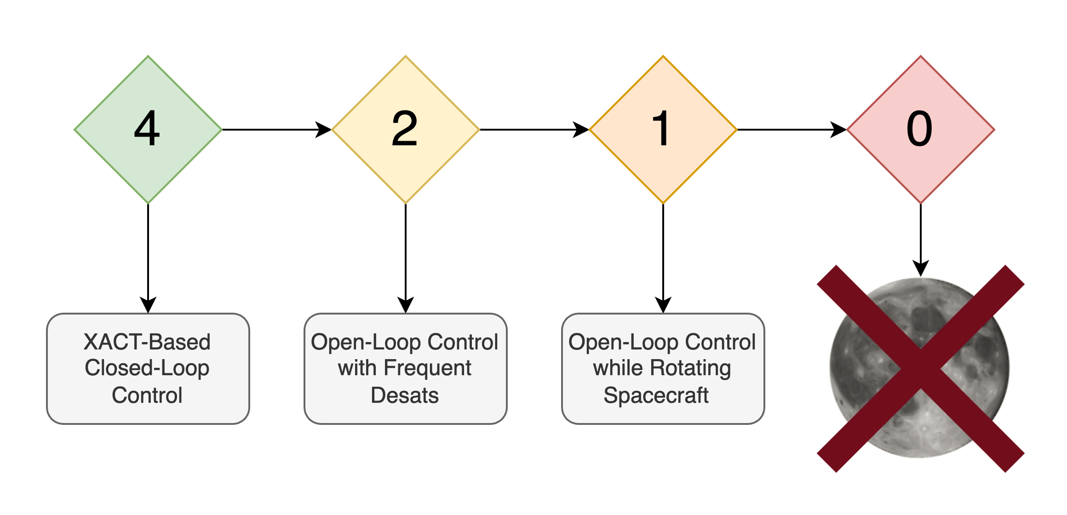
TCM Options
Lunar Flashlight: Propulsion System Challenges and Insights from a Lunar CubeSat Mission
How Many Working Thrusters?
Notes:
We needed a trajectory correction maneuver strategy. This depended heavily on the number of working thrusters
If each thruster was working well enough, even if they weren’t all at 100% <CLICK>, we could utilize our Attitude Control System’s closed-loop DeltaV algorithm
If we had two opposite thrusters producing a similar amount of thrust <CLICK>, we could do an open-loop command sequence, with lots of desats to remove momentum build-up
Otherwise <CLICK>, we could fire a single thruster at a time, rotating the spacecraft to limit momentum build-up
Finally <CLICK>, if we had no working thrusters, we would leave our lunar trajectory and eventually leave the Earth-Moon system

Slide 16
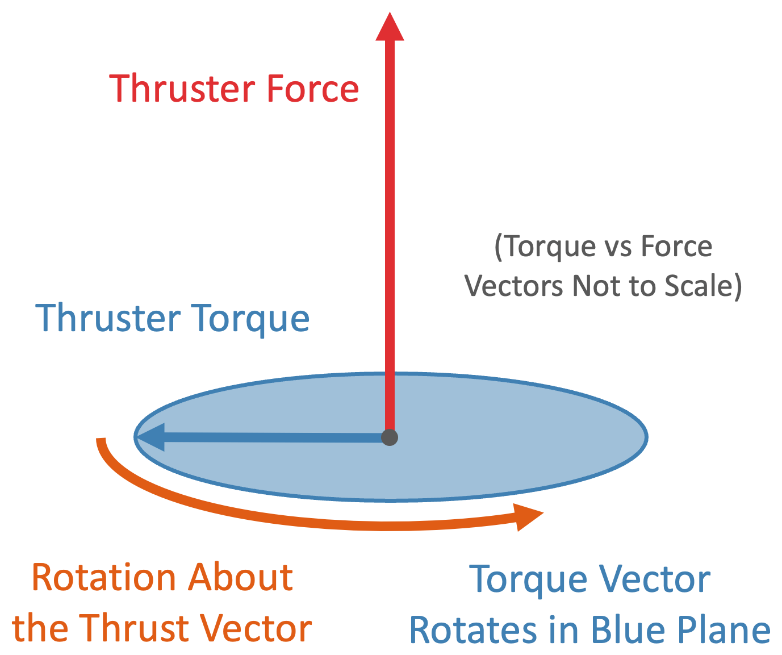
Brief Overview of Rotating TCMs
Lunar Flashlight: Propulsion System Challenges and Insights from a Lunar CubeSat Mission
Notes:
At this point, thruster 4 was the only nominally-performing thruster, so we quickly started to develop the 1-thruster option.
The main idea:
Use the reaction wheels to rotate the spacecraft around the axis of the thruster while burning
The thruster produces some torque as it burns, but if the thrust stays fairly constant as the spacecraft rotates, torque on one side of the circle can cancel out torque on the opposite side of the circle.

Slide 17

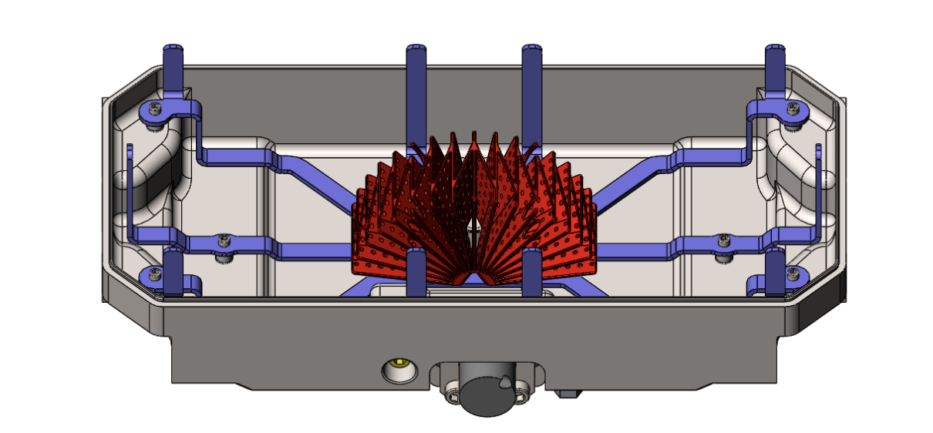


Rotating TCMs: Considerations
Lunar Flashlight: Propulsion System Challenges and Insights from a Lunar CubeSat Mission
  Force Limits
    PMD Acceleration Limit
      Designed for 3 mm/s² lateral
    Momentum Wheel Torque Limit
      Implied maximum thrust: 26 mN
  Rotation Rate
    6 deg / sec
  Automation
    Quick sequence generation
LFPS Propellant Management
Notes:
There were lots of things to consider when developing this maneuver
How much force can the system handle?
If we rotate too fast, the propellant management device might not hold onto the propellant, causing us to depressurize the tank
If we get too much thrust from the thruster, the reaction wheels can’t keep up with the torque
We ended up selecting a rotation rate of 6º/second which fell comfortably within the PMD’s limits, and gave us 1 rotation per minute
To keep the wheels happy, we set an appropriately low thruster duty cycle
Finally, a big desire was to automate this process as much as possible
The ops team developed multiple automation tools, allowed us to quickly generate rotating TCM command sequences
This would allow us to run multiple of these rotating maneuvers per day, when needed
Mason Starr will be giving a talk about these tools at 9:00AM tomorrow
OLD NOTES:
What speed do we spin at?
Without XACT updates, the max sc rotation rate is 6 ºC, faster was better for more thrust, so can we use this rate
Can our propellant management device handle that? We don’t want to let nitrogen pressurant out of the tank. Yes it can!
Designed for 3 mm/s^2 lateral acceleration, we expect 0.3-0.6 mm/s^2 of radial acceleration, seems low enough
Can our reaction wheels handle that torque? It turns out they could safely handle about 26mN of thrust. We could set our thruster duty cycle to match.
Lastly, we need to automate this
Managing burn attitudes, timing of command sequences, too much to be manually preparing for each burn.
We might need to do multiple burns per day.
Ops team put a lot of effort into automated tools to develop rotating TCM sequences.
Old Notes re. preload:
How do we burn most efficiently while staying within limits of the reaction wheels?
Turns out that you need to preload momentum in one direction
This can be done by burning for 10 seconds at the start, then pausing
<TODO I don’t really want to talk about this>

Slide 18
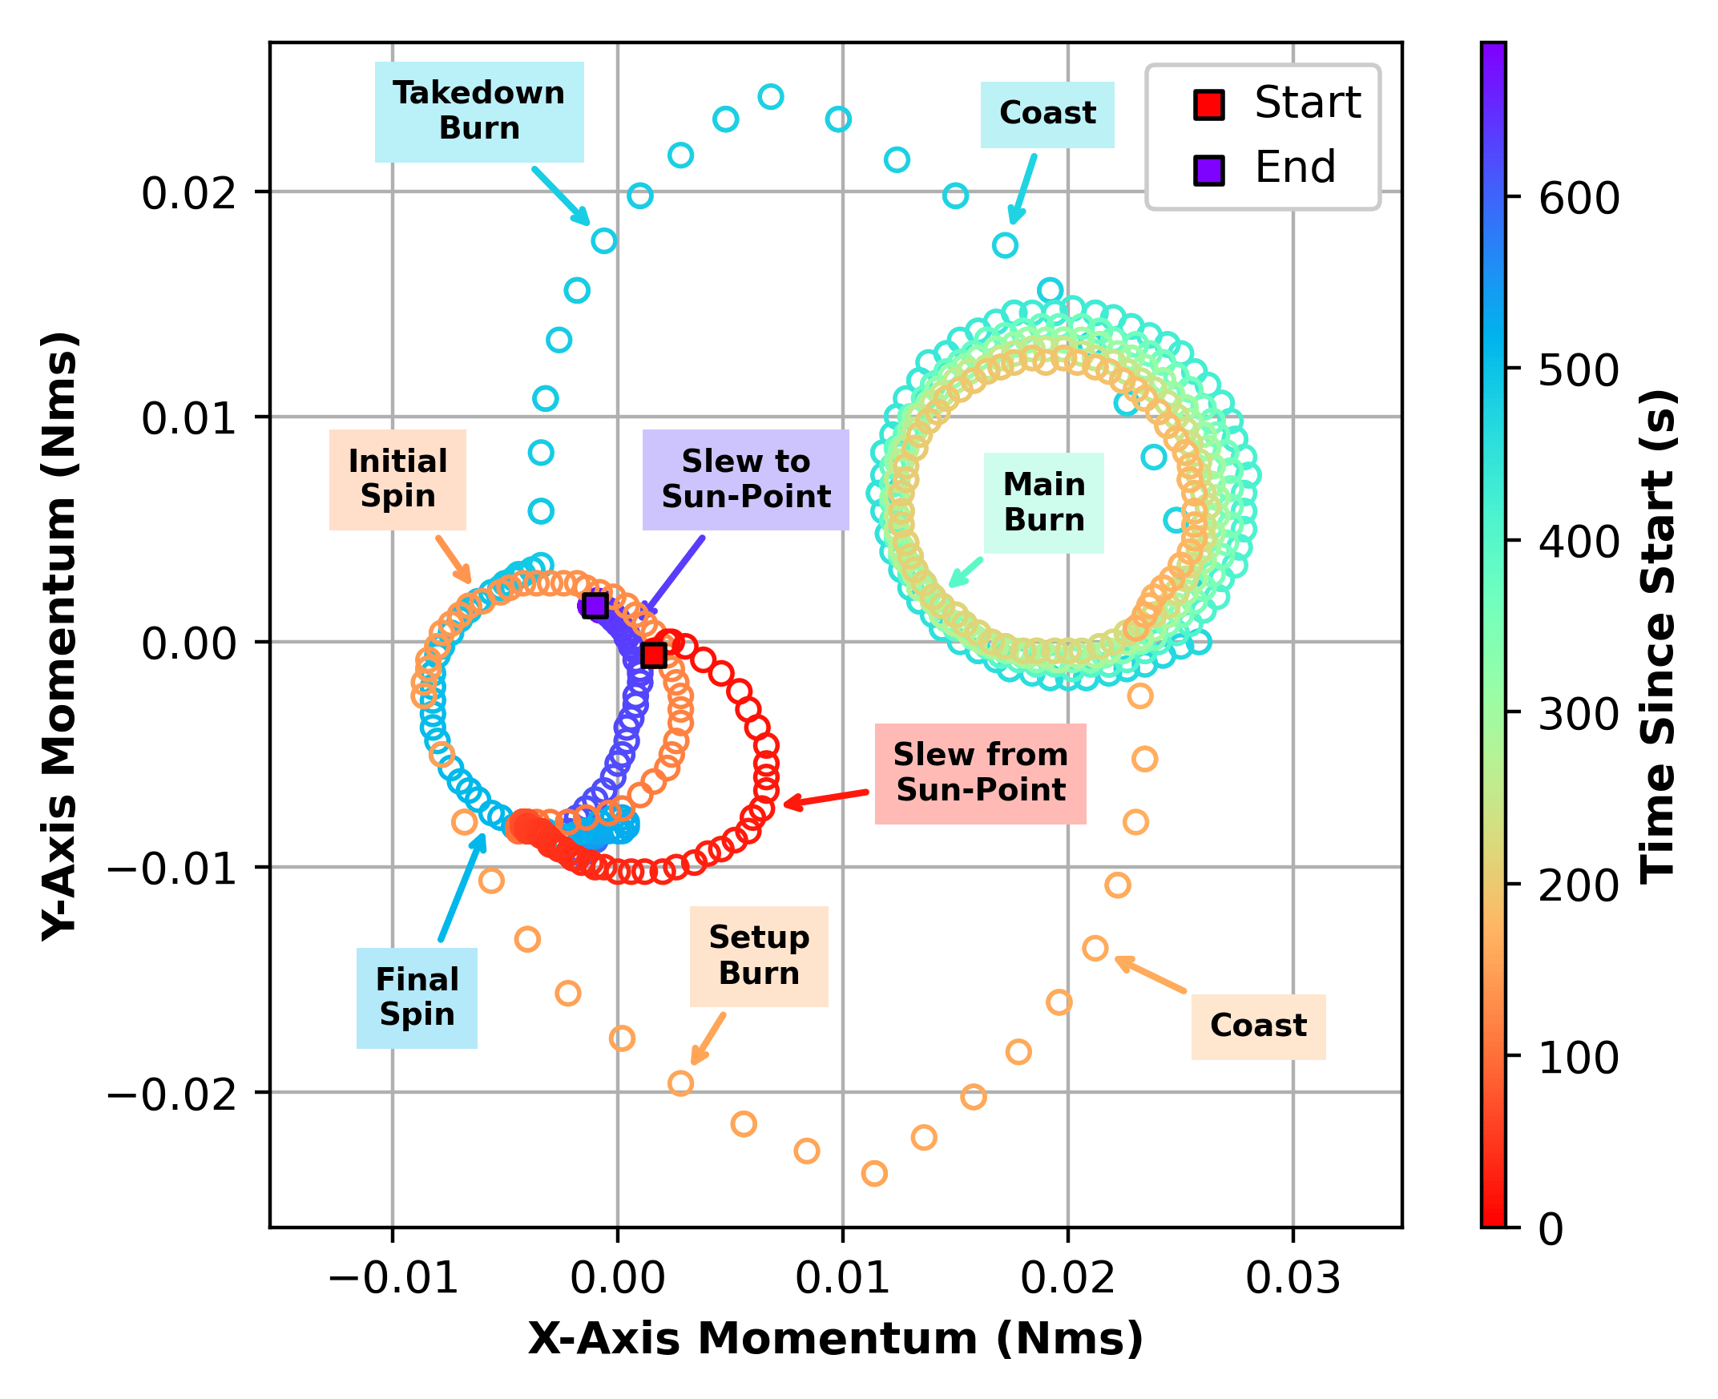
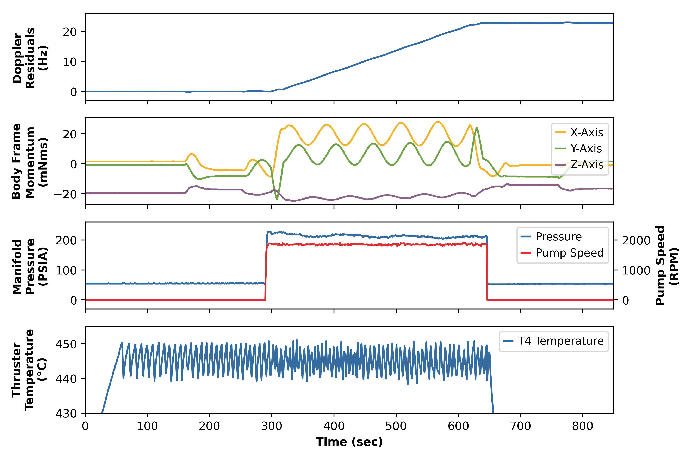
Rotating TCMs Work!
Lunar Flashlight: Propulsion System Challenges and Insights from a Lunar CubeSat Mission
Notes:
And, we proved that this rotating TCM technique works!
Here’s a chart showing a successful burn, the automated sequence configured the prop system, took the spacecraft to its burn attitude, started spinning, and performed a 5-minute main burn, then disabled the prop system and went back to sun-pointing mode
Got just over 0.5 m/s
Another cool way of visualizing this maneuver is by plotting the X vs Y axis momentum
Here, we see how momentum changes during the burn, then returns back very close to where we started.
This proved we could do these maneuvers repeatedly, rarely requiring desaturation maneuvers in between
Key info about thruster 4 rotating TCMs
8 maneuvers executed nominally
8 m/s of delta-v in 91 minutes
Change from lunar orbit to lunar flybys
Thruster 3 performed 5.2 m/s dV
We could add the falling off of performance chart if we wanted to

Slide 19
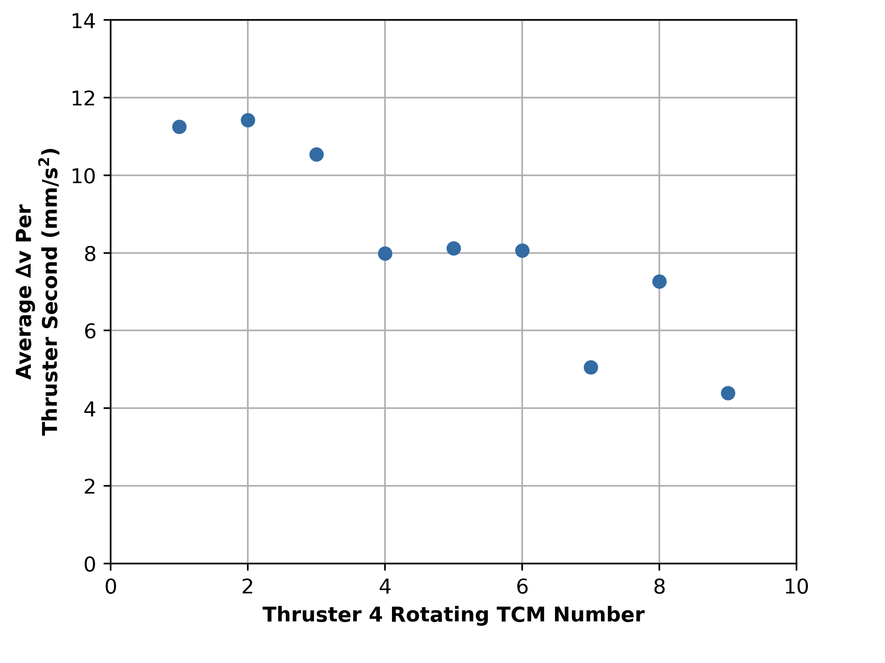
Thruster 4 & 3 RTCM Performance
Lunar Flashlight: Propulsion System Challenges and Insights from a Lunar CubeSat Mission
Thruster 4 RTCM Performance
Thruster 4
  8 m/s of delta-v in ~97 minutes
  Sudden performance drop during 9th TCM
Moon orbit no longer feasible
New goal: Lunar flybys with extended timeline
Thruster 3
  Capable of 25 mN of thrust
  Highly variable performance
Notes:
We initially performed 8 nominal TCMs (on thruster 4) using this new method
Performance was dropping over time
During 9th TCM we saw a quick drop to basically 0 thrust, weren’t able to recover
With this latest performance, we know a moon orbit was no longer feasible
But the Nav team came up with a lower-thrust option that would give us lunar flybys in 2024
Thruster 3 had been performing at around 25% nominal thrust, so we switched to that
Unfortunately, it showed even higher performance variability, and we lost that thruster after 11 maneuvers and ~5.2 m/s cumulative dV
At this point, we started to look at higher-risk options to generate thrust
OLD NOTES:
We did these rotating TCMs on thruster 4 and thruster 3
Thruster 4 was at 100% performance for the first 8 TCMs, but performance dropped to about 0% during the 9th TCM and did not recover
This thruster accomplished 8 m/s of dv in 91 minutes
Shown in this chart, we can see that as more maneuvers were performed on thruster 4, each pulse produced less thrust until it crashed to 0
After performance dropped on thruster 4, the Nav team looked at our trajectory options and concluded there was no moon orbit trajectory reachable with the performance we have left on the thrusters, so we switched to a series of lunar flyby trajectory with an extended timeline
Thruster 3 was still outputting 25 mN of thrust, so we trying to follow this new trajectory with thruster 3
Unfortunately thruster 3 displayed highly variable performance, but was still able to impart 5.2 m/s of delta-v in 11 maneuvers before performance also fell to 0 mN.
Key info about thruster 4 rotating TCMs
8 maneuvers executed nominally
8 m/s of delta-v in 91 minutes
Change from lunar orbit to lunar flybys
Thruster 3 performed 5.2 m/s dV
We could add the falling off of performance chart if we wanted to
8 maneuvers executed nominally
8 m/s of delta-v in 91 minutes

Slide 20
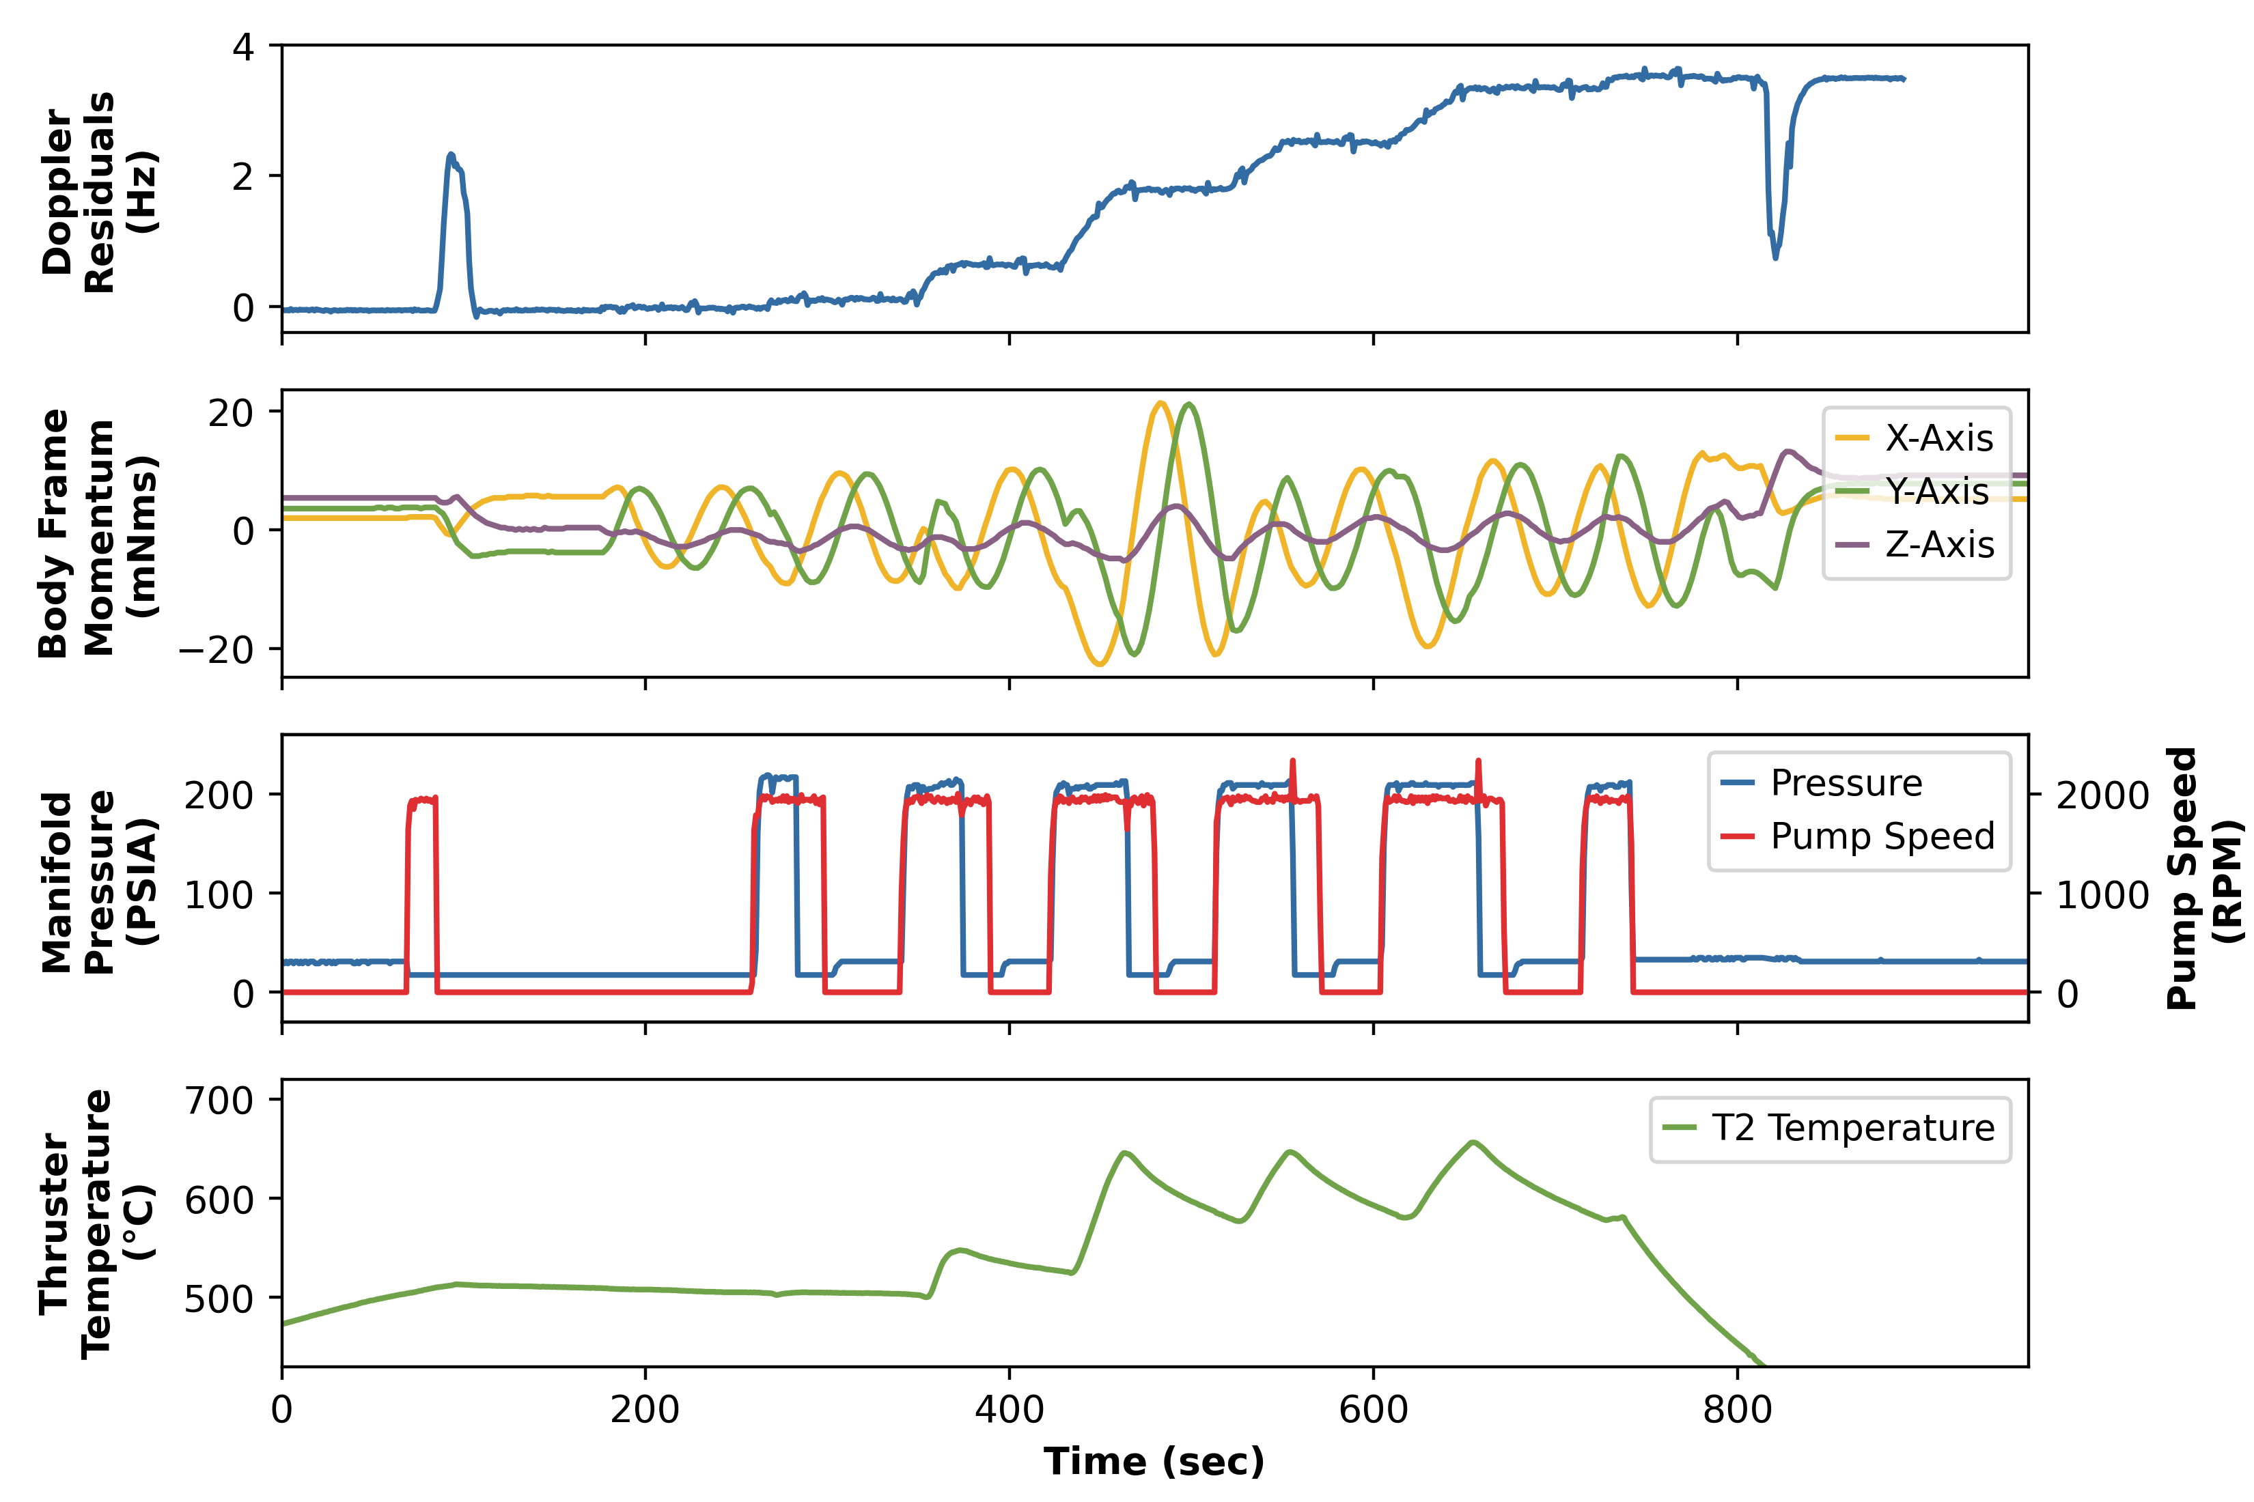
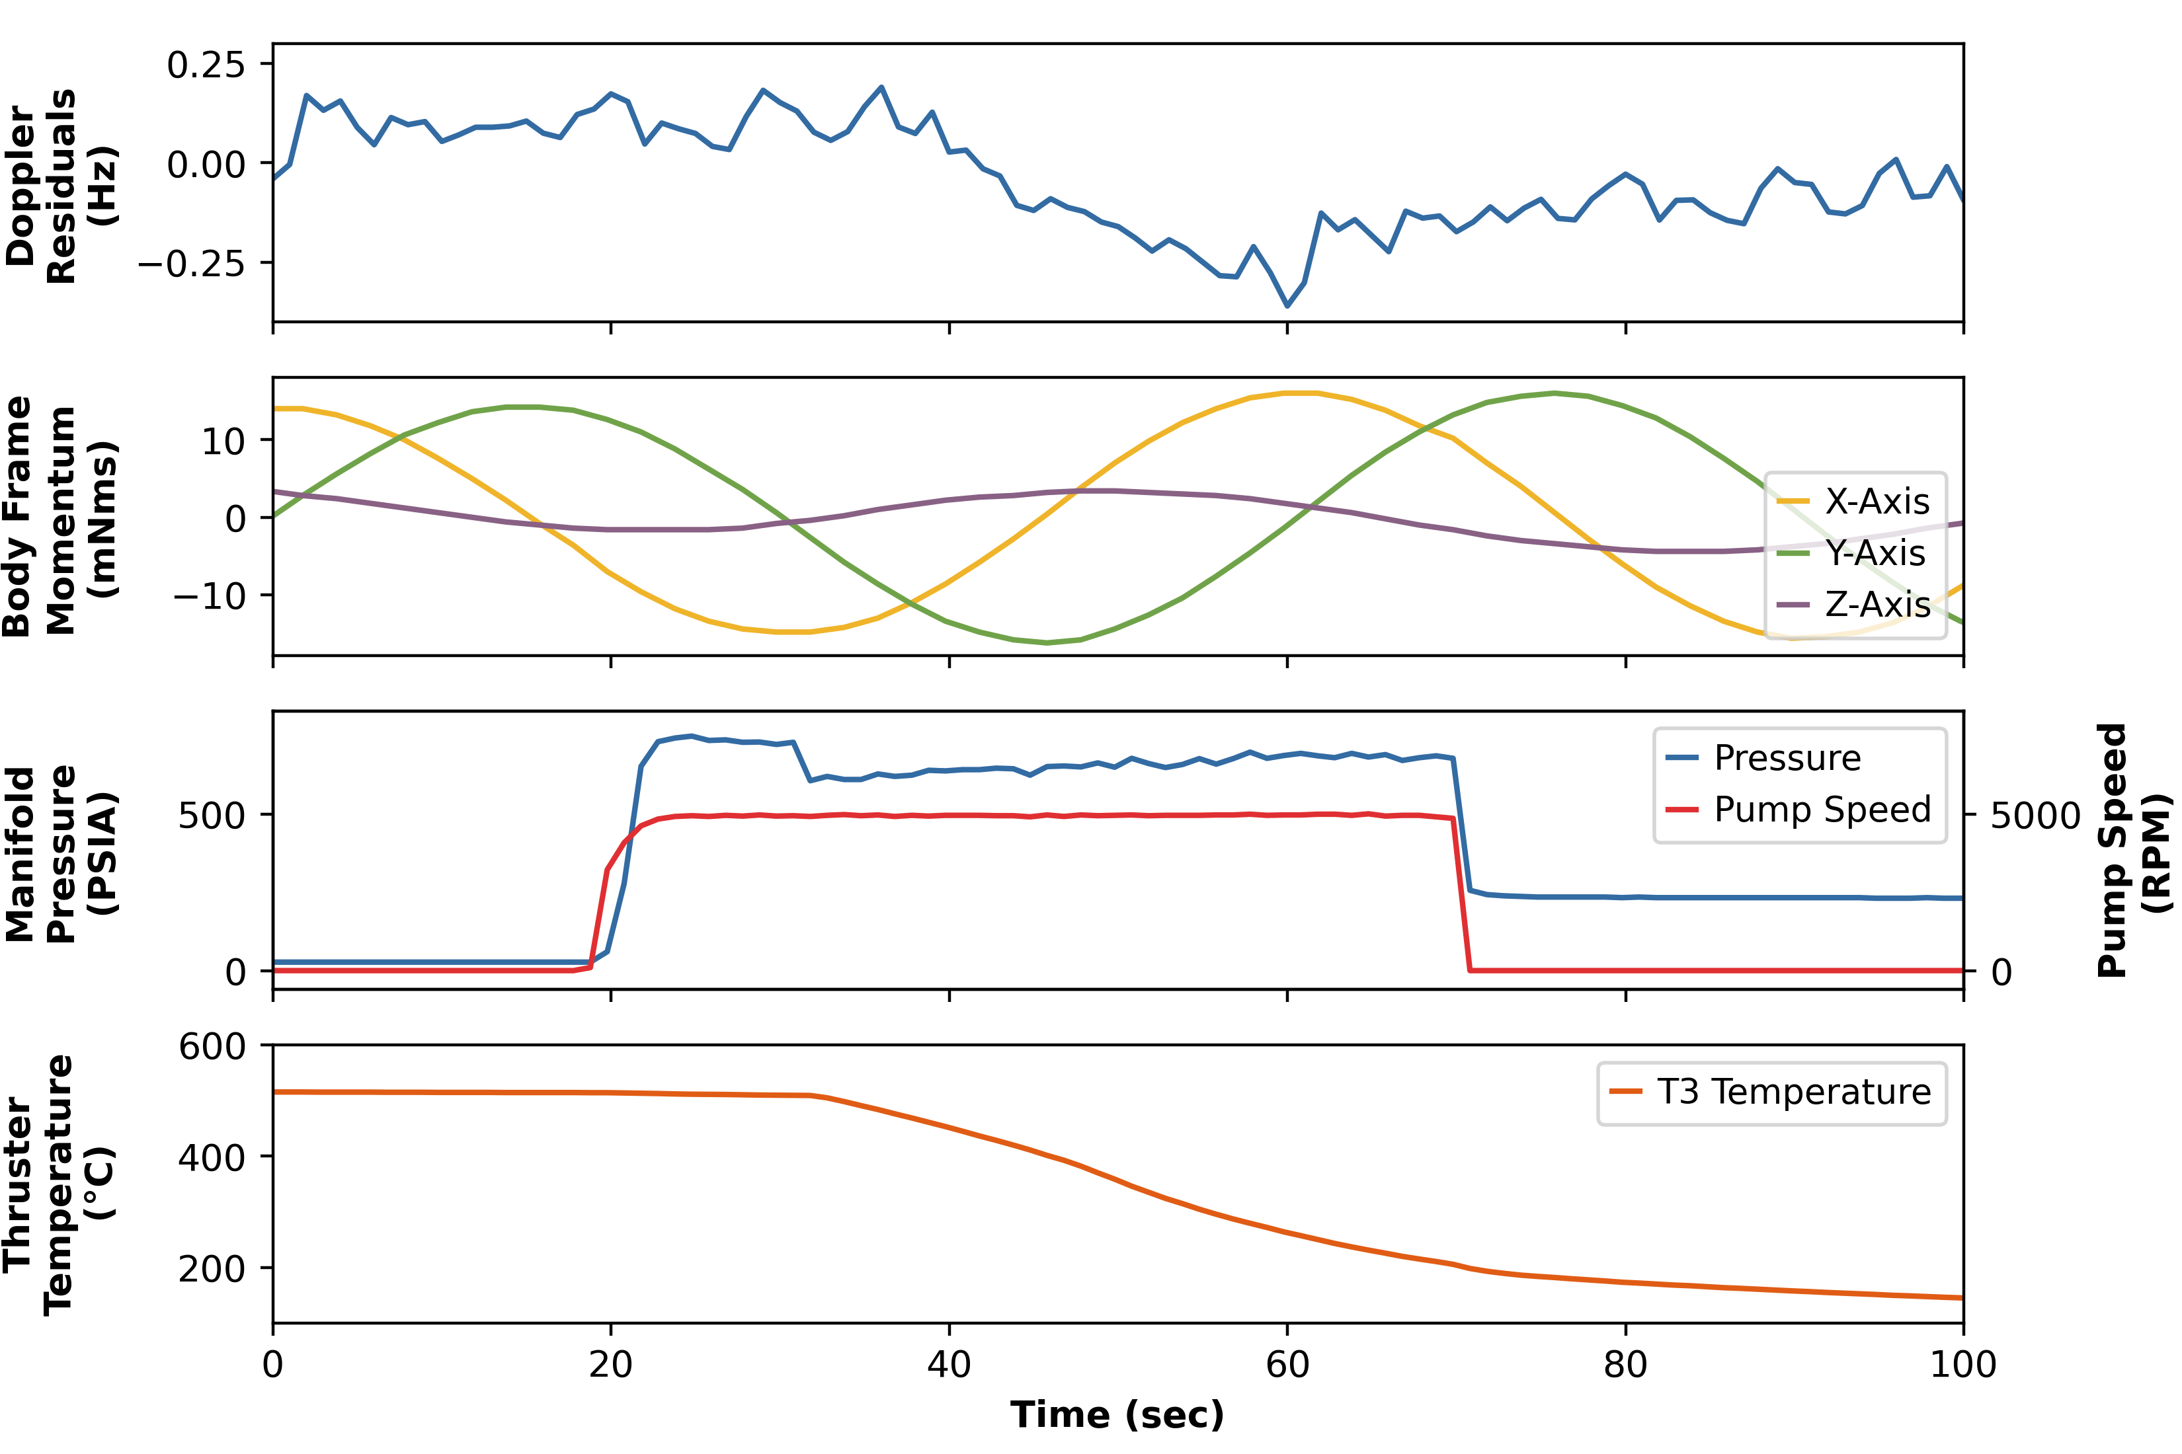
High Risk Thruster Recovery Attempts
Lunar Flashlight: Propulsion System Challenges and Insights from a Lunar CubeSat Mission
Thruster 3 Anomalous High-Pressure Activity
Reversing the propellent pump
  Goal: dislodge debris
      Fire with pump running forward
      Quickly reverse
      Fire forward with increased flow
    Briefly improved thruster 2’s performance
  Maximum pressure
  Run pump to burst pressure (1250 psia)
Thruster 3 showed increased thrust
  Likely fractured feedtube
End of primary mission
Notes:
Our first high-risk idea was to reverse the propellant pump
We were pretty sure FOD was clogging up a downstream orifice, can we get it to move by spinning the pump backwards?
This technique actually worked! Sometimes…
We got a huge performance increase on thruster 2, and we were able to repeat this approach a few times
But over time the method stopped working.
Our second idea was to run the system at a maximum pressure
We reviewed test data and determined a max value to be 1250 psia
Ran the pump as close to this as possible
Thruster 3 performance increased
But during a repeat test, we saw a quick drop in pressure and temperature
Doppler/momentum changes that didn’t align with a thruster
As best as we could tell, the high pressure combined with the location of the FOD had caused a feedtube to fracture
At this point, since we were about to escape the earth-moon system, we declared an end to the JPL mission
After the end of primary mission, the Ops team was able to focus more on testing out other tech demo aspects of the spacecraft, including the science instrument and Iris radio
OLD NOTES:
At this point, we went back to the drawing board and the project was willing to accept higher risk. The first high risk activity attempted was reversing the propellent pump. This was high risk because debris could get in to the pump gears and destroy the pump, we could also uncover the propellant management device and lose pressure in the tank. The goal of this technique was to dislodge debris by firing a thruster with the pump running forward so propellent gets beyond the the FOD, then quickly reversing the pump to hopefully use the propellent to push the fod back or at least reposition it. Finally fire forward with increased flow. This technique improved performance in thruster 2, this was the best thruster recover we had seen so far. Unfortunately very little delta-v was able to be imparted using this technique due to unreliable performance and eventual lack of performance
We then ran the pump to burst pressure, and called this maximum pressure testing. Thruster 3 initially showed improved performance, but while attempting to get delta-v thruster 3’s temperature dropped off suddenly and momentum changed in unexpected directions as can be seen in the figure. The mostly likely cause of this was that fod was able to get pushed through the tiny passage and enter the thruster’s feedtube and the feedtube was fractured
At this point, we were about a week away from escaping the Earth-moon system with no way of generating delta-v, so an end of mission was declared
30 – 50 mN of thrust
Max pressure risks
Risks:
High power draw
Thrust overwhelms reaction wheels
Leak/rupture
This led to the project ending the mission

Slide 21
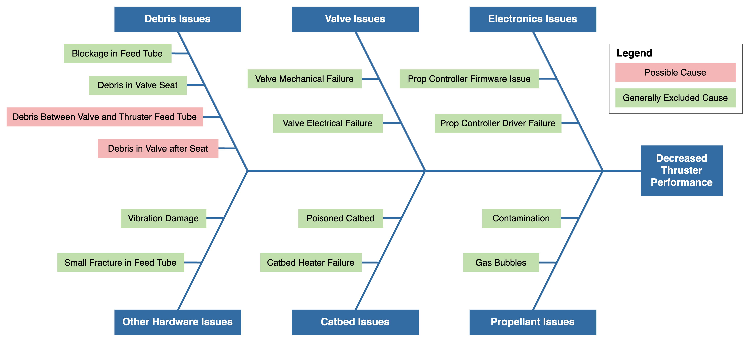
Anomaly Root Cause Analysis
Lunar Flashlight: Propulsion System Challenges and Insights from a Lunar CubeSat Mission
Notes:
Now that the mission was over, we could take a step back and try to determine what caused the performance issues that plagued the mission
We were able to exclude just about everything, leaving the idea that debris had accumulated around the valve or just before the thruster feed tube of each thruster
Starving each thruster of propellant
OLD NOTES:
more analysis was done on the root cause analysis. In this analysis, through analyzing flight data, we have eliminated all possibilities other than debris in the fuel path to the thrusters. The exact location was not able to be pinned down, but…

Slide 22
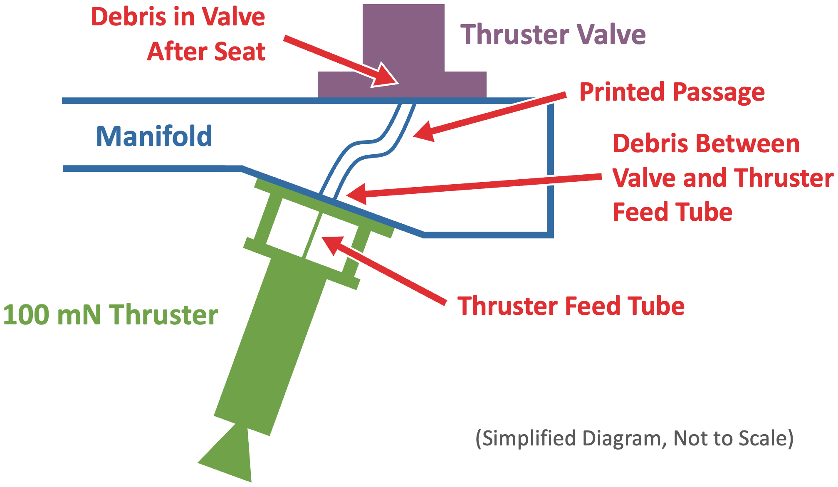
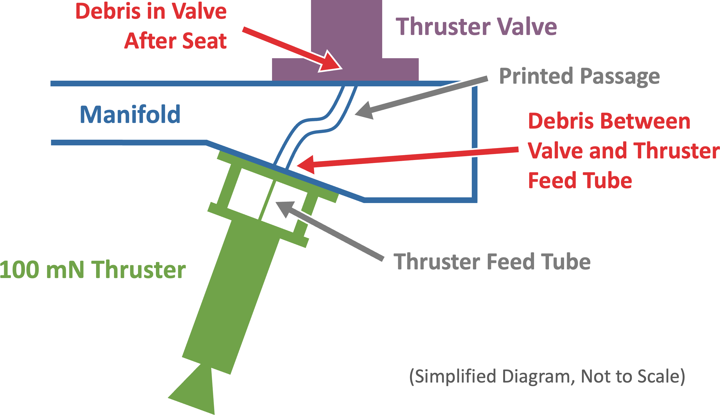
The Culprit
Lunar Flashlight: Propulsion System Challenges and Insights from a Lunar CubeSat Mission
Notes:
This cross-section drawing shows the most likely locations of that debris:
The printed manifold is shown in blue, and here you can see the printed passage between valve and thruster
Likely FOD accumulated in the valve, or right at the orifice where propellant would enter the thruster feed tube
But where did the FOD come from? Celeste is going to go over this in our lessons learned…
OLD NOTES:
This diagram shows the two most likely places debris could have been within the propulsion system, before the maximum pressure testing.
Debris would have been in the valve, after the seat or between the valve and thruster feed tube
TODO: make the FOD location colors different

Slide 23
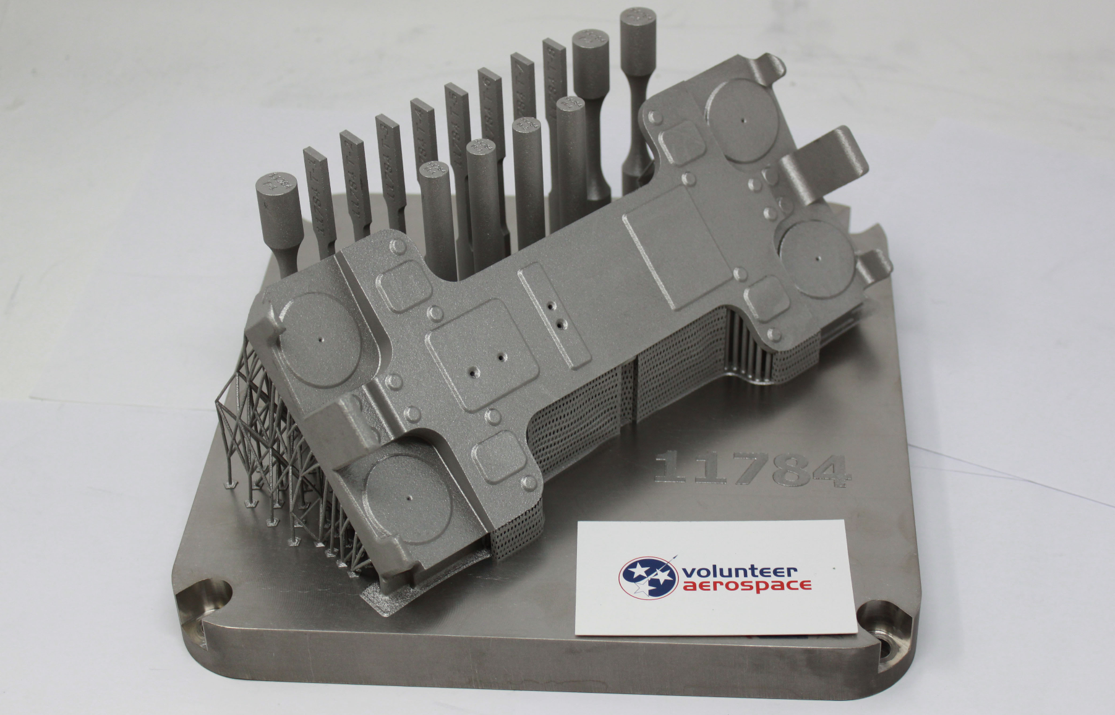
Lessons Learned and Recommendations: Design
Lunar Flashlight: Propulsion System Challenges and Insights from a Lunar CubeSat Mission
Potential Sources of FOD
  Sintered particles or powder from the additive manufacturing process
  Machining debris/burrs
  Krytox lubricant
  Methods of dislodging
      Launch / prelaunch vibration loads
      Cyclical pressurization and flow
Prevention
    Chemical etch surface finish
    Abrasive cleaning
Mitigation
    Filters
Printed Manifold
Notes:
The LFPS was designed, integrated, and tested under extreme schedule pressure as Lunar Flashlight was originally slated for launch on the first flight of the SLS and needed to be delivered before cubesat integration.
This led to certain design decisions that have how been reviewed by NASA MSFC, including additive manufacturing experts and they provided some recommendation. First, dislodged sintered particles could be the debris plaguing the propulsion system and this could have been produced in the AM manifold due to prelaunch and launch vibration loads, along with cyclical pressurization and flow during operations. It could also be machining burrs or Krytox lubricant used on o-rings.
Shedding from the AM manifold could be controlled by applying a chemical etching surface finish to the printed passages, which would clear leftover sintered particles.
The effect of the debris could have also been mitigated through the addition of upstream filters

Slide 24
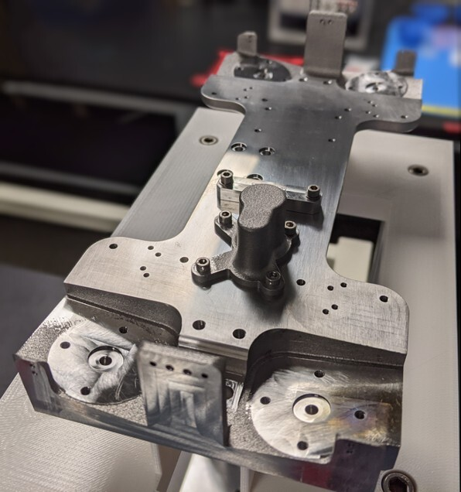




Lessons Learned and Recommendations: Testing
Lunar Flashlight: Propulsion System Challenges and Insights from a Lunar CubeSat Mission
  CT Scanning
    Might have spotted potential FOD
  Flight-Like Hot-Fire Testing
    No flight-like tank/manifold
  Liquid Flow Testing
    Only used helium
  AM Parts Vibration Testing
    Only tested at system level
Printed Manifold after Machining
Notes:
In terms of testing, actions like performing a CT scan, a flight like hot-fire test, a system liquid flow test, and vibration testing of AM parts could have spotted some of the issues with the LFPS before integration and flight. For example, flow testing during integration used Helium, which would not have shown a blockage of this type. Also, flat-sat hot fire testing occurred, but the tank and manifold passages were not flight like.

Slide 25
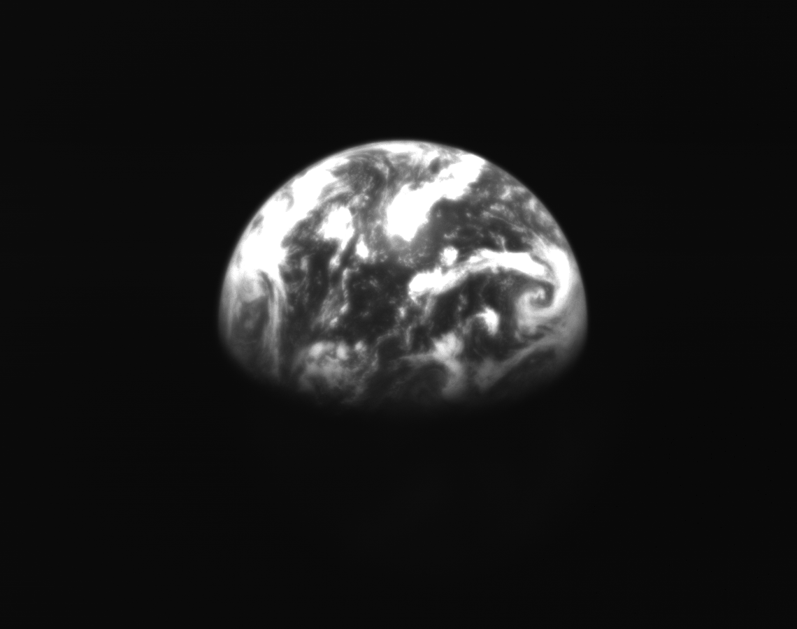
Conclusion
Lunar Flashlight: Propulsion System Challenges and Insights from a Lunar CubeSat Mission
Lunar Flashlight was a successful technology demonstration
  ASCENT propulsion system
    16.2 m/s dV imparted
  Infrared laser reflectometer instrument
  Sphinx C&DH with F Prime FSW
  First flight demonstration of PN DDOR
  Student operated JPL Mission
Valuable lessons for future CubeSat missions and 3D-printed propulsion systems
  Filters
  Surface finishing / cleanliness
  Rotating TCM design
Image of Earth Captured by Lunar Flashlight
(2023-05-17 at 20:43 UTC)
Notes:
Overall, lunar flashlight was a successful technology demonstration. The ASCENT based propulsion system was able to function in flight and impart 16.2 m/s of delta-v.
The infrared laser reflectometer performed successful experiments and had every indication of gathering useful science data if it was close enough to the moon. LF also demonstrated the Sphinx C&DH running Fprime flight software. It also demonstrated the first use of Pseudo-random noise delta door and was the first student operated JPL mission.
Lunar Flashlight demonstrated valuable lessons for future cubesat mission including the rotating TCM design and lessons for 3D-printed propulsion systems like including filters, surface finishing the interior AM surfaces and having stringent cleaning processes.

Slide 26
Acknowledging our Sponsor:
NASA’s Small Spacecraft Technology Program
Chris Baker and Roger Hunter
This is a JPL managed mission

Slide 27
Citations
Lunar Flashlight: Propulsion System Challenges and Insights from a Lunar CubeSat Mission
D. Andrews, G. Huggins, E. G. Lightsey, N. Cheek, N. Daniel, A. Talaksi, S. Peet, L. Littleton, S. Patel, L. Skidmore, M. Glaser, D. Cavender, H. Williams, D. McQueen, J. Baker, and M. Kowalkowski, “Design of a Green Monopropellant Propulsion System for the Lunar Flashlight CubeSat Mission,” in Proceedings of the Small Satellite Conference, 2020.
B. A. Cohen, P. O. Hayne, B. Greenhagen, D. A. Paige, C. Seybold, and J. Baker, “Lunar Flashlight: Illuminating the Lunar South Pole,” IEEE Aerospace and Electronic Systems Magazine, vol. 35, no. 3, pp. 46–52, 2020.
B. A. Cohen, P. O. Hayne, C. G. Paine, D. A. Paige, and B. T. Greenhagen, “Lunar Flashlight: Mapping Lunar Surface Volatiles Using a CubeSat,” in 46th Lunar and Planetary Science Con- ference, 2015.
C. Smith, D. Cavender, L. Littleton, and E. G. Lightsey, “Assembly Integration and Test of the Lunar Flashlight Propulsion System,” in AIAA SciTech 2022 Forum, 2022.
L. M. Littleton and E. G. Lightsey, “Assembly, Integration, and Testing of a Green Monopropellant Propulsion System for NASA’s Lunar Flashlight Mission,” 2021.
N. Cheek, N. Daniel, E. G. Lightsey, S. Peet, C. Smith, and D. Cavender, “Development of a COTS-Based Propulsion System Controller for NASA’s Lunar Flashlight CubeSat Mission,” in Proceedings of the Small Satellite Conference, 2021.
N. Cheek, C. Gonzalez, P. Adell, J. Baker, C. Ryan, S. Statham, E. G. Lightsey, C. Smith, C. Awald, and J. Ready, “Systems Integration and Test of the Lunar Flashlight Spacecraft,” in Proceedings of the Small Satellite Conference, 2022.
T. P. McElrath, S. Collins, and C. Smith, “A Delicate Balance of Torque and Thrust: How Lunar Flashlight Used Rotating Maneuvers to Make One Thruster Do the Work of Four,” in AIAA/AAS Astrodynamics Specialist Confer- ence, to be published.
M. Starr, “Development of Tactical and Strategic Operations Software for NASA’s Lunar Flash- light Mission,” in Proceedings of the Small Satellite Conference, 2023.

Slide 28
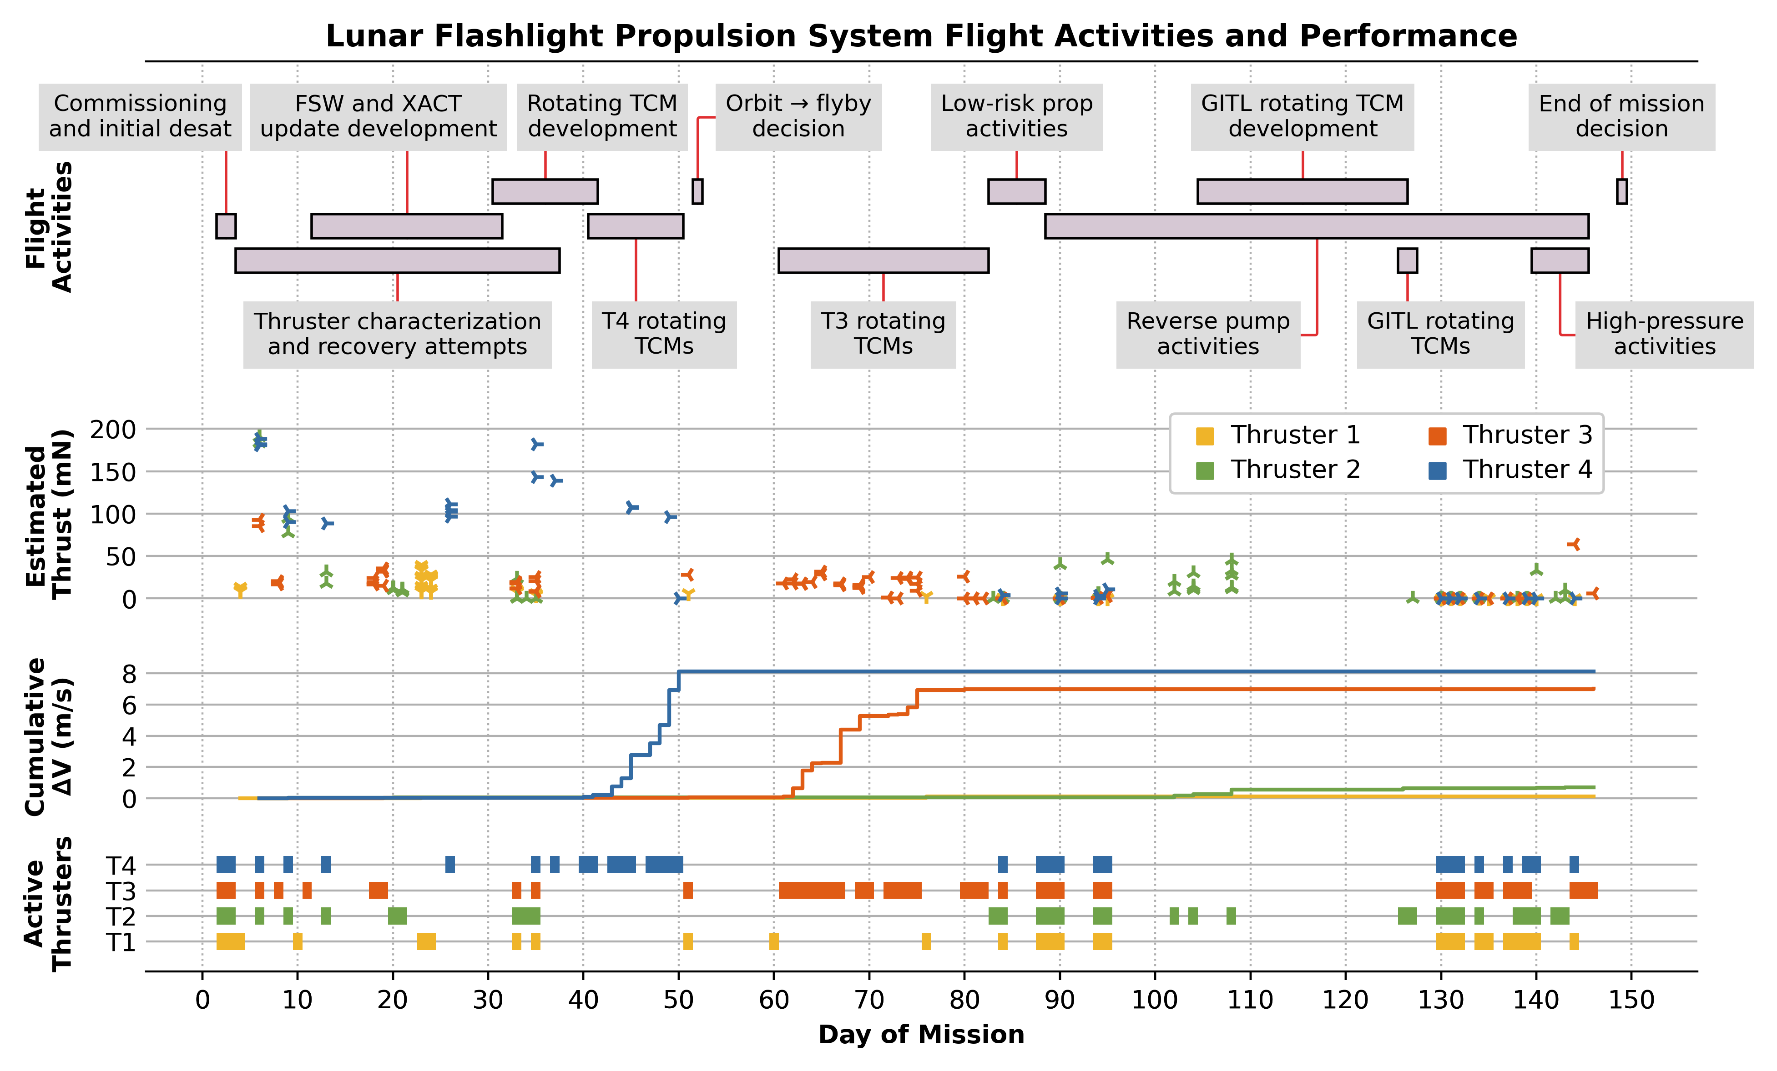
Mission Overview
Lunar Flashlight: Propulsion System Challenges and Insights from a Lunar CubeSat Mission
Notes:
Idk

Slide 29
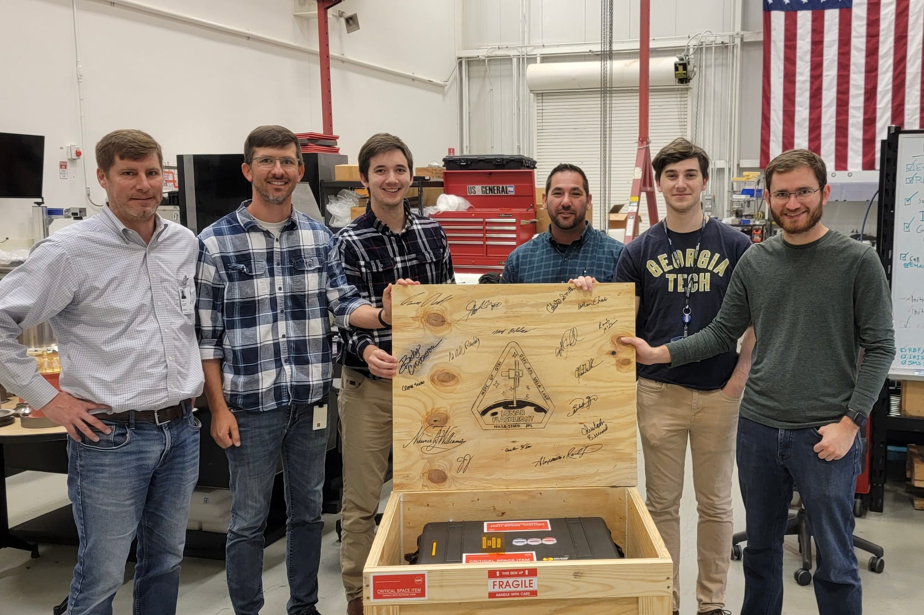
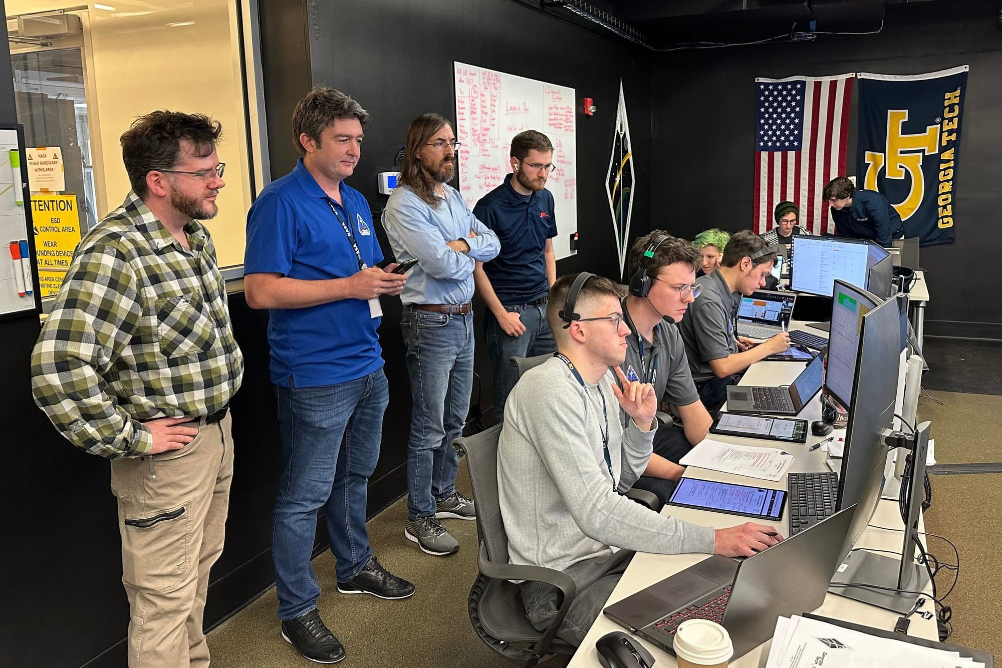

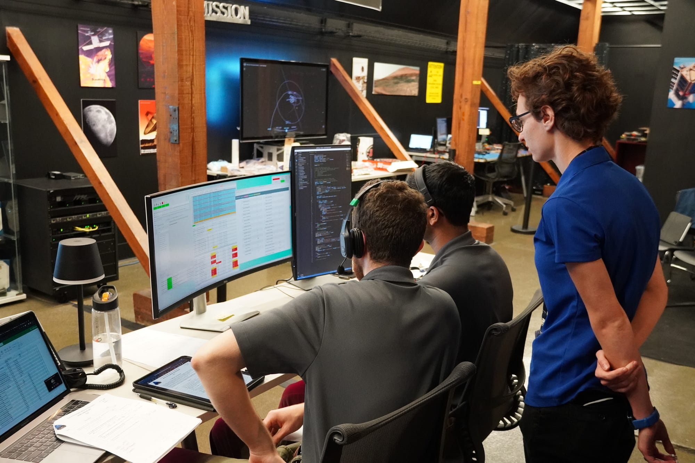
Lunar Flashlight: Propulsion System Challenges and Insights from a Lunar CubeSat Mission

