Slide 1
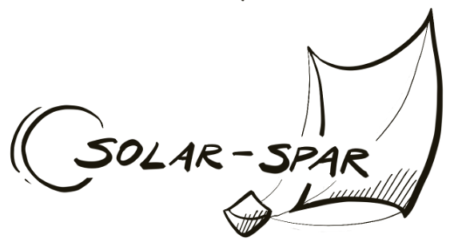



Solar-SPAR
Solar Sail Propulsion for Alternate Redirection
S. Stevens, J. Barger, S. Henley, C. LeClaire, A. Maloney,
Mentor: Dr. S. Shkarayev, and A. Bouskela

Slide 2
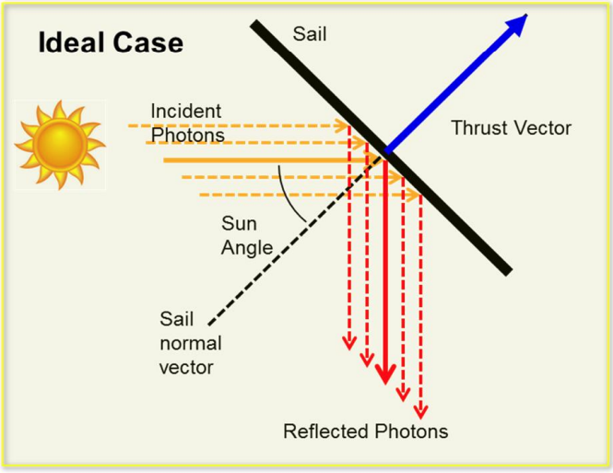
Physics of Solar Sails
Solar Sails
  Do not require fuel
    Increase mass and volume allotments for scientific instruments
  No harmful exhaust products
  No single-use disposable components
    Do not contribute to space debris
Solar sails function on the basis of the conservation of momentum in quantum mechanics
  Photons from the sun reflect off the sail and impart momentum
  Results in small but usable force
Johnson [1]

Slide 3
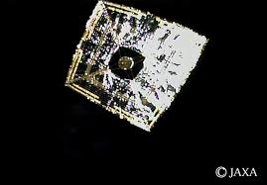
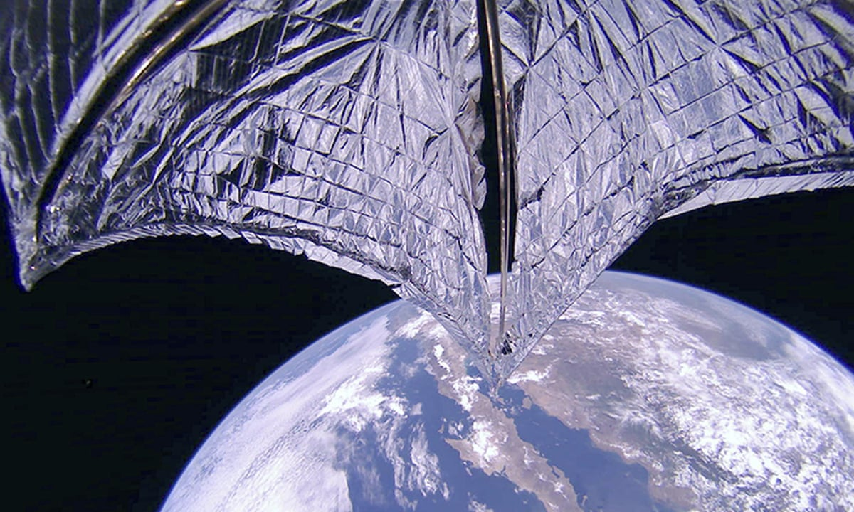
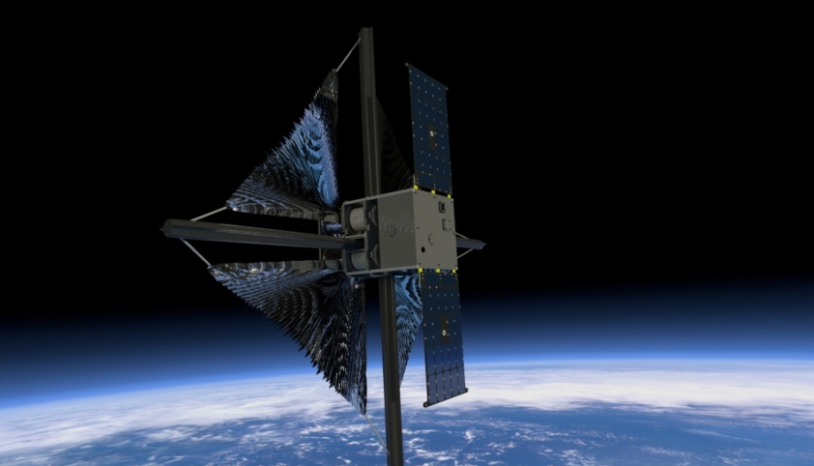
Solar Sail Based Missions
Ikaros (JAXA)
  First successful solar sail
  Spin-deployed
  Sun-centered orbit
LightSail 2 (Planetary Society)
  Successfully changed its orbit around Earth
NASA’s Advanced Composite Solar Sail System (ACS3)
  New composite booms for structural improvement
  Enables larger scaled solar sail missions
Ikaros [2]
LightSail 2 [3]
ACS3 [4]

Slide 4
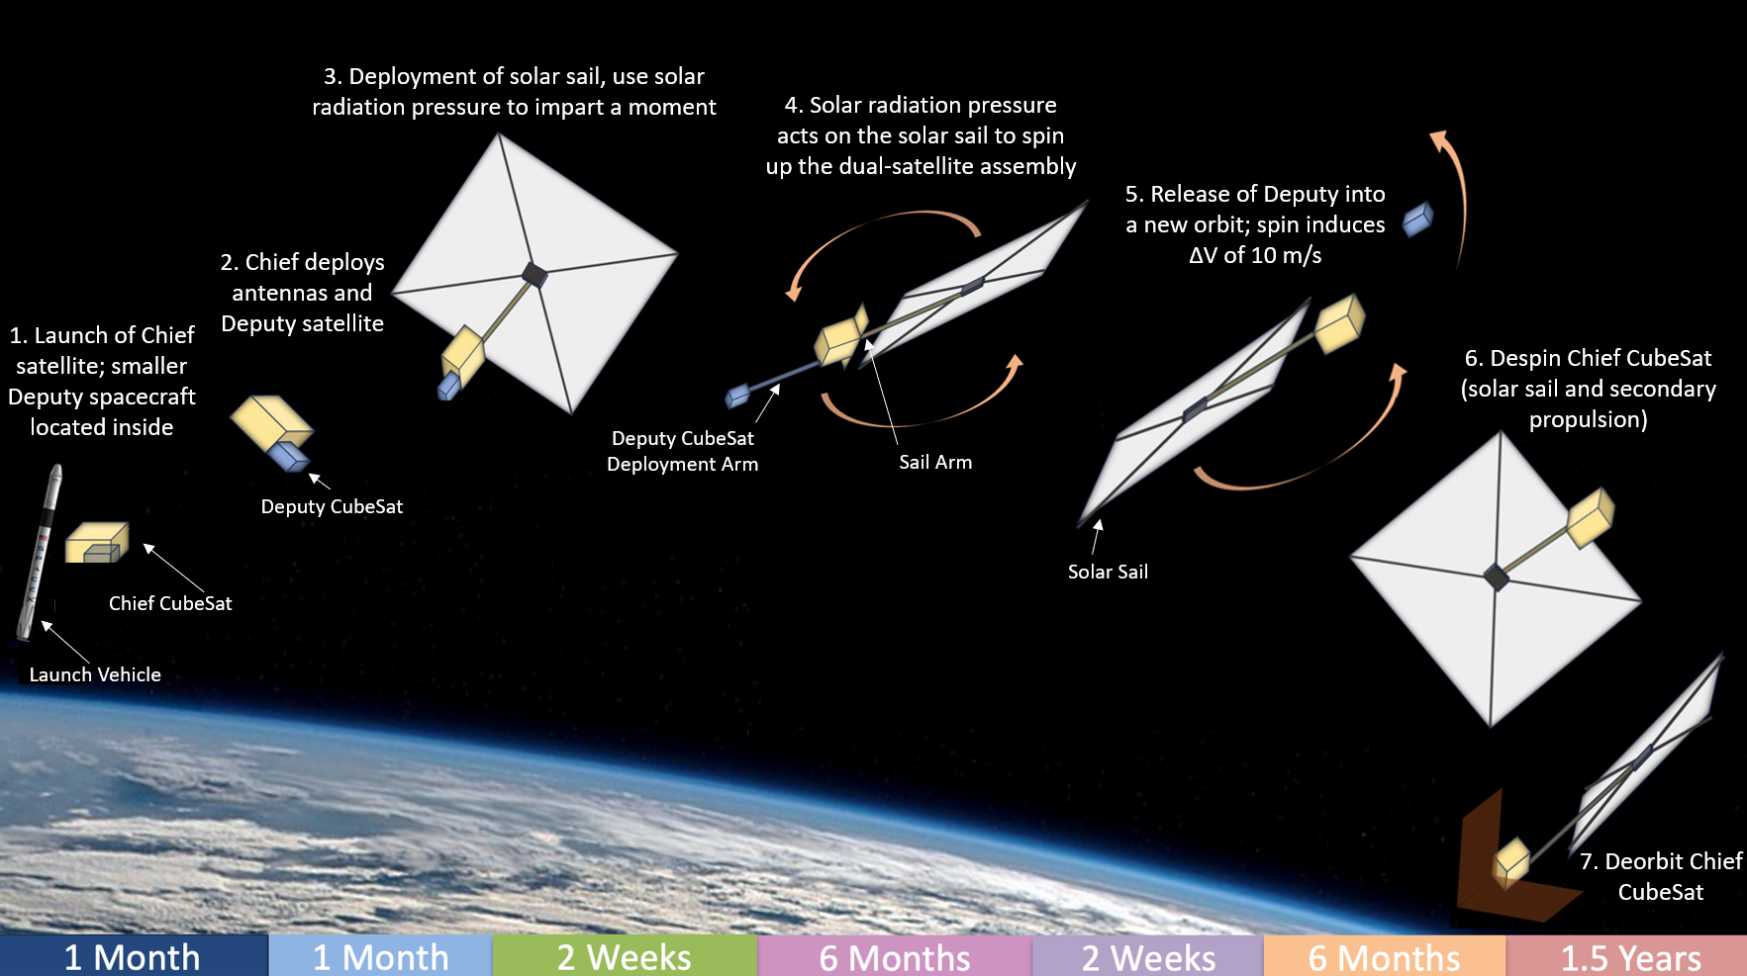
Solar-SPAR Concept of Operations
Solar sails are traditionally used to provide a direct propulsive force
Our innovative concept expands their operational domain by using solar sails to harness and store kinetic energy as rotational velocity to provide energy to launch a secondary payload into a new orbit
Deputy CubeSat

Slide 5
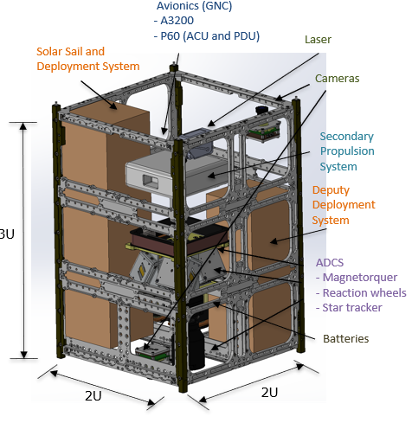
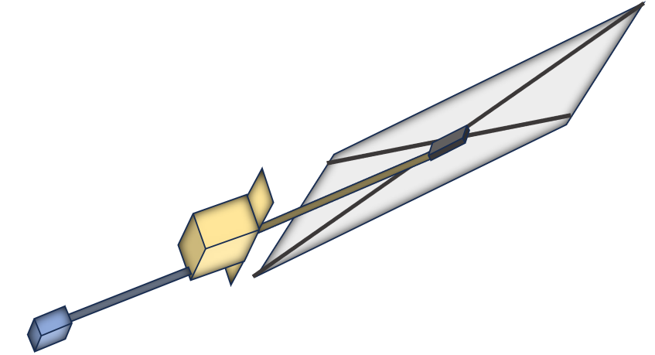
Spacecraft Assembly Overview
Mission Objectives:
Primary: Deploy a CubeSat assembly into LEO, deploy a solar sail from the ‘Chief’ satellite, and demonstrate that solar radiation pressure can be used to impart a moment on the assembly.
Secondary: Use solar radiation pressure acting on the solar sail to spin up the dual-satellite assembly in LEO enough to impart a delta V of 10 m/s to the deputy CubeSat upon its release.
Tertiary: Deorbit the Chief CubeSat using a combination of the solar sail and potential secondary propulsion system.
Chief CubeSat
Solar Sail
Sail Arm
Deputy CubeSat Deployment Arm
Deputy CubeSat

Slide 6
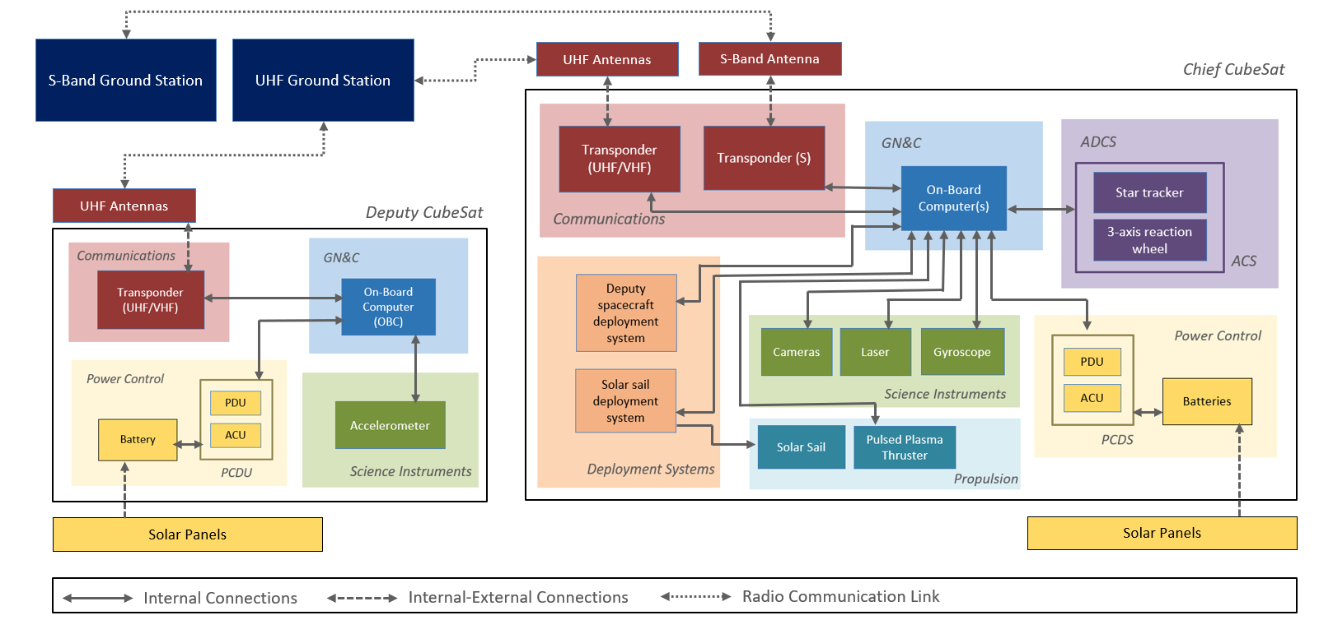
Systems Block Diagram
Deputy CubeSat must be fully independent from Chief CubeSat to be able to operate and maintain communication for path tracking to ground station upon its release.

Slide 7
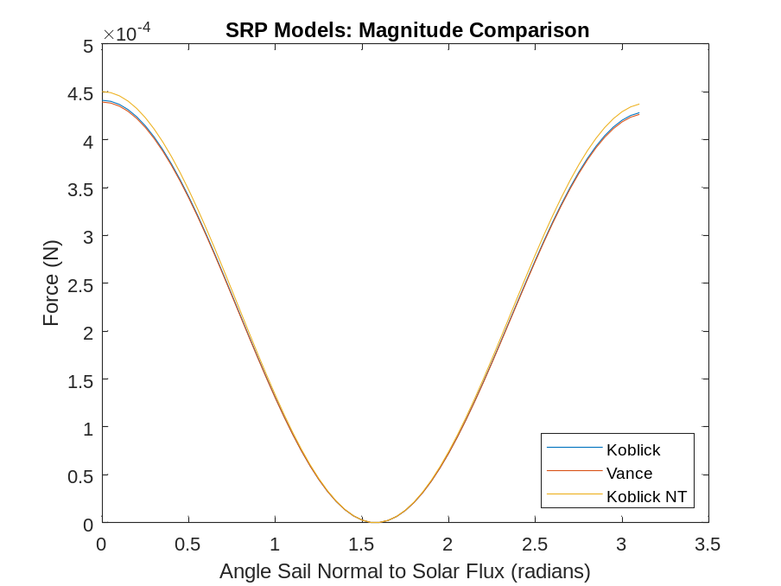
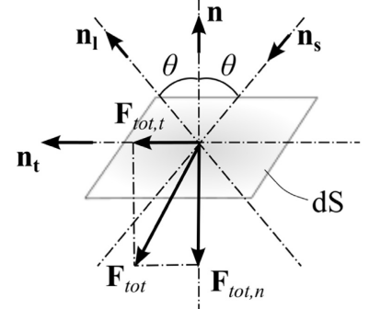


Dynamic Models
Solar sail forces are a function of optical properties of solar sail, sail area, incidence angle, and solar flux.
  Multiple SRP models were compared to ensure accurate force predictions
$$F=\frac{E}{c}Acosθ\left[\left(1−τ−\tilde{ρ}\right)l+2\left(\tilde{ρ}cosθ+\frac{1}{3}δ\right)n\right]$$
Koblick (Solar Flux and Sail Normal)
$$\vec{F}=PA\left(\vec{S}∙\vec{n}\right)\left\{\left(1−ρ_{s}\right)\vec{S}+\left(2ρ_{s}\left(\vec{S}∙\vec{n}\right)+\frac{2}{3}ρ_{d}\right)\vec{n}\right\}$$
Vance (Solar Flux and Sail Normal)
$$F=\frac{E}{c}Acosθ×\left\{\left[\left(1−τ−\tilde{ρ}\right)cosθ+\frac{2}{3}δ\right]n+\left[\left(1−τ−\tilde{ρ}\right)sinθ\right]τ\right\}$$
Koblick (Solar Flux and Sail Tangental)
Koblick et al., Vance et al. [5][6]
Minimal deviation noted between models
Koblick et al. [5]

Slide 8
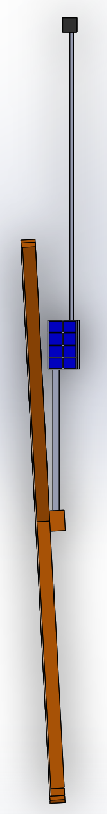
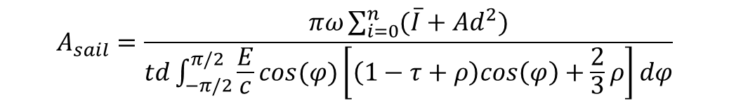
Solar Sail Sizing
Sail size was determined using Newton’s second law in the angular form, angular kinematics, and the average moment due to the solar radiation pressure force over each rotation
0.1352mN
F_{sail} = 0.1352mN
1m
Sail Moment = 0.1352mN*m
$$A_{sail}=\frac{πω\sum_{i=0}^{n}{(\overline{I}+Ad^{2})}}{td\int_{−π/2}^{π/2}{\frac{E}{c}cos(φ)\left[\left(1−τ+ρ\right)cos\left(φ\right)+\frac{2}{3}ρ\right]dφ}}$$

Slide 9
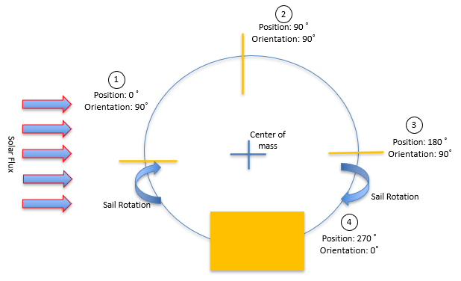
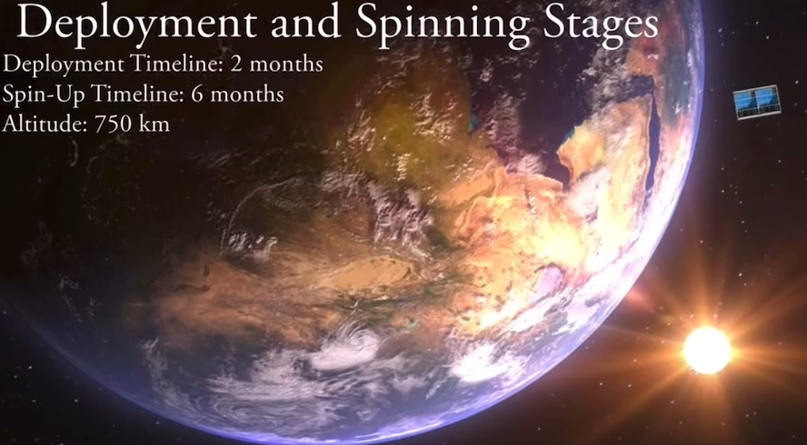
Solar Sail Rotation
Sail is maneuverable to maximize forces in optimal directions
  Utilize primary force in sail normal direction to create moment
Sail is programmed to rotate 90˚ when at positions 0˚ and 180˚
  Position 0˚: Rotate sail normal perpendicular to axis of rotation to maximize solar force
  Position 180˚: Rotate sail normal parallel to axis of rotation to minimize solar and atmospheric drag
    Sail remains locked in this position while in Earth’s shadow to minimize atmospheric drag

Slide 10
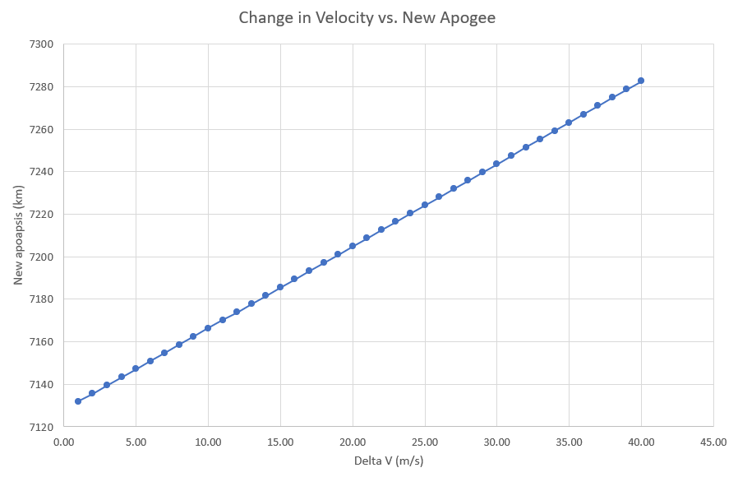
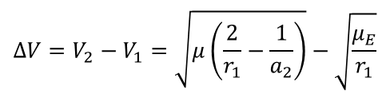
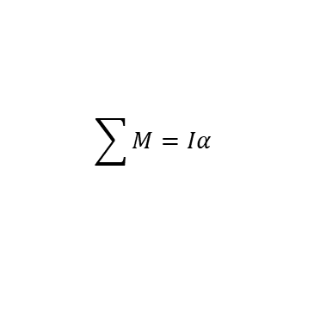
Orbital Parameter Changes
The higher the delta-V imparted, the more elliptical the orbit becomes
With our target of 10 m/s, we reach an apoapsis of 7166 km (an altitude of 788 km)
$$∆V=V_{2}−V_{1}=\sqrt{μ\left(\frac{2}{r_{1}}−\frac{1}{a_{2}}\right)}−\sqrt{\frac{μ_{E}}{r_{1}}}$$
$$\sum{M}=Iα$$

Slide 11
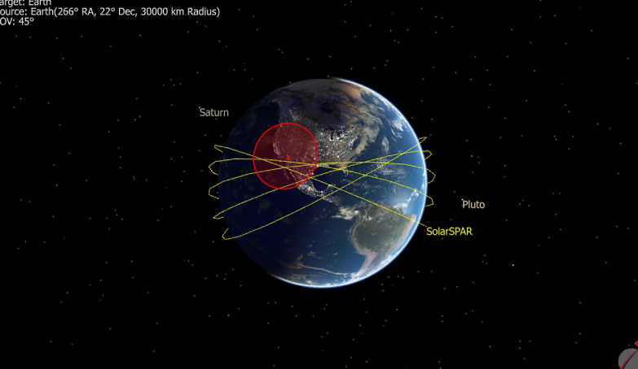
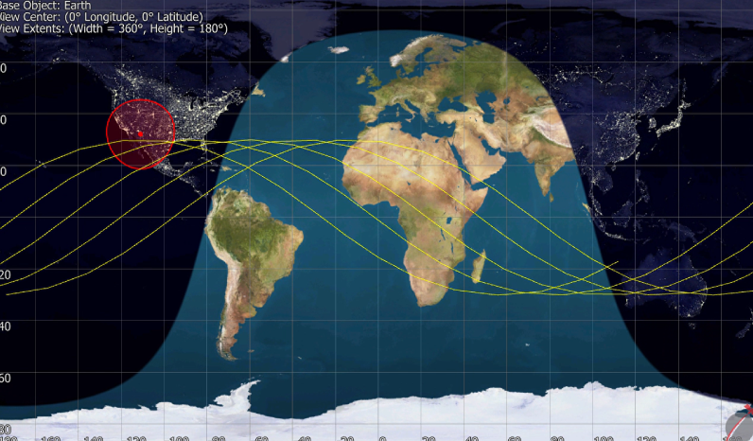
Orbital Simulations
Orbital STK and FreeFlyer were used to simulate orbital parameters through each mission phase and to determine deorbit timeline
At an altitude of 750 km, the spacecraft will see around 15 hours of sunlight; this provides enough solar flux on the sail for the spacecraft assembly to ‘spin up’ to a target speed of 60 revolutions per minute, and for the spacecraft batteries to recharge via the external solar panels
Based off the simulations there will be approximately 4 orbits per day that result in a connection between the ground station and the CubeSat lasting between 5-7 minutes
FreeFlyer 3D Simulation
FreeFlyer Ground Track

Slide 12
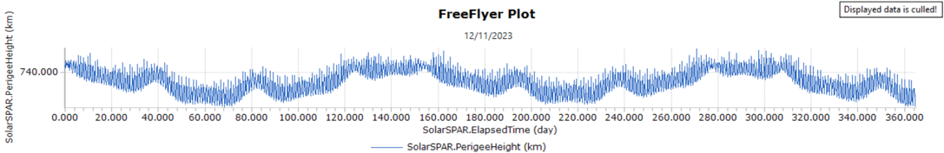
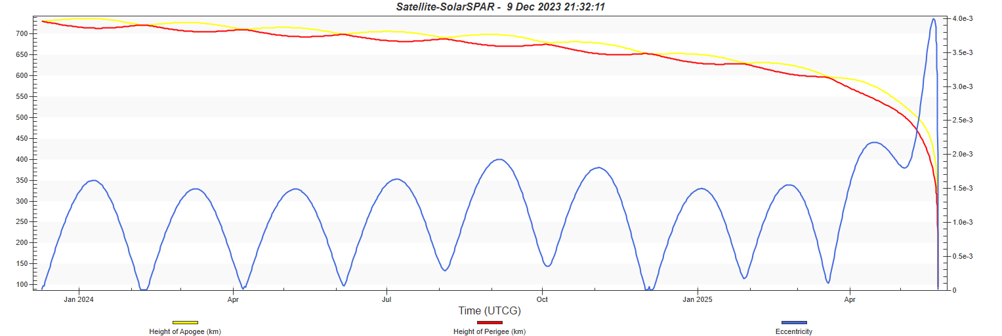
Trajectory Simulations
Solar Sail will add eccentricity to initially circular orbit but will average out throughout the year due to symmetry
Drag plays a minor role during spin-up, and a major role in deorbit when drag sail configuration reaches low altitude (meets FCC 5-year deadline)

Slide 13
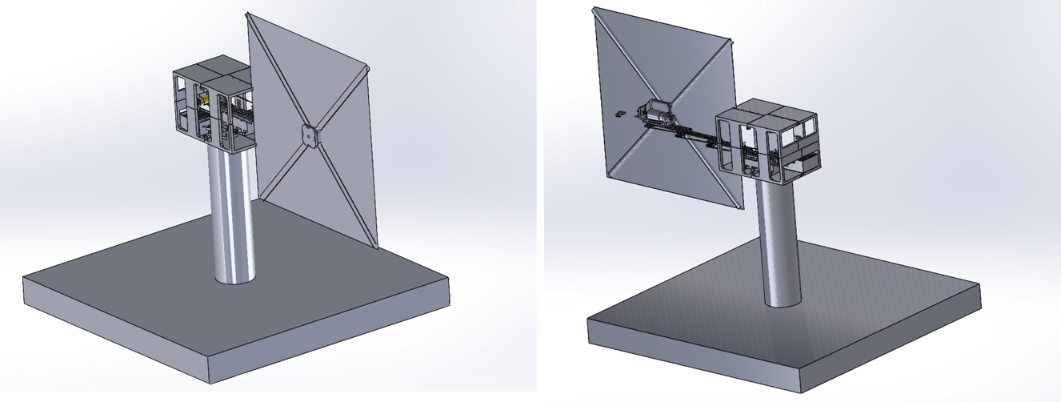
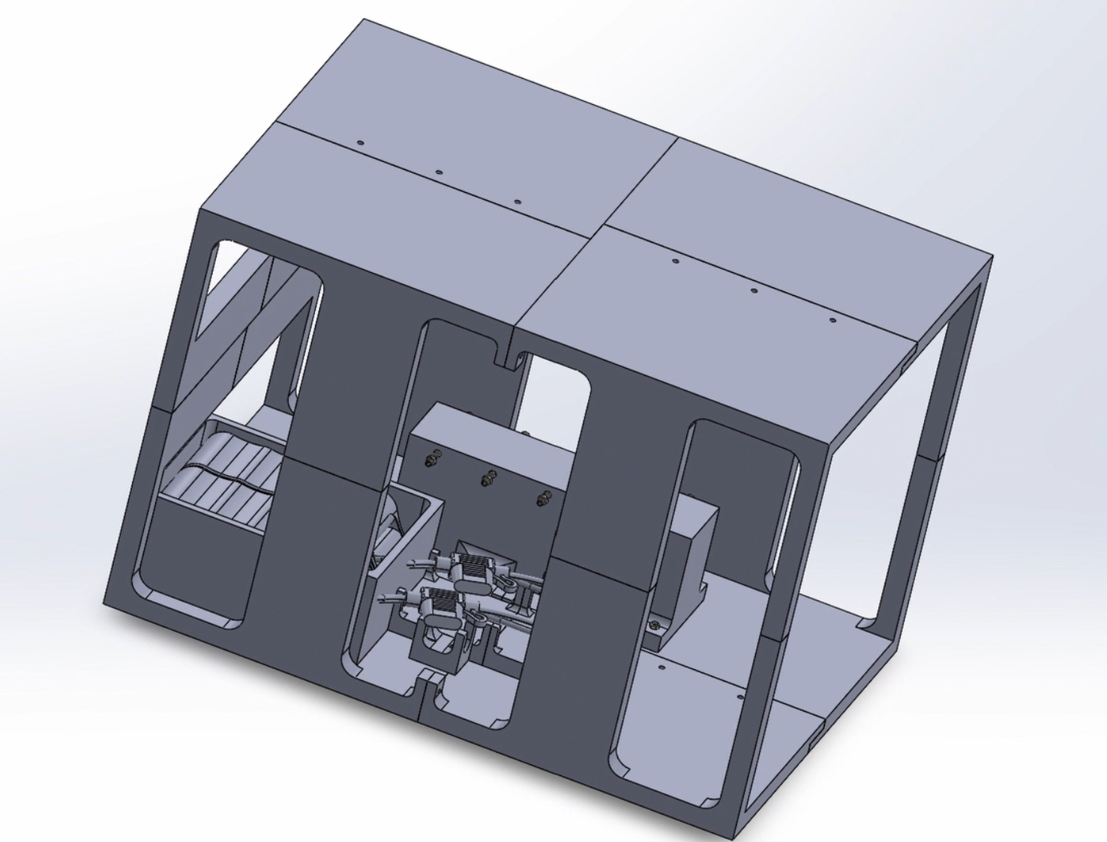
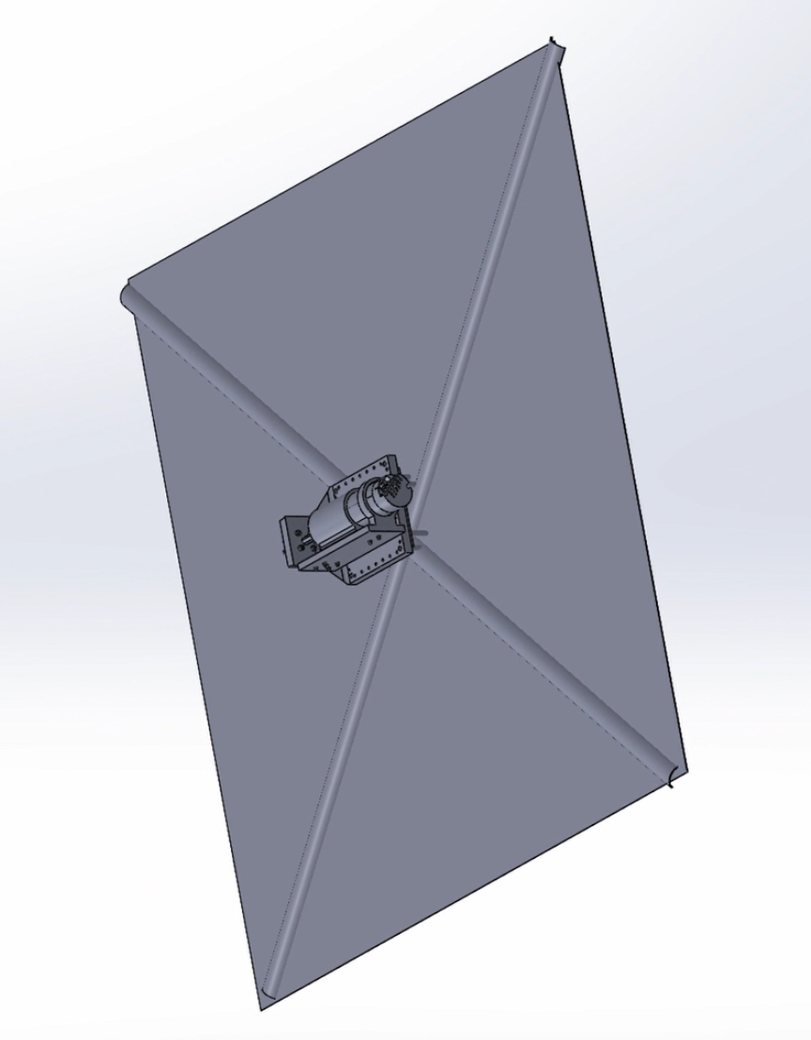
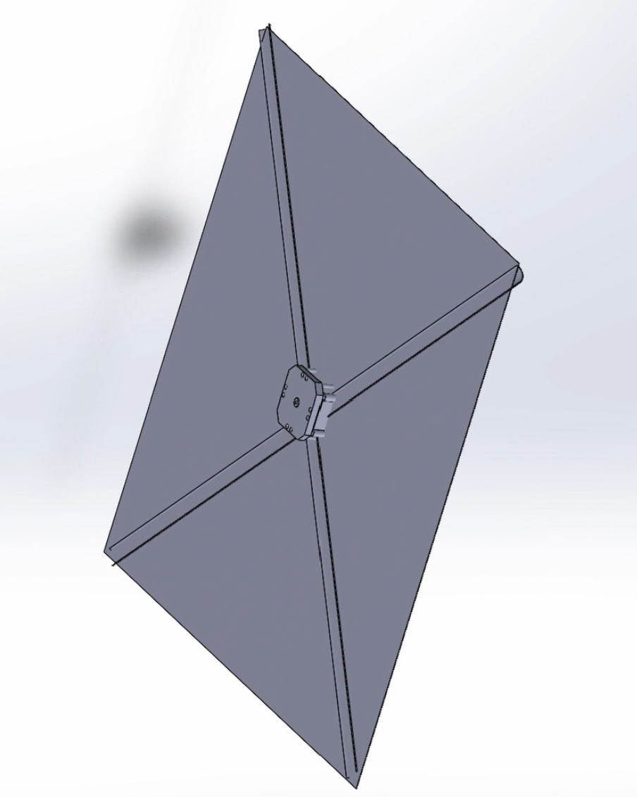
Prototype Design

Slide 14
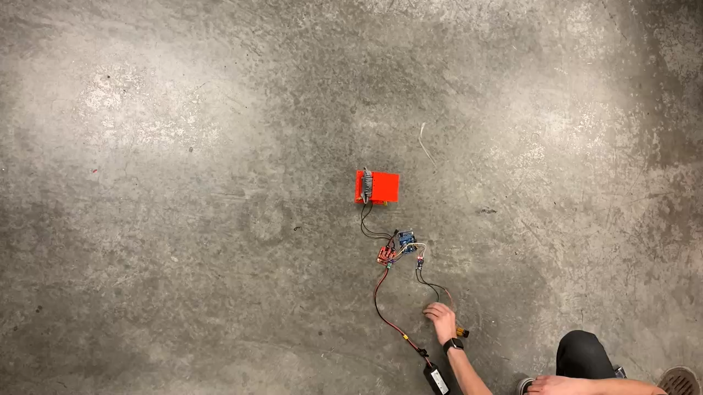
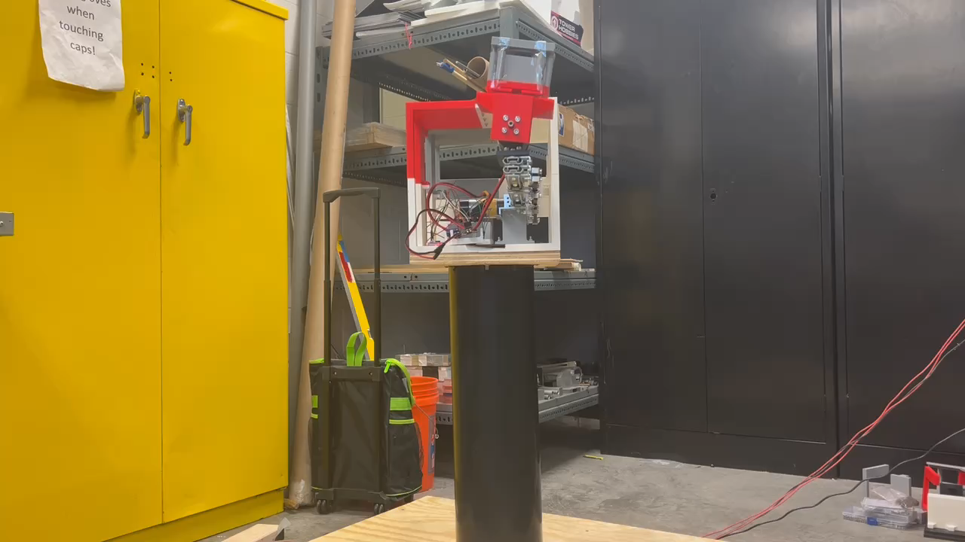
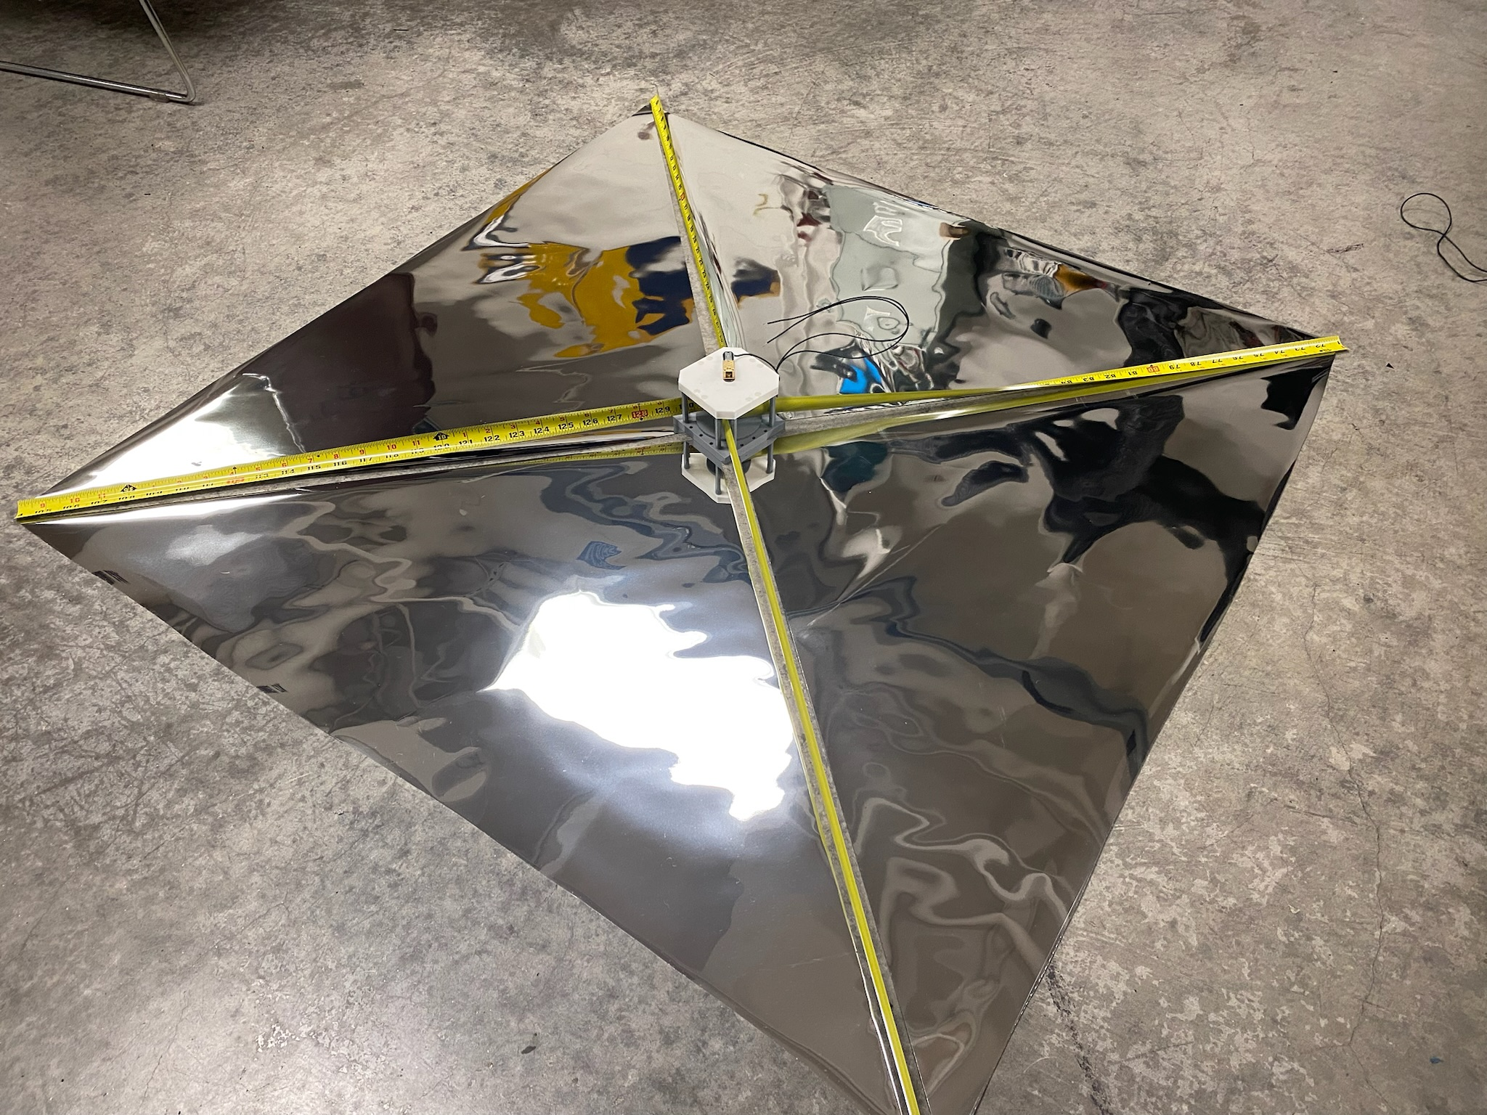
Prototype Testing

Slide 15
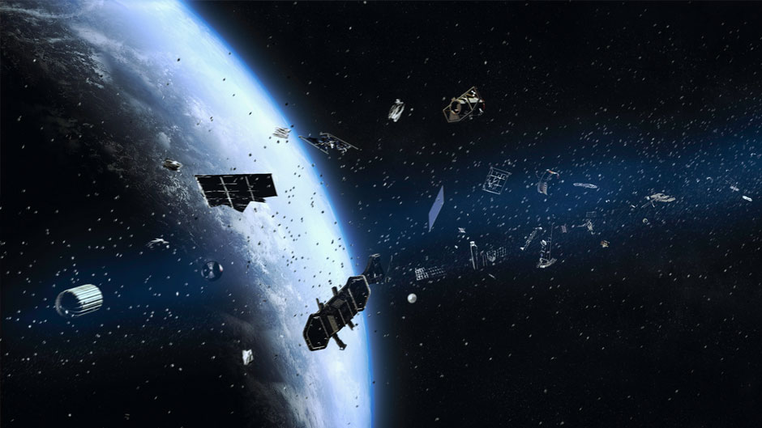
Results and Outlook
Successfully demonstrated the mechanics of our novel concept of operations
Expanded operational domain of solar sail spacecraft
Potential future use case scenarios:
Removal of space debris orbiting Earth
CubeSat orbit maintenance and redirection
Space Debris and Micrometeorites Orbiting Earth [7]

Slide 16
Thank you!

Slide 17
References
[1] Johnson, Les. “Solar Sails - NASA Technical Reports Server (NTRS).” NASA NTRS, 15 Feb. 2018, ntrs.nasa.gov/api/citations/20180003180/downloads/20180003180.pdf.
[2]Howell, E., “Ikaros: First successful solar sail,” Space.com Available: https://www.space.com/25800-ikaros-solar-sail.html.
[3] Reed, B., “Lightsail 2 spacecraft glides on sunlight in orbit around Earth,” The Guardian Available: https://www.theguardian.com/science/2019/aug/08/lightsail-2-spacecraft-glides-on-sunlight-in-orbit-around-earth.
[4] Bailey, M., “Rocket lab selected to launch NASA’s Advanced Composite Solar Sail System,” Business Wire Available: https://www.businesswire.com/news/home/20211006005938/en/Rocket-Lab-Selected-to-Launch-NASA%E2%80%99s-Advanced-Composite-Solar-Sail-System.
[5] V. Koblik, E. Polyakhova, L. Sokolov, Solar sail near the Sun: Point-like and extended models of radiation source, Advances in Space Research, Volume 48, Issue 11, 2011, Pages 1717-1739, ISSN 0273-1177, httpsP://doi.org/10.1016/j.asr.2011.04.024.
[6] Leonard D. Vance, Ravi Teja Nallapu and Jekan Thangavelautham. "Solar Sailing
Fundamentals with an Exploration of Trajectory Control to Lunar Halo Orbit," AIAA 2020-1207. AIAA Scitech 2020 Forum. January 2020.
[7] Perez, Amanda M. “A Crash Course in Space Junk.” University of Miami News and Events, University of Miami, 2 Apr. 2019, news.miami.edu/stories/2019/04/a-crash-course-in-space-junk.html.

