Slide 1
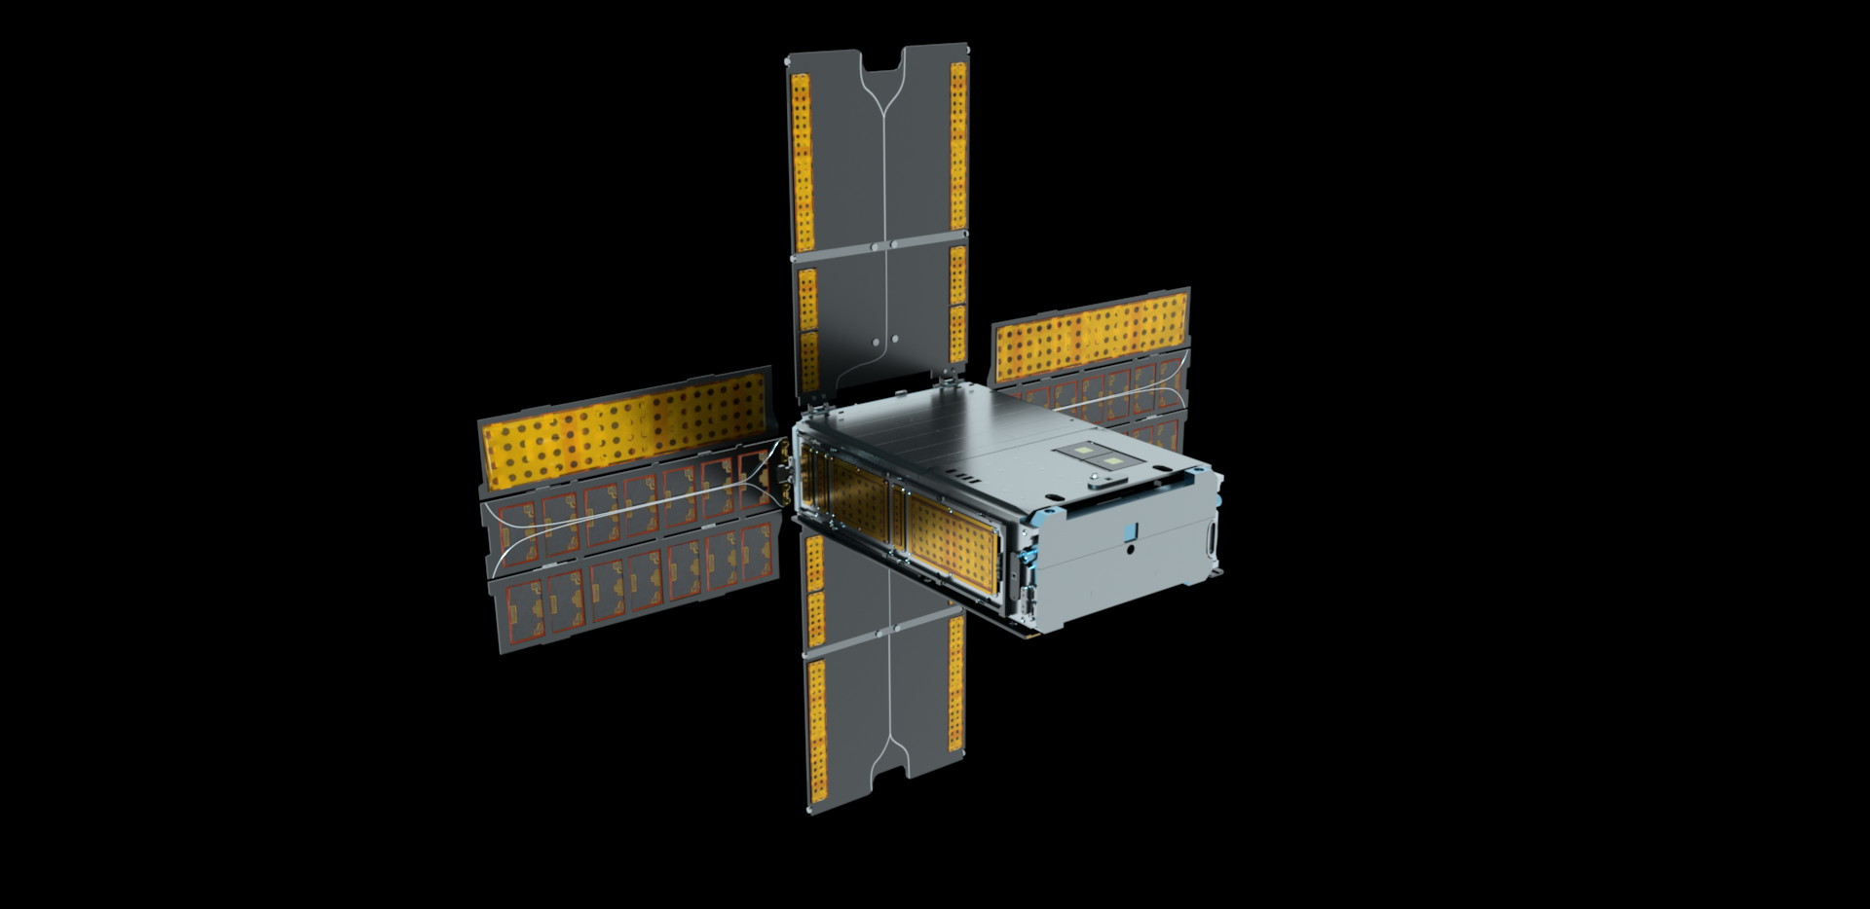

BioSentinel: Update on extended mission operations
Matthew Napoli, PM
Andres Dono, Nav Lead
NASA Ames Research Center
NASA/Daniel Rutter

Slide 2






BioSentinel: sending biology further than ever before
The limits of life in space – as we know it – is 12.5 days on a lunar round trip or 1.2 years in LEO. As we send people further into space, we need to understand the biological risks and how they can be addressed
36 million mi
Mars
Millions mi
NEA
• L2
240,000 mi
Unknown
Distance from Earth
Known
180-300 mi
Extended ISS
62 mi
6 months
12 months
18 months
3 years

Slide 3
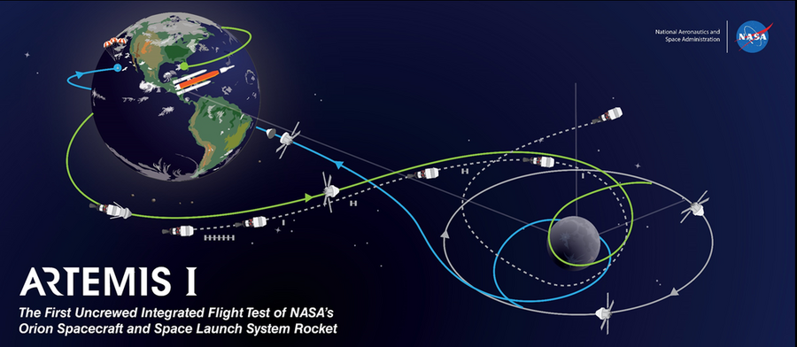

BioSentinel Mission
HQ Directorate: Exploration Systems Development Mission Directorate Mars Campaign Office (ESDMD-MCO)
Objective: develop a deep space tool with autonomous life support technologies to study the biological effects of the space radiation environment
NASA’s first biological study in interplanetary deep space:
  Combine bio studies with autonomous
  capability & dosimetry beyond Low
  Earth Orbit (LEO)
  Beyond the protection of Earth’s
  magnetosphere
  Compare radiation environments
  (deep space, LEO, Earth)
Lunar transit
(3-7 days)
Heliocentric Orbit
(6 months)
Secondary payload
deployment (L+4-5 hrs)

Slide 4
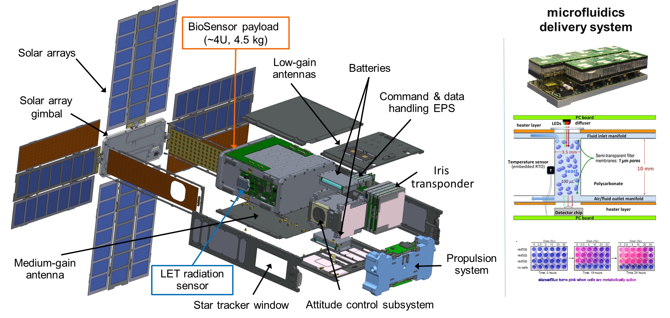
BioSentinel: 4U experiment in a 6U CubeSat

Slide 5
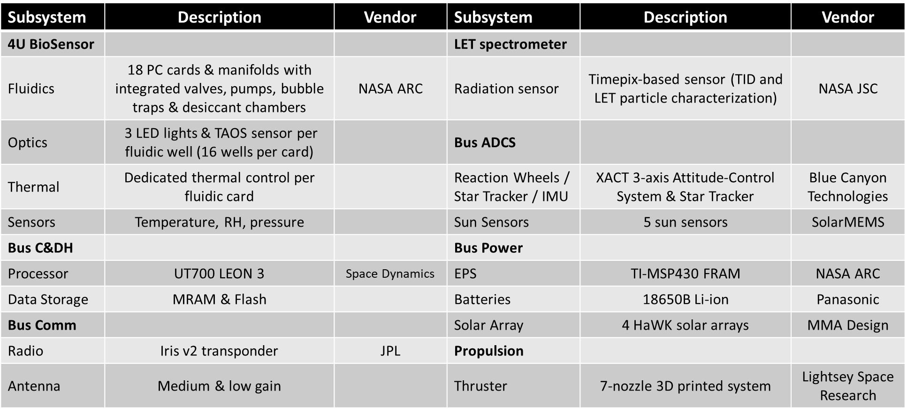
BioSentinel Subsystems

Slide 6
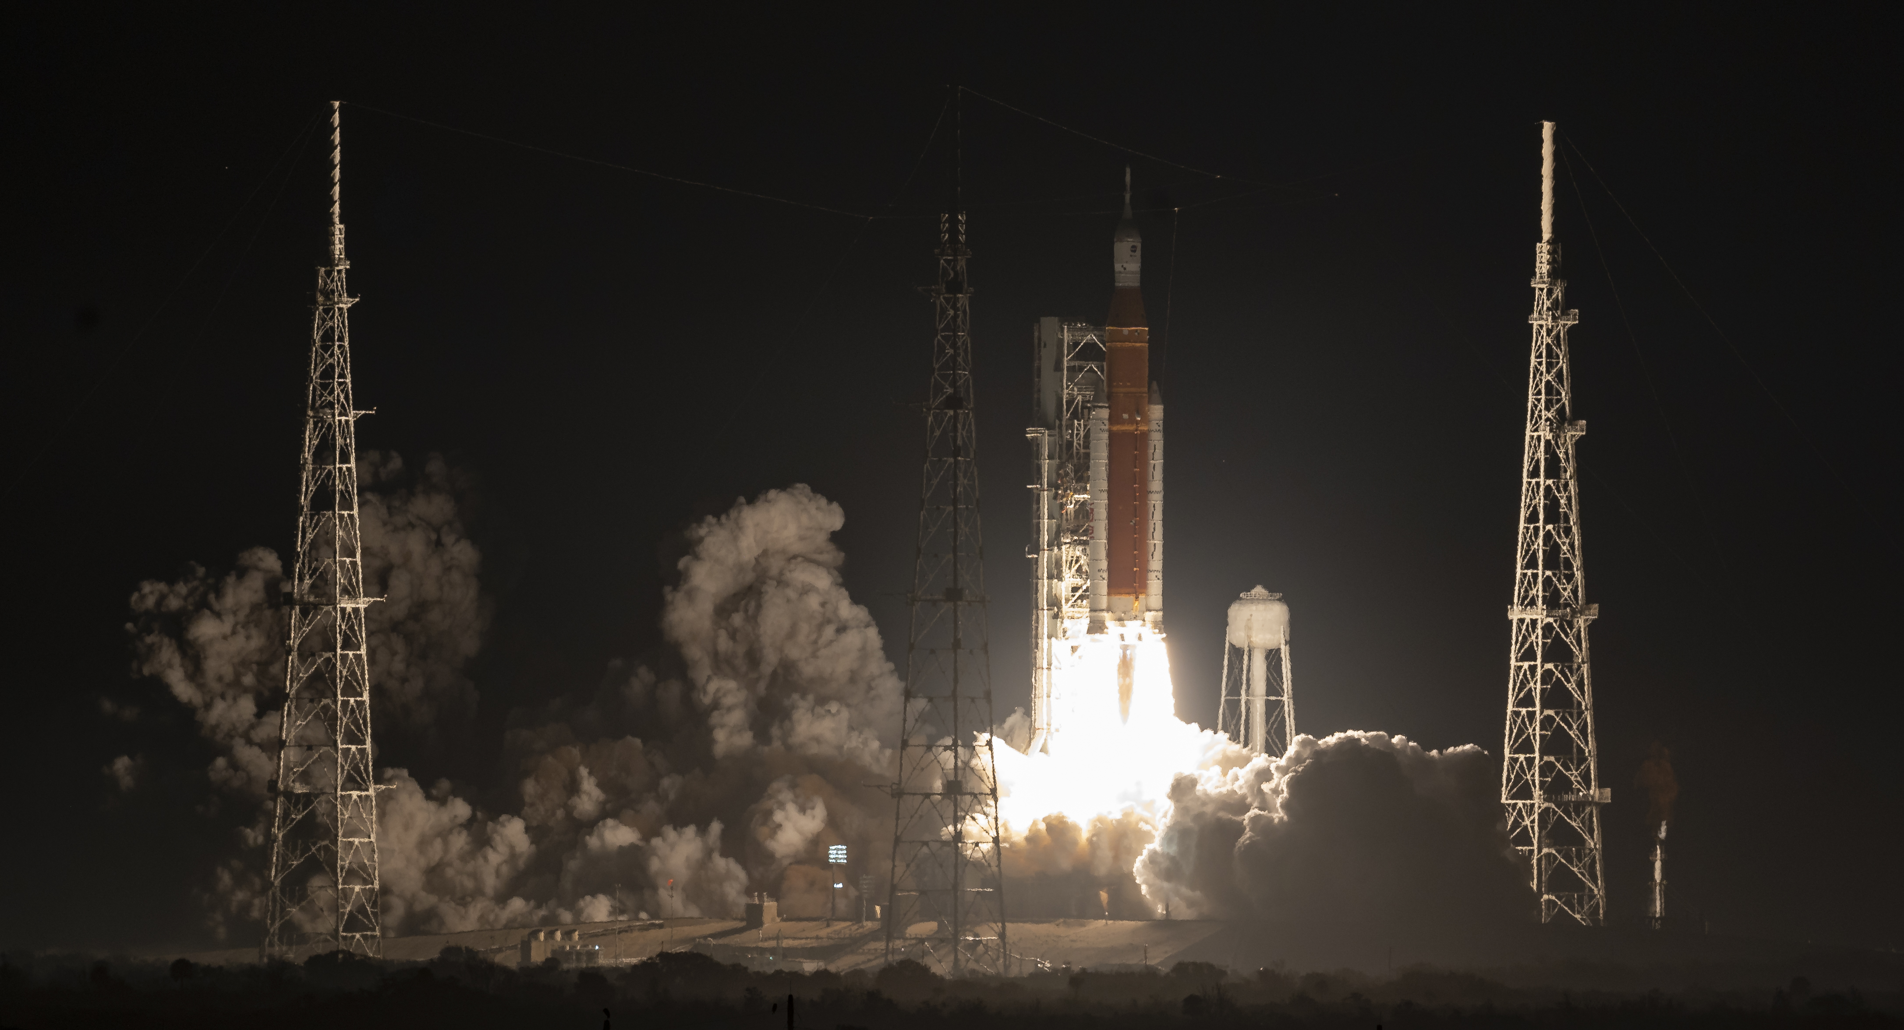
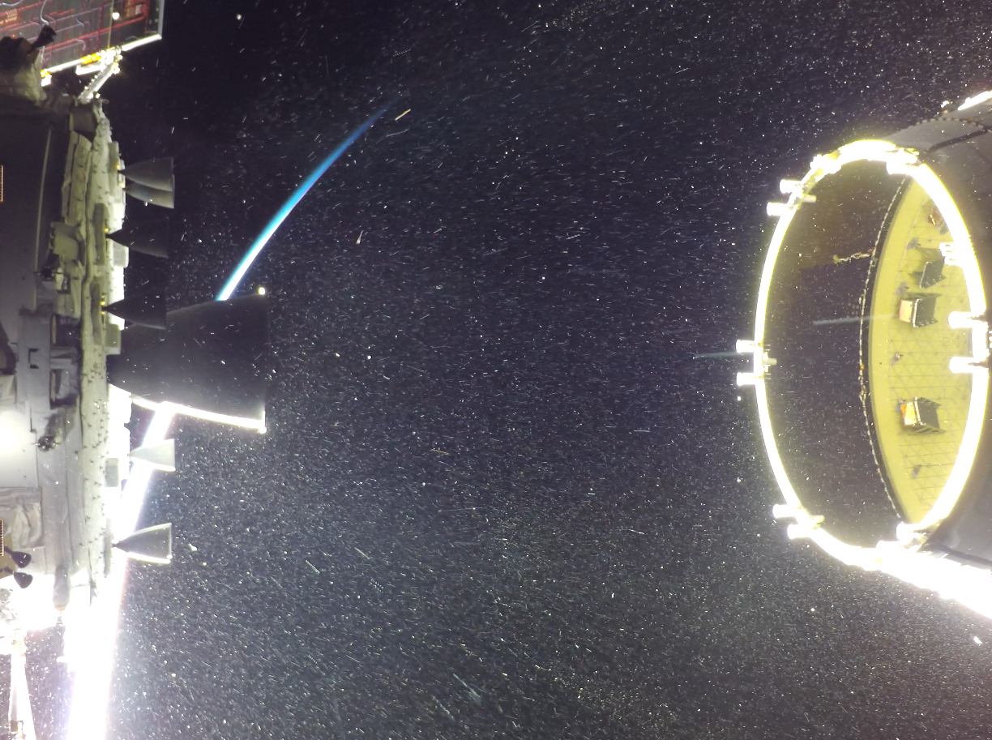
Launch and Deployment: November 16, 2022
NASA/Bill Ingalls

Slide 7
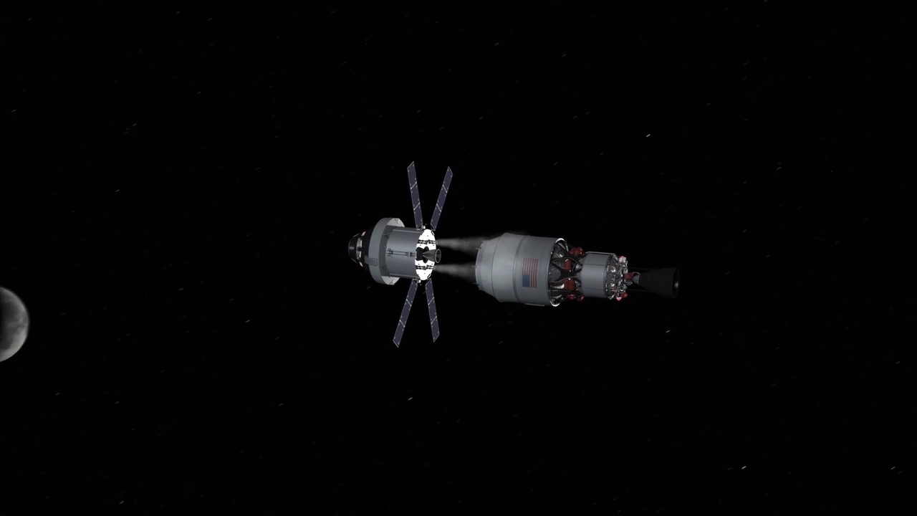
Deployment
NASA

Slide 8
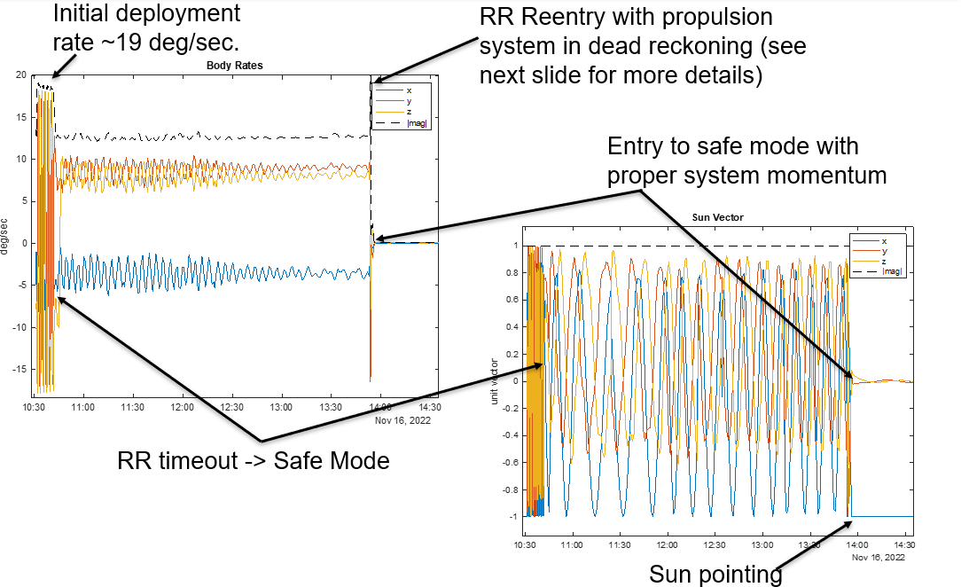
Initial Deployment – Tumbling Anomaly
Tumbling on Deployment

Slide 9
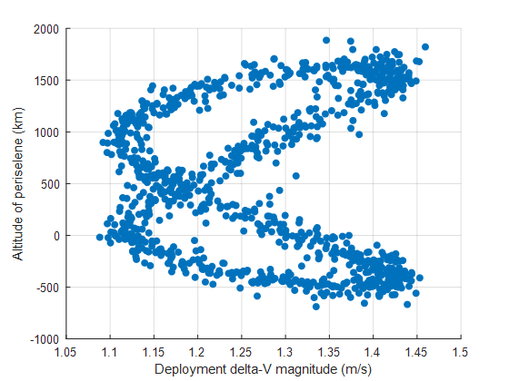
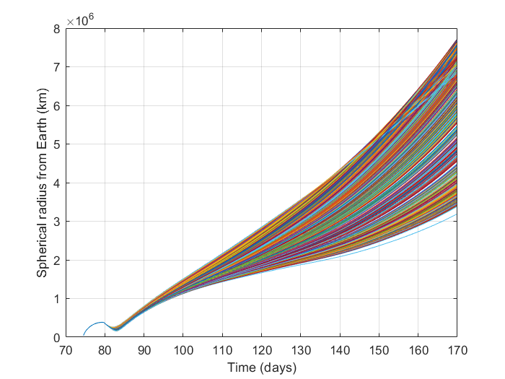
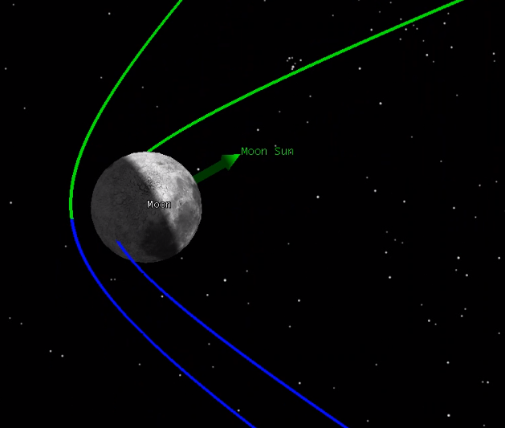
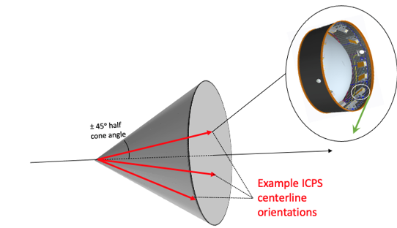
Lunar Impact Risk – Example Analysis
Trajectory Uncertainty
Baseline CONOPS did not have a dV maneuver planned. Initial lunar impact risks of <10% was deemed an acceptable risk.
However, VERY high probability of lunar impact for new launch dates:
  Aug 29th - 30%, Sept 2nd - 54%, Sept 5th - 56%, Nov 16th - 14%
Avoiding this impact requires a dV maneuver shortly after deployment
Prop Subsystem:
  The capability for avoidance dV was 4.2 m/s. This was possible because the propulsion system fortuitously included extra fuel and an extra rear nozzle that had not been planned for the nominal mission.
Lunar Impact
August 29th Launch Deployment Variability
Monte Carlo:
Earth distance vs time, for a 3-burn case

Slide 10
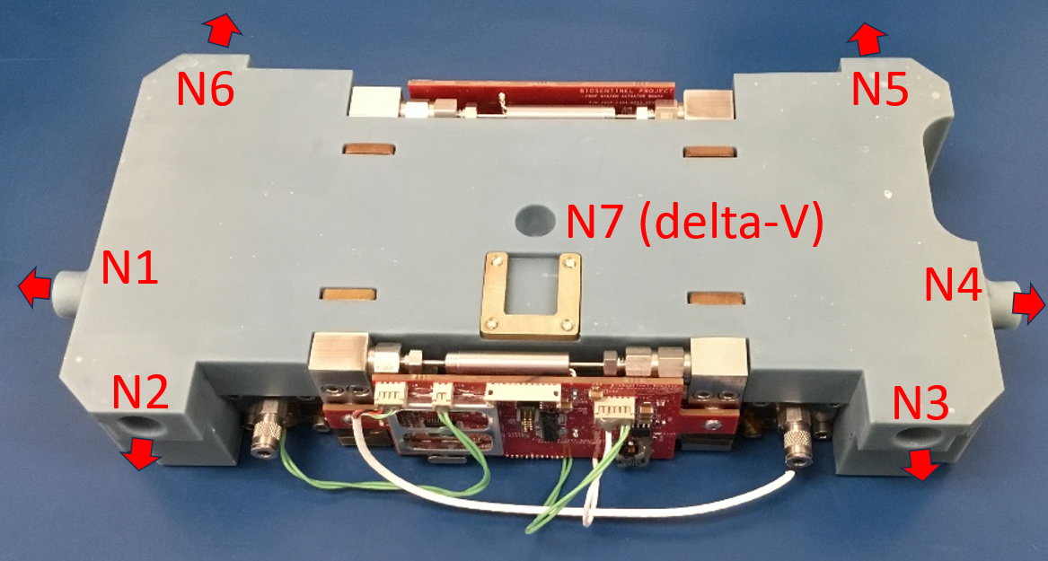
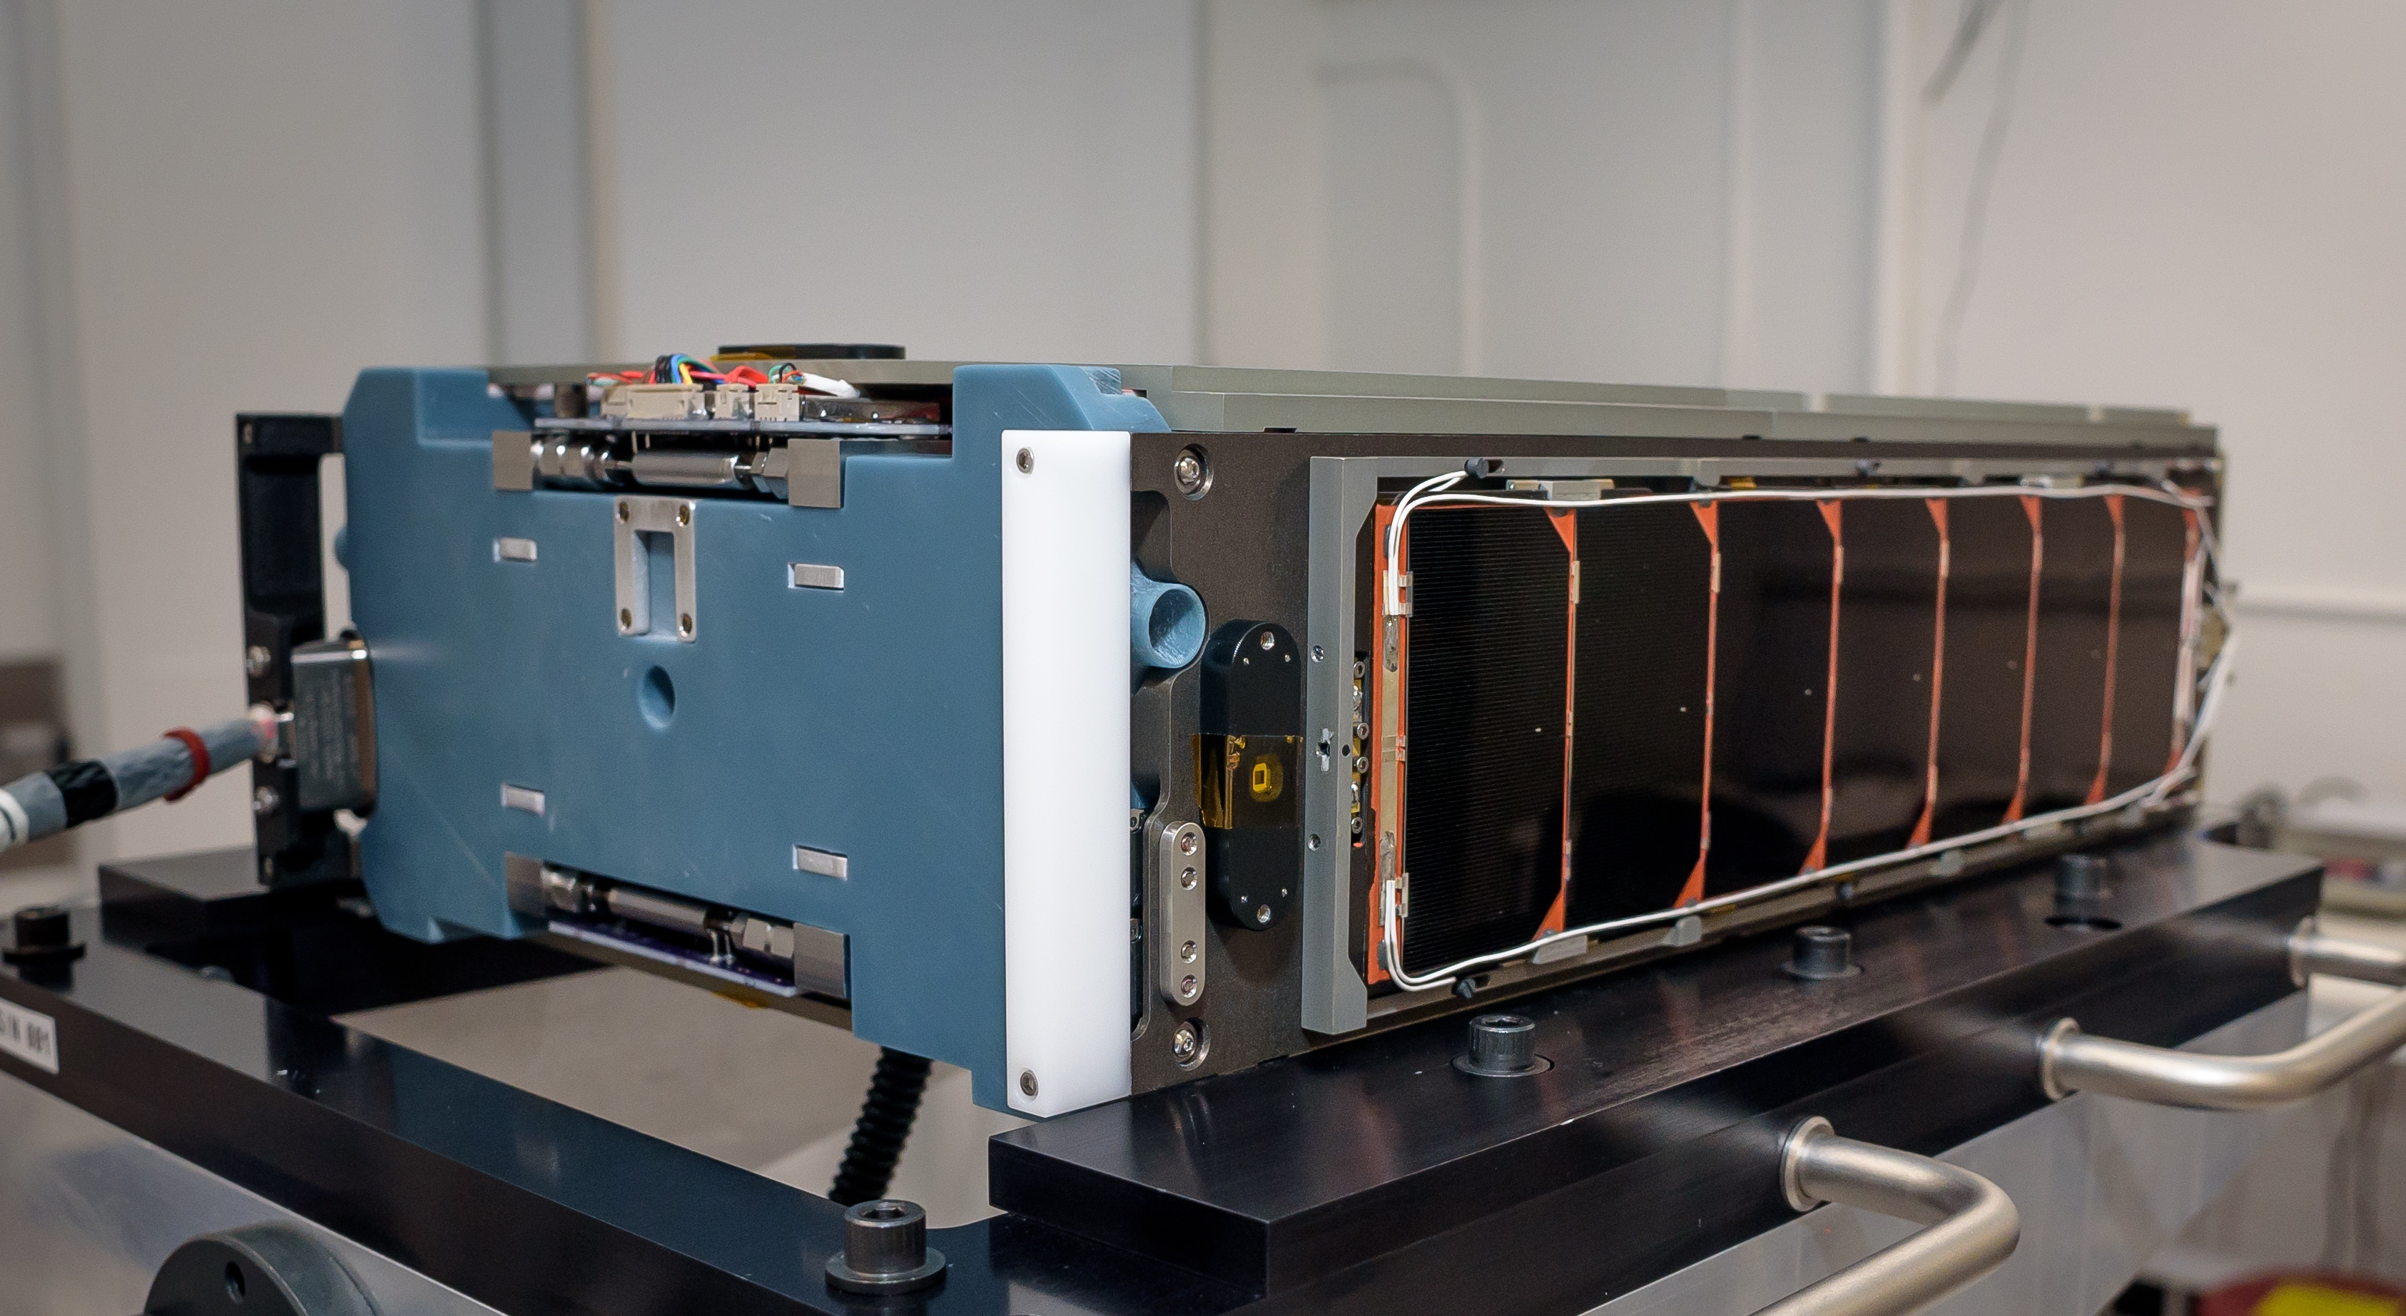
Propulsion System
A propulsion system is required for deep space operation
  Detumble after deployment
  Momentum unloading throughout mission
  Delta-V technology demonstration
7-thruster cold gas system
  Full 3-axis control, but not redundant
Mostly 3D printed structure
  Efficient use of restricted space
    Total volume: 21 x 11 x 4 cm
    Includes: Two propellant tanks, eight valves, propellant state sensors, driving electronics
  Lower cost to manufacture
Thrust measurements in flight agree with ground measurements, no performance degradation yet observed
Propulsion system with nozzles and exhaust directions
Propulsion system (left) integrated with EDU spacecraft

Slide 11
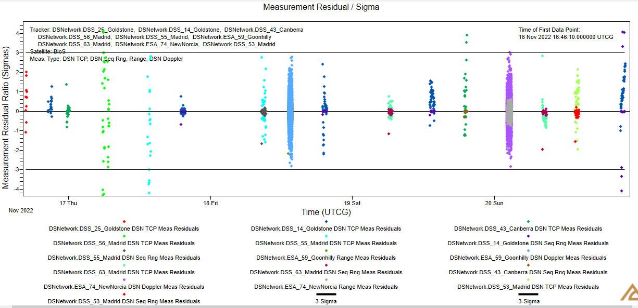
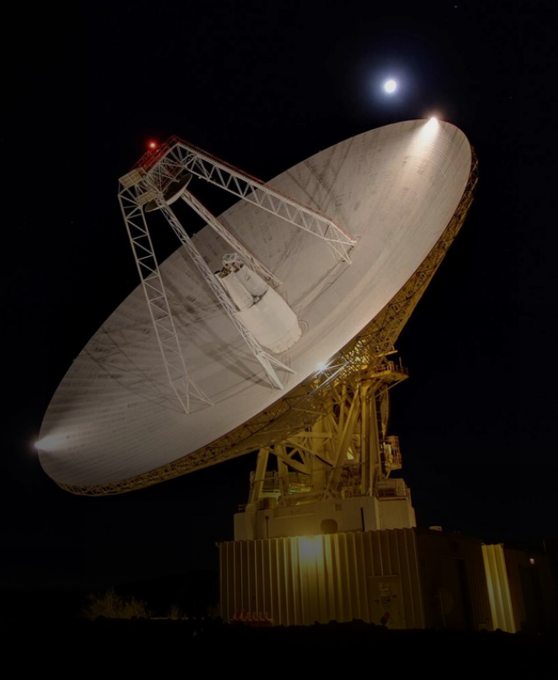
Navigation
Pre-flyby Orbit Determination
  Final pre-flyby OD (includes TCP, Sequential Ranging, DSN & ESA tracking data) indicated:
    Flyby Altitude: 406 km
    Eclipse Duration: 36.5 minutes
NASA/JPL

Slide 12
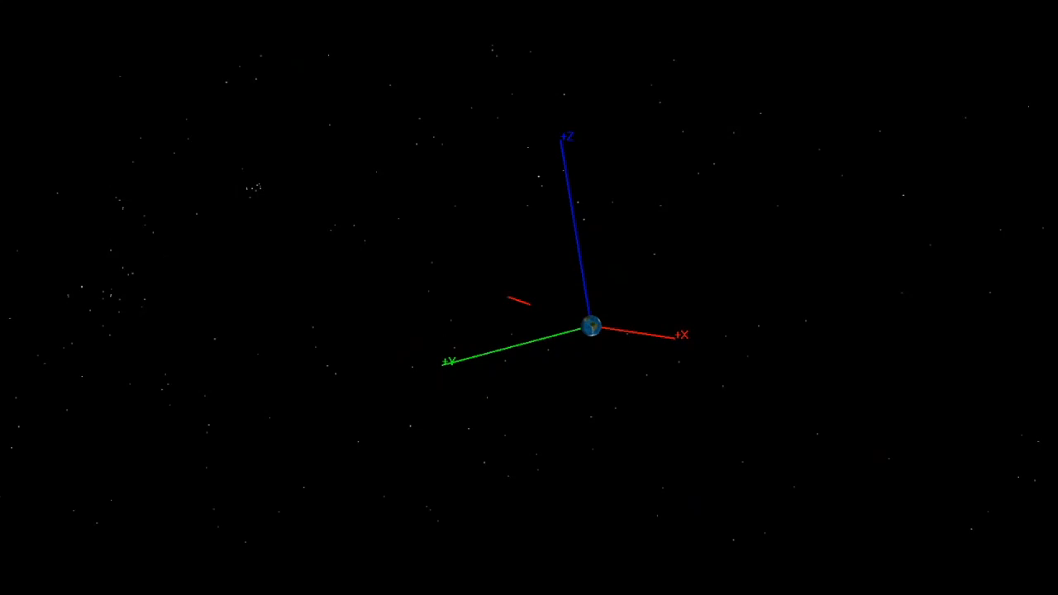
Lunar Flyby
NASA/Jose Alvarellos

Slide 13
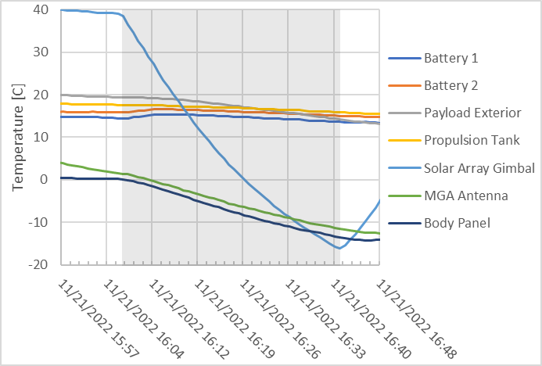
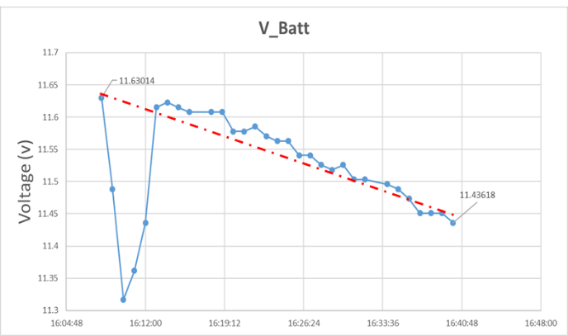
Lunar Eclipse Performance
  During the 36.5-minute eclipse payload could not drop below freezing or risk bursting fluidics
*The initial voltage dip was due to transmitter enabling.
Notes:
36.5 minutes

Slide 14
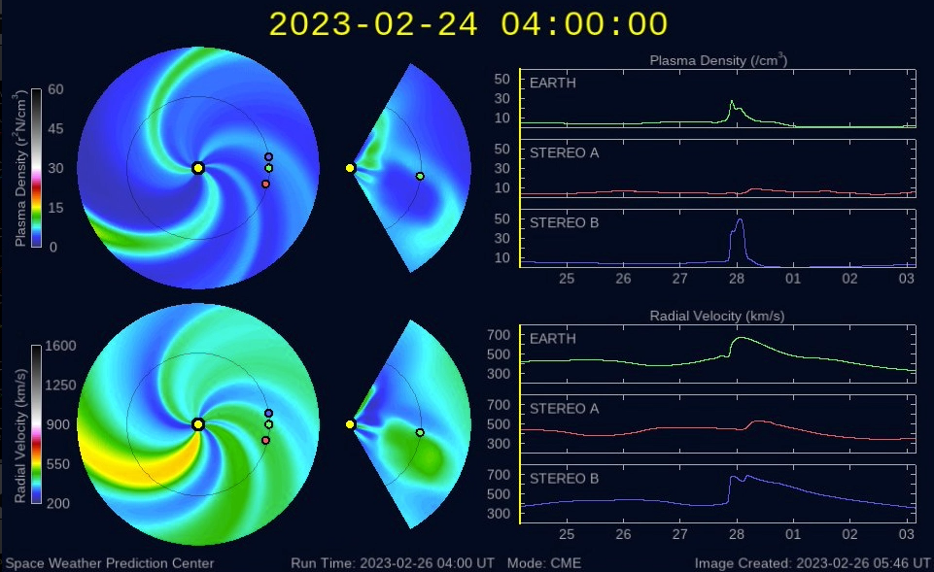
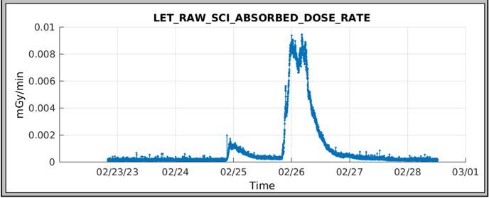
Deep Space Science Operations
  BioSensor Payload
  Performed 4 sets of biology experiments on the spacecraft. No growth observed in cell samples and similar results were observed on the ground control unit. The cell viability was affected by long exposure to increased humidity inside the BioSensor.
  The BioSensor payload technology was demonstrated in deep space and learnings will be utilized in future mission including CLPS project, LEIA.
  Linear Energy Transfer (LET) Spectrometer Payload
  Continues to gather radiation dosimetry
  Has captured solar events including coronal mass ejections
  Flux measurements from the GOES satellite (top) and BioSentinel LET spectrometer (bottom) recorded for a pair of Coronal Mass Ejection events on Feb. 24 and 25, 2023

Slide 15
Extended Mission Science
ESDMD-MCO Program Office has extended the BioSentinel Mission
Science Objectives in partnership with the JSC RadWorks team:
Characterize solar energetic particle (SEP) events, especially as we head deeper towards solar maximum. Such measurements will provide valuable information to the heliophysics community for the development of SEP models.
Provide space radiation characterization in multiple environments using the same radiation detector, including heliocentric orbit, low Earth orbit, cis-lunar space, and on the lunar surface.
Monitor galactic cosmic radiation (GCR) flux rates in a unique location while transitioning into the solar cycle maximum period.
Hardware Heritage for long durations (up to 2 years) in deep space
LET Timepix detectors ahead of future operations on Lunar Gateway and Artemis
NASA Engineering and Safety Center (NESC) EEE Cots Parts Validation for cubesat components

Slide 16

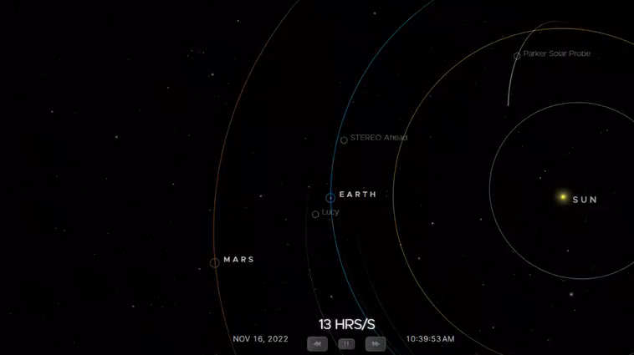
NASA/JPL

Slide 17
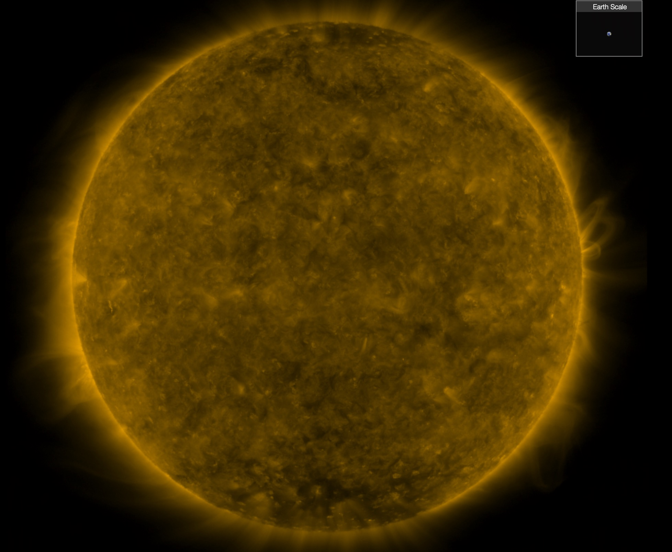
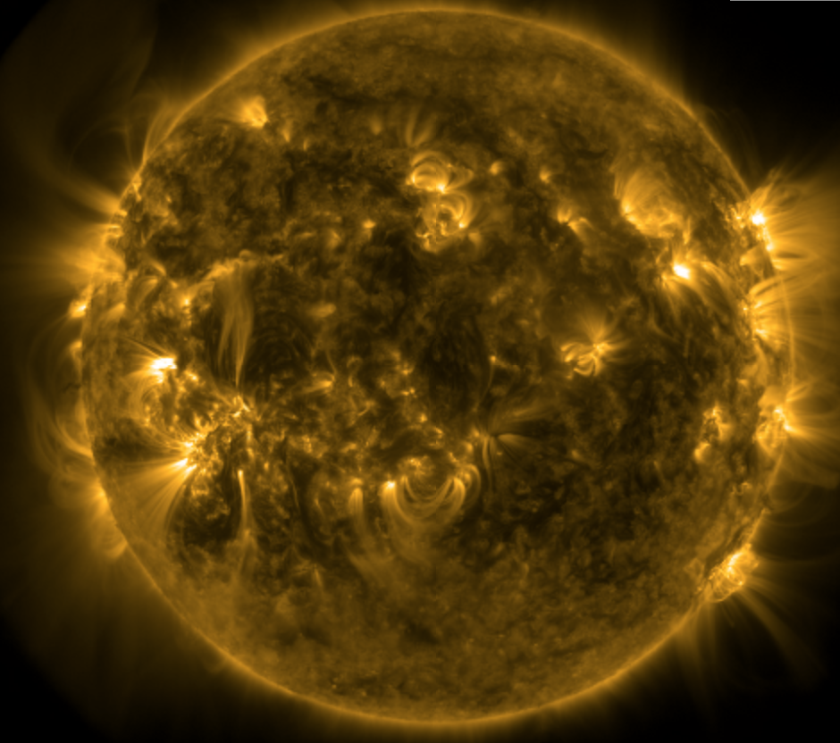
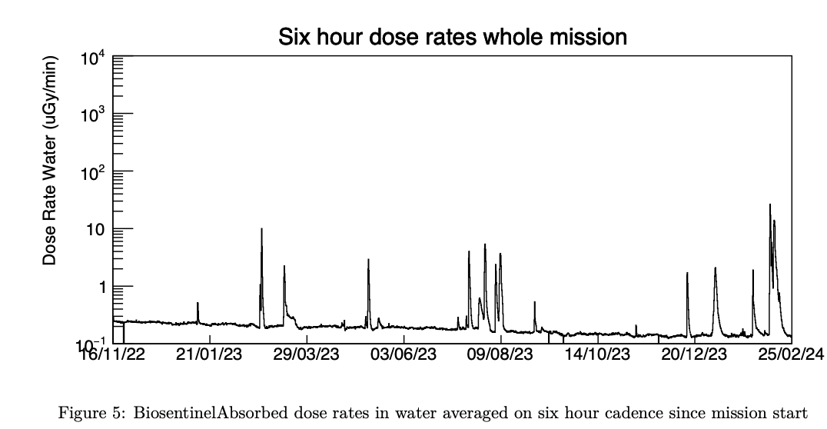
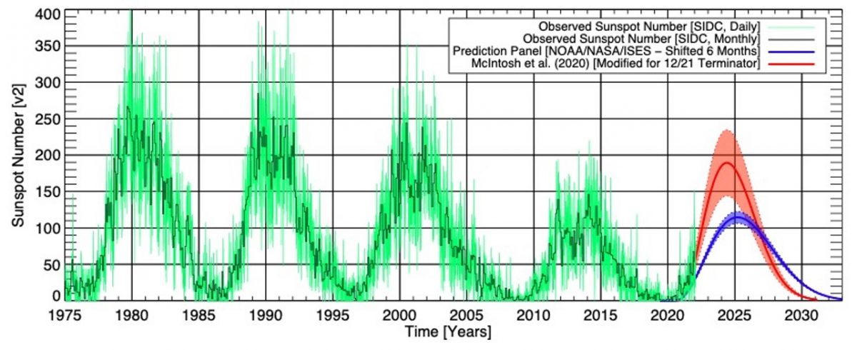
Solar Maximum
Characterize solar energetic particle (SEP) events, especially as we head deeper towards solar maximum. Such measurements will provide valuable information to the heliophysics community for the development of SEP models.
Provide space radiation characterization in multiple environments using the same radiation detector, including heliocentric orbit, low Earth orbit, cis-lunar space, and on the lunar surface.
Monitor galactic cosmic radiation (GCR) flux rates in a unique location while transitioning into the solar cycle maximum period.
Spotless Disk During Solar Min
Feb 2019 (SDO AIA Imagery, 171 nm)
~Solar Max, Feb 2024 (SDO AIA 171 nm)
  BioSentinel Flight Data
  Captured over 18 solar events
  Solar Cycles

Slide 18
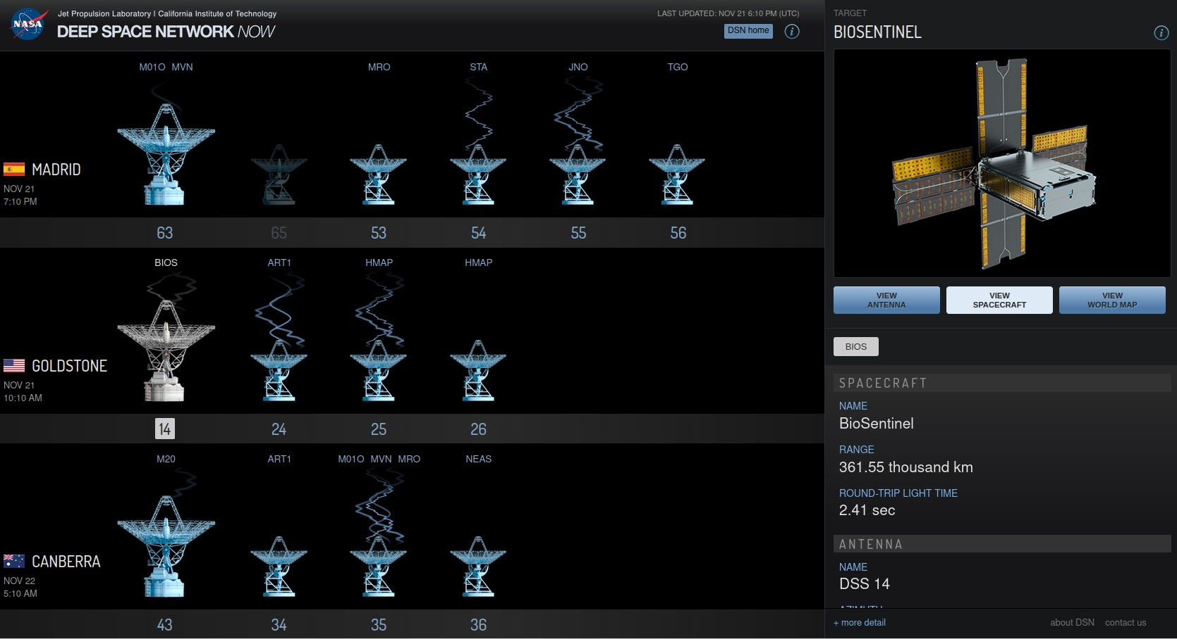
DSN Experience
DSN / ESA support
  99% successful comm passes
  NOPE and MIM have been very responsive to issues and continue to meet with team to work open issues
  Actual signal levels are ~3 dB higher than predicted for 8000 bps and 500 bps (changing) after the first few days
  BioSentinel sent out a beacon tone signal and DSS-17 (Morehead State antenna) received it.
  BioSentinel is being used as a test platform for additional DSN capabilities.
https://eyes.nasa.gov/dsn/dsn.html
Notes:
NOPE: Network Operations Project Engineer. MIM: Mission Interface Manager

Slide 19
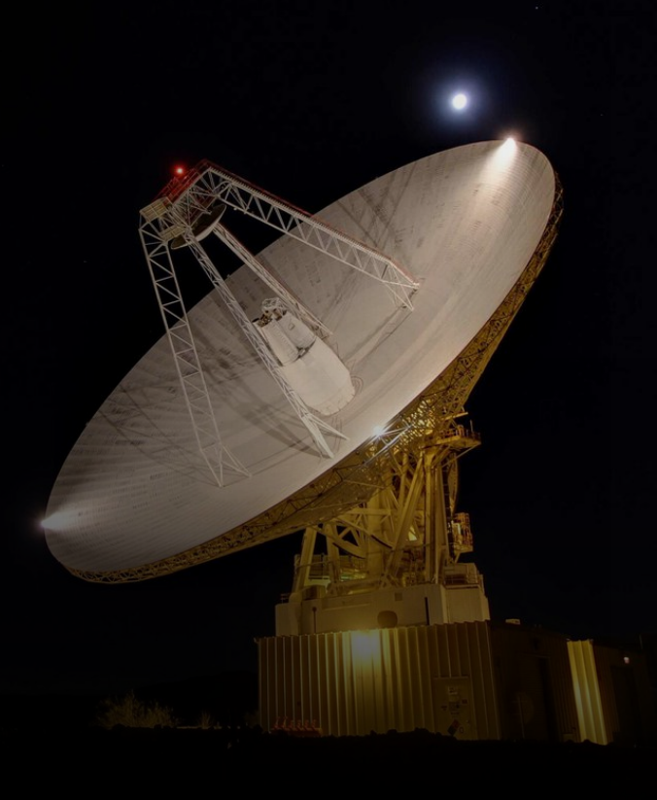
DSN Communication Performance
Requirement | Performance
DL: 8000 bps / 48 ksps | Baseline data rate. Good success. See occasional drops in BSNR with few frame drops.
DL: 1000 bps / 6 ksps | Good. For some passes, downlink signal level is significantly lower than predicts, for others nominal.
DL: 500 bps / 1 ksps | Successful locks.
DL: 62.5 bps / 125 bps | Initially unsuccessful at locking on telemetry. Configurations adjusted then checkout was nominal.
UL: 2000 bps | No issues on checkout. Intermittent dropout requires radio reboot.
UL: 1000 bps | No issues
UL: 500 bps | No issues
UL: 62.5 bps | No issues
Ranging | No issues.
Monitor Data | No issues.
As of April 2024, BioSentinel uplink is reduced to 1000 bps on the 34-m dish and continues to operate nominally. No issues have been found.
NASA/JPL

Slide 20
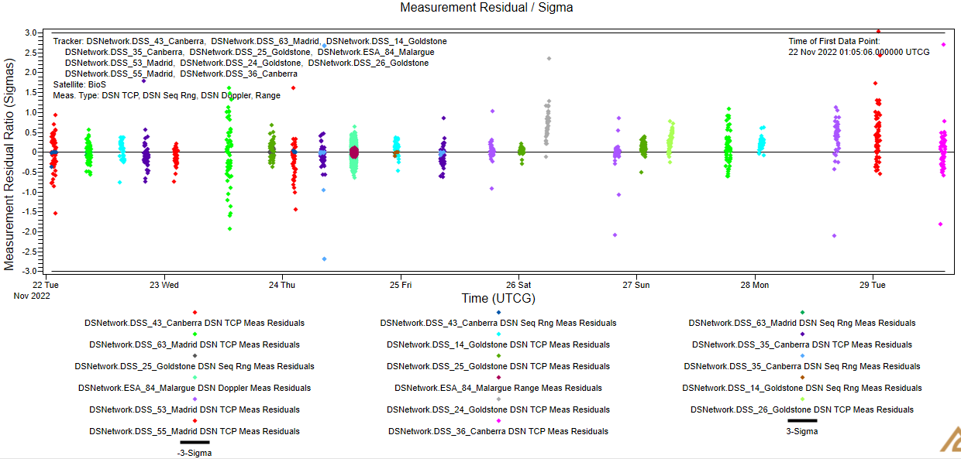
OD: Post-Flyby
  Post-flyby OD includes TCP, Sequential Ranging, Doppler tracking data
  Tracking data from both DSN & ESA stations

Slide 21
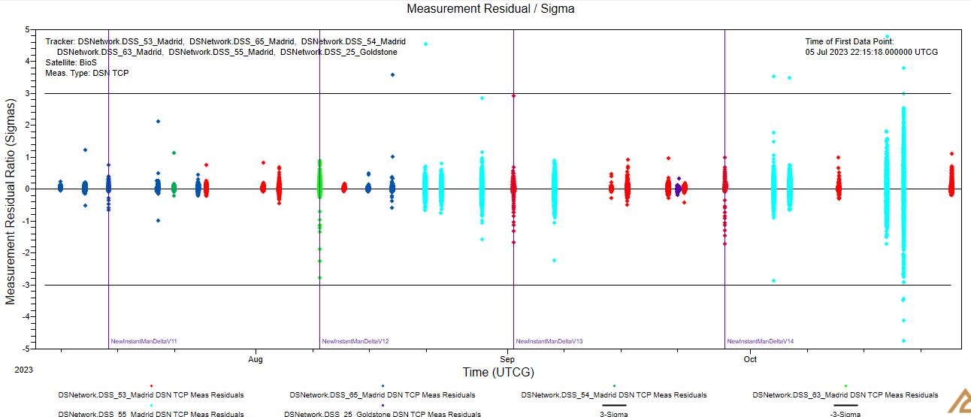
OD: Post-Flyby, Heliocentric space
  Heliocentric OD includes only TCP data from DSN
  Vertical lines represent ΔH maneuvers (10⁻⁴ < ΔV < 10⁻³ m/s)
  Current semi-major axis (May 2024) is 1.019 AU
  Earth-trailing orbit
Notes:
TCP: Total Count Phase

Slide 22
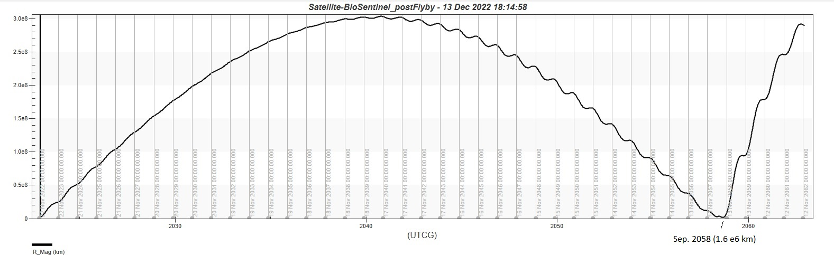
Distance to Earth (long-term)
Max. distance ~300e6 km in 2041
Min. distance post-flyby ~1.6e6 km in 2058!
The current (as of May 2024) semi-major axis is about 1.019 AU

Slide 23
Mission Summary
Successfully operating for over a year
  Completed the science phase and currently in extended mission
  About 40 million km from Earth (as of May 2024) with no mission ending anomalies
  LET radiation detector still collecting valuable science data
All subsystems are in good shape
  ADCS has performed fabulously – high performance, no errors
  Prop system has overcome some issues but maintains very high propellant margins (94% remain!)
  FSW/CDH had some early hiccups, but has stabilized with a patch applied to fix most bugs
    No unexplained or radiation-drive processor reset
  EPS has incurred no anomalies from deep-space environment
    Excellent performance through 34min eclipse
    SA and Batteries show better than predicted degradation over time, maintaining large margins
  Comm subsystem has operated as expected
    Downlinked >24,000 files (50/50 payload/bus)
    Link margins supporting highest data rates w/ MGA
    Supported DSN beacon tone test
    Thermal constraints limit transmitter on time to 3hrs
NASA

Slide 24
Conclusions
  Stable heliocentric orbit. Orbit determination is performed every two weeks.
  BioSentinel is surviving during solar maximum (the highest solar activity since 2017)
  Very good performance of the IRIS radio over a year and a half of operation (up to 38 million km).
  DSN /ESA support has exceeded expectations.
  Currently working on a Mission Extension to study Deep Space Radiation.
  We plan to continue the mission at least until the end of 2024, hopefully beyond.

Slide 25
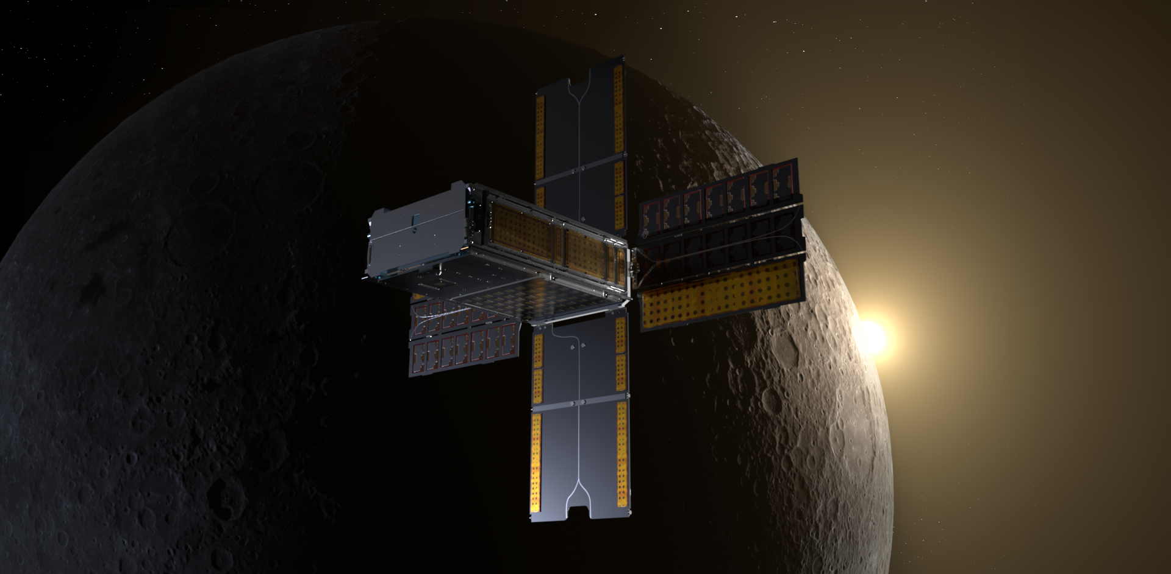
Thank you!
NASA/Daniel Rutter

Slide 26
Backup slides

Slide 27
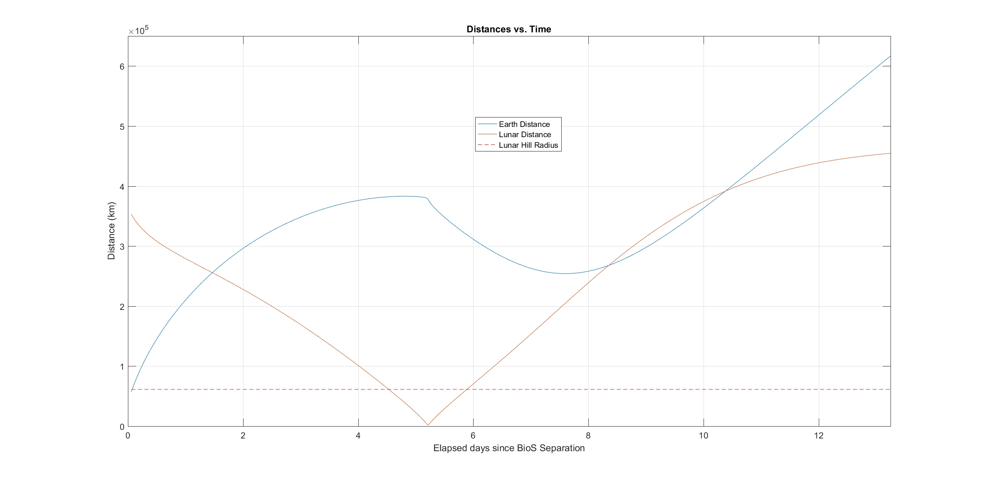
Distances to Earth and Moon (short-term)
Distance to Earth (blue curve) and Moon (red curve) vs. time since BioSentinel deployment
  The horizontal dashed red line at bottom represents the lunar Hill sphere radius
Min. post-flyby distance to Earth 254,000 km
Flyby
21-Nov-2022, 15:40:39 UTC
Notes:
Almost 2 days inside lunar Hill sphere

Slide 28
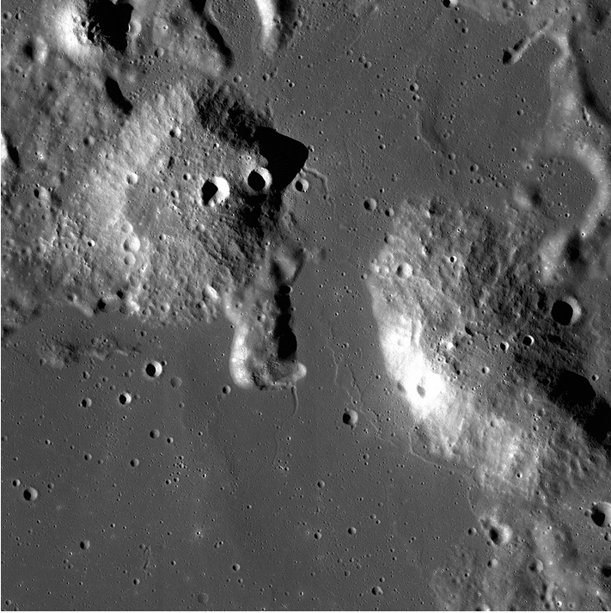
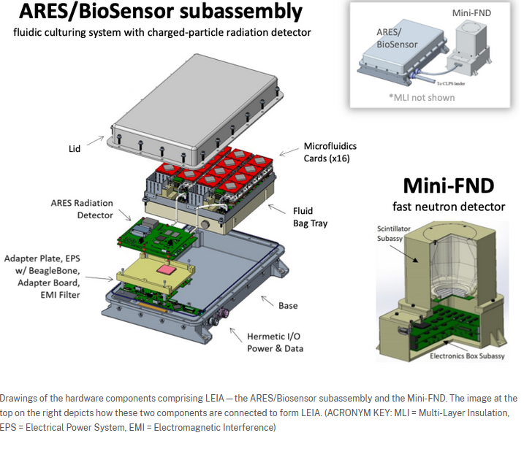
What’s Next…
Lunar Explorer Instrument for space biology Applications (LEIA)
Credits: NASA/GSFC/Arizona State University

