Slide 1




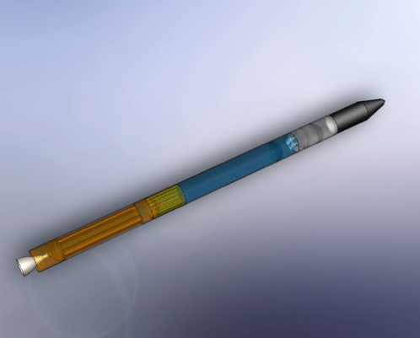
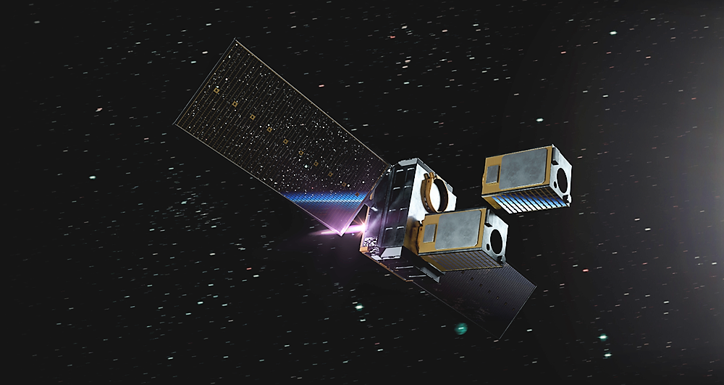
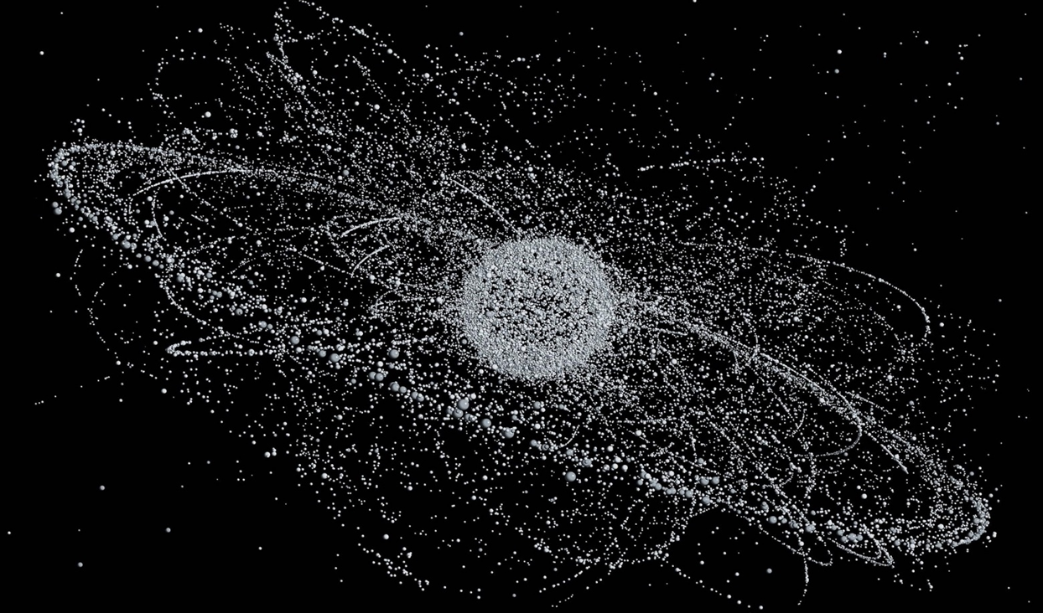
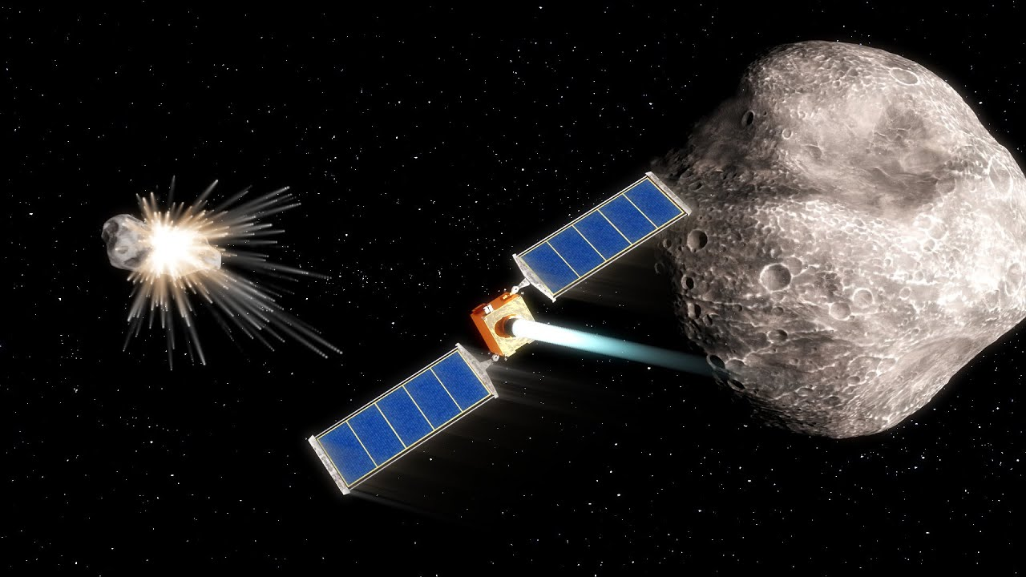
Space Debris Mitigation: Cloud Interceptor Method
Jared Bartunek, Gaddiel González Mejías, Dr. Greg Ogden
Department of Chemical & Environmental Engineering
University of Arizona

Slide 2
Presentation Outline
Motivation
  Where we fit in
Objective
Method
Analysis/Results
Discussion
Challenges
Future Plans

Slide 3
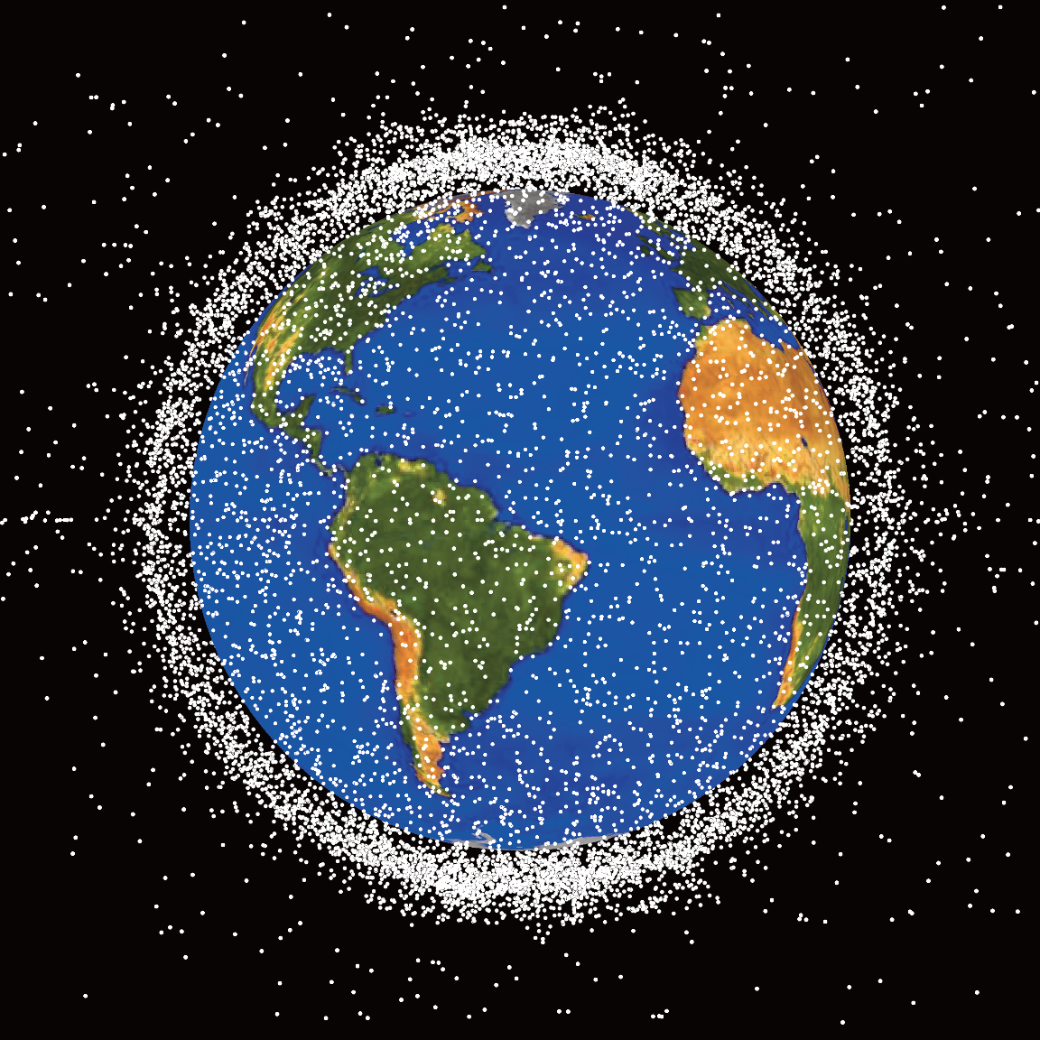
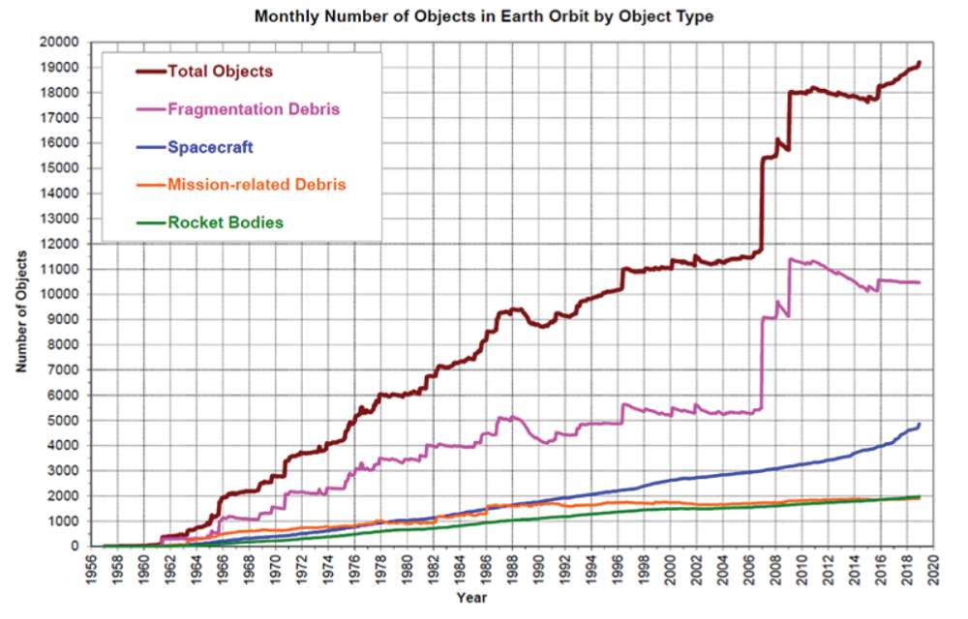
Big Picture - Motivation
Existing problem since 1957
Exponentially increasing
Accumulation could lead to the Kessler Syndrome
Reesman, 2021

Slide 4
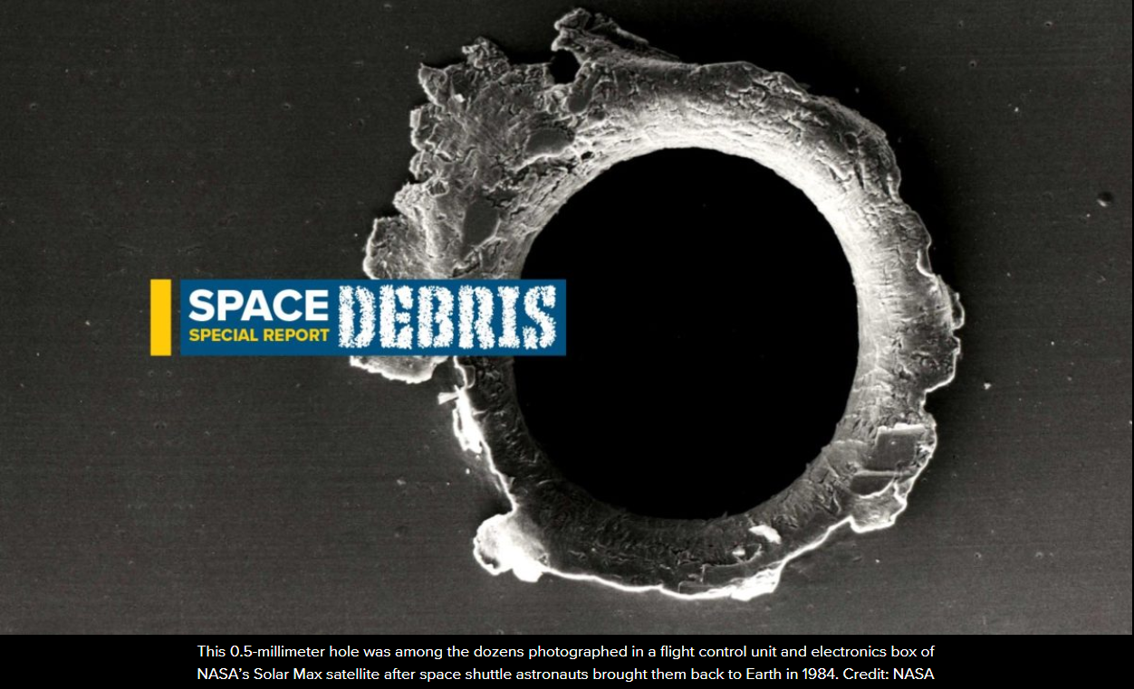
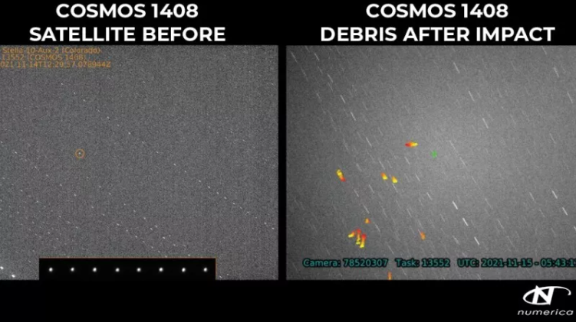
Recent News Headlines
O’Callaghan, 2022 Gohd, 2021

Slide 5
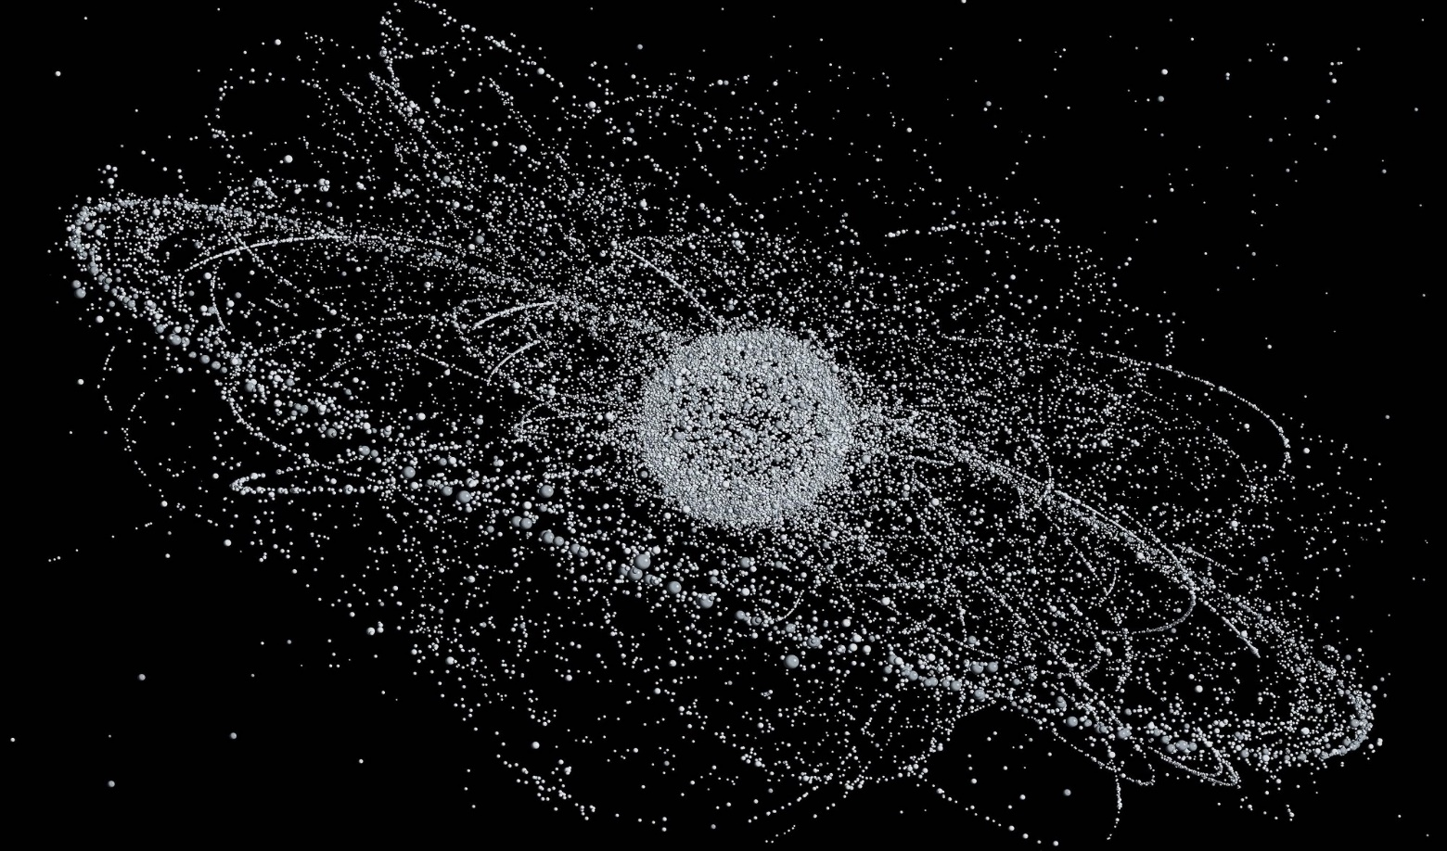
Visualizing Space Debris
Visualization of space debris in 2012. (Michael Najjar, 2012)

Slide 6
Proposed Solution – Cloud Interceptor Method
We are proposing a cloud interceptor to deorbit large pieces of debris
Through contact with the material cloud, the orbital mechanics of the debris will be altered enough to deorbit it through atmospheric contact

Slide 7
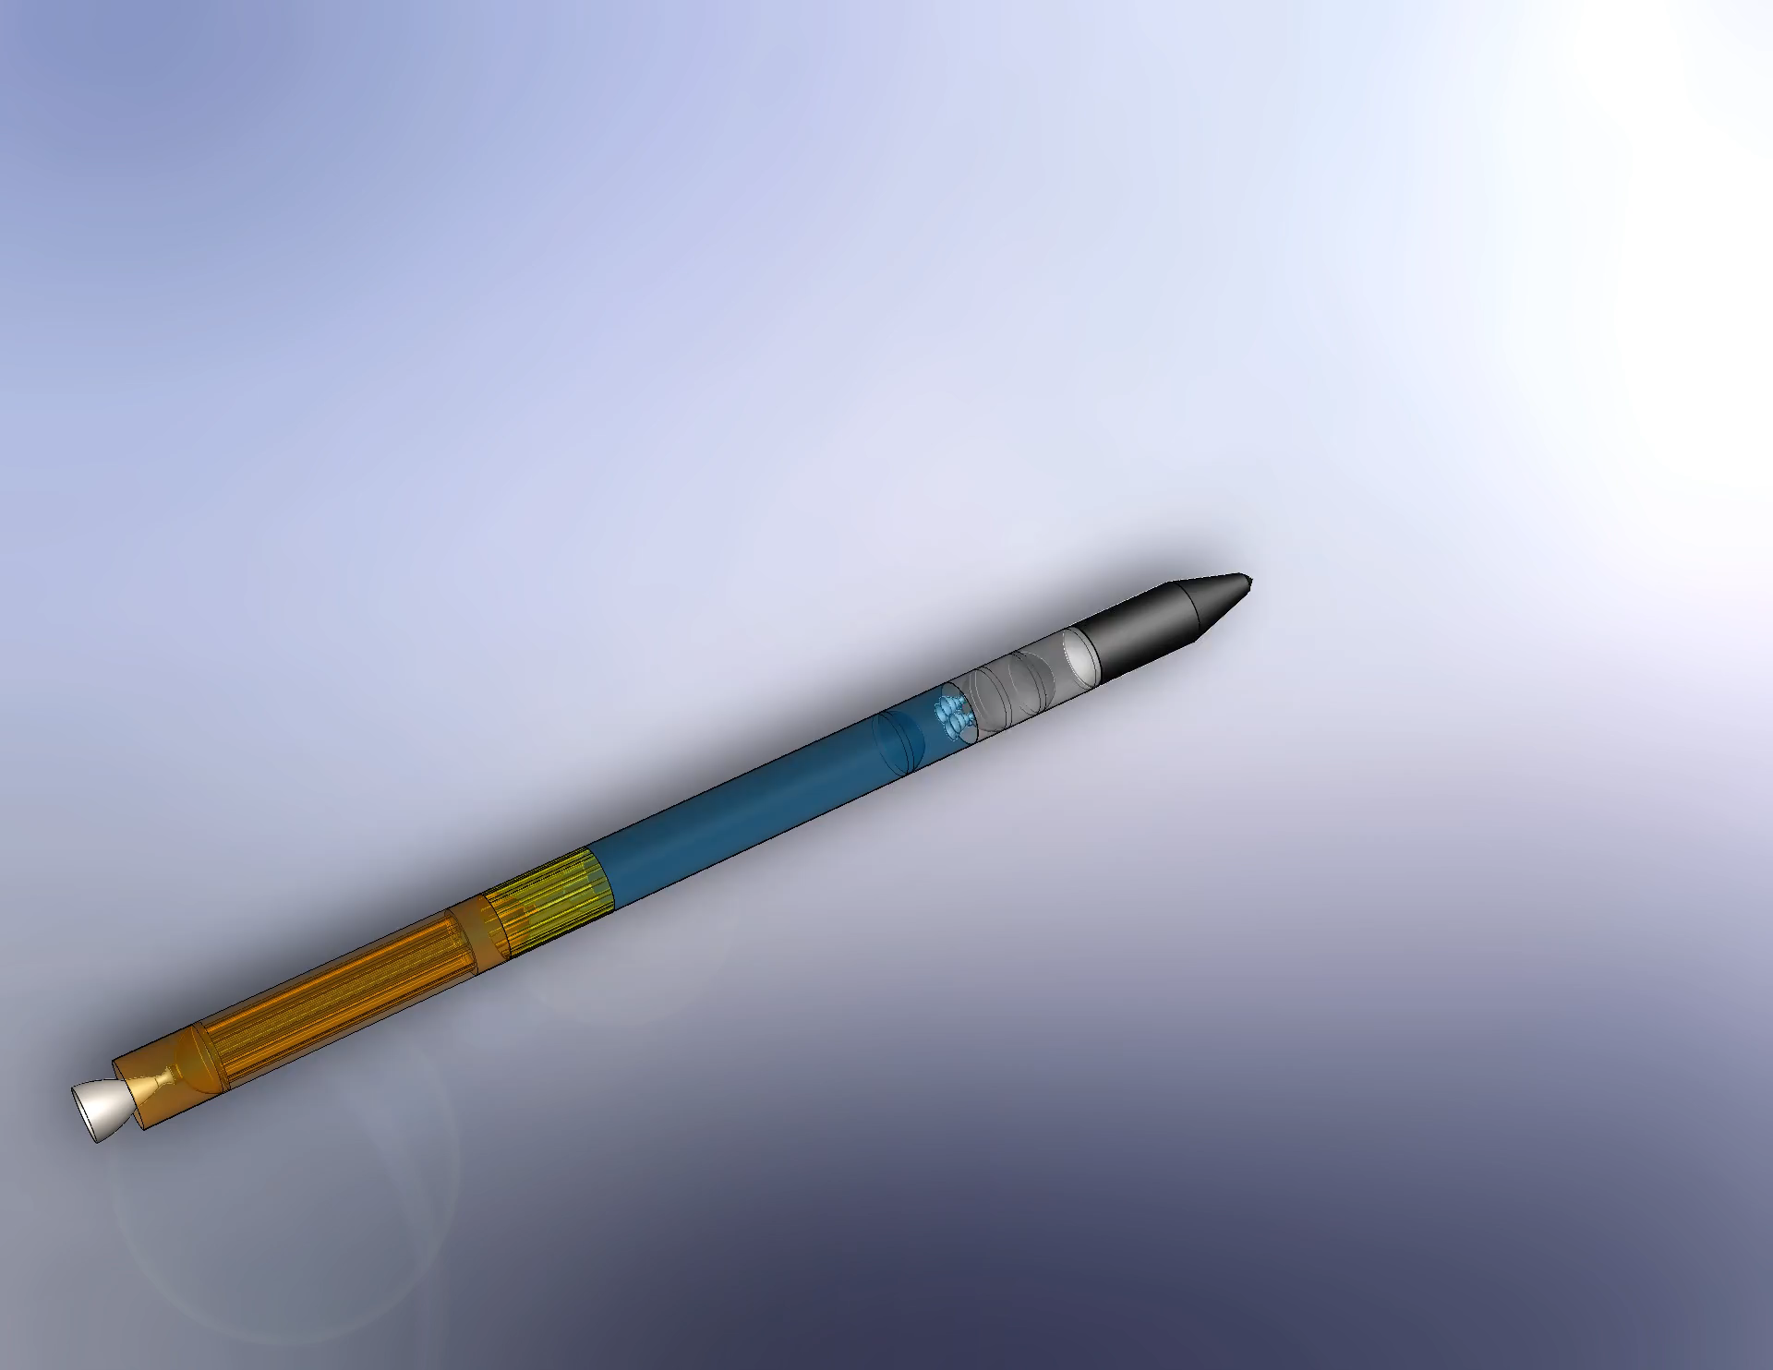
R3 Rocket Assembly
Consisting of:
  First stage solid rocket motor
  Support ring
  First stage LOX fuel tank
  Second stage fuel tank
  Second stage booster
  Nose cone

Slide 8
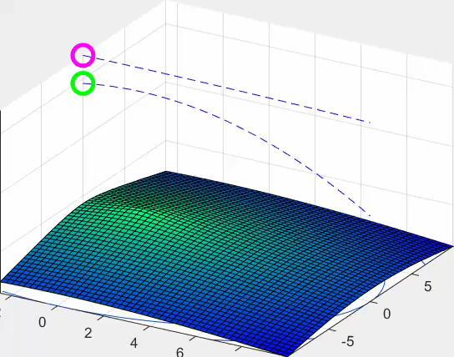
Objectives – Con Ops
Track debris using open-source software
Determine threat level
Launch rocket from TX
Deploy second stage and spray material cloud
Intercept debris with cloud and deorbit
Recover rocket bodies in Gulf of Mexico
First Stage
Second Stage / Interceptor
Debris

Slide 9
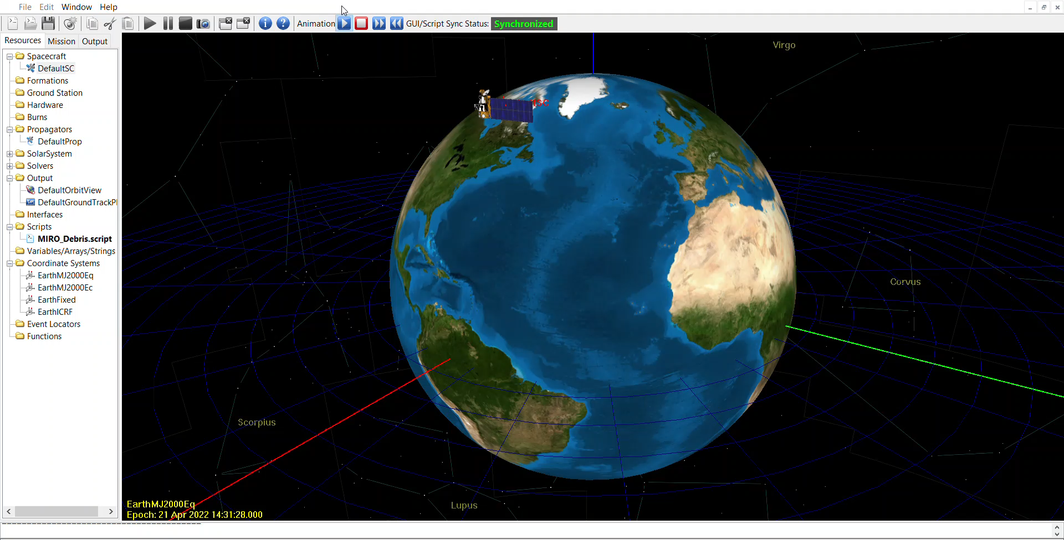
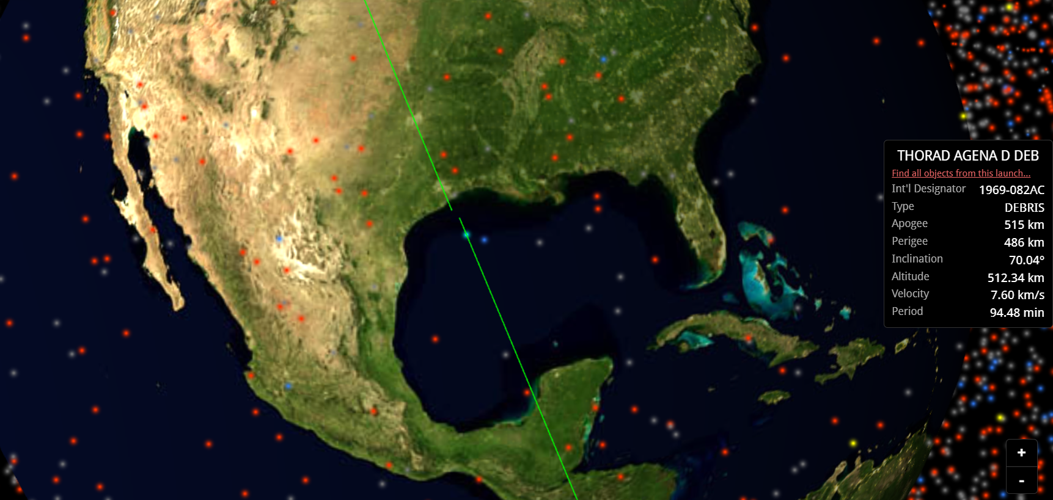
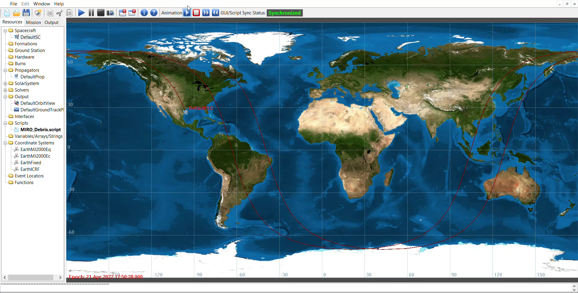
Debris Path Modeling
Debris trajectory can be modeled from parameters taken from free tracking sources

Slide 10
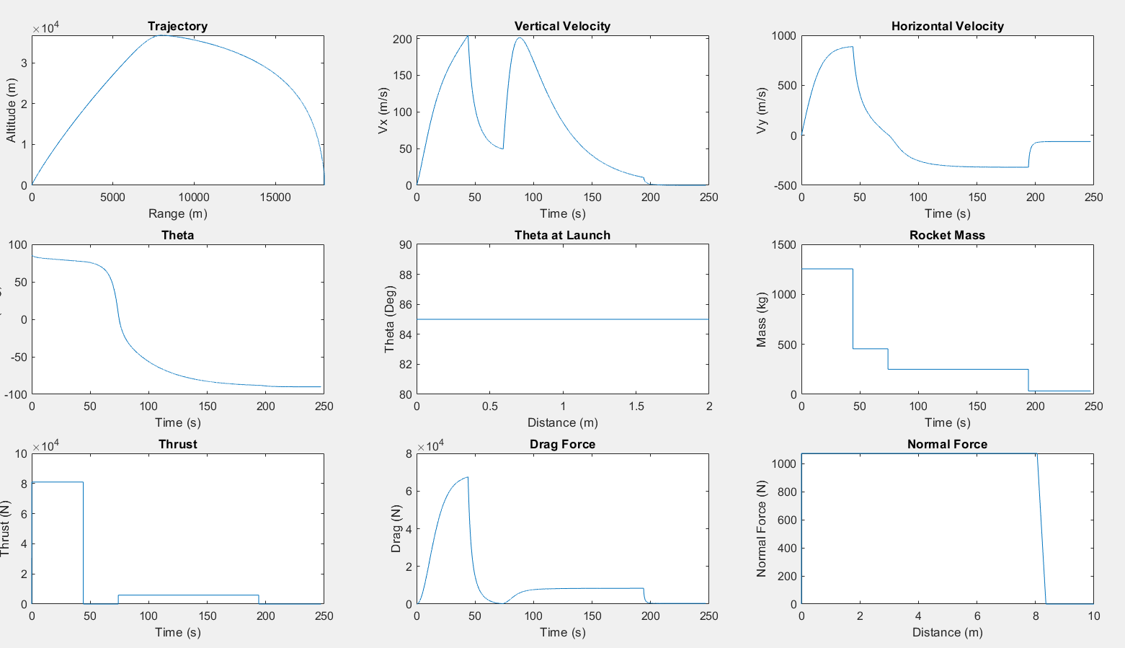
Trajectory Modeling
Preliminary modeling for the two-stage interceptor rocket
Shows two distinct burns and loss of boosters

Slide 11
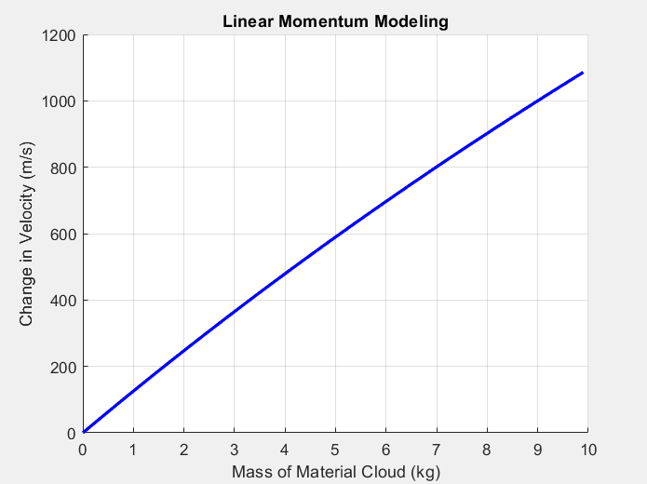
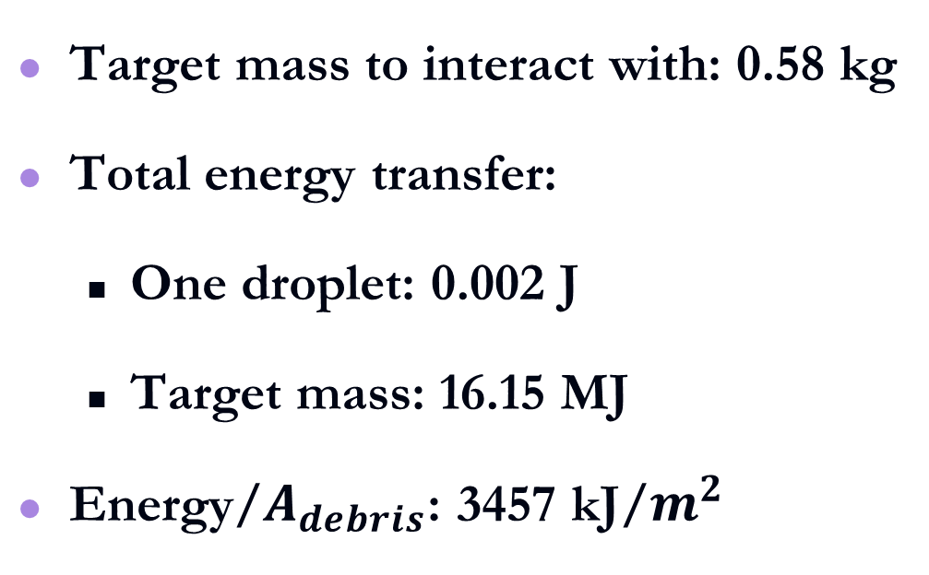
Results
Target mass to interact with: 0.58 kg
Total energy transfer:
  One droplet: 0.002 J
  Target mass: 16.15 MJ
Energy/$A_{debris}$: 3457 kJ/$m^{2}$

Slide 12
Challenges
Being in Puerto Rico
  Not being able to work as a team in person
Accessing high-fidelity software
Field is constantly changing

Slide 13
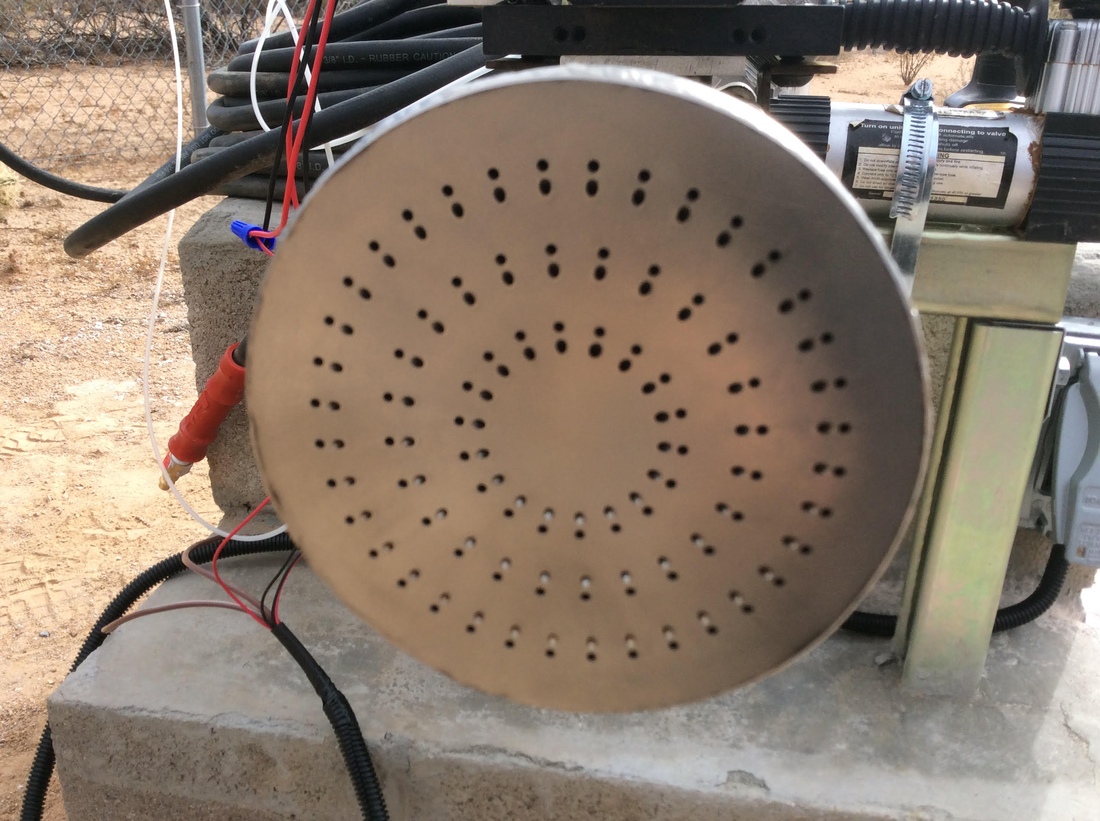
Future Plans
Simulate the nozzle flow and resulting cloud shape
Working to increase capability between trajectory simulations
Write white paper

Slide 14
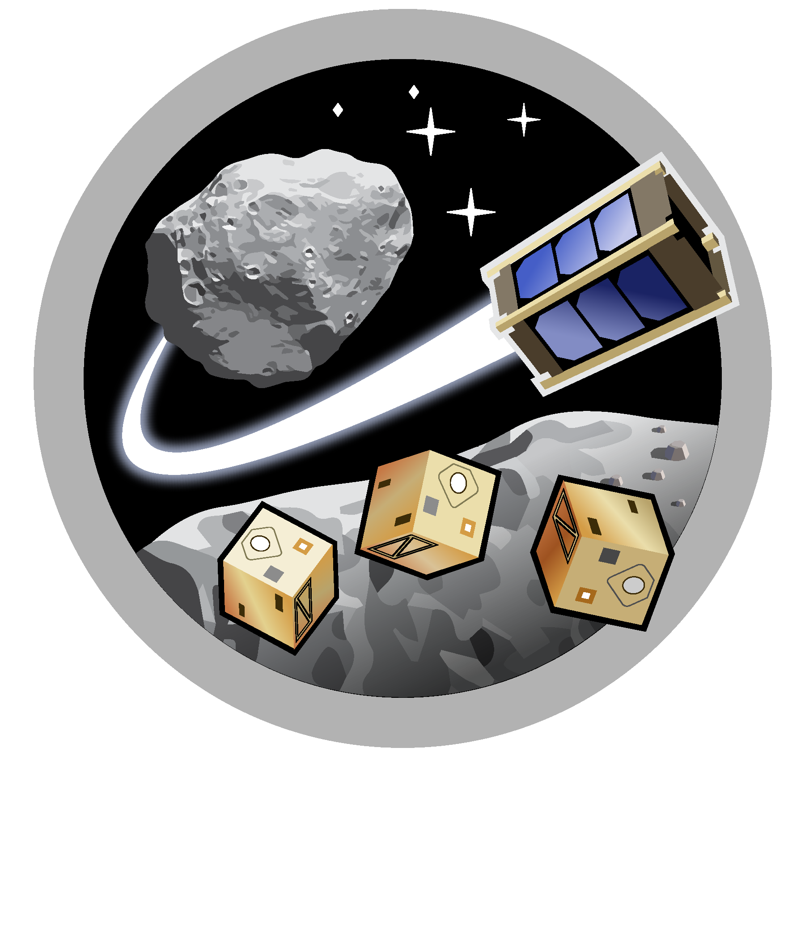
Questions?
Asteroid Science, Technology and Exploration Research Organized
by Inclusive eDucation (ASTEROID) Center

Slide 15
References
“About Space Debris.” ESA, https://www.esa.int/Safety_Security/Space_Debris/About_space_debris.
Al Jazeera. “Space Debris: The Rubbish You Didn't See Coming.” Space News | Al Jazeera, Al Jazeera, 21 Nov. 2021, https://www.aljazeera.com/podcasts/2021/11/20/space-debris-the-trash-you-didnt-see-coming.
Amos, Paul Rincon & Jonathan. “Russian Anti-Satellite Test Adds to Worsening Problem of Space Debris.” BBC News, BBC, 16 Nov. 2021, https://www.bbc.com/news/science-environment-59307862.
“Classification of Artificial Space Debris.” Space Debris - A Guide, https://www.spaceacademy.net.au/watch/debris/gsd/gsd.htm#class.
Ganguli, Gurudas, et al. A Concept For Elimination Of Small Orbital Debris. https://arxiv.org/ftp/arxiv/papers/1104/1104.1401.pdf.
Garcia, Mark. “Space Debris and Human Spacecraft.” NASA, NASA, 14 Apr. 2015, https://www.nasa.gov/mission_pages/station/news/orbital_debris.html.
“General Mission Analysis Tool (GMAT) User Guide.” General Mission Analysis Tool (GMAT), http://gmat.sourceforge.net/docs/R2020a/html/index.html.
Gohd, Chelsea. “Russian Anti-Satellite Missile Test Was the First of Its Kind.” Space.com, Space, 17 Nov. 2021, https://www.space.com/russia-anti-satellite-missile-test-first-of-its-kind.
Johnson, Michael. “Sensor to Monitor Orbital Debris Outside Space Station.” NASA, NASA, 12 Dec. 2017, https://www.nasa.gov/mission_pages/station/research/news/sensor_to_monitor_orbital_debris_outside_ISS.
Liou, J.C. Engineering and Technology Challenges for Active Debris Removal. https://www.eucass-proceedings.eu/articles/eucass/pdf/2013/01/eucass4p735.pdf.
“A Model of the Space Debris Environment.” Joint Air Power Competence Centre, 5 July 2016, https://www.japcc.org/model-space-debris-environment/.
NASA’S EFFORTS TO MITIGATE THE RISKS POSED BY ORBITAL DEBRIS. 2021, https://oig.nasa.gov/docs/IG-21-011.pdf.
O'Callaghan, Jonathan. “Hope for Solving Space Debris.” Aerospace America, 4 Apr. 2022, https://aerospaceamerica.aiaa.org/features/hope-for-solving-space-debris/.
Orbital Debris - Quarterly News - Vol.24 Issue 1. https://orbitaldebris.jsc.nasa.gov/quarterly-news/pdfs/odqnv24i1.pdf.
Reesman, Rebecca, et al. “Slash the Trash: Incentivizing Deorbit.” Journal of Space Safety Engineering, Elsevier, 2 June 2021, https://www.sciencedirect.com/science/article/abs/pii/S2468896721000410.
“Space Debris by the Numbers.” ESA, https://www.esa.int/Safety_Security/Space_Debris/Space_debris_by_the_numbers.
“Space Debris: The Trash You Didn't See Coming - the Take.” Enterprise Podcasting Made Simple - Omny.fm, https://omny.fm/shows/the-take/space-debris-the-trash-you-didn-t-see-coming.

