Slide 1
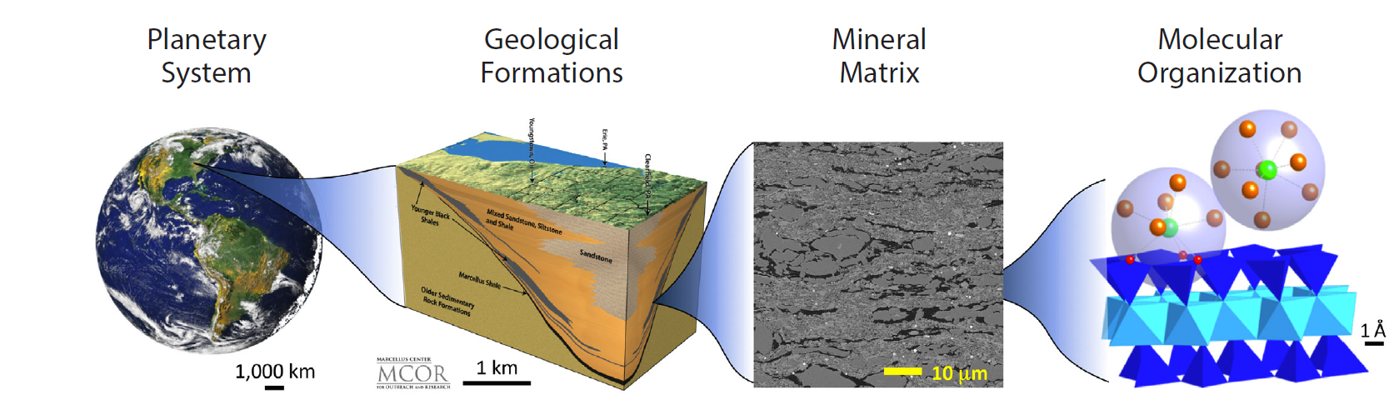
XPLAin: Compact, rapid elemental, mineralogical, and textural analysis of unprepared samples
Interplanetary Small Satellite Conference
Pamela Clark, Przemyslaw Dera, Daniel Scheld and Christopher Dreyer
May 3, 2022

Slide 2


Earth is a complex and dynamic system.
Major geologic events have significant effect on the human civilization.
Human activity can significantly affect the stability of the Earth system in the long run and require geological resources, which form in the interior.
Understating of the structure, composition and properties of the Earth interior offers us a better chance to live in harmony with our planet (e.g. geo-hazards, mineral resources, etc.).
?

Slide 3
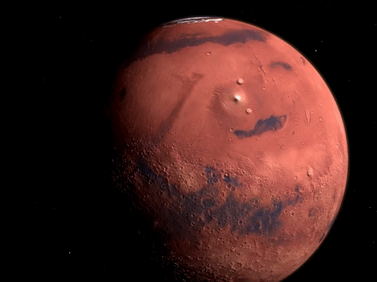
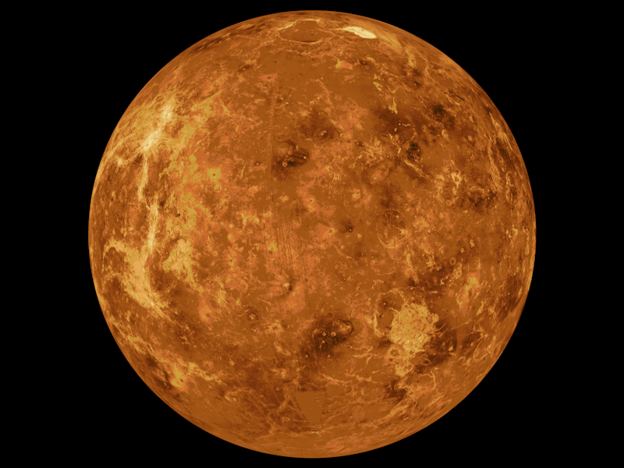
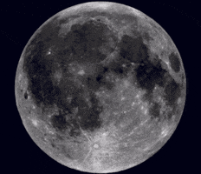
Motivation for understanding planetary mineralogy
Geologic history
Colonization resources
Natural hazards

Slide 4
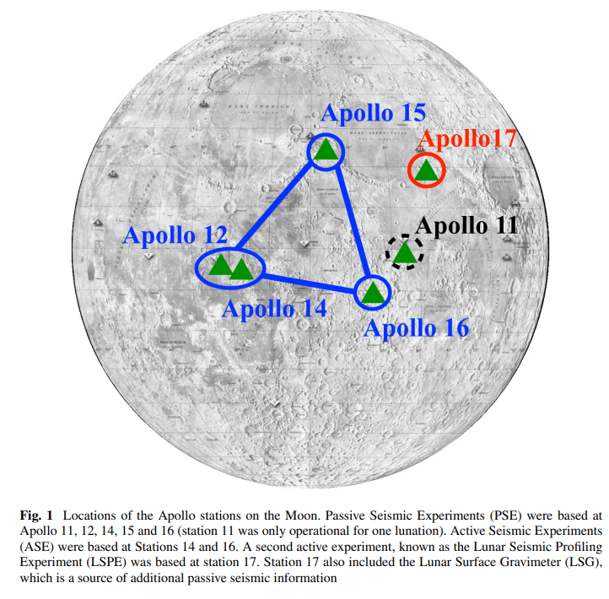
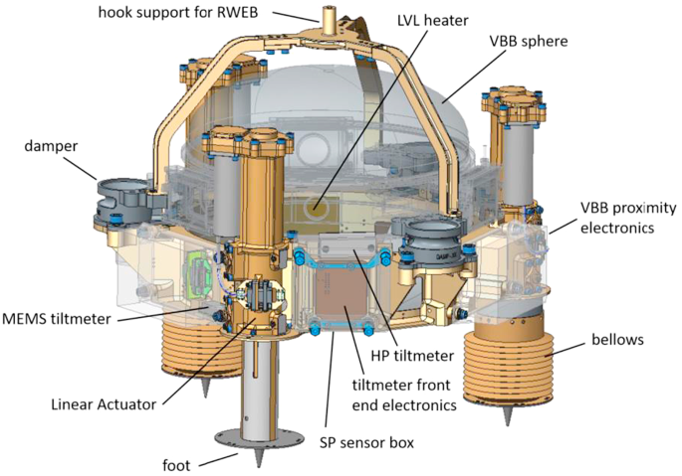
The Apollo Lunar Surface Experiment Packages (ALSEPs) were a unique series of in-situ geophysical experiments, which included seismic experiments. No seismic observations have been performed on the Moon since Apollo. The experiments included the Passive Seismic Experiment (PSE), the Active Seismic Experiment (ASE), and the Lunar Surface Profiling Experiment (LSPE). For decades, these data have been used to investigate the internal structure of the Moon
NASA's InSight spacecraft touched down Nov. 26, 2018, on Mars to study the planet's deep interior. A little more than one Martian year later, the stationary lander has detected more than 480 quakes and collected the most comprehensive weather data of any surface mission sent to Mars.

Slide 5
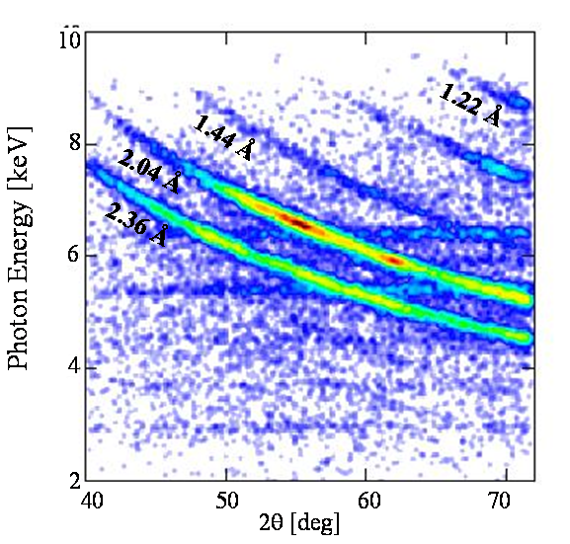
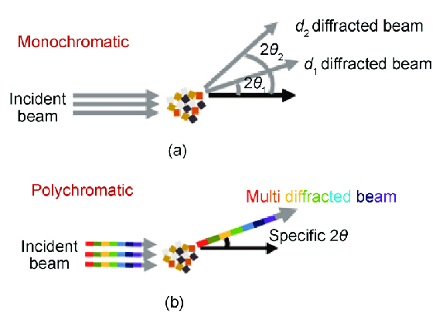
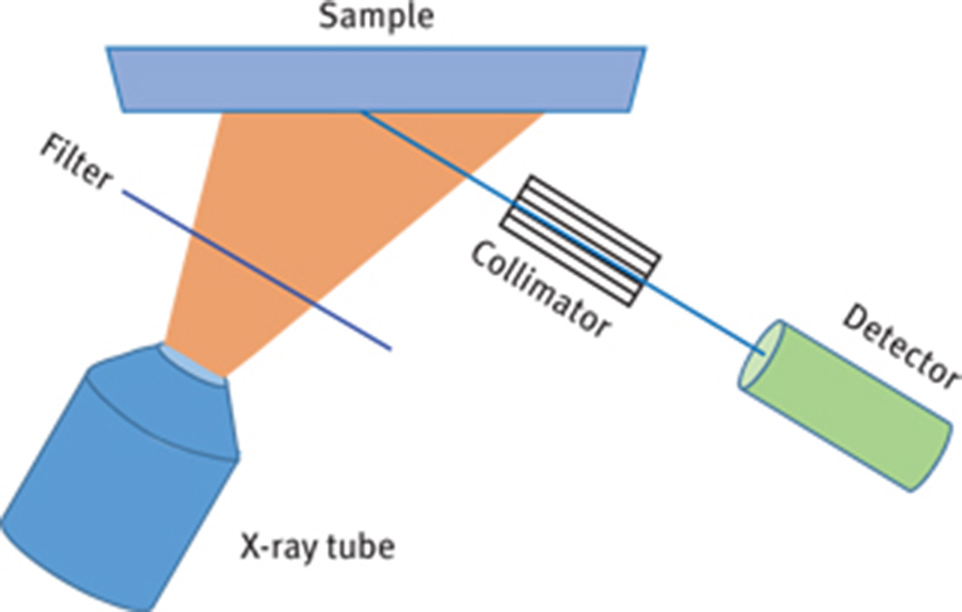
XRD
XRF
Each mineral phase contributes a set of diffraction peaks
Bulk phase composition can be refined by refining phase fraction
Signal has a geometric distribution (directional peaks or cones of radiation)
Peak intensities are sensitive to elemental composition
Each element contributes a set of peaks
Signal is isotropic
There is no information about crystal structure
Emission lines of light elements (below Al) are very difficult to detect

Slide 6
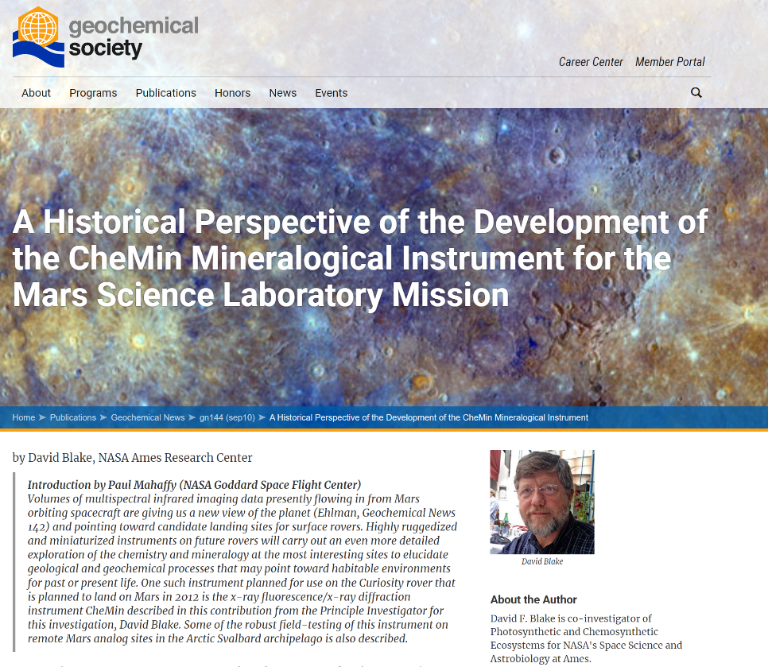
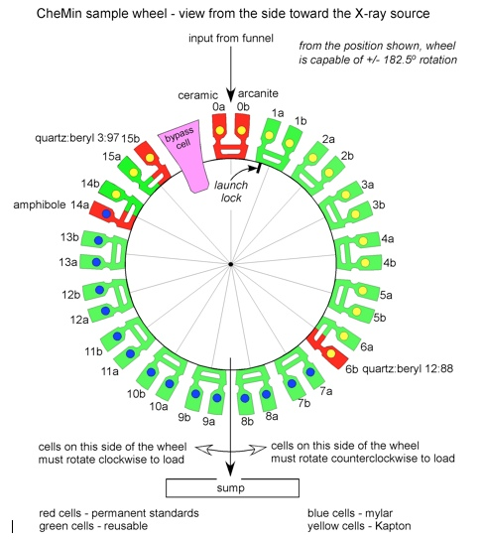
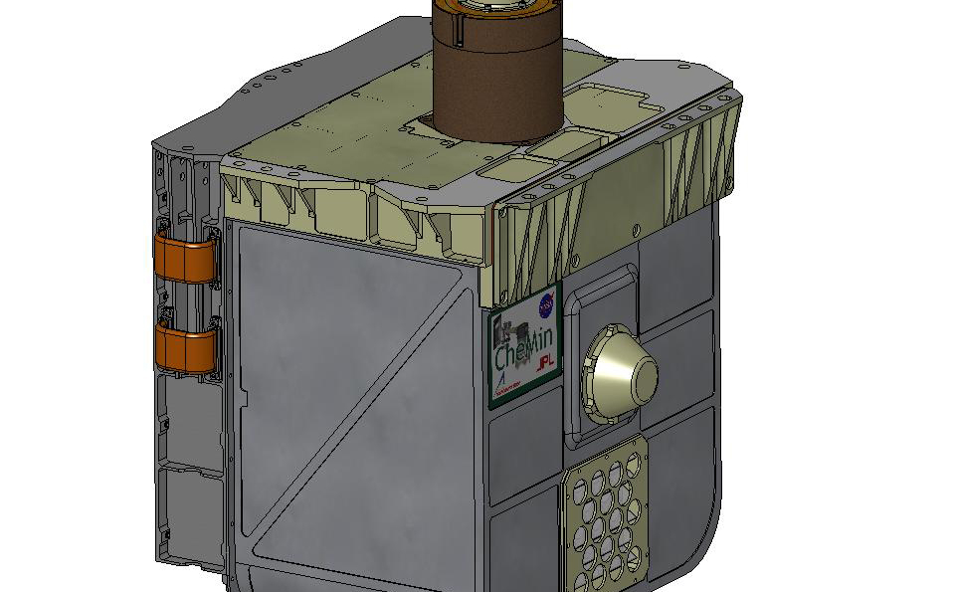
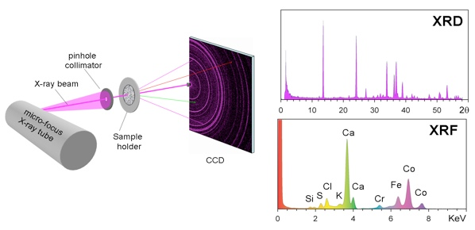
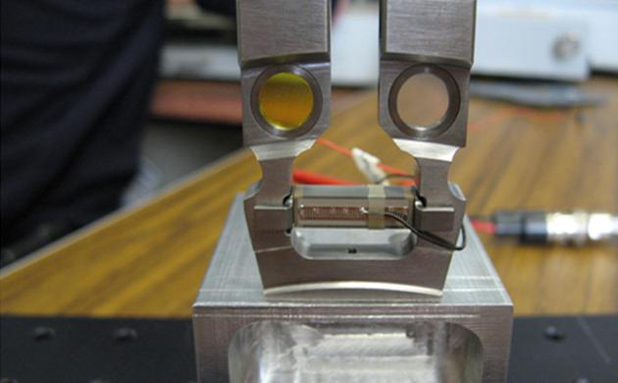
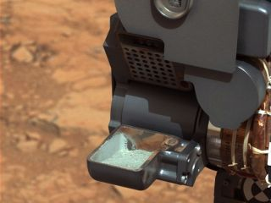
CheMin
https://mars.nasa.gov/msl/spacecraft/instruments/chemin/for-scientists/
The first sample of powdered rock extracted by the Curiosity rover's drill. The image was obtained by Curiosity's Mast Camera on Feb. 20, or Sol 193, Curiosity's 193rd Martian day of operations. (Image credit: NASA/JPL-Caltech/MSSS) ttps://www.space.com/20182-ancient-mars-microbes-curiosity-rover.html

Slide 7
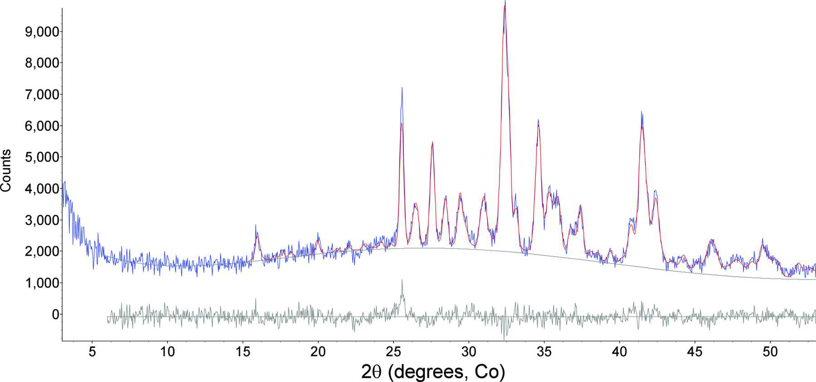
CheMin data
Plagioclase | 22 | 22
Fe-forsterite | 3 | 1
Augite | 4 | 4
Pigeonite | 6 | 8
Orthopyroxene | 3 | 4
Magnetite | 4 | 4
Anhydrite | 3 | 1
Bassanite | 1 | 1
Sanidine | 1 | 2
Quartz | 0.4† | 0.1†
Hematite | 0.6† | 1
Ilmenite |  | 0.5†
Akaganeite | 1 | 2
Pyrite | 0.3†
Pyrrhotite | 1 | 1
Phyllosilicate | 22 | 18
Amorphous | 28 | 31
Bish et al. (2014) IUCrJ 1, 514-522

Slide 8
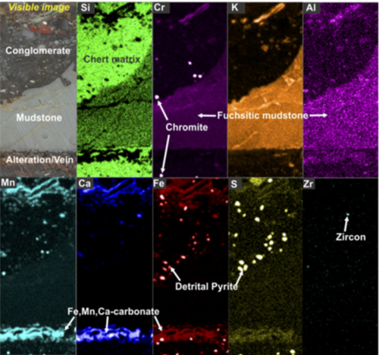
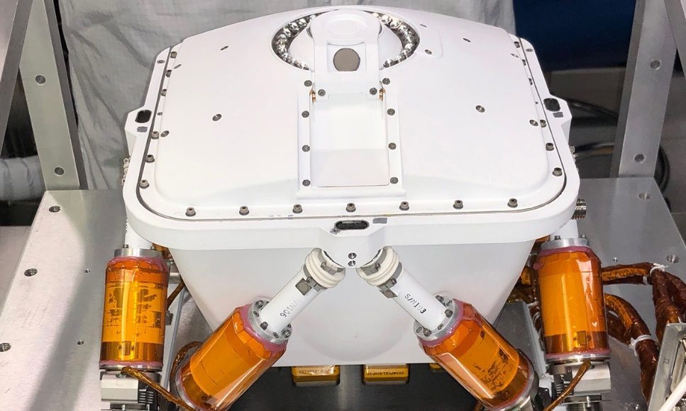
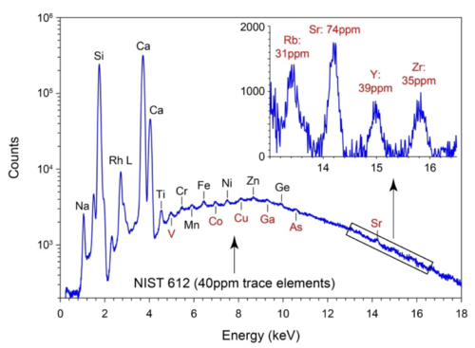
NASA PIXL:(Planetary Instrument for X-ray Lithochemistry)
https://mars.nasa.gov/mars2020/spacecraft/instruments/pixl/for-scientists/

Slide 9
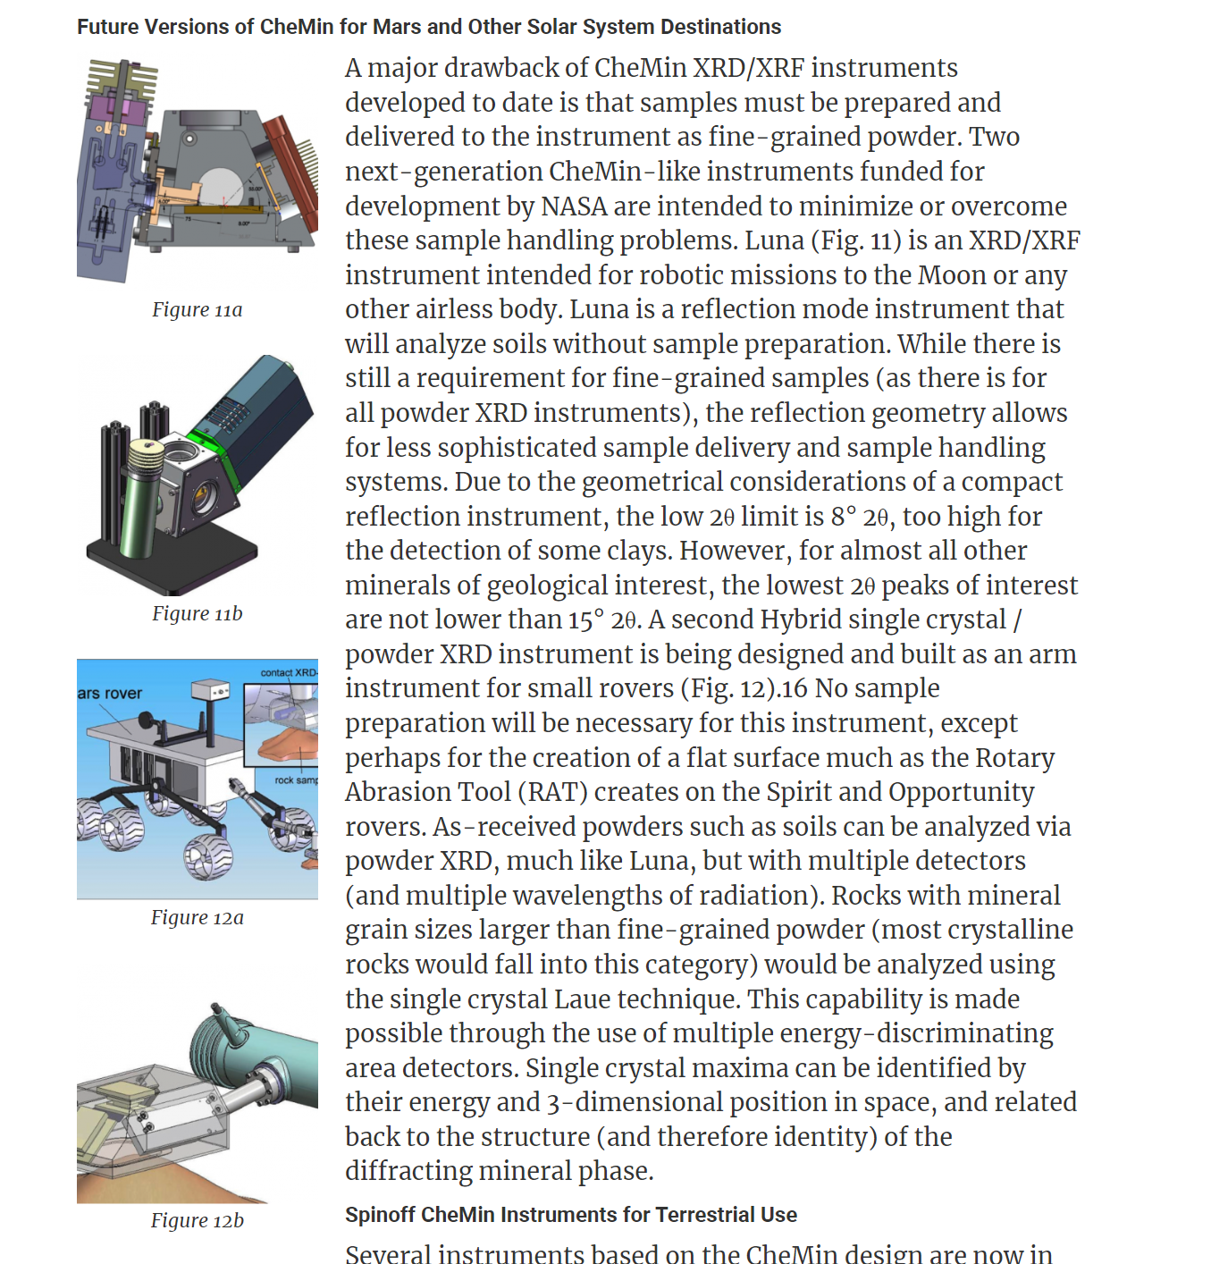
CheMin –type instrument challenges
Sample processing-induced alterations
  Different phases grind with different ease
  Mesh filtration can significant alter phase fractions (different phases have different grain sizes)
  Mechanochemistry induced by sample grinding can decompose some minerals or cause other chemical reactions
  Information about granularity and texture of rocks is valuable from petrological perspective
Sample chamber contamination
Cloggage of transport lines
Signal absorption by heavy mineral phases
Mineral phase-specific chemical information
Quantitative information on amorphous phases
2008 NASA ASTID: Hybrid powder / single-crystal X-ray diffraction instrument for planetary mineralogical analysis of unprepared samples. PI S. Sarrazin
2014 NASA PICASSO: Miniature Guinier X-ray Diffraction Instrument for Planetary Exploration. PI S. Sarrazin
2018 NASA DALI: XTRA: An eXTraterrestrial Regolith Analyzer for Lunar Soil. PI D. Blake

Slide 10
Why mineralogy without chemistry is not enough
Chemistry of amorphous component cannot be deduced by Rietveld Refinement.
  Martial soil contains unusually high fraction of amorphous material
  So far with CHEMIN data we assumed that there is single amorphous phase with chemical composition close to the average of
  Amorphous phases can be important clues about mineral alteration processes

Slide 11
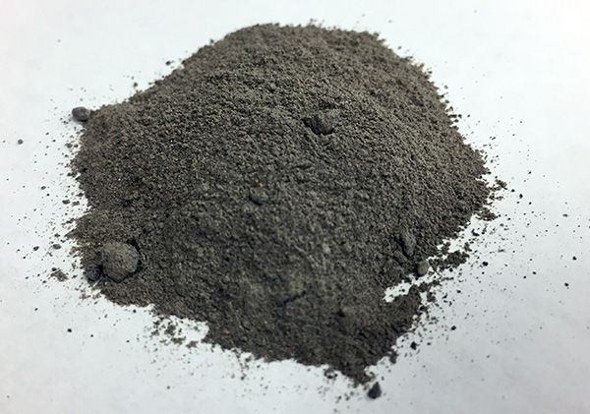
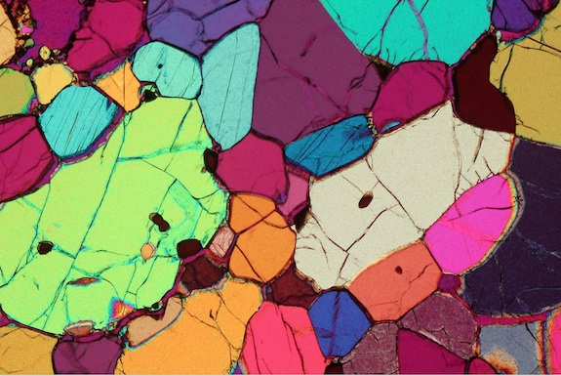
Bulk mineralogy vs. microanalysis/petrography
https://simulantdb.com/simulants/bp1.php
http://microckscopica.altervista.org/en/
Only major and minor mineral fractions are determined.
No information about grain orientations, sizes and contact is preserved.
The mineral content and the textural relationships within the rock are described in detail.
The classification of rocks is based on the information acquired during the petrographic analysis.
Micro-texture and structure are critical to understanding the origin of the rock.

Slide 12
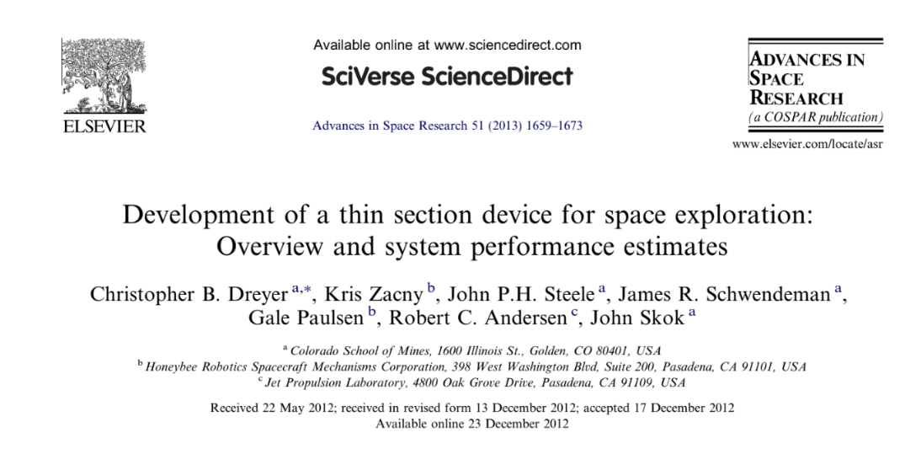
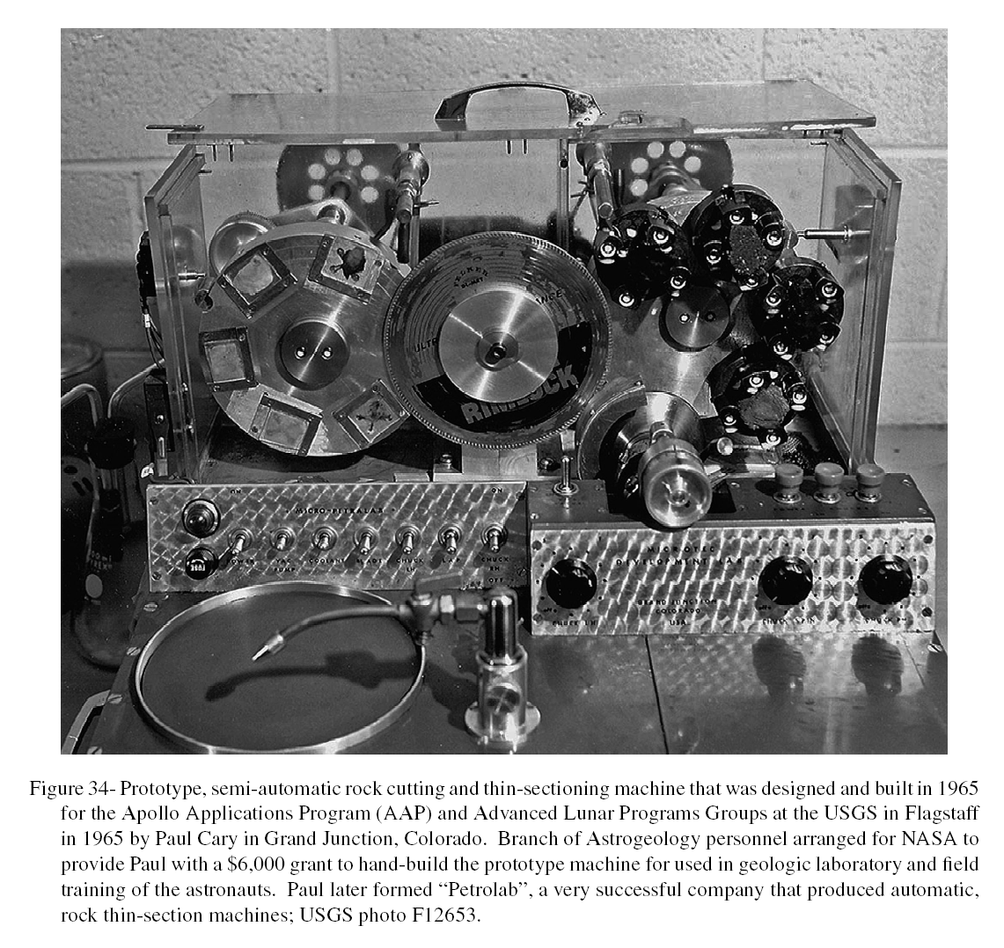

Slide 13
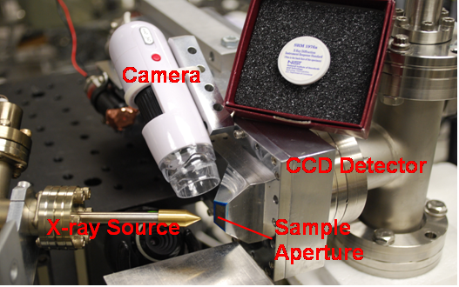
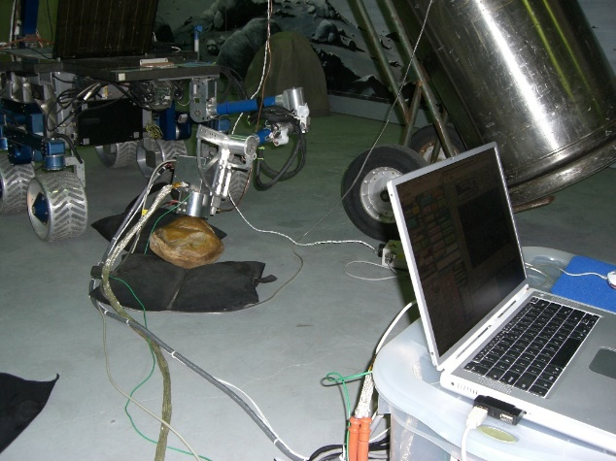
XPlAin design principles
Design principles
  Reflection-geometry “camera” that can be deployed on a rover arm
  No sample processing required
  Functional complementarity & redundancy (multiple detectors, multiple sources)
  Micro analysis on planetary surface (mineralogy and chemistry from a single grain)
  Quantitative characterization of amorphous material (chemistry and pdf)
  Texture analysis
CMIST (PI K. Gendreau) 2012
Chromatic Mineral Identification and Surface Texture
MICA (PI J. Marshall) 2005
Mineral Identification and Composition Analyzer

Slide 14
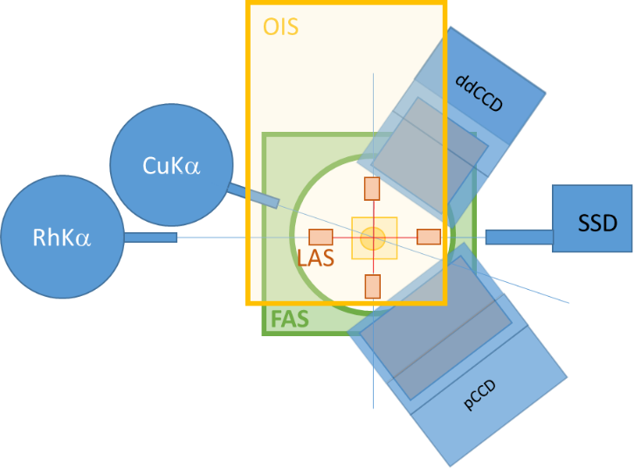
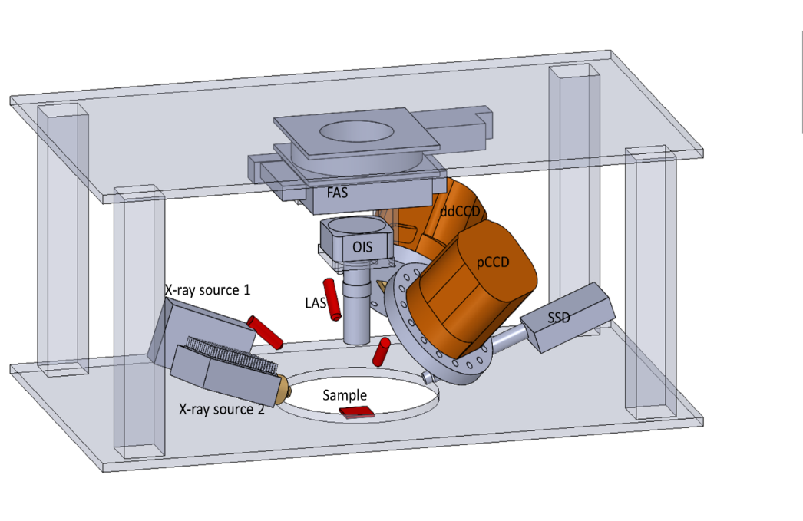
XPlaIn design concept
Notional diagram of XPLAIn components. FAS: Fine Actuation System, OIS: Optical Imaging System, LAS: Laser Alignment System, pCCD: phosphor CCD, ddCC: direct detection CCD, SSD: solid-state detector.
Notional diagram of XPlAIn components viewed from the top of the instrument.

Slide 15
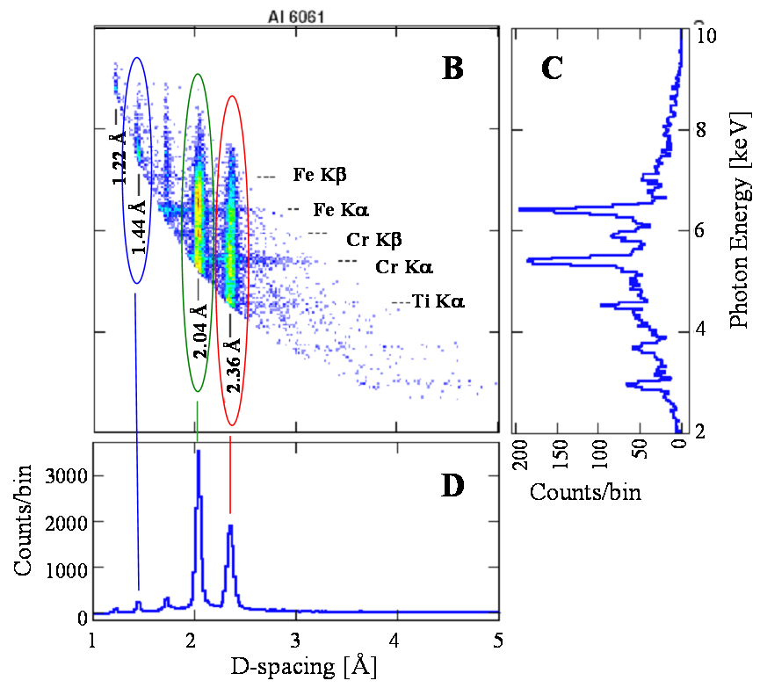
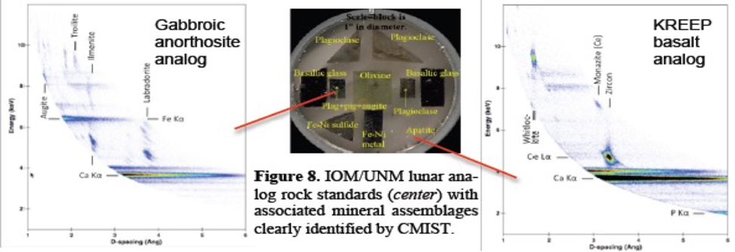
Preliminary data from previous NASA projects
Lunar Analog rock standards (center) with associated mineral assemblage clearly identified by XPlAIn predecessor - CMIST

Slide 16
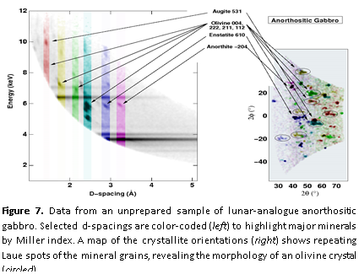
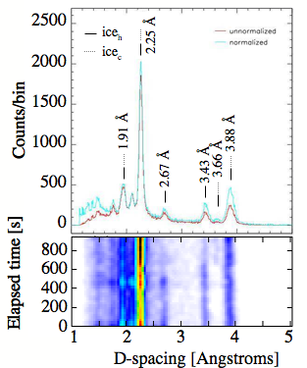
Preliminary data from previous NASA projects
Figure 6. CMIST Time-dependent XRD revealing changes in frost consistent with a crystal phase transition

Slide 17

Accurate positioning challenge
Robotic arm: coarse actuation
Robotic arm: coarse actuation
Precision translation platform
Fine XYZ actuation (1inch range)

Slide 18
Accurate positioning challenge
Robotic arm: coarse actuation
Robotic arm: coarse actuation
Precision translation platform
Fine XYZ actuation (1inch range)
On a rough surface, a hight adjustment will be needed when scanning laterally.

Slide 19
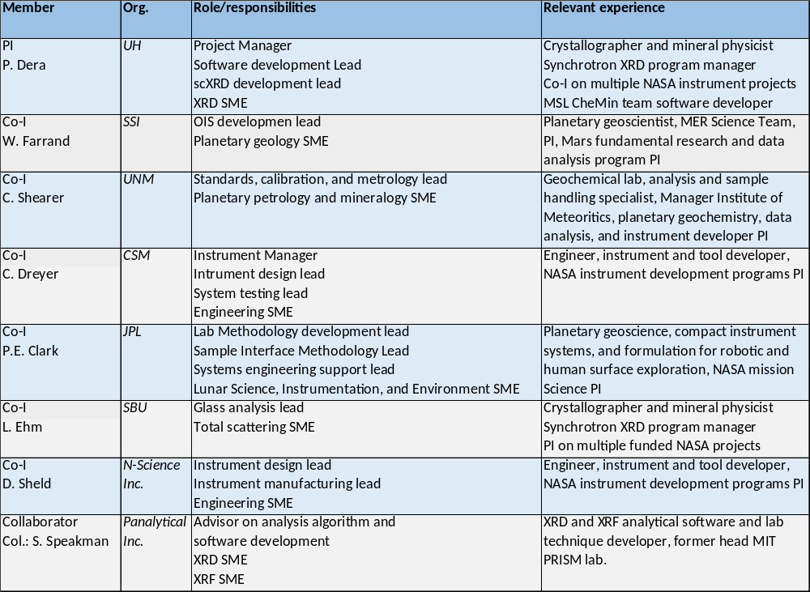
XPLAIN proposal team

Slide 20
Conclusions
XPLAin will enhance analytical capabilities for mineralogical and petrological analysis of rocks and soil on planetary surfaces enabling single gain characterization.
Transmission geometry design will remove the necessity to process the sample material.
Functional redundancy and complementarity of the different detectors and X-ray sources will make the instrument more fail-safe and accurate.
XPLAin will enable quantitative analysis of amorphous materials which might be critical for understanding of the nature of mineral alteration processes.
Textural information for rock sample will provide valuable petrological insights.

