Slide 1





Hardy Tree-Mounted Loop Antenna for the Tree of Life Mission
ISSC 2022, California Polytechnic State University, May 3rd, 2022
Charles Penny*, Alessandra Babuscia*, Steven Anderson, Julia Christensen**, Steve Matousek*, Roger Klemm*,
* Jet Propulsion Laboratory, California Institute of Technology; **Oberlin College
Notes:
INSERT© 2022 California Institute of Technology. Government sponsorship acknowledged.
INSERT NASA Meatball logo
INSERT Conference Date and Details

Slide 2
Outline
Motivation
Project Background
Objectives
Prior Research
Methods
Some Results
Changes
More Methods
More Results
Discussion/Moving Forward

Slide 3
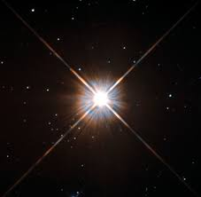
Motivation (1/2)
The Tree of Life Mission:
Interstellar missions may last
200+ years
How do we design craft to last for such durations?
How do we design missions to last for such durations?
Proxima Centauri – Image taken by the Hubble Space Telescope

Slide 4
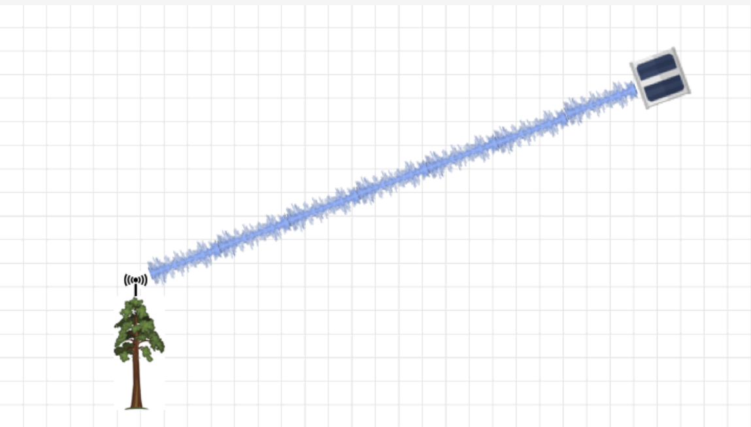
Motivation (2/2)
Upgradeable tree-based antenna and ground station
Combine space and Earth science missions of similar duration
  Diversify sources of interest
  Crowdsource ground station upkeep
Trees can have long lifespans
  Trees became focus of Earth science
CubeSat ‘health’/environment data
Tree health/environment data
200-year CubeSat designed for longevity
Credit: Space Song Foundation
Notes:
INSERT Motivation (2/2)

Slide 5
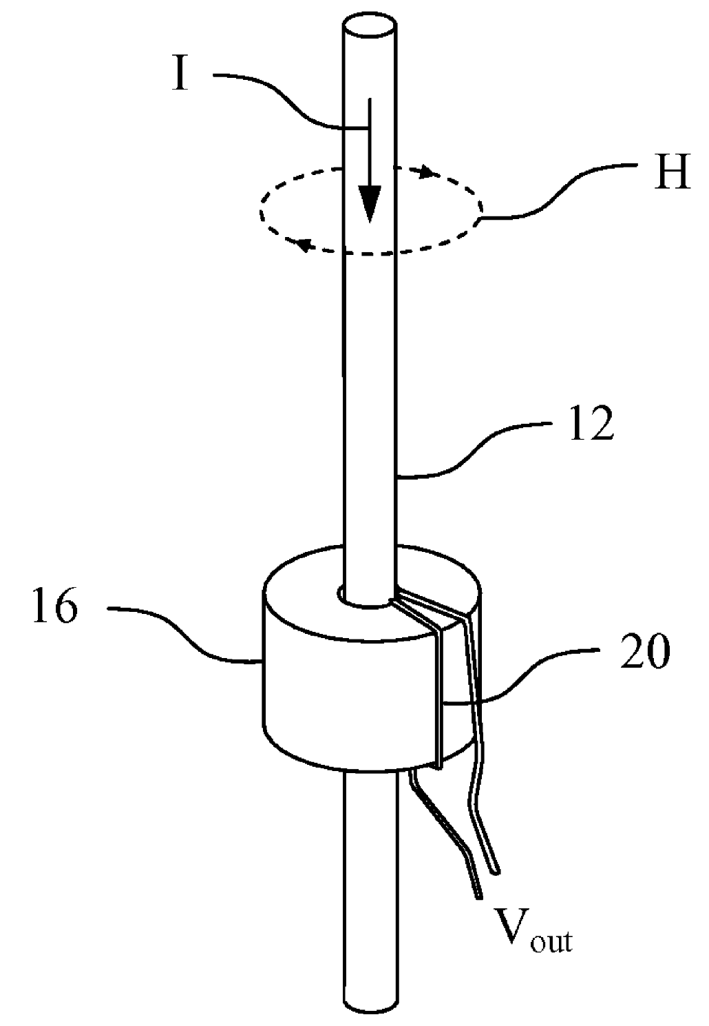
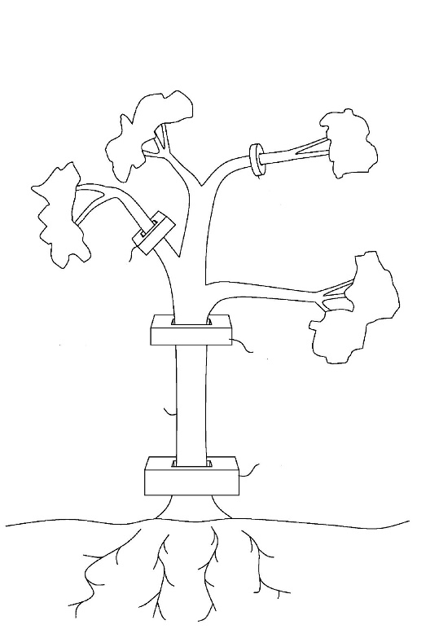
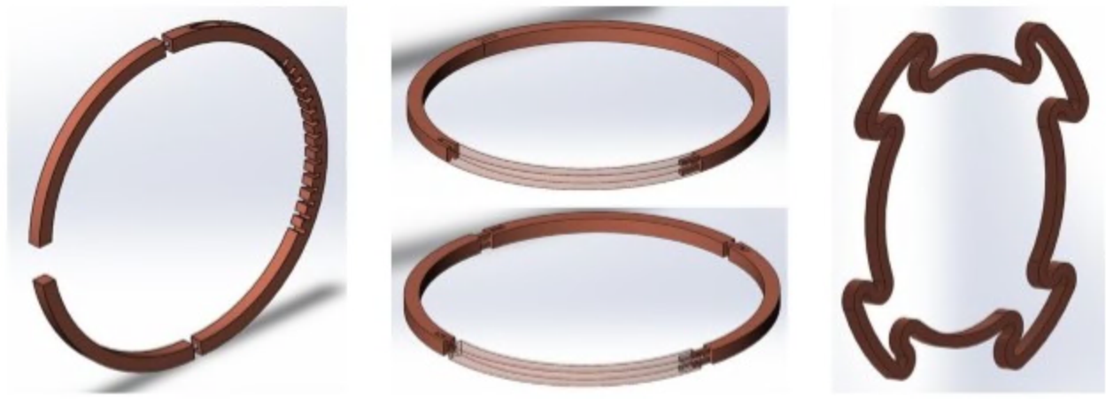
Project Background – Tree Antenna
Daniel Tam and John Rockway - US Patent No. 8,094,083
Steven Anderson – Tree of Life Antenna concepts (2020)
CON – Trees are somewhat unpredictable regarding location, shape, etc.
CON – Trees exhibit non-constant electrical and physical properties
PRO – Antenna has close proximity to data collection station and high mounting location
PRO – Tree-Antenna system has somewhat improved beamwidth for an uncomplicated antenna
Notes:
Maybe mention that other approaches seek to use the tree as an antenna, only coupling branches with current sensors

Slide 6
Objectives
Design antenna that is hardy to an on-tree environment
To do this we must
1. Understand typical tree conditions
– namely electrical properties
2. Characterize antenna performance in typical conditions
Notes:
CHANGE Minimize - > Understanding
CHANGE Characterize antenna performances in typical tree conditions

Slide 7
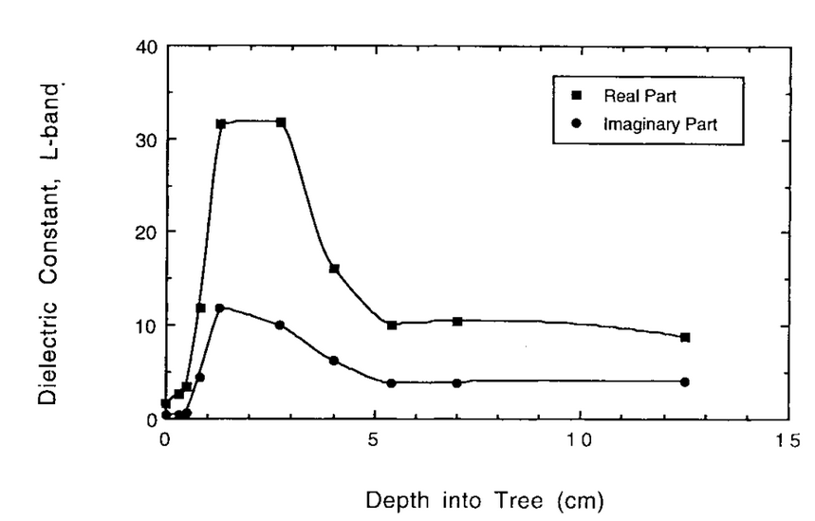
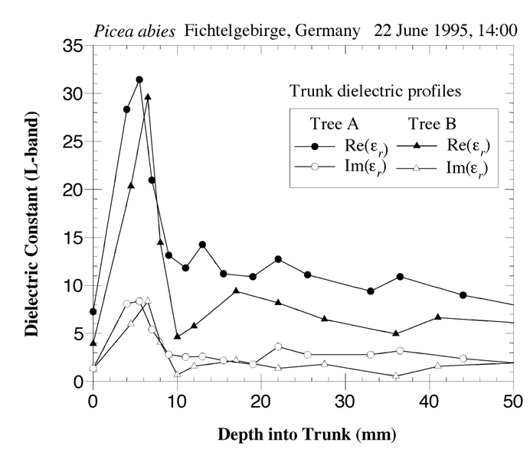
Prior Research (1/2)
Automated Instrumentation for Continuous Monitoring of the Dielectric Properties of Woody Vegetation: System Design, Implementation, and Selected In Situ Measurements
Kyle C. McDonald, Reiner Zimmermann, JoBea Way, William Chun
Diurnal and Spatial Variation of Xylem Dielectric Constant in Norway Spruce (Picea abies [L.] Karst.) as Related to Microclimate, Xylem Sap Flow, and Xylem Chemistry
Kyle C. McDonald, Reiner Zimmermann, and John S. Kimball

Slide 8
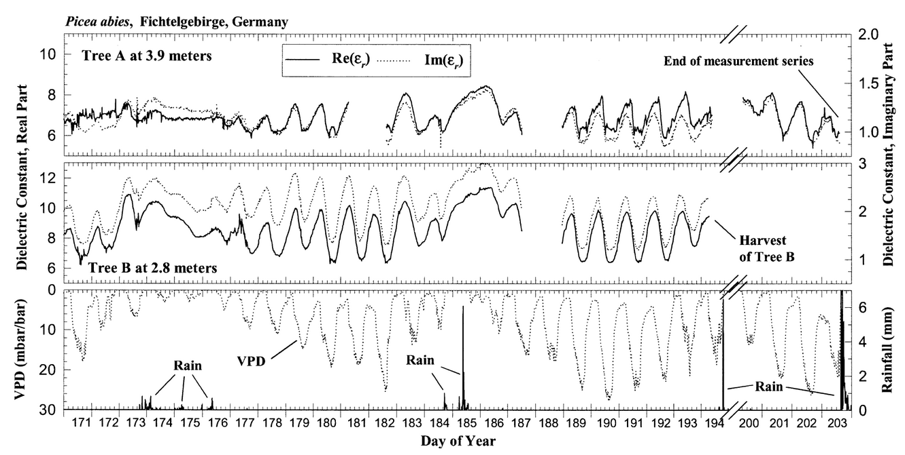
Prior Research (2/2)
Diurnal and Spatial Variation of Xylem Dielectric Constant in Norway Spruce (Picea abies [L.] Karst.) as Related to Microclimate, Xylem Sap Flow, and Xylem Chemistry
Kyle C. McDonald, Reiner Zimmermann, and John S. Kimball

Slide 9
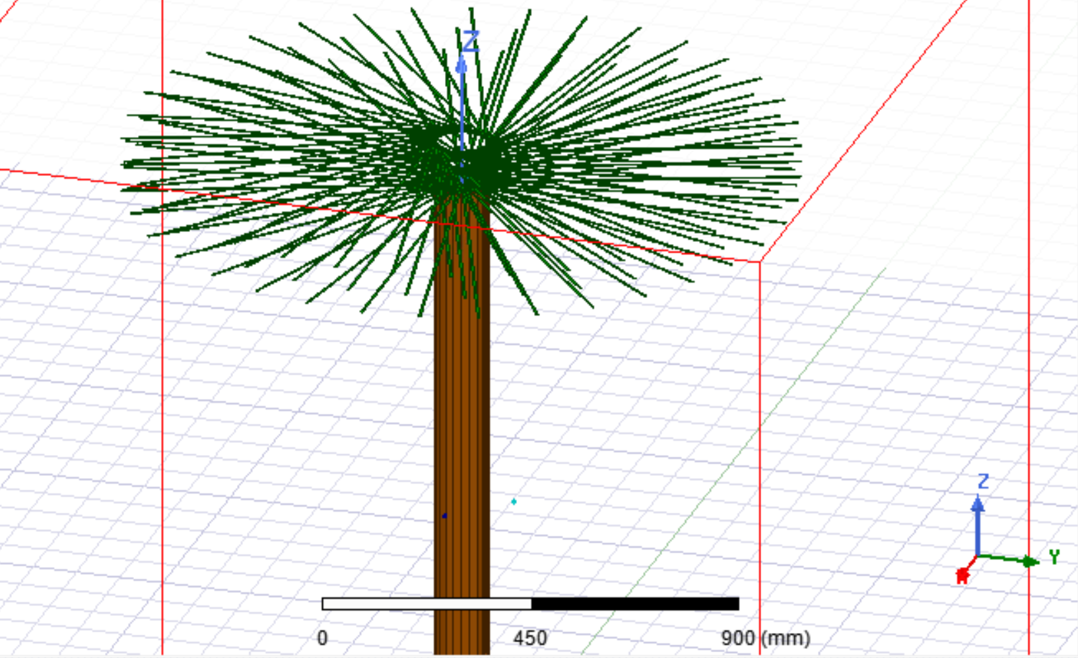
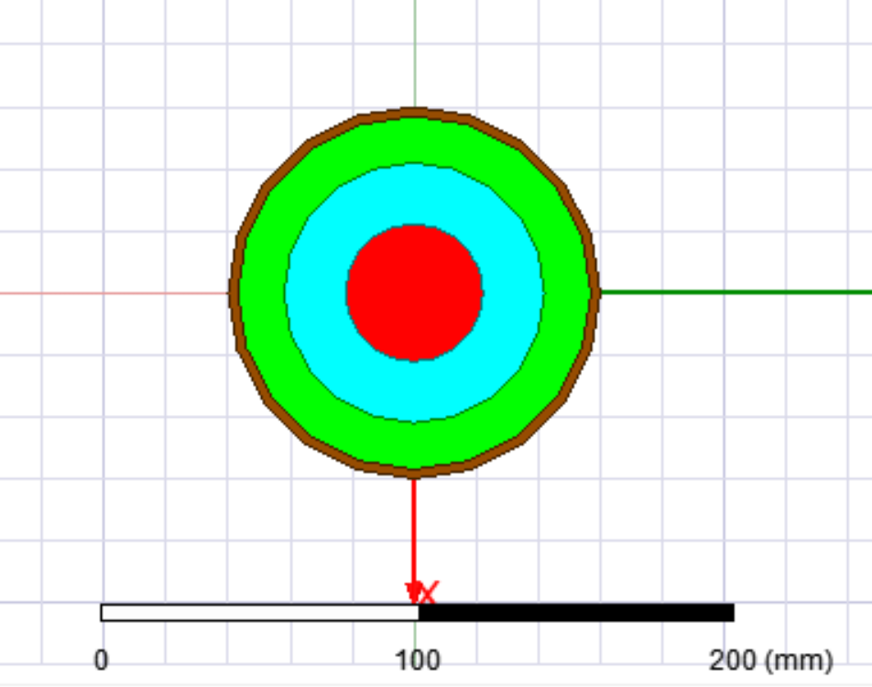
Methods - Simulation
Ansys HFSS models aiming to represent different layers of tree tissue and foliage

Slide 10
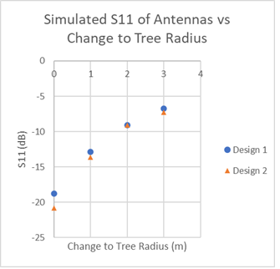
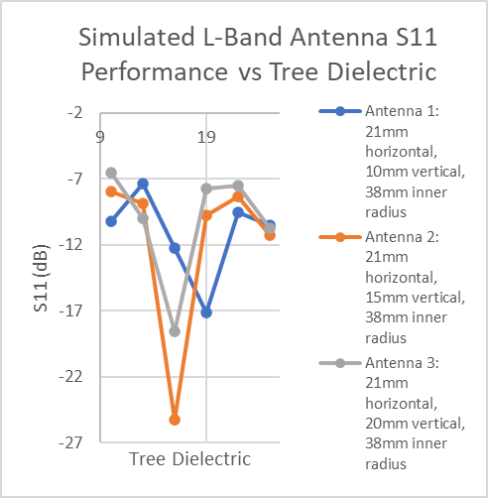
Some Results – Antenna Sensitivity to Tree Properties
Changing dielectric results in shifting resonant frequency
Deformation due to gradual tree growth ruins antenna
Antenna is very sensitive to tree’s changes!

Slide 11
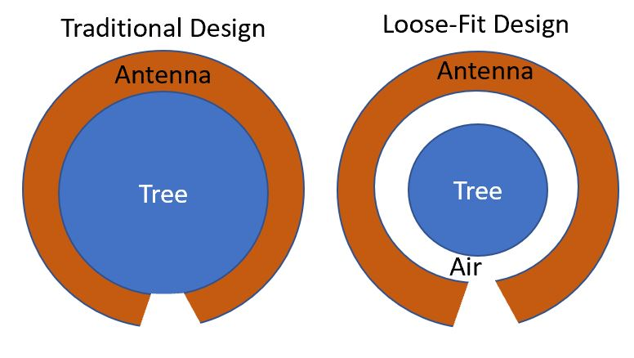
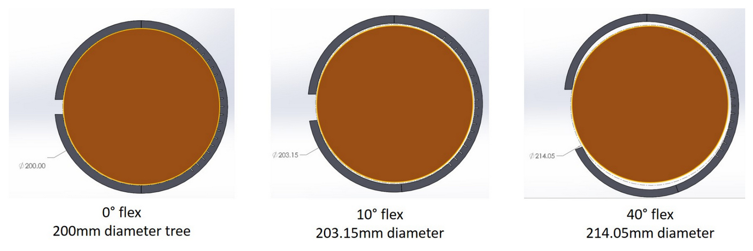
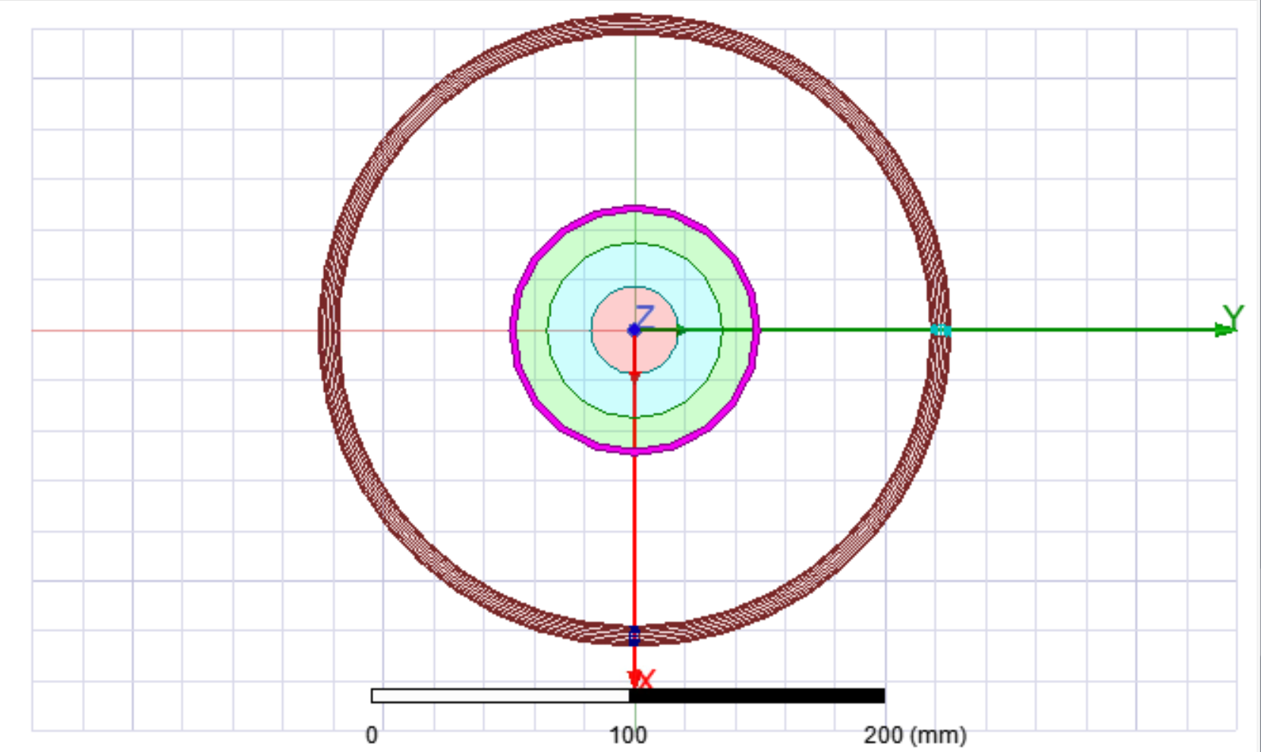
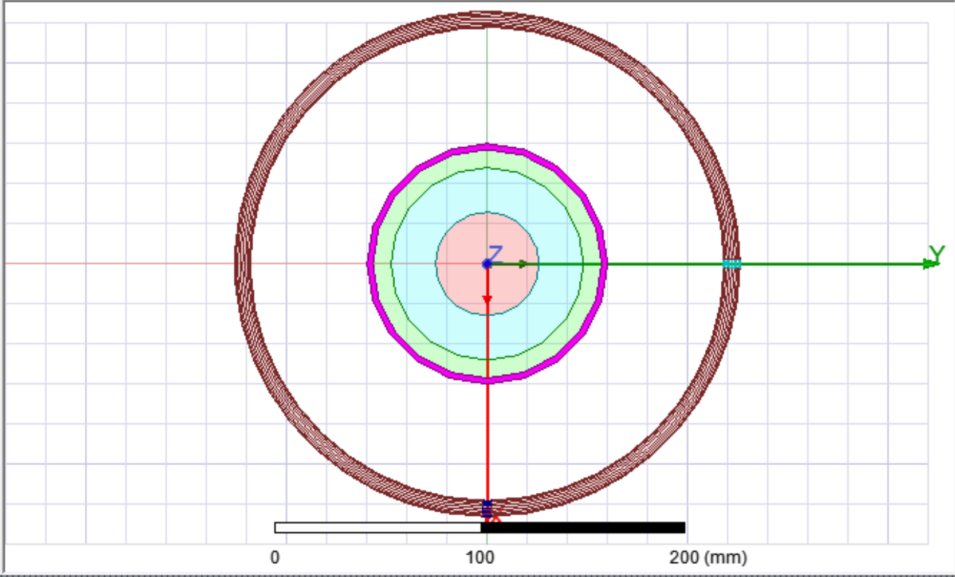
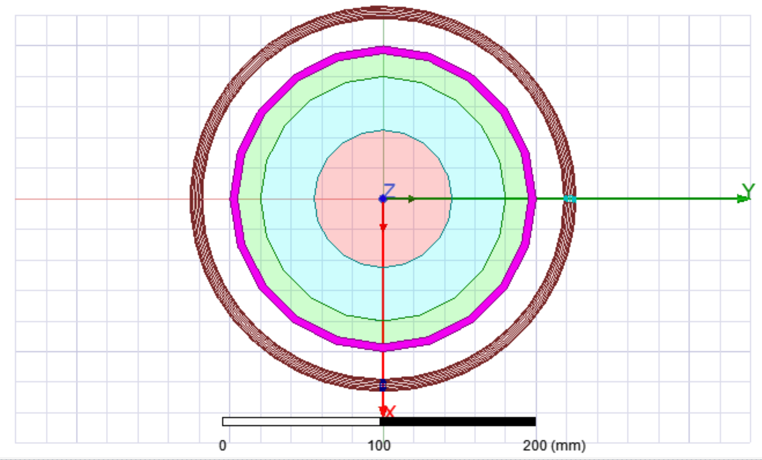
Minimizing Impact
Decrease volume of tree enclosed by loop antenna
Decrease deformation caused by tree growth
Simulate design in HFSS for varied conditions
Notes:
CHANGE - effects

Slide 12
Impact Minimization
Simulation sweeps of tree dielectric values for varying tree area show more consistent antenna performance for smaller tree areas

Slide 13
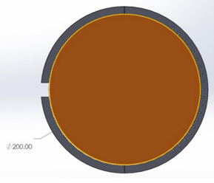
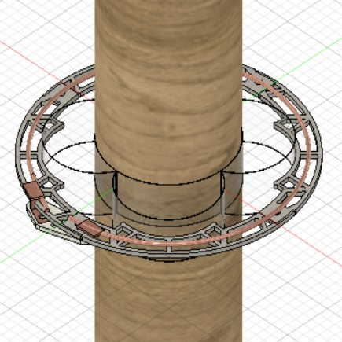
Design Changes
  Reduces tree branch size enclosed
  Spring absorbs deformation instead of antenna
  Wider range of fitting branches due to spring mount

Slide 14
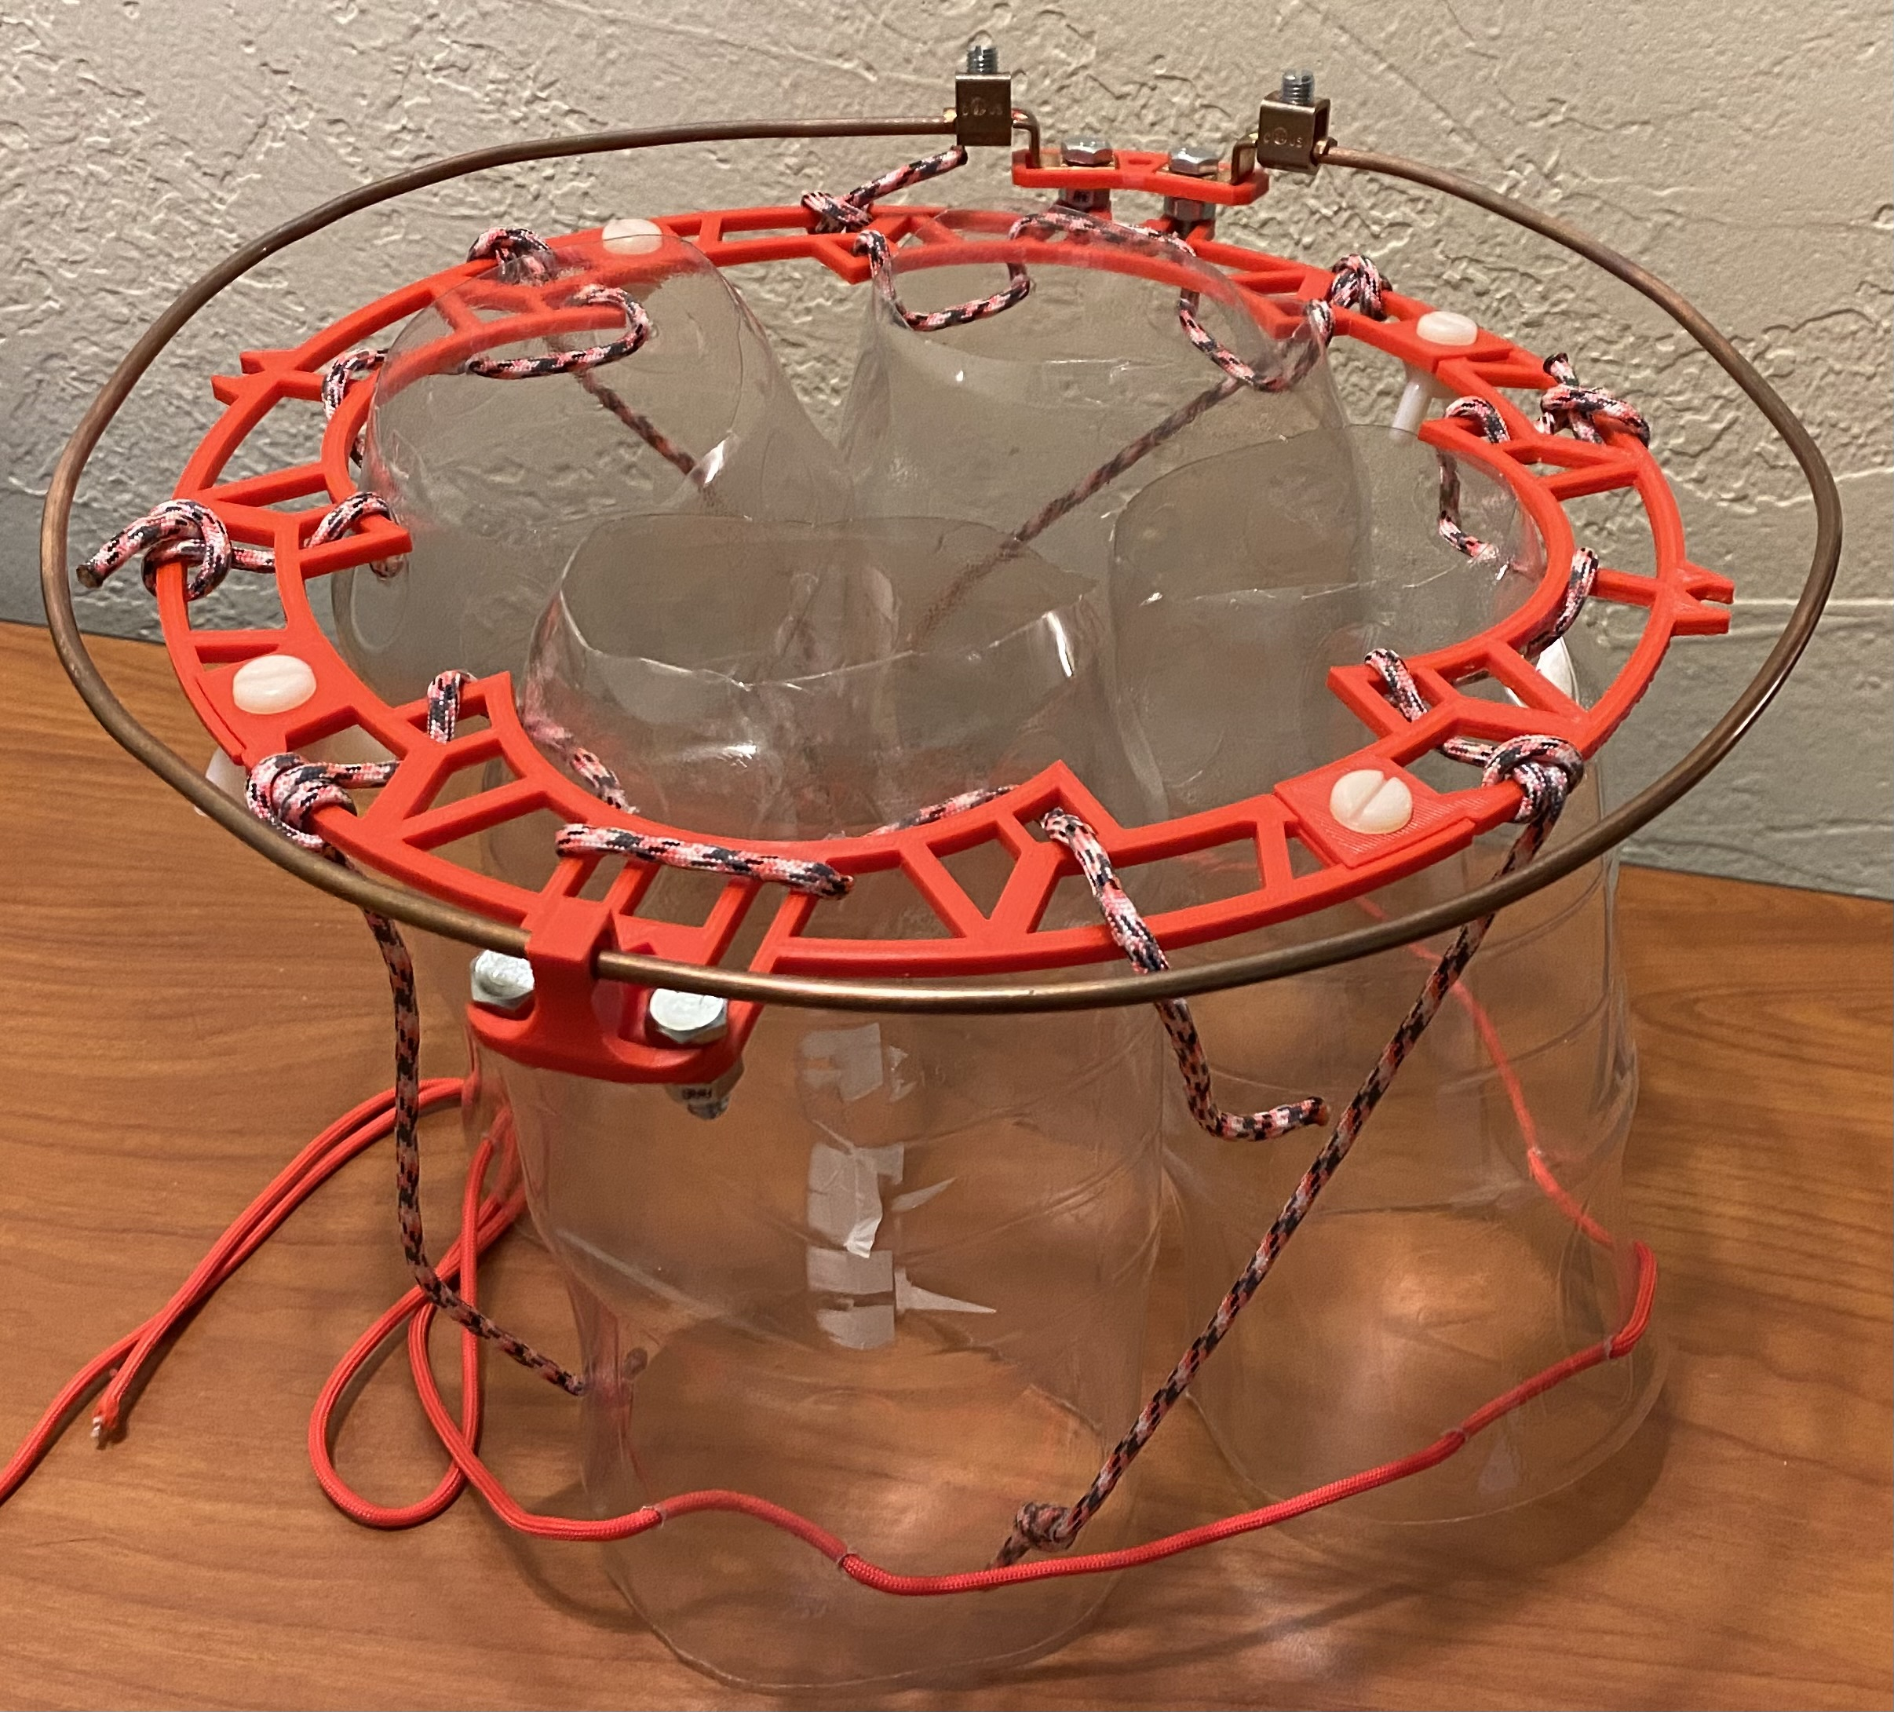
How do we know our simulations are any good?
Testing!

Slide 15
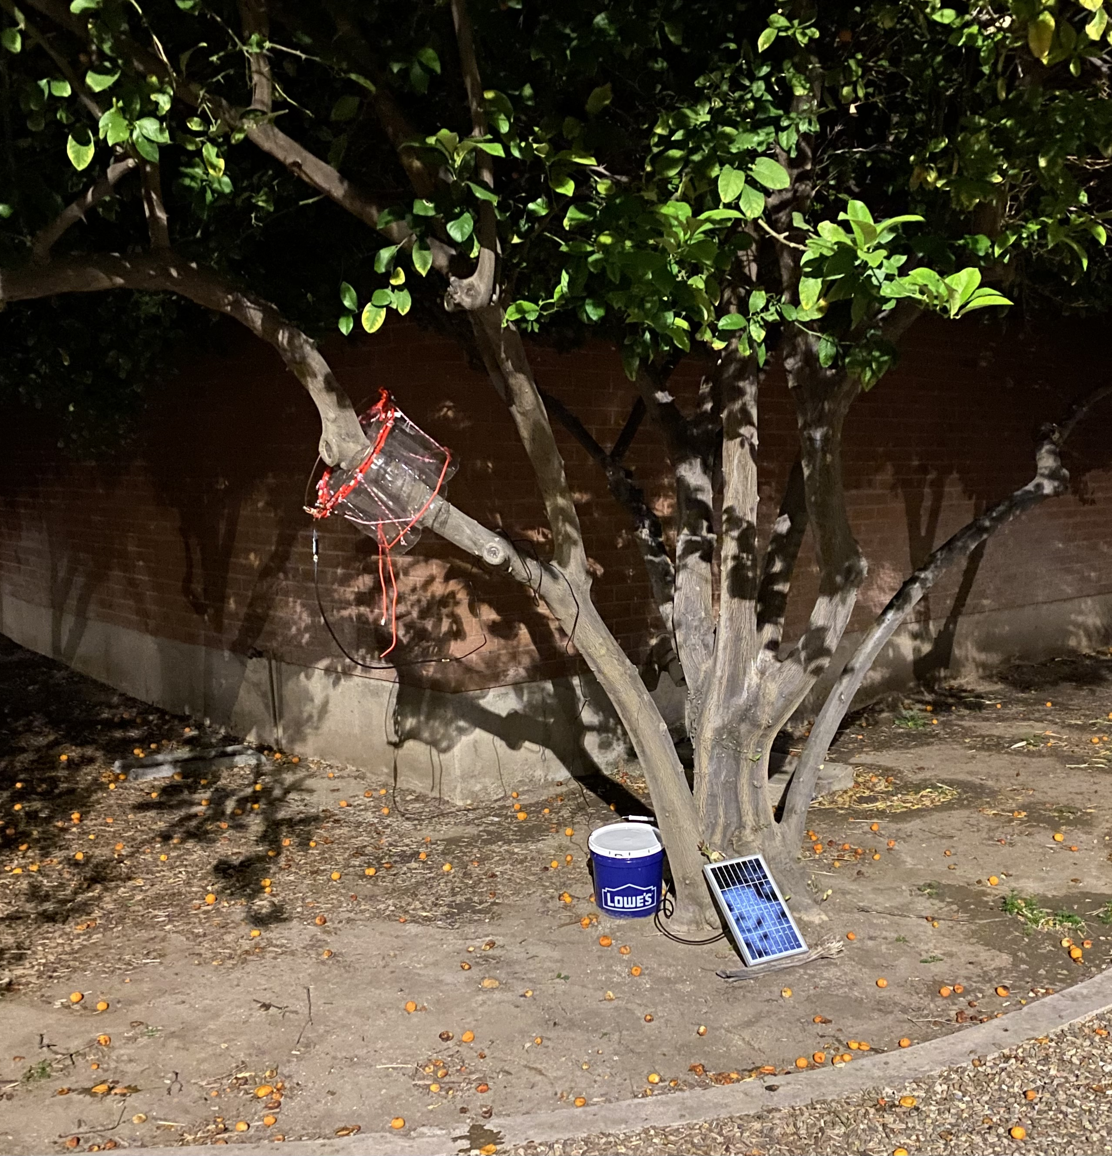
More Methods –
Testing in Typical Conditions
How will the Antenna react to real life dielectric shifts?
Is our simulation model accurate?
Antenna on tree, VNA, raspberry pi, battery, and solar panel in bucket

Slide 16
Typical Conditions Results/Analysis

Slide 17
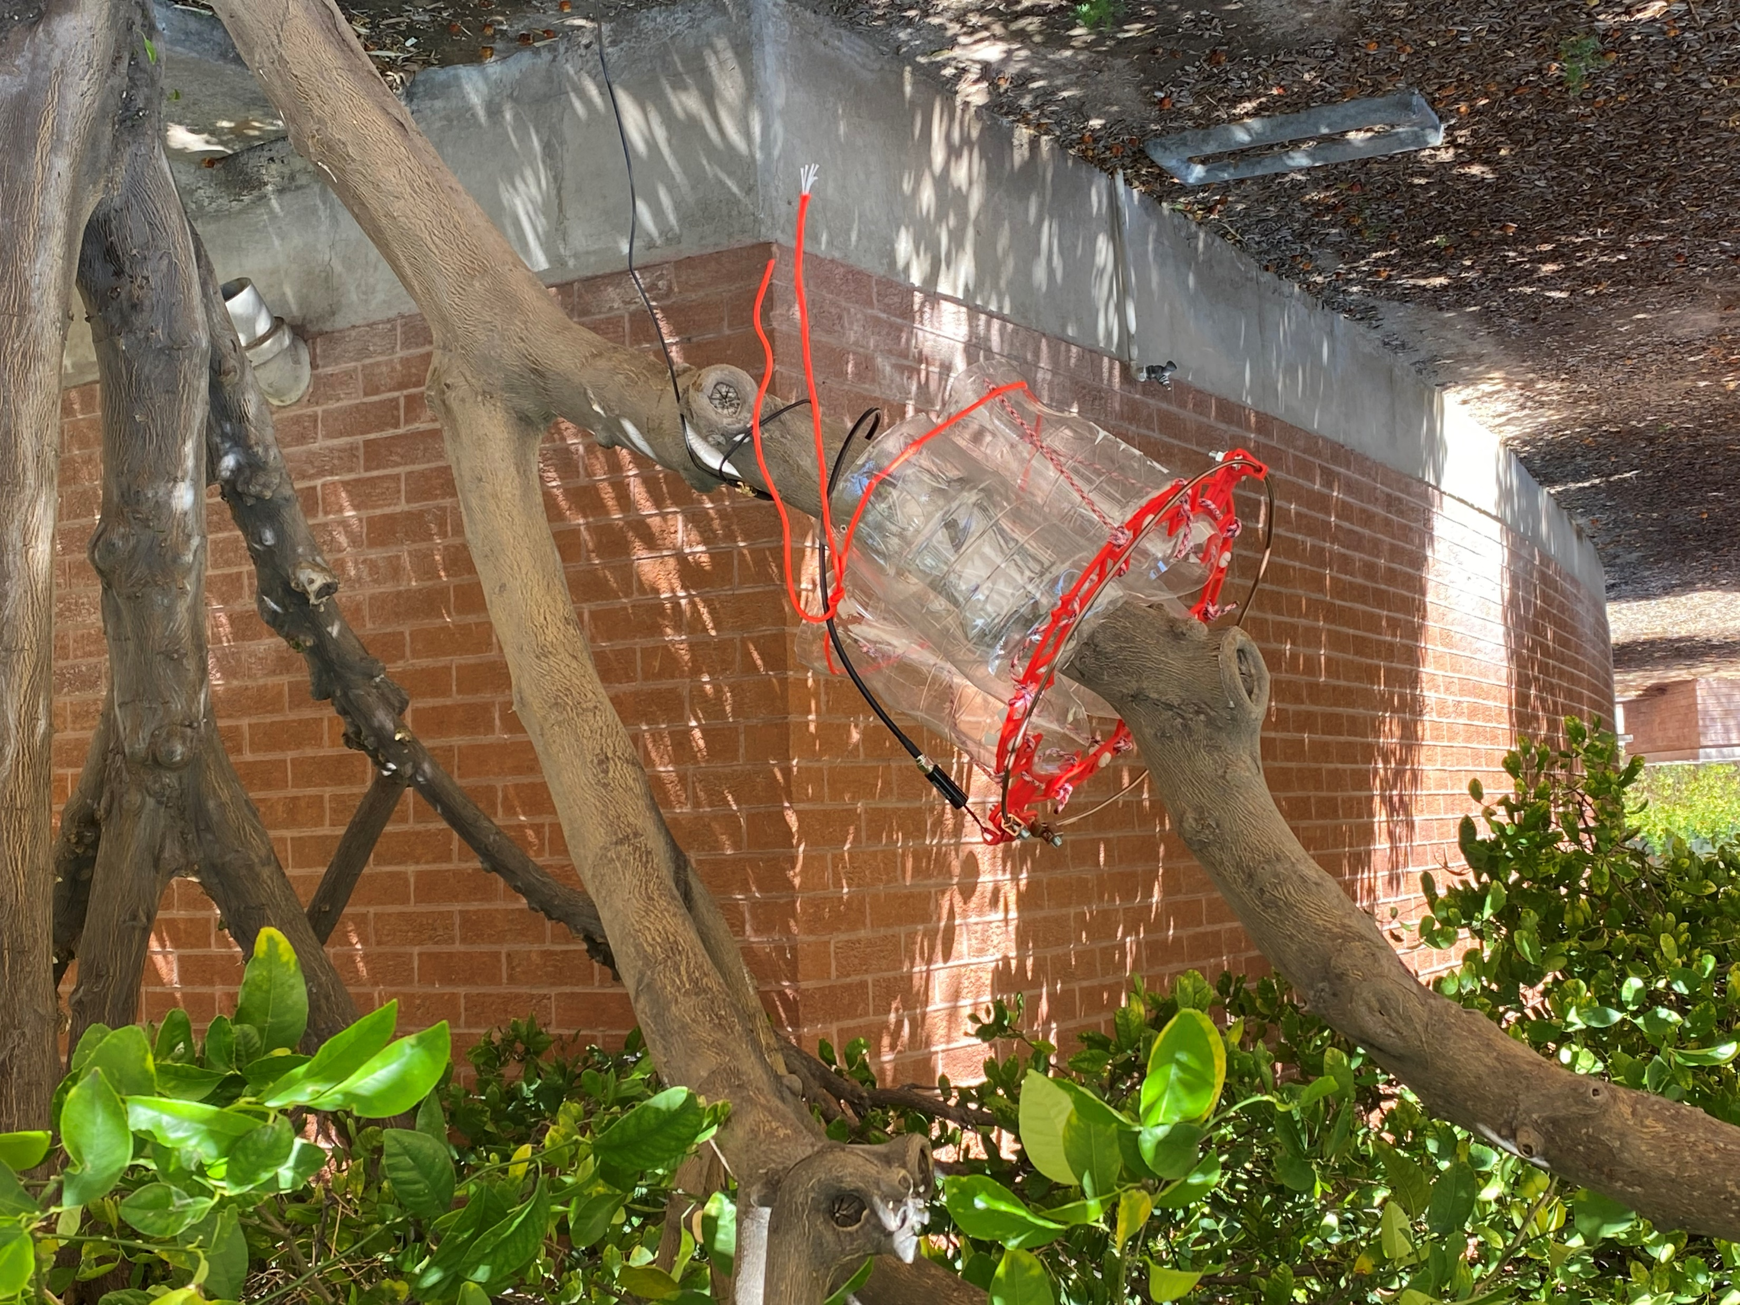
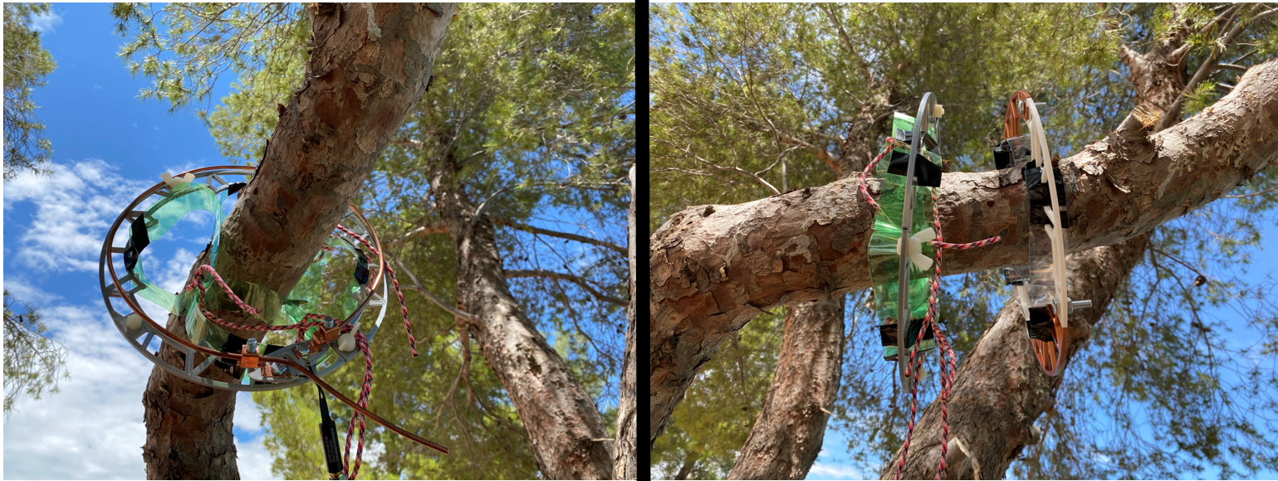
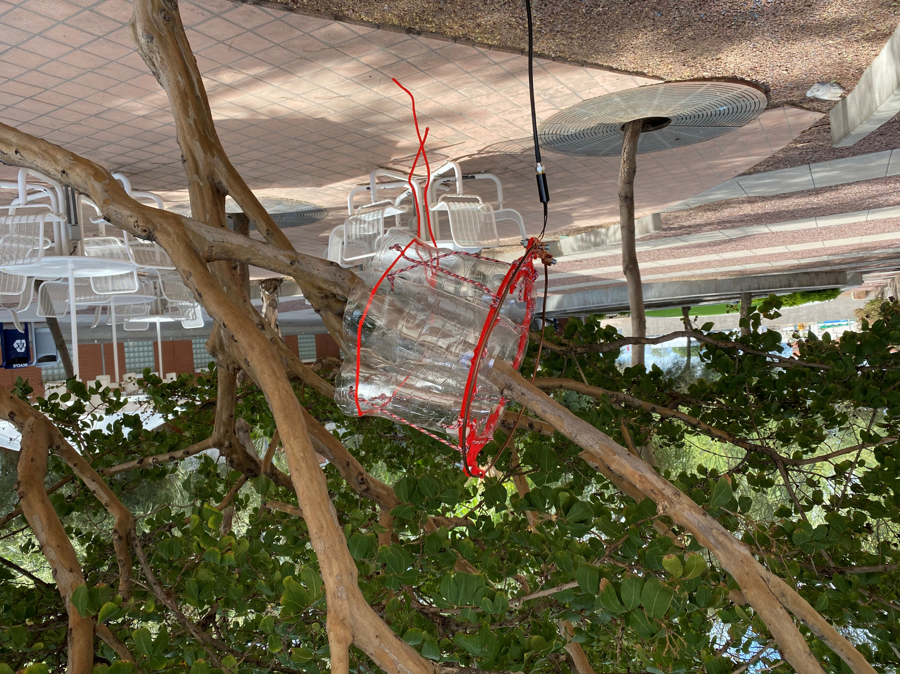
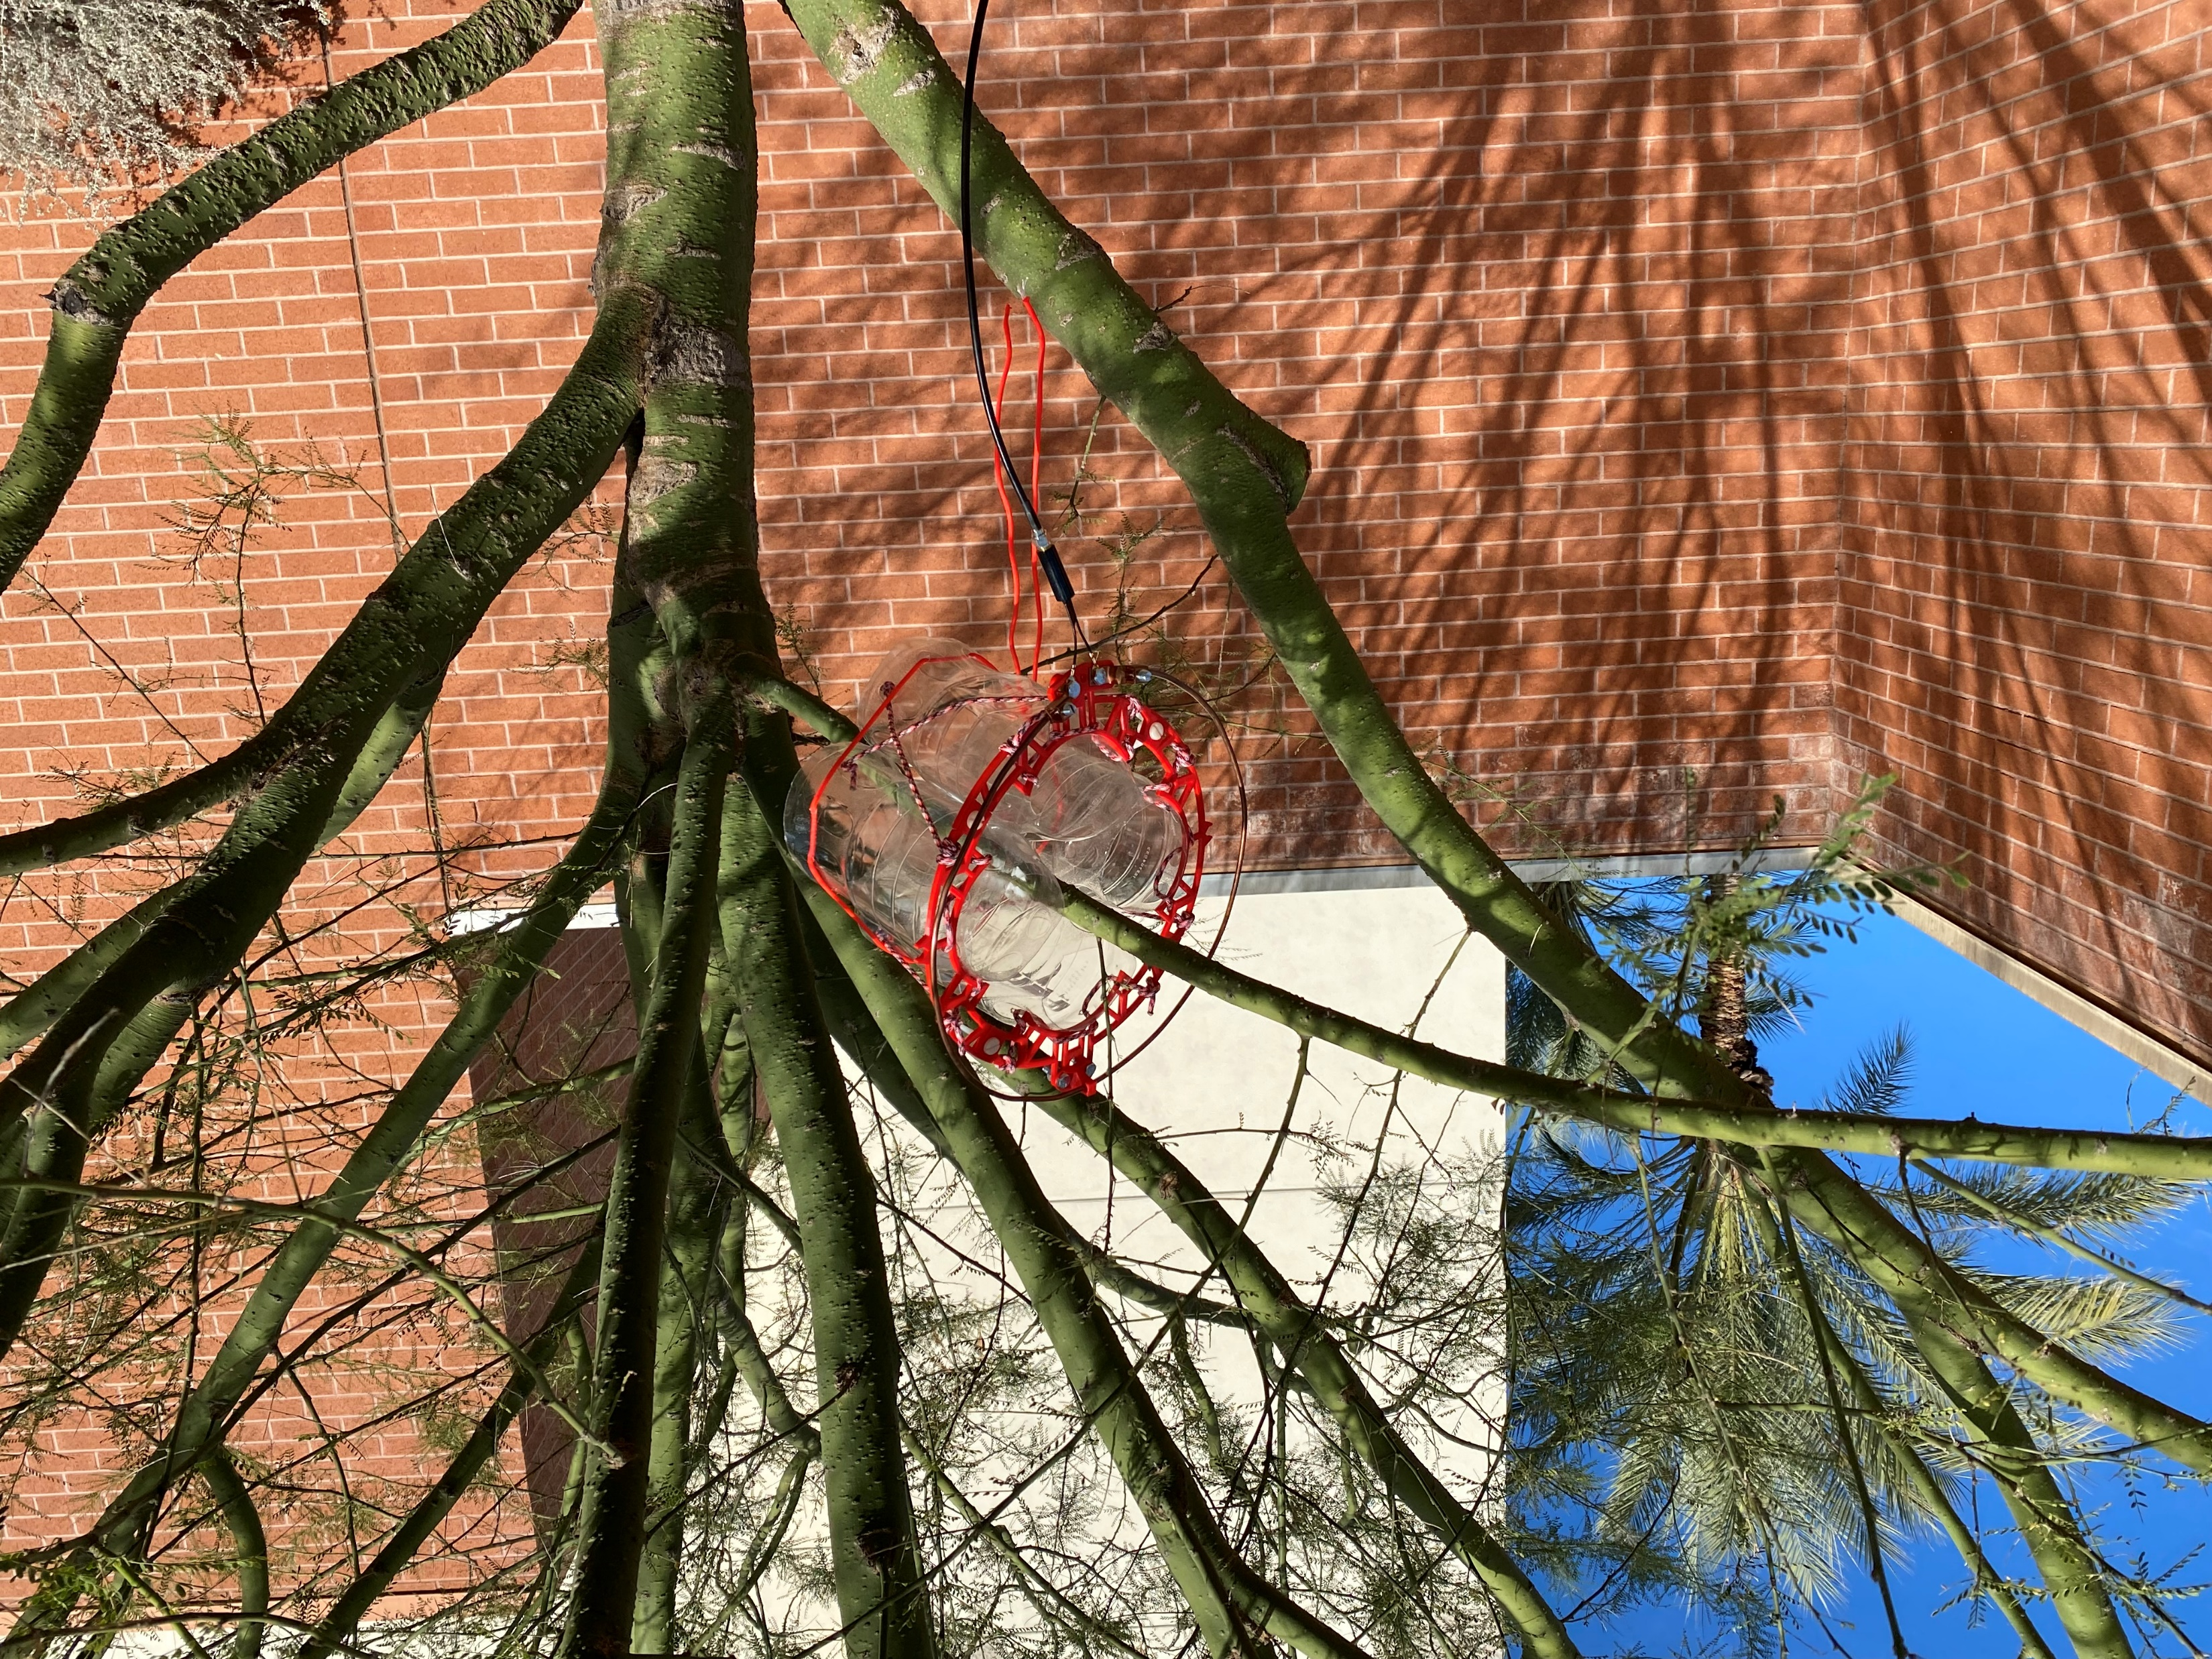

Slide 18
Antenna Performance vs Environmental Factors
Data generally showed high correlation to ambient temperature and solar radiation

Slide 19
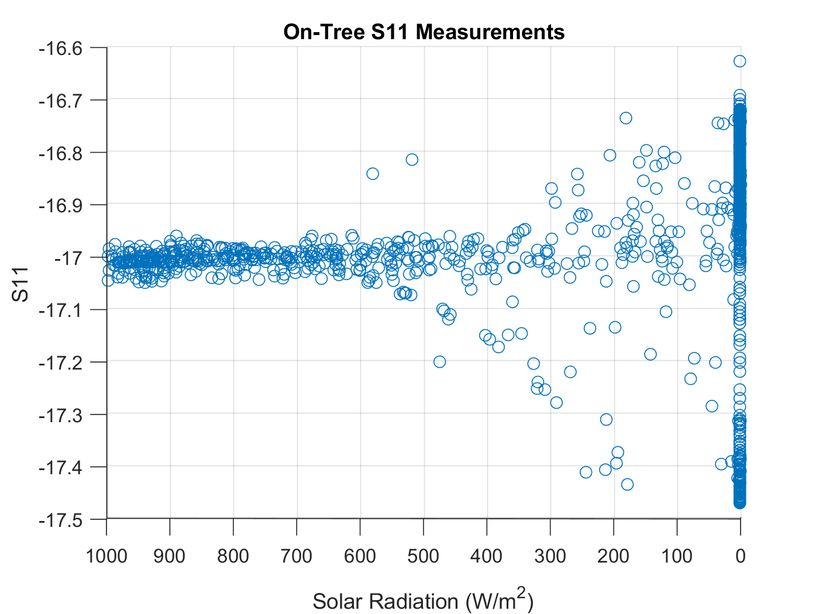
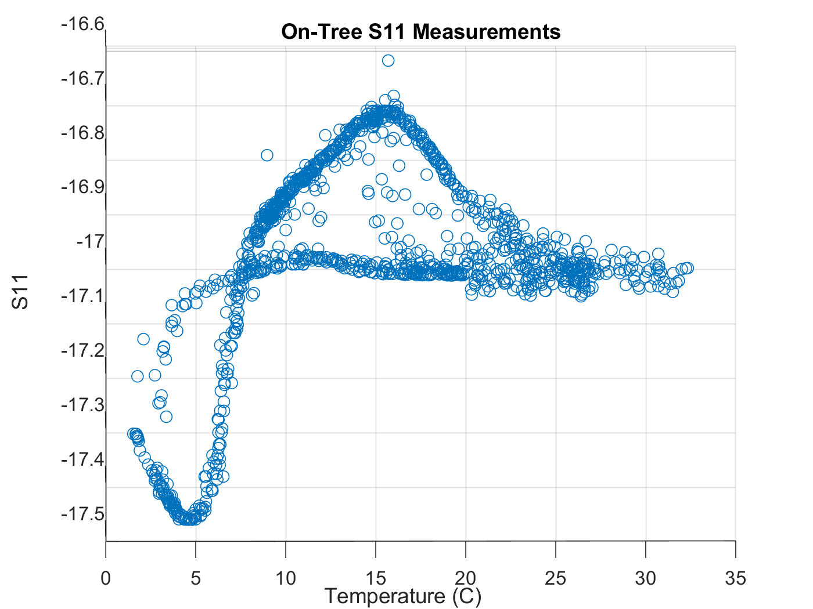
Antenna Performance vs Environmental Factors
Antenna performance seems to be powerful indication of tree’s environment

Slide 20
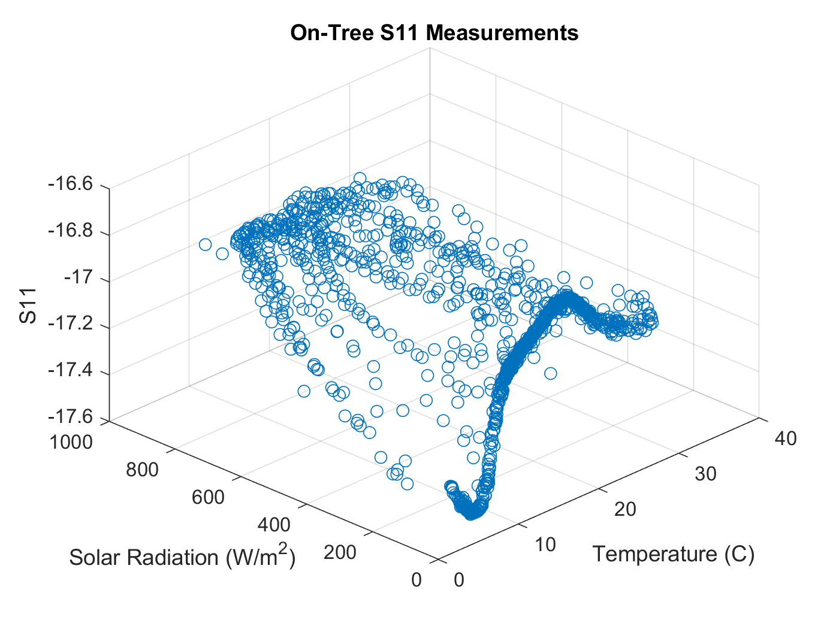

Slide 21
Discussion
Antenna design changes successfully minimize effect of tree activity on antenna performance
-antenna is also generally less sensitive than in simulation
Antenna performance still reflects tree activity
Notes:
CHANGE Conclusion Next steps

Slide 22
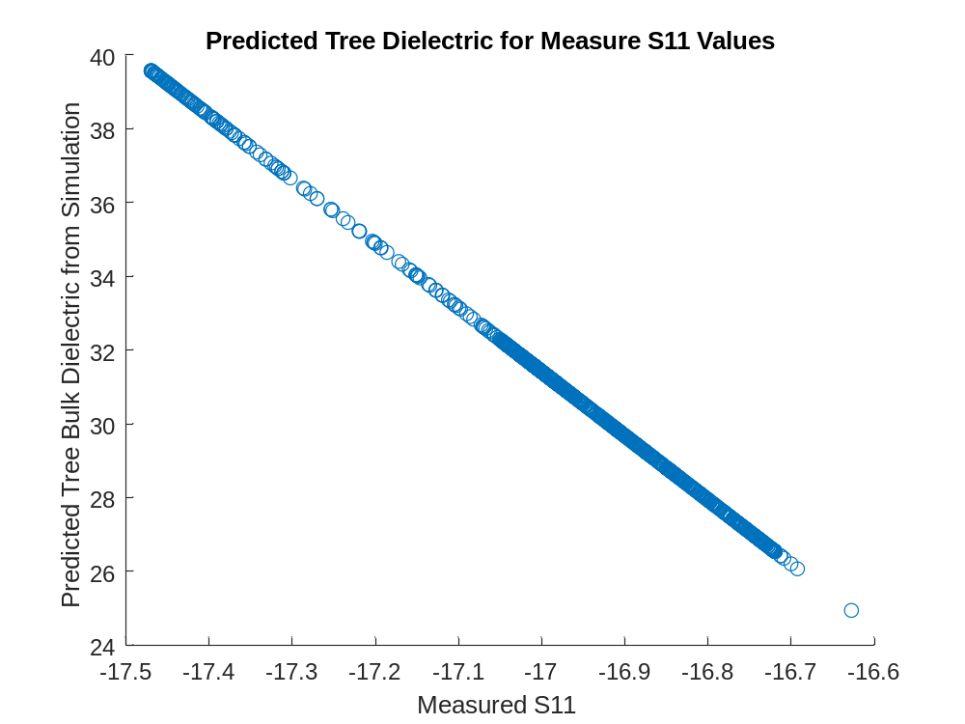
Moving Forward
A Tree-Antenna as a Tree-Transducer?
Further development of the system
  Multi-branch array
  Multi-tree array
  Testing against ‘open-source’ 433MHz satellites

Slide 23
Acknowledgements
Thanks to Alessandra Babuscia for her mentorship!
Thanks to all the former interns who worked on this and whose work laid the foundation for everything I have done!
Inge Baho - Thomas Choi - Steven Anderson
Thanks to Dr. Kyle McDonald for insight into the dynamic properties of trees!
Thanks to The Tree Song Foundation for involving me!
Thanks to Dr. Jekan Thanga and SpaceTREx Labs for supporting this research!

Slide 24
Thank you!
for your time

Slide 25
References
https://www.spacesong.org/
Q. Xiao and E. G. McPherson, “Tree health mapping with multispectral remote sensing data at UC Davis, California,” Urban Ecosystems, vol. 8, no. 3-4, pp. 349–361, 2005. https://link.springer.com/article/10.1007/s11252-005-4867-7
M. Acker, K. Ikrath, and W. A. Schneider, “HELICAL COIL COUPLED TO A LIVE TREE TO PROVIDE A RADATING ANTENNA,” 29-Feb-1972. https://patentimages.storage.googleapis.com/31/f8/8b/e11a188592e001/US3646562.pdf
D. W. S. Tam and J. W. Rockway, “MULTI-BAND TREE ANTENNA,” 10-Jan-2012. https://patentimages.storage.googleapis.com/19/cf/0f/424d5e0be1614f/US8094083.pdf
I. Baho, rep. “Tree of Life: Designing and Simulating the Antenna Tree,” 2019.
T. Choi, rep. “Tree Antenna Report,” 2020.
S. Anderson, rep. “Tree of Life: A Multi-Generational Telecommunication Concept”, 2021.
K. C. McDonald, R. Zimmermann, J. Way, and W. Chun, “Automated instrumentation for continuous monitoring of the dielectric properties of woody vegetation: System design, implementation, and selected in Situ Measurements,” IEEE Transactions on Geoscience and Remote Sensing, vol. 37, no. 4, pp. 1880–1894, 1999.
K. C. McDonald, R. Zimmermann, and J. S. Kimball, “Diurnal and spatial variation of xylem dielectric constant in Norway spruce (picea abies [l.] karst.) as related to microclimate, xylem sap flow, and xylem chemistry,” IEEE Transactions on Geoscience and Remote Sensing, vol. 40, no. 9, pp. 2063–2082, 2002.

