Slide 1




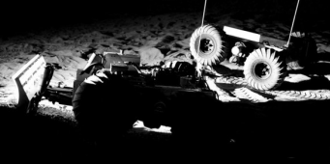
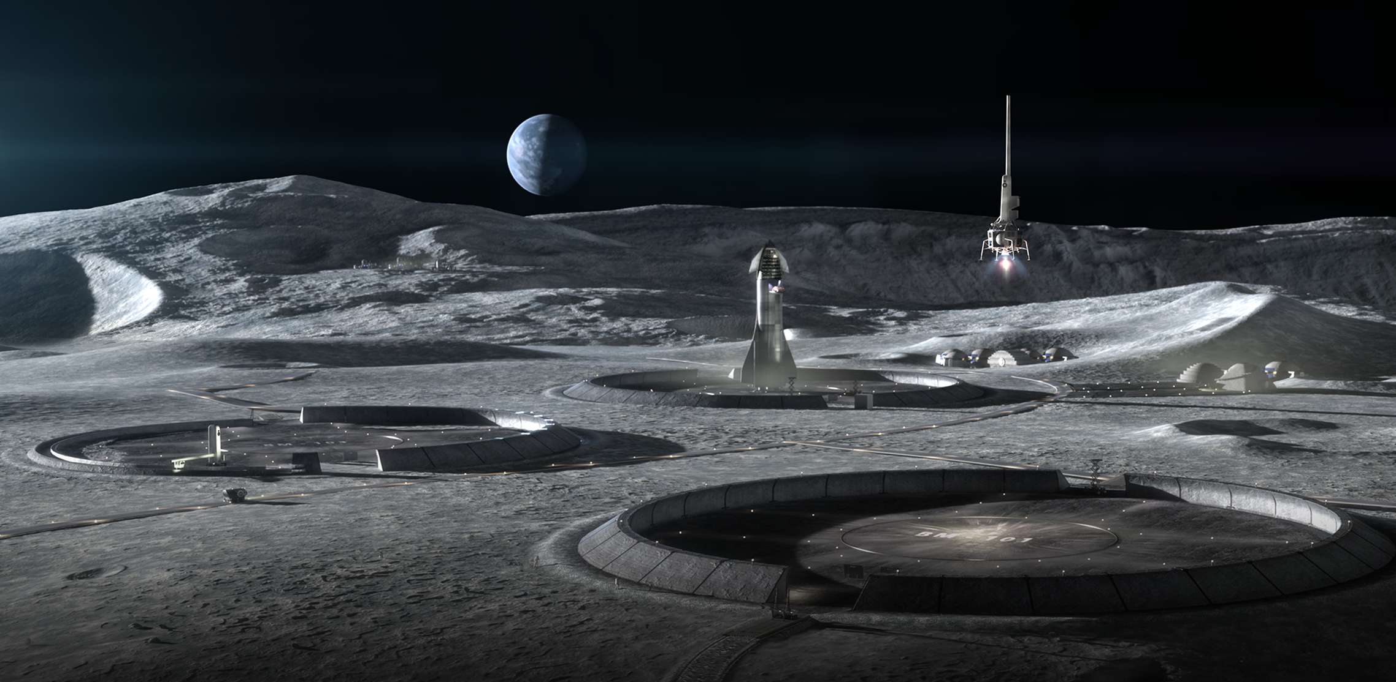
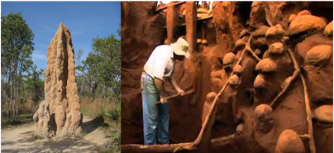
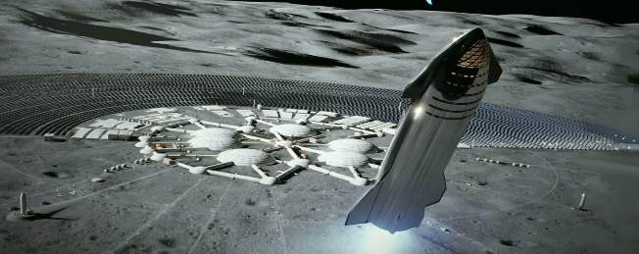
First Steps Towards Lunar Settlements: Small Multirobot Chains For Landing Pad Construction
Jekan Thangavelautham*, Yinan Xu
Space and Terrestrial Robotic Exploration (SpaceTREx) Laboratory
Asteroid Science, Technology and Exploration Research Organized by Inclusive eDucation Systems (ASTEROIDS) Laboratory
University of Arizona

Slide 2
Outline
Motivation
Launch and Landing Pads
Challenges
Objectives
Approach
Results
Summary
Future Work

Slide 3
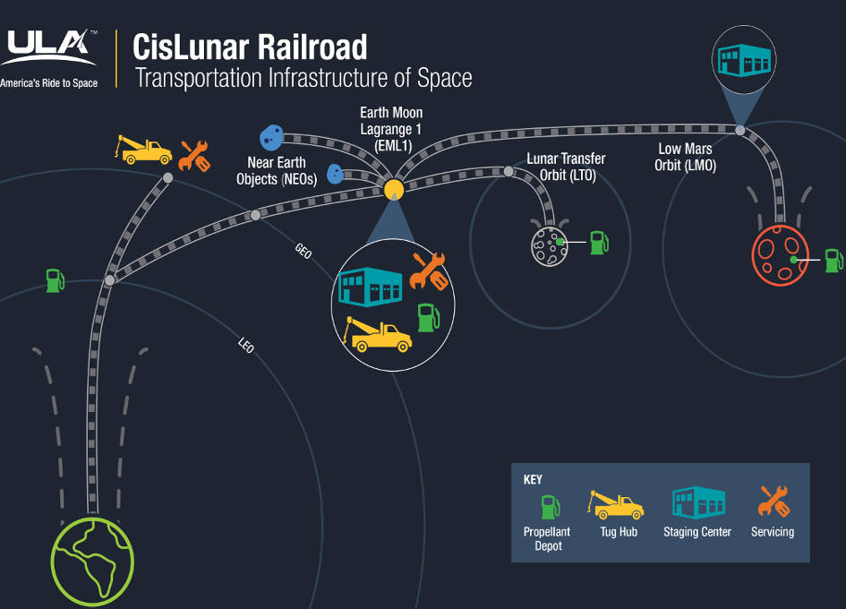
Motivation

Slide 4
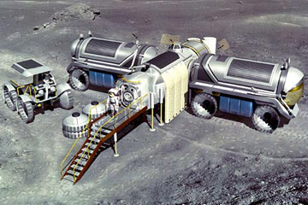
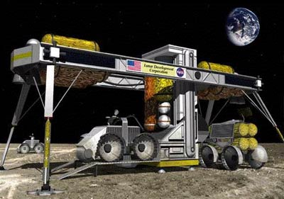
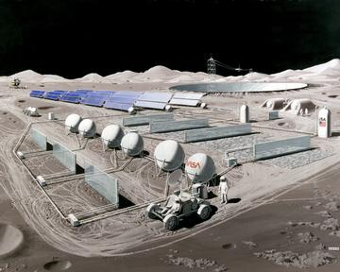
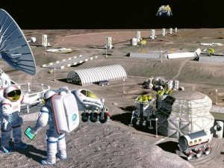
Motivation
Refueling base at various locations in cis Lunar space
Water electrolyzed to produce H₂ and O₂
Fuel and raw material for transport, construction and manufacturing

Slide 5
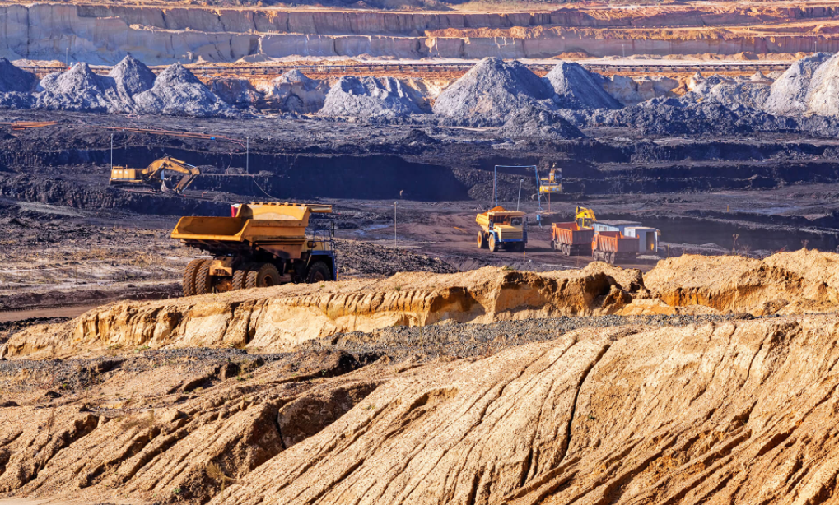
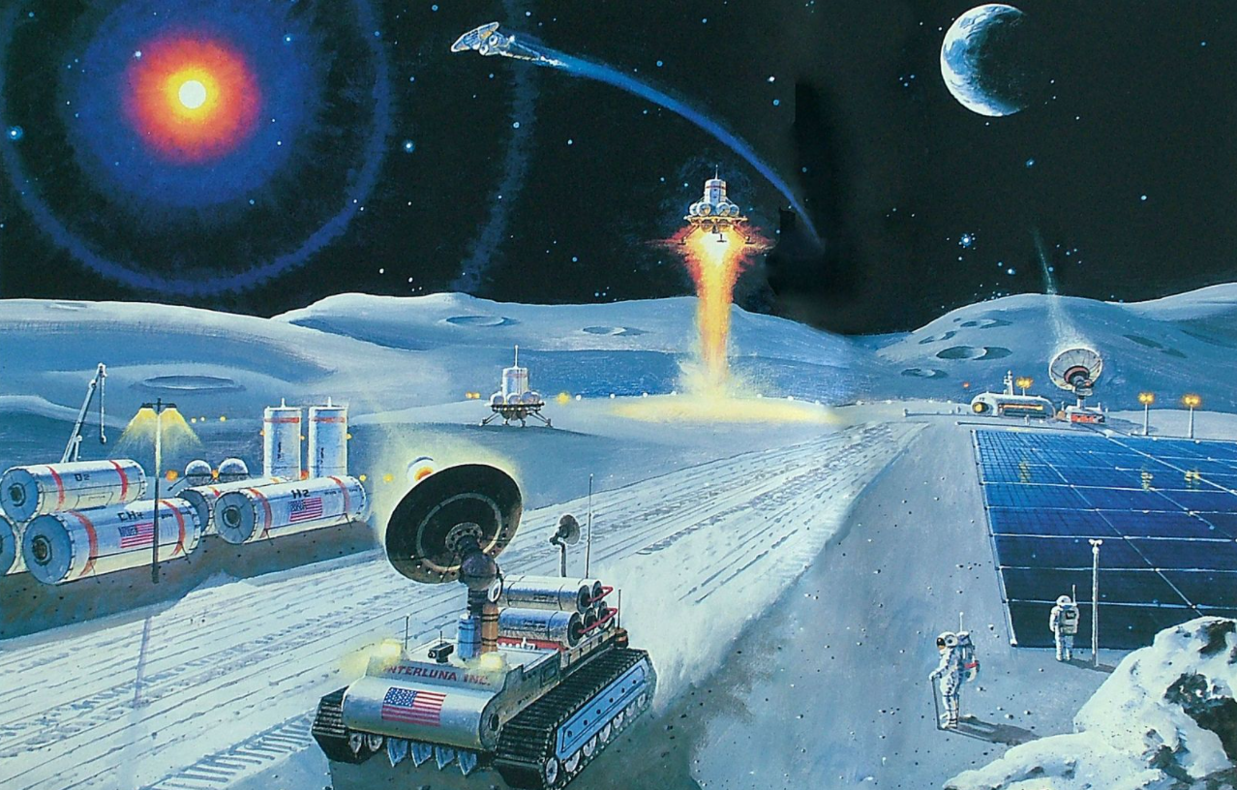
Motivation
How to practically extract resources at large scale
  Full automation
  Self-encapsulated
  Extensible
  Minimal functionality
Can we seek out exemplars from the bio-world ?
  What can we mimic ?
  What do we discard ?

Slide 6

Importance of Launch and Landing Pads
Quick means of transport of goods, services, astronauts to mining sites and outposts will be critical.
Launch and landing pads will be the main gateway into the base and needs to be in excellent condition.
Withstand high demand use
Handle heavy and uneven loading/unloading.

Slide 7
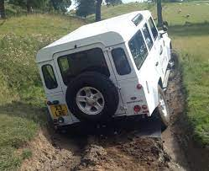
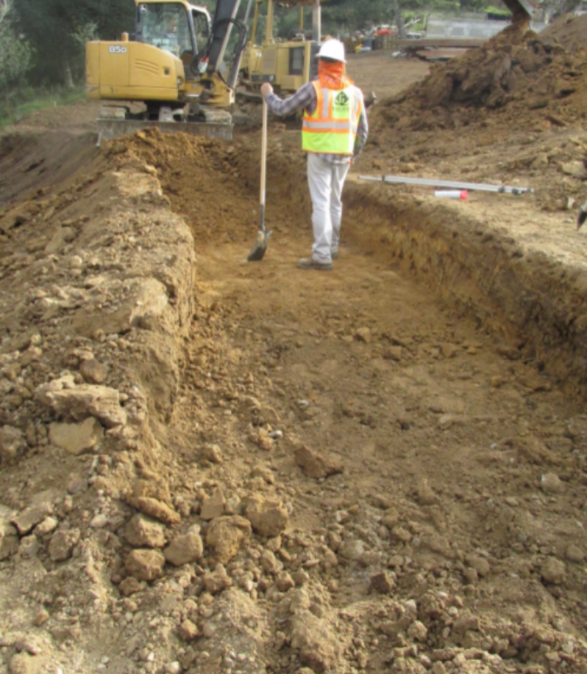
Challenges
Low gravity – low traction → low speeds
Low cohesion sand/dust → increased wear and tear
  Rutting – due to uneven compaction
  Windrows – Build up of material along side due to excavation
Temperature variations
Surface radiation env.
Human support vs. autonomy
Rutting
Windrows

Slide 8
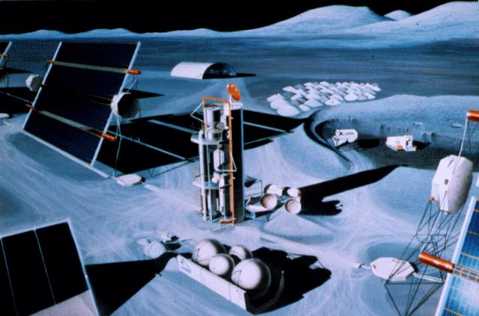
Keys to Lunar Base Robotics
Autonomous Control
  Unstructured environments
  Minimal supervision and task decomposition
  In-situ adaptation
Multiple robots
  Cooperation
  Specialization
  Redundancy
  Ability to improvise
Control development
  Adaptive, robust, little or no onsite support

Slide 9
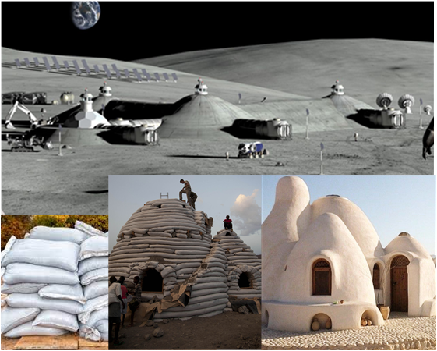
From Excavation to Construction
Papers being presented at Earth and Space, 2022

Slide 10
Objective
Develop an autonomous robotic system to construct Lunar Landing Pads (LLP).
Thrusts: What are the interaction behaviors needed to attain a desired global behavior for a given number of robots ?
  Effective templates
  Effective stigmergy (communication mediated via environment)
  Minimal human input
  How to deal with antagonism ? - negative interaction with too many robots
  Scalable autonomy

Slide 11
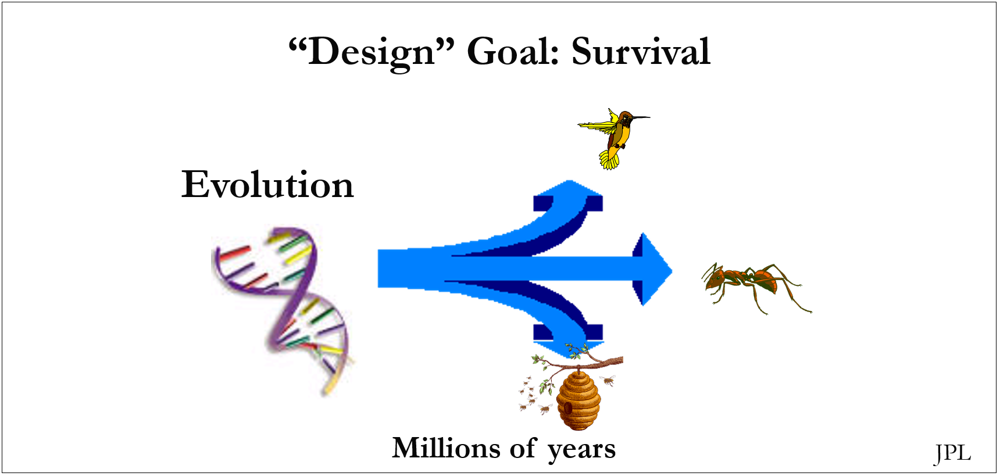
Approach
Biologically inspired ideas suited for design of space robotic systems
Model of natural selection:
  Evolutionary Algorithms [Rechenberg, 1971], [Holland, 1975]

Slide 12
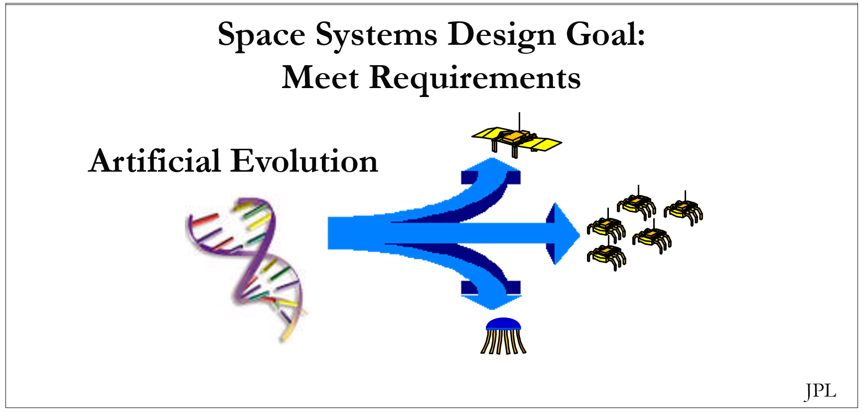
Approach
Biologically inspired ideas suited for design of space robotic systems
Model of natural selection:
  Evolutionary Algorithms [Rechenberg, 1971], [Holland, 1975]

Slide 13

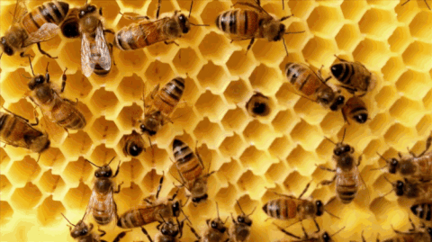
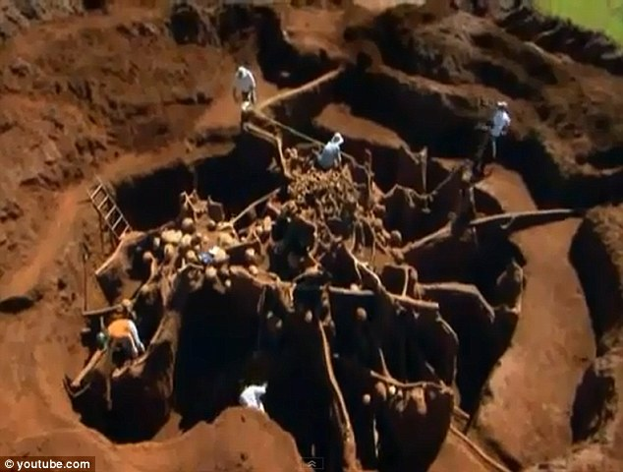
The Engineering Model: Social Insects
“Whole greater than the sum of the parts” -Koffka
Solve a complex task using many individuals.
Individuals are simple, low-cost, disposable.
They have survived for 400+ million years through 2 major extinction events.

Slide 14
The Engineering Model: Social Insects
Stigmergy
Templates
Self-organization

Slide 15
Computation Intelligence for Constructing LLPs
Effective task decomposition
  Task allocation – multiple robots
Find solutions where little task domain knowledge available
  Plastic
  Creative
  Extensible
  Robust, scalable, multiplatform

Slide 16
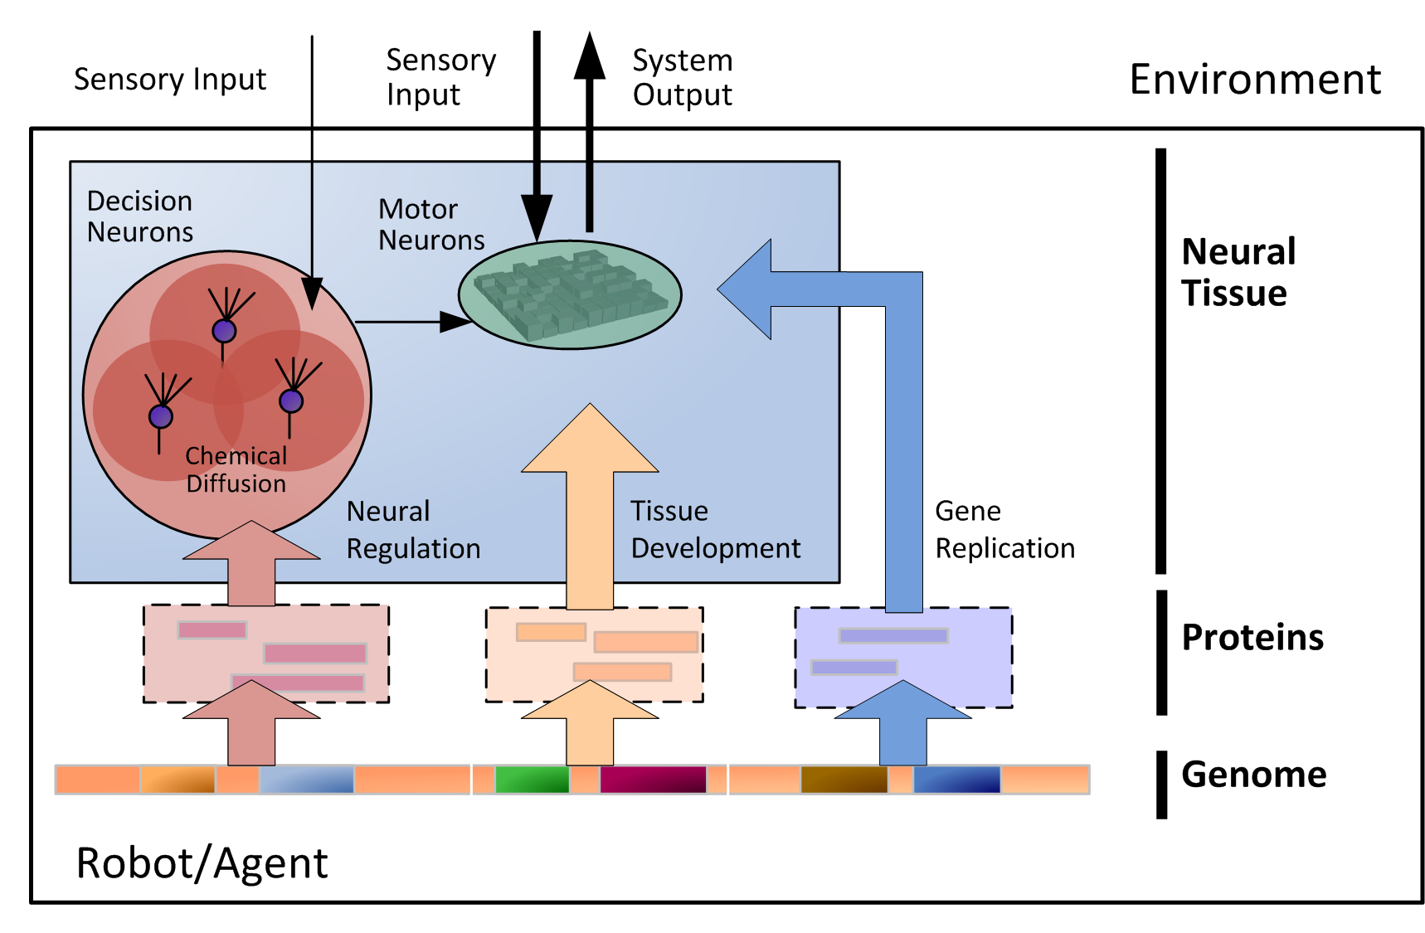
Artificial Neural Tissues
[Thangavelautham & D’Eleuterio, 2005]

Slide 17

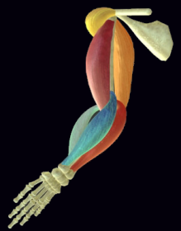
Neural Regulation
Redundancy
Increased Resolution
Competition
Spatial Crosstalk [Jordan & Jacob, 1991]
Sensory Input
Motor Control

Slide 18
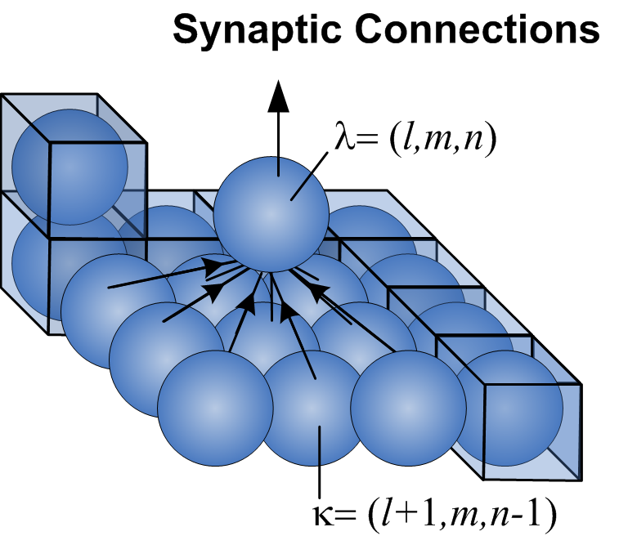
ANT Topology

Slide 19
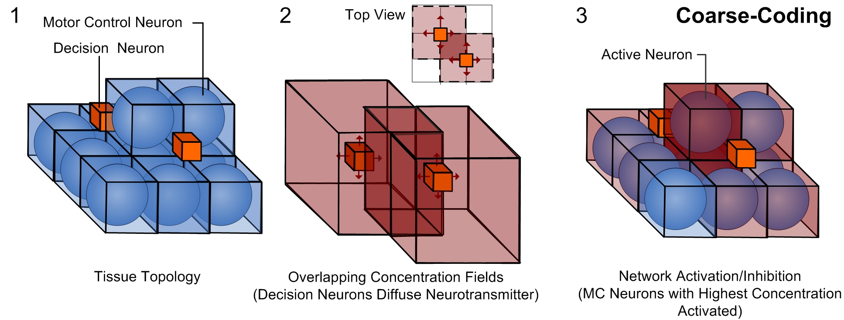
Neural Regulation within ANT

Slide 20
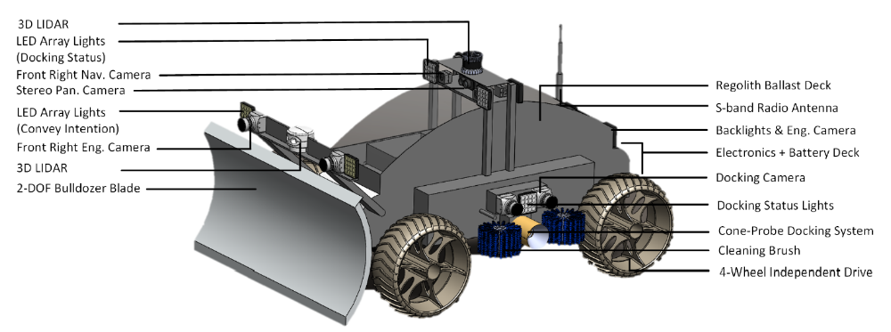
Landing Pad Construction Robot

Slide 21
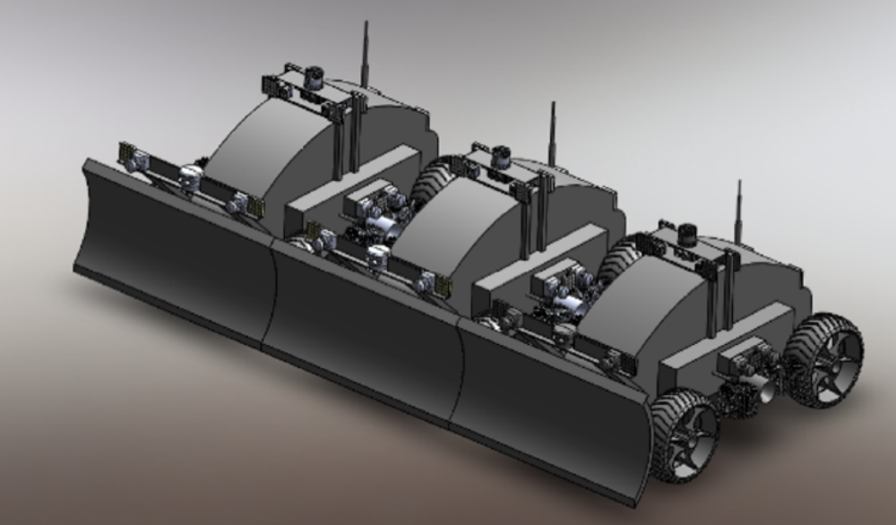
Chaining

Slide 22
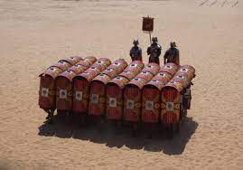
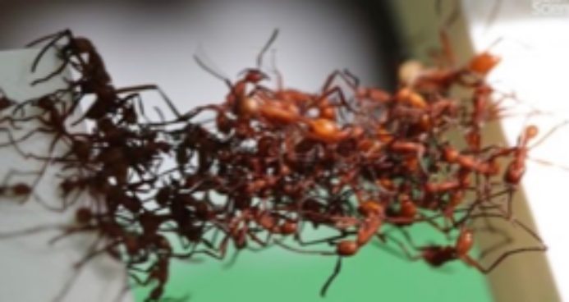
Why Chaining and Aggregation ?
Chaining is form of an aggregation strategy
Requires close coordination but provides x advantage
Ancient Romans used Turtle Formations with great success in battle.
Ants use it as bridges, transport of large objects and a general defensive strategy against a larger threat.

Slide 23
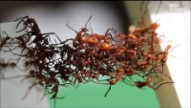
Ant Chaining Behavior

Slide 24
Why Chaining ?
The robots can work cooperatively to clear the landing pad space – avoid antagonism
Exploit the advantage of parallelism
Load evenly distributed.
Reduced windrows per unit area.
Challenge:
How to coordinate the robots
How physically place them next to each other.

Slide 25
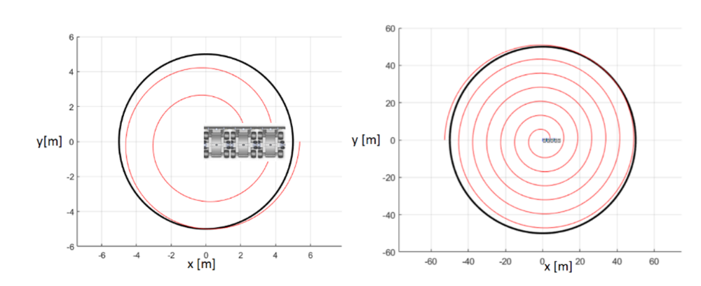
Landing Pad Construction Strategy

Slide 26
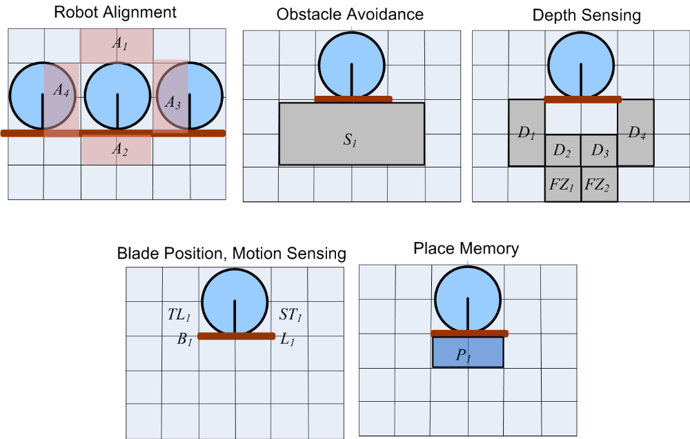
Sensor Inputs

Slide 27
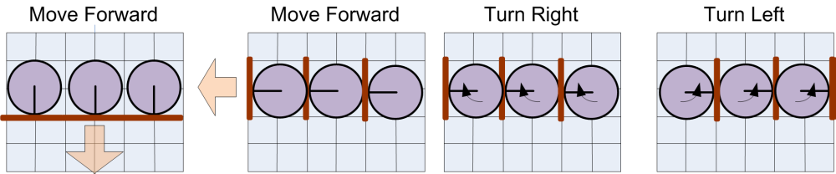
Chained Movement

Slide 28
Task Specification
Robots given blueprint of site to excavate/clear. Also includes site for dumping regolith.
Blueprint specifies depth, grade, and don’t care areas.
The task is time limited.
Evolutionary training involves evaluation of 100+ scenarios.
Robots cannot collide.
Robots cannot get buried in regolith.

Slide 29
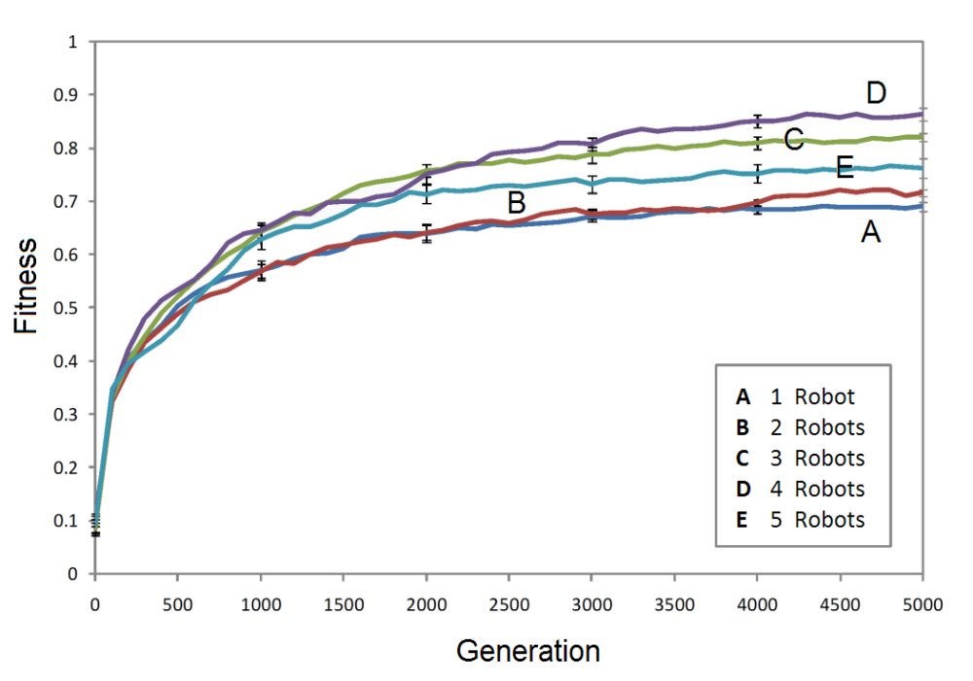
Evolution – No Chaining

Slide 30
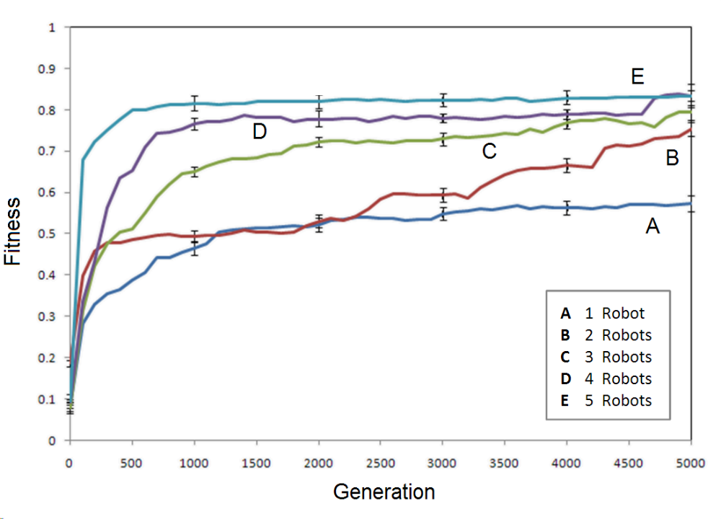
Evolution - Chaining
Under the right conditions chaining reduces learning time towards near-optimal solutions.

Slide 31
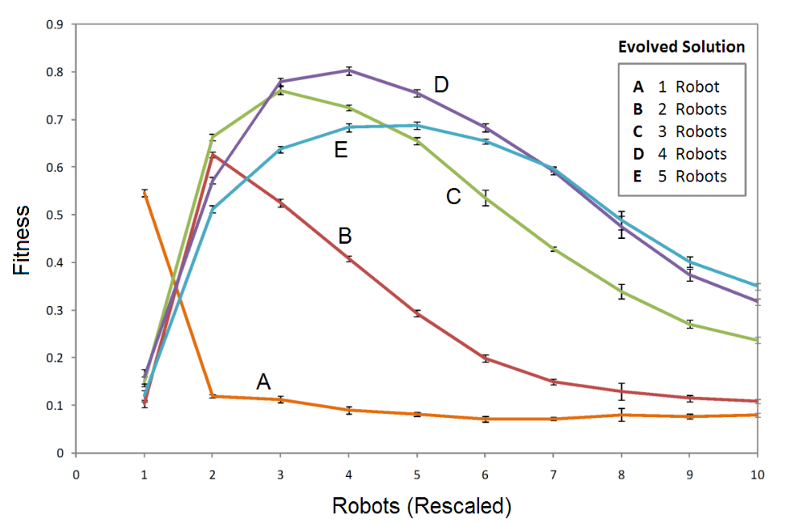
Scalability – No Chaining
Reduced performance with too few robots due to insufficient labor. Too many robots and we have antagonism.

Slide 32
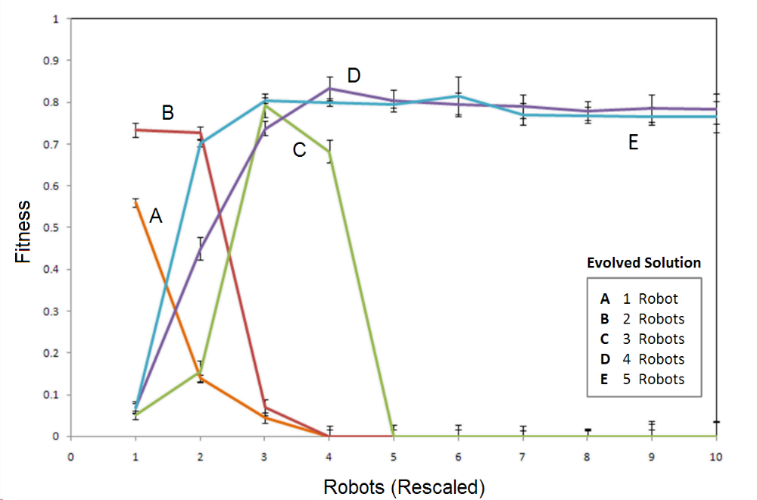
Scalability – Chaining
Antagonism can be significantly reduced and chaining is an advantage over a decentralized approach.

Slide 33
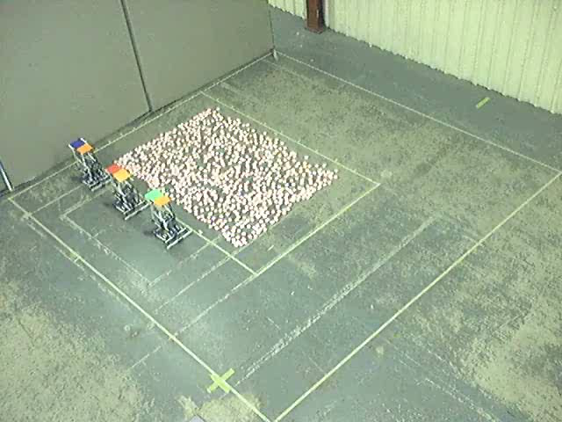
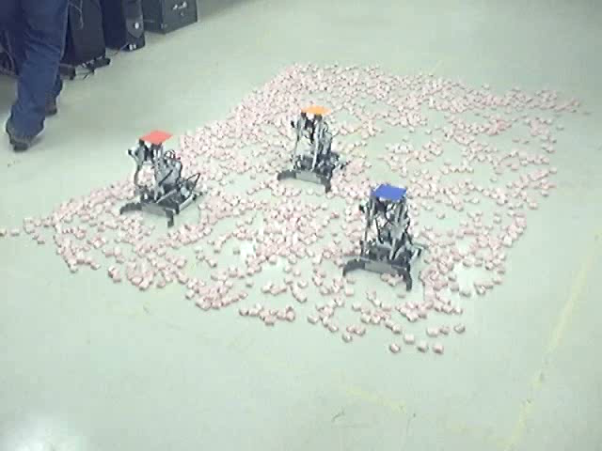
Lab Experiment Comparison
Chaining approach effective at clearing windrows.
Unlikely to get stuck in closed loop that limits area coverage.

Slide 34
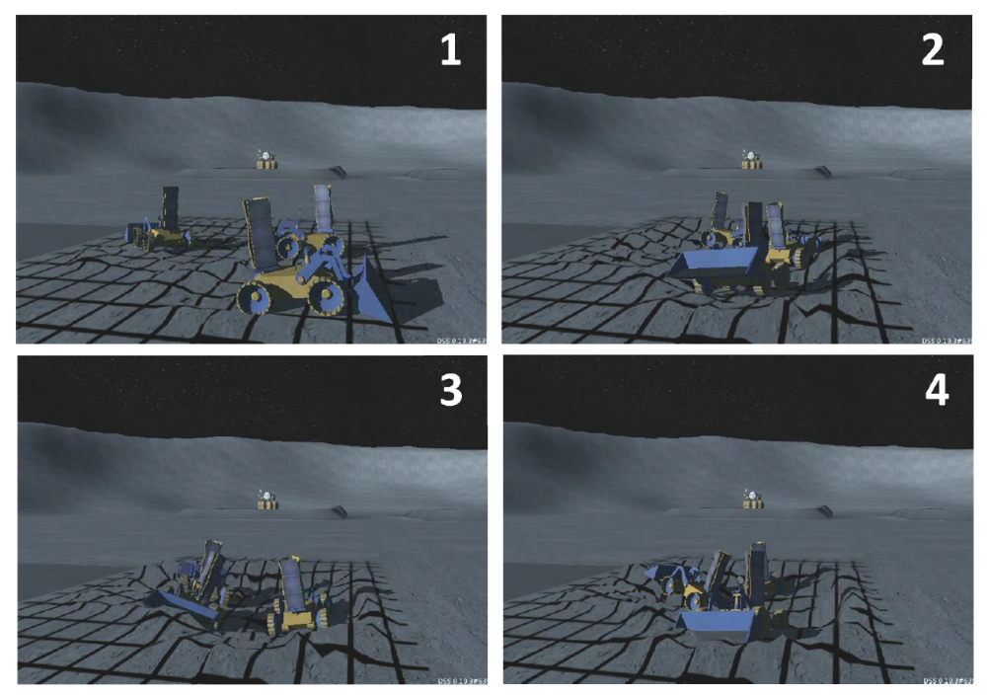
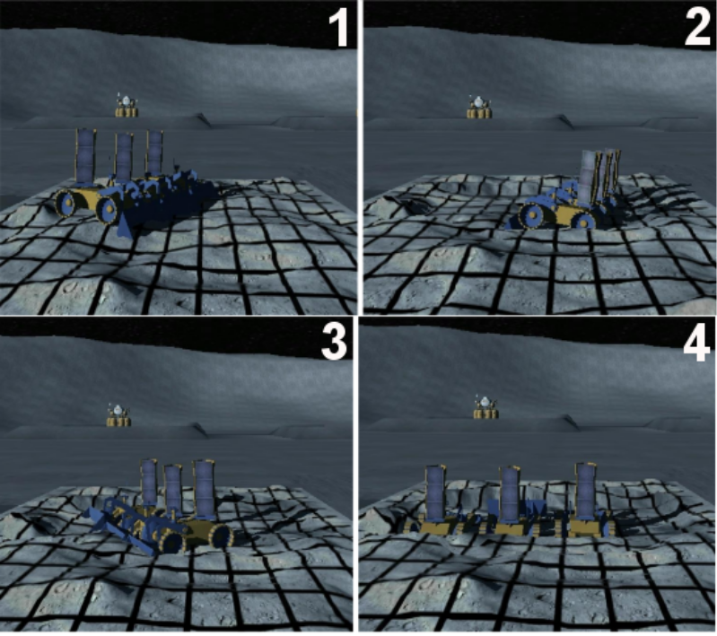
High Fidelity Simulations
Chaining approach shows increased quality (flatness, contiguous) and requires reduced time for clearing an area.

Slide 35
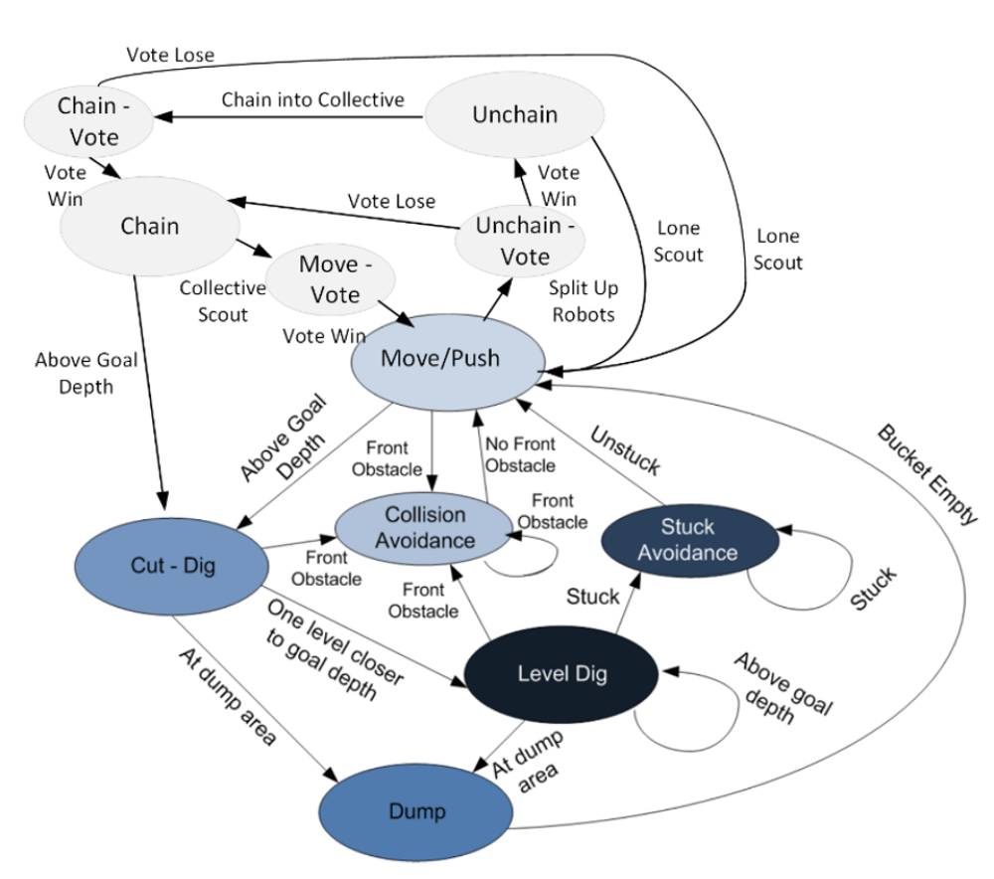
Finite State Machine Controller Derived from ANT
Captures key behaviors
FSM easy to understand
Easy to port.
Helps with prediction

Slide 36
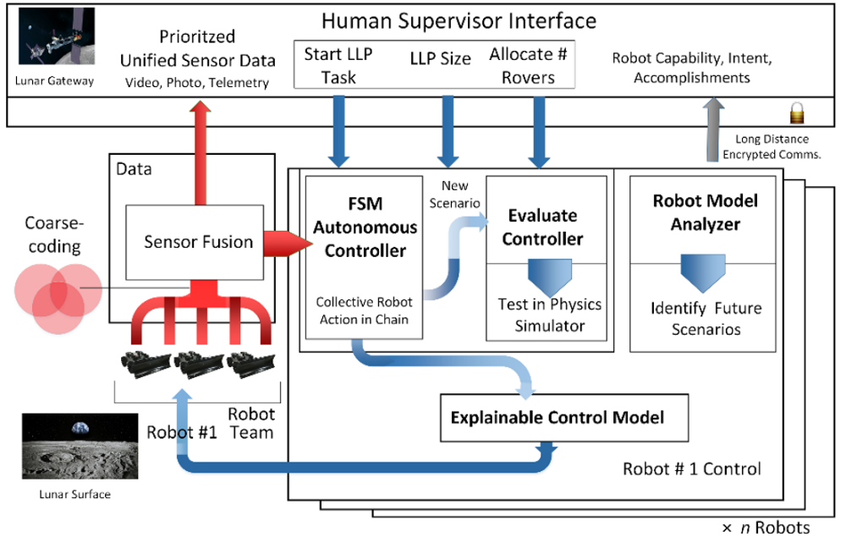
Implementation on a Mission

Slide 37
Discussion
Chaining/aggregation approach shows promising results for area clearing tasks.
  Increased quality, reduced time due to increased efficiency.
  Avoids antagonism
Experiments have shown it clear windrows. It has the potential to reduce rutting. More experiments needed.
Challenge is how to implement on real robots without substantial increase in complexity.
  Deal with large obstacles that may require unchaining (?)

Slide 38
Future Work
Physical comparison of several candidate chaining methods including using docking.
Evaluation of robots performing chaining, dispersal and chaining.
Construction of half or third scale rover team for the landing pad construction task.

Slide 39


Slide 40
Thank You!

Slide 41
Questions ?

Slide 42
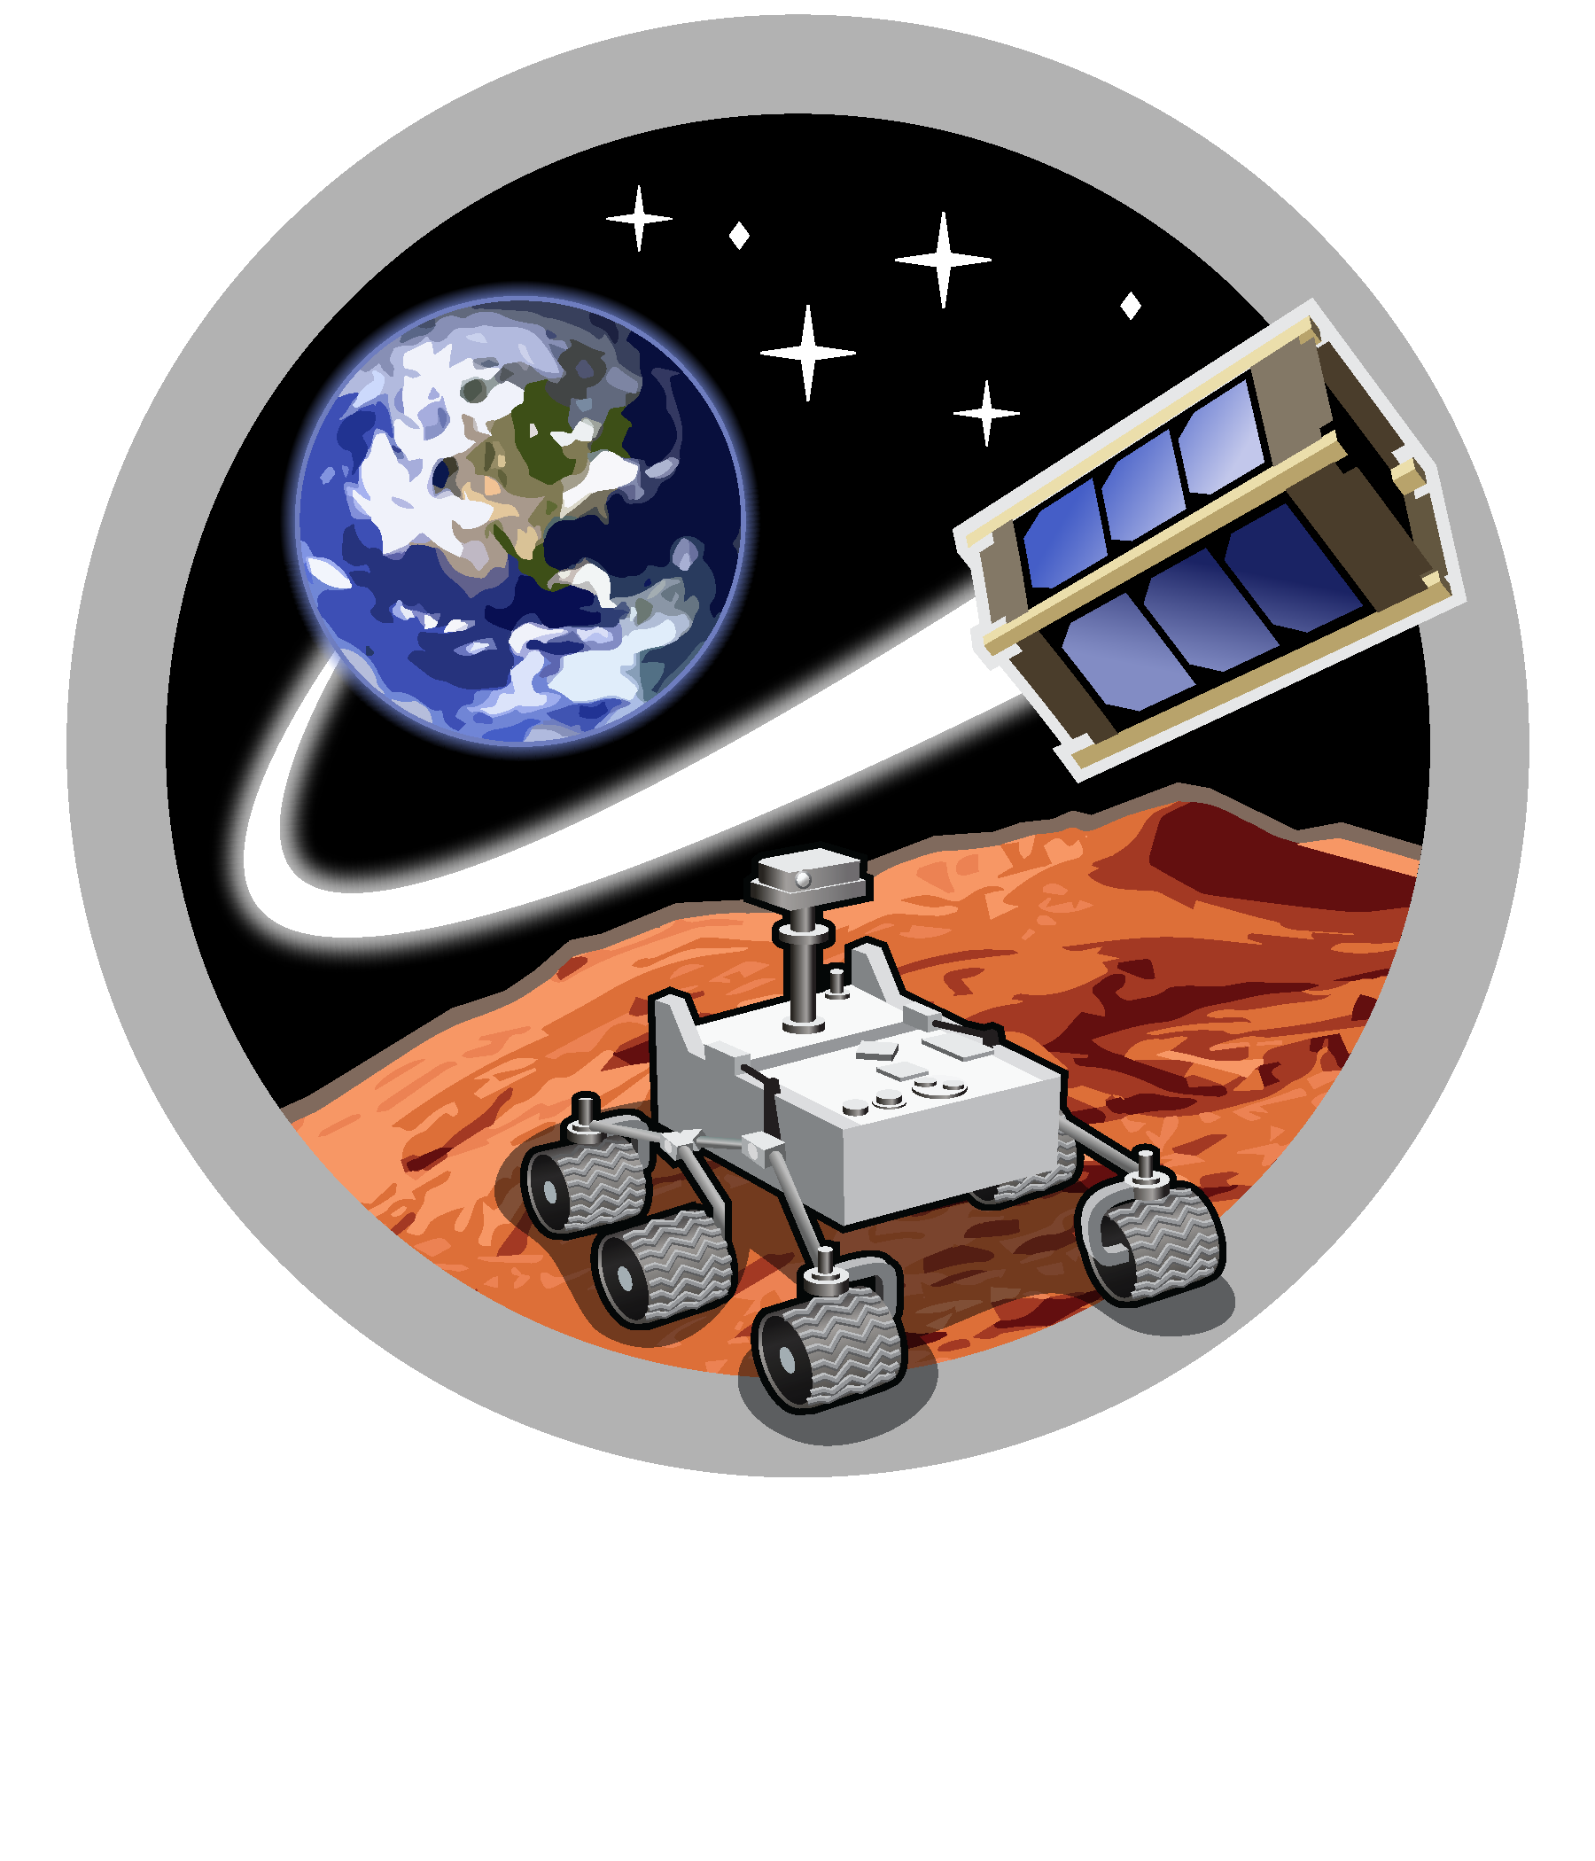
Space and Terrestrial Robotic Exploration (SpaceTREx) Laboratory

Slide 43

Asteroid Science, Technology and Exploration Research Organized
by Inclusive eDucation (ASTEROID) Center

