Slide 1

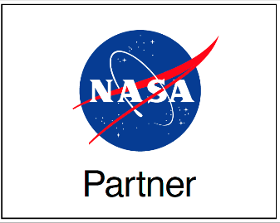

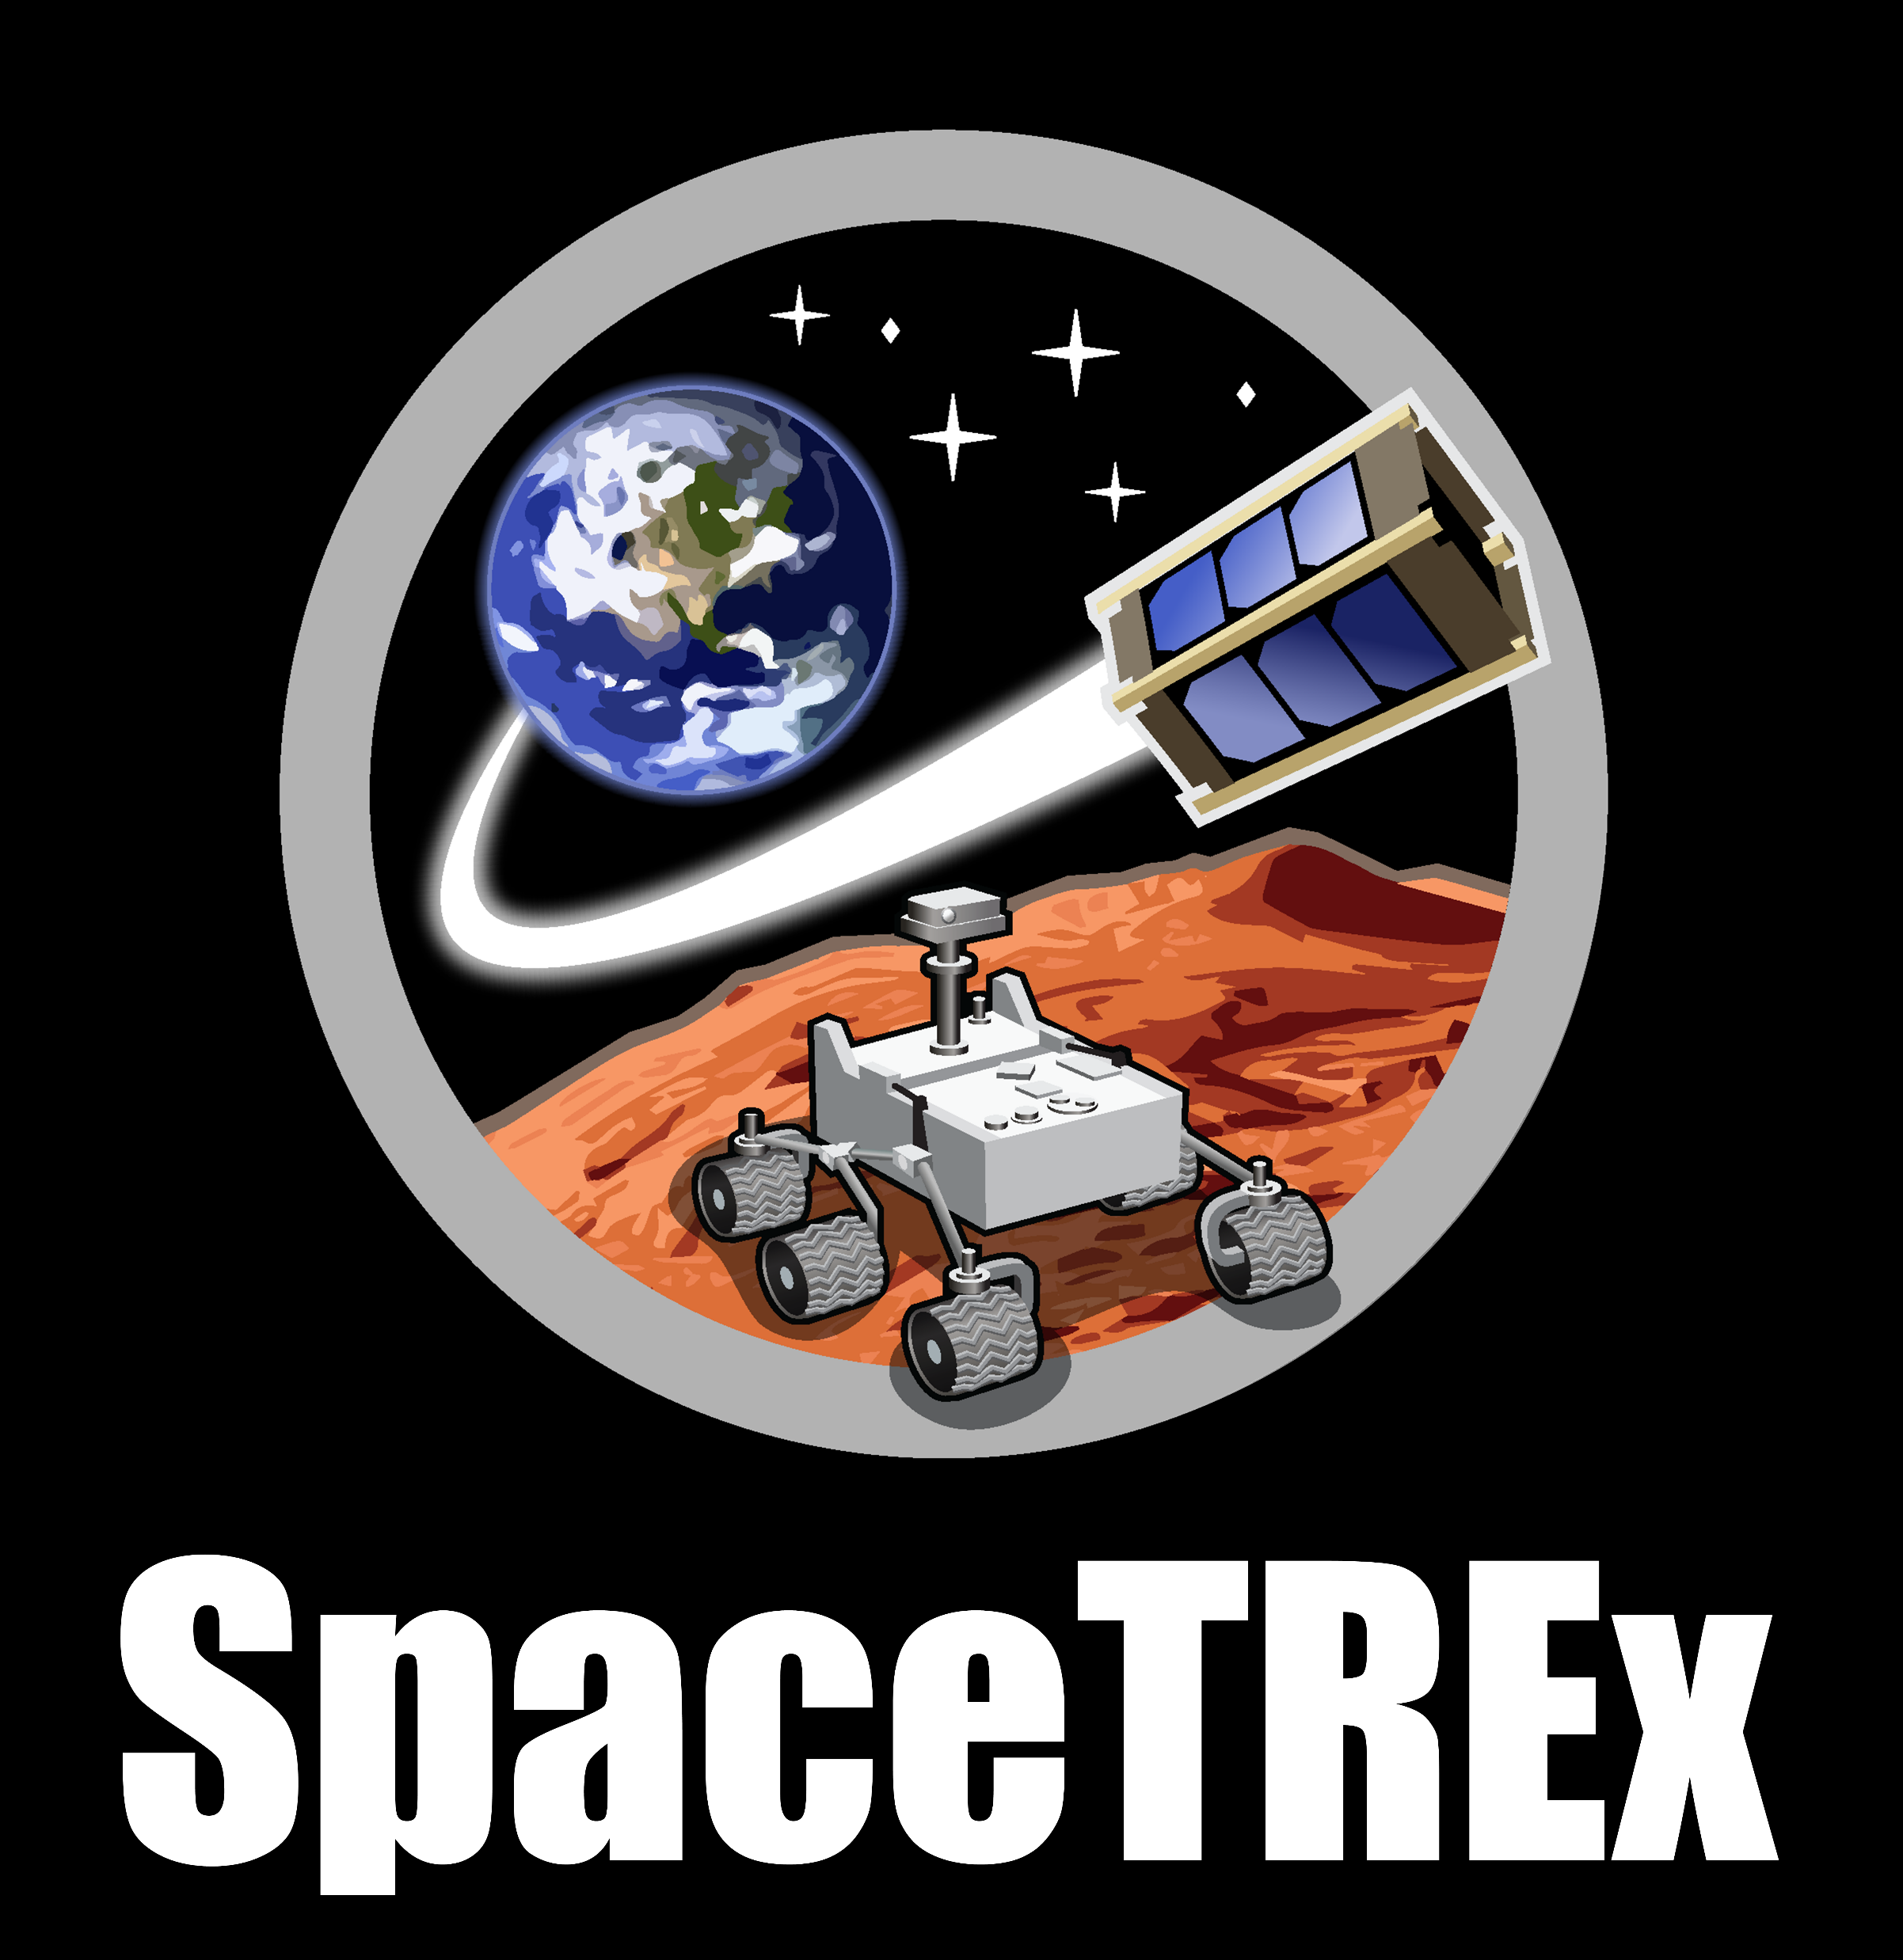
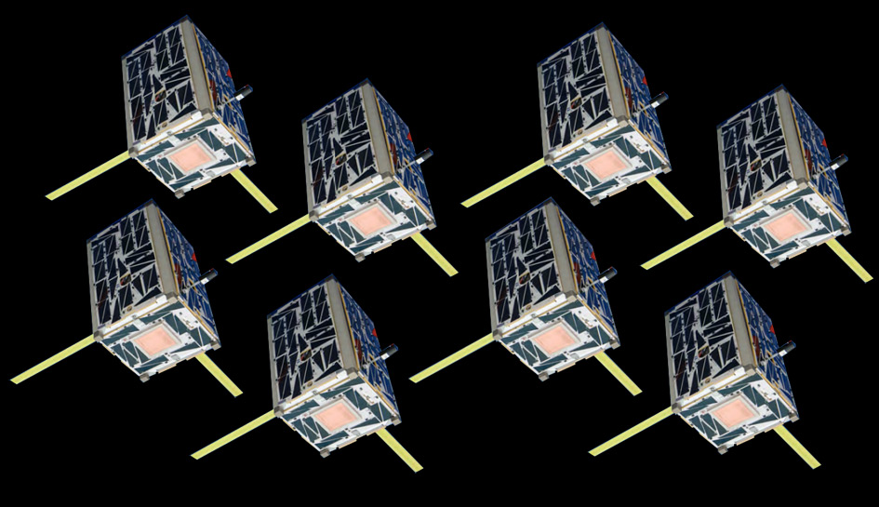
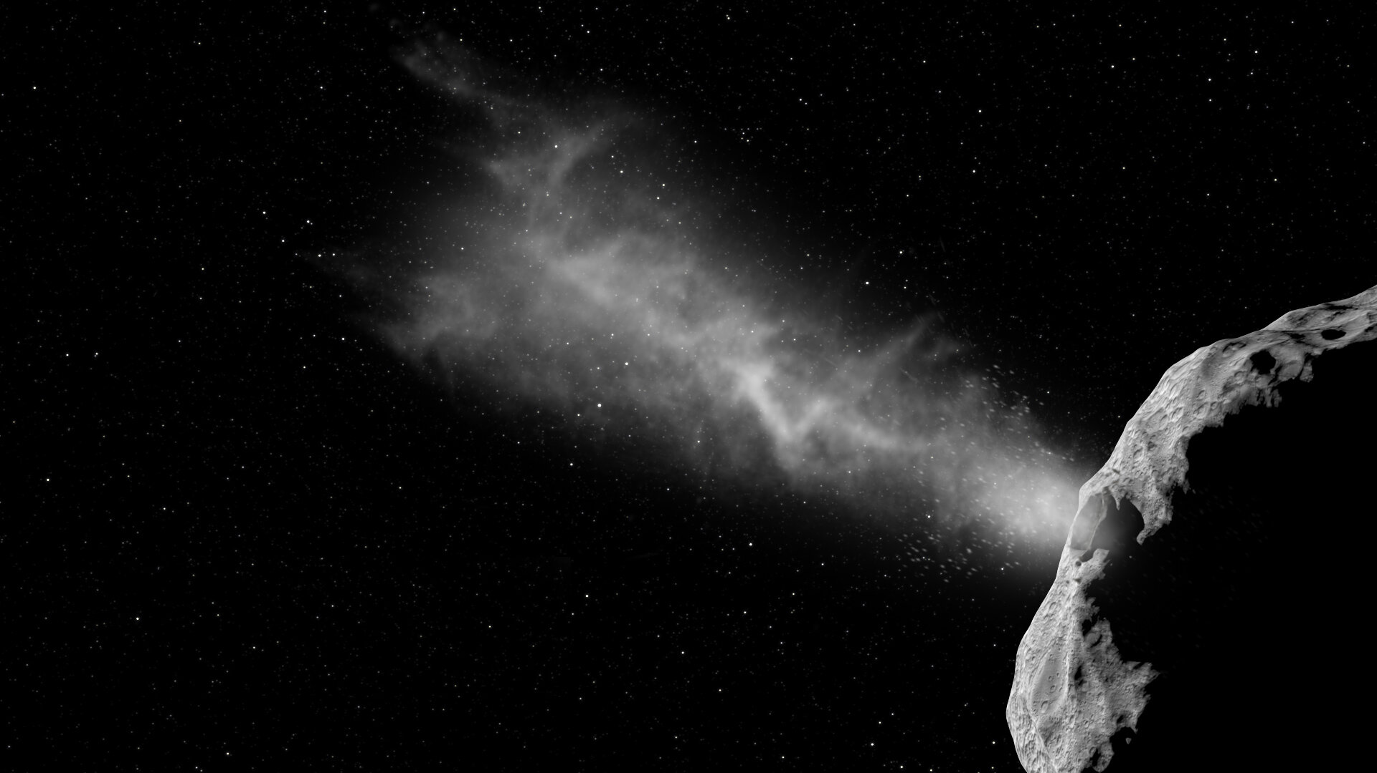
CubeSat Asteroid Impact Matrix
Sample Return Mission Concept
Jiawei Qiu, Virupakshan Vilvanathan, Athip Thirupathi Raj, Sebastian B. Miranda,
Erik Asphaug, Jekan Thangavelautham
Space and Terrestrial Robotic Exploration (SpaceTREx) Laboratory
Aerospace and Mechanical Engineering Department
University of Arizona

Slide 2
Outline
Motivation
Challenge
Approach
  Spacecraft design
  Concept of Operation
  Distributed satellite network
Conclusion / Future Work

Slide 3
Motivation
Science Motivation
Planetary Defense
Technology Demonstration
Bennu
Topological
Map
Artist’s
Impression
DART Mission
(NASA)
(GETTY)
(NASA)

Slide 4
Challenges
Estimated target for this mission concept:
USD$10M for spacecraft development
1 year development time
2-3 years mission duration
Flyby return ΔV for near Earth asteroids
Mission | DART | OSIRIS-REx | Hayabusa 2
Development Budget (USD$M) | 308 | 588.5 | 100 (estimated)
Development Time | 3 years | 5 years | 4 years
Mission Duration | 11 month | 7 years | 6 year
Target Body | Didymos | Bennu | Rygyu
Rendezvous return ΔV (km/s) | 6.34 | 6.97 | 6.29
Flyby return ΔV (km/s) | 3.40 | 3.73 | 3.36

Slide 5
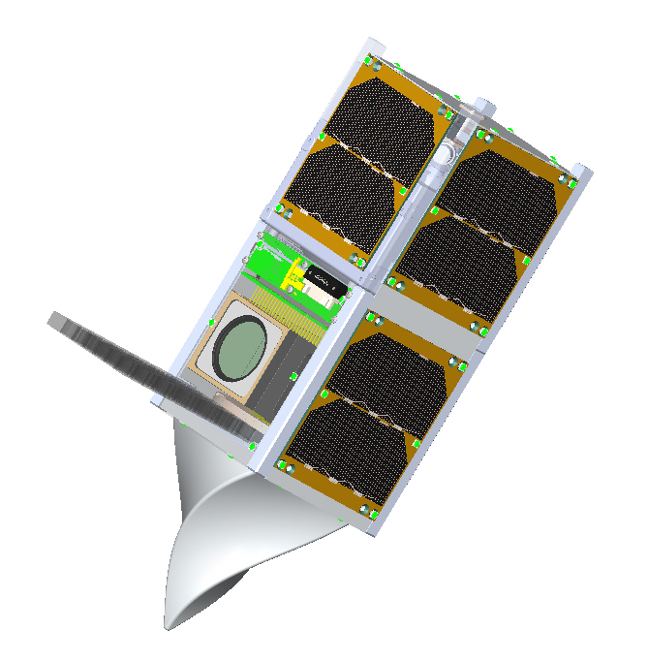
Preliminary Spacecraft Design
Docking Adapter
(female)
 | CubeSat Requirement
1 | Volume at 3-4 U
2 | Fully autonomous
3 | COTS components if possible
4 | Docking possible
5 | Distributed command network
6 | Communicate with nearby CubeSats
7 | ADCS + monopropellant propulsion
On-board computer
Radio Telecom
Telescope Camera
+ Spectrometer
Extendable
Aerogel Capture
LED
Docking Adapter
(male)
V. Vilvanathan, Athip. T. Raj
SpaceTREx,University of Arizona
3D Rendering of Sacrificial CubeSat

Slide 6
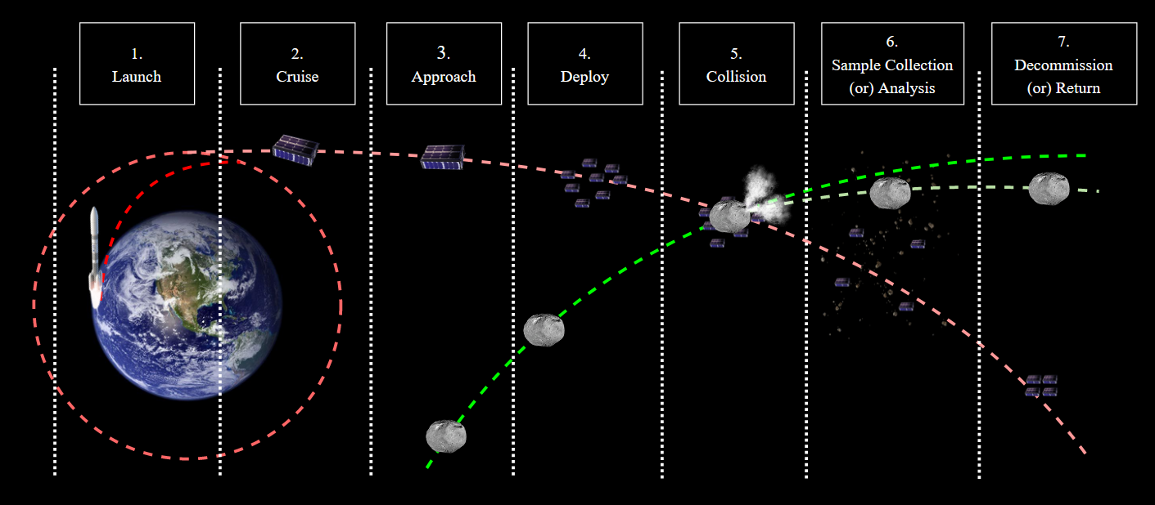
Concept of Operation
Notes:
Launch
Cruise
Arrive at Intercept Point
Deploy CubeSats
Collision
Sample Collection/Analysis
Retrieve CubeSats
Return trajectory / Decommission

Slide 7

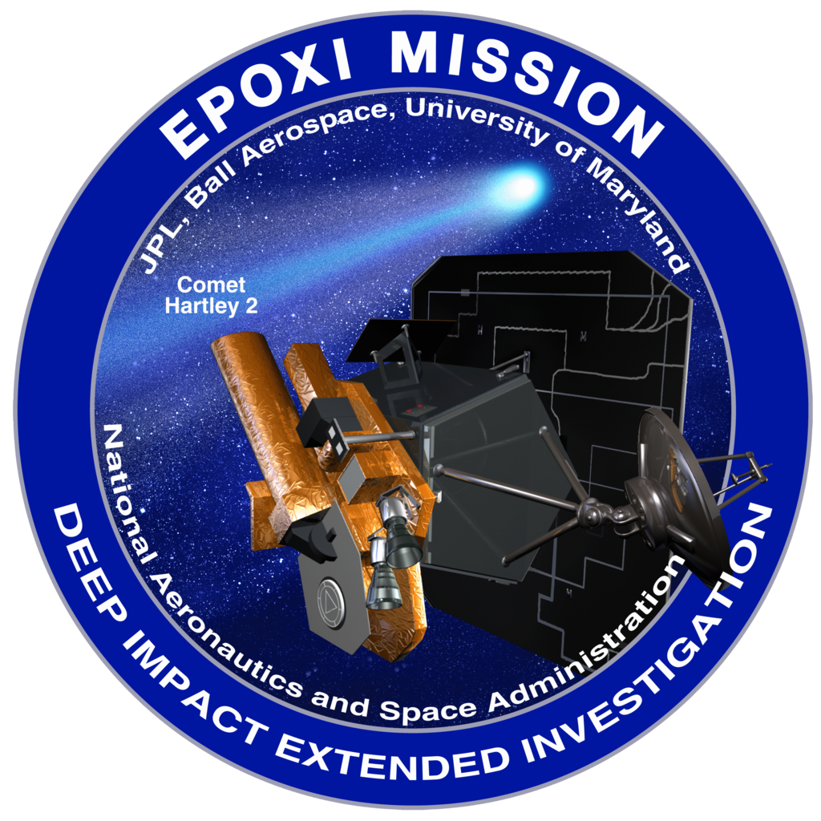
Phase 3: Approach
Cameras track the asteroid position during approach and GNC subsystem operates
Optional adjustments to trajectory in order to increase the probability of collision and sample collection
Images of comet captured by EPOXI mission during flyby in 2010 (NASA)

Slide 8
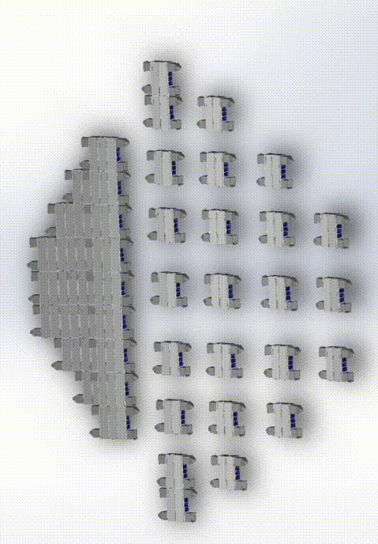
Phase 4: Deploy CubeSats
CubeSats separate from the mothership/docked formation and form a 2D grid “fish-net” formation
  “Fish-net” diameter 2x asteroid’s
  CubeSat separation less than asteroid diameter
CubeSat swarm formation studied extensively in Earth’s orbit
  Further study required for deep space
Athip. T. Raj, SpaceTREx
University of Arizona
CubeSat Deploy Procedure

Slide 9
Phase 5: Collision
A fraction of CubeSats are destroyed
Surviving CubeSats use camera to monitor downrange debris, adjust position to avoid secondary collision in critical modules
Further study into component robustness
Further simulation required for ejecta modelling
  Ensure good amount of downrange ejecta for collection
  Realize specification for CubeSats (mass, size)

Slide 10
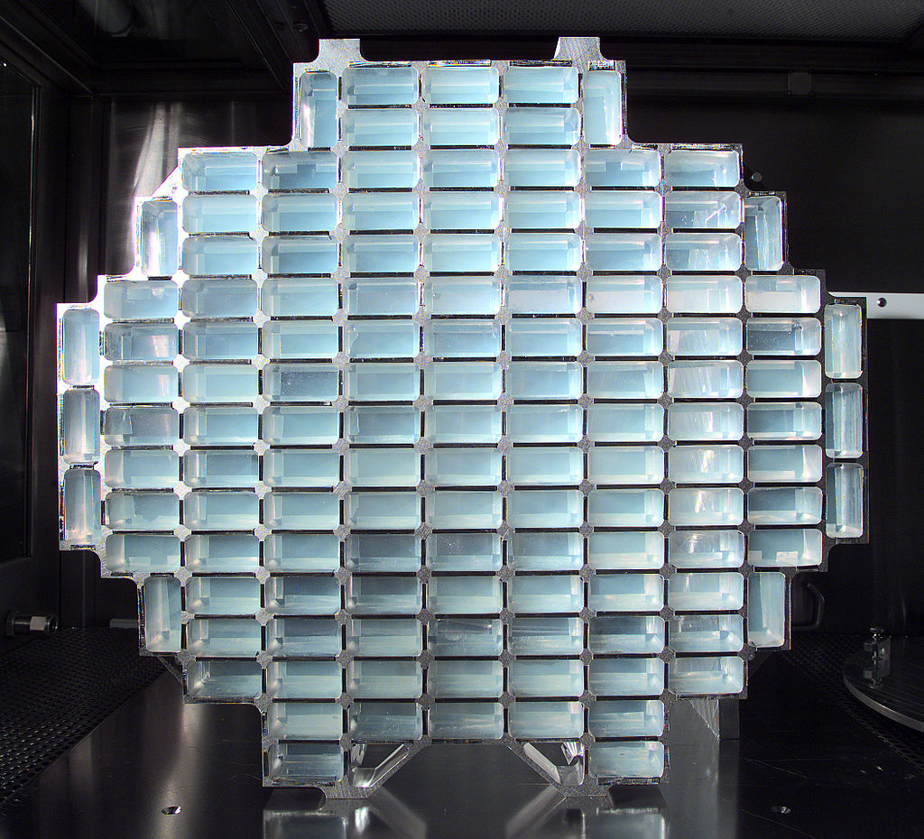

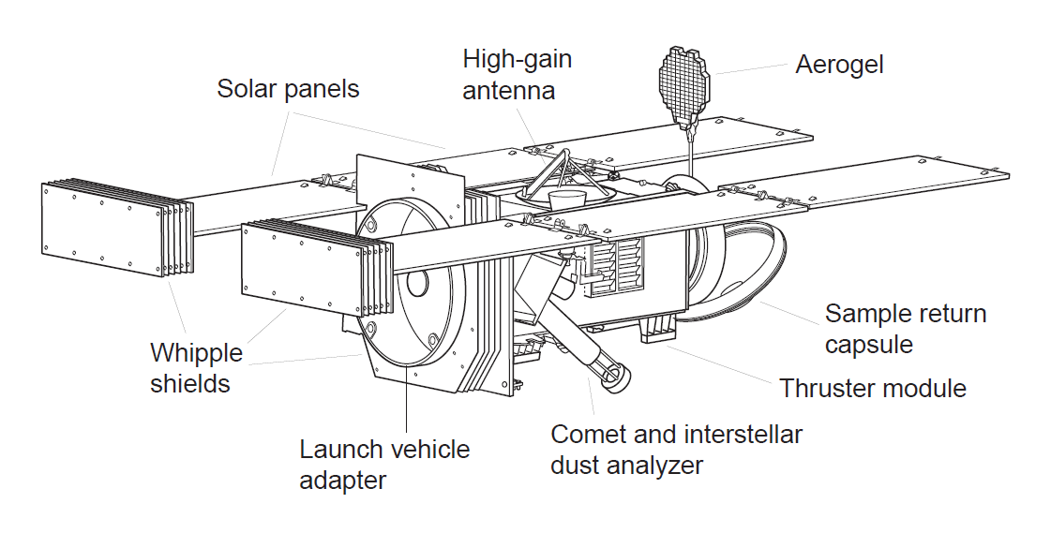
Phase 6: Collection/Analysis
Surviving CubeSats attempt to use GNC to capture debris in aerogel collection module
In-situ analysis
  Composition
  Regolith size distribution
  Surface regolith cohesion
Further ejecta simulations required to improve sample capture efficiency
Stardust Sample Collection Module
(NASA)
Stardust Mission Spacecraft

Slide 11
Phase 7: Return/Decommission
The surviving CubeSats recombine and return to mothership
  No re-entry heat shielding on CubeSats
  Downlink primary scientific data
Trajectory adjustment for Earth return trip
If mission-critical failure occurs, adjust for decommission
  No collision occurred
  No sample collected
  No CubeSats survived

Slide 12
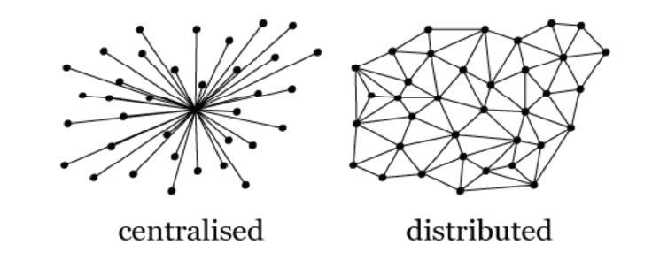
Distributed Processing Network
Centralized command not possible in the “fish-net” CubeSat configuration
Surviving CubeSats after the collision can reestablish another smaller functional network

Slide 13
Distributed Processing Network
Physical: antenna design, specification, frequency band
  …depend on “fish-net” specification
Data link: scalability, bandwidth utilization, fairness
  Require protocol to avoid collision
  Contention-based (CSMA) vs. conflict-free (CDMA)
Network: data packet routing
  Proactive vs. reactive scheme
  Multiple routing algorithm developed extensively
  Consider switching scheme/algorithm at different phases
Application
Presentation
Session
Transport
Network
Data link
Physical
Framework for Inter-satellite communication (T. Vladimirova, 2010)
Notes:
Carrier Sense Multiple Access
Code Division Multiple Access

Slide 14
Conclusion / Future Work
Enables a new age of asteroid exploration with low-budget, quick- turnaround, fast-result missions
Standardizes asteroid exploration mission spacecraft development process with minor modifications for mission-specific objectives
Demonstrates distributed network technology of CubeSats in deep space – requires further study to realize implementation
Collision simulations and ejecta modelling required to evaluate the success rate of mission concept

Slide 15
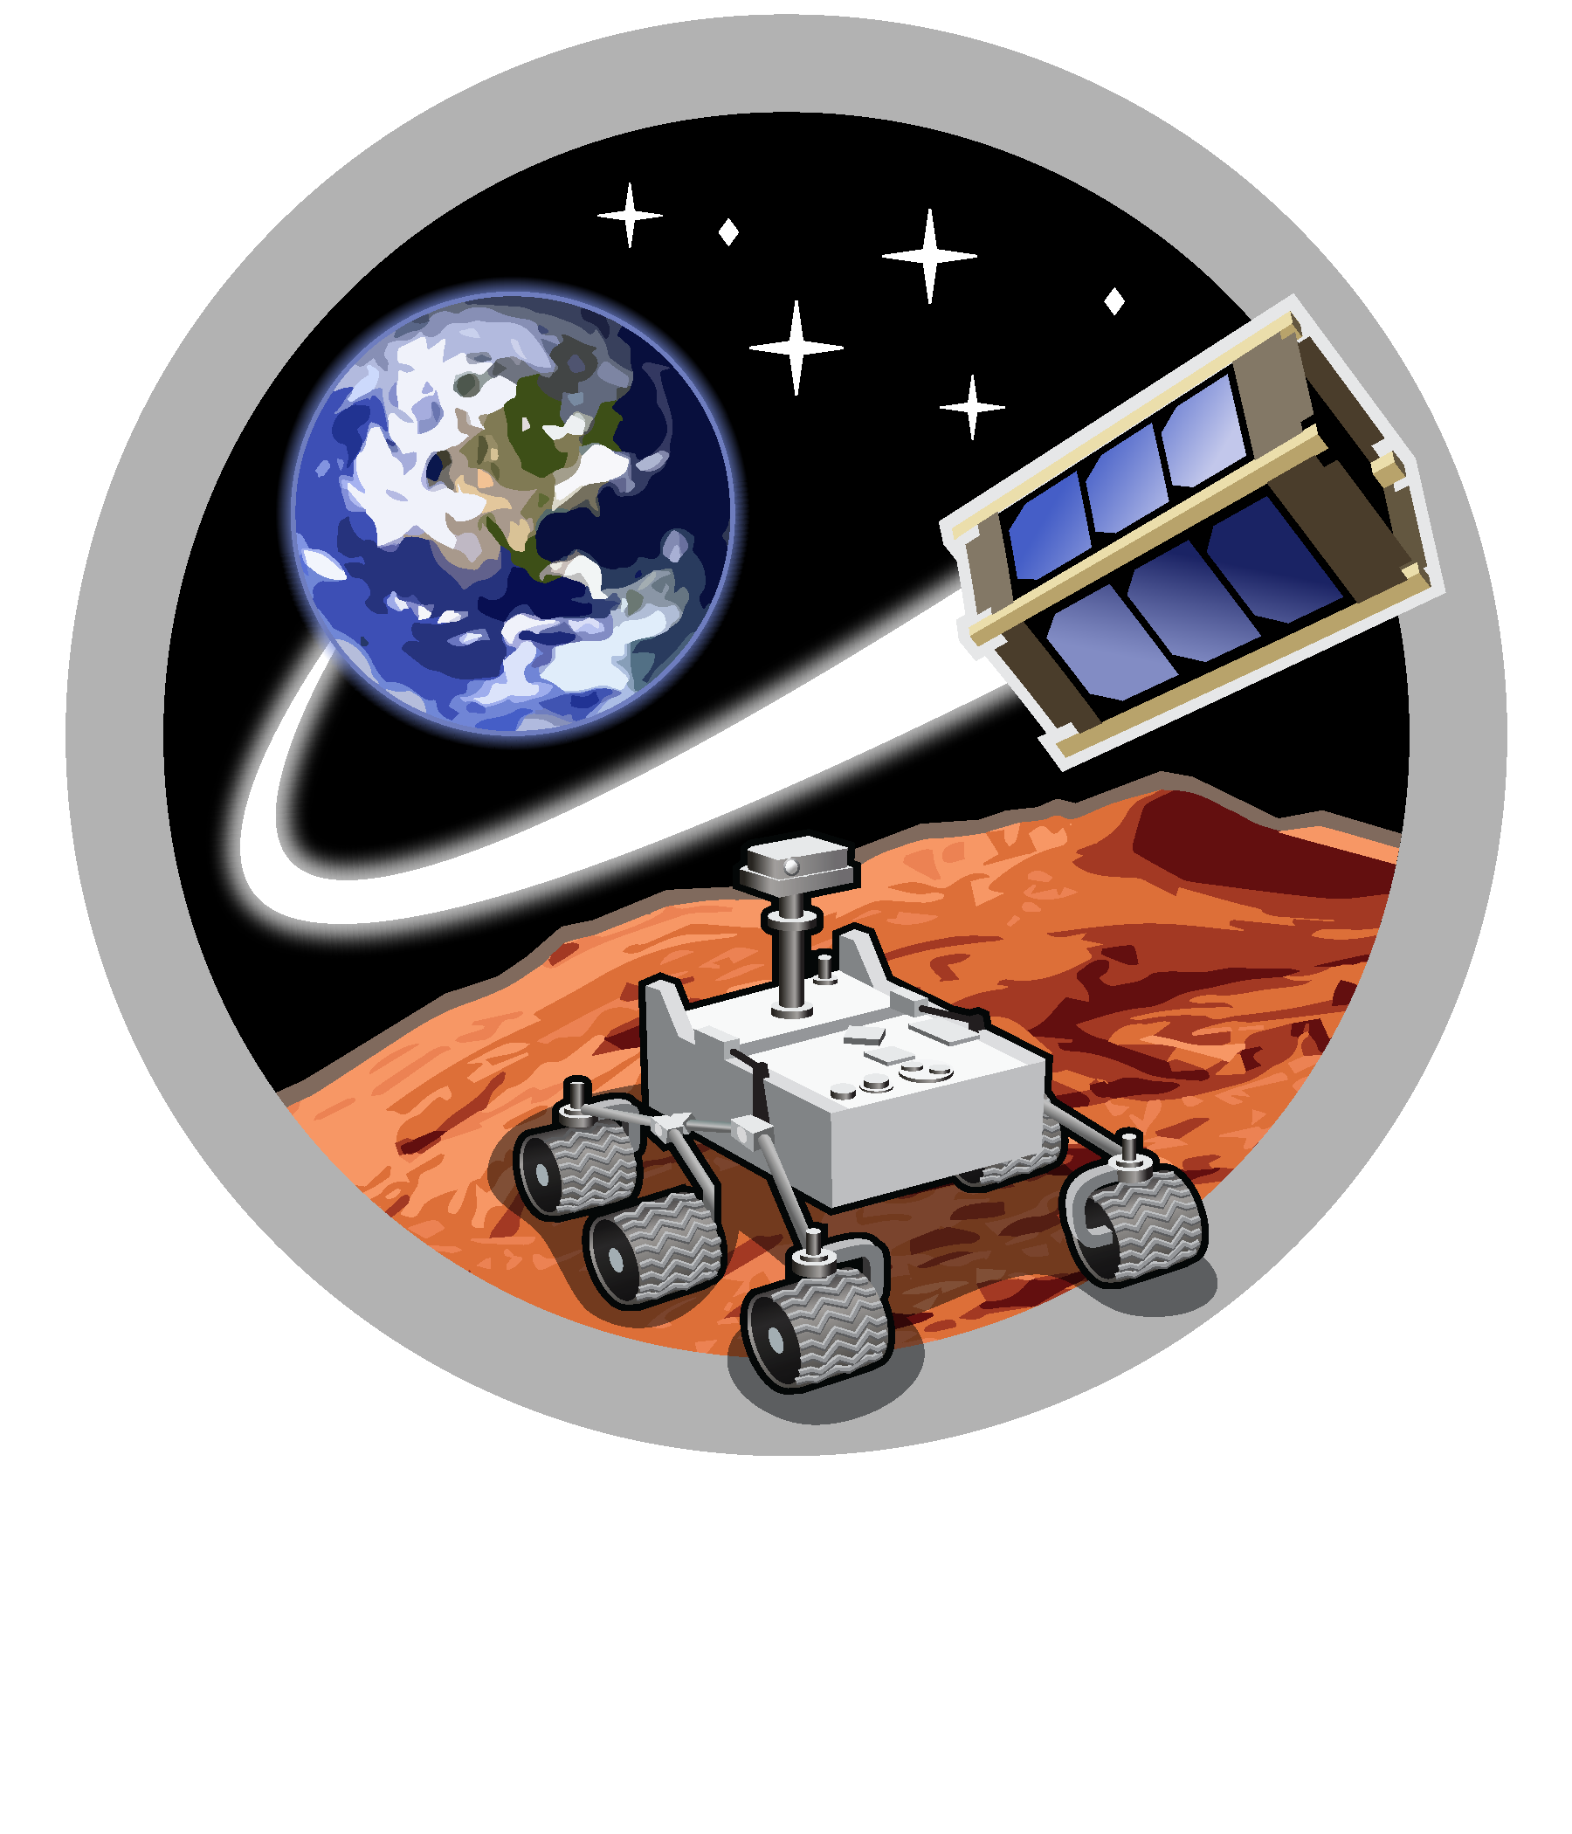
Space and Terrestrial Robotic Exploration (SpaceTREx) Laboratory

Slide 16
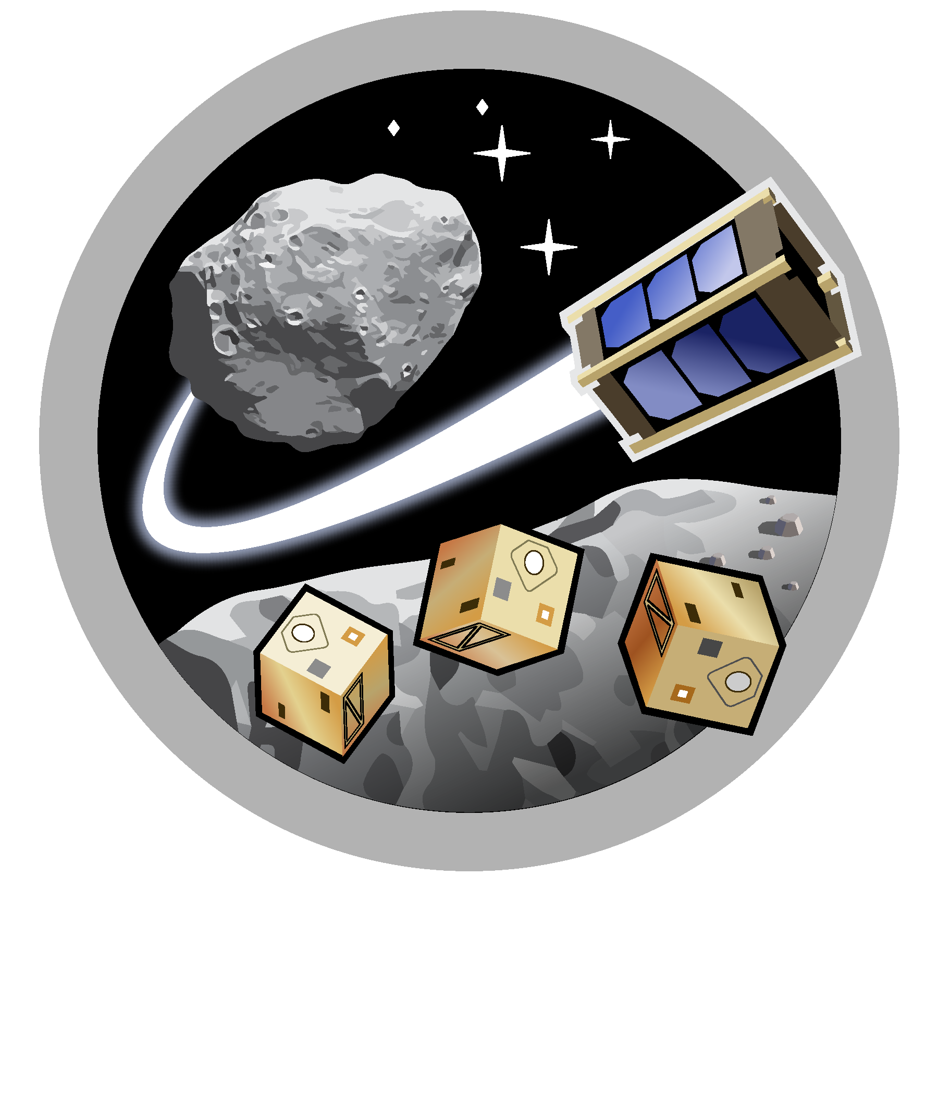
Asteroid Science, Technology and Exploration Research Organized
by Inclusive eDucation (ASTEROID) Center

Slide 17
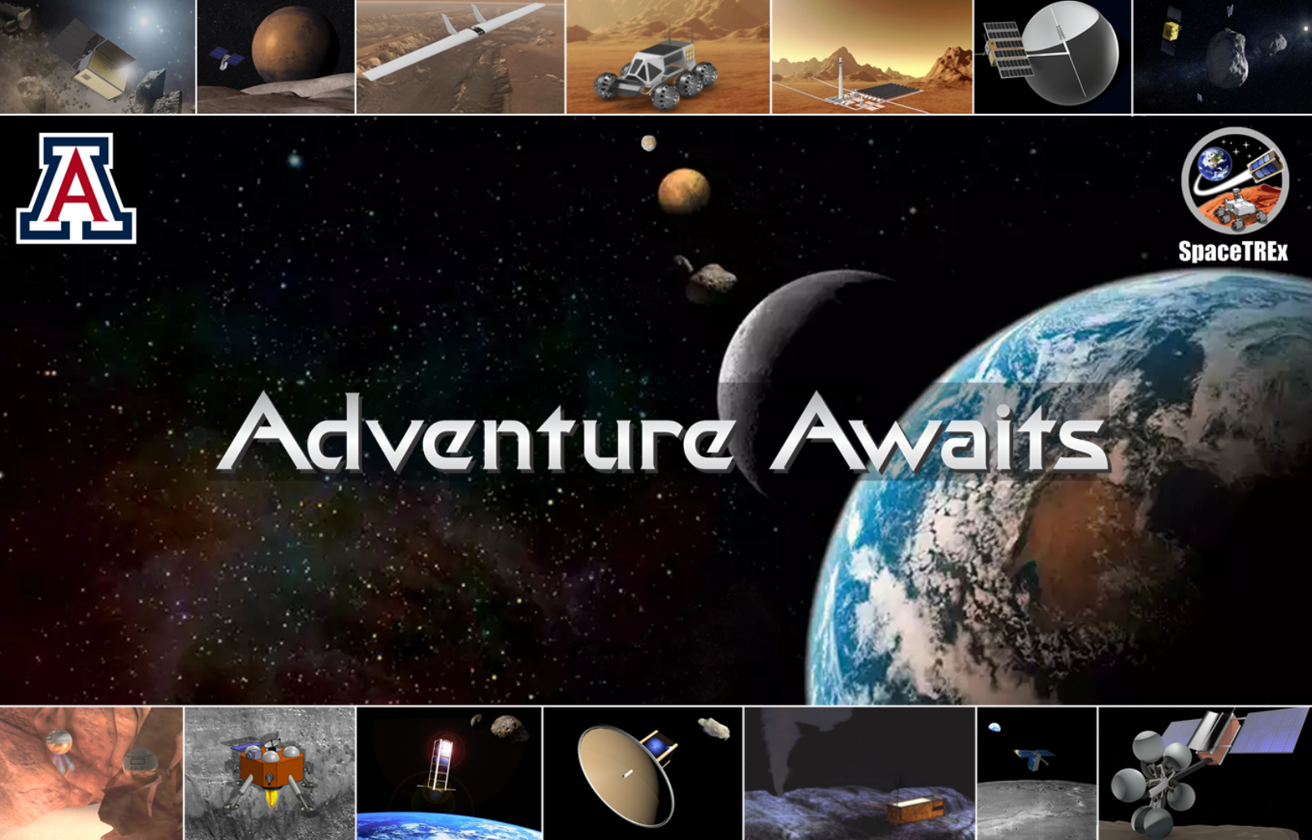

Slide 18
Reference
Vladimirova, T., Bridges, C.P., Paul, J.R., Malik, S.A. and Sweeting, M.N., 2010, March. Space-based wireless sensor networks: Design issues. In 2010 IEEE aerospace conference (pp. 1-14). IEEE.
Radhakrishnan, R., Edmonson, W.W., Afghah, F., Rodriguez-Osorio, R.M., Pinto, F. and Burleigh, S.C., 2016. Survey of inter-satellite communication for small satellite systems: Physical layer to network layer view. IEEE Communications Surveys & Tutorials, 18(4), pp.2442-2473.

Slide 19
Motivation
Asteroid Sample Return + Trajectory Redirection
Scientific motivation
  Asteroid composition
  Asteroid origin
  History of Solar System
Planetary Defense
  Modify trajectory of hazardous objects

Slide 20
Challenges
Specifically designed for each asteroid encounter mission
  Significant development budget
  Long development duration
Significant launch budget
  High delta-v for rendezvous return trip
  Precise navigation and trajectory design required
Long mission duration

