Slide 1




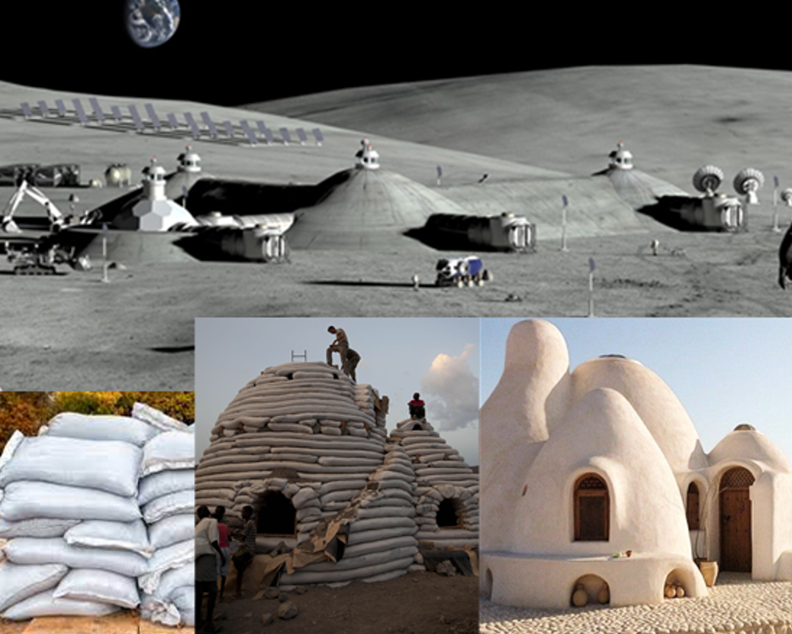
Robust Lunar Base Architectures using
Smart Pico-Building Blocks
Jiawei Qiu, Sebastian B. Miranda, Virupakshan Vilvanathan, Yinan Xu, Athip T. Raj,
Erik Asphaug, Jekan Thangavelautham
Space and Terrestrial Robotic Exploration (SpaceTREx) Laboratory
Aerospace and Mechanical Engineering Department
University of Arizona

Slide 2
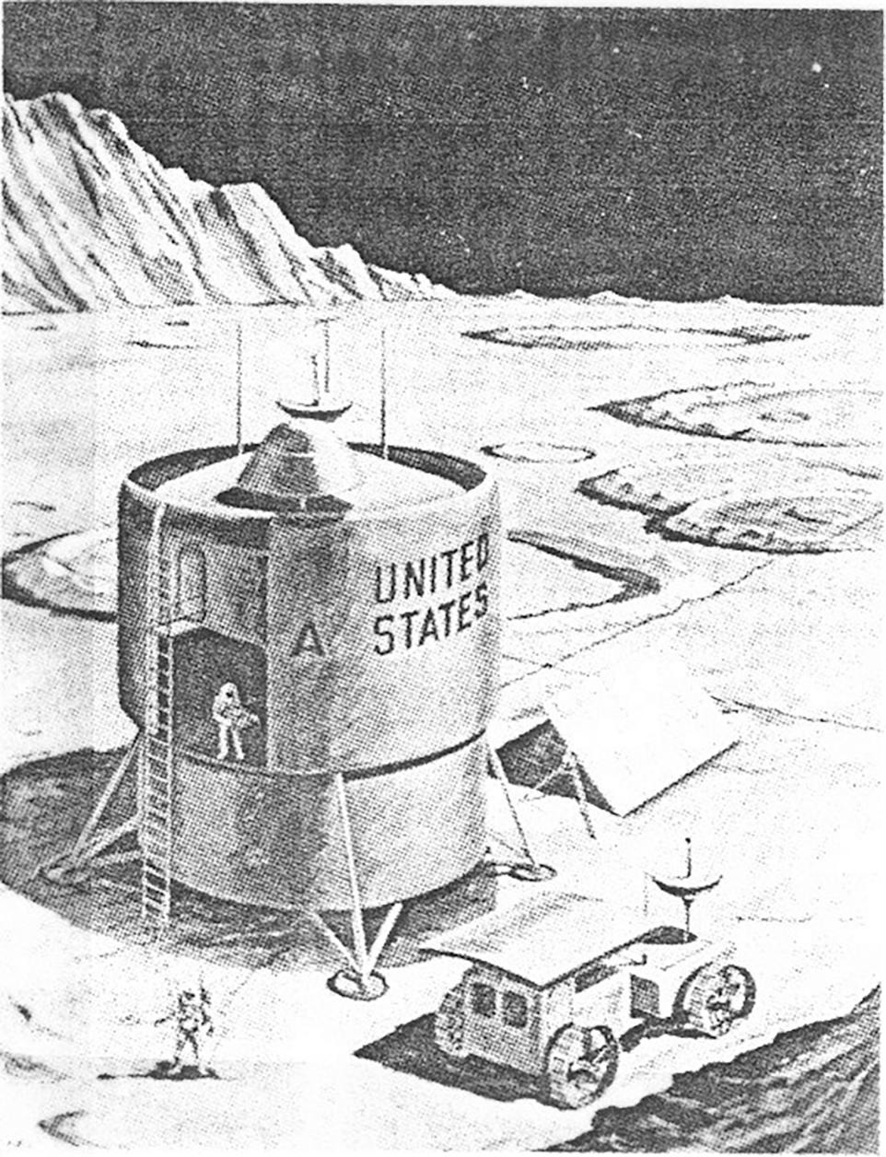
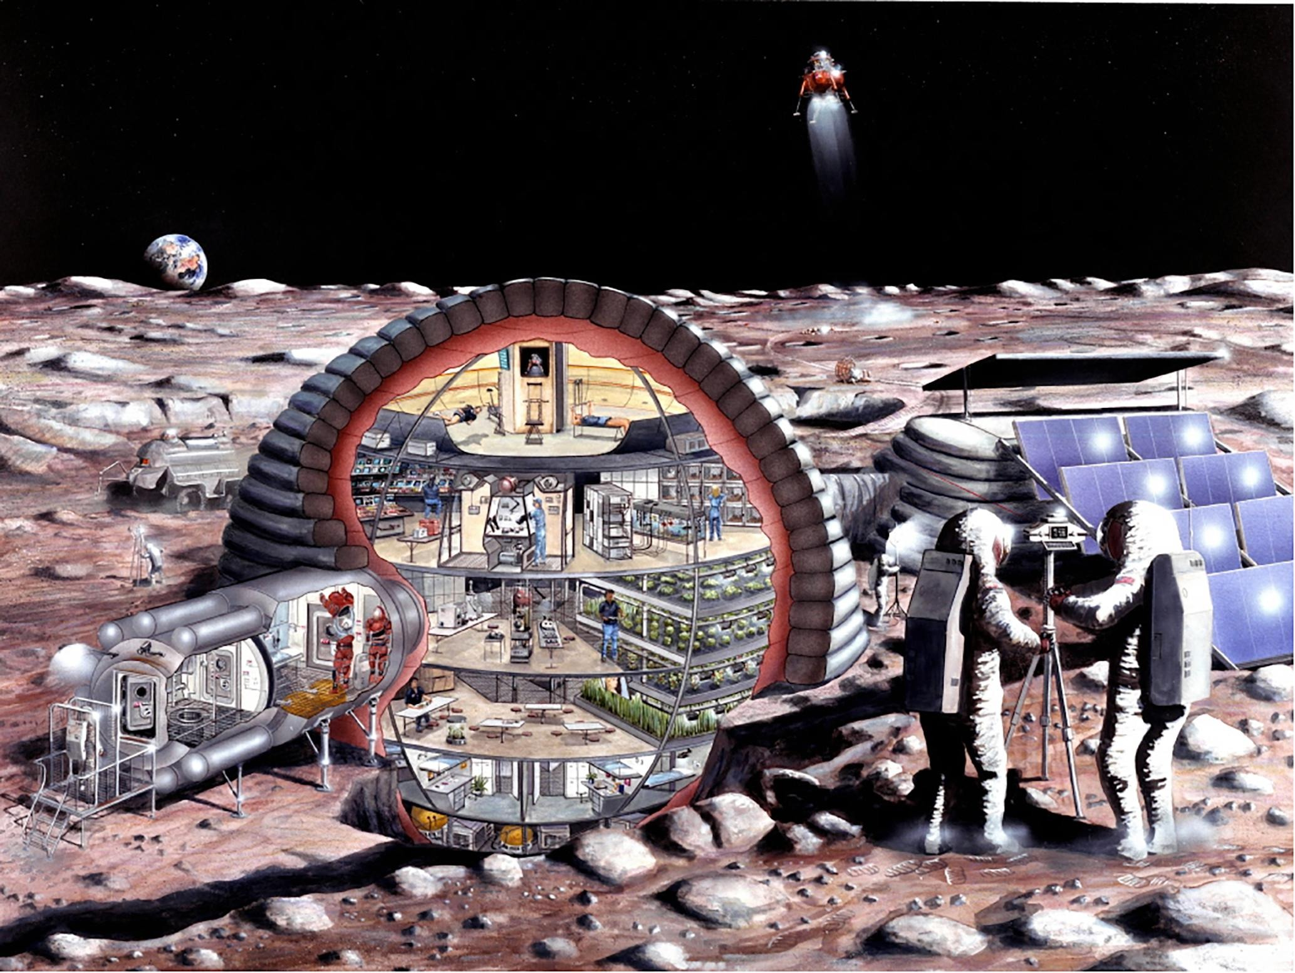
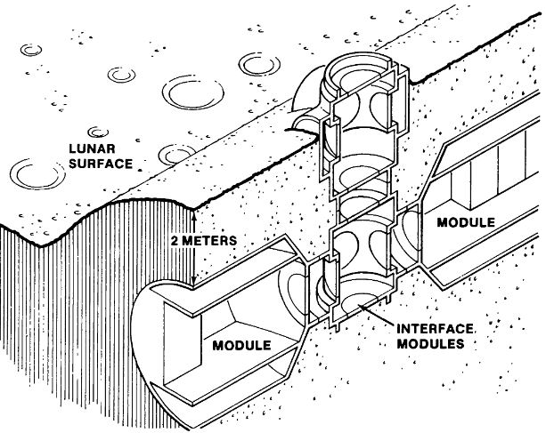
Motivation
Artemis Program - Establish a permanent habitat on the Moon
Rigid Structures
(LPI, NASA)
Inflatable Structures
(G. Kitmacher, NASA)
Underground Structures
(LPI, NASA)

Slide 3
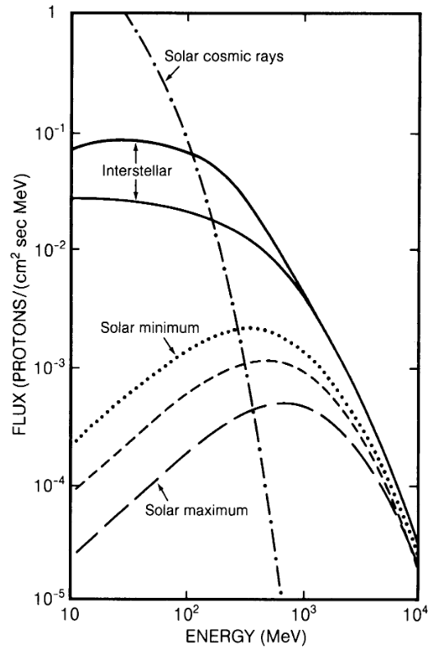
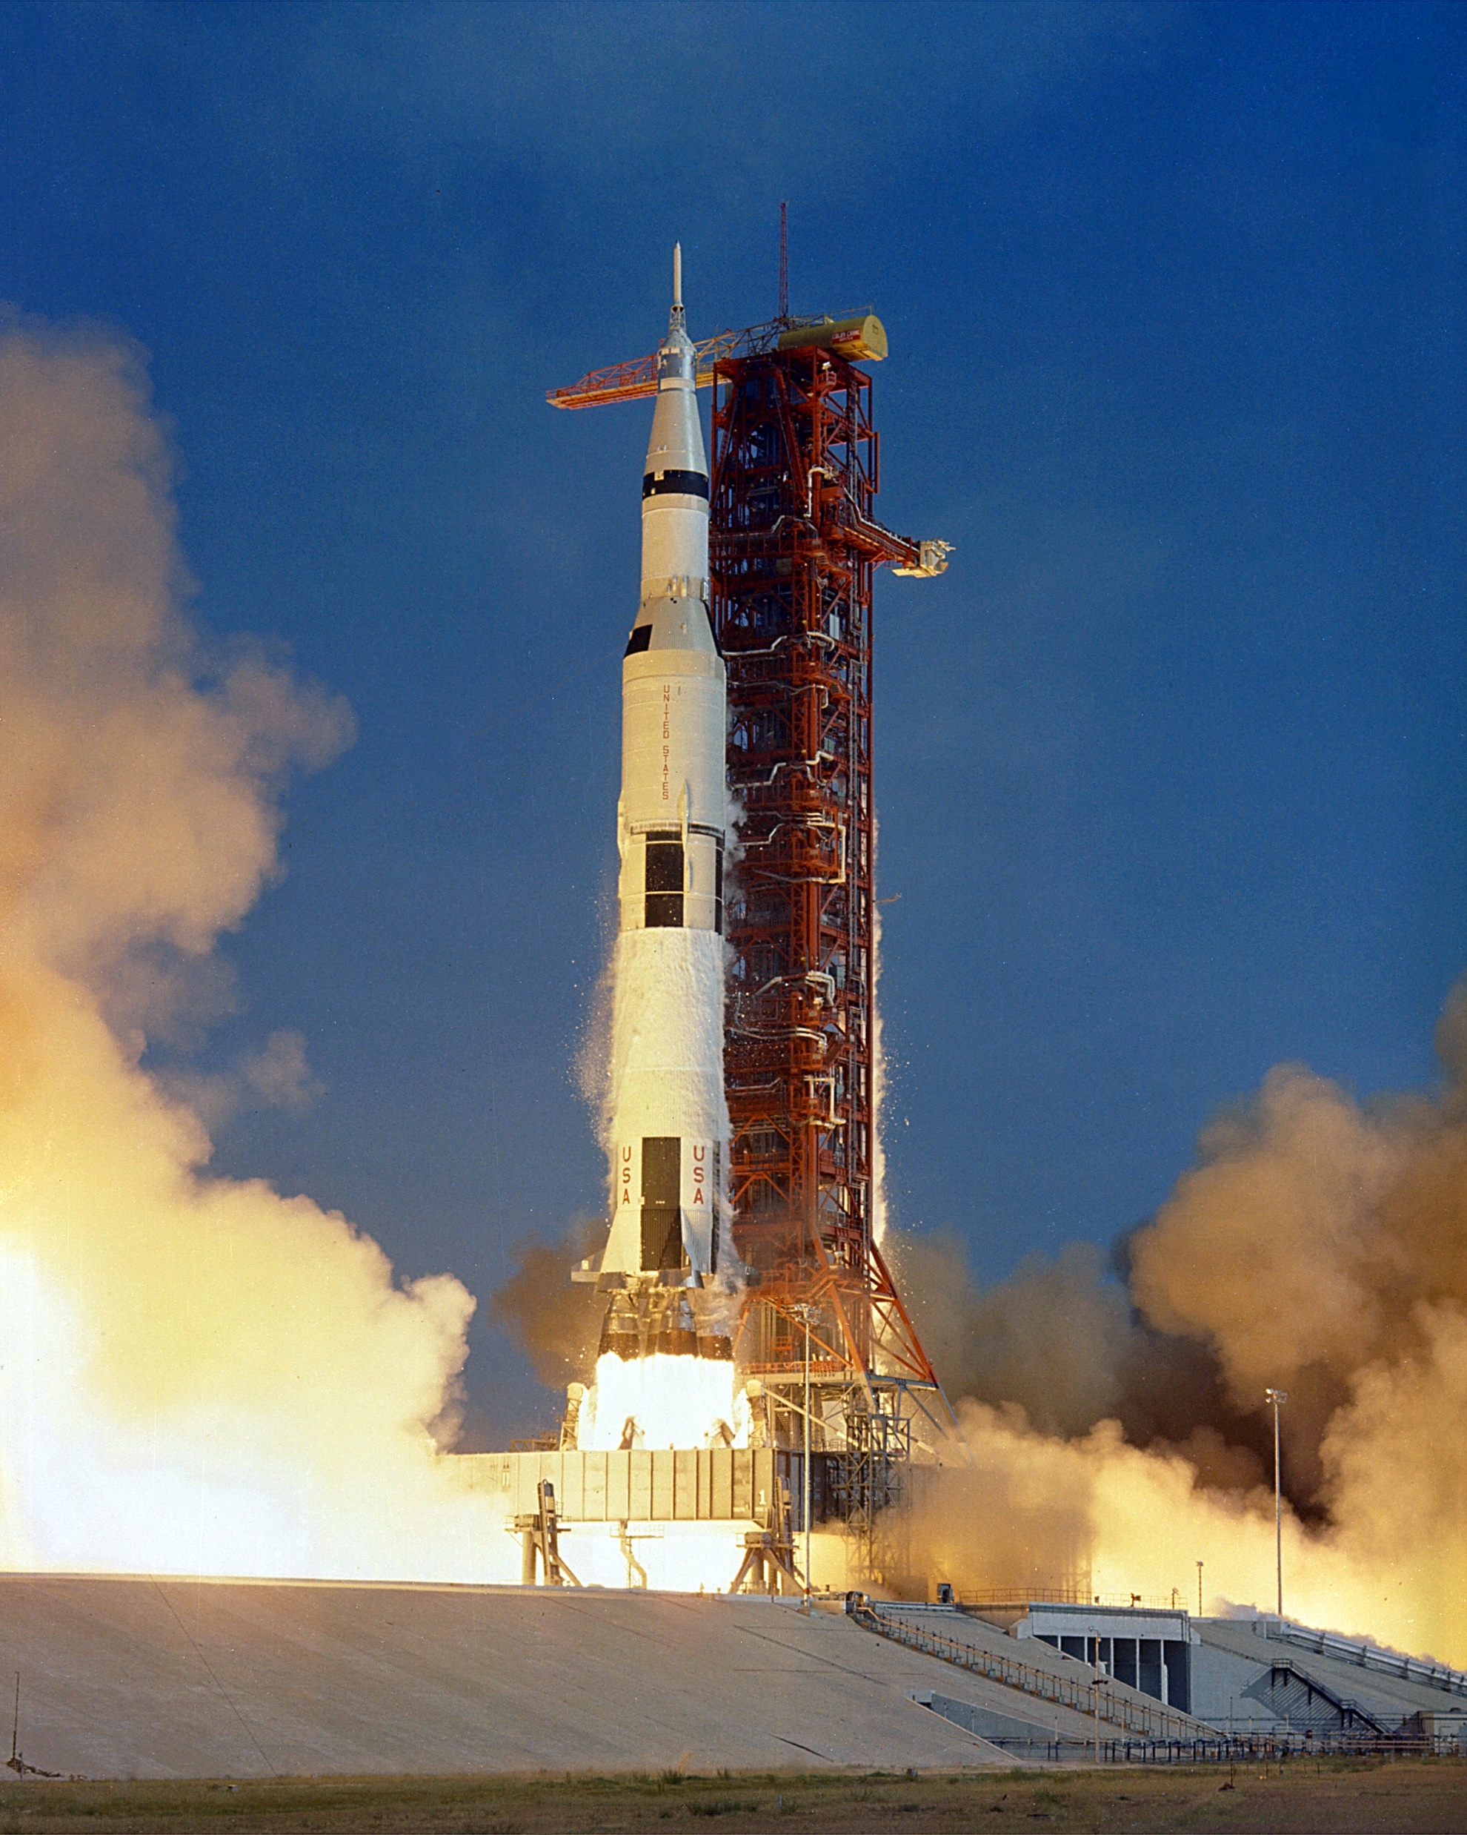
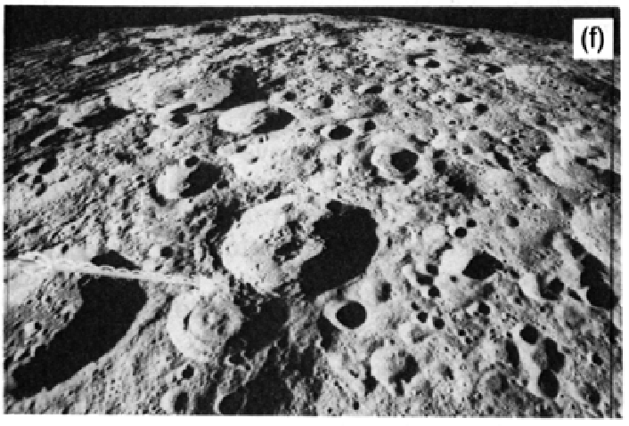
Challenges
Harsh environment + expensive launch budget
Meteorite Bombardment
(LPI, NASA)
Lunar Surface Radiation
(LPI, NASA)
Saturn V Launch
(NASA)

Slide 4
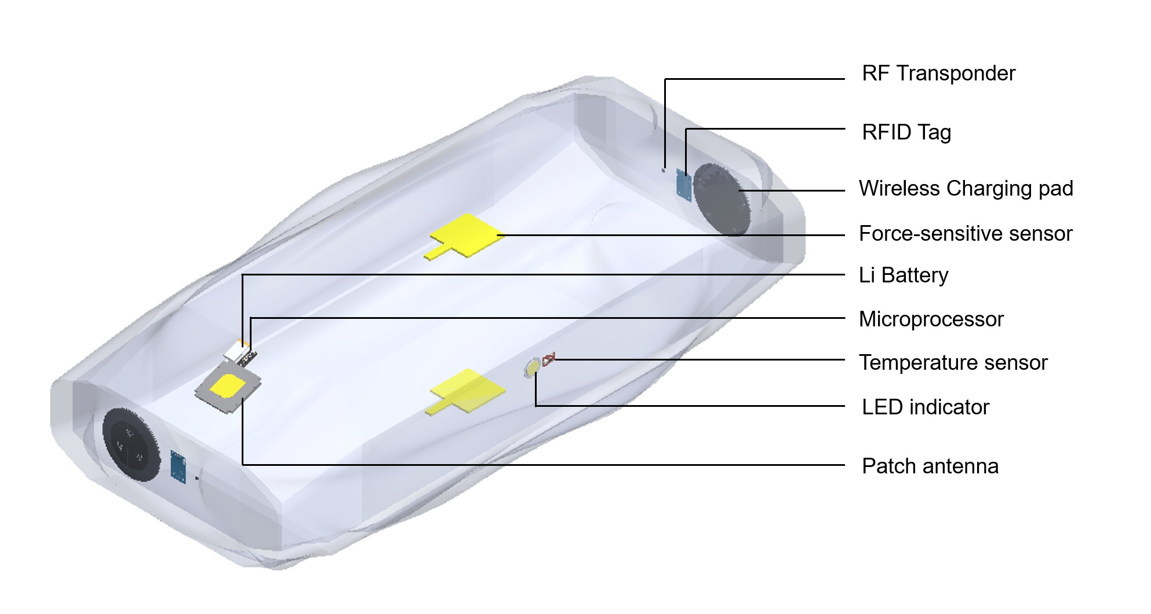
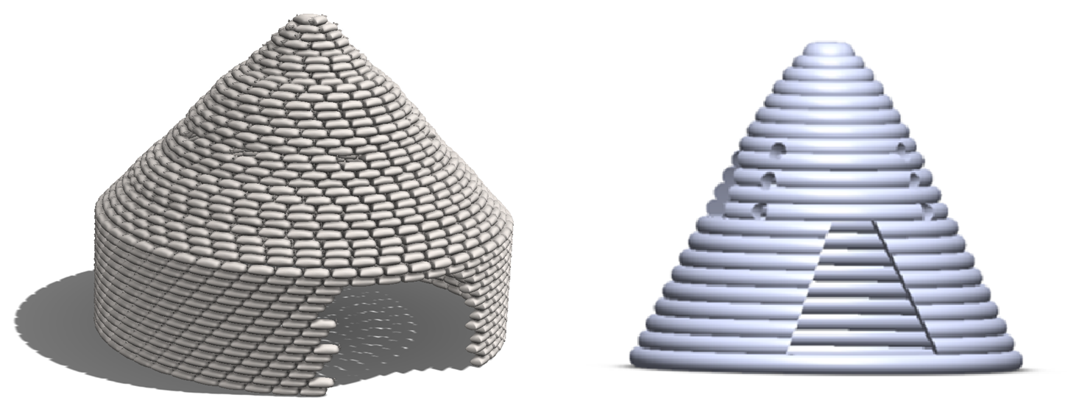
Approach
In-situ resource utilization (ISRU) with “smart” sandbags
Superadobes Built with Sandbags
(N. Khalili)
Embedded Electronics in
Smart Sandbags

Slide 5
Approach
Electrical Components | Usage | Application
Proximity Sensors | Detect presence of neighboring sandbags | Enable streamlined construction process involving multiple simple rovers
LED / LED Matrices | Indicate warnings, display info | Signage for machine/human vision
Thermocouples | Measure temperature | Monitor structure in/exterior temperature
Force Sensors | Detect presence of sandbags above | Facilitate construction process; monitor structural integrity;
Accelerometer | Determine orientation of sandbag; detect movement | Monitor structure integrity; monitor micrometeorite bombardment
Low range antenna | Communicate info to nearby system | Establish info channel across infrastructure; beacon presence for rover guidance
Localization module | Broadcast geolocation of self | Facilitate construction process; label/tag structure on habitat map

Slide 6
Approach
Energy harvesting technologies to prolong sandbag lifetime
Charging Technology | Pros | Cons
Induction coupling | Simple implementation High efficiency | Precise alignment required Short charging distance (mm to cm)
Magnetic resonance coupling | Charges multiple devices simultaneously High charging efficiency Non-line-of-sight charging | Limited charging distance (cm to m) Complex implementation
RF radiation charging | Long charging distance (m to km) No alignment required | Line-of-sight transmission Unsafe for human if high power Low efficiency
Thermoelectric | No extra infrastructure required Passive harvesting method | Low power output Somewhat complex implementation

Slide 7
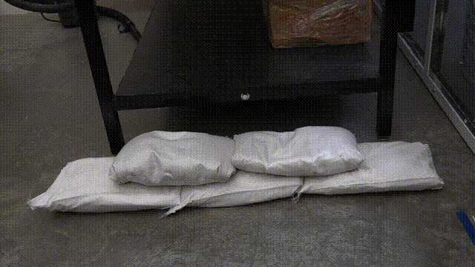
Results
Demo: Sandbags implemented with force sensors

Slide 8
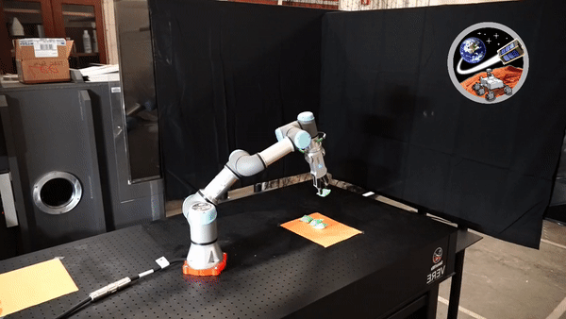
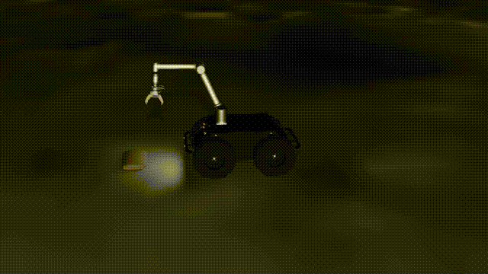
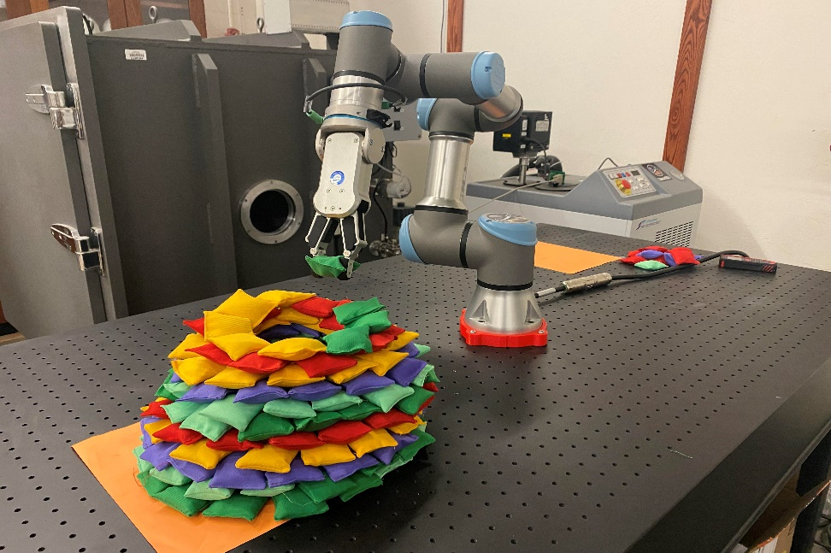
Results
Joseliz Perez, SpaceTREx
University of Puerto Rico
Superadobe construction using pick-and-place rovers
Yinan Xu, SpaceTREx
University of Arizona

Slide 9
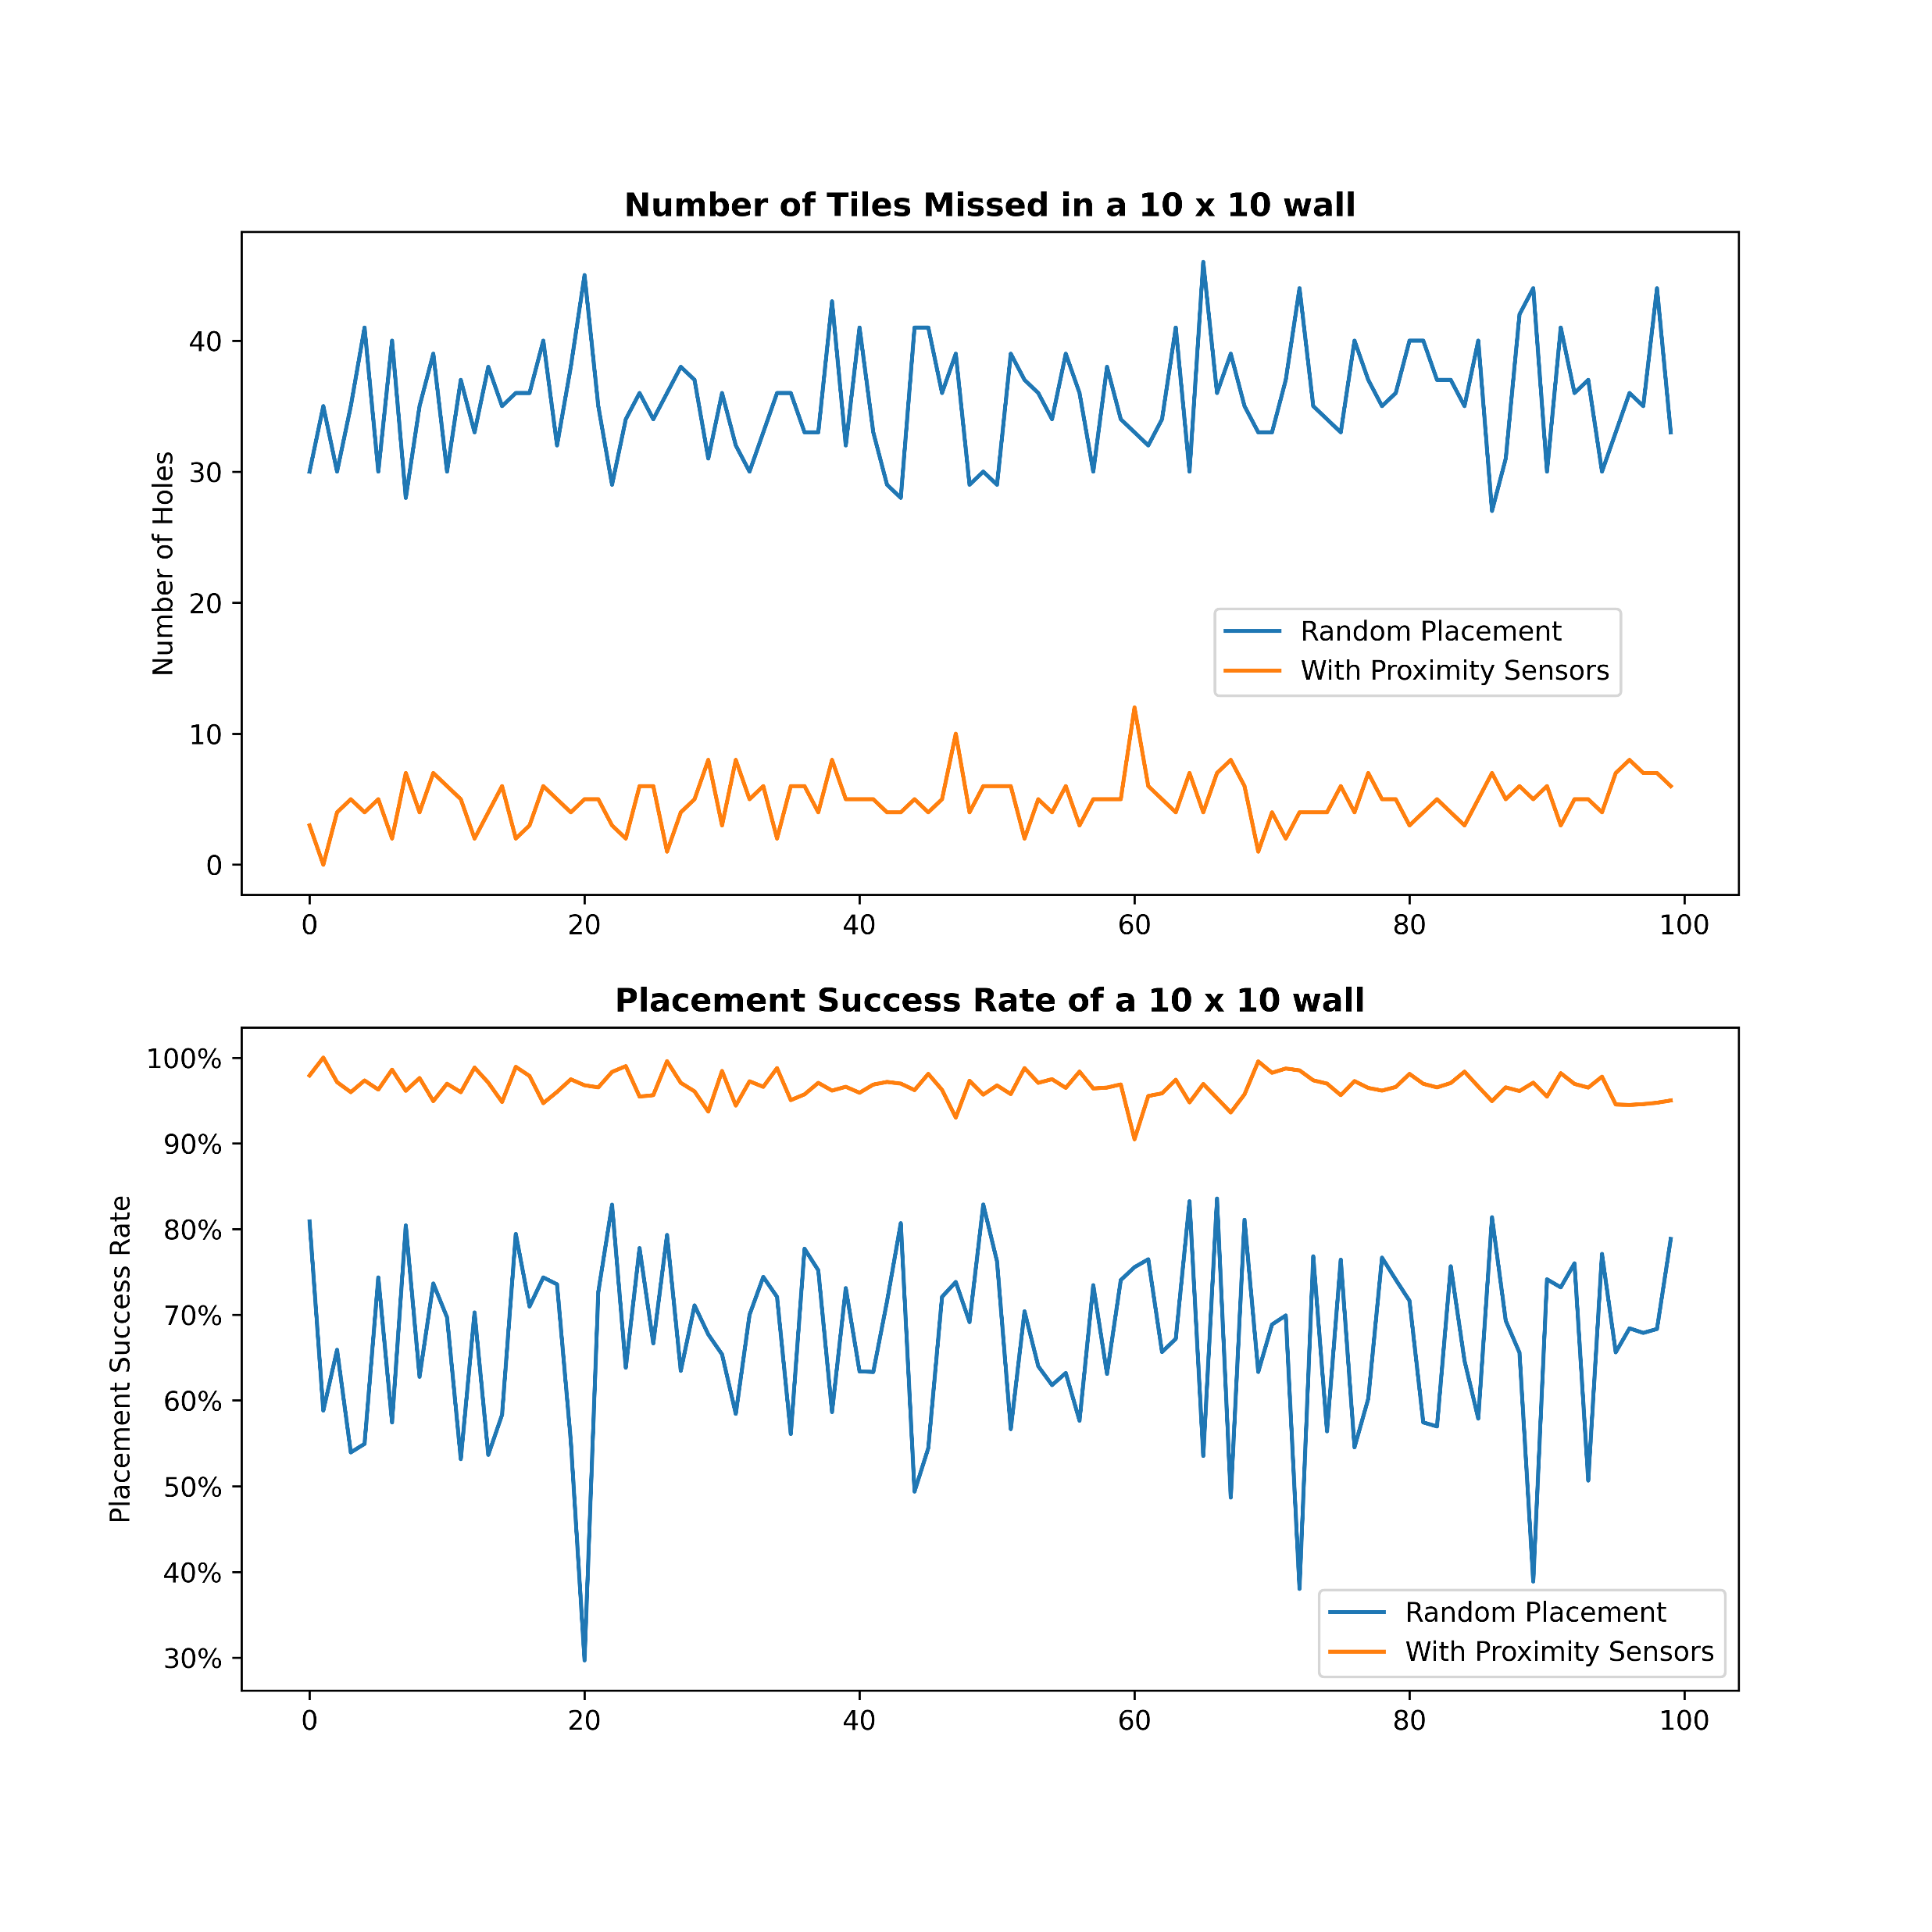
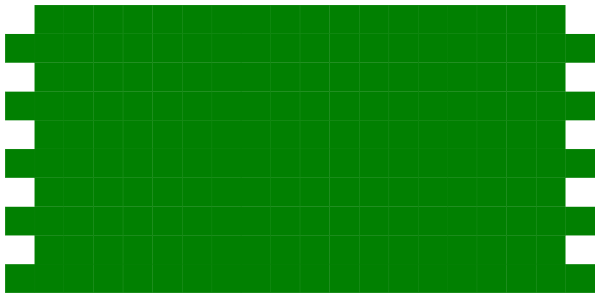
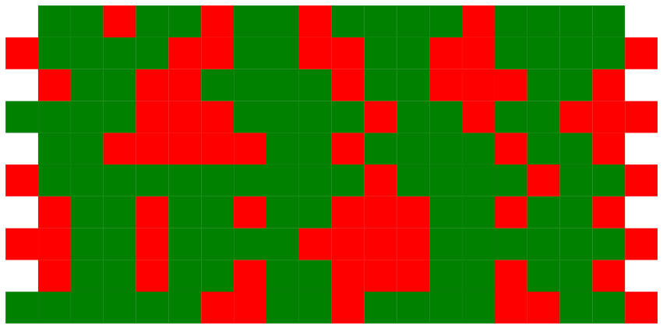
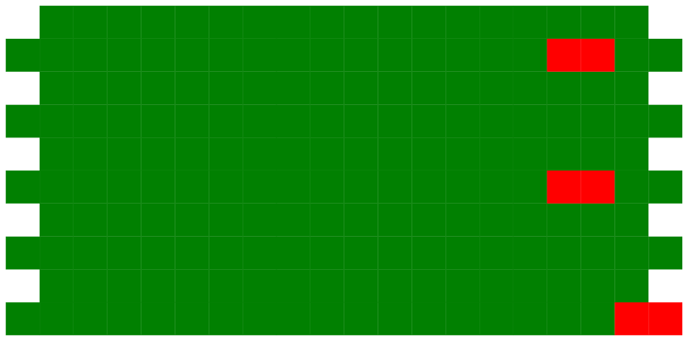
Results
Proximity sensors improves construction process efficiency
Linear Layering
Random Placement
Proximity Sensors
Simulation of constructing a 10x10 sandbag wall
(green = sandbag, red = holes)

Slide 10
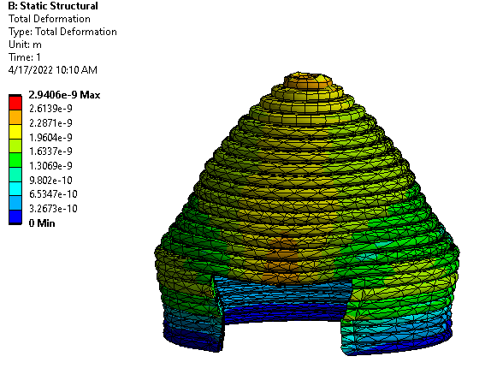
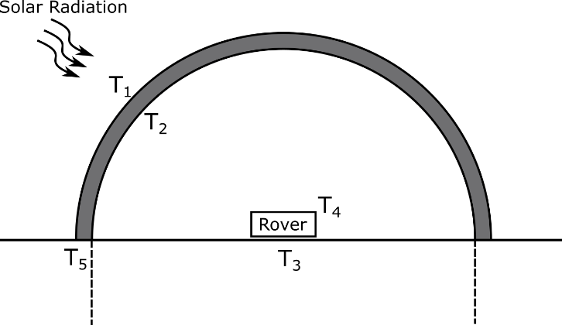
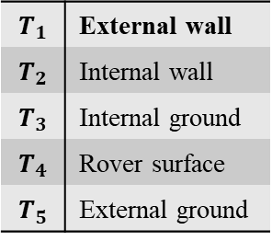
Results
ANSYS simulation for sandbag structural and thermal analysis
$$T_{1}$$ | External wall
$$T_{2}$$ | Internal wall
$$T_{3}$$ | Internal ground
$$T_{4}$$ | Rover surface
$$T_{5}$$ | External ground
Superadobe with
ANSYS static structural solver
Superadobe physical thermal modeling

Slide 11
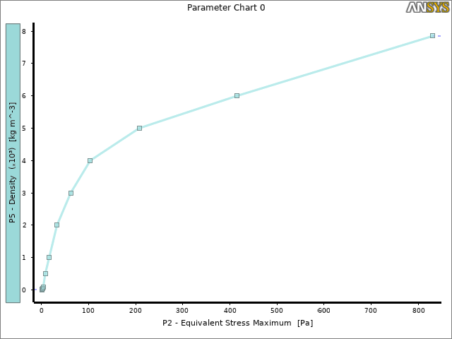
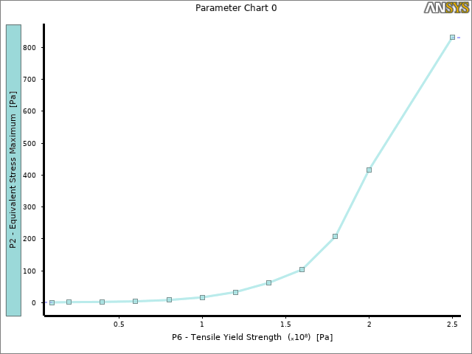
Results
From the initial structural studies, the material density and yield strength has the most affect on the equivalent stress.

Slide 12
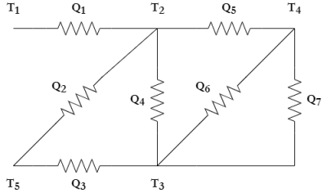
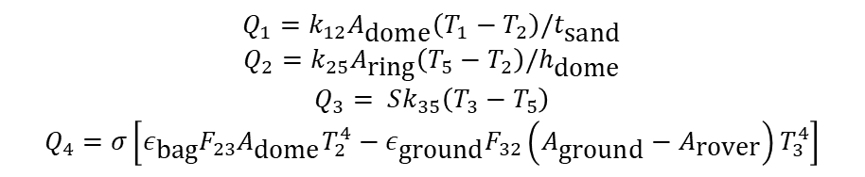
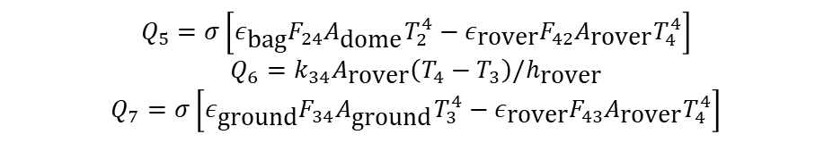
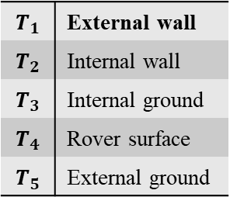
Results
$$T_{1}$$ | External wall
$$T_{2}$$ | Internal wall
$$T_{3}$$ | Internal ground
$$T_{4}$$ | Rover surface
$$T_{5}$$ | External ground
Superadobe physical thermal modeling
Superadobe thermal circuit
$$Q_{1}=k_{12}A_{\text{dome}}\left(T_{1}−T_{2}\right)/t_{\text{sand}}$$
$$Q_{2}=k_{25}A_{\text{ring}}\left(T_{5}−T_{2}\right)/h_{\text{dome}}$$
$$Q_{3}= Sk_{35}\left(T_{3}−T_{5}\right)$$
$$Q_{4}=σ\left[ε_{\text{bag}}F_{23}A_{\text{dome}}T_{2}^{4}−ε_{\text{ground}}F_{32}\left(A_{\text{ground}}−A_{\text{rover}}\right)T_{3}^{4}\right]$$
$$Q_{5}=σ\left[ε_{\text{bag}}F_{24}A_{\text{dome}}T_{2}^{4}−ε_{\text{rover}}F_{42}A_{\text{rover}}T_{4}^{4}\right]$$
$$Q_{6}=k_{34}A_{\text{rover}}\left(T_{4}−T_{3}\right)/h_{\text{rover}}$$
$$Q_{7}=σ\left[ε_{\text{ground}}F_{34}A_{\text{ground}}T_{3}^{4}−ε_{\text{rover}}F_{43}A_{\text{rover}}T_{4}^{4}\right]$$

Slide 13
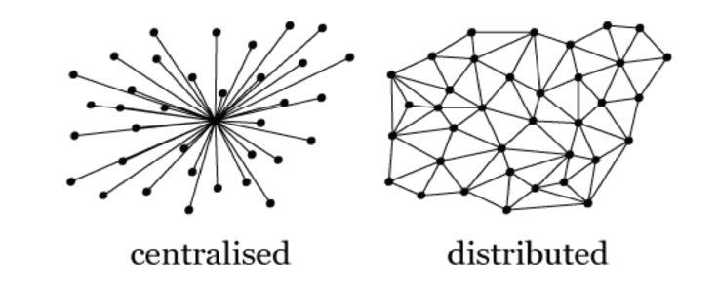
Distributed Processing Network
With microprocessors and antenna in sandbags, they could be utilized as a distributed processing network to offload routine and mundane tasks (e.g. monitor important parameters, structure maintenance)
Centralized processing resource is vulnerable in the unforgiving lunar surface

Slide 14
Conclusion
Smart sandbags to provide semi-permanent shelter
  Cheaper alternative for expanding lunar habitat
Smart sandbags offload tasks from mobile systems and astronauts
  A more robust processing system
  Versatility of sandbags with different config. of electronics

Slide 15
Future Work
Test structural integrity of sandbag structures
  Accurately scale down to simulate lunar gravity on Earth
Prototype sandbags embedded with electronics
  Material requirements
  Mass/Volume/Cost estimates
Investigate fibers from lunar regolith
  Further step in ISRU

Slide 16
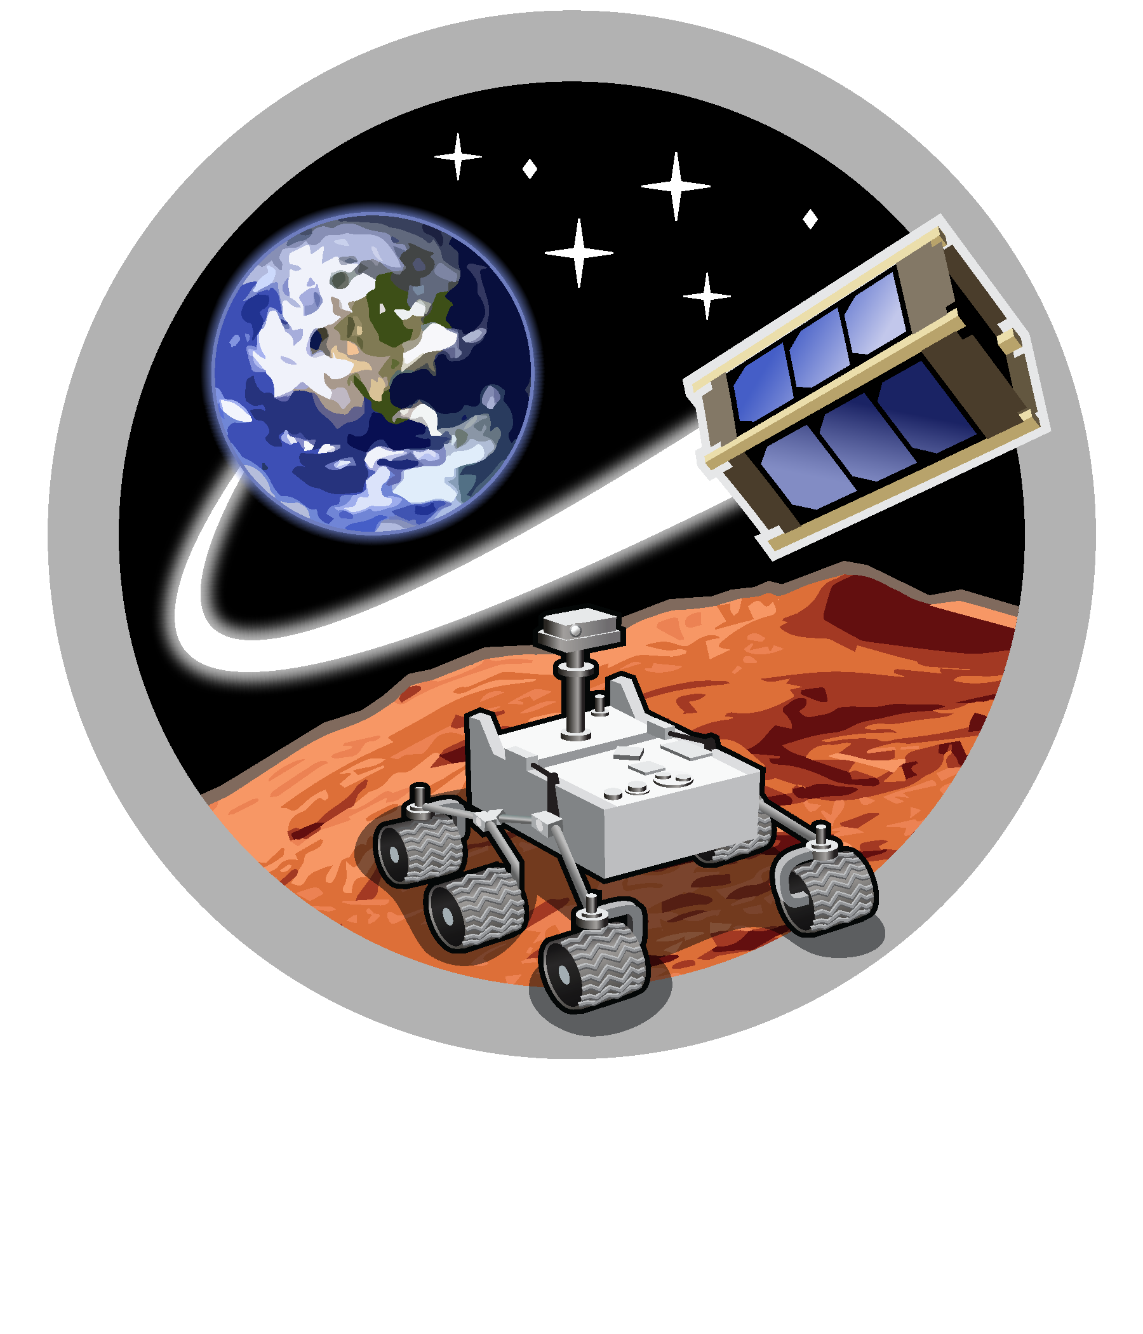
Space and Terrestrial Robotic Exploration (SpaceTREx) Laboratory

Slide 17

Asteroid Science, Technology and Exploration Research Organized
by Inclusive eDucation (ASTEROID) Center

Slide 18


