Slide 1




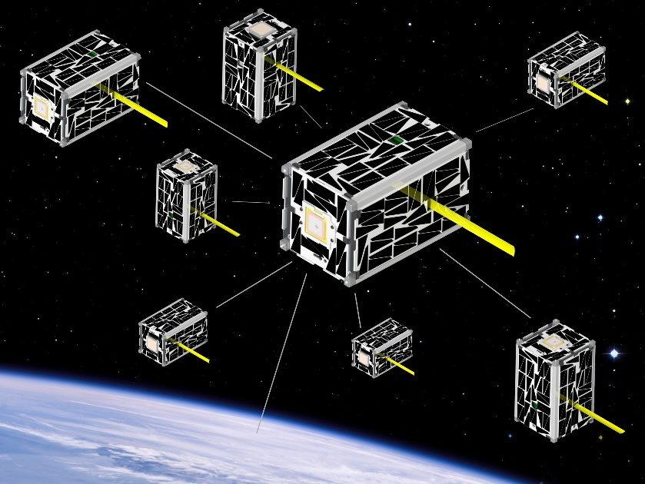
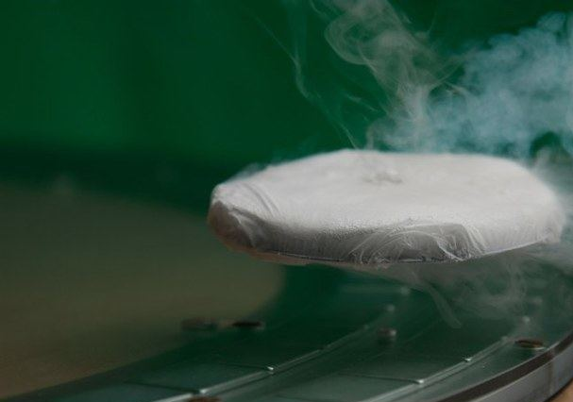
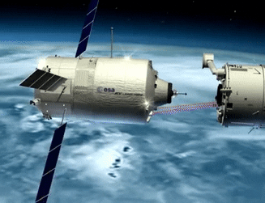
On the Feasibility of Quantum Docking for Cubesats
Massimo Biella¹, Jekan Thangavelautham¹
¹Space and Terrestrial Robotic Exploration (SpaceTREx) Laboratory
Aerospace and Mechanical Engineering Department
University of Arizona

Slide 2
Outline
Introduction and Motivation
Related Work
Objectives
Challenges
ConOps
Flux Pinning
Methodology
Conclusion and Future Work

Slide 3
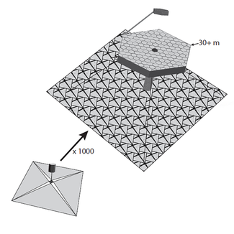
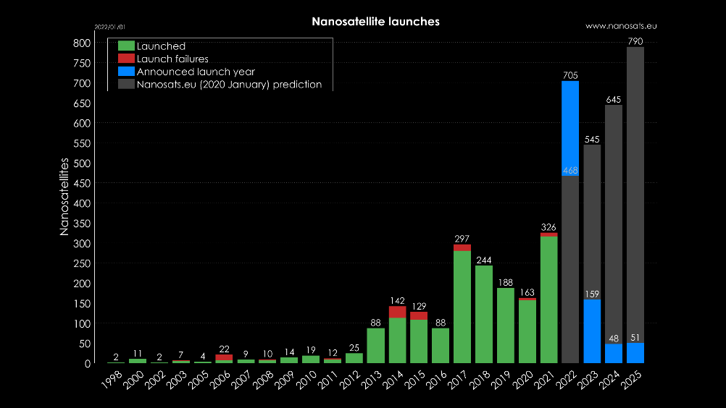
Introduction and Motivation – Quantum Docking
CubeSat launches are increasing at an exponential rate
On-Orbit assemblies of CubeSats
Flux-pinning provides very high mechanical stiffness
No voltage or power are required
No plumes ejected
Figure 1: Graphic depiction of Modular Active Self-Assembling Space Telescope Swarms from NASA (Credit: D. Savranasky)
Figure 2: CubeSats lunched history and future prediction (Credit: Nanosat.eu)
Notes:
On-Orbit assemblies of CubeSats allow for construction of large commercial and scientific platforms (e.g. space station or solar sails)
1600+ CubeSats launched as of February 1, 2022. Forecasted 2500+ nanosats to launch in next 6 years [2].
Flux-pinning provides very high mechanical stiffness (> 200 N/m for only a few 100s grams of material) and damping (2% of critical value).
No voltage or power are required if the HTSC is sufficiently passively cooled. Fewer failures possible.
No plumes would be ejected in close proximity = no pollution of optical devices

Slide 4
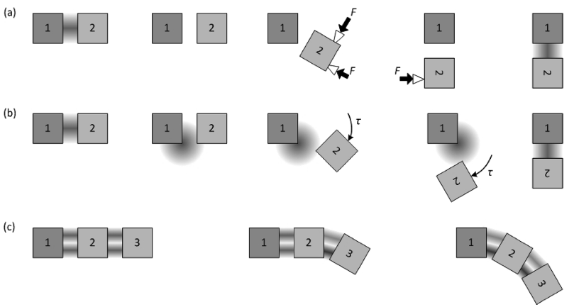
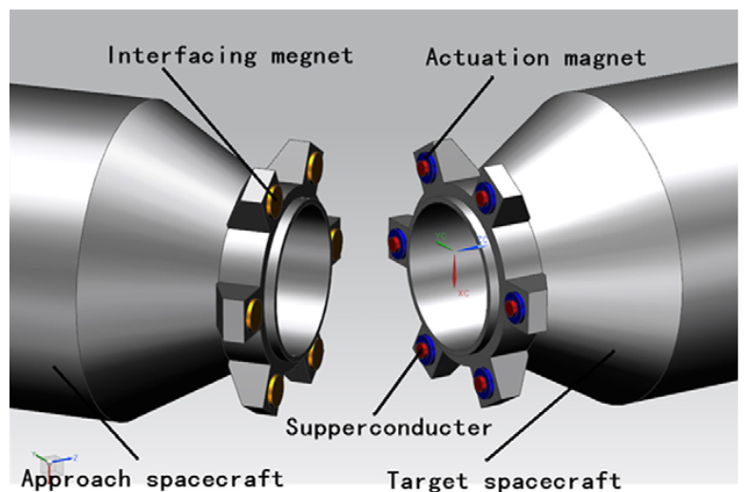
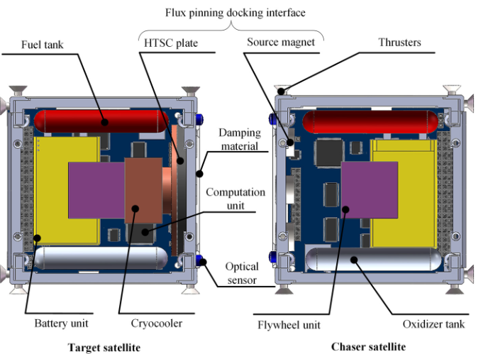
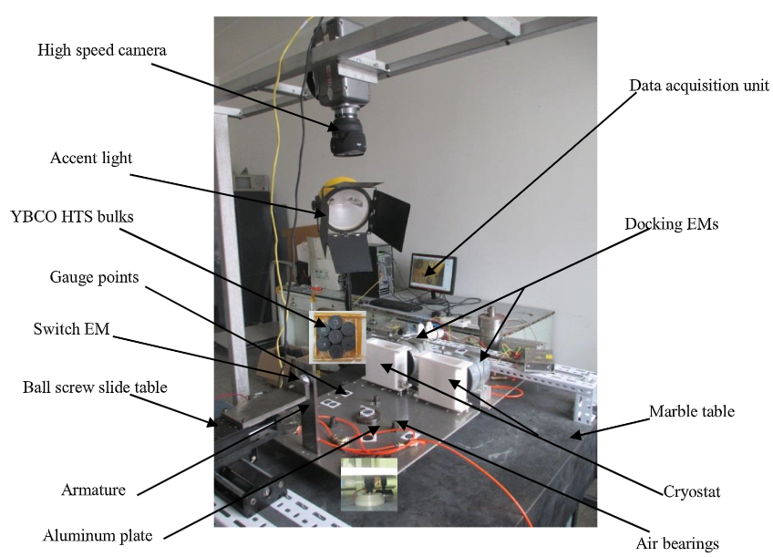
Related Work
Figure 3: Example configurations (Shoer & Peck, 2009)
Figure 4: A non-contacting spacecraft docking configuration using superconducting interface modules (Yang et al., 2012)
Figure 5: The configuration of FPDI on two satellites (Yang et al., 2018)
Figure 6: Simulated Docking Experimental Platform (SDEP) (3DOF) (Zhang et al., 2019)
Notes:
Trends Observed in Literature:
Cryogenic cooling or liquid N2 / H2 vs using sun to turn HTS on/off.
Yttrium Barium Copper Oxide (YBCO) is one of more promising HTS.
There is not a preferred pattern or interface configuration.
Different combinations of magnets and HTS have been tested experimentally (on earth).
TOP LEFT
Flux pinning fixes modules only in their initial and end states, other actuators (such as the thrusters shown) are used for the reconfiguration. (b) Flux pinning selects the available degrees of freedom between modules; in this example they hinge. (c)Electromagnets bend flux-pinned interfaces and articulate a modular structure.
BOTTOM LEFT
The HTSC plate is mounted on the target satellite, and the source magnet is mounted on the chaser satellite

Slide 5
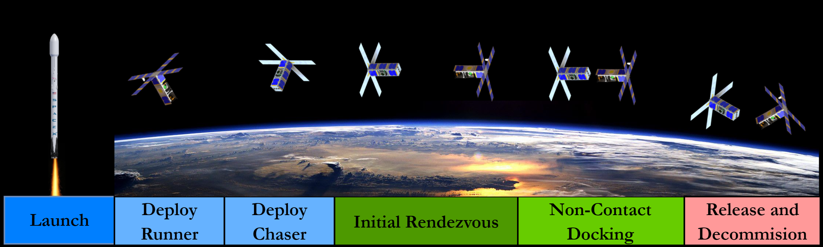
Objectives
Need algorithms to manage morphing
Rendezvous, Dock, Release of two or more 3U CubeSats in Low Earth Orbit (LEO)
Limit Electromagnetic Interferences (EMI) within spacecrafts

Slide 6
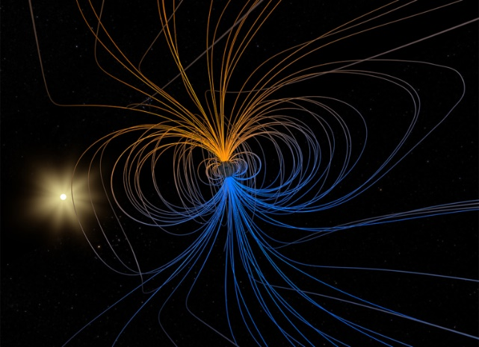
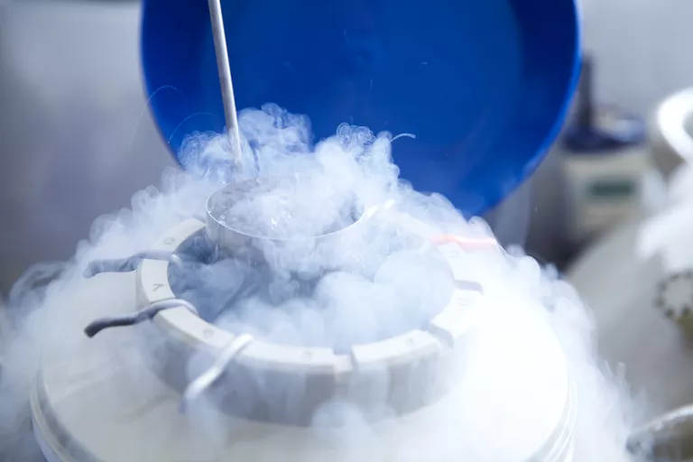
Challenges
Electromagnetic Interference (EMI)
Flux-Pinning Docked Interfaces (FPDI) takes more time to reach equilibrium state
Actuation – Need to cool down the superconductor to very low temperatures (50 – 80 K)
Figure 7: Earth’s gravitational field (Sadiku, 1989)
Figure 8: Egg Cryptoconservation in N₂
Notes:
Need algorithms to autonomously manage docking, morphing of structures and simultaneous coordination between crafts
Electromagnetic Interference (EMI) from magnets magnetic field and other components. Want to restrict only selected DOFs, other fields might “disengage” pivot / anchor points
- FPDI takes more time to reach equilibrium state
Relative attitude deviations may accumulate with time due to asymmetric MF of source magnets
Oscillations may lead to latent failure during the docking process
Actuation – Need to cool down the superconductor to very low temperatures (Usually in the range of 50 – 80 K)

Slide 7

Concept of Operations

Slide 8
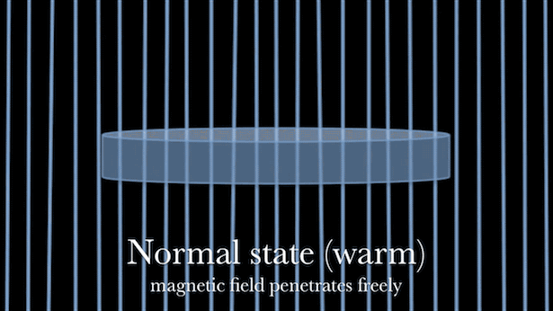

Flux Pinning
What are the physics that enable quantum locking?
How does the “pinning” happen?
Figure 9: Stages of Flux-Pinning
Magnetic levitation demo (Credits: Tel-Aviv University, 2011)
Notes:
Field cooling is that HTS bulk is chilled below its critical temperature in the magnetic field of permanent magnet or EM, while zero field cooling is that HTS bulk is chilled below its critical temperature without the magnetic field, a part of magnetic field can be trapped and pinned in the pinning center of HTS bulk in the process of field cooling.
Degradation of a high-temperature superconductor's properties due to flux creep is a limiting factor in the use of these superconductors. SQUID magnetometers suffer reduced precision in a certain range of applied field due to flux creep in the superconducting magnet used to bias the sample, and the maximum field strength of high-temperature superconducting magnets is drastically reduced by the depression in critical field.

Slide 9

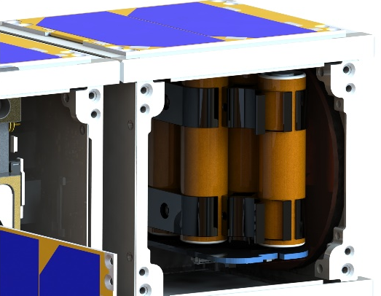
Methodology
Perform initial rendezvous with “lighting cues”
HTSC is cooled below its critical temperature (N₂ or cryocooler)
EM controls interaction between chaser and runner
Magnetic Flux
Runner
Chaser
Notes:
Field cooling is that HTS bulk is chilled below its critical temperature in the magnetic field of permanent magnet or EM, while zero field cooling is that HTS bulk is chilled below its critical temperature without the magnetic field, a part of magnetic field can be trapped and pinned in the pinning center of HTS bulk in the process of field cooling.

Slide 10
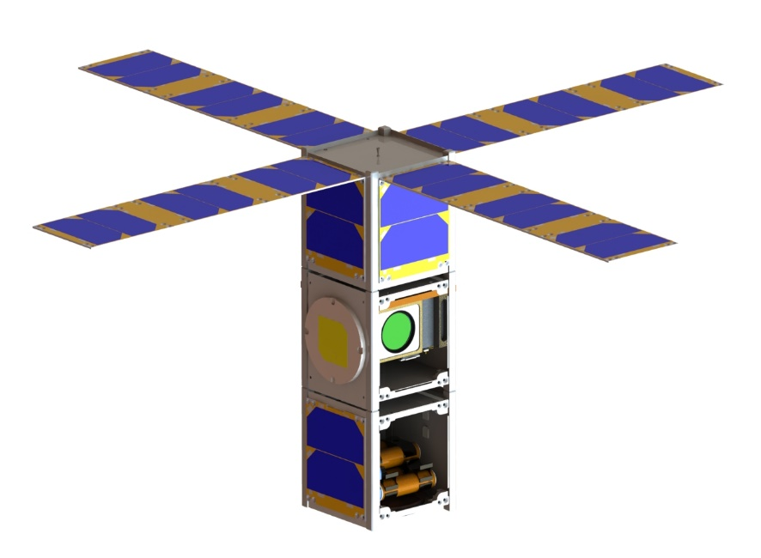
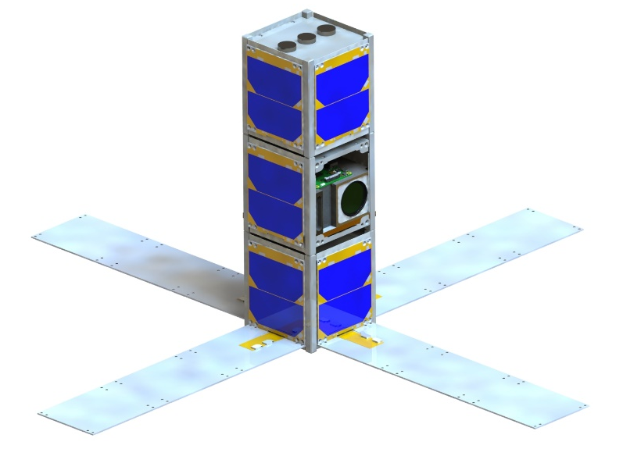
Methodology
3U Runner
3U Solar Panels
Thruster Nozzle
Integrated ADCS
S-Band Patch Antenna
Battery
Cryocooler + HTCS
Damping Material
Electromagnets
Body Mounted Solar Panel
On-Board Computer
3U Chaser
Notes:
Damping materials such as aluminum or copper plates can dissipate the relative kineticenergy of the two satellites by the effects of current loss causedby the resistance of the materials. In consideration of weight reduction, an aluminum plate is used as the damping material,21which is mounted on the surface of the target satellite
Permanent Magnet (PM) + High Temperature Superconductor (HST) Plate: Very simple configuration to produce a strong applied field, but it affects the field environment of the spacecraft during the whole mission span, possibly leading top some uncertainties.
Electromagnet (EM) + HST: Reduces risk of “polluting” magnetic field when not in action, is more flexible given it is controlled by current (that can also be flowing CW or CCW to give different force interactions)
PM + EM + HST: Combines the advantages of both the above combinations and is used in experimental settings to measure different key performance parameters such as axial forces and displacement due to its easier implementation when compared to using 2 EMs.

Slide 11

Conclusion & Future Work
Early-stage development for sizing, system design
Flux-pinning can lead to new levels of non-contact interactions between spacecrafts
Vast range of applications possible – lunar ark storage?
Notes:
Earl stages sizing, system design , trying to come up with demonstration system to advance flux pinning capability
Not restricted to cubesats
Can use in sample return missions
Kinematic chains
-- Could use as storage? If satellite is already cold, we could enable quantum docking as secondary goal, while keeping material stored safe
-----------------------------------------------------
Based on previous slides, this research would greatly benefit from the building an experimental bench. That would allow us to measure different parameters such as axial forces, influence of the current in the EMs on the applied magnetic field, and damping / oscillations on approach. An alternative test bed such as the one presented in [5] will enable us to achieve those results.
Testing in microgravity and vacuum will also be critical in achieve further validation of the experimental results we would get on a test bed as discussed above.

Slide 12
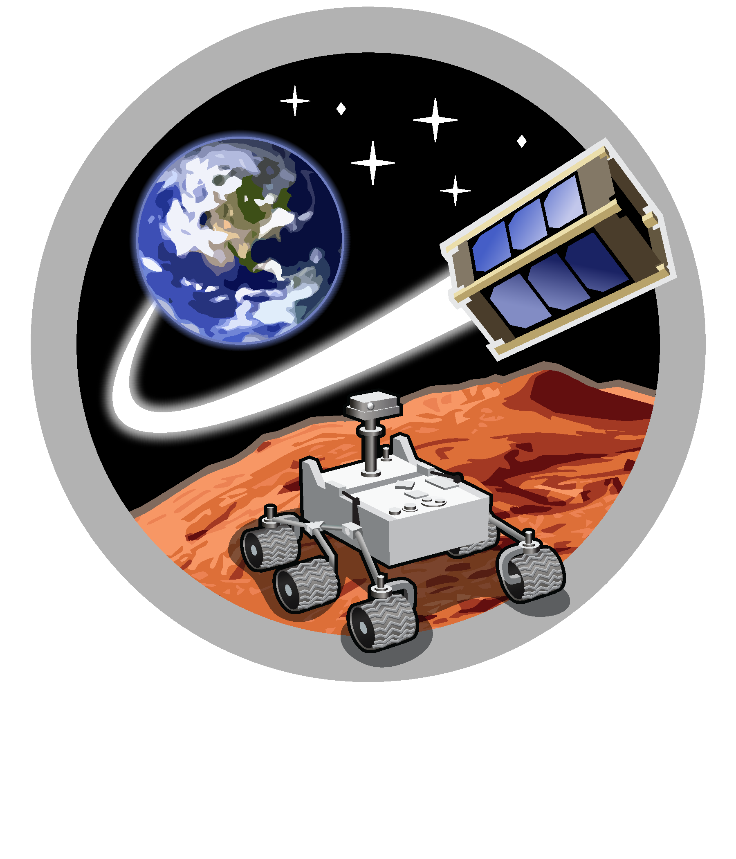
Space and Terrestrial Robotic Exploration (SpaceTREx) Laboratory

Slide 13
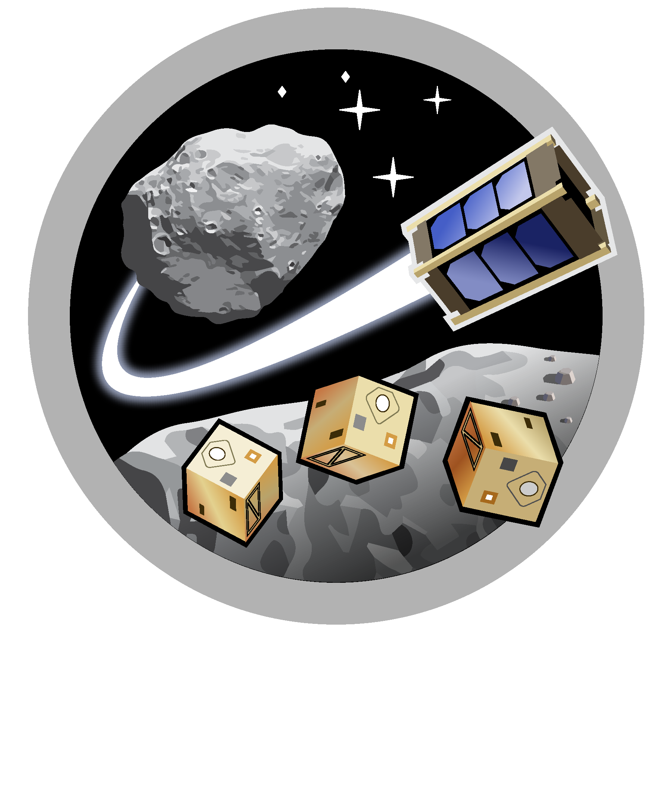
Asteroid Science, Technology and Exploration Research Organized
by Inclusive eDucation (ASTEROID) Center

Slide 14


Slide 15
References
[1] Shoer, J. P., and Peck, M. A., “Flux-pinned interfaces for the Assembly, manipulation, and reconfiguration of Modular Space Systems,” The Journal of the Astronautical Sciences, vol. 57, 2009, pp. 667–688.
[2] Kulu, E., “Nanosats database,” Nanosats Database Available: https://www.nanosats.eu/.
[3] Yang, Wenjiang, Dongping Liao, Yu Ji, and Lu Yao. "Effects of Magnetization Conditions on Dynamic Characteristics of Spacecrafts with Superconducting Flux Pinning Docking Interfaces." Journal of Applied Physics 124.21 (2018): 213901. Web.
[4] Kordyuk, Alexander A. "Magnetic Levitation for Hard Superconductors." Journal of Applied Physics 83.1 (1998): 610-12. Web.
[5] Zhang, Mingliang, Meiyu Ye, Pengfei Liu, Zhuang Qi, Zhiliang Hong, Meiqi Wang, Guohua Chen, Feiyue Deng, and Lianpeng Zhang. "The Demonstrations of Flux Pinning for Space Docking of CubeSat Sized Spacecraft in Simulated Microgravity Conditions." IEEE Transactions on Applied Superconductivity 29.6 (2019): 1-16. Web.
[6] Yang, Wenjiang, Jia Xu, Long Yu, and Yu Liu. "Experimental Investigation of Mechanical Characteristics in Superconducting Interfaces for Self-assembly of Spacecraft Modules." Physica. C, Superconductivity 483 (2012): 173-77. Web.\
[7] Thirupathi Raj, Athip. Laboratory Experimental Validation of Lighting Cues for On-Orbit Rendezvous and Docking for Small Spacecraft. https://www.researchgate.net/publication/358199127_Laboratory_Experimental_Validation_of_Lighting_Cues_for_On-Orbit_Rendezvous_and_Docking_for_Small_Spacecraft.

