Slide 1
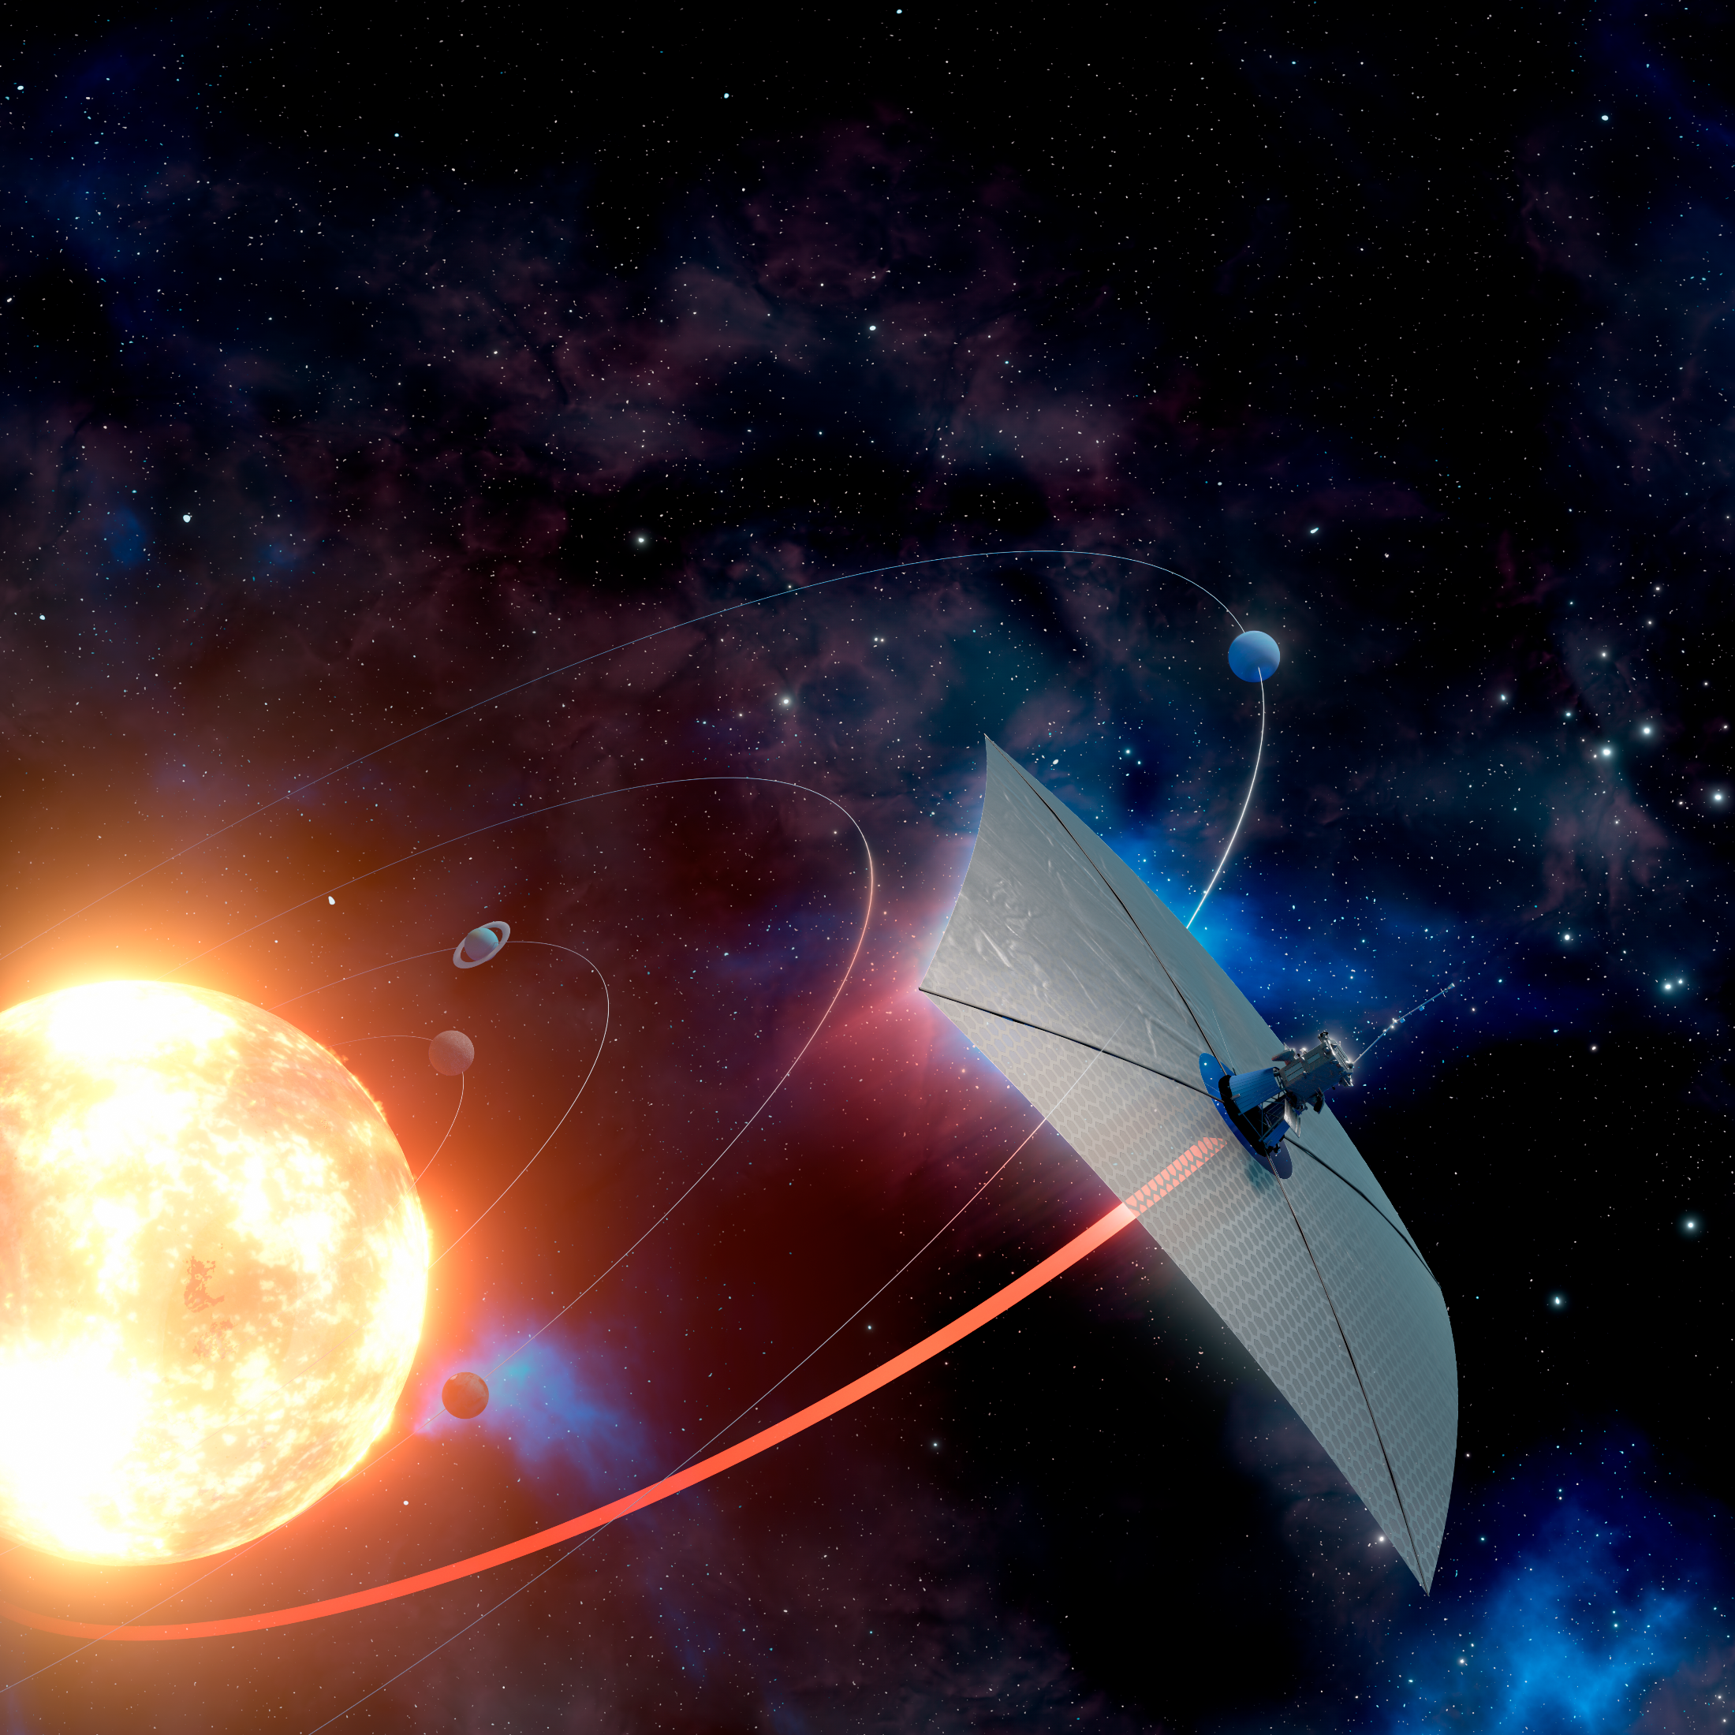
Fast Transit Missions with Extreme Solar Sailing
Artur Davoyan
University of California,
Los Angeles

Slide 2
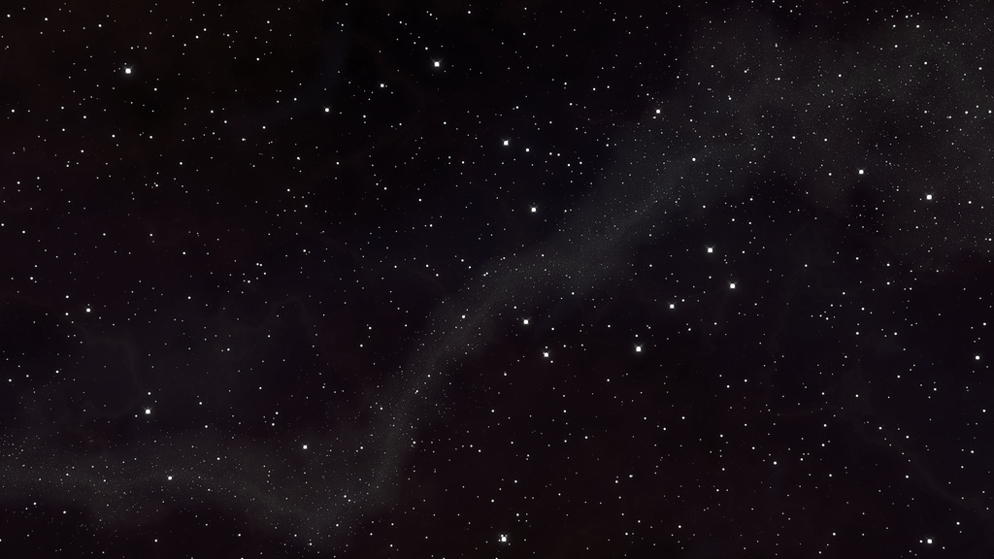


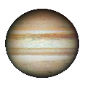
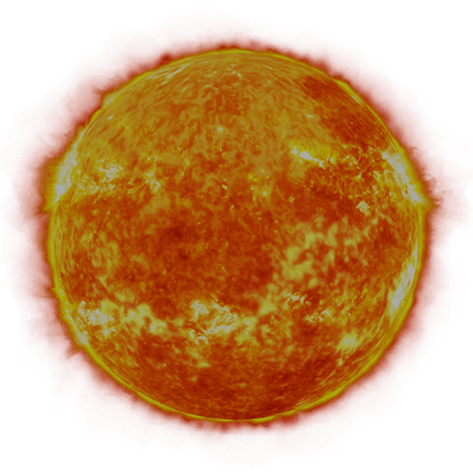




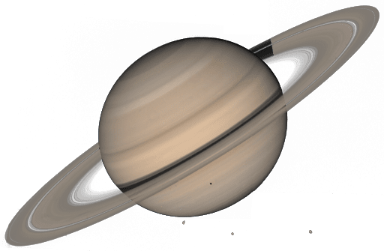


Deep Space Exploration Today
1 mission
9 missions
2 missions
2 missions
4 missions
1 mission
1 mission
60 years of space exploration

Slide 3
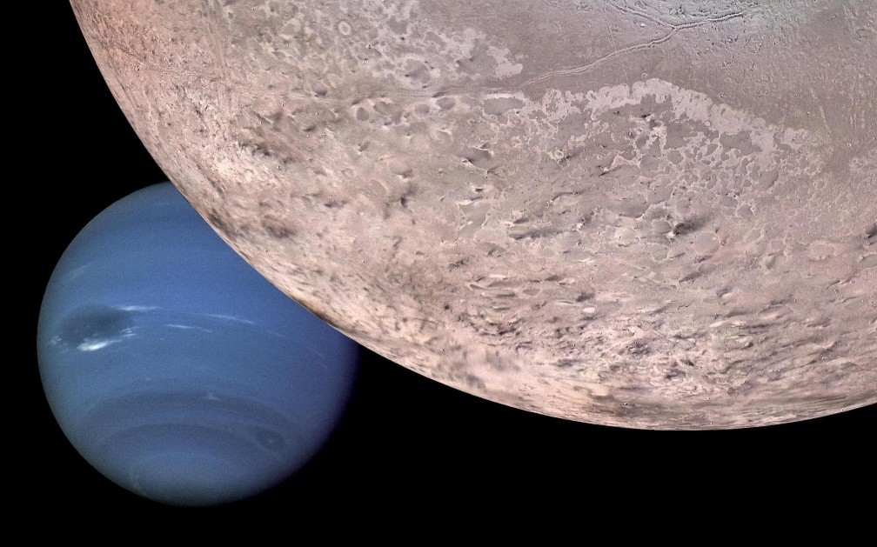
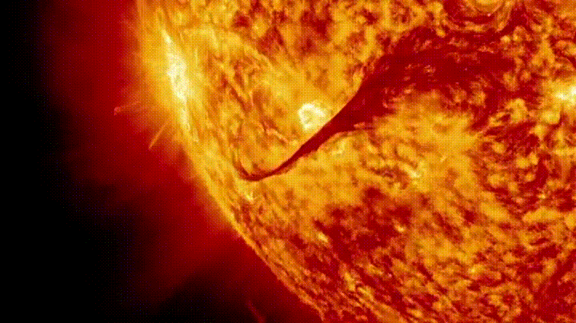
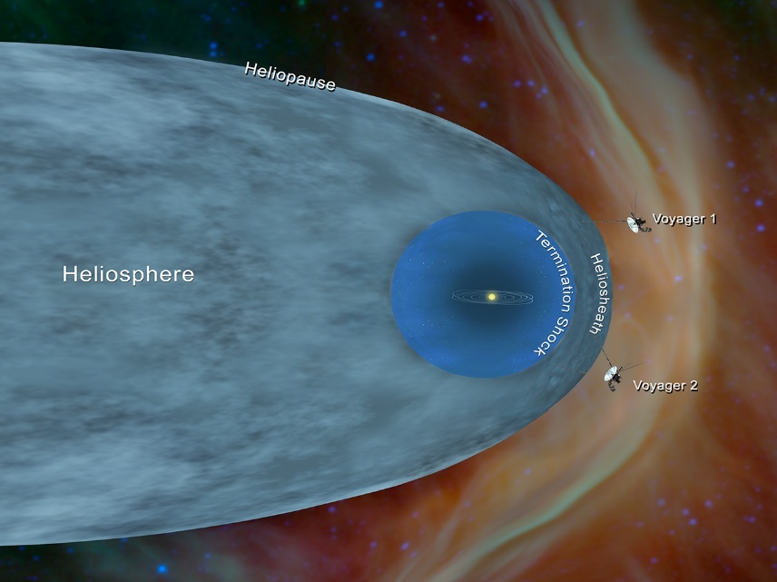
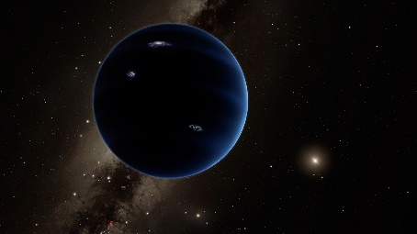
Need For Breakthrough Science
Outer planets & moons
Our star
Interstellar medium & beyond
Search for life
Need to scale exploration
Travel takes many years (>7 years to Saturn)
Missions require decades long costly (~$1B) development
Understanding our Sun
Need inner corona observations
4D mapping of the corona
Going to far reaches
Only two probes have reached the interstellar medium
Planet X?
Oort cloud
Solar gravity lens

Slide 4
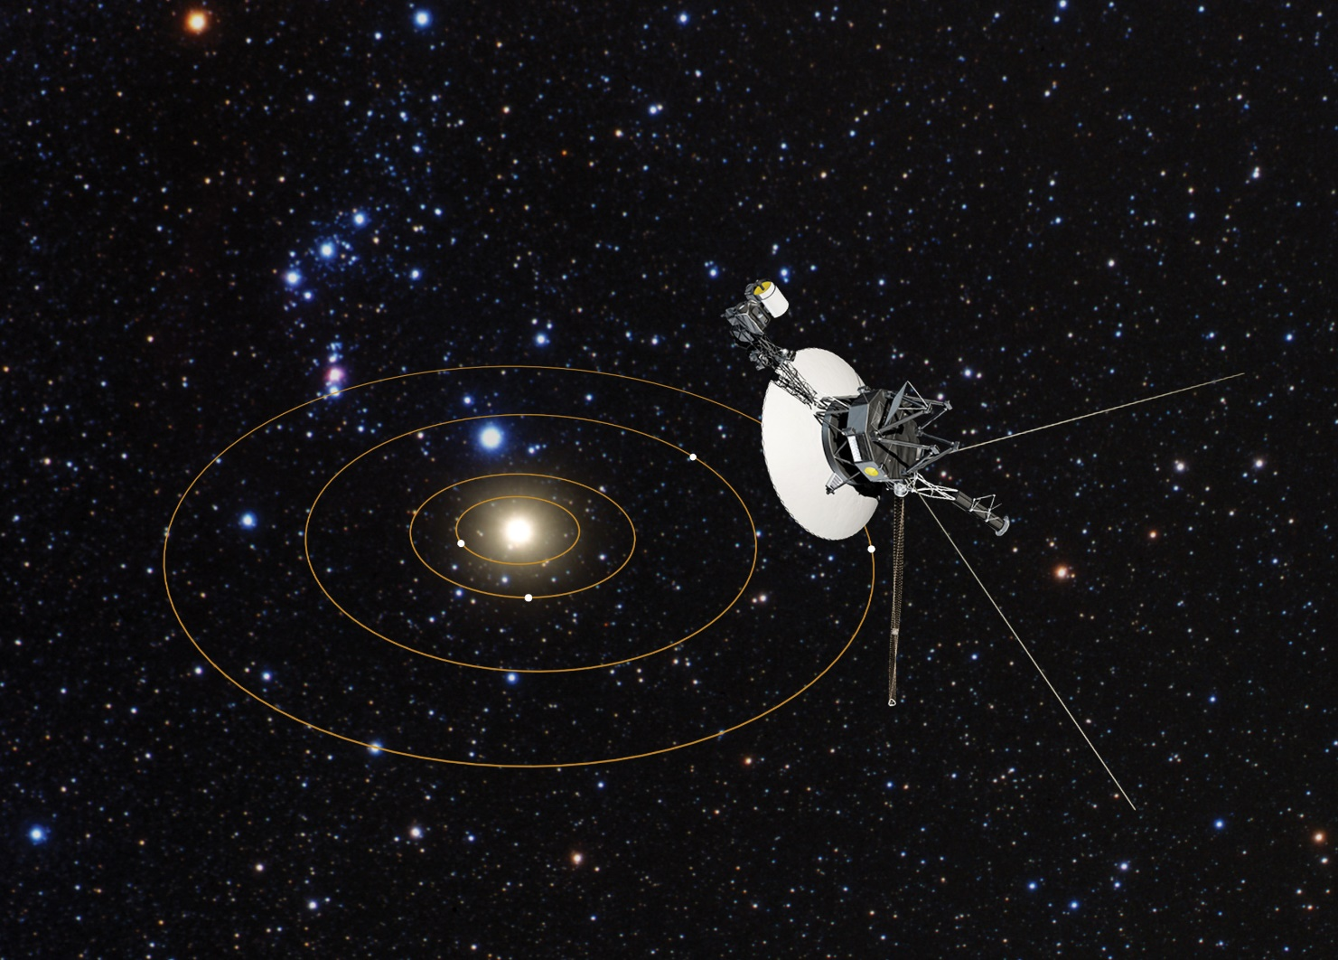
State Of The Art: Outer Space
Voyager 1 (1977) is the fastest spacecraft ever built.
Travelling at a record 17km/s it took 35 years to reach interstellar medium at 120 AU (the first spacecraft to reach this milestone).
Most distant spacecraft as of today (155 AU after 45 years of travel)
Image credit: NASA

Slide 5
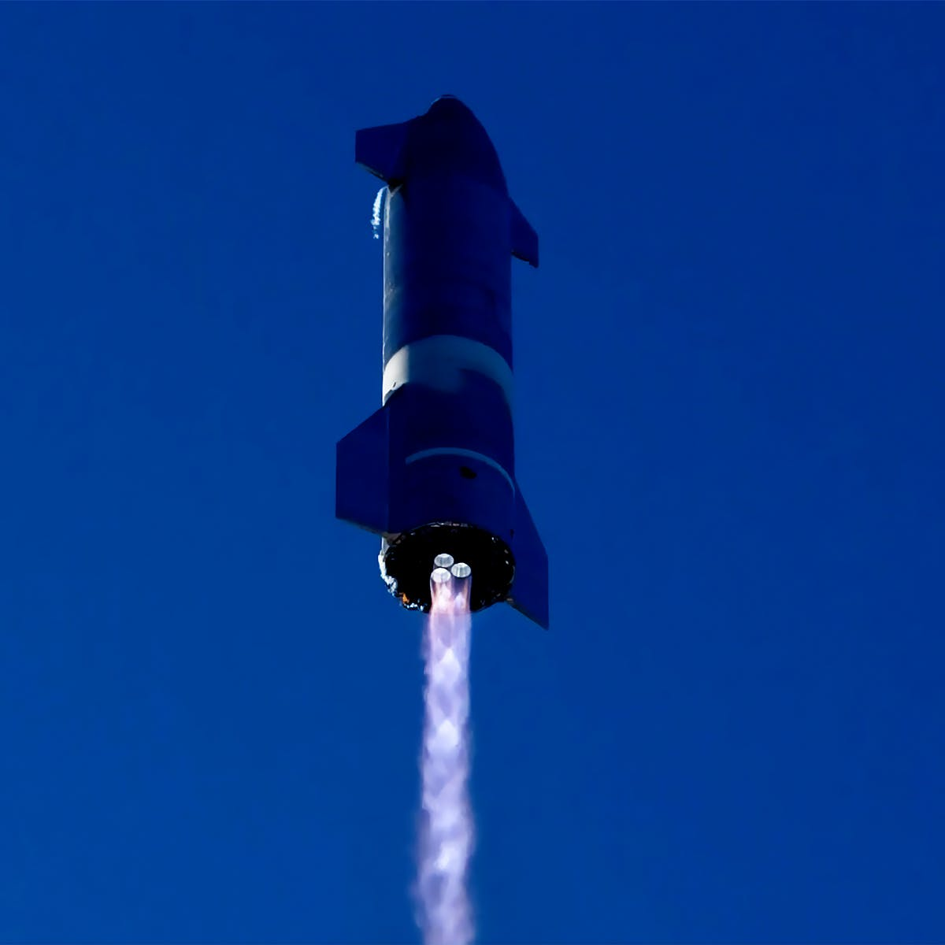
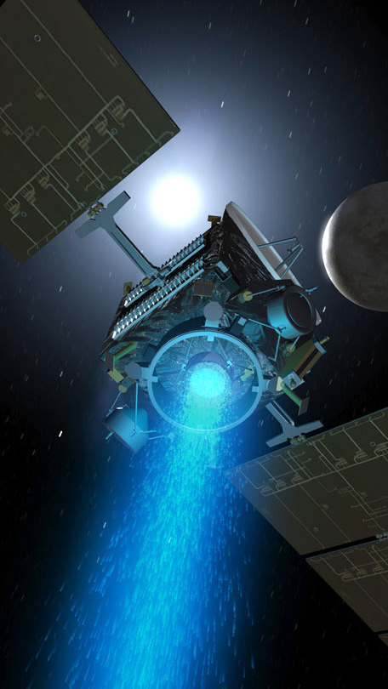
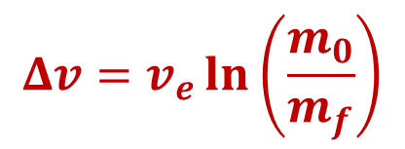
Limitations Of Propulsion
Need to carry fuel and “throw” it away to propel
Limited by the rocket equation
$$Δv=v_{e}\ln\left(\frac{m_{0}}{m_{f}}\right)$$

Slide 6

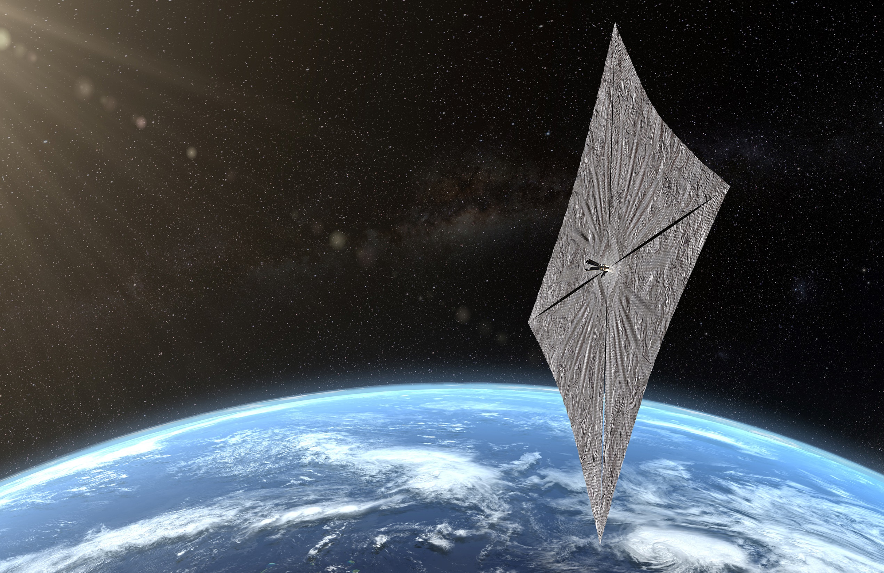
Solar sails
Image credit: the Planetary Society

Slide 7
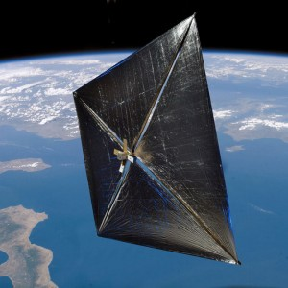
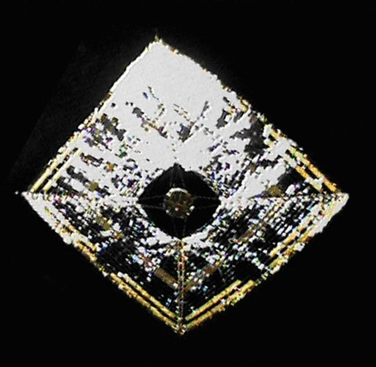
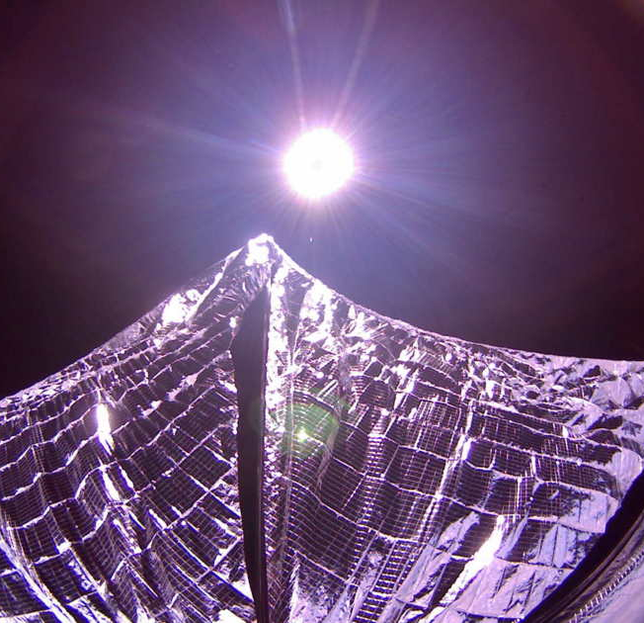
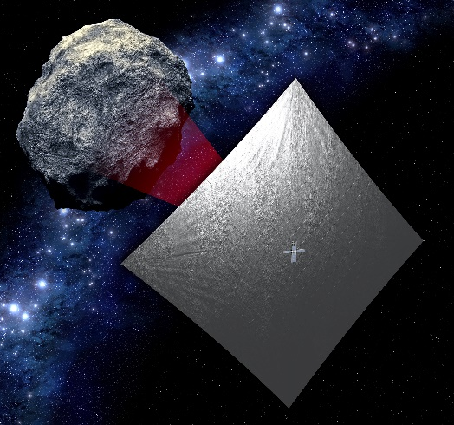
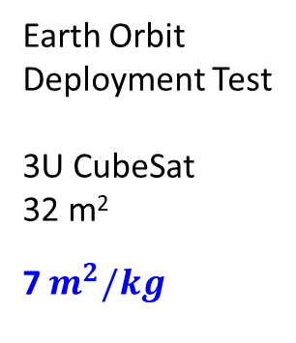
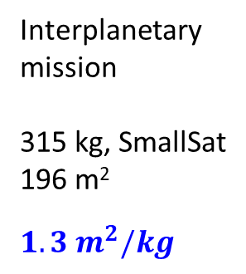
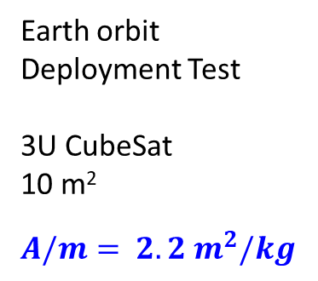
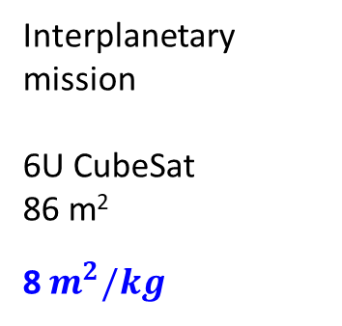
Solar sail missions flown and planned
NanoSail-D (2010)
NASA
IKAROS (2010)
JAXA
LightSail-1 (2015)
The Planetary Society
NEA Scout (2021)
NASA
Earth orbit
Deployment Test
3U CubeSat
10 m²
$$A/m= 2.2 m^{2}/kg$$
Interplanetary
mission
315 kg, SmallSat
196 m²
$$1.3 m^{2}/kg$$
Earth Orbit
Deployment Test
3U CubeSat
32 m²
7$m^{2}/kg$
Interplanetary mission
6U CubeSat
86 m²
8$m^{2}/kg$

Slide 8
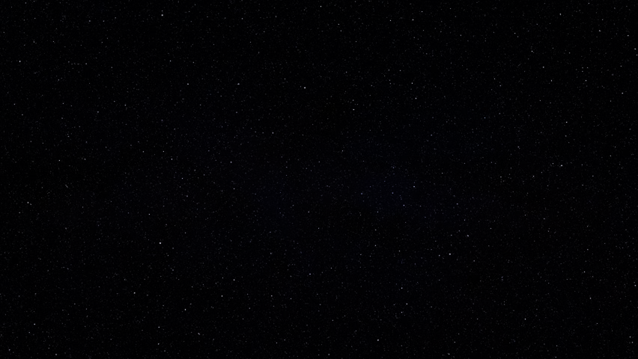
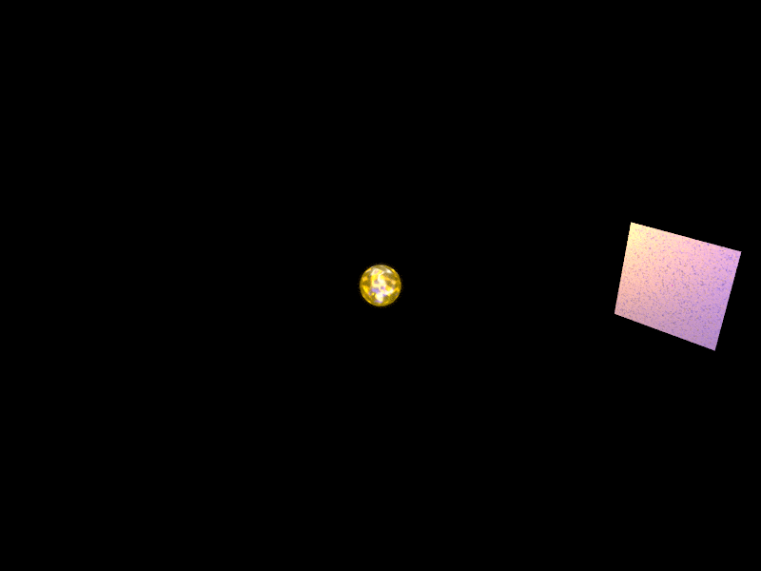
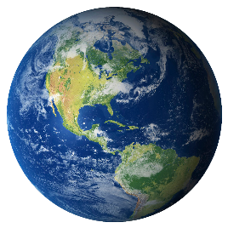

Slide 9
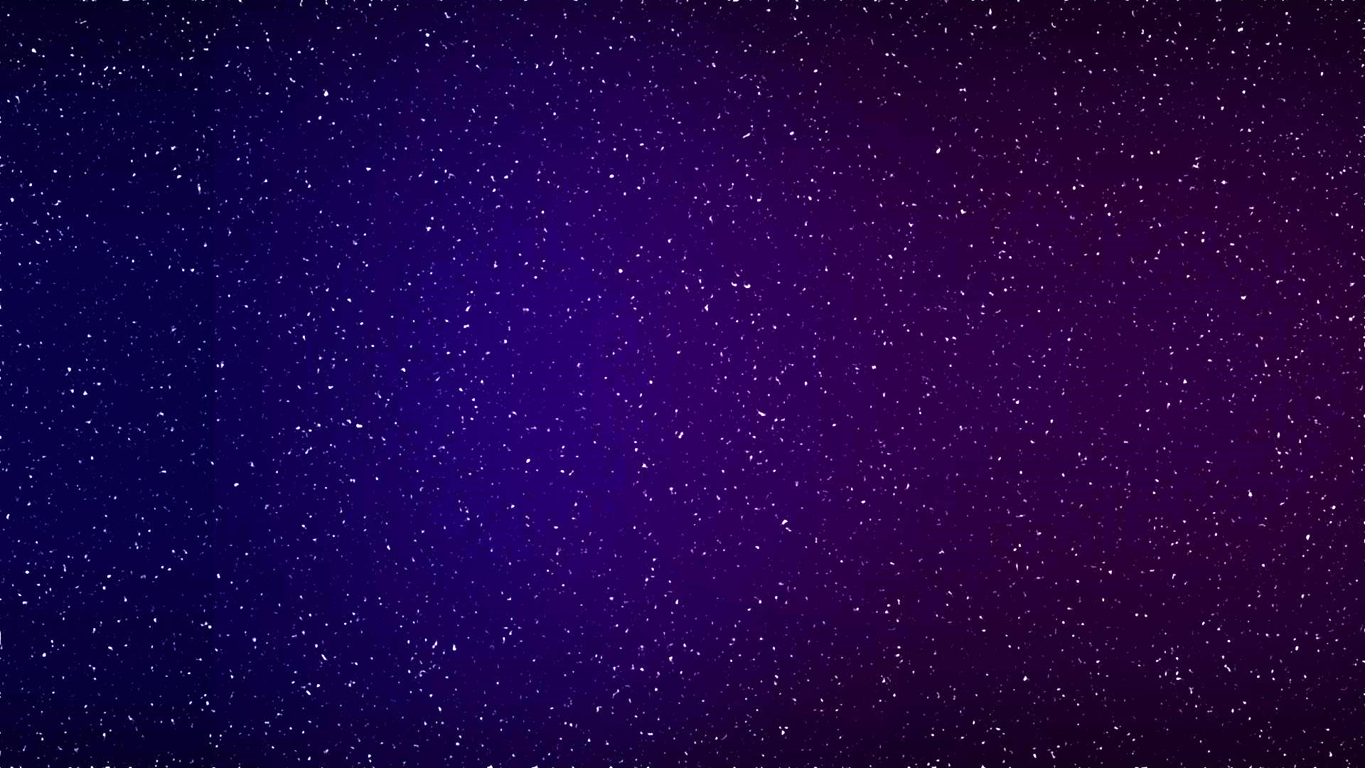
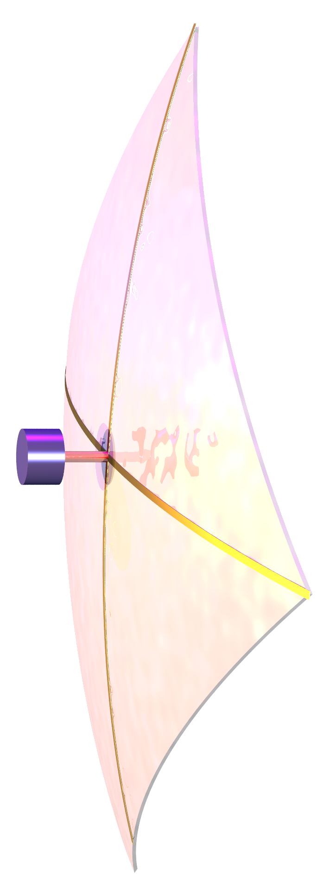
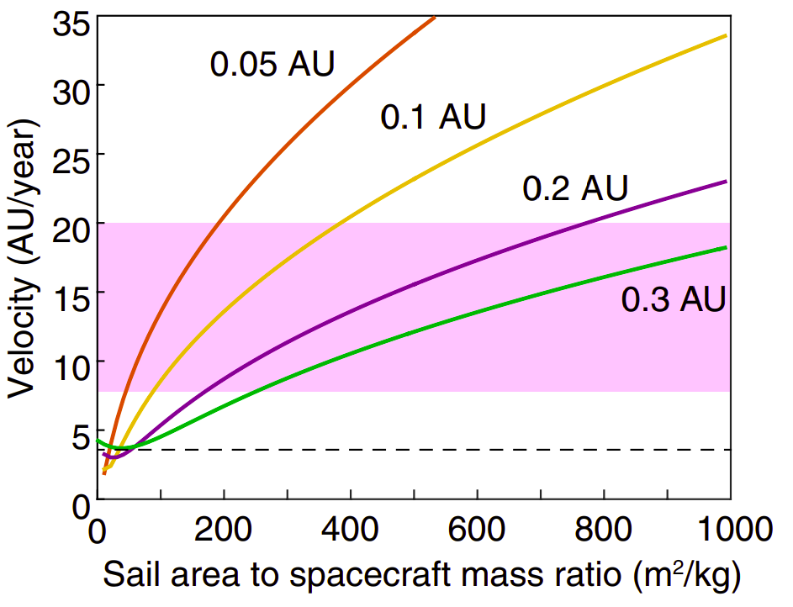
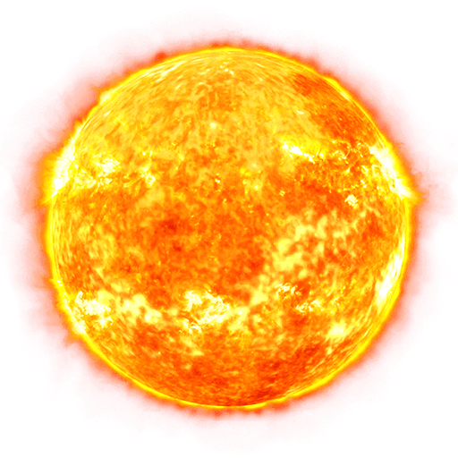
How fast can we go?
Sail area: ~100m x 100m
Payload mass: 10-20 kg
Overall S/C mass: ~50 kg
Cost: <$100M
<10 R☼
Goal: fast
>20 AU/yr (up-to 60 AU/yr)

Slide 10
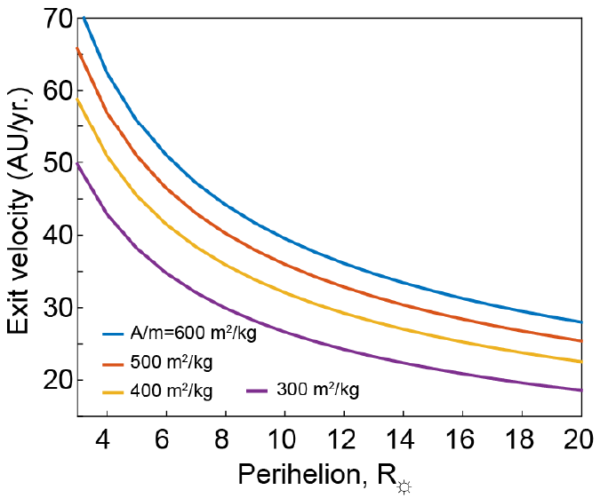
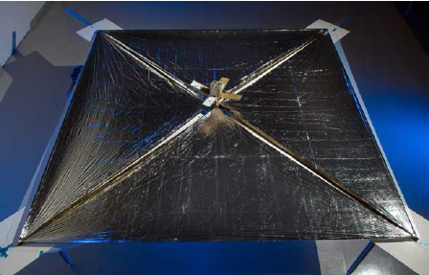
Where is the limit?
Parameters needed for 60 AU/yr
Parameter | Range
Spacecraft bus mass (excluding sail systems) | 10-20 kg
Sail area | 10,000 m² – 25,000 m²
Perihelion pass | 3-5R☼
Sail material density | <1 g/m²
Sail material reflectivity | > 0.7

Slide 11
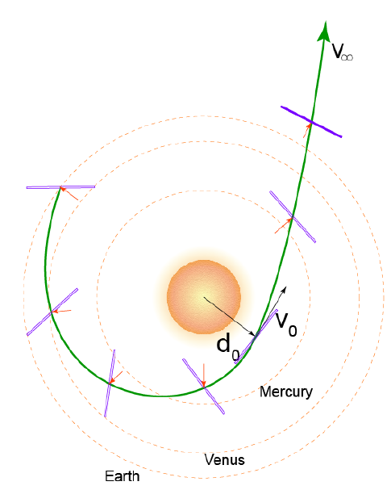
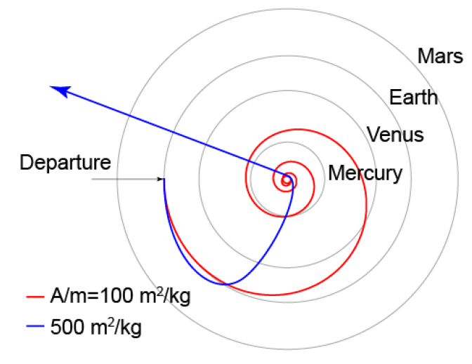
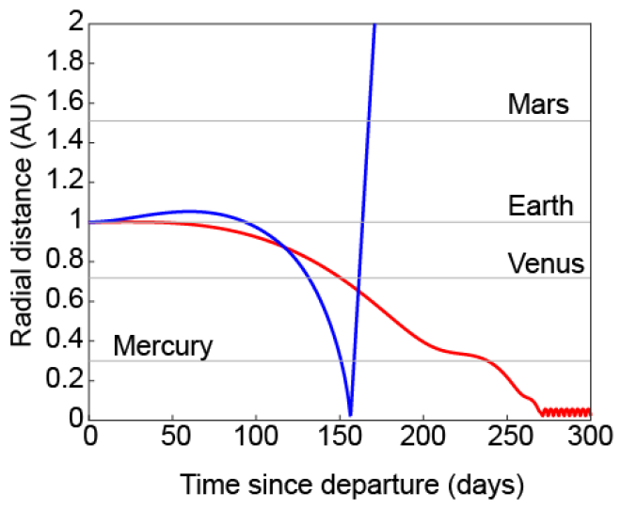
Trajectory & mission profile
C3=0
Start with MEO and “spiral out”
5R☼ perihelion
100% reflectivity
7 days between entering and leaving Mercury orbit
150 days to reach perihelion
A.R. Davoyan et al., Optica 8, 722 (2021)

Slide 12

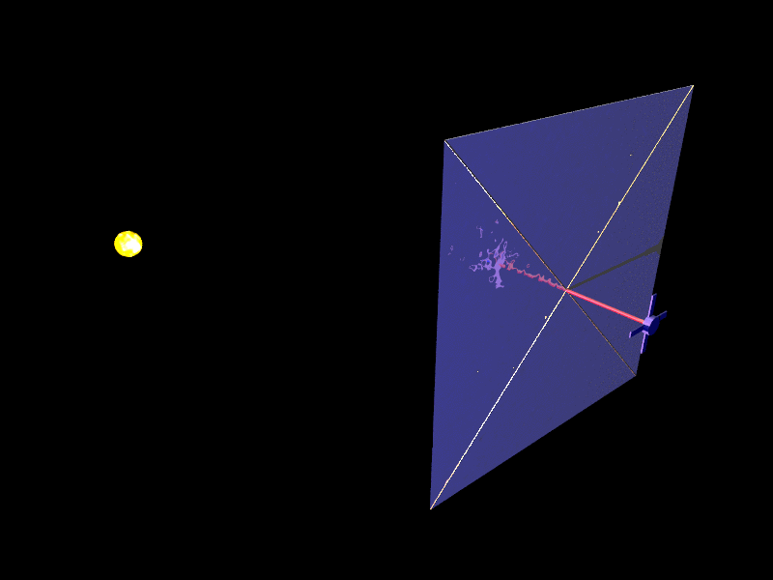
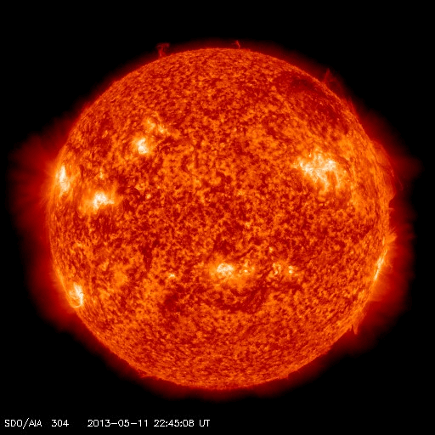
Getting Close To The Sun
Outstanding mission challenges
Harsh environment
Need for new materials
Large lightweight architectures
Spacecraft controls & navigation
Power and communications

Slide 13
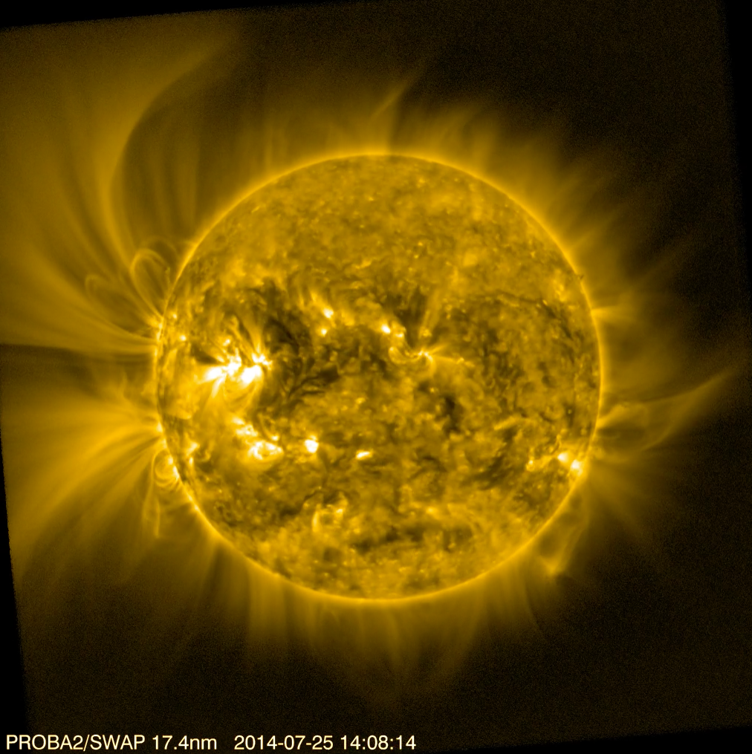
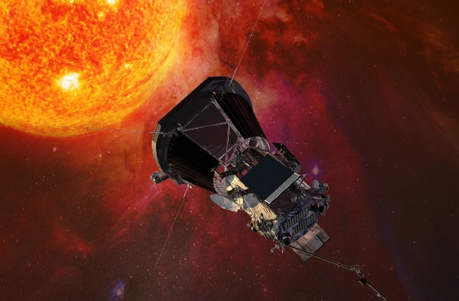
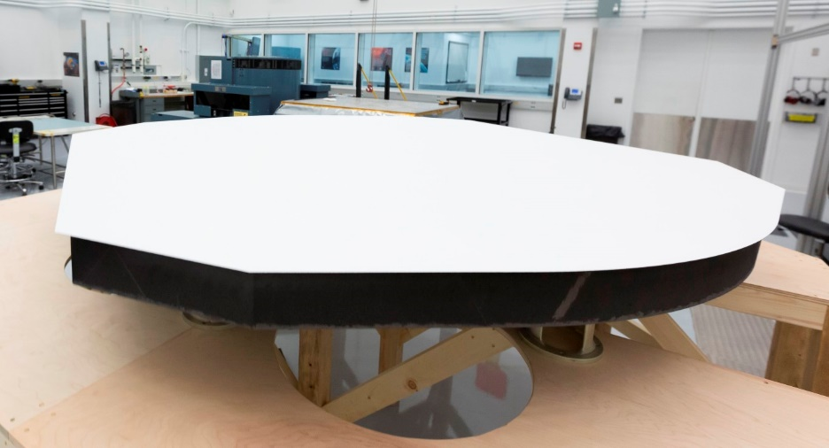
Grand challenge
Radiation, plasma, particles
Parker solar probe
(9 R☼)
Heavy heat shield

Slide 14
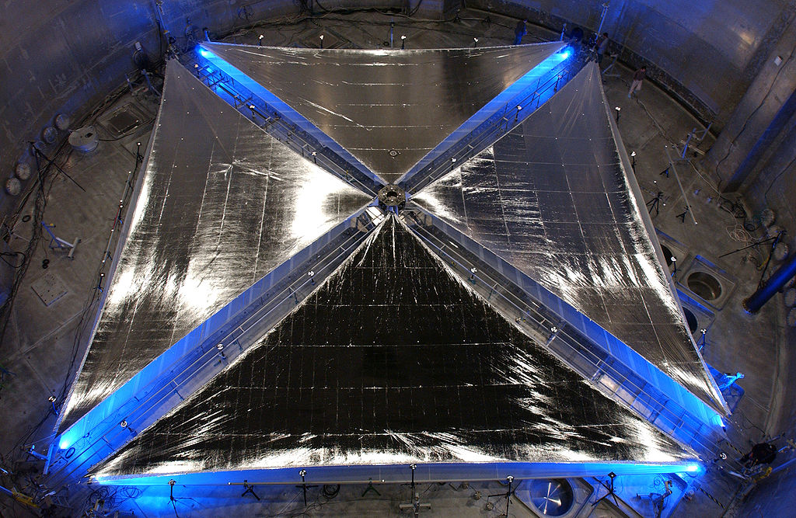
Current sail material technology
Credit: NASA

Slide 15

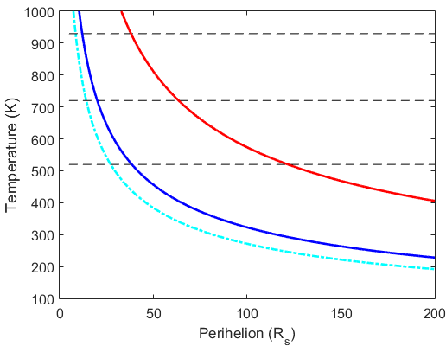









Limitations of current materials
$$38 R_{s} (0.177 AU)$$
Al
$$ε=0.1$$
Kapton
Sunlight
Mylar, CP1
$$ε=1$$
Al (50 - 100 nm)
$$ε=2$$
Organic film (few $μm$)
$$12 R_{s} (0.056 AU)$$
$$64 R_{s} (0.3 AU)$$
Heat rejection
*10% - Al absorbance
$$20 R_{s} (0.09 AU)$$
$$122 R_{s} (0.56 AU)$$
*0.04 – Al emissivity

Slide 16
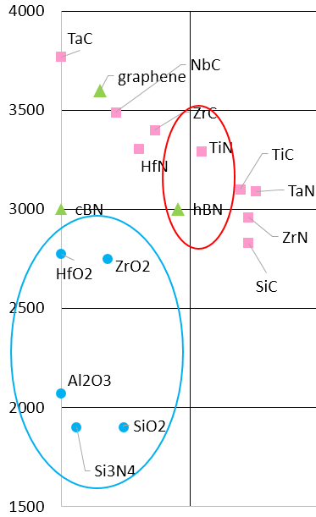
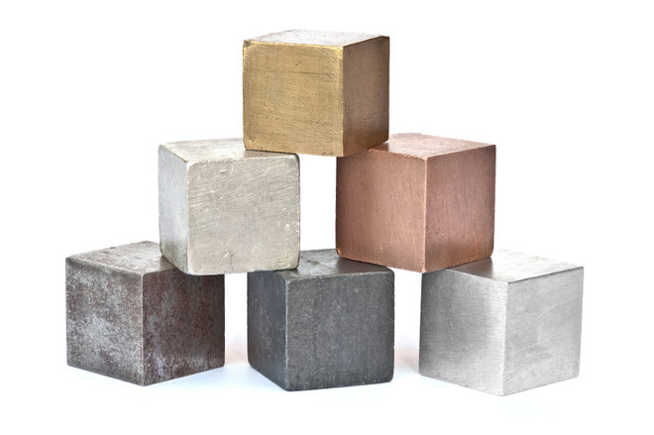
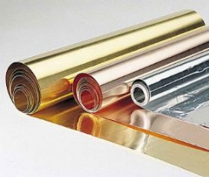
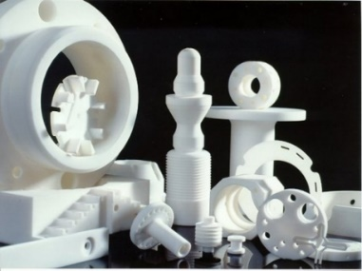
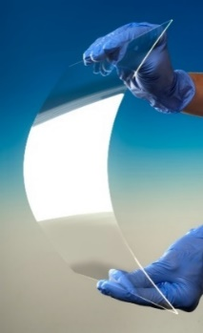
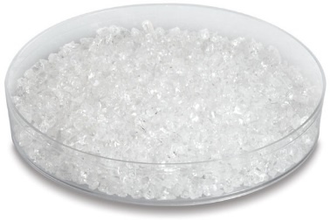
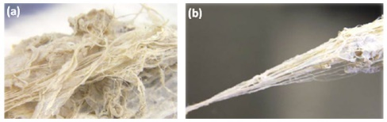
Extreme sail materials
Refractory metals: Titanium nitride, tungsten
Transparent ceramics

Slide 17
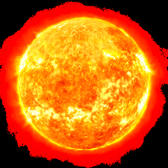
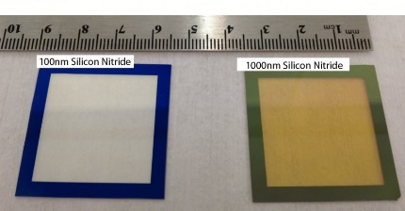






Two types of sail materials
TiN sails
SiN metamaterial sails
TiN
100nm
500nm-1000nm
High temperature inorganic film
Bragg reflectors
Photonic crystals
High T
Easy to make
Lower T
Harder to make
>70% reflection, <0.7 g/m², survive at <5R☼

Slide 18


TiN sails
TiN
100nm
500nm-1000nm
High temperature inorganic film
High T
Easy to make
High melting point (3200 degree C) – can survive around 2.5 solar radii
Density: 5.4 g/cm³
Absorbs 40% of sunlight
Estimated density: <1.5 g/m²
Tested at ~500C (no degradation found)

Slide 19



Ultrathin films
front
back
Reflectance
Wavelength (nm)
~100 nm thick free standing Al/CNT films
Estimated density: <1.5 g/m²
Tested at ~500C (no degradation found)
Coated with CNTs on the backside

Slide 20



Toward TiN sail materials
LEO environmental testing via MISSE mission
(launched Aug 29th, 2021)
Thanks to Miria Finckenor (NASA MSFC)

Slide 21




Sail craft architecture
~10kg spacecraft bus,
~0.7g/m² sail material areal density,
50-70g/m boom density
150m by 150m sail
All aspects of the mission are feasible and doable
(A/m = 554 m²/kg) & v>50 AU/yr
 | Bus | Sail support/booms | Sail material | Total
Mass (kg) | 10 | 14.8 | 15.75 | 40.55
Fraction (%) | 25% | 36% | 39% | 100%
Interaction with solar plasma
Payload protection
Control authority
Power & mass budget
<50 W (RTG)
Optical comms
Total bus mass ~10 kg
H+ energy ~1keV
Solar wind
300km/s
100nm
200nm
Sputtered atoms

Slide 22

Roadmap

Slide 23

Vision: Sun as a Launch Pad
Oort cloud
Kuiper belt
Goals:
low cost (~$10M)
short lead time
missions to arbitrary destinations (e.g., high inclination)
fast (50-60 AU/year)

Slide 24












Team and Acknowledgements
PI: Artur Davoyan
Co-Pis: Henry Helvajian, Les Johnson, Marco Velli
Collaborators: S. Turyshev (JPL), D. Garber (NXtrac), L. Friedman (Planetary Society), P. Hon (Northrop Grumman), J. Carr (MSFC), M. Nehls (MSFC), M. Finckenor (MSFC)
UCLA student team: H.T. Tung, H. Ling, P. Krings, J. Digani, S. Huang, A. Dunn, S. Martinez, R. Rio

