Slide 1




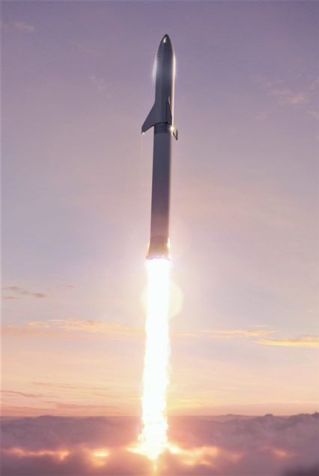
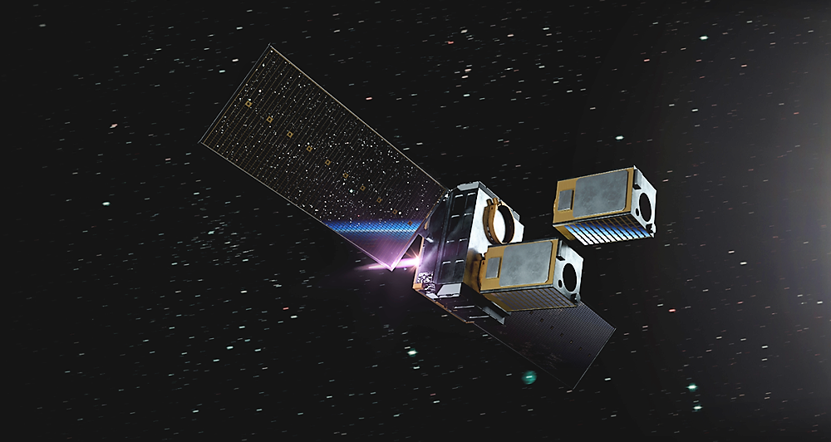
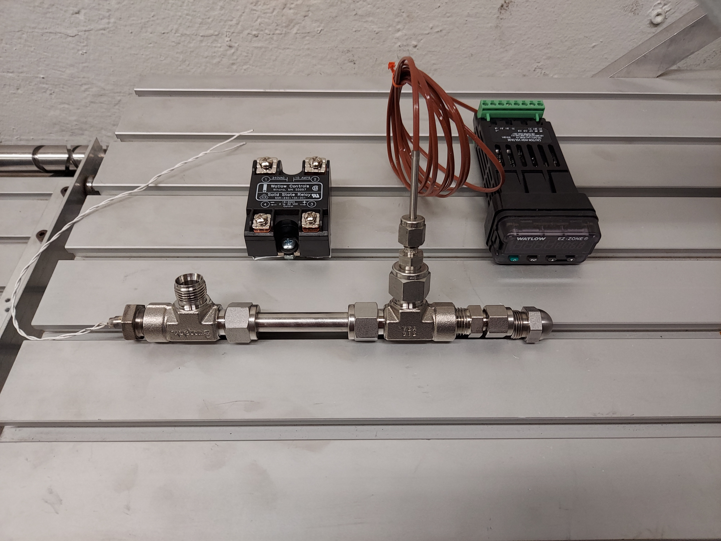
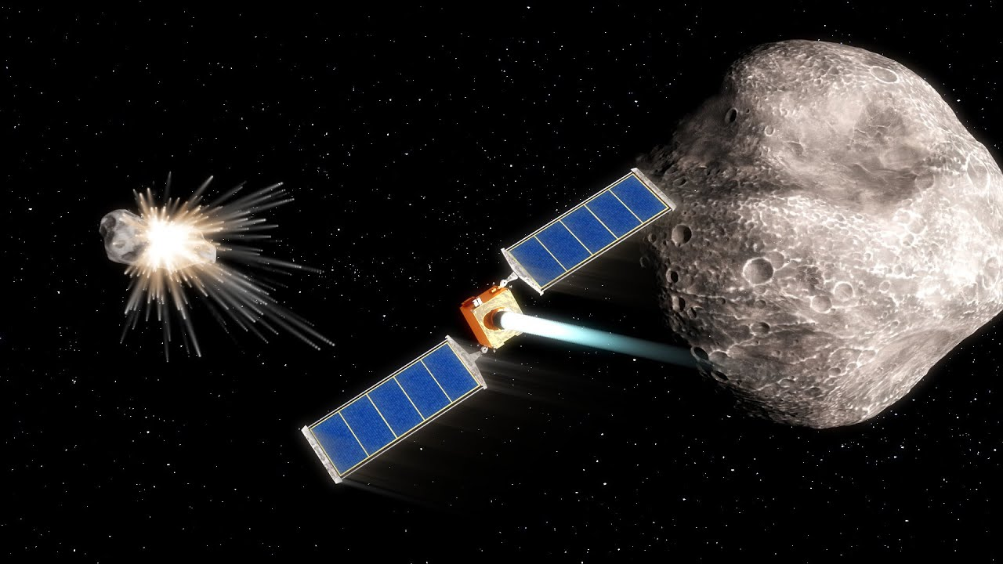
Resistojets for CubeSat Propulsion
Derek Gilbert, Nathan Grossman, Garrett Romero, Dr. Greg Ogden
Department of Chemical & Environmental Engineering
University of Arizona

Slide 2
Presentation Outline
Motivation
  Where we fit in
Objective
Challenges
Methods
Current Status
Discussion
Takeaway

Slide 3
Big Picture
Develop Green Propulsion System for 1-3U CubeSat
  Early CubeSats did not have propulsion systems
  Increased CubeSat activity increased demand for extended mission lifetimes and navigation
  Resistojets are simple engines that only require a heat source and control valves
  Interplanetary CubeSats with Resistojets could use water from asteroid regolith to extend their mission operations

Slide 4
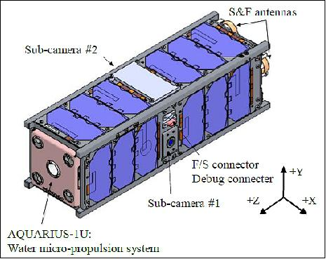
Objectives
Create a Thruster that is:
Clean
Cheap
Simple in design
Solution:
Resistojets are common and simple in design
Water is clean and cheap

Slide 5
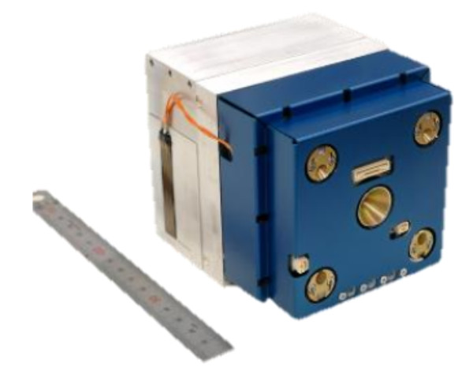
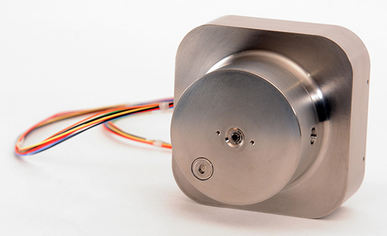
Current CubeSat Resistojets
CUA Resistojets simplify design by using refrigerants
AQT-D Resistojet successfully operated from ISS deployment in 2019

Slide 6
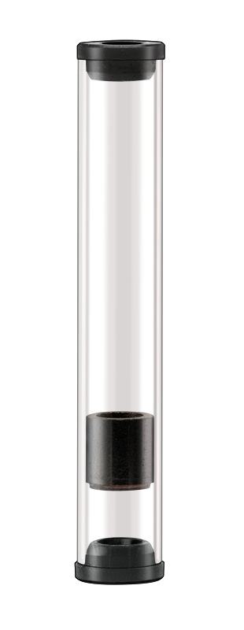
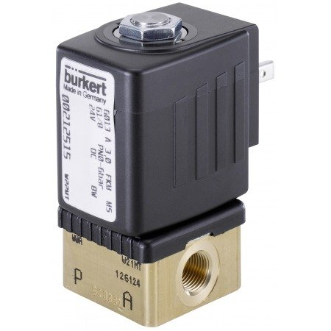
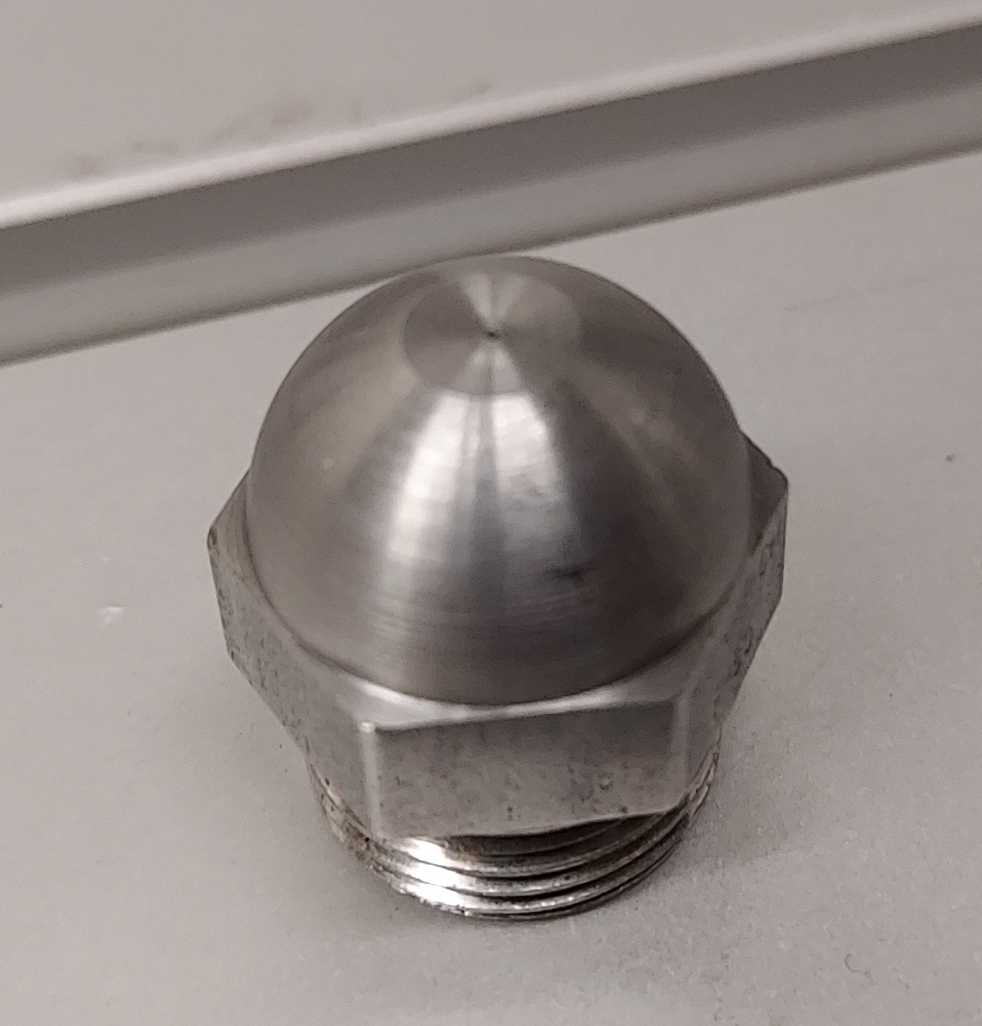
Challenges
Steam is not an ideal gas (CEA code is not valid)
Converging-diverging manufacturing difficulties (currently using a simple hole nozzle)
Finding small parts was difficult
Lead times of these parts extended the assembly timeline

Slide 7

CEA Code Analysis
Major Finding: CEA relies on expelled gasses being an ideal gas
Limiting Factor: Steam is not an ideal gas for temperatures below 748 Degrees Celsius (and pressures above 109 atm)
  500.0 C / 374.0 C = 1.337 (Fails)
  1.97atm /217.7 atm = 0.009 (Does not Fail)

Slide 8
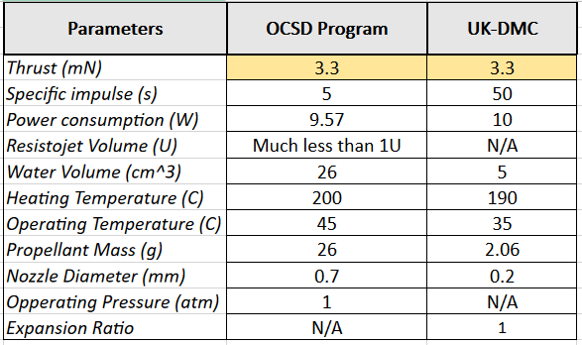
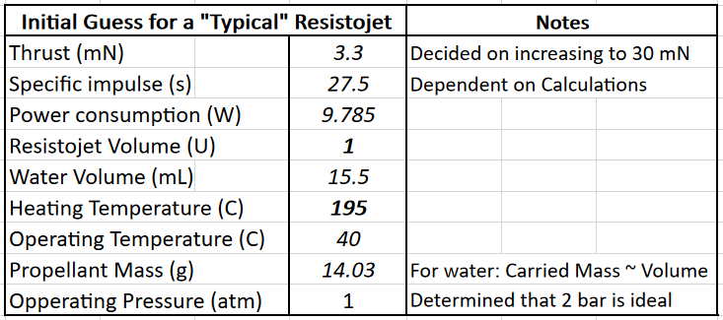
Analyzed research articles to obtain typical Resistojet values
A comparison of the UK-DMC Cubesat and the Optical Communications and Sensor Demonstration (OCSD) Cubesat
Gave us a starting point to determine our required Resistojet parameters​

Slide 9
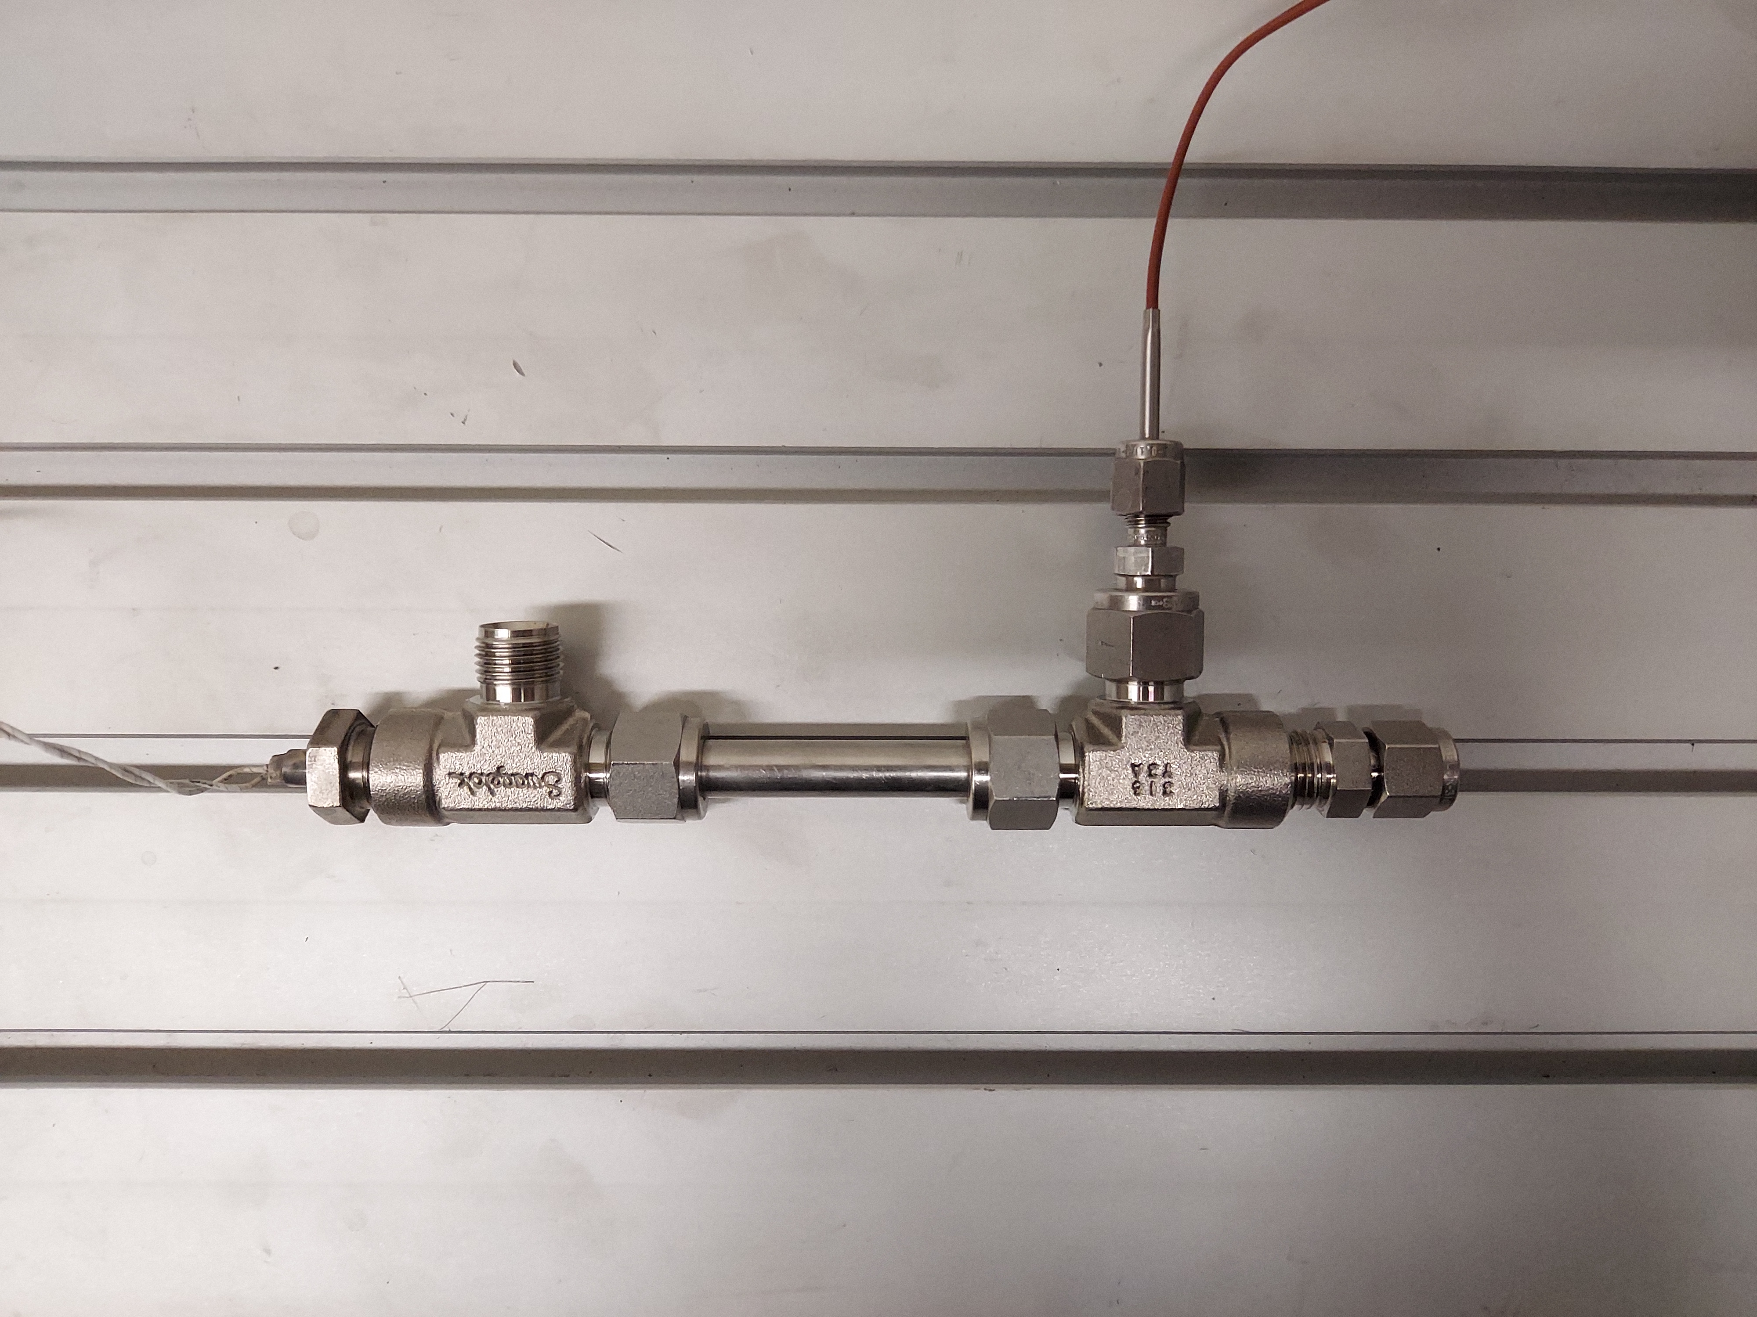
Experimental Sizing
Heater Section:
Mass Flow Rate: 2.0 mL/min
Temperature: 200 to 300 C
Pressure: 2 to 4 bar
Feed Water Pump:
Up to 6LPM
Periodic Operation
  Fill unit, self pressurizes upon heating, then expel in pulse

Slide 10
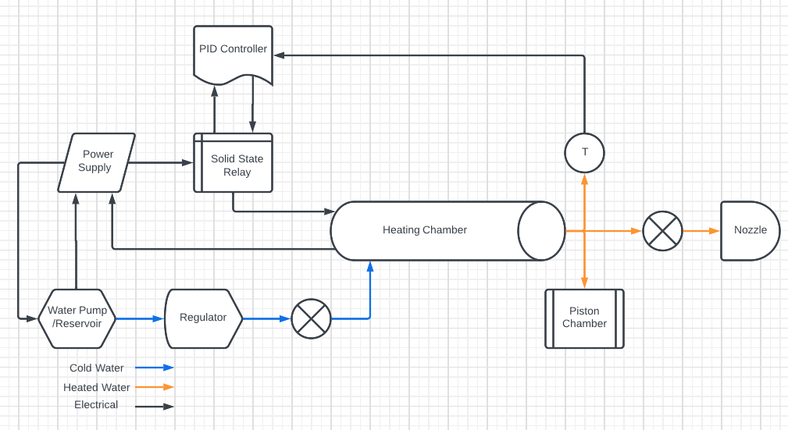
Process Flow Diagram

Slide 11
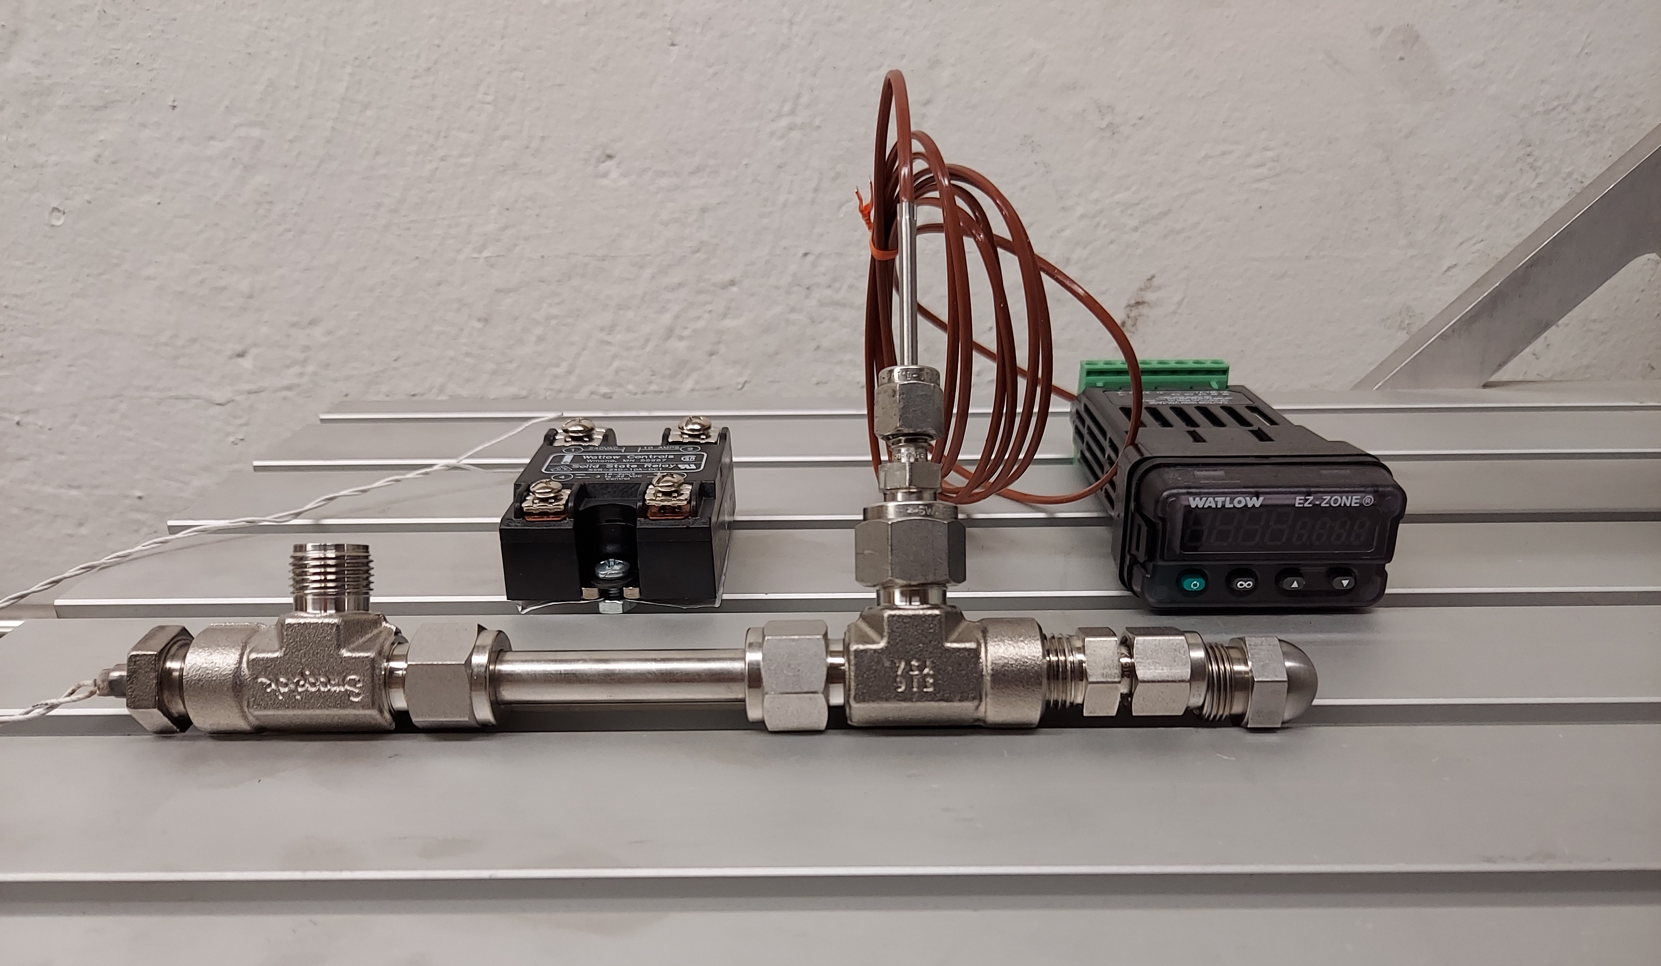
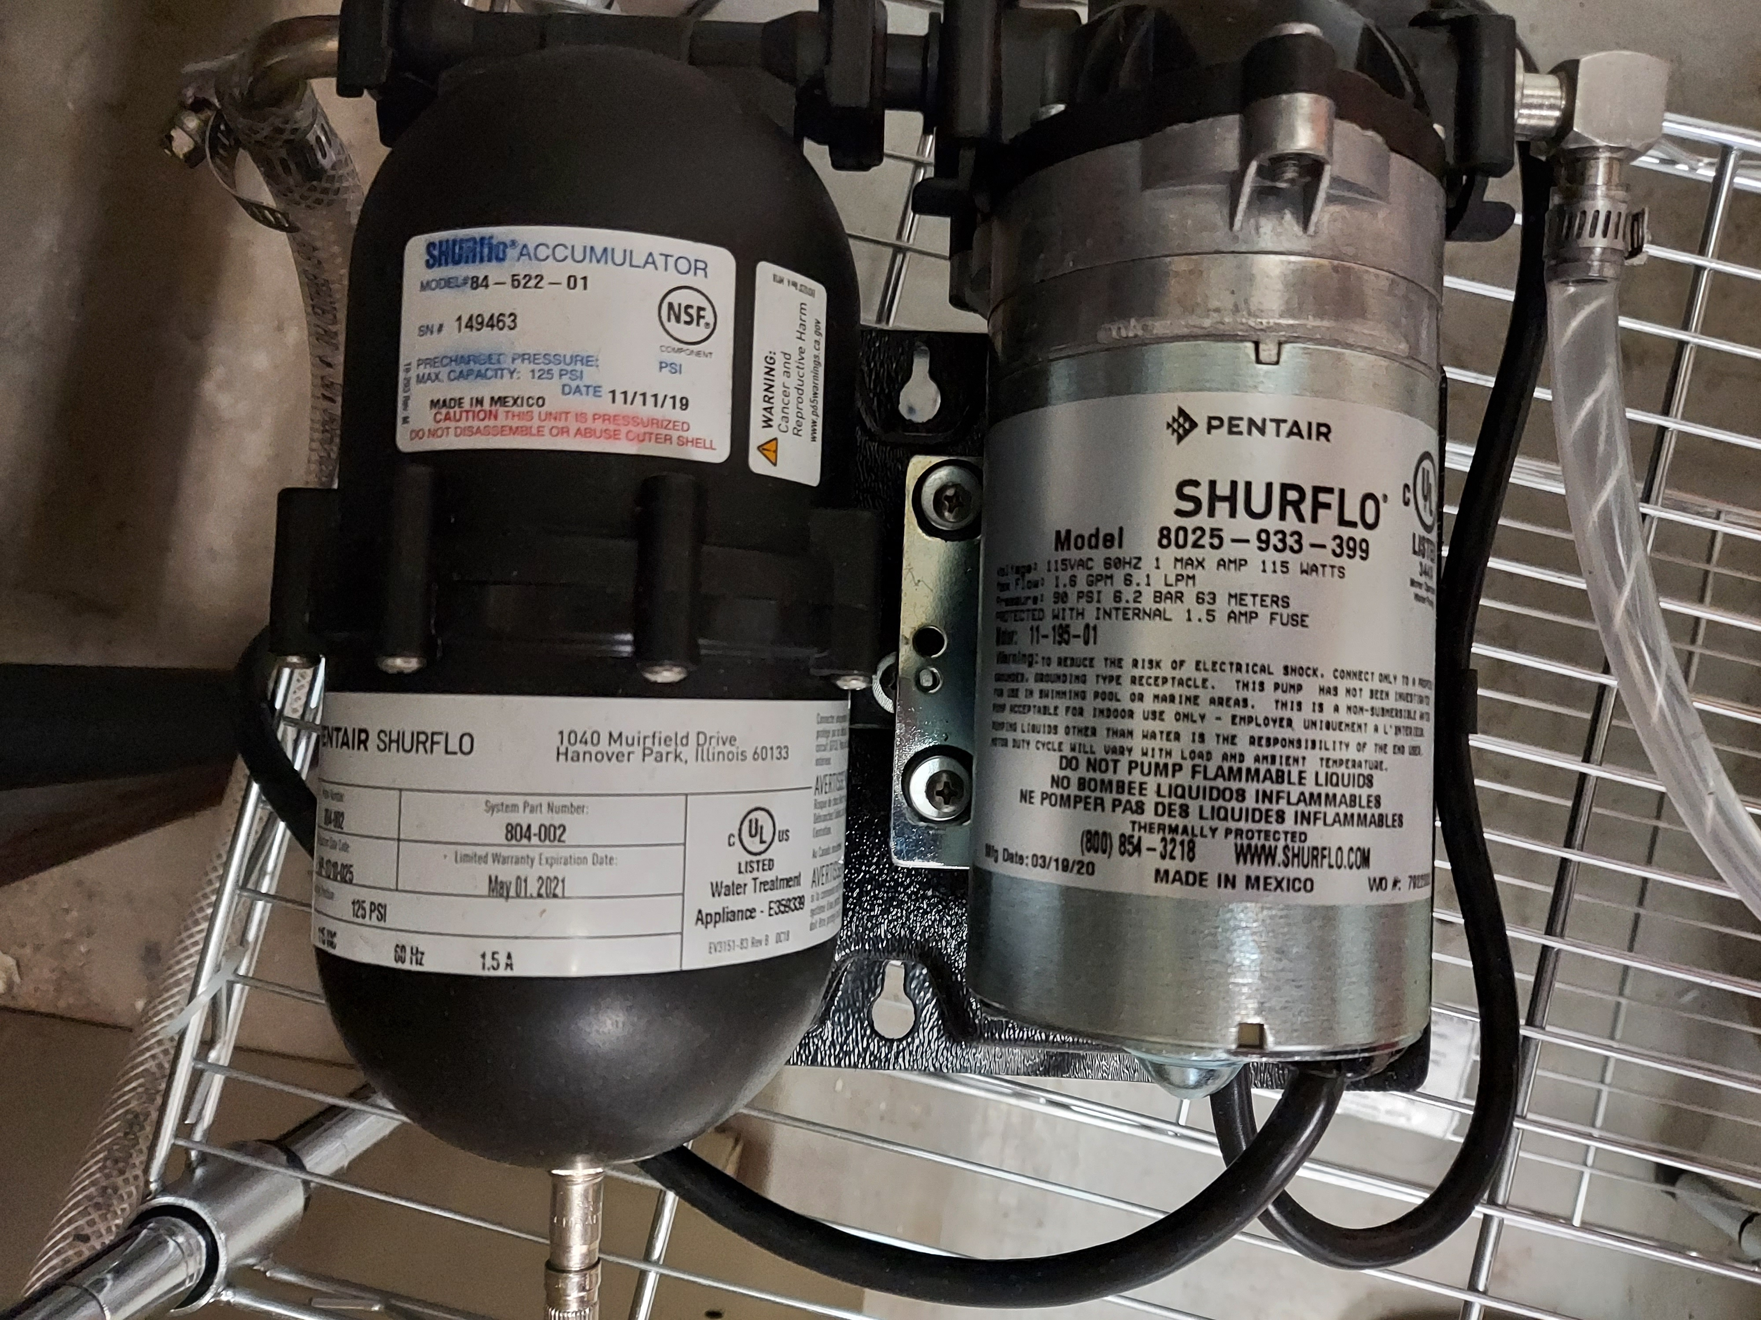
Purchased Design Components
Heater Assembly
  ¼” 60V, 140W heater
  3/8” SS sheath
PID heater & thermocouple
Solid State Relay
Feed Water Pump

Slide 12
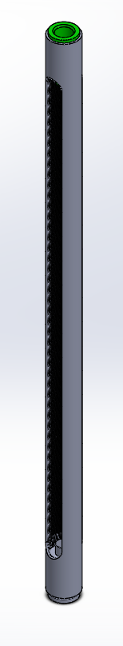
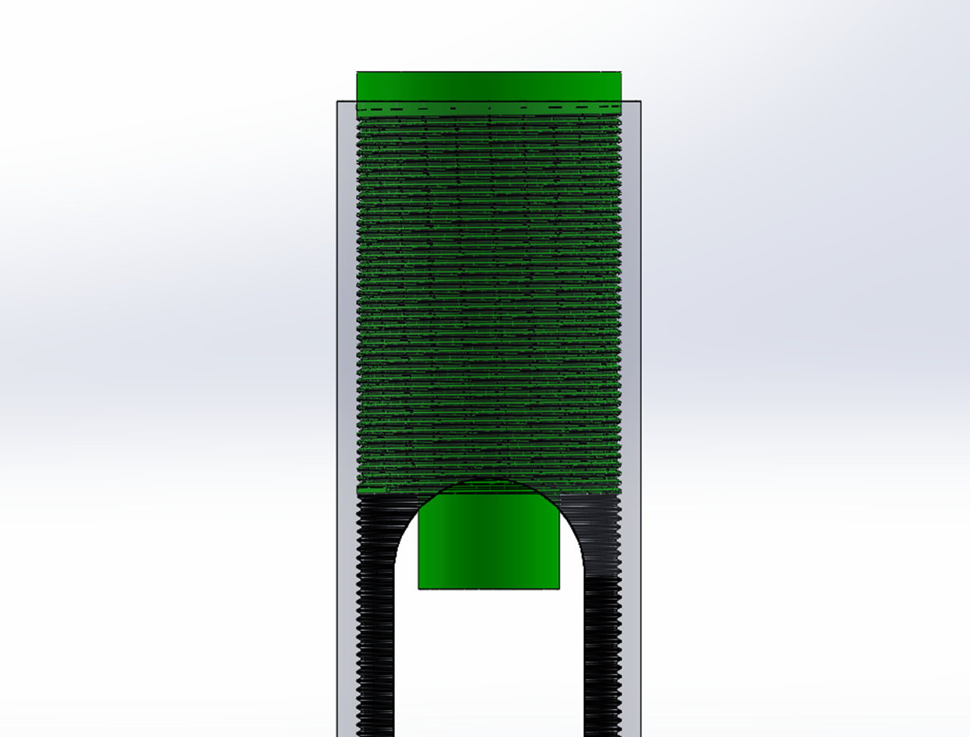
Remaining Parts
Power Supply (15 V)
Expansion Relief Piston (Airpot 2KS95-3.0CP-ET)
Solenoid Valve (Burkert 6013 136019)

Slide 13
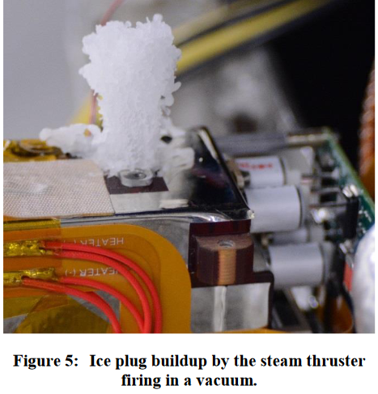
Future Work
Experimental verification of MATLAB data
Converging-Diverging nozzle design and fabrication
Vacuum Chamber testing
Ice Plug buildup experimentation

Slide 14
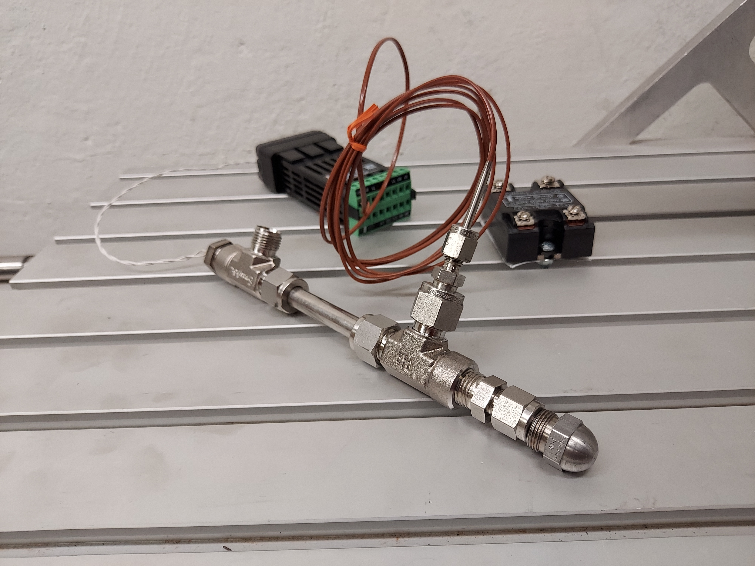
Questions

