Slide 1




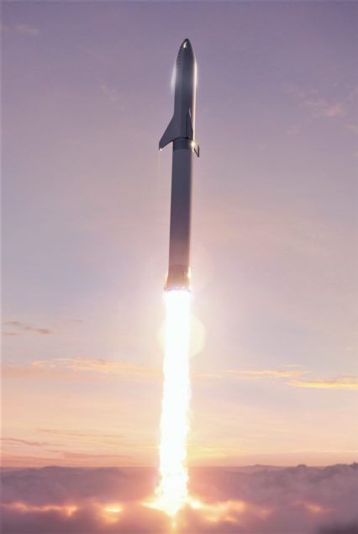
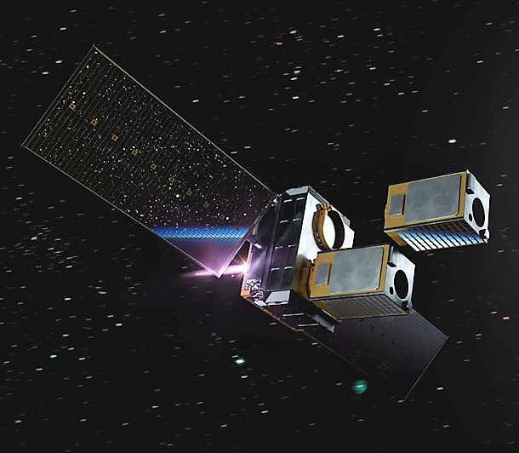
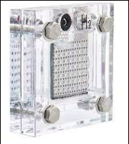
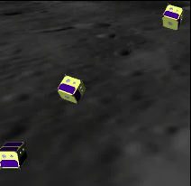
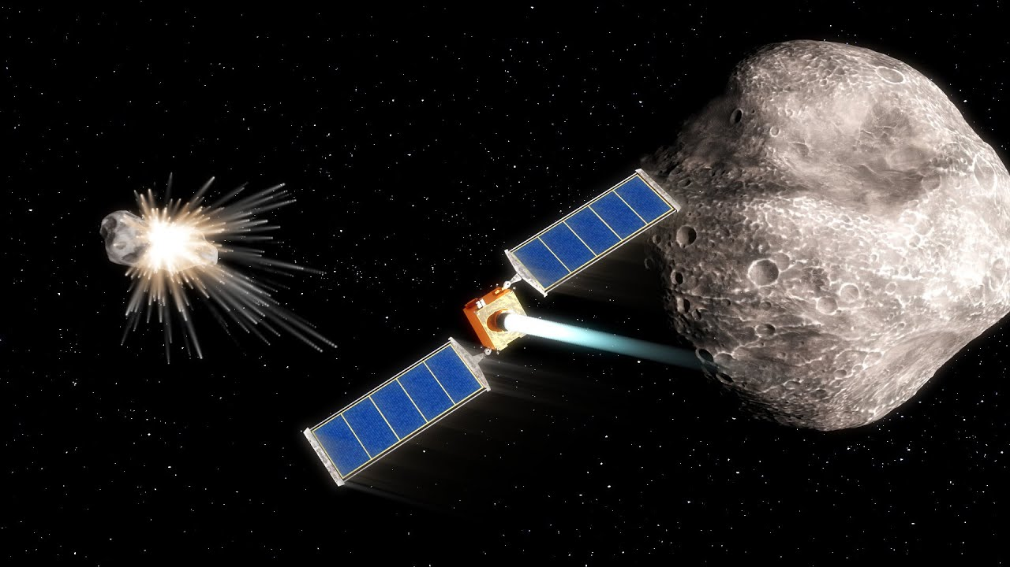
Design for a CubeSat Propulsion System Using Polymer Electrolyte Membrane Electrolyzers
Maanyaa Kapur, Avery Stockdale
Mentor: Dr. Greg Ogden
Department of Chemical & Environmental Engineering, University of Arizona

Slide 2
Presentation Outline
Big Picture
Objective
Challenges
Experiment Progress
  PFD and CEA
System Design
Analysis
Discussion

Slide 3
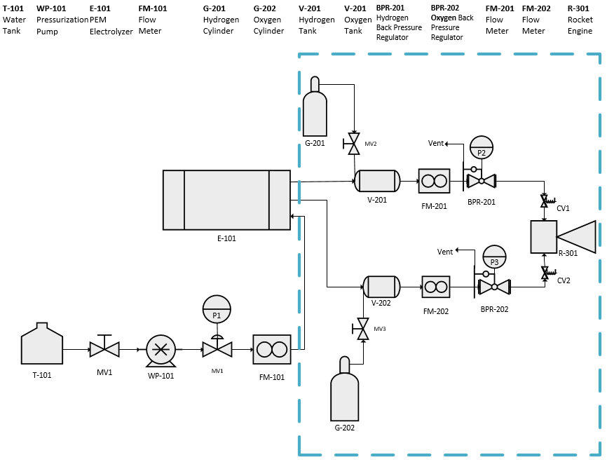
Big Picture

Slide 4
Objectives
Determine volumetric flow rates necessary to produce the required thrust
Develop Flame Safety System
Test the system at different pressures to optimize flame stability
Design a nozzle within mass budget constraints

Slide 5
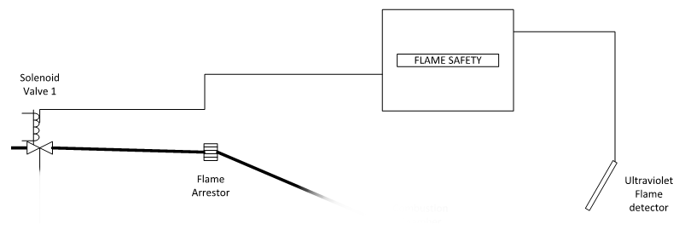
Challenges
Flame safety system setup (to prevent backward flow of hydrogen)
Getting a stable flame at relatively low pressures
Viewing the hydrogen and oxygen flames
Integrating nitrogen in our system design
Setting up and testing the system with limited resources and time constraints

Slide 6
Experiment Progress
System design and PFD is complete
Flame detection device wired into the flame safety system
CEA code used to determine flow rates needed for 2N thrust
Volumetric flow rates calculated
Developed preliminary design nozzle that fits within the CubeSat mass and volume constraints

Slide 7
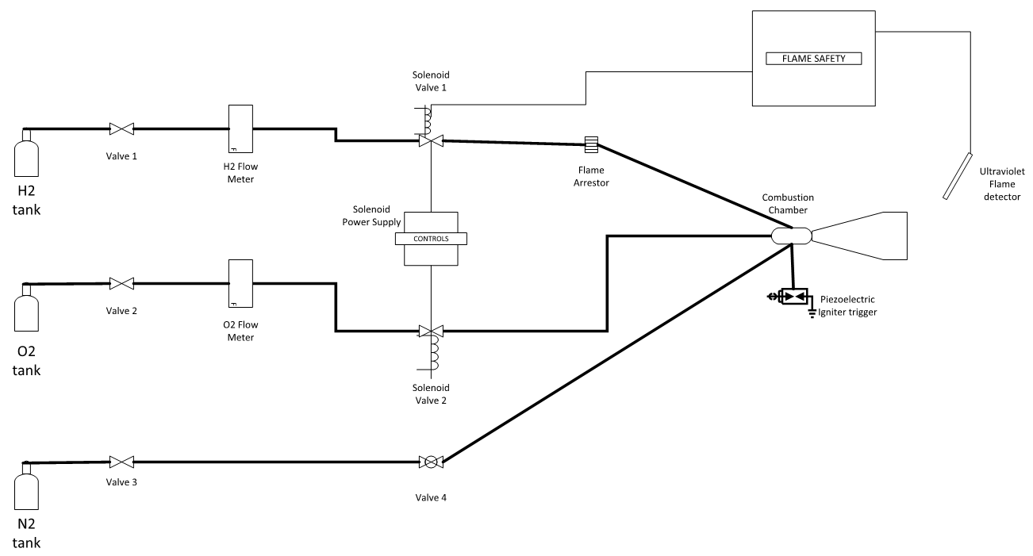
Combustion Experiment PFD
PFD key features:
  Solenoid valves
  Flame arrestor
  Nitrogen injection into combustion chamber

Slide 8
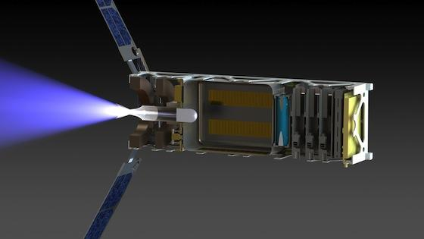
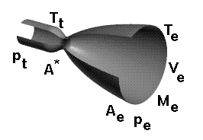
System Design Considerations
Nozzle design
  Designing ejecting nozzle for generating 2N nominal thrust
Volumetric flow rates
  CEA code
  Important to determine gas nozzle sizes

Slide 9
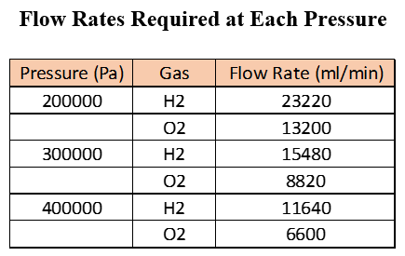

Volumetric Flow Rates
Used CEA code and
Based on 8:1 O/F
Given mass flow rates, estimated volumetric flows based on gas densities at pressure
These flow rates are important for sizing nozzle ejectors through which our gases flow into the combustion chamber and burn

Slide 10
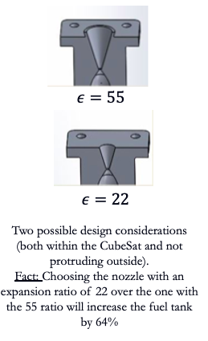
Sample Nozzle Design
Nozzle design
  In addition to stabilizing pressure in and out of fuel cell, need further pressurization (done through the nozzle)
  Smaller expansion ratio required to meet mass-volume budget constraints and design specifications
  More area for fuel tank

Slide 11
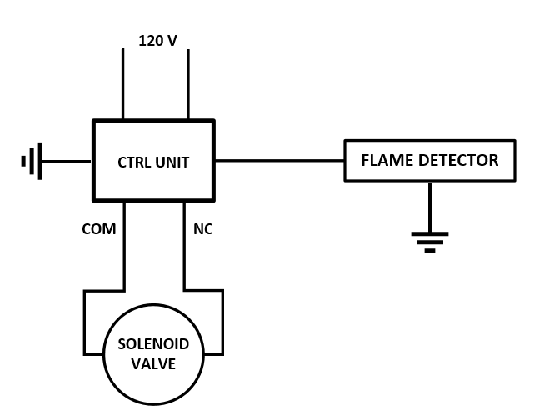
Flame Safety System Design
Ultraviolet light detection system
  Prevents uncontrolled release of flammable gases in the fume hood
  Flame detector signals the solenoid shut off valve in absence of a flame

Slide 12
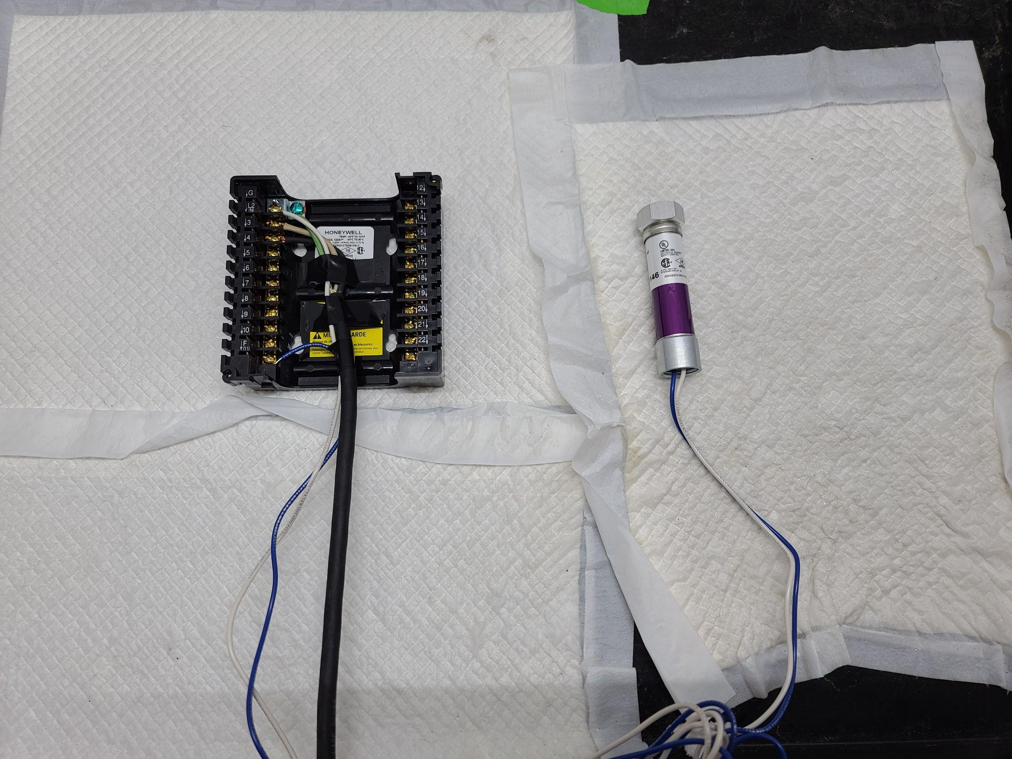
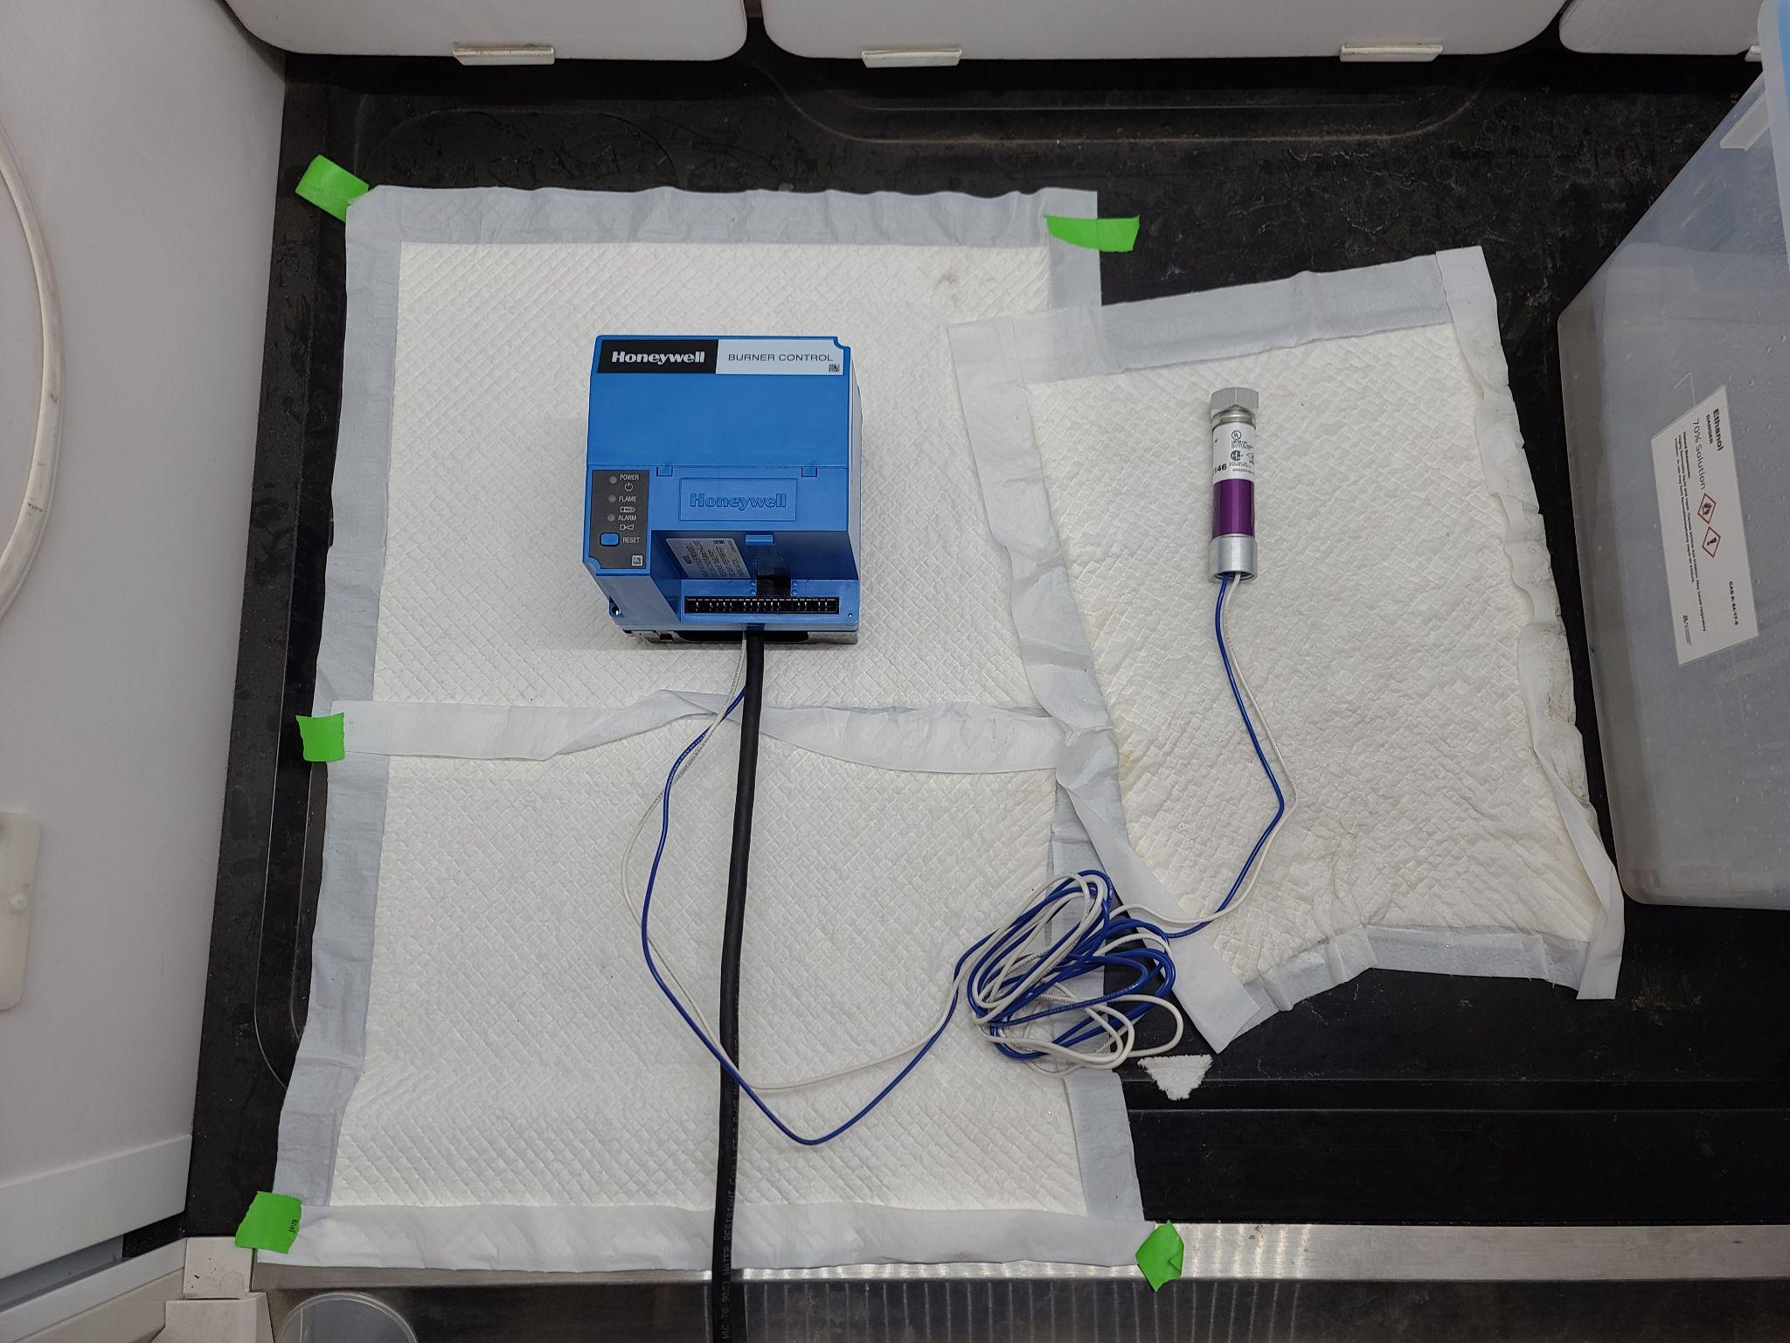
Flame Detector Wiring

Slide 13
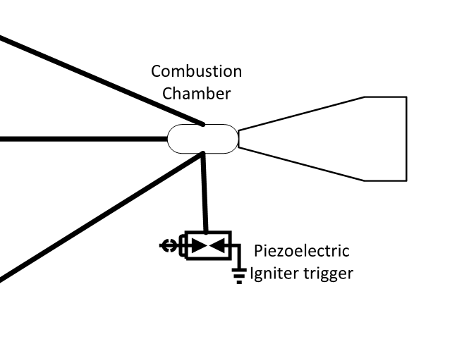
Analysis
Testing to get a stable flame
    First at the pressure that the gases flow out at
    Then at different pressures (different nozzles) until a stable flame is obtained.
Inert Setup (flushing nitrogen in the combustion chamber)
    Ensures Hydrogen burns in presence of oxygen produced by fuel cell
    Adjustments can be made to balance the oxygen flowing out and aiding in combustion.

Slide 14
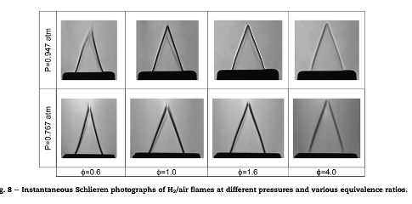
Discussion
CubeSat Propulsion System: Overview
  CEA analysis performed
  Hydroproofed PEM units
  Tested electrolyzer gas production under different pressures
  Flame Safety setup
  Combustion experiment setup
Next steps:
  Test flame stability
  Integrate within electrolyzer
  Run entire system tests

Slide 15
Sources
Pareja, Jhon, et al. “Laminar Burning Velocities and Flame Stability Analysis of Hydrogen/Air Premixed Flames at Low Pressure.” International Journal of Hydrogen Energy, vol. 36, no. 10, 2011, pp. 6317–24. Crossref, https://doi.org/10.1016/j.ijhydene.2011.02.042.
Geere, Duncan. “Bottle Rockets: Water Could Propel Tiny Satellites of the Future into Deep Space.” The Verge, The Verge, 2 Dec. 2013, https://www.theverge.com/2013/12/2/5166398/cubesat-kickstarter-water-for-satellite-propulsion.
Liu, Yuen. “Performance Testing of Various Nozzle Design for Water Electrolysis Thruster” 2016, Air Force Institute of Technology PhD Dissertation
Walter, Colum. “Development and Definition of a CubeSat Demonstrator for a Water Propulsion System” 2021, University of Stuttgart. Master Thesis.

