Slide 1




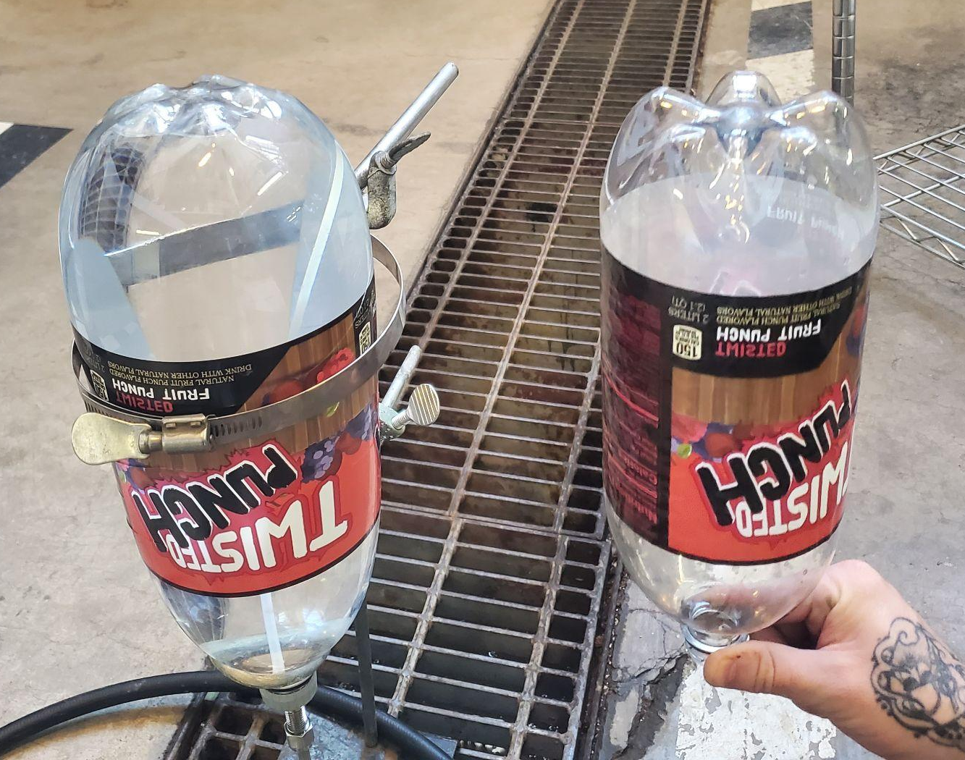
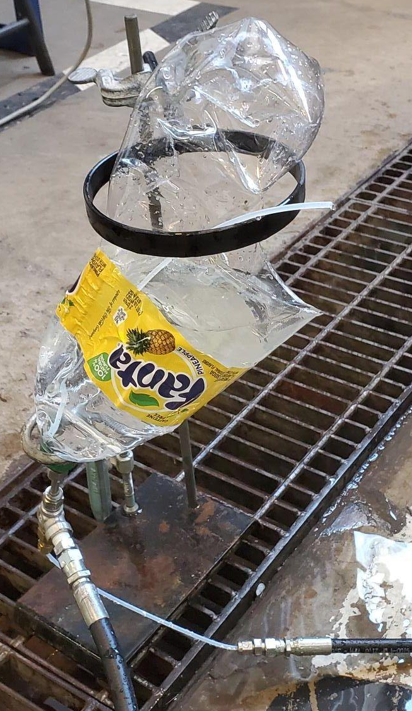
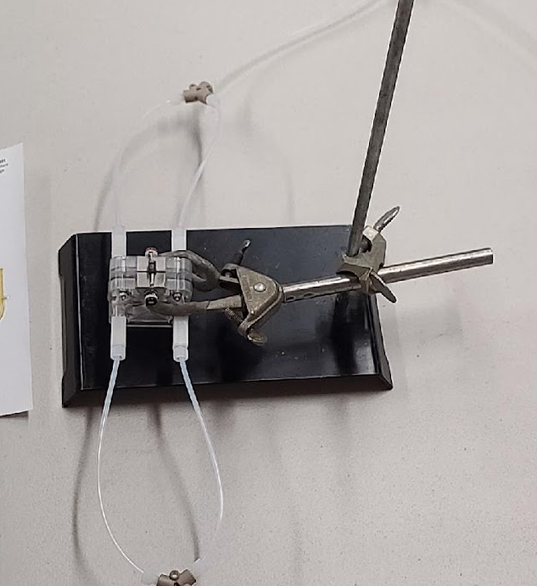
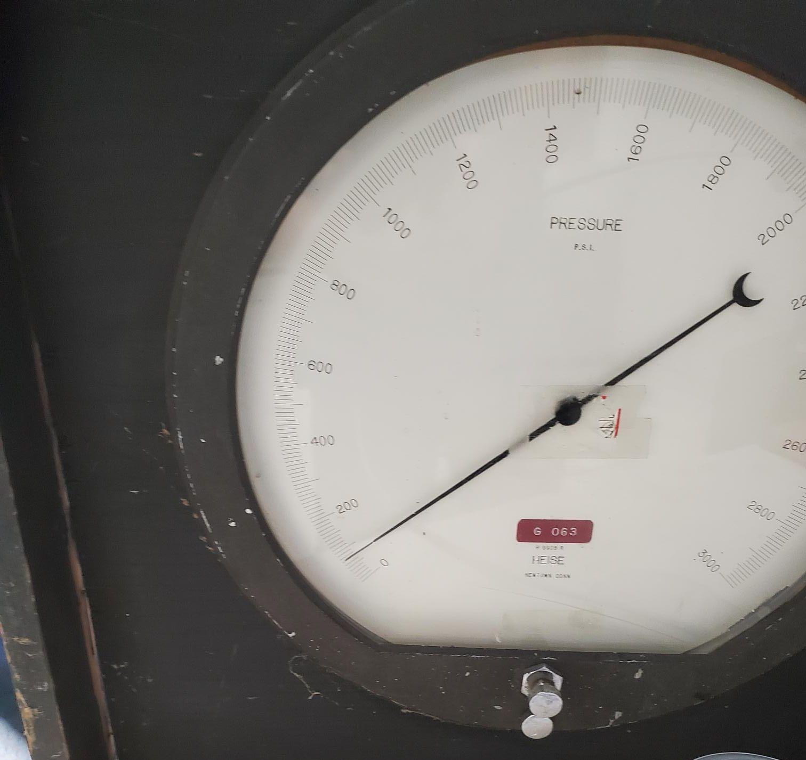
System Design for a Polymer Electrolyte Membrane
Hydro-Proof Test Apparatus
Ryan McCabe, Ronnie Sabatino, Dr. Greg Ogden
Department of Chemical & Environmental Engineering
University of Arizona
Dr. Dennis Just, Pima Community College

Slide 2
Presentation Outline
Big Picture
Background
Objectives
Challenges
Experimental Methods
Results
Findings
Discussion
Next Steps
Questions

Slide 3
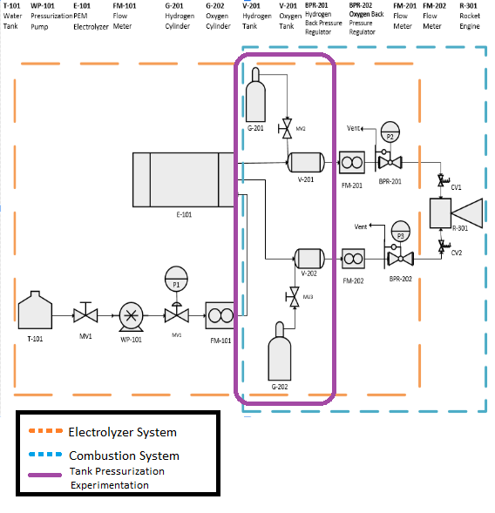
Big Picture
Develop a Green Propulsion System for a 1-3U Cubesat
Utilize a Polymer Electrolyte Membrane (PEM) to separate Water into Hydrogen (Fuel) and Oxygen (Oxidizer)
Product from burning Hydrogen with Oxygen for thrust is Water
Water is a stable, nontoxic, non-polluting substance that can be collected via In-Situ Resource Utilization (ISRU)

Slide 4
Background
Determined that 3.5 atm is the optimal operating pressure for the propulsion system
Evaluating Educational PEM Electrolyzers to stay in CubeSat paradigm of low cost access to space
Ran hydrostatic tests to determine electrolyzer pressure limits

Slide 5
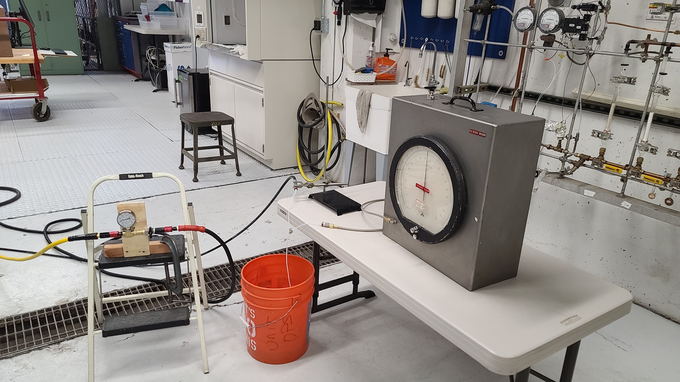
PEM Testing

Slide 6
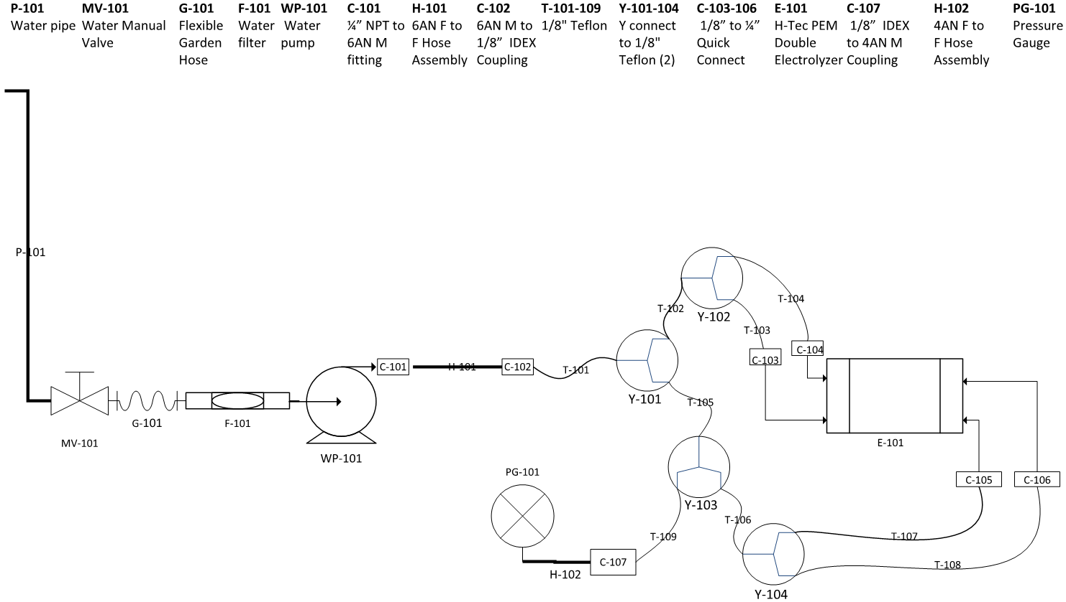
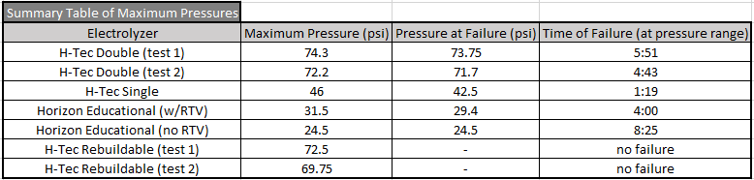
PEM Pressure Tests

Slide 7
Further Background
Obtained gas storage tanks that are rated to 2000 psi
Determined that it would be beneficial to hydrostatically test these storage tanks up to their rated pressure
  In case of accidental over pressurization
  In case future research pursues higher operating pressures
Initially conducted experiments on low-cost, low-pressure containers (large soda bottles)

Slide 8
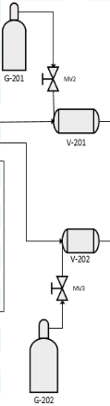
Objectives
Develop a hydrostatic test system which can be used to pressure test storage tanks
Design the system to be capable of withstanding pressures up to 2000 psi.
Follow the KISS mentality

Slide 9
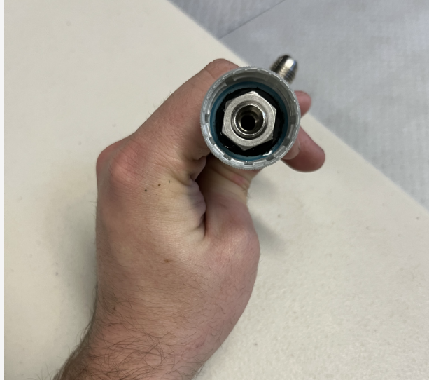
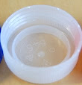
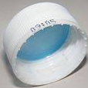
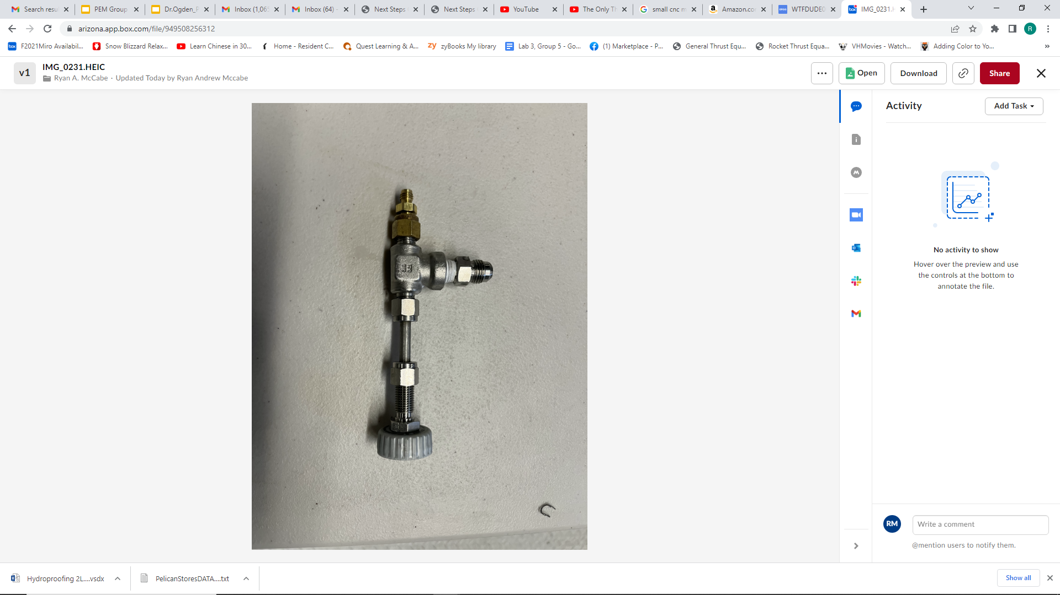
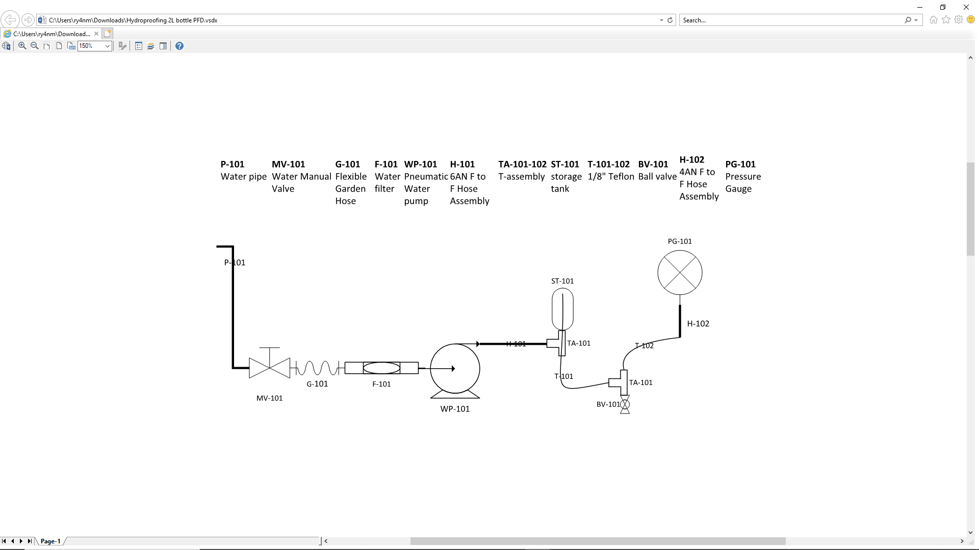
Challenges
Bulkhead fitting
  Creating sufficient seals on bottle caps
    Overcame this issue by
      Soda bottle threads are universal across all brands
      But some have Inner Protrusions
      Made gaskets that worked with caps that had no inner protrusion
      Developed one interchangeable cap seal for all tests
Air in the system
  Designed a way to vent the air while filling the bottle with water
    Developed a system with the water inlet and air outlet at the
    bottom
    Air outlet was a teflon tube that drew out of the top

Slide 10
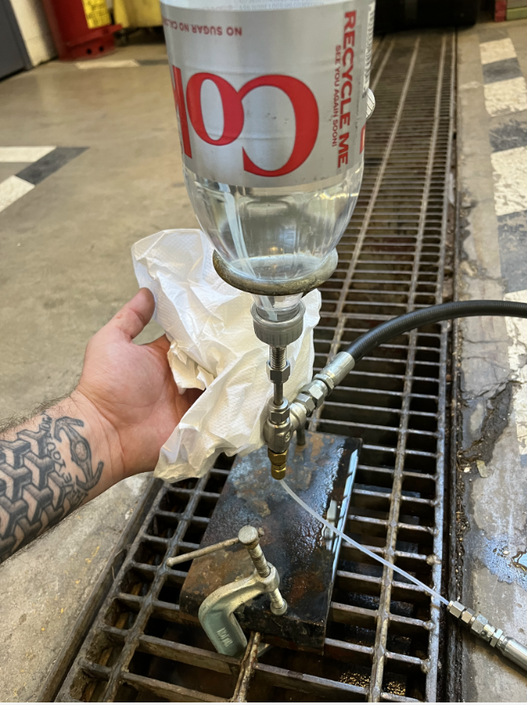
Experimental Methods
  Tested containers at various pressures
  Held each pressure for 60 seconds
    Tested for leaks frequently using dry paper towels and monitoring the pressure gauge
  Increased the pressure in approximately 10 psi increments until failure

Slide 11
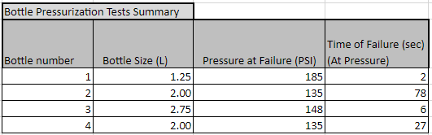
Results

Slide 12
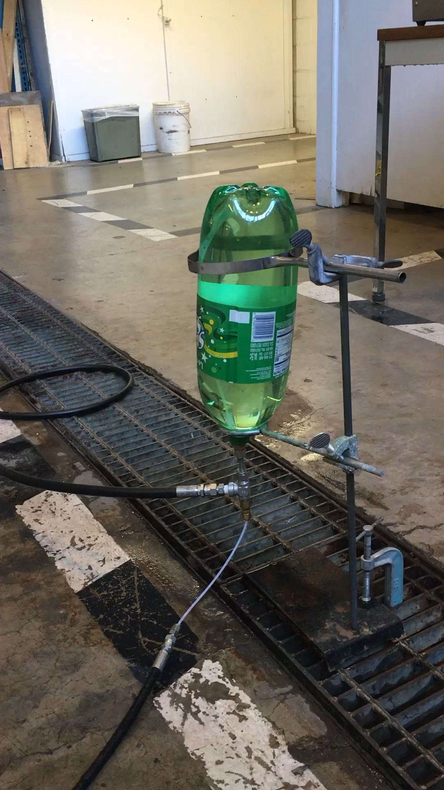
Results
Bottle 3
Rupture
Bottle 2
Hydroforming

Slide 13
Findings
Developed a system that can be used to safely and accurately pressure test a container
Had persistent leaks and had to modify the fabricated cap seal several times
Reached a Maximum pressure of 185 psi (with Bottle 1) out of all the experiments
Bottle 1 failed at the cap, indicating that the walls of the bottle could have withstood higher pressures
All containers had significant hydroforming prior to rupture

Slide 14
Discussion
Proof of concept in the system
  Can move onto testing the higher pressure storage tanks
Modular System
  Can add alternate components for unique configurations including using 3000 psi rated gauge
Hydroforming should not be an issue with the stainless steel gas storage tanks rated to withstand up to 2000 psi

Slide 15
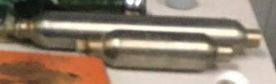
Next Steps
Hydrostatic testing of the gas storage tanks
  Utilizing most of the current experimental setup with some changes
    No need for fabricated seals since pipe fittings can directly attach to the tanks
    Different hydraulic line setup since the tanks have separate inlet and outlet ports
  Designing a system to prevent implosion of lightweight balloon tanks during draining
    Determined several potential solutions
  Solenoid valve
  Motorized ball valve
  Vacuum breaker valve

Slide 16
Questions

