Slide 1




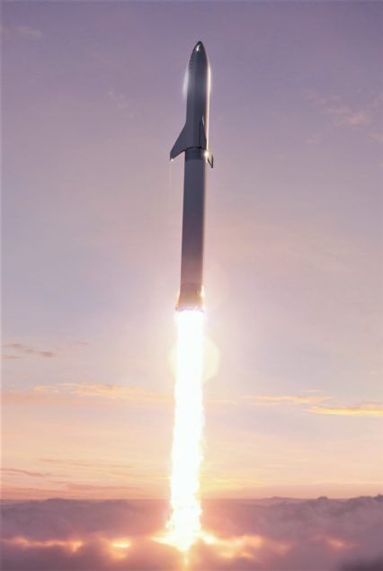
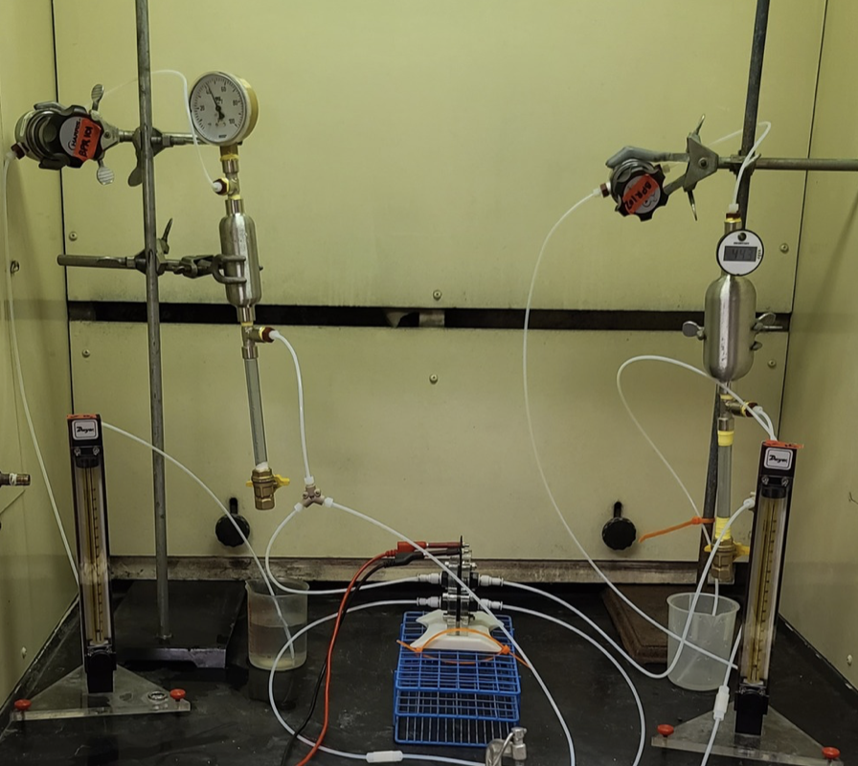
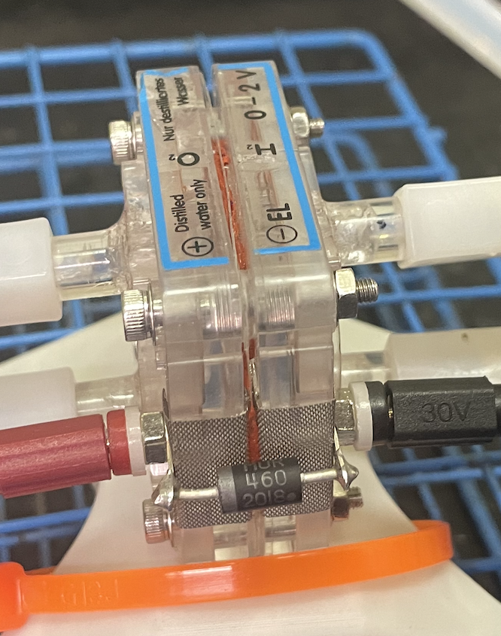
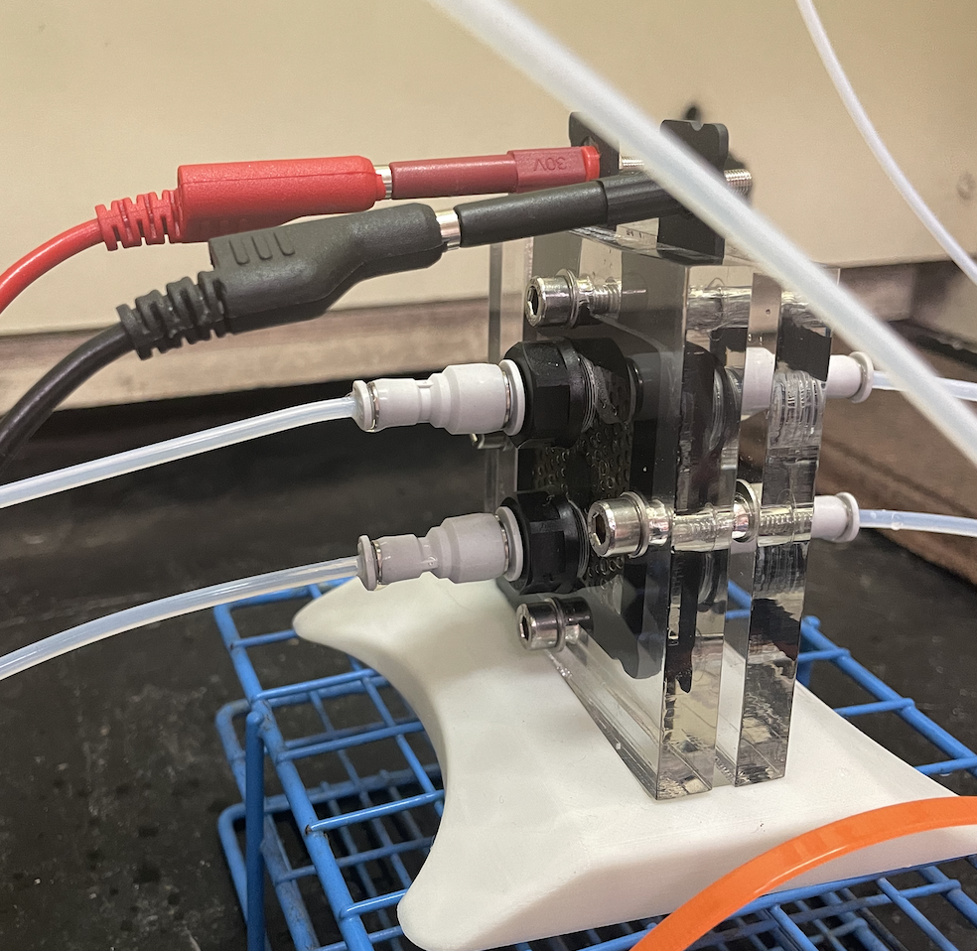
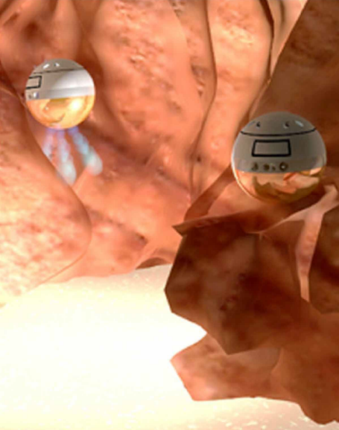
Design and Testing of Polymer Electrolyte Membrane (PEM) Hydrolysis System for Producing Hydrogen and Oxygen Propellants for CubeSat Applications
Alyza Khan, Dr. Greg Ogden
Department of Chemical & Environmental Engineering
University of Arizona

Slide 2
Agenda
Motivation
  Where we fit in
Objective
Challenges
Method
Analysis/Results
Discussion
Takeaway

Slide 3

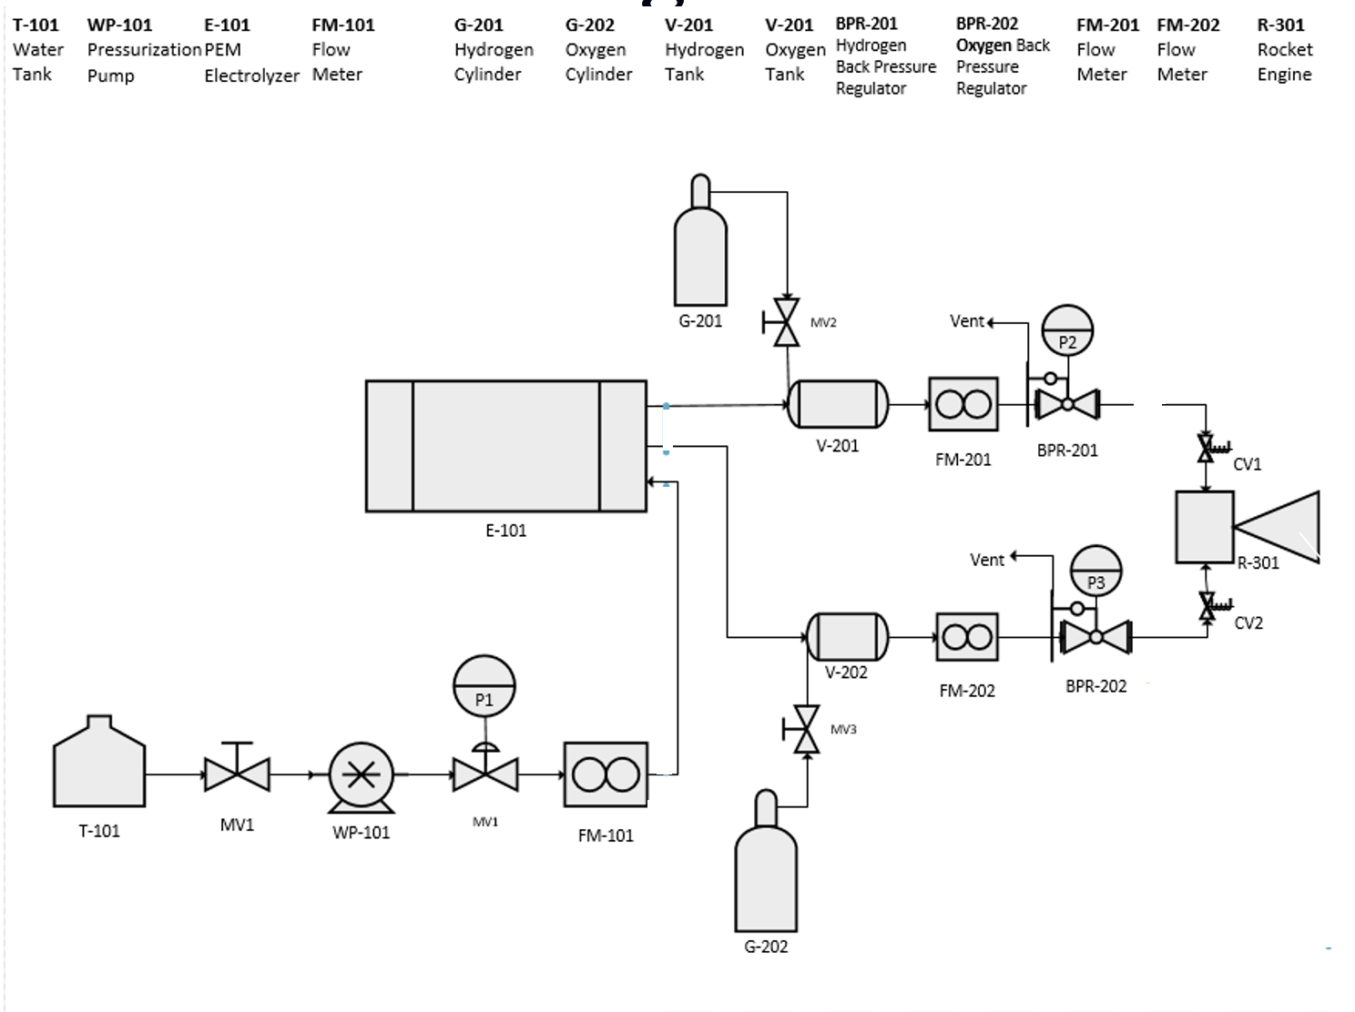
Big Picture: Green Propulsion System Development
Electrolyzer Experiments
Combustion Experiments

Slide 4
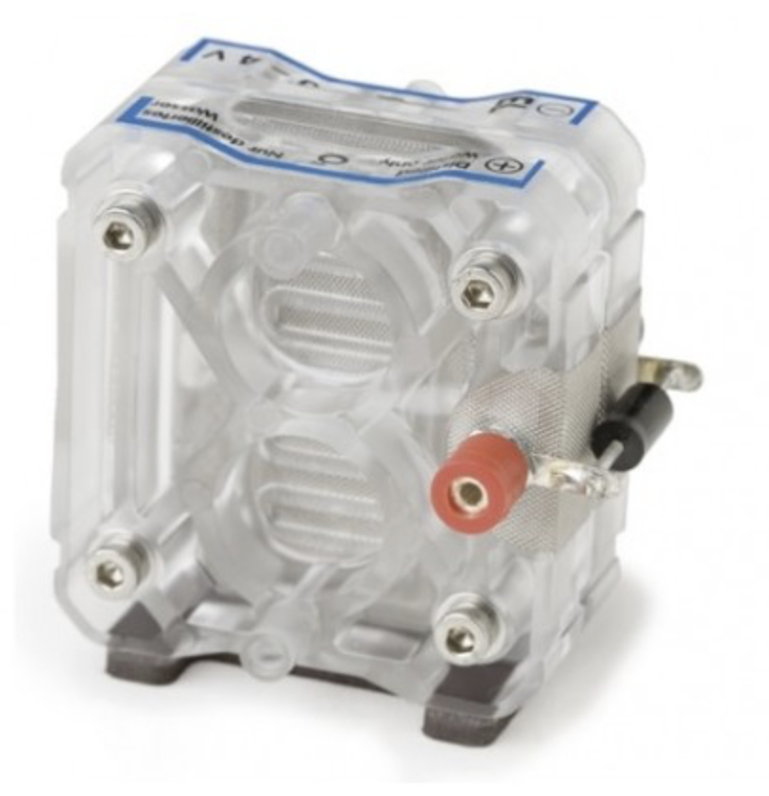
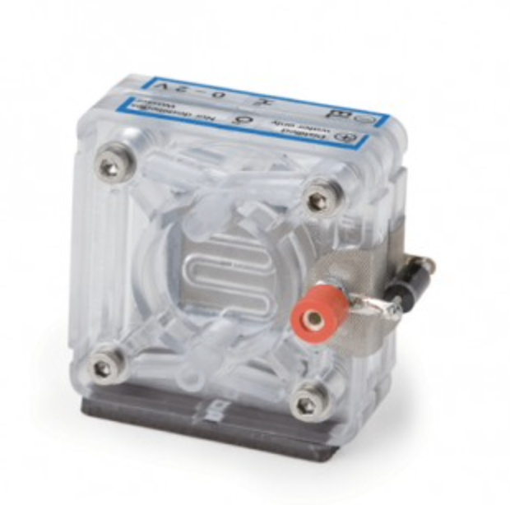
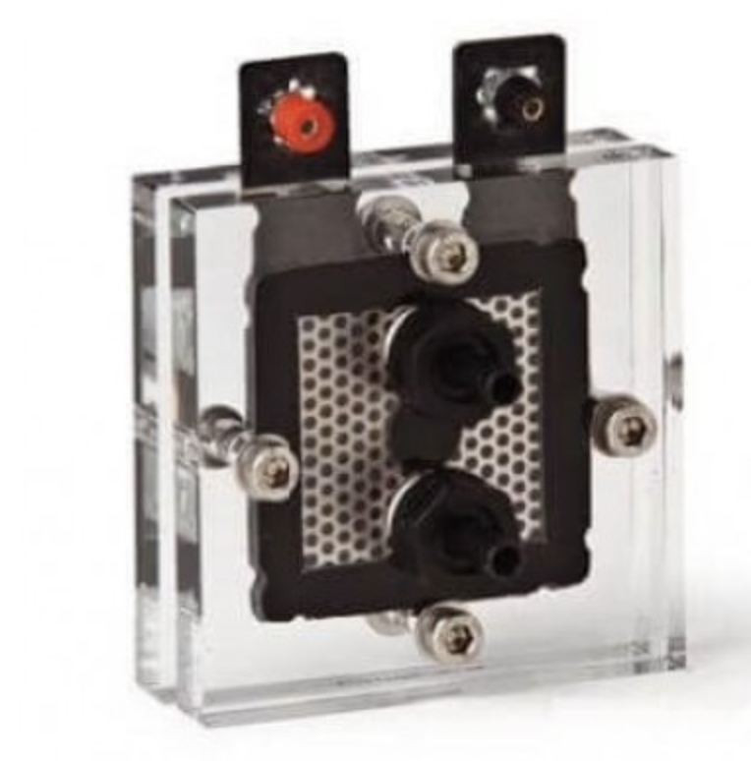
Objectives
  Develop 1U CubeSat Propulsion System using commercial Polymer Electrolyte Membrane (PEM) Electrolyzers
    Water→ propellant storage medium
    Electrolyzers produce hydrogen and oxygen for propulsion
Double Electrolyzer
$100
Single Electrolyzer
$80
Single Rebuildable Electrolyzer
$200

Slide 5
Challenges
Building the entire experimental apparatus in our lab
  Pressurizing the system with Hydrogen & Oxygen instead of Nitrogen
  Leak testing and calculating impact on data accuracy
  Difficulty with back pressure regulators
  Testing different Educational Electrolyzers
  Making and accounting for modifications to various Units
  Coordinating support for testing

Slide 6
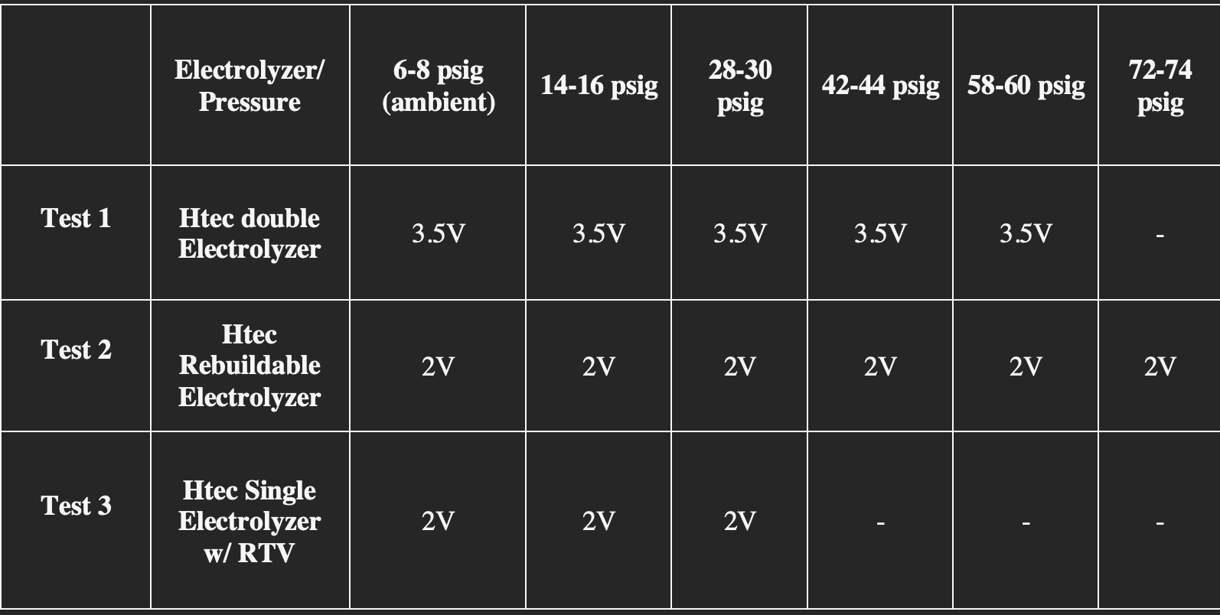
Experimental Plan
Parameters Measured: Hydrogen & Oxygen Flowrates and Current

Slide 7
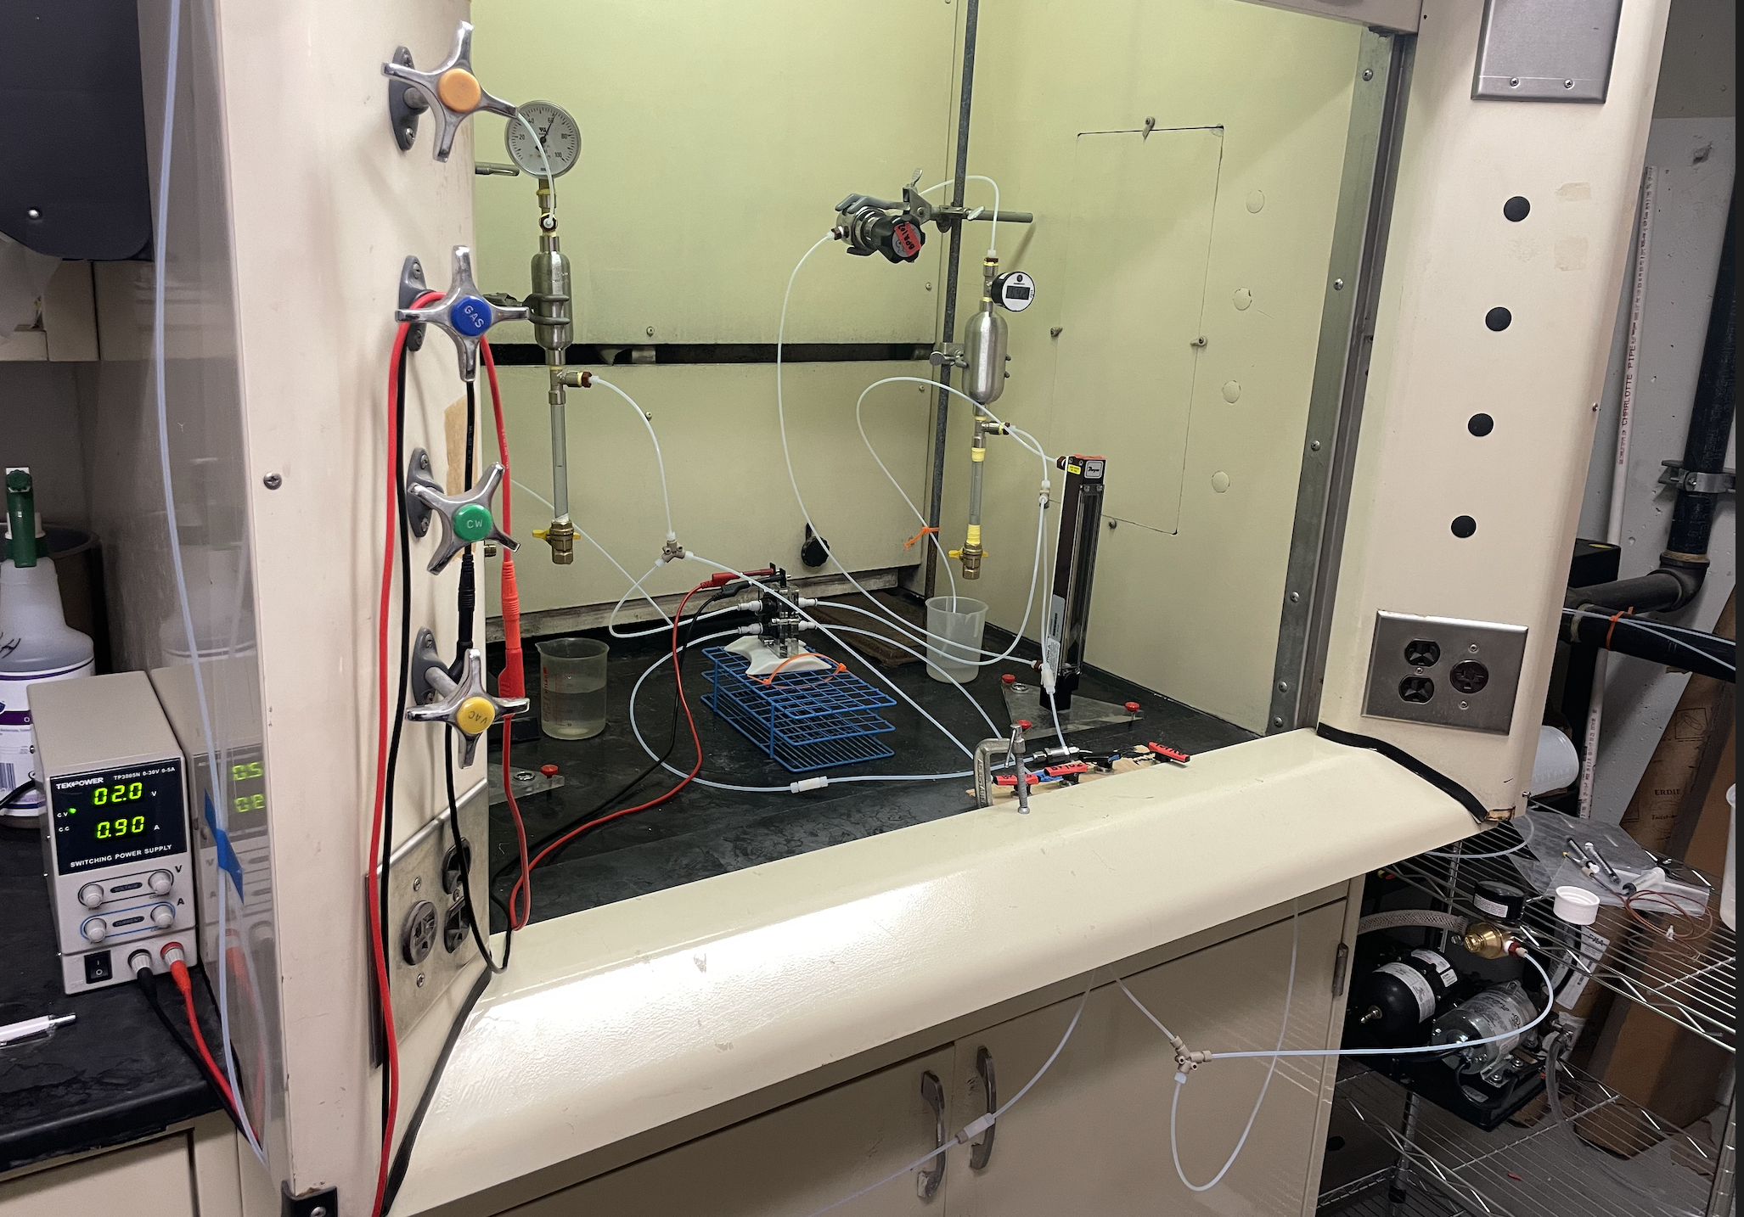
Experimental Apparatus
Oxygen Cylinder + Pressure gauge
Hydrogen BPR
Hydrogen Cylinder + Pressure gauge
Hydrogen Flowmeter
Power Supply
Water Pump

Slide 8
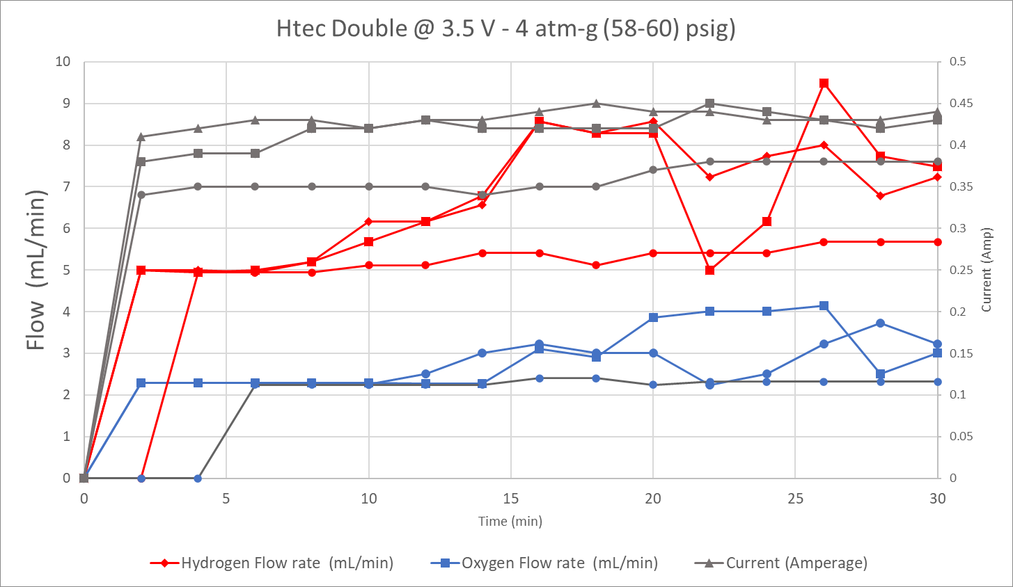
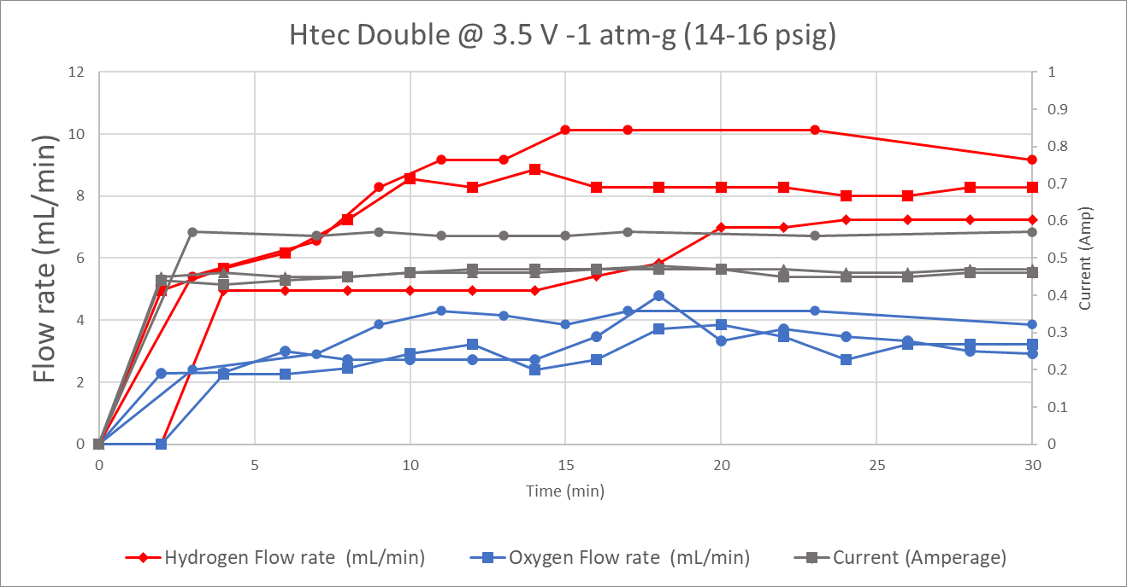
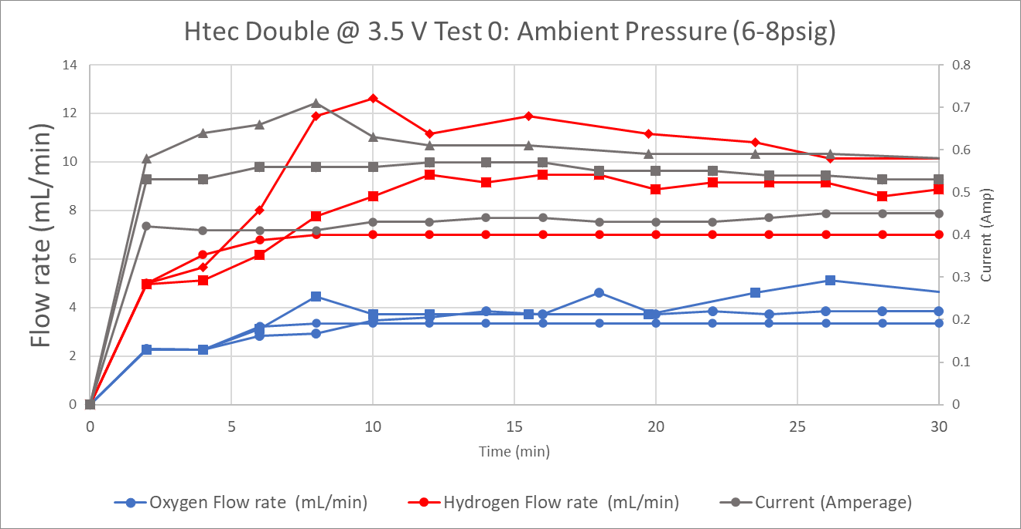
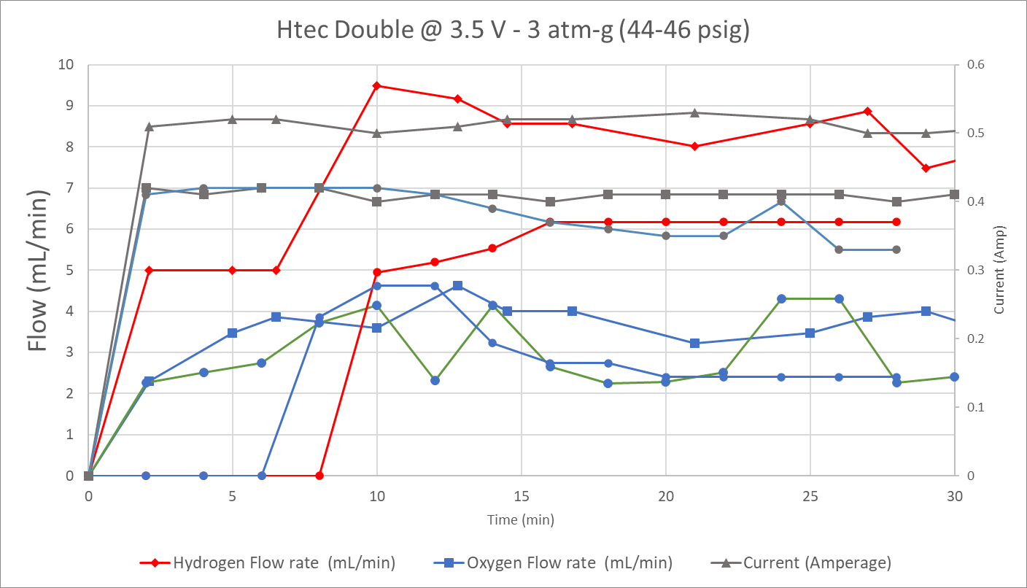
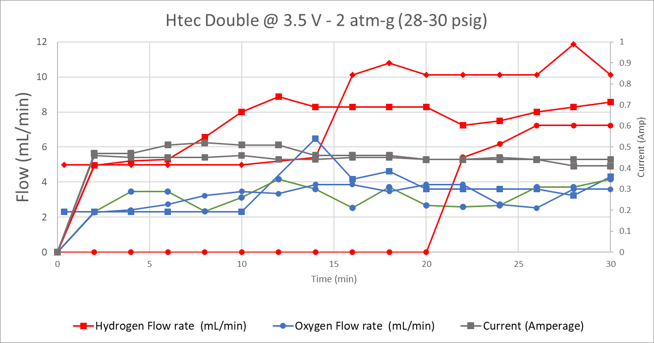
HTec Double Electrolyzer Tested at 3.5V

Slide 9
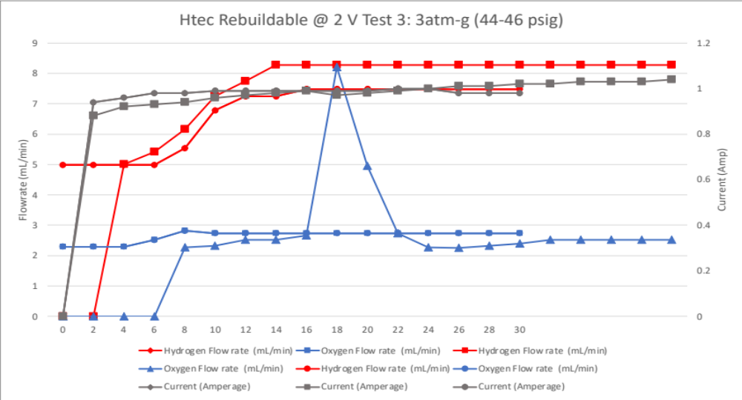
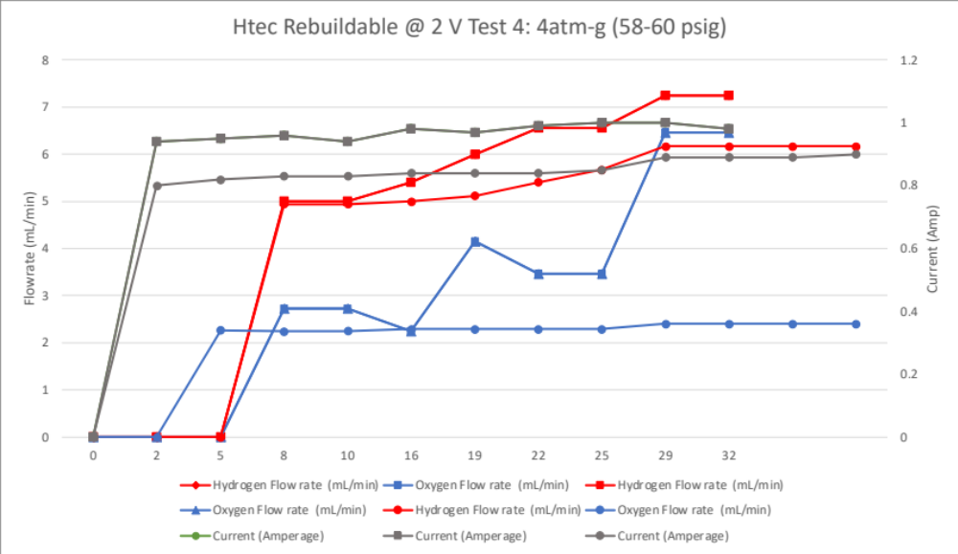
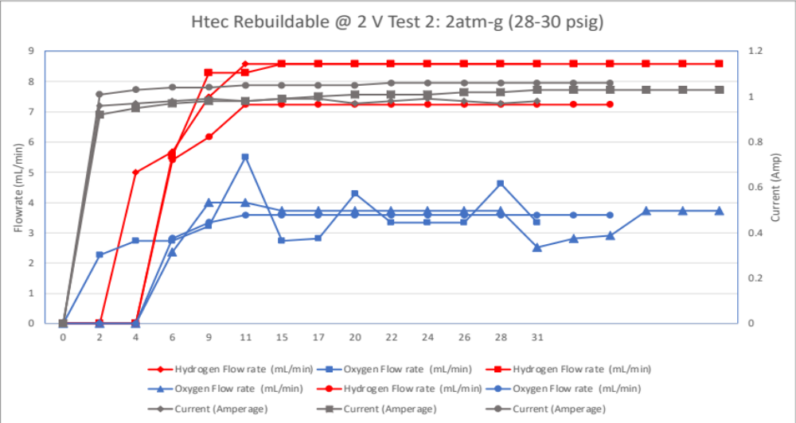
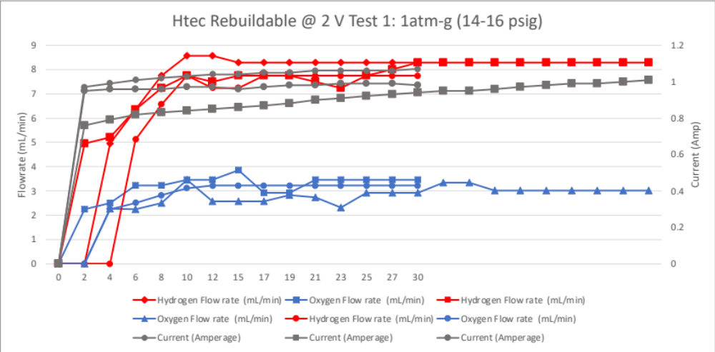
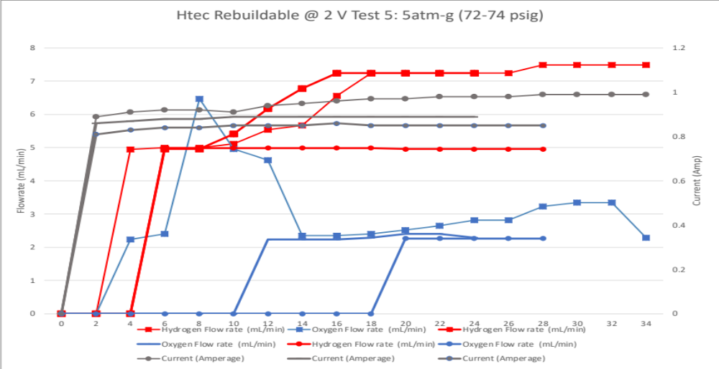
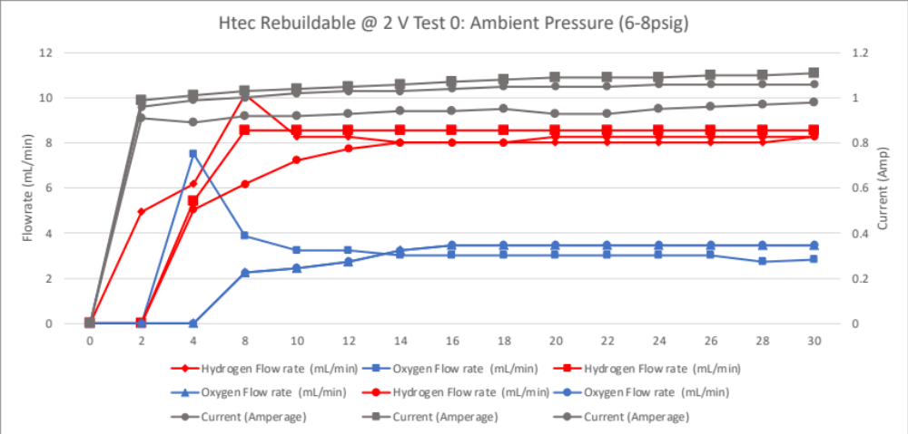
HTec Single Rebuildable Electrolyzer Tested at 2V

Slide 10
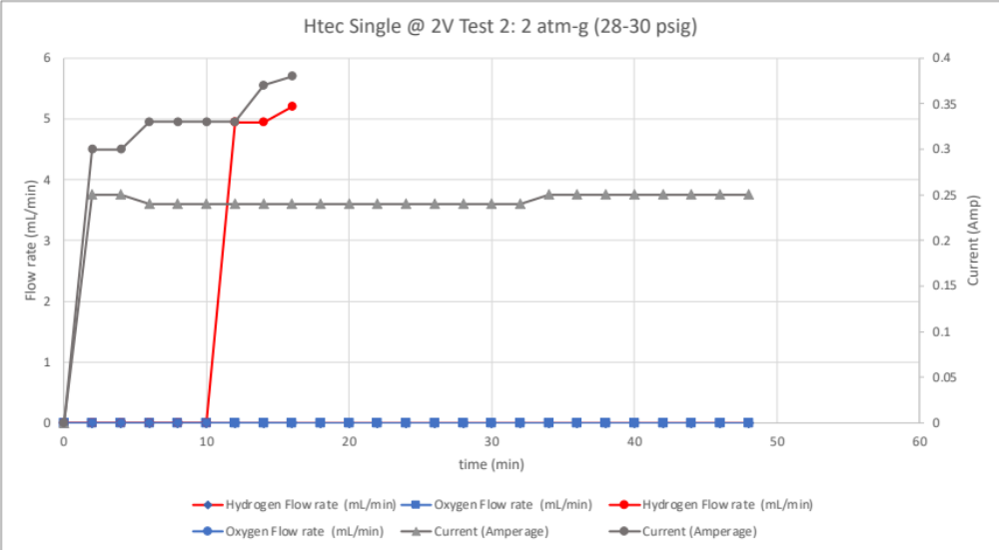
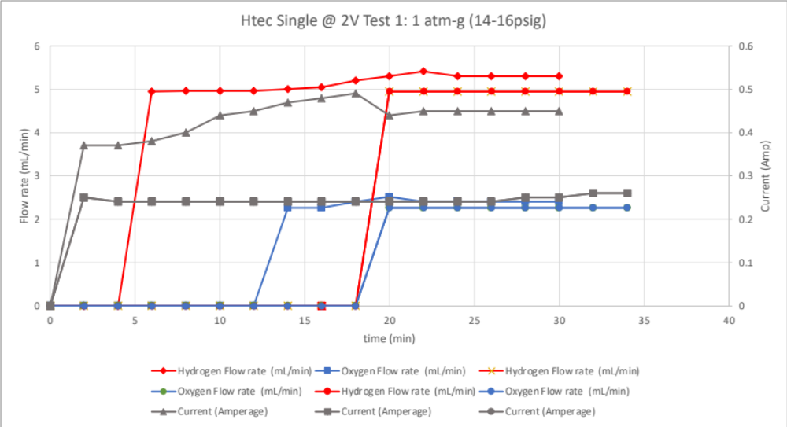
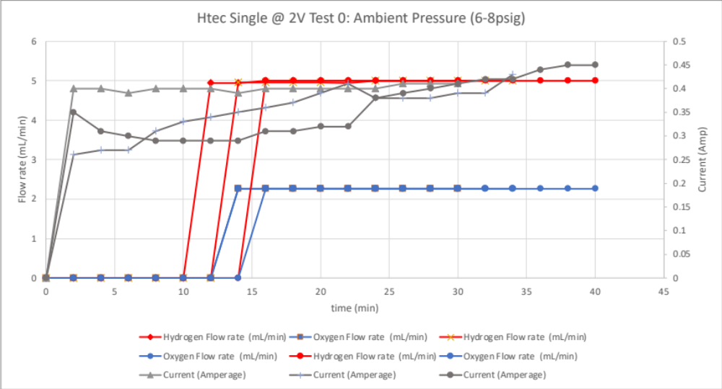
HTec Single Electrolyzer: Tested at 2V

Slide 11
Data
Electrolyzer/ Pressure | Ambient (6-8 psig) | 1 atm-g (14-16 psig) | 2 atm-g (28-30 psig) | 3 atm-g (44-46 psig) | 4 atm-g (58-60 psig) | 5 atm-g (72-74 psig)
HTec Double Electrolyzer | H2 : 7.75 mL/min O2 : 3.30 mL/min Current: 0.49 Amps | H2 : 6.91 mL/min O2 : 3.06 mL/min Current: 0.48 Amps | H2 : 5.39 mL/min O2 : 3.11 mL/min Current: 0.46 Amps | H2 : 5.81 mL/min O2 : 2.76 mL/min Current: 0.40 Amps | H2 : 5.67 mL/min O2 : 2.38 mL/min Current: 0.37 Amps
HTec Rebuildable Single Electrolyzer | H2 : 7.07 mL/min O2 : 4.06 mL/min Current: 0.94 Amps | H2 : 6.75 mL/min O2 : 3.73 mL/min Current: 0.89 Amps | H2 : 6.36 mL/min O2 : 3.89 mL/min Current: 0.94 Amps | H2 : 5.96 mL/min O2 : 2.41 mL/min Current: 0.89 Amps | H2 6.26 mL/min O2 : 2.34 mL/min Current: 0.84 Amps | H2 5.91 mL/min O2 : 1.91 mL/min Current: 0.83 Amps
HTec Single Electrolyzer | H2 : 4.49 mL/min O2 : 2.18 mL/min Current: 0.36 Amps | H2 : 3.79 mL/min O2 : 1.88 mL/min Current: 0.31 Amps | H2 : 0.75 mL/min O2 : 0 mL/min Current: 0.27 Amps

Slide 12
Data Summary
HTec Double
  Survived Pressures up to 4 atm
  Current and Pressure are inversely proportional
  Flowrates and Current are directly proportional
HTec Single Rebuildable
  Survived Pressures up to 5 atm
  Current and Pressure are inversely proportional
  Flowrates and Current are directly proportional
HTec Single
  Only worked well under ambient conditions

Slide 13
Conclusion & Discussion
3 commercial electrolyzer units were tested under pressure
  2 survived, 1 failed
As Pressure rises, Current drops, and Flowrates drop
  Large variability in H₂ flow rates
Feasibility of using Educational Units determined
Next steps:
  Correct flow rates to surface Area
  Resolve Water pressurization Issue
  Test other commercial units, different membranes

Slide 14
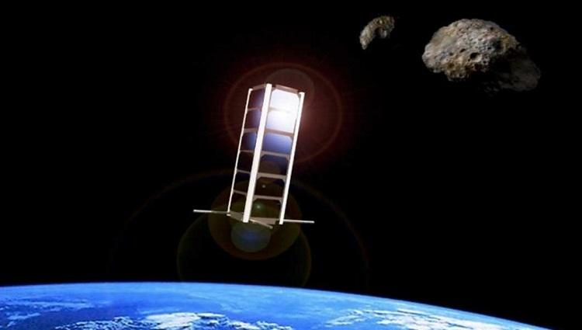
Questions?
Thank you

