Slide 1




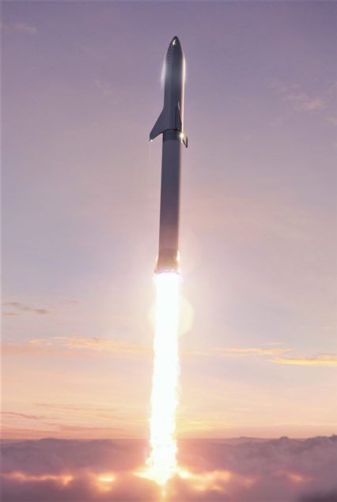
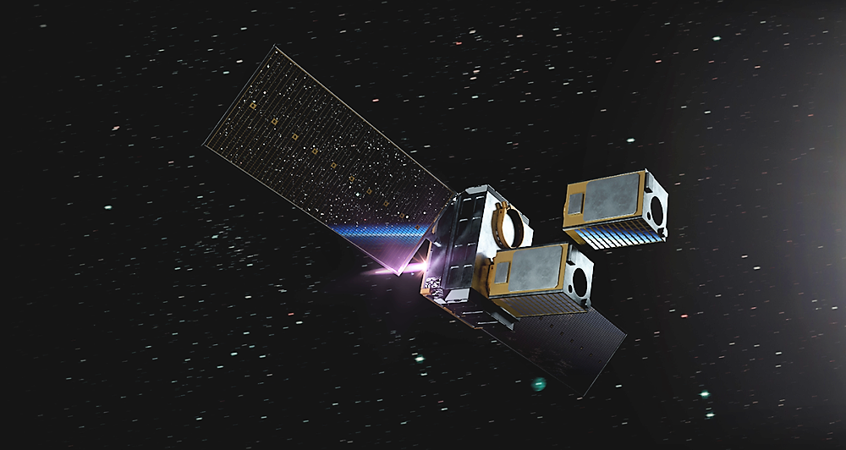
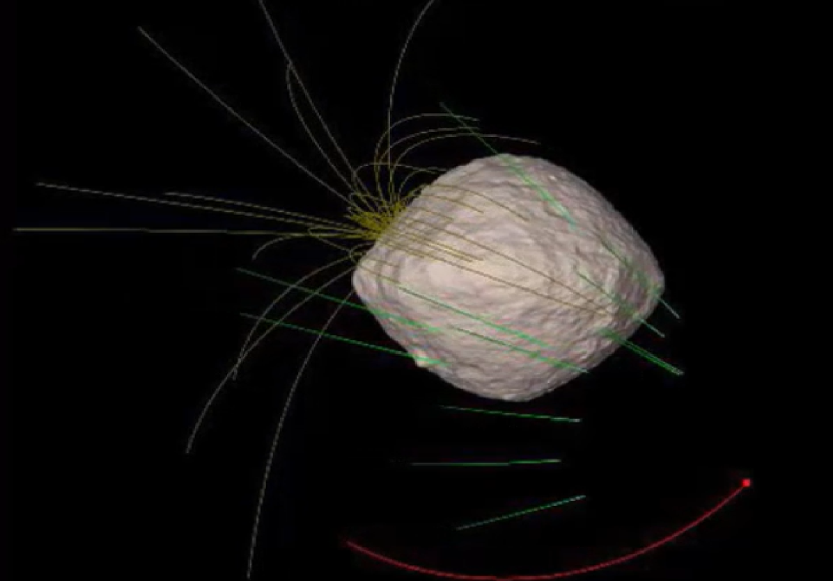
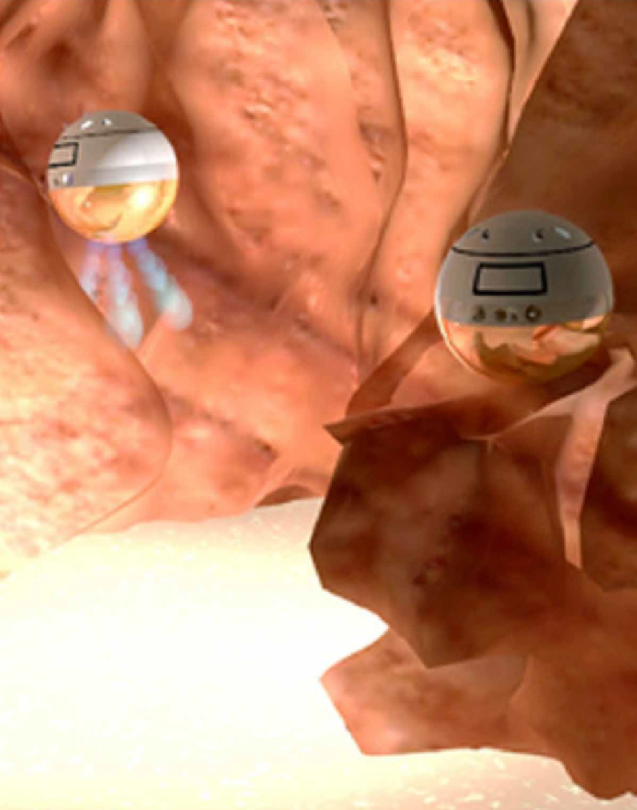
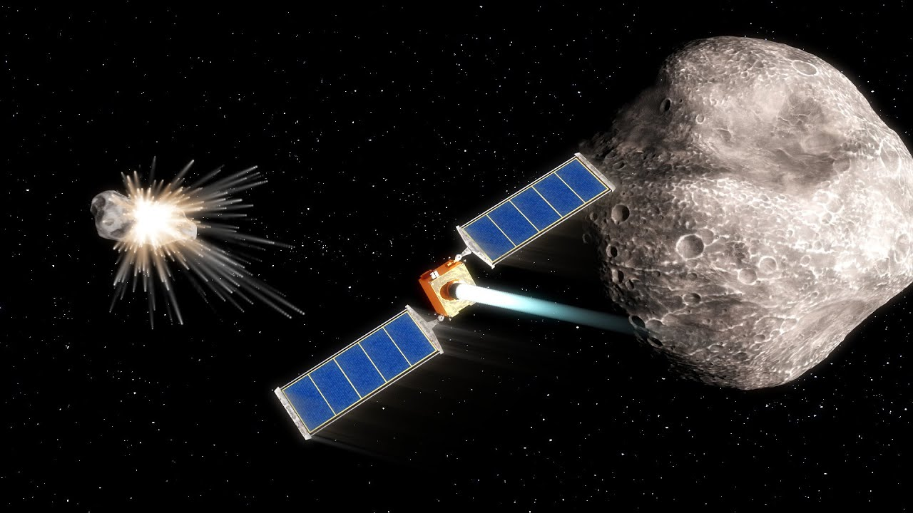
PEM Self-Pressurization Tank Design
CJ Jauregui., Dr. Greg Ogden
Department of Chemical & Environmental Engineering
University of Arizona

Slide 2
Presentation Outline
Big Picture
  Where we fit in
Objectives
Background/Motivation
Initial Research
Potential Complications
Calculations
Equipment
Challenges
Next Steps

Slide 3
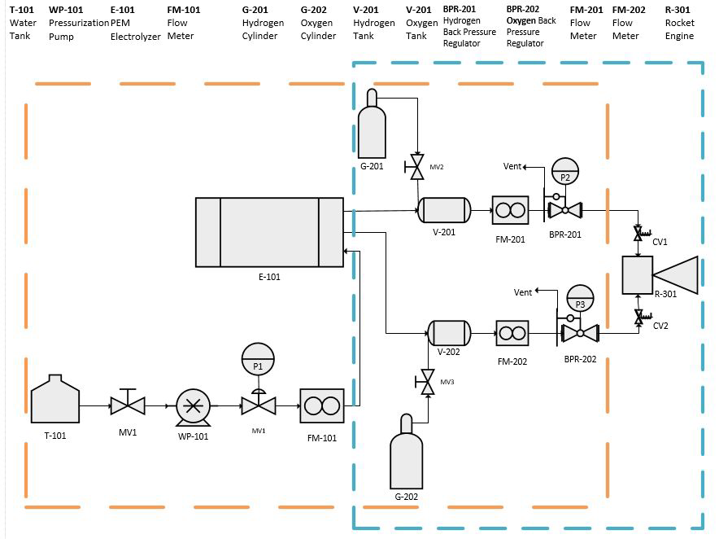
Big Picture
Develop Green Propulsion System for 1-3U CubeSat

Slide 4

Objectives
Literature study on relevant tank systems to evaluate various designs
Design and eventual construction of a self-pressurizing tank apparatus to be assessed under various pressure conditions to determine feasibility

Slide 5
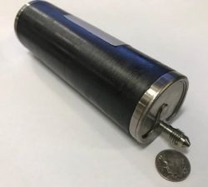
Background/Motivation
CubeSat Propulsion Systems historically nonexistent
“Development and Definition of a CubeSat Demonstrator for a Water Propulsion System” by Colum Walter
  No final proposed water tank
Motivation
  No compressor necessary
  No hazards at launch

Slide 6

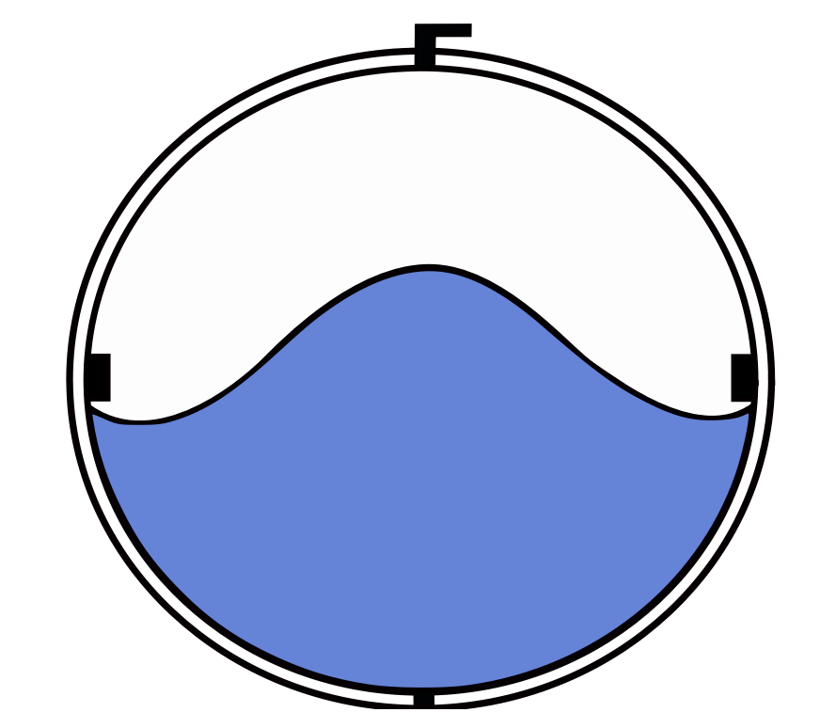
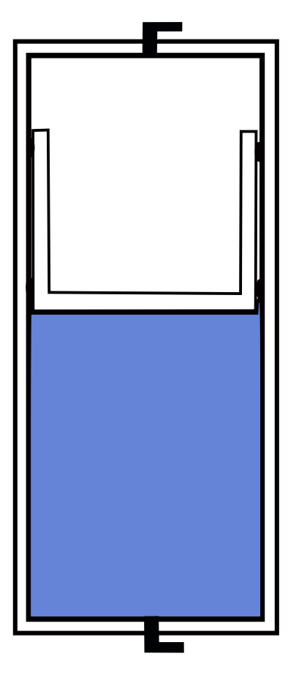
Initial Research
Different tank types
  Propellant Management Devices
  Positive Expulsion Devices
    Bladder Tanks, Diaphragm Tanks, Piston Tanks

Slide 7
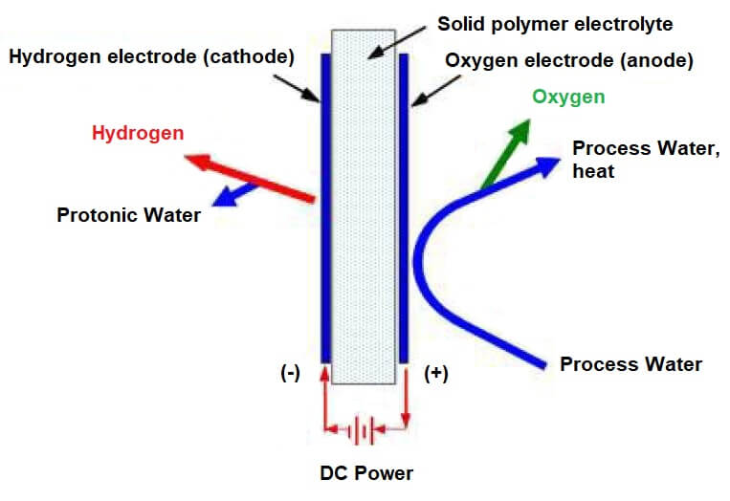
Potential Complications
PEM oxygen product line contains liquid water
No water can be in oxygen side of tank
Possible solutions
  Tank separator
  Filter or membrane

Slide 8
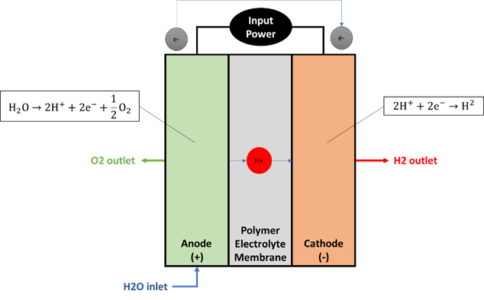
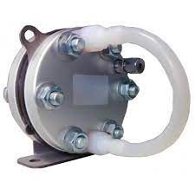
Calculations
Flow rates from Titan EZ-60 Stack
  Water: 4 mL/hr
  Oxygen: 0-30 mL/min
Proposed experiment runtime of 1 hour
  Minimum tank volume 4 mL
  If oxygen confined to 10 mL:
    Pressure: 180 atm

Slide 9
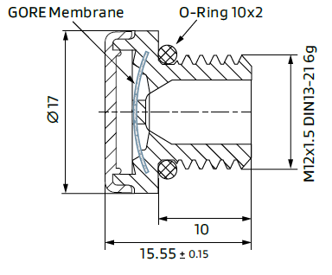
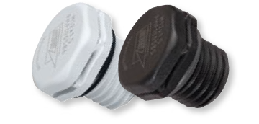
Equipment
Gore PolyVent Standard
  Model: PMF100321 (gray)
    Typical Airflow: 450 ml/min

Slide 10
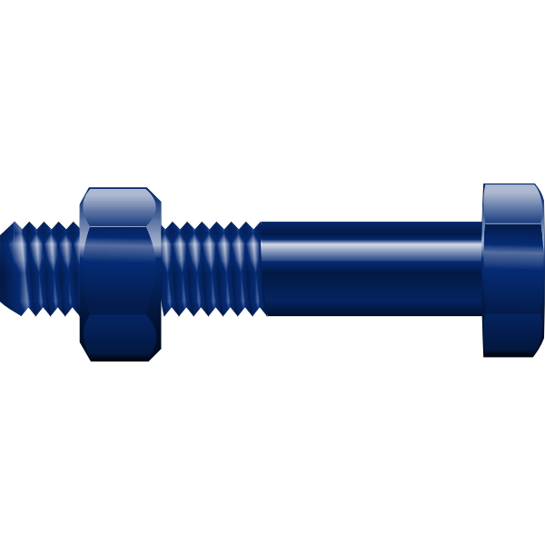
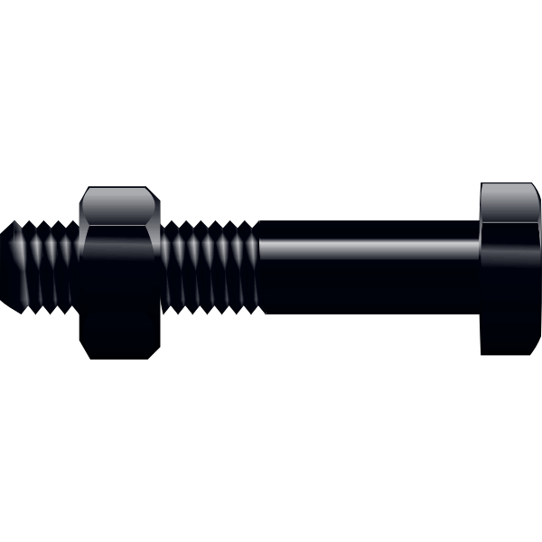
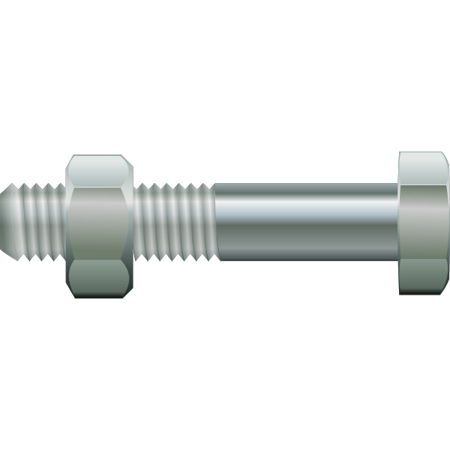
Proposed Vent Housing Design

Slide 11
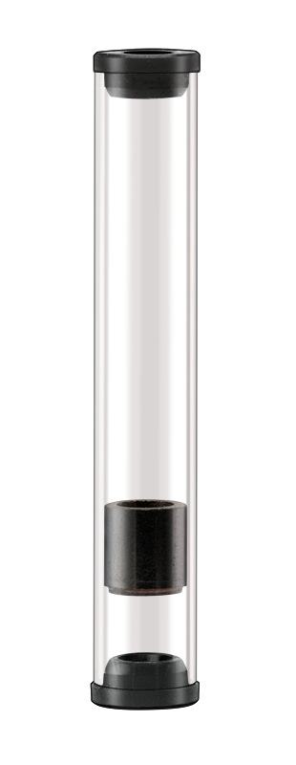
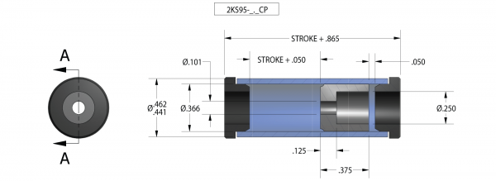
Equipment
Airpot Piston-Cylinder set
  Model: 2KS95-8.0CP
    Available Volume: 14.3 mL
    Customer made housing

Slide 12
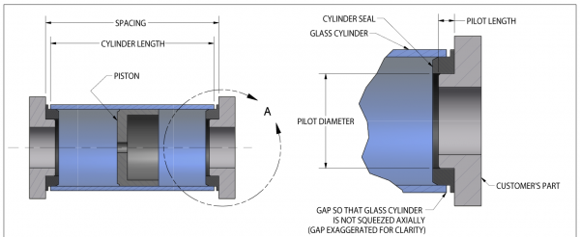
Proposed Tank Housing Design
To be machined from a ¼ straight threaded pipe
Ends tapped for a 1/16 NPT fitting
Silicone rubber seals provided by Airpot

Slide 13
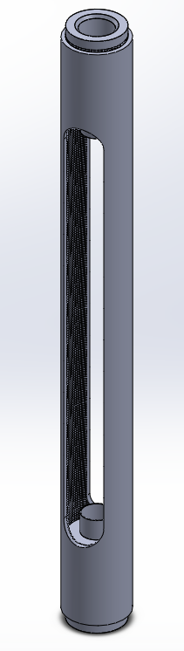
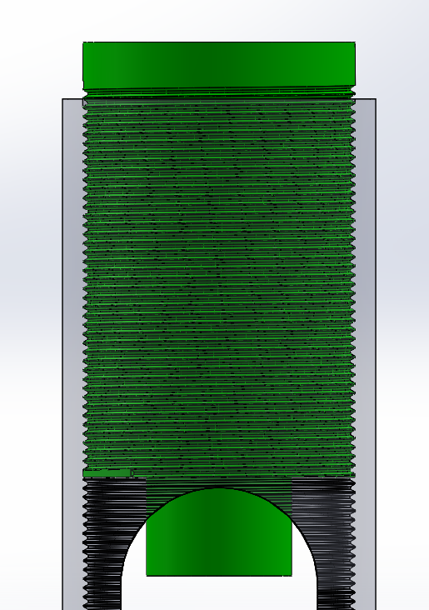
Initial Design for Piston Tank Housing

Slide 14
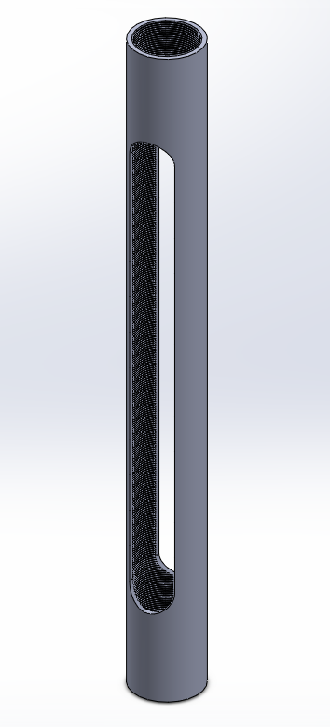
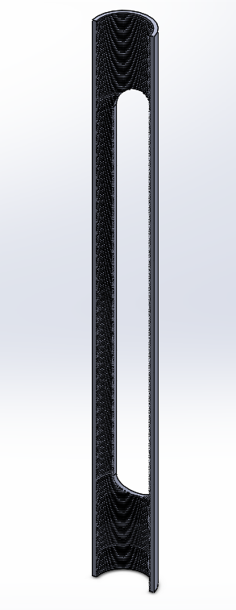
Housing Shell

Slide 15
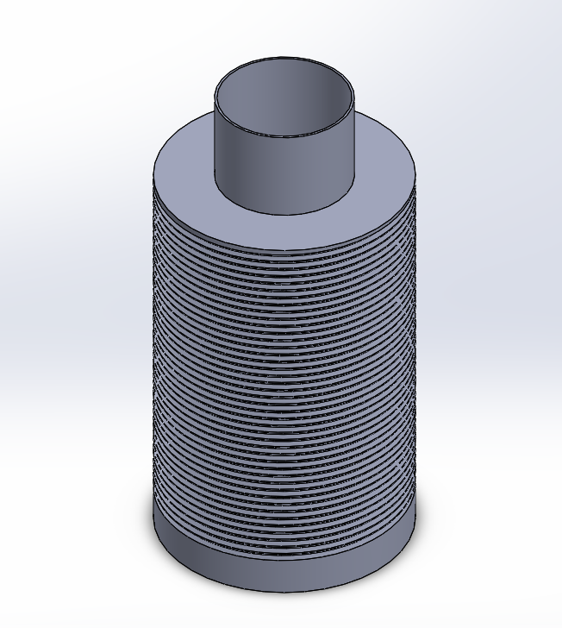
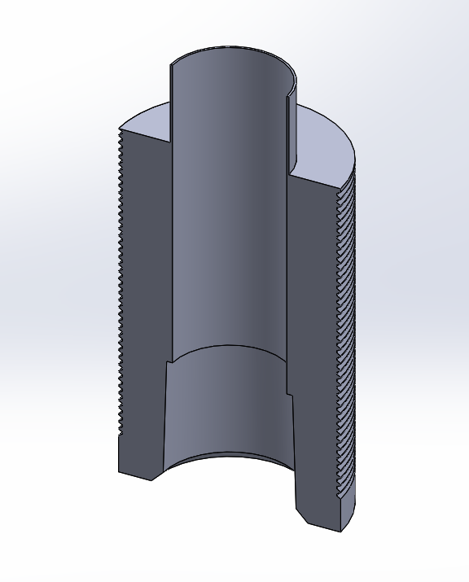
Housing Ends

Slide 16
Challenges
Project started in January
Access to SolidWorks
Obtaining equipment information
  Corresponding with companies
Balancing Senior workload and project goals

Slide 17

Next Steps
Place order for Piston-Cylinder set
  Start machining housing
Finalize vent housing design
  Order required parts and construct
  Assess impermeability of vent under pressure
Begin construction and experimentation of tank apparatus

Slide 18
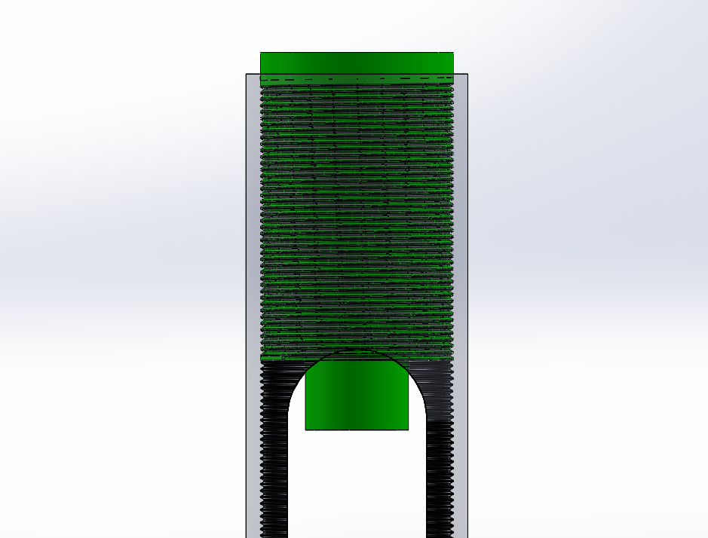
Questions?

Slide 19
References
Admin. “Valcor Engineering Debuts New CubeSat Propellant Tanks.” Valcor Engineering Corporation, 15 Aug. 2021, www.valcor.com/valcor-debuts-new-cubesat-propellant-tanks/.
Development and Definition of a CubeSat Demonstrator for a ... elib.dlr.de/143063/1/Walter%20Master%202021.pdf.
“Gore® Protective Vents – Screw-in Series – Data Sheet & Installation Guide.” Gore, www.gore.com/resources/gore-protective-vents-screw-series-data-sheet-installation-guide.
“Piston-Cylinder Set 2KS95-CP.” Airpot, 9 Oct. 2020, www.airpot.com/product/piston-cylinder-set/.
“Titan EZ-60 Stack.” Fuel Cell Store, www.fuelcellstore.com/pem-electrolyzer-cell-stack-titan-60.

