Slide 1
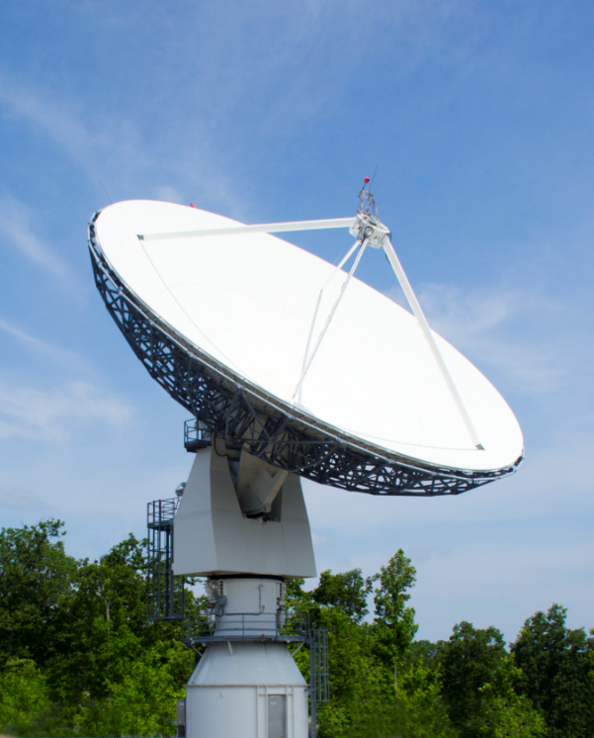
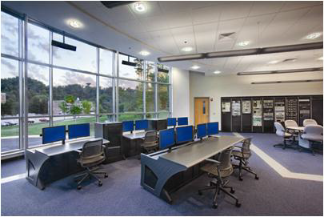
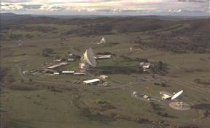
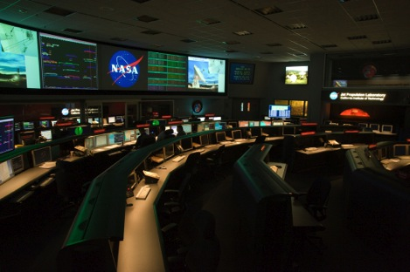
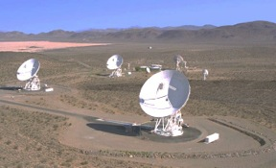
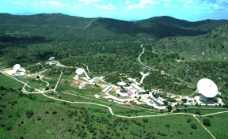


Deep Space Station 17: A University-Operated Affiliated Node on the NASA Deep Space Network for Interplanetary Small Satellite Missions
Briefing for the Interplanetary Smallsat Conference
May 2, 2022
Tim Pham, Jay Wyatt (JPL)
Ben Malphrus, Jeff Kruth (MSU)
In Partnership with

Slide 2
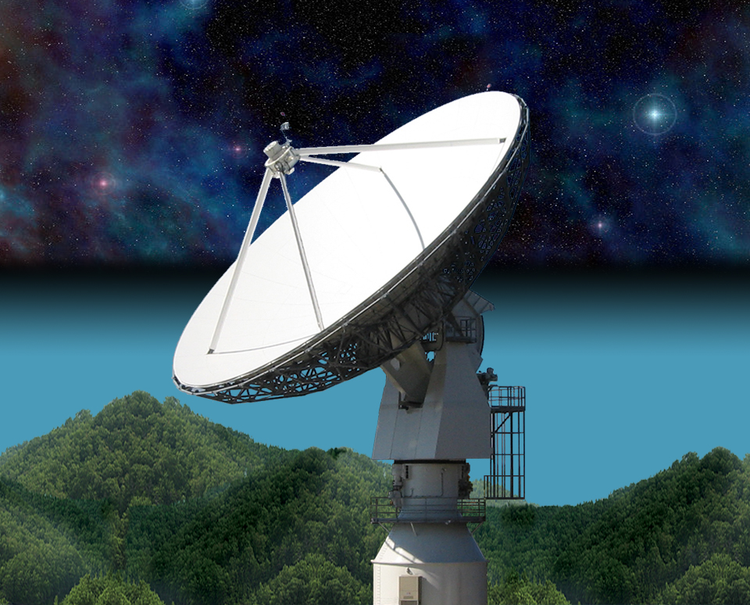
21 Meter Space Tracking Antenna
at Morehead State University
Specifications by MSU faculty with NASA assistance
Dual Purpose Instrument
  Ground Station for Smallsats
  Radio Telescope for Astronomy Research
Built and Installed by VertexRSI (General Dynamics)
Operational in 2006
Program Funded by AES in 2016 to Upgrade for DSN Compatibility

Slide 3

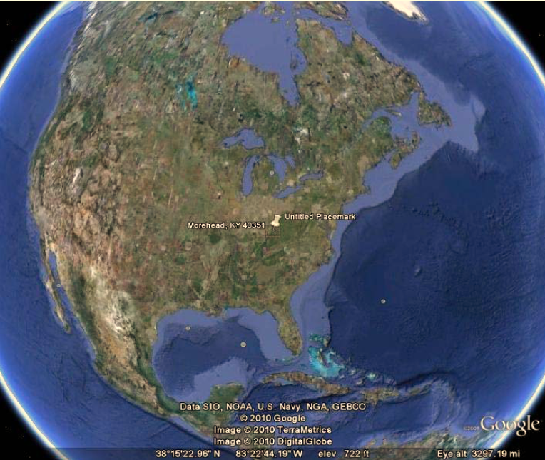
The Morehead State University Ground Station
Relatively Quiet RFI Environment in Eastern Kentucky
21 m Ground Station (few in the US large enough for DSN Work)
Staff Experienced in Mission Operations
Caveats:
There is weather in Kentucky!
University-based Asset- with Single String Instrumentation

Slide 4
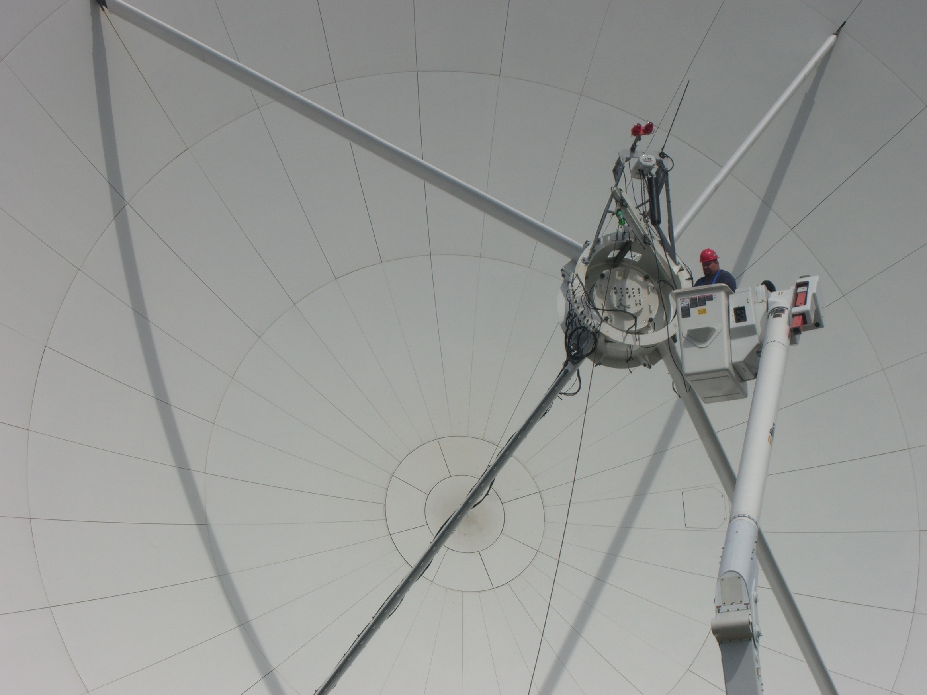
21 M Operations
Pre-DSN Compatibility Upgrade
Satellite Ground Station for Morehead State SmallSat Missions and Others
JPL ASTERIA Ground Station
Radio Telescope Mode for Research in Astrophysics
Test-Bed for Experimental Communication Systems and Processes- DTN, Autonomous Ops, OMSPA

Slide 5

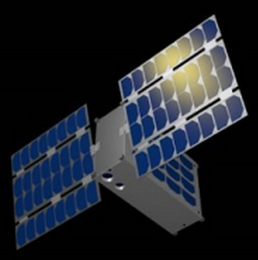
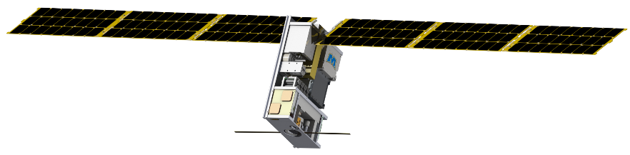
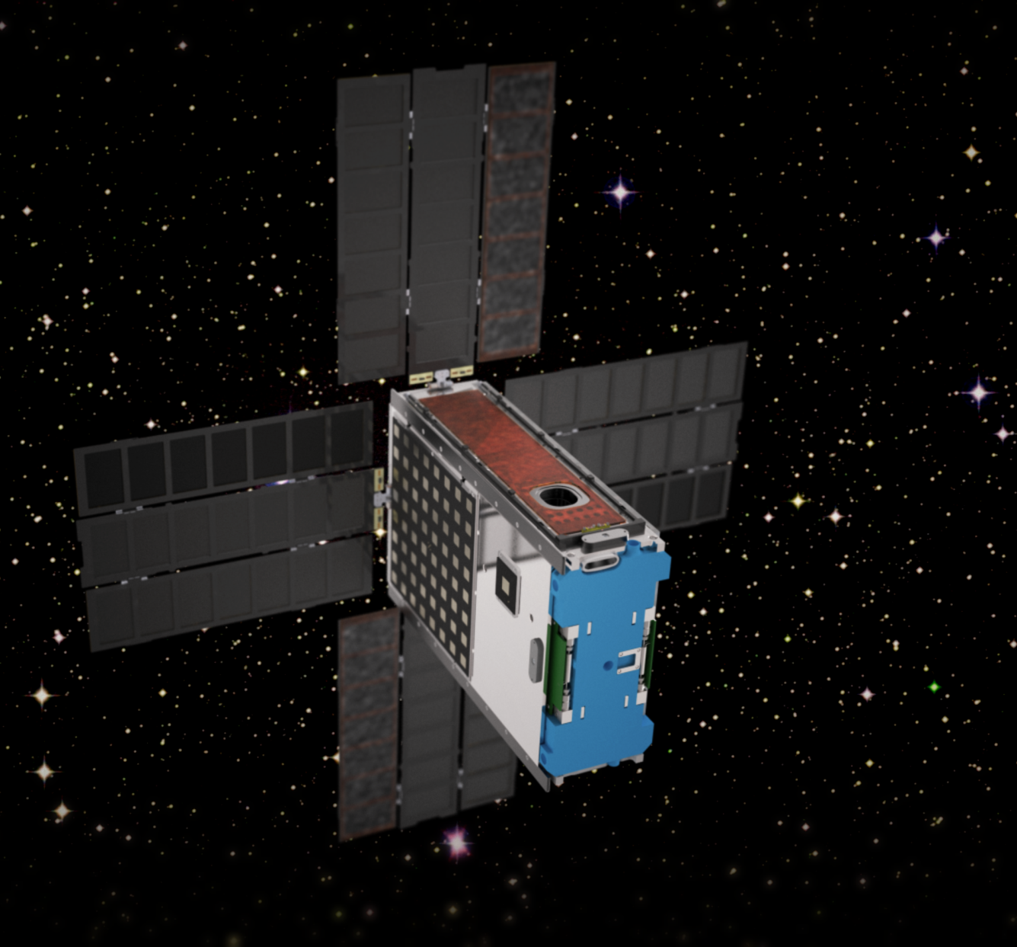
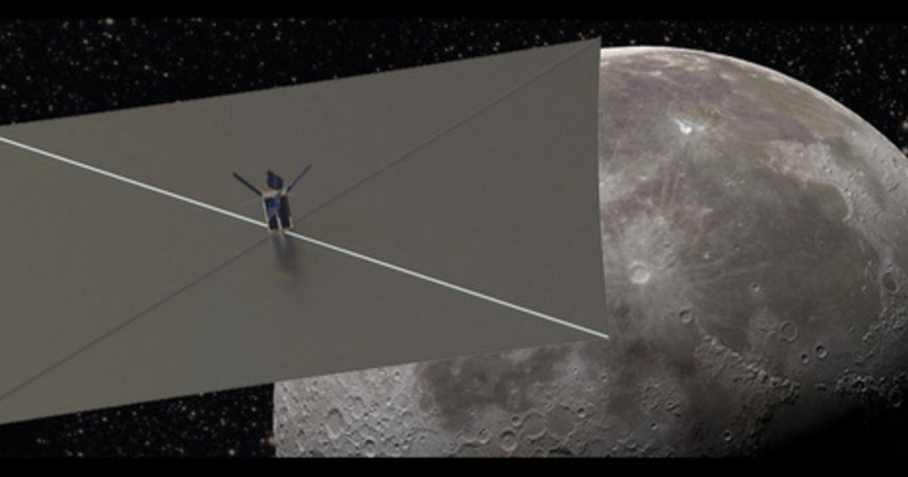
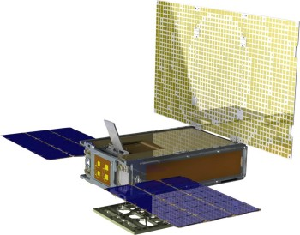
A New Era of Planetary Exploration with Small Satellite Platforms
History was Made in 2018 with the Launch of MarCO A and their subsequent success
Artemis 1 will Launch 13 Interplanetary CubeSats
Numerous Interplanetary SmallSat Missions are in Planning (PSDS3 Studies, Others at NASA Centers and in the Private Sector)
All Need Deep Space Communications and Ranging Support
DSN is Heavily Subscribed
Idea Emerged to Utilize Large Aperture non-NASA Assets*
This Project Represents the Prototype Experiment
* Suggested by Rob Staehle JPL in 2014

Slide 6



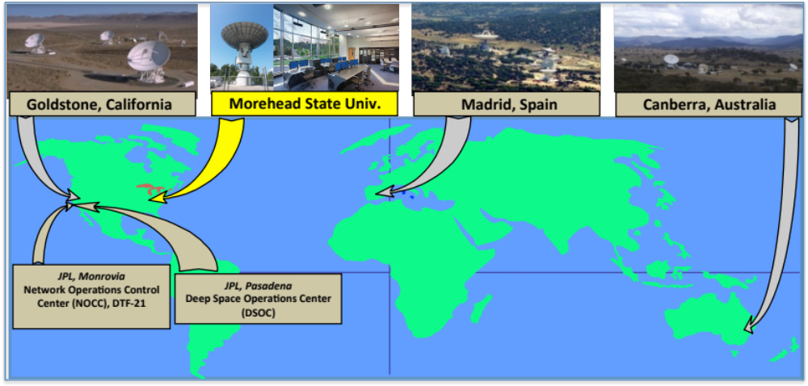
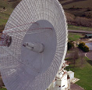

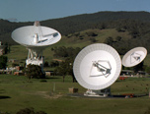
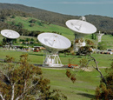
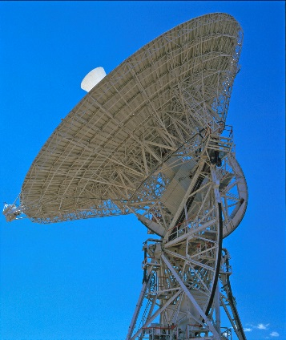
DSS-17 Affiliated Station
Fig. 1: LH2 Tank Installed at Test Site
Fig. 3new: C&C Trailer
Notes:
6

Slide 7



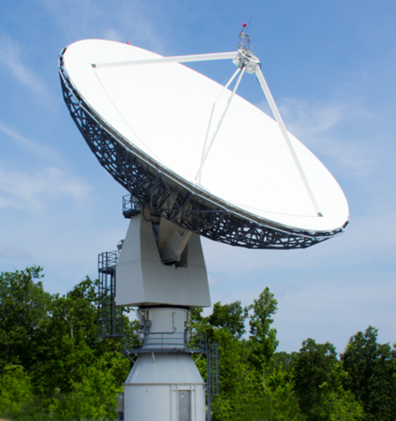
AES Program: 21m DSN Station (DSS-17)
Project Description and Objectives Demonstrate a cost-effective process for expanding DSN capabilities by utilizing non-NASA assets to provide communication and navigation services to CubeSat missions to the Moon and inner solar system, thereby enabling interplanetary research with small spacecraft platforms. DSS-17's Operational Philosophy is: "A Class-D Ground Station Supporting Class D Interplanetary CubeSats"
Technical Approach Develop and implement a strategy to transfer Deep Space Network (DSN) equipment, processes and protocols to the MSU 21 m antenna system to enable integration into the DSN as an auxiliary station to support small spacecraft missions. Implement deep space communications, tracking and navigation techniques as well as adoption of CCSDS standards. Implement systems upgrades, conduct tests/demonstrations, and transition to an operational capability.
Benefits Serves as a test-case for other non-NASA ground stations to provide auxiliary deep space navigation and tracking support for interplanetary small spacecraft missions. Serves as an Experimental Station for Advanced DSN Communications Experiments Transparent to Missions Being Supported | Targets Full DSN Compatibility Scheduled by DSN Support CCSDS-SLE DSN Tracking and Ranging Support Lunar, NEA, Lagrange Point Missions

Slide 8
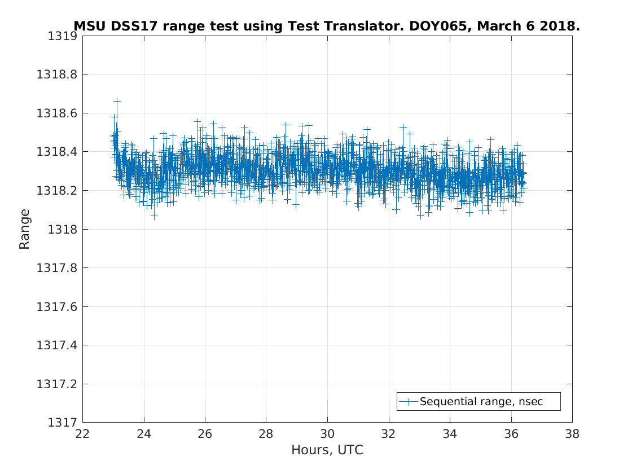
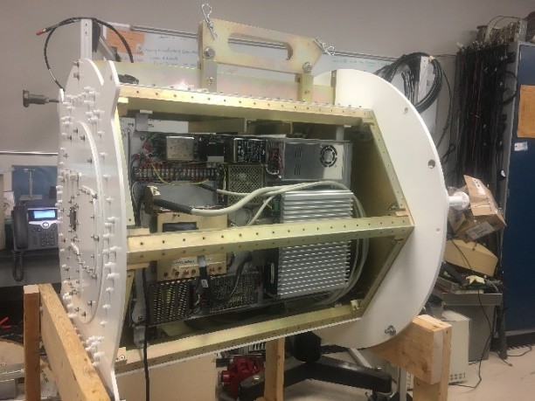
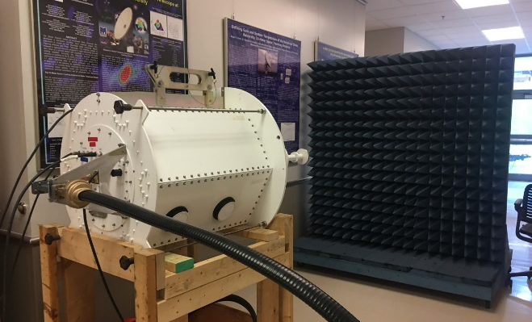
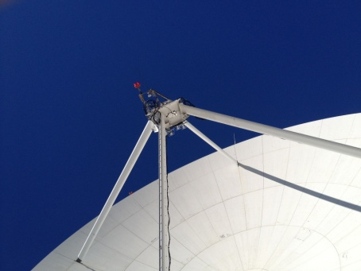
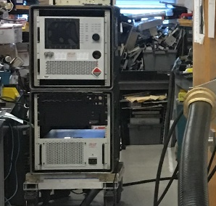
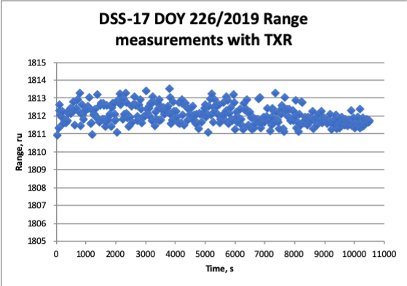
Morehead State University 21m Upgrade to DSN Compatibility Challenging Technical Implementation
Cryogenic X-band Feed
High Power Amplifier
Ranging
Initial Transmit and Ranging laboratory tests proved successful
Custom X-band feed is based on a cryogenically cooled LNA that operates at <20K.
DSS-17 Ranging Stability Results- measurement stability over > 13 hours exceeds requirement
DSS-17 Ranging Results- precision within +/-1 range unit (0.94 ns). Implies 1 meter accuracy ranging at the Moon
X-band Feed is located at the prime focus
3 kW High Power Amplifier under test

Slide 9
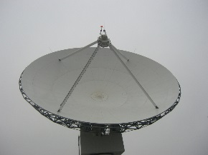
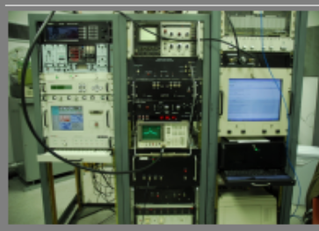
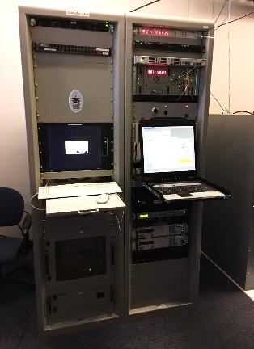
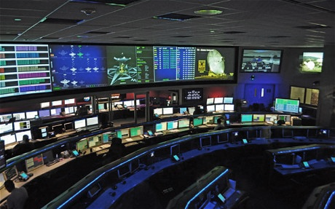

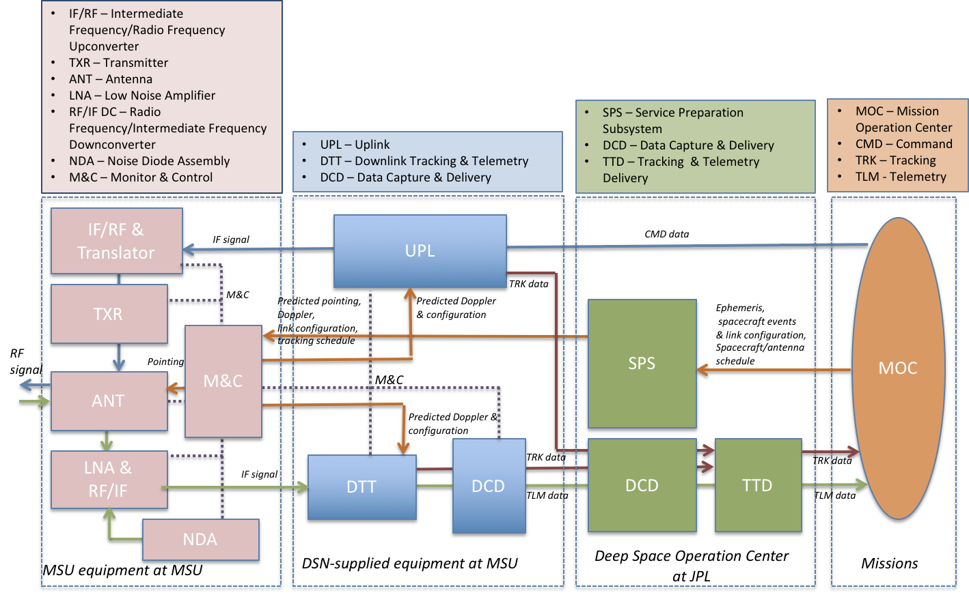
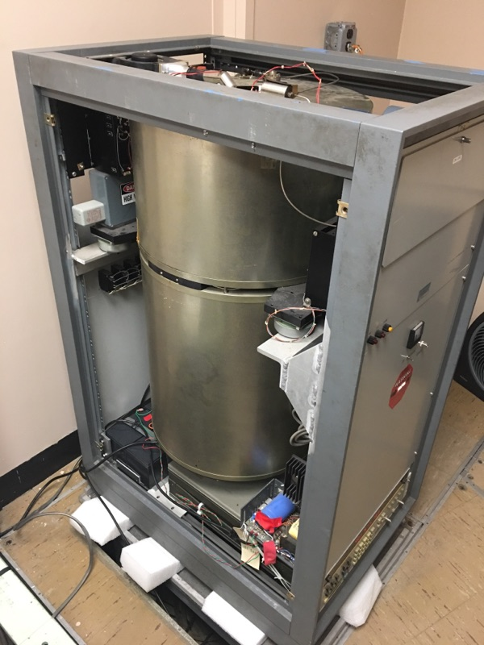


DSS-17 System Architecture
“Lite” Version of DSN Block 6 Exciter System Developed for Morehead State
Morehead State 21 m Antenna System
21 m Antenna Control System
Deep Space Operation Center- JPL Mission Control
Updated Cryogenic X-Band Feed
H- MASER
Morehead State University Mission Operations Center

Slide 10

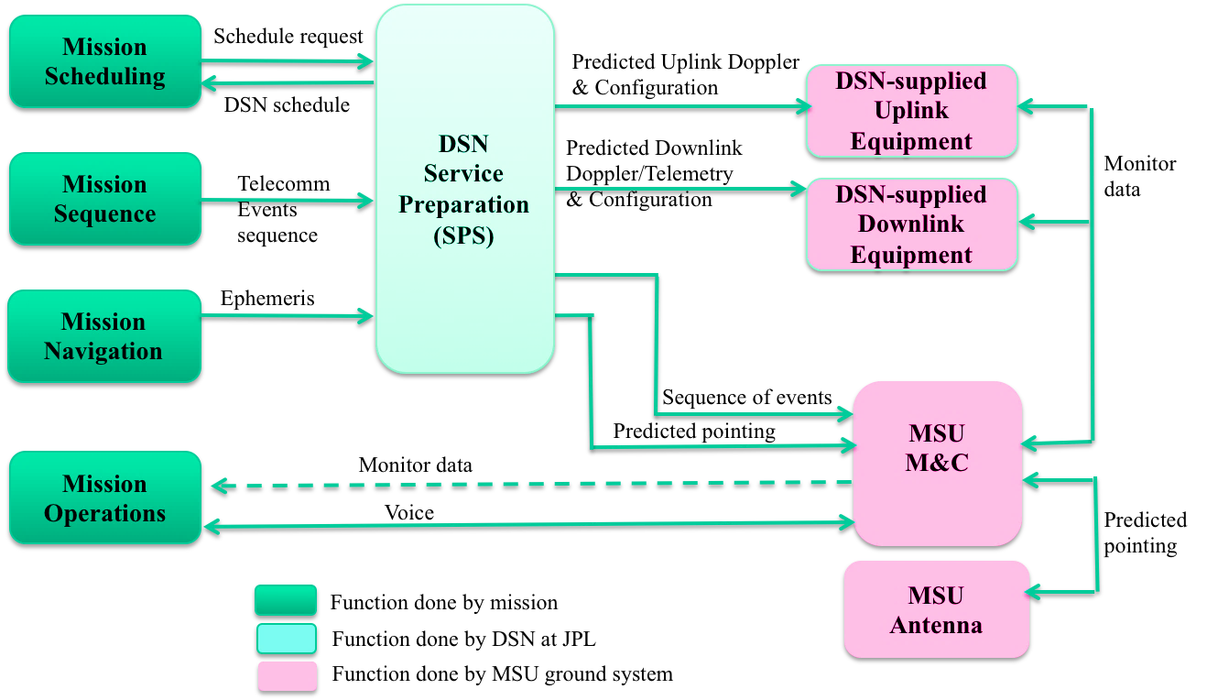
Service Management Data Flow
For NASA Missions

Slide 11
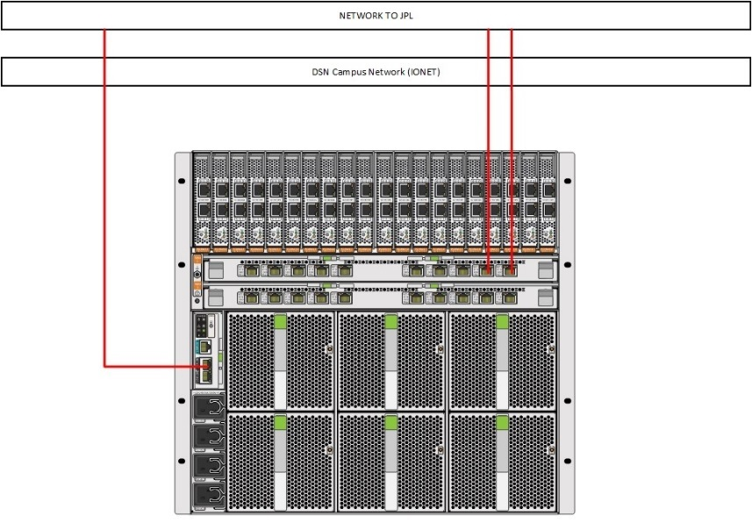
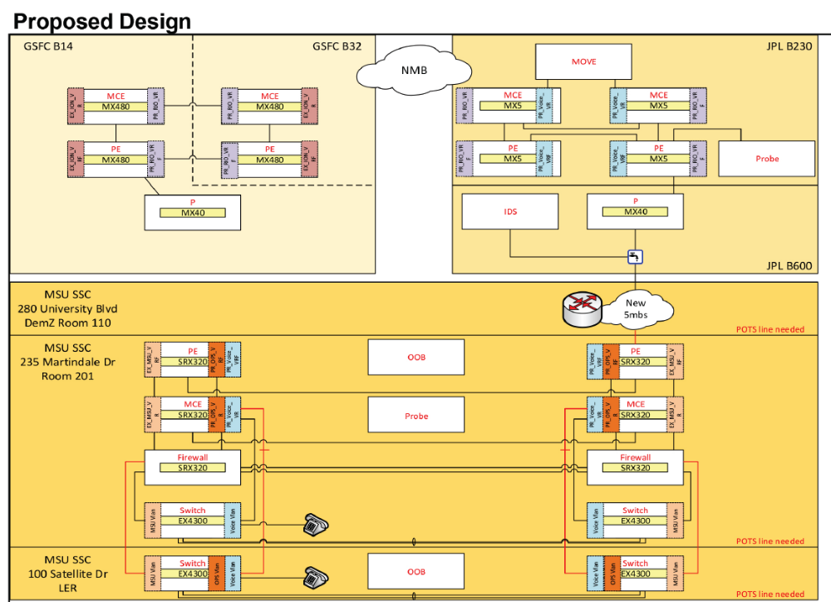
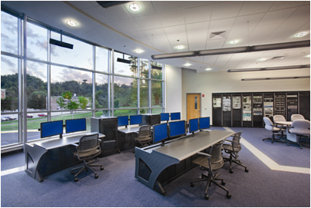
IT Security and NMB Connection
IT Security and Network Connection Required
  LAN Independent of University Network
  Architecture Designed with JPL and CSO
  Behind NASA Firewall
  Designed by NASA JPL and CSO
  Direct Connection to the NASA NMB

Slide 12
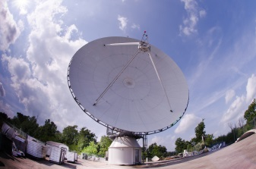
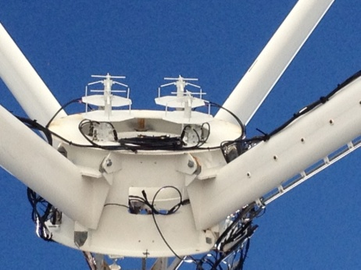
DSS-17 Performance
Parameter | Measured Values
Axis Slew Velocity
Azimuth | > 3.0 º/sec minimum
Elevation | > 1.6 º/sec minimum
Polarization | > 0.7 º/sec minimum
Axis Acceleration
Azimuth | 1.0 º/sec²
Elevation | 0.6 º/sec²
Travel Range
Azimuth | ± 269.8º
Elevation | 1.0º to 90.3º
Polarization Range | ± 90º
Pointing Accuracy | 0.005º RMS
Tracking Accuracy | 0.0004º RMS
Aperture Efficiency, η (L/Ku) | 0.653/0.563
Surface Tolerance @ 35 mph wind | < 0.020” RMS
Performance Measure | DSS-17 Performance Metric
X-Band Frequency Range | 7.0 – 8.5 GHz
LNA Temperature | < 20 K
System Noise Temperature | 90 K
Antenna Gain | 62.7 dBi (@8.4 GHz)
System Noise Spectral Density | <-178 dBm/Hz
G/T at 5° Elevation | 41.25 dB/K
Time Standard | Hydrogen maser (1 ns/day)
EIRP | 93.7 dBW
HPBW | 0.115 deg
SLE Compliance | Yes
CCSDS Compliance | Yes
Forward Error Coding | Reed Solomon/Convolutional, Turbo, Low Density Parity Check
Radiometric | Angle, Doppler, Ranging

Slide 13
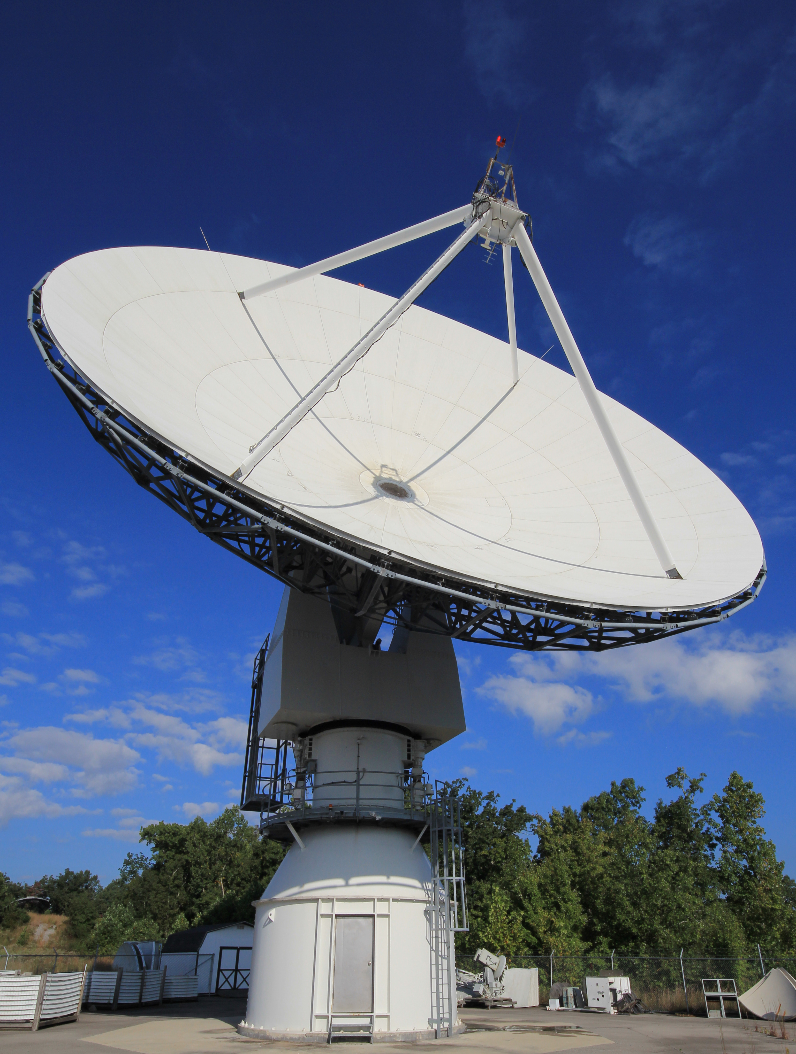
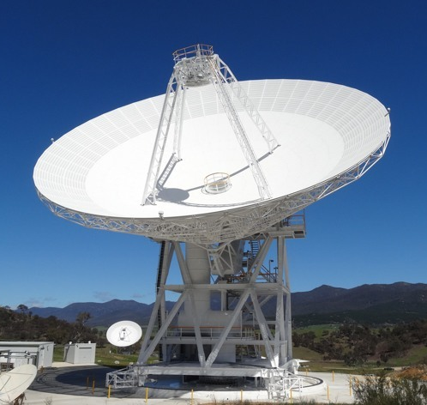
COMPARISON to 34m BWG
G/T: 10 dB less (~ 5 dB less Gain, 5 dB higher noise temperature)
EIRP: 92.7 dBW vs. 110 dBW (1 kW PA vs 20 kW PA)
Ranging Accuracy: 1 m (1 sigma accuracy) vs 1 m (1 sigma accuracy)

Slide 14
Performance Metrics
The Morehead State University and DSN/JPL teams performed the following set of tests to empirically determine the performance of DSS-17:
G/T as a function of elevation (from 0° to 90° in 5° intervals)
SNT as a function of elevation (from 0° to 90° in 5° intervals)
EIRP
Pointing and Tracking Error Measurements
Telemetry Tracking of S/C: Chart that includes Coding and Modulation Tests- examples from Missions; Telemetry Data Capability (Capture Rates and grades)
Commanding (DTT locks to carrier and sub-carrier, measure variations, command verification. Confirm that USG generates signals of X, at a bit rate of Y)
Radiometric Measurements- Ranging Data- loop back test with command
Stability of Ranging Measurements - STEREO A 3-Way
Doppler Noise
8) Horizon Mask
9) Operational Tests (retrieval of predicts, achieving carrier and symbol lock, etc.) Reference 4 and 6, Spacecraft Tracks (SNR, data rates, modulation schemes, etc.)

Slide 15
DSS-17 X-Band KPA
New X-Band Feed High Power TX Capability
CPI GEN IV Klystron PA
Frequency Range 7.9 - 8.4 GHz
Klystron Power Output 3.0 kW min. (64.77 dBm)
Gain at 3 KW = 77 dB, min.
Gain Stability vs. Time ±0.25 dB/24 hr. max. at constant drive
and temperature
Noise and Spurious = -65 dBW/4 kHz, 4.2 - 12.0 GHz

Slide 16
Ranging Accuracy Measurements
DSS-17 Ranging Results (Tx Stability)- precision within +/-1 range unit (0.94 ns). Implies 1 meter accuracy ranging at the Moon Lab Test

Slide 17
G/T Empirical Measurements

Slide 18
Pre-Operational Tests
Pre-Operational Tests involved testing all aspects of an operational track:​
Retrieval of Predicts and Configuration Files from the SPS Server ​
Achieving carrier lock, Frame lock and Symbol lock​
Reference Telemetry Tracking​
Radiometric Measurements​
Flowing Data and Telemetry to DSOC​
Flowing Radiometric Data to FDF​
Testing Uplink (Unable to Complete- did not receive Mission Permission)​
​
Additional Tests involved Shadow DSN tracking of missions with sufficient SNR (>10 dB link margin)​
Hayabusa2​
Osiris-Rex​
Maven​
STEREOA​
​

Slide 19
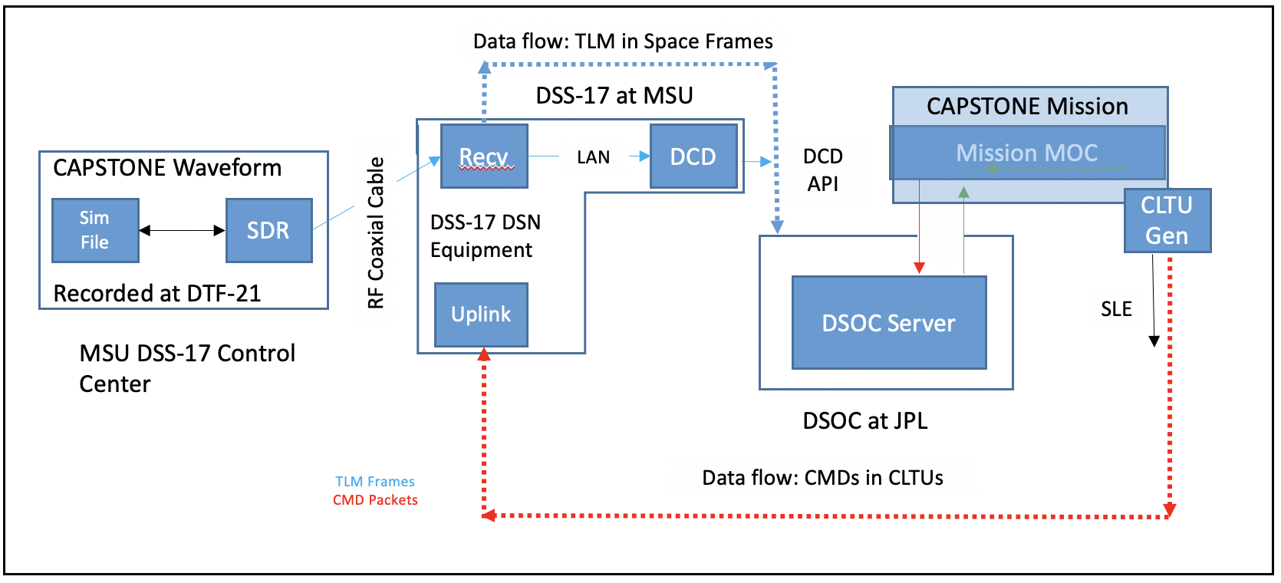
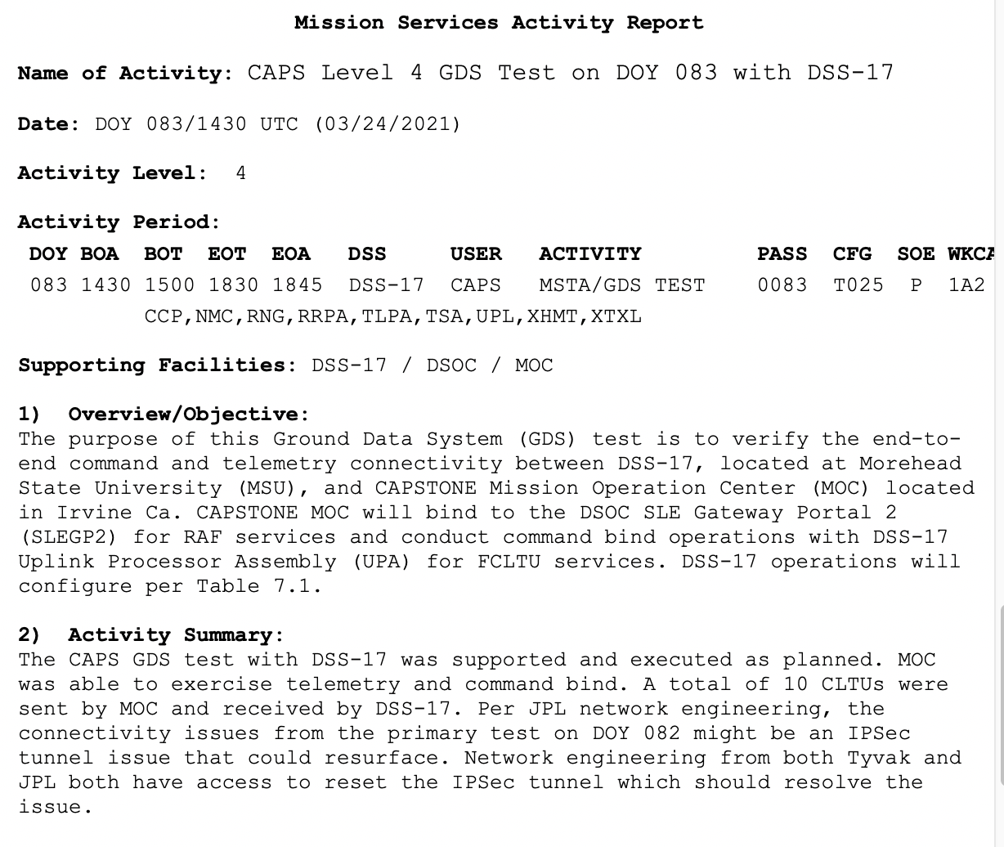
Results with CAPSTONE GDS Test
Successful command and telemetry data flows between DSS-17 and CAPSTONE MOC established on Mar. 24, 2021
NOTE: DSS-17 is Prepared to Support GDS Testing with All Artemis 1 Missions for which Tracking Services are being Provided

Slide 20
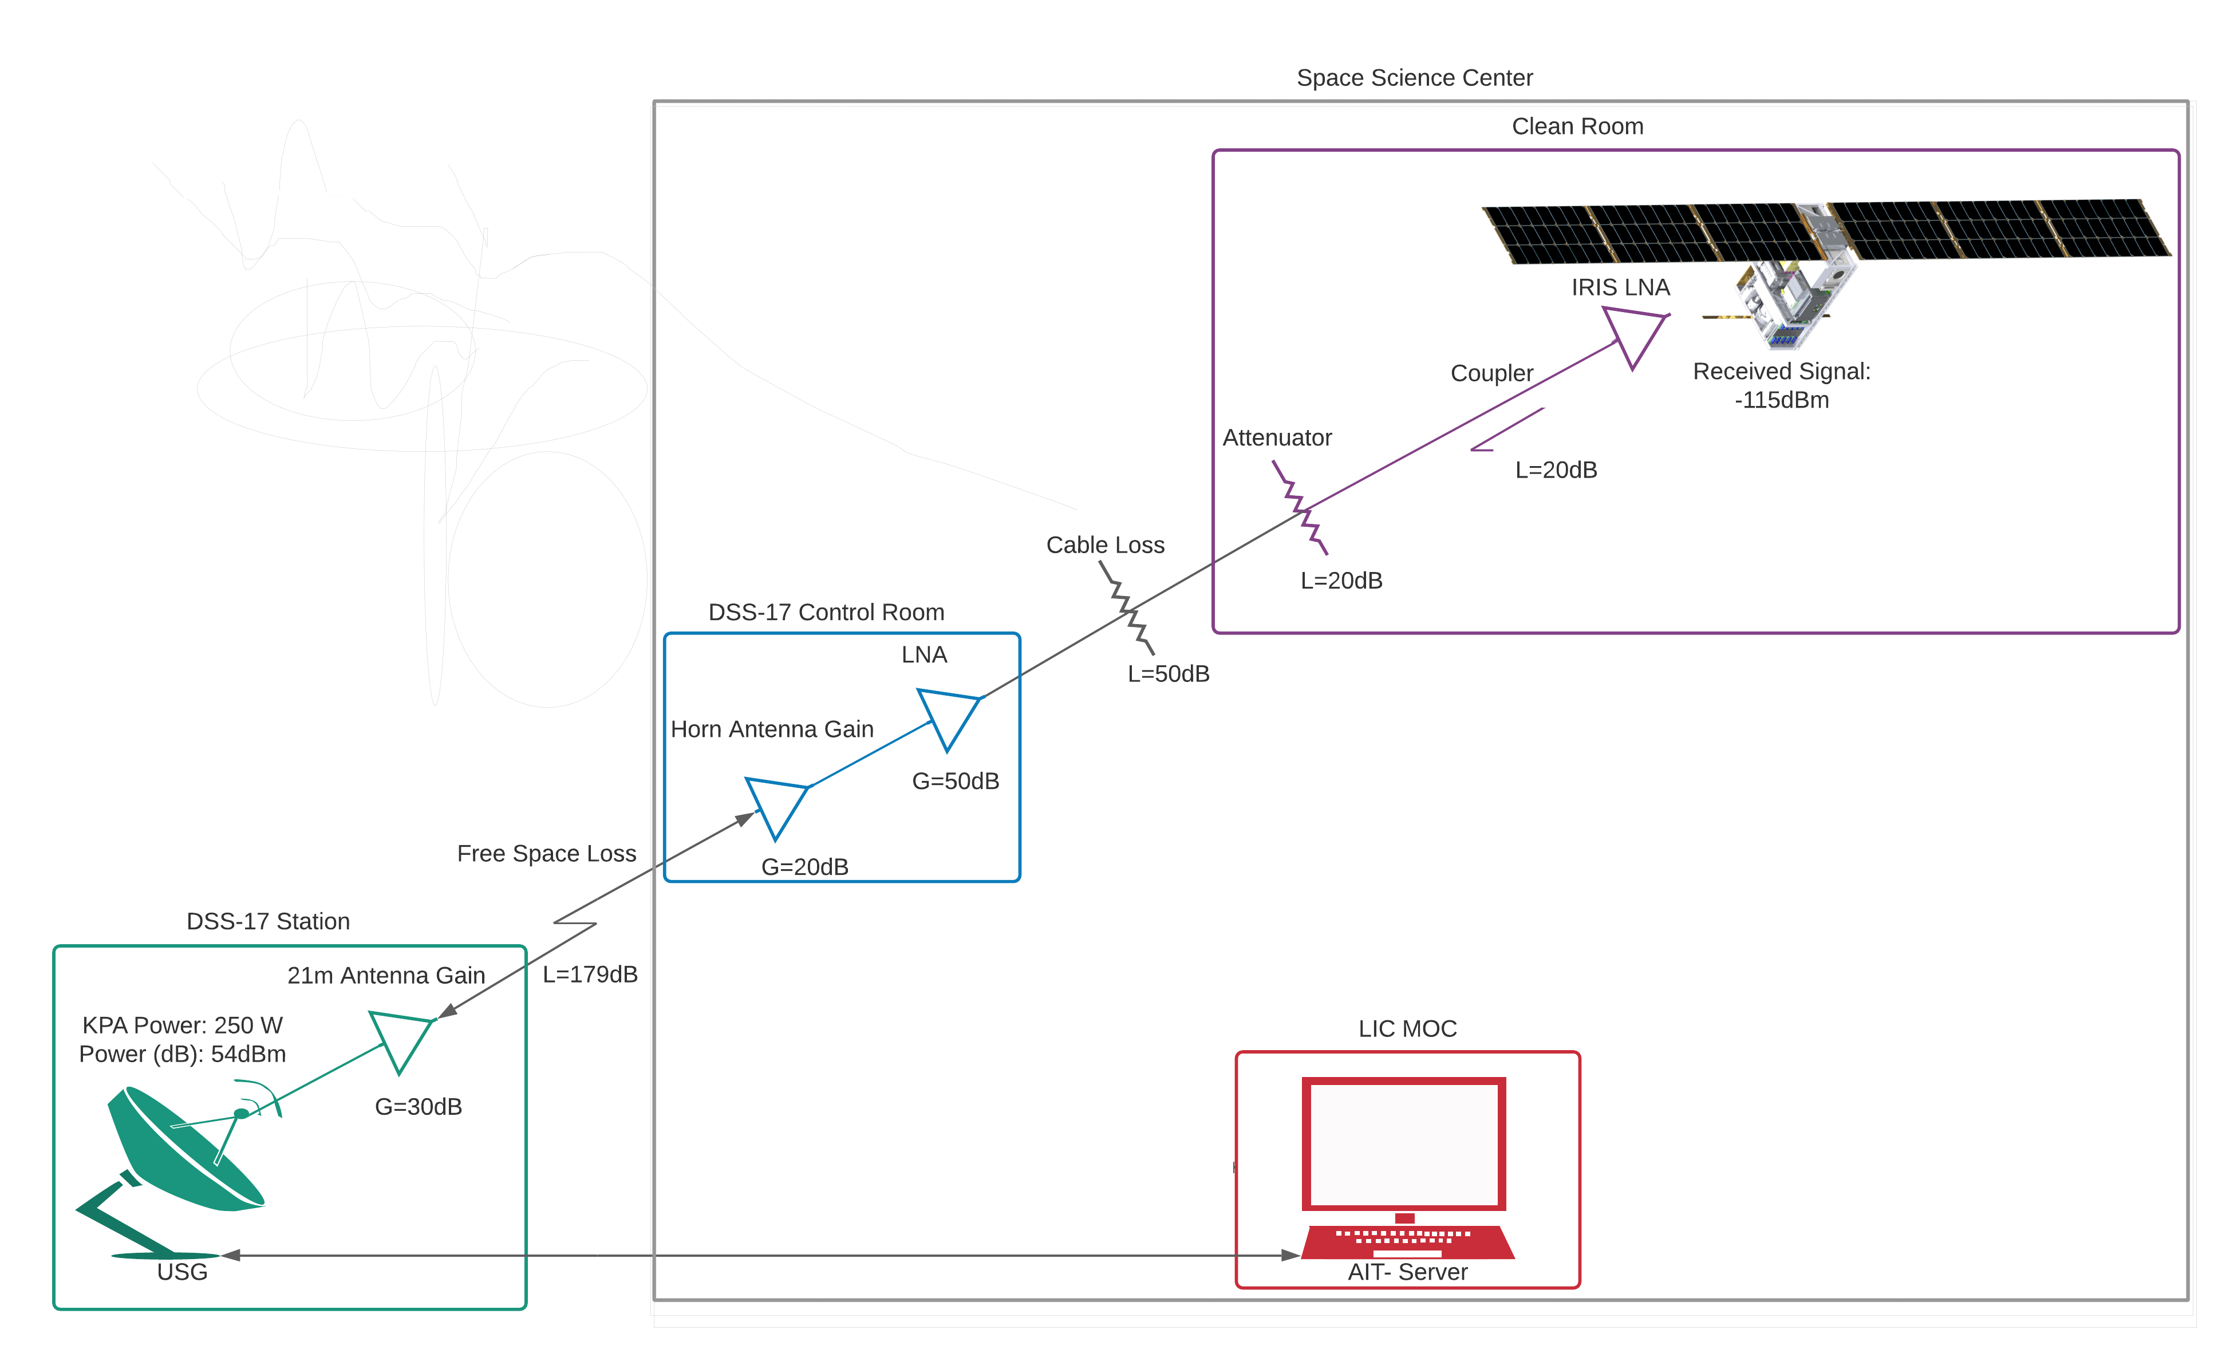
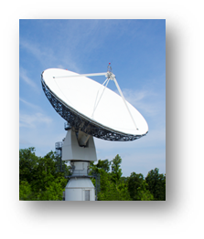
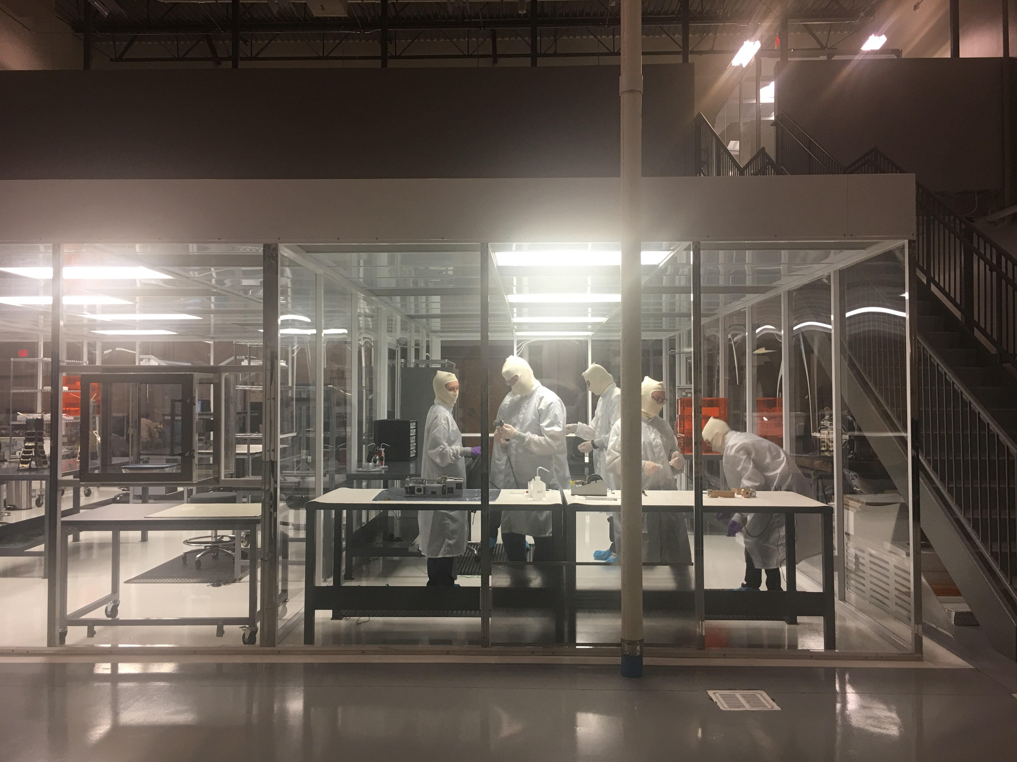
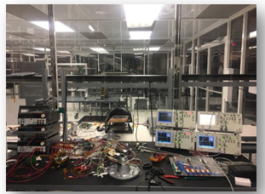
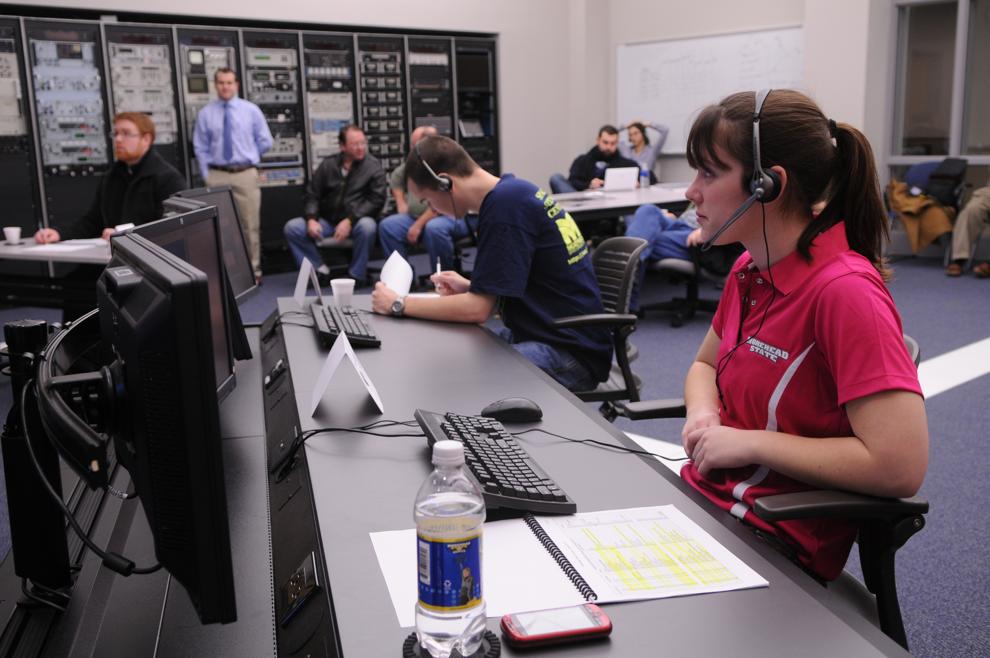
E2E testing Capability – Overall Elements

Slide 21
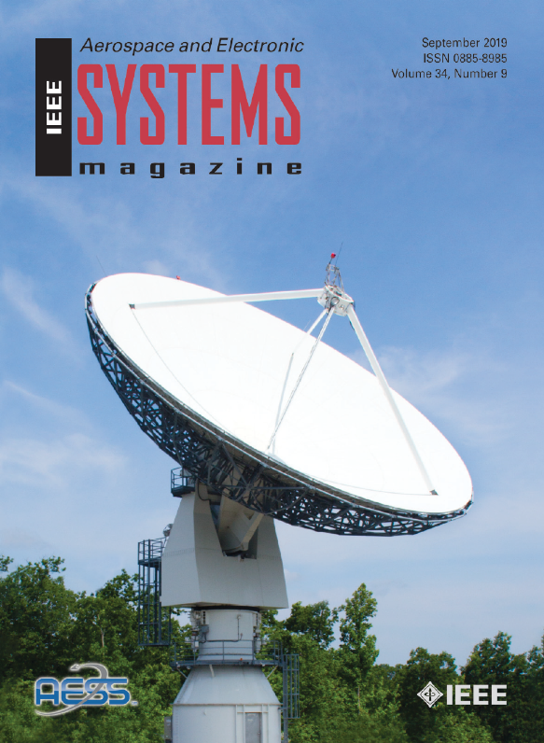
DSS-17 Milestones and Timeline
X-Band Downlink Capability Developed and Tested with Real Spacecraft, including Stereo, Osiris Rex, and MAVEN
Telemetry connection to JPL over NASA Mission Backbone Network Operational
  Enables telemetry and commanding in the same manner as other DSN antennas
X-band Transmit and Ranging
  Ranging Measurements Successful
    Results imply 1m ranging accuracy at the Moon
Conducted Series of DTN Demonstrations Using Lunar IceCube (LIC), DSS-17 and LIC Ground Data System
Conducted first OMSPA Demonstration with a CubeSat using the X-band Feed and custom SDR-based Multiple Receiver System
Successfully conducted approximately 1,000 S-band ASTERIA Mission passes
  Enabled staff and students to obtain significant operational experience
DSS-17 on the Cover of the IEEE Aerospace and Electronic Systems Magazine Special Issue on Artemis 1 (September 2019)
Critical Milestones
ΔSRR | NMB Connection | Downlink Demo | Uplink Demo | Ranging Demo | ORR | Artemis 1 Support | Artemis 1 Ops | Mission Duration | Future
01/15/2016 | 6/15/2018 | 5/5/2019 | 8/15/2019 | 9/15/2020 | 8/12/2021 | Aug 2022 | 2022-2024 | Artemis 1 Duration | CLIPS, Artemis
ISEE-3 Carrier During Lunar Fly-by Sept 2014
© 2020. All Rights Reserved

Slide 22
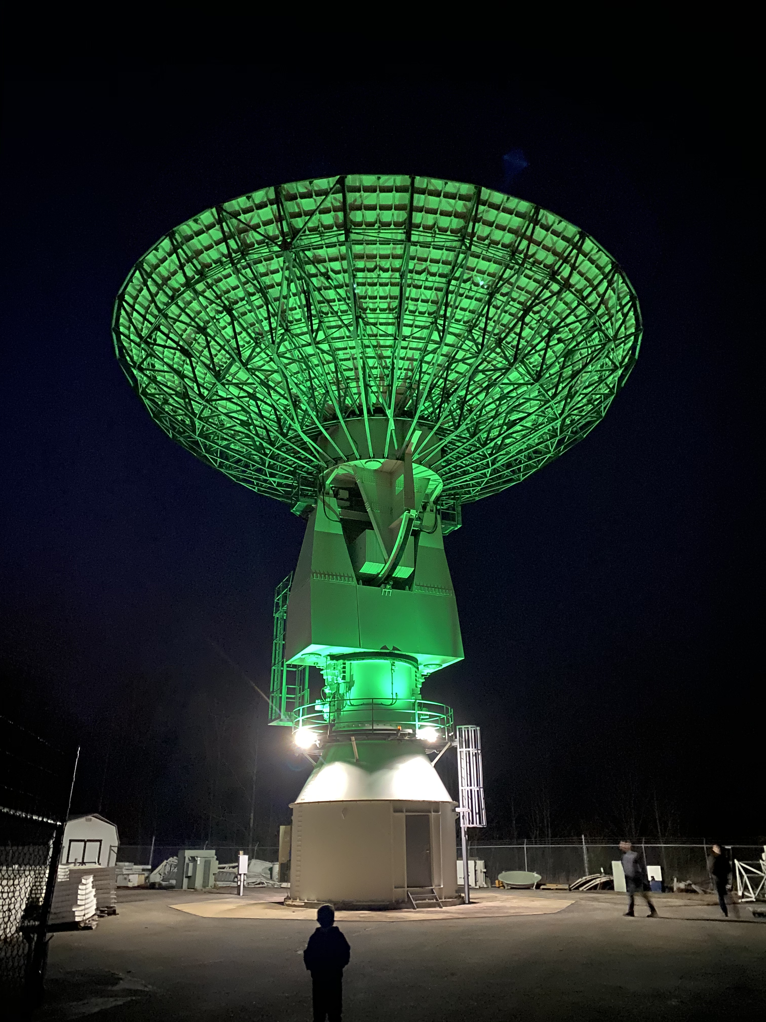
Deltas Between DSS-17 and DSN Stations
DSS-17 is a Class D Station Supporting Class D Interplanetary Missions
DSS-17 has operational differences including:
  Simplified Monitor and Control System with MC Data stored locally
  DSN discrepancy reporting has heritage
    Interaction between DSN DR and DSS-17 ARs needs to be defined
  Several single point of failures (SPFs)

Slide 23
Services to be Provided to Artemis-1 Interplanetary CubeSat Missions
DSS-17 will Provide Support for NASA Artemis 1 CubeSats
Lunar IceCube NEA Scout LunaH-Map
Lunar Flashlight CuSP Plus CAPSTONE
Spacecraft |  | Downlink Band | Uplink Band | Bus Stop | DSS-17? Y/N | Near-Earth* or Deep-Space U/L
HMAP |  | X | X | 2 -30mins | Y | Near-Earth
LFL |  | X | X | 1 | Y | Near-Earth
MLIC |  | X | X | 1 | Y | Near-Earth
NEAS |  | X | X | 1 +90mins | D/L only | Deep-Space
CuSP |  | X | X | 2 +120mins | Y (D/L only) | Deep-Space
 | *Near-Earth X-Band Uplink: 7.145 GHz – 7.190 GHz Color Code: Uplink/Downlink/Ranging Downlink Only

Slide 24
DSS-17 Anticipated Upcoming Missions
Mission | Services | Uplink | Downlink | Modulation | Regulatory | Duration | Launch
Lunar IceCube | Uplink, Downlink, Doppler, Ranging | 7233.765 | 8498.95 | PCM/PSK/PM 16kHz Sine | Included on NTIA Stage 4 | 24 months | SLS Launch- 11/2021
LunaH-Map | Uplink, Downlink, Doppler, Ranging | 7193.6 | 8496.93 | BPSK | Included on NTIA Stage 4 | 24 months | SLS Launch- 11/2021
NEAScout | Downlink Only | N/A | 8402.78 | PCM/PSK/PM | Included on NTIA Stage 4 | 24 months | SLS Launch- 11/2021
CuSP | Downlink Only | N/A | 8416.36 | BPSK, Manchester | Included on NTIA Stage 4 | 24 months | SLS Launch- 11/2021
CAPSTONE X-Band | X-Band
CAPSTONE | Uplink, Downlink, Doppler and Ranging | 7235 | 8500 | BPSK | Info for NTIA Stage 4 provided | 9 months | November 2021
ISRO Cross Support X-Band | X-Band
Aditya-L-1 | Uplink, Downlink, Doppler, Ranging | 7219.611 & 7232.531 | 8482.32 & 8497.50 | PM/PSK/PCM | Apply for Experimental? | TBD | TBD
CLPS S-Band | S-Band
NOVA-1 IM – Intuitive Machines | Uplink, Downlink, Doppler, Ranging | 2035.594 | 2200-2290 (requested 2250) | PM/BPSK, for high data rate: OQPSK | FCC S-band Experimental? 21 m included on ITU Filing | 4 weeks | January 28, 29, 30
LN-1 NASA – MSFC | Downlink Only – Navigation Beacon | N/A | 2272.5 | BPSK, NRZL, Bi-phase | Included on NTIA Stage 4 | 4 weeks | January 28, 29, 30
NOTE: Artemis 1 and CAPSTONE are the Primary Missions to be serviced by DSS-17. Others, including Aditya-L-1, NOVA-C, and LN-1 will be serviced on a non-interventional basis, that is when time is not scheduled on DSS-17 for Artemis 1 and CAPSTONE

Slide 25
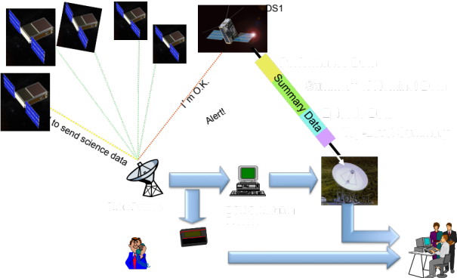




Overview – New Technologies in the 21m Upgrade Project
Technology Enhancements
MSU 21m Antenna Upgrade to DSN Compatibility
University Partnerships
Spacecraft-Initiated Operations
Tracking On Demand
Opportunistic Multiple Spacecraft per Antenna Inexpensive downlink
Disruption Tolerant Networking
More efficient communications

Slide 26


Future of DSS-17
DSS-17 Supports Interplanetary Class D Missions while MSU 12m (Gifted by JPL) Supports LEO SmallSat Missions and University student training

Slide 27

Q&A
“We’ve reached the end of the beginning”

