Slide 1




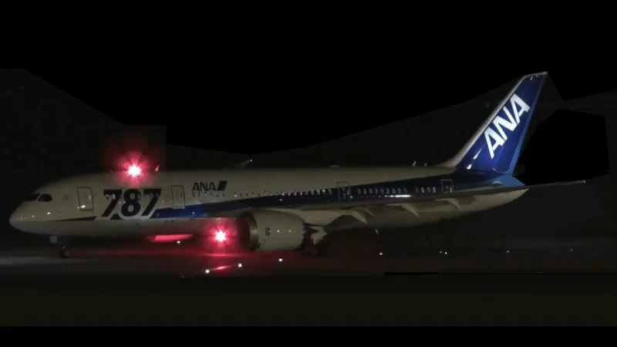
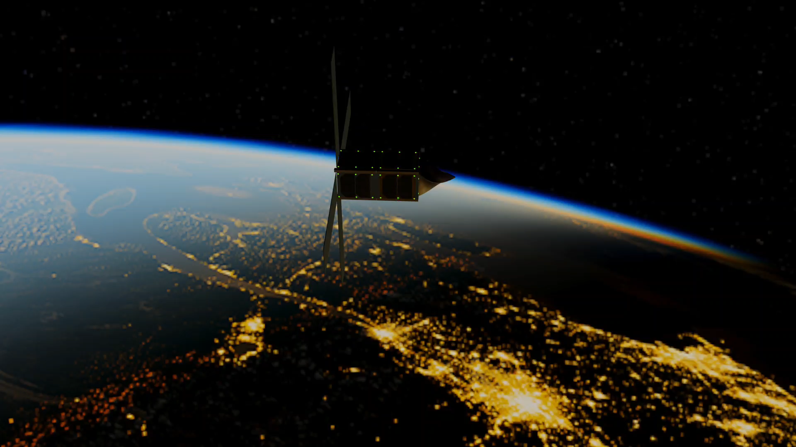
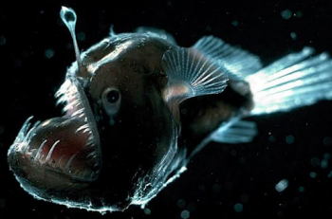
Visible Light Communication Between CubeSats
During Close Proximity Operations
Athip Thirupathi Raj and Jekan Thangavelautham
Space and Terrestrial Robotic Exploration (SpaceTREx) Laboratory
Aerospace and Mechanical Engineering Department
University of Arizona
Notes:
Good morning, all! I am Athip, a PhD Student working at the Space and Terrestrial Robotic Exploration lab at the Aerospace and Mechanical Engineering Department at the University of Arizona.

Slide 2
Outline
Introduction and Motivation
Proposed Solution
Inspiration
Related Work
Advantages of VLC
Objectives
Technical Methodology
  Concept of Operations
  System Design
  Proposed Testing Methodology
Conclusions and Future Work
Notes:
Here is a quick outline of what I am going to talk about today. We go over the introduction and motivation for the project, then a little about the literature survey, the work done related to this area so far,

Slide 3
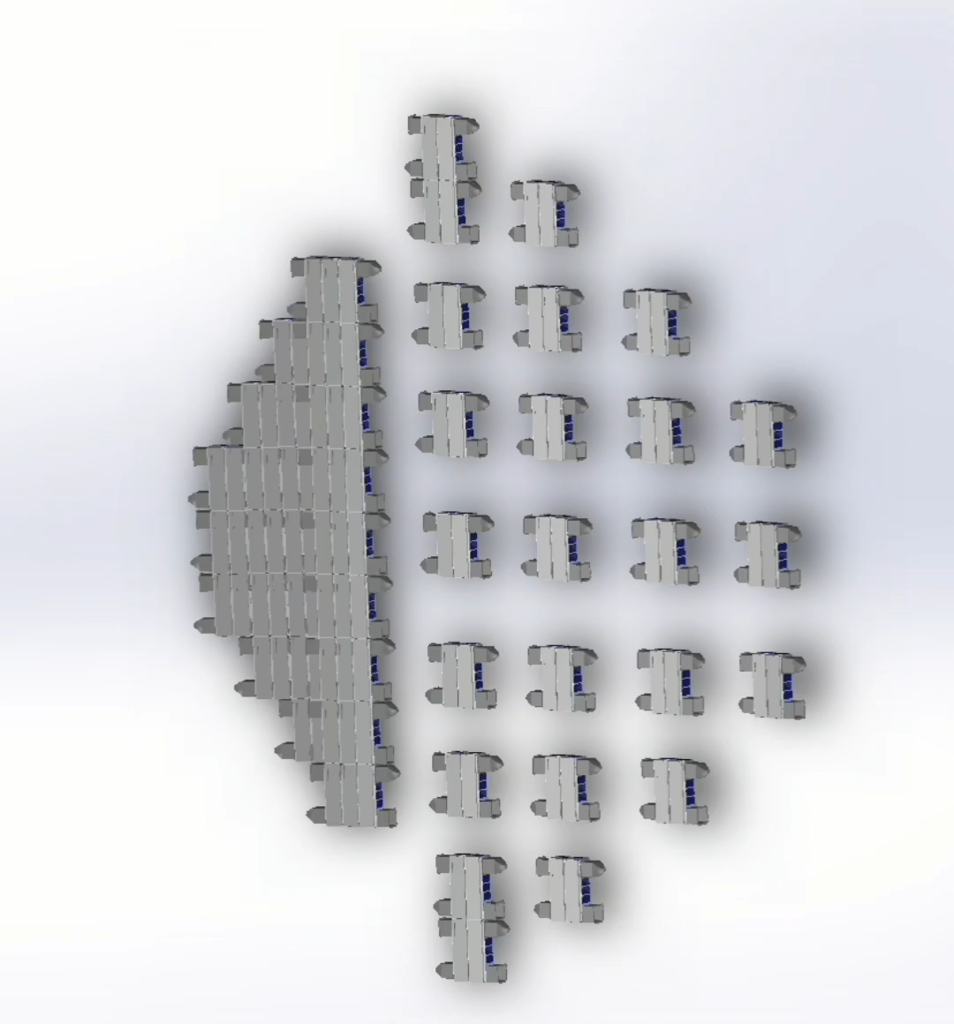

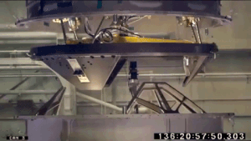
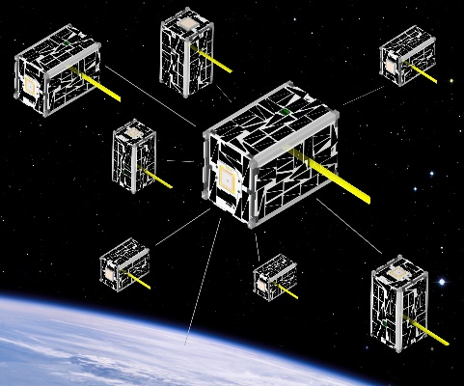
Introduction and Motivation
Co-ordination, Co-Operation, Formation Flying:
Required for Space Commerce
In-Space Assembly
Rendezvous, Proximity Operations, and Docking
Mother-Daughter satlet swarms
Figure: Shipping Containers on a ship
In-Space Assembly
NASA
Requirement for a CubeSat Form Factor
Inter-Satellite Communications System
Figure: ISS Docking and Berthing
Figure: Satellite Swarm
Credit: NASA (SODA) ¹

Slide 4
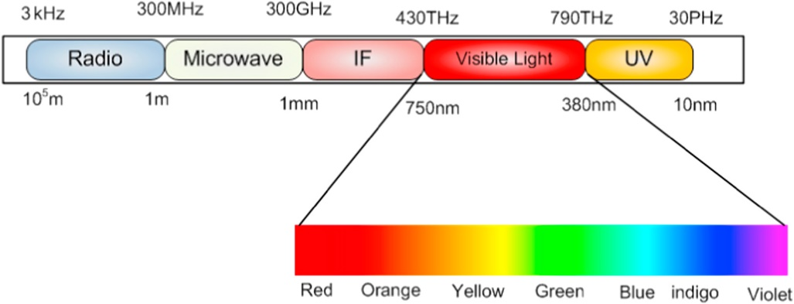
Proposed Solution
Visible Light Communication (VLC)
Encoding messages (bits) in Visible Light bandwidth (wavelength spectrum of 380 nm to 750 nm corresponding to a frequency spectrum of 430 THz to 790 THz)
Figure: VLC Spectrum ²

Slide 5
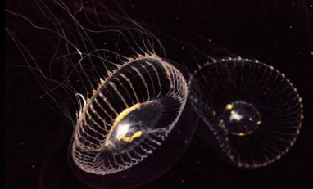
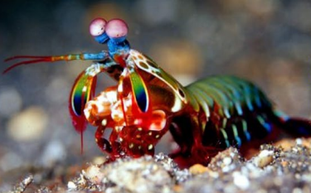
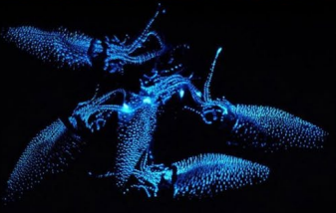
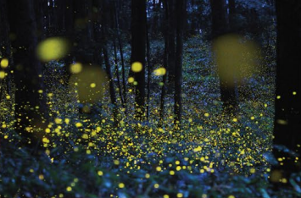
Inspiration
Nature
Use of Bioluminescence to communicate
More prevalent in deep-sea areas
Man Made
Aircraft Strobe Lights
Inspiration from Bioluminescence found in
Deep-Sea to apply in Deep Space.
Figure: Crystal Jellyfish (Top); Firefly Squid (Middle); Fireflies (Bottom)
Figure: Mantis Shrimp (Top); Angler Fish (Middle);
Airplane Strobe Lights ³ (Bottom)
Notes:
The mantis shrimp are theorized to use special Circular Polarized (CP) light reflected from their shells in different patterns to communicate with one another.
The fireflies use flashing lights to communicate, some having unique flashing patterns to identify members of their own species, and to distinguish members of the opposite sex.
Angler Fish use bioluminescent flesh to attract and lure prey.
Firefly Squid found in the shores of Japan during Spring, use bioluminescence to ward off predators as well as catch prey, and attract mates.

Slide 6
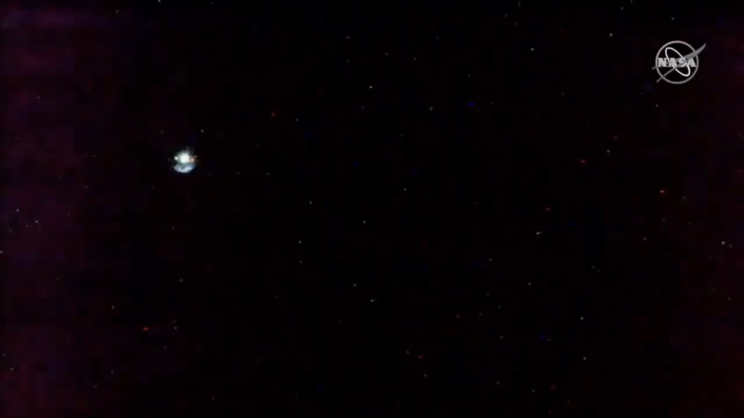
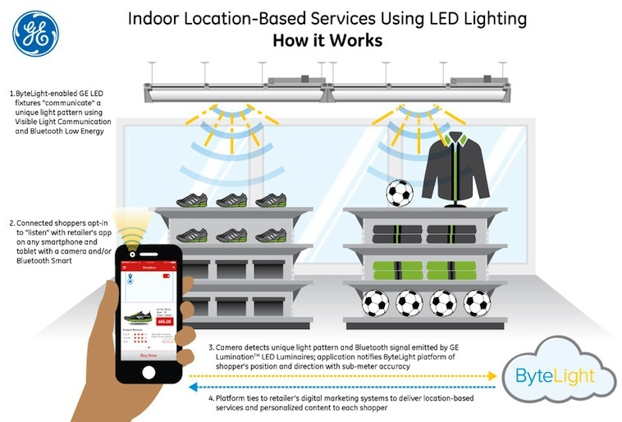
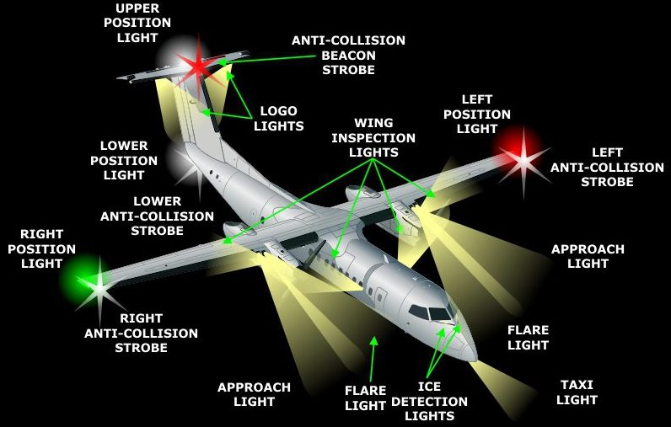
Related Work
Used in Aircraft and Maritime activities as a standard
Demonstrated commercially for localization
SpaceX Dragon – ISS Docking using strobe lights (Credit: NASA/SpaceX)
Lighting Cues as a standard for
Aircraft and Maritime applications
Figure: VLC Demonstration by GE and ByteLight ⁵
Figure: Exterior Lighting System of an Aircraft ⁴.

Slide 7
Advantages of VLC
Traditional Advantages (Terrestrial)
Higher Speed – Up to 10 Gbps ✓
No EMI ✓
Lower Cost ✓
Spectrum: RF is getting saturated; VLC is 10000 times larger in Bandwidth ✓
Dynamic Load Balancing
Traditional Disadvantages (Terrestrial)
Requirement for Line of Sight
  Not an issue in space
Lower Range
  Not an issue for proximity operations
Interference by external noise
  Due to sun, need to use optical filters
We get the best of both worlds using VLC in space
Notes:
Dynamic Load Balancing: Sharing the data load with RF, also redundancy

Slide 8
Objectives
Develop a system to identify a target 3U CubeSat in Deep Space
Must fit in a 3U CubeSat Form factor (mass, volume, power)
Develop a VLC system with the following key specifications:
  Target Identification Range = 50 m (TBR)
  Bit Rate = 100 Mbps (TBR)
Notes:
Bit rate was taken from Ouster OS 2 LIDAR data rate. It has 86.6 Mbps in the low data rate mode for the 128-channel configuration.

Slide 9

Concept of Operations

Slide 10
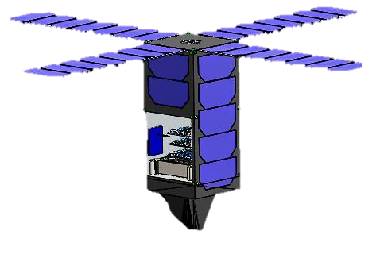
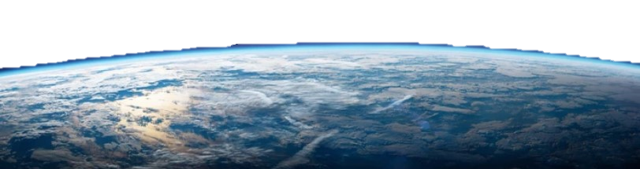
Phase 1: Initial Rendezvous
“Active Lighting Cues"
Use of Blinking LED lights on all surfaces of each S/c
Identification using Light-to-digital converters (Photodetectors)
If S/c does not exit "Searching" mode after a set time, it executes a manual spin using thrusters/magnetorquers
LED Lighting Cues Blink frequency Truth Table
Blink Frequency | Message
1 Hz | “Searching” Mode
2 Hz | “Target Identified” Mode
3Hz | “Contact Established” Mode
4Hz | Distance = 50 to 10 meters (TBR)
5 Hz | Distance = 10 to < 1 meters; Close contact
Off | End of Initial Rendezvous Phase; Switching to Soft Capture Phase
T + 0 seconds:
LED Off
T + 1 seconds:
LED On
T + 2 seconds:
LED Off
T + 3 seconds:
LED On
T + 4 seconds:
LED Off
Chaser CubeSat in "Searching" mode, executing a manual spin with blink frequency of 1 Hz

Slide 11
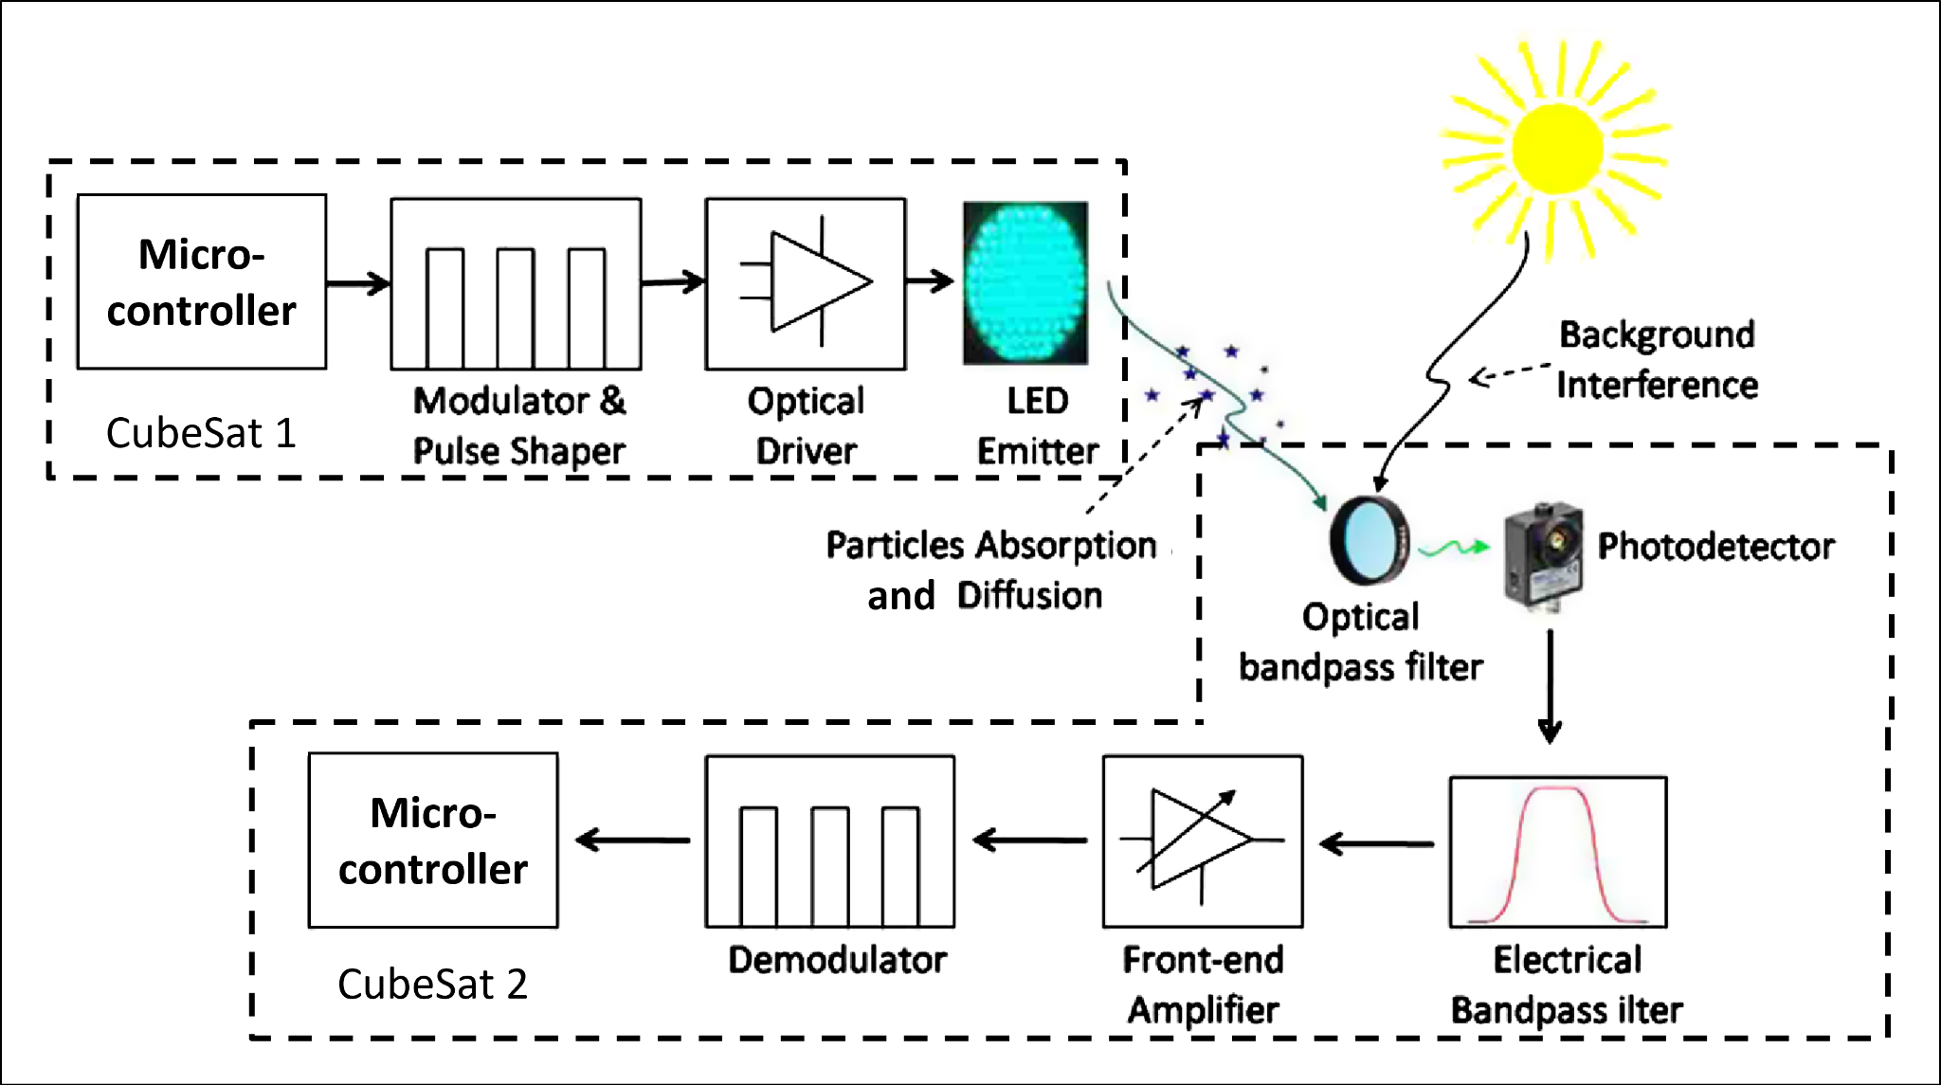
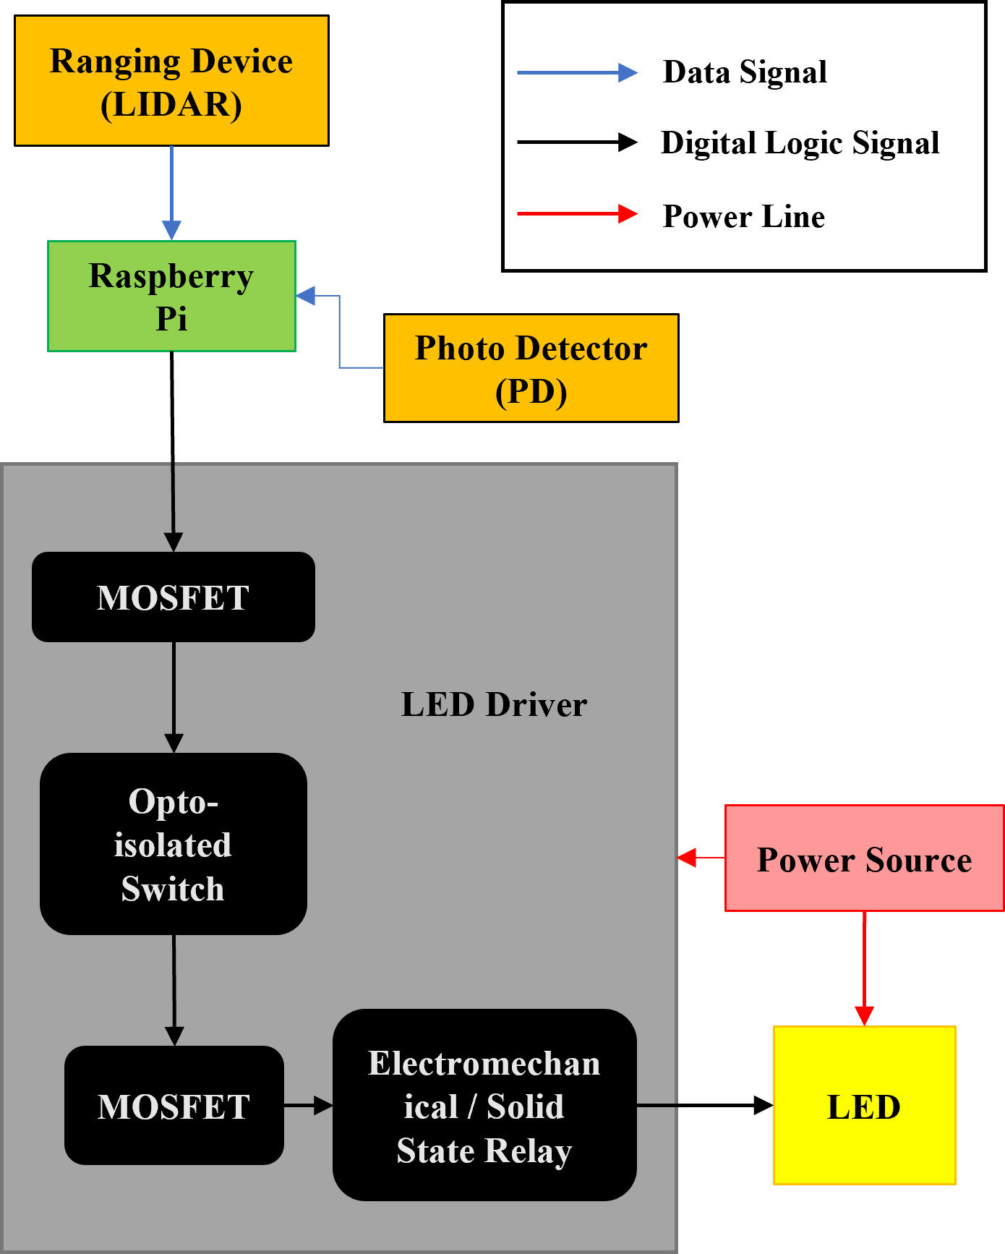
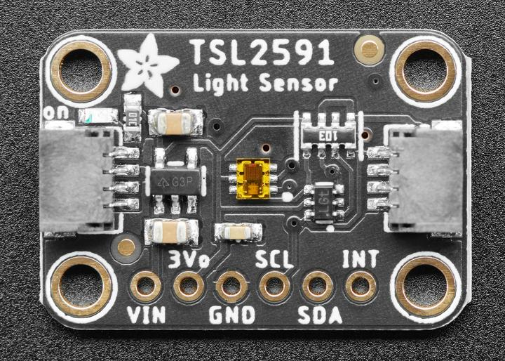
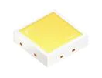
System Design
LED Lighting Cues System Architecture, modified from⁶
Block Diagram of High-Power LED Driver Circuit with Photo Detector and Lidar Input
TSL 2591 Light Detector
amsOSRAM High Power LED used in testing

Slide 12
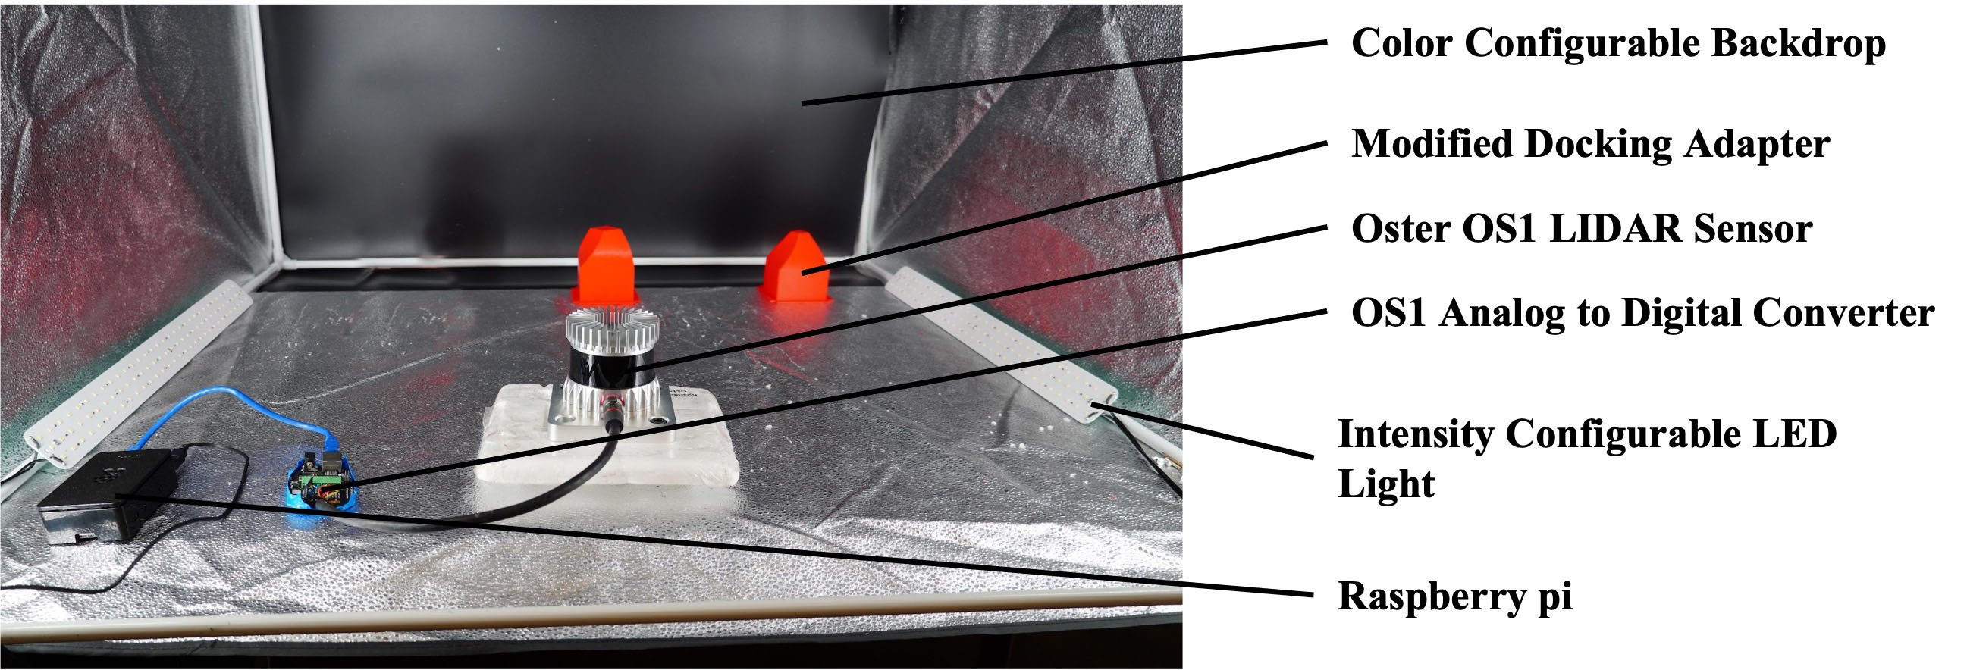
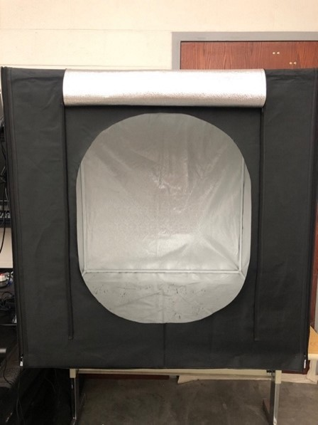
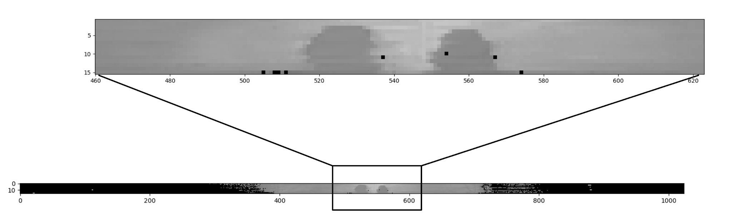
Testing Methodology
Ranging Proof of Concept Example Test Setup
Light Adjustable Lighting Studio
Scan of 1U Docking Adapters by the OS1 Sensor

Slide 13
Conclusions and Future Work
Fabrication of LED-Photo Detector circuit to validate Lighting Cues as a proof of concept complete.
Identification of 1U Docking Adapter using available LIDAR hardware complete.
Experimental verification of design over various distances and lighting conditions underway

Slide 14
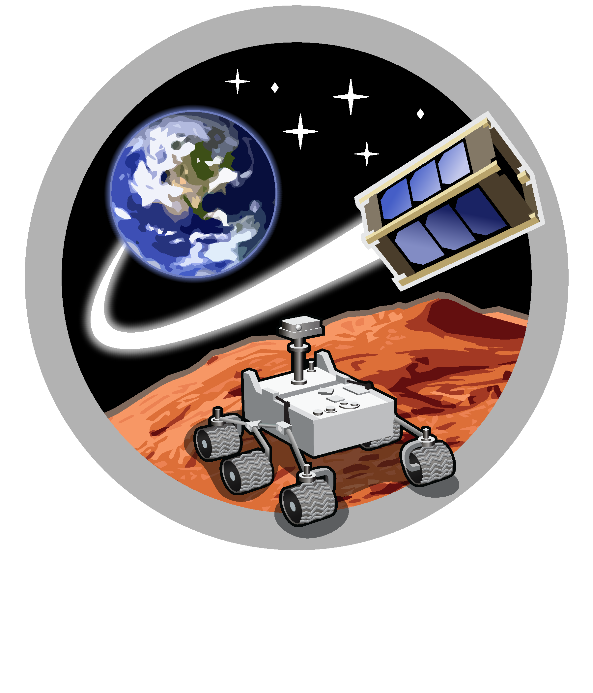
Space and Terrestrial Robotic Exploration (SpaceTREx) Laboratory

Slide 15
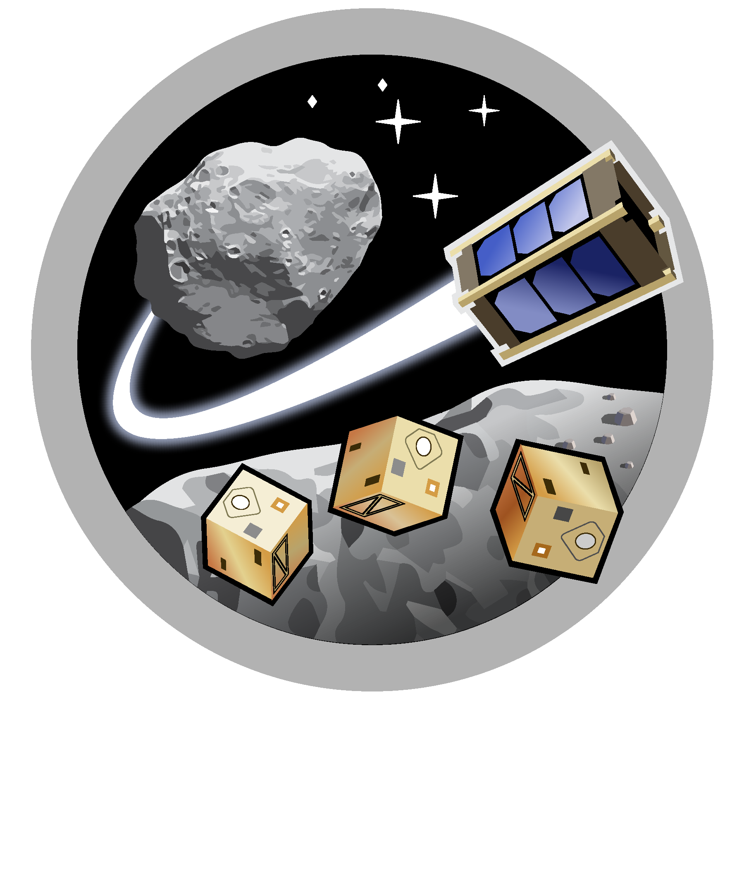
Asteroid Science, Technology and Exploration Research Organized
by Inclusive eDucation (ASTEROID) Center

Slide 16
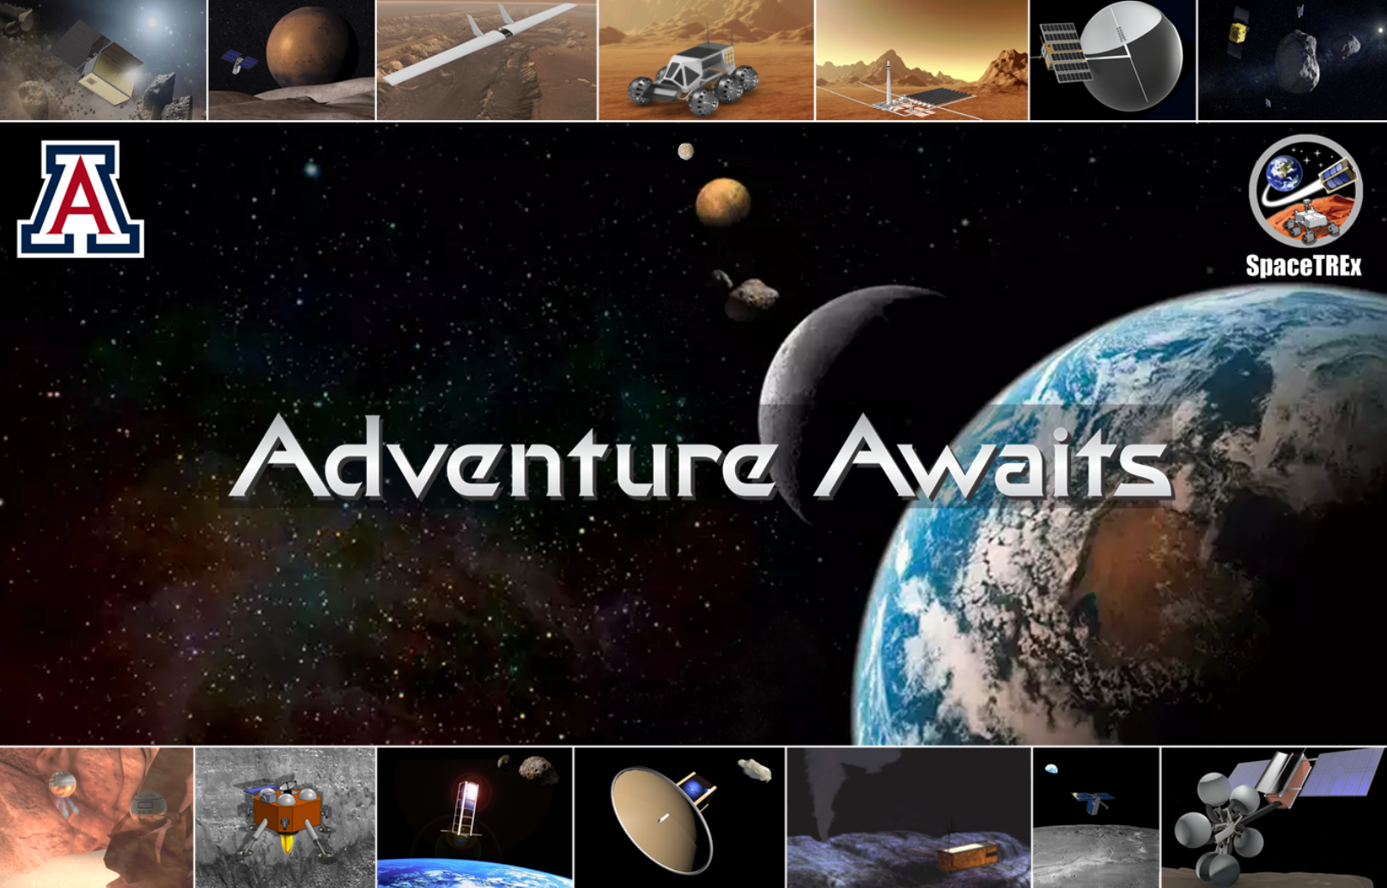

Slide 17
References
¹ Swarm/SODA. (2017, August 6). NASA. Retrieved April 29, 2022, from https://www.nasa.gov/feature/swarmsoda/
² Khan, L. U. (2017). Visible light communication: Applications, architecture, standardization and research challenges. Digital Communications and Networks, 3(2), 78–88. https://doi.org/10.1016/j.dcan.2016.07.004
³ Low, I. (2022, March 30). The lights on modern airliners - Isaac Low. Medium. Retrieved April 29, 2022, from https://isaaclow.medium.com/the-lights-on-modern-airliners-6d2b7ea932e1
⁴ Nikam, A. (2022, February 18). Aircraft Exterior Lighting Market is expected to exhibit a CAGR of 3.8% by the end of 2027. TechBullion. Retrieved April 29, 2022, from https://techbullion.com/aircraft-exterior-lighting-market-is-expected-to-exhibit-a-cagr-of-3-8-by-the-end-of-2027/
⁵ LaMonica, M. (2014, June 2). GE Brings ByteLight-enabled Smart LED Lights to Stores. IEEE Spectrum. Retrieved April 29, 2022, from https://spectrum.ieee.org/ge-brings-bytelightenabled-smart-lighting-to-stores
⁶ Cui, K., Chen, G., Xu, Z., & Roberts, R. D. (2012). Traffic light to vehicle visible light communication channel characterization. Applied Optics, 51(27), 6594. https://doi.org/10.1364/ao.51.006594

