Slide 1


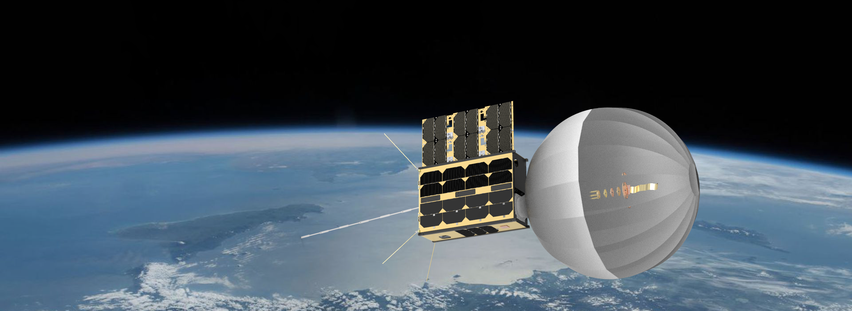
CATSAT: A 6U Inflatable antenna technology demonstrator mission
Aman Chandra¹, Christopher K. Walker^{1,2}, Juan Carlos Lopez Tonazzi² ,Terrance pat²
¹ Aerospace and Mechanical Engineering, The University of Arizona
² FreeFall Aerospace, Inc

Slide 2
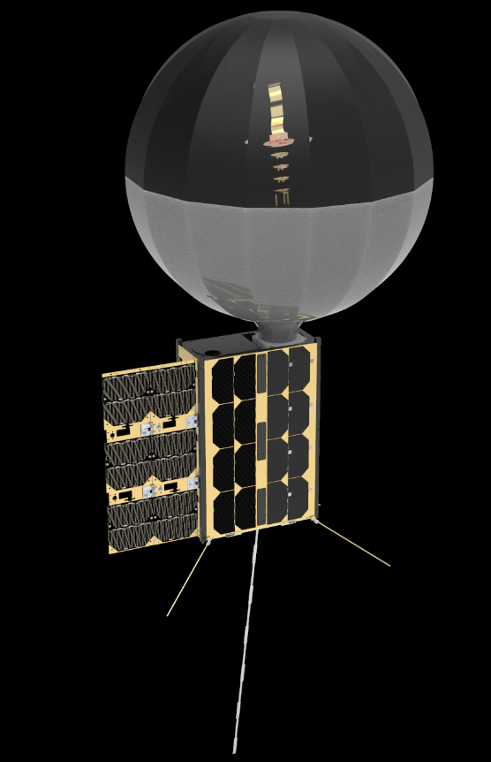
Mission Description
6U CubeSat technology demonstrator mission
  Selected for launch under NASA CSLI program.
  Sun synchronous orbit at 550 km.
  Launch NET August 2022 on board Fire-Fly Black Alpha.
  Nominal mission lifetime: 6 months.
Payload
  Inflatable antenna deployment system.
  Instrument module.
  WSPR antenna deployment system.
  Metrology module.

Slide 3

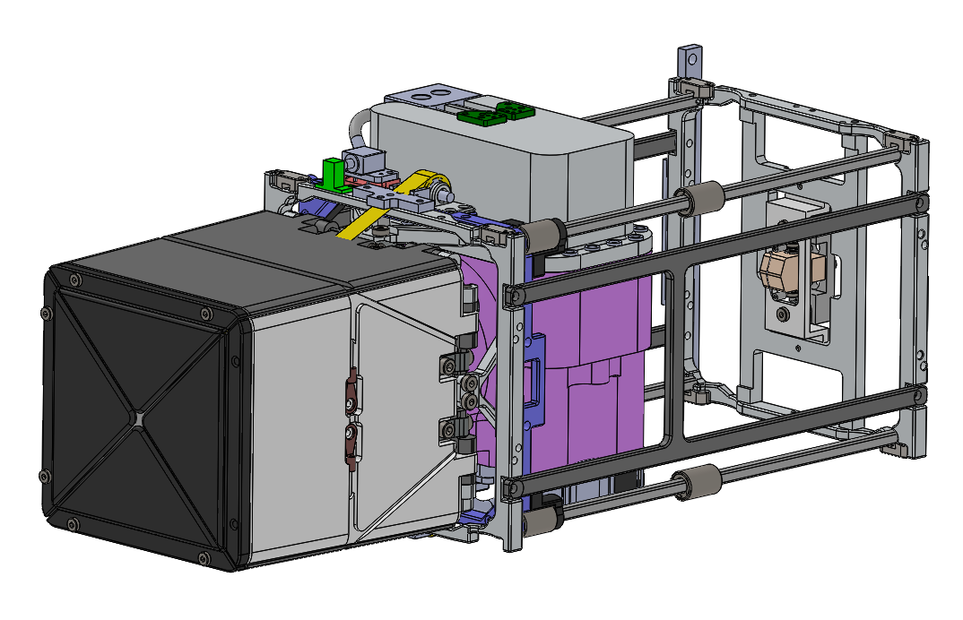
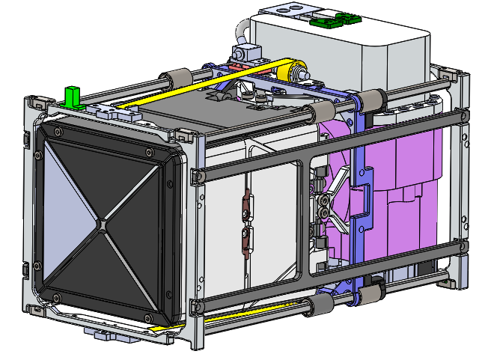
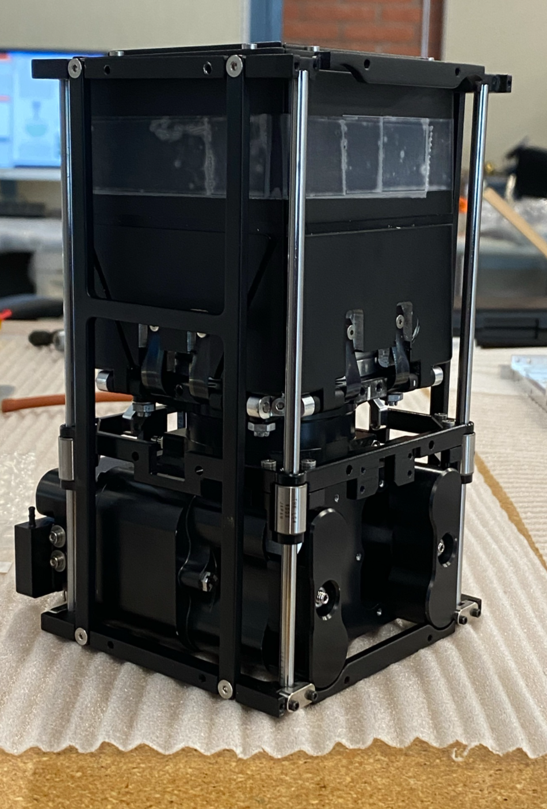
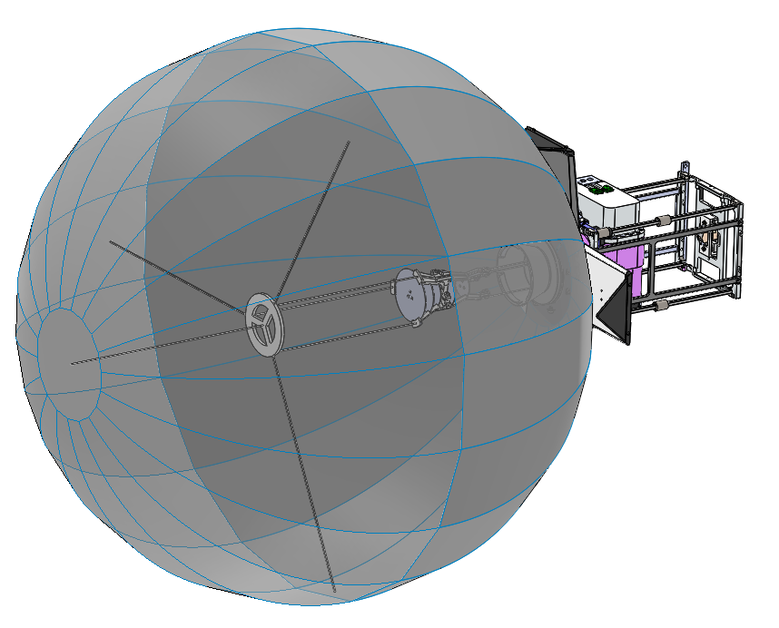
1.5 U Inflatable antenna system
Membrane stowage system
CubeSat interface
150 mm
90 mm
Gas delivery and control system
80 mm
Phased array feed assembly
Phased array feed assembly
Engineering prototype
500 mm

Slide 4
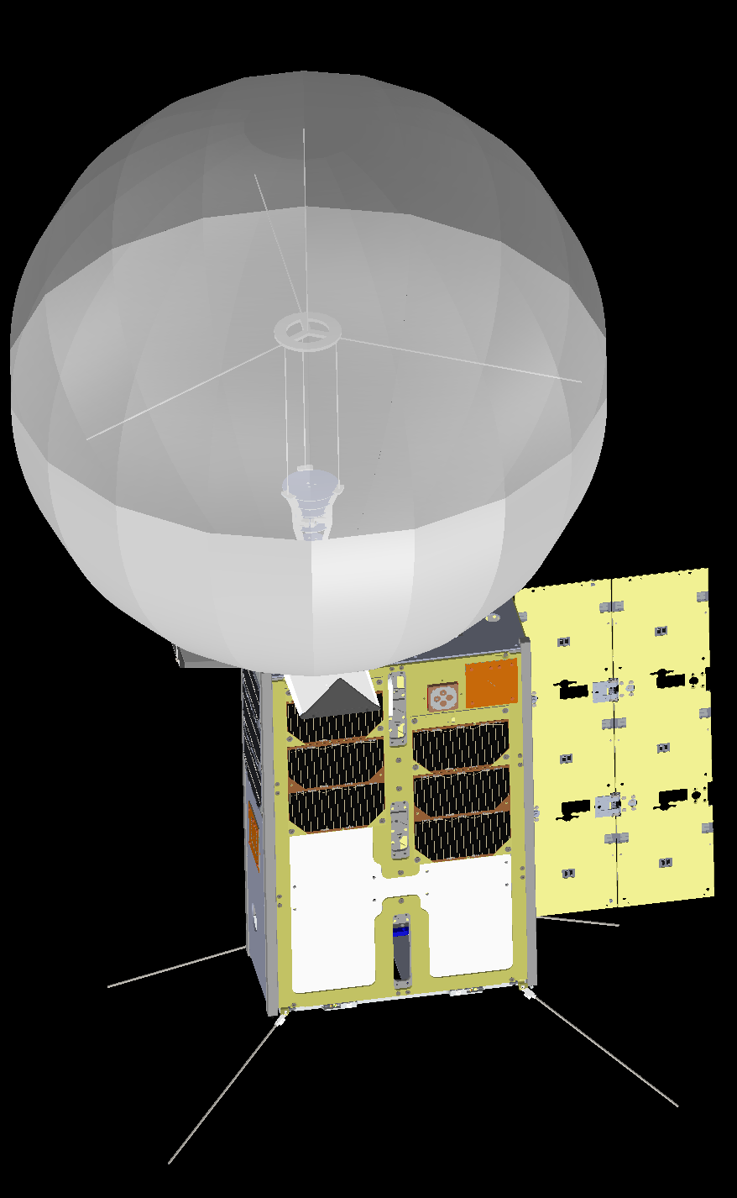
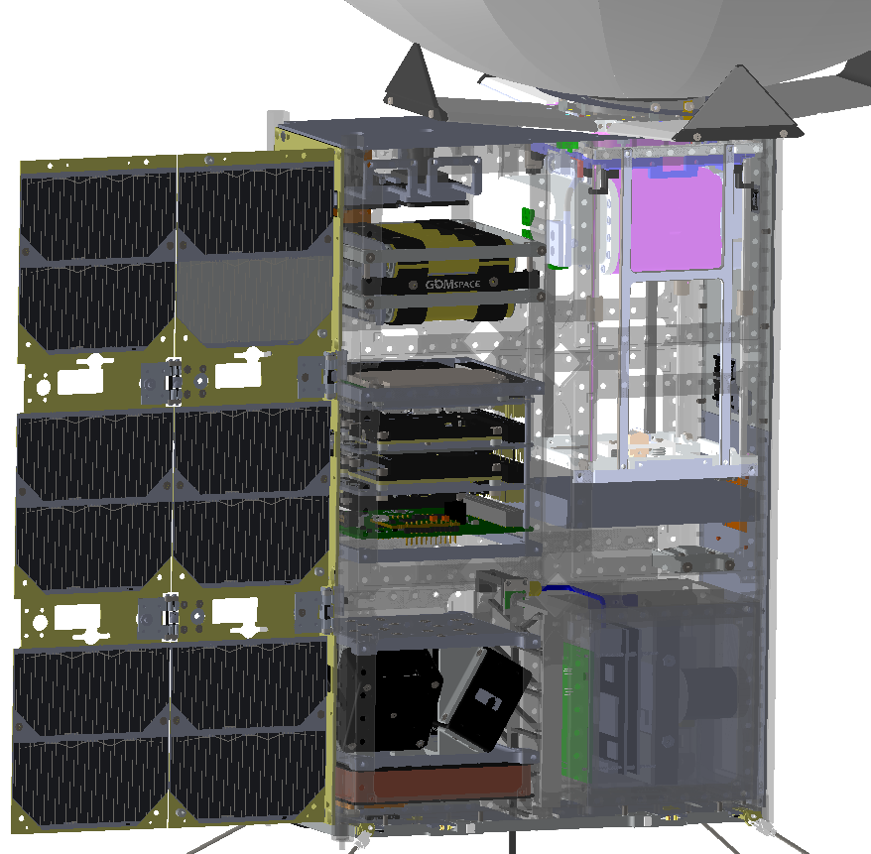
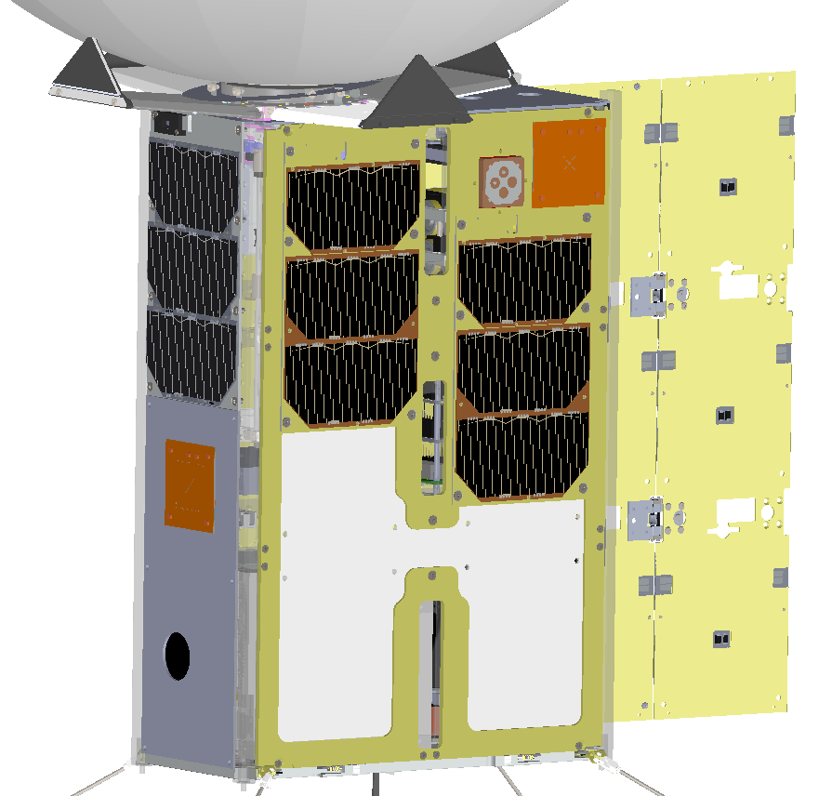
6U CubeSat System Overview
Feed support structure
Vectran ties
Deployable solar panel
Antenna metrology module
Battery pack
X-band patch antenna
GPS antenna
Microwave upconverter
UHF antenna
ASTRO SDR
Avionics stack
Whip antenna deployer
WSPR antenna
Line feed unit
AD&CS
HD camera
Radiator panel

Slide 5
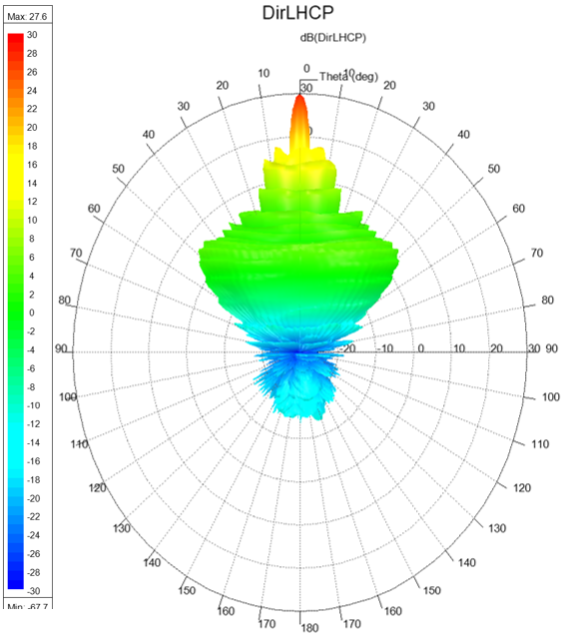
Line feed system
The gain from just the antenna is 26.7 dBi and the first side-lobe level is -18 dB.
A peak directivity of 31 dBi is expected assuming no losses.
Figure shows the LHCP component of the antenna pattern and shows it is primarily left-hand circular polarized.

Slide 6
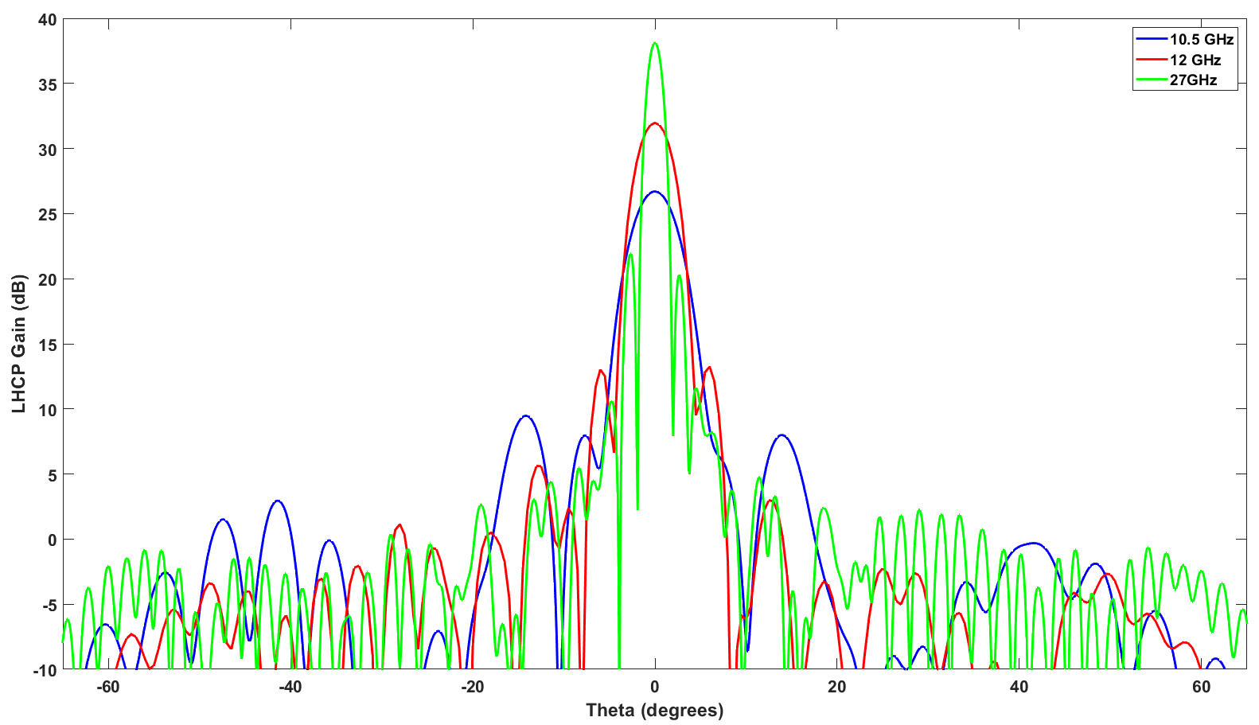
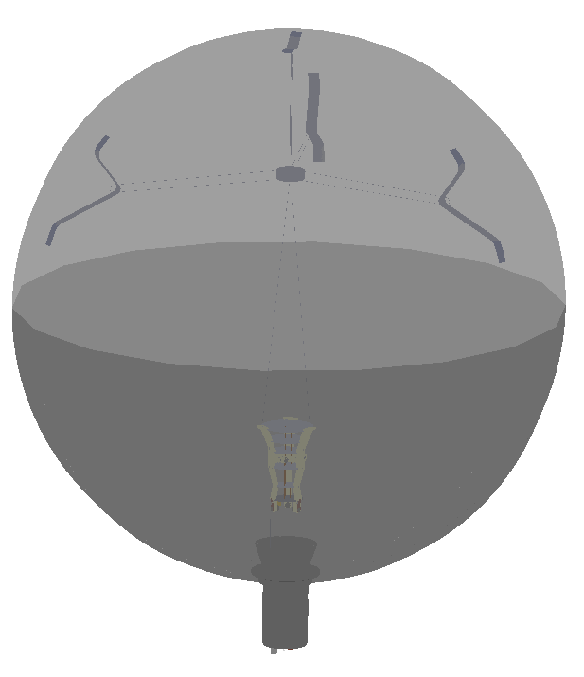
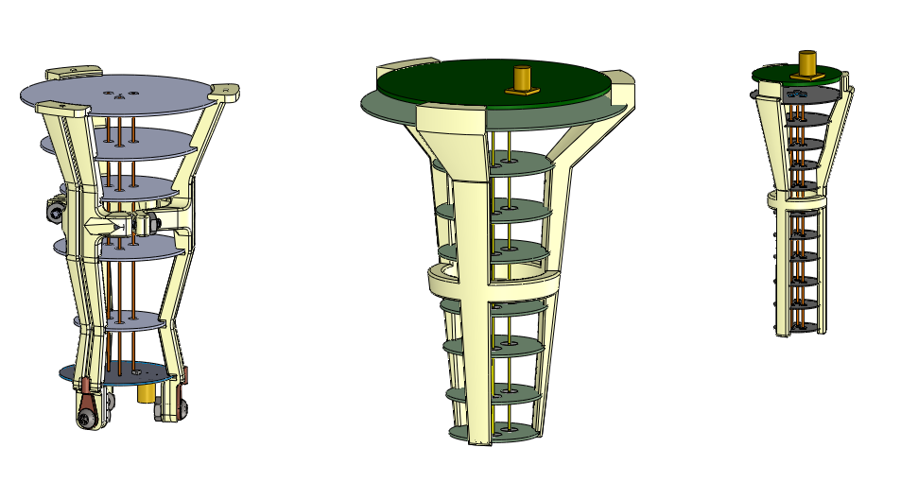
Scalability over X, Ku / K / Ka Bands
L
500 mm reflector
10.5 GHz
12 GHz
27 GHz
Frequency (GHz) | Peak gain (dB) | Beamwidth (degrees) | Sidelobe level (dB)
10.5 | 26.7 | 5 | -17.3
12 | 32.0 | 4 | -18.7
27 | 38.1 | 1.6 | -16.3
L = 67.4 mm
L = 79.6 mm
L = 56.7 mm

Slide 7
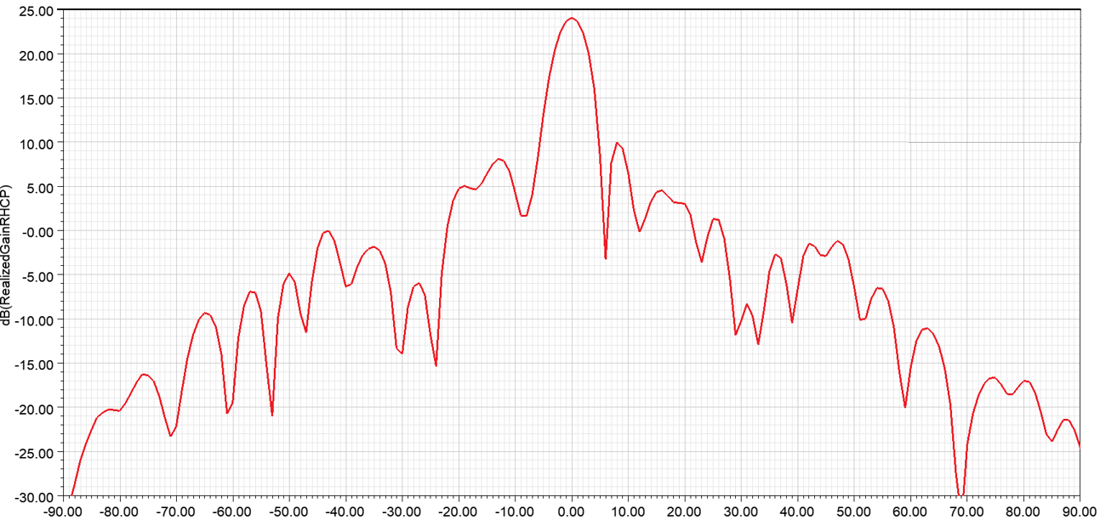
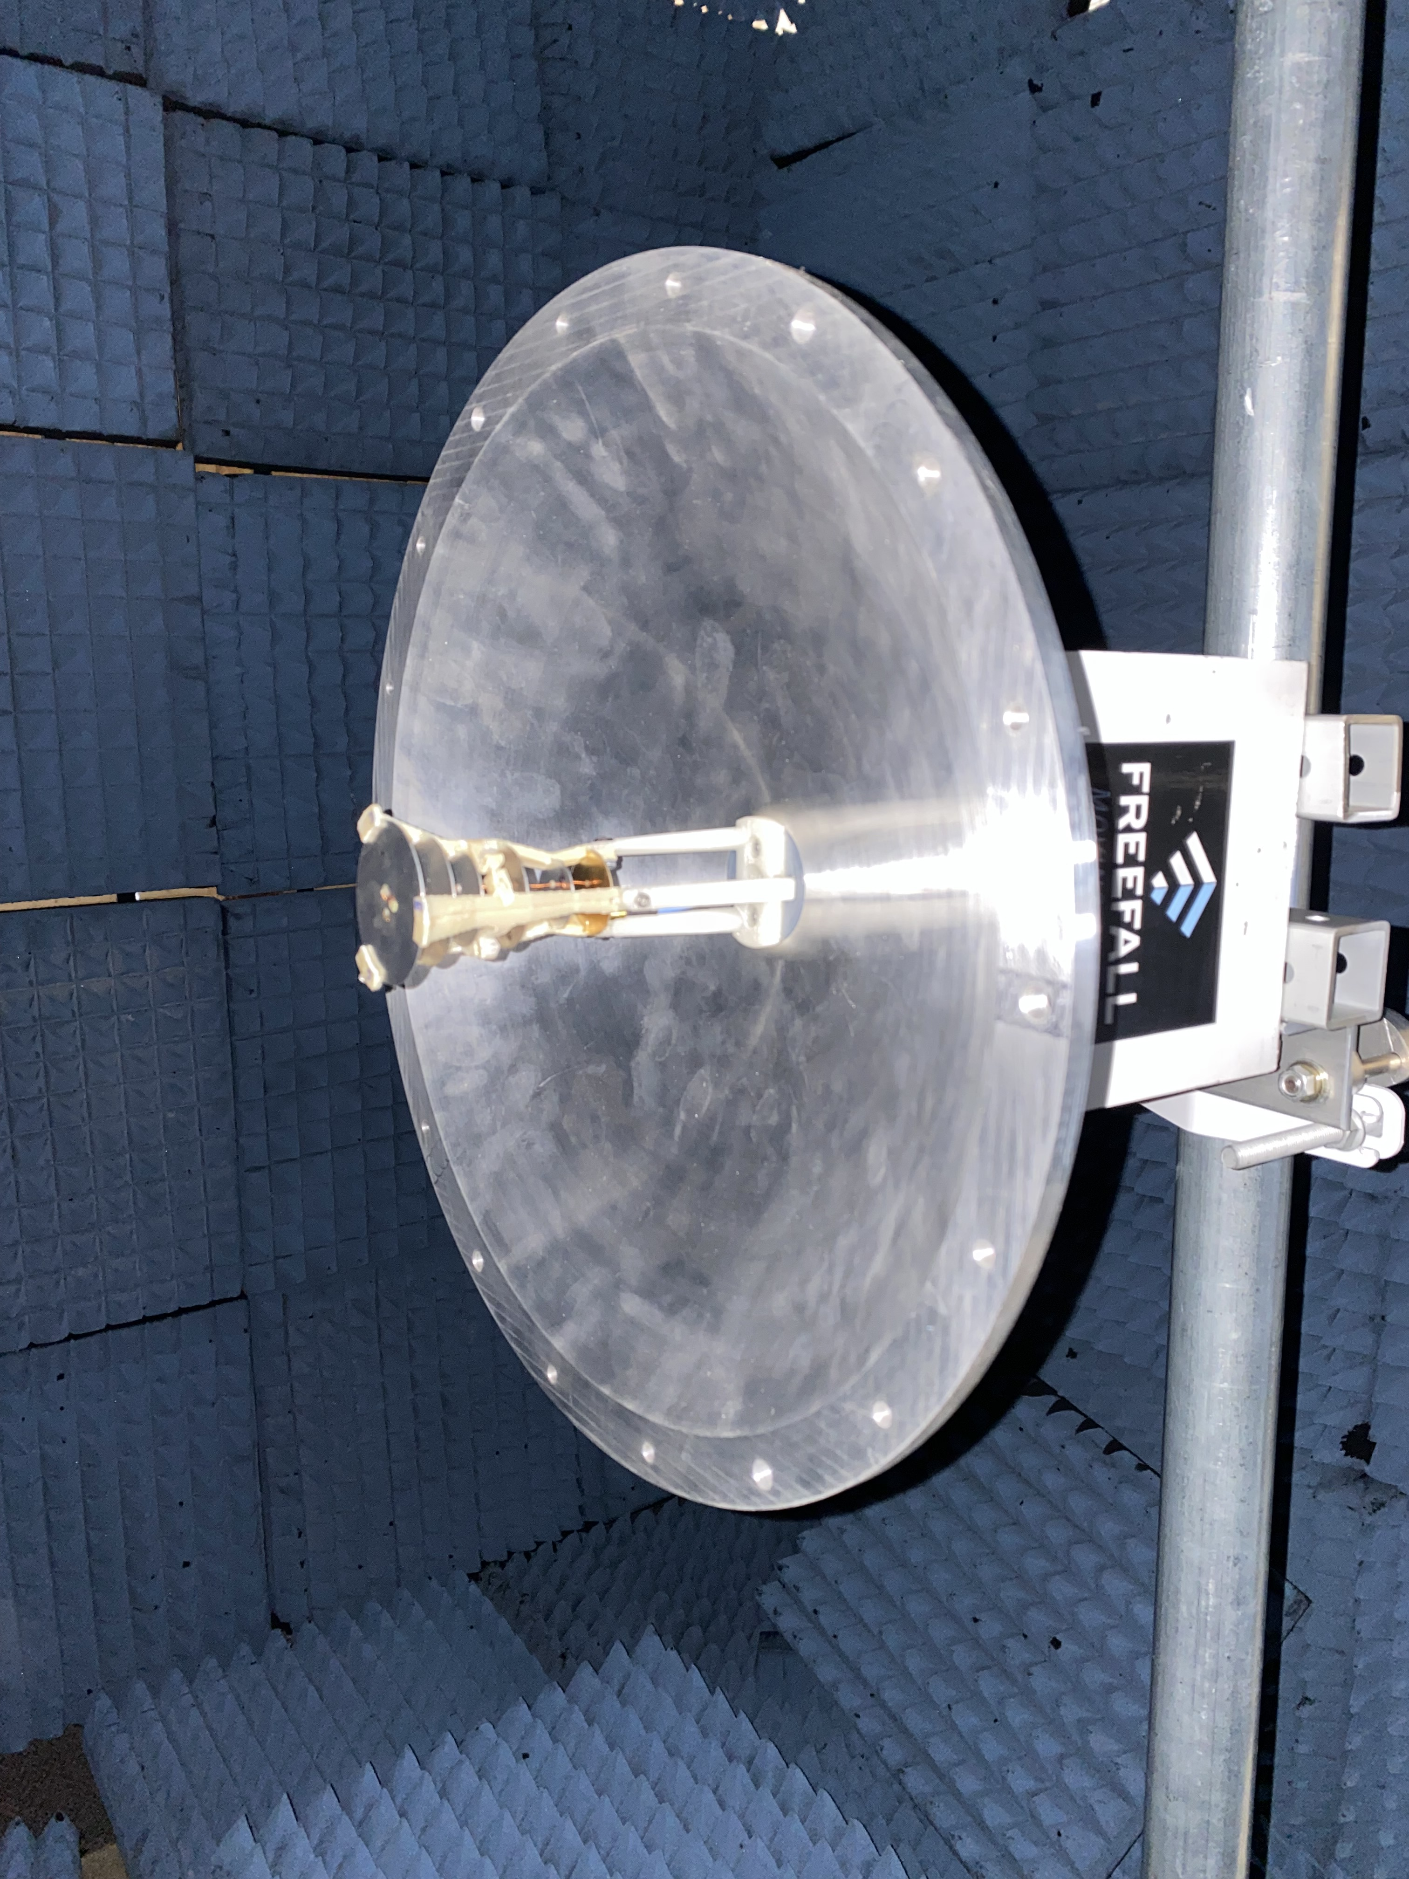
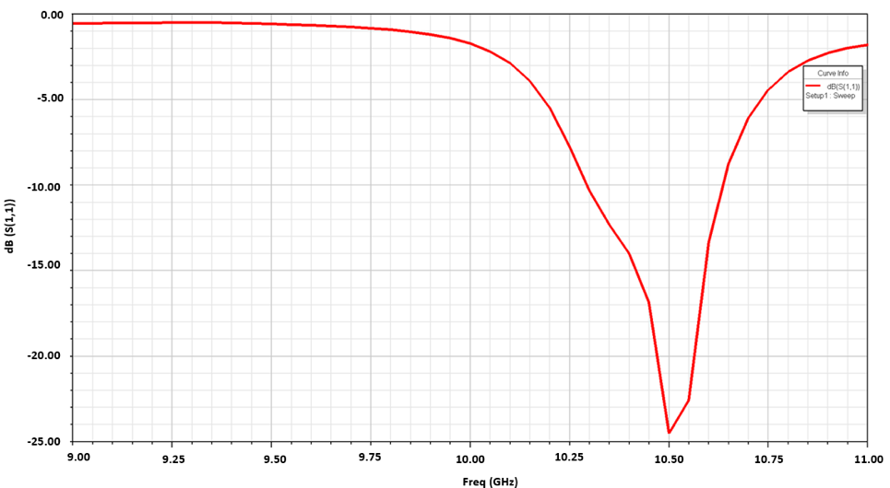
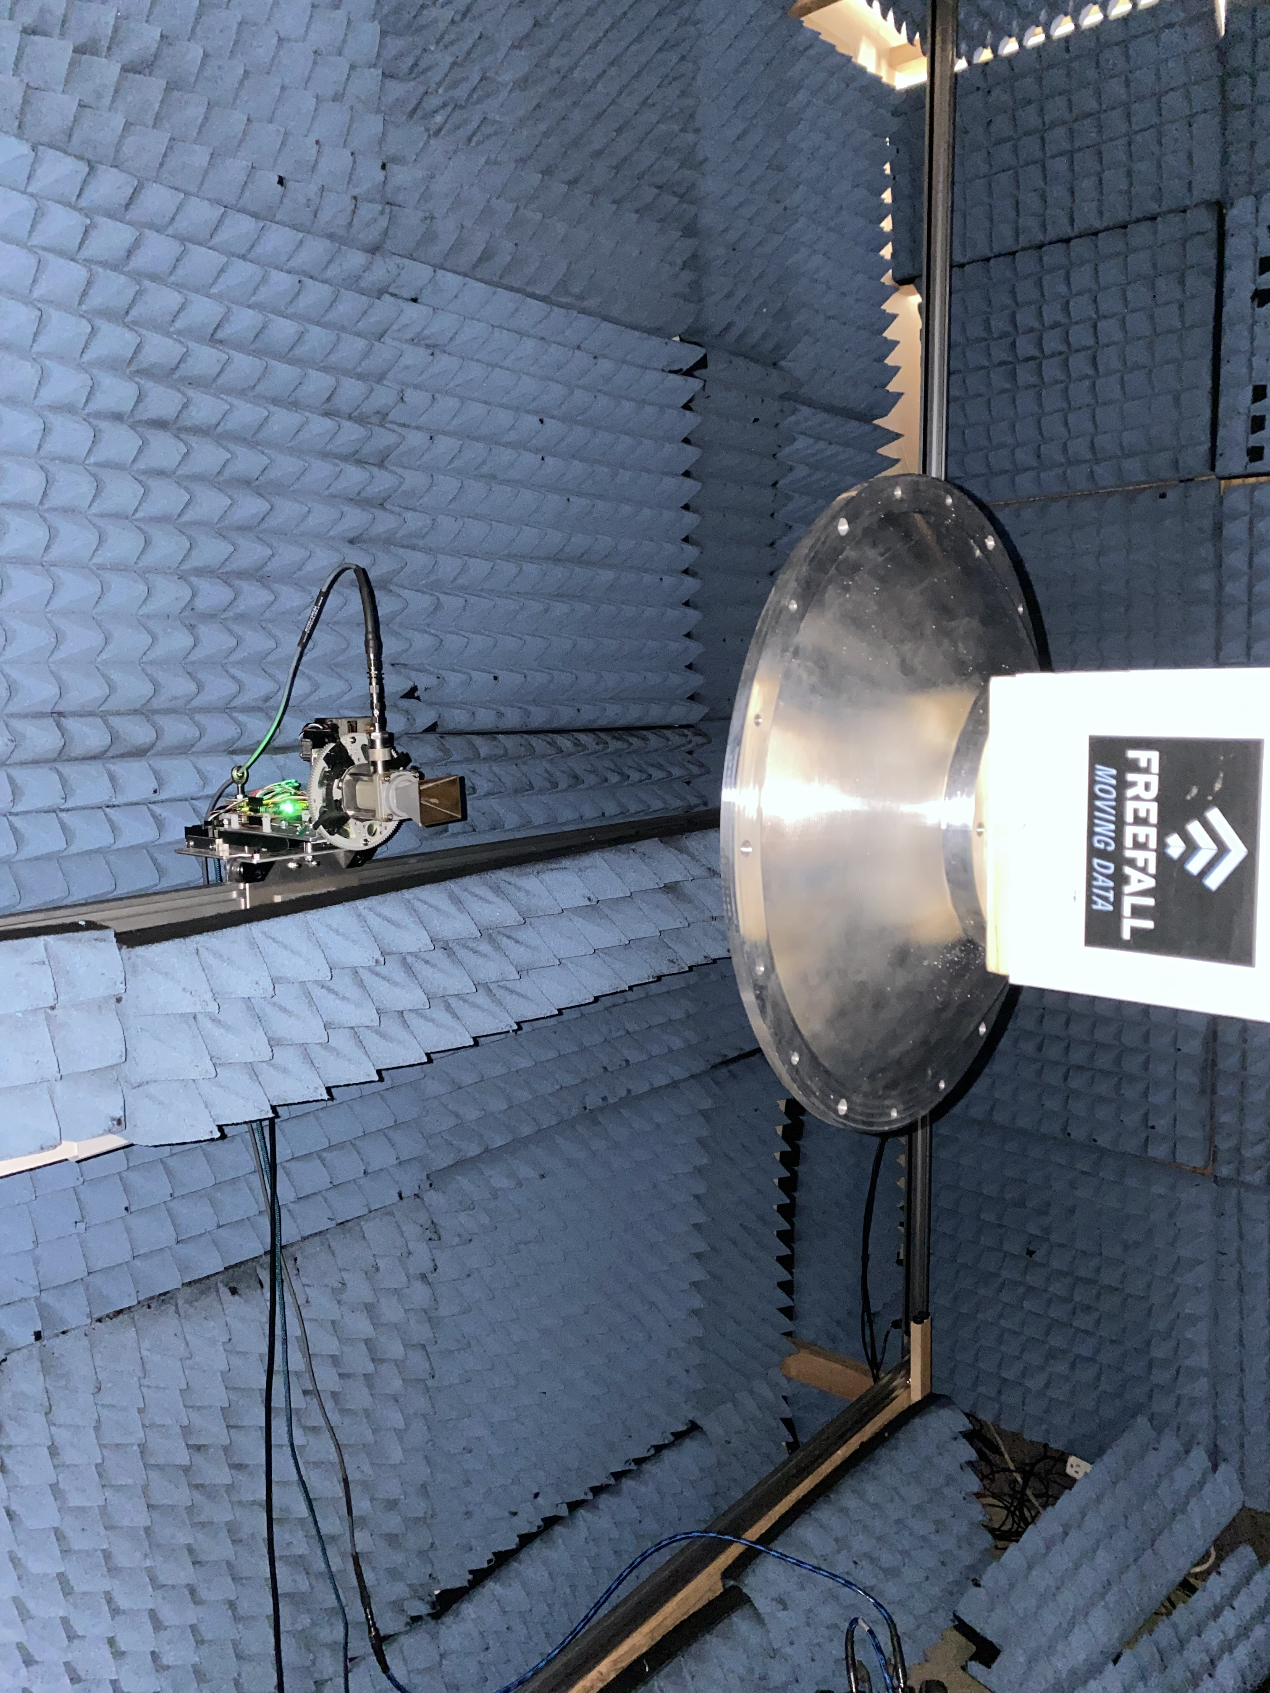
Line feed – field measurments

Slide 8
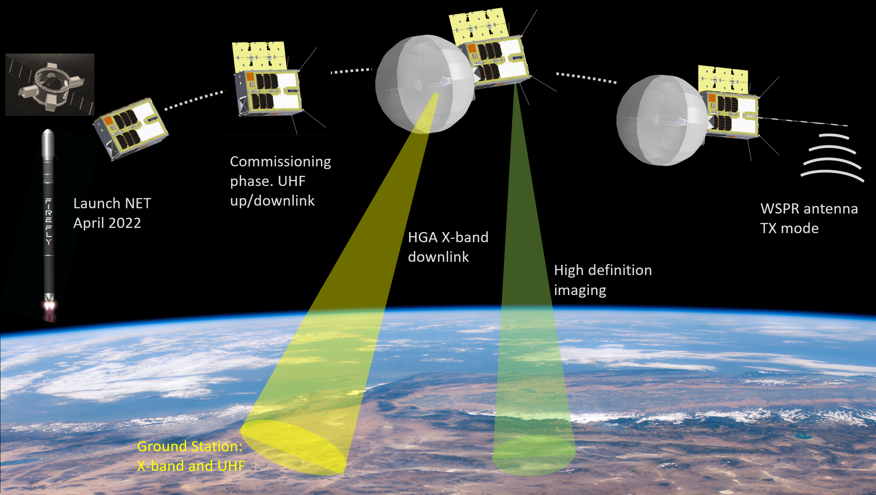
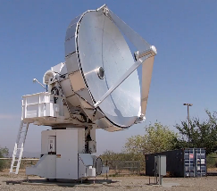
Concept of operation
CatSat X-Band Ground Stations:
Biosphere 2: Tucson AZ
Rincon Research: Centennial CO

Slide 9
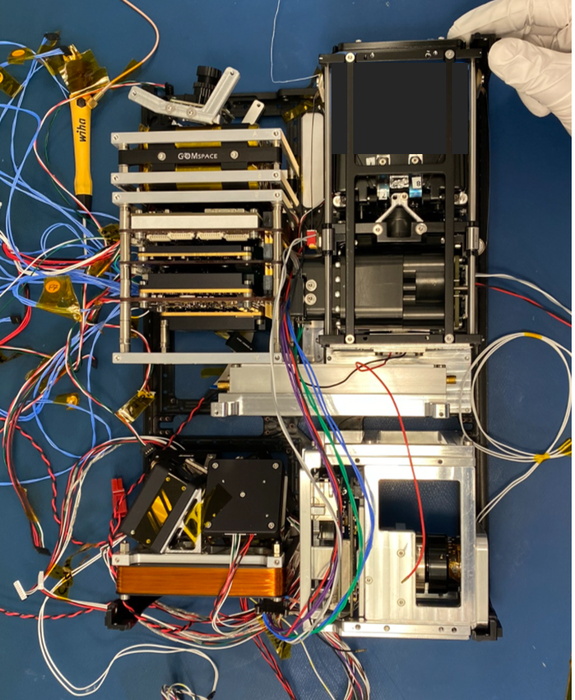
6U CATSAT Flight Hardware Integration
Deployable solar panel
Antenna metrology module
Battery pack
Microwave upconverter
ASTRO SDR
Avionics stack
Whip antenna deployer
AD&CS
HD camera

Slide 10
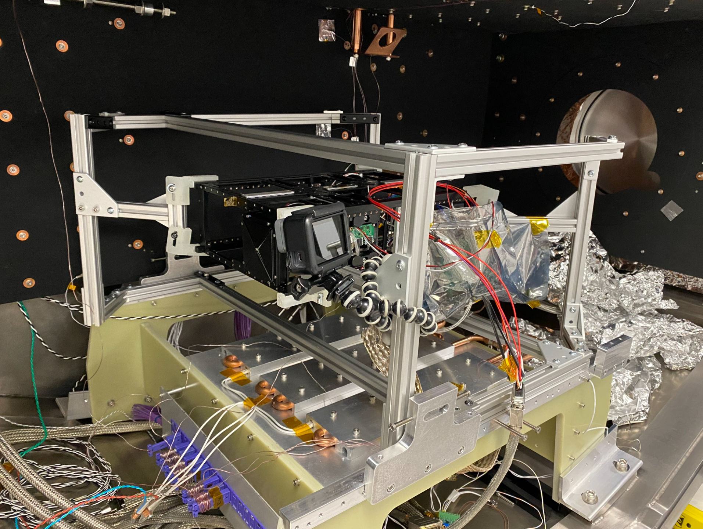
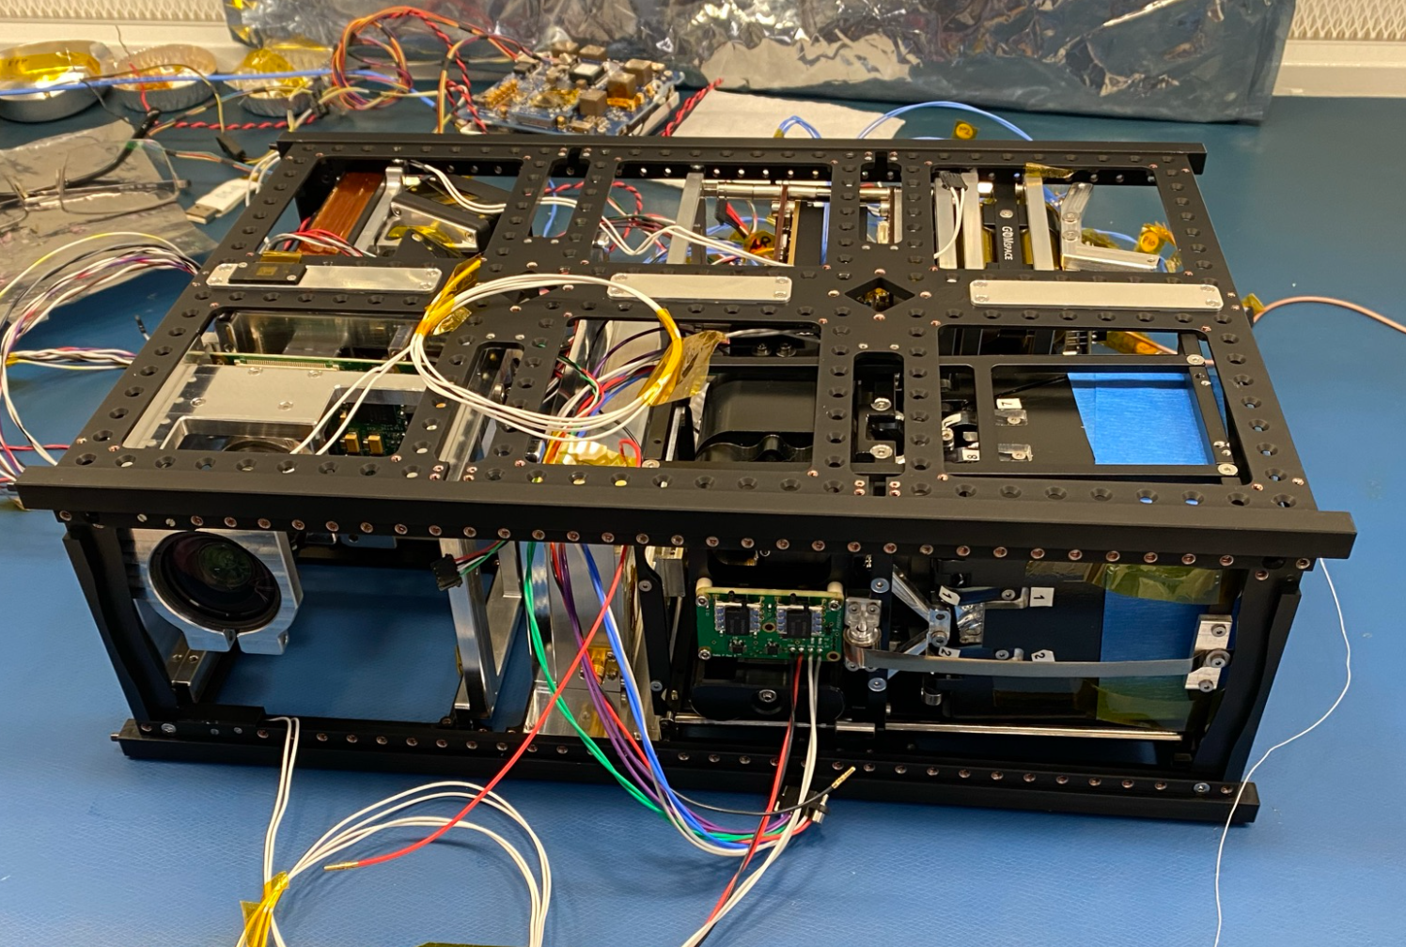
6U CATSAT Flight Hardware TVAC testing
Integrated 6U system
Assembly in TVAC chamber

Slide 11
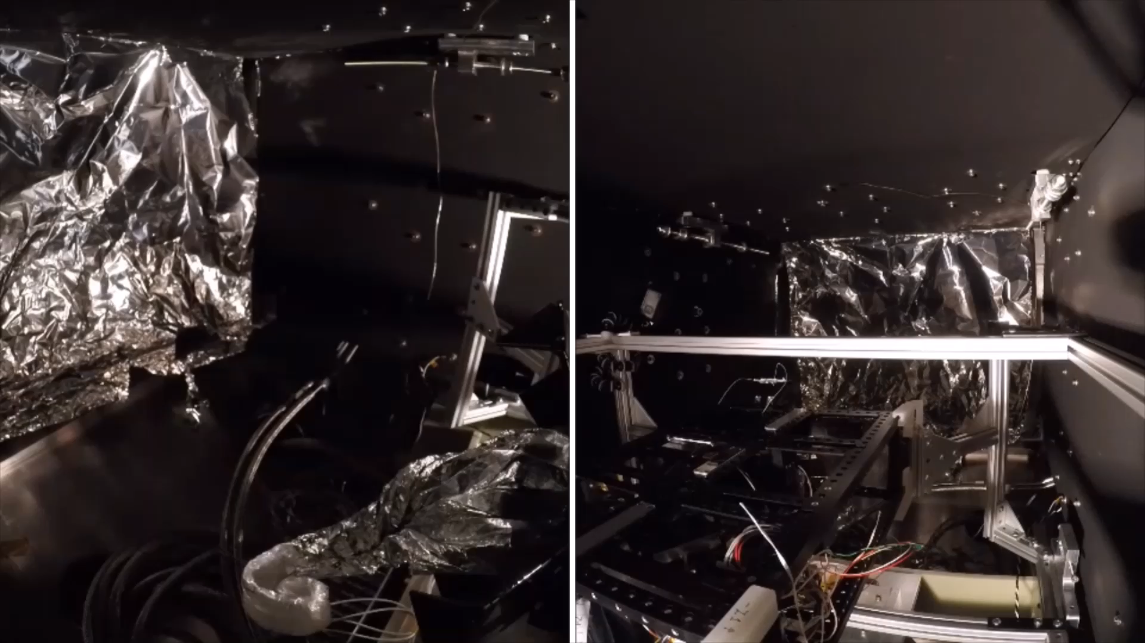
6U CATSAT Flight Hardware TVAC testing

Slide 12
Inflatable lifetime assessment models
Estimated LEO lifetime in years
CubeSat Platform | Mass (kg) | Ballistic Coefficient | Lifetime in years | 550 km | 600 km | 650 km
 |  |  | 500 km | 550 km | 600 km | 650 km
6U | 9 | 20.83 | 2.00 | 3.75 | 11.94 | 24.48
12U | 12 | 27.78 | 2.45 | 4.56 | 14.52 | 28.98
16U | 16 | 37.04 | 3.07 | 6.53 | 17.24
12U | 20 | 46.30 | 3.64 | 11.43 | 25.10
16U | 24 | 55.56 | 4.10 | 13.49 | 27.87
16U | 25.8 | 59.73 | 4.31 | 14.12 | 29.31
Lifetime sensitivity analysis conducted with respect to:
Low Earth Orbit altitude and inclination (circular).
Launch year.
Gas composition (Helium, Nitrogen, Carbon dioxide, Argon studied).
Membrane material.
Membrane thickness.
NASA ORDEM 3.1
Atmospheric Model - NRLMSISE2000
Drag coefficient ~ 2.2
Orbit inclination: 30 degrees

Slide 13
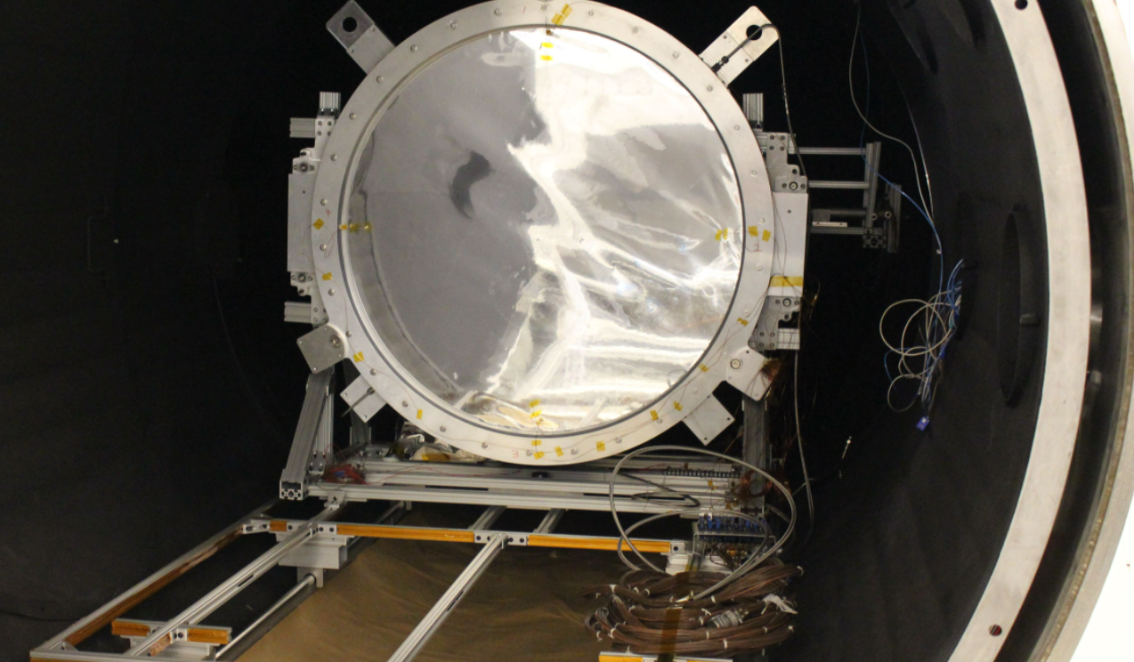
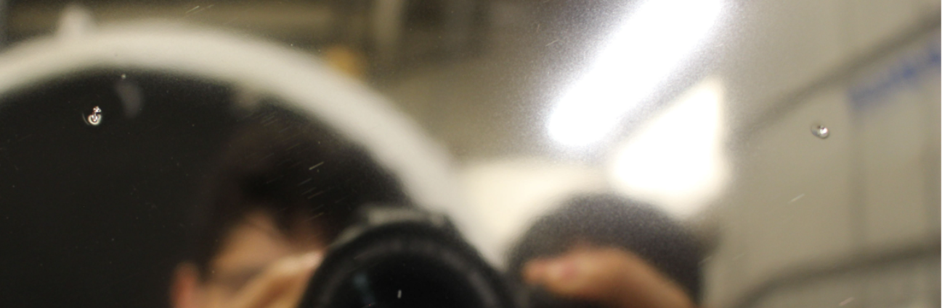
TVAC – Shape measurement and leak-rate analysis
The inflation control system was able to maintain required ΔP in response to controlled punctures on the membrane surface.
Measured leak rate of the inflatable under nominal TVAC conditions: 12 Pa/hr (0.0017 PSI/hr)
Estimate lifetime based on leak rate: ~ 5 months (over pressure state), ~8 months (nominal pressure state). True lifetime between 5-8 months as we switch between these states.
Inflated shapes repeatable with a 10 μm precision
Test setup – Northrop Grumman
Simulated punctures

Slide 14
Current status and future work
An integrated 6U System currently undergoing final test phase.
Ground communication tests completed.
Spaceflight acceptance vibration tests to be conducted next.
Data from CATSAT mission to be used to validate lifetime assessment models.

