Slide 1


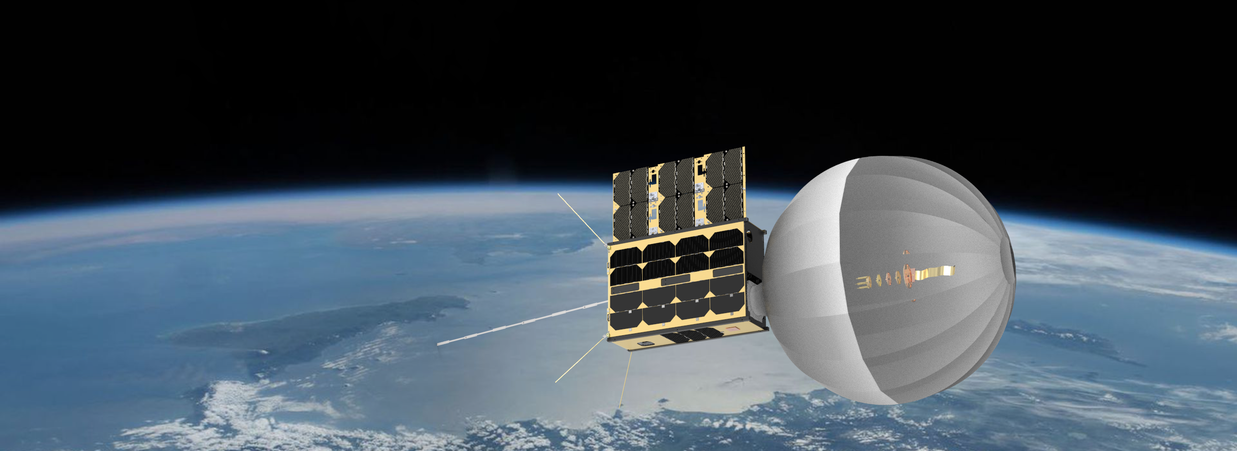

CATSAT: A 6U Inflatable antenna technology demonstrator mission

Slide 2
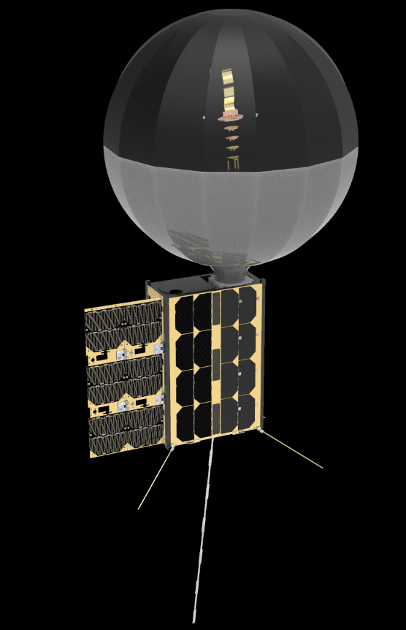
Mission Description
6U CubeSat technology demonstrator mission
  To be launched on NASA’s ElaNa 43 mission.
  Launch NET August 2022 on board Fire-Fly Black Alpha.
  Sun synchronous orbit at 550 km.
  Nominal mission lifetime: 6 months.
Payload
  X-band inflatable antenna system - 1.5U
  HF whip antenna deployment system - 0.1U
  Instrumentation module - 1U
    HD Cameras, FPGA processor, SDR
  Metrology camera system – 0.5 U

Slide 3
Science/Technology Traceability Matrix
Science/Technology Questions | Objective | Measurement Requirement | Mission Requirement
How can low power, high data rate communications be achieved with a Small Satellite? | Demonstrate a deployable, high gain antenna | Relay high definition images from orbit in near real time | Orbital platform High Def Camera imaging system Inflatable, 0.5m reflector X band data link ~550 km, sun synchronous orbit >1 month
How does the structure of the ionosphere vary from day to night? | Measure ionospheric structure along the terminator | Monitor multiple HF WSPR beacons above the ionosphere | Orbit along terminator >550 km altitude >1 month

Slide 4
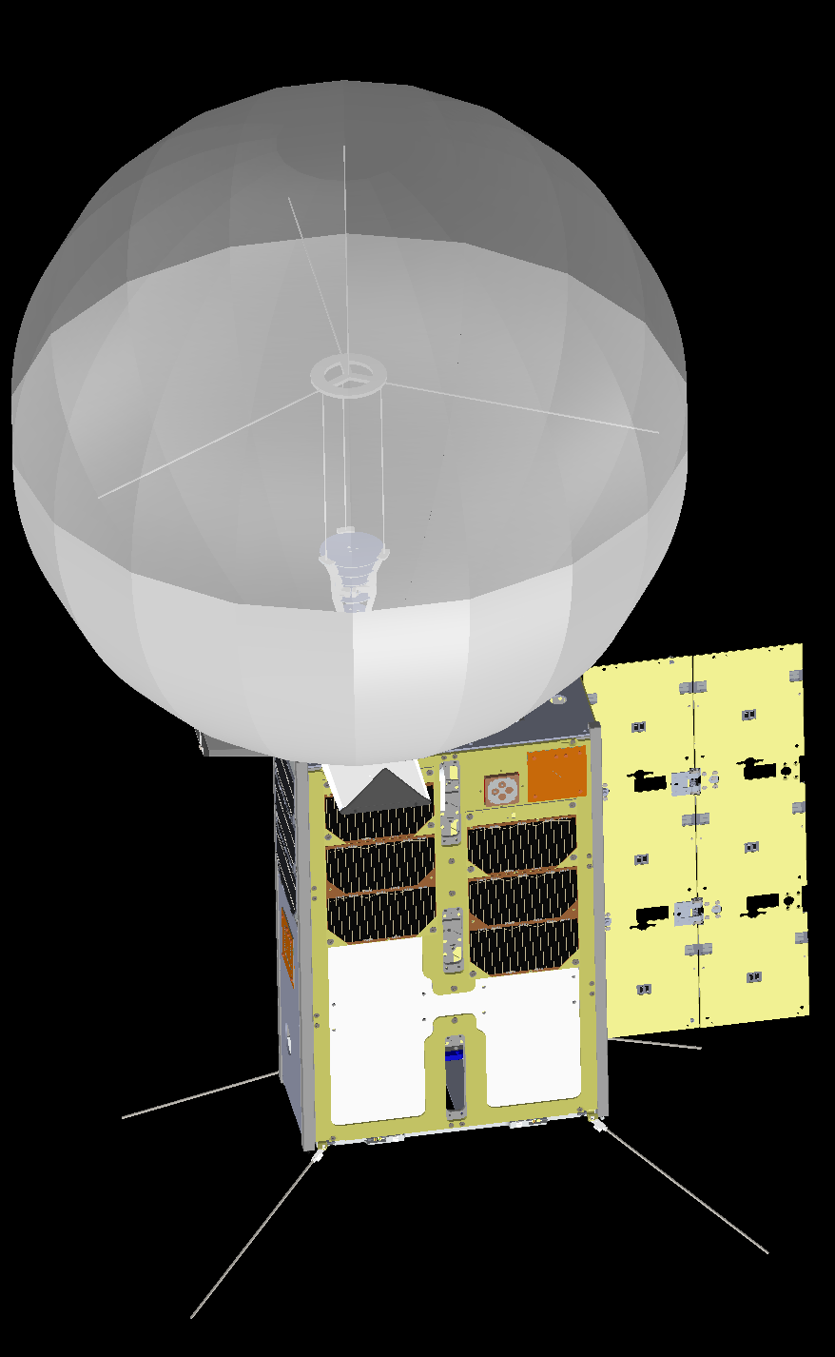
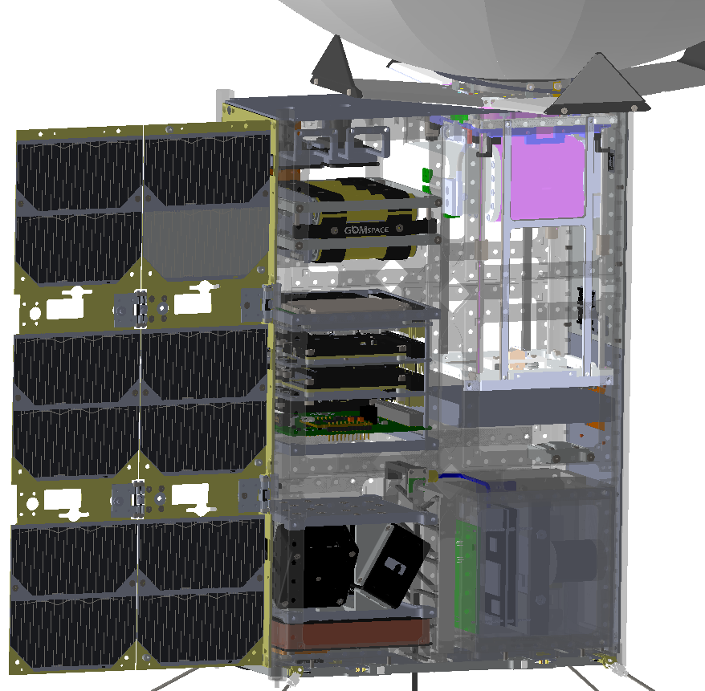
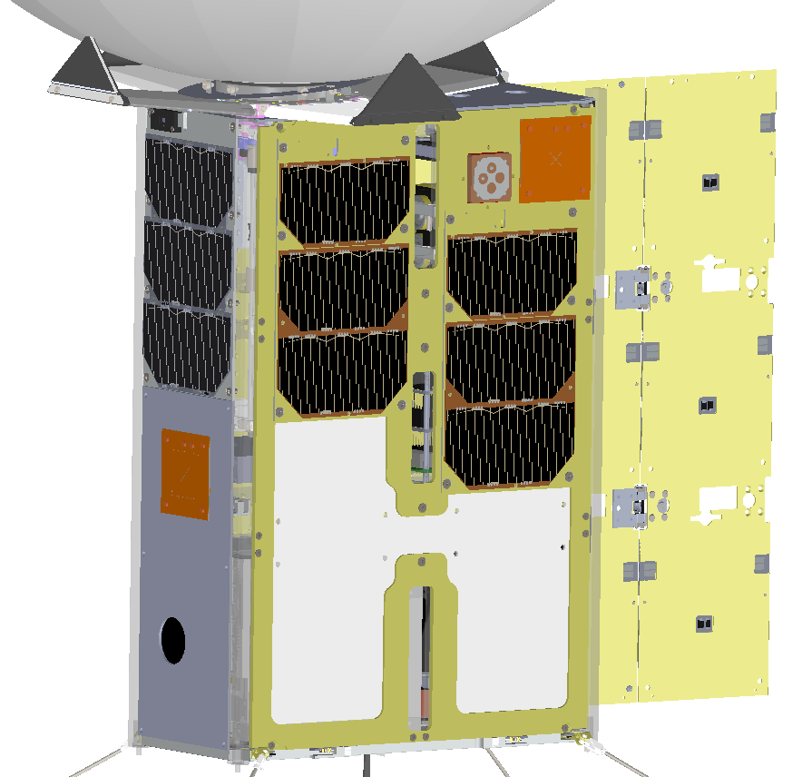
6U CubeSat System Overview
Feed support structure
Vectran ties
Antenna metrology module
X-band patch antenna
Microwave upconverter
UHF antenna
ASTRO SDR
Whip antenna deployer
Whip antenna
Line feed unit
AD&CS
HD camera

Slide 5
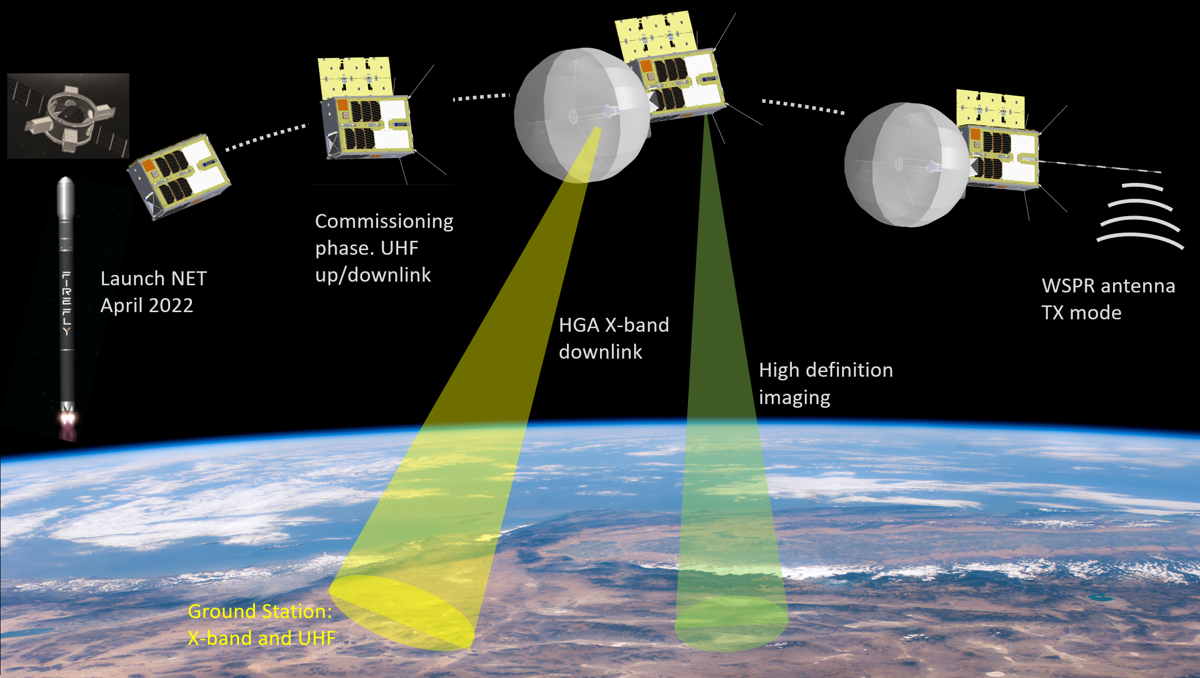
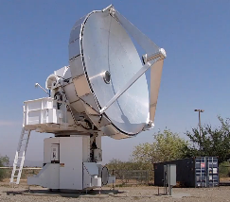
Concept of operation
Whip Antenna Rx mode
CatSat X-Band Ground Stations:
Biosphere 2: Tucson AZ
Rincon Research: Centennial CO

Slide 6
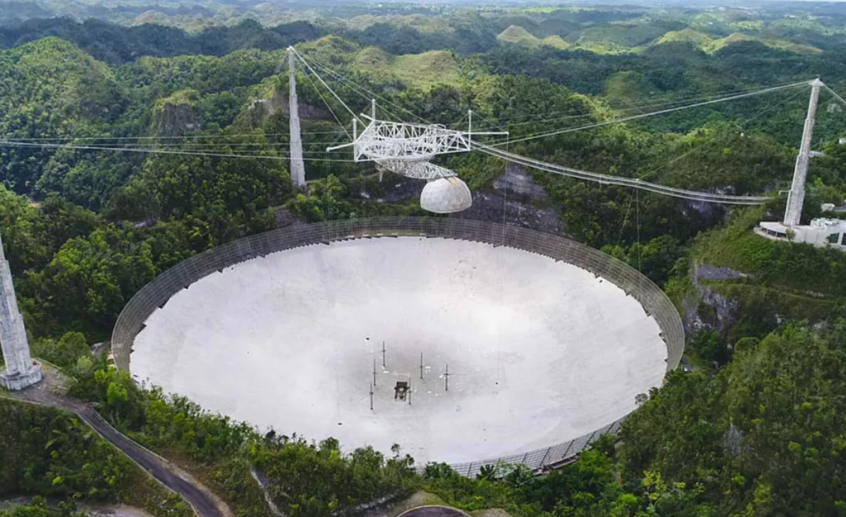
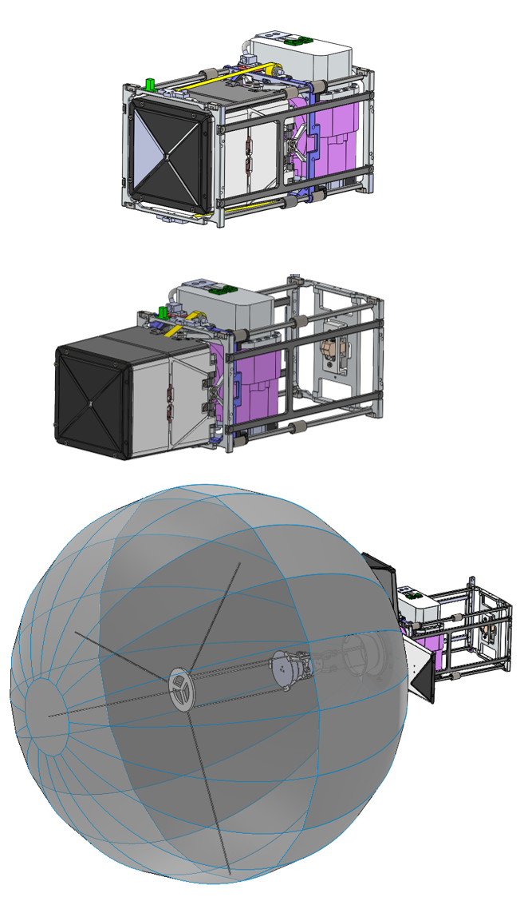
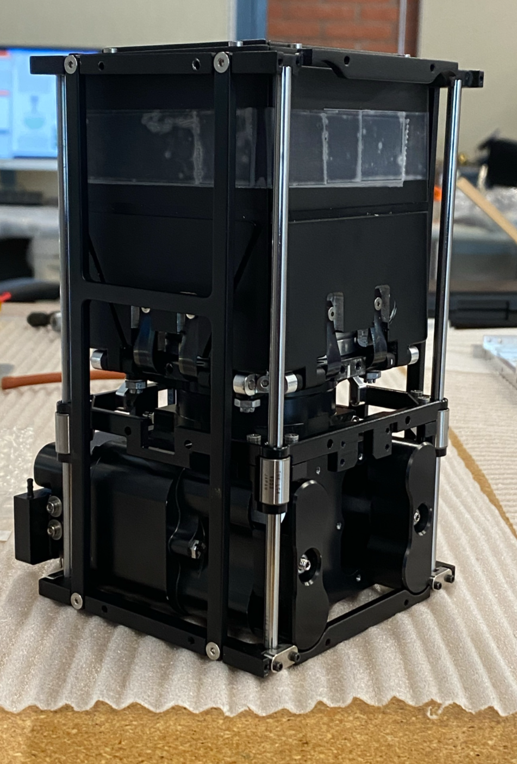
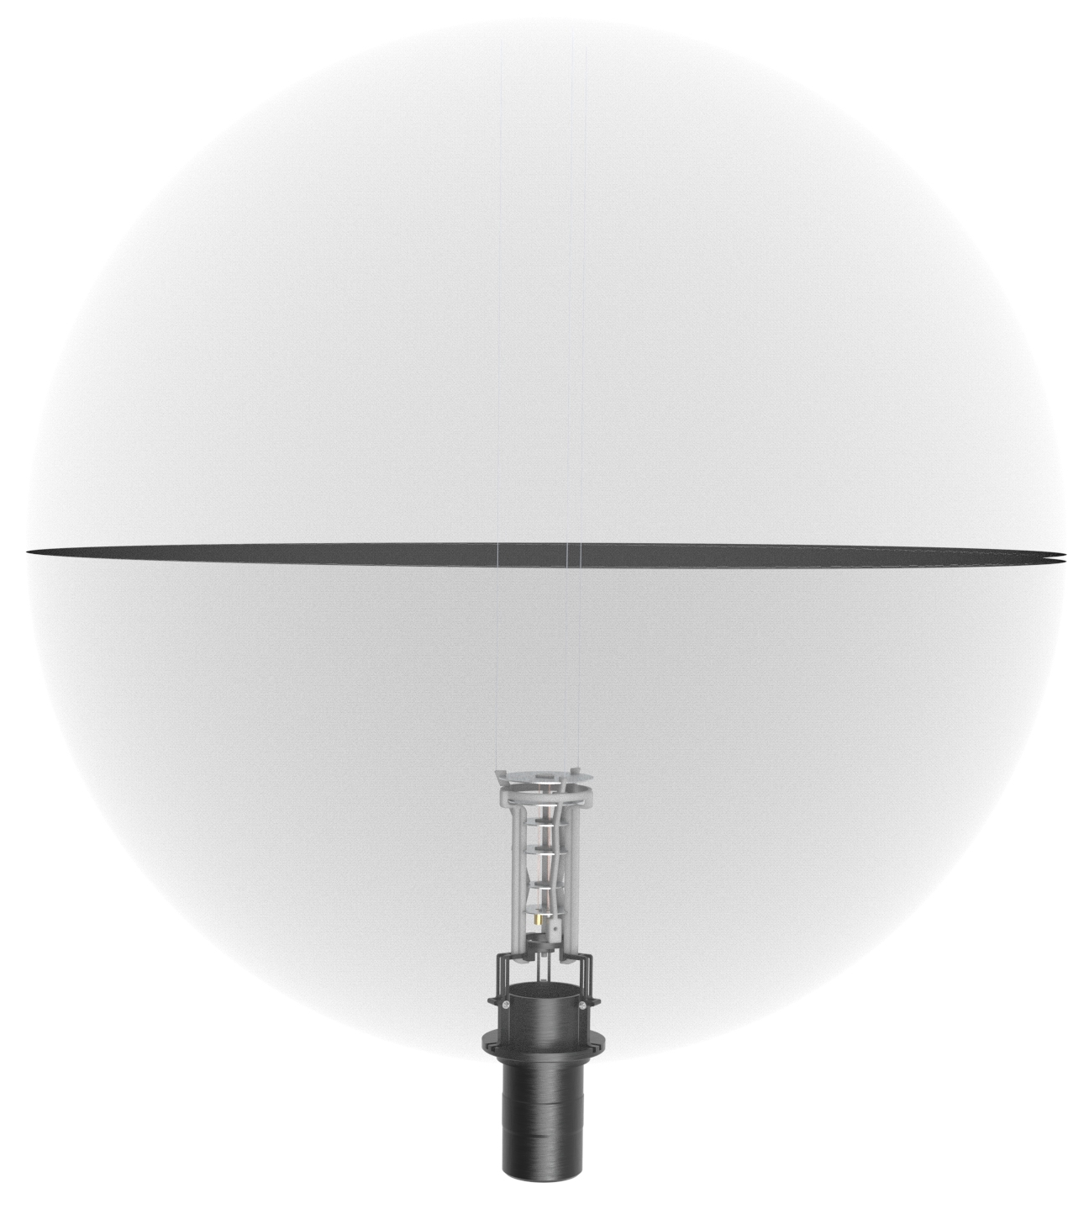
Spherical Inflatable Antenna
Arecibo observatory
0.5 m spherical reflector
Engineering prototype
Line feed
1.5 U System

Slide 7
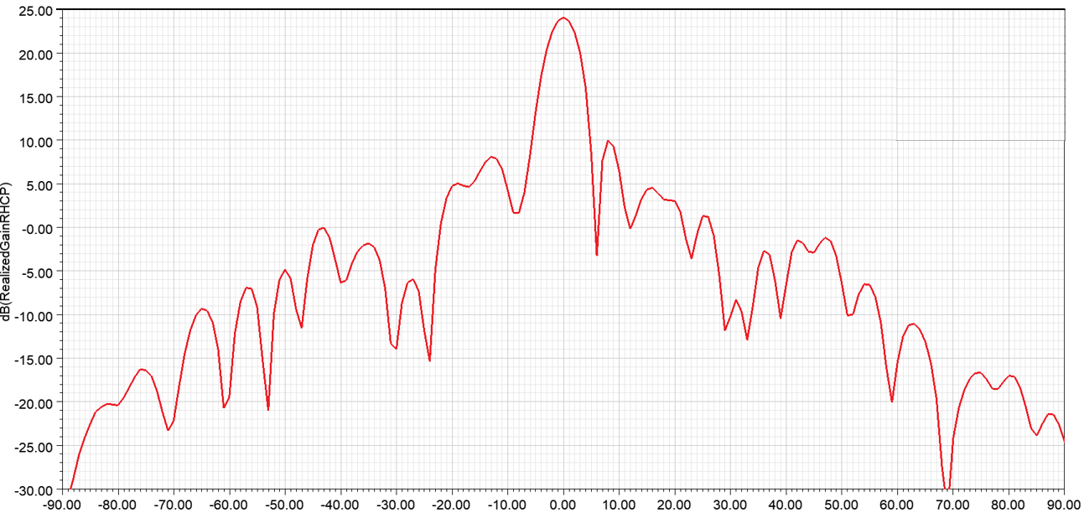
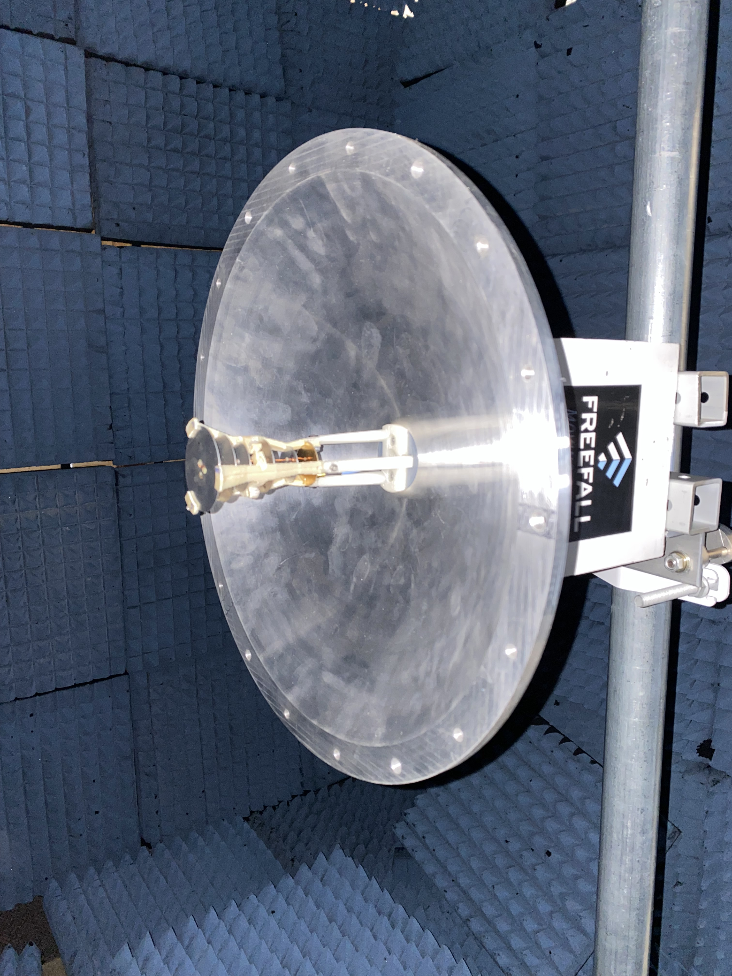
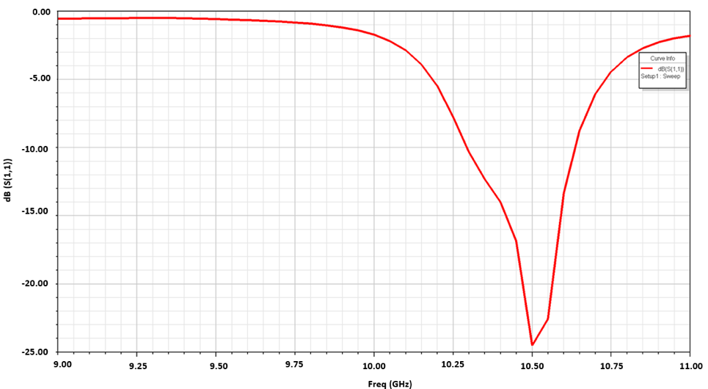
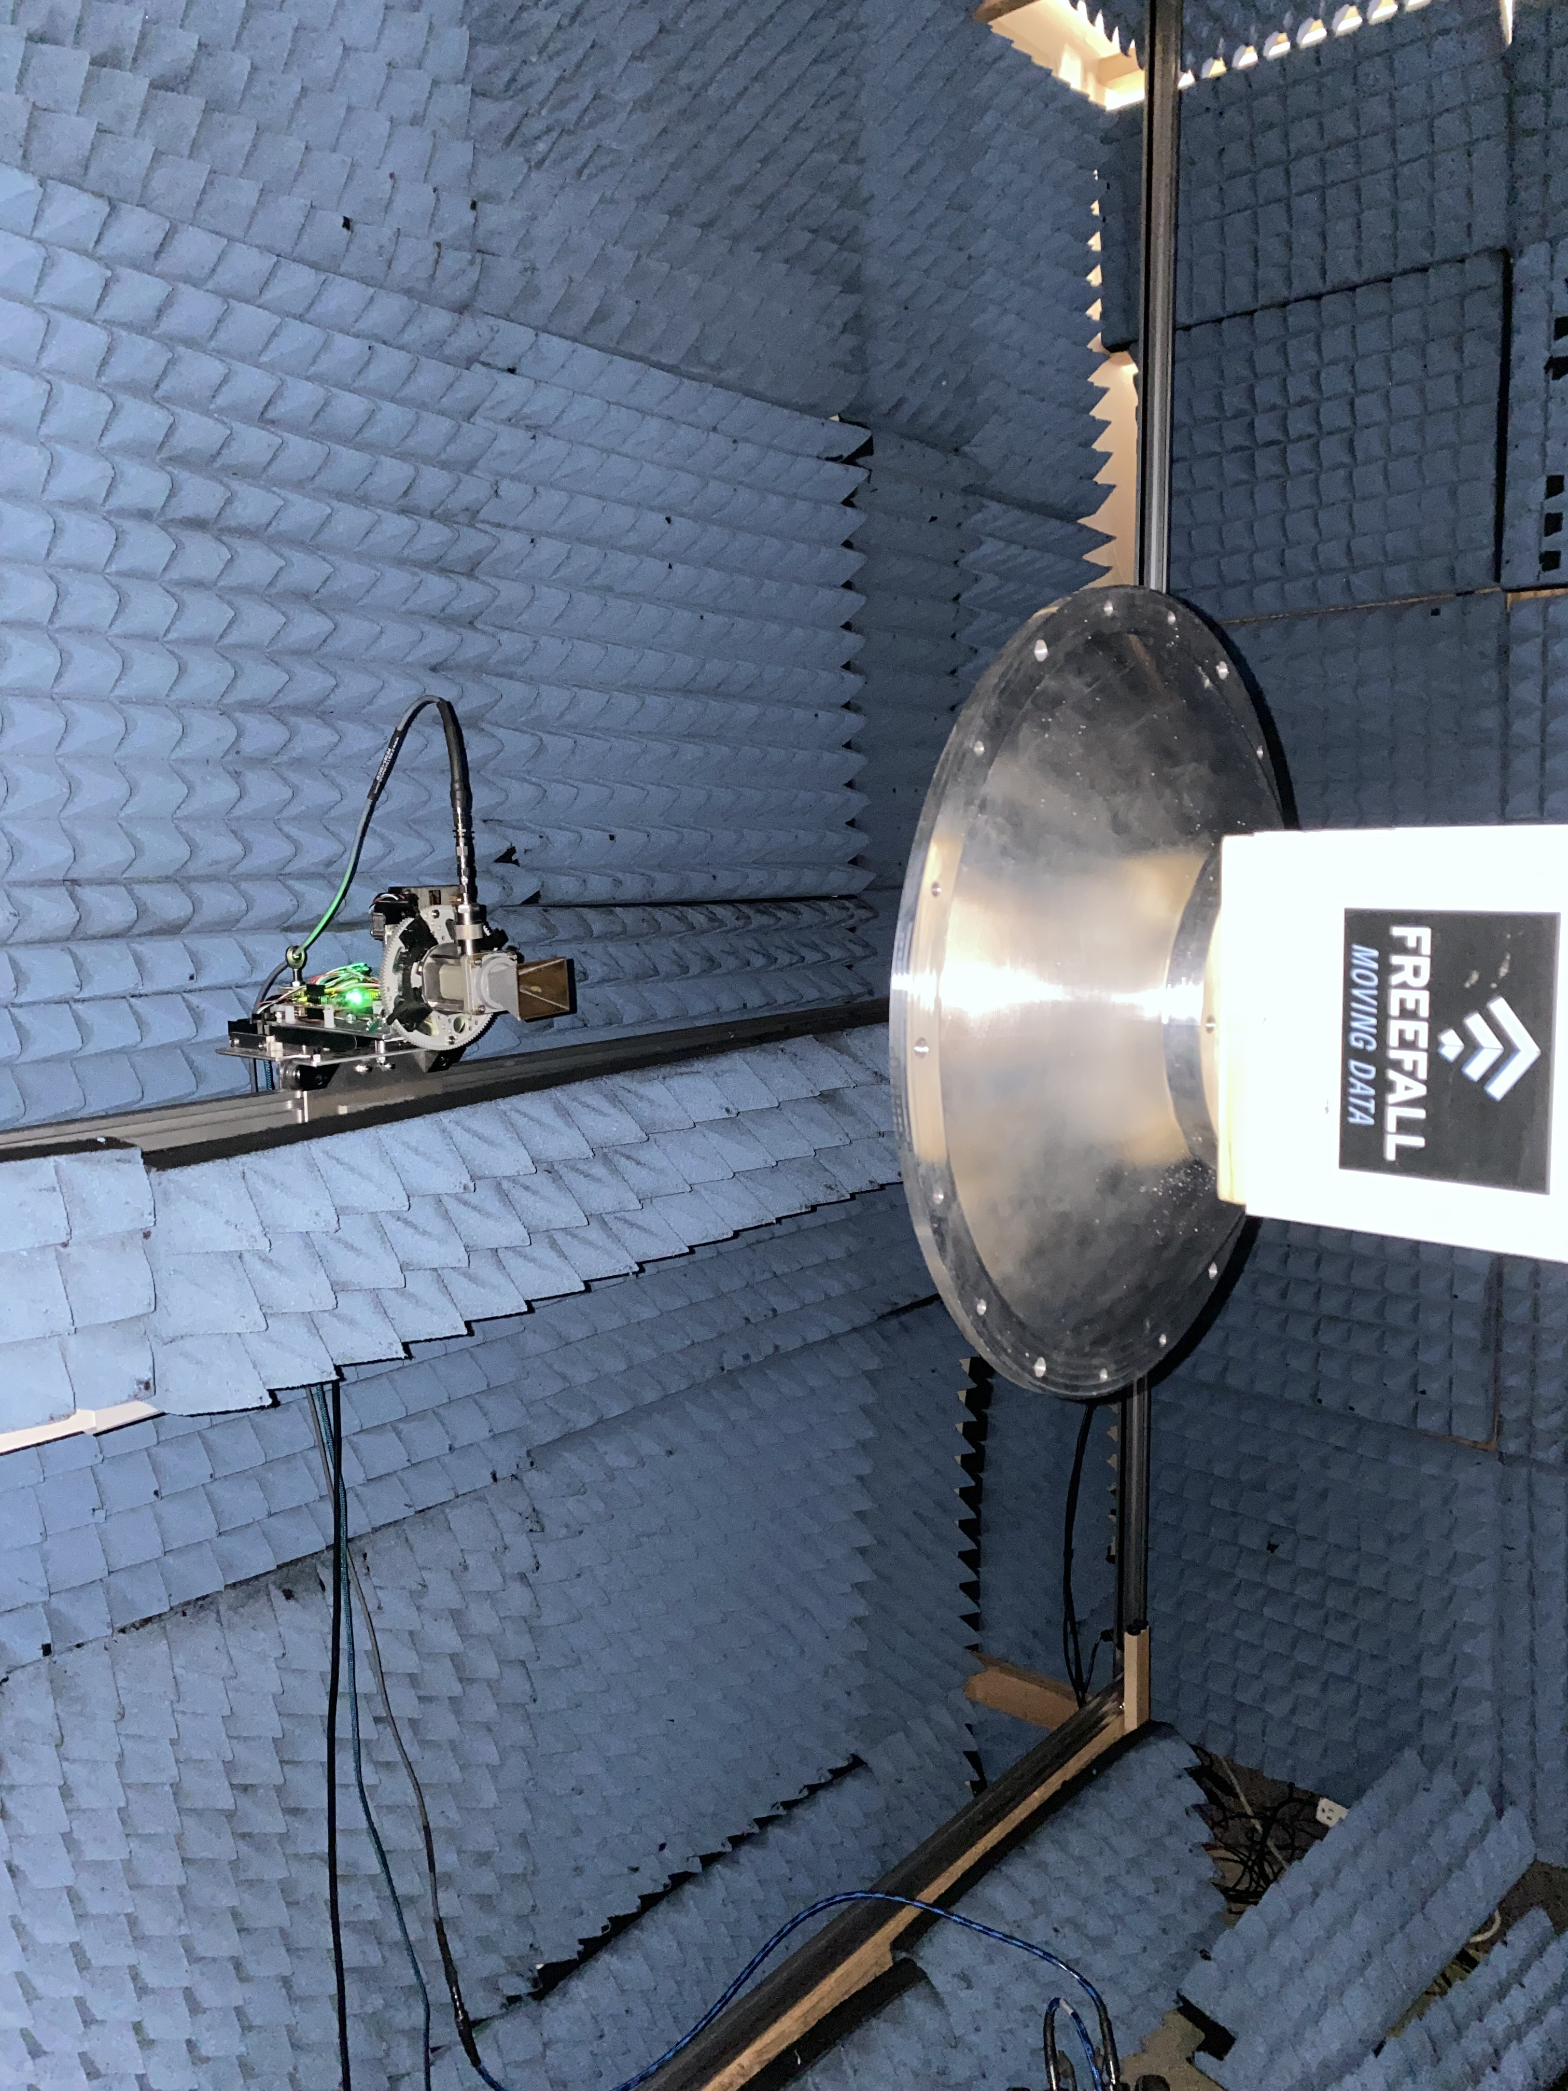
Line feed – field measurements

Slide 8
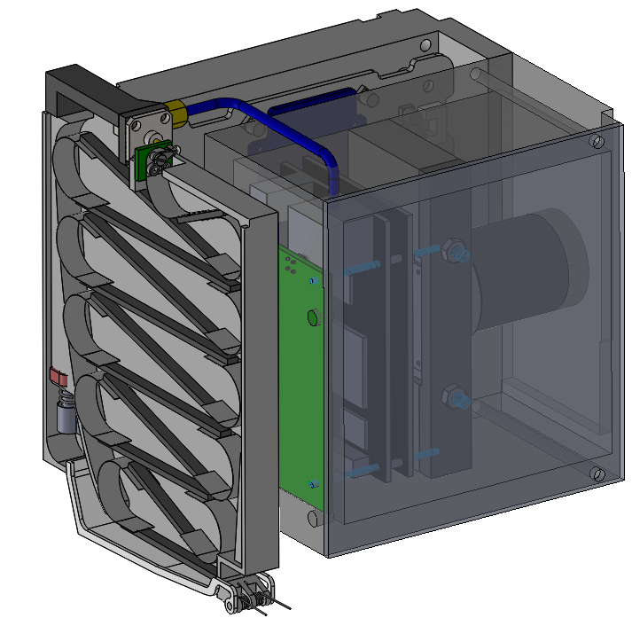
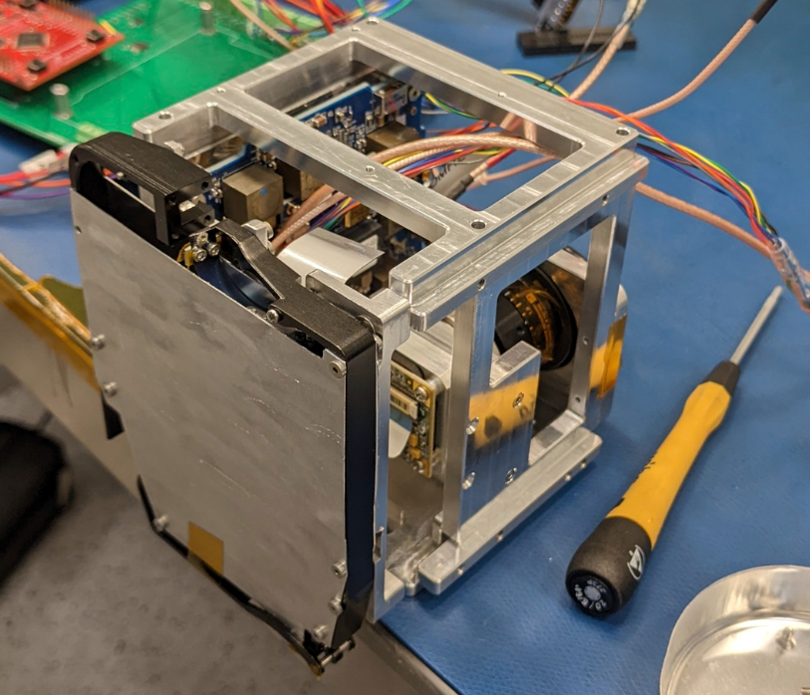
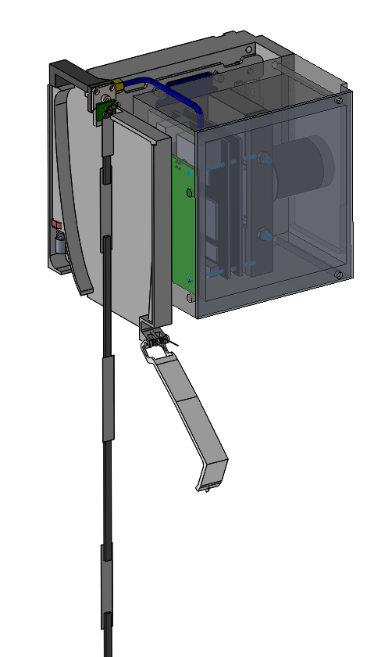
HF Whip Antenna
Probe diurnal variation in the Ionosphere.
A 0.6 m whip antenna deployed from a 0.1U packaging system.
Listens to Weak Signal Propagation Reporter (WSPR) from Amateur radio stations.
Probes from above Ionosphere.
Aim to generated 3D Ionosphere ray tracing along terminator.
Antenna deployment system

Slide 9
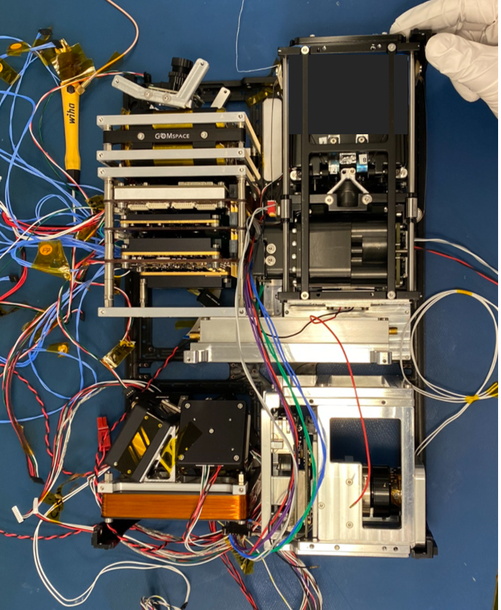
6U CATSAT Flight Hardware Integration
Antenna metrology module
Microwave upconverter
ASTRO SDR
Whip antenna deployer
HD camera

Slide 10
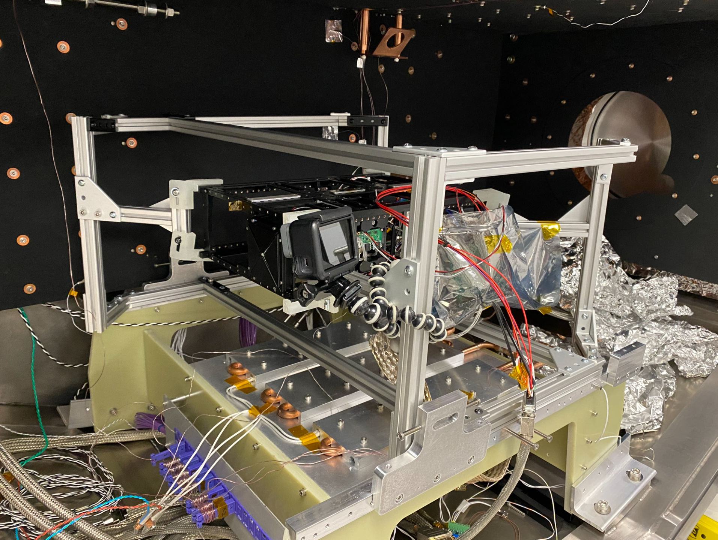
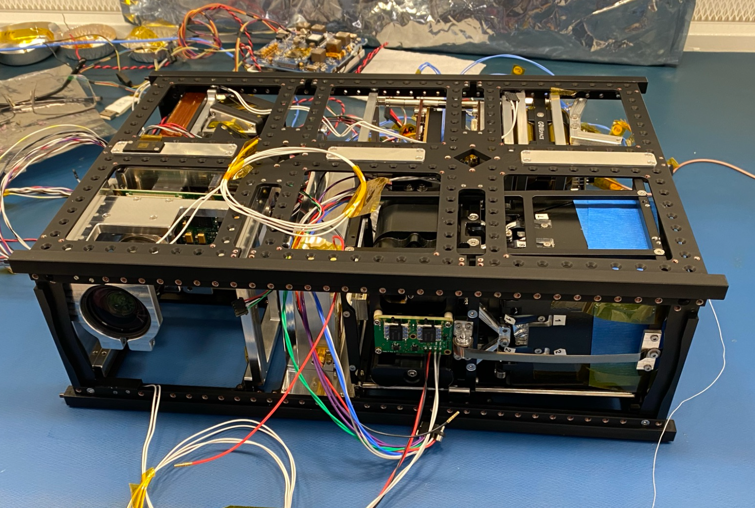
6U CATSAT Flight Hardware TVAC testing
Integrated 6U system
Assembly in TVAC chamber

Slide 11
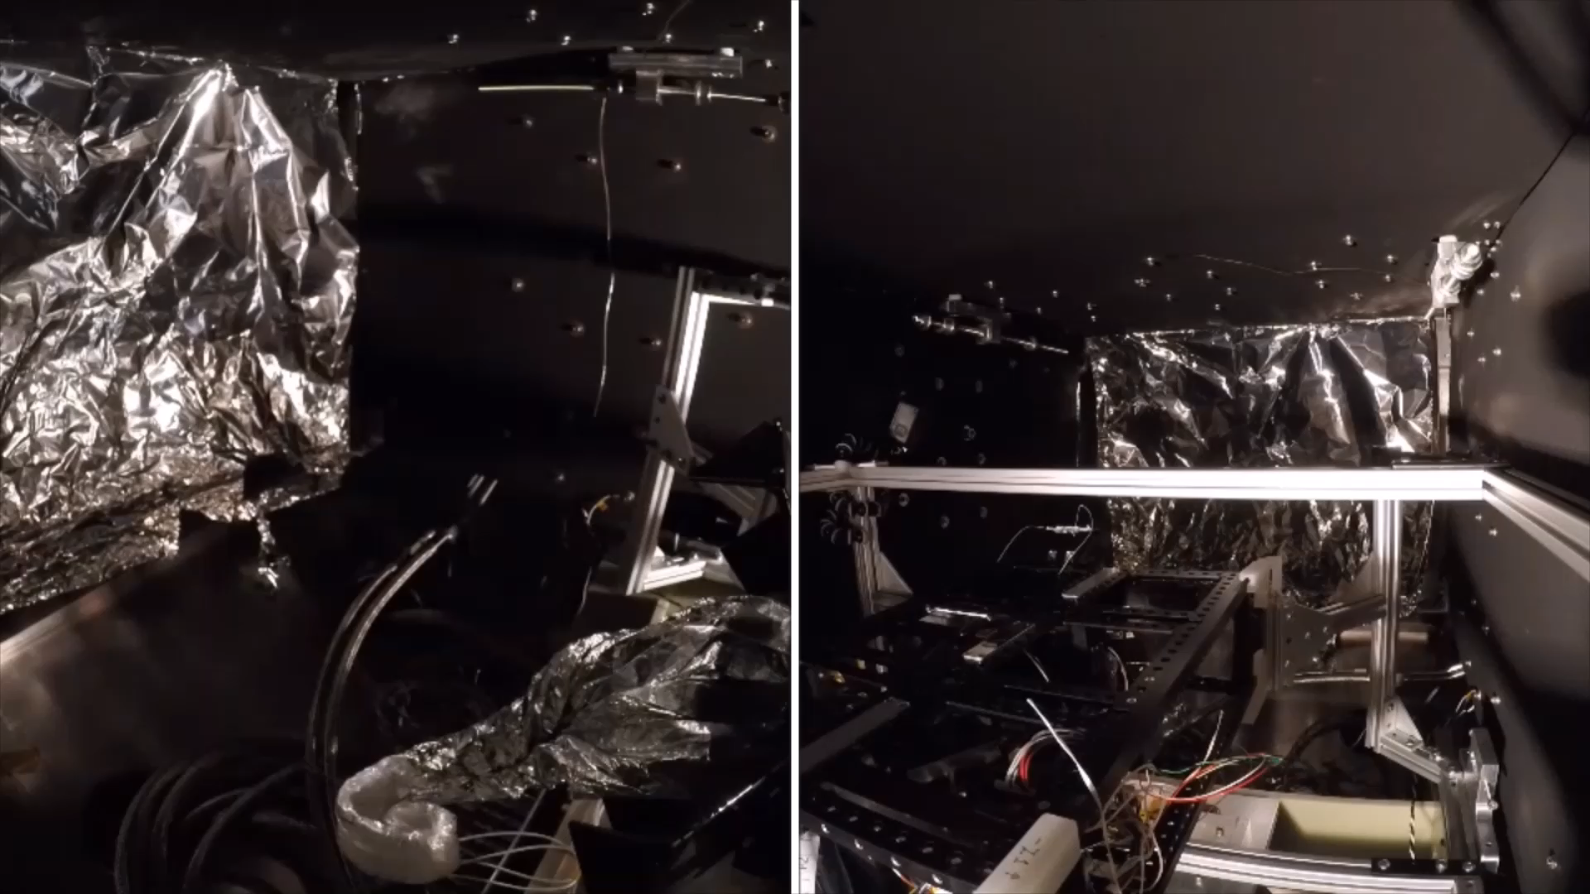
6U CATSAT Flight Hardware TVAC testing

Slide 12
Orbit lifetime assessment model
Estimated LEO lifetime in years
CubeSat Platform | Mass (kg) | Ballistic Coefficient | Lifetime in years | 550 km | 600 km | 650 km
 |  |  | 500 km | 550 km | 600 km | 650 km
6U | 9 | 20.83 | 2.00 | 3.75 | 11.94 | 24.48
12U | 12 | 27.78 | 2.45 | 4.56 | 14.52 | 28.98
16U | 16 | 37.04 | 3.07 | 6.53 | 17.24
12U | 20 | 46.30 | 3.64 | 11.43 | 25.10
16U | 24 | 55.56 | 4.10 | 13.49 | 27.87
16U | 25.8 | 59.73 | 4.31 | 14.12 | 29.31
Lifetime sensitivity analysis conducted with respect to:
Low Earth Orbit altitude and inclination (circular).
Launch year.
Gas composition (Helium, Nitrogen, Carbon dioxide, Argon studied).
Membrane material.
Membrane thickness.
NASA ORDEM 3.1
Atmospheric Model - NRLMSISE2000
Drag coefficient ~ 2.2
Orbit inclination: 30 degrees

Slide 13
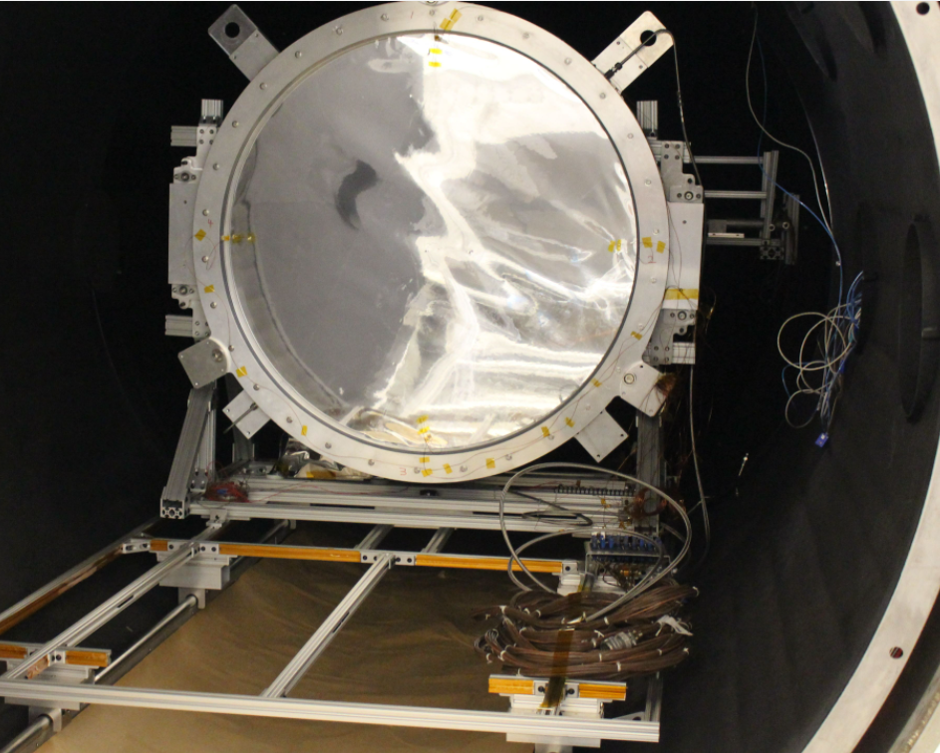
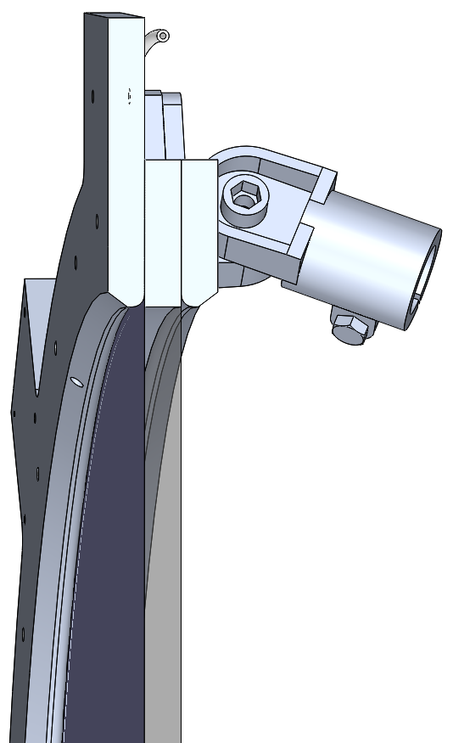
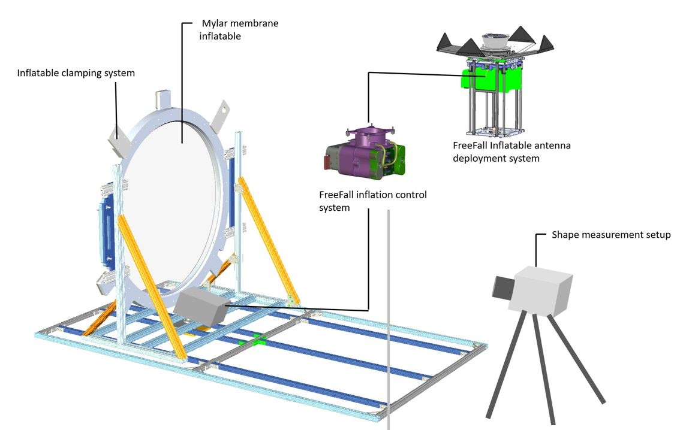
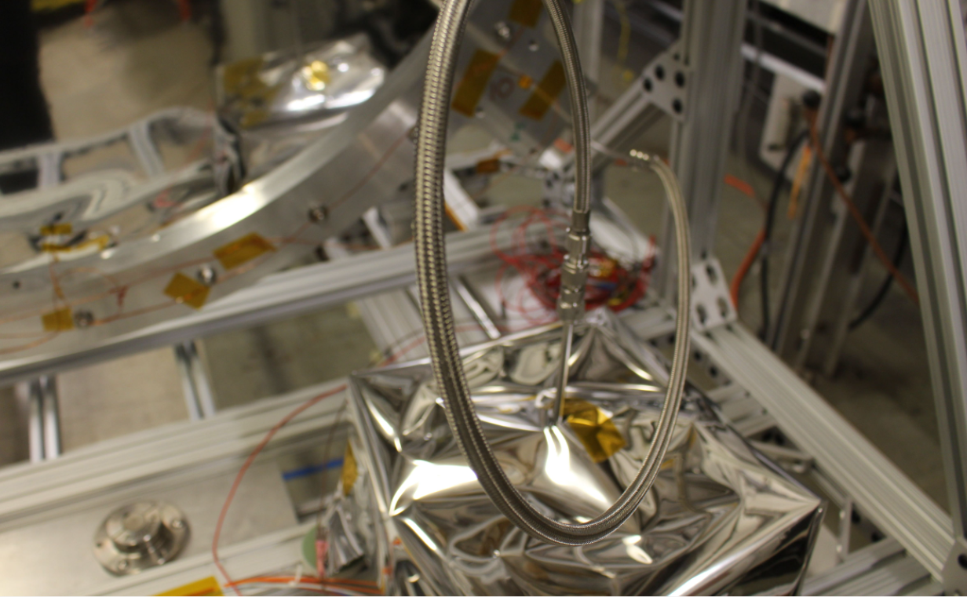
Inflation control system TVAC test setup – Northrop Grumman
Flat clear membrane
Flat reflective membrane

Slide 14
TVAC – Shape measurement and leak-rate analysis
The inflation control system was able to maintain required ΔP in response to controlled punctures on the membrane surface.
Measured leak rate of the inflatable under nominal TVAC conditions: 12 Pa/hr (0.0017 PSI/hr)
Estimate lifetime based on leak rate: ~ 5 months (over pressure state), ~8 months (nominal pressure state). True lifetime between 5-8 months as we switch between these states.
Inflated shapes repeatable with a 10 μm precision

Slide 15
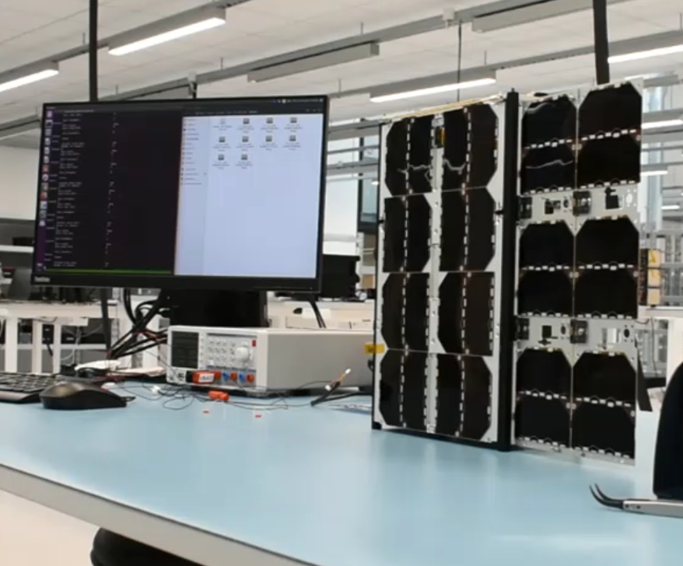
Conclusion
CATSAT aims to establish the efficacy of inflatable systems in LEO.
Flight data to be used to validate lifetime assessment models and RF performance.
Paves the way for further enhancements including membrane Rigidization and feed steering.
Integrated CATSAT system

Slide 16
Thank you!
Contact: achandra@email.arizona.edu

