Slide 1
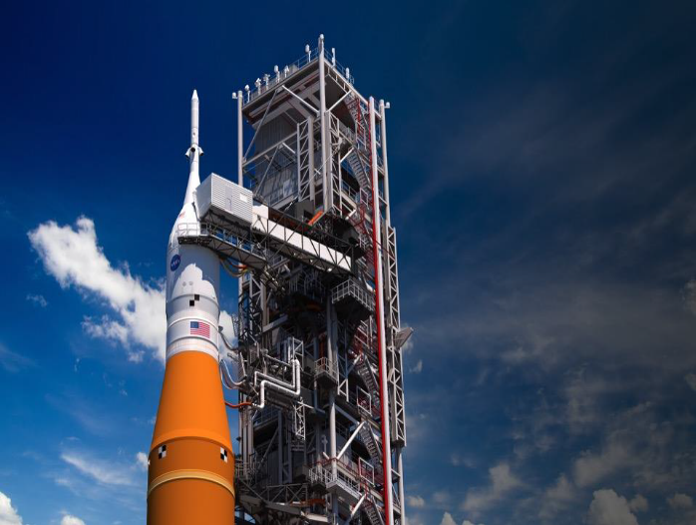


Lunar Ice Cube: All Dressed up and Ready to Go
P.E. Clark (Science PI) (Morehead State U, formerly CalTech/JPL),
B.Malphrus (PI), N. Fite (SE), C. Smith, E. Walton, A. Pedigo (Morehead State U),
C. Brambora, G. Young, T. Hewagama, D. Patel, T. Hurford, D. Folta, P. Mason (NASA/GSFC)
and members of the Lunar ICe Cube Team
Jet Propulsion Laboratory
California Institute of Technology
National Aeronautics and Space Administration
Jet Propulsion Laboratory, California Institute of Technology, Pasadena, California
www.nasa.gov © 2022. All rights reserved.
Government sponsorship acknowledged.

Slide 2


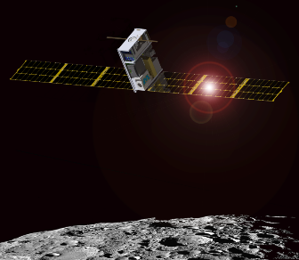
NextSTEP - Lunar IceCube Mission
Mission Description and Objectives Lunar IceCube is a 6U small satellite whose mission is to prospect for water in ice, liquid, and vapor forms and other lunar volatiles from a low-perigee, inclined lunar orbit using a compact IR spectrometer. 1.) Lunar IceCube will be deployed by the SLS on EM-1 and 2.) use an innovative RF Ion engine combined with a low energy trajectory to achieve lunar capture and a science orbit of 100 km perilune.
Strategic Knowledge Gaps 1-D Polar Resources 7: Temporal Variability and Movement Dynamics of Surface-Correlated OH and H2O deposits toward PSR retention 1-D Polar Resources 6: Composition, Form and Distribution of Polar Volatiles 1-C Regolith 2: Quality/quantity/distribution/form of H species and other volatiles in mare and highlands regolith (depending on the final inclination of the Lunar IceCube orbit)
Technology Demonstrations Busek BIT 3 - High Isp RF Ion Engine NASA GSFC - BIRCHES Miniaturized IR Spectrometer - characterize water and other volatiles with high spectral resolution (5 nm) and wavelength range (1 to 4 μm) Space Micro C&DH- Inexpensive Radiation-tolerant Subsystem JPL Iris v. 2.1 Ranging Transceiver BCT- XACT ADCS w/ Star Tracker and Reaction Wheels Custom Pumpkin- High Power (120W) CubeSat Solar Array | Current Status V&V Complete Vehicle Delivered to KSC Preparing for Operational Readiness Navigation and Trajectories Models and Processes Evolving
Critical Milestones
PDR | Phase 1 | CDR/ΔCDR | Phase 2 | Phase 3 | IRR | FRR | ORR | Launch | Mission Ops | Mission Duration | Project Closure
05/19/2016 | 06/20/2016 | 05/16/17 3/14/18 | 04/26/2018 | 5/23/2019 | 11/04/2020 | 7/28/2021 | 04/14/2022 | June 2022 | 2022-2024 | 2 years incl. ext. | 2024

Slide 3
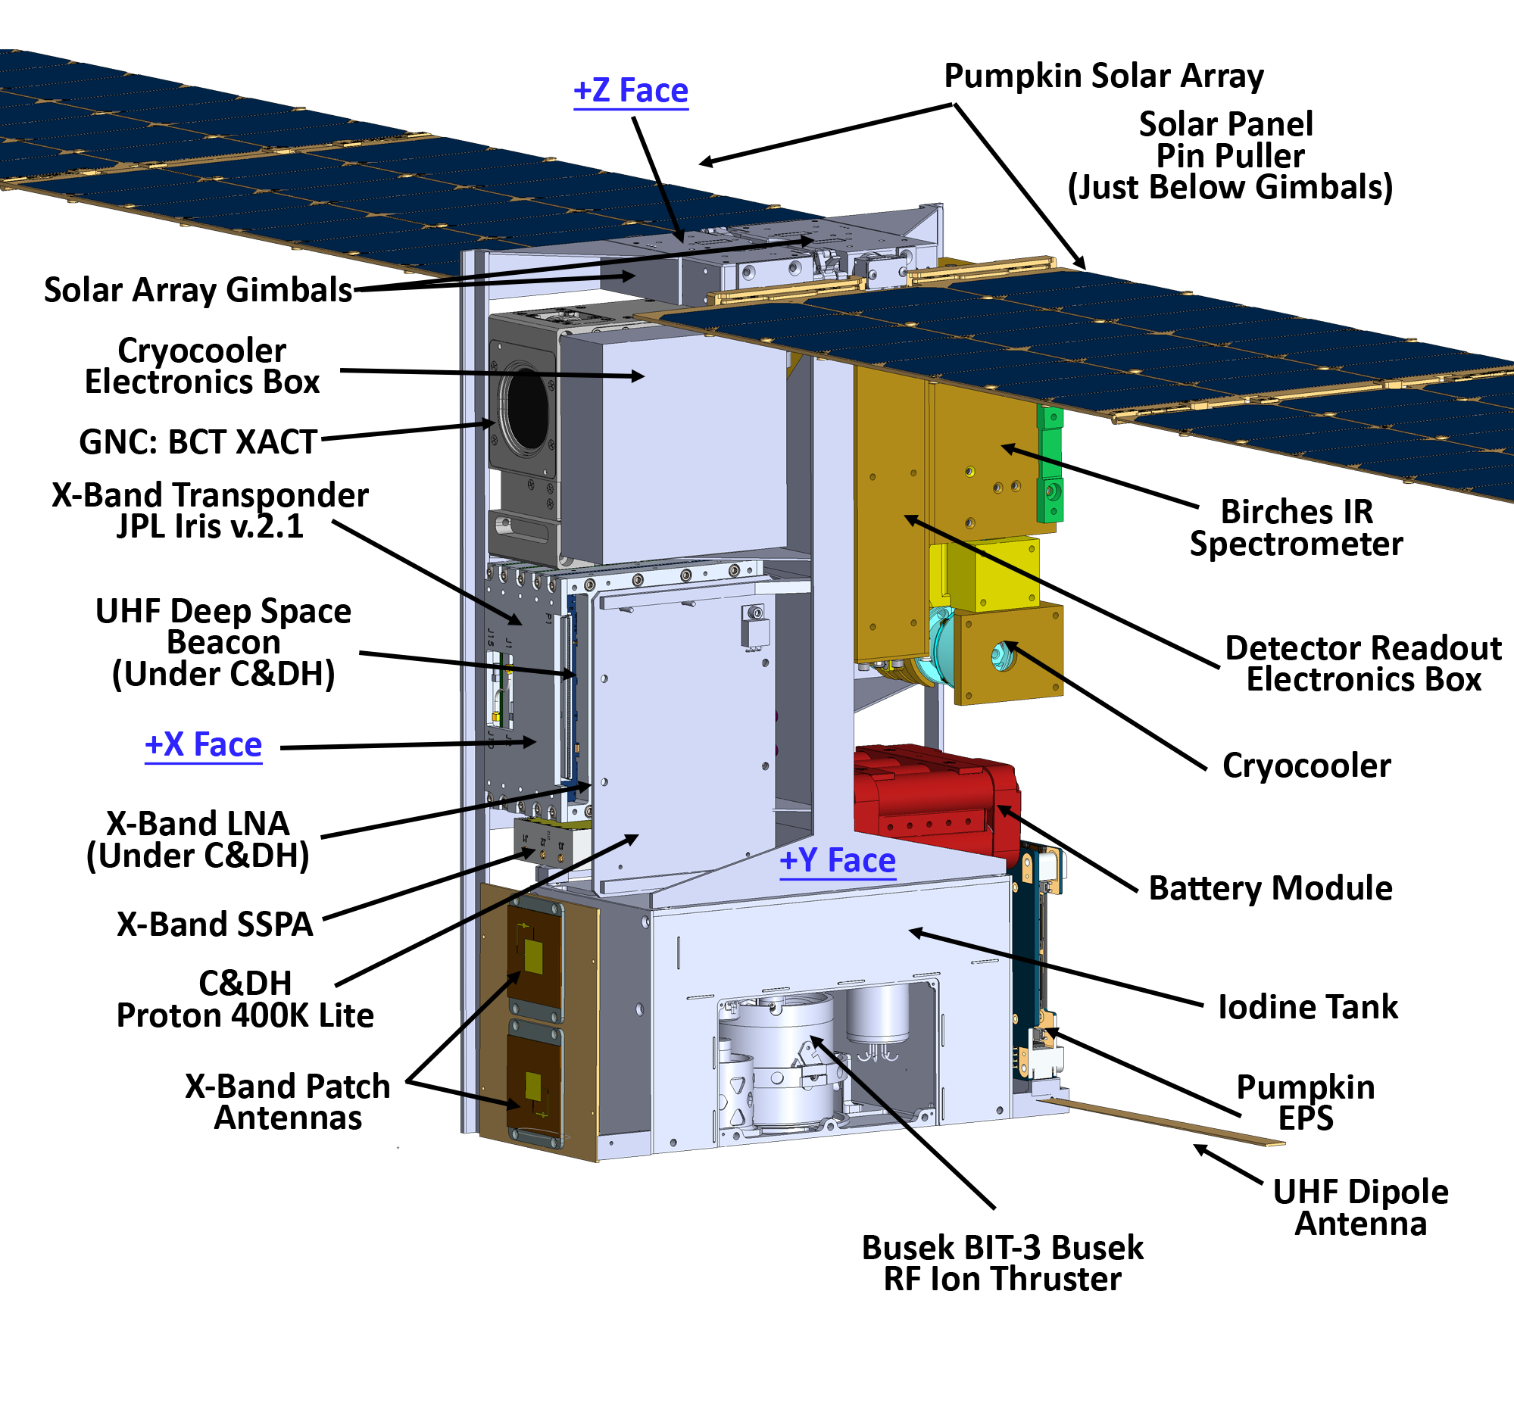
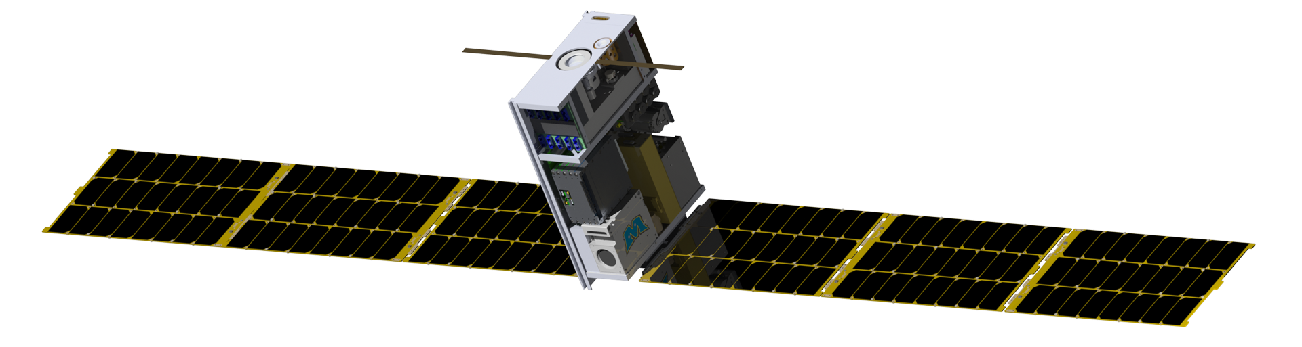
Lunar IceCube
Pumpkin Solar Arrays
Cryocooler Electronics Box
GNC: BCT XACT
Solar Arrays Gimbals
Proton 400K Lite (Under Transponder)
X-Band Transponder
Pumpkin EPS
UHF Deep Space Beacon
UHF Dipole Antenna
Busek Bit-3 RF Ion Thruster
BIRCHES IR Spectrometer
Iodine Tank
Cryocooler
Battery Module
X-Band LNA
X-Band SSPA

Slide 4
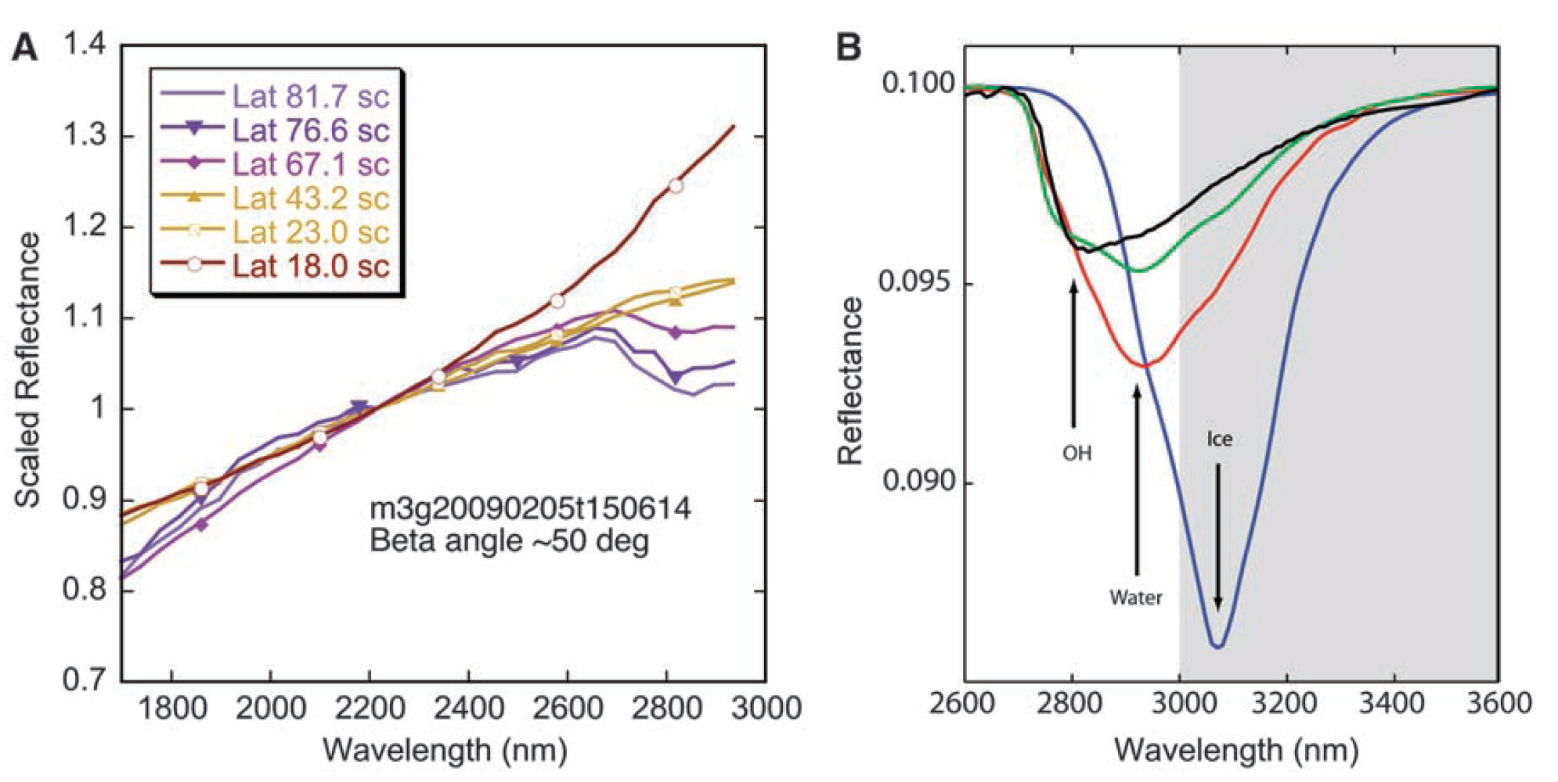
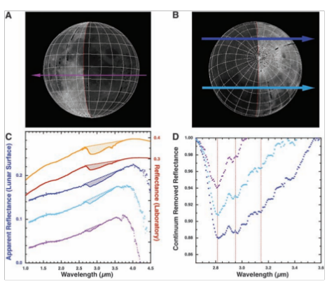
Evidence for Water
Reflectance spectra showing water and hydroxyl aborption features (near 3 microns) depth as a function of latitude. Chandrayaan M3, Pieters et al 2009
Water and Hydroxyl on Moon. Combined Red (Pyroxene), Green (Reflectance continuum), Blue (water and hydroxyl absorption) bands. Blue, Cyan, Magenta, Pink water indicators. Chandrayaan M3, Pieters et al 2009
Reflectance spectra with absorption feature strength correlated with time of day. Deep Impact Epoxi. Sunshine et al 2009

Slide 5
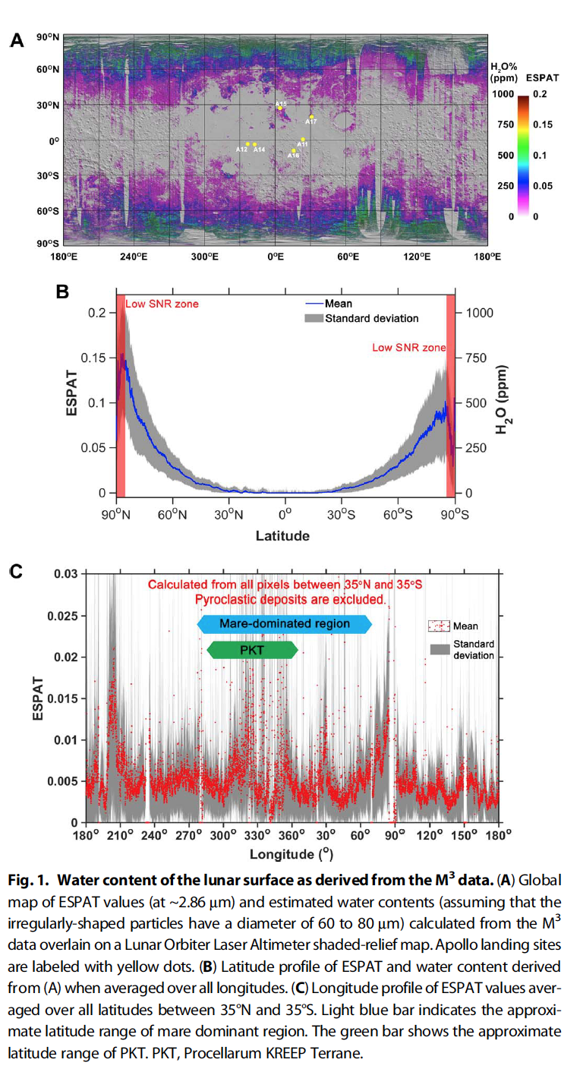
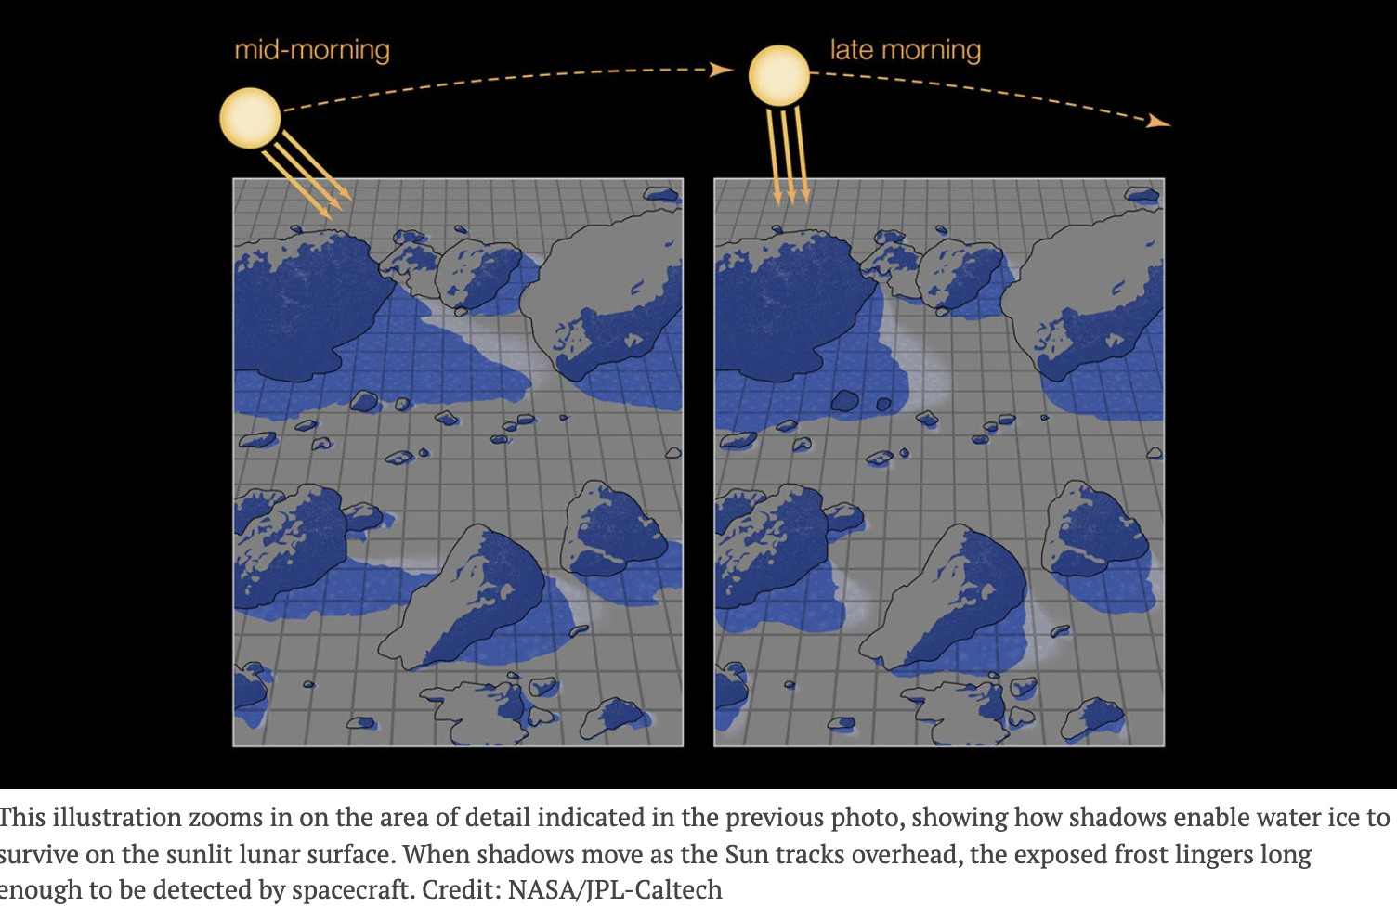
Further Evidence for Water
M3 calculated ESPAT estimated water content (Apollo landing sites in yellow) map (A), all longitude-averaged latitude profile (B), and +/- 35 degree latitude-averaged longitude profile (C). Li and Milliken, 2017.
Map of 2.85 u Effective Single Particle Absorption Thickness (ESPAT) derived from M3 at low lunar latitudes. Features apparently associated with pyroclastic deposits, lending credence to hypothesis of volatile-rich (hundreds ppm) sources in mantle. A aristarchus; O orientale, RB Rima Bode, SG Sulpicius Gallus, TL Taur-Littrow. Milliken and Li, 2017.

Slide 6
Science Goal and Objectives
Verify hypothesis that lunar water (forms and components) production is an ongoing global distribution process, thus water (forms and components) are ‘cold trappable’ and observable as a function of temperature
Goal Lunar Ice Cube Science Payload: Utilize a compact IR spectrometer on a 6U platform to obtain measurements of water-related absorption features from lunar orbit over several lunar cycles to address the HEOMD SKG requiring improved understanding of physics driving the spatial and temporal distribution of all forms of water on the Moon.
Science Objectives
# | Objective
L1-1 | Primary: Determine distribution of forms and components of water in lunar regolith as a function of time of day and latitude
L1-2 | Secondary: Determine impact of variations in surface properties (composition, slope, orientation) on water distribution
L1-3 | Secondary: Provide inputs to constrain models for Lunar volatile origin, production, and loss.

Slide 7
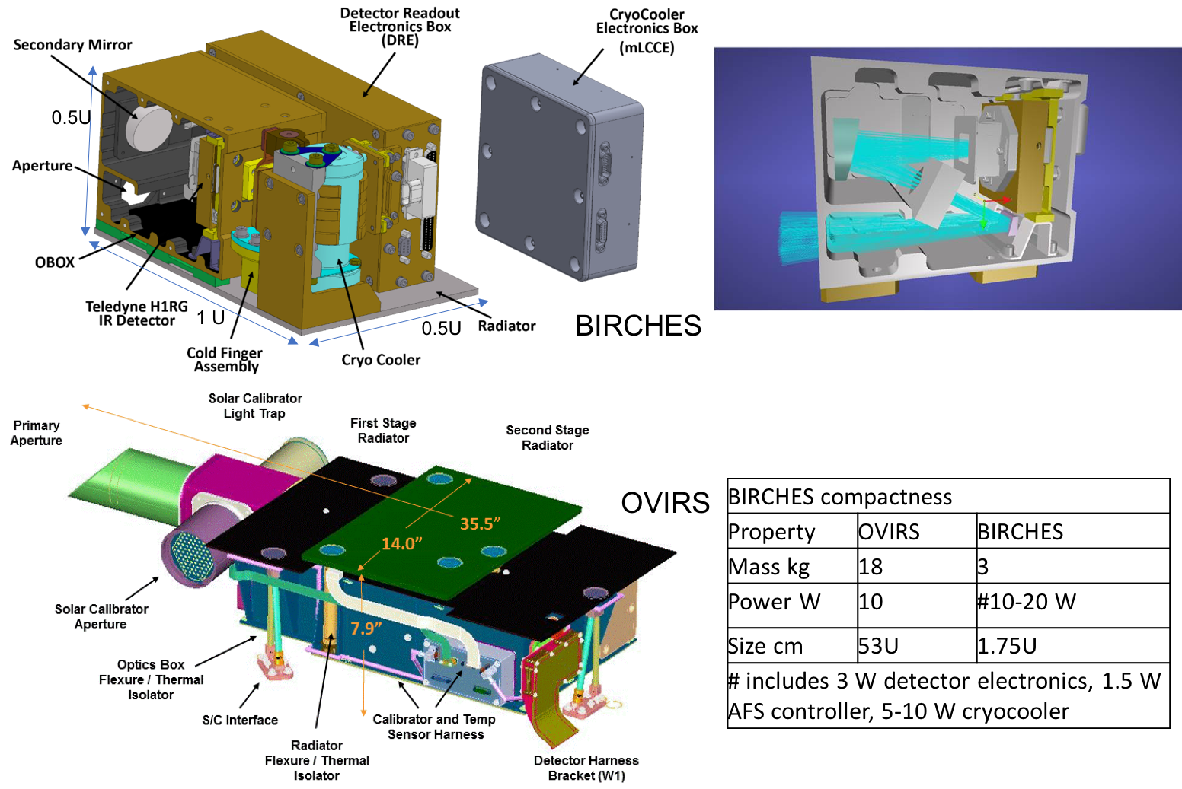
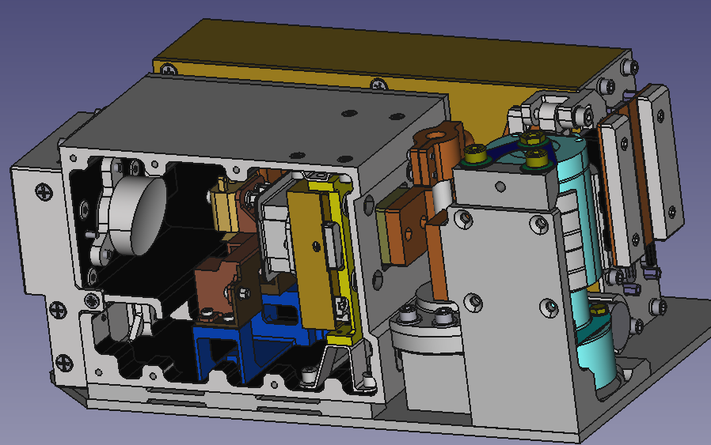
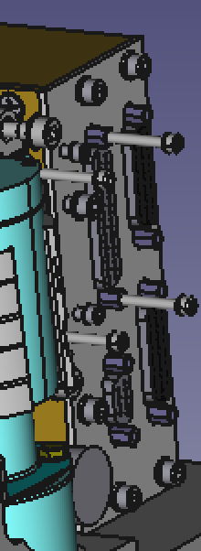
BIRCHES IR Spectrometer HW Architecture
OBOX (<200 K)
Detector Readout
Electronics (DRE) (~300 Kelvin)
Secondary
Mirror
Outer Door
Adjustable
Field
Stop
(AFS)
Cryo Cooler Electronics
Optical Input
Cryo Cooler
Teledyne H1RG
IR Detector (~120 K) with Linear Variable Filters
Ultem Spacers
Primary Mirror
(Obscured)
Cold Finger
Assembly
DRE and Cryo-Cooler
Radiator 274K – 289K

Slide 8
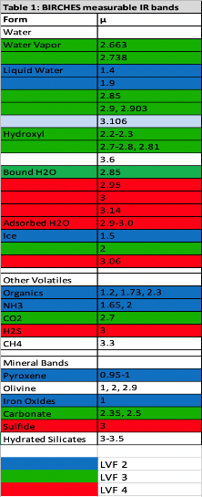
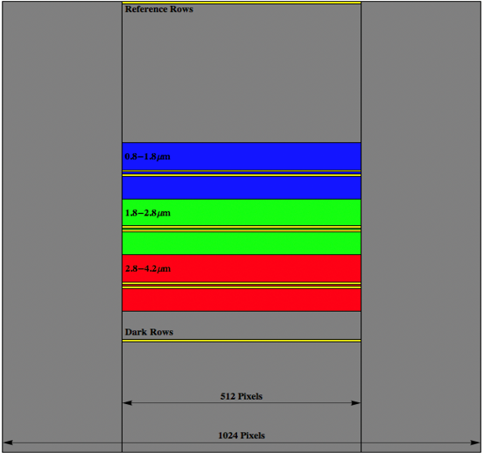
Detector Linear Variable Filter Details
Latest Data post processing results show many more detected bands of IR
LVF2
LVF3
LVF4
LVF – Linear Variable Filter

Slide 9
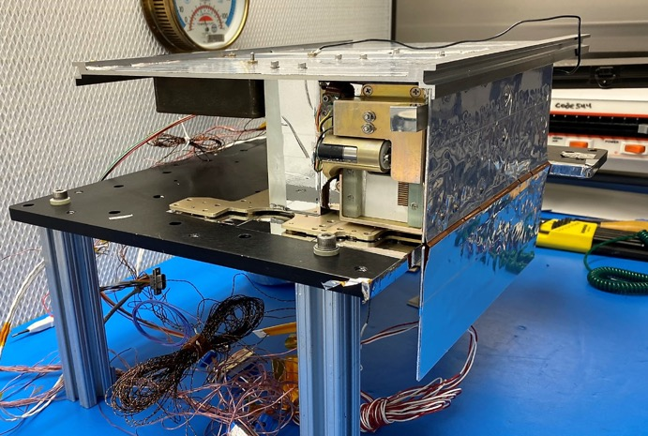
–Y Radiator
(0ºC)
MLCCE
Double
O-box
Radiators
(98K)
+ Y Radiator
(50ºC)
Figure 5-2 BIRCHES Integrated Test Configuration

Slide 10
PreFlight Calibration Data
Activity | Status | Current DataSets | Who
Detector Characterization (readout settings) | Preflight calibration gain, Vclp. To be verified by model and observation during Inflight calibration. | Sharepoint, raw mode files, Data Table | Brambora
Adjustable Field Stop Settings | Preflight calibration. In flight verification. | Sharepoint, Spreadsheet | Brambora
Bad Pixel map and Detector Row Selection | Preflight calibration. To be verified Inflight calibration (rows 1-4, 385-388, 424-427, 511-514, 547-550). Report on data reduction method. | Sharepoint, raw mode files (with bad pixels), report | Hewagama
Optical/Spatial (FOV, alignment to S/C) | Preflight calibration. To be verified Inflight calibration | Sharepoint, data table, report | Brambora
Detector Characterization (dark noise vs temperature) | Preflight calibration at two BIRCHES temperatures. To be verified inflight at minimum three temperatures. | Sharepoint, raw mode files, report | Brambora
Spectrometry (wavelength assignment, spectral resolution) | Wavelength/pixel map for LVF2, LVF3, LVF4, measured resolution: 57.2 nm LVF2; <53.8 nm LVF 3; 92.9 nm LVF4 | Sharepoint, raw mode files, wavelength map file, report (figures and equation). See Spectroscopic slide below. | Hewagama
Out of Band Correction | In flight calibration needed. |  | Hewagama
Radiometry (counts to luminance vs temperature) | Preliminary (0.008 ergs/s/cm⁻¹/cm²/count at 135 K), InFlight calibration at two other Temperatures. Working on conversion to radiance units. | Sharepoint, raw mode files, report (figures and equation). See Radiometric slide below. | Hewagama
Observation and Raw modes | Modification FPGA code to correct bug in observation mode (V68-2) during preflight testing. Verify at room T only. To be verified inflight calibration. | Sharepoint, observation and raw mode files. | Brambora
Raw mode: Complete 1024 x 1024 FPA readout; Observations modes: readout central 512 x 512 with LVF segments with and without pause and second read

Slide 11
In-Flight Calibration: Steps in order
0) 24 hours+ direct sunlight on Obox radiator for decontamination ending by performing 1) below (mid-June)
Verify relationship between S/C T sensors, Obox T, cold finger T (from mid-June and then monitor)
Verify cryocooler settings (time, voltage) required to achieve maximum detector (cold finger) temperature (performed along with 1)
Verify relationship between Obox T and Cold Finger T whenever taking data
Verify Boresight on available target (limb/terminator/limb) to verify BIRCHES pointing offset (June/July with 5)
Verify Boresight on available target (limb/terminator/limb) to determine FOV as function of AFS setting (with 4)
Verify Vclp and Gain settings as function of illumination and temperature (two or more targets and phases) (raw mode) (July/August with 7)
Verify bad pixels as function of degree of illumination (from door closed) and temperature (raw mode) (with 6)
Determine relationship between Counts/Sec and radiance as function of temperature (with 6, 7, 9, 10)
Verify pixel wavelength position and resolution from target with known spectral signature (while performing radiometry with 8)
Determine out of band correction as a function of temperature (while performing radiometry with 8)

Slide 12
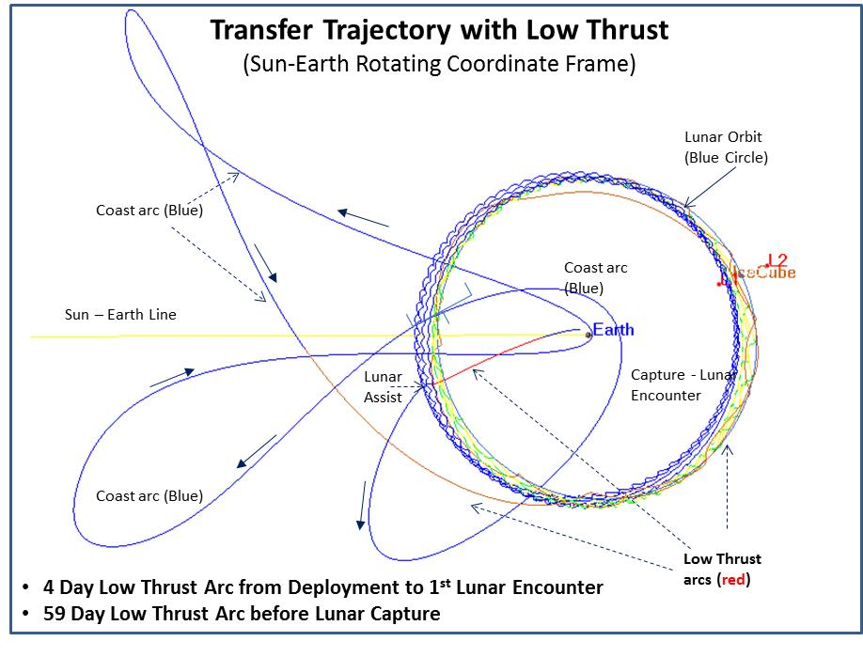
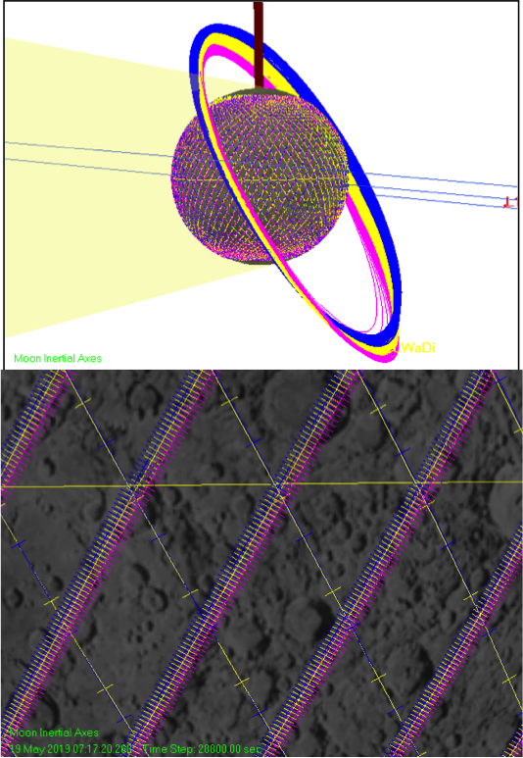
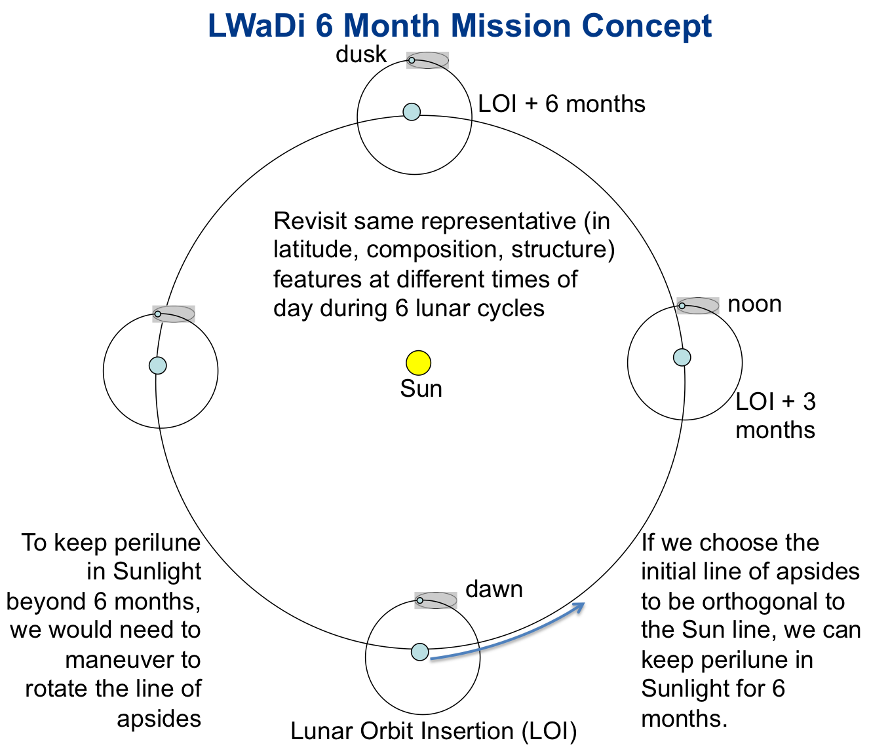
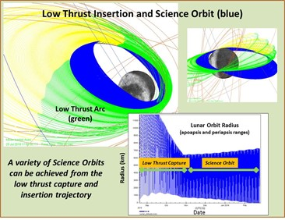
Lunar Ice Cube MIssion Concept

Slide 13
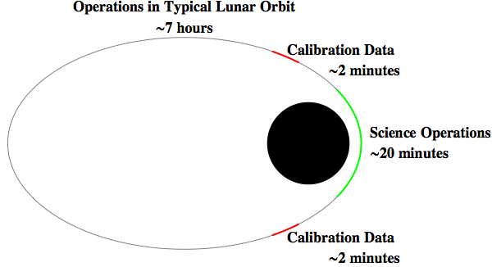
Science Mode Operations
Continue OBS mode during Terminator for calibration, then close window, end AFS setting sequence, go into idle mode
After terminator crossing, continue AFS setting sequence, data taking (OBS mode) until 30 degrees latitude then go into idle mode
~25
South Pole
Start (OBS mode) data taking after 30 degrees latitude, reverse AFS setting sequence. Continue until before terminator crossing
Altitude (100Km – 1000Km – 100Km over the 40 min science Observation) with a +-10Km variability.
Before Terminator Crossing nadir alignment, make sure window open, Begin AFS setting sequence, send Start command, data taking (OBS mode) for calibration

Slide 14
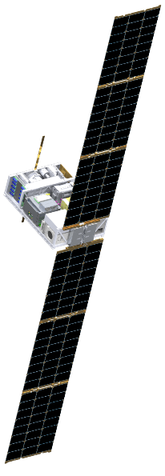
Ground Elements Data Flow
v. 3.28.2022 PEC
LUNAR ICECUBE
MISSION OPERATION CONCEPT
Ground elements data flow
AIT: AMMOS Instrument Toolkit
DSN: Deep Space Network
FDF: Flight Dynamics Facility
MSU: Morehead State University
* NAIF Processing Tasks
RX Telemetry paths
L1 propulsion Telemetry (points)
Busek
Propulsion system performance
RX Science data paths
TX command and
TX requests paths
BIRCHES Instrument
(GSFC)
MSU Mission Operations Center
(MSU MOC)
Mission Archive
(L0 Data + Telemetry)
L1 – Software telemetry (points)
Science Observation and Flight Code requests
IV&V
Software development
Mission Operations Center (MOC)
AIT Server
Uplink Processing
Downlink Processing
DSOC
DSN
S/C communi-cation and tracking
NMC
CCSDS L0 RX Packets
L1 – Nav telemetry
CCSDS TX commands
CLTU Format
L1 – Full telemetry
Planetary Data System
L0, L1 Science data
Tx command
NAIF SPICE
Spacecraft
planning
and analysis (Team)
S/C Health and Safety
Geosciences
L0 Science data
Virtual SOC
L0-L3
Internet/ Website
L1 Science data
JPL Flight LAN
Naif tools, SPICE kernels
Mission Science Team*
NAIF Toolkit
L1, L2, L3
Propulsion requests
L1 - Navigation
Telemetry (points)
FDF (GSFC)
Flight dynamics
Analysis
NAV and ACS
L1, L2, L3 Science data
Radiometric (tracking)
Radiometric (tracking)

Slide 15
Challenges Summary
Challenges and Mitigations
Shutdown limited resources and time available to complete planned calibration process. In future, a Plan B for alternate testing and integration plan (outside of NASA centers) should be required.
Thermal design (on-orbit heat removal an issue for 6U, and on-surface heat retention during lunar night an issue if minimum resource (including cost) solutions sought: In future, take advantage of High performance thermal solutions now being developed. Additional work (remove some stand offs, modify detector surfaces, add small dedicated deployable radiator, variable thickness radiator) to reduce heat transfer to detector to reduce pixel saturation without increasing mass. Go to 12U for future cubesats.
Development process: version controlled design and interface control documentation, and scheduled essential reviews and deliverables. Learning curve for ‘early cubesat deep space qualification'. Define 'threshold' early and go to threshold as cost cap issues arise.
Team membership: high turn over and no guaranteed backups for student team. In future, would appoint staff thermal engineer, mission operations, ground data system managers.
Non-scalable (in cost and schedule) development and operation: Support and utilize design, subsystem simulation and driver tools, operating systems, operations facilities, and data delivery pipeline tools already developed or under development for cubesats.

Slide 16
Conclusions
Lunar Ice Cube is the most operationally complex cubesat to date.
Lunar Ice Cube goal to provide measurements from which liquid water, ice, OH distribution across the lunar surface can be derived to understand function of time of day (temperature and illumination) at a variety of representative locations.
Regardless of the degree of overlap with other missions (LunaH-Map and Lunar Ice Cube) in space or time, these measurements when combined will provide far more systematic understanding of the water cycle, and the accessibility of water as a resource on the Moon.
We are doing what cubesats are supposed to do: creating an innovative and tailored solution with a standard platform.
Serious challenges for thermal design in 6U volume must be addressed (go to 12U) for next round of deep space opportunities.

Slide 17

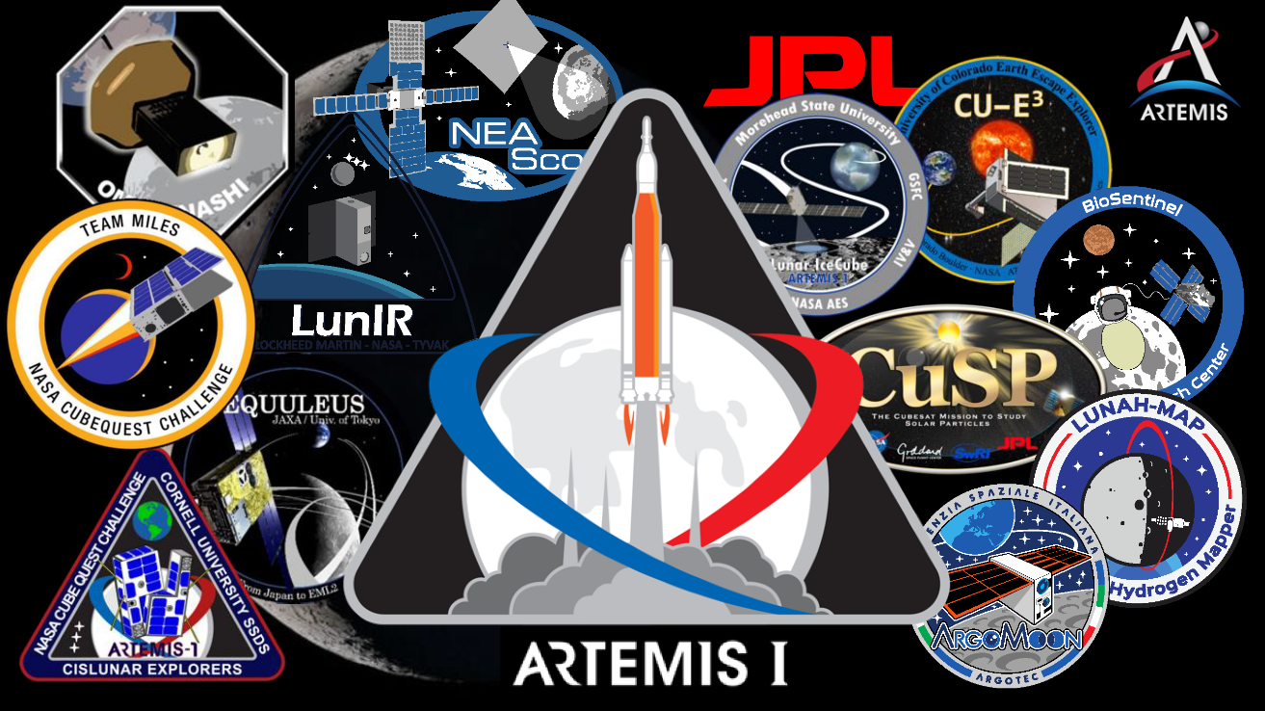
Cubesats are Ready to Go!

Slide 18
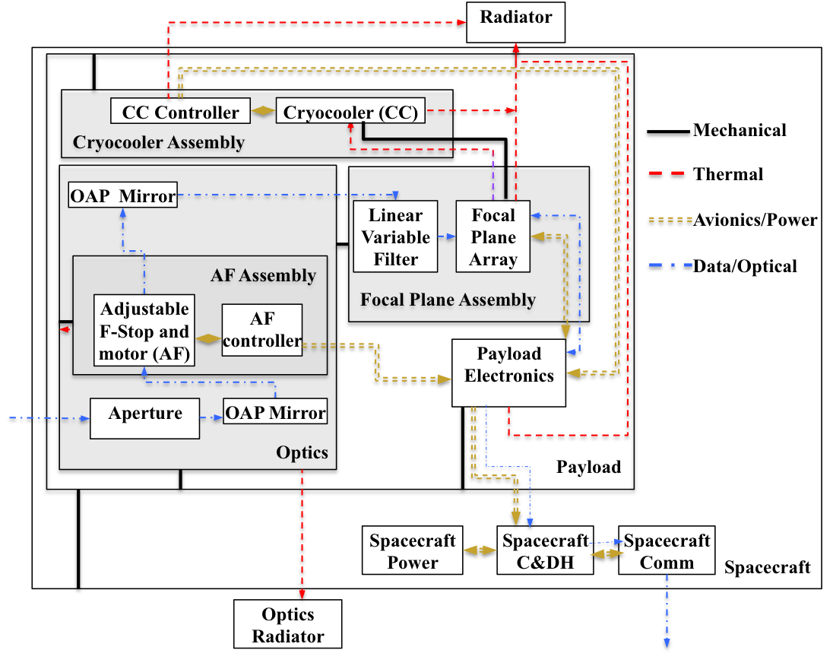
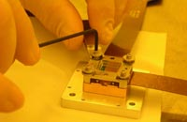
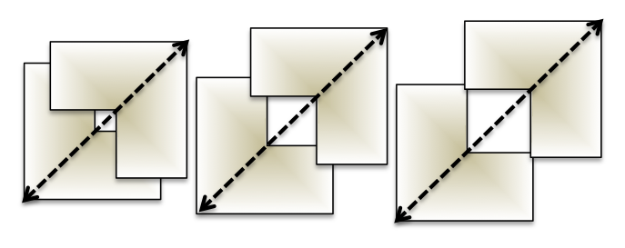
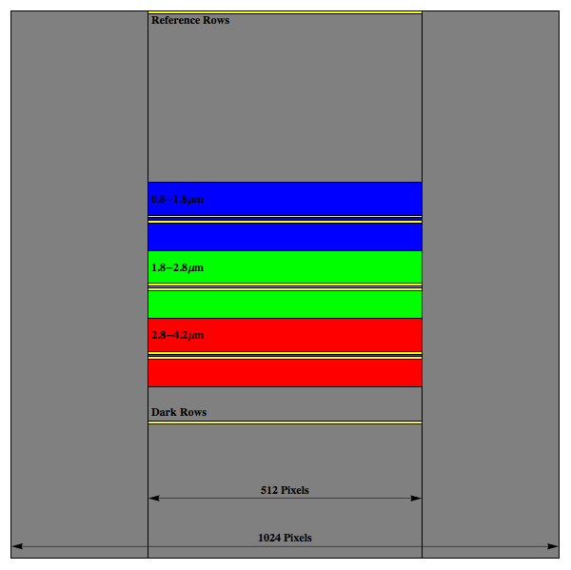
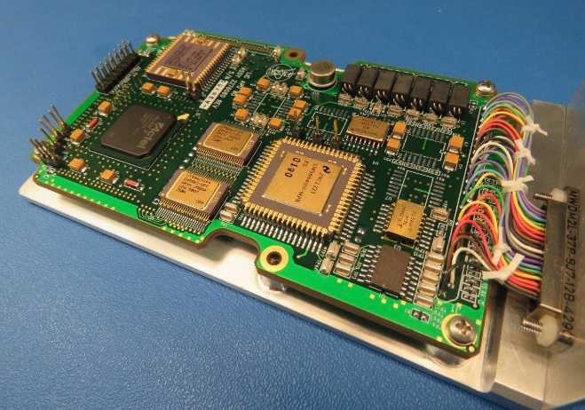
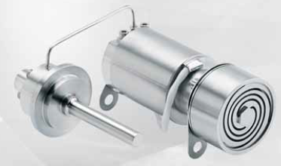
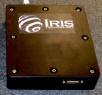
Spectrometer Schematic and Components
BIRCHES utilizes a compact Teledyne H1RG HgCdTe Focal Plane Array and JDSU linear variable filter leveraging OSIRIS REx OVIRS.
Adjustable Iris maintains footprint size at 10 km by varying FOV regardless of altitude
Linear Variable Filter Segments over H1RG focal plane array with reference, dark, segment 1, segment 2, and segment 3 rows (yellow lines) superposed.
BIRCHES Analog Processing Unit (APU) (top)
COTS AFRL developed AIM SX030 microcryocooler with cold finger to maintain detector at ≤115K and iris controller

Slide 19
GSE Calibration
Control (Functional, T Balance, T Noise)
Day in the Life Test
GSE Commands
BIRCHES Command
Radiometry
NB Transmissions Filters
Fiber
OAP
BIRCHES
Blackbody Thermal Source
Theodolite/
Hexapod
BIRCHES Output
ZnSe
Optical/Spatial
Monochrometer
Fiber
OAP
Spectrometry
TVAC Chamber
Manual Command aligned with GSE
Settings for Rotational Stage (Hexapod) and Alignment Template for Metrology
NIST Calibrated Power Meters
Monochrometer with new Gratings, Collimator and Optical Fiber Alignment
Cleanroom

