Slide 1
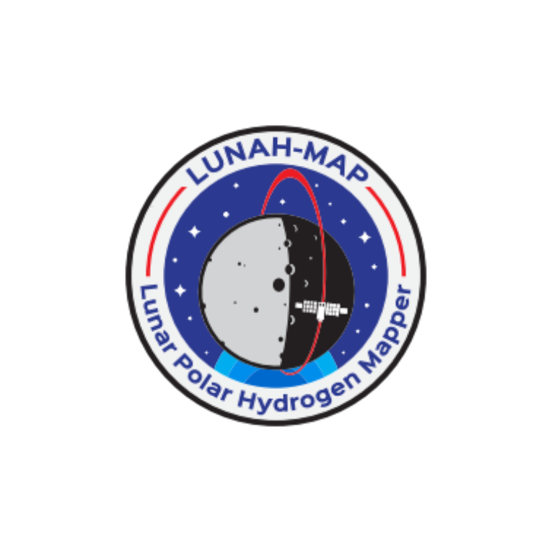
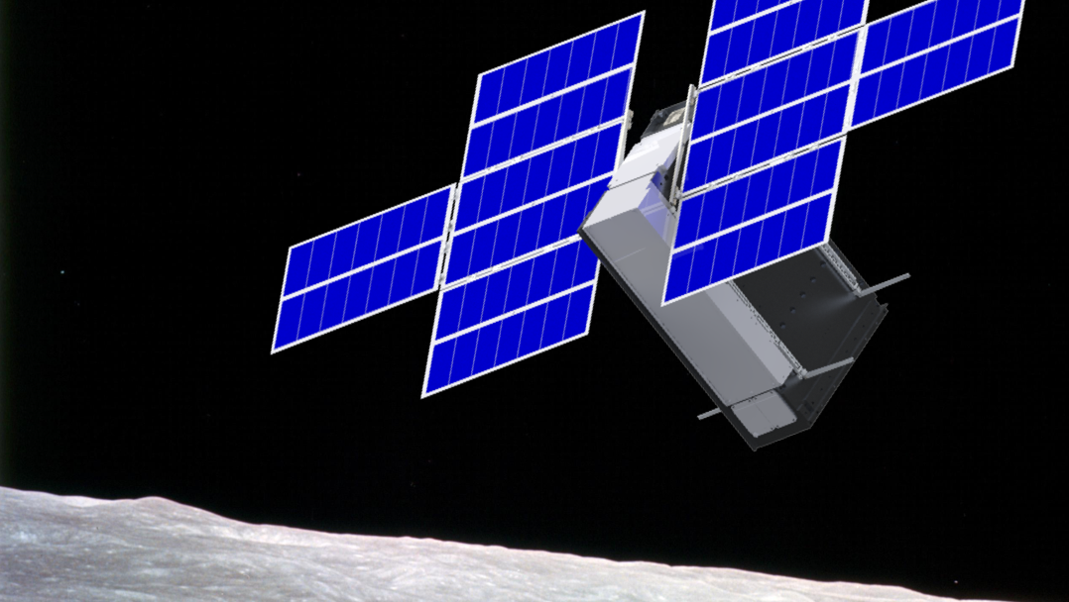
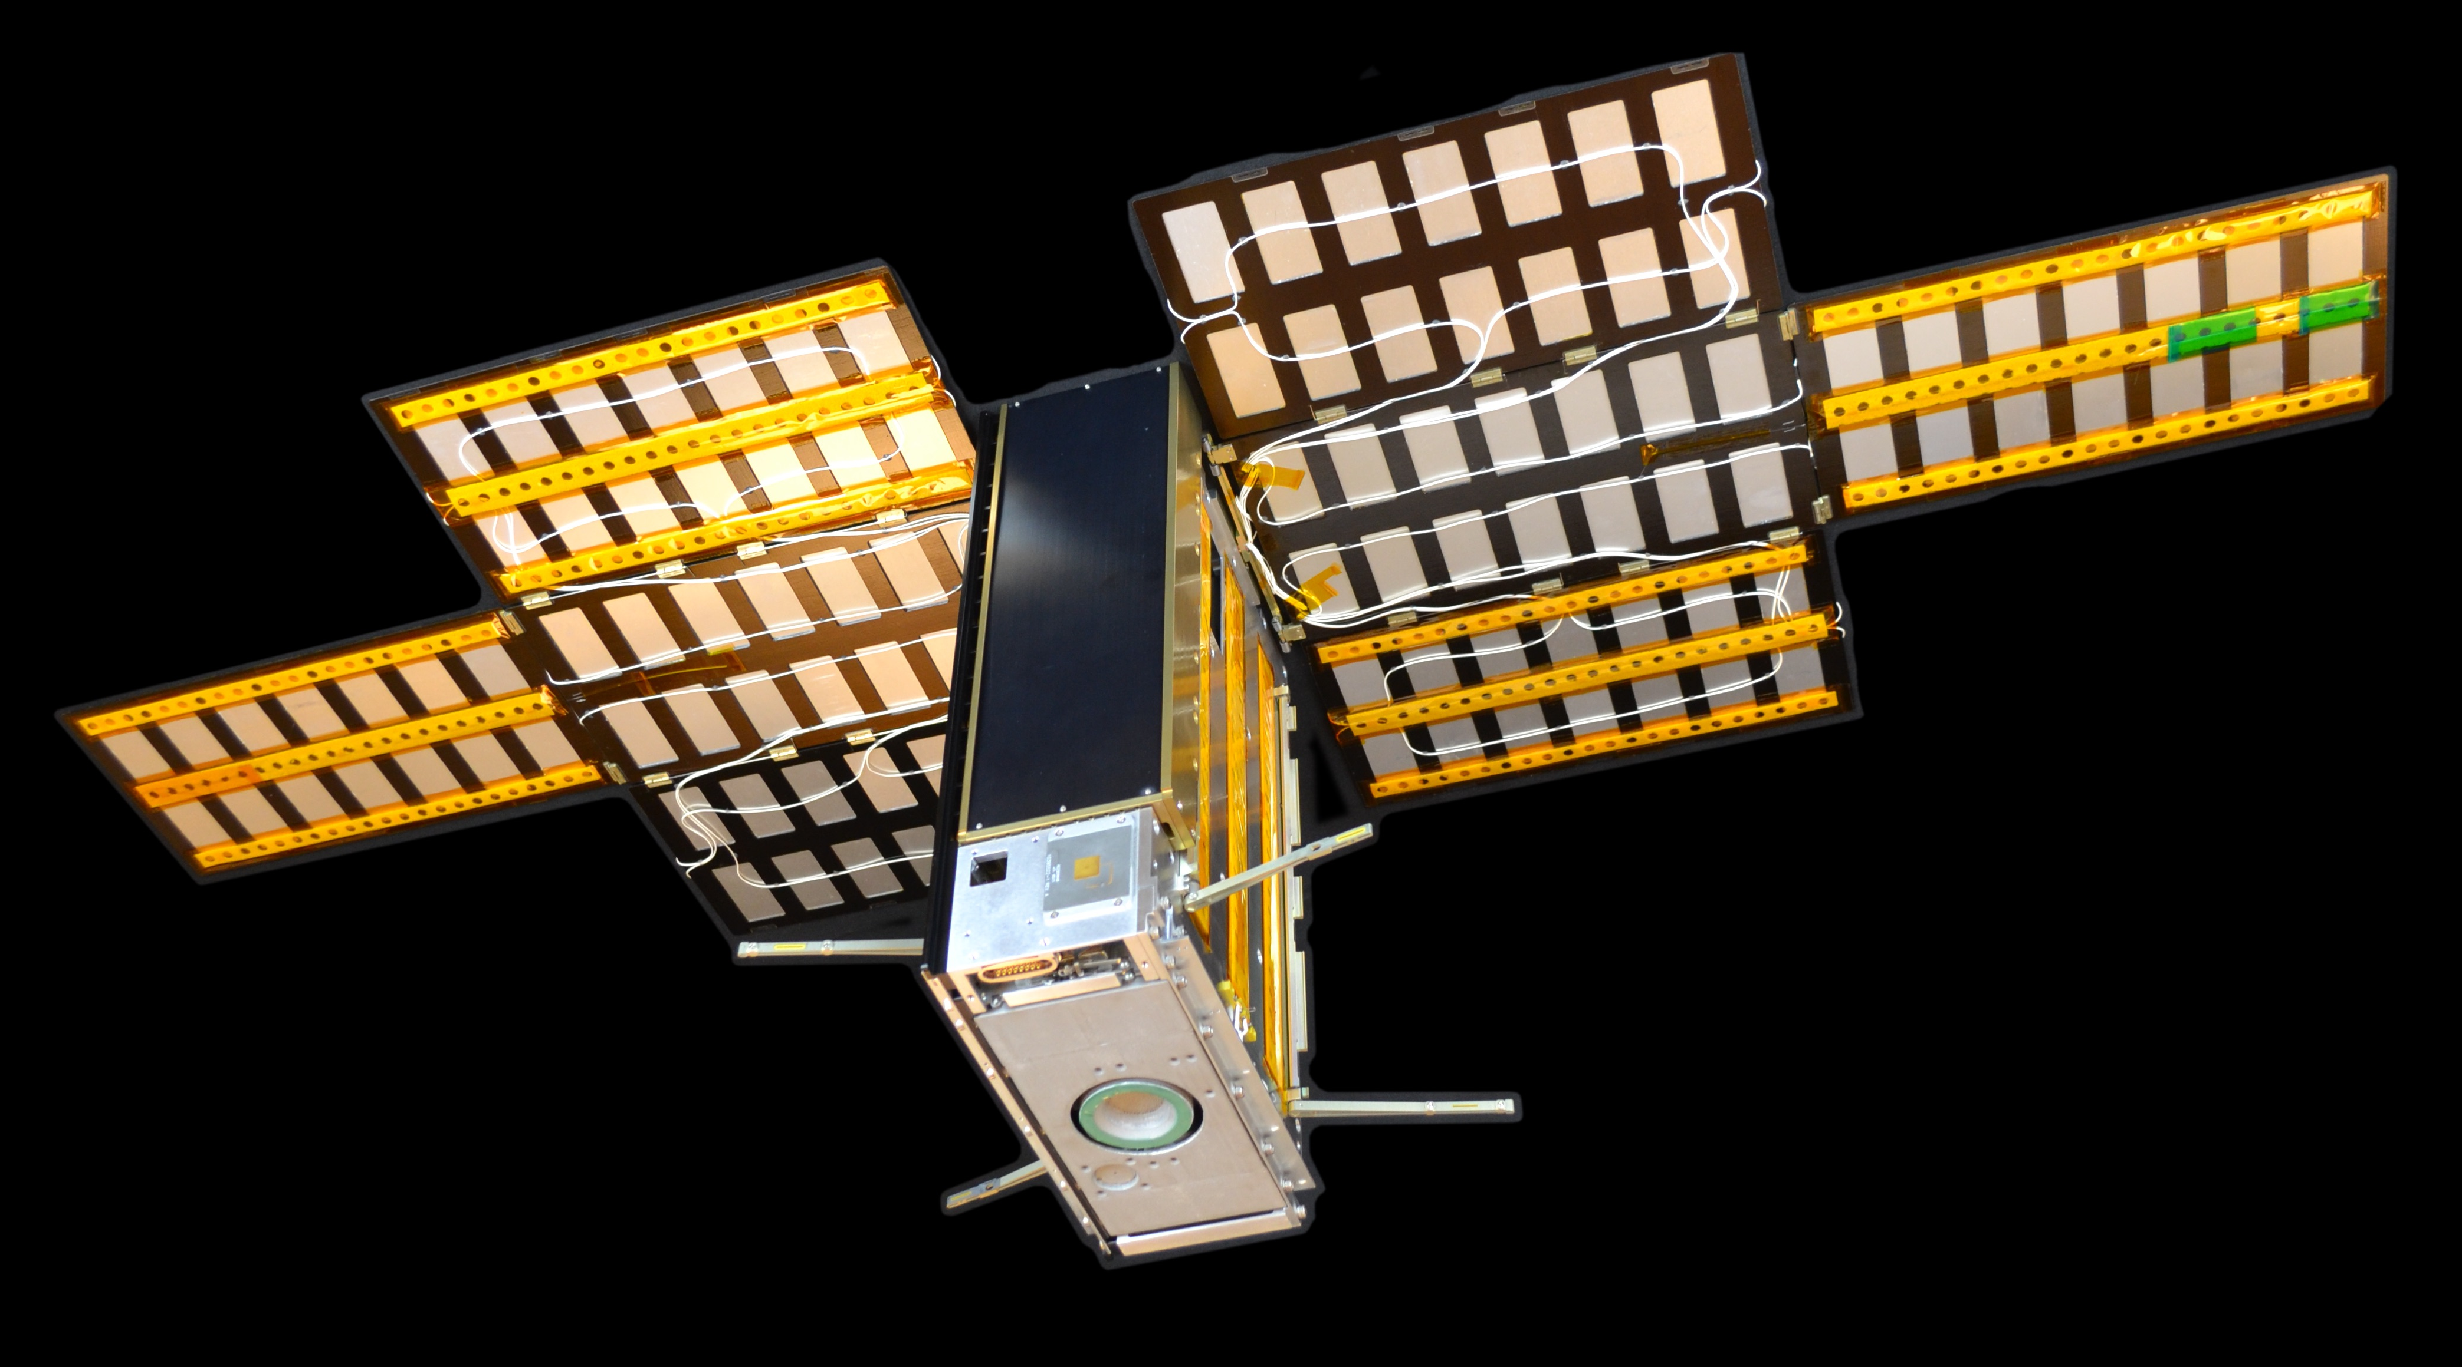











LunaH-Map
Lunar Polar Hydrogen Mapper
Craig Hardgrove
LunaH-Map Principal Investigator
School of Earth and Space Exploration
Arizona State University
Interplanetary Small Satellite Conference 2022

Slide 2
LunaH-Map
Lunar Polar Hydrogen Mapper
1st NASA Science Mission Directorate SIMPLEx mission selection in 2015. Solicitation via NASA ROSES 2014.
Developed from 2015 - 2020. Spacecraft delivered to NASA KSC in July 2021.
Launching on SLS Artemis-1 no-earlier-than August 2022.
Life cycle costs <$18M

Slide 3
LunaH-Map
Lunar Polar Hydrogen Mapper
Outline
LunaH-Map Science and Mission Overview
Development and Delivery Accomplishments
Low Cost Interplanetary Mission Thoughts

Slide 4
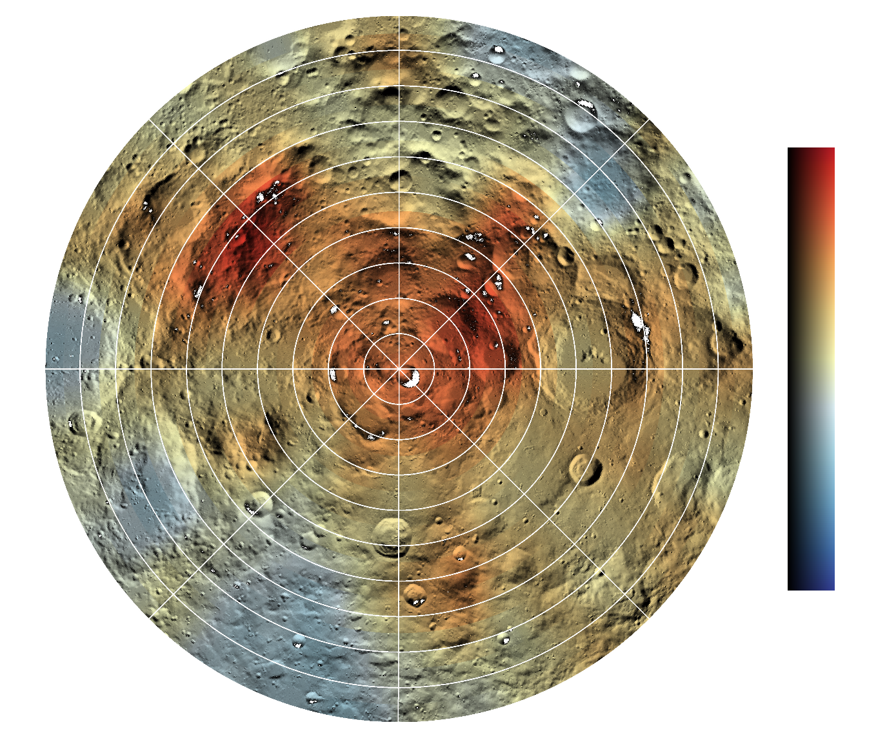
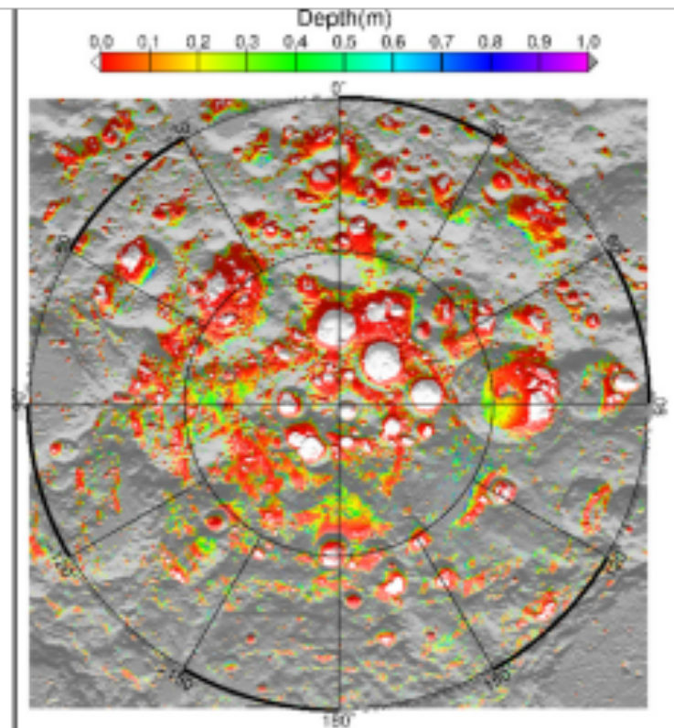
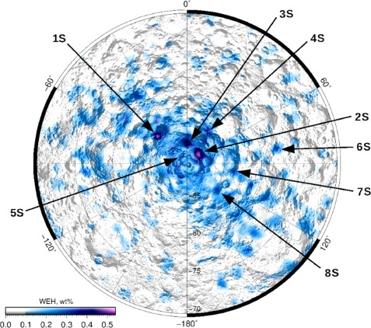
Lunar Polar Water Abundance and Distribution
Lunar Prospector (2001)
Diviner (2015)
Lunar Reconnaisance Orbiter (2017)
0E
[H] μg/g
270E
90E
180E
Analysis of LEND data (Sanin et al 2017) reveals higher WEH abundances (~0.5 wt%) in south polar craters Shoemaker, Haworth, and Faustini
Feldman, W. C. et al. (1998, 2000, 2001)
Figure 1 Map of current day ice stability depth from Siegler et al [2015] as used in constraint map development
Notes:
LP – launch 1998, 30/100 km, 19 mos (12 @ 100, 7 @ 30)
LRO – launch 2009, 50/100km as low as 30

Slide 5
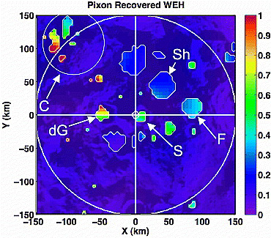
Lunar Polar Water Abundance and Distribution
Lunar Prospector (2007)
Diviner (2015)
Lunar Reconnaisance Orbiter (2017)
Pixon-based reconstruction of LPNS data (Elphic et al 2007) reveals high WEH abundances in Cabeus (near 1 wt%) and lower abundances in Shoemaker, Haworth, and Faustini (~0.3 wt%)
Analysis of LEND data (Sanin et al 2017) reveals higher WEH abundances (~0.5 wt%) in south polar craters Shoemaker, Haworth, and Faustini
Figure 1 Map of current day ice stability depth from Siegler et al [2015] as used in constraint map development
Notes:
LP – launch 1998, 30/100 km, 19 mos (12 @ 100, 7 @ 30)
LRO – launch 2009, 50/100km as low as 30

Slide 6
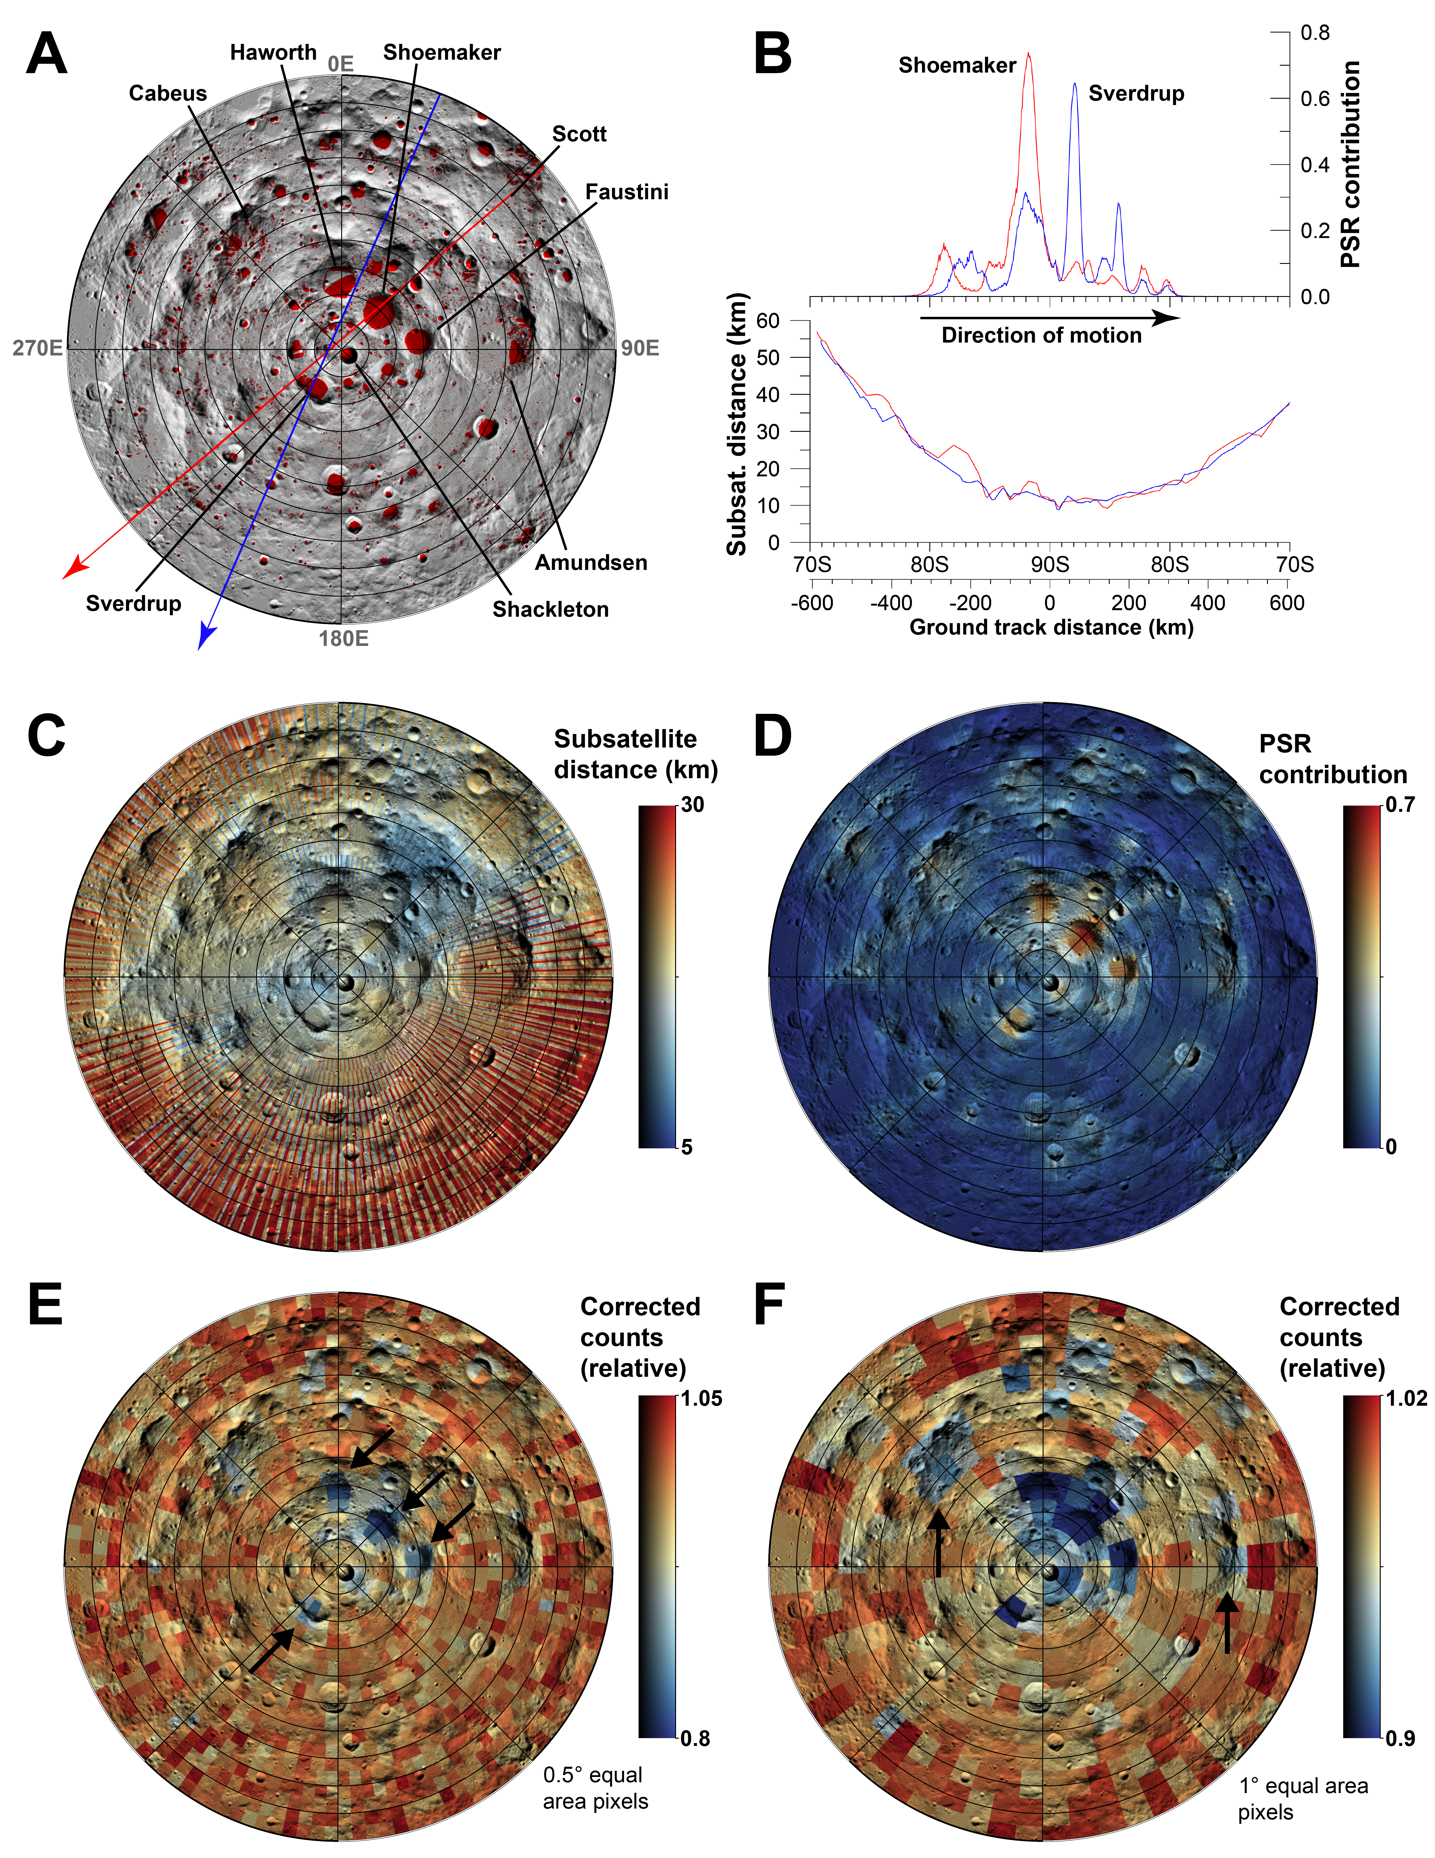
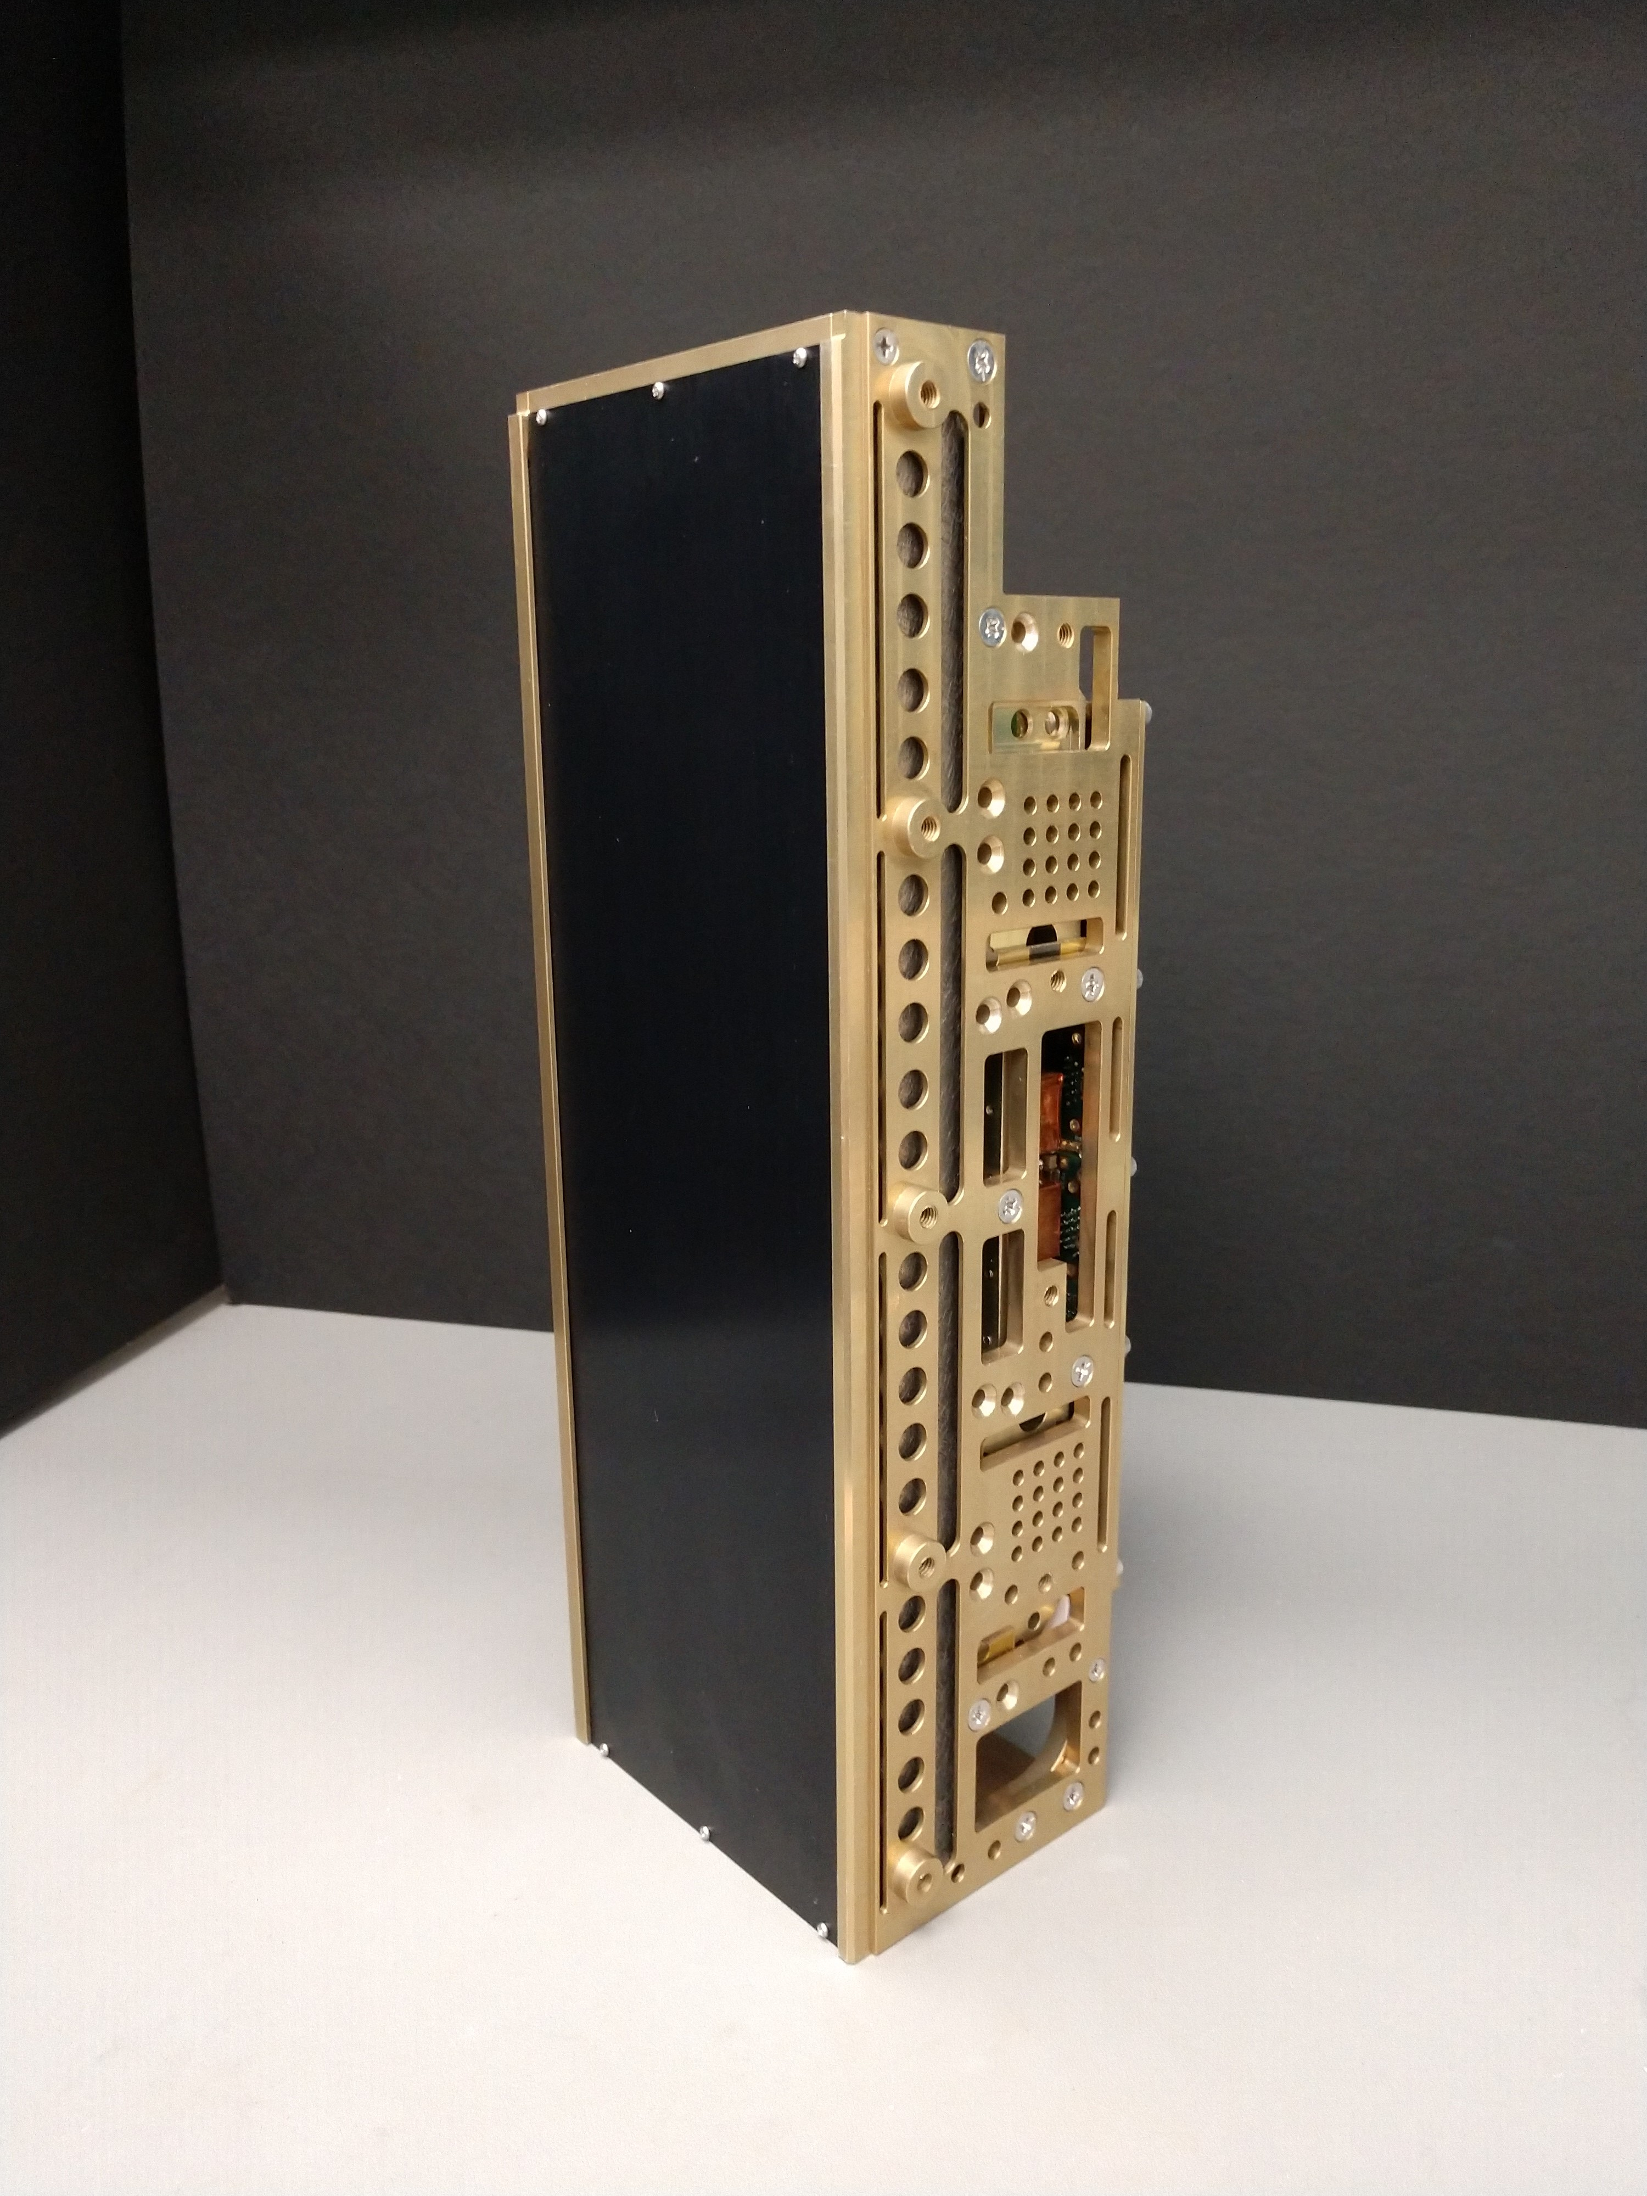
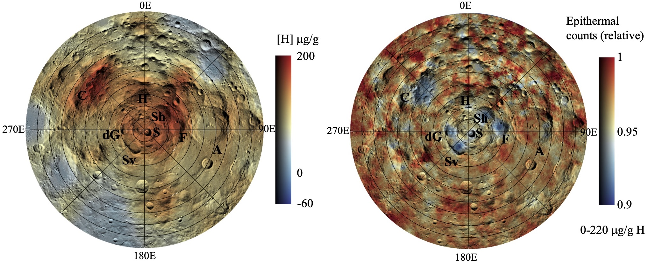
LunaH-Map Mission Overview
6U+ CubeSat form factor launching on SLS Artemis-1
  14 kg spacecraft
  1 science instrument.
  Deploy SLS. Use ion propulsion to navigate to weak stability boundary and lunar capture. Transition from high altitude circular to elliptical science orbit
  Science phase 2 months. Total mission duration 18 months.
LunaH-Map will enter a low-altitude perilune orbit above the South Pole, enabling neutron measurements that can reveal hydrogen enrichments within and surrounding individual PSRs.
Science Objective: Map hydrogen enrichments within PSRs at the lunar south pole at spatial scales <20 km²
Tech Objectives: Deep space navigation and operations using ion propulsion on a small sat
Ground tracks for select perilune passes during science orbit*
Mini-NS: Compact neutron and gamma-ray spectrometer for small spacecraft*
*Hardgrove et al., IEEE (2020); Heffern et al., NIM-A (2022)

Slide 7
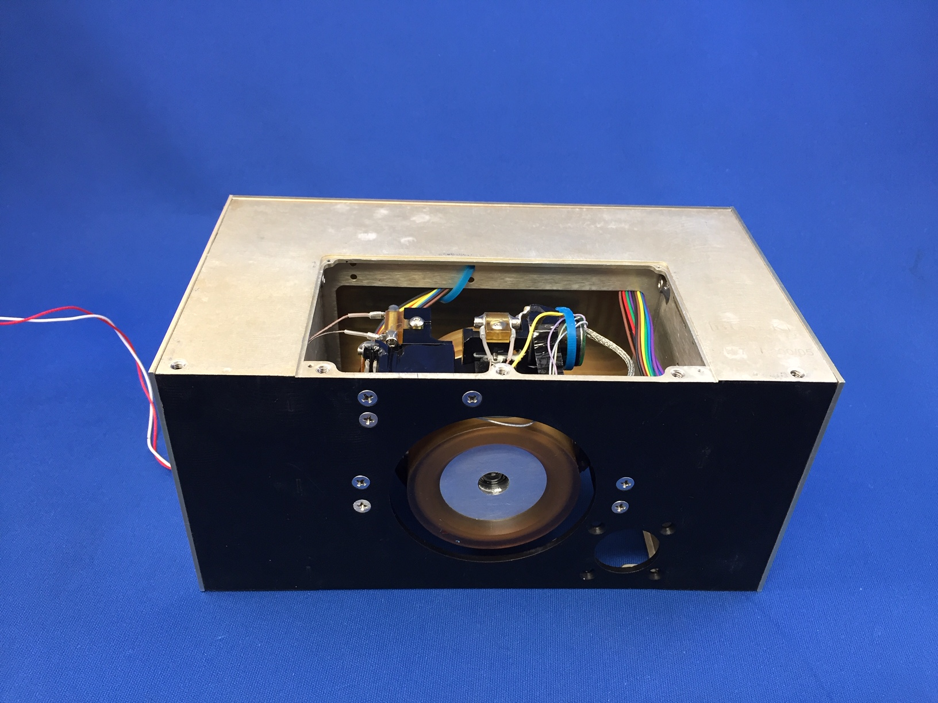
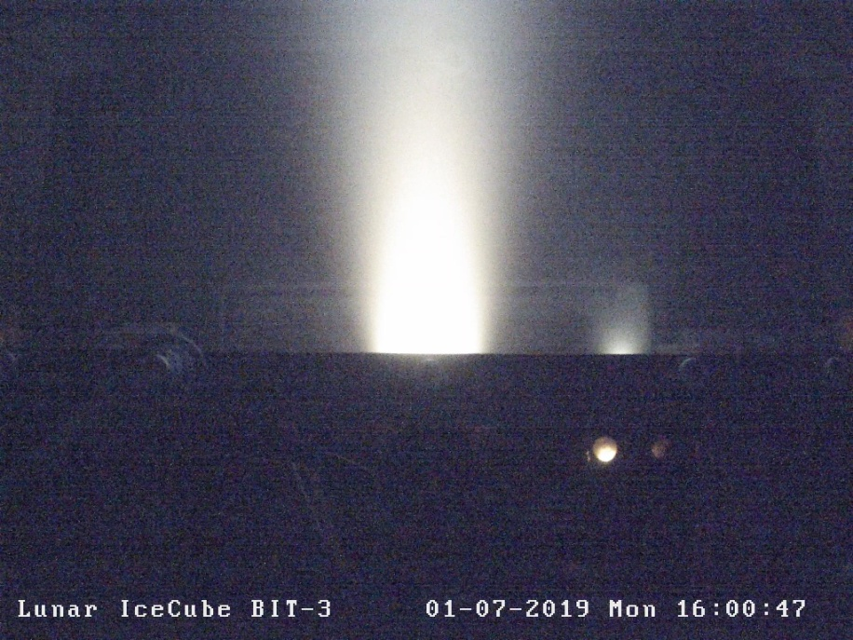
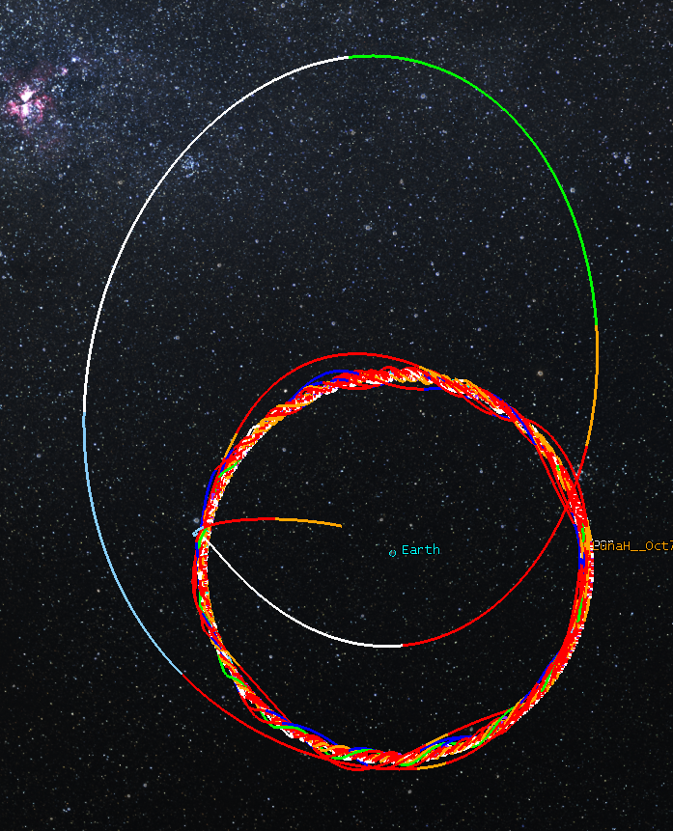
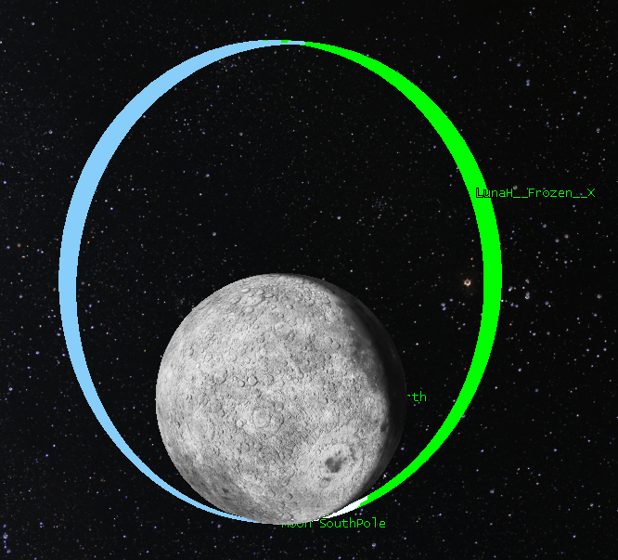
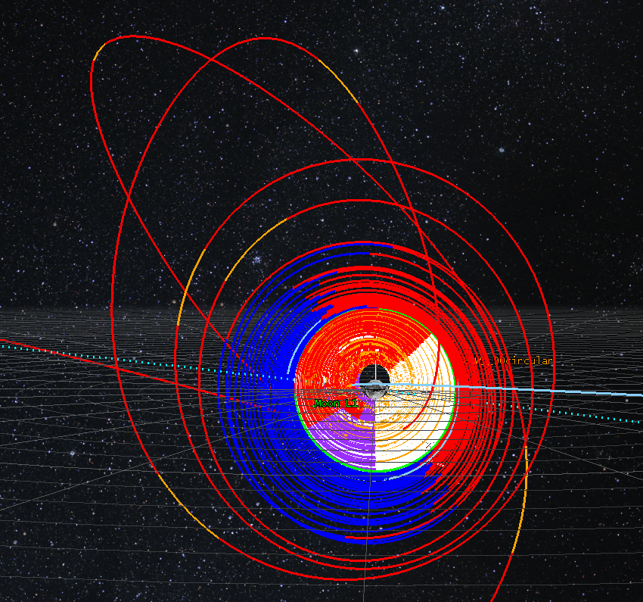
LunaH-Map Navigation
1
3
LunaH-Map Flight BIT-3 propulsion system – Delivered Decmber 2019
BIT-3 QM Hot Fire Iodine Testing
Orbit Period | 4.76 hour
Aposelene Altitude | 3150 km
Periselene Altitude | RAAN dependent 15-25 km
Inclination | 90°
Argument of Periselene | 273.5°
2
Genova, A. L. and Dunham, D. W. (2017) 27th AAS/AIAA Space Flight Mechanics Meeting 17-456.

Slide 8
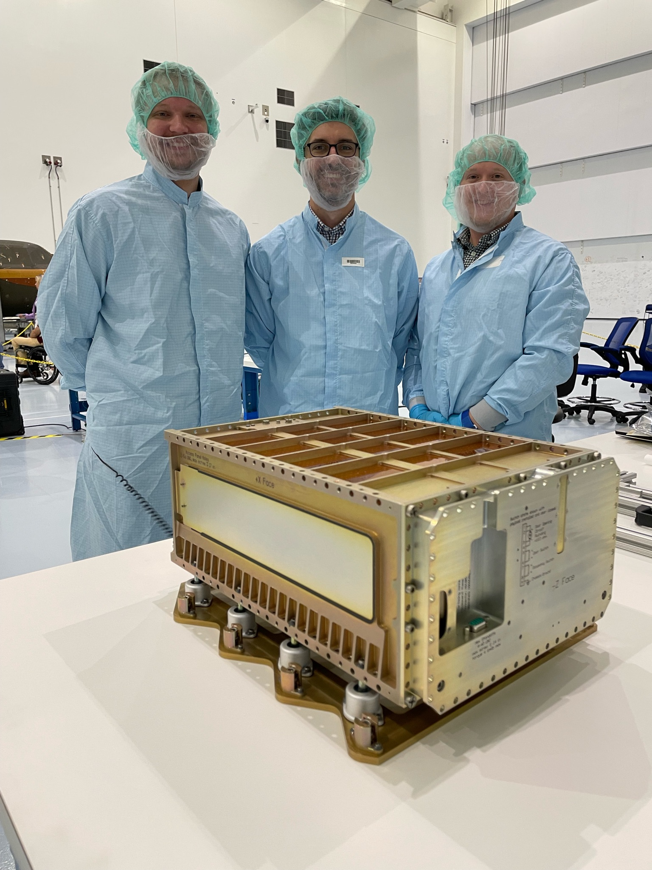
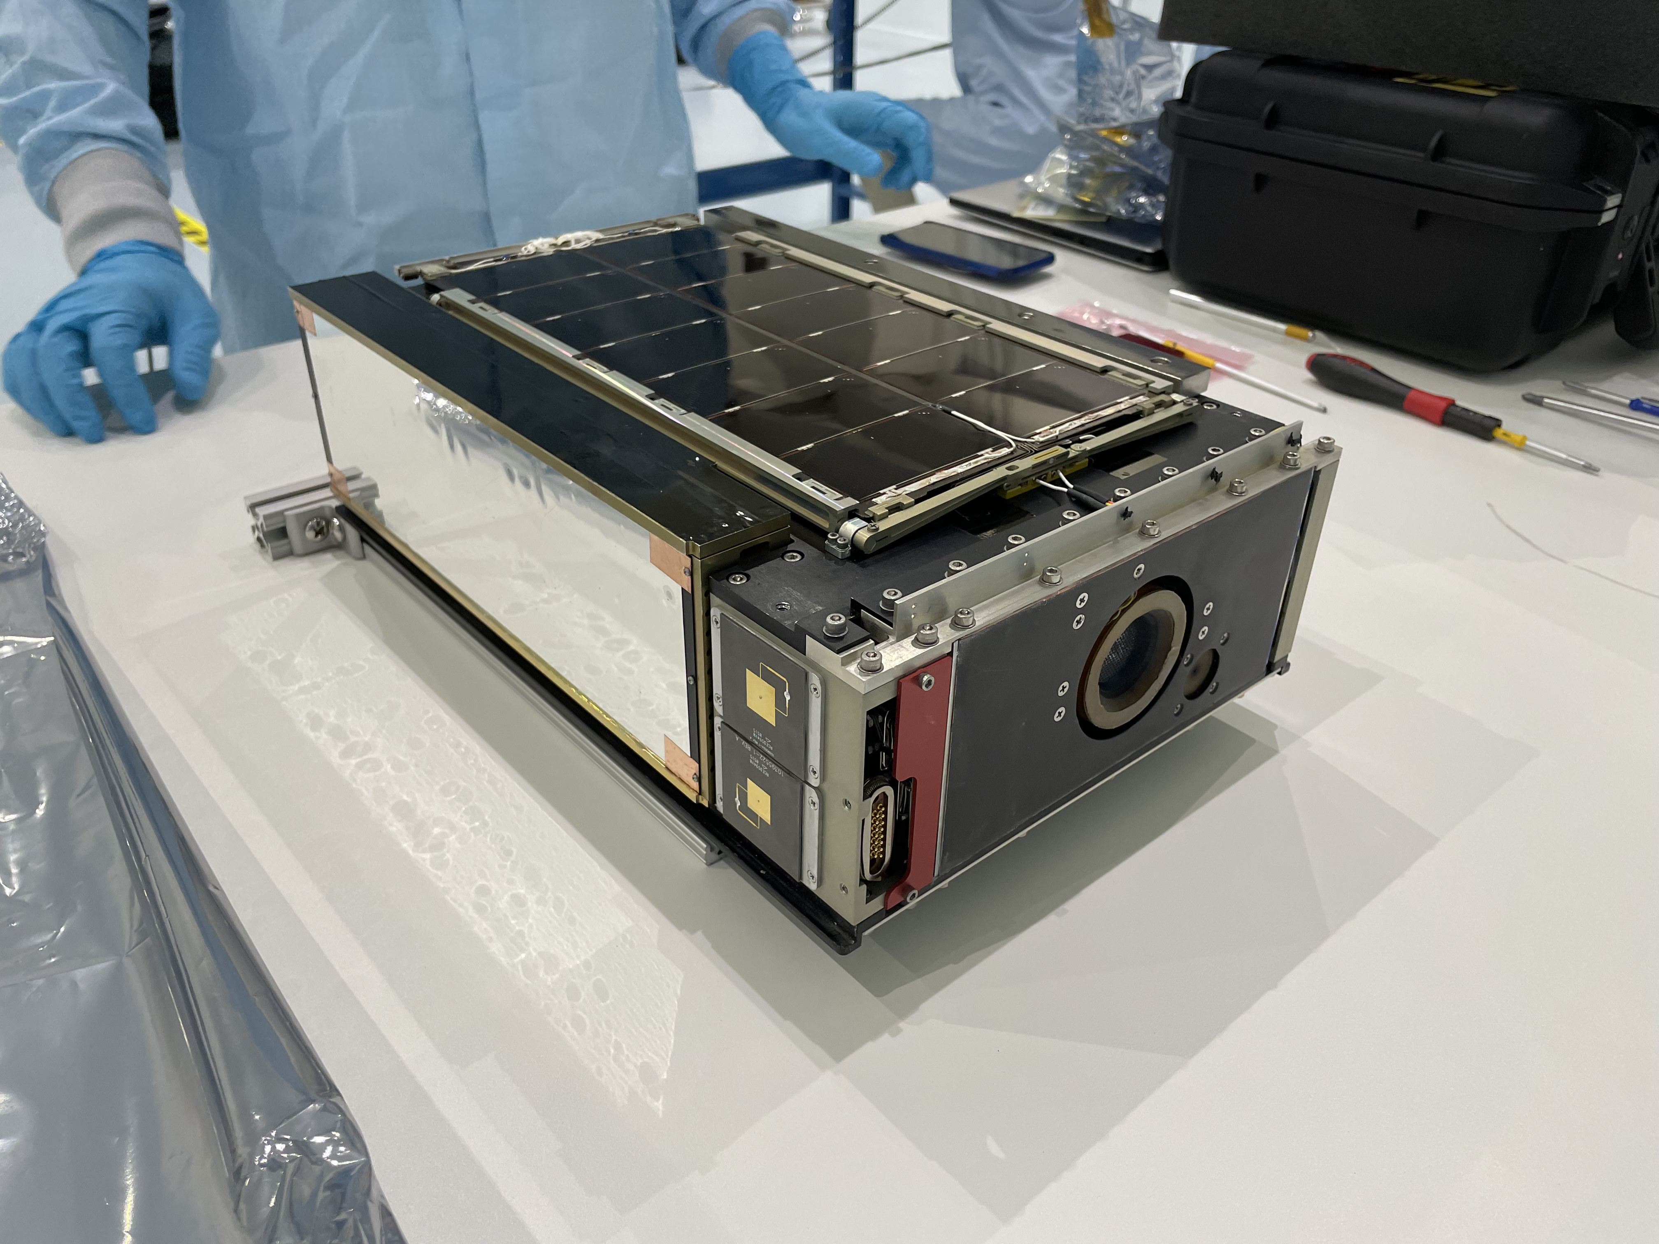
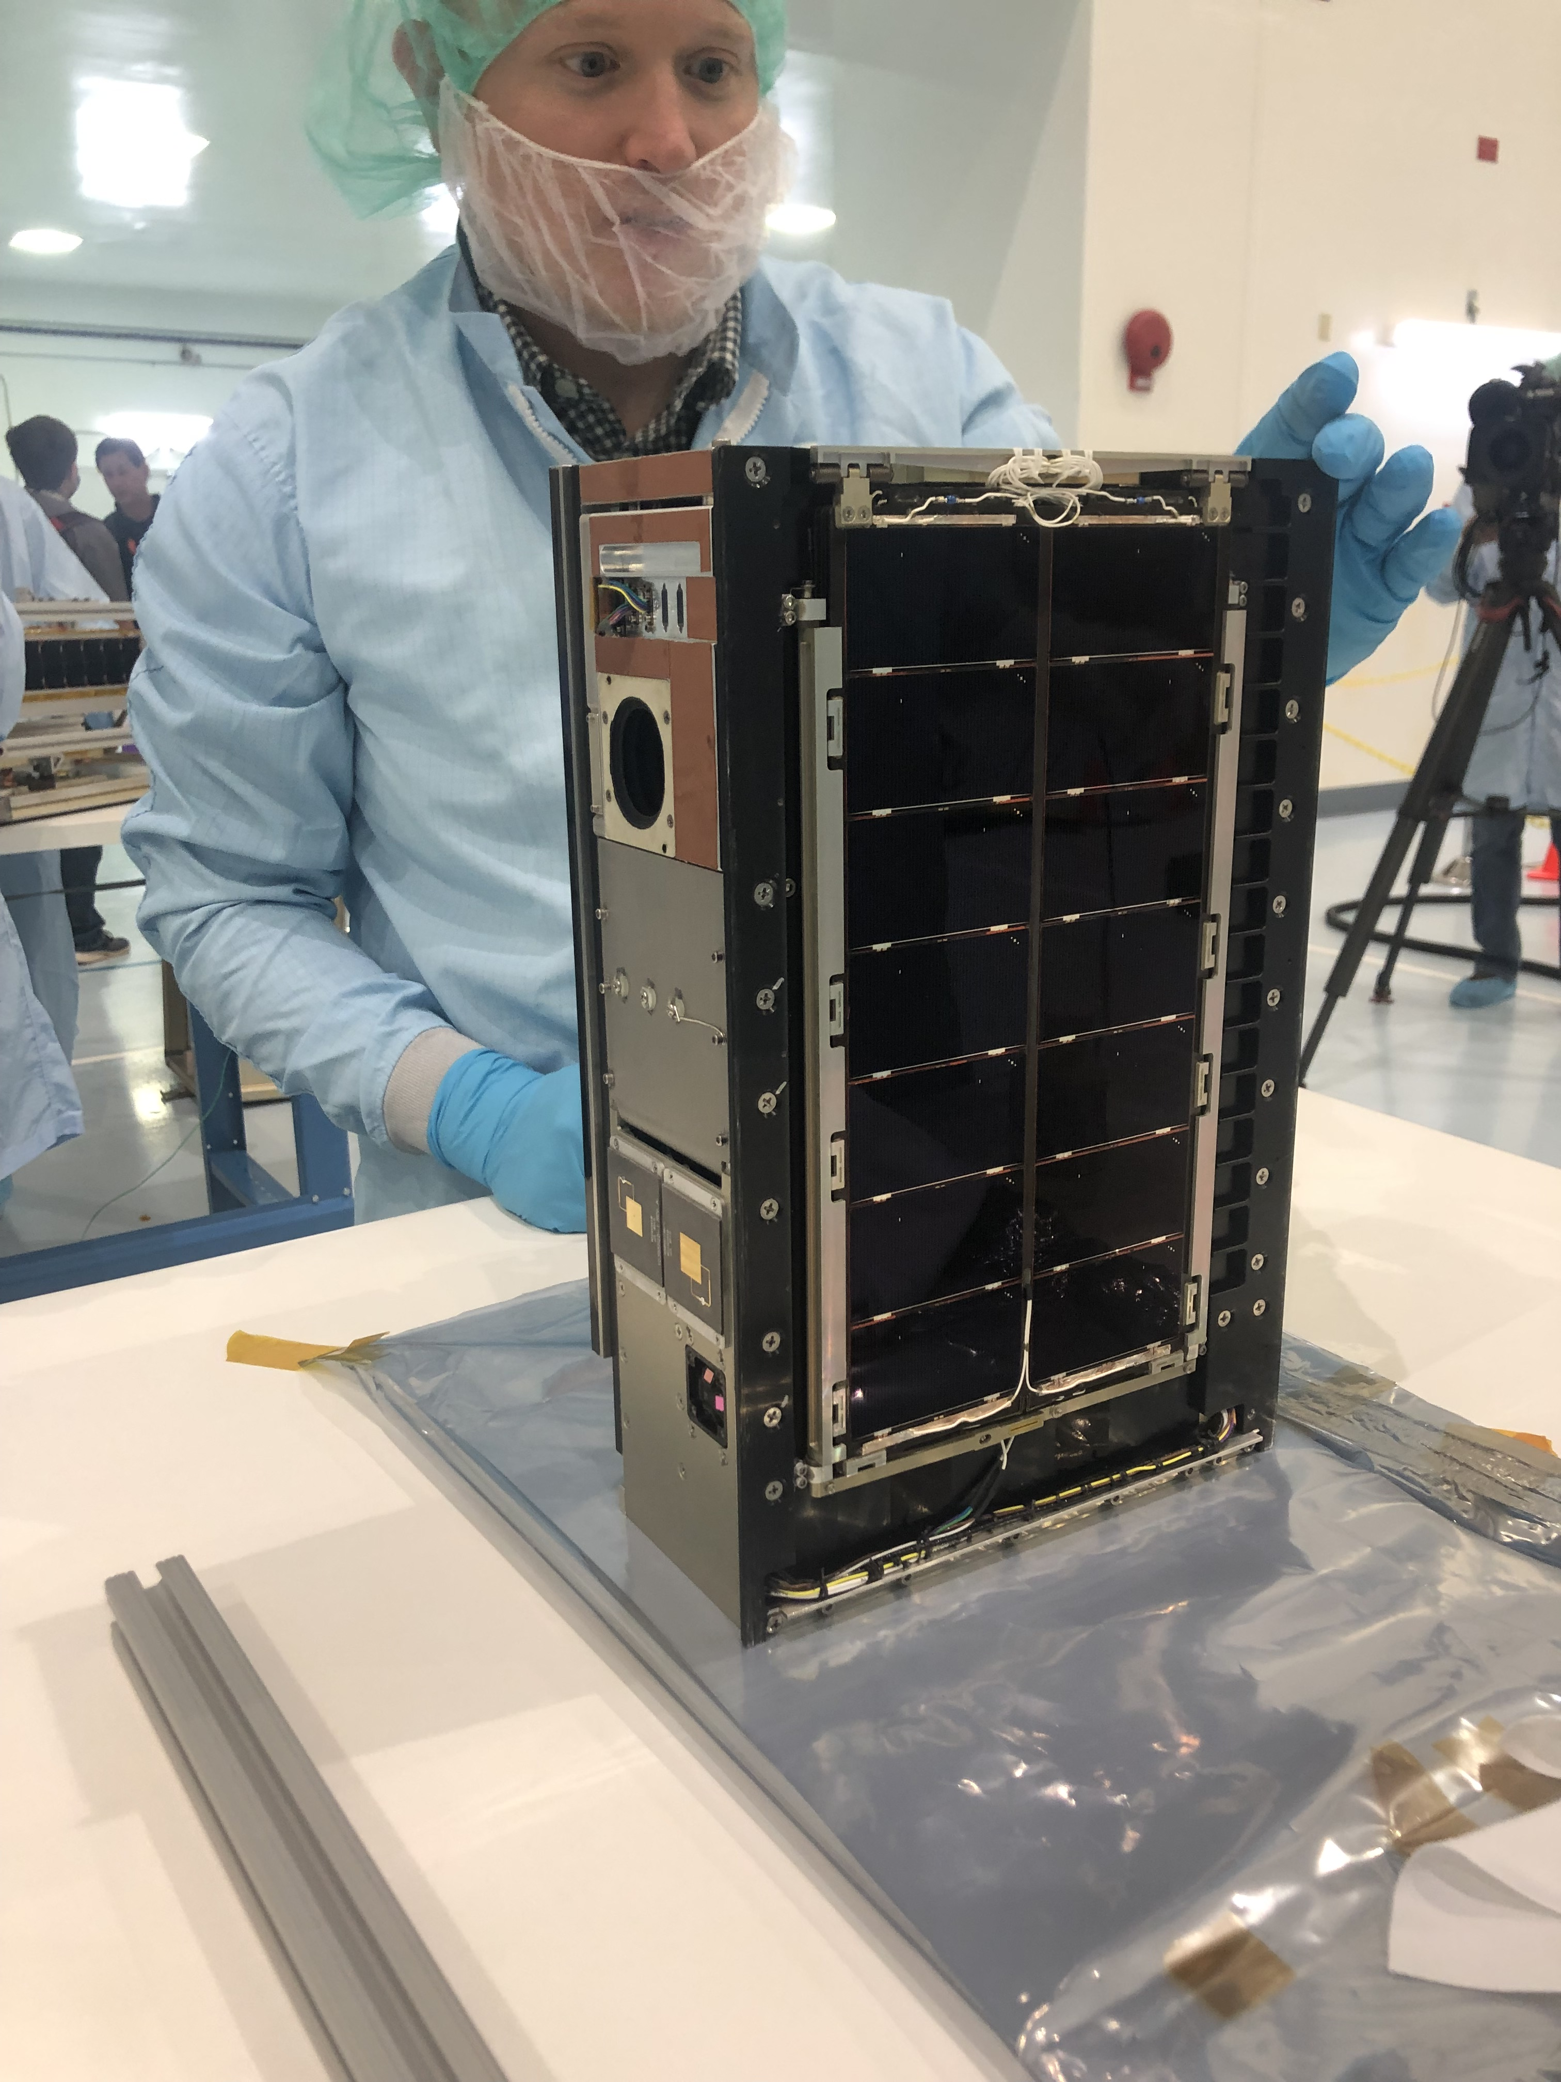
LunaH-Map Delivery to SLS Artemis-1
Inspection: LunaH-Map delivery to NASA KSC July 2021
Inspection: LunaH-Map delivery to NASA KSC July 2021
Loaded into PSC Deployer: Delivered!

Slide 9
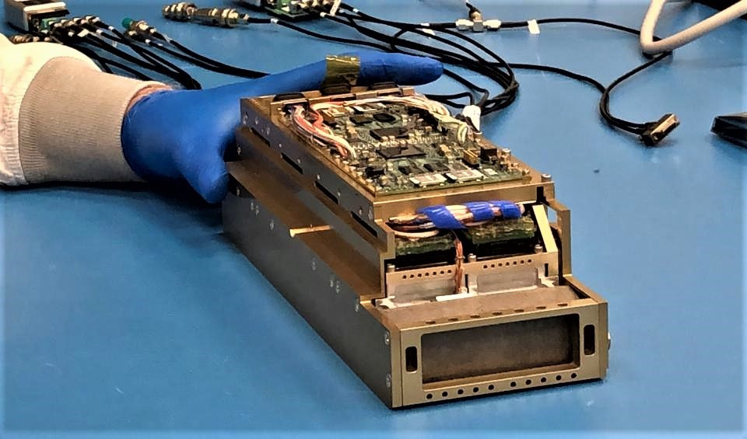


Mini-NS: Miniature Neutron
Spectrometer
Mini-NS Flight Unit

Slide 10
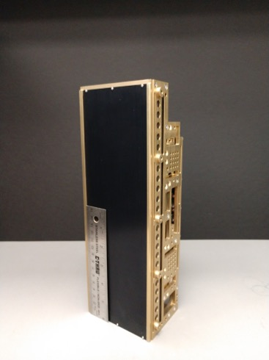
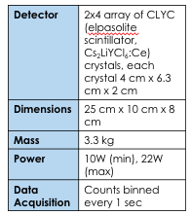
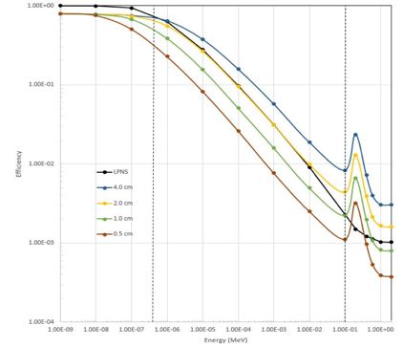
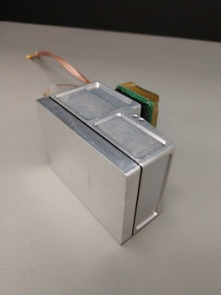
Miniature Neutron Spectrometer for CubeSats and SmallSats – Flight Unit
Mini-NS epithemal neutron intrinsic efficiency*
Mini-NS achieves twice the epithermal neutron count rate of Lunar Prospector NS in a modular cubesat design.
Mini-NS Flight Unit delivered and calibrated at Los Alamos National Lab Neutron Free In-Air (NFIA) facility in late Fall 2018
*Hardgrove et al., IEEE (2020)
Notes:
Yes add graphic

Slide 11
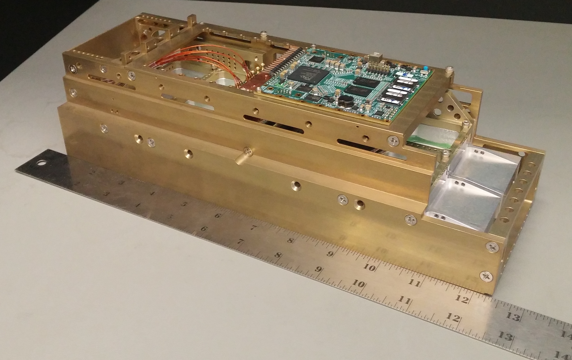
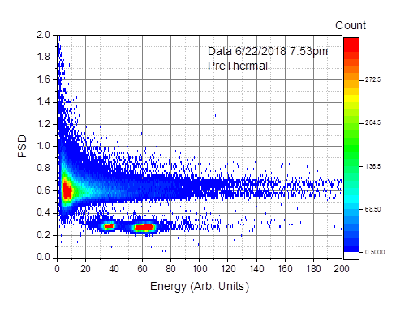
Miniature Neutron Spectrometer for CubeSats and SmallSats – Dev Unit
neutrons
Each Mini-NS detector module is sensitive to both neutrons (to detect hydrogen on planetary surfaces) and characteristic gamma-rays (to detect elements like Fe, K, Th, Si, Al, Mg) ← ready to be proposed with YOUR mission ☺
LunaH-Map protoflight Miniature Neutron Spectrometer (Mini-NS) unit was developed with a subset of the 8 detector modules, analog and digital boards populated prior to final assembly and qualification.
Notes:
Yes add graphic

Slide 12
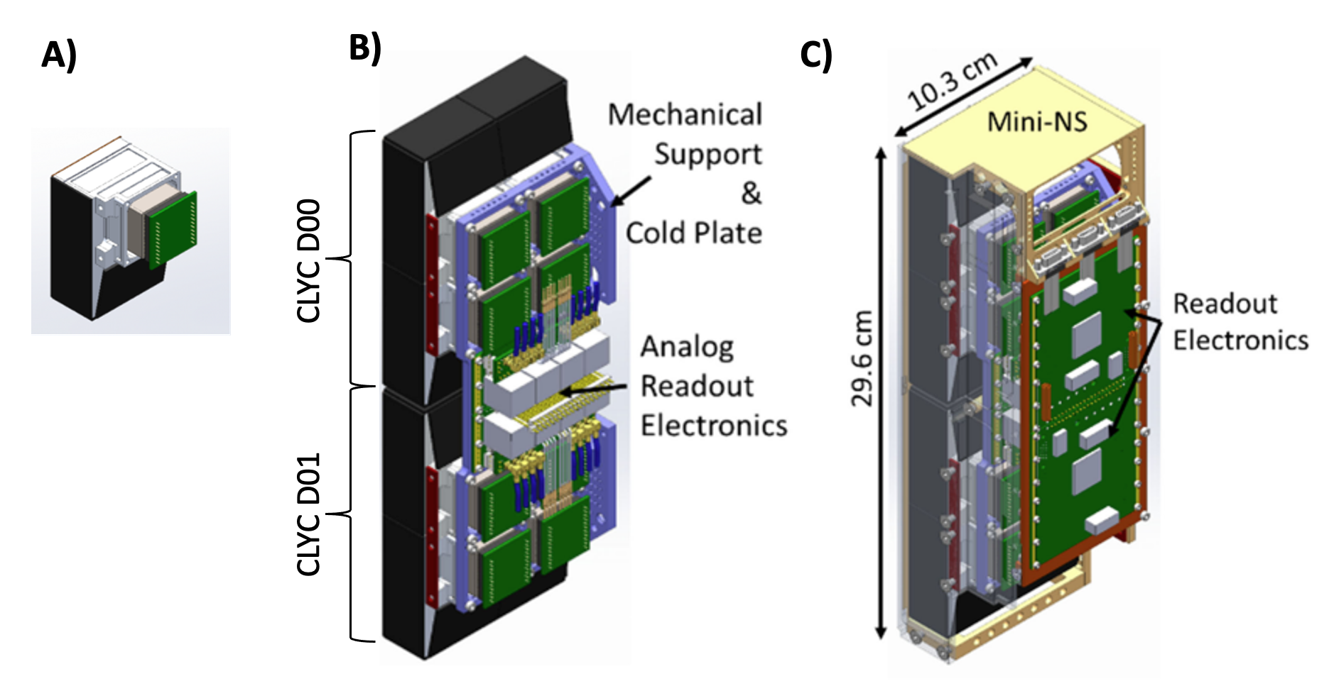
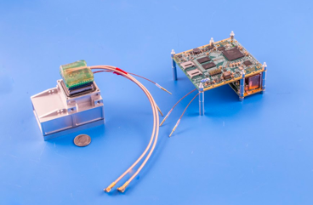
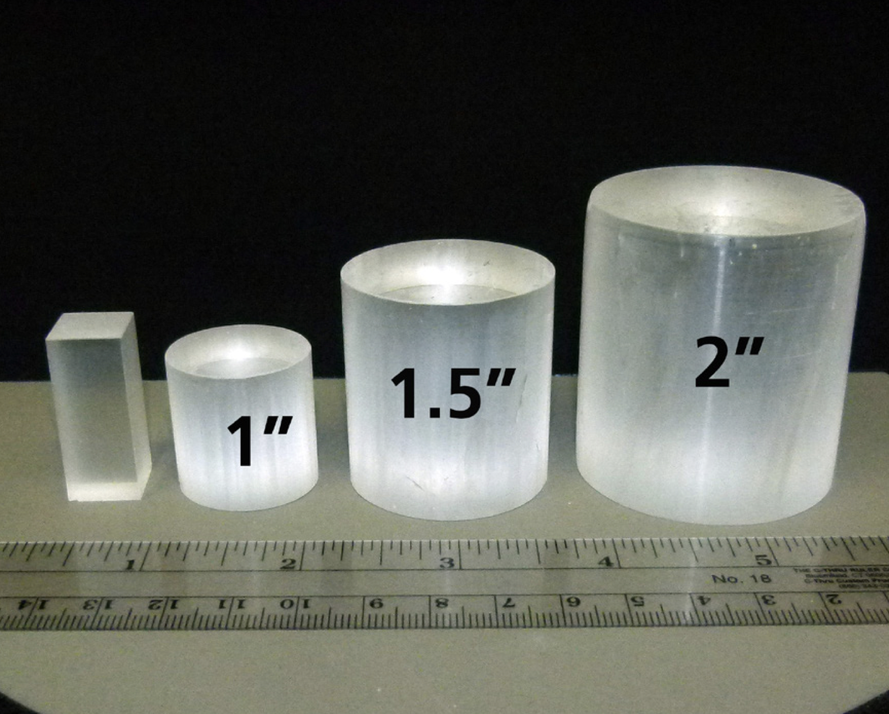
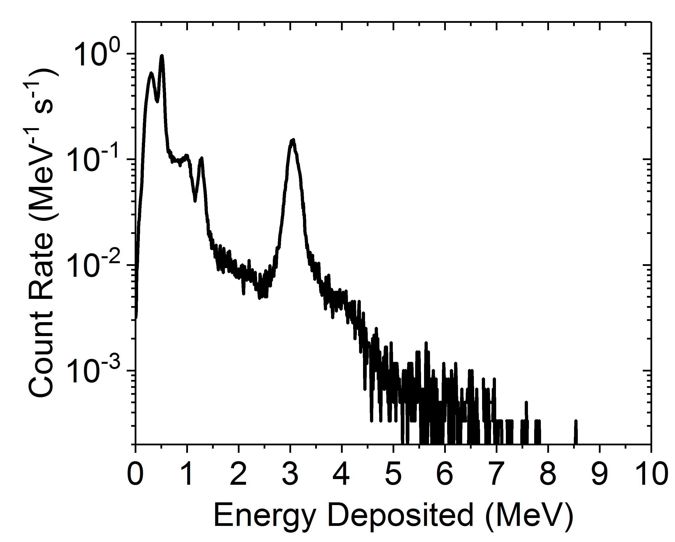
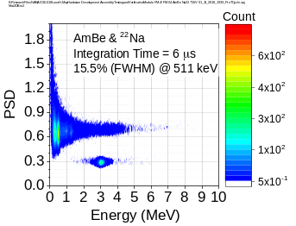
COMPACT, MODULAR NEUTRON AND GAMMA-RAY SPECTROMETER FOR SMALL SPACECRAFT
Sensitive to the top meter of Mars, can identify shallowly buried ice, salts, hydrated mineral enrichments
Used to identify enrichments or depletions in surface or buried hydrated materials (H2O, ice), Cl-rich salts, Fe-poor or high-Si materials.
Flight Mini-NS for LunaH-Map (8 modules)
At Mars, one or two sensor heads could be used on a surface or ariel vehicle to identify enrichments of 1-2 wt.% water
At the Moon, from orbit 8 sensor heads will be used to identify enrichments of 200 ppm H in tens of minutes.
Mass = 400 grams per sensor head
Mini-NS Tech Specs
Sensitivity | Thermal (<0.3 eV), epithermal (>0.3 eV - ~10 keV) and fast neutrons (>1 MeV and < 3 MeV); Gamma-rays (< 4 MeV) with energy resolution 4% FWHM at 662 keV
Sensor head | 1 sensor head = 4cm x 6.3cm x 2cm rectangular CLYC crystal attached to ruggedized photomultiplier tube (Hamamatsu)
Mass | 1.7 kg per 4 sensor head detector
Power | 1.8 W (standby), 4.8 W (data acquisition) per 4 sensor head detector
Volume | 12.5 cm x 5 cm x 4 cm per 4 sensor head detector
Data Rate | 7 bytes/sec, 25 kB/sec stored locally per 4 sensor head detector
Data products | Counts per second, event-by-event
Internal Storage | 16GB
CLYC is a scintillator sensitive to both neutrons and gamma-rays. Pulse shape discrimination is used within the FPGA to record an energy spectrum per module

Slide 13
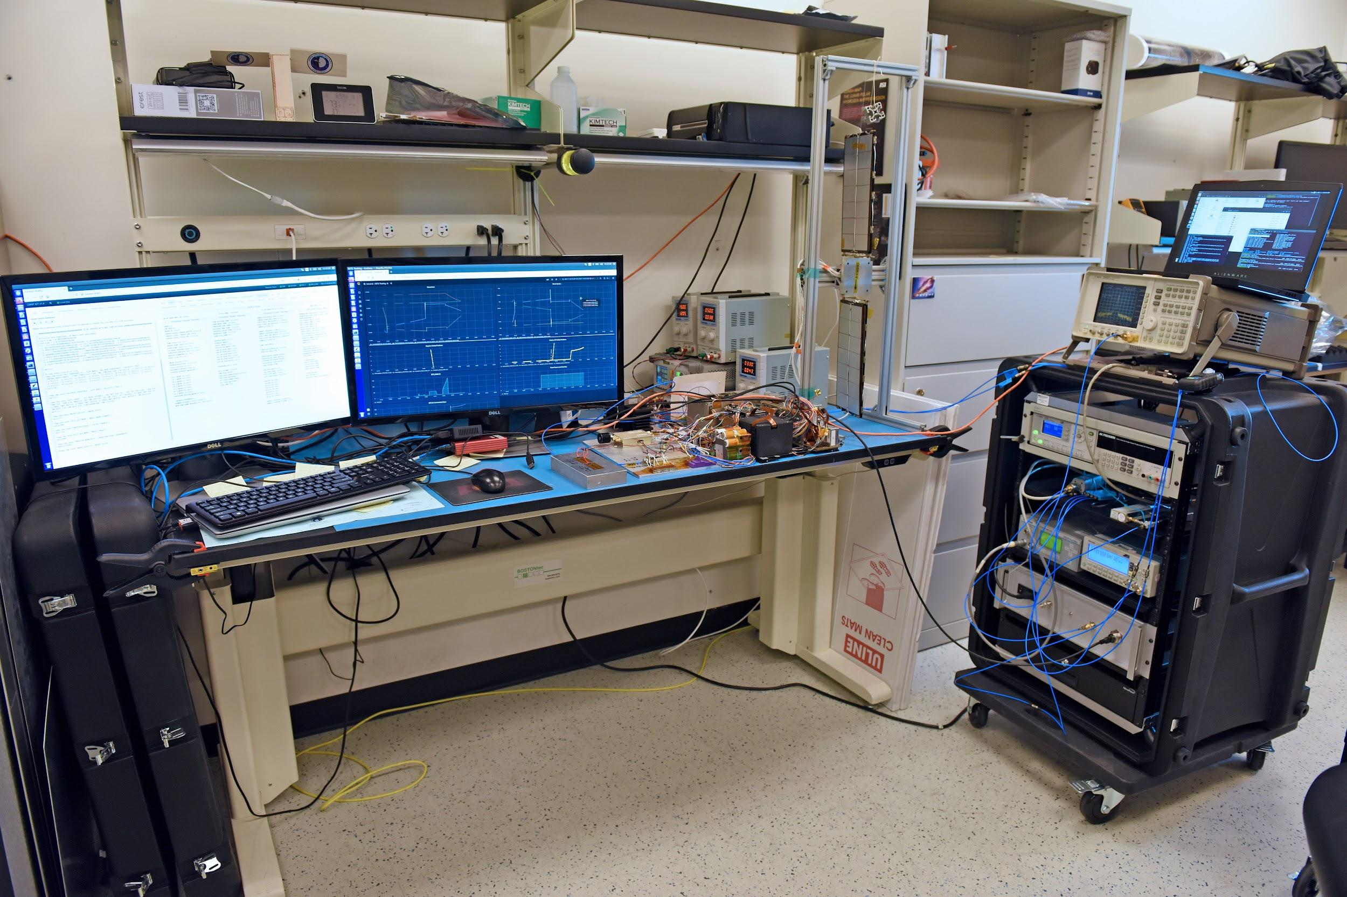
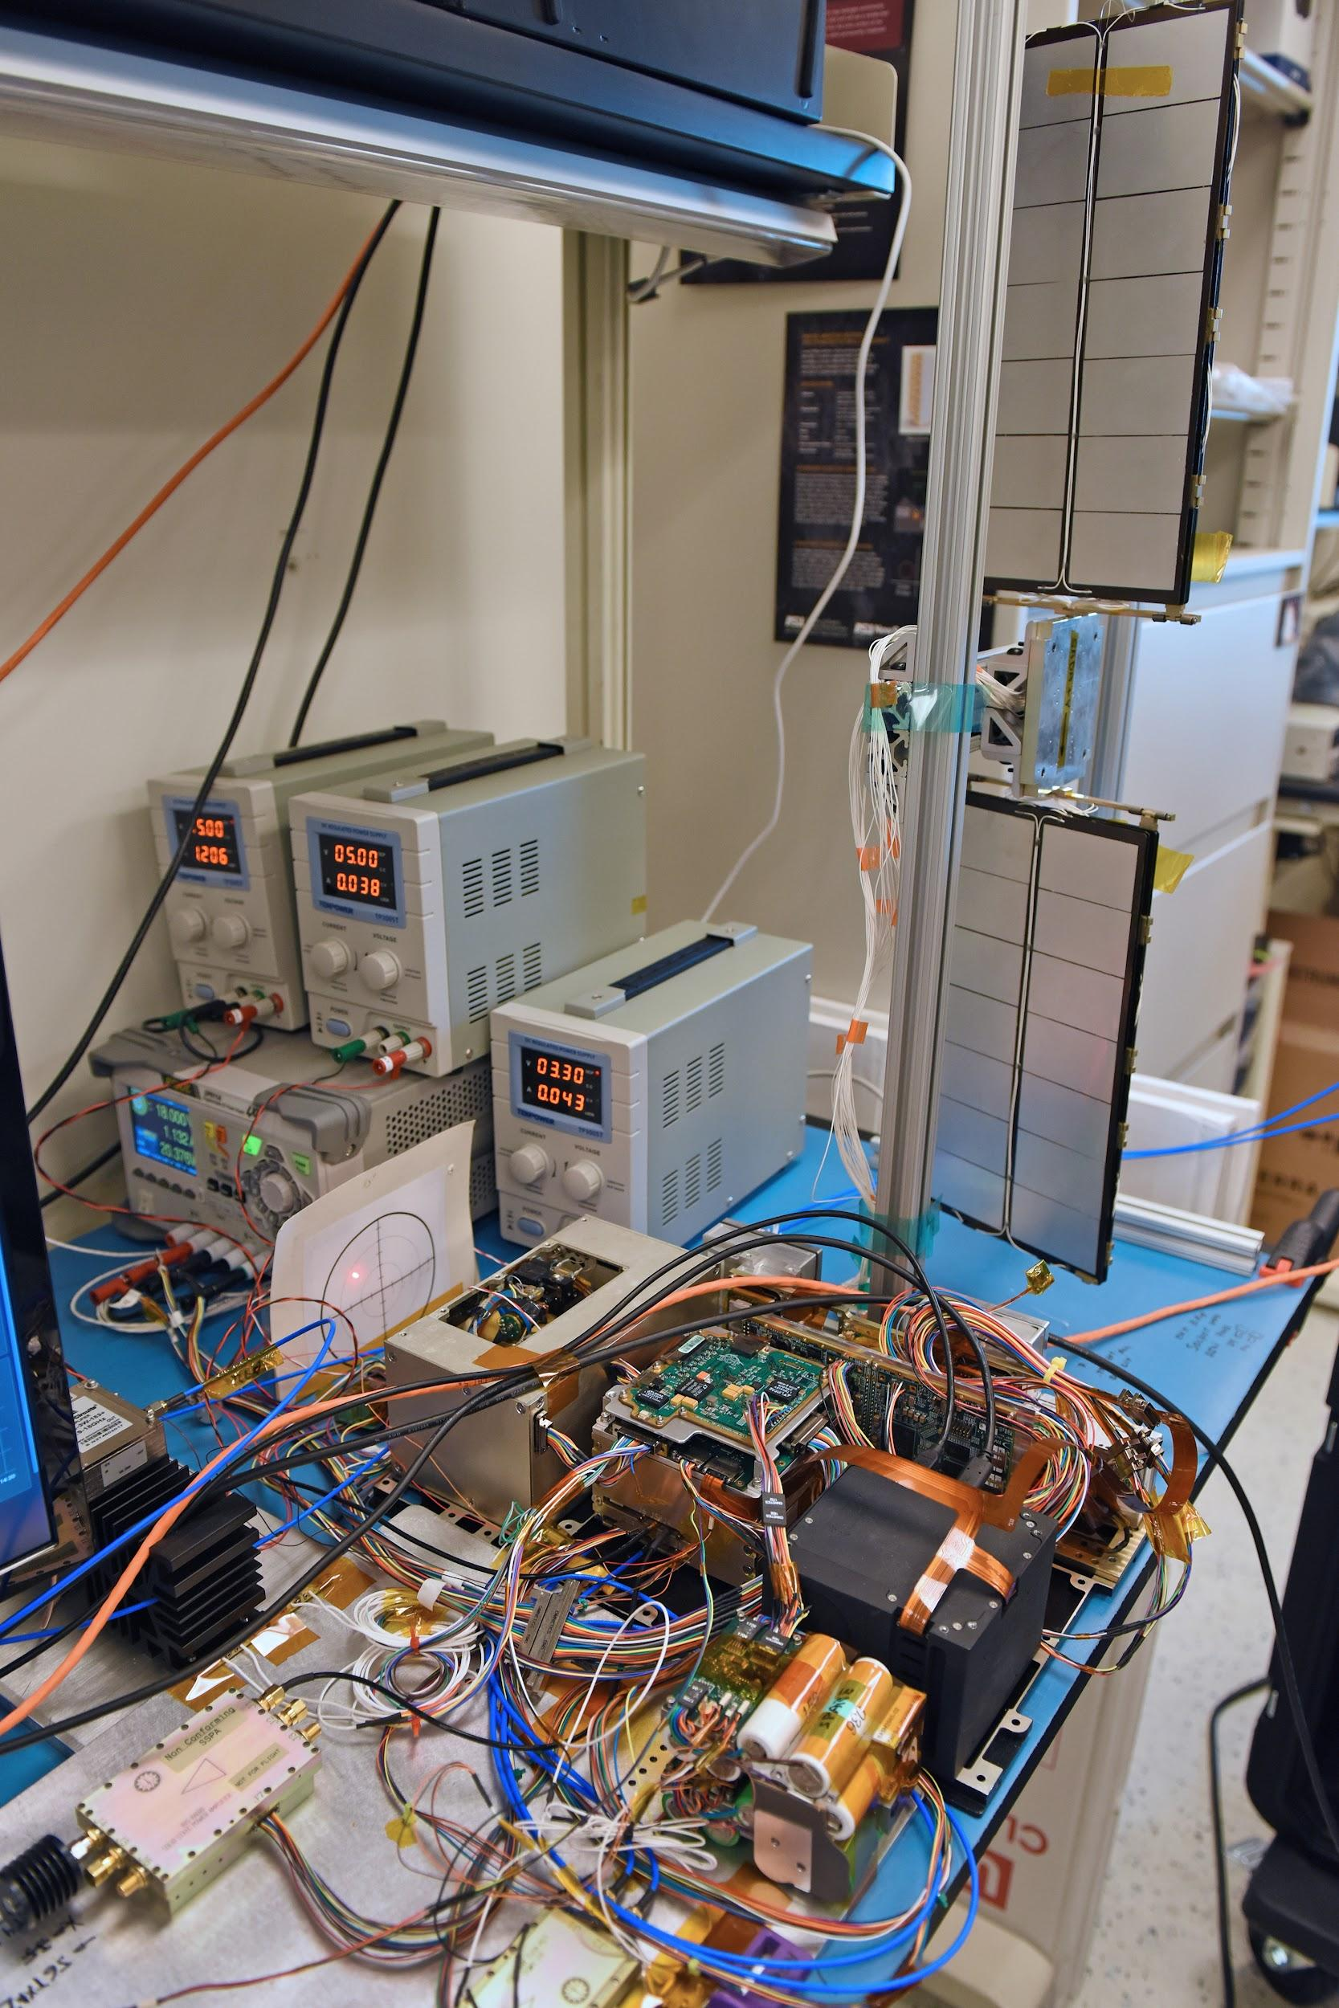
Preparation for Launch
Solar array
AIT and Grafana for commanding and telemetry visualization
Mini-NS (instrument)
CASSY to simulate DSN comms
BIT-3
Primary operations activities:
Negotiating DSN schedule L+7 days
Onboarding full time ops staff, training, rehearsals and ORTs
Thread tests between MOC and NAV
Preparing NASA PDS archiving agreement and draft archive plans
Iris
XB1-50 & XEPS
LunaH-Map flatsat and testbed at Arizona State University

Slide 14
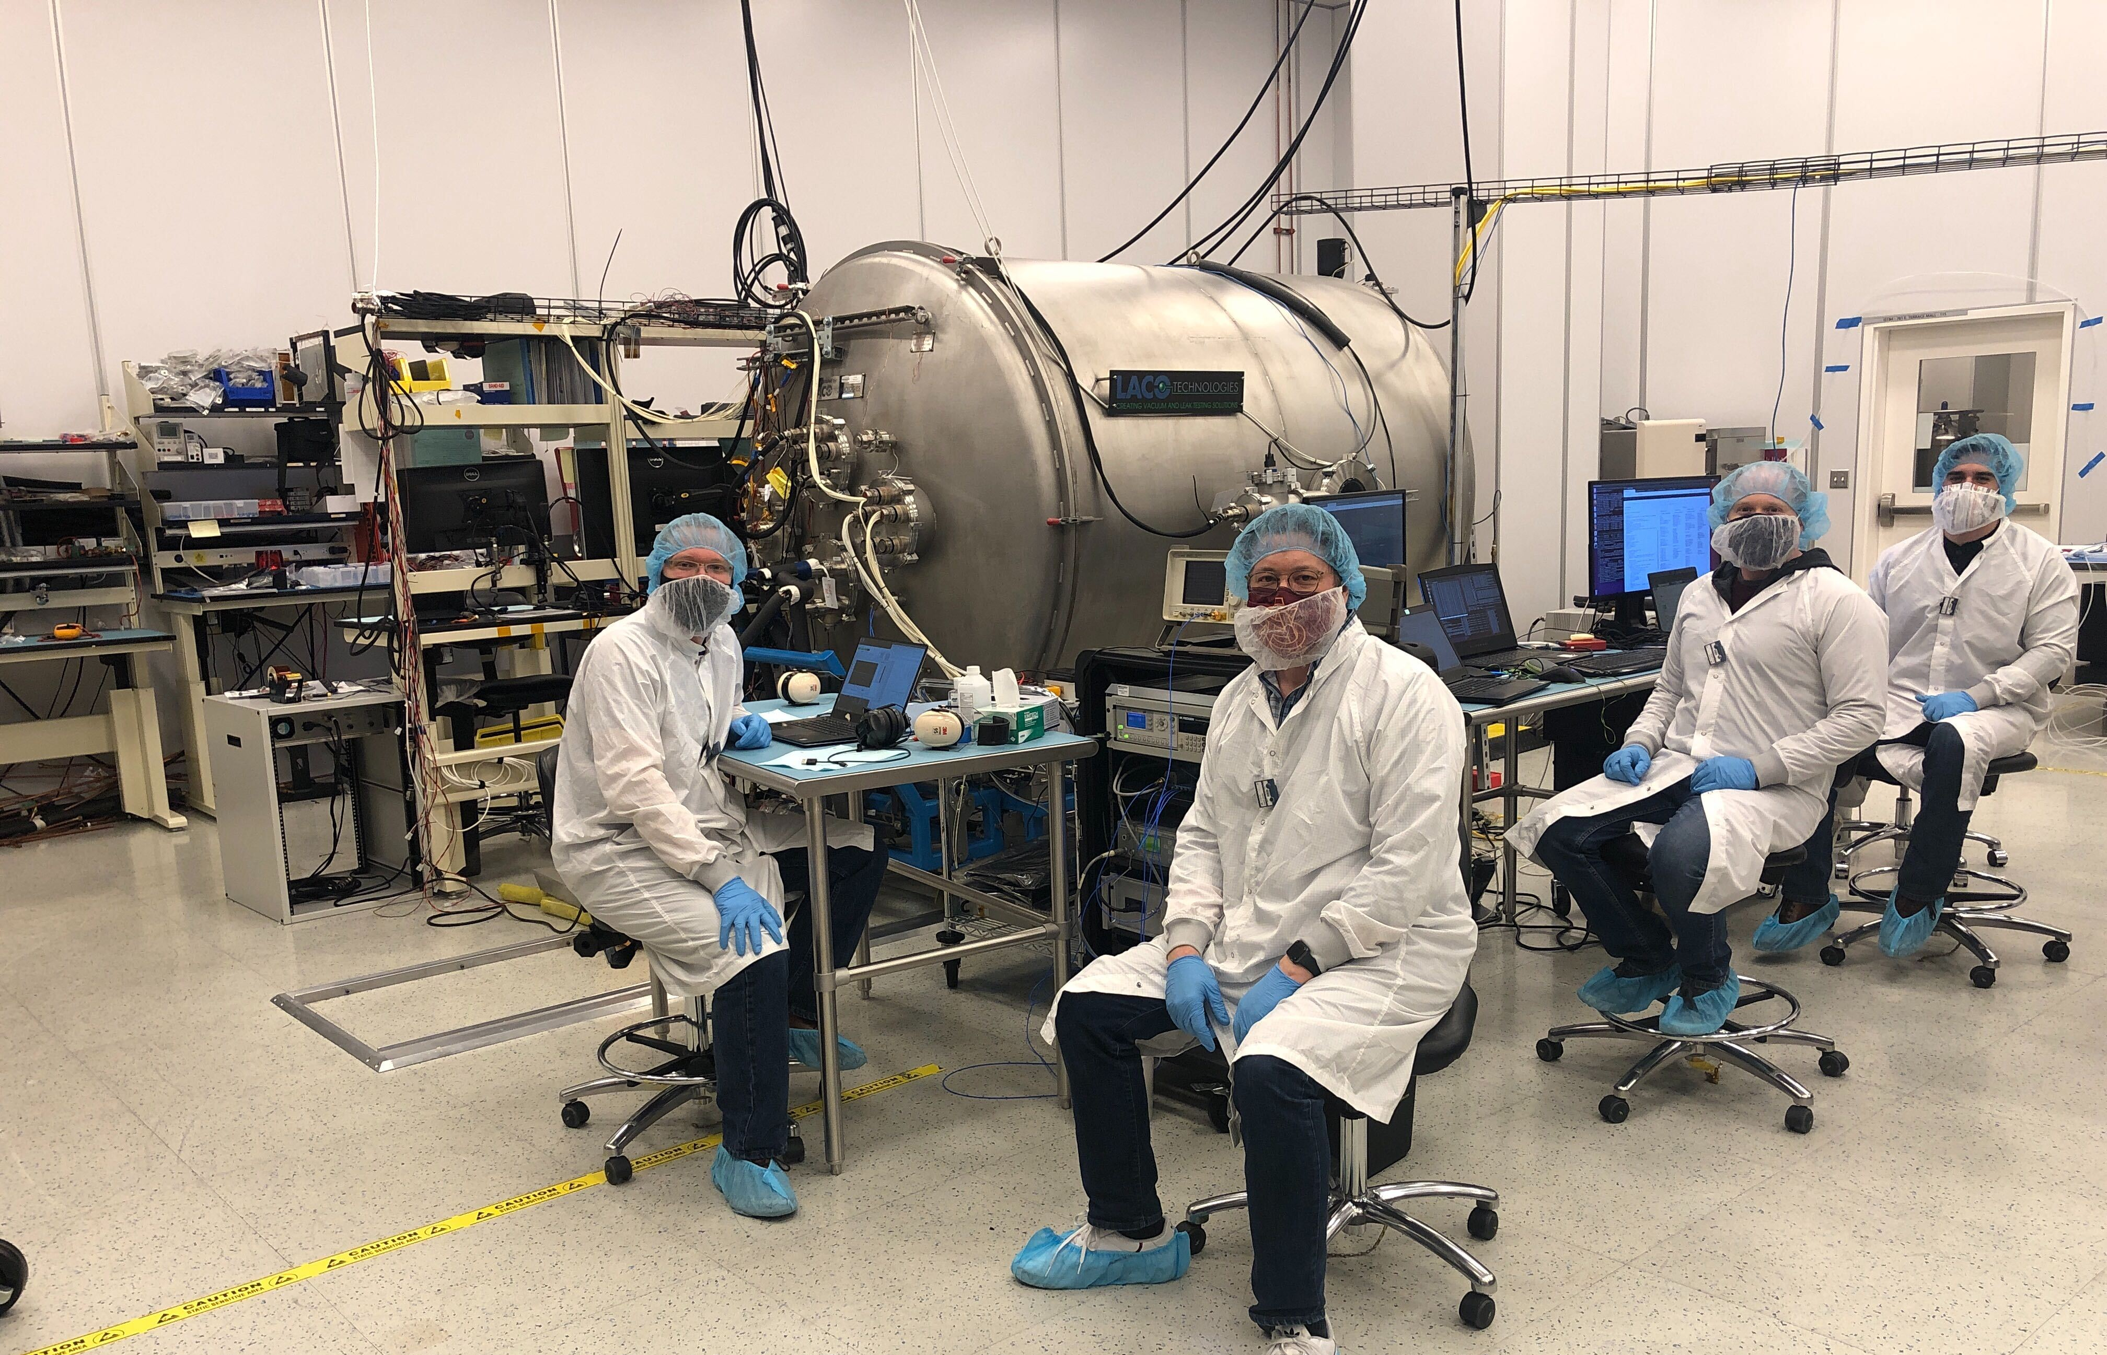
Low-cost factors for LunaH-Map
Science
1 science instrument
Small science team
Few measurement observation requirements (i.e. pointing)
Instrument technology developed via SBIR/STTR and NASA PICASSO programs. Partnerships with LANL enabled calibration.
Technical
Few redundant systems
Fault protection prioritizes spacecraft health and safety over science
Acceptance and testing of COTS parts
I&T and environmental testing at ASU
I&T team became operations team, with mission ops at ASU
Testing of critical mission scenarios
Propulsion technology developed via SBIR/STTR and NextSTEP programs. Also flying on Lunar IceCube.
Management
Minimal project personnel. Each person in multiple roles.
Tailored 7120.8 (NASA Research and Technology Program and Project Management Requirements ) for management and reviews
Table-top reviews with SMEs at milestones
Reviews and outcomes convened by the project
<<pic of TVAC facility/team>>

Slide 15
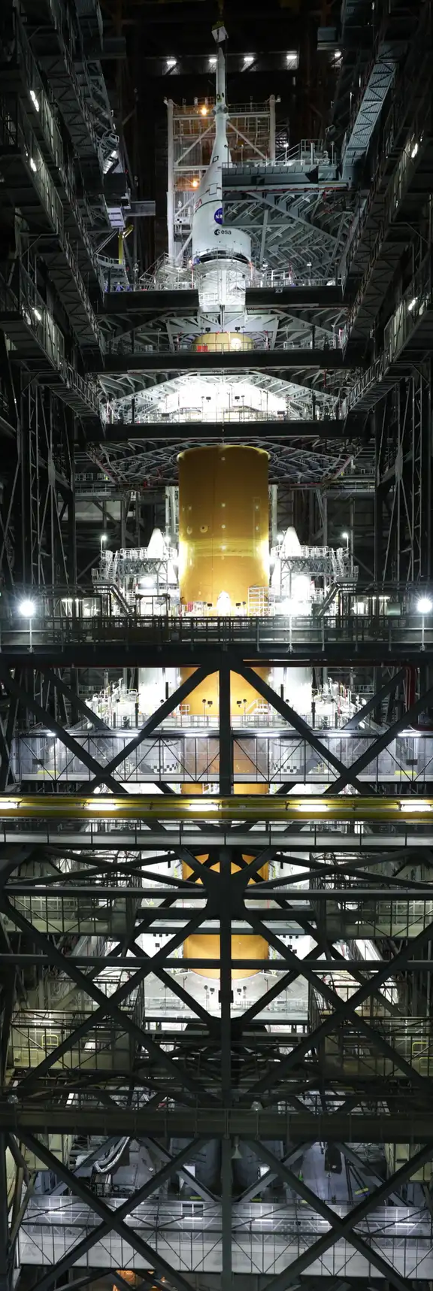
Low-cost factors for LunaH-Map
Some lessons so far….
Most/all of your team will be part-time, however, flexibility in accommodating full-time periods was critical.
You may not be able to afford EMs. Prototypes, EDUs, development units, etc are all useful. A flatsat is essential.
Your vendors are your partners.
  You need “buy in” from everyone on your team.
Test as much as you can
  Set clear mission expectations with your team and with NASA
Launch vehicle challenges. New requirements and documentation for SLS. Now at 11 months advance delivery. Safety engineers are critical. Plan for delays if you can.

Slide 16
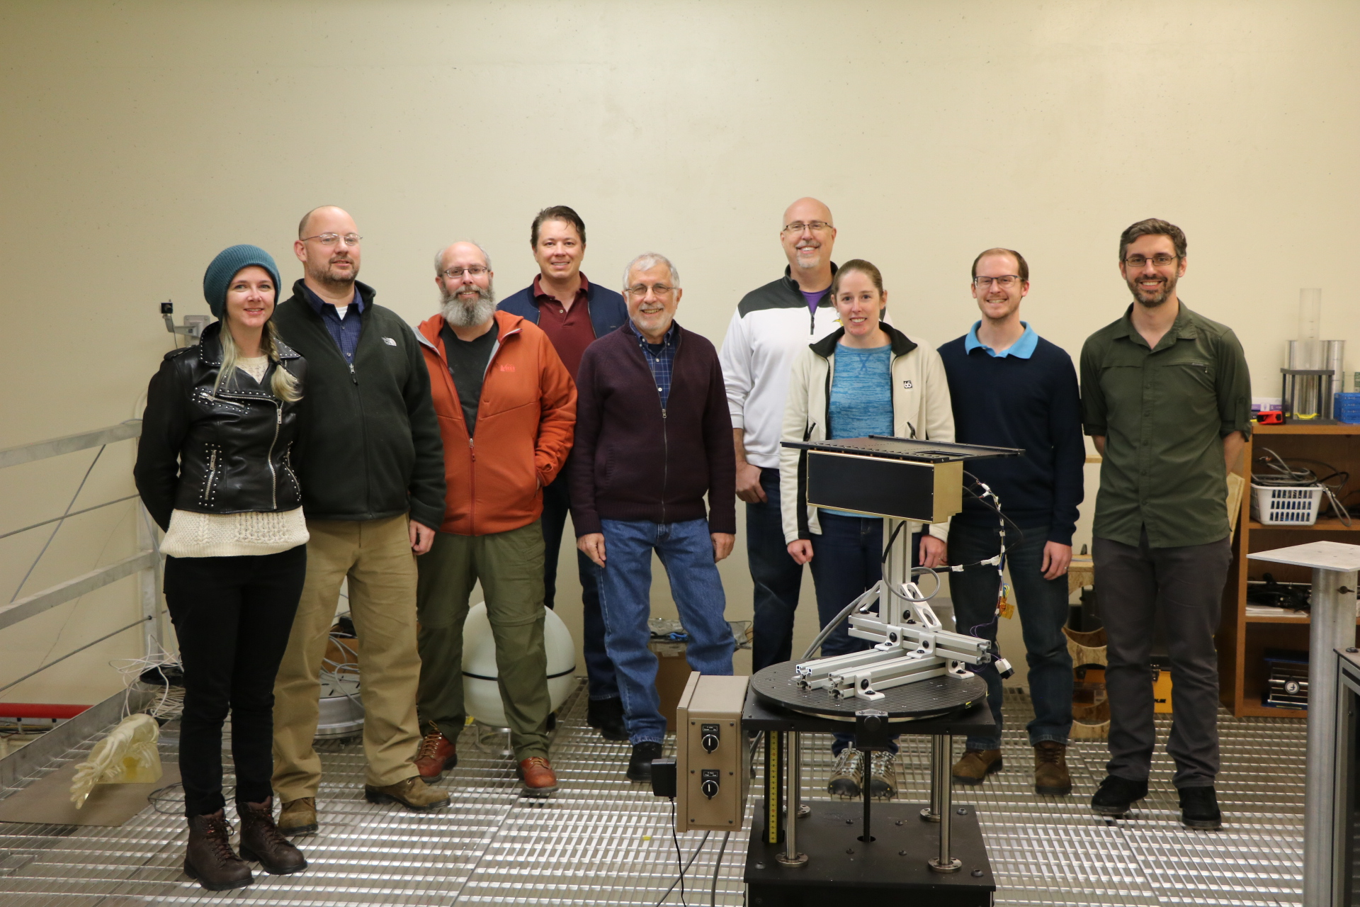
Low-cost factors for LunaH-Map
Some lessons so far….
Executing a mission at this end of the cost spectrum is challenging… but you CAN build a spacecraft (and a science instrument) capable of achieving a science mission at this price point (<$18M TLC). The LunaH-Map flight unit went through environmental and qualification testing at both the system and subsystem level. So….The rest is all about risk.
At this size, the mission should fill a niche. High-risk, high-reward is a good mantra. I.E. LunaH-Map science measurements require a low-altitude perilune (~10-12 km altitude) orbit over the lunar South Pole. This sets the risk posture and associated mission risks can flow from there. IMO: THESE TINY BUT MIGHTY MISSIONS SHOULD BE DARING AND EXCITING! ☺ now that we know they are possible
It’s the team that makes it possible
Don’t let anyone tell you you can’t build this

