Slide 1

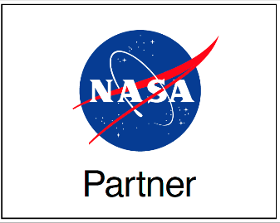
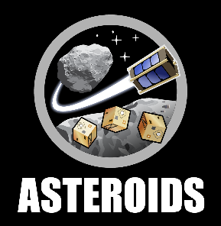
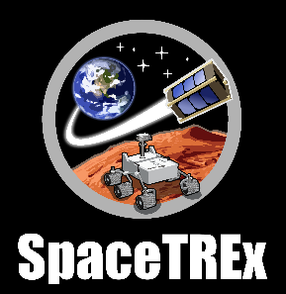
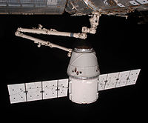
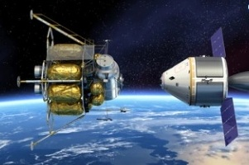
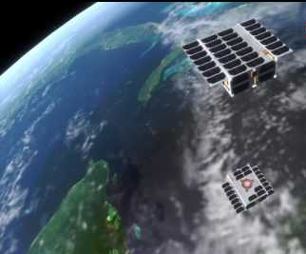
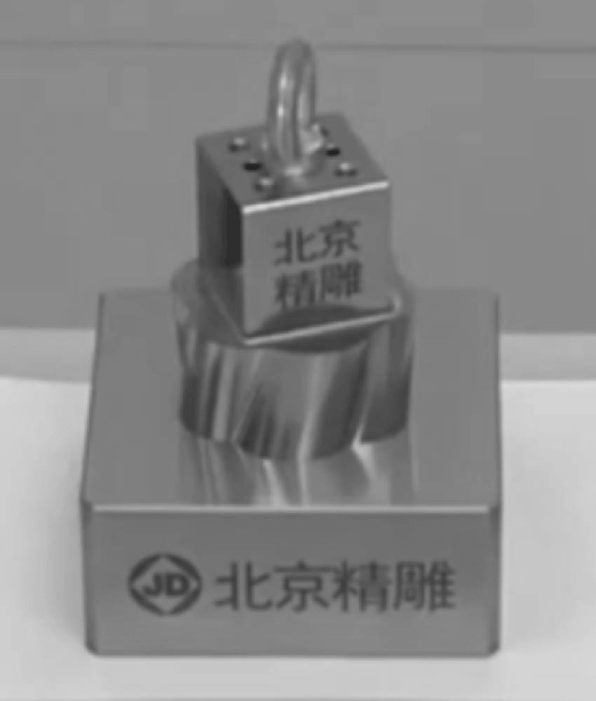
Two Stage CubeSat Docking with Visual Cues
Athip Thirupathi Raj, Connor Sturgeon

Slide 2

Motivation
Trading Goods and Services in space
On-Orbit assembly of small satellites into larger specialized modules to fit customer needs
Reliance on human intervention for On-orbit servicing and construction (eg. Hubble, ISS)
Figure: Shipping cargo containers on a ship

Slide 3
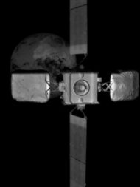
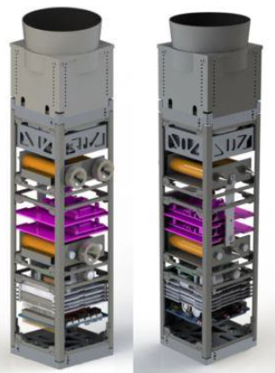
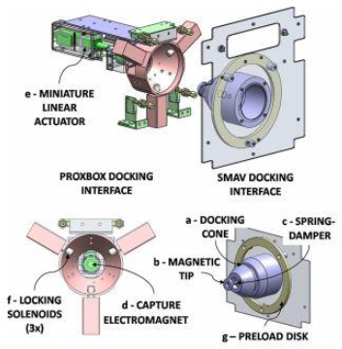
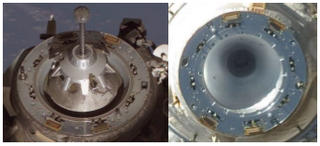
Related Work / Literature Survey
Soyuz Docking System [4]
Intelsat 10-02 taken by MEV-2's infrared wide field of view camera at 15 meters away [3]
ARCADE-R2
Docking System [2]
AAReST MirrorSats [1]

Slide 4
Challenges
Size - Only Big Satellites have been docked in space so far
Cubesats - Size, Mass and Power Restrictions for sensors and actuators
Small Satellite docking has been tested in the Upper Atmosphere, but no Space Heritage

Slide 5
Objectives
Rendezvous, Dock and Release two 3U cubesats in Low Earth Orbit
Two Stage Docking
Use Visual Cues

Slide 6
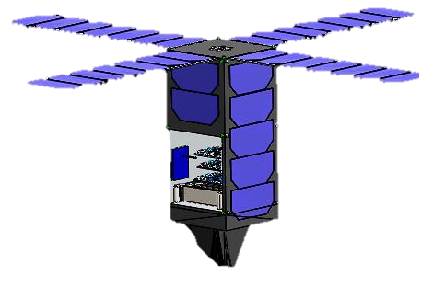
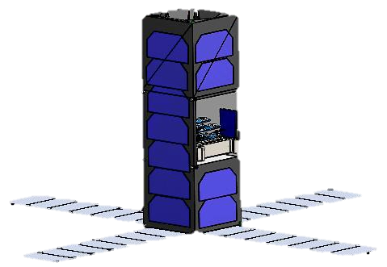
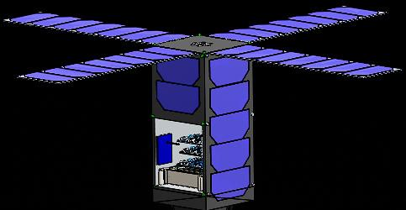
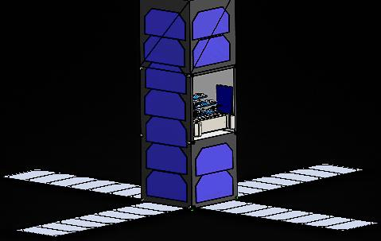

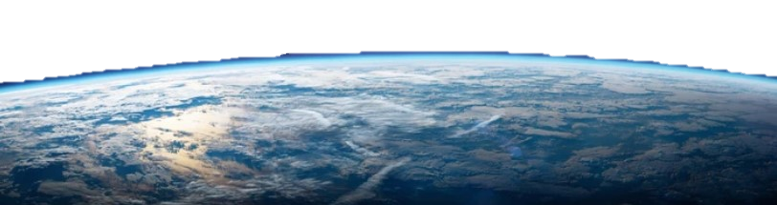
Concept of Operations
Launch
Deploy Chaser
Deploy Runner
Phase 1: Initial Rendezvous
Phase 2: Soft Capture
Phase 3: Hard Capture
Phase 4: Release and Decommission

Slide 7
Phase 1: Rendezvous
"Lighting Cues"
Use of Blinking LED lights on all surfaces of each S/c
Identification using Light-to-digital converters
If S/c does not exit "Searching" mode after a set time, it executes a manual spin using thrusters/ magnetorquers
Blink Frequency | Message
1 Hz | "Searching"
2 Hz | "Identified"
3 Hz | "Contact Established"
4 Hz | "Distance = TBD - TBD meters"
5 Hz | "Close contact, switching to fine attitude adjustments"
Off | "End of Rendezvous Phase; switching to Soft Capture Phase"
Figure: Chaser CubeSat in "Searching" mode, executing a manual spin with blink frequency of 1 Hz
T + 0 seconds:
LED Off
T + 1 seconds:
LED On
T + 2 seconds:
LED Off
T + 3 seconds:
LED On
T + 4 seconds:
LED Off

Slide 8
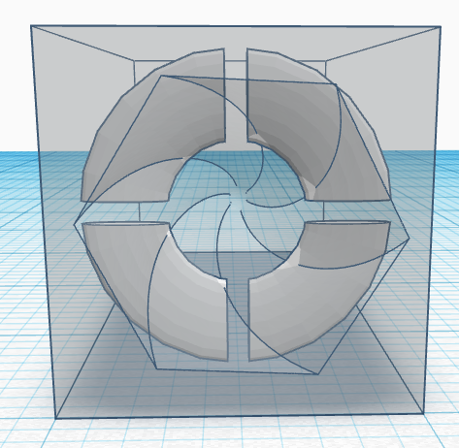
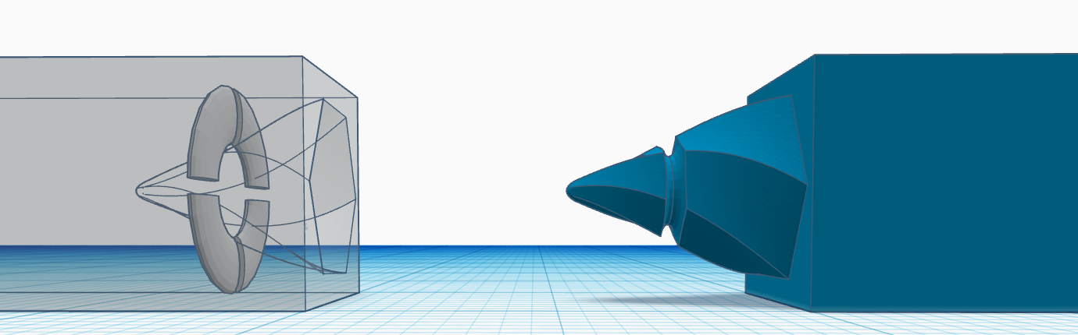
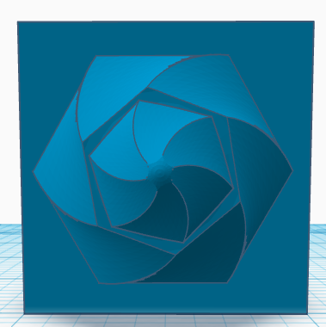
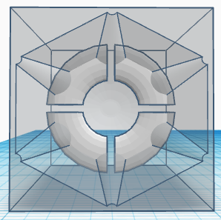
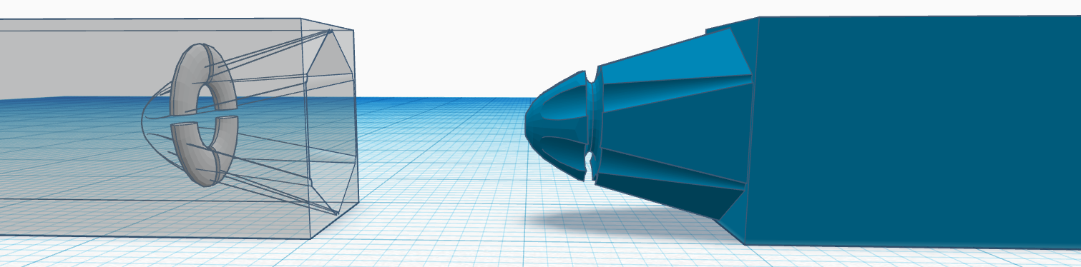
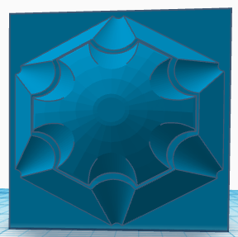
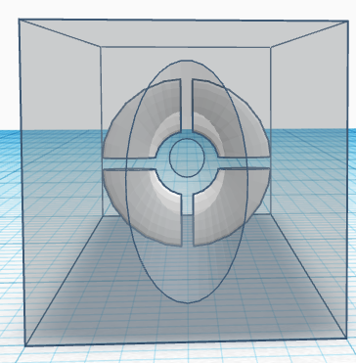
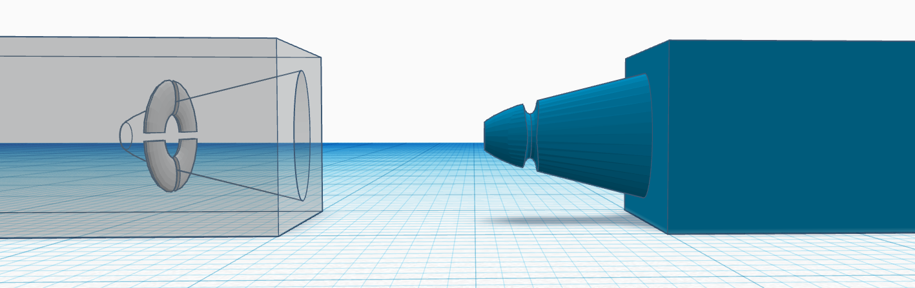
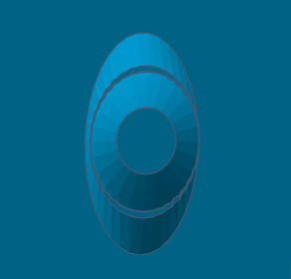
Phase 2: Soft Capture
Correct for minor misalignments in attitude and orientations using geometry
Use of Electromagnetic force/ tether in addition to thrusters if necessary
Sharp tips may be damaged if inserted incorrectly at high velocities
Figure: Cone and Probe geometry designs A (top), B (middle), and C (bottom); Left: Example of the proposed cone and probe mechanism in action, courtesy of [5]

Slide 9
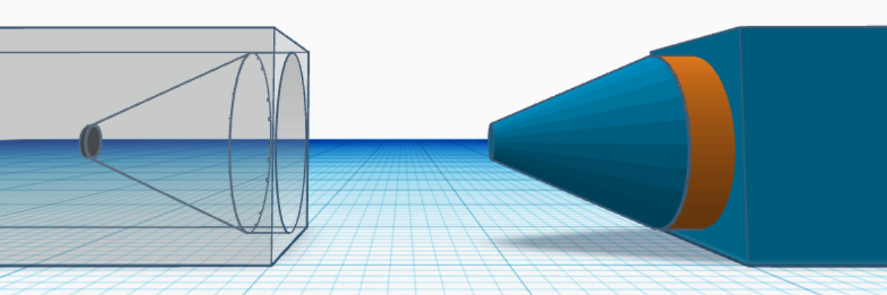
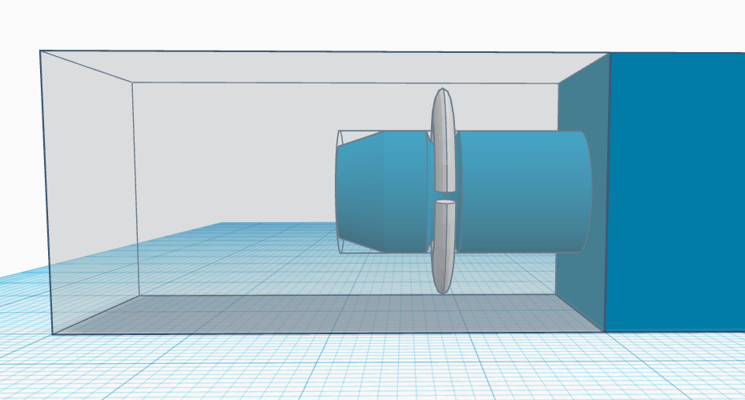
Phase 3: Hard Capture
Trade Study between Friction Locking using expanding materials (dried silicone) and Shape Memory Alloys (SMA)
Dried Silicone Expands when heated, creating a friction based lock
SMA contracts into a ring shaped groove (lock and key)
Cylindrical piece made of dried silicon and will expand
Shape Memory Alloy (SMA) Segmented Ring
Figure: Friction Locking (top) and SMA Segmented Ring locking (bottom) designs

Slide 10
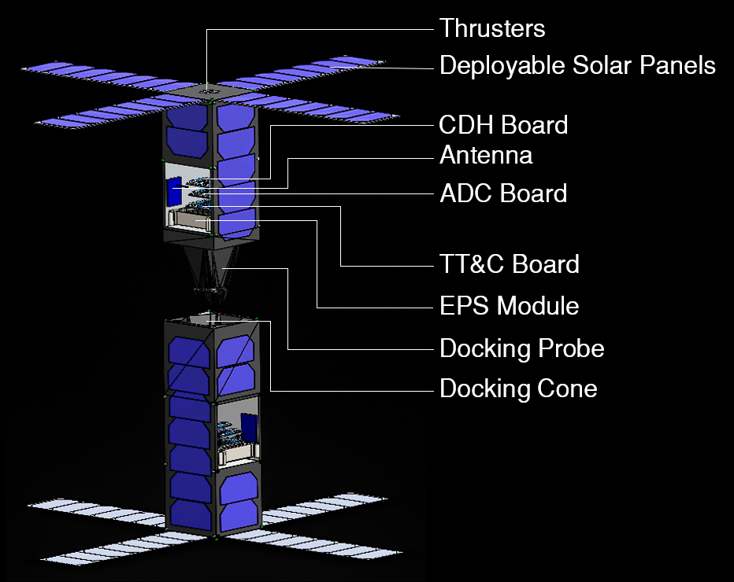
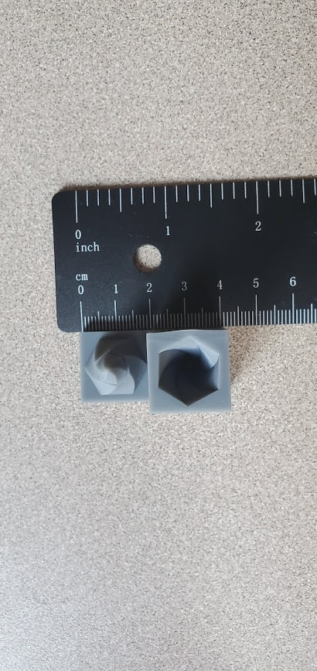
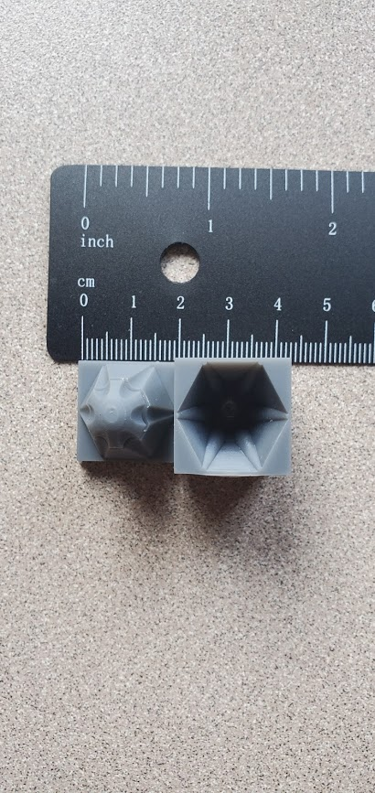
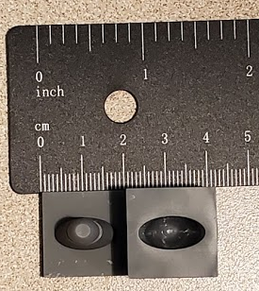
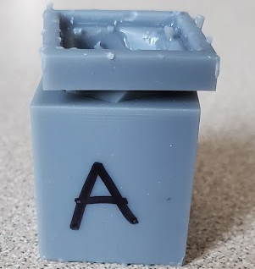
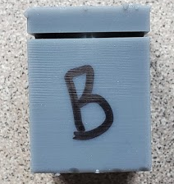
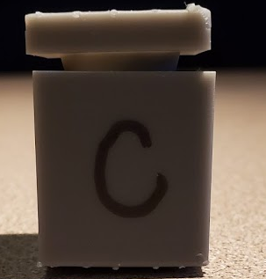
Results
SLA 3D Printed Cone and Probe Combinations (Scale = 1:5)
System Level Design for a 3U Runner-Chaser CubeSat Pair

Slide 11
Conclusions and Future Work
Preliminary system level design for 3U Runner and Chaser CubeSats completed
Manufacture of high precision components for soft capture
Subsystem design
Hardware selection
Subsystem/System testing in simulated space environment

Slide 12
Acknowledgements
Prof. Jekan Thangavelautham, SpaceTREx Lab
Connor Sturgeon, SpaceTREx Lab
Harsh Bansal, SpaceTREx Lab
Kairav Kukkala, SpaceTREx Lab

Slide 13
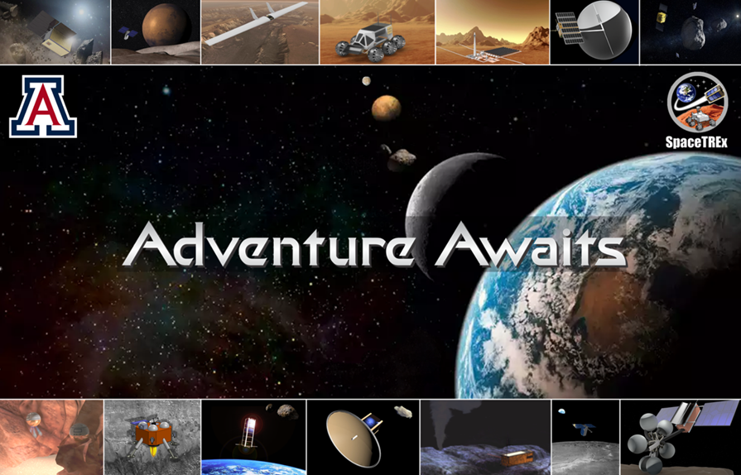
Thank you!
Questions?

Slide 14
References
[1] S. Eckersley, C. Saunders, D. Lobb, G. Johnston, T. Baud, M. Sweeting, C. Underwood, C. Bridges, and R. Chen, "Future rendezvous and docking missions enabled by low-cost but safety compliant guidance navigation and control (gnc) architectures", in Proceedings of The 15th Reinventing Space Conference. British Interplanetary Society, 2017
[2] M. Barbetta, A. Boesso, F. Branz, A. Carron, L. Olivieri, J. Prendin, G. Rodeghiero, F. Sansone, L. Savioli, F. Spi-nello et al., "Arcade-r2 experiment on board bexus 17 stratospheric balloon", CEAS Space Journal, vol. 7, no. 3, pp. 347-358, 2015.
[3] "Northrop Grumman and Intelsat Make History with Docking of Second Mission Extension Vehicle to Extend Life of Satellite", Northrop Grumman Newsroom, news.northropgrumman.com/news/releases/northrop-grumman-and-intelsat-make-history-with-docking-of-second-mission-extension-vehicle-to-extend-life-of-satellite. Accessed 21 Apr. 2021.
[4] J. Cook, V. Aksamentov, T. Homan, and W. Bruner, "ISS interface mechanisms and their heritage", in AIAA SPACE 2011 conference & exposition, 2011, p. 7150.
[5] Beijing Jingdiao Group Co., Ltd. "#EMO2019 & Beijing Jingdiao #The World of µ-Level Precision Fitting." YouTube, 27 Aug. 2019, www.youtube.com/watch?v=XBqsAlt7bIk&t=110s&ab_channel=BeijingJingdiaoGroupCo.%2CLtd.

