Slide 1

SILVIR Surface Imaging of Lunar Volatiles in the InfraRed
JPL: Pamela E Clark (PI), Mark Schwochert, Tom Pagano, Sarath Gunapala, David Bugby, Adarsh Rajguru
U. Hawaii: Shuai Li
Jet Propulsion Laboratory
California Institute of Technology
National Aeronautics and Space Administration
Jet Propulsion Laboratory
California Institute of Technology
Pasadena, California
www.nasa.gov
© 2021. All rights reserved.
Government sponsorship acknowledged.
University of Hawaii at Manoa
Notes:
below cost, within power, mass constraints, high profile university partner for key science, lot of slides for information

Slide 2
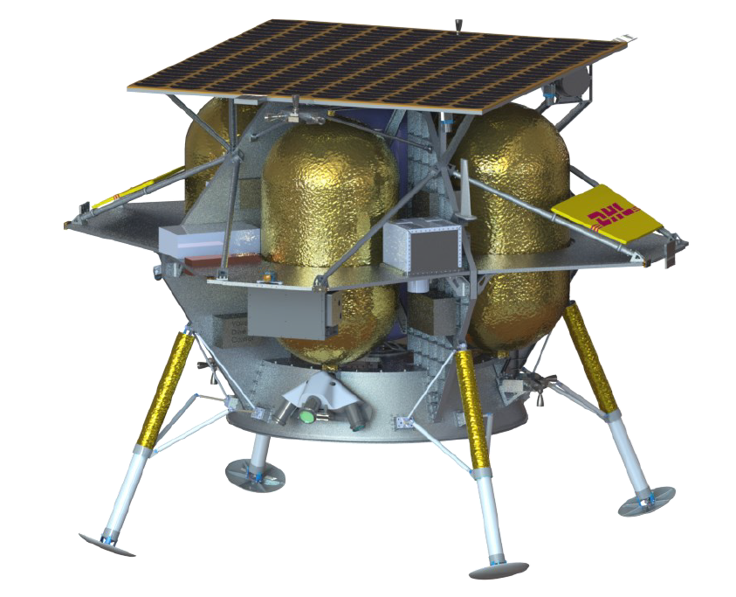

SILVIR+ Suite Description and Concept
Lunar Lander Deck Placement
(Astrobotic Peregrine Lander Shown)
SILVIR IR
2-Axis Gimbal
2 VisCam in Enclosure
Name | Mass (kg) | Cont, Pk Power (W) | Data Rate (kbps) | Op Temps (ºC) | Key characteristics | Special Needs
IR Spectrometer (SILVIR) | 8 (w/out external enclosure) | 30 min, 22-27 W | 88 Mb per 30 min observation | Detector 90K +/- 2K, gimbal ambient surface, rest nominal avionics (in enclosure) | 2 axis gimbal, 2.5 to 6.5 microns, cryocooler | Clear half hemisphere FOV
FLIR NAV Camera x 2 | 0.7 x 2 | 5 min, 3.5 W x 2 | 250 Mb per 5 min obs x 2 | Nominal avionics (in enclosure) | Visible images | None
SILVIR uses 2-axis gimbaled IR camera based on the HOTBIRD sensor to scan lunar surface, and two COTS (FLIR) VisCams in enclosure obtain data on lunar volatiles cycle. Lunar survivability provided by thermally-switched enclosure, parabolic reflector radiator (PRR), advanced spacerless MLI. 3 years to get from TRL 4-5 to TRL 5-6.
Notes:
Lander deck placement, orientation, gimbaling (conceptual)

Slide 3
Molecular Water of Hydroxyl on the Moon
Figure 1-2. Water and hydroxyl on the Moon. Combined red (pyroxene), green (reflectance continuum), and blue (water and hydroxyl absorption) bands. Blue, cyan, magenta, and pink are water indicators. Chandrayaan M3 (Pieters et al. 2009).
Figure 1-3. Early evidence for diurnal variation trend in OH absorption (Sunshine et al. 2009), which will be geospatially linked by Lunar Ice Cube.
Notes:
Water ‘features’ affected by latitude (polar) and time of day

Slide 4
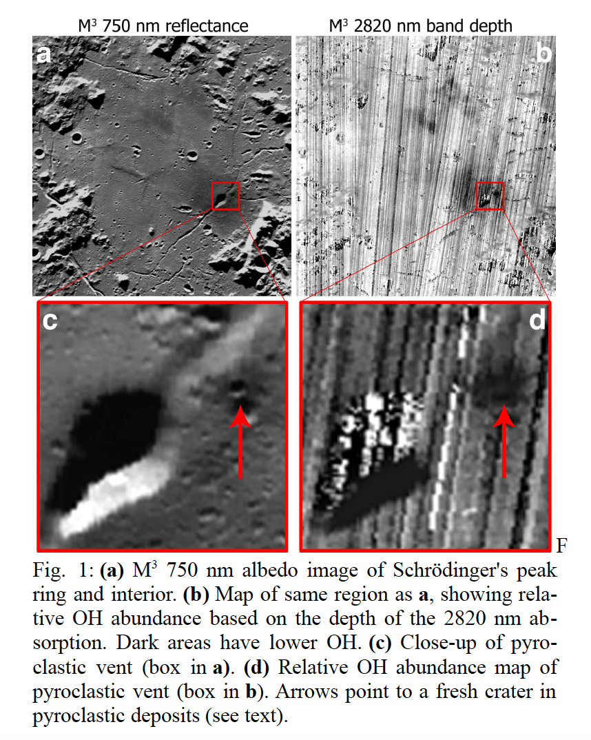
Where?
Map of 2.85 u Effective Single Particle Absorption Thickness (ESPAT) derived from M3 at low lunar latitudes. Features apparently associated with pyroclastic deposits, lending credence to hypothesis of volatile-rich (hundreds ppm) sources in mantle. A aristarchus; O orientale, RB Rima Bode, SG Sulpicius Gallus, TL Taur-Littrow. Milliken and Li, 2017. See similar data for Schrodinger (Kramer et al, 2015).
Figure 1-4. M3 calculated effective single-particle absorption-thickness (ESPAT) estimated water content (Apollo landing sites in yellow) map (A), and averaged profile by latitude (B). (Li and Milliken 2017)
Notes:
Pyroclastics as well molecular water/OH, and ability to separate two

Slide 5
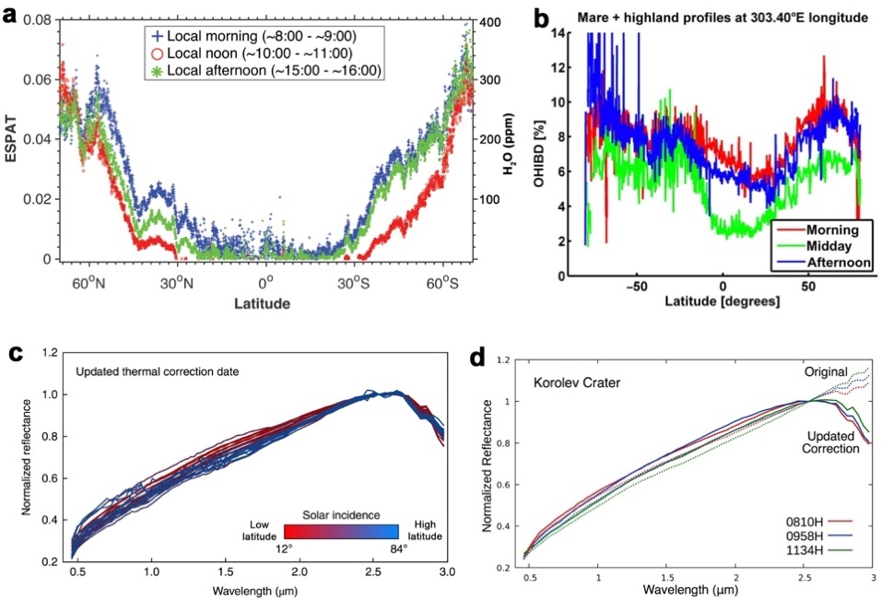
Is the variation real?
(a) The mapped water content from M3 data exhibits strong latitudinal diurnal variations (Li and Milliken 2017, Fig. 6A); (b) The y axis indicates the absorption strength of water bands near 3 µm of M3 data; suggest latitudinal and diurnal variations of the lunar surface water (Wöhler et al. 2017, Fig. 4B); (c,d) Mapped lunar surface water shows no latitudinal variation (c) and weak/no diurnal variation (d) (Bandfield et al. 2018, Figs. 2A, S1).
Notes:
Anticipated profile from M3 implying latitude variation, bandfield correction implies little latitude variation…. SILVIR could resolve

Slide 6
Science Questions
How much does the lunar surface water cycle vary with latitude, in particular what is the extent of diurnal variation in polar regions such as Schrodinger?
How much molecular water is on the illuminated surface or in shadowed areas as a function of day?
Does water content vary with rock/regolith type on the Moon?
What is the origin of surface exposed water ice in the lunar permanently/frequently shaded areas as a function of size (Li et al 2018)
What is the speciation/form of water? (e.g., OH, bound or adsorbed molecular H2O, ice)
What is the origin and nature of lunar volcanism? For example what is olivine implying about the depth of eruption and relationship to South Pole Aitken Basin?
Notes:
Schrodinger is rich…. Unexplored polar region, connection to South Pole Aitken Basin impact and farside volcanism, lunar water

Slide 7
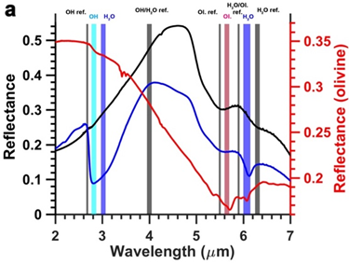
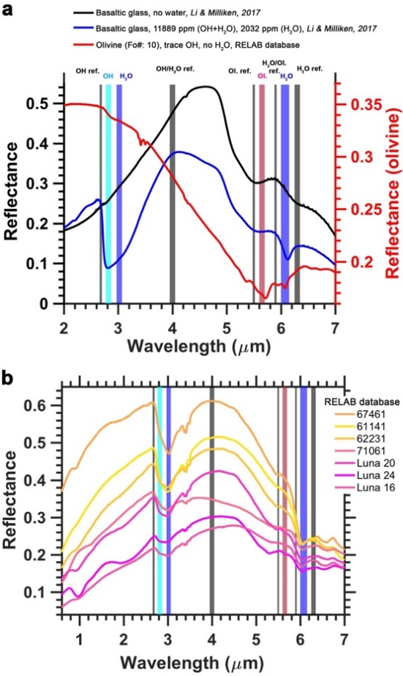
Verifying measurements from SILVIR
Table 1-4. SILVIR bands.
Species | Band | SNR @L_{min} | Note | Ref
Ref band | 2.66–2.70 | 209 | For OH, H₂O absorptions | 1, 2
Mostly OH | 2.72–2.82 | 481 | Fundamental OH stretching | 1, 2
Mostly H₂O | 2.97–3.07 | 841 | Overtone of H₂O bending | 1
Ref band | 3.95–4.05 | 190 | OH, H₂O absorptions | 1, 3
Ref band | 5.48–5.52 | 101 | For olivine absorption | 1, 4
Olivine | 5.60–5.70 | 195 | Absorption center | 1, 4
Ref band | 5.88–5.92 | 132 | Olivine, H₂O absorptions | 1, 4, 5, 6
H₂O | 6.00–6.15 | 270 | Fundamental H₂O bending | 5, 6
Ref band | 6.25–6.35 | 315 | H₂O absorption | 5, 6
Refs: 1) Stolper 1982; 2) Li and Milliken 2016; 3) Milliken 2006; 4) Dyar et al. 2010; 5) Falk 1984; 6) Warren and Brandt 2008
Lunar reflectance with superimposed selected filter bands illustrating the bands effectiveness in characterizing OH and H₂O absorption features
Notes:
SILVIR separate OH and molecular H2O, reference bands (to remove thermal emission)

Slide 8
SILVIR Derivables
Our objectives, answerable based on measurements capable of distinguishing OH and molecular H2O absorption features (IR Spectrometer, 2.5 to 6.5 microns) as well as olivine combined with visible images providing geological context (Camera),
To determine the extent to which rock and regolith types in basins, particularly to confirm the extent to which pyroclastic deposits already noted to have enhanced water absorption, influence cold trap formation (see PRODUCTS in yellow)
To determine the nature of the water cycle and cold trap formation on a local scale as a function of time day (and induced shadowing) and thus further constrain current water cycle models derived from remote observations;
To create in situ maps of OH and H₂O variations on the scale of <cm to 1 m and establish their relationship to physical features (e.g., pyroclastic or other volcanic deposits, rock size and frequency, induced shadows, slope orientation) which could be associated with local time of day dependent cold traps.
To map any olivine (mafics/pyroclastics) present on a local scale.
To confirm the validity of Chandrayaan M3 (the most widely used water related feature data) temperature induced thermal effects correction
References: (McCord et al 2011; Li and Mliliken 2017; Wohler et al 2017; Bandfield et al 2018; Hendrix et al 2018)
Notes:
data products….. Incidence, maps Mafic materials/olivine, pyroclastics; incidence, maps OH, H2O; confirm temperature induced thermal correction (band selection)

Slide 9
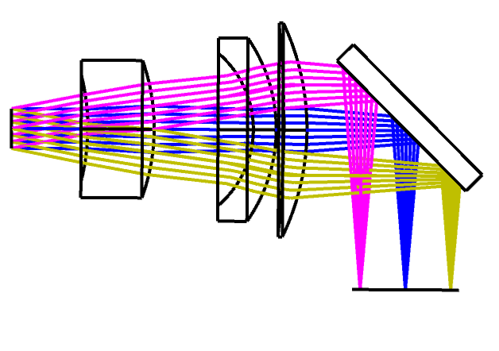
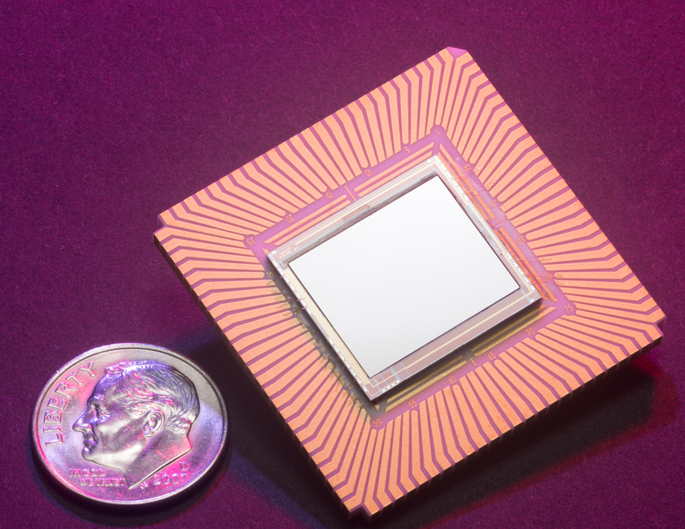
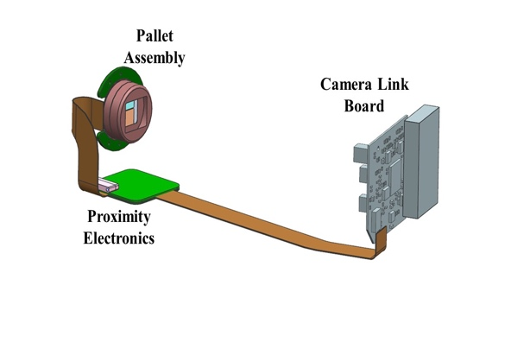
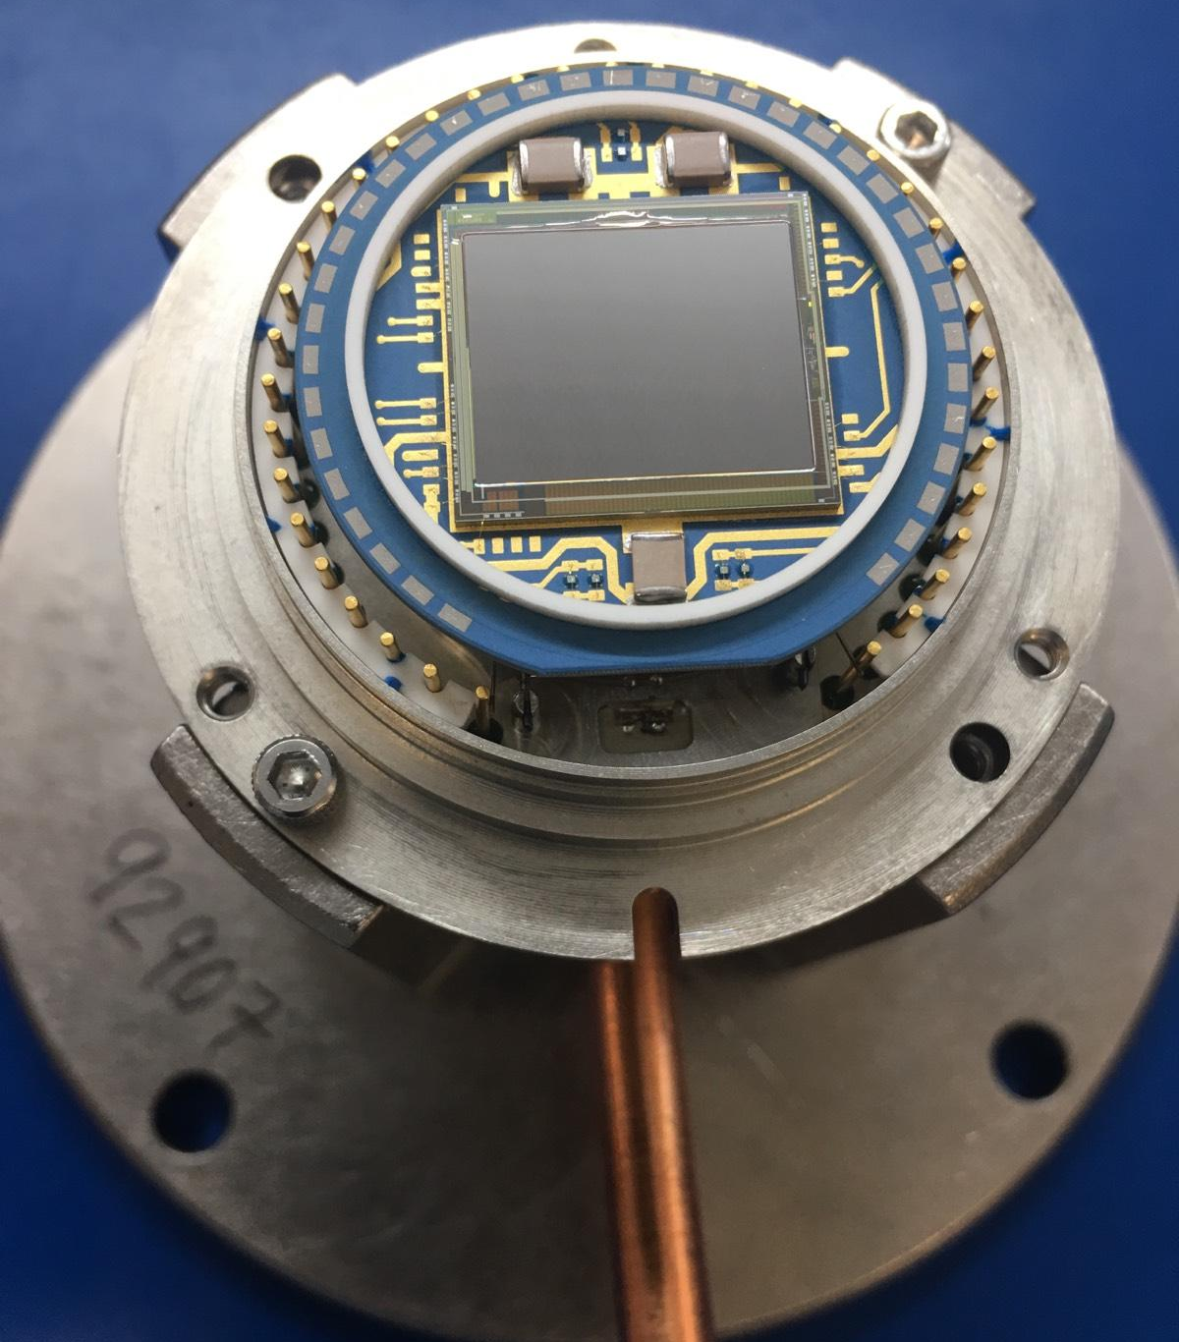
SILVIR + Suite Concept
IR Camera Uses Proven JPL Sensor, Electronics, and Optics
ClearTran (ZnS)
Fold Mirror
Pupil
Achromatic Doublet
Detector Interface (Striped Filter)
SILVIR’s three-element, F/6, (Stingray) telecentric lens enables consistent spectral performance across each filter stripe (PixelTek striped filter assembly) and depth-of-field extending from 2 m to the lunar horizon. The fold mirror enables a compact design.
HOT-BIRD detector Integrated with Dewar Cooler (RICOR K508N) with cameralink electronics (in preparation for CIRAS detector and electronics) in pallet assembly. Top left HOTBIRD Focal Plan Array. Bottom left HOTBIRD FPA on RICOR cold finger.
Notes:
Pallet configuration for Hotbird and associated electronics with cryocooler. Optics. Telecentric lens (low distortion, invariant magnification)

Slide 10
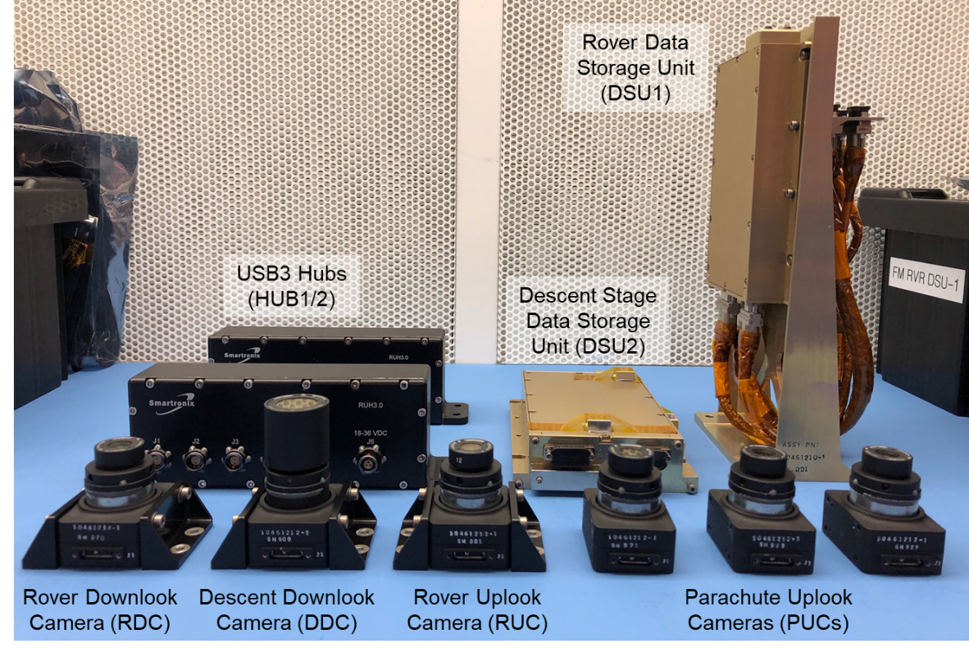
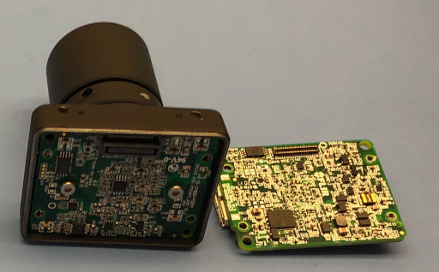
SILVIR + Suite Concept
JASIS Lunar NavCam
JPL Adaptive Spacecraft Imaging System (JASIS) LunarNavCam now under development (16 months started in March 2020) for Lunar Rover, including all necessary hardware to operate them (controller electronics, cables, optics…)
FLIR CM3-U3-50S5M-CS camera. See https://www.flir.com/products/chameleon3-usb3/?model=CM3-U3-50S5M-CS for product detail. They are the 5-megapixel version of the cameras used in the other variants of JASIS.
Universe Kogaku BL060C C-Mount, wide angle (100 degree FOV) modification.
Notes:
JPL camera already under development to be available mid 2021

Slide 11
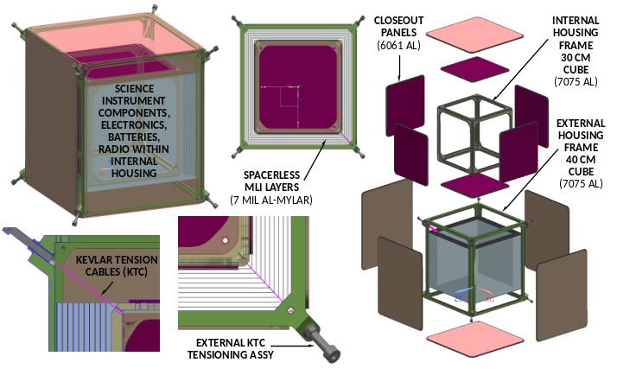
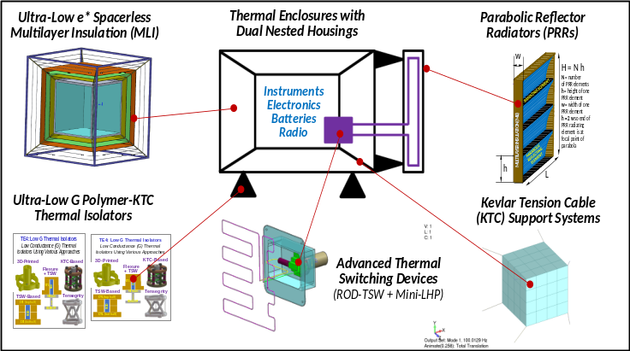
SILVIR + Suite Concept
State of the Art Packaging and Thermal Protection
ARTEMIS-T-IA Enclosure Technology
High performance thermal packaging with interfaces for lander power, communications.
Thermal packaging from ARTEMIS-T (JPL SR&TD) and PALETTE (NASA GCD) projects. To accommodate either PRISM landing site, design uses advanced features such as PRR, ROD-TSW/mini-LHP, Kevlar tension cable (KTC) supports, spacerless MLI, and KTC thermal isolators. For Schrodinger site, some of these advanced features may be omitted for cost savings.
Cryogenic cooling provided by Ricor K508N cryocooler and across gimbal mechanical system providing 2-axis IR camera motion. Focal plane located at center of rotation axes to minimize amount of flex strap length/motion.
HOT-Bird Detector
at Center of 2-Axes
of Rotation (90 K)
Elevation
Gimbal
IR Optics
(220 K)
Elevation Flex Strap
Azimuth Flex Strap
Conduction Rod
Ricor K508N
Cryocooler
PALETTE Thermal Technologies
External Housing
Spacerless MLI
Internal Housing
Azimuth
Gimbal
Radiator
Electronics
Vis Camera
Lander
Elec I/F
Lander Deck
Notes:
Take advantage of high performance thermal components (PALETTE) and enclosure approaches (ARTEMIS)

Slide 12
SILVIR + Suite Concept
Honeybee Robotics Gimbal
Heritage Microsat SADE Driver and motor controller (above) based on Honeybee Size 0 solar array drive actuators and biaxial gimbal assemblies (to right)
Delivery for COTS biaxial gimbal in 6 months from order for use in design and testing. Further qualification for lunar surface environment and delivery of qualified gimbal six months later.
Biaxial gimbal: azimuth control of IR pallet assembly turret within enclosure. Elevation control of IR pallet assembly on turret.
Notes:
Gimbals by experienced provider already developing gimbals for lunar rovers at 6 and 12 months in.

Slide 13
Suite Description/Operations Plans
Suite on end of lander deck facing (south poleward) in opposite direction from sun. Suite will image up to 180 degrees from side to side and from ground at lander to just above horizon (90 degrees or more).
Scans (SILVIR) and snapshots (camera) will be taken as a function of time of day (and shadowing changes) throughout lunar day until night terminator is reached. Observations made during insolation every time the temperature changes by 25 K, or, if the temperature has not changed to that extent over a 24-hour period, at least once during that period.
The data collection process requires approximately 30 min, including the gimbal resetting time (28 deg/sec speed) between steps. Typically, we will frame average at time of day-dependent rates (8 to 120 frames) to minimize the risk of saturation (near the middle of the day) as well as the data volume (overall).
At the end of the series of scans, the gimbal will stow the detector assembly in a position that blocks the aperture to minimize heat leak and allow detector dark noise measurements to be taken.
The instrument will otherwise be turned off between observation periods. The thermal system is designed to shield the instrument from thermal emission (from the Sun and surrounding ground).
Validation and verification processes regularly performed at the target will include:
  Using reference bands and if necessary a cryogenic IR target on the lander to calibrate and correct performance for each of the filter bands;
  Measuring dark noise with aperture blocked before and after each scan, while temperature sensors will be used to monitor the instrument and surface thermal environment; and
  Background minus thermal emission will be measured during each observation when taking measurements of the sky above the horizon.

Slide 14
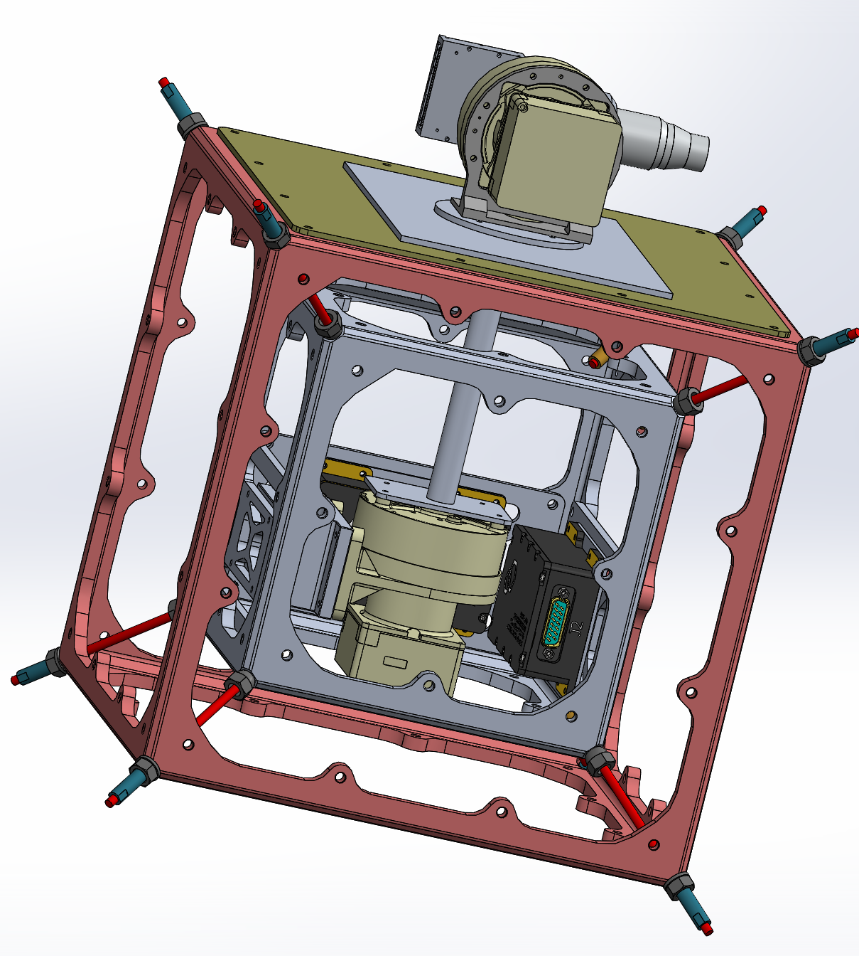

Suite Mechanical Configuration
Optical Detector Assembly
Optical Housing
Elevation Gimbal (Honeybee)
Kevlar Rope
Cameras
Gimbal Controller Box
Azimuth Gimbal (Honeybee)
FOV
Notes:
Gimbals detector assembly, cameras, FOV.

Slide 15
Summary
SILVIR utilizes state of the art IR detector (HOTBIRD) and camera (JASIS) components, along with thermal design, and compact gimbal technology, already under development for other applications.
SILVIR, requiring only a lander (or landers), would generate detailed local high spatial resolution measurements of molecular water and hydroxyl correlated with geological features as a function of time of day over one or more lunar cycles.
Thus, SILVIR could provide the local ‘ground truth’ essential for understanding the lunar water cycle by providing

Slide 16
Backup Slides

Slide 17
Suite Merit / Comparison with the Competition
Table 1.1. SILVIR comparison to other instruments.
Attribute | SILVIR | UCIS | NIRVSS
Spatial Coverage | LARGER: 120 × 90 degrees, full anti-sun side of lander, from lander to horizon. BETTER CONTEXT through visible camera imaging. | 30 degrees, selected targets | ~10 degrees, across, downward pointing
Spectral Properties | 9 bands specifically representing OH and molecular H₂O near 3 and 6 µm | 1850–3600 µm, 20 nm resolution | Acousto-optic tunable filter (AOTF) IR spectrometer, 1200–4000 nm, 20 nm resolution
Spatial Resolution | COMPARABLE 0.3 cm @ 1 m to <1 m at horizon | 0.2 cm @1 m–5 cm @30 m | 0.3 cm @ 1 m above surface
Signal-to-Noise Ratio (SNR) | HIGHER: >100 at >100 ppm for all bands | >/=100 at <2500 nm, >/=50 at >2500 nm | 200
Detection Limit | LOWER: 50 ppm | 100 ppm | 2500 ppm
Temporal | ~38 images each in 9 bands from dawn to dusk during lunar day over multiple cycles | Long ‘stares’ | Twice a 24-hour day for 45 min
Platform | MORE ROBUST REGARDLESS OF PLATFORM: Equipped for any size lander (with gimbal), adjustable FOV | Any rover. If on lander, no way of extending FOV | Rover (Volatiles Investigating Polar Exploration Rover (VIPER)) (downward looking)
Operational Factors | SIMPLE, AUTOMATED scans: HOTBIRD detector (operating 90K) and camera optics with cryocooler. | Teledyne Chroma MCT spectrometer (operating 120 K) with cryocooler and offner split mirror optics | AOTF IR spectrometer, (also visible context imager and IR radiometer on VIPER rover)
Science Goals | UNIQUELY Distinguish H₂O and OH as function of time of day in a fixed location (anywhere from mid-latitudes to poles) to determine systematic changes within and between lunar cycles and variations. UNIQUELY identify olivine. | Map abundance of water related absorption and mineralogy features at scale of rocks and outcrops at poles | Support VIPER goal to identify ice at extractable levels utilizing volatile surface signatures for context
Notes:
SILVIR larger FOV, better context than UCIS, comparable spatial res, platform agnostic (doesn’t require rover); distinguish OH, H2O, olivine; automated ‘set and forget’

