Slide 1


LARGE: Lunar Amended Regolith Gardening Experiment:
Toward Achieving Sustainable Food for Lunar Habitation
P.E. Clark¹, Simon Gilroy², John Elliott¹, Gerald Voecks¹, Max Coleman¹, Don Ruffato¹, Chi Yeung Chiu¹, Barry Nakazono¹, Nitin Singh¹, Paul Briggs¹, Kevin Anderson¹,
¹Jet Propulsion Laboratory/California Institute of Technology, ²University of Wisconsin, Department of Botany, Madison

Slide 2
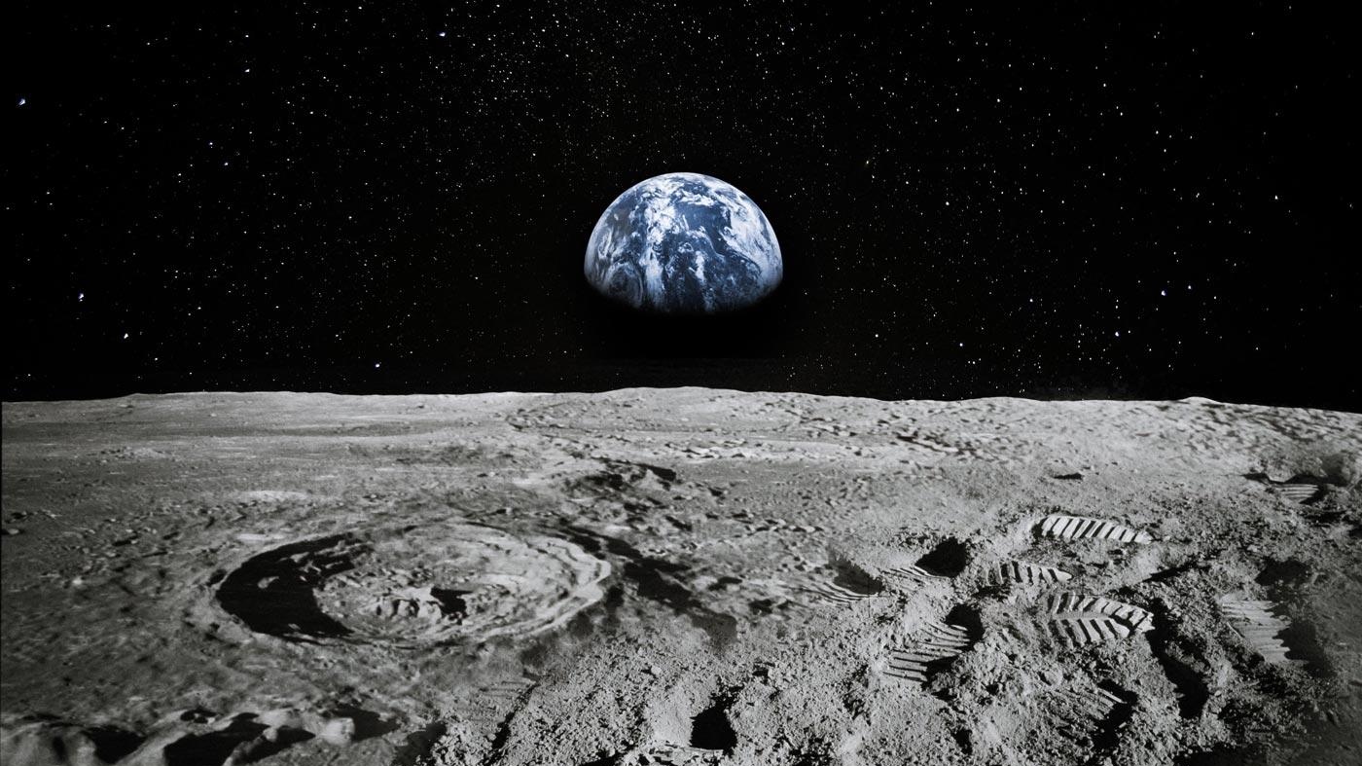
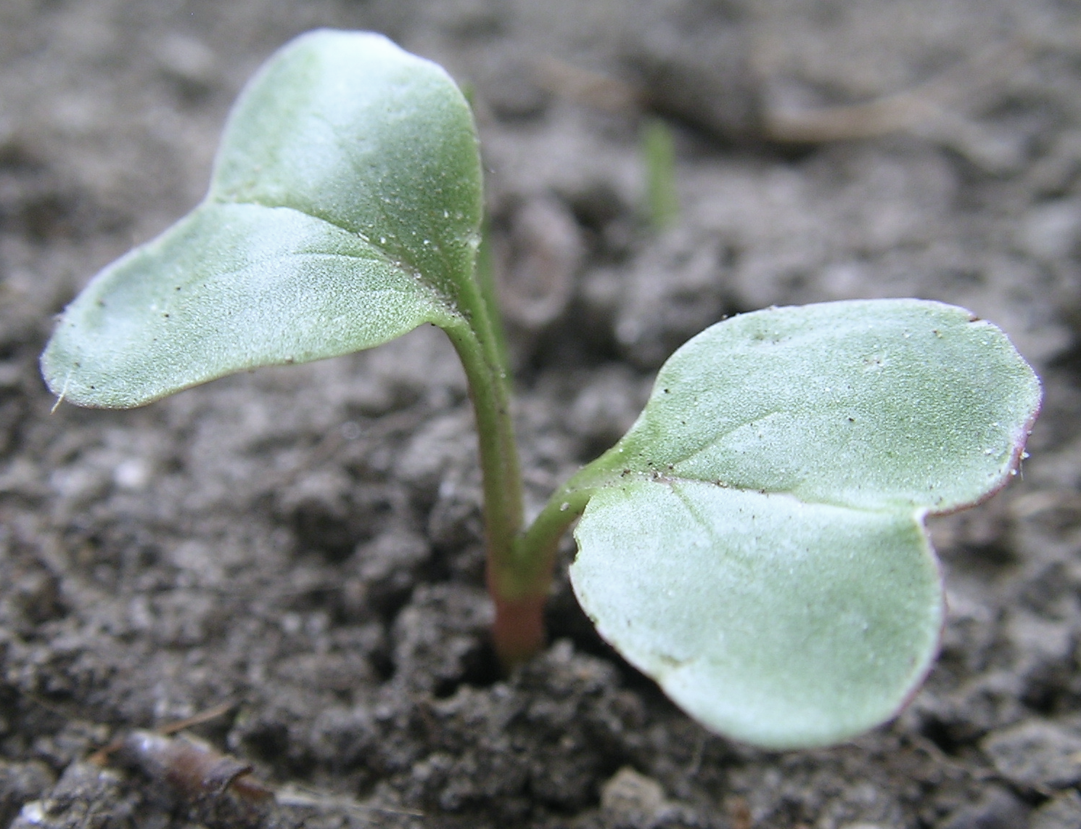
Goal: to demonstrate in situ resource utilization for plant growth on the lunar surface

Slide 3
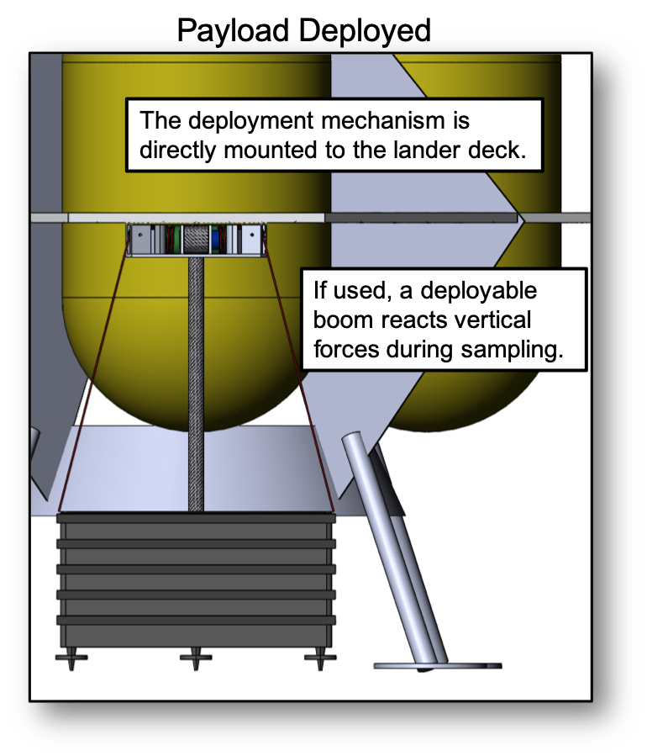
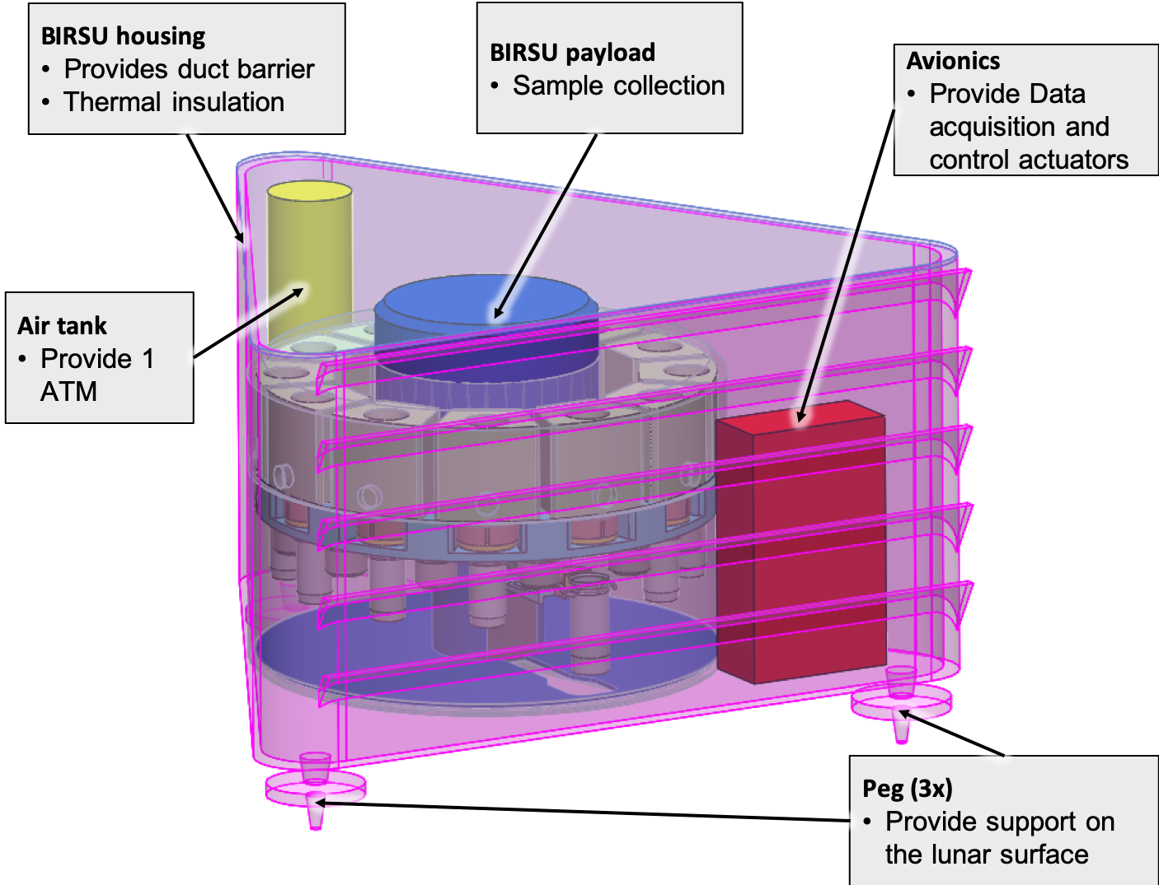
Experiment Concept:
Enclosure attached below a landing deck and lowered to the surface to sample regolith.

Slide 4
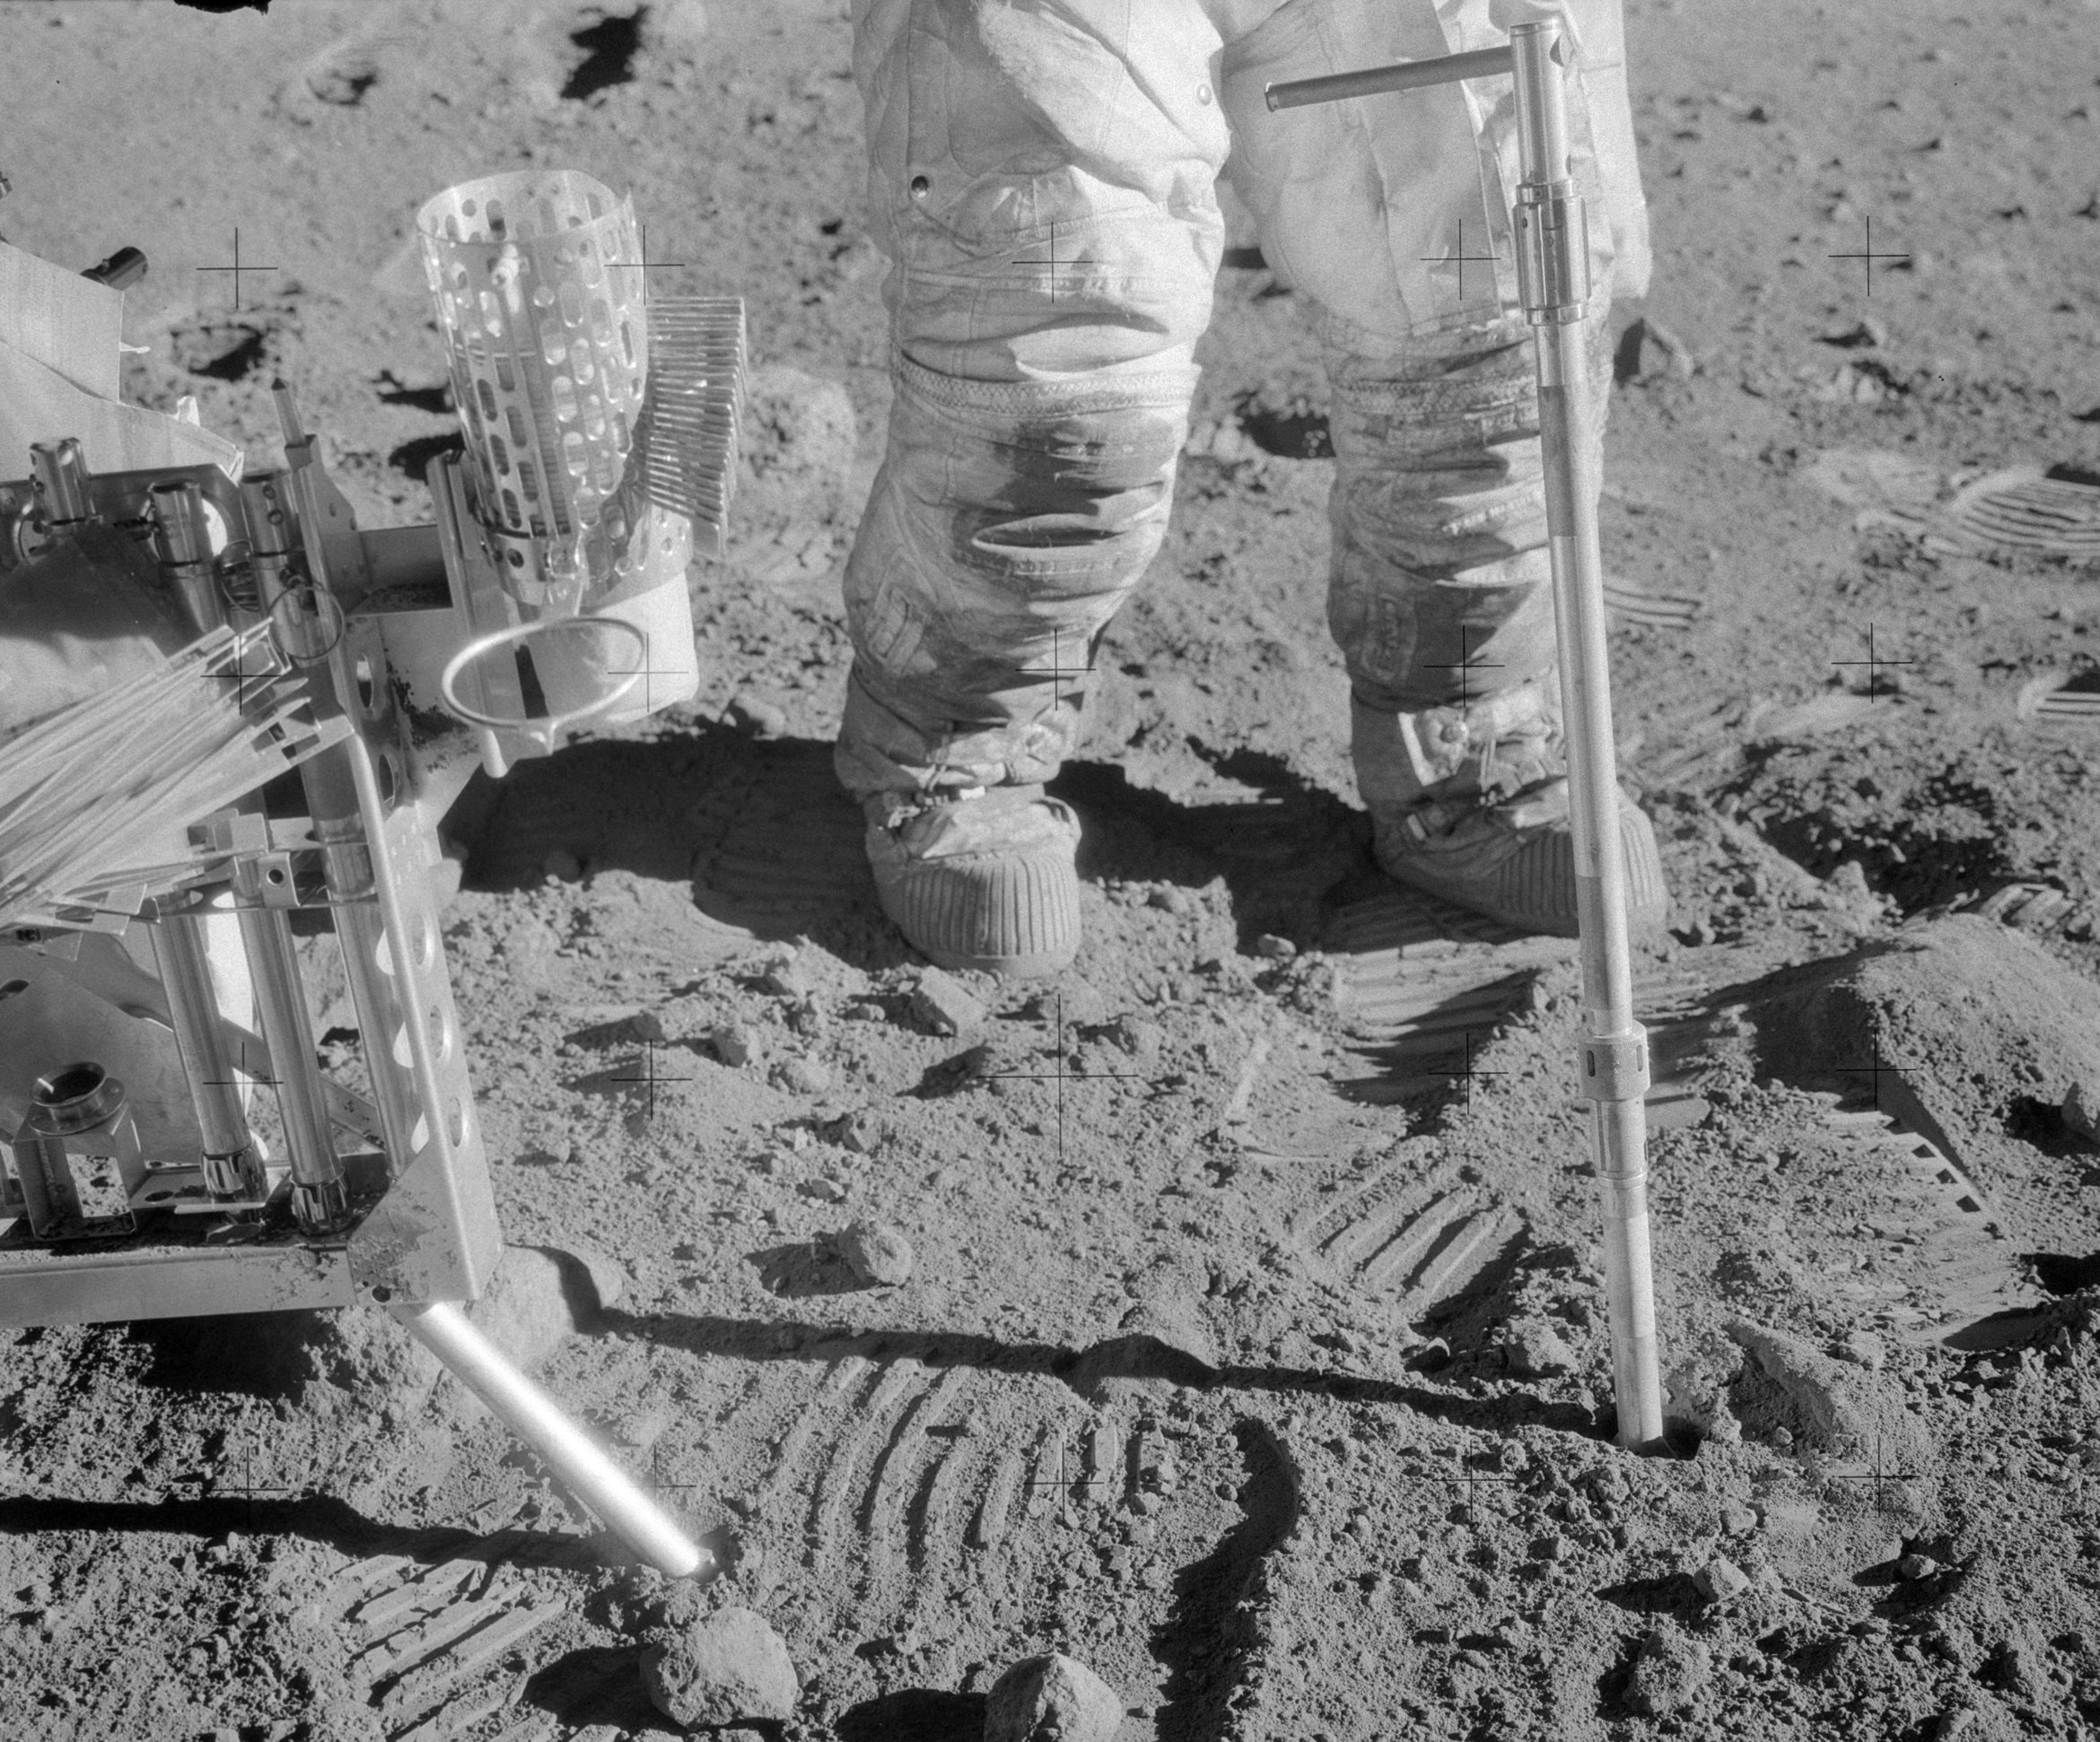
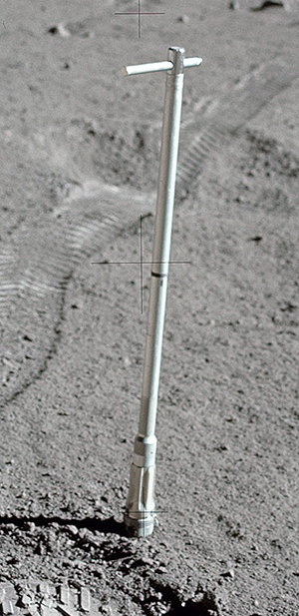
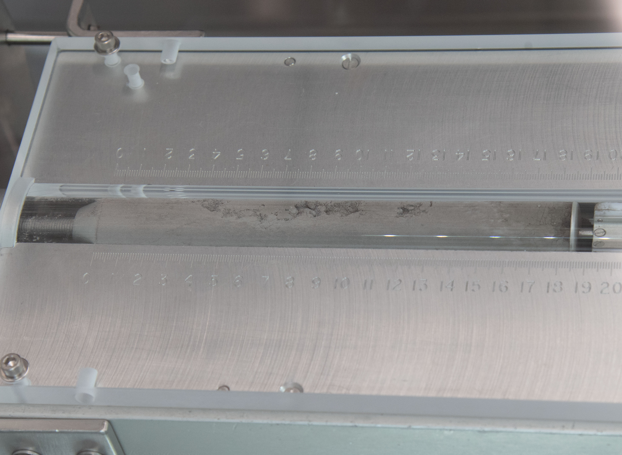
Apollo core sampling
Core sample
Apollo 12 astronaut Allan Bean

Slide 5
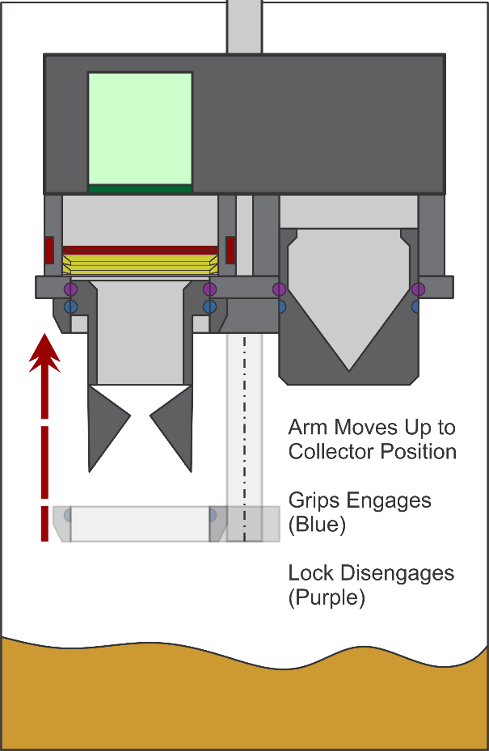
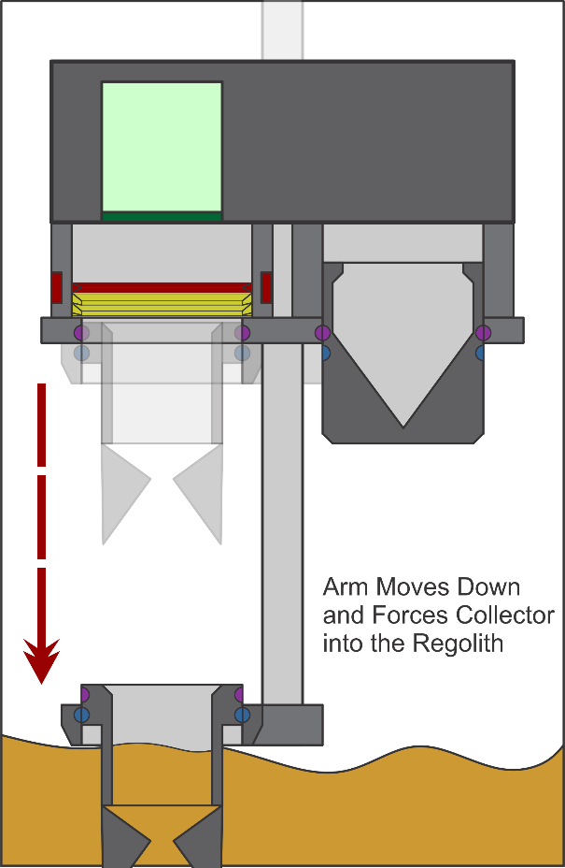
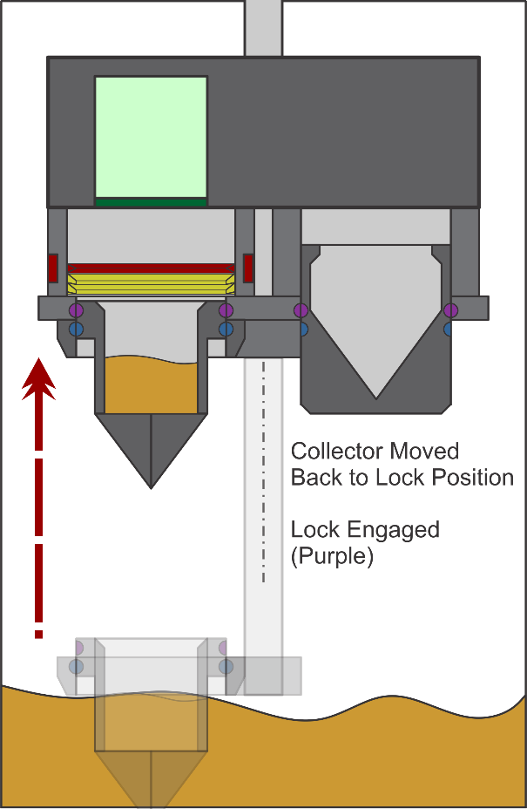
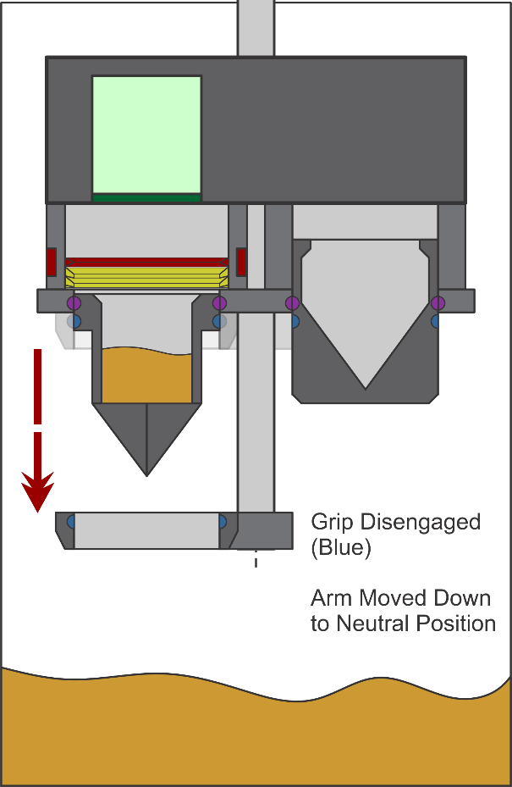
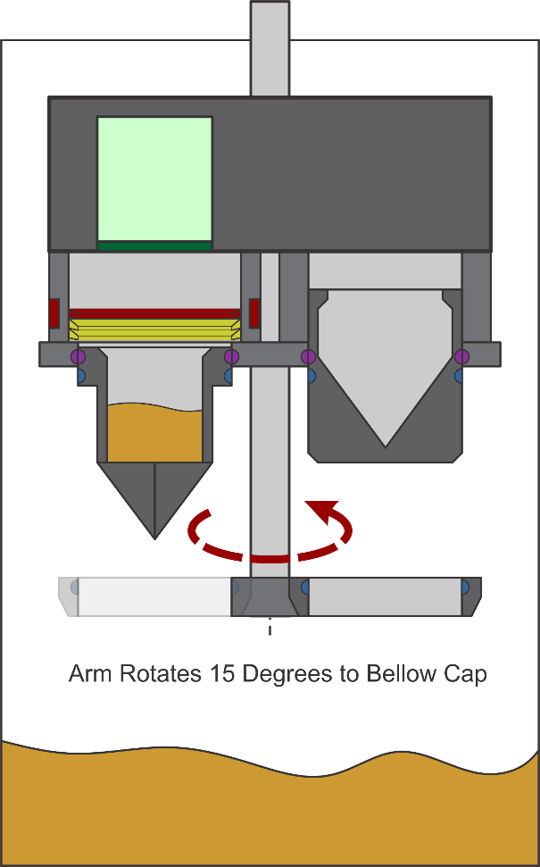
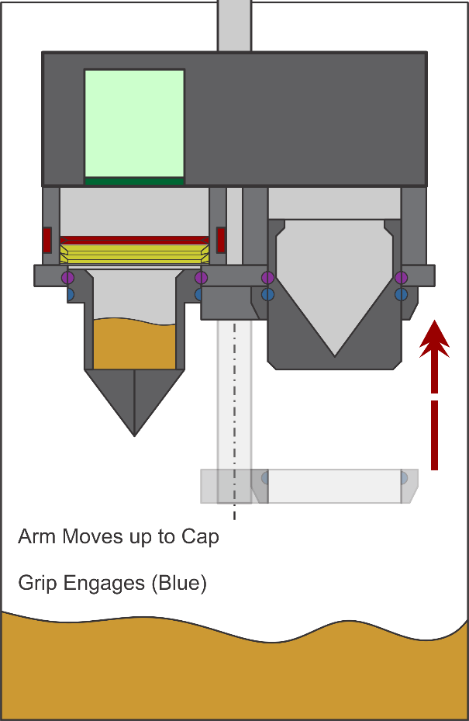
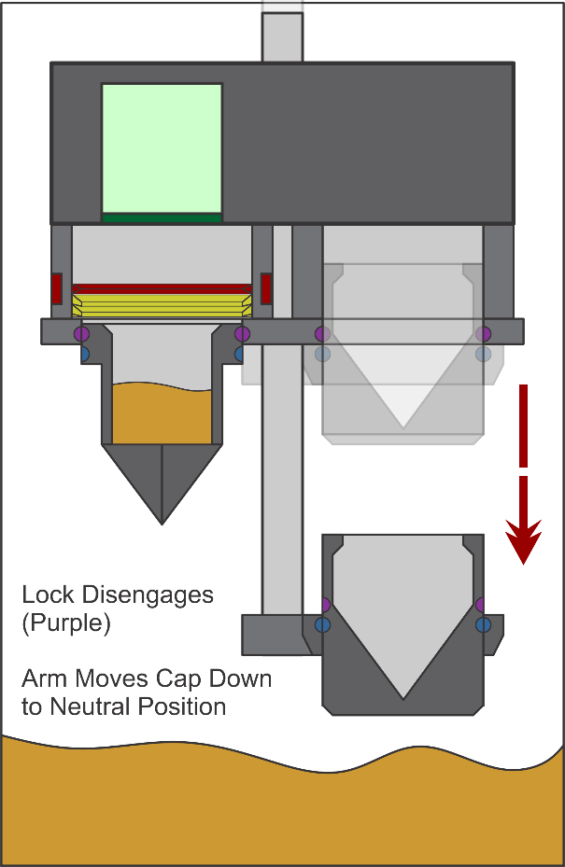
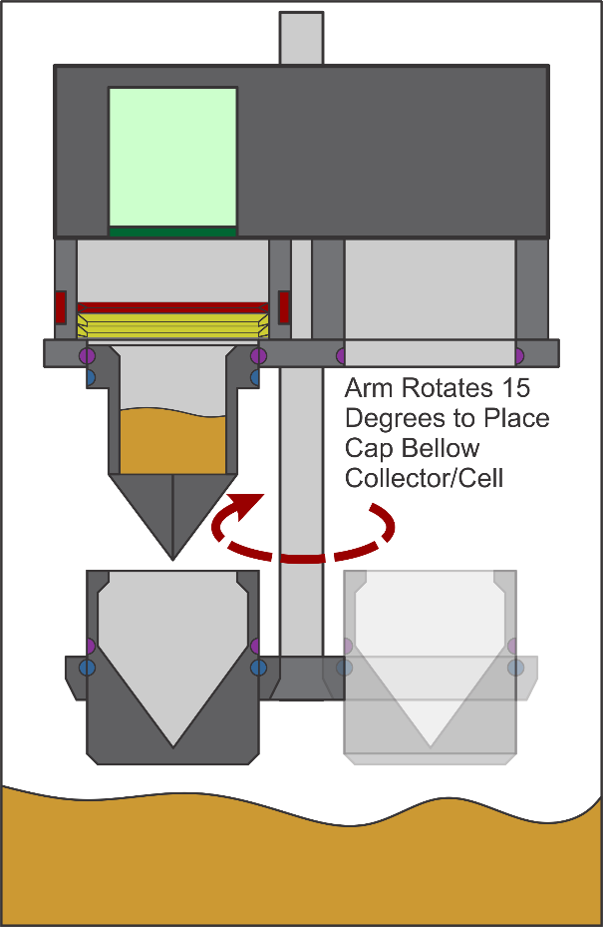
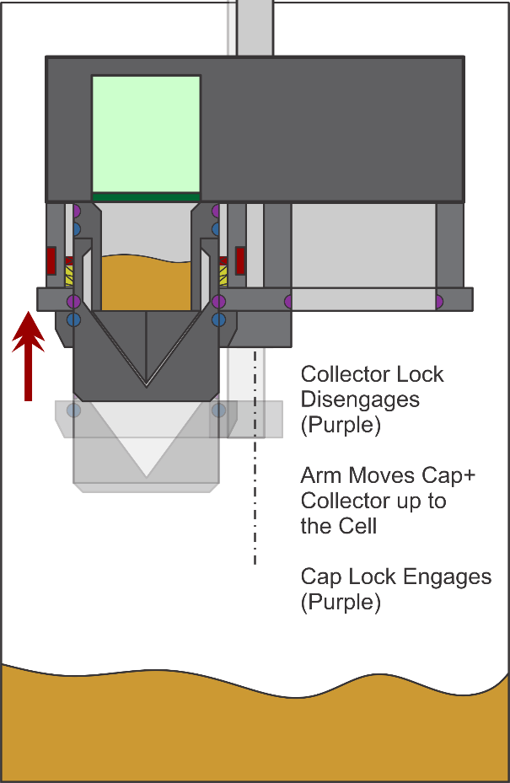
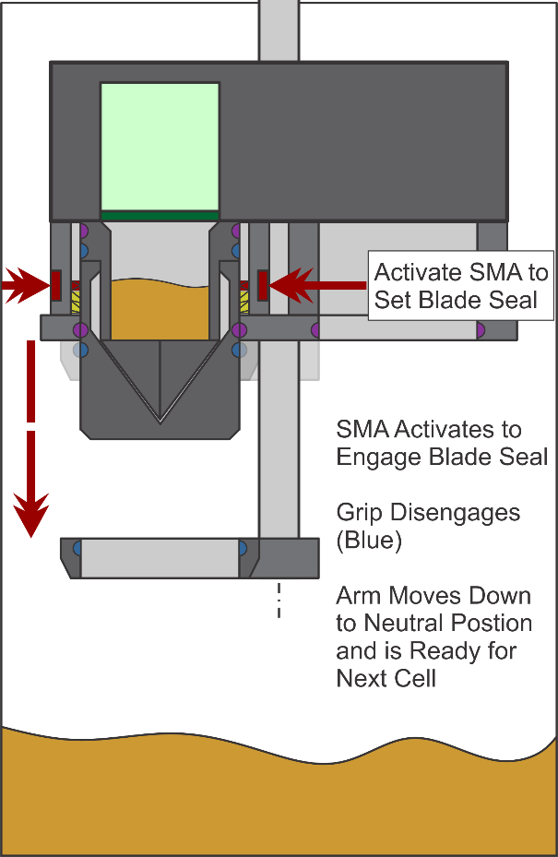
Sampling based on Apollo collection tube-like action
Collect Sample in Core Tube
Seal bottom of core tube
Notes:
Thought about the process for Garry

Slide 6

Experiment Concept and Closeup Growth Cell:
Water deployer (syringe) and sensors with seeds attached in the top portion are driven into the sample when the lower sealed to upper portion.
Cells pressurized to one Earth atmosphere and nutrient-containing water progressively added directly to sample to wet the regolith. Added water dissolves the water soluble seed coatings.
Soil and atmosphere sensor measurements and imaging of atmosphere/soil interface immediately begin to monitor germination process.
Growth Cells components and design
Light Source
Light Source
Atmosphere source
CO2 sensors
atmosphere source
CO2 sensors
T, P, humidity sensor chips
T, P, humidity sensor chips
Resource Compartment with Metal/Metal Seal
H2O tank with nutrient
Fiber Optic Camera
Fiber Optic Camera
O2, pH, salinity, ion sensors
Water soluble seal
O2, pH, salinity, other sensors
Sample compartment with Metal/Metal Seal
Water Tube with Seeds at Tip
Lunar regolith with nutrients and water
Lunar regolith
Before and After Combining of Resource and Sample compartments
Time lapse photography of entire process for education and public outreach.
Notes:
Extra slide with few words talking about time lapse photography.

Slide 7
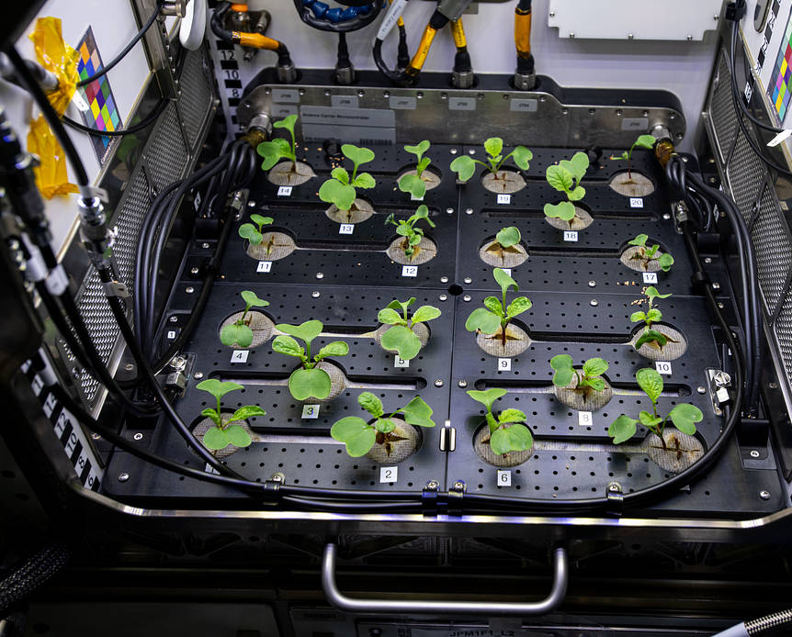
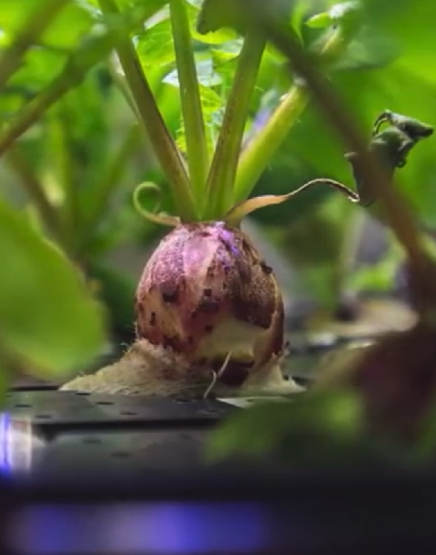
Radishes
Already a space target crop
Very rapid germination and growth to allow for ‘short’ lunar day
Radishes on ISS/NASA

Slide 8
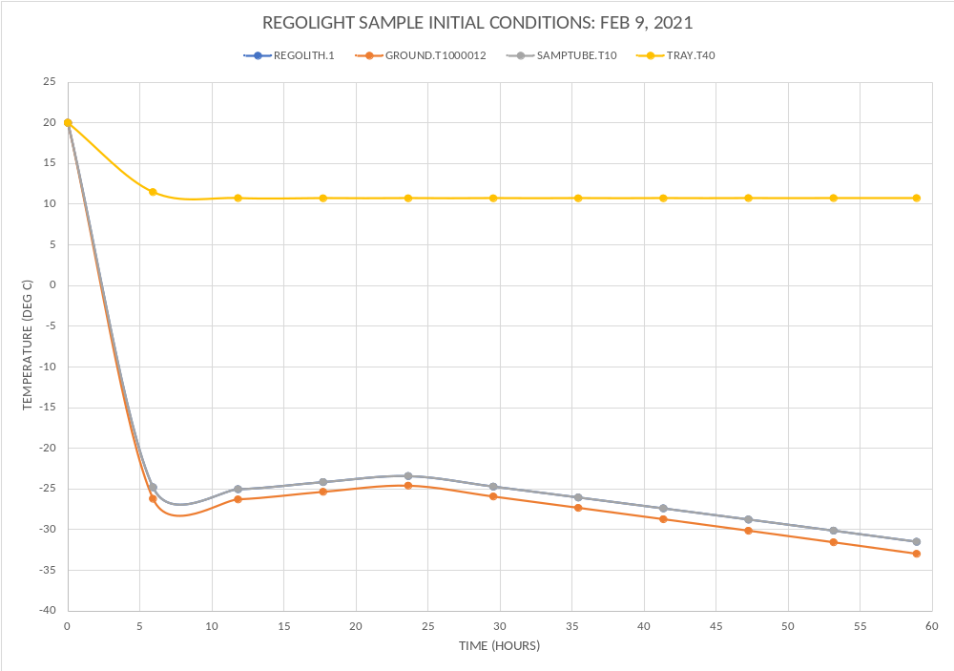
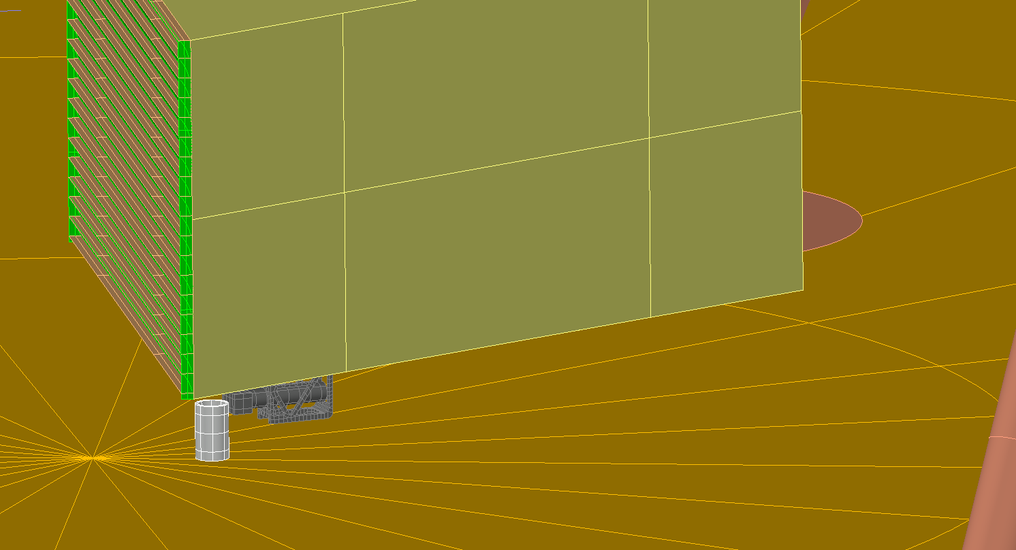
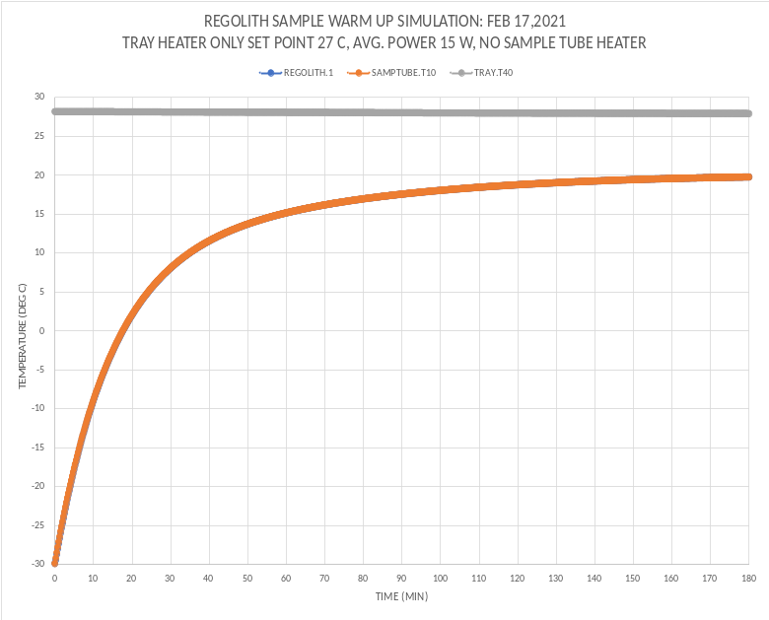
Special Concern: Initial Thermal Condition of Sample (Worse Case: LAT 85 after DAY 3.5)
THESE TEMPS. USED TO INITIALIZE SAMPLE WARM UP SIMULATION (USED FOR TIME ZERO ON WARMUP SIMULATION)
TRAY
LUNAR SURFACE (40 mm DEPTH)
SAMPLE TUBE
REGOLITH WITHIN SAMPLE TUBE MODELES AS LUMPED CAPACTIANCE C = 12.7 J/K,
m =0.015 kg
h=500 W/m^2-K CONDUCTOR REGOLITH LUMPED CAPACITANCE TO INNER WALL OF SAMPLE TUBE
SAMPLE TUBE,
REGOLITH SAMPLE
LUNAR SURFACE (40 mm DEPTH)
WARM UP TIME FOR REGOLITH SAMPLE TO REACH 20 DEG C ~140 MINS.

Slide 9
Ongoing Preliminary plant analyses for LARGE
Define minimal optimal water addition
Goal: Establish optimal amount of water addition for germination and biomass production
Approach: Using lunar regolith simulant, vary water addition (% weight) and assess growth and germination
Results: optimum = 25% water by weight
Effect of planting depth
Goal: Define how depth of seed planting can affect germination and growth as fine particles in regolith simulants bind together in the presence of water forming a “hard-pan” layer
Approach: vary seed planting depth and monitor effects on germination, growth and regolith physical character
Results: Planting below 1 cm impedes seedling emergence, planting shallower than 5 mm leads to seedling roots failing to penetrate the substrate and then drying and dying
Simulants obtained and used include LHS1, NULHT, Off Planet Mare and Nearside Highland (regolith and agglutinates)
Goal: Use a range of simulants, as no ‘ideal’ simulant exists
Approach: Perform tests below on more than one simulant, and on simulants which have had water driven off to approximate lunar conditions, and compare results.
Anticipated results: Off Planet will be similar to NULHT in being most analogous to lunar soil
Growth time-course analysis: Size and biomass
Goal: Establish baseline of plant growth characteristics
Approach: Monitor growth under optimal lab conditions (complete medium, plant growth chamber) to provide a robust comparison to lunar regolith simulants
Anticipated Results: Similar to ISS and terrestrial results for this variety of radish seeds
Role of inorganic nutrients
Goal: Assess how lack of some essential plant nutrients in regolith affects plant growth.
Approach: Test effects of addition of nothing, Nitrogen, Phosphorous or a complete inorganic fertilizer on plant growth in simulant
Anticipated Results: nitrate addition improves biomass

Slide 10
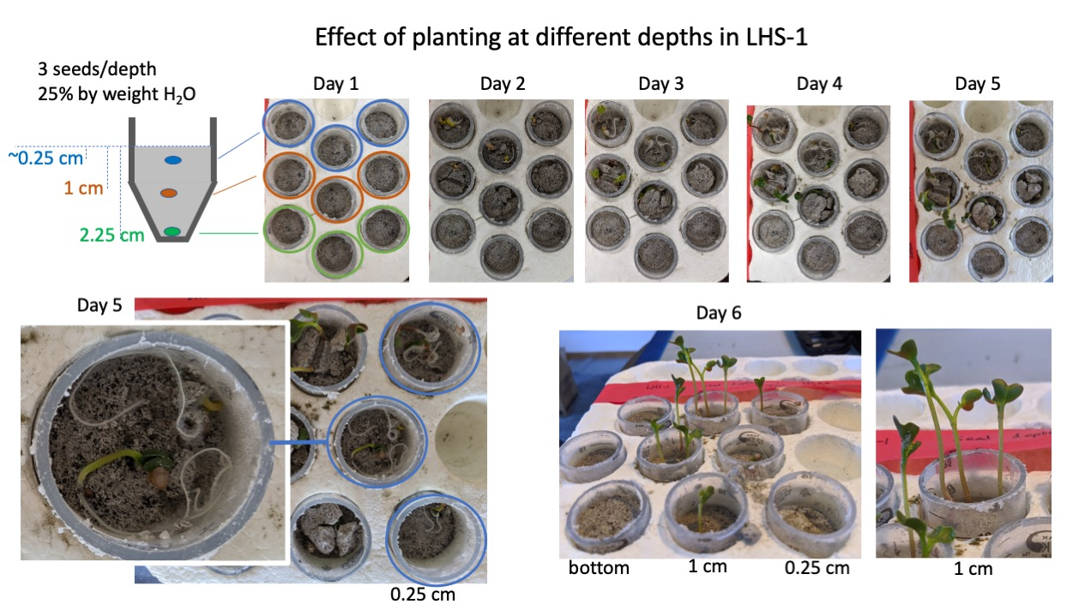

Slide 11
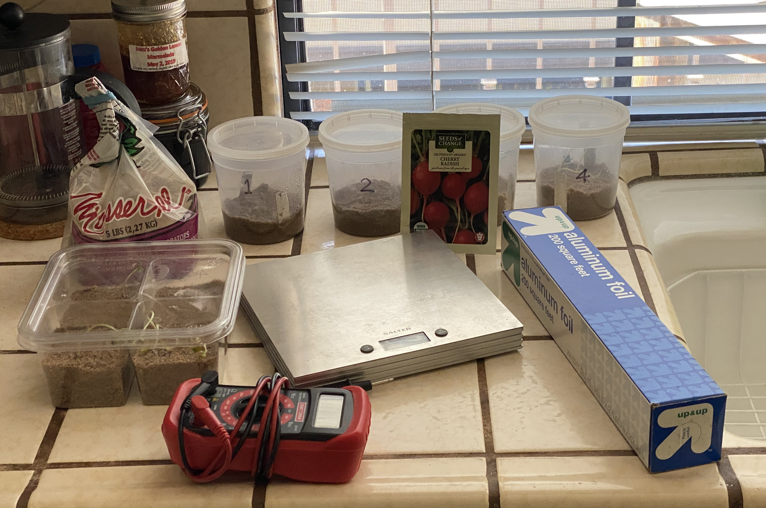
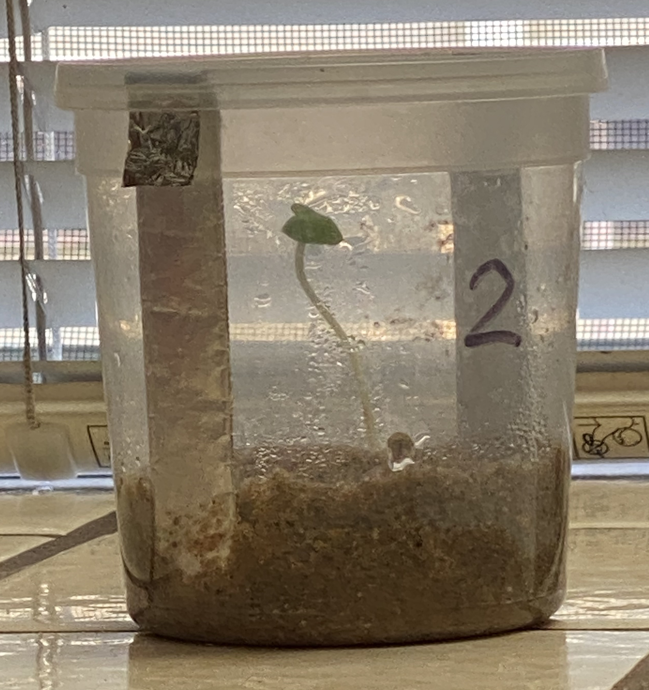
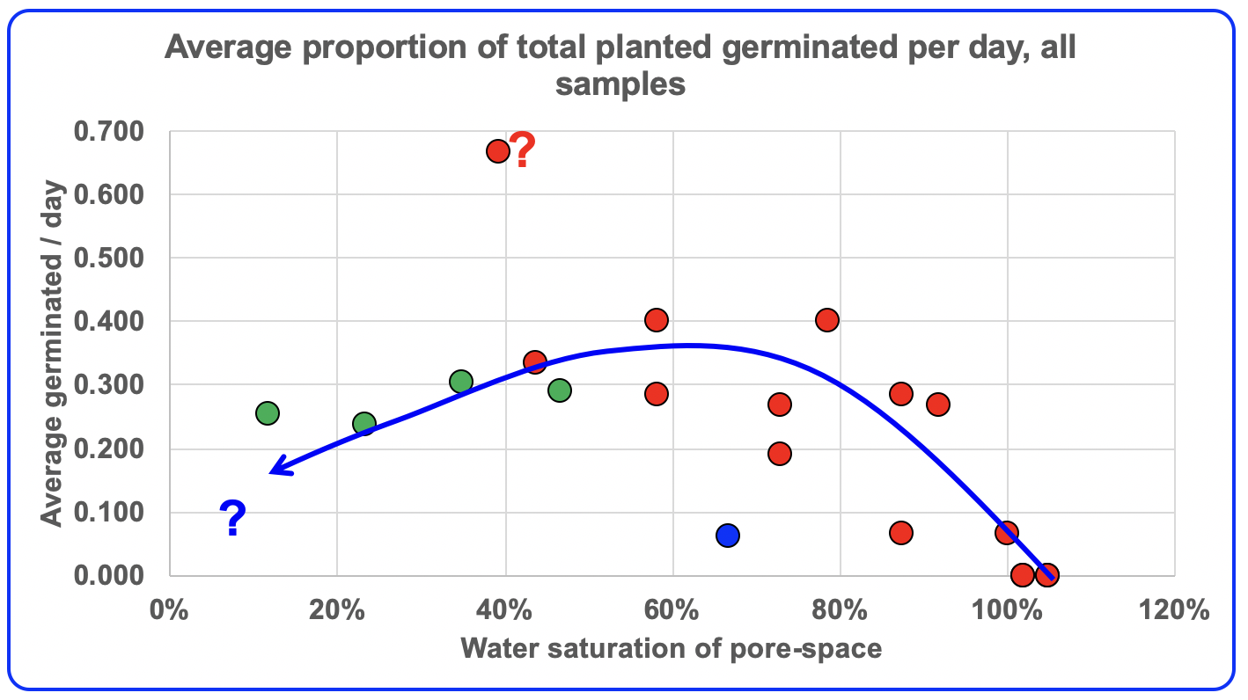
Max Coleman: Water and germination
Investigated how much water needed to germinate seeds
Bought seeds and soil on Amazon Prime, during WebEx meeting, and
Grew seeds in re-used deli containers
Large allowable range for water saturation with mode around 50%, typically 2-3 days
Seeds optimal position away from walls.
Water spread optimal if added into soil.
Water dissolves protective solubag coating
Outreach
JPL Space item: JPL Scientist over the Moon with homegrown radish research
JPL News release: NASA Scientist over the Moon with homegrown radish research
Zoom talk as a Pasadena Public Library Special Event
Spectrum TV interview

Slide 12
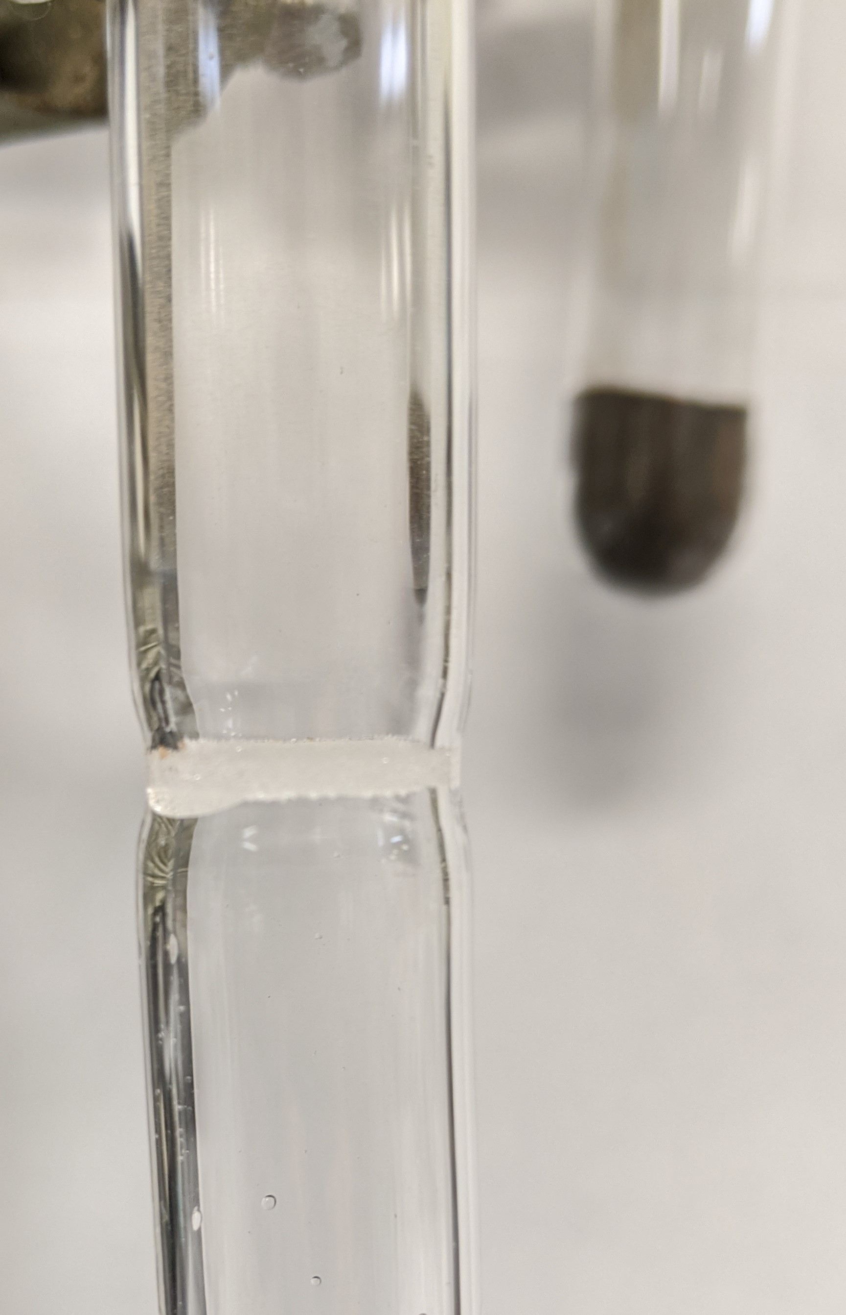
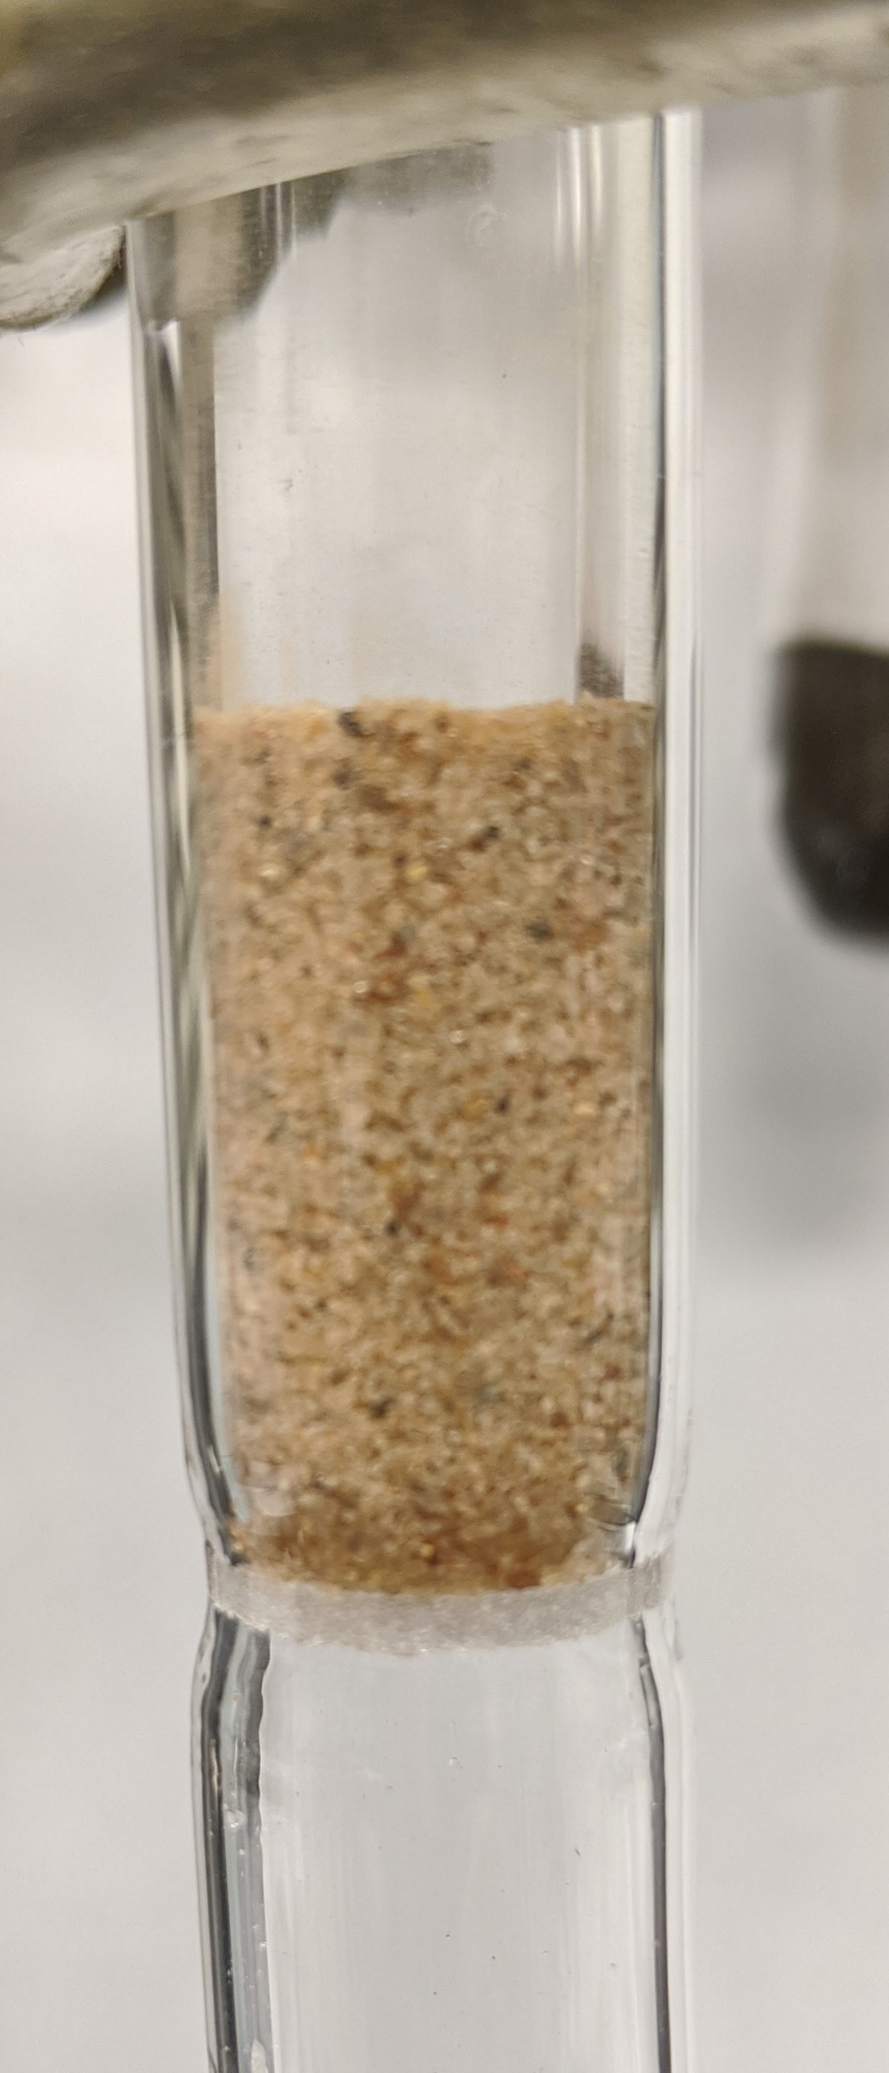
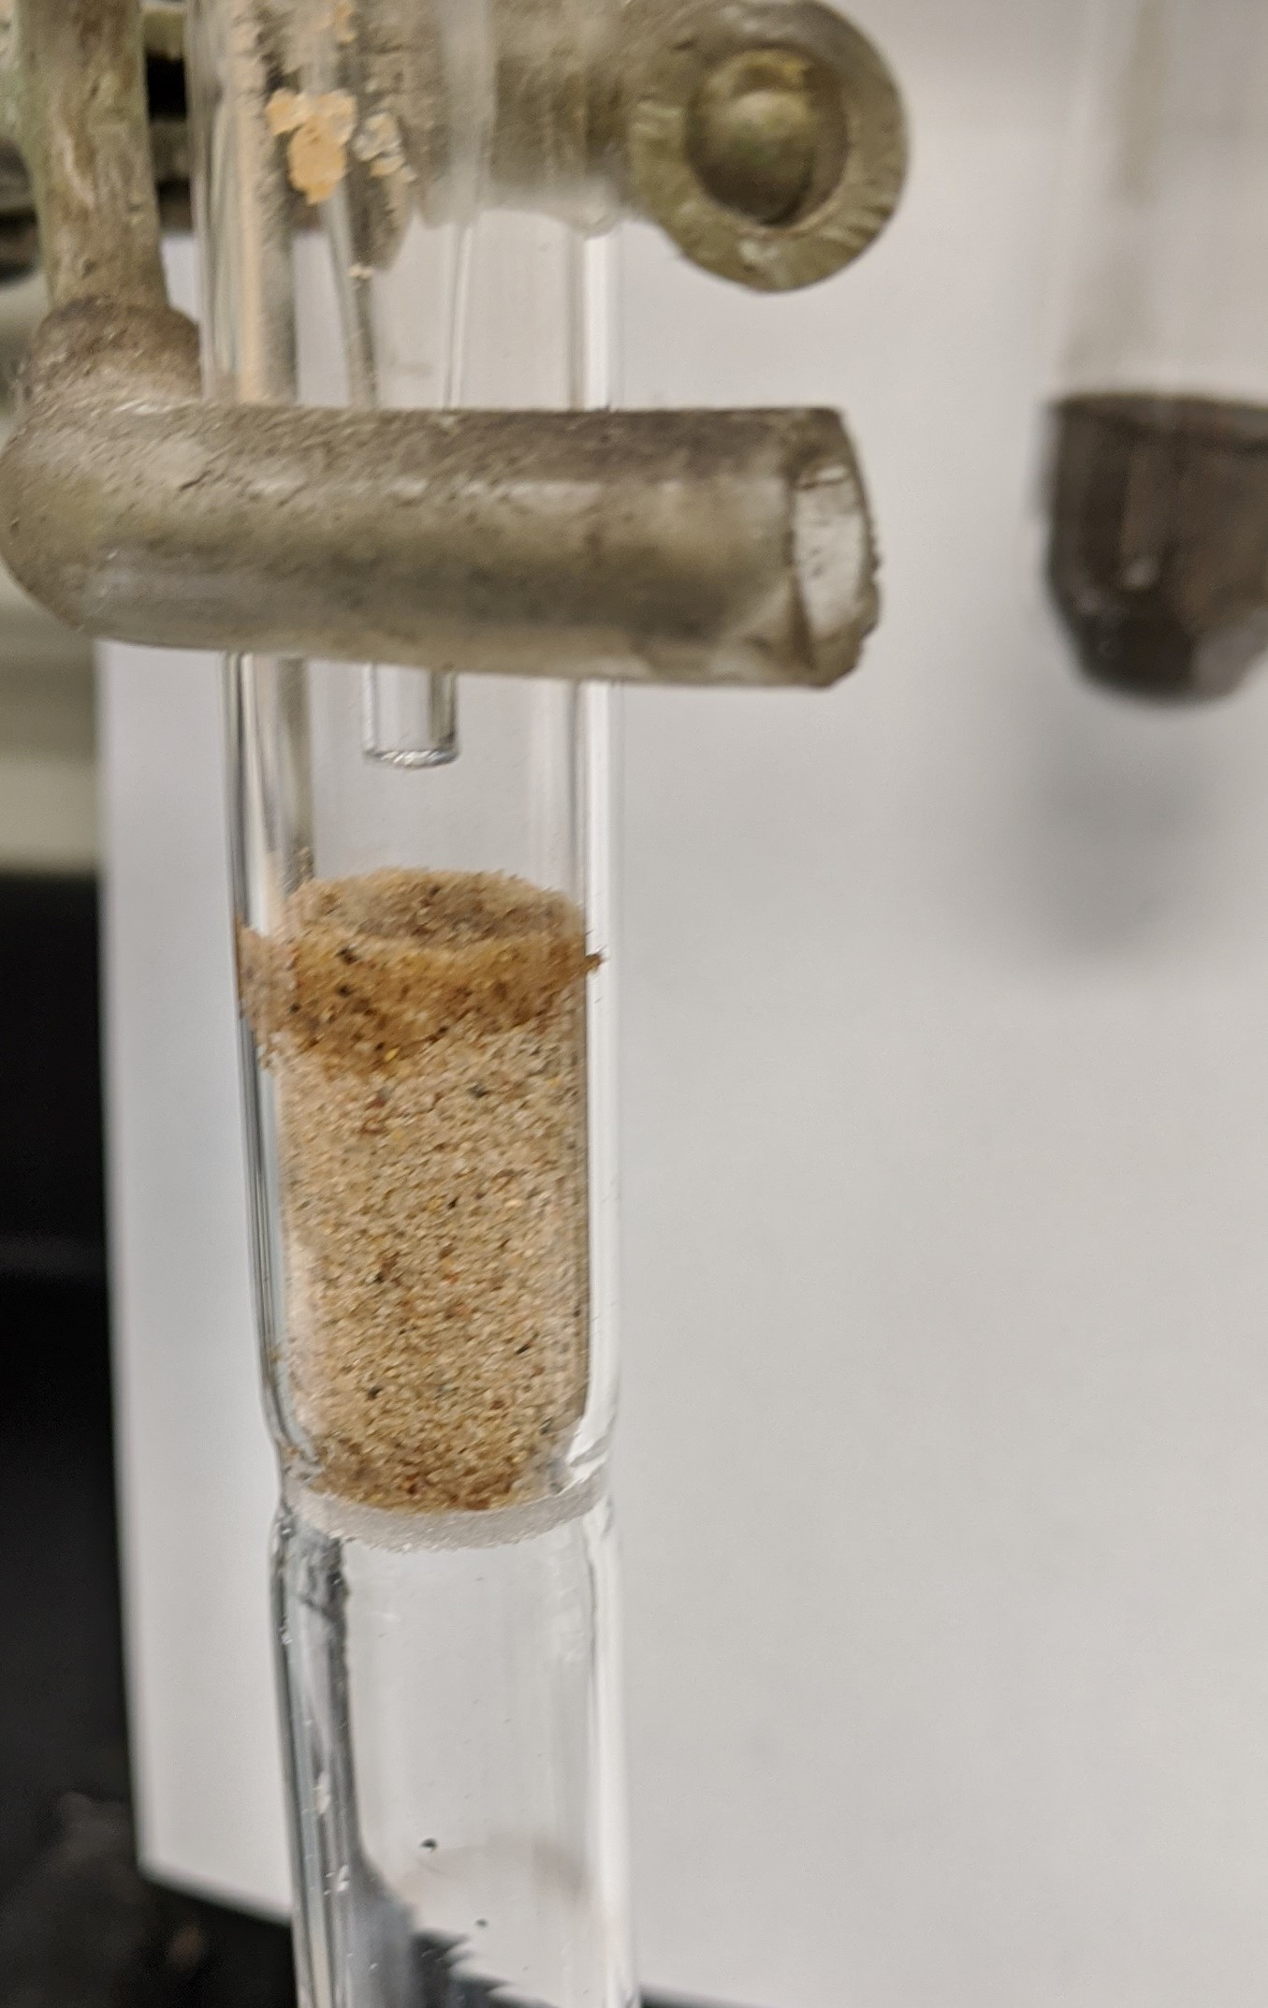
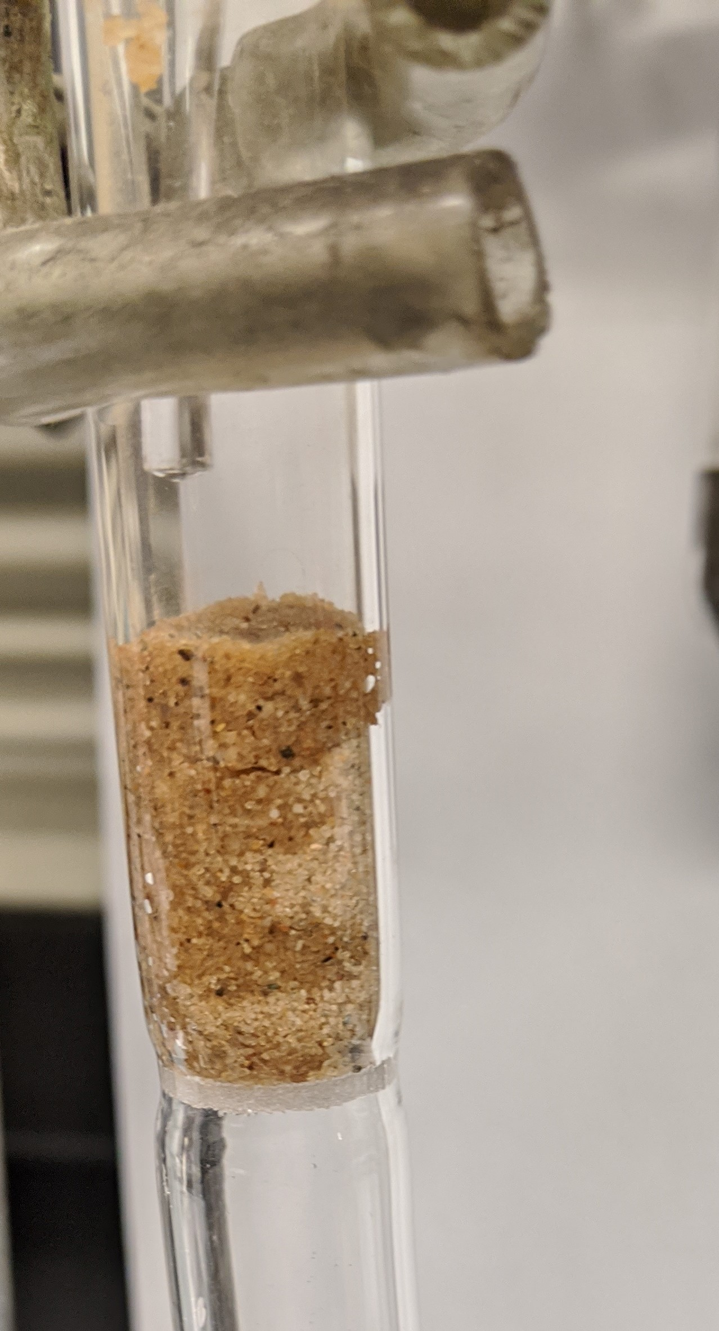
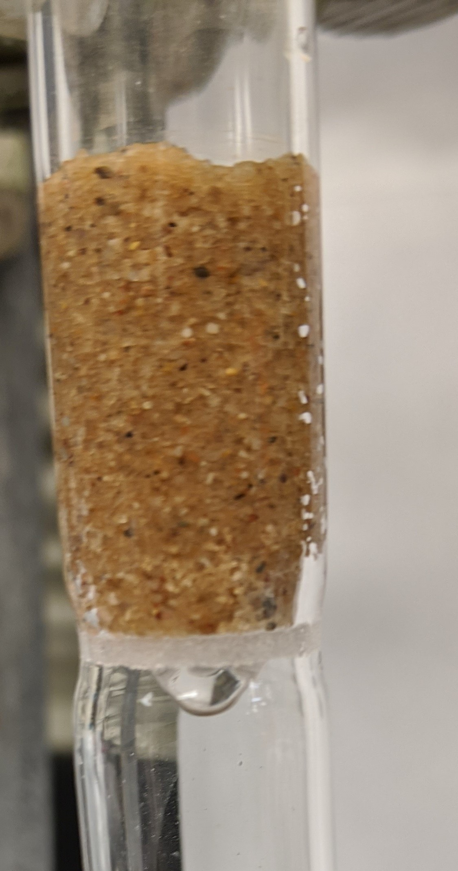
Gerald Voecks: Procedure to Determine ‘Saturated’ Soil
Saturated Frit
Dried Simulant
Initiation/Process of Wetting Simulant
Saturated Simulant

Slide 13
Next Steps: Sample Preparation/Handling, Testing Cell Model
Preparing a vacuum chamber testbed to evaluate the effectiveness of the drive tube sampling mechanism concept.
Utilizing prepared OP simulant, via the recommended and tested pre-drying protocol, with varying proportions of agglutinate and compaction.
Employ a sample container of sufficient size and volume to minimize boundary effects and effectively represent lunar regolith.
Harnessing vacuum test chamber hardware previously developed in Section 347 for testing ice surface anchoring mechanisms (for the Ice Worm project and others) under vacuum and at cold temperatures.
Utilizing the amount of force recommended by Harrison Schmitt (Apollo core sample tube collection) as a baseline.
Observe (with a camera) and measure both the amount and consistency/compaction of the collected sample. .
Early Force Tests – Used a simple single axis load cell with the sample tube manually inserted into the test medium (flour was used due to easy access). Tests showed low required insertion force and moderate sample retention, now needs to be tested with the proper simulant and environment.

Slide 14
Next Steps: Create Cell Model, Build and Test Cell
Complete testing of collection and sealing mechanisms
Incorporate results from experiments to refine cell design (placement and arrangement of components) and operational scenario (timing and amounts of environmental factors)
Build 6-cell model.
Run simulated plant growth experiment to
  Verify recommended pretreatment (drying) options
  Verify optimal placement of seeds
  Verify optimal water addition mechanism
  Verify optimal sensor placement and adequacy (range and rate of change)
  Varying impact of nutrient amounts and types (e.g., varying nitrogen supplement abundances from 0 to TBD)
  Varying impact of compaction (porosity range anticipated in lunar soils)
  Varying impact of simulant preparation (OP, NULHT, etc.) composition and agglutinate content (mare and nearside highlands, in anticipated range agglutinate content)

Slide 15
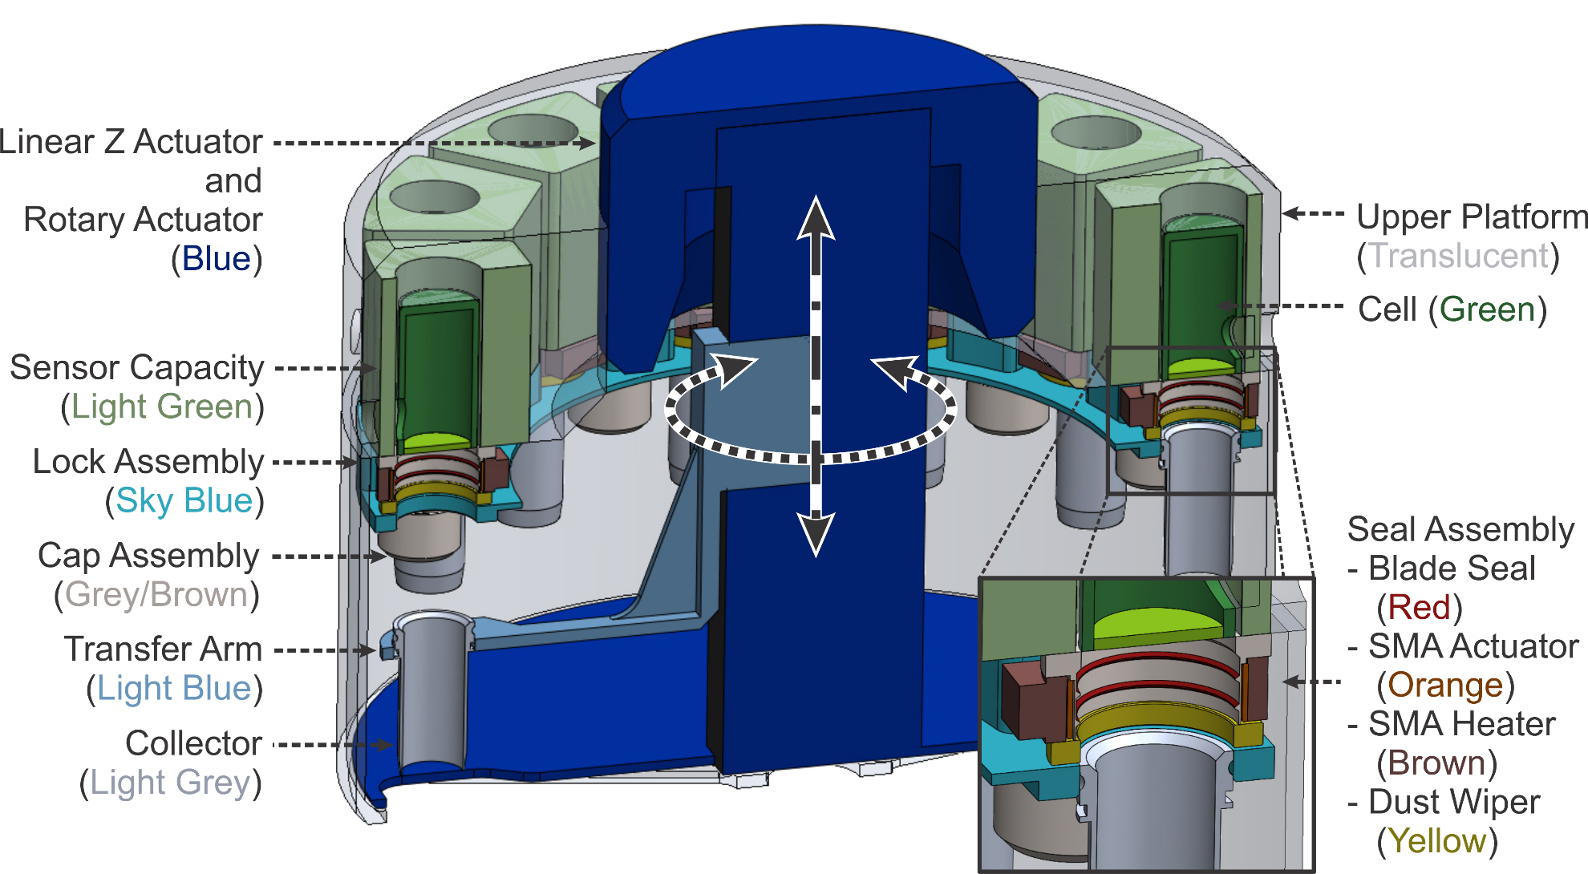
Experiment Concept Closeup Carousel and Sampler:
Collection approach is based on successful Apollo drive tube regolith collectors.
After rotating the bottom of the carousel to create an opening, a linear actuator assembly drives, one at a time, into the regolith, with a controlled constant downward thrust and upward removal. Limitation devices within the samplers control the amount of sample collected.
The sample is then rotated into position for sealing the bottom of the lower portion and then joining and sealing the bottom to the top portion.

Slide 16
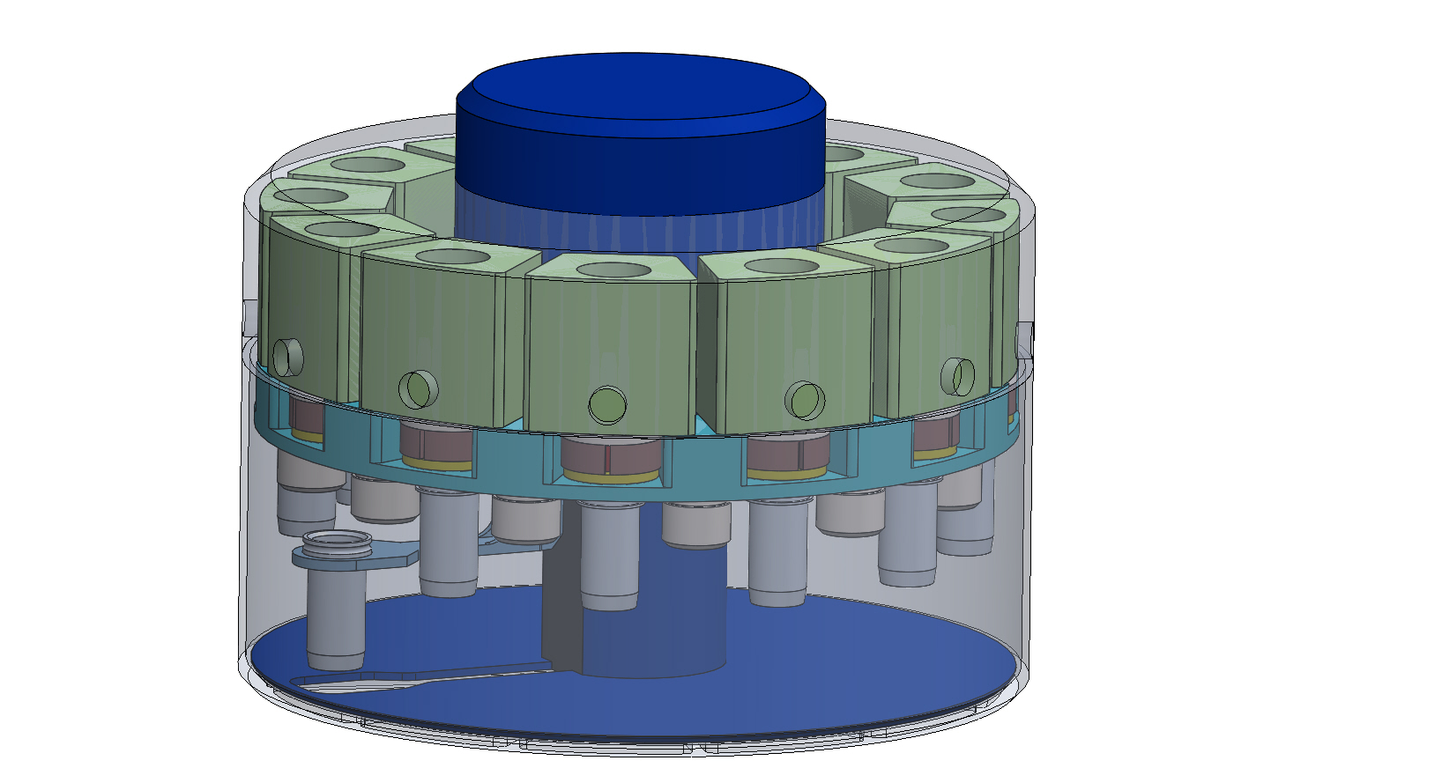
Gas Containment
Maintain atmosphere within carousel to within standard variations in atmospheric pressure
Gas supply tank (170 cc) inside enclosure with 1 mm Al thickness estimated at <1 kg with redundant COTS lightweight solenoid and valves with Mars lander/rover heritage outside of Carousel
Single egress sealed after sample holding.
Low inlet pressure requirement and Relaxed leakage requirement, with compensation 1 gram/day from supply.
ISO

Slide 17
Avionics Concept
Deploy (Pyro)
Heaters
Lights
On/Off
Power Subsystem
P, T, HUMIDITY
In each cell, controls for diurnal light, water release, air release, sealing mechanisms, imager, heater, linear actuator, rotary actuator.
One interface card per each 4 cells.
Interface
Interface
CO₂
INTERFACE
OEM
O₂
pH
SPECTROMETER
SPHINX COMPUTE ELEMENT
HYGROMETER
ION SENSITIVE WIRE
ELECTRICAL IMPEDENCE
MOTOR CONTROL
Linear Z
Rotary
SMA

Slide 18
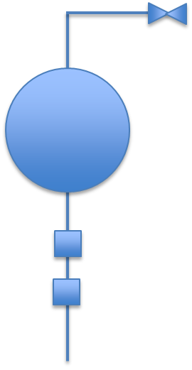
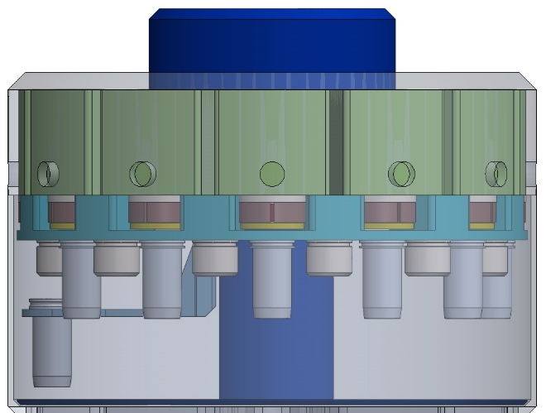
Thermal Architecture
Passive thermal architecture with
  Parabolic Reflector Radiator (PRR) provides heat rejection for the Payload/Thermal Enclosure
  Operational and Survival Heaters on PRR controlled by mechanical thermostats
  Temperature sensors to monitor cell temperatures
  MLI surrounding thermal enclosure
Avionics/Control Electronics mounted to thermal enclosure base
Gas Containment mounted to thermal enclosure
Assumptions
Payload is not required to survive overnight
Power provided by host (this includes survival heater power)
Payload Power Dissipation (~20 W total)
  Sampling System Power From actuators~ 15 W
  Avionics Electronics ~ 5 W
Temperature Requirements:
  Survival (Non-Operational): 5 to 35°C
    Launch, Cruise, EDL
    Stowed on Lander
    Surface
  Science (Operational): Carousel 18 to 24°C on Surface
Lander: Comm and 28V
Parabolic Reflector Radiator (PRR)
Umbilical Cord
~25cm
Lander Deck
Gas containment system
~35cm
MLI
PAYLOAD
Thermal Enclosure (covered with MLI)
Avionics/Control Electronics
Lunar Regolith

