Slide 1

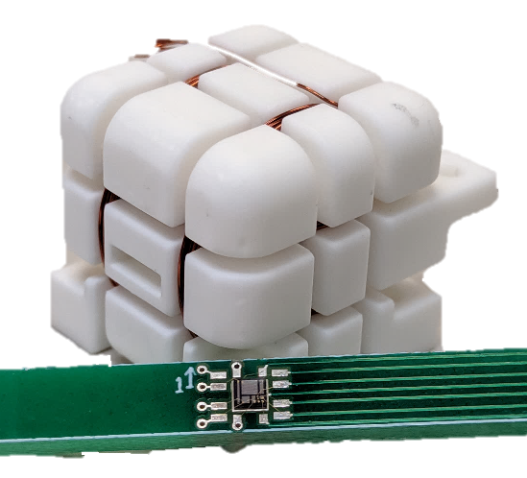
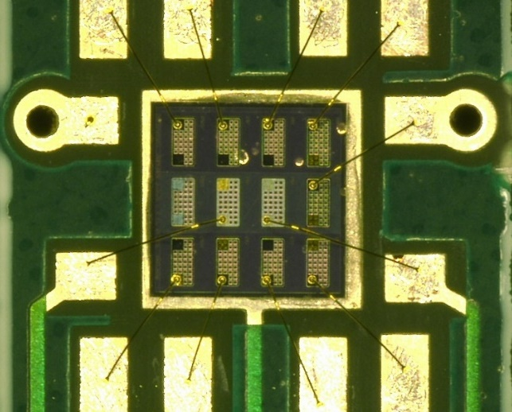
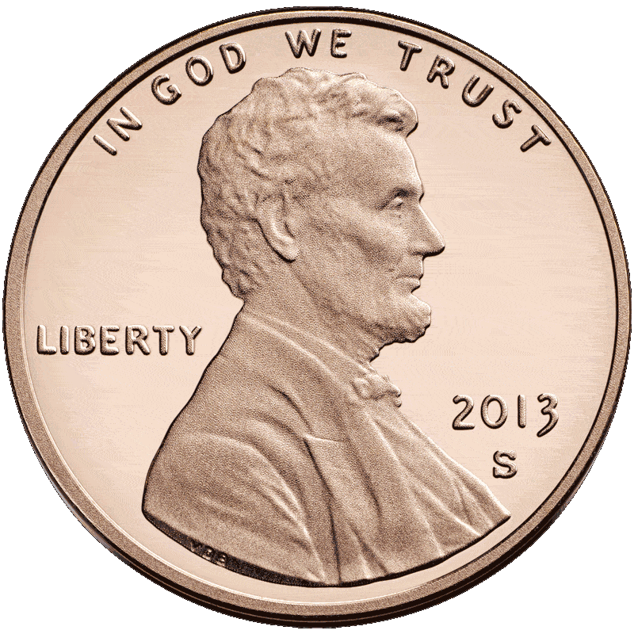
Miniaturized Solid-State Quantum Magnetometer for Space Applications
Inter-Planetary Small Satellite Conference 2021
C.J. Cochrane¹, H. Kraus¹, N. Murphy¹, P. Neudeck² , D. Spry²
¹ Jet Propulsion Laboratory, California Institute of Technology, Pasadena, CA USA
² NASA Glenn Research Center, Cleveland, OH, USA

Slide 2
Why the need for magnetometers?
STRATEGIC GOAL 1:
EXPAND HUMAN KNOWLEDGE THROUGH NEW SCIENTIFIC DISCOVERIES.
Strategic Objective 1.1:
Understand The Sun, Earth, Solar System, And Universe.
There are three core contexts of NASA’s first strategic objective:
Discovering the Secrets of the Universe
Searching for Life Elsewhere
Safeguarding and Improving Life on Earth
Magnetometers address each of these topics

Slide 3
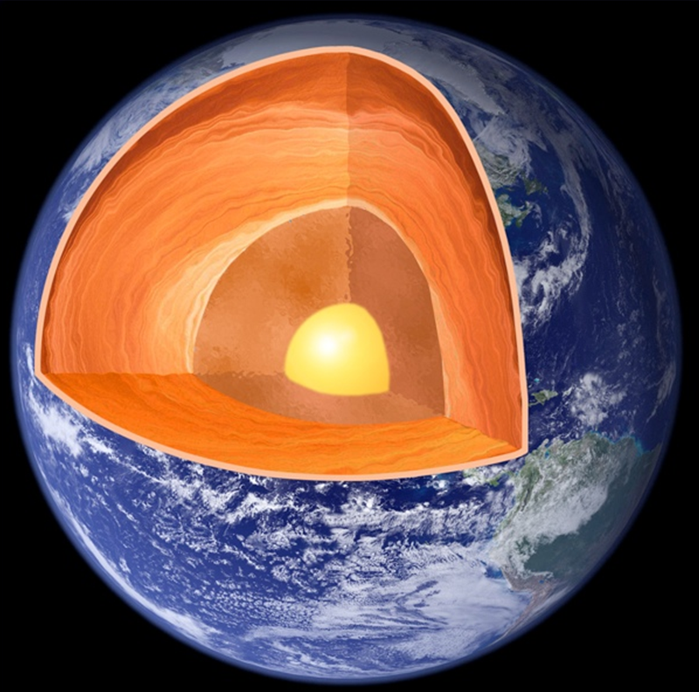
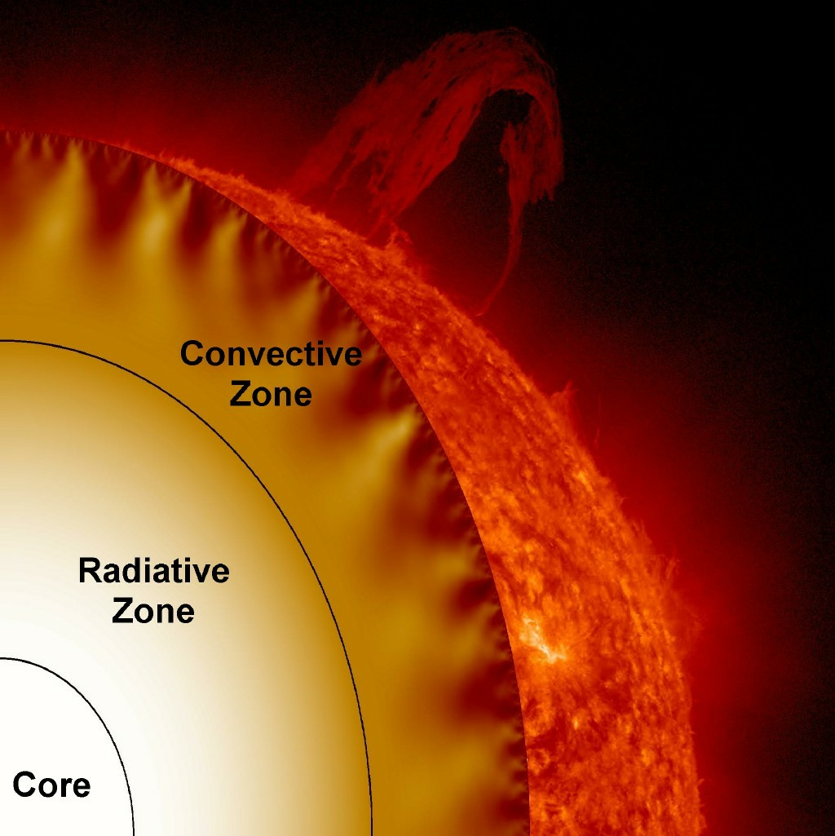
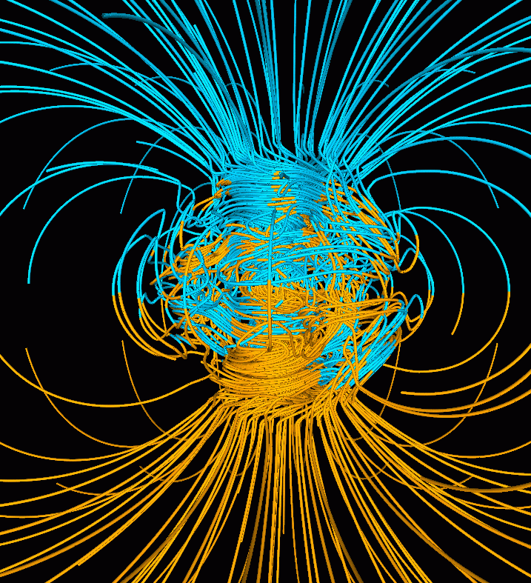
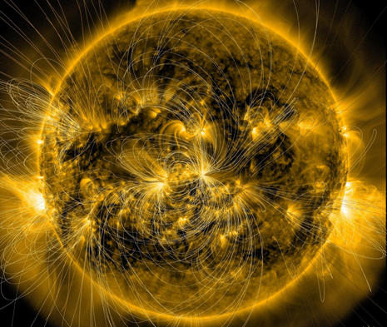
Why are magnetometers needed?
Discovering the Secrets of the Universe
Are able to remotely probe interior of planetary body to assess composition, dynamics, and magnetic history of the body
Image Credit: Glatzmaier 1995
Image Credit: NASA, SDO

Slide 4
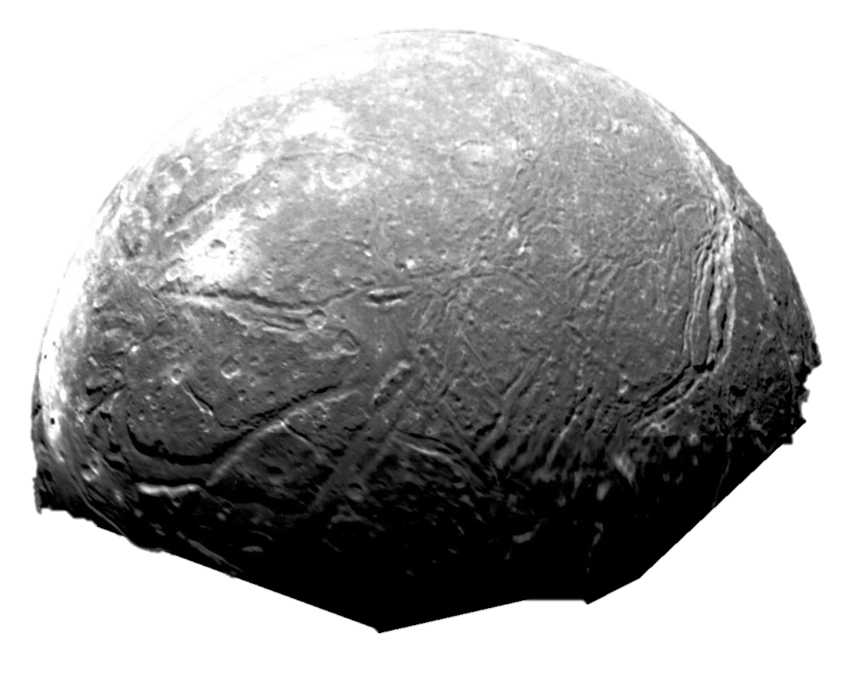
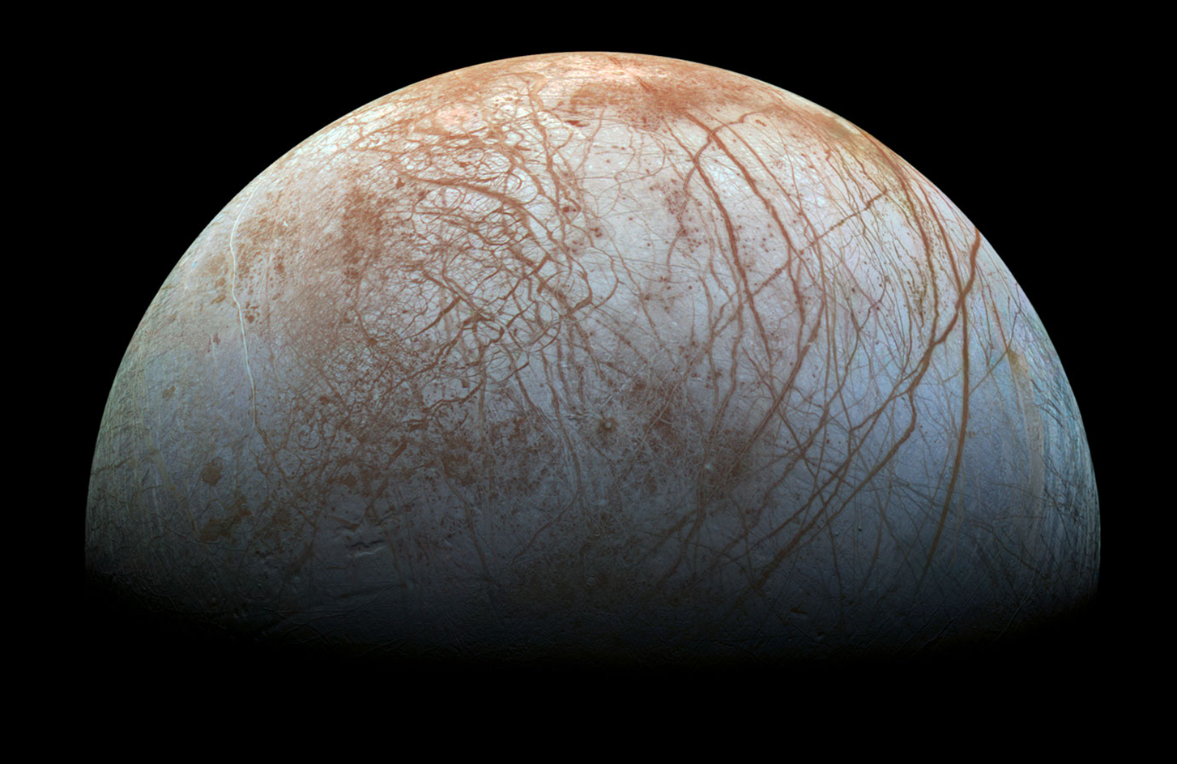
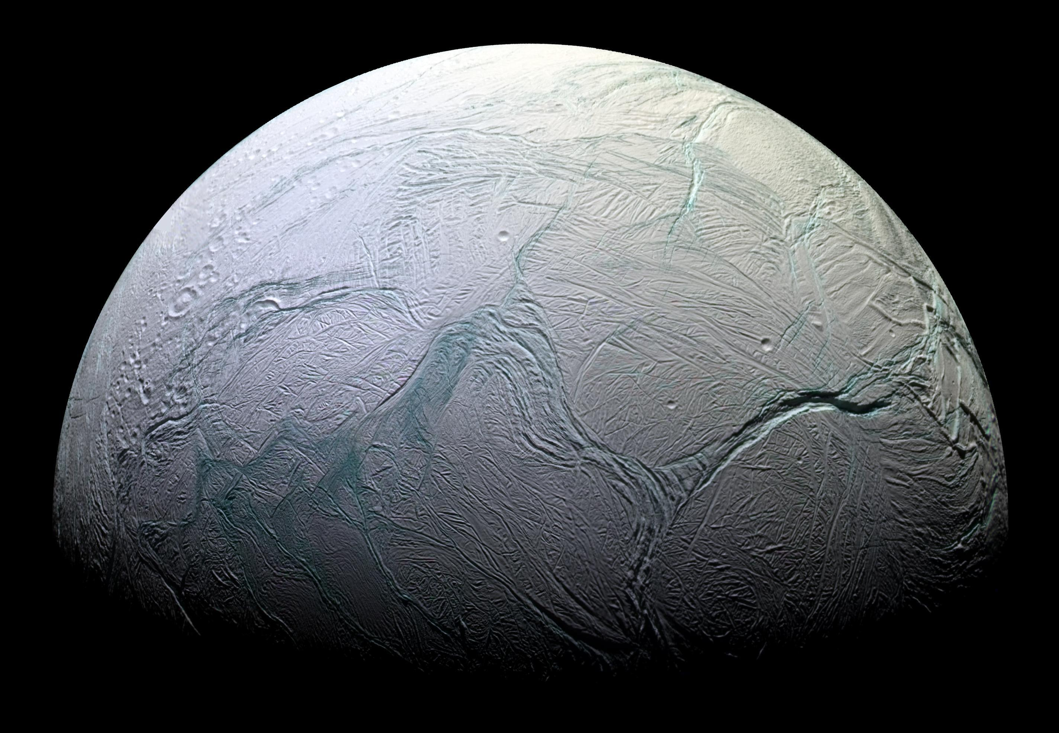
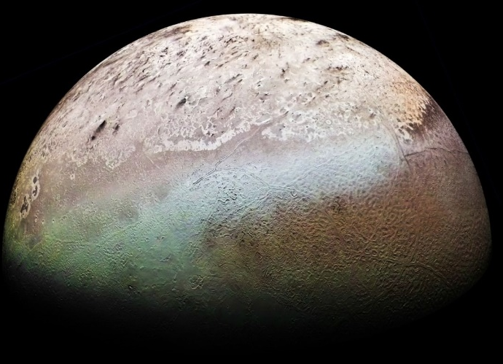
Why are magnetometers needed?
2. Searching for Life Elsewhere
Magnetometers have the ability to find hidden oceans … best place to find life!
Ariel/Uranus
(and other moons)
Europa/Jupiter
Enceladus/Saturn
Triton/Neptune
Galileo magnetometer discovered planetary-scale ocean under the surface of Europa.
Cassini magnetometer confirmed the plumes of Enceladus consisted of Ionized water vapor from ion cyclotron measurements
Voyager 2 didn’t flyby close enough to either of these moons to detect an induced magnetic field, but could to potentially harbor subsurface oceans based on the endogenic surface features they exhibit.
Europa Clipper magnetometer will help characterize the ocean’s conductivity in which salinity and habitability can be inferred.
Trident mission hopes to detect Ocean on a single flyby using a magnetometer… perfect application for a magnetometer equipped cubesat

Slide 5
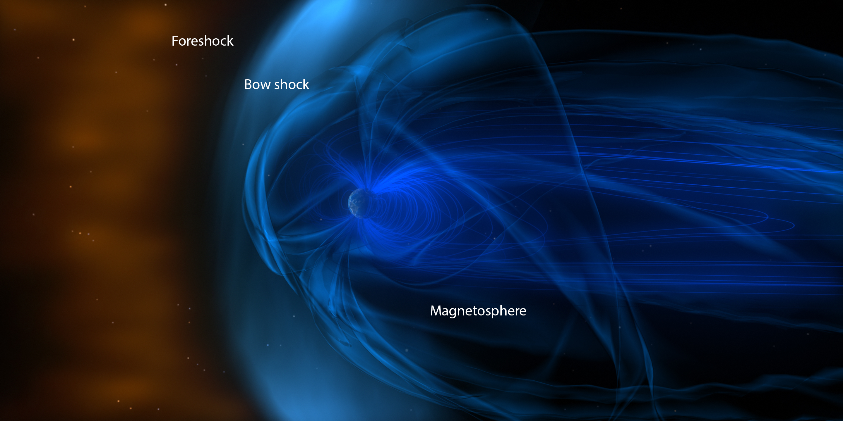

Why are magnetometers needed?
3. Safeguarding and Improving Life on Earth
When used with plasma based instruments, magnetometers can be very useful for …
1. solar wind weather monitoring
2. predicting geomagnetic storms resulting from dangerous solar events such as CME (solar flares)
Space weather warnings very useful for spacecraft operations (e.g. GPS, radio communications), increased radiation exposure to astronauts, and voltage surges in power grids on Earth that can cause blackouts

Slide 6
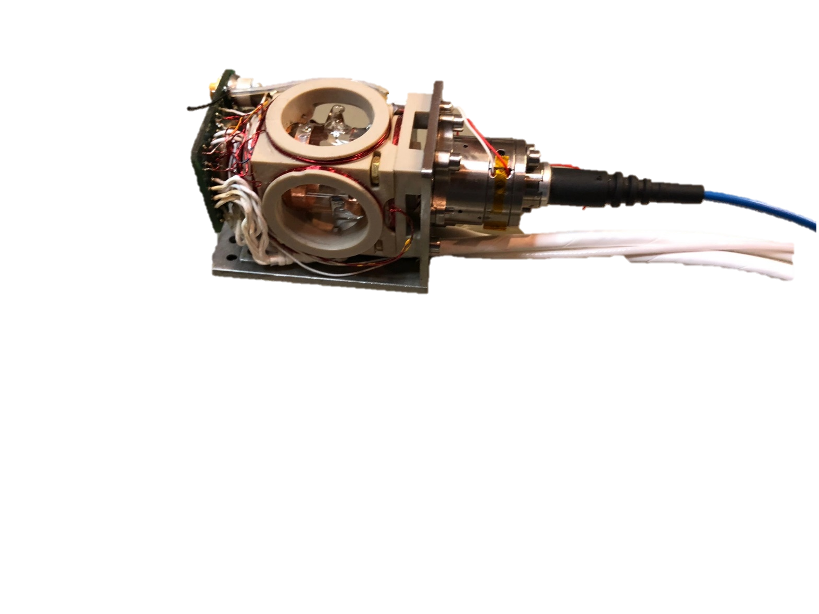
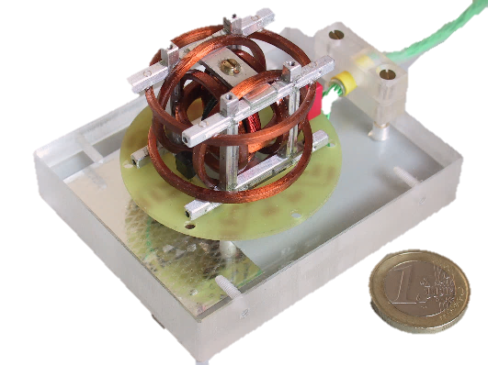
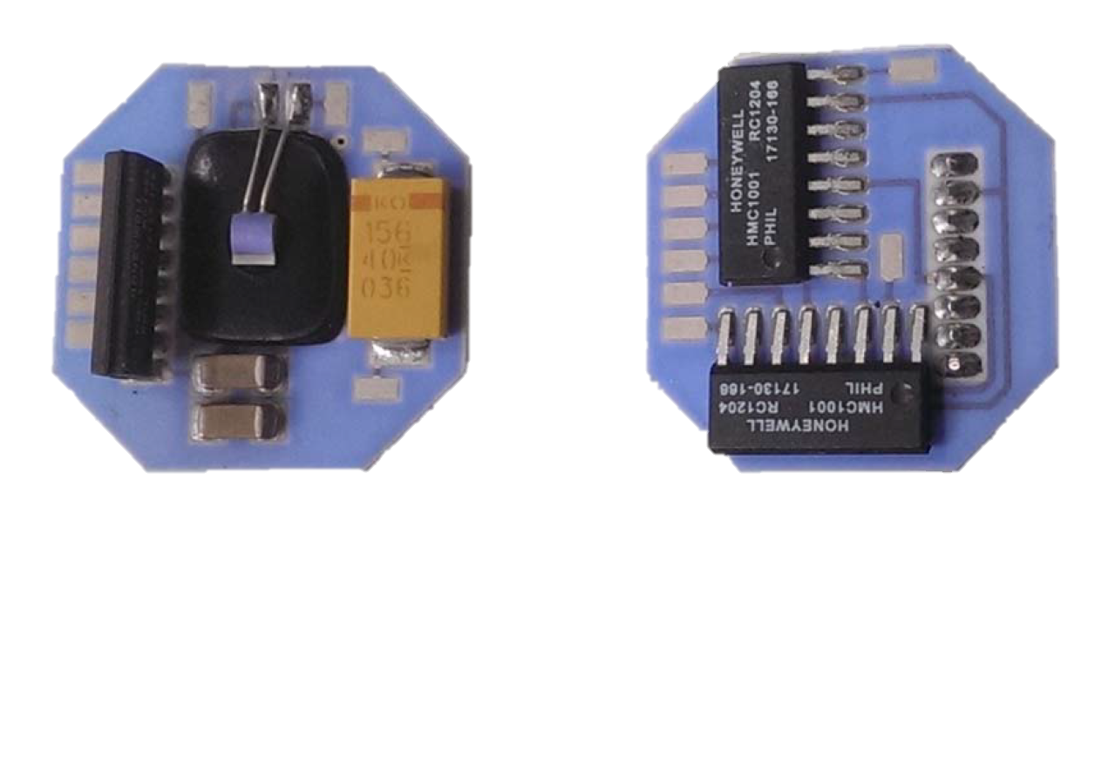
State-of-the-Art Vs. Up-and-Coming Mag Tech
Optically Pumped Atomic Gas
Anisotropic Magnetoresistance (AMR)
Solid-State Quantum Sensors
Fluxgate
Bepicolombo
JPL CuSP
MAGIC
(MAGnetometer from Imperial College)
SiCMag
(Silicon Carbide Magnetometer)
Function: Vector, 3 coil design, drive ferromagnetic core, sense induced field, and cancel field using 2nd harmonic as feedback signal
Sensitivity: 10’s pT @ 1Hz
Stability: 100’s pT over 1 week
Advantages: inexpensive, robust, good sensitivity, reliable,
Disadvantages: larger footprint, average stability, complex coil system
Function: optically pumped alkali or metastable ⁴He
- Vector : rotating field varies pumping efficiency,
- Scalar: Electron Paramagnetic Resonance Sensitivity: 10’s nT @ 1Hz
Stability: 10’s pT over 2 weeks
Advantages: Very sensitive, stable, scalar/vector modes
Disadvantages: Relatively expensive, higher power, larger footprint, complex, RF and optical components
Function: anisotropic magnetoresistance using commercial Honeywell HMC1001 sensor
Sensitivity: 100’s pT @ 1Hz
Stability: ???
Advantages: inexpensive, robust, good sensitivity, reliable, great SW&P
Disadvantages: not absolute, potential radiation effects, temperature dependent response, can have large offset errors:
Function: electrical read out of quantum centers in SiC diode
Vector: Magnetoresistance,
Scalar: Electrically detected magnetic resonance
Sensitivity: < 10’s nT @ 1Hz
Stability: 10 nT
Advantages: Small, low-power, simple, purely electrical, can make absolute measurement for self-calibration
Disadvantages: Sensitivity not yet optimized

Slide 7
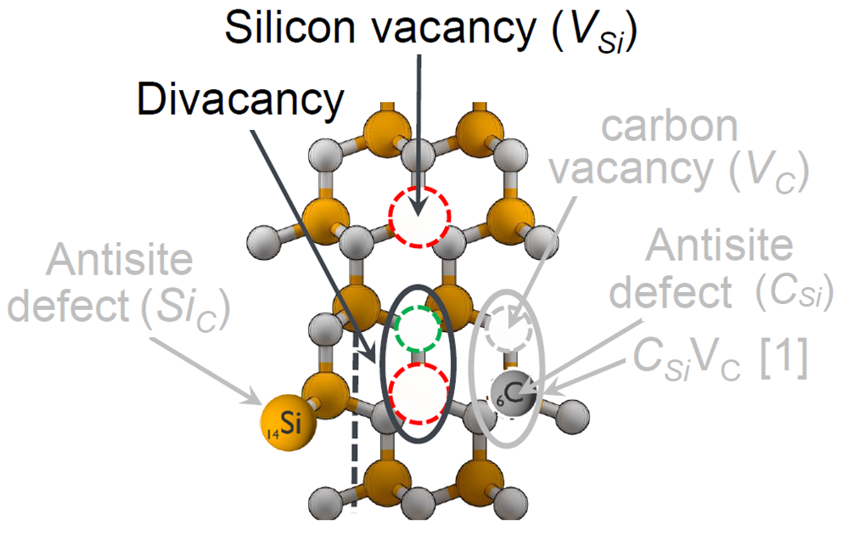
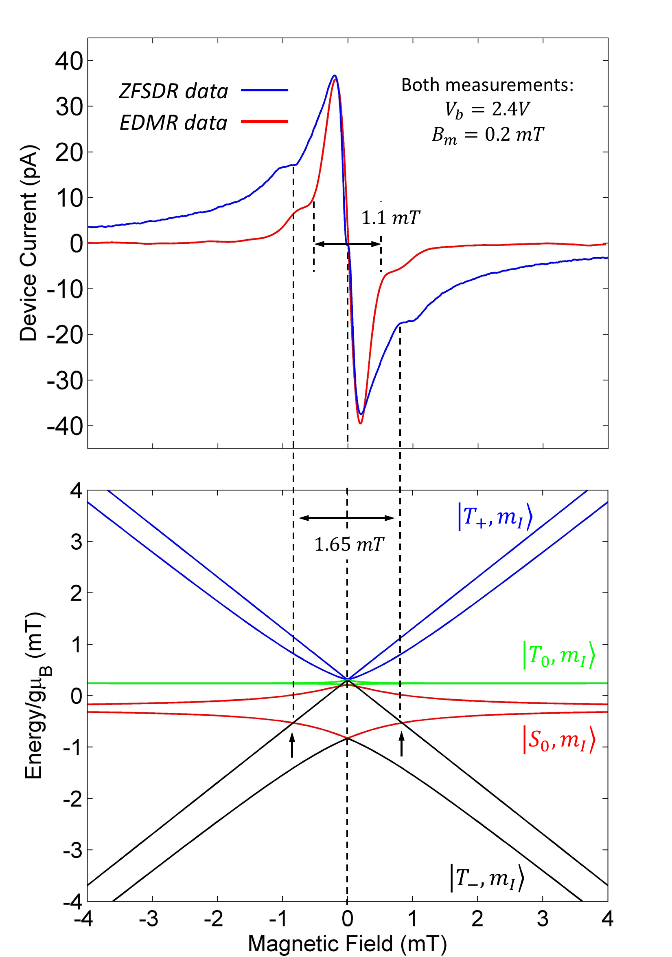
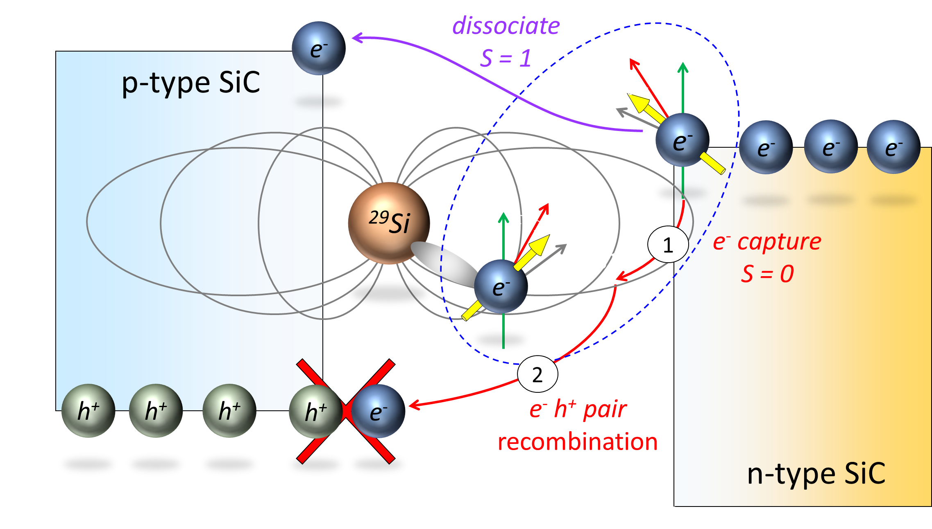
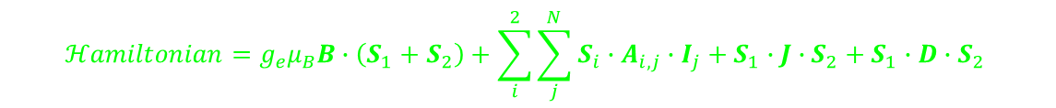
What’s the Concept?
Defects allow for changes in current to be detected for changes in magnetic field
One can use quantum center (i.e. defects) intrinsic to a SiC semiconductor to sense near-zero magnetic fields electrically
SiC Lattice
External magnetic field mixes of spin states of quantum center via electron nuclear hyperfine interaction
$$ℋamiltonian=g_{e}μ_{B}B∙\left(S_{1}+S_{2}\right)+\sum_{i}^{2}{\sum_{j}^{N}{S_{i}∙A_{i,j}∙I_{j}}}+S_{1}∙J∙S_{2}+S_{1}∙D∙S_{2}$$

Slide 8
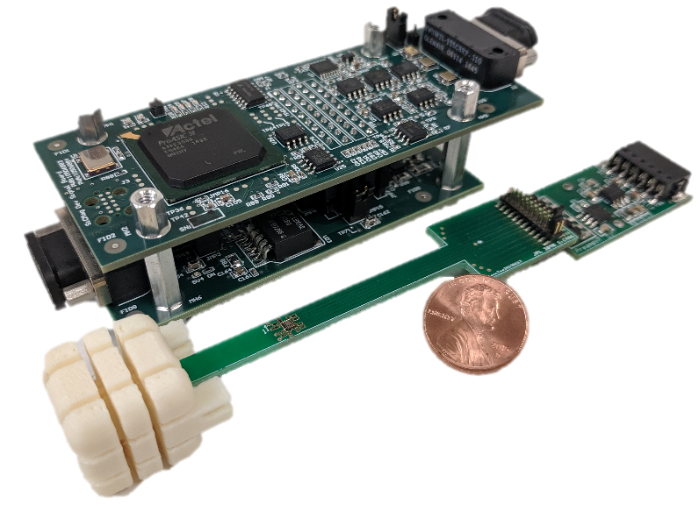
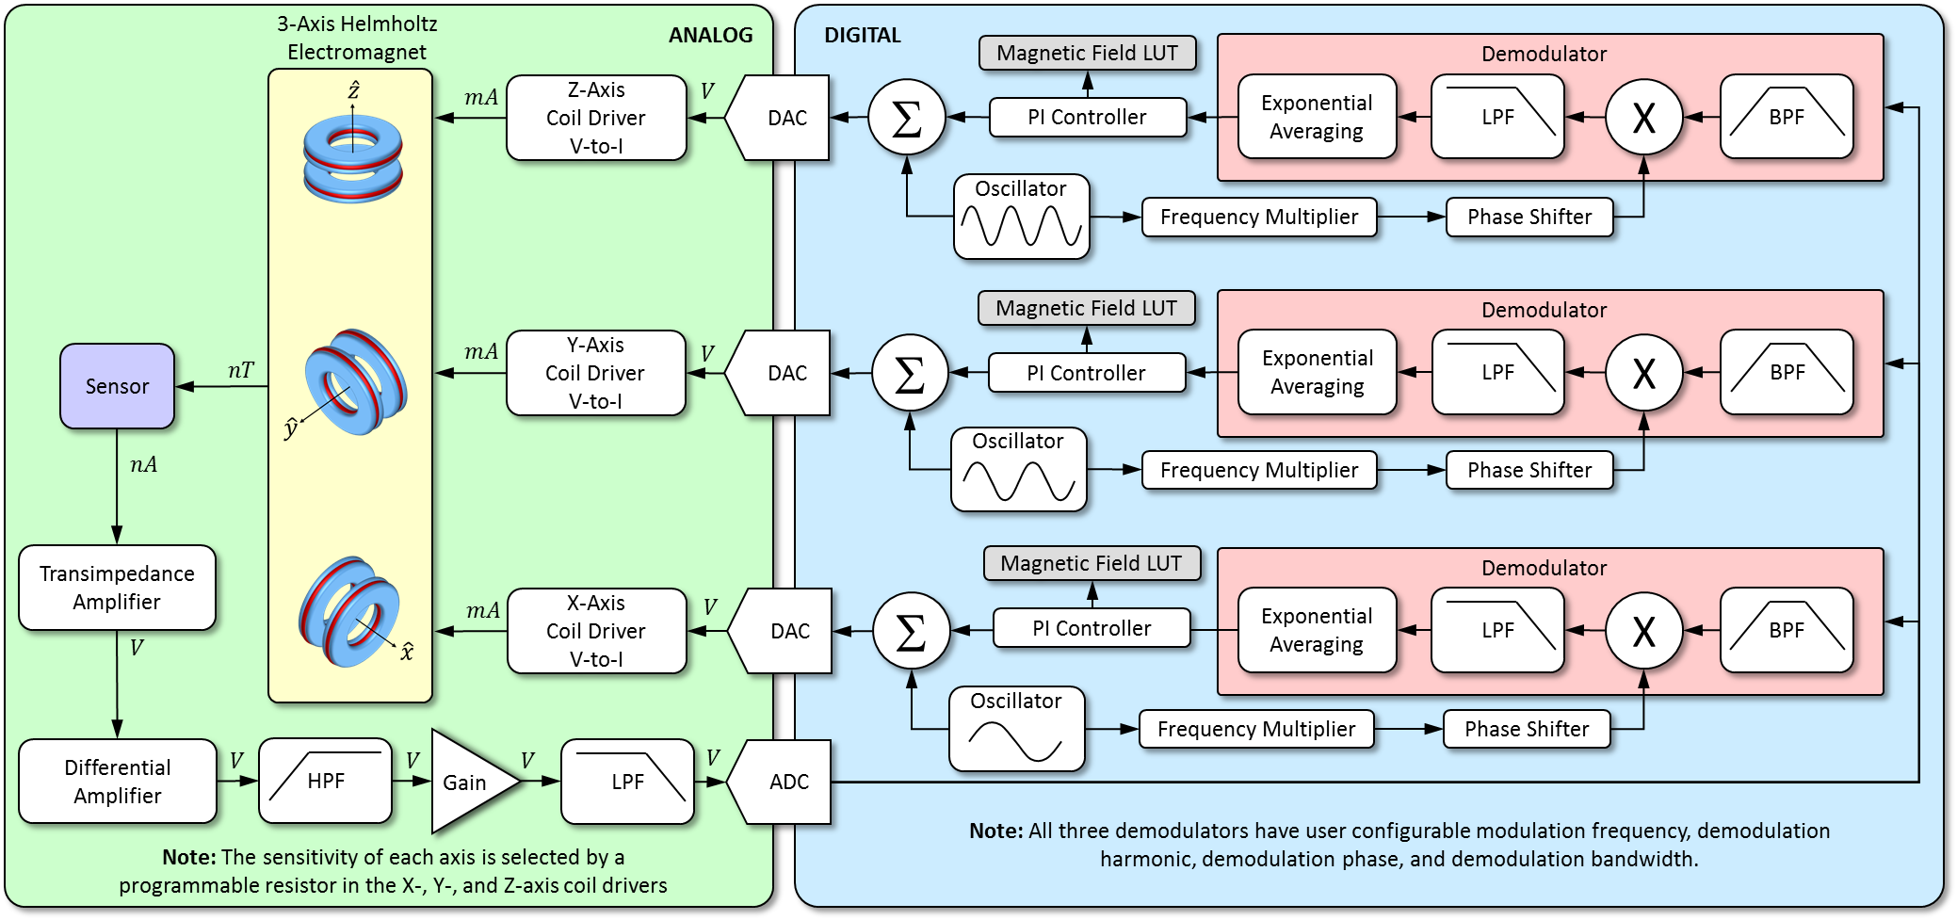
Advantages of the Instrument
Allows for the design of a very simple instrument
Solid state, purely electrical, magnetic field encoded in a spin dependent current
Field nulling design with no dead zones
No high frequency RF or optical components which require stable temperatures for reliable operation (audio frequency only, ~1kHz)
Simultaneous measurement of 3 axes using only a single sensor
Potential to self-calibrate

Slide 9
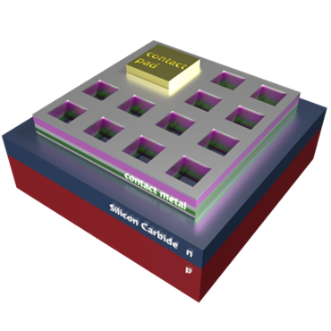
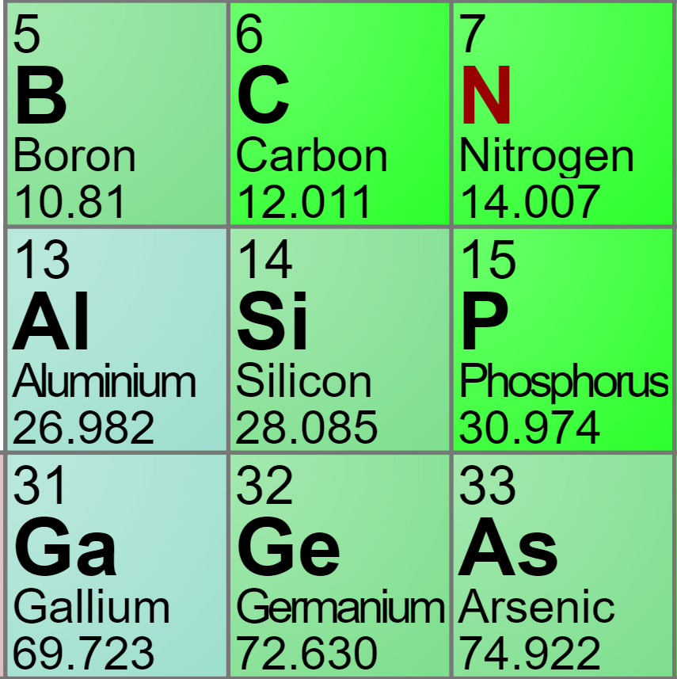
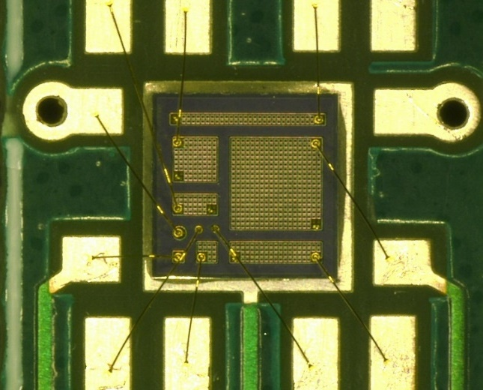
Fabrication of SiC Sensors
Fabricate a variety of n⁺p diode layouts and doping profile (still determining which recipe works best)
Perform a post irradiation (protons) treatment to increase defect count to boost sensitivity.
Epi-Contact SiC Diodes
 | Patterned Implant #1 (25 °C) | Patterned Implant #2 (25 °C) | Patterned Implant #3 (600 °C)
Wafer #1 | Boron Deep Low Dose p-type | N Middle Depth Middle Dose n-type | N Shallow High Dose n-type
Wafer #2 | Aluminum Deep Low Dose p-type | Ph Middle Depth Middle Dose n-type | Ph Shallow High Dose n-type
Wafer #3 | Ga Deep Low Dose p-type | As Middle Depth Middle Dose n-type | As Shallow High Dose n-type
Wafer #4 | C Deep Low Dose neutral | Si Deep Low Dose neutral | N Shallow High Dose n-type
Contact Metal
N Epi 0.2um 1e19 cm-3
Implants
Implants
Al- 2.5um 2e15 cm-3
Al+ 0.5um 1e18 cm-3
P-Type Substrate
2 mm
Contact Metal

Slide 10
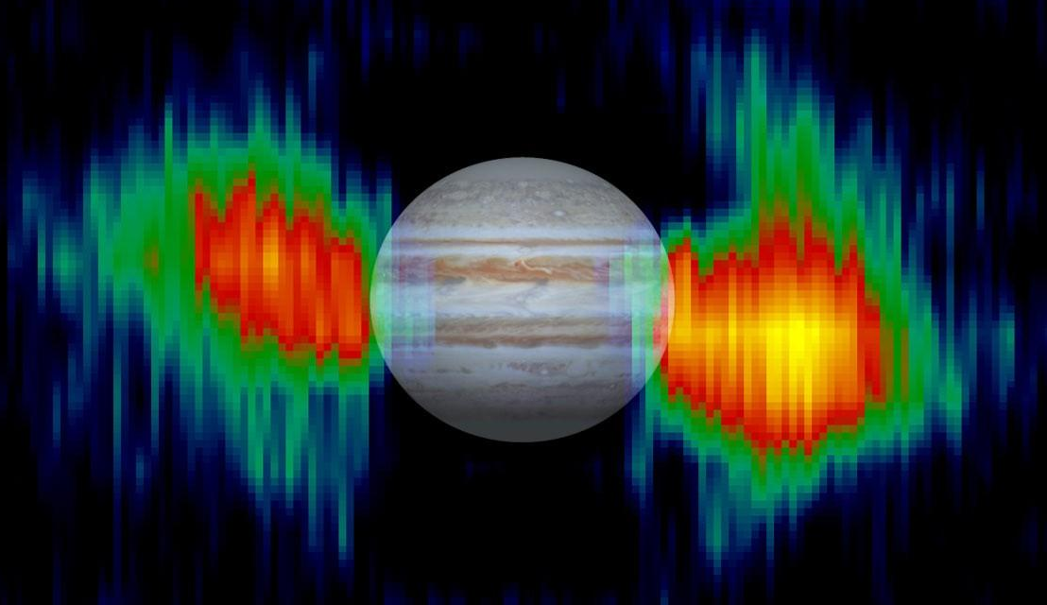
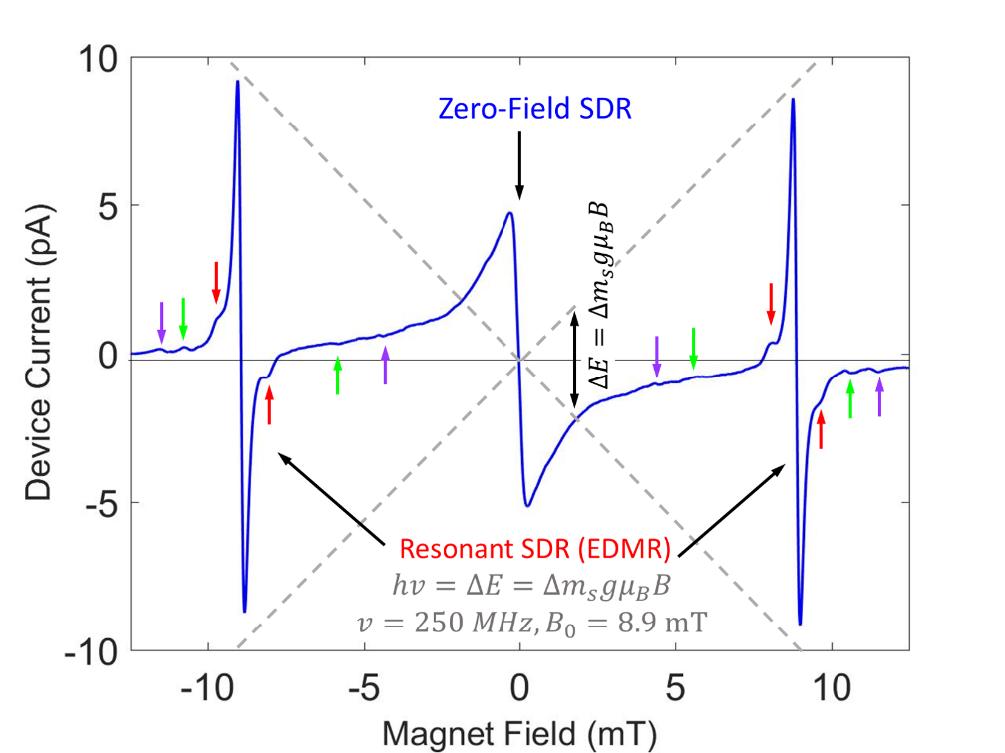
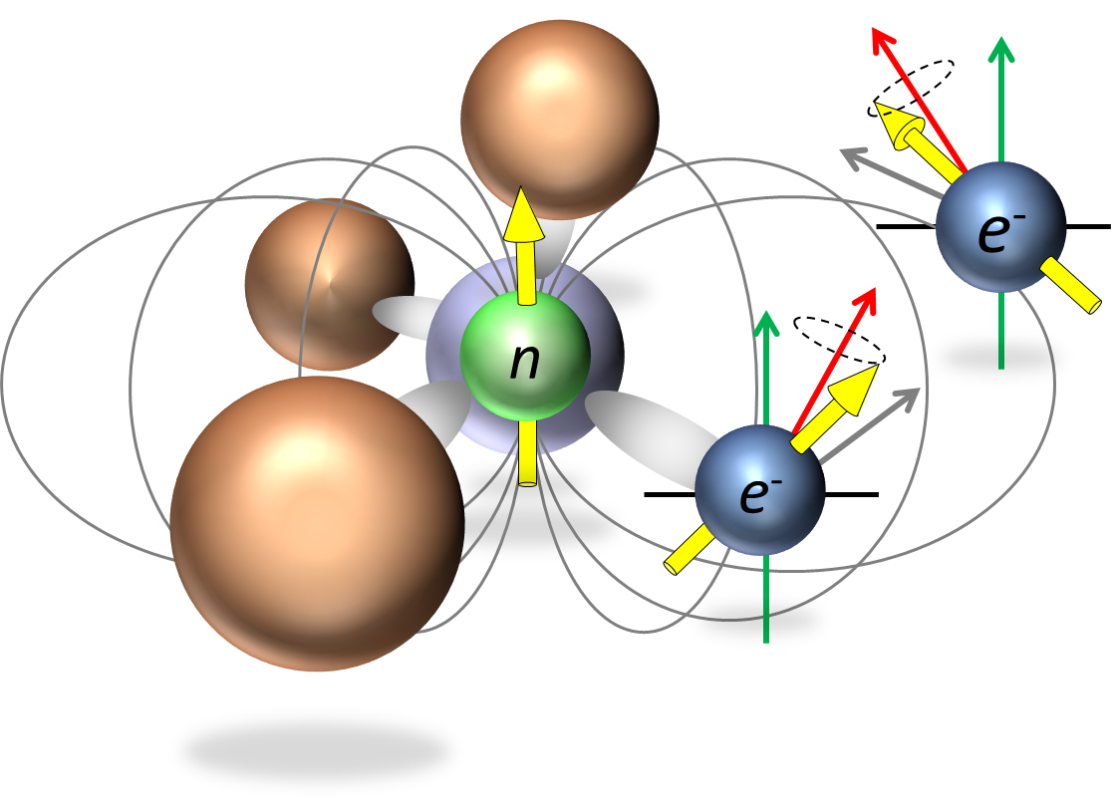
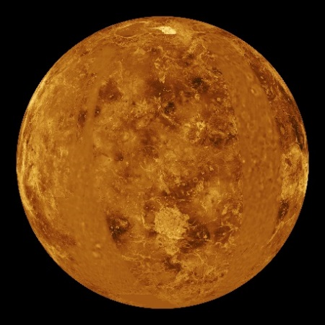
Why is this important?
The importance of Silicon Carbide
Quantum Centers Intrinsic to Semiconductor
Crystalline lattice allows for a relatively sharp response to be detected
Magnetic dopants:
1. Facilitates phenomenon of electron nuclear hyperfine mixing
2. Ability self-calibrate (Electrically Detected Magnetic Resonance) without the need for spacecraft rolls
Large bandgap (> 3eV)
Inherently rad-hard, can be used as a radiation monitor
operable in very high temp environments (> 500°C)
High Radiation Environments
Venus

Slide 11
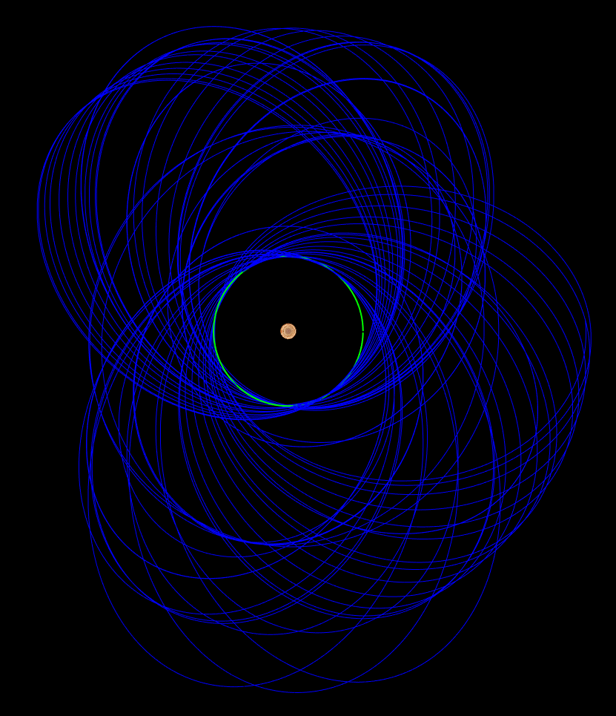
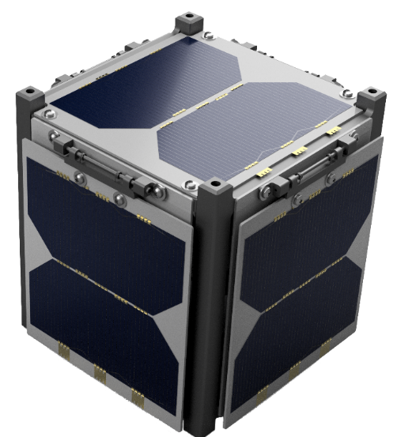
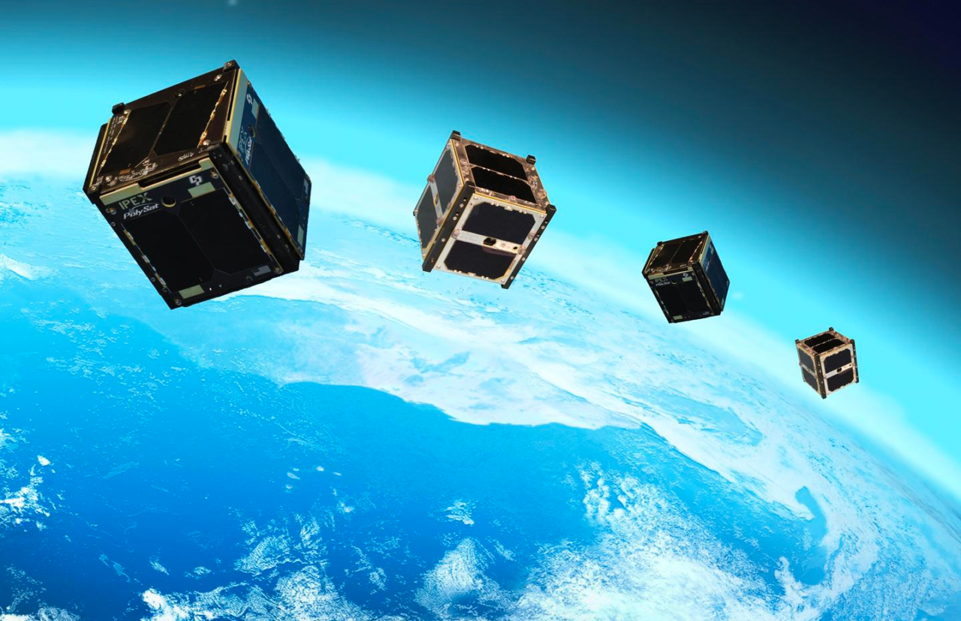
Why the need for small sensors?
Accommodation on cubesats
Small enough for nano- and picosats
Enables swarms, constellation, or trains of cubesats which allows for new science investigations to be performed
Removes the need for complex mission plan to achieve appropriate coverage

Slide 12
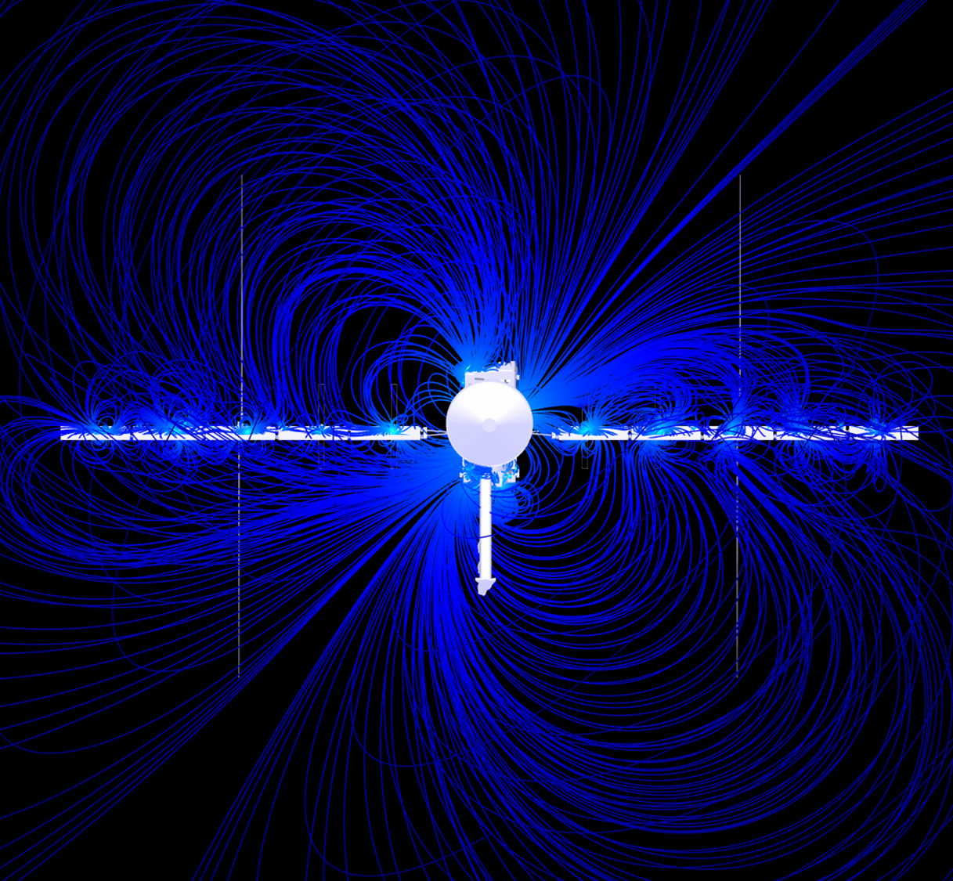
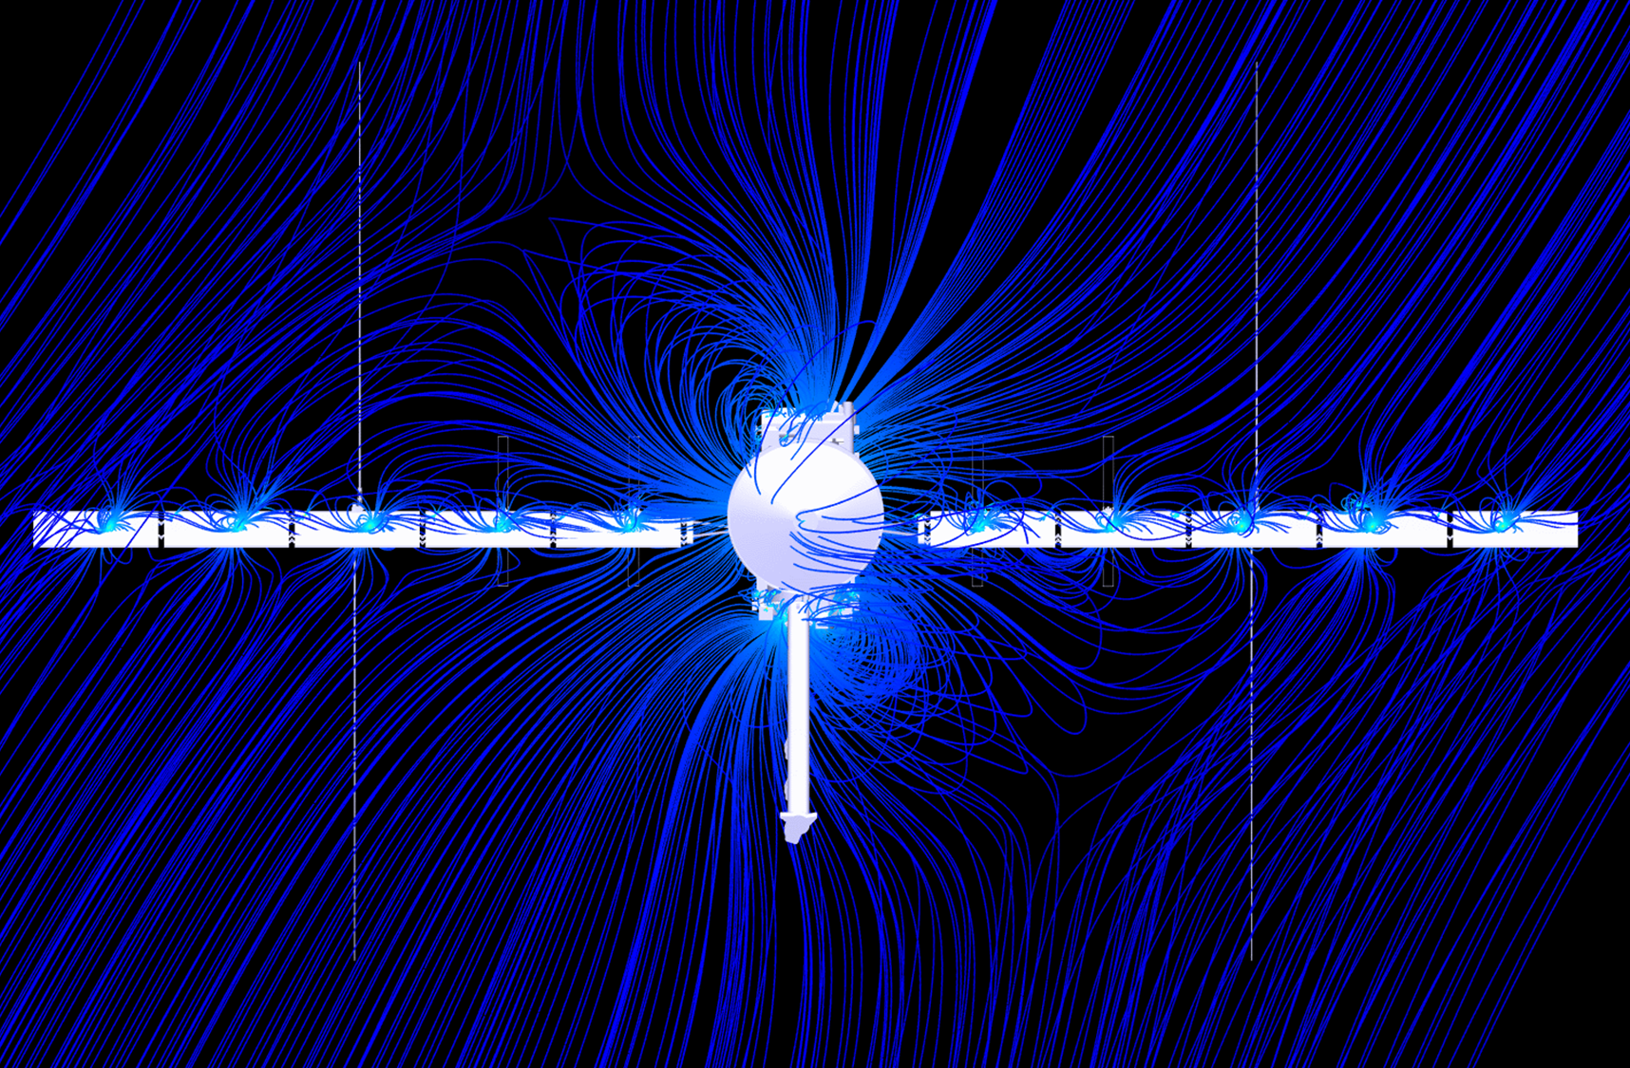
Why the need for small sensors?
Europa Clipper Spacecraft Field
Spacecraft Field Distortion of Ambient Field
Cubesats are faced with the same problem
Animated Visuals Available for Download:
https://europa.nasa.gov/resources/176/magnetic-field-of-the-europa-clipper-spacecraft/
https://europa.nasa.gov/resources/177/europa-clipper-spacecraft-distortion-of-the-ambient-magnetic-field/

Slide 13
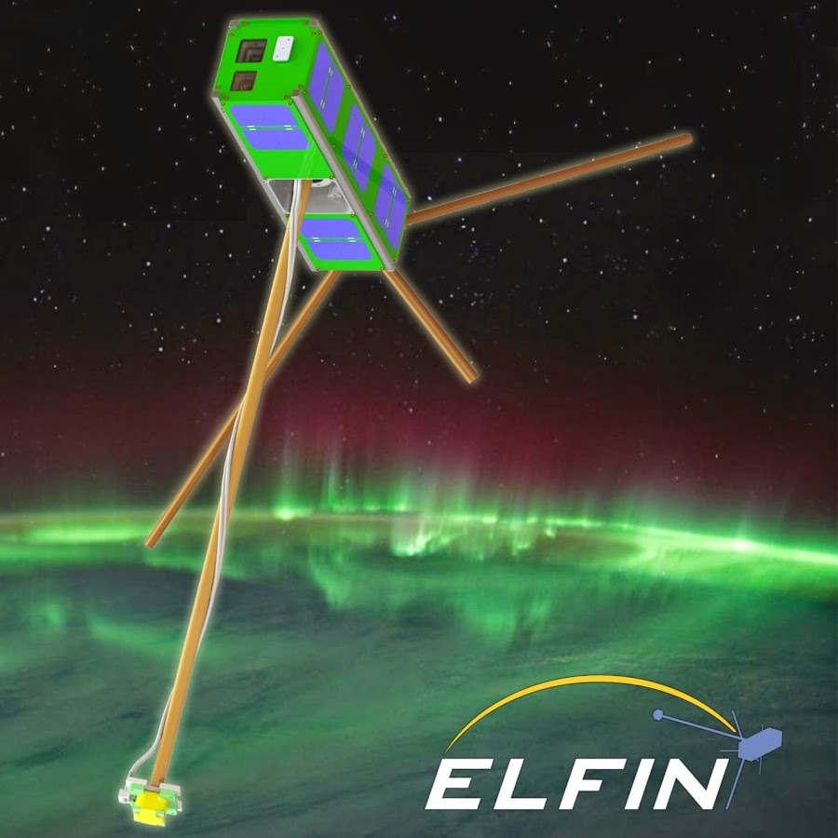
Why the need for small sensors?
Improved SW&P allows for dozens of sensors on a spacecraft
Cancelation of stray spacecraft fields
  Removes the need for a long mag boom or a boom entirely
Sensor redundancy
Sensor intercalibration
  Removes the need for mission planning maneuvers such as rolls
mag boom
mag
Image Credit: UCLA

Slide 14
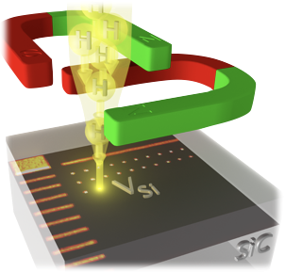
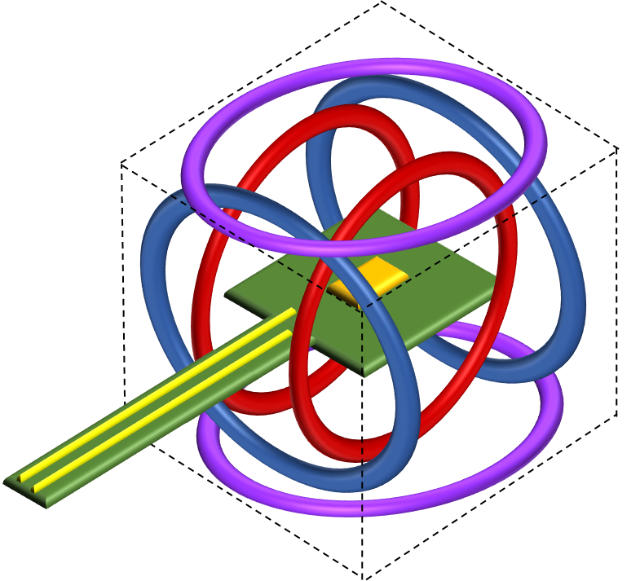
Future Work
Still in process of optimizing sensor performance.
What is ideal dopant atom?
Post proton irradiation
Redesigning the electronics and firmware
Miniaturization and low power in mind
Possibly integrating into an ASIC package
Miniaturing Coil System
Pushing limits of 3D printing capabilities
Possibly MEMS coil system

Slide 15
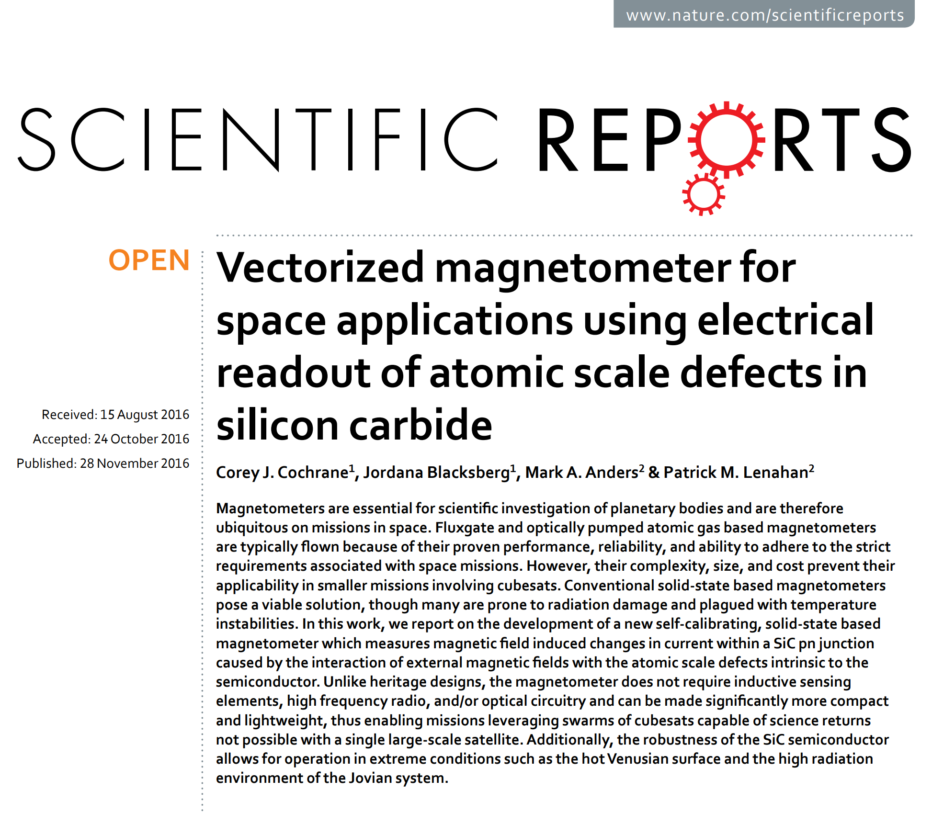

Questions?
  For more information, see C.J. Cochrane, et al., Nature Scientific Reports 6, 37077 (2016)
Funding
NASA Postdoctoral Program (NPP), Center Innovation Fund (CIF),
Planetary Instrument Concepts for the Advancement of Solar System Observations (PICASSO)
Team

