Slide 1
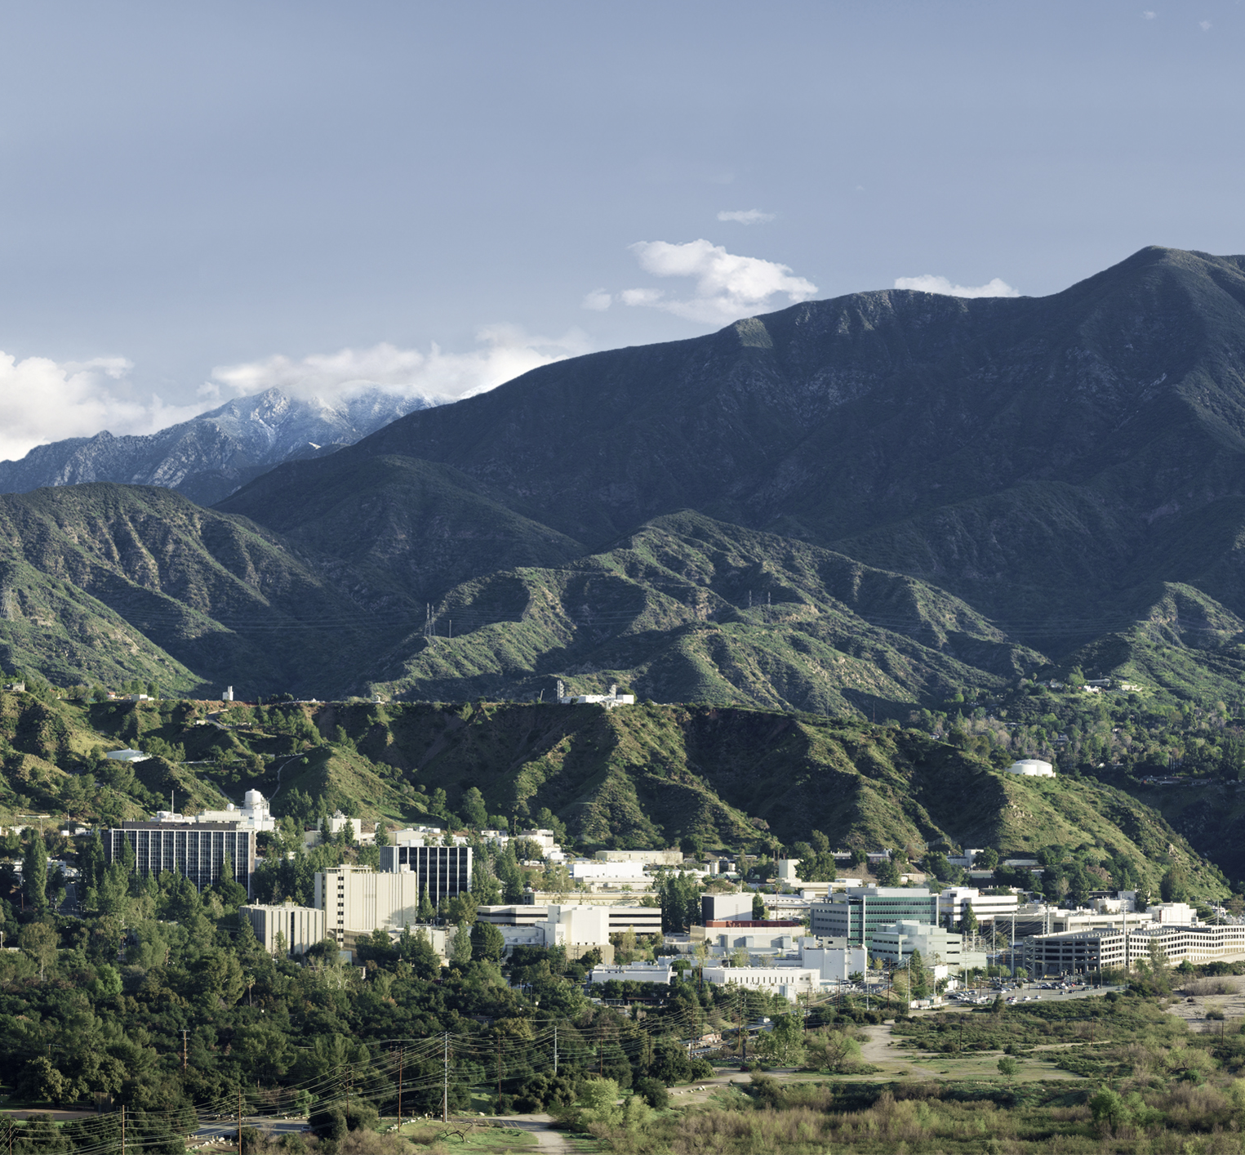
2021 Interplanetary Small Satellite Conference
Instrument Thermal Management for Lunar Night Operation/Survival without Radioisotopes
D. Bugby, J. Rivera
3-4 May 2021
Approved for Unlimited Release
Reference herein to any specific commercial product, process, or service by trade name, trademark, manufacturer, or otherwise, does not constitute or imply its endorsement by the United States Government or the Jet Propulsion Laboratory, California Institute of Technology.

Slide 2
PROBLEM
Thermal Management in Extreme Environments
We want to use one of these ...
Carrying one or more of these …
To operate and stay within temperature limits, in Extreme Environments such as these …
Using a thermal control architecture that is …
Rover
Lander
Orbiter
Flyer
Airship
Science Payload (SP)
253-313 K
Moon (50-400 K, Vac)
Mars (148-293 K, Non-Vac)
Europa (53-113 K, Vac)
Titan (90-94 K, Non-Vac)
Io (105-123 K, Vac)
Venus 70-30 km alt. (173-473 K, Non-Vac)
Low Power
Lightweight
Passive
Compact
Reliable
Affordable
Radioisotope-Free
Advanced thermal control architectures integrate the following four key elements …
EXTREME
ENVIRONMENTS
THERMAL
TOOLBOX
3
1
2
1 – VARIABLE CONDUCTANCE THERMAL LINK
SP
RAD
ENV
2 – LOW SINK TEMPERATURE RADIATORS
4
3 – LOW EFFECTIVE EMISSIVITY MLI
UV + IR
4 – LOW CONDUCTANCE THERMAL ISOLATORS
CARRIER

Slide 3
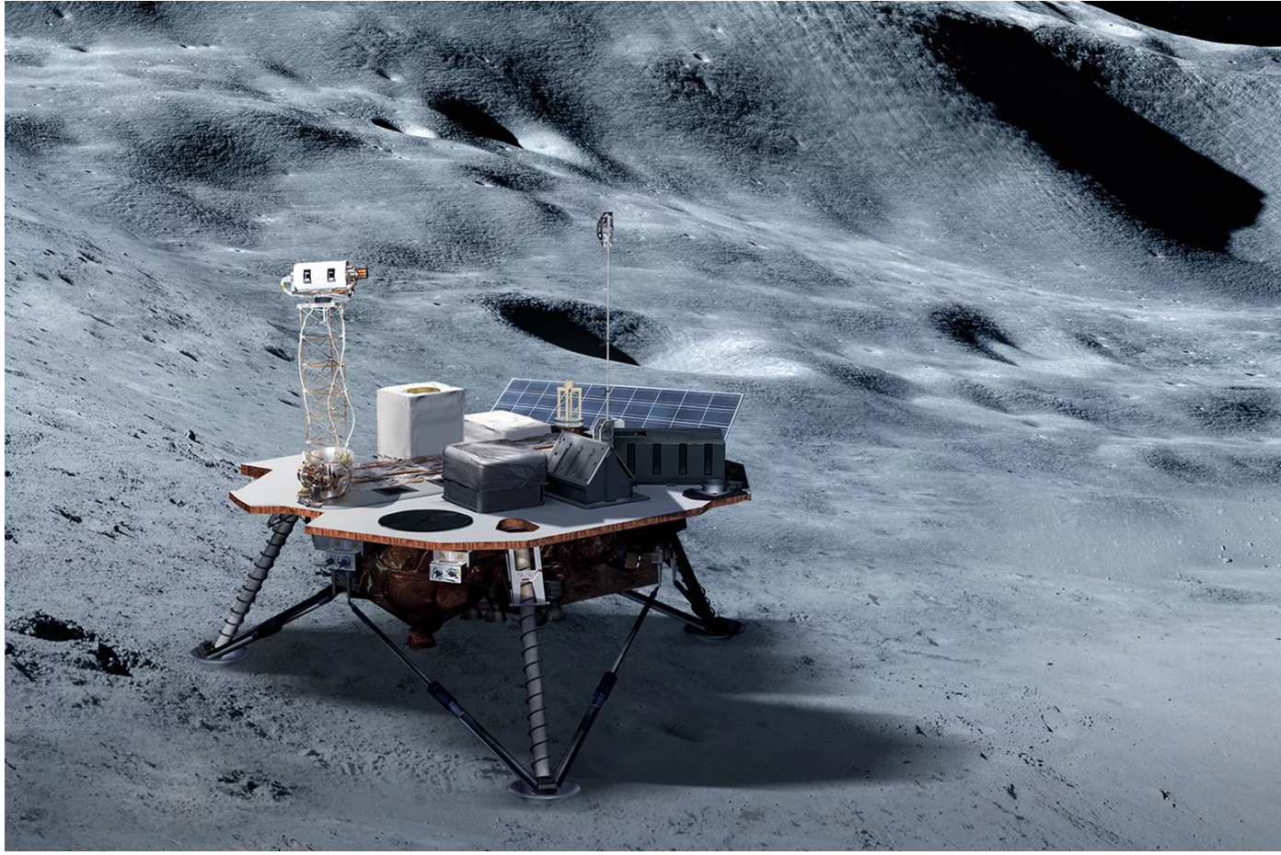
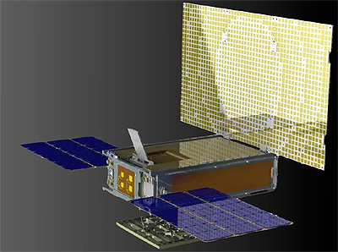
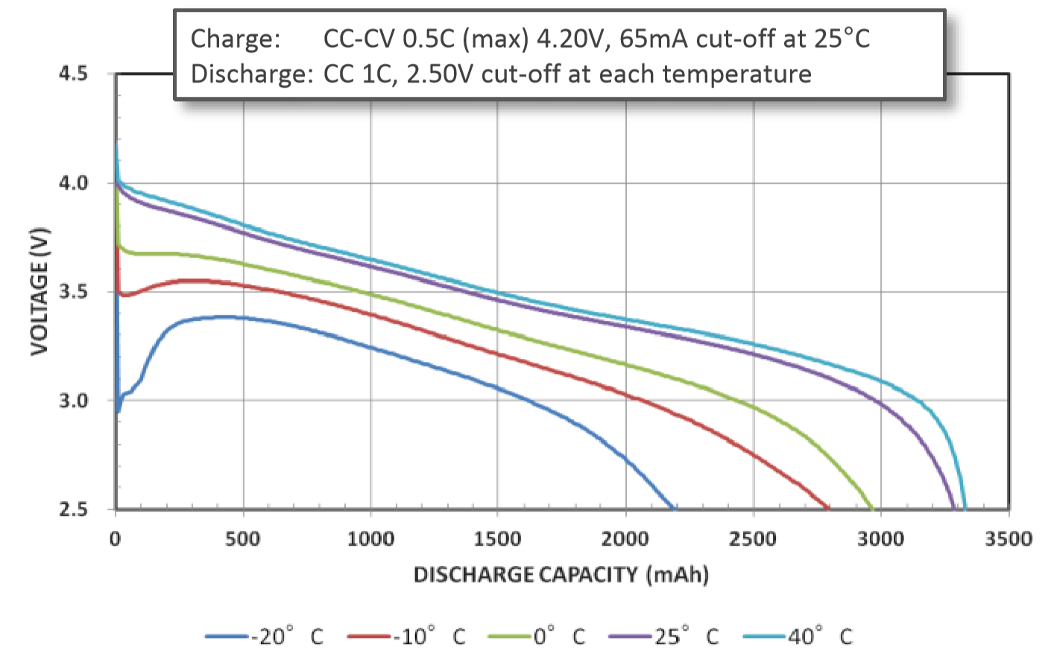
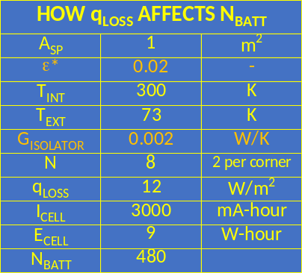
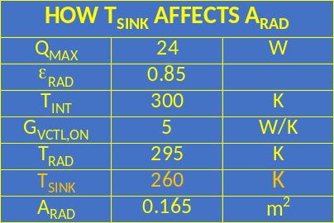
PROBLEM (cont’d)
Science Payload (SP) Operation/Survival Overnight on the Lunar Surface
SPs depend on CLPS landers ...
Science instrument focus at JPL …
Lunar surface conditions and design constraints that make day/night survival so challenging …
How to become CLPS lander independent …
Initial CLPS Landers and their SPs will not Survive Lunar Night
Self-Sufficient Science Payloads that are Capable of Operating Over Multiple Lunar Day/Night Cycles
Daytime highs of > 130 °C
Days that last 15 Earth days
Nighttime lows of < -200 °C
Nights that last 15 Earth days
Solar/battery power only
No radioisotope heat/power
Add Cubesat-Based
C&DH
Telecom
Power
Batteries
to SP Thermal Design
MarCO
Cubesat
CLPS Providers
Astrobotic Technology
Blue Origin
Ceres Robotics
Deep Space Systems
Draper Laboratory
Firefly Aerospace
Intuitive Machines
Lockheed Martin Space
Masten Space Systems
Moon Express
Orbit Beyond
Sierra Nevada Corp
SpaceX
Tyvak Nano-Sat Syst.
Seismometers
Magnetometers
IR Spectrometers
HEAT LOSS FLUX (q_{LOSS})
LUNAR NIGHT KPP
RADIATOR SINK TEMP (T_{SINK})
LUNAR DAY KPP
Simplest Packaging
SP Completely Inside
Trans. Func. 1.0 < 3 Hz
Typical 18650 Cell
D = 18 mm
H = 65 mm
m = 50 grams
More Complex Packaging
External Booms/Wires
External Heated Sensors
Most Complex Packaging
2-Axis Gimbals/Motors
Mechanical Cryocoolers
Research Goal is to Improve
ε*, G_{ISOLATOR}, and T_{SINK}

Slide 4
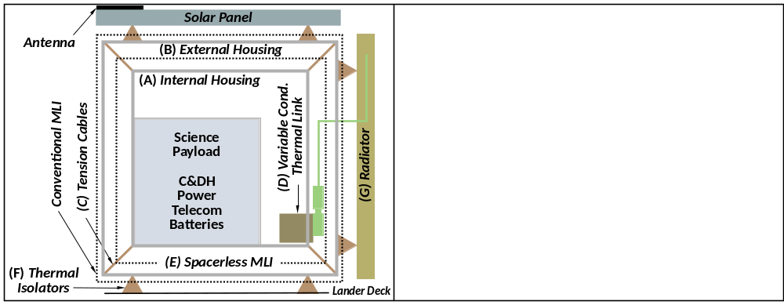
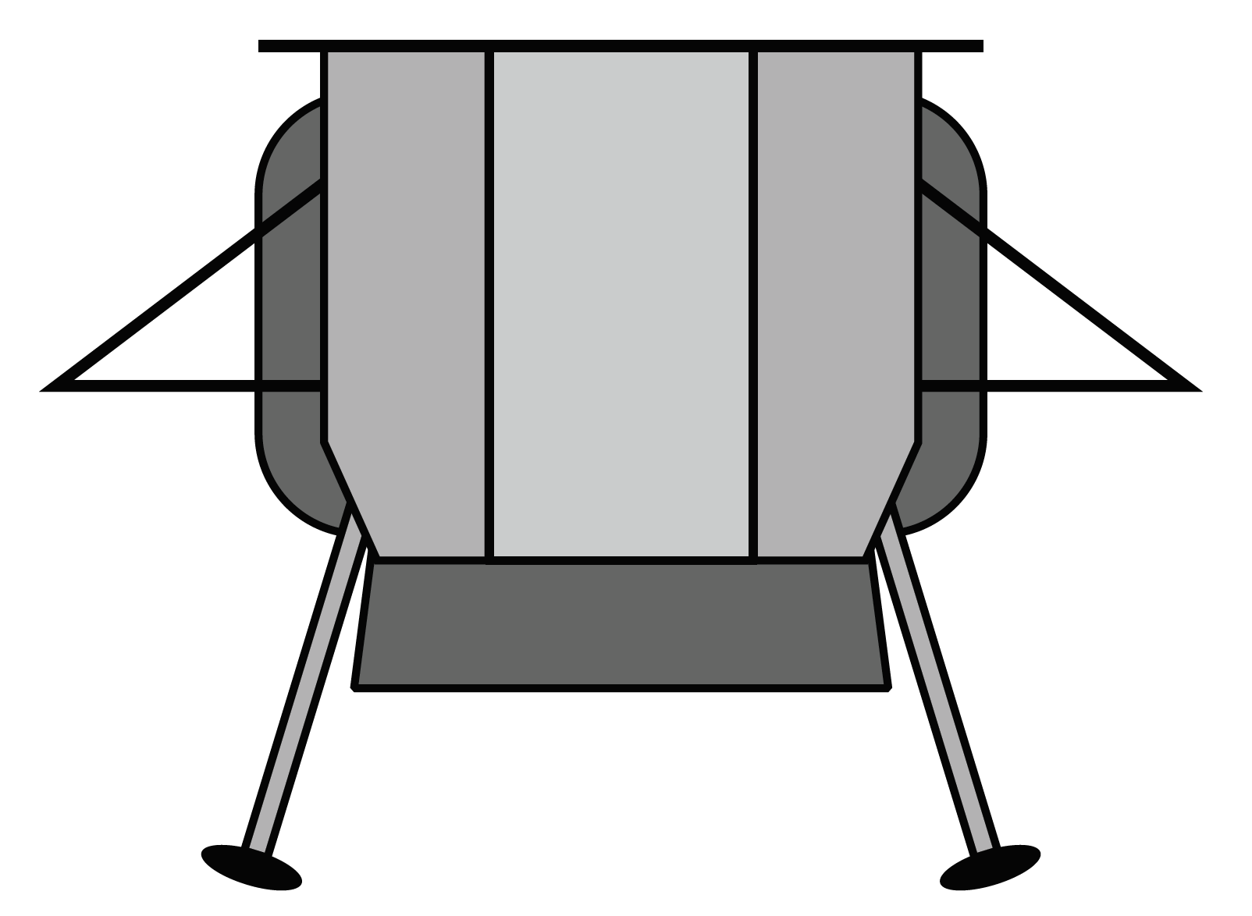
THERMAL ARCHITECTURE
Stand-Alone, Extended-Life Lunar Instrument Architecture (Lower Latitude Sites)
Thermal Architecture Features
(A) Internal Housing
(B) External Housing
(C) Tension Cables
(D) Variable Conductance Thermal Link
(E) Spacerless MLI
(F) Thermal Isolators
(G) Radiator (PRR)
Q
Lunar Surface Very Hot During Day, Cold at Night

Slide 5
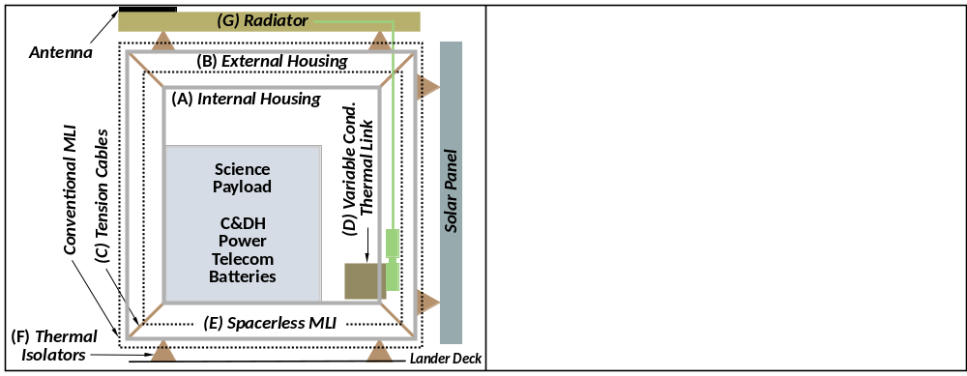
THERMAL ARCHITECTURE (cont’d)
Stand-Alone, Extended-Life Lunar Instrument Architecture (Higher Latitude Sites)
Thermal Architecture Features
(A) Internal Housing
(B) External Housing
(C) Tension Cables
(D) Variable Conductance Thermal Link
(E) Spacerless MLI
(F) Thermal Isolators
(G) Radiator (non-PRR)
Q
Lunar Surface Cool-to-Warm During Day, Very Cold at Night

Slide 6

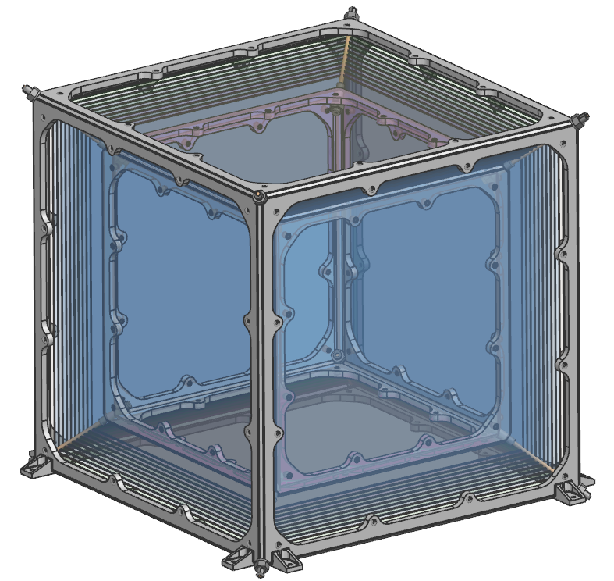
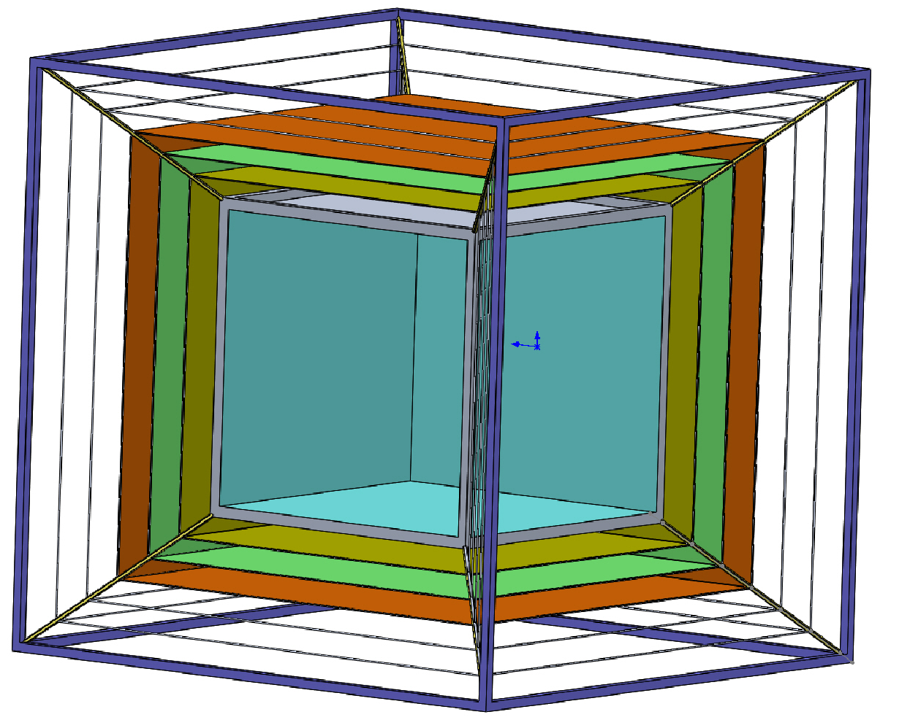
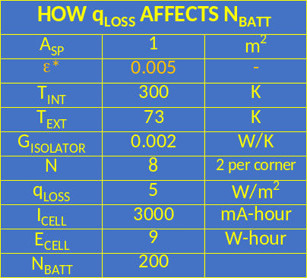
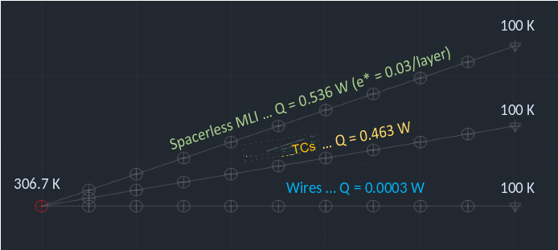
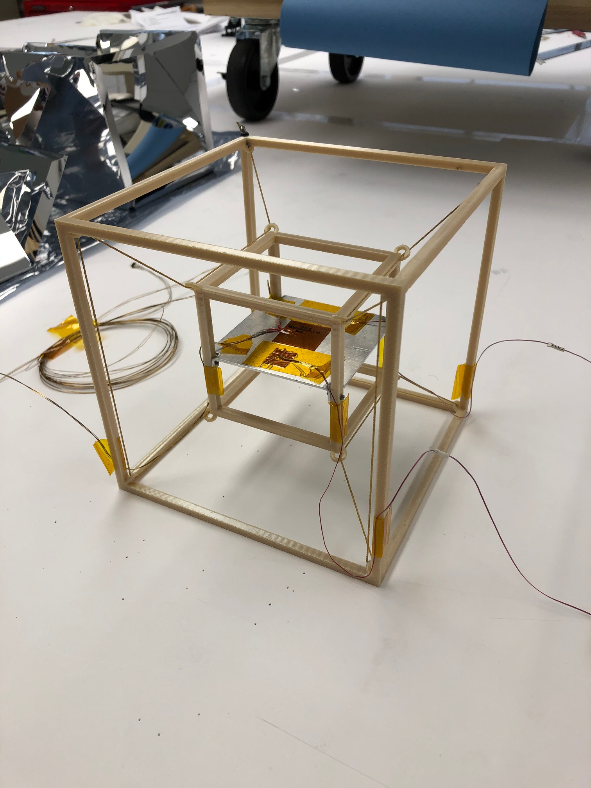
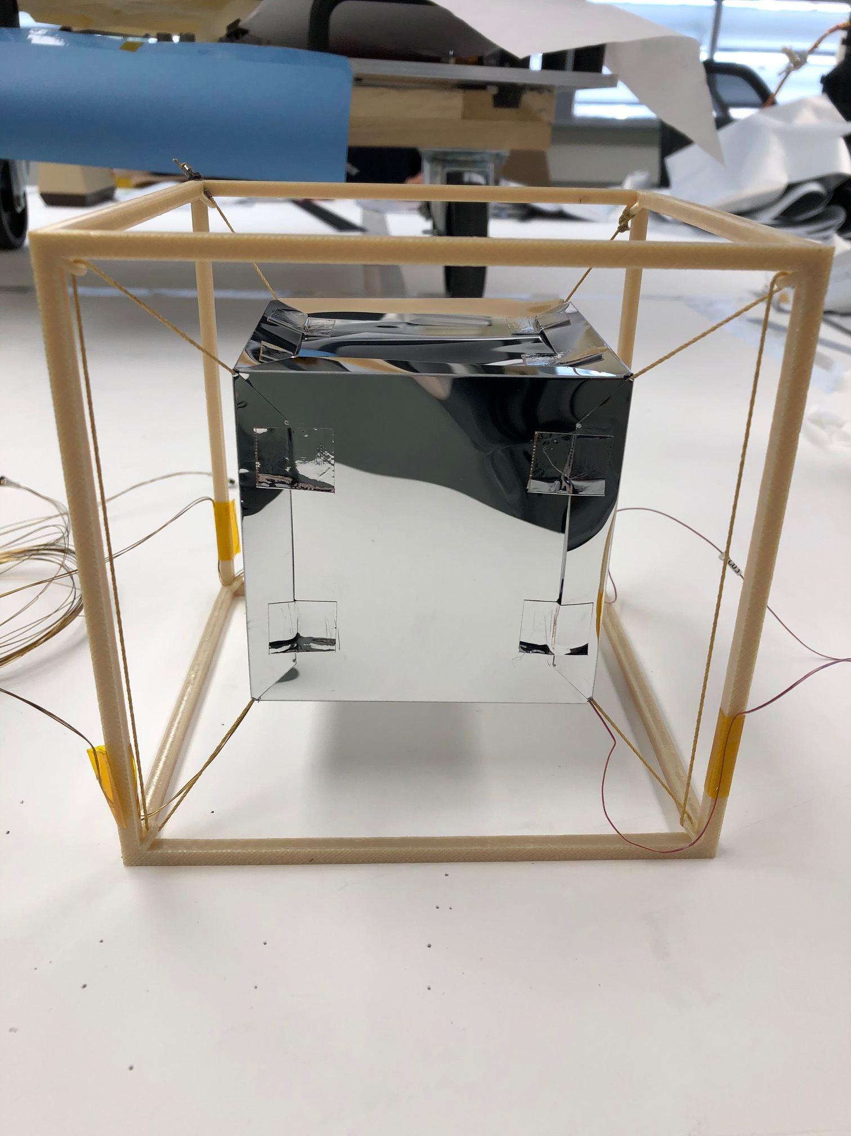
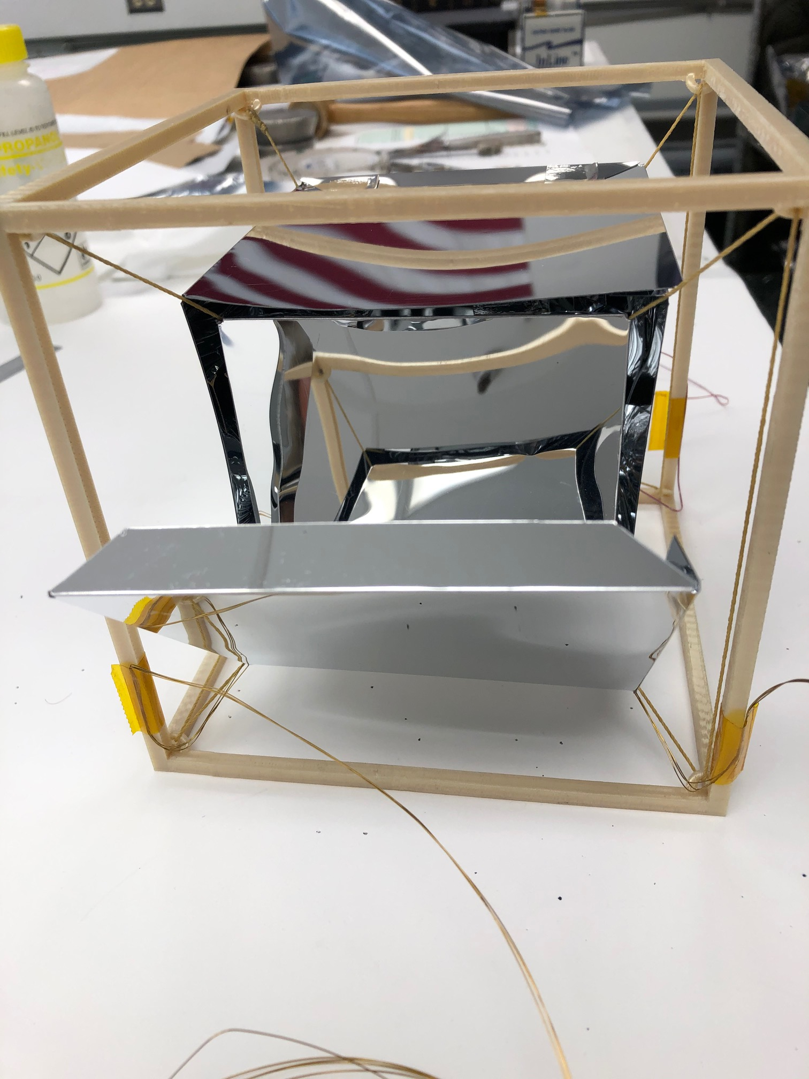
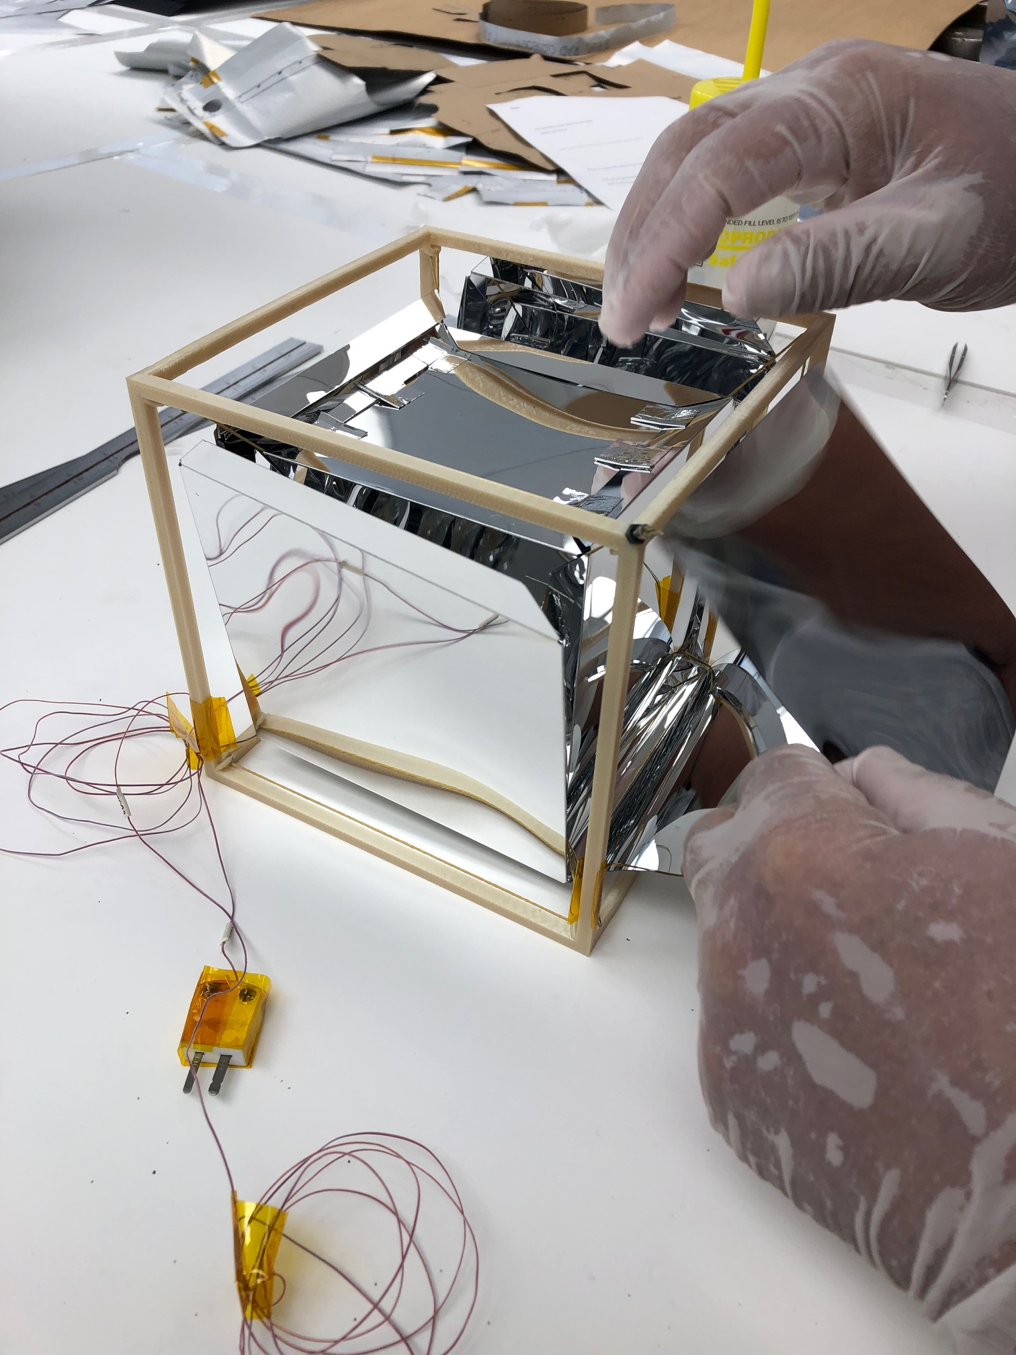
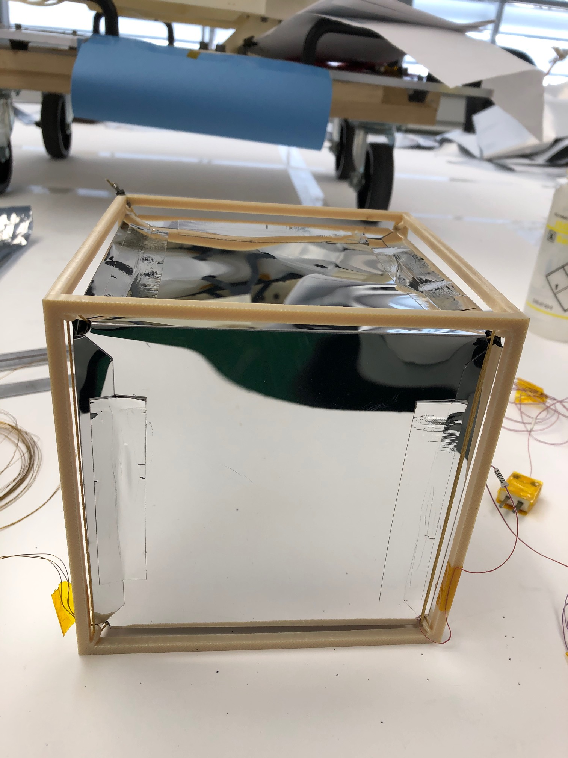
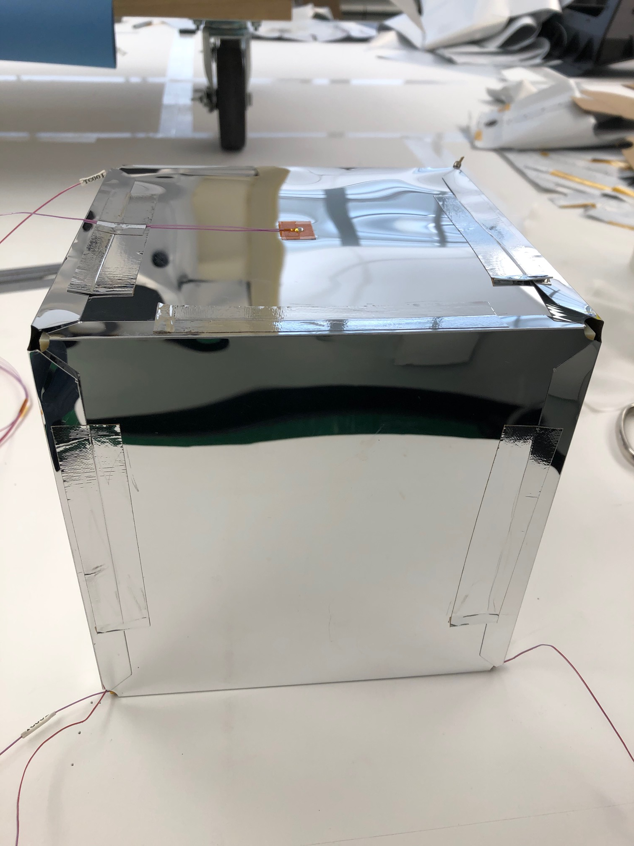
LOW ε* MLI
Spacerless MLI
CONCEPT
DESIGN
Internal Housing (IH) supported from External Housing (EH) by High Strength Tension Cables (TCs). MLI layers hang from TCs.
Two cube designs under development for lunar applications.
1. EH/IH 40 cm/30 cm.
2. EH/IH 30 cm/20 cm. 10 MLI layers in each. TC OD 1-5 mm.
Reducing ε* from
0.02 to 0.005
Saves mass of
280 cells (14 kg)
MODELING
TESTING
10-layer Spacerless MLI (30 cm EH, 20 cm IH, 3 mm TC)
ε*/layer T (K)
0.03 306.7
0.04 291.3
0.05 279.4
0.06 269.9
0.07 262.0
Small demo unit gave ε* = 0.005. Testing of larger prototype unit to start a few weeks after preparing this briefing.
1 W to IH

Slide 7
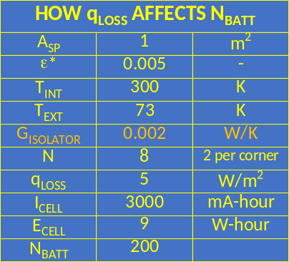
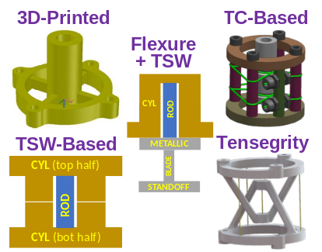
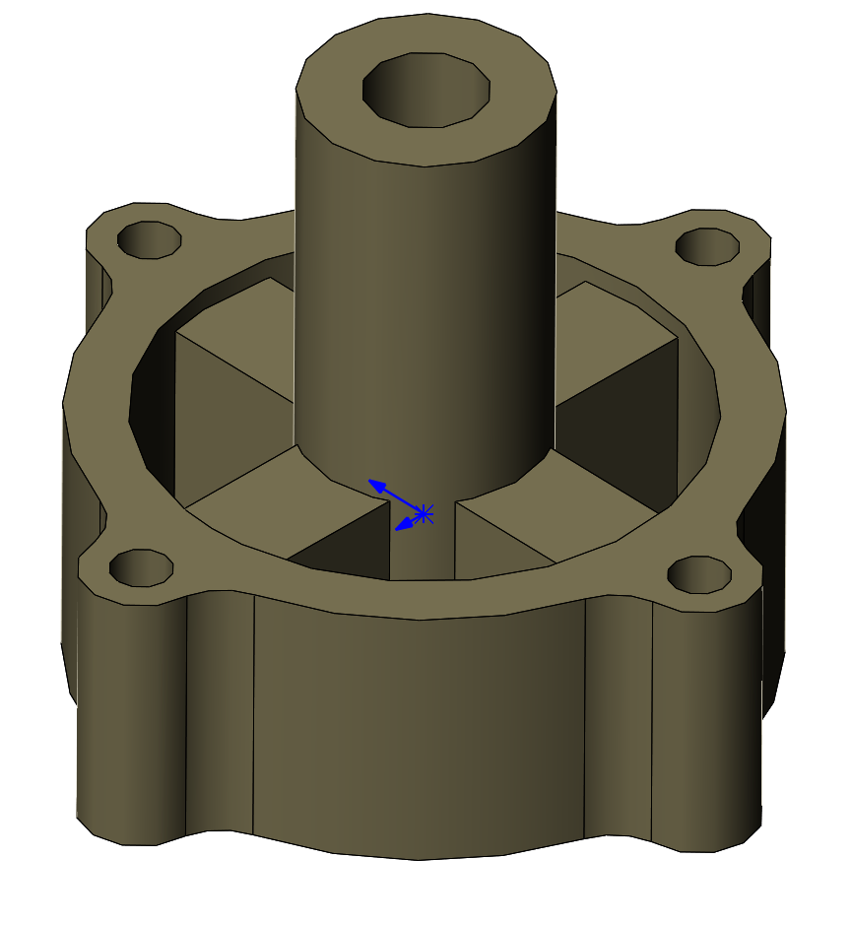
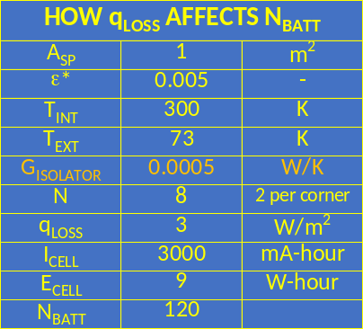
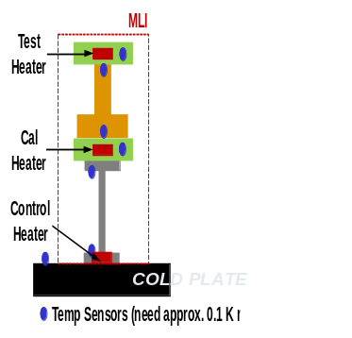
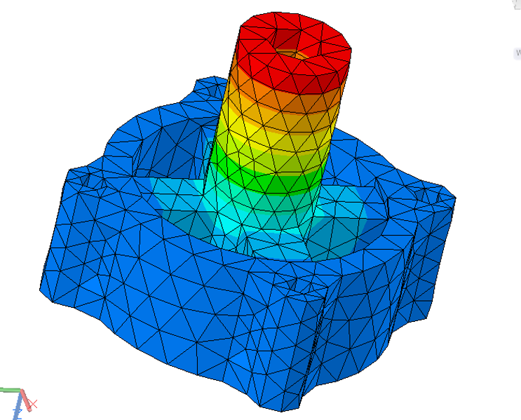
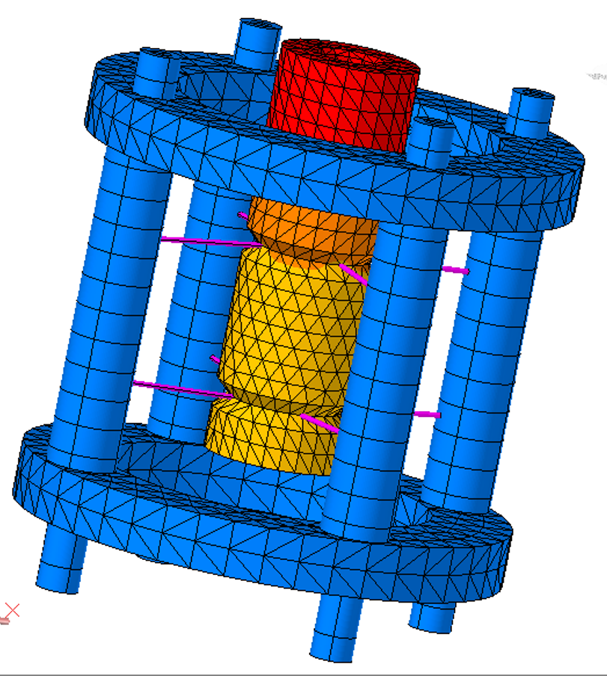
LOW G THERMAL ISOLATOR
3D-Printed Polymer and Tension Cable (TC)-Based Thermal Isolators
CONCEPT
DESIGN
Low G thermal isolator options we postulated. The two that were pursued were 3D-Printed and TC-Based.
The 3D-Printed polymer unit is
being pursued for lunar night survivable instruments due to ease of mfg.
Reducing G from
0.002 to 0.0005 W/K
Saves mass of
80 cells (4 kg)
MODELING
TESTING
G_{3DP-ISOLATOR} = 6E-4 W/K
G_{TC-ISOLATOR} = 2E-4 W/K
Thermal models created of the 3D-Printed polymer thermal isolator and the TC-based thermal isolator.
Testing of the 3DP thermal isolator to be performed by PALETTE NASA GCD project. Tests challenging due to very low Q values.
Q-Meter

Slide 8
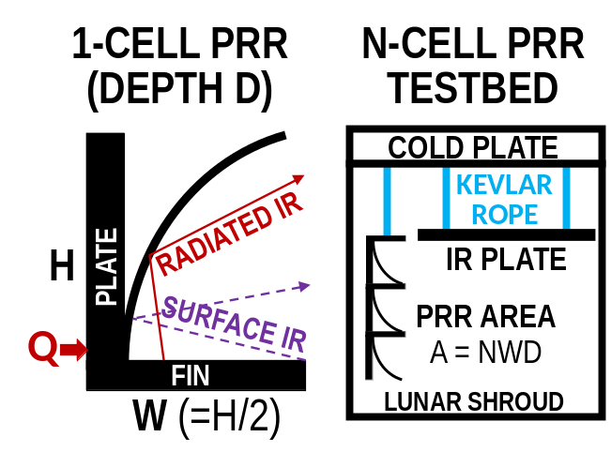
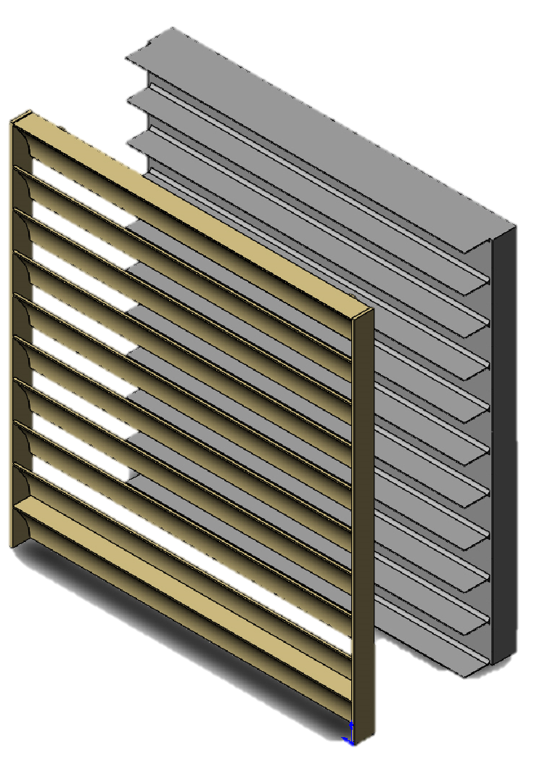
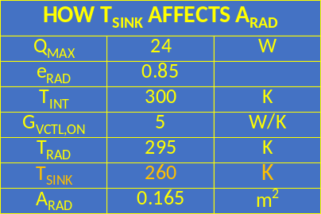
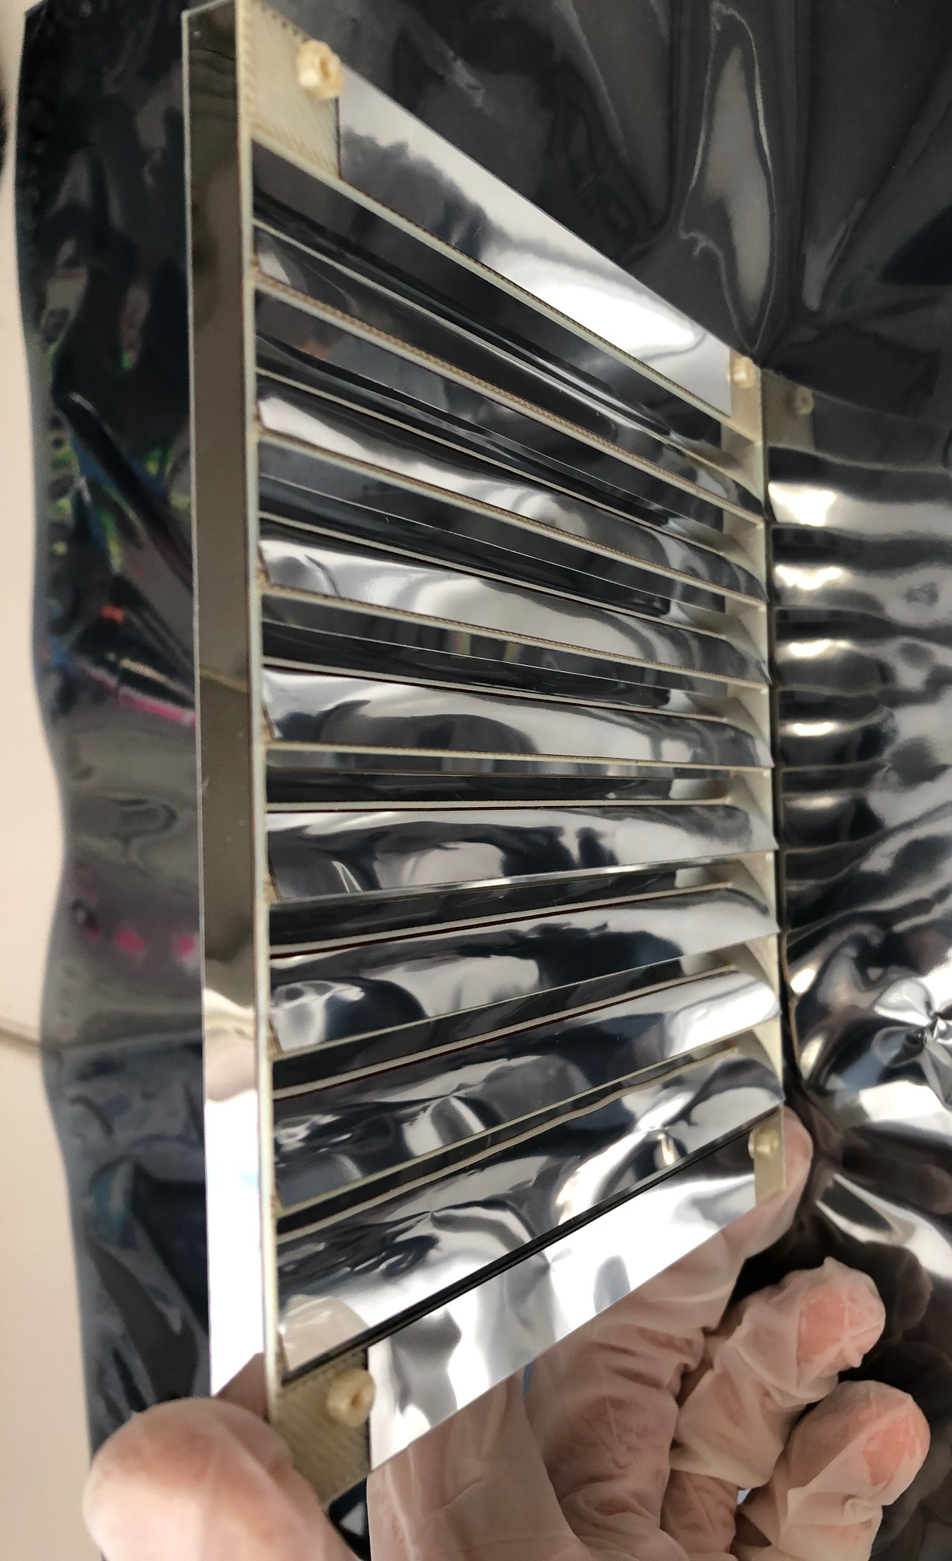

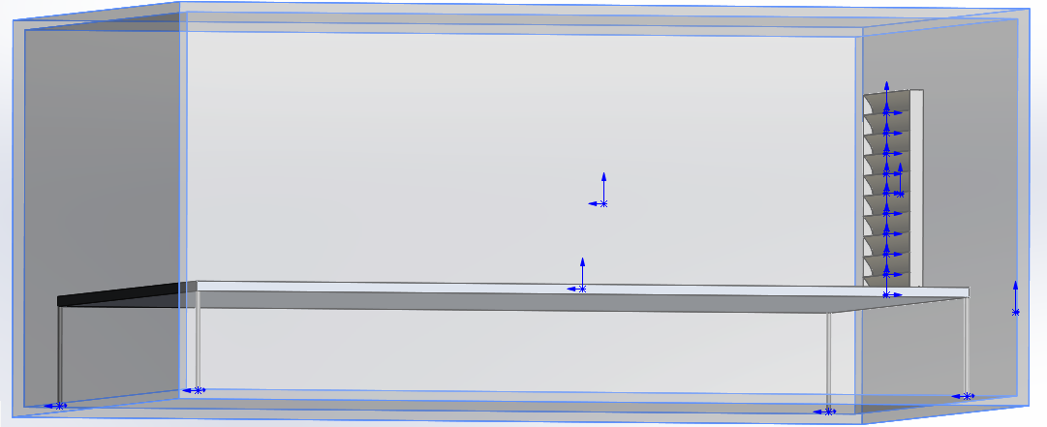
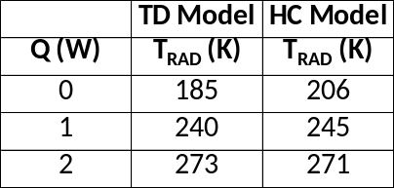
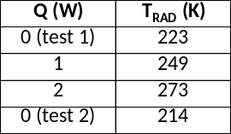
LOW T_{SINK} RADIATOR
Parabolic Reflector Radiator (PRR)
CONCEPT
DESIGN
Aluminum
Radiator
Reflective parabola of height 2W and radiating fin of width W (fin tip at focus of the parabola), reflect lunar surface and radiated IR to space.
Breadboard and prototype use 2-pc. polymer (refl.), Alum. (rad.) 3D-printed design. Fin width exactly half of refl. cell height.
H = 2W
W
Polymeric
Reflector
Reducing T_{SINK} from
260 K to 200 K
Cuts Radiator
Area in Half
MODELING
TESTING
Model Predictions
TD and hand calc (HC) models of breadboard and prototype units. Models do an acceptable job of predicting temps.
Shroud (90 K)
Tests carried out with compact breadboard unit with 400 K IR plate. Tests of 2.5X larger prototype planned for JPL TVAC.
PRR
IR Plate (400 K)
Test
Data
T_{SINK} is T_{RAD} at Q = 0 W

Slide 9
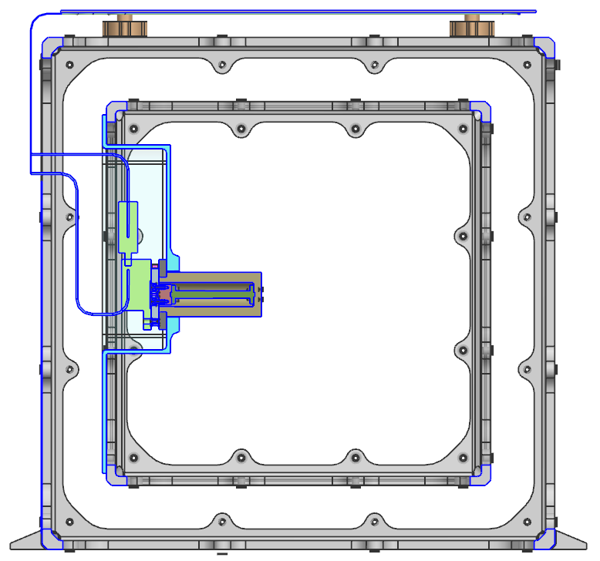
VARIABLE COND. THERMAL LINK (VCTL)
Reverse-Operation DTE Thermal Switch (ROD-TSW) + Miniaturized LHP (mini-LHP)
VCTL → ROD-TSW + mini-LHP in series
ROD-TSW ON/OFF ratio is 2500
  GON = 5 W/K
  GOFF = 0.002 W/K
  TON/OFF = 273 K
Mini-LHP ON/OFF ratio is 10000
  GON = 10 W/K
  GOFF = 0.001 W/K (probably lower)
  TON/OFF = adjustable (RSVR control)
  Fluid = propylene (T_{FREEZE} = 89 K)
See Lunar Seismometer (LS) on next slide
For LS, IH 300-318 K over entire mission
  ROD-TSW normally turns ON/OFF at 273 K
  For LS, ROD-TSW acts as mini-LHP backup
Heat Flow Path
Components
IH Frame/Panels
ROD-TSW
Mini-LHP Evaporator
Mini-LHP Radiator
Lunar Surface T_{SINK}

Slide 10
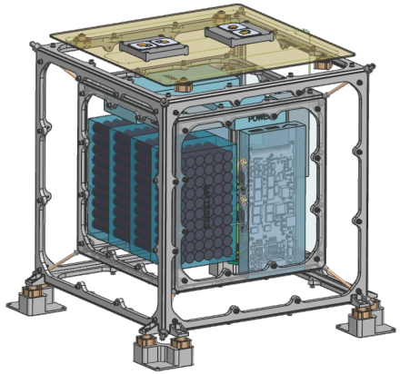
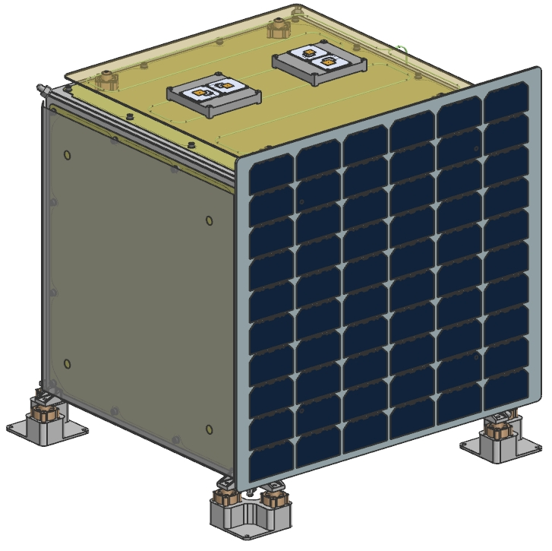
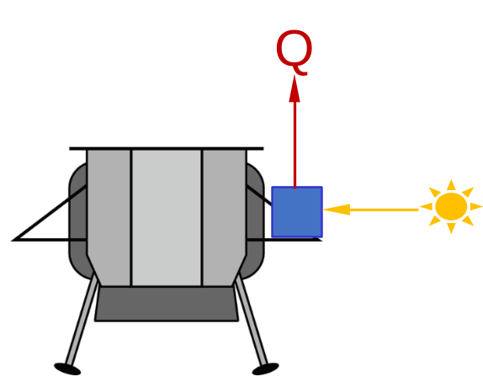
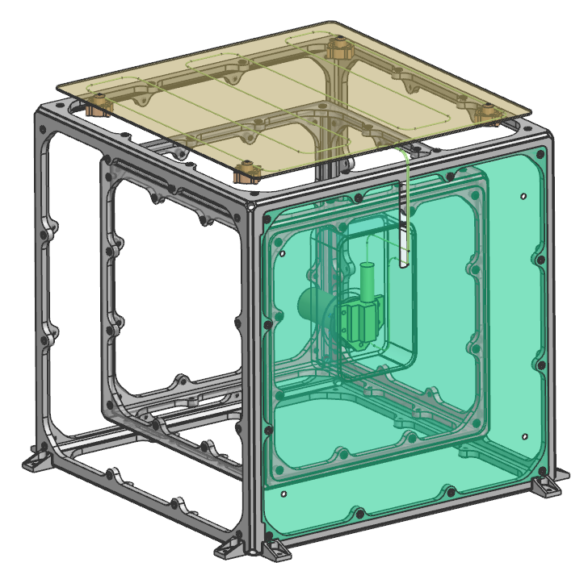
LUNAR SEISMOMETER
Generic Concept for Lunar Seismometer (LS) at a High Latitude Site
Standard MLI
(exterior)
Antennas
Thermal
QDAY-OP = 10 W
QDAY-COMM = 20 W
QNIGHT-OP = 5 W
TDAY-MAX = 318 K
TNIGHT-MIN = 300 K
Structural
LS Hard Mount to Deck
TCs Tuned to Reduce Loads
Sensor Heads Protected
Trans. Function = 1.0 (< 3 Hz)
Mars Insight Heritage
Thermal
Isolator
Solar Panel
Zenith Heat
Rejection
(PRR not required)
Sensors, Electronics
C&DH, Comm, Power
Lander Adapter
Batteries
Radiator (non-PRR)
(mini-LHP condenser)
Tension
Cables
(TCs)
Variable
Conductance
Thermal Link
(VCTL)
Sun Low
in Sky
Spacerless MLI

Slide 11
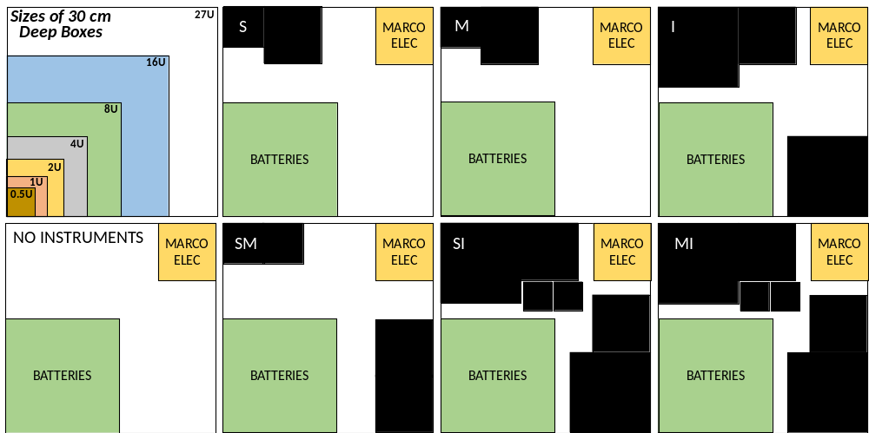
INSTRUMENT ACCOMMODATION
Area Packaging Analysis: How Various SP Combinations Fit in 30 cm IH Cube
S = Seismometer
M = Magnetometer
I = IR Spectrometer
14U
14U
7U
SP Size
Assumptions
S = 3U
M = 3U
I = 10U
Batt. = 8U
Elec. = 2U
All combos fit in IH including MIS (not shown, 1U)
Spare Volume Shown in Red
17U
11U
4U
4U

Slide 12
CONCLUSION
Impact on Future JPL Lunar Instruments
A unique thermal control architecture is under development at JPL that will enable future lunar instruments to operate and survive lunar night without radioisotopes
The thermal architecture incorporates the following key thermal and operational features that enable stand-alone, extended-life lunar day/night operation
  Low effective emissivity (ε*) “spacerless” MLI
  Low conductance (G) thermal isolators
  Low sink temperature (T_{SINK}) parabolic reflector radiators (PRRs)
  Variable conductance thermal link (ROD-TSW + mini-LHP)
  MarCO cubesat-based C&DH, power, telecom, and batteries
JPL is currently working on extended duration designs for lunar seismometers, magnetometers, and IR spectrometers that use the above architecture to outlive CLPS landers and provide science data for multiple lunar day/night cycles
JPL is planning on submitting future proposals in response to future NASA solicitations for self-sufficient science payloads that will provide science data for multiple lunar day/night cycles

Slide 13
ACKNOWLEDGMENTS
The authors would like to thank the many JPL engineers, scientists, managers, and contractors listed to the right for their help in conducting this work. A portion of this work was funded internally by JPL and a portion was funded by a 3-year project funded by the NASA Game Changing Development (GCD) program office at NASA Langley Research Center (LaRC) entitled “Planetary and Lunar Environment Thermal Toolbox Elements” or PALETTE. The authors would also like to thank NASA GCD program management personnel including Shawn Britton, Amanda Cutright, and Mark Thornblom. This research was carried out at the Jet Propulsion Laboratory, California Institute of Technology, under a contract with the National Aeronautics and Space Administration (80NM0018D0004).
Kevin Anderson
Richard Bahng
Garry Burdick
Chris Chrzanowski
Pamela Clark
Corey Cochrane
Mike Dombrower
Dave Eisenman
John Elliott
Sabrina Feldman
Abigail Fraeman
Gani Ganapathi
Doug Hofmann
Jenny Hua
Chris Hummel
Tri Huynh
Sharon Kedar
Satish Khanna
Bob Kovac
Ying Lin
Virgil Mireles
Mason Mok
Stefano Morellina
Neil Murphy
Tim O’Donnell
Mark Panning
Bart Patel
Hung Pham
Chuck Phillips
Carol Raymond
Andrew Shapiro
Rob Staehle
Kris Stone
Eric Sunada

Slide 14
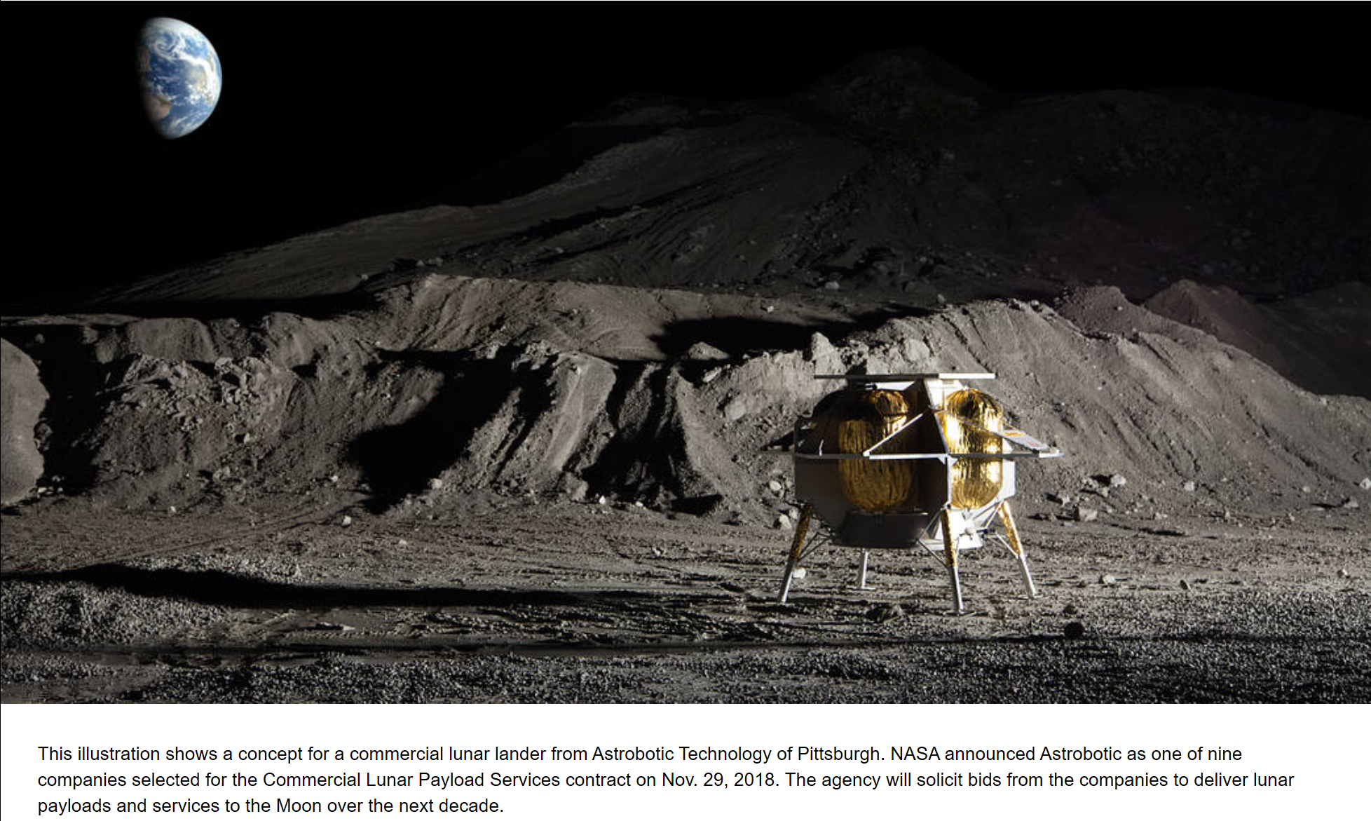
APPENDIX
CLPS Providers
Astrobotic Technology

Slide 15
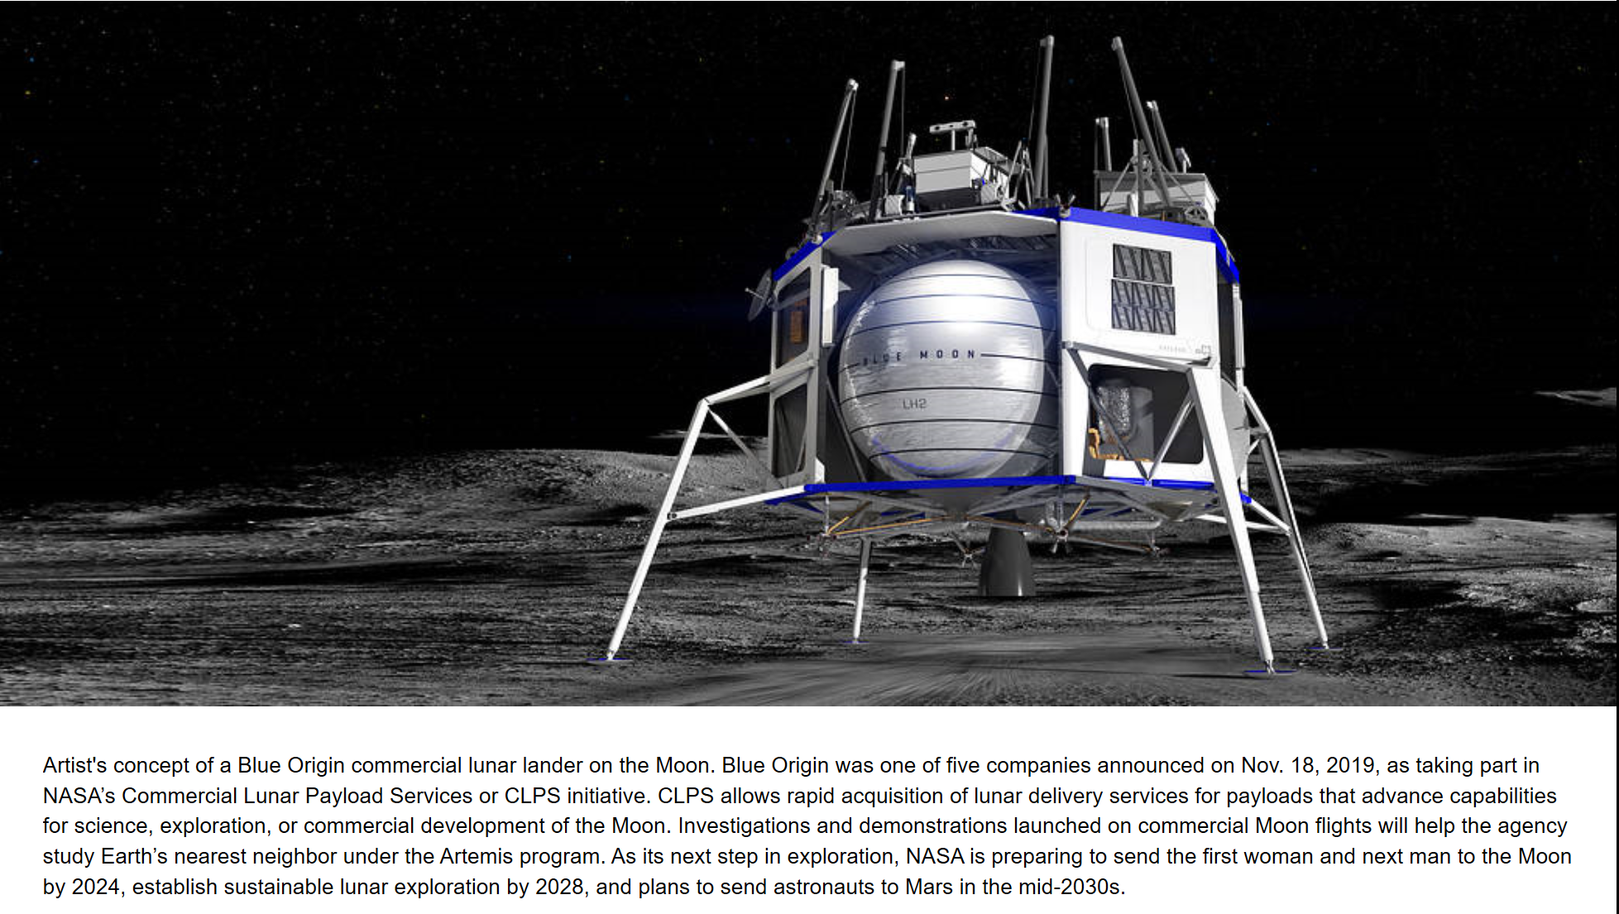
APPENDIX (cont’d)
CLPS Providers
Blue Origin

Slide 16
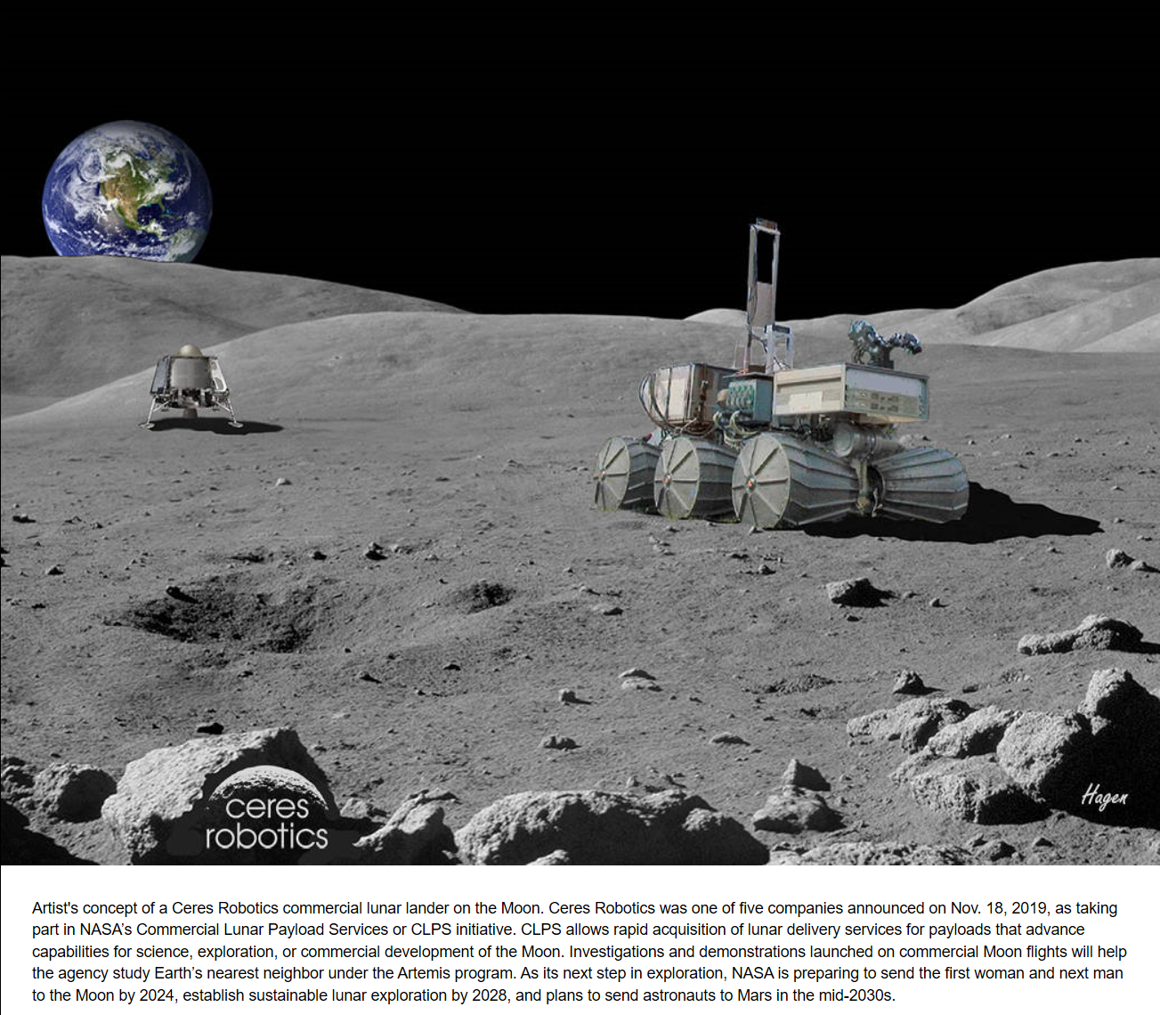
APPENDIX (cont’d)
CLPS Providers
Ceres Robotics

Slide 17
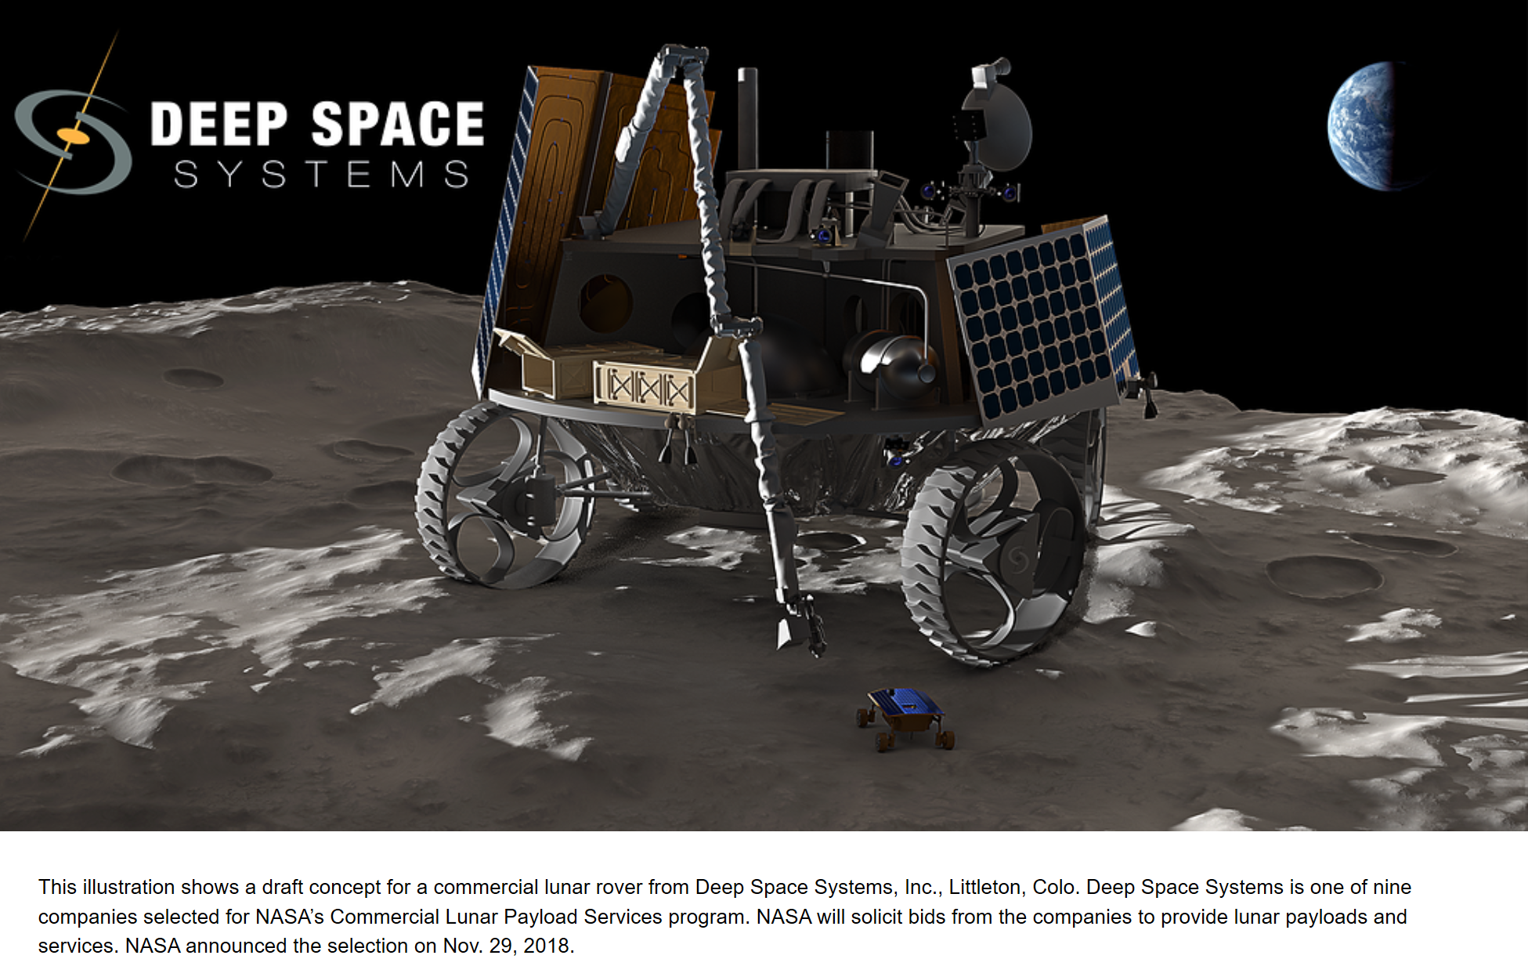
APPENDIX (cont’d)
CLPS Providers
Deep Space Systems

Slide 18
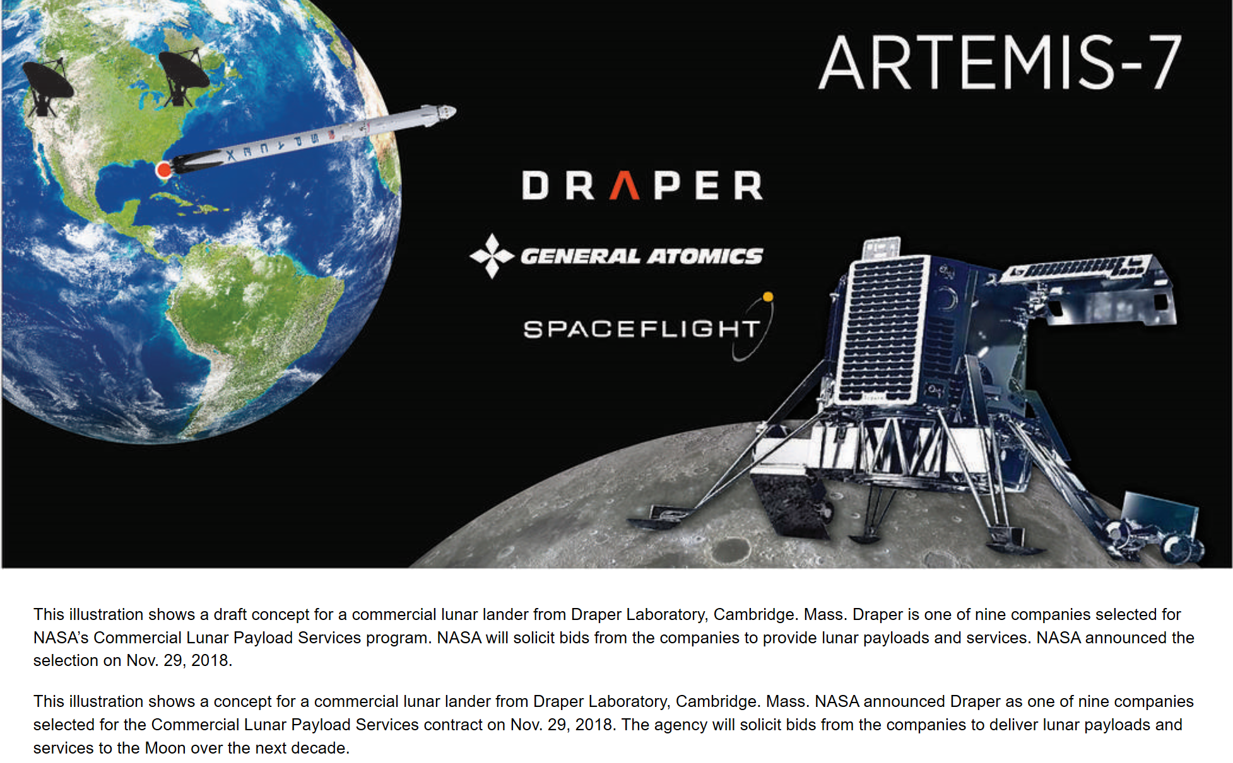
APPENDIX (cont’d)
CLPS Providers
Draper Laboratory

Slide 19
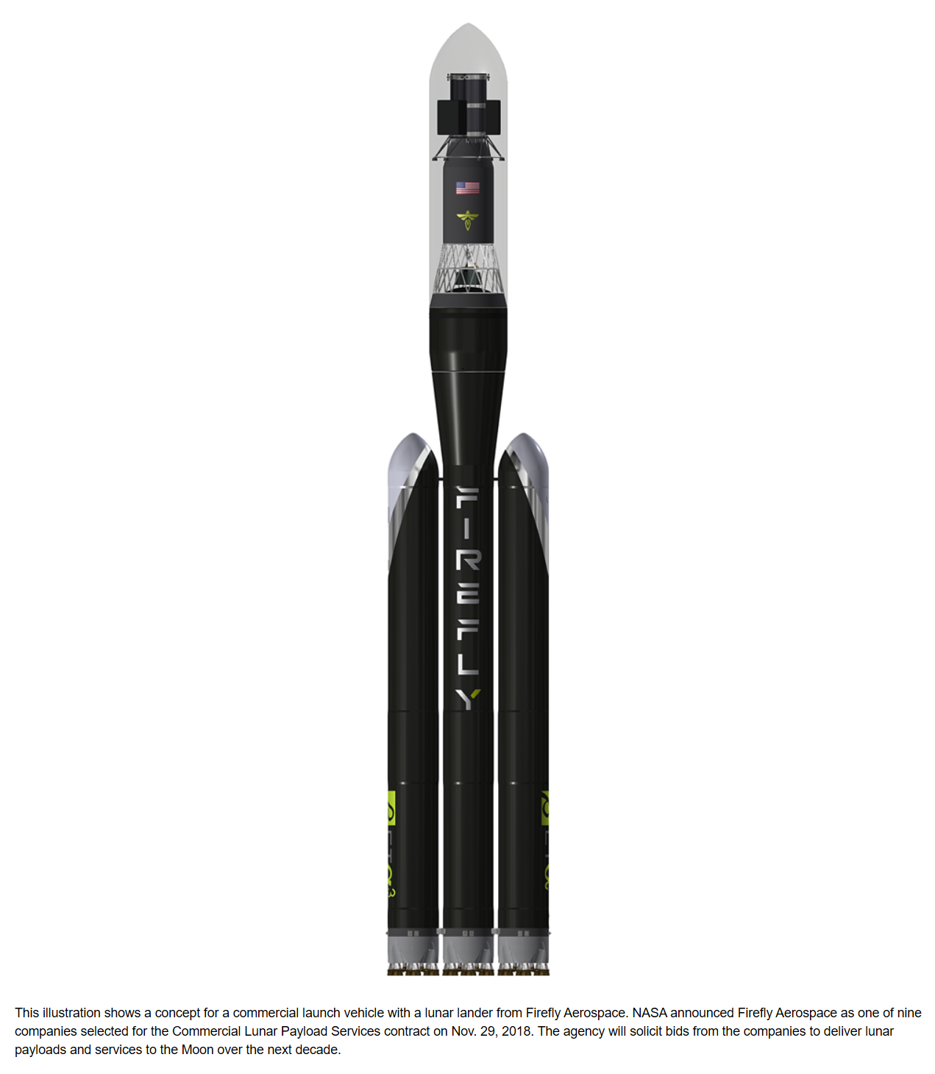
APPENDIX (cont’d)
CLPS Providers
Firefly Aerospace

Slide 20
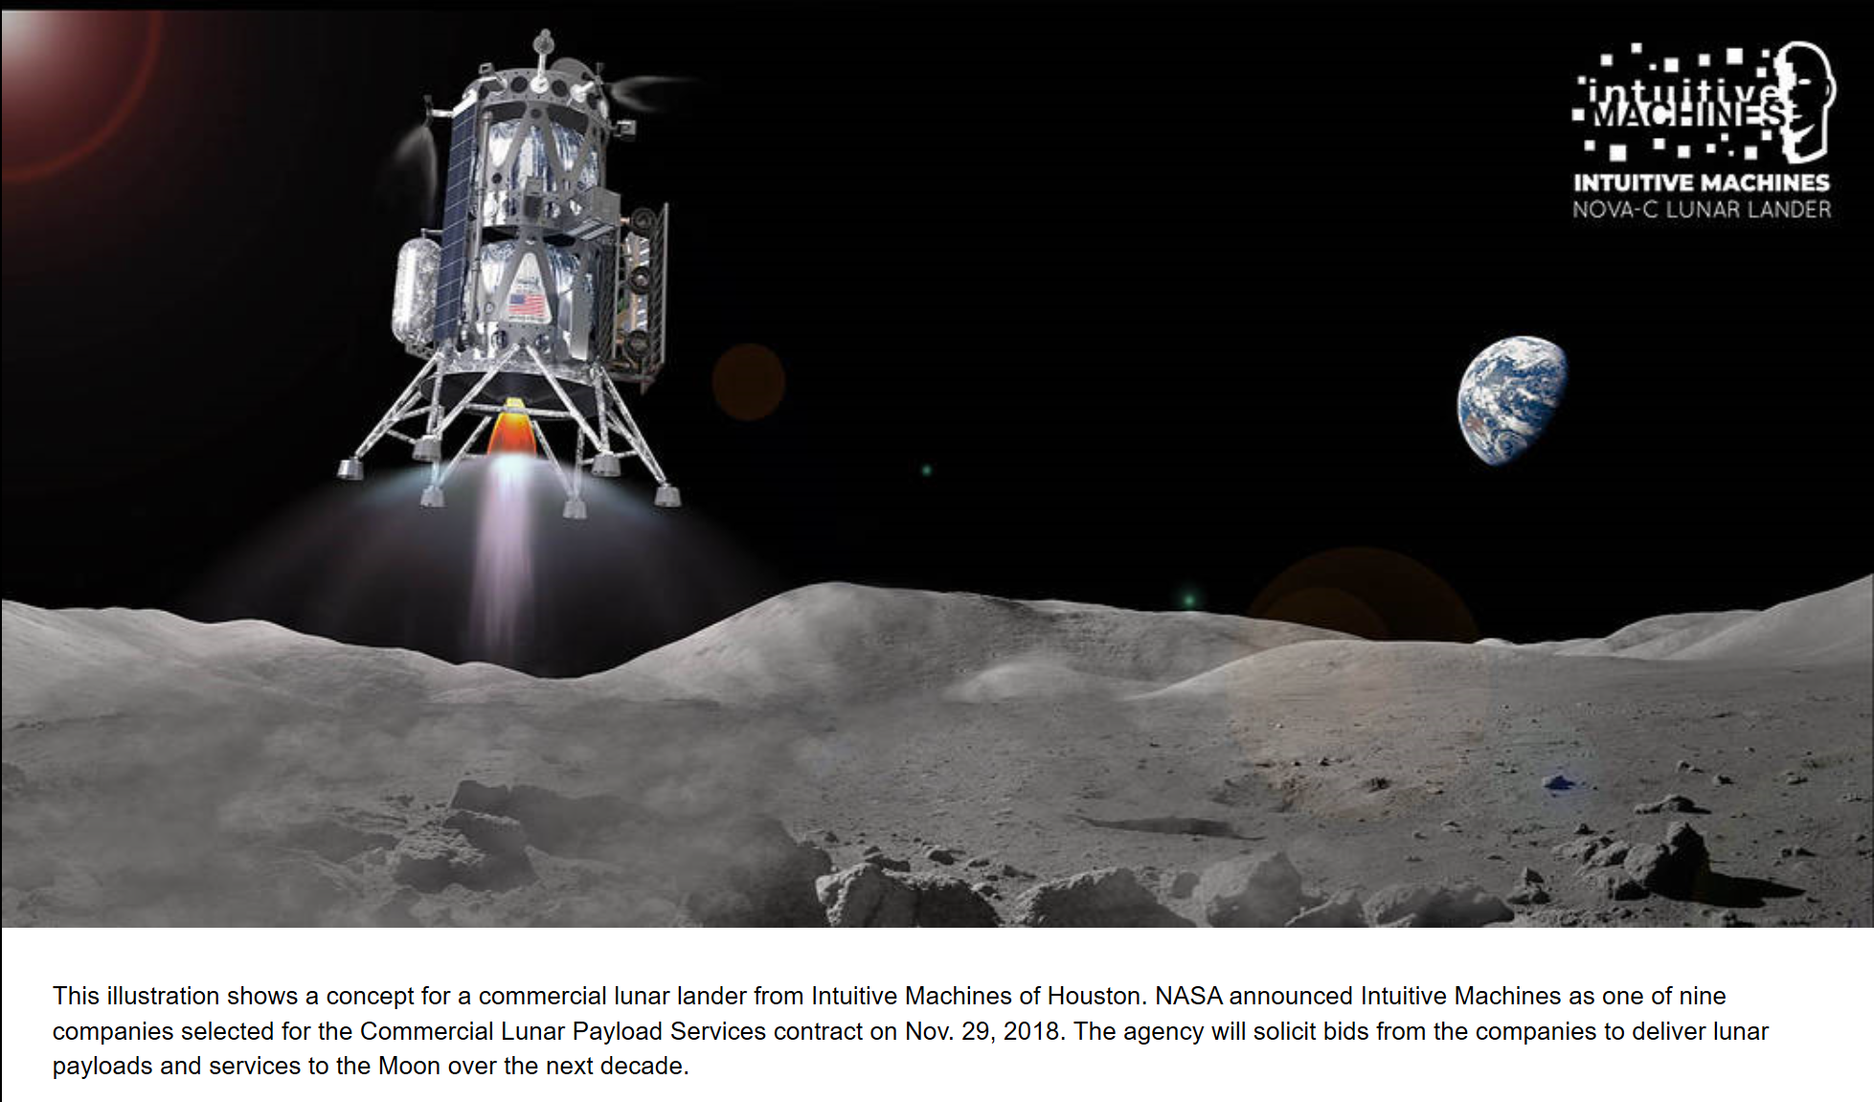
APPENDIX (cont’d)
CLPS Providers
Intuitive Machines

Slide 21
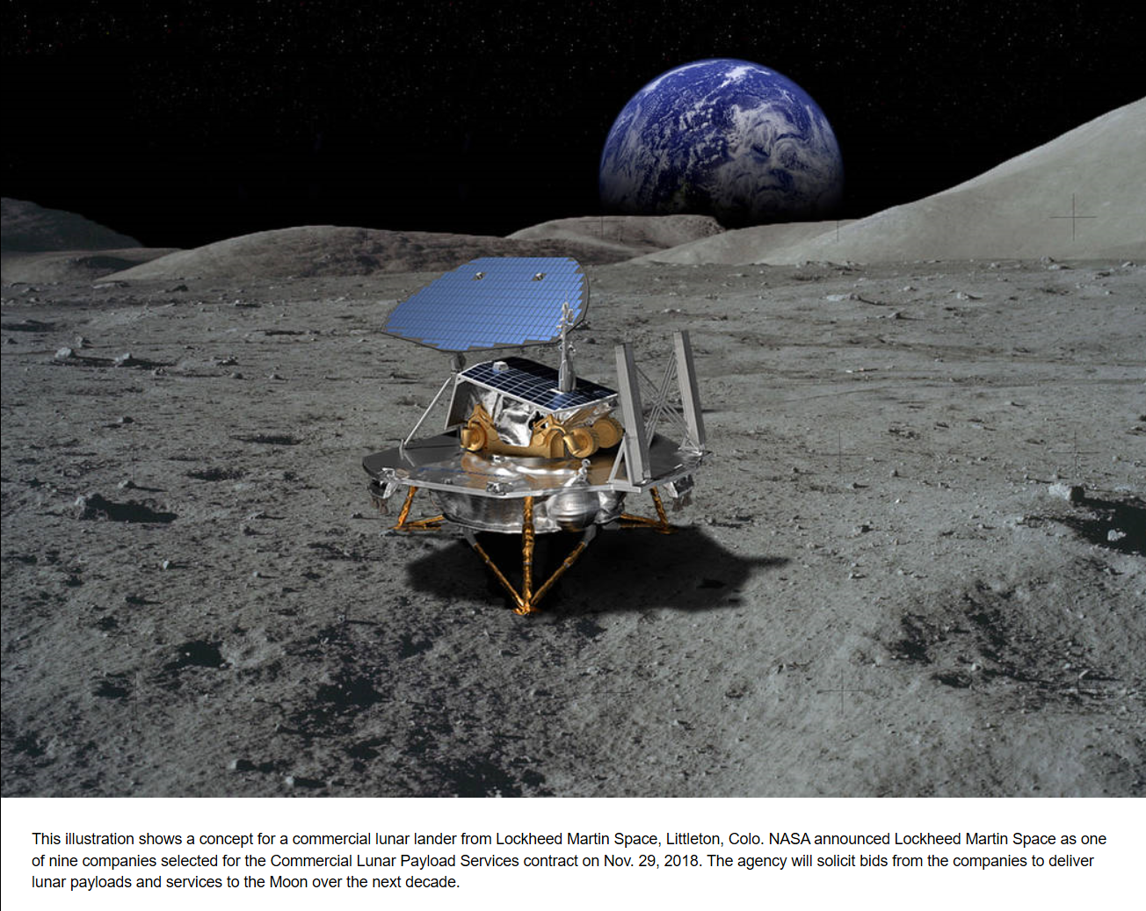
APPENDIX (cont’d)
CLPS Providers
Lockheed Martin Space

Slide 22
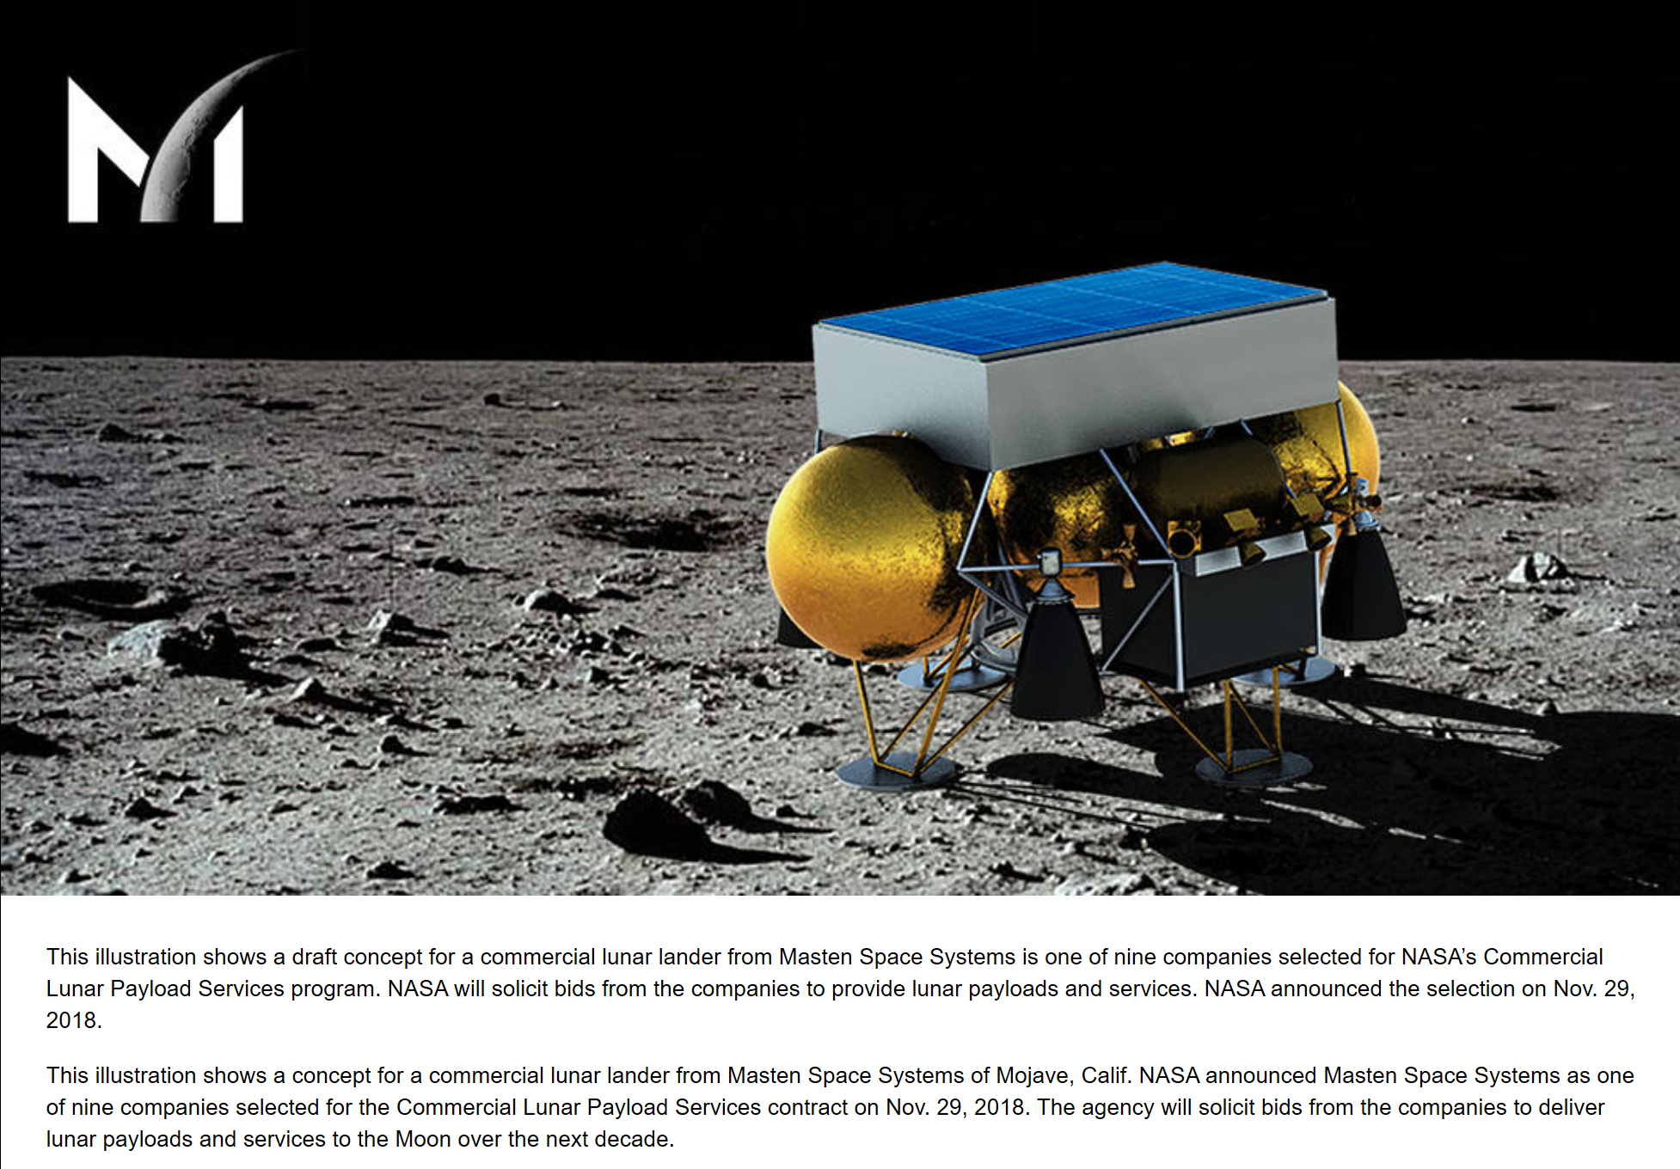
APPENDIX (cont’d)
CLPS Providers
Masten Space Systems

Slide 23
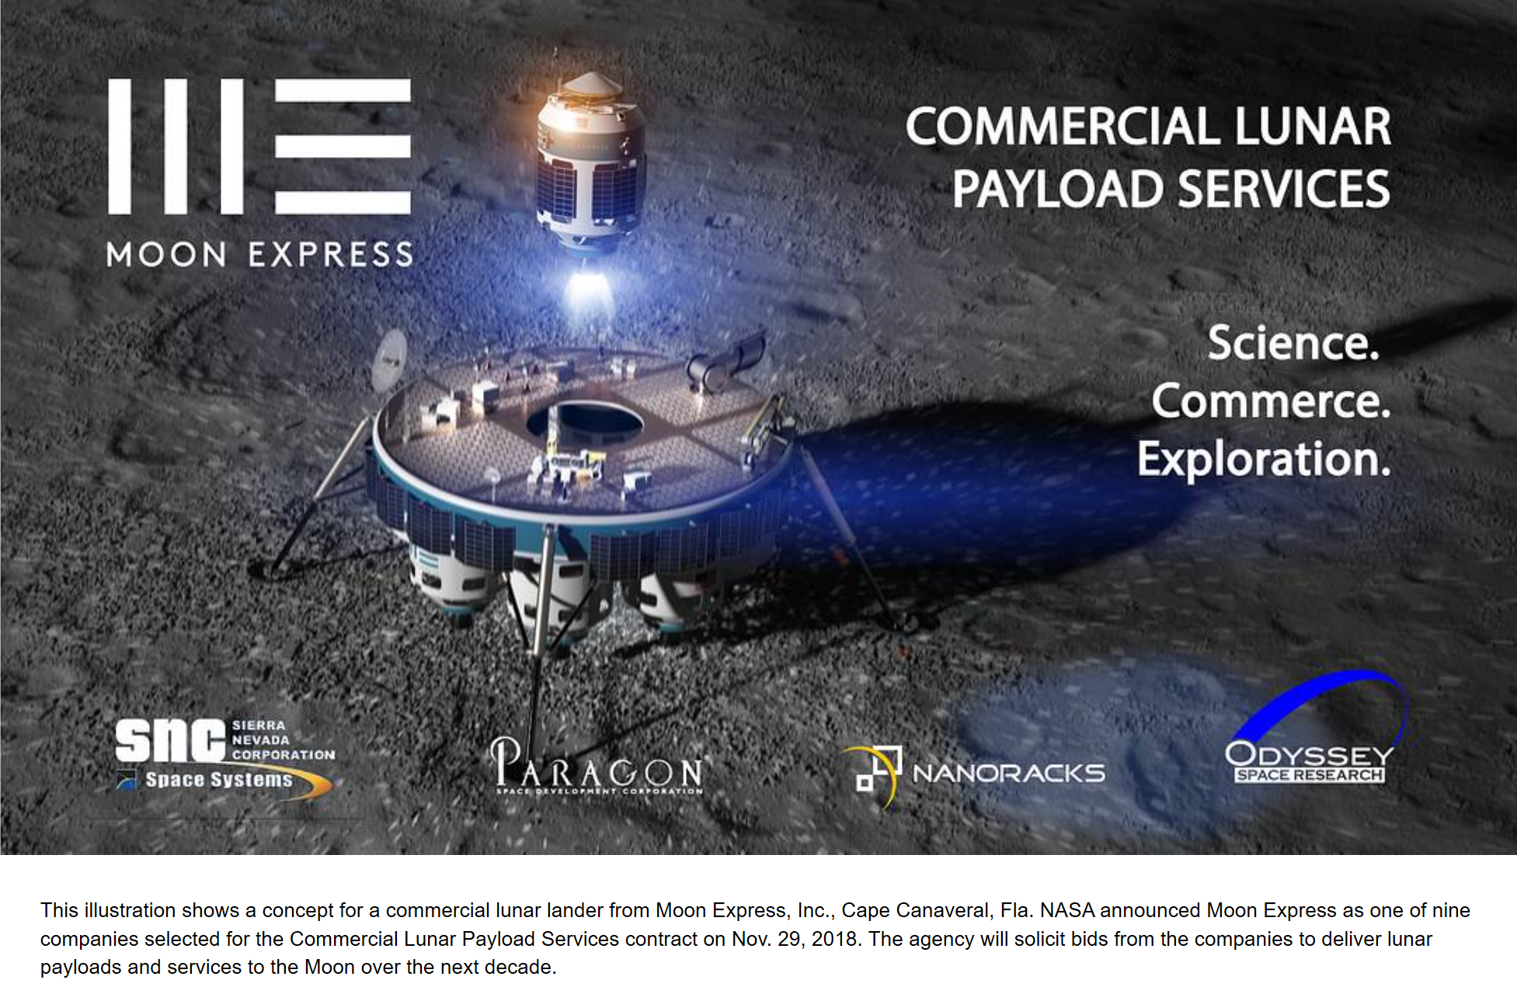
APPENDIX (cont’d)
CLPS Providers
Moon Express

Slide 24
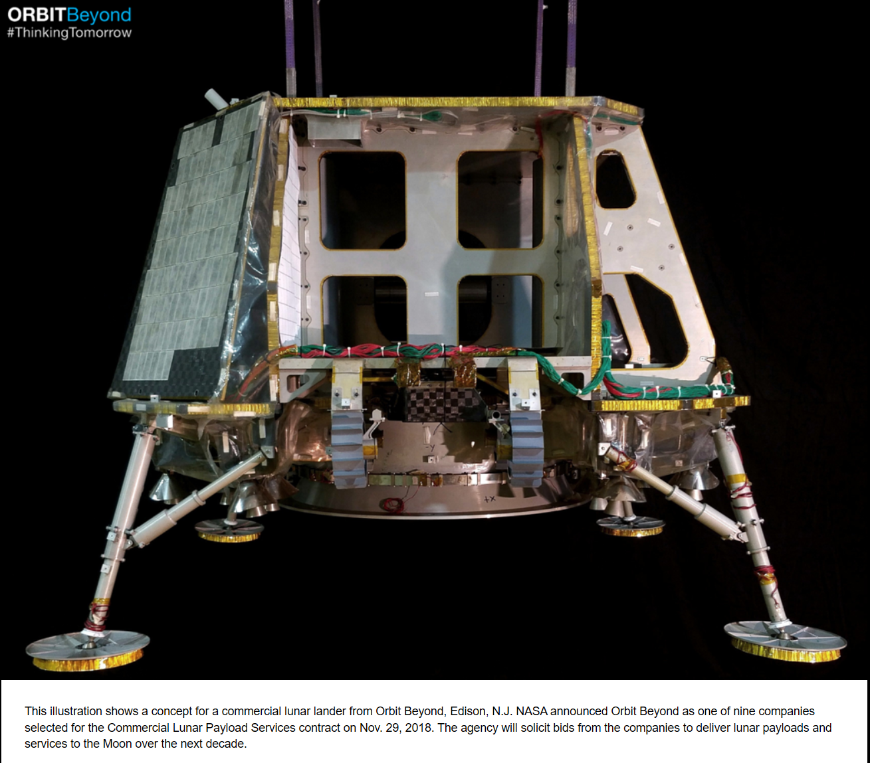
APPENDIX (cont’d)
CLPS Providers
Orbit Beyond

Slide 25

APPENDIX (cont’d)
CLPS Providers
Sierra Nevada

Slide 26

APPENDIX (cont’d)
CLPS Providers
SpaceX

Slide 27

APPENDIX (cont’d)
CLPS Providers
Tyvak Nano-Satellite Systems

