Slide 1
Design and Construction of a Hot-Fire Rocket Test Stand at The University of Arizona Amid Restrictive Pandemic Protocols
Devon Schmitt, Dr. Gregory Ogden
The University of Arizona
Department of Chemical and Environmental Engineering

Slide 2
Agenda
Introduction and Background
Hardware
Data Acquisition System
Thermoelectric Cooling Study
Safety Protocols

Slide 3
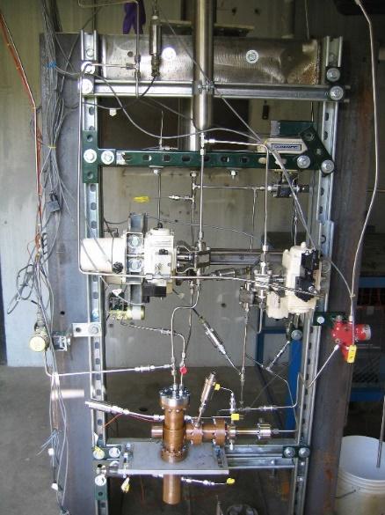
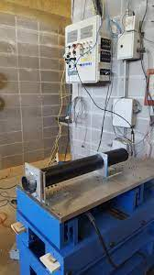
Introduction and Background
Test Stands are a secure means of firing engines and collecting data
  Chamber temperature, pressure
Examples
Purdue
UAH

Slide 4
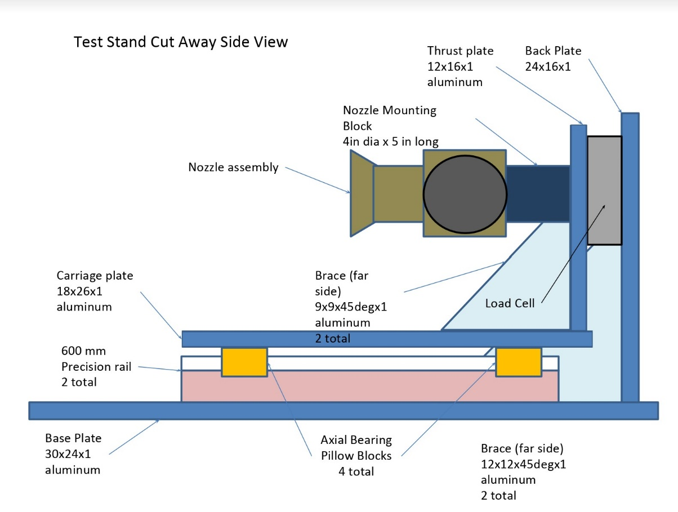
Initial Stand Design

Slide 5
Changes Made
Increased modularity
Streamlined Assembly
Adjusted Plate dimensions

Slide 6
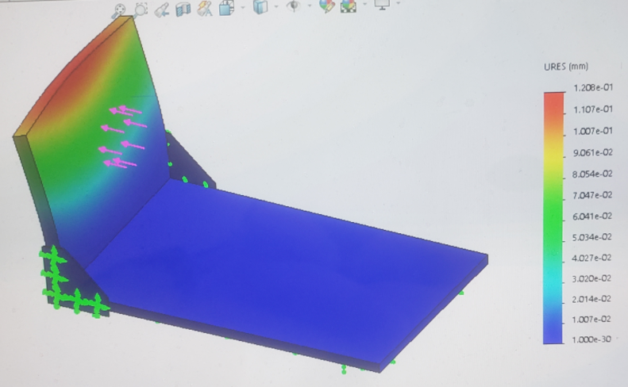
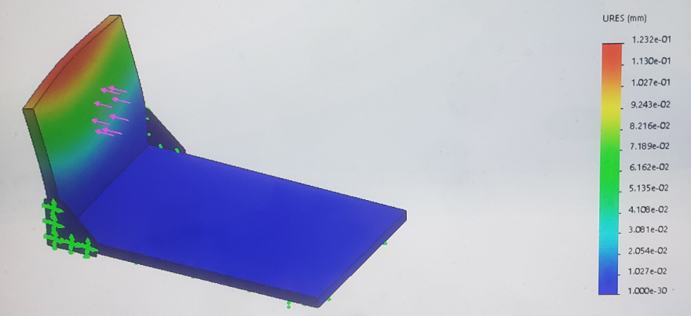
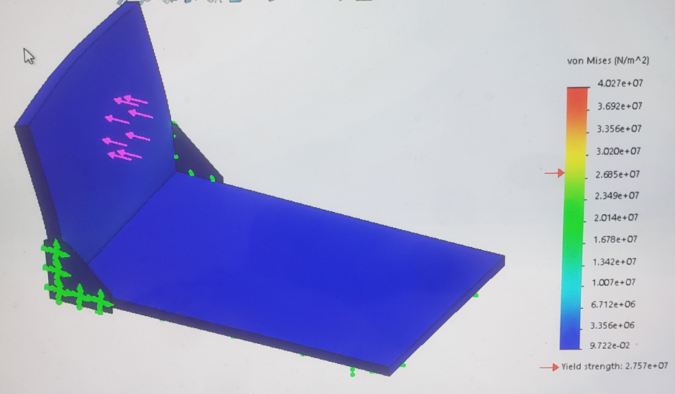
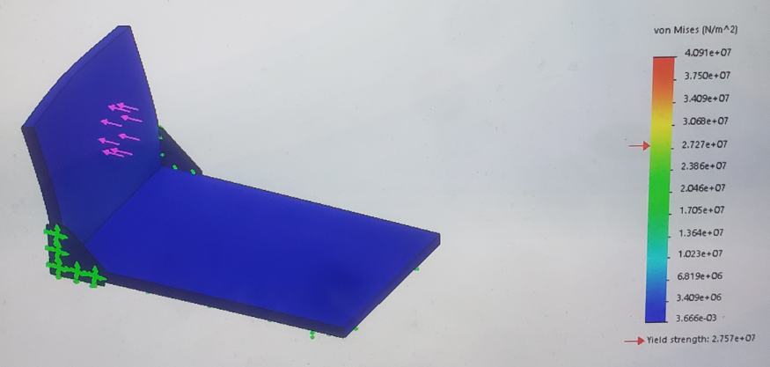
Stress Tests
Displacement, ½”
Displacement, 1”
Von Mises Stress, ½”
Von Mises Stress, 1”

Slide 7
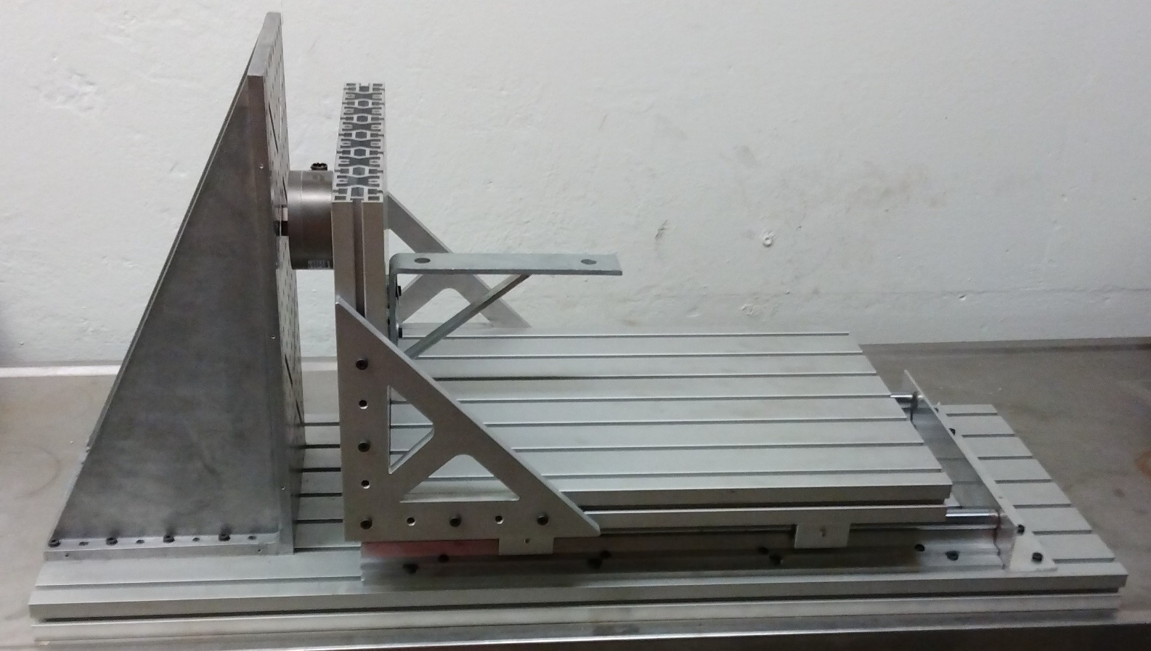
Final Mechanical Assembly

Slide 8
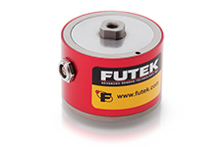
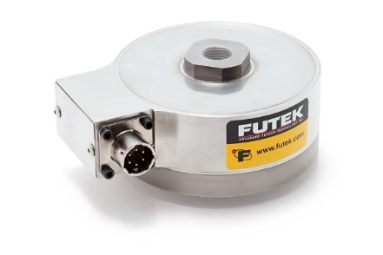
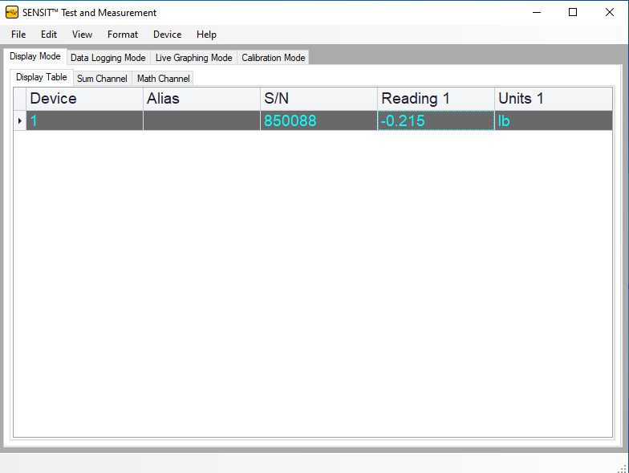
Data Acquisition System
Three Major Components
  2x Futek Load Cells
  Pressure Sensor
    100 bar (not pictured)
SENSIT Software
  User interface
50 lbs
500 lbs

Slide 9
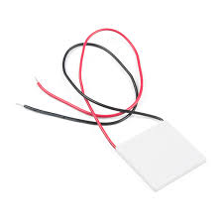
Thermoelectric Cooling Study
Phones used for videotaping engine tests overheated during summer academy
Needed a solution to keep them cool
Chosen Method: Thermoelectric Coolers

Slide 10
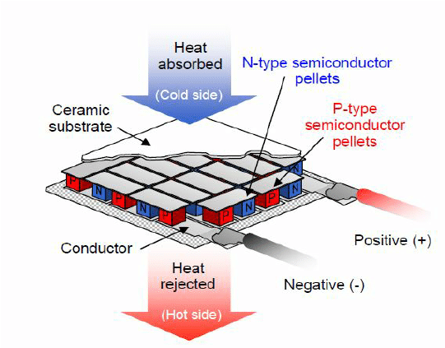
What is a Thermoelectric Cooler?
https://toroccoscoolingandheating.com/thermoelectric-wine-coolers-work/

Slide 11
TEC Study Parameters
Parameter | Value
T_{amb} | 100 ºF
T_{o} | 25 ºC
T_{mo} | 95 ºF
iPhone 8 dimensions | W: 67.3mm, H: 128.44mm
Max Output of a Phone | 3 W
Working Current TEC | 4 – 4.6 W
Max Output TEC | 60 W
Solar Radiation | 1,361 W/m²
h_{air, nc} | 25 W/(m²K)

Slide 12
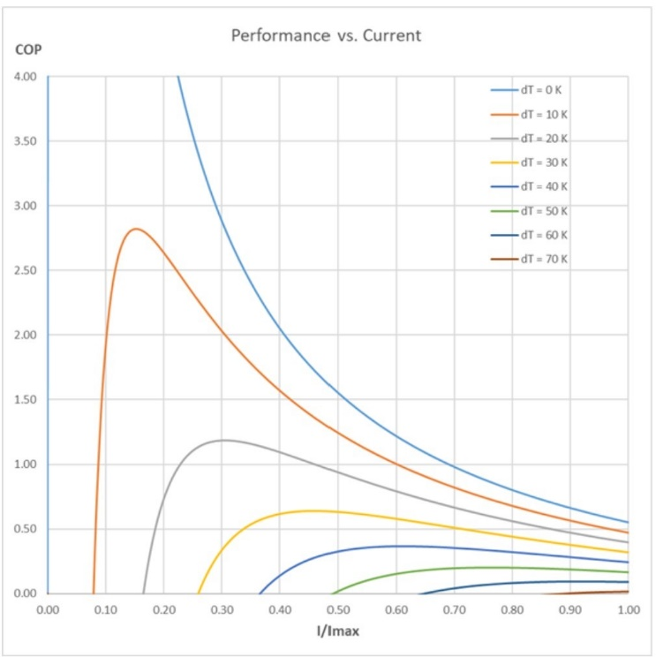
Results of Study
Total Energy Transfer
to System: 15.644 W
dT (chart) : 10o
Peltier Efficiency: 40%
Power Required: 39.11 W
The TEC system will work

Slide 13
Safety Protocols
Standoff Distance is the minimum distance required for all operators to safely fire a rocket engine
Various Sources
  Legacy military documents
  Explosive safety manuals
  Demolition Data
Used data from High Power Rocket Safety Code

Slide 14
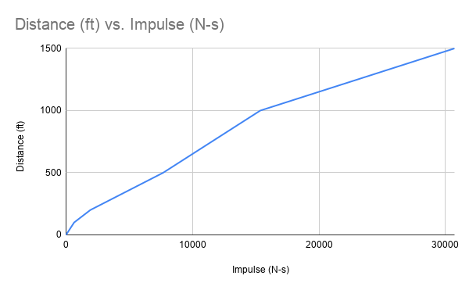

Standoff Distance (cont.)

Slide 15
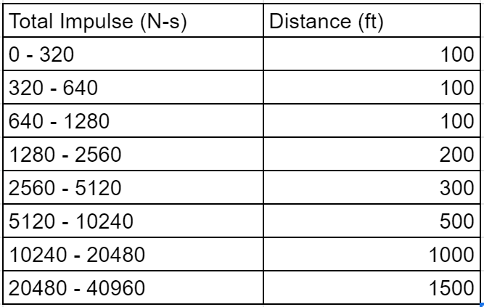
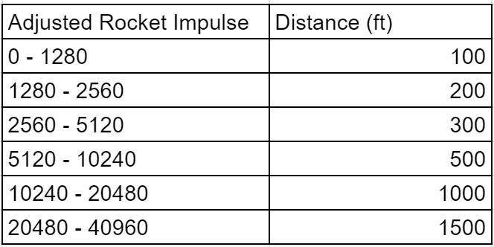
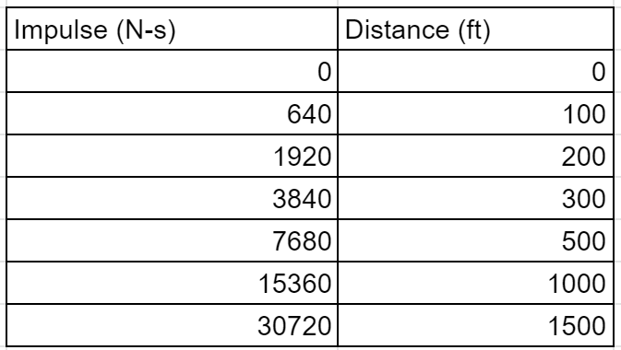
Standoff Distance

Slide 16
Standoff Distance Adjustment
Long distance means remote ignition trouble
Instead of simply standing further, implement protective barriers
  Reduces standoff distance considerably
  Better for remote ignition, operation cost

Slide 17
Safety Procedures
Remote Ignition from Protective Covering
Most Likely Failures
  Failure to Ignite
    Caused by faulty wiring, bad rocket
  Dislodged Rocket
    Caused by poor/malfunctioning mounting
  Detonation
    Caused by a faulty rocket

Slide 18
Procedure in the Event of Failure
Failure to Ignite
  Turn off ignition system, wait 60 – 120 seconds, approach the rocket and remove the ground wire first, troubleshoot
Dislodged Rocket/Detonation
  Remain behind protective barrier for 3 – 4 minutes, turn off ignition, proceed with caution and retrieve fragments

Slide 19
References
National Association of Rocketry High Power Rocket Safety Code URL: nar.org/safety-information/high-power-rocket-safety-code/
II-VI The Peltier Effect. URL: ii-vi.com/how_do_thermoelectric_coolers_tec_work
Futek LCF300/400 Images. URL: futek.com

