Slide 1




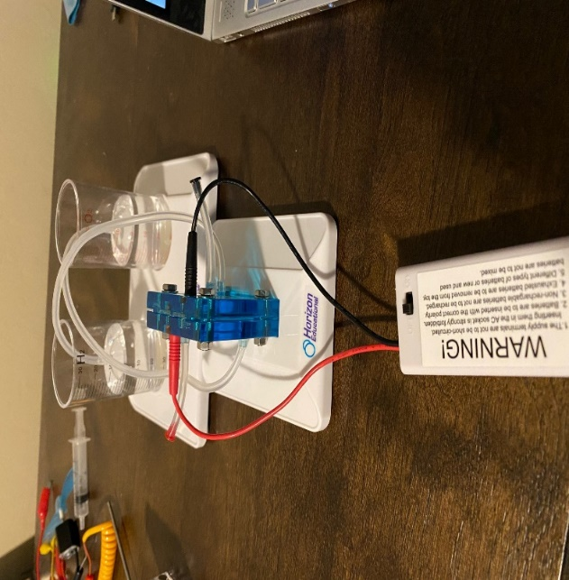
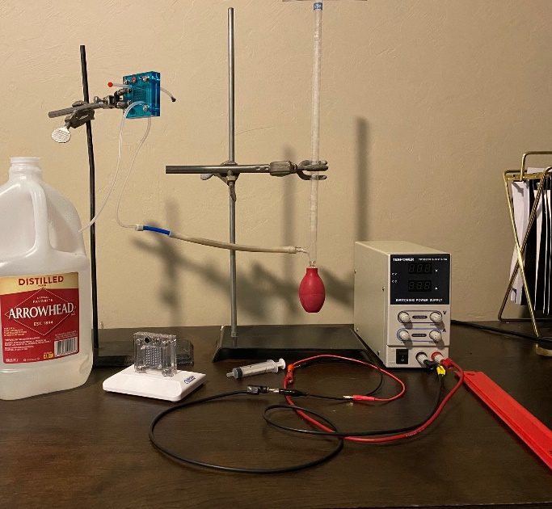
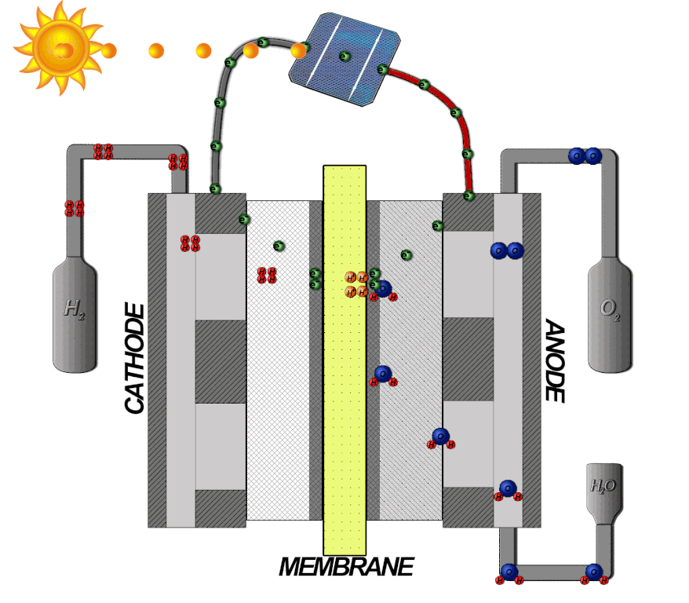
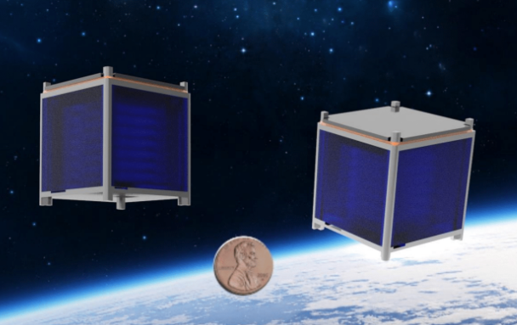
MIRO
ASTEROIDS
Design and Testing of PEM hydrolysis system for producing hydrogen and oxygen propellants for Cubesat Applications
Julia English
Space and Terrestrial Robotic Exploration (SpaceTREx) Laboratory
Aerospace and Mechanical Engineering Department
University of Arizona

Slide 2
Presentation Outline
Motivation
Challenges
Objective
Method
Analysis/Results
Discussion
Takeaway

Slide 3

Motivation
Alleviate Fuel Storage
Sustainable “green” technology

Slide 4

Challenges
Device Challenges
  Cubesat dimensions
  Membrane Durability
Experimental Challenges
  Remote Research
  Recording issues

Slide 5

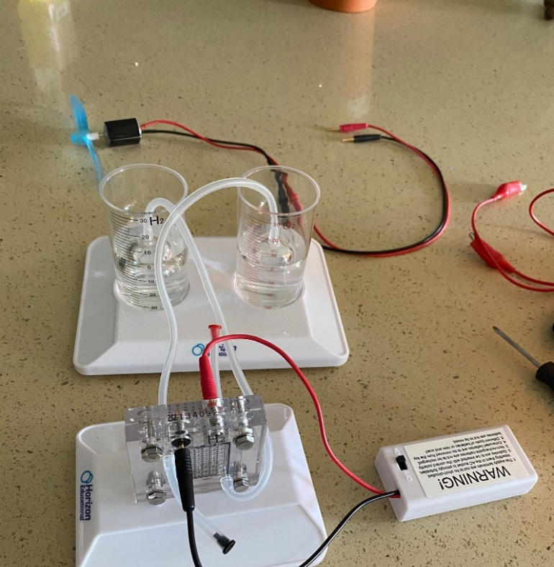
Objective
Analyze the feasibility of a PEM (Polymer Electrolyte Membrane) Electrolyzer in propulsion

Slide 6
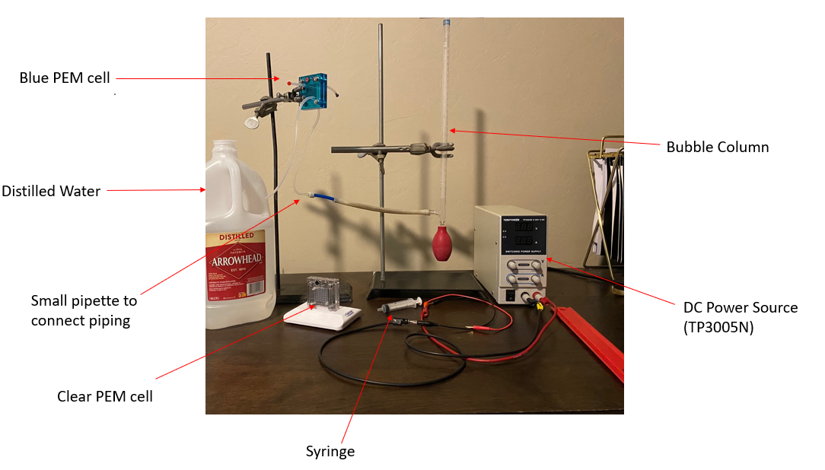
Method

Slide 7
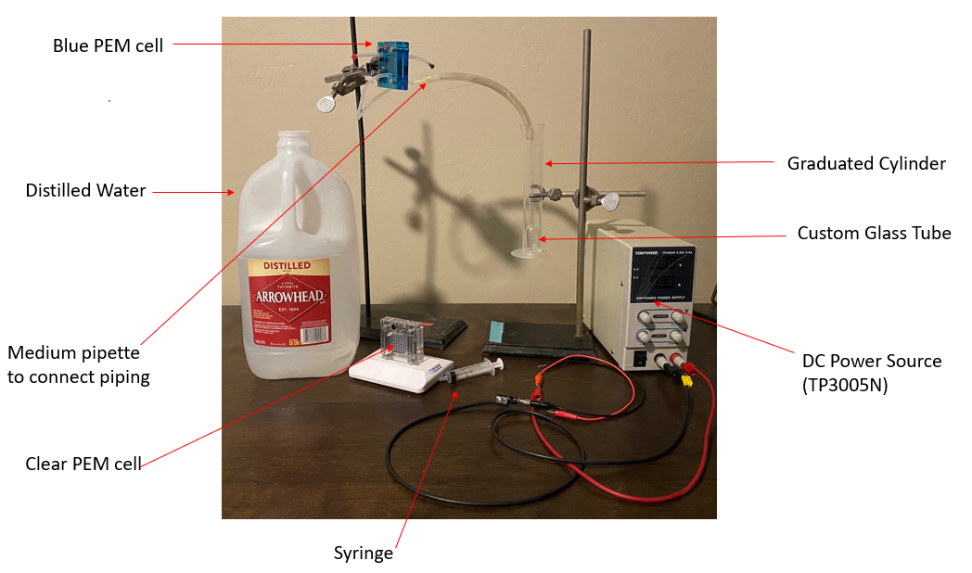
Method

Slide 8
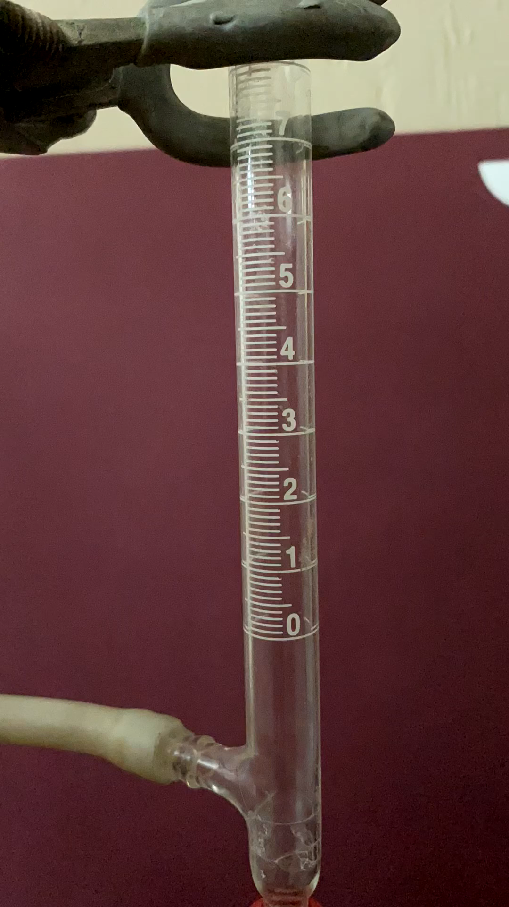
Method
Bubble Rate

Slide 9
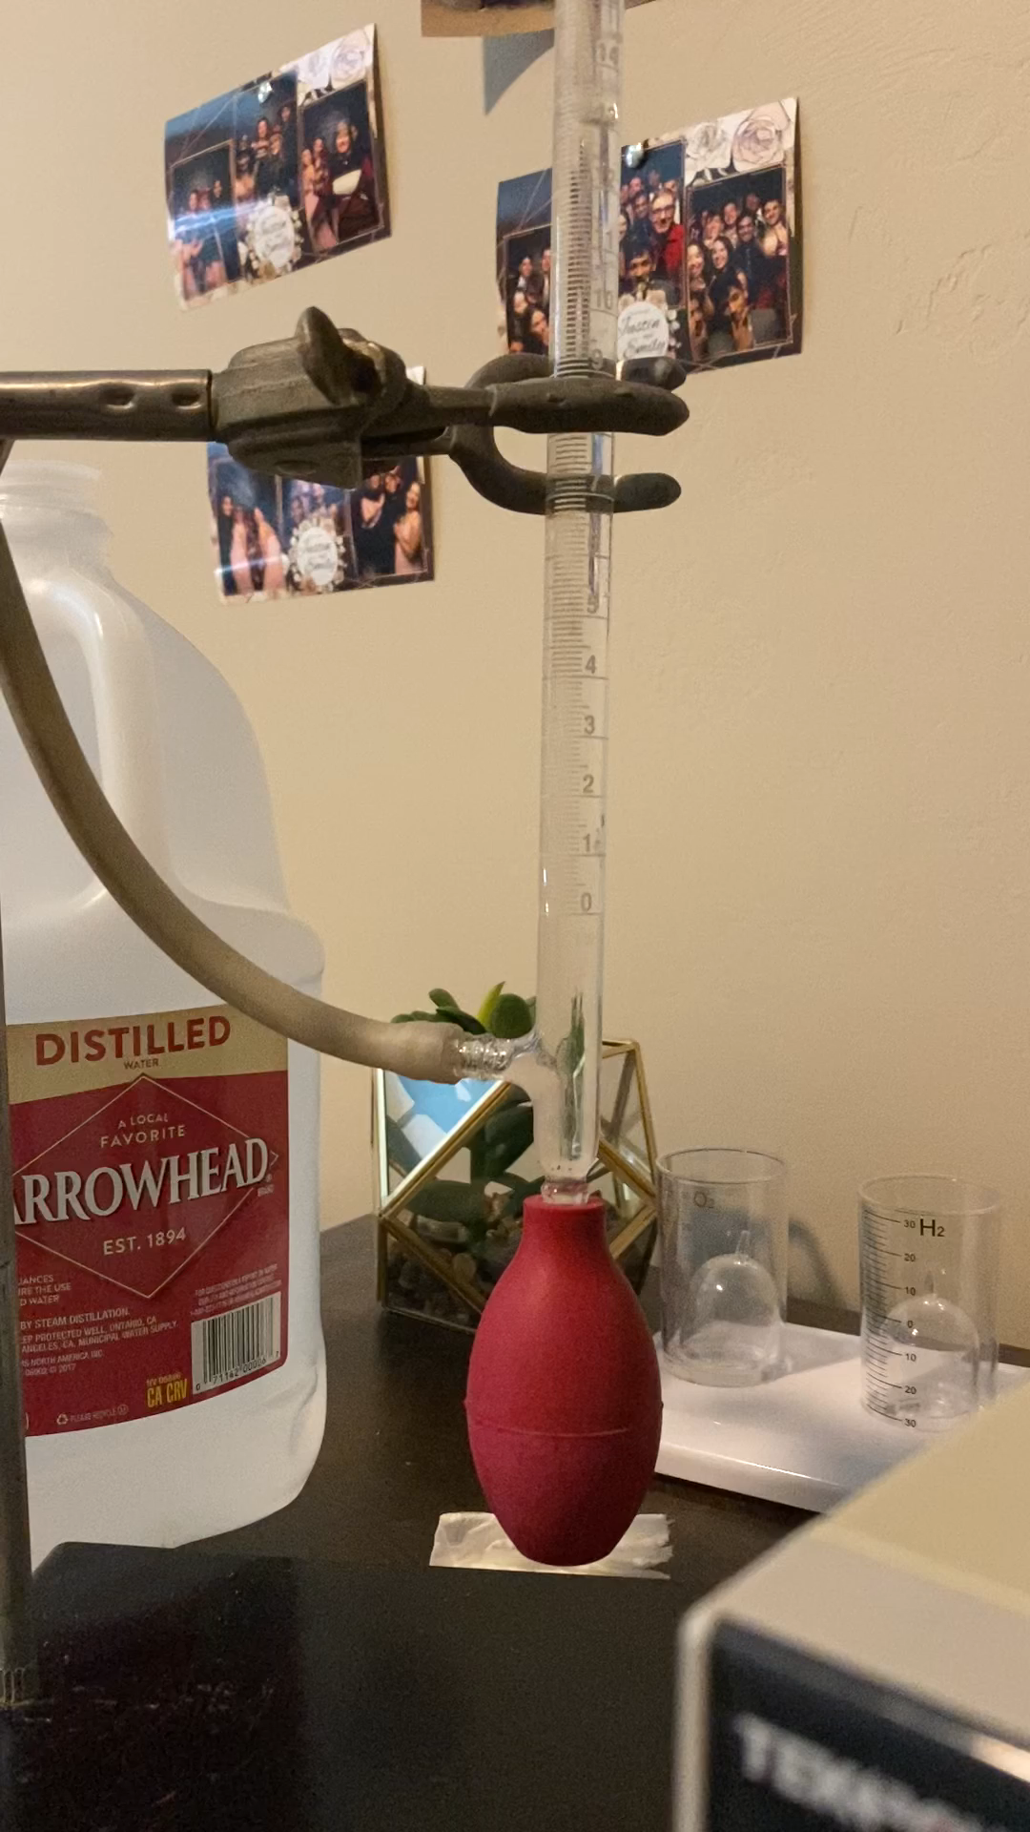
Method
Bubble Production Rate

Slide 10
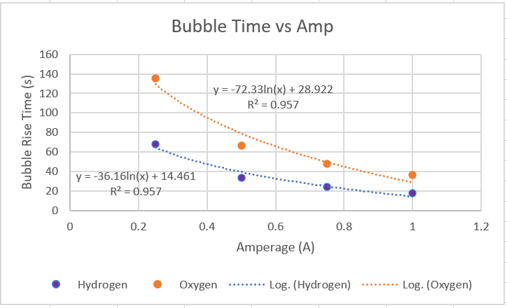
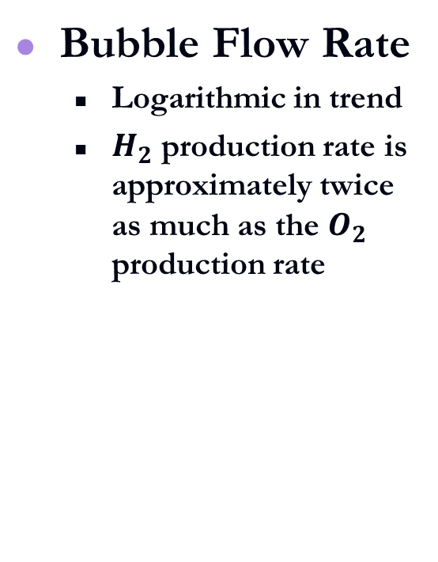
Results
Bubble Flow Rate
  Logarithmic in trend
  $H_{2}$ production rate is approximately twice as much as the $O_{2}$ production rate

Slide 11
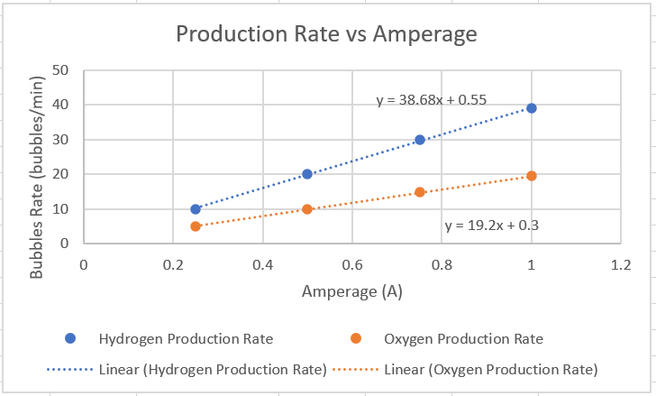
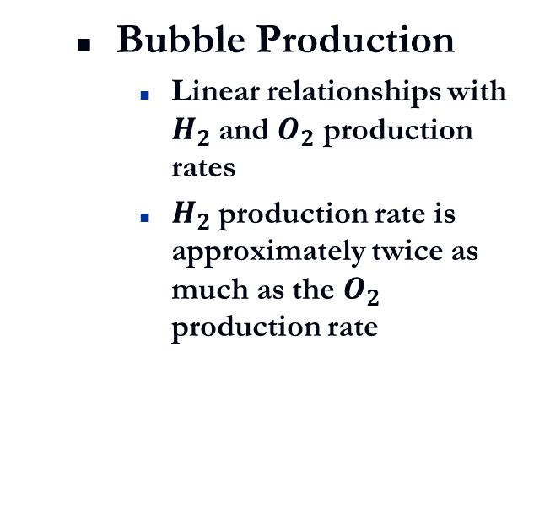
Results
  Bubble Production
    Linear relationships with $H_{2}$ and $O_{2}$ production rates
    $H_{2}$ production rate is approximately twice as much as the $O_{2}$ production rate

Slide 12
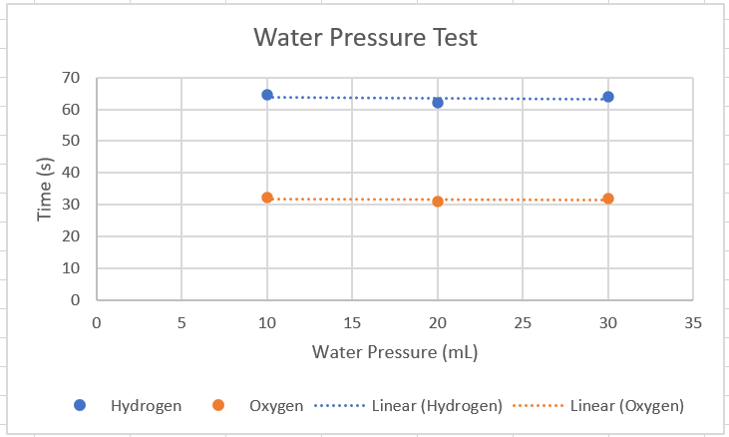
Results
  Pressure Test
    Pressure does not seem to change the gas production rate significantly

Slide 13
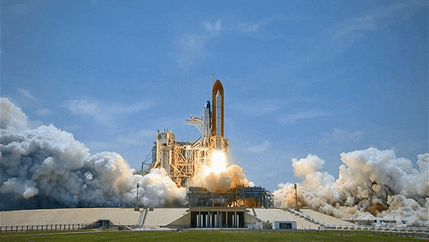
Discussion
Design Benefits
  Improved Safety
Related Work

Slide 14
Conclusion
Potential in PEM propulsion
Green Technology

Slide 15

Acknowledgements
ASTEROIDS Laboratory
Dr. Ogden
  My mentor

Slide 16
References
NASA Research
  David J. Bents, Vincent J. Scullin, B.J. Chang, Donald W. Johnson, Christopher P. Garcia, Ian J. Jakupca, Hydrogen-oxygen PEM regenerative fuel cell development at Nasa Glenn Research Center, Fuel Cells Bulletin, Volume 2006, Issue 1, 2006, Pages 12-14, ISSN 1464-2859, https://doi.org/10.1016/S1464-2859(06)70909-9.(https://www.sciencedirect.com/science/article/pii/S1464285906709099)
PEM Cells Bought at
  https://www.horizoneducational.com/solar-hydrogen-science-kit/p1224

Slide 17
