Slide 1

Innovation to Flight Lunar CubeSats
Chrishma Derewa
Office of Strategic Planning

Slide 2

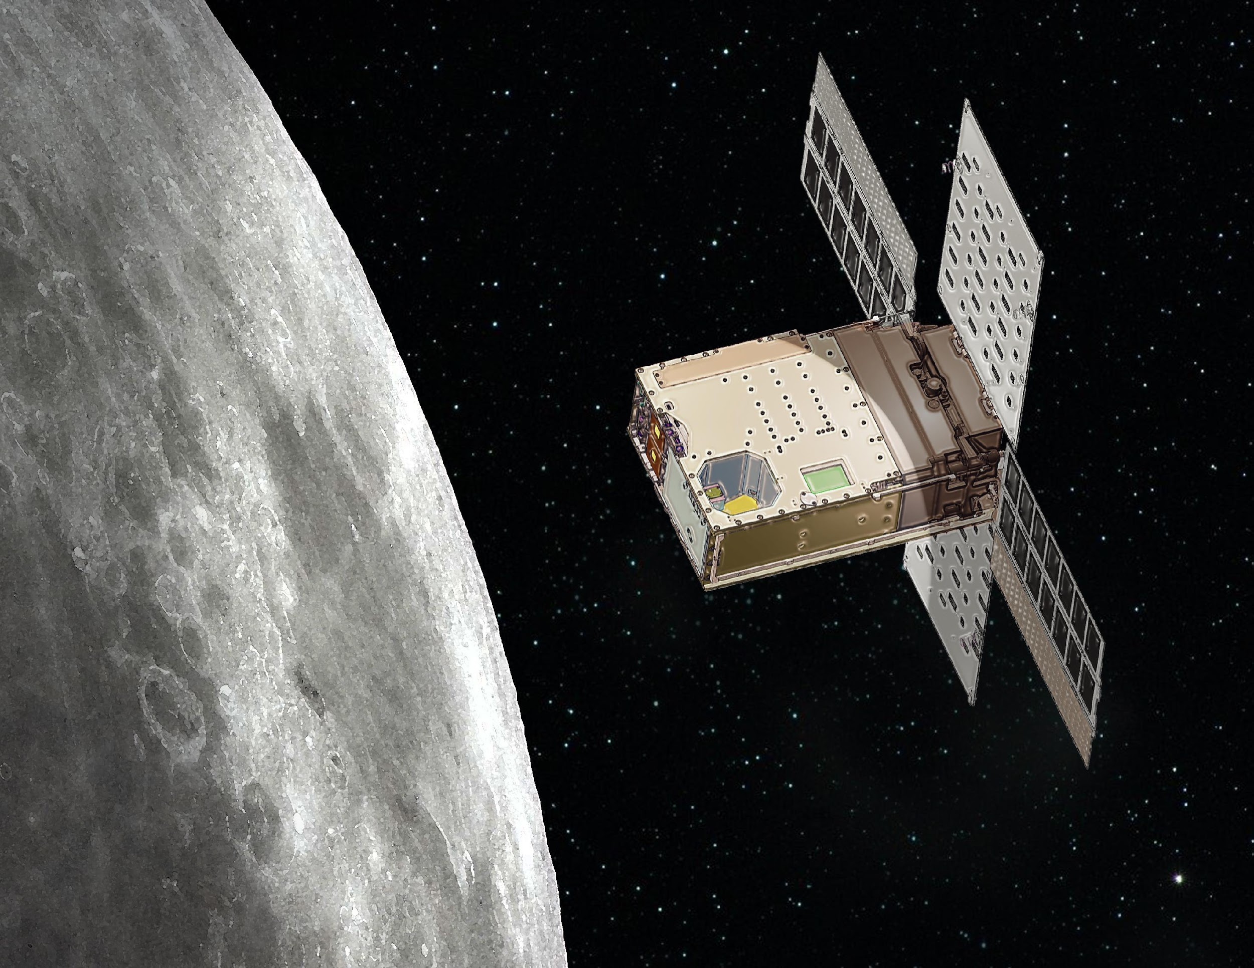
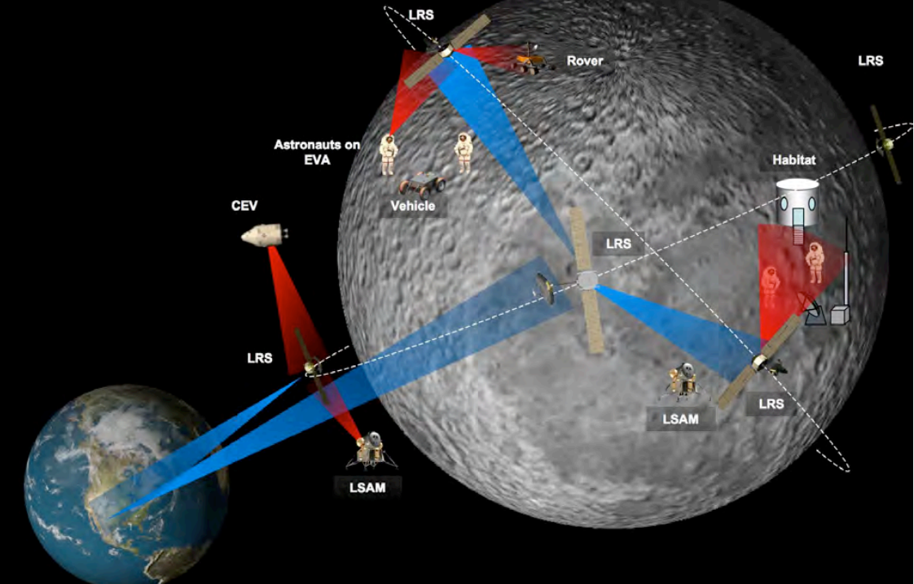
Lunar Asset Messaging and On Orbit Nav.
LA-MOON
Objectives
Investigate the potential for lunar CubeSat constellations capable of supporting lunar surface assets
Capabilities include:
  Bent-Pipe Communications: Relay ground asset’s data through the simulated formation to other lunar-simulated assets or to remote observers and operators
  Ground Asset Localization: GPS like location information from simulated constellation provided to simulated lunar asset
Expand the partnership between NASA, JPL, and CU Boulder
  Work with CubeSat subject matter experts at JPL and CU Boulder (Scott Palo, Courtney Duncan, and Zaid Towfic)
  Study a CubeSat-based solution for lunar communication and localization
Notes:
replace image
second half cut donw

Slide 3
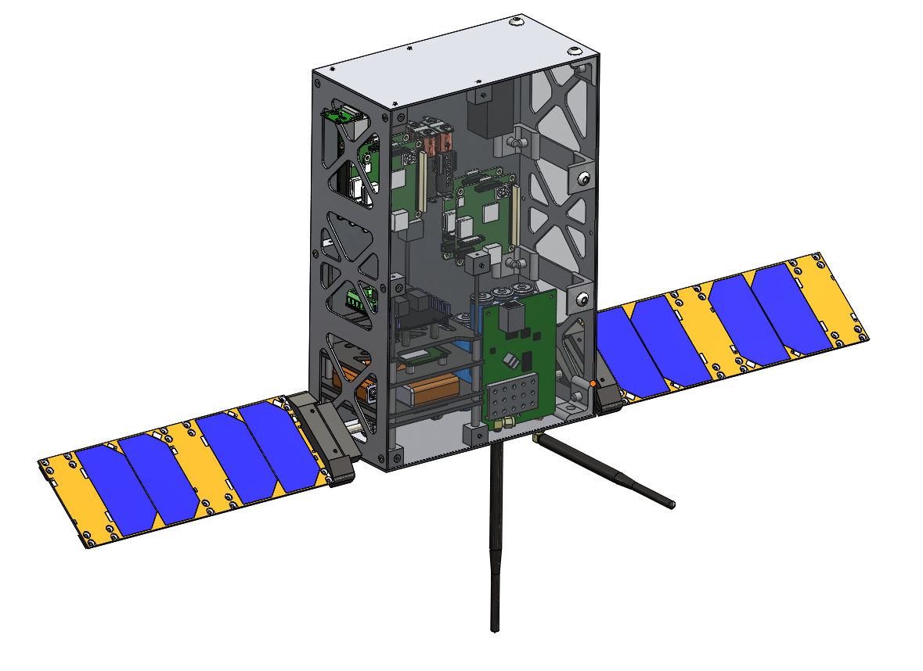
Innovation to Flight Background
Program for increasing the TRL of promising new technologies through rapid prototyping and testing
2019 - high altitude balloon based CubeSat test platform for low cost technology demonstration in a near space environment
2019 Payload
6U form factor
Qualcomm Snapdragon processor
Deployable solar panels w/ sun tracking capabilities
Live video downlink

Slide 4

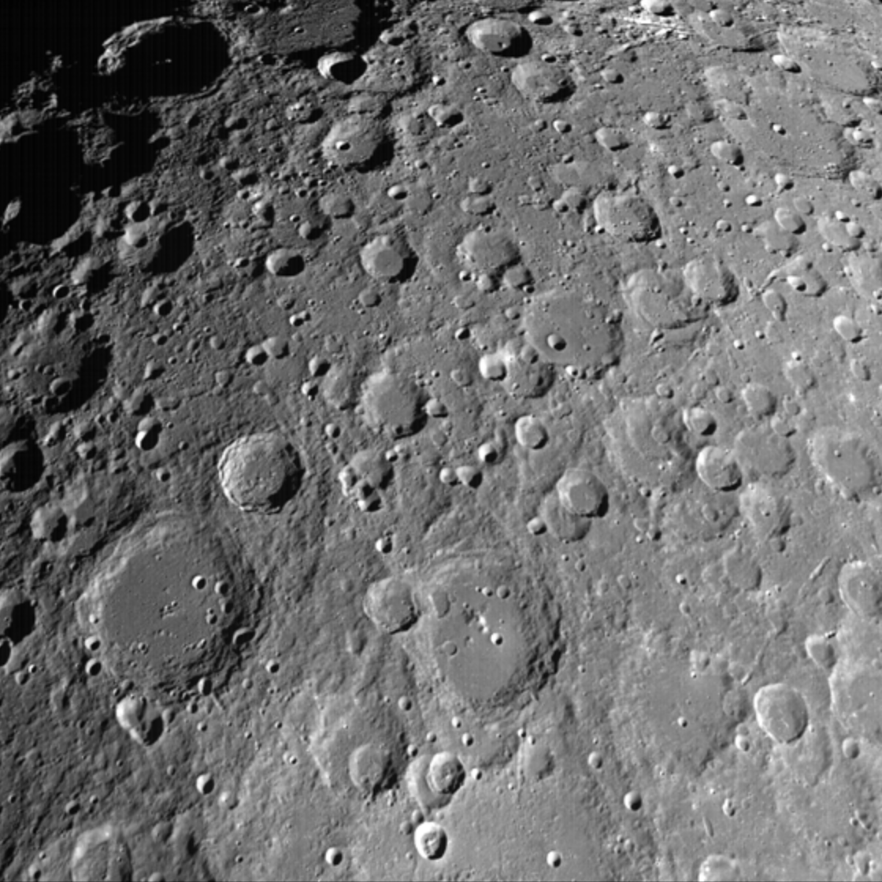
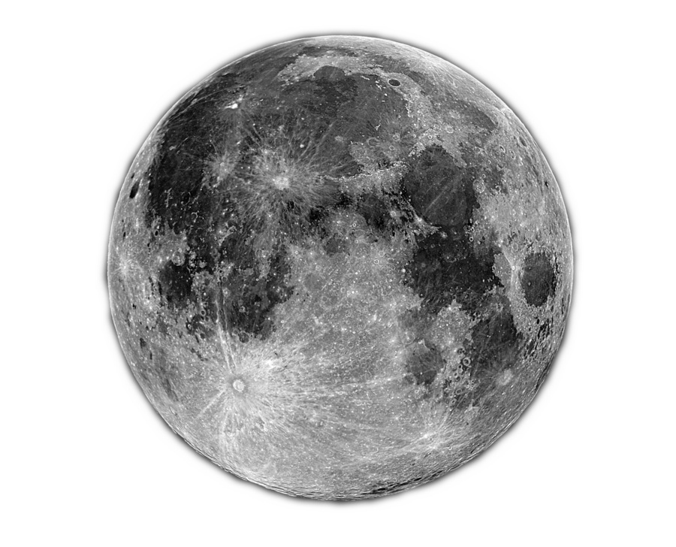
Innovation to Flight 2020: Team Omega
Leverage 2019 test platform to investigate the potential for a lunar CubeSat constellation
Sustained human and robotic operations on the Moon require additional infrastructure
Constellation of lunar CubeSats can reduce cost & overhead by providing general-purpose services to future missions
Bent-Pipe Communications
Localization
Constellation can relay data, facilitating both:
Surface-to-Earth communications
Surface-to-surface
communications
Constellation can use multiple CubeSats to provide location estimations to surface assets.
Enable precise surface operations.

Slide 5
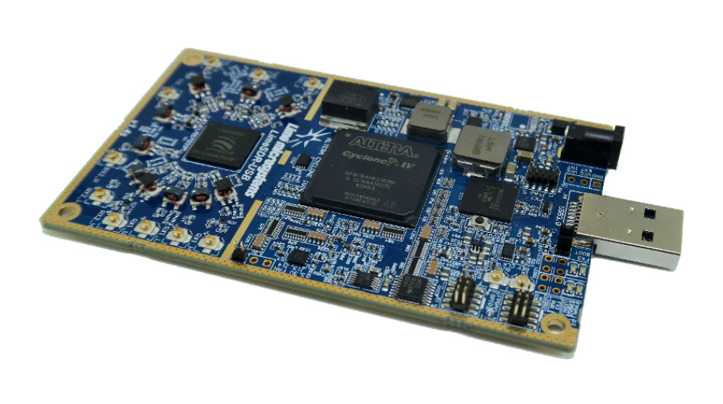
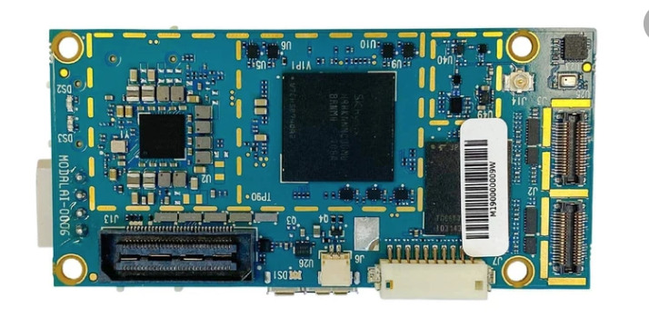
Objectives
Increase TRL of off-the-shelf technologies involved
  LimeSDR software defined radio
  ModalAI VOXL Flight Board (Qualcomm 821 Snapdragon Processor)
Outfit CubeSat Test Platforms with LimeSDR and ModalAi VOXL
Designing a test plan that uses the Test Platforms for
  Bent-Pipe Communications: Relay Surface Asset’s data through Test Platforms to a simulated ground station
  Surface Asset Localization: Provide GPS-like localization to Surface Asset using trilateration, calculated using distance measurements between asset and multiple Test Platforms
Expand the partnership between NASA, JPL, and CU Boulder
LimeSDR Software Defined Radio
ModalAI VOXL Flight Board

Slide 6
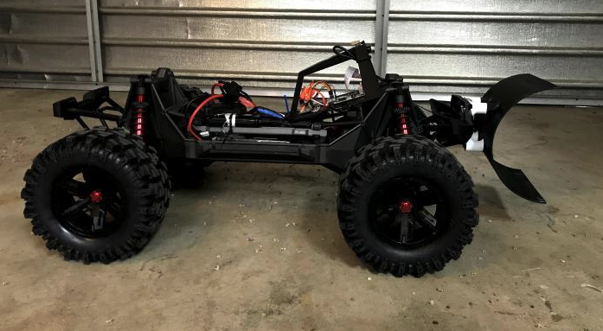
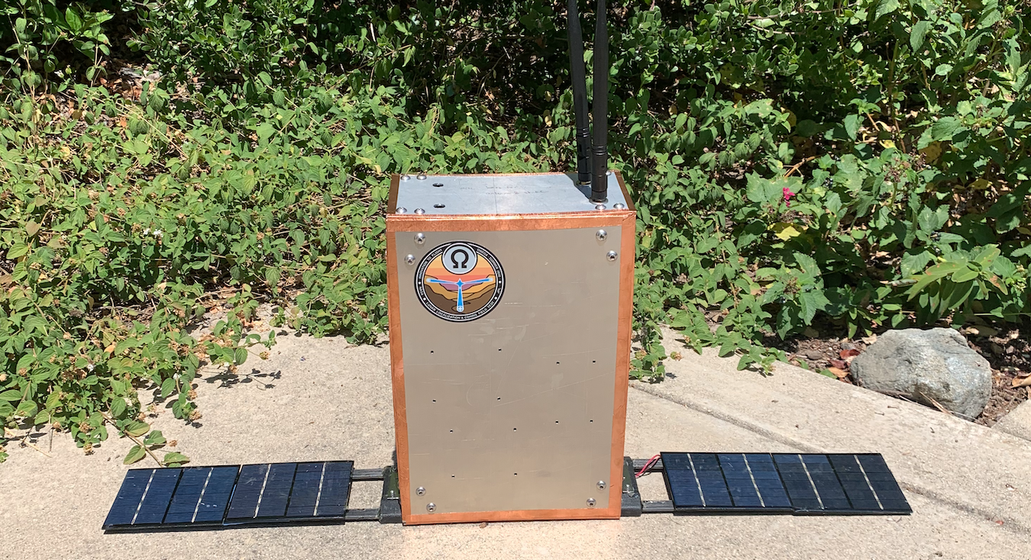
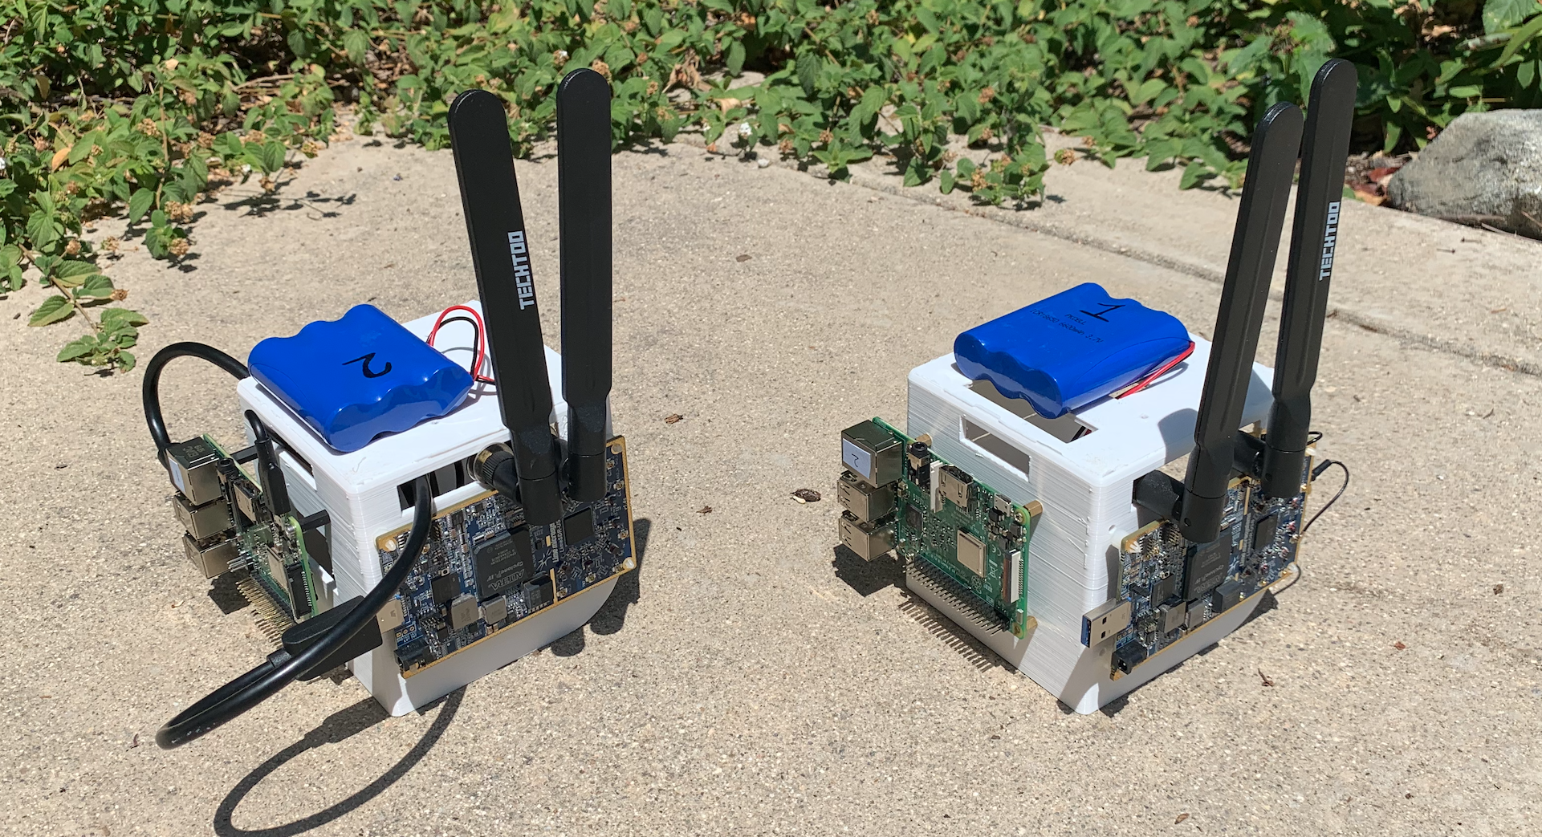
Systems in Development
CubeSat Test Platforms
Mock Surface Asset
Primary Platform
Miniature Platforms
6U aluminum chassis, interior space for payloads
C&DH: Raspberry Pi 3
ModalAI VOXL
Comms: LimeSDR USB
Miniature mockups, same base components as main
C&DH: Raspberry Pi 3
Comms: LimeSDR Mini
Carry out simulated surface tasks supported by CubeSats
Structure: Traxxas X-maxx
RC Vehicle
C&DH: Raspberry Pi 3
Radio: LimeSDR Mini

Slide 7
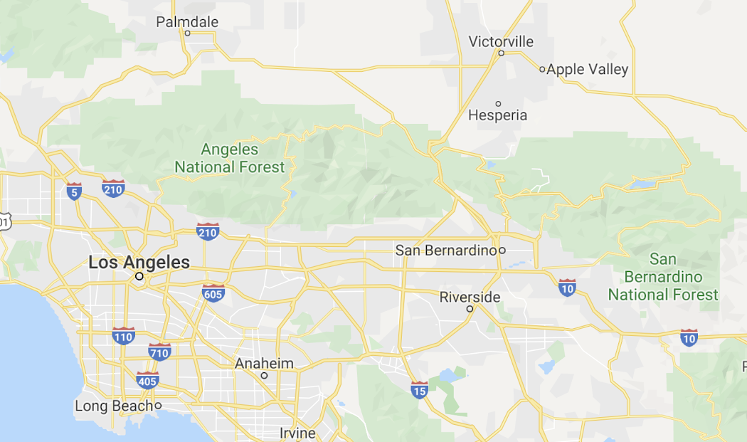
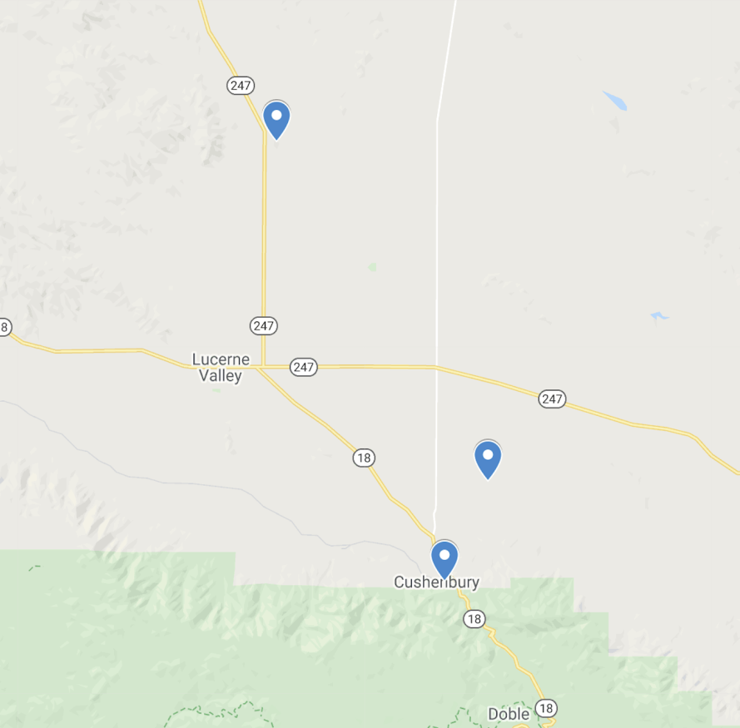
Concept of Operations
Peterman Hill (+958m)
CubeSat Test Platform
Lucerne Valley
Lucerne Valley Test Site (+890m)
Tethered Balloon with 6U CubeSat test platform
Surface asset to assist with location and communications testing
tethered balloon
Test Overview
Surface asset will establish communication link with test platforms
Test platforms will provide the surface asset with localization data
Surface asset will use localization data for semi-autonomous navigation
Surface asset’s telemetry will be relayed to ground station via bent pipe
cubesat
ground asset
Mitsubishi Cement Corporation(+1470m)
CubeSat Test Platform

Slide 8
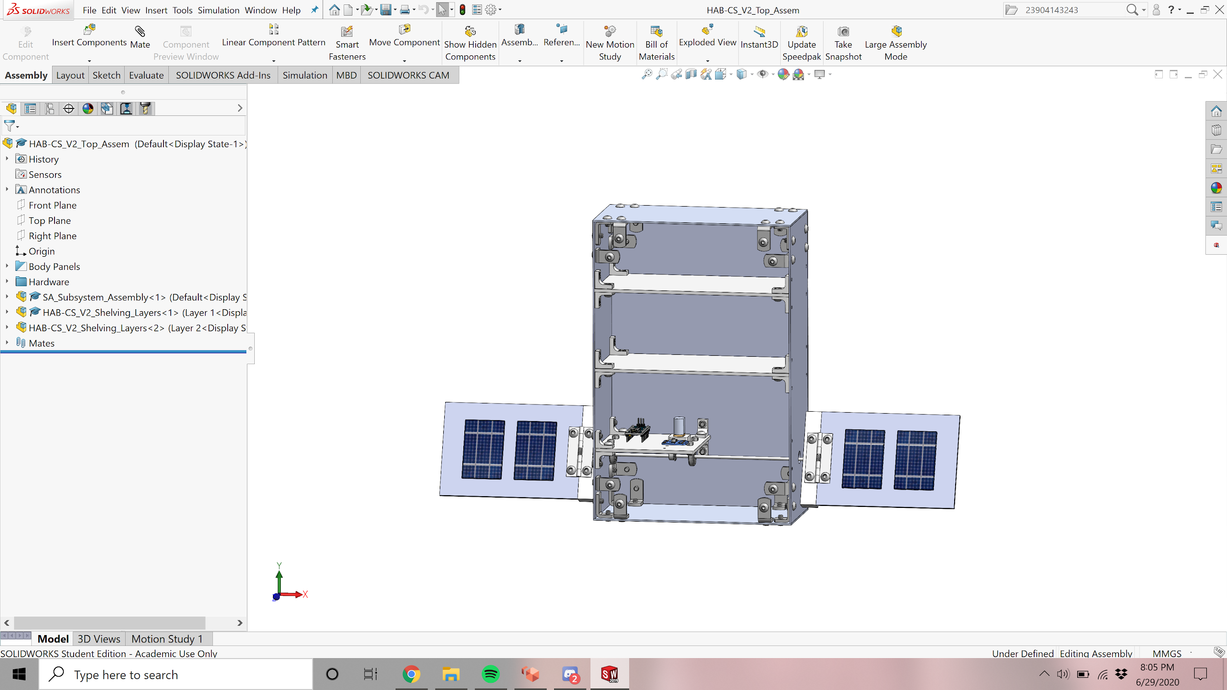
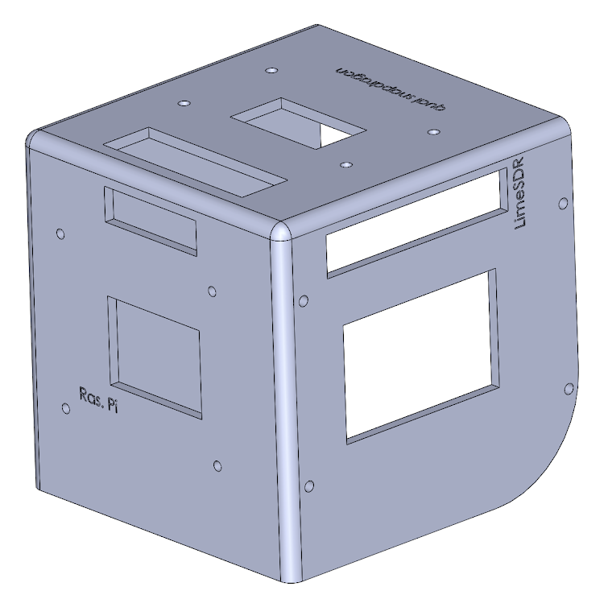
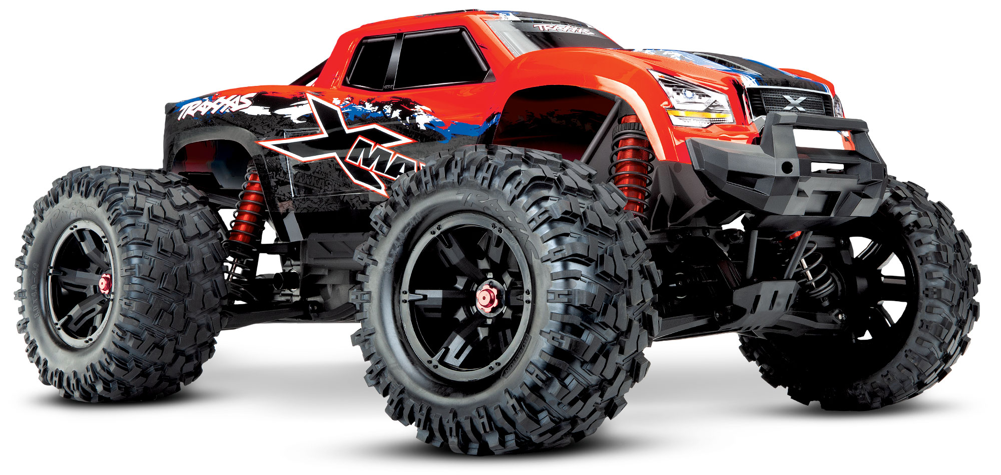

Concept of Operations
Data Path
Bent Pipe
Localization
CubeSat Test Platforms
Ground Asset
Mission Control

Slide 9
CubeSat Test Platform Block Diagram
6U Aluminum Structure
USB 3.0
Omni Antenna (TX)
Surface Asset & Ground Station
Raspberry Pi
LimeSDR
5 V
Omni Antenna (RX)
5 V
Boost Converter
ModalAI VOXL
Camera
Data
Power
5 V
3.7 V
Li-Ion Battery

Slide 10
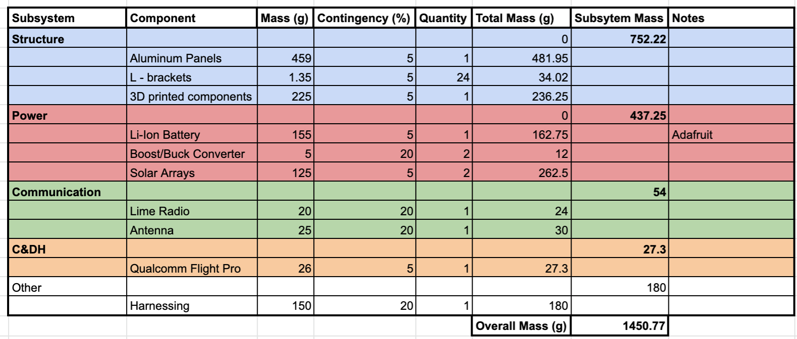
CubeSat Test Platform Mass Budget

Slide 11
Testing Goals and Results
Goal | Priority Level | Accomplished (Y/N)
Send telemetry from rover through a CubeSat test platform to Ground Station using bent-pipe | I | Y
Send video from rover to Ground Station | II | Y
Ranging | III | N
Trilateration | I | Y
Semi-Autonomous Surface Asset Navigation | I | Y
Simulating Regolith Collection | I | Y
Crater imaging | II | Y
Terrain relative navigation | III | N

Slide 12
Structures
Overview
Provides a housing for all of the electrical components
Can be attached to a tethered balloon
Based off of last year’s 6U structure, with modifications for this year’s hardware
One primary platform to be built and iterated on, with two Engineering Development Units to work with the CubeSat platform

