Slide 1
Spacecraft Charging as an Asset to Interplanetary Small Spacecraft
Interplanetary Small Satellite Conference
Presentation D.4
Sean A. Q. Young, Nicolas Lee, & Sigrid Close
Stanford University, Department of Aeronautics and Astronautics
May 4th, 2021

Slide 2
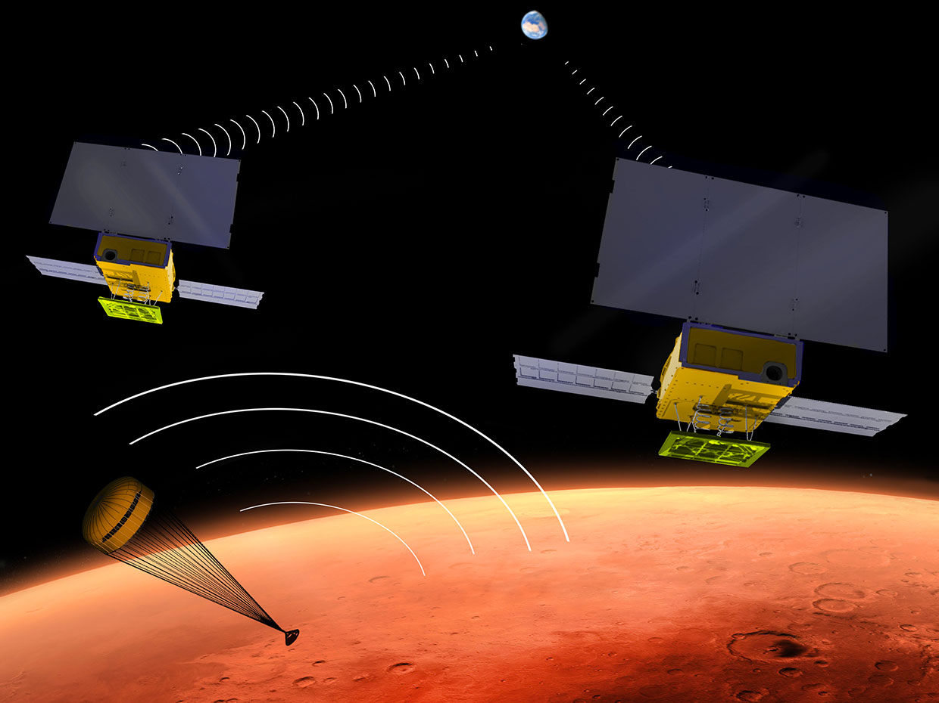
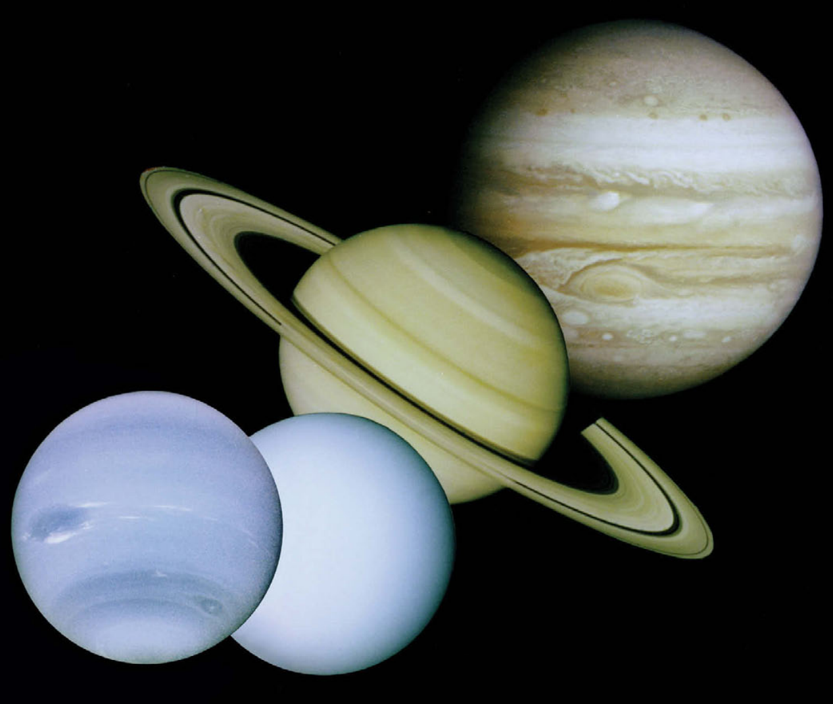
Motivation – Small Satellites in Deep Space
  Nanosatellites as client spacecraft to large spacecraft
    Telemetry relays (MarCO)
    Distributed sensing of outer planetary magnetospheres (proposed)
  Spacecraft are power starved in the outer solar system
    Large solar array required
    RTGs not powerful relative to size/mass
  Can we harness the space environment for spacecraft operations to enable new missions?
Image Credit: NASA
“The Giant Planets: Local Laboratories and Ground Truth for Planets Beyond,” Vision and Voyages for Planetary Science in the Decade 2013-2022, National Academy of Sciences, 2013, pp. 175–216.
Notes:
CubeSats and small satellites have proven their ability to aid in deep space exploration and enable new capabilities.
MarCO provided a data relay from the InSight lander back to operators on Earth.
Missions designed to explore the gas giant magnetospheres would benefit from a Cluster-like architecture
Cluster and similar missions took multipoint measurements earth's magnetosphere and yielded valuable information about its fine structure.
Replicating this mission in the outer solar system using similarly sized spacecraft would be cost prohibitive.
However using CubeSats as free flying sensors alongside a larger spacecraft might be feasible.
Traditional sources of power can provide only small amounts of power to CubeSats in the outer solar system
Solar cells are not very effective in the outer solar system due to the extreme distance from the sun and the large mass of the solar arrays required to generate usable power.
The low power density of RTG's makes them unsuitable for use on CubeSats
Can we do better by harnessing the space environment?

Slide 3
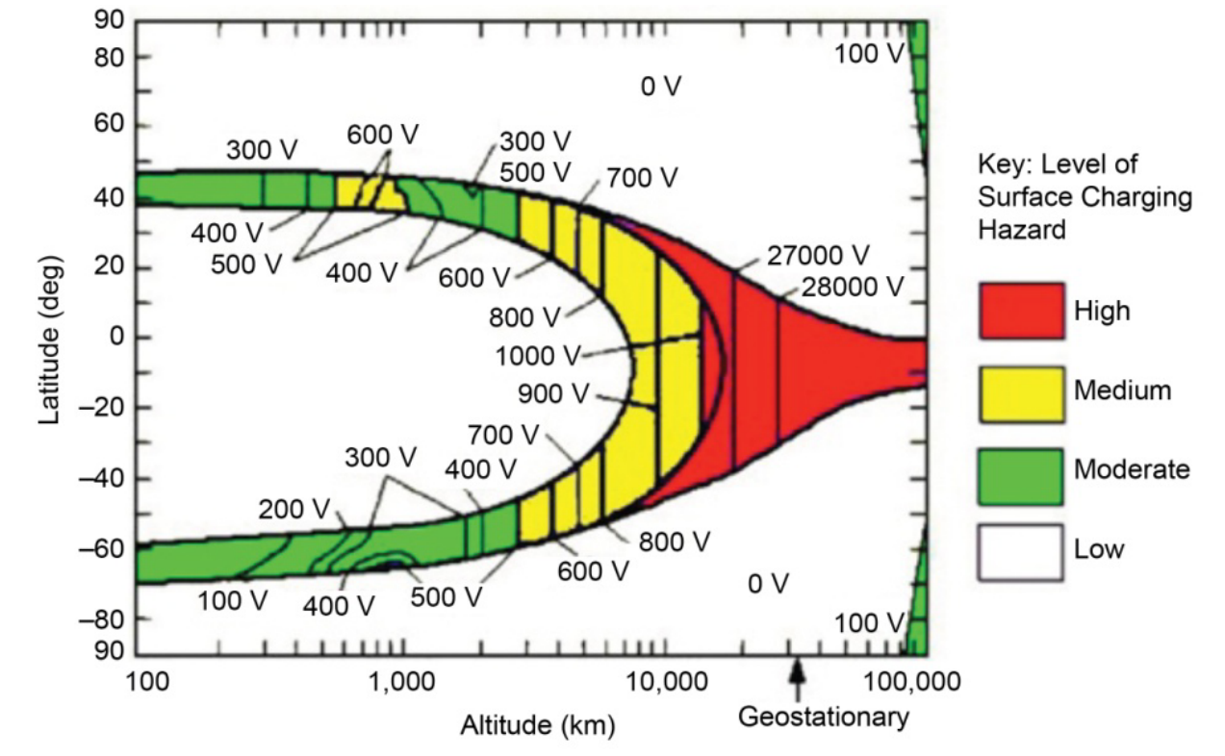
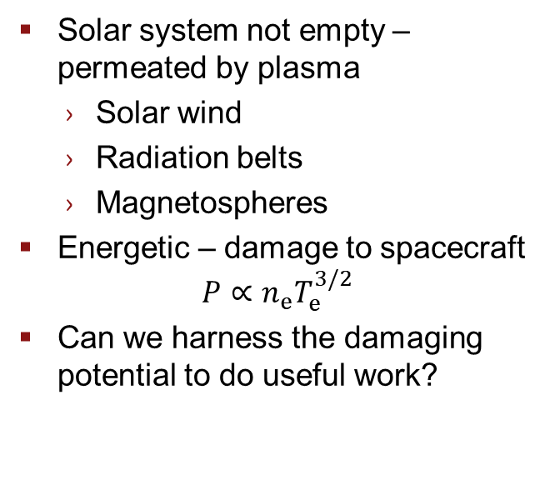
Space Plasmas
  Solar system not empty – permeated by plasma
    Solar wind
    Radiation belts
    Magnetospheres
  Energetic – damage to spacecraft
  $$P∝n_{e}T_{e}^{3/2}$$
  Can we harness the damaging potential to do useful work?
Hazards from Space Plasmas
Garrett, H.B., Whittlesey, A.C., “Guide to Mitigating Spacecraft Charging Effects,” JPL Space Science and Technology Series, pp .2, 2012, https://descanso.jpl.nasa.gov/SciTechBook/st_series3_chapter.html
Notes:
Energy sources in the space environment - excluding the sun - include space plasmas and hypervelocity impacts. Space plasmas are ubiquitous in the solar system and consist of charged particles from the sun and active satellites. The Jovian magnetosphere, shown on the left, contains some of the hottest, densest plasma in the solar system. Hypervelocity impacts occur when the relative speed between the spacecraft and objects like orbital debris, dust, or micrometeoroids is larger than the material speed of sound. For nanogram to microgram sized particles, the impact energy ranges from 10 mJ to 10 J. The video on the right is high speed footage from an aluminum impactor on tungsten, showing the formation of an impact plasma.
If not getting energy from PV/RTGs, need an alternative source
Sources of energy we considered are space plasmas and hypervelocity impacts
Space plasmas are ubiquitous in space and contain energetic charged particles from the sun and active satellites
For instance the Io plasma torus, pictured left in Jovian magnetosphere, contains some of the densest, hottest plasma in the solar system apart from the sun
Hypervelocity impacts of dust particles (shown on the right, from recent experiment at AVGR)
Not talking about large (> mg) particles
Have between 10 mJ to 10 J kinetic energy for particles between ng and ug
These impacts create a hot plasma that expands and emits an EMP; also affects the charging state of the spacecraft
The space environment holds a good deal of energy in space plasmas, magnetic fields, and dust/micrometeoroid environments
If we can determine a method for harvesting this energy, we might be able to more efficiently sample the outer planetary space environment

Slide 4
Proposed Space Plasma Applications
Direct Harvesting
ACS Actuator
Langmuir Probe

Slide 5
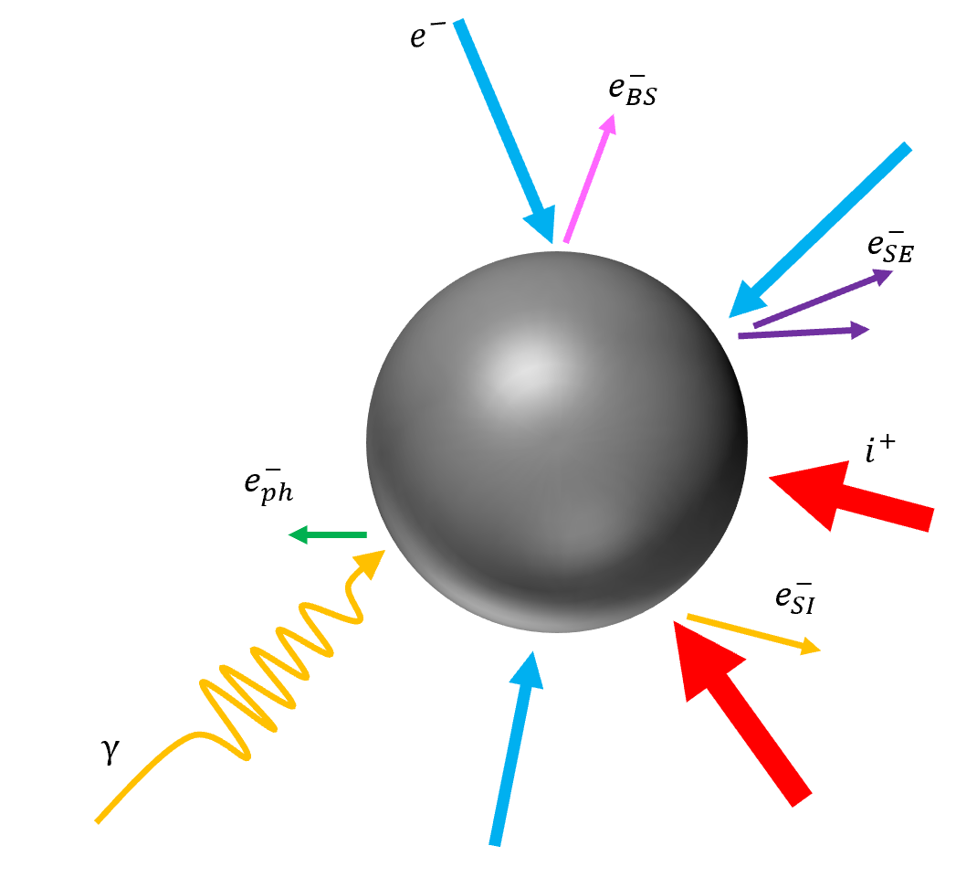
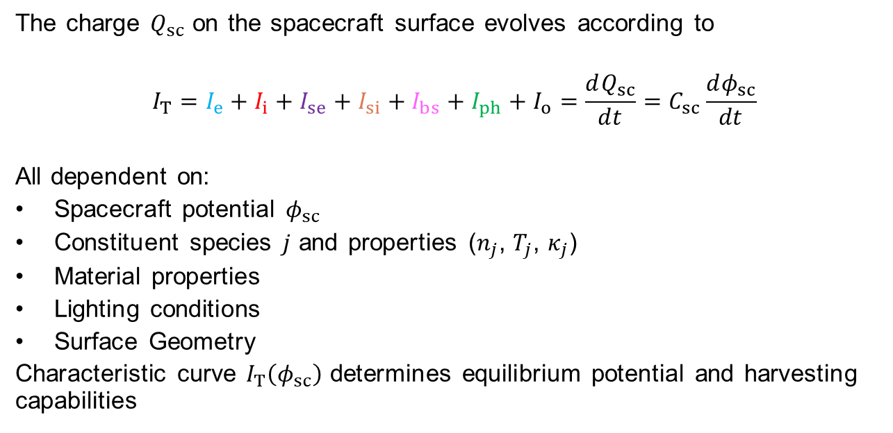
Spacecraft Charging – Overview
The charge $Q_{sc}$ on the spacecraft surface evolves according to
$$I_{T}=I_{e}+I_{i}+I_{se}+I_{si}+I_{bs}+I_{ph}+I_{o}=\frac{dQ_{sc}}{dt}=C_{sc}\frac{dφ_{sc}}{dt}$$
All dependent on:
Spacecraft potential $φ_{sc}$
Constituent species $j$ and properties ($n_{j}$, $T_{j}$, $κ_{j}$)
Material properties
Lighting conditions
Surface Geometry
Characteristic curve $I_{T}\left(φ_{sc}\right)$ determines equilibrium potential and harvesting capabilities
Backscattered electron current
Ion current
Other current
Electron current
Secondary electron current
Photoelectron current
Notes:
Objects in contact with a plasma build up a charge (potential) relative to that plasma. To first order, these surfaces charge negatively. Electrons are far less massive than ions and so the flux of electrons will outpace the flux of ions. Surface physics modifies this reasoning slightly, as incoming electrons, ions, and photons can eject electrons from the surface or be elastically scattered, decreasing the net electron current.
All these effects are functions of the spacecraft potential. This can be viewed as a current balance problem, where the sum of all currents is related to the rate of change of the potential. Usually, the background plasma changes far more slowly than the charge state, and so we typically solve for the equilibrium floating potential.
Quick review:
Spacecraft acts as a capacitor with the potential reflecting the charge stored
Charge arrives/leaves the surface due to a few different mechanisms
(walk through each term)
Each term is a function of material and plasma properties
Build up a functional form for the characteristic curve, which determines how the surface charges and how much power can be harvested.

Slide 6
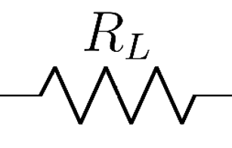







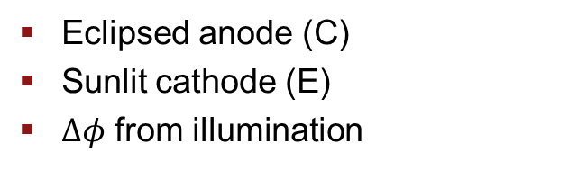


Spacecraft Charging – Prior Work on Energy Harvesting
Field Effect Emitter
Photoemission
  Spacecraft Chassis as electron collector (C)
  Field effect electron emitter (E)
  Eclipsed anode (C)
  Sunlit cathode (E)
  $Δφ$ from illumination
$$e^{−}$$
$$I_{e}$$
$$e^{−}$$
(E)
(C)
$$e^{−}$$
$$i^{+}$$
$$I_{c}$$
$$i^{+}$$
$$e^{−}$$
(E)
$$γ$$
$$φ>0$$
$$φ<0$$
(C)
$$I_{L}$$
Grard, R. J. L., “The magnetospheric plasma as a source of energy for space instrumentation,” Planetary and Space Science, Vol. 25, No. 7, 1977, pp. 615–620. https://doi.org/10.1016/0032-0633(77)90100-3.
Gale, W., “Spacecraft Charge as a Source of Electrical Power for Spacecraft,” Masters Thesis, Air Force Institute of
Technology, 1988. https://doi.org/10.1063/1.460797.
Both rely on differences in $I_{T}\left(φ\right)$
Notes:
Two methods for harvesting from spacecraft charging have been explored.
(Left) one involved using the spacecraft as an electron collector
Circuit completed by using a passive electron emitter, such as a field effect emitter
(right) another relied on illumination of half of the spacecraft.
Sunlit side acted as a cathode, eclipsed as an anode
Connected load allowed current to flow
Both approaches generated current through a load by relying on differences in how each surface charged.

Slide 7
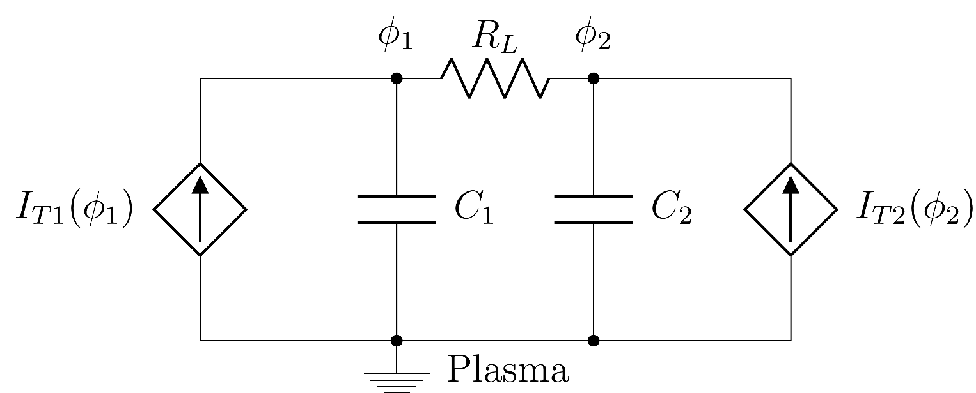
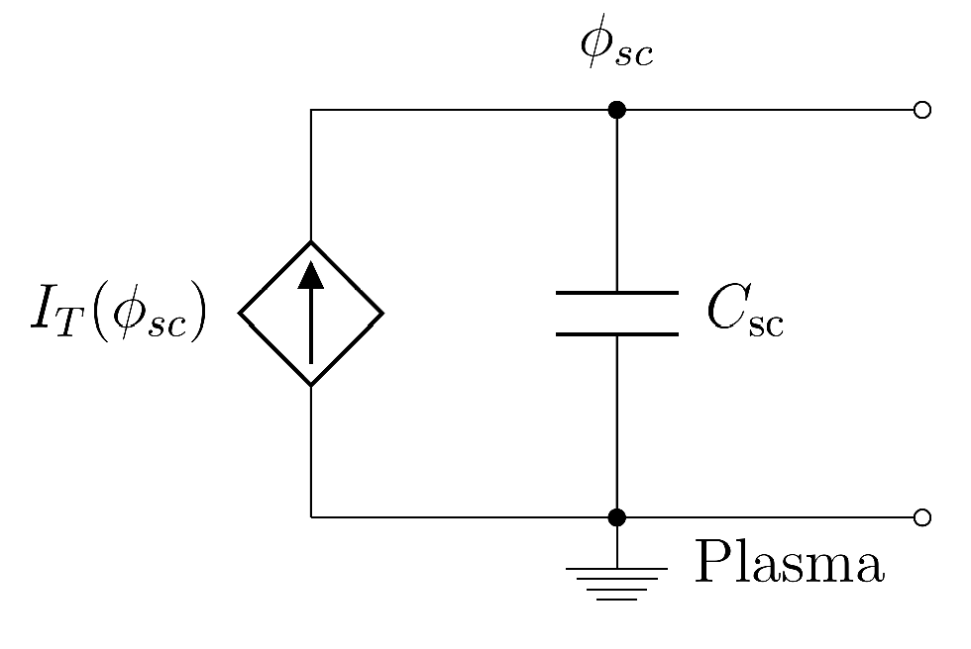
Spacecraft Charging – Equivalent Circuit Model
Spacecraft Body
(Eclipsed)
Spacecraft Body (Sunlit)
or Electron Emitter
Notes:
To illustrate this, think of the spacecraft in its equivalent circuit representation.
Plasma represented as a voltage-controlled current source, surface as a capacitor
Can connect two surfaces that charge differently with a load and harvest power. The form of the voltage-controlled current source depends on the geometry, illumination, and surface material. In Grard’s case, the electron emitter provides a particular for of I(V). In Gale’s case, the photoemission is the difference between I1 and I2.

Slide 8
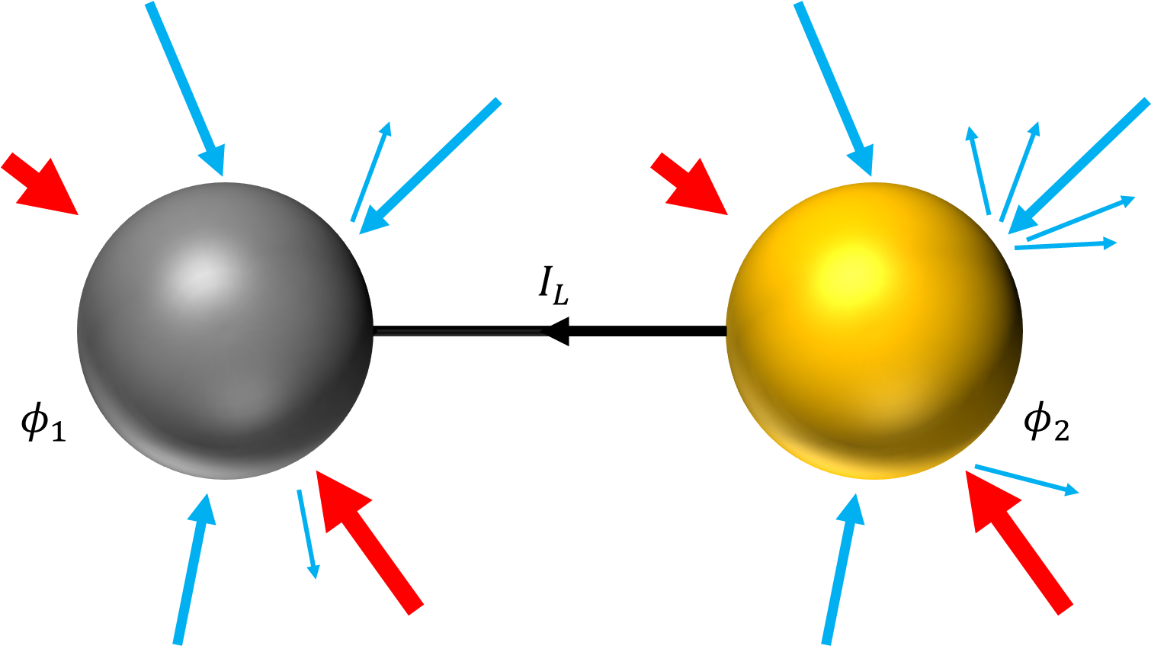
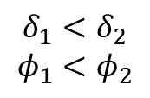


Implementation – Exploit Material Properties
$$δ_{1}$$
$$δ_{2}$$
Anode
Cathode
$$δ_{1}<δ_{2}$$
$$φ_{1}<φ_{2}$$
Notes:
Our approach follows the previous ones, but exploits material properties that don’t depend on the lighting conditions
Secondary electron emission depends only on the material properties and plasma temperature
Different materials charge to different levels for the same plasma temp
Can use this information to choose anode and cathode materials
Toy model of how a spacecraft using this technology might look

Slide 9
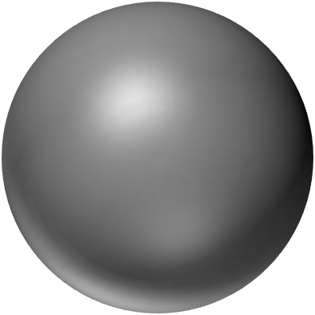
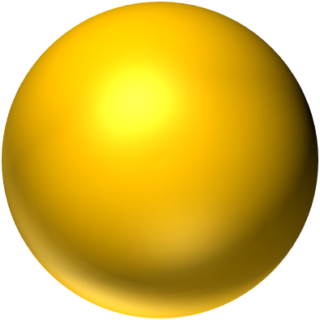
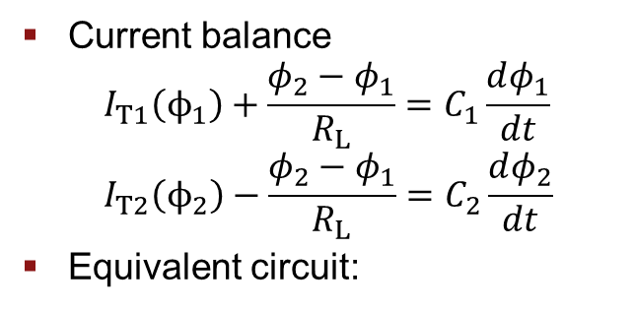
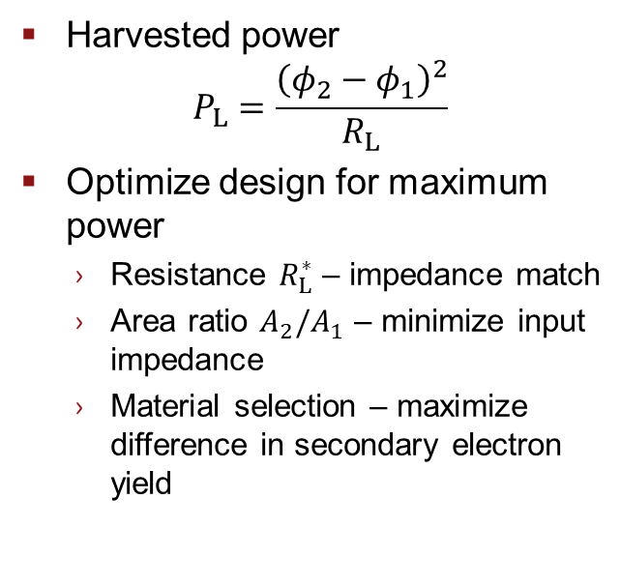
Implementation – Exploit Material Properties
  Current balance
  $$I_{T1}\left(ϕ_{1}\right)+\frac{φ_{2}−φ_{1}}{R_{L}}=C_{1}\frac{dφ_{1}}{dt} \\ I_{T2}\left(ϕ_{2}\right)−\frac{φ_{2}−φ_{1}}{R_{L}}=C_{2}\frac{dφ_{2}}{dt}$$
  Equivalent circuit:
  Harvested power
  $P_{L}=\frac{{\left(φ_{2}−φ_{1}\right)}^{2}}{R_{L}}$
  Optimize design for maximum power
    Resistance $R_{L}^{∗}$ – impedance match
    Area ratio $A_{2}/A_{1}$ – minimize input impedance
    Material selection – maximize difference in secondary electron yield
Notes:
As before, this is a current balance problem. Model spacecraft as simple circuit shown in lower right and solve the circuit equations in steady state.
Again, we have an optimum load in the form of an impedance match, but to both current sources.
Finite cathode introduces another design variable in the form of the anode area fraction or, equivalently, the anode-to-cathode area ratio. Minimizes the overall input impedance
Can compute the optimum power given the optimum impedance and area relationship.

Slide 10
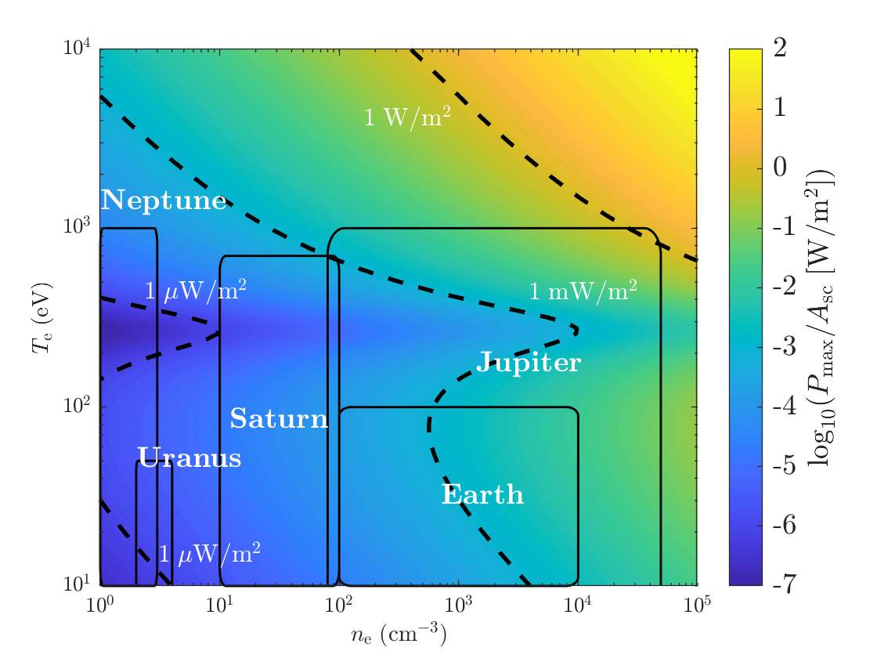
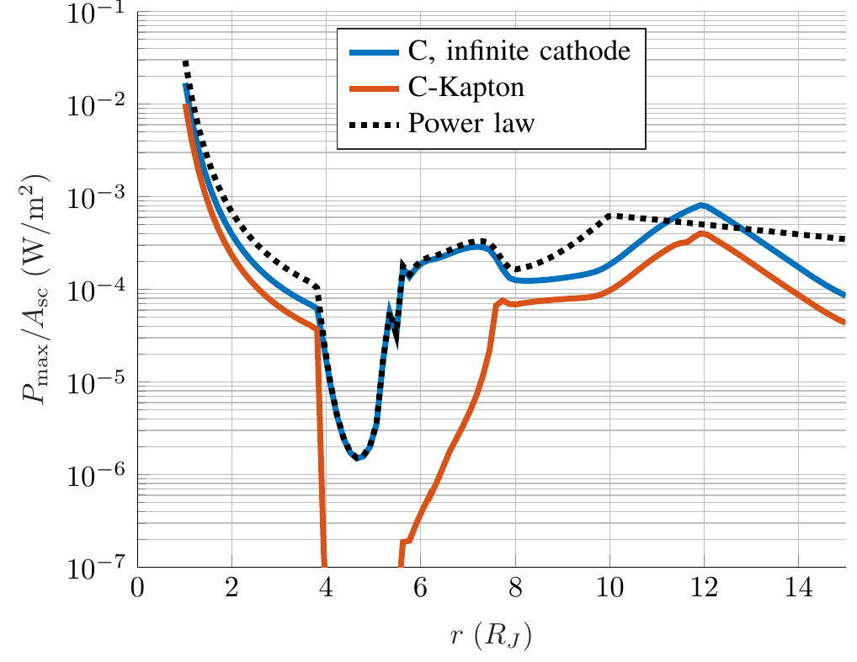
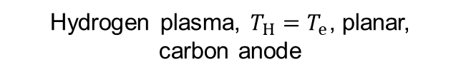
Harvesting in Relevant Space Environments
Io
Europa
Hydrogen plasma, $T_{H}=T_{e}$, planar, carbon anode
Plasma from Divine-Garrett model, planar anode

Slide 11
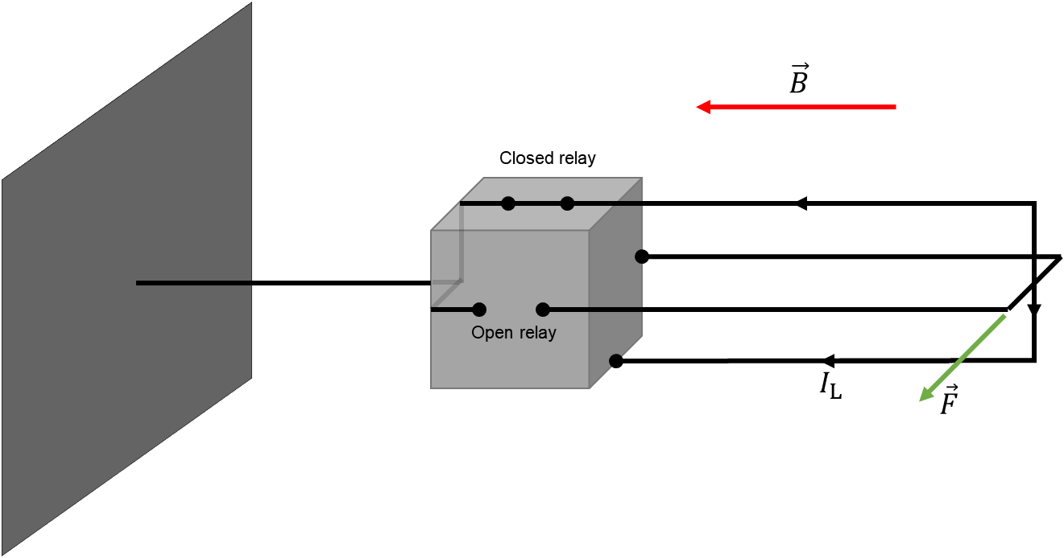
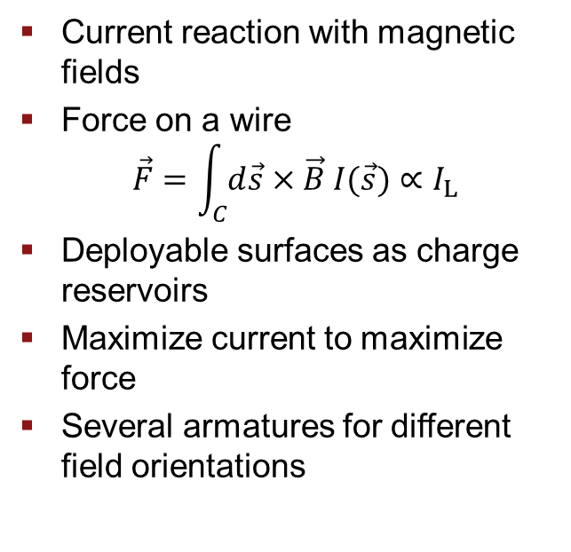

Attitude Control System (ACS) Actuator
  Current reaction with magnetic fields
  Force on a wire
  $\vec{F}=\int_{C}{d\vec{s}×\vec{B} I(\vec{s})}∝I_{L}$
  Deployable surfaces as charge reservoirs
  Maximize current to maximize force
  Several armatures for different field orientations
$e^{−}$ collector (Anode)
s/c body
(Cathode)
Reaction armature
(Current path)
Example actuator geometry

Slide 12
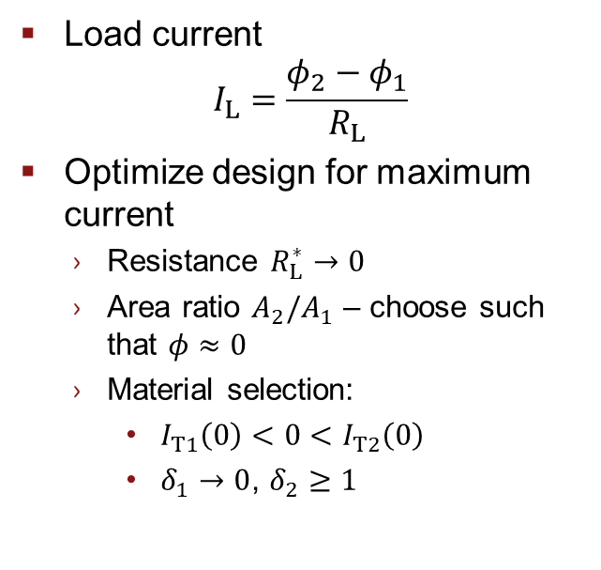
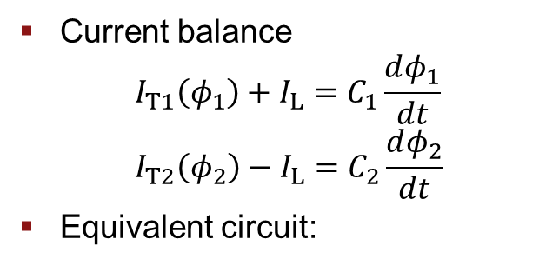
ACS Actuator Implementation
  Current balance
  $$I_{T1}\left(φ_{1}\right)+I_{L}=C_{1}\frac{dφ_{1}}{dt} \\ I_{T2}\left(φ_{2}\right)−I_{L}=C_{2}\frac{dφ_{2}}{dt}$$
  Equivalent circuit:
  Load current
  $I_{L}=\frac{φ_{2}−φ_{1}}{R_{L}}$
  Optimize design for maximum current
    Resistance $R_{L}^{∗}→0$
    Area ratio $A_{2}/A_{1}$ – choose such that $φ≈0$
    Material selection:
      $I_{T1}\left(0\right)<0<I_{T2}\left(0\right)$
      $δ_{1}→0$, $δ_{2}≥1$
Notes:
As before, this is a current balance problem. Model spacecraft as simple circuit shown in lower right and solve the circuit equations in steady state.
Again, we have an optimum load in the form of an impedance match, but to both current sources.
Finite cathode introduces another design variable in the form of the anode area fraction or, equivalently, the anode-to-cathode area ratio. Minimizes the overall input impedance
Can compute the optimum power given the optimum impedance and area relationship.

Slide 13
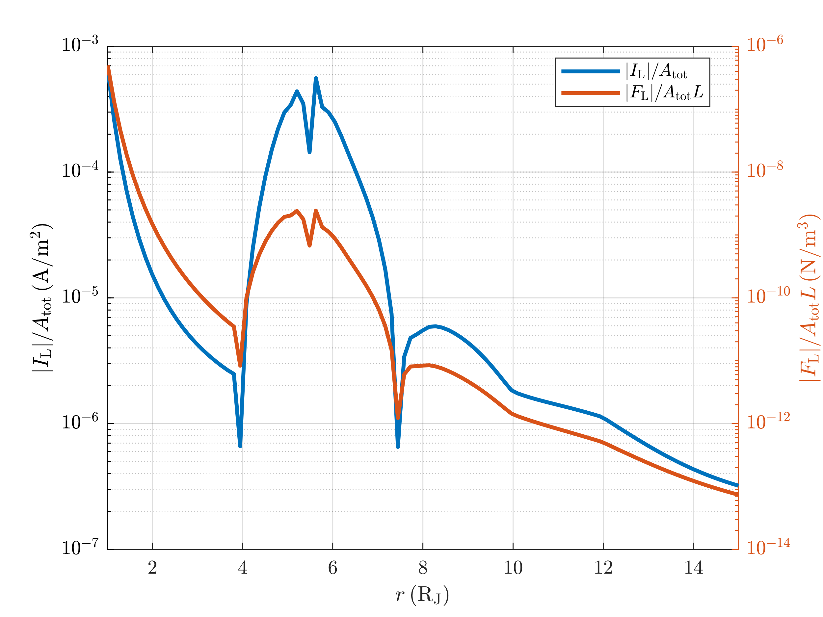

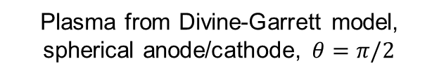
ACS Actuator Results
  Currents significant in Inner magnetosphere, Io torus
  Force is small
    Large moment arm
    Passive station keeping
  Transient currents are larger, more useful
  Future work: stability, control requirements
Plasma from Divine-Garrett model, spherical anode/cathode, $θ=π/2$
$$L$$

Slide 14
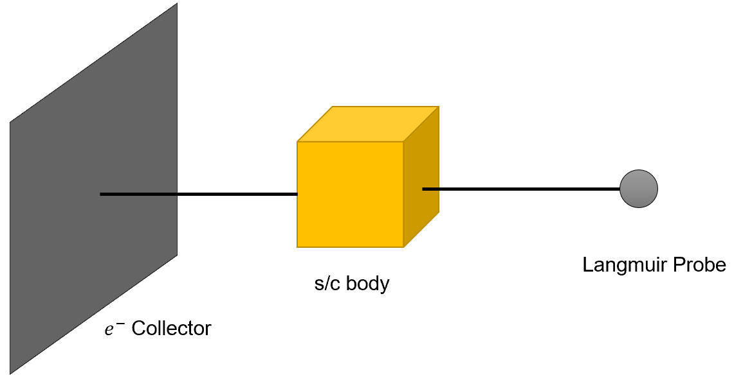
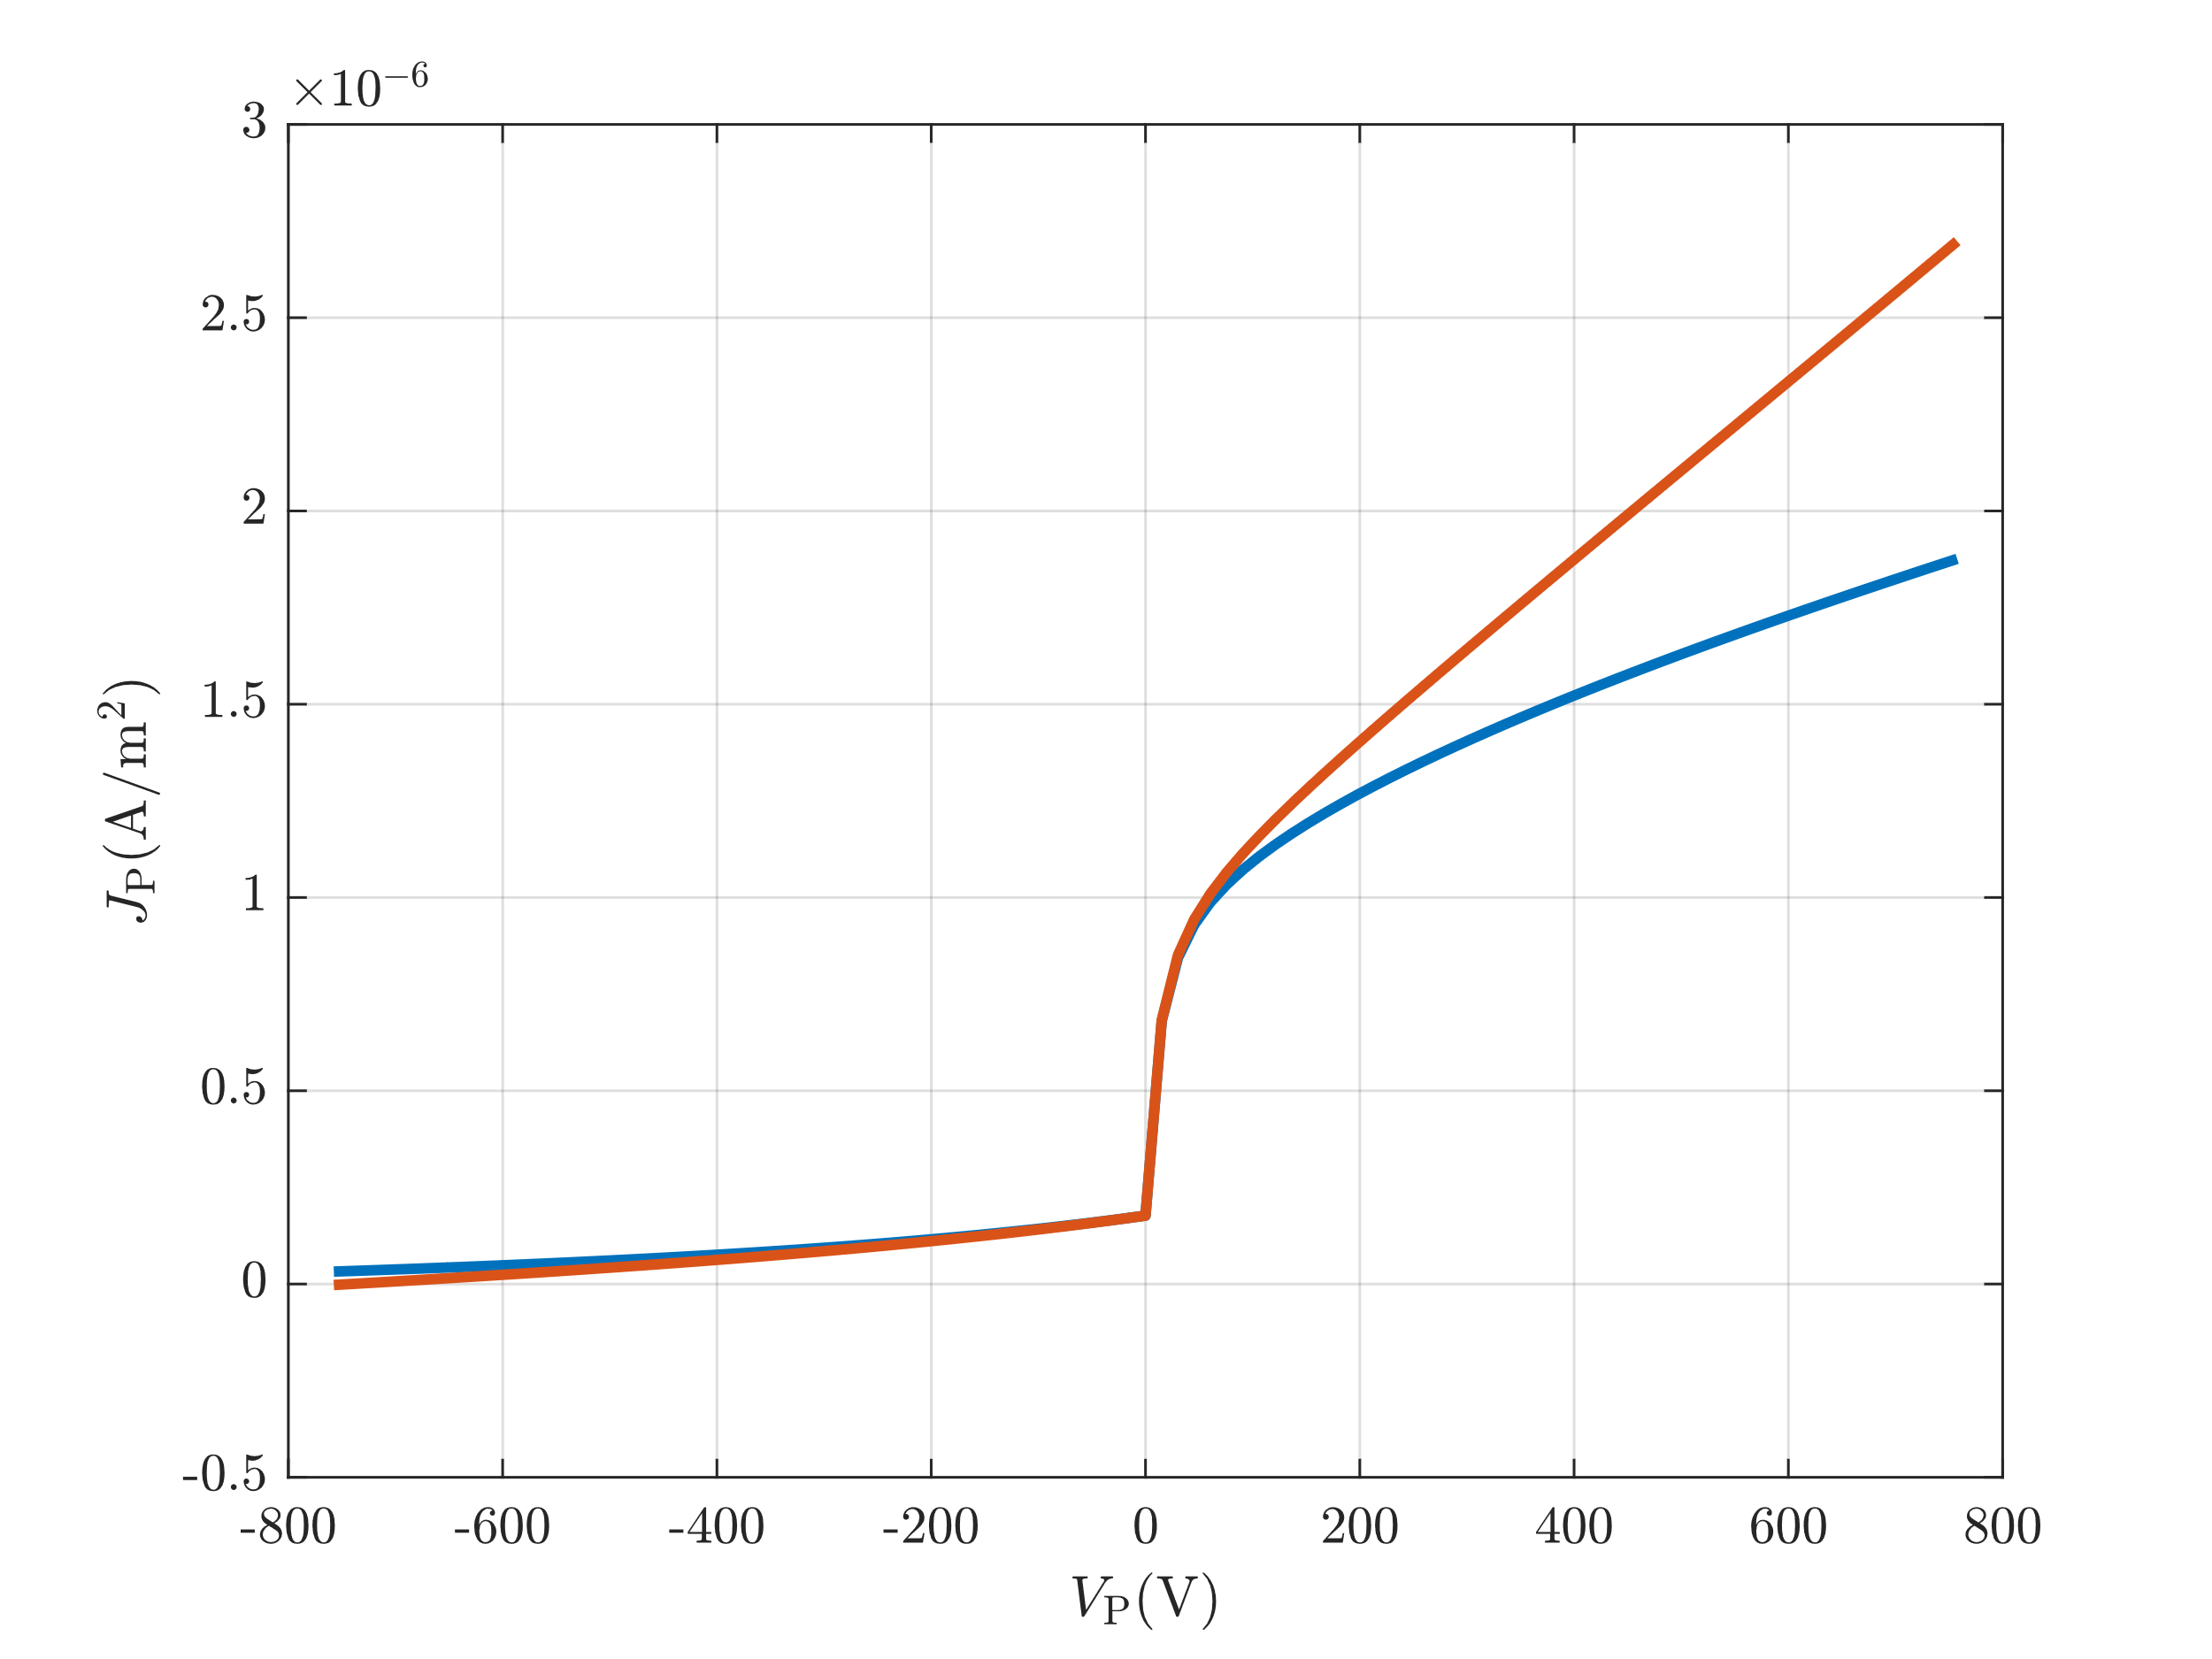
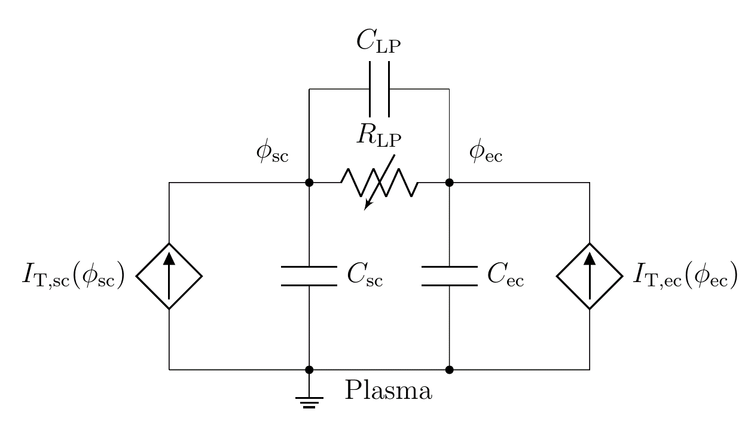
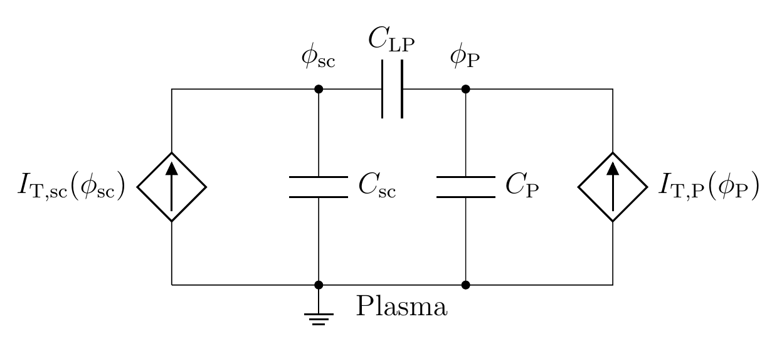

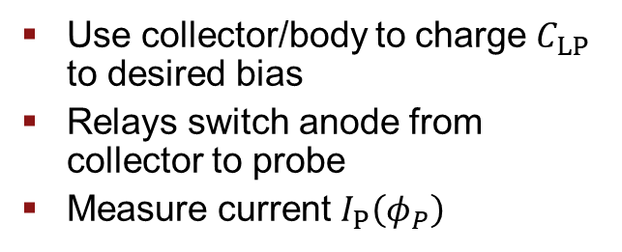


Plasma Powered Langmuir Probe
$$sc$$
  Use collector/body to charge $C_{LP}$ to desired bias
  Relays switch anode from collector to probe
  Measure current $I_{P}\left(φ_{P}\right)$
$$ec$$
$$P$$
Spherical probe
Cylindrical probe
Charge stage
Discharge stage
Notes:
Optimize design for maximum $\left|φ_{2}−φ_{1}\right|$

Slide 15
Conclusions
Direct Harvesting
ACS Actuation
Langmuir Probe
  Space plasmas contain energy that can be useful for the spacecraft
  Three ways to harness
    Direct energy harvesting – usable of power at Jupiter
    Attitude control – can react against magnetic field, use for passive station keeping
    Plasma sensor – capacitor charged with plasma to make plasma measurements

Slide 16
Questions?
Contact: saqyoung@stanford.edu
https://sess.stanford.edu
This work was supported by a NASA Space Technology Research Fellowship
(NASA Grant 80NSSC18K1152)

Slide 17
Backup
17

Slide 18
Motivation (cont.)
  Lab Mission: use the space environment for the benefit of the spacecraft.
    Enable new missions, new space science
  Approaches:
    Hypervelocity impacts
      to probe asteroid composition (MIDEA, NIAC 2018)
    Space plasmas
      Spacecraft power through spacecraft charging
      Novel actuation/sensing

Slide 19
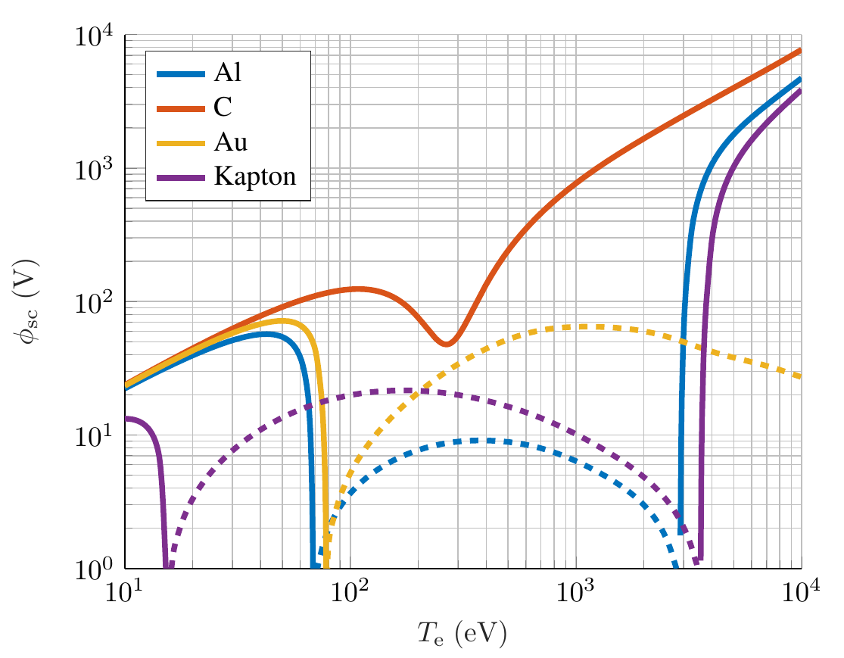
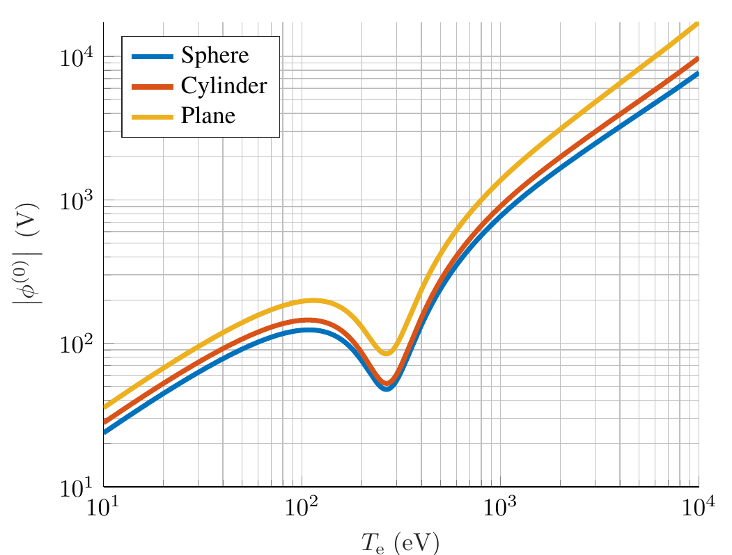

Implementation – Broken Symmetries
  Many options, including
    Passive electron emitter
    Photoemission
    Geometry
    Secondary electron emission (SEE)
  Develop general theory for harvesting from two surfaces
  Choose SEE in particular
Solid Curves $φ<0$
Dashed Curves $φ>0$

Slide 20
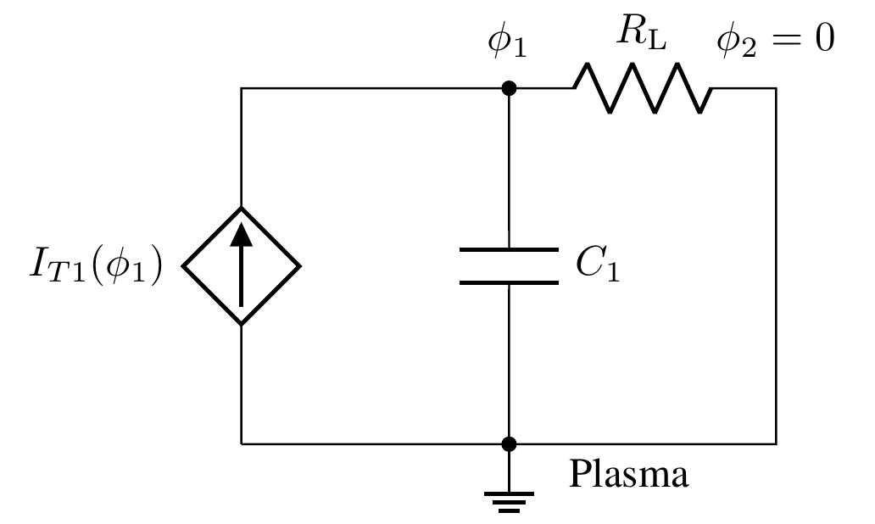
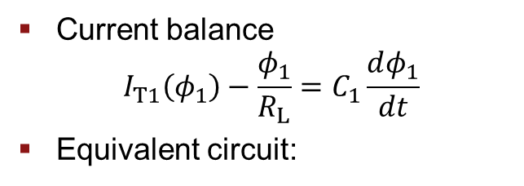
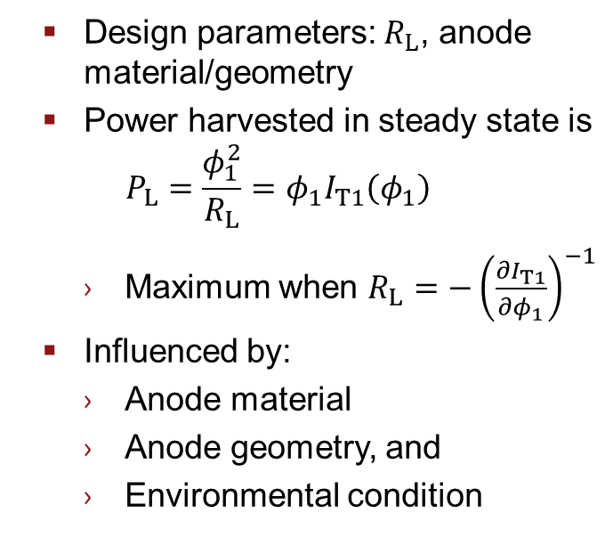
Implementation – Fixed Cathode
  Current balance
  $$I_{T1}\left(φ_{1}\right)−\frac{φ_{1}}{R_{L}}=C_{1}\frac{dφ_{1}}{dt}$$
  Equivalent circuit:
  Design parameters: $R_{L}$, anode material/geometry
  Power harvested in steady state is
  $P_{L}=\frac{φ_{1}^{2}}{R_{L}}=φ_{1}I_{T1}\left(φ_{1}\right)$
    Maximum when $R_{L}=−{\left(\frac{∂I_{T1}}{∂φ_{1}}\right)}^{−1}$
  Influenced by:
    Anode material
    Anode geometry, and
    Environmental condition
Notes:
Get a feel for the maximum power available to be harvested from a given environment
Assume that the spacecraft has a perfect path to ground. Think of as attaching a load resistor between the node at the anode surface and ground.
Load resistance is free to be chosen. Power is zero when $R_{L}$ is at extremes (0 and infinity). There exists an optimum value in between.
Using the charging equations, can show that this is related to the slope of the I-V characteristic. Can think of this as an impedance match between the load and the ambient plasma.
The I-V characteristic and optimum resistance depend on the surface material, geometry, and environmental conditions. Can compute the optimum power while varying these quantities.
Can compute using charging codes like NASCAP and SPIS. Easiest/fastest to implement an OML model

Slide 21
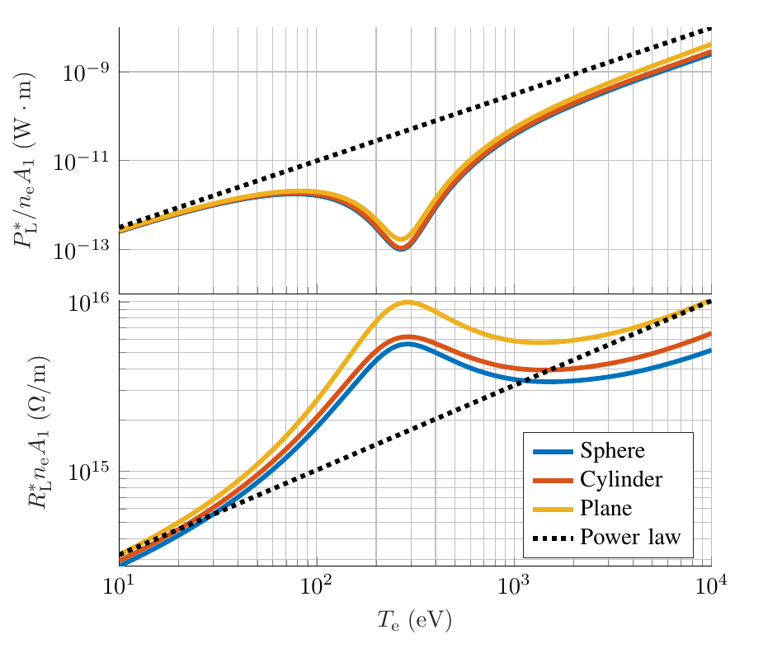
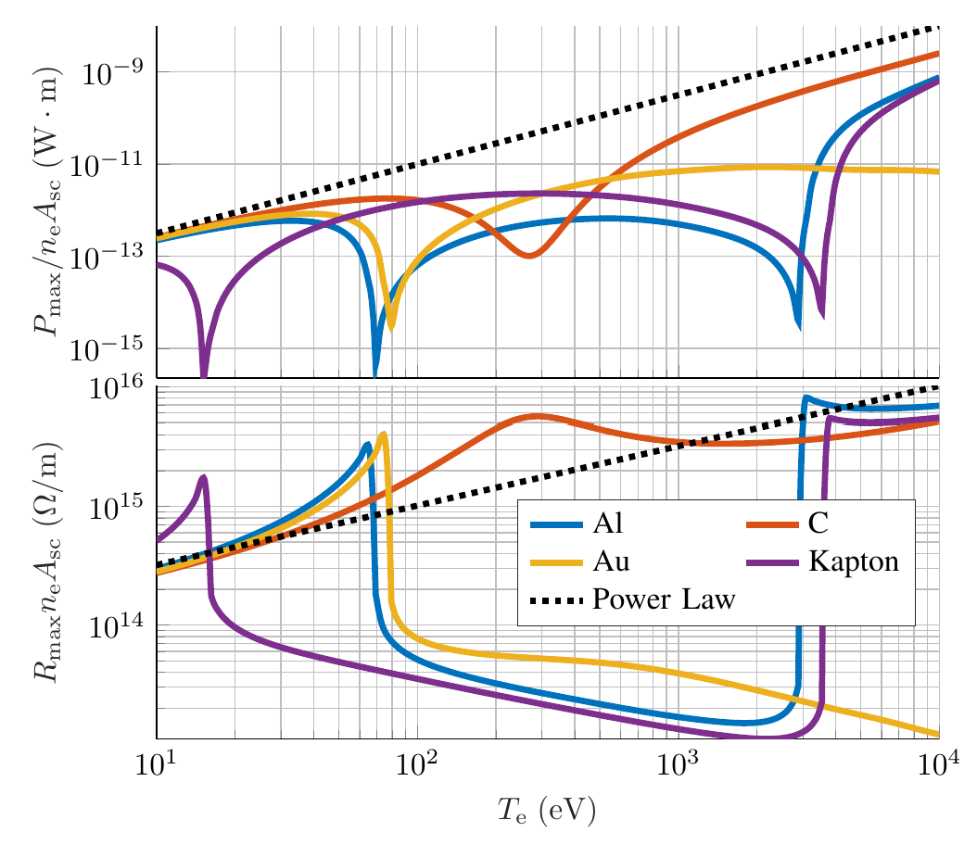
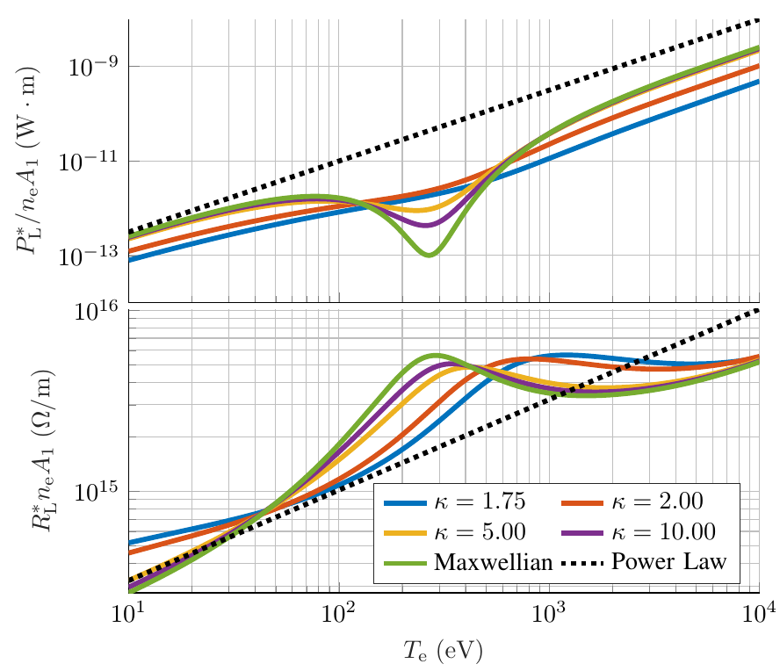
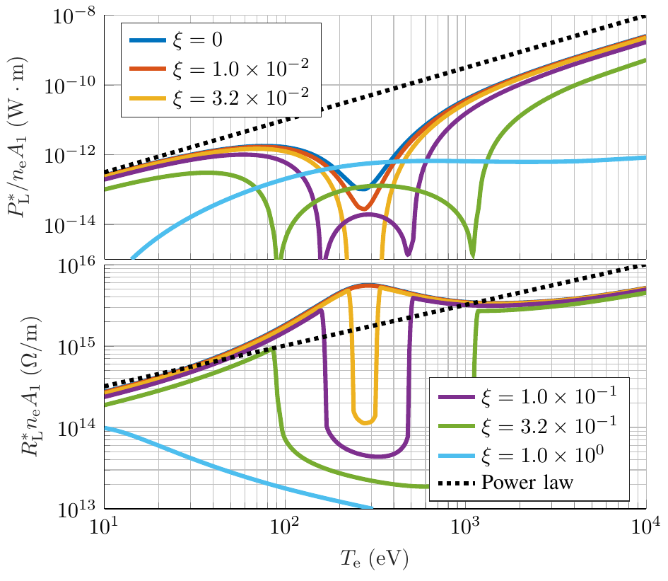
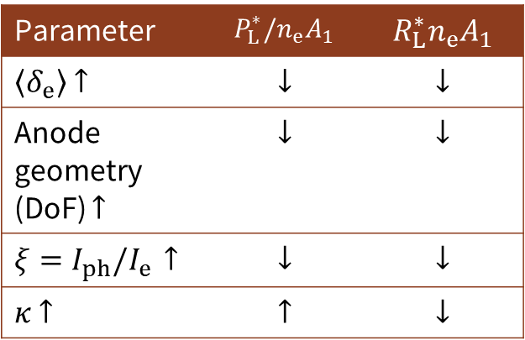
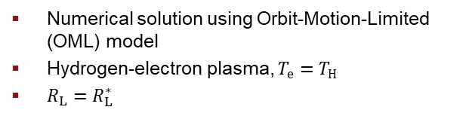
Optimal Power/Load Trends
Parameter | $$P_{L}^{∗}/n_{e}A_{1}$$ | $$R_{L}^{∗}n_{e}A_{1}$$
$\left\langle δ_{e}\right\rangle$ $↑$ | $$↓$$ | $$↓$$
Anode geometry (DoF) $↑$ | $$↓$$ | $$↓$$
$ξ=I_{ph}/I_{e}$ $↑$ | $$↓$$ | $$↓$$
$κ$ $↑$ | $$↑$$ | $$↓$$
  Numerical solution using Orbit-Motion-Limited (OML) model
  Hydrogen-electron plasma, $T_{e}=T_{H}$
  $R_{L}=R_{L}^{∗}$

Slide 22
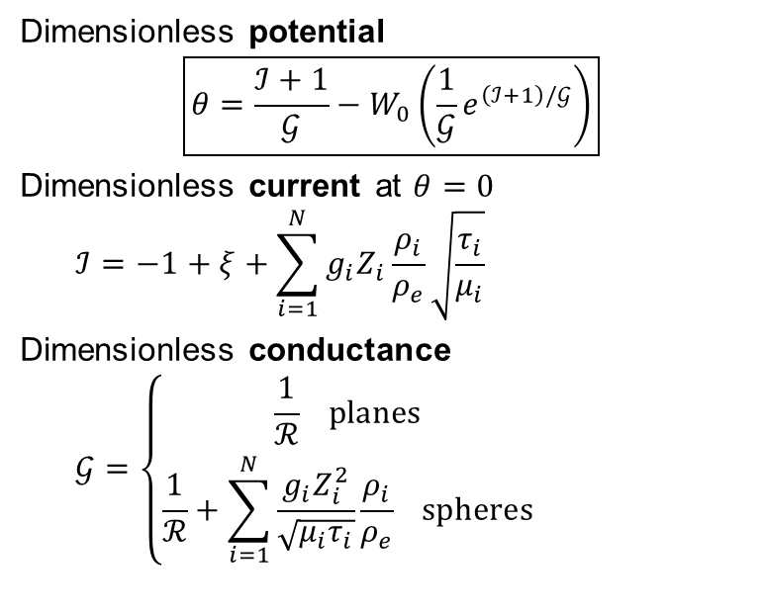

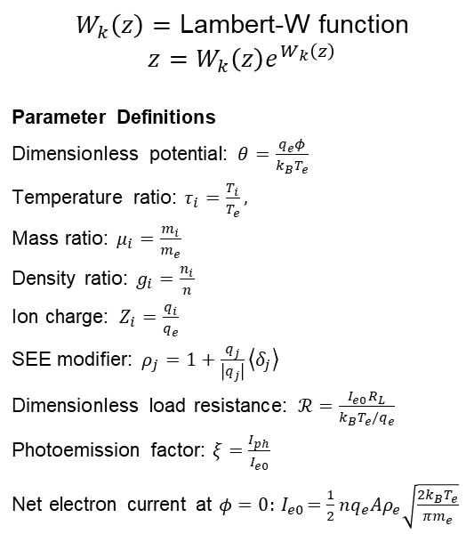
Analytic Expression – Potential
$W_{k}\left(z\right)=$ Lambert-W function
$$z=W_{k}\left(z\right)e^{W_{k}\left(z\right)}$$
Parameter Definitions
Dimensionless potential: $θ=\frac{q_{e}φ}{k_{B}T_{e}}$
Temperature ratio: $τ_{i}=\frac{T_{i}}{T_{e}},$
Mass ratio: $μ_{i}=\frac{m_{i}}{m_{e}}$
Density ratio: $g_{i}=\frac{n_{i}}{n}$
Ion charge: $Z_{i}=\frac{q_{i}}{q_{e}}$
SEE modifier: $ρ_{j}=1+\frac{q_{j}}{\left|q_{j}\right|}\left\langle δ_{j}\right\rangle$
Dimensionless load resistance: $ℛ=\frac{I_{e0}R_{L}}{k_{B}T_{e}/q_{e}}$
Photoemission factor: $ξ=\frac{I_{ph}}{I_{e0}}$
Net electron current at $φ=0:{ I}_{e0}=\frac{1}{2}nq_{e}Aρ_{e}\sqrt{\frac{2k_{B}T_{e}}{πm_{e}}}$
Dimensionless potential
$$\boxed{θ=\frac{ℐ+1}{𝒢}−W_{0}\left(\frac{1}{𝒢}e^{\left(ℐ+1\right)/𝒢}\right)}$$
Dimensionless current at $θ=0$
$$ℐ=−1+ξ+\sum_{i=1}^{N}{g_{i}Z_{i}\frac{ρ_{i}}{ρ_{e}}\sqrt{\frac{τ_{i}}{μ_{i}}}}$$
Dimensionless conductance
$$𝒢=\left\{\begin{aligned}\frac{1}{ℛ} planes \\ \frac{1}{ℛ}+\sum_{i=1}^{N}{\frac{g_{i}Z_{i}^{2}}{\sqrt{μ_{i}τ_{i}}}\frac{ρ_{i}}{ρ_{e}}} spheres\end{aligned}\right.$$
$$𝒢′$$
Notes:
Can manipulate the previous expression into the boxed expression on this page. The current and conductance are defined here
All the dimensionless parameters are defined on the right (and there’s a lot of them), but the important quantity is the dimensionless resistance. We can also note the effect of multiple ion species on the result by how each affects I and G.
The resulting equation is very accurate for most purposes, the major discrepancy coming from the dependance on $φ$ of the SEE due to ions. Hot electrons can also invalidate this if their current is too large. Need to alter the approximation in this case.

Slide 23
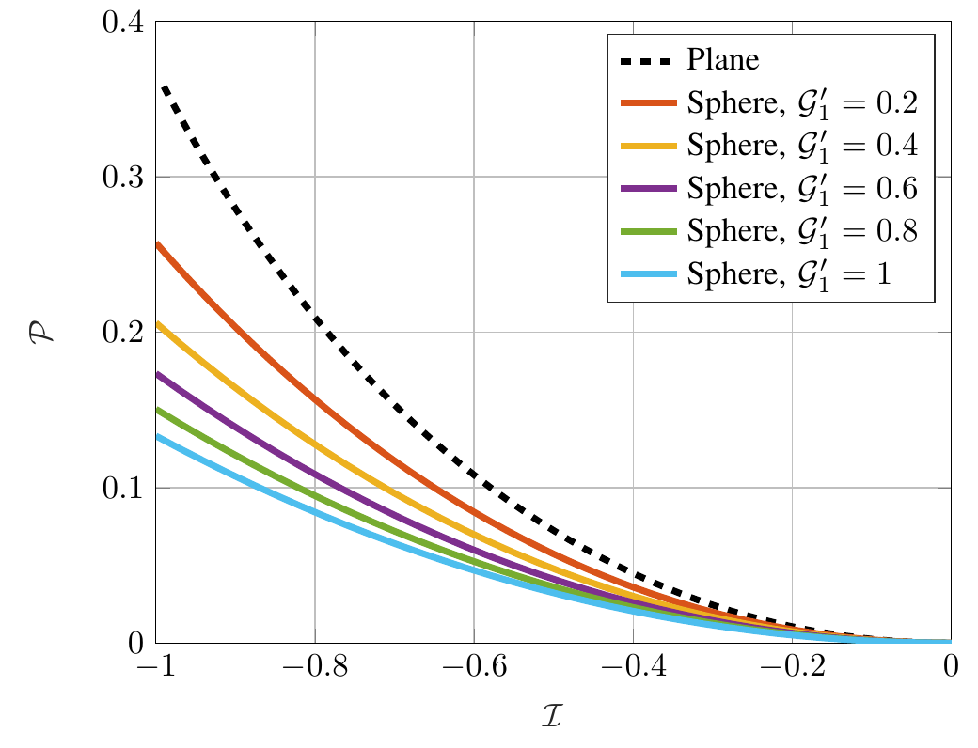
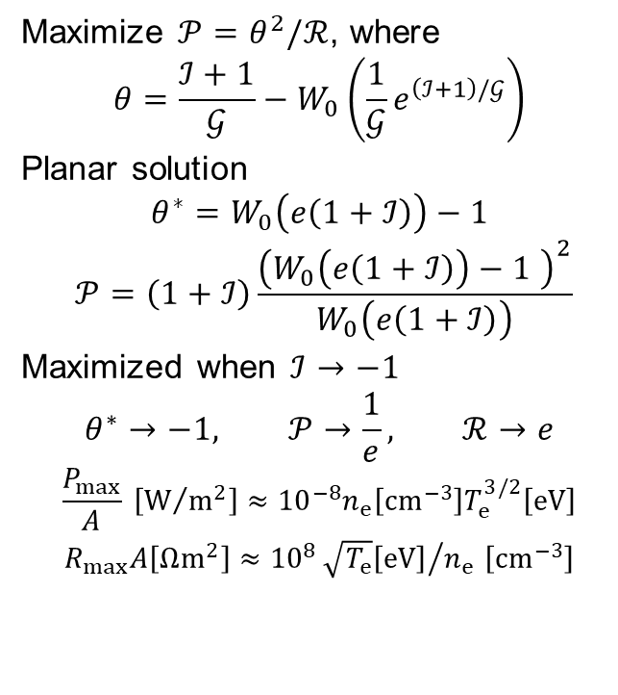
Analytic Expression – Optimum Power
Maximize $𝒫=θ^{2}/ℛ$, where
$$θ=\frac{ℐ+1}{𝒢}−W_{0}\left(\frac{1}{𝒢}e^{\left(ℐ+1\right)/𝒢}\right)$$
Planar solution
$$θ^{∗}=W_{0}\left(e\left(1+ℐ\right)\right)−1$$
$$𝒫=\left(1+ℐ\right)\frac{{\left(W_{0}\left(e\left(1+ℐ\right)\right)−1 \right)}^{2}}{W_{0}\left(e\left(1+ℐ\right)\right)}$$
Maximized when $ℐ→−1$
$$θ^{∗}→−1, 𝒫→\frac{1}{e}, ℛ→e$$
$$\frac{P_{max}}{A} \left[W/{m^{2}}\right]≈{10}^{−8}n_{e}\left[cm^{−3}\right]T_{e}^{3/2}\left[eV\right]$$
$R_{max}A\left[Ωm^{2}\right]≈{10}^{8}{\sqrt{T_{e}}\left[eV\right]}/{n_{e}}$ $\left[cm^{−3}\right]$
Dimensionless
Power
Dimensionless Current
Notes:
Can make use of this analytic expression to not only estimate the floating potential in most environments, but also to obtain an estimate of the optimized power.
A closed form can be obtained for planar surfaces, given here, and plotted on the right along with the spherical solutions. Planar surfaces charge to higher potentials and harvest more power.
Power approaches zero as I->0 (charges to zero potential). Power is maximized as I-> -1, corresponding to an ambient current of only electrons .Power laws representing the maximum power and estimate for optimum load resistance are the results.

Slide 24
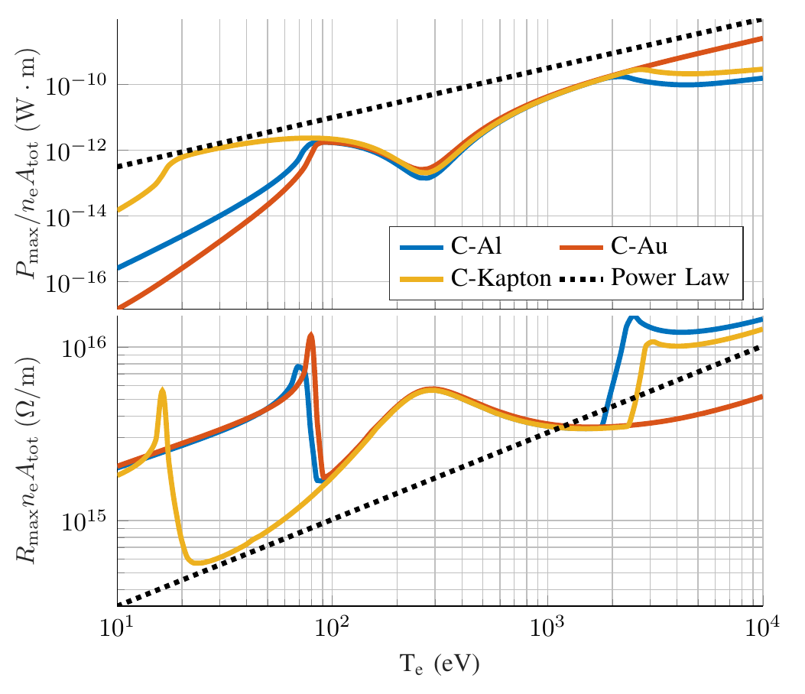
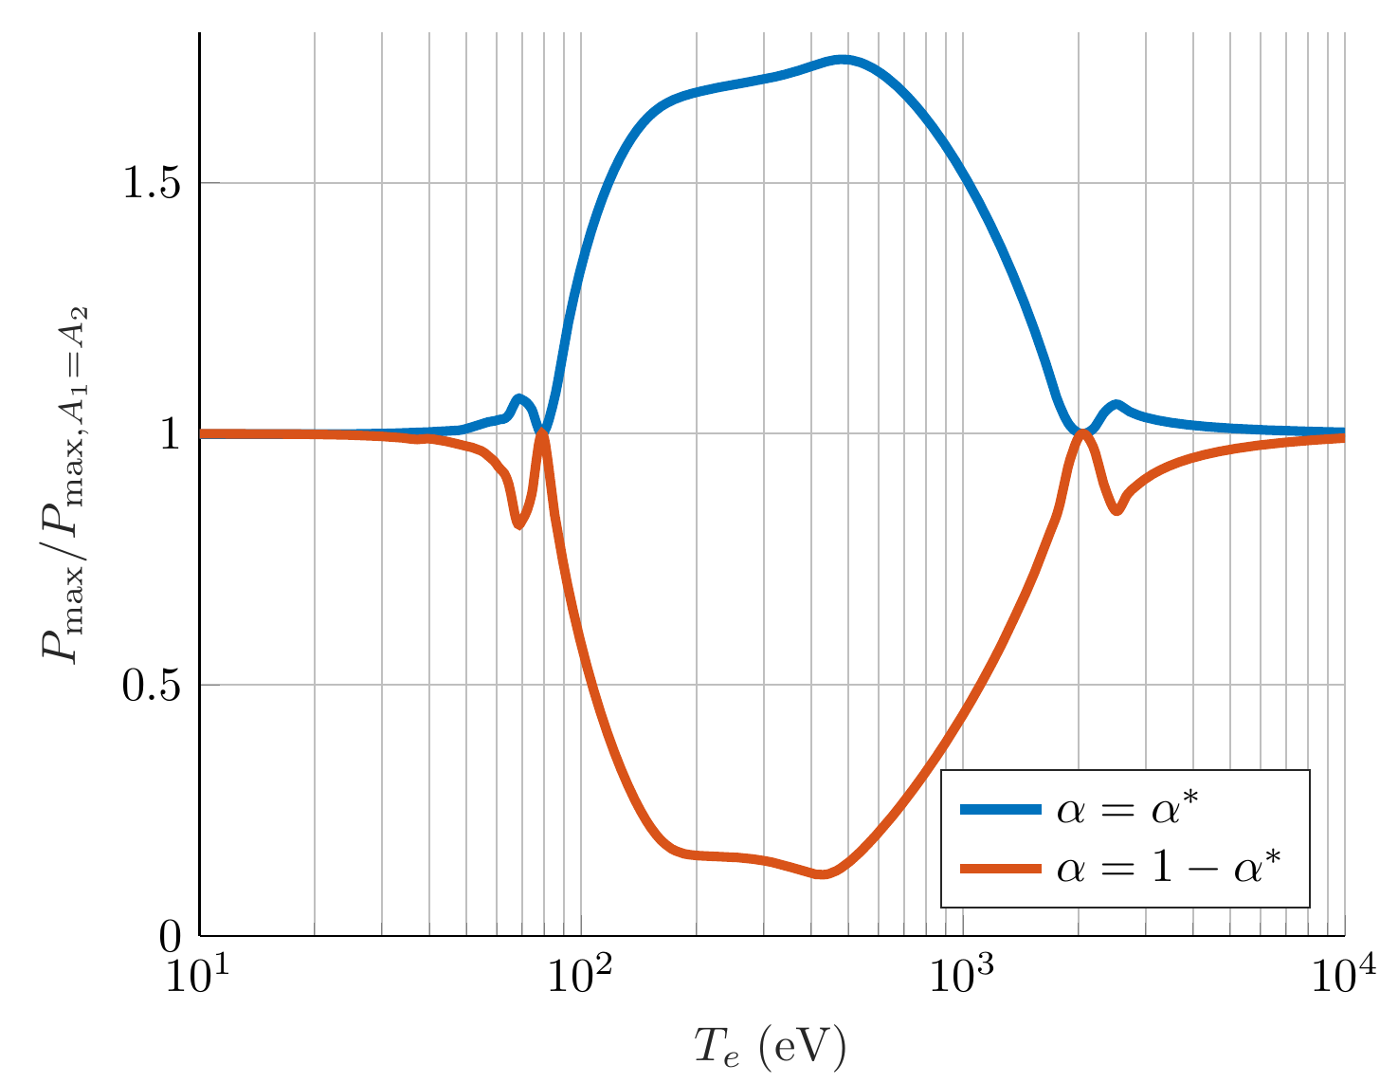
Free Cathode – Material/$α$ Dependence
Hydrogen/electron plasma, Maxwellian, $T_{e}=T_{H}$, spherical cathode/anode
Notes:
Plot on the left shows the power harvested using equal area cathodes. Anode material is assumed to be Carbon. We see that different cathode materials are better depending on the environment; this is a general trend. Best combination is C-Kapton or C and another material with large $δ$ at low energies/temperatures.
Plot on the right shows the ratio of power to the equal area power for two different area fractions for a C-Al system; the optimum area fraction and with the anode/cathode areas swapped. The reason for the second configuration will become clear shortly. The optimum area ratio yields powers about 1.7 times that the equal area configuration, while the suboptimal case yields about 10% the equal area case at minimum.

