Slide 1
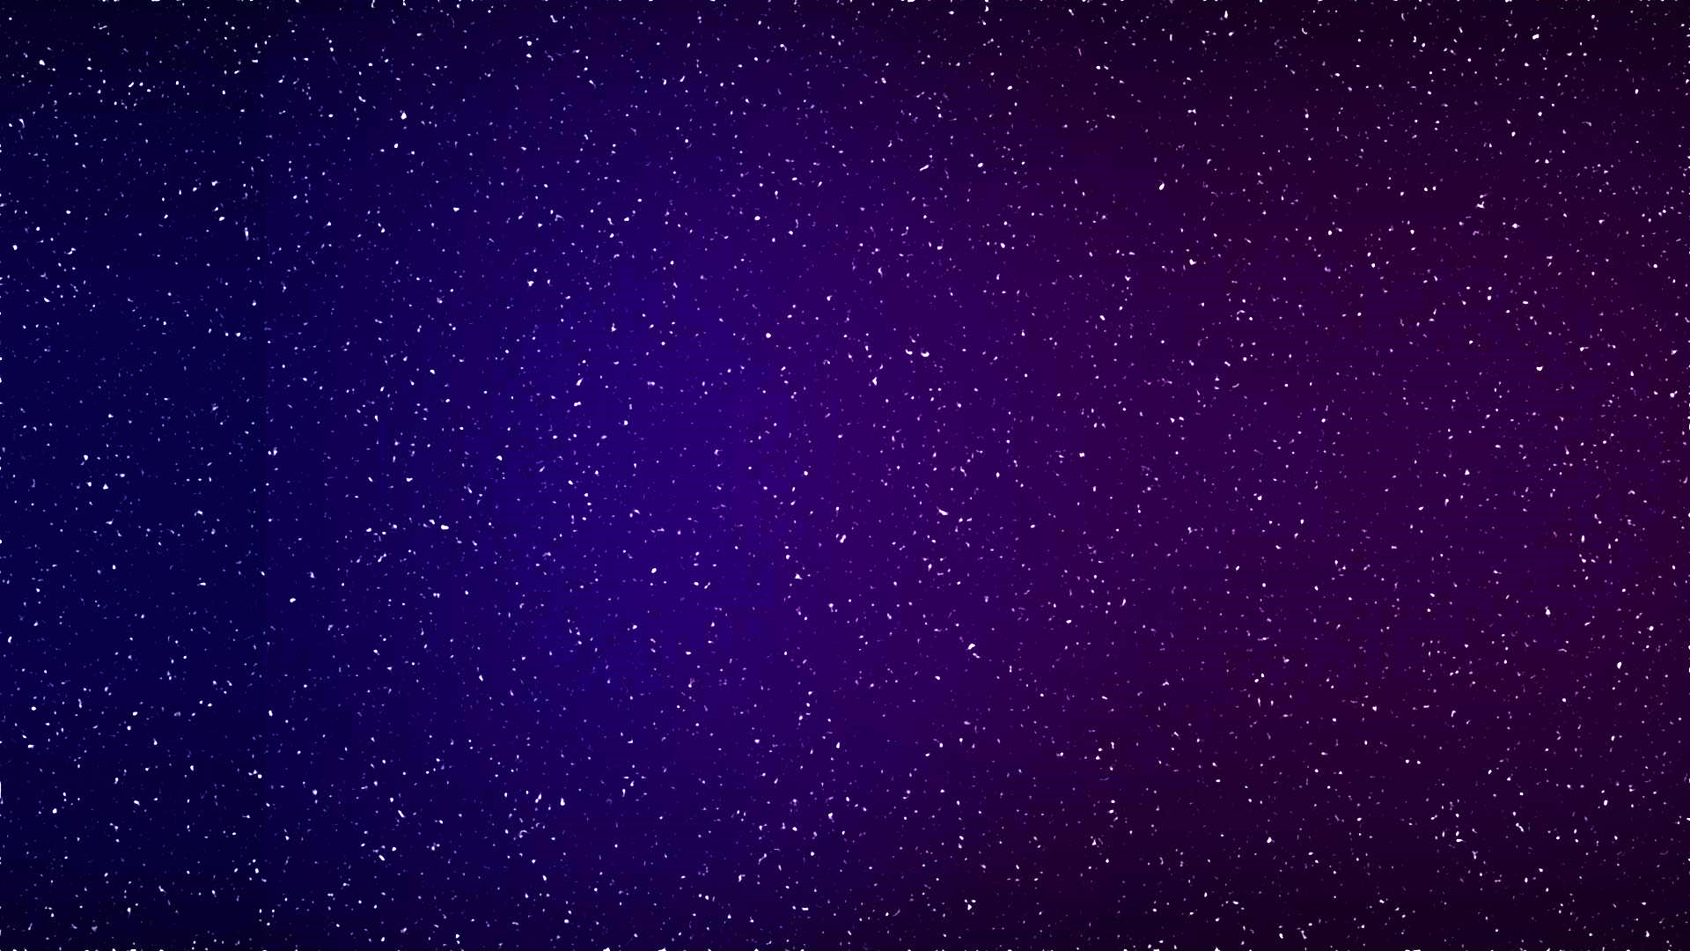
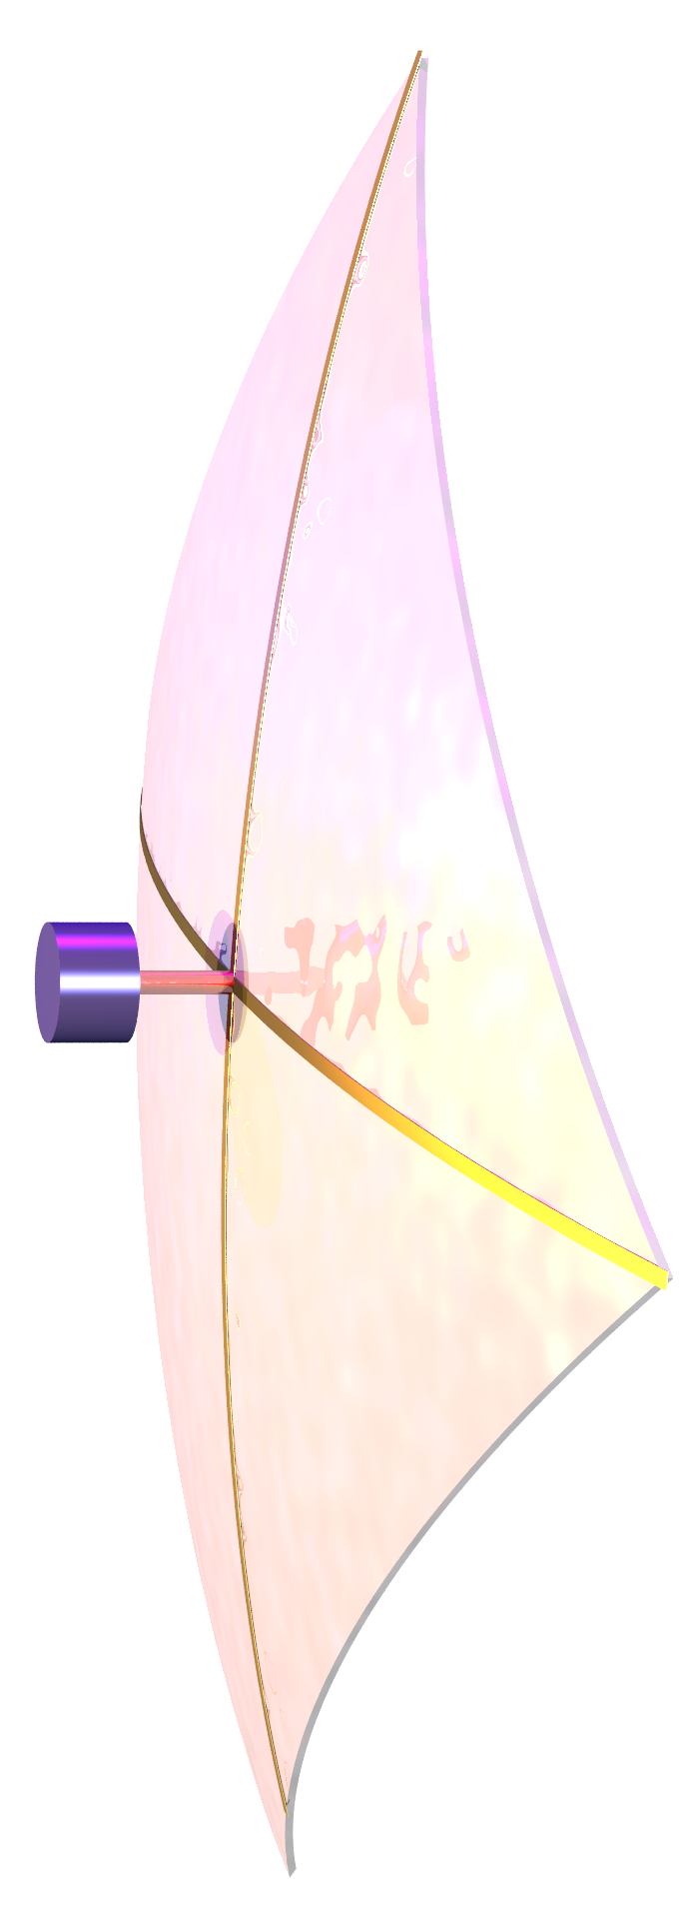
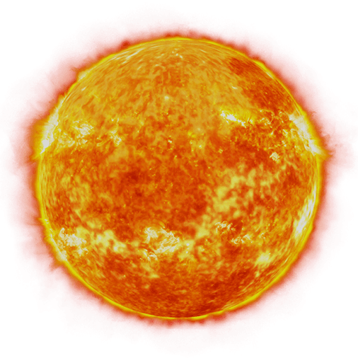

Ultrafast missions to outer planets and Kuiper belt objects with extreme solar sailing
Artur Davoyan

Slide 2



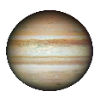
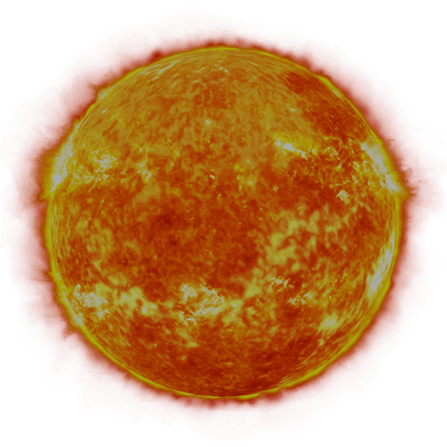




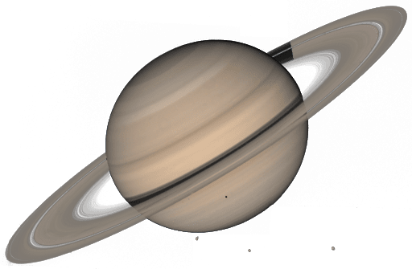


1 mission
9 missions
4 missions
1 mission
1 mission

Slide 3
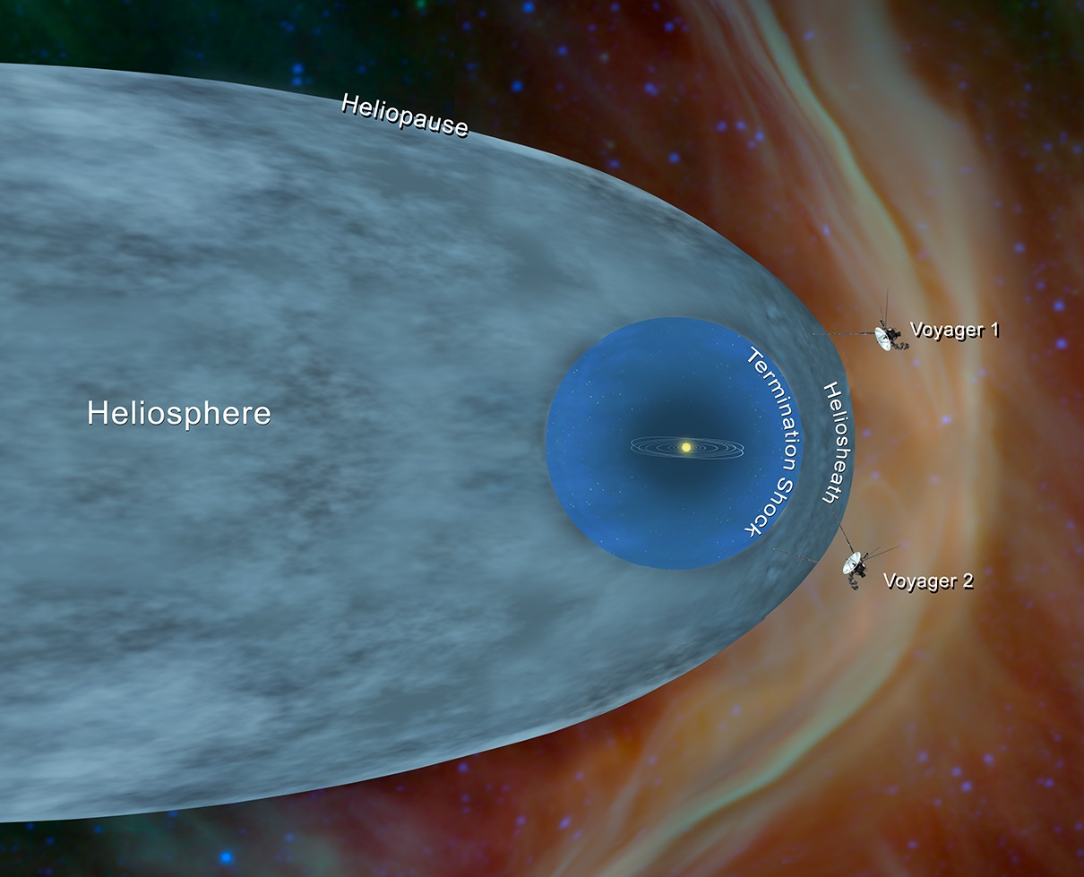
140 AU
120 AU
Credit NASA/JPL

Slide 4
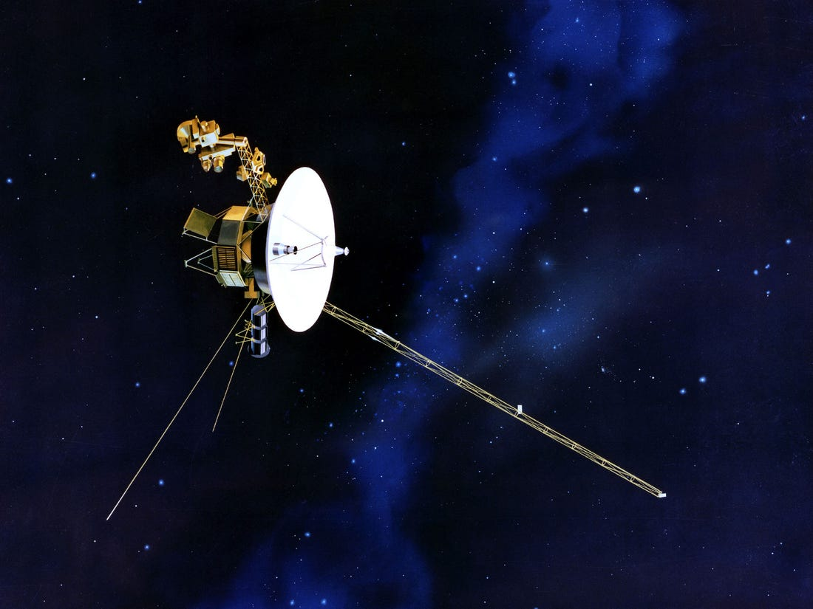
3.5 AU/yr. (17 km/s)
120 AU in 35 years
Credit NASA/JPL

Slide 5
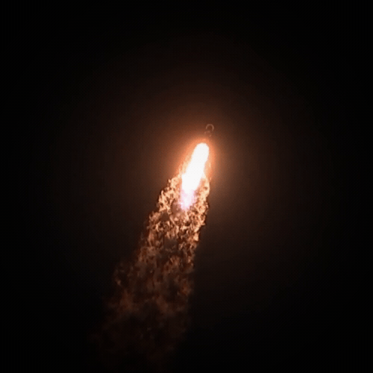
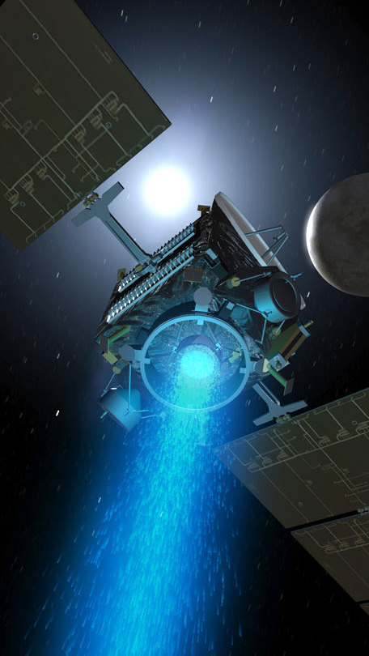
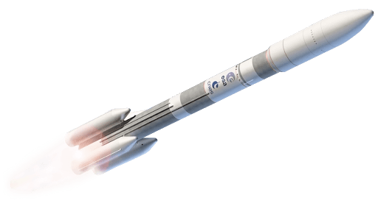

Slide 6

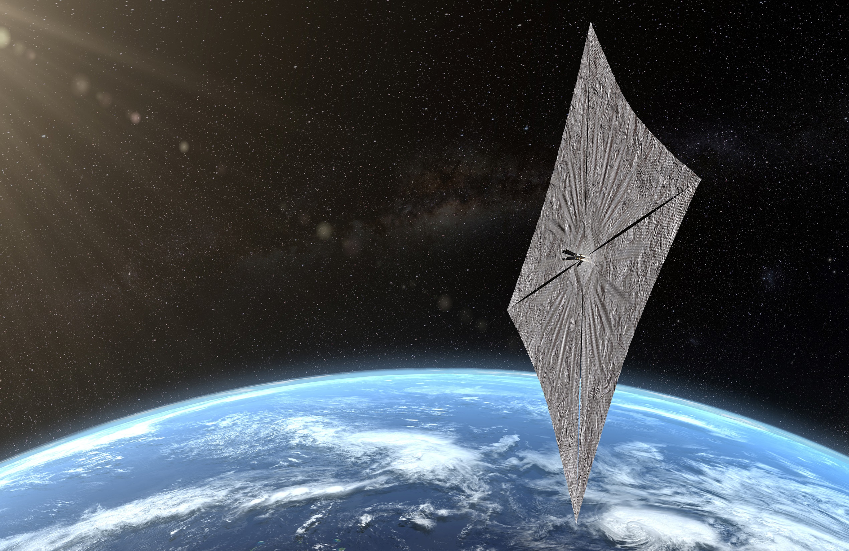
Credit the Planetary Society

Slide 7
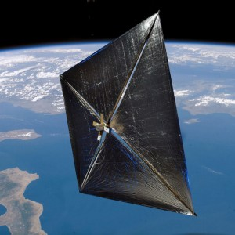
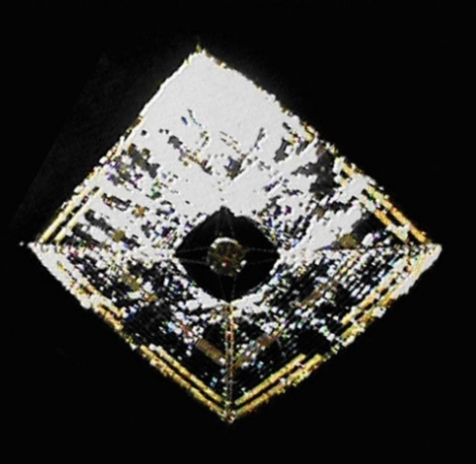
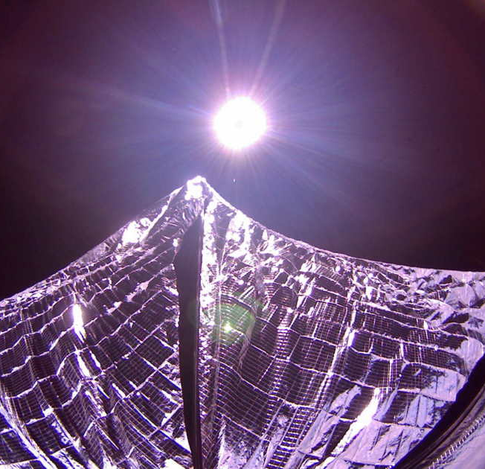
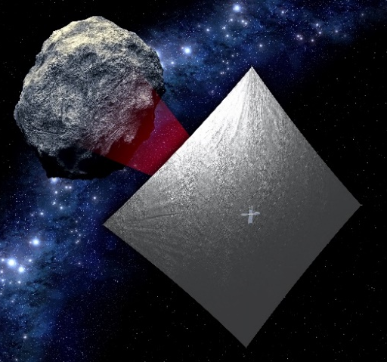
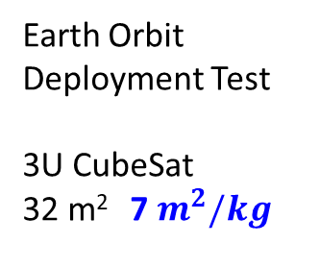
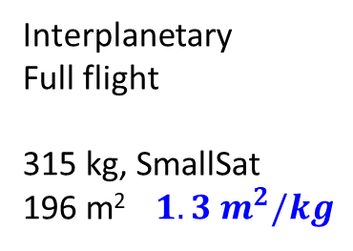
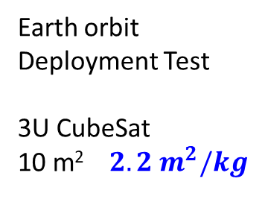
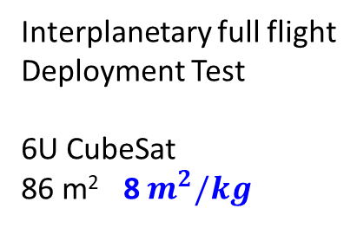
Solar sail missions flown and planned
NanoSail-D (2010)
NASA
IKAROS (2010)
JAXA
LightSail (2015,2019)
The Planetary Society
NEA Scout (2021)
NASA
Earth orbit
Deployment Test
3U CubeSat
10 m² $2.2 m^{2}/kg$
Interplanetary
Full flight
315 kg, SmallSat
196 m² $1.3 m^{2}/kg$
Earth Orbit
Deployment Test
3U CubeSat
32 m² 7$m^{2}/kg$
Interplanetary full flight
Deployment Test
6U CubeSat
86 m² 8$m^{2}/kg$

Slide 8
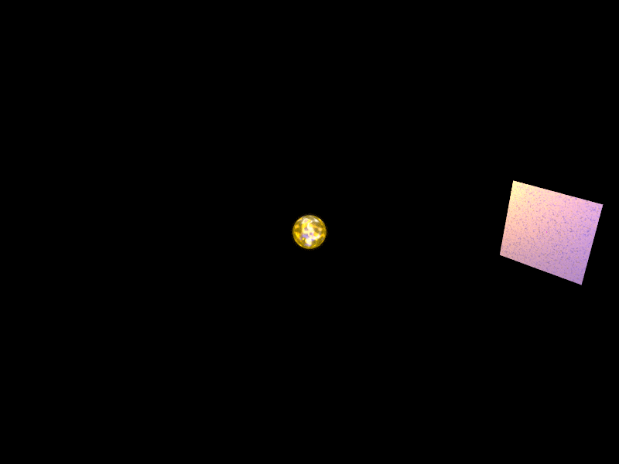
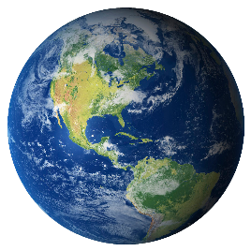

Slide 9
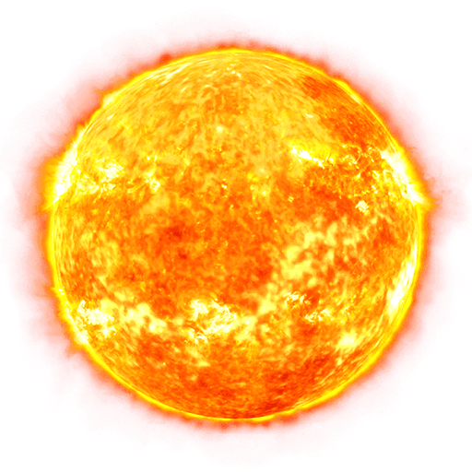
Area: ~10,000 m²
Payload mass ~10-20 kg
Cost: $10 mln
>50 AU/yr
Jupiter 5 months
Neptune 10 months
Voyager 1 2.5 years
1000 AU 20 years
2-5 R
G. Matloff , G. Landis, JPL Interstellar Probe (1999), L. Johnson, S. Turyshev & L. Friedman

Slide 10
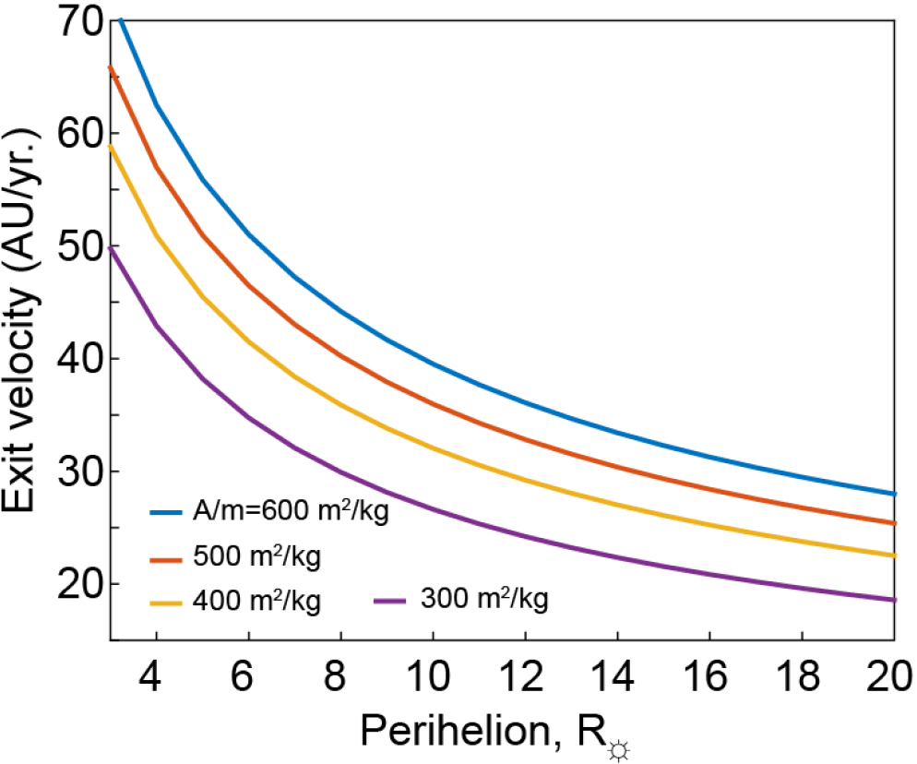
Sail exit velocity
If available
Fast transit outer planet flyby missions
Interstellar medium probe missions
Interstellar objects (asteroids, trans-Neptunian objects)
2-5 R
A.R. Davoyan et al., Optica (2021)

Slide 11
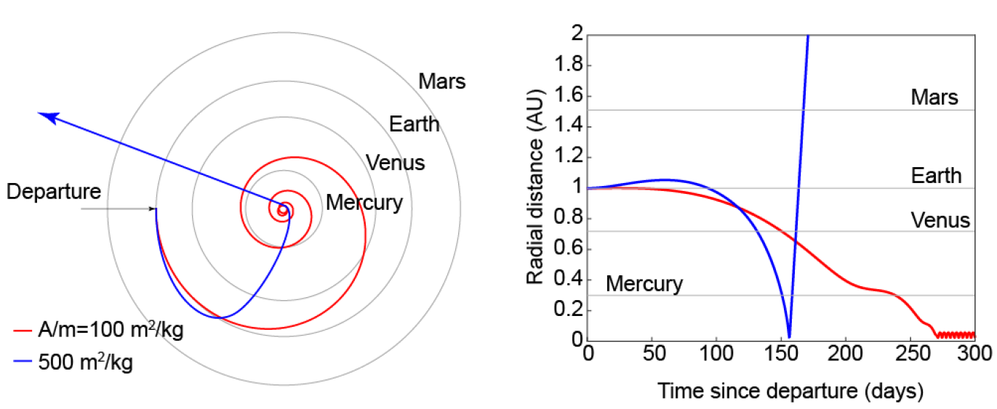
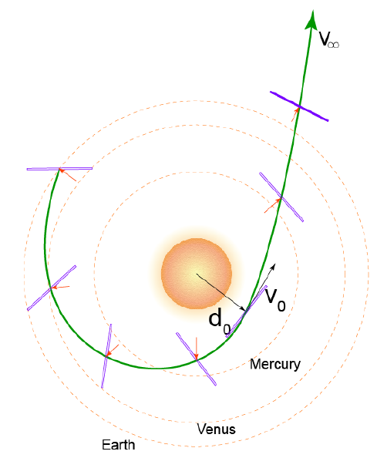
Mission profile
160 days to perihelion
7 days within Mercury (0.3 AU) orbit
5R☼ perihelion pass is assumed

Slide 12
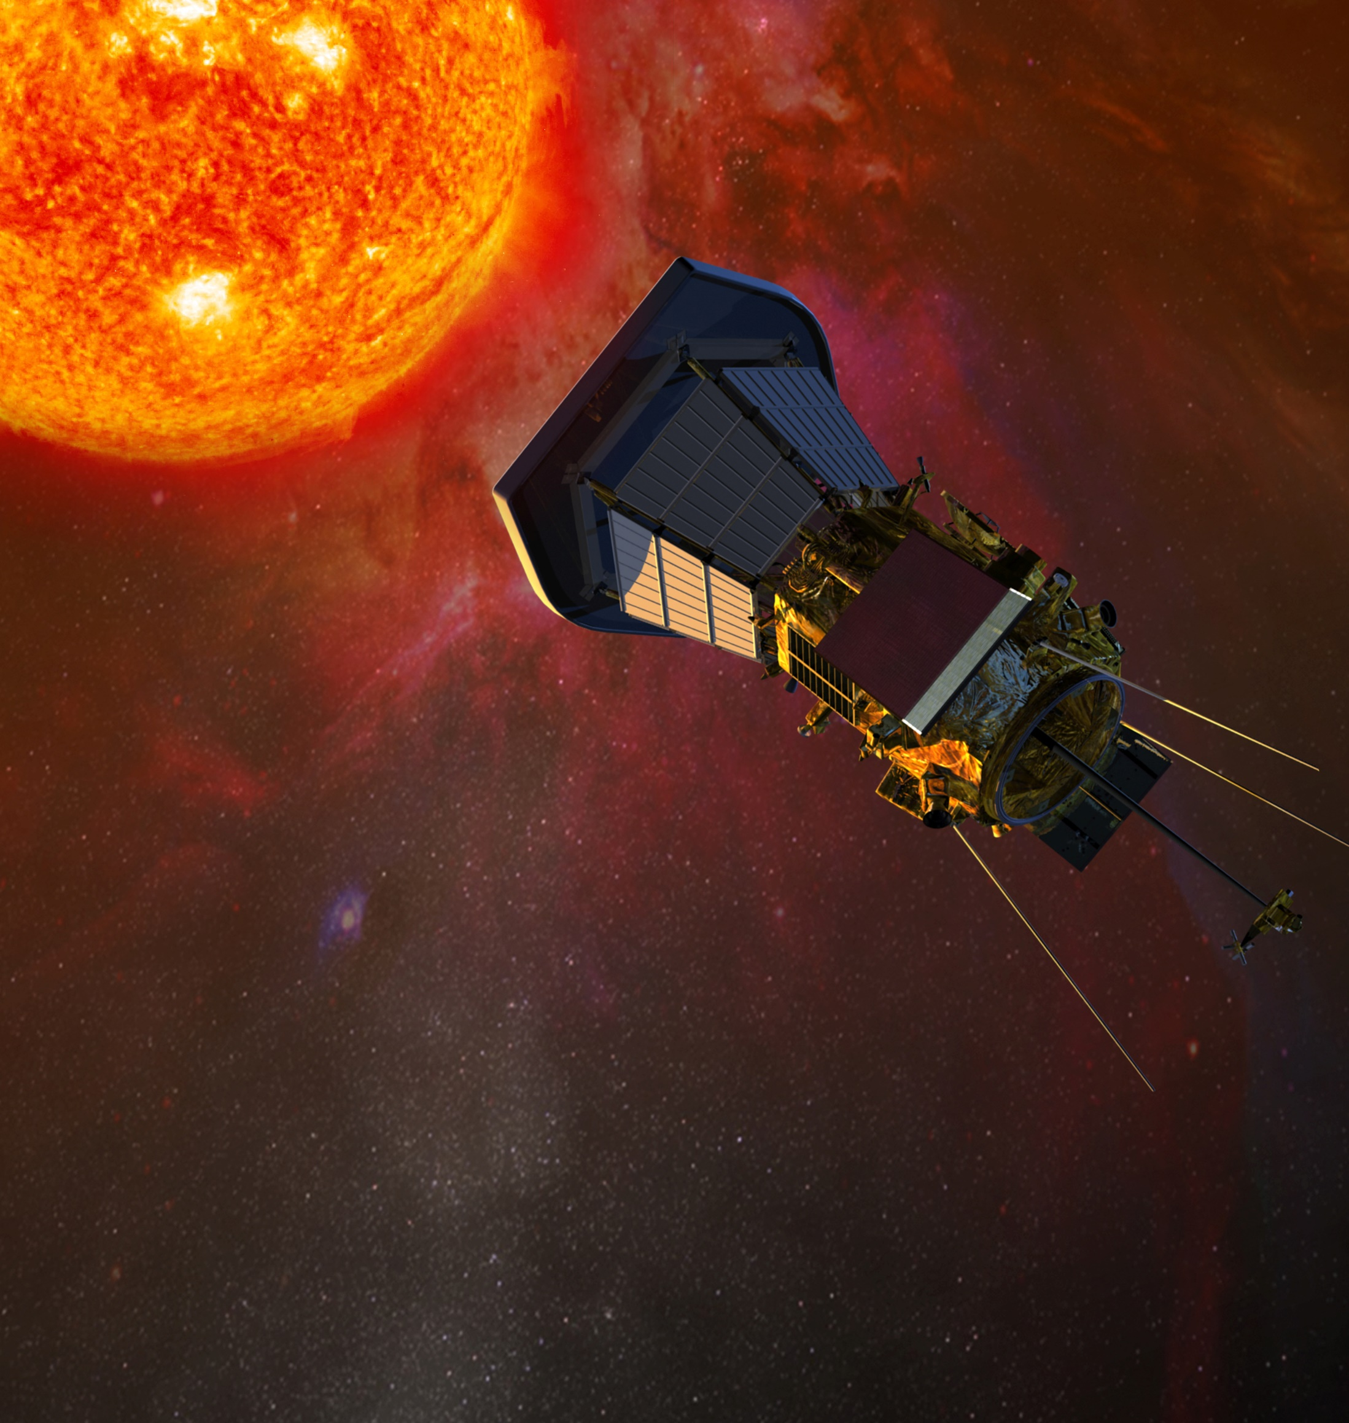
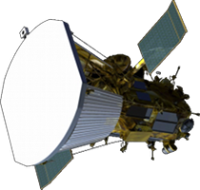
Solar Paker Probe – 9 solar radii
Credit NAAS

Slide 13

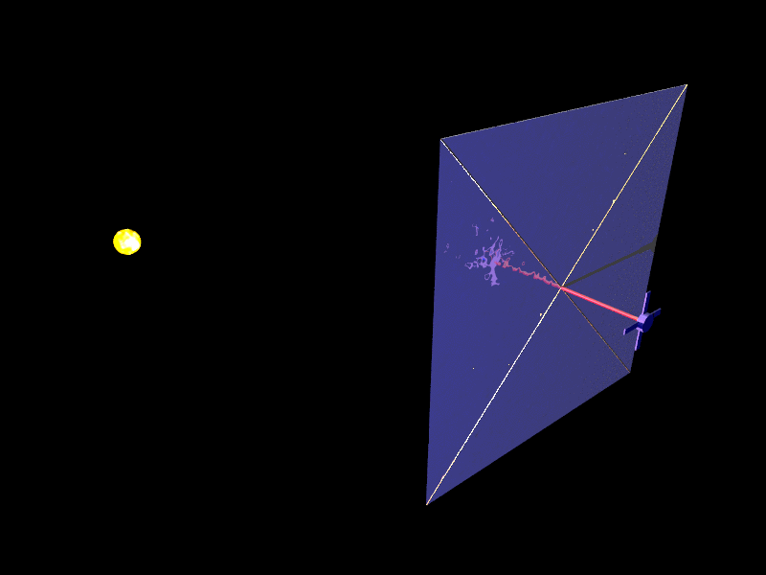
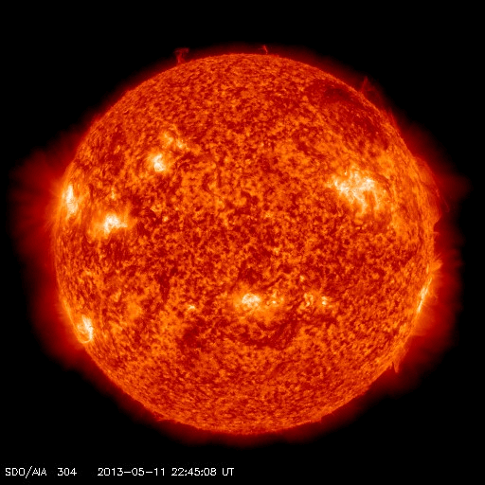

Slide 14
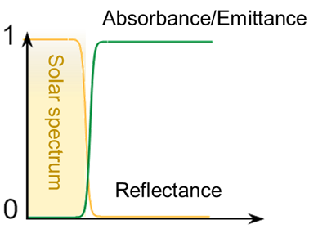
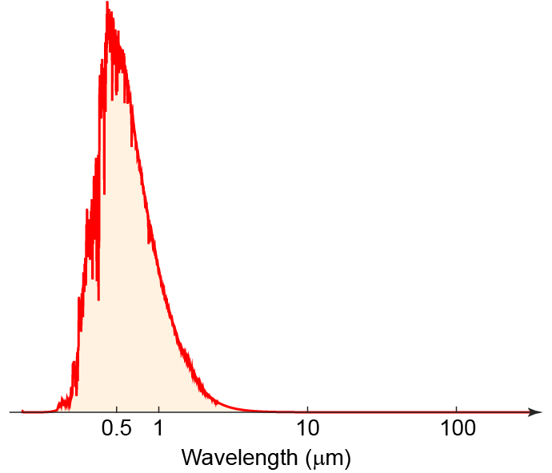
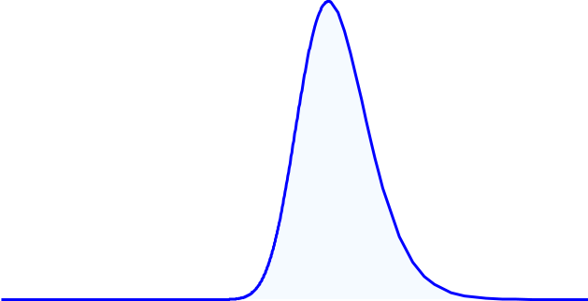









Thermal balance
Solar power absorbed = Thermal power emitted
$$α_{sun}P_{in}=ε_{IR}σT^{4}$$
$$α_{sun}$$
$$T$$
$$P_{in}$$
$$ε_{IR}$$
$$T$$
$$T$$
$$<2 μm$$
$$P_{out}$$
BB peak shift with T
Notes:
Radiative heat transfer – only means

Slide 15
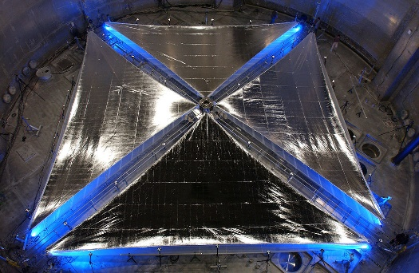
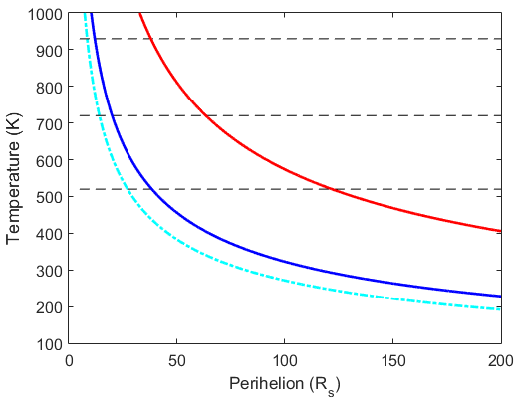









Limitations of current materials
$$38 R_{s} (0.177 AU)$$
Al
$$ε=0.1$$
Kapton
Sunlight
Mylar, CP1
$$ε=1$$
Al (50 - 100 nm)
$$ε=2$$
Organic film (few $μm$)
$$12 R_{s} (0.056 AU)$$
$$64 R_{s} (0.3 AU)$$
Heat rejection
$$20 R_{s} (0.09 AU)$$
*10% - Al absorbance
$$122 R_{s} (0.56 AU)$$
*0.04 – Al emissivity

Slide 16
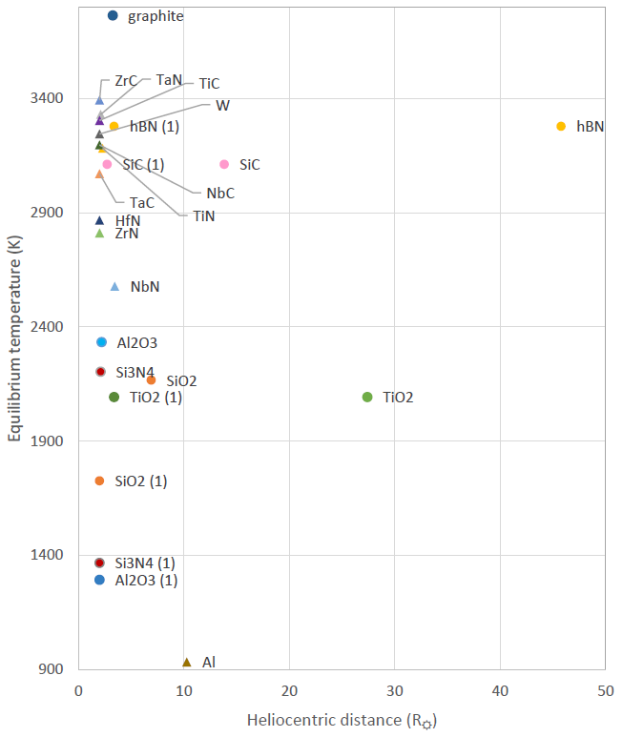
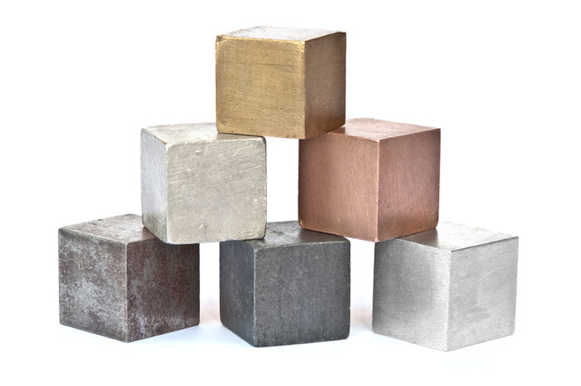
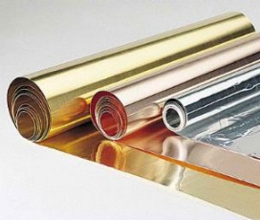
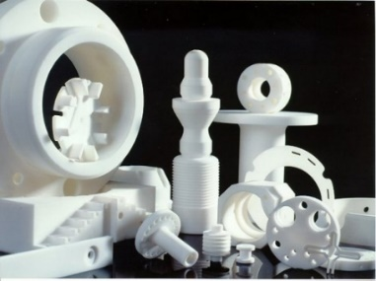
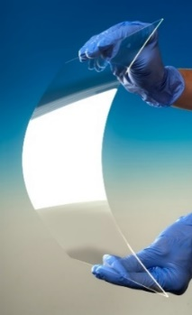
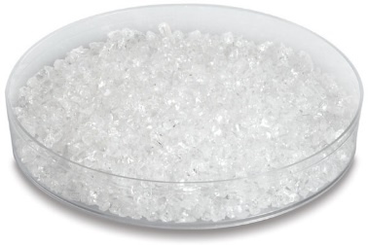
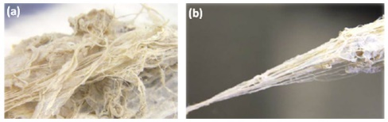
Extreme sail materials
Refractory metals: Titanium nitride, tungsten
Transparent ceramics

Slide 17

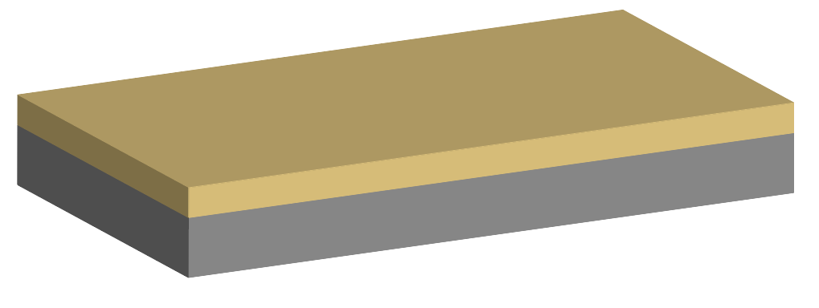
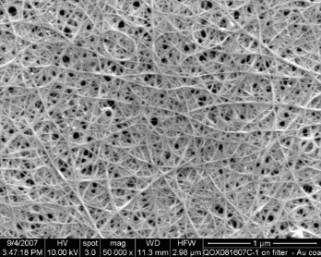
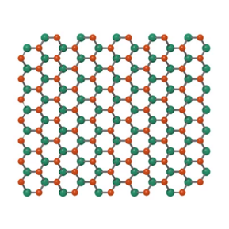
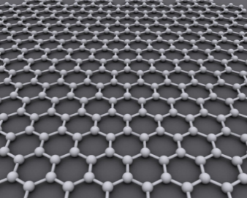
TiN solar sail
TiN
100nm
200nm
High temperature inorganic film
~1 g/cm²
High melting point (3200 degree C) – can survive around 2.5 solar radii
Density: 5.4 g/cm³
Absorbs 40% of sunlight

Slide 18
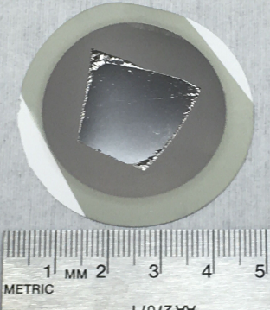
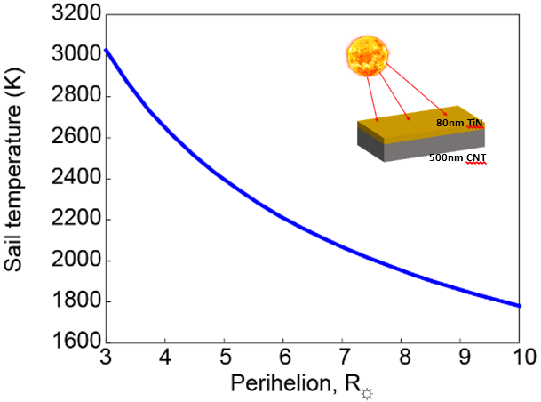
Toward TiN sail materials
With TiN coating
30nm
Large area reflective surface
Graphene oxide is not stable at higher temperatures (>200-300 C)
Plan to extend to reduced graphene oxide or carbon nanotubes

Slide 19
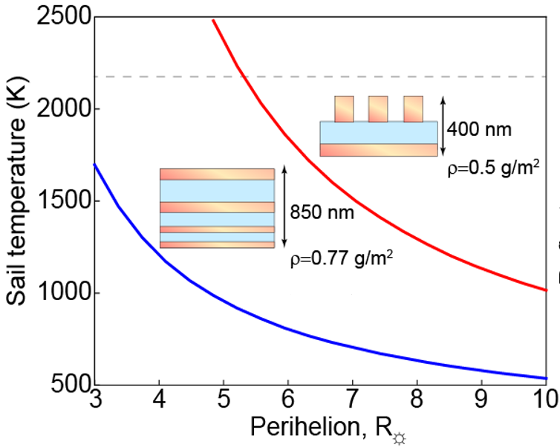
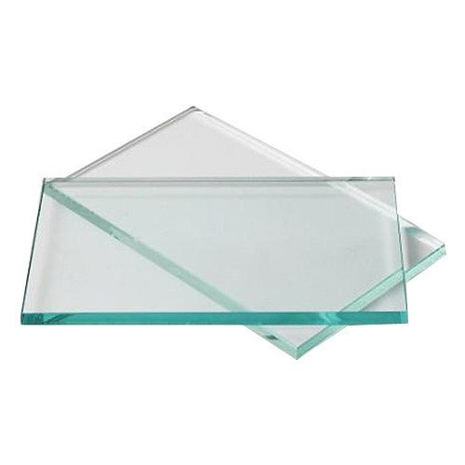

Reflective ceramics?

Slide 20

Many other questions to solve
Harsh solar environment
Architecture
Control
Communications
Power
Control

Slide 21


Solar environment
“Steady state” effects
Solar wind
Radiation
Relatively well understood and predictable
“Transient” effects:
Coronal Mass Ejections
Solar Energetic Particles
Flares
Transient effects can’t be predicted
Environment mitigation strategies have been identified

Slide 22


Sail interaction with solar wind
TiN on graphene as an example
Average implementation depth: 15nm
2.08%/hr atom displacement at peak damage depth.
0.004 nm/hr of film removed via sputtering.
Solar wind
300km/s
H+ energy ~1keV
100nm
200nm
Sputtered atoms
Damage from H+ plasma is negligible.
Environmental effects although harsh can be mitigated and tamed

Slide 23



Sail-craft architecture
~10kg spacecraft bus,
~0.7g/m² sail material areal density,
70g/m boom density
150m by 150m sail
(A/m = 554 m²/kg) & v>50 AU/yr
 | Bus | Sail support/booms | Sail material | Total
Mass (kg) | 10 | 14.8 | 15.75 | 40.55
Fraction (%) | 25% | 36% | 39% | 100%
Payload protection
Control authority
Power & mass budget
<50 W (RTG)
Optical comms
Total bus mass ~10 kg

Slide 24

Sun as a Launch Pad
Oort cloud
Kuiper belt
Multiple missions
Low cost and scalable exploration
Distributed architecture
Jupiter 5 months
Neptune 10 months
Voyager 1 2.5 years
1000 AU 20 years

Slide 25




Team and Acknowledgements
Henry Helvajian, Les Johnson, Slava Turyshev, Lou Friedman, Darren Garber, Tom Heinsheimer
UCLA Solar sail study group: Sophia Martinez, Audrey Dunn, Ho-Ting Tung, Steven Huang, Ryan Rio, Phillip Krings, Haonan Ling

