Slide 1

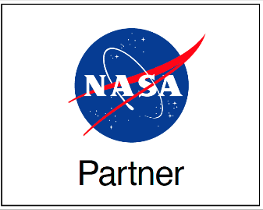
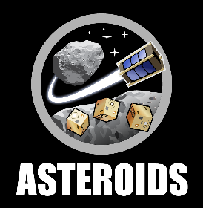

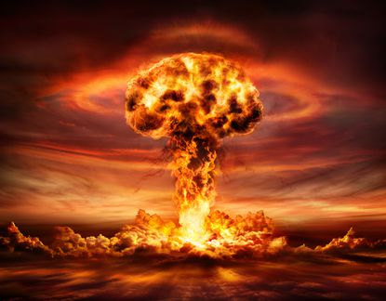
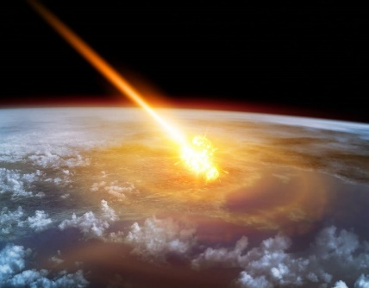
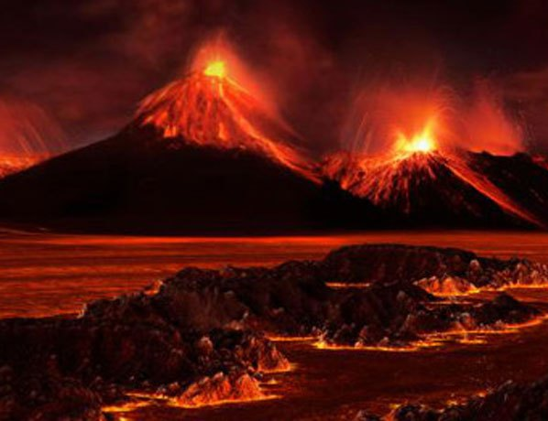
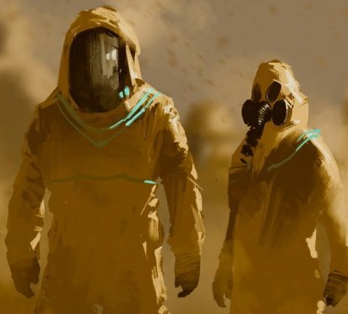
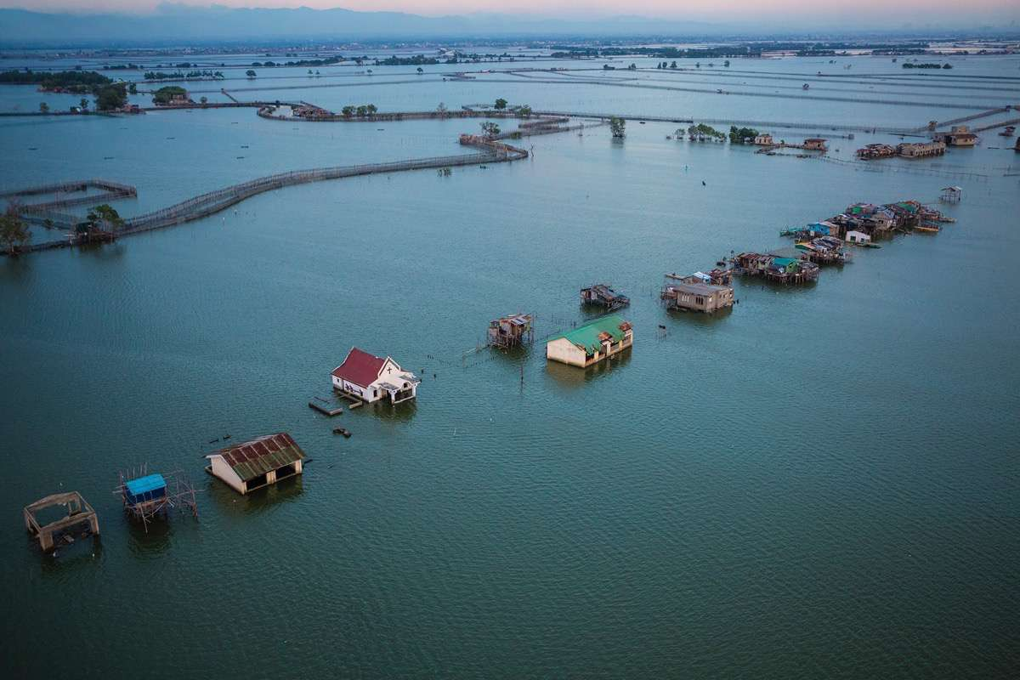
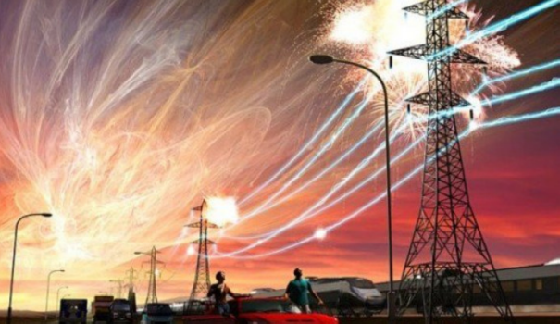
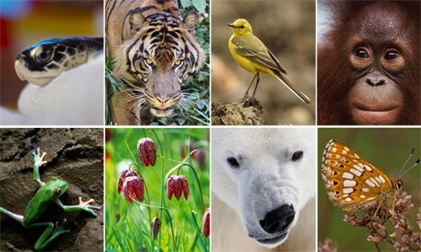
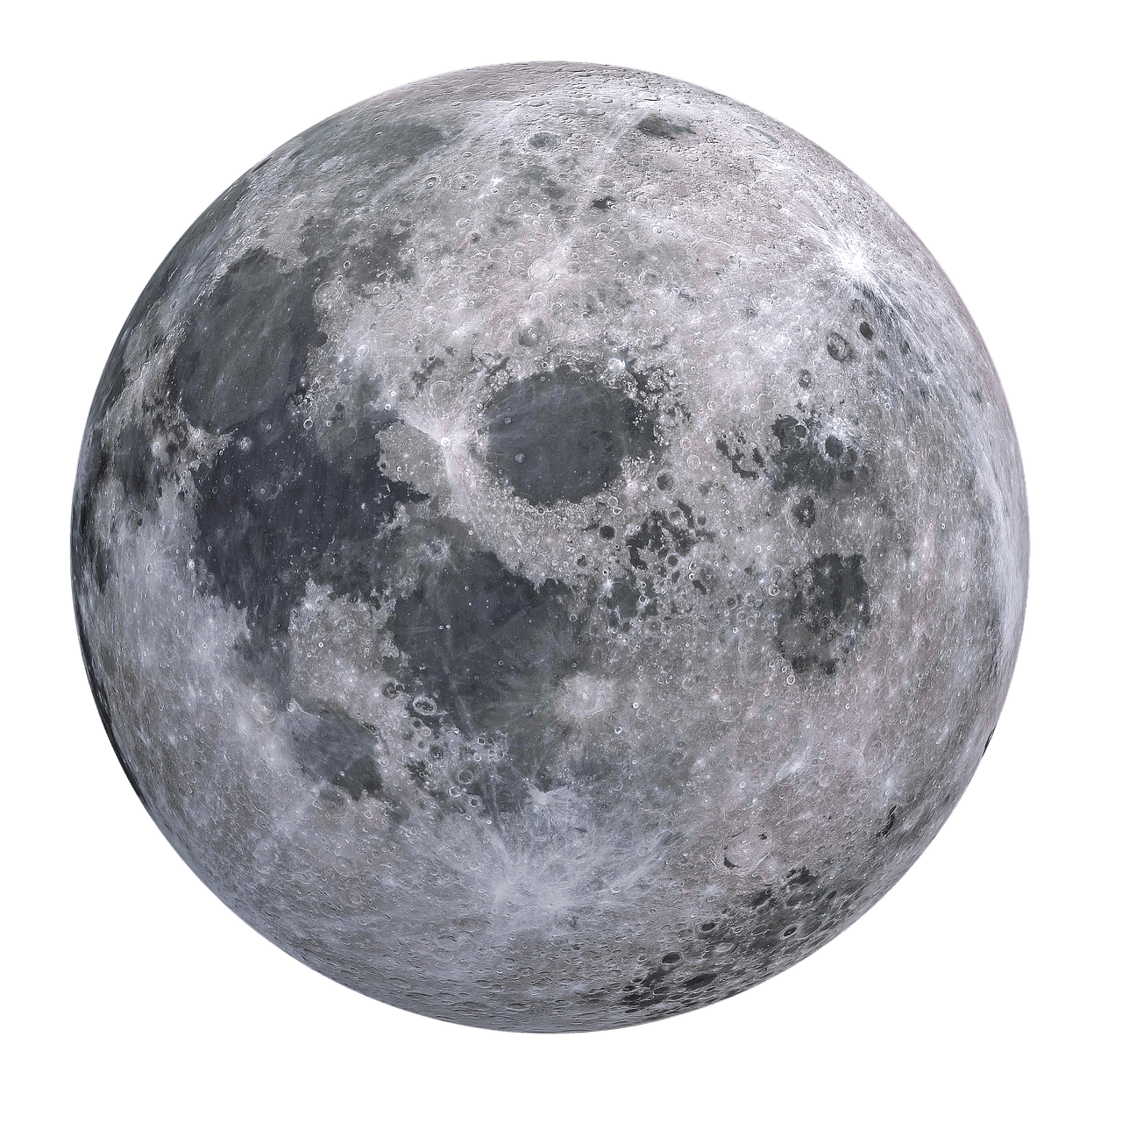
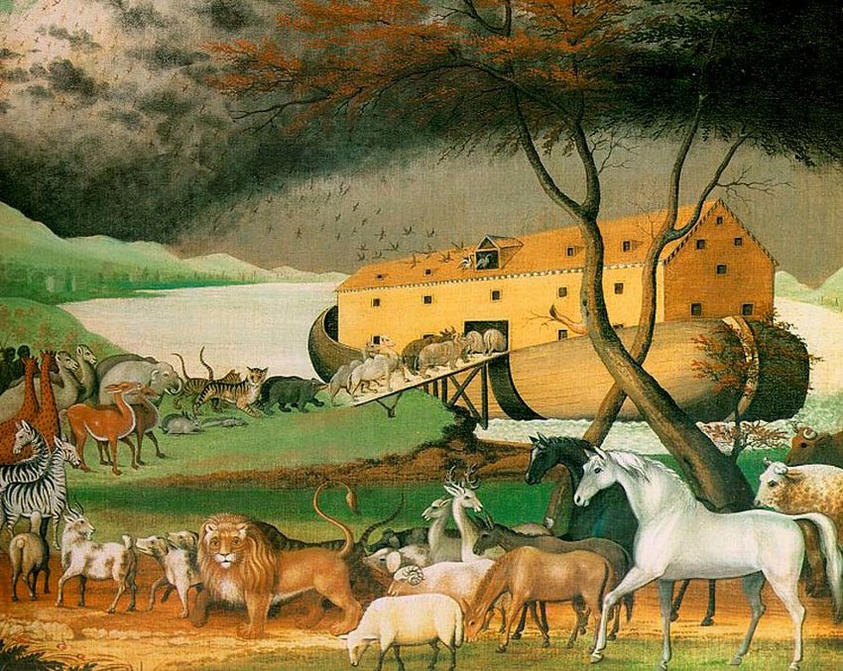
First Phase of the Lunar Ark Concept – Towards Saving Life on Earth from a Future Catastrophe
Alvaro Diaz-Flores¹, Claire Pedersen², Yinan Xu¹, Lindsey Williams², Cho Lik Chan³ and Jekan Thangavelautham^{1,2}
¹Space and Terrestrial Robotic Exploration (SpaceTREx) Laboratory
²Asteroid Science, Technology and Exploration Research Organized by Inclusive eDucation Systems (ASTEROIDS) Laboratory
³Aerospace and Mechanical Engineering Department, University of Arizona

Slide 2
Outline
Introduction
Motivation
Objectives
Lunar Lava Tube Exploration
Lunar Ark Concept
Feasibility Summary
Conclusions

Slide 3
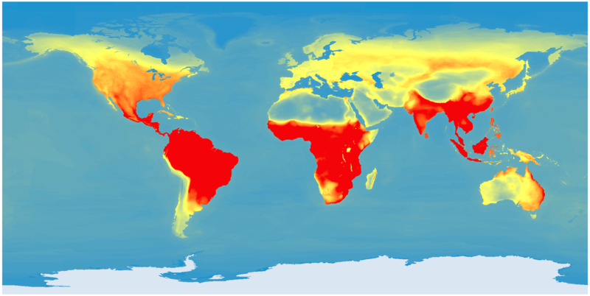
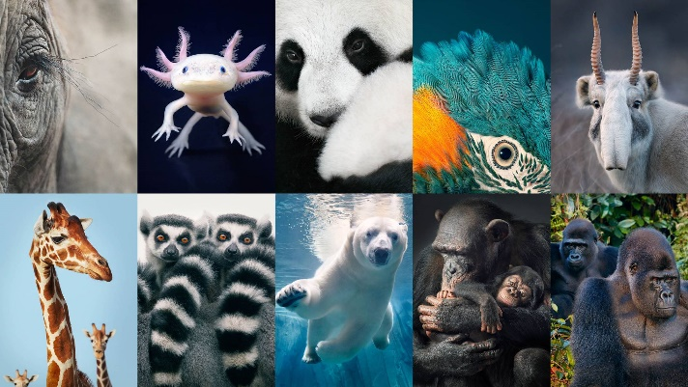
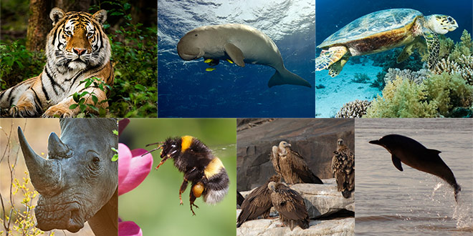
Introduction – Living Organism Endangered
Diverse ecosystems in danger on every continent
Large fraction of every kind of plant and animal in danger
Due to human activity and other factors, we don’t fully understand
IUCN Endangered Animals

Slide 4
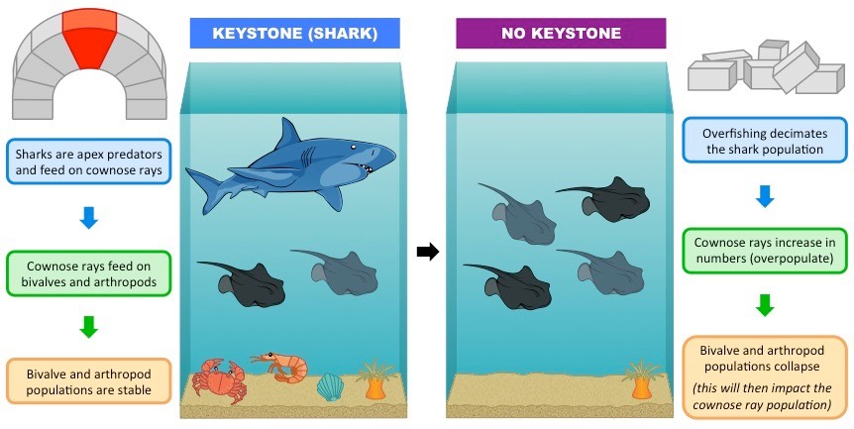
Motivation
Loss of apex predators cascades down to entire food chain.
Devastating loss to animal and plant diversity

Slide 5
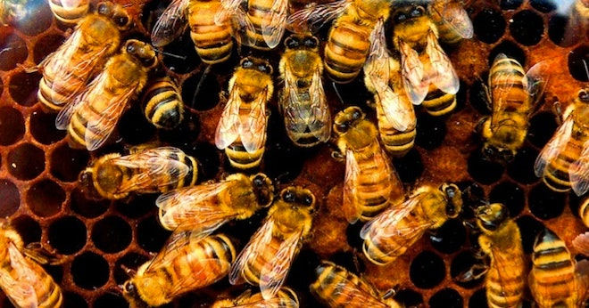
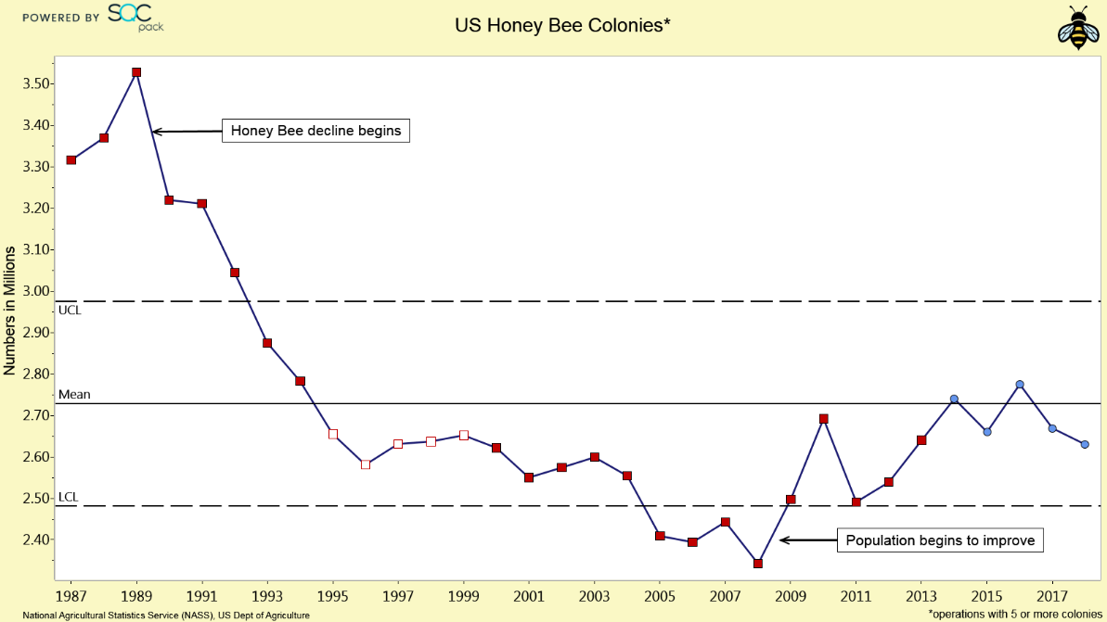
Motivation – Collapse of World’s Food Supply
Pesticides, artificial chemicals, predators, disease, change in climate
Combination of factors killing of critical organisms such as honeybees holding up the world’s (human) food supply

Slide 6

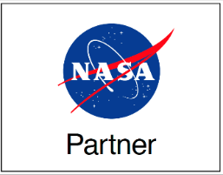
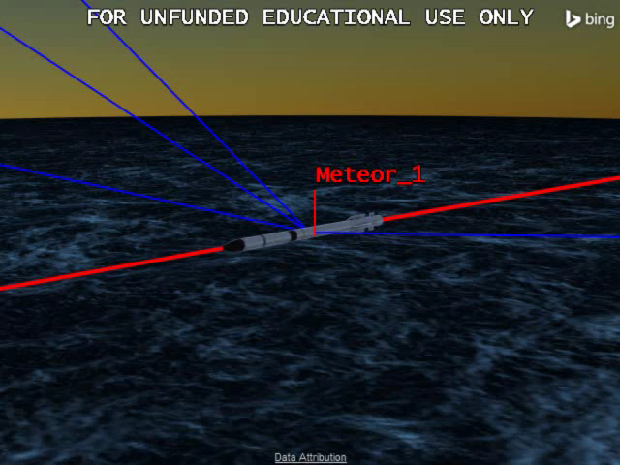
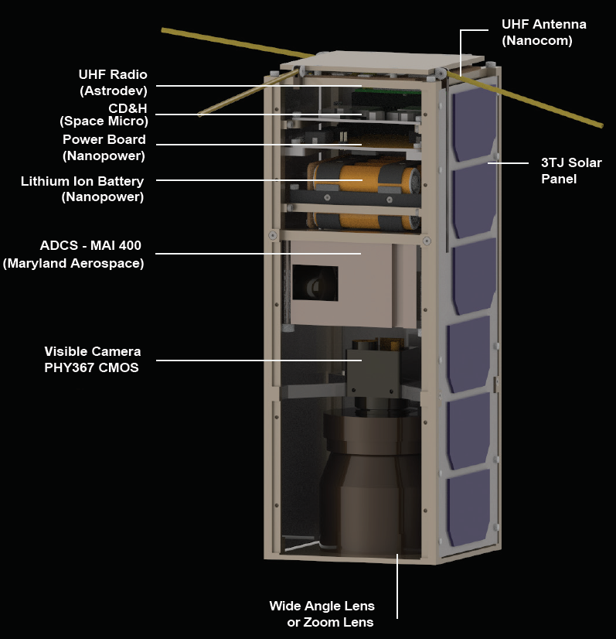
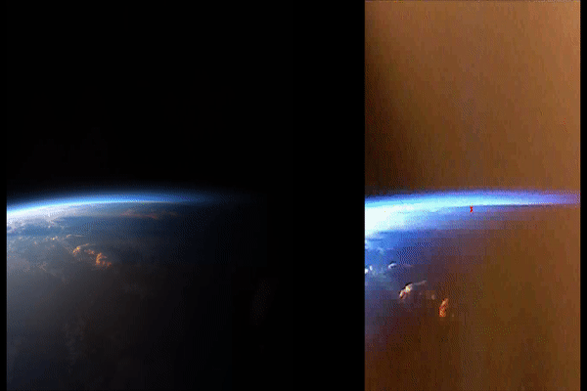
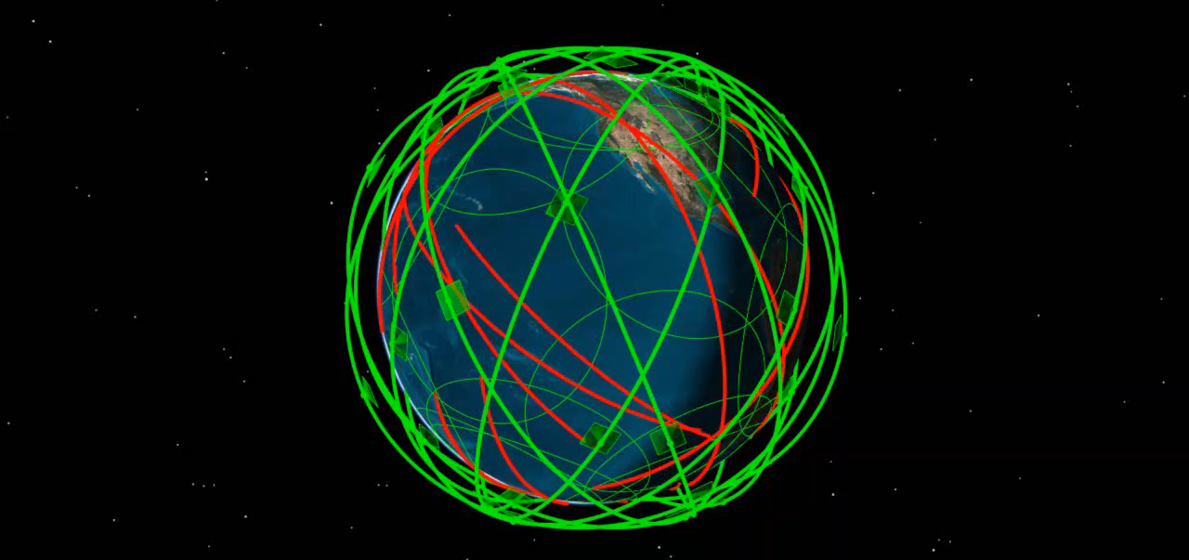
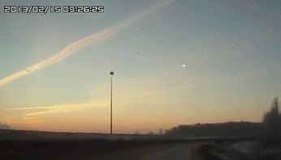

Constellation Validation
Constellation for Monitoring Space Threats
[J. Thanga*, V. Reddy, R. Furfaro]
Scene
Camera View
Performance of the constellation simulated for 1 day.
Chebalinsk, 2013

Slide 7

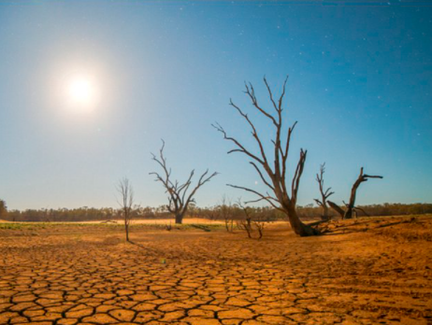
Motivation - Mass Extinction Dangers on Earth
Super Volcanic Eruption
Global Nuclear War
Asteroid Impact
Global Epidemic
Climate Change Accelerated
Global Solar Storm
Global Drought
Earth is in an extremely fragile state. Humans have already faced one close call, 75,000 years ago.

Slide 8
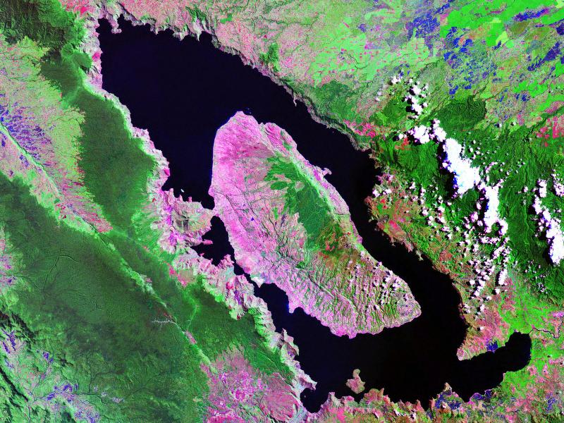
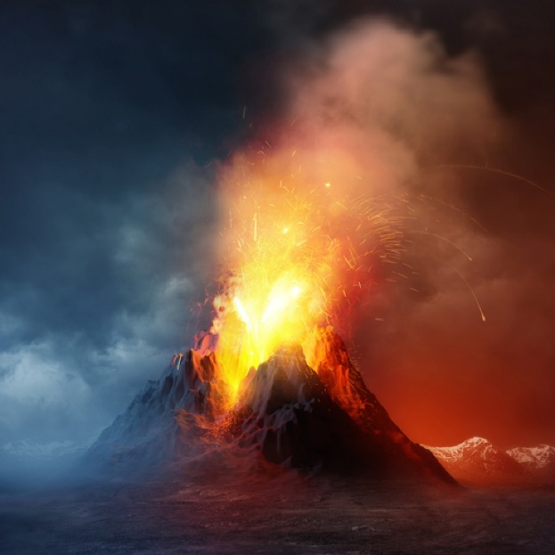
Motivation – Toba Super Volcano
Toba Super-volcanic eruption nearly 74,000 years ago.
Prolonged winter for decades or more and 1,000 year cooling period
Aligns with estimated drop in human diversity

Slide 9
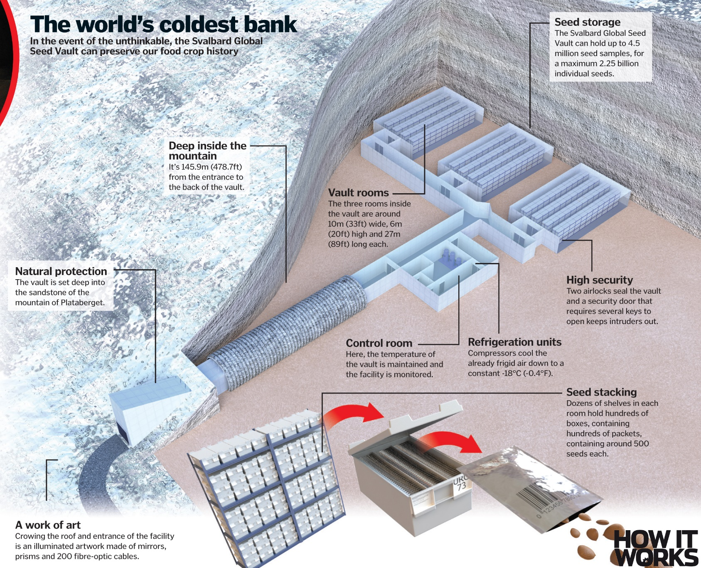
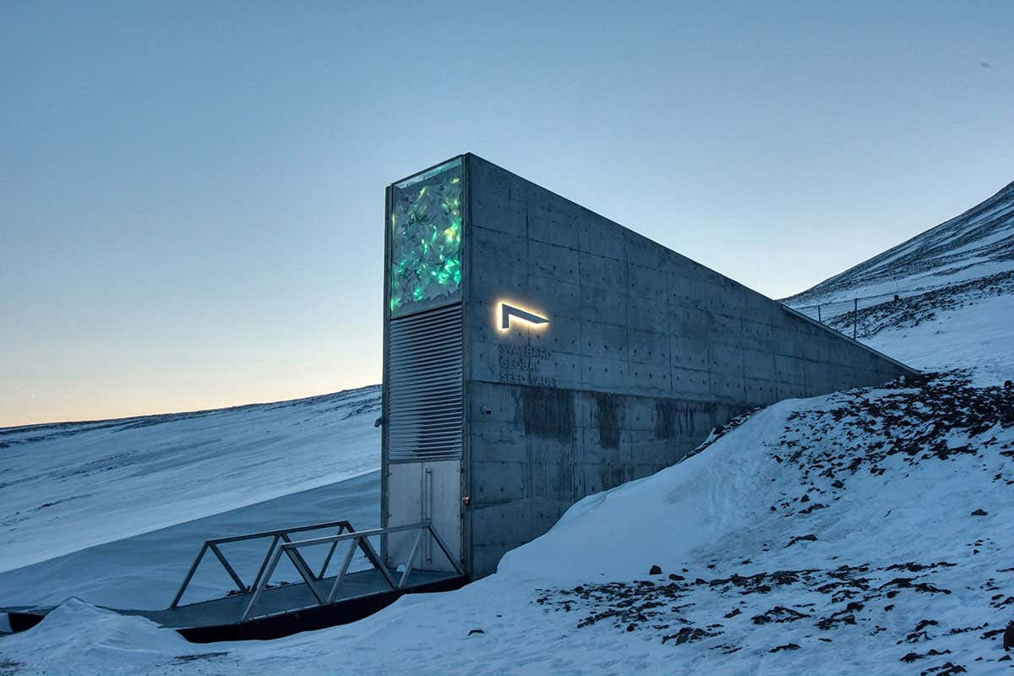
Need for a Modern Ark
More cost-effective than trying to protect all the endangered species any other way.
More cost-effective than creating an entire artificial ecosystem to keep them alive.
Save them till technologies advances to re-introduce these species.
A modern global insurance policy!
Biblical Noah’s Ark
Biblical Noah’s Ark
Svalbard Seed Vault
Svalbard Seed Vault

Slide 10
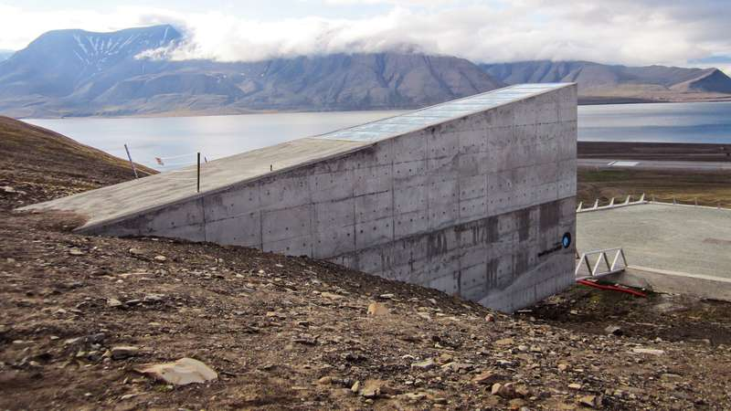
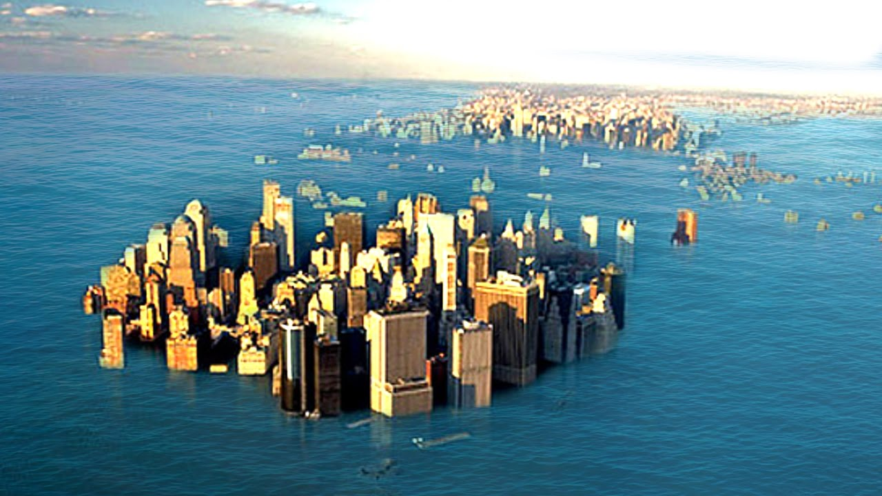
Need for a Modern Ark
Why ? Humanity has responsibility to protect the diversity of life.
Svalbard Doomsday Seedbank one-step in the right direction.
Svalbard Seedbank can be in danger of Earthly cataclysms, especially rising ocean from climate change.

Slide 11
Objectives
Develop a secure modern Ark that can house all the endangered species of the Earth and avoid any Earthly cataclysm.
  Explore potential for lunar lava tubes and caves.
  Perform preliminary concept development and determine energy/power feasibility.
  Determine how we can start small and get started now!

Slide 12
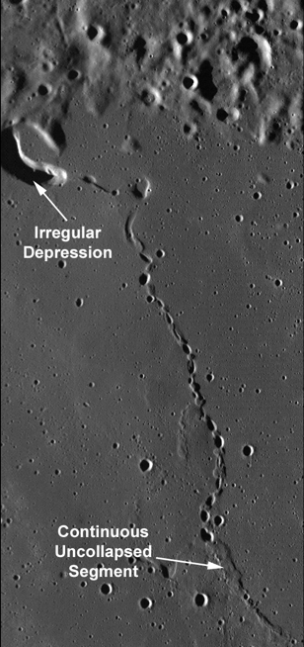
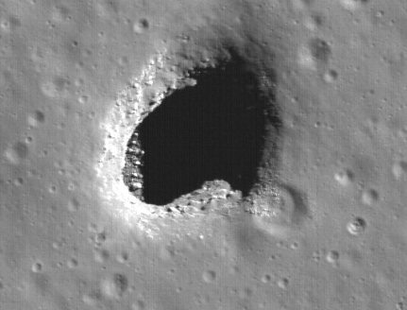
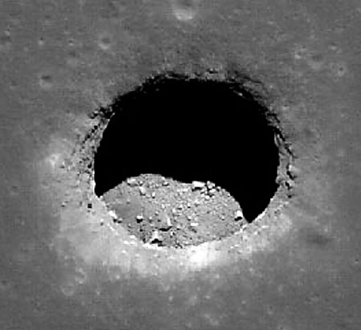
Lunar Pits and Lava Tubes
Recently discovered lunar mare “pits” are key science and exploration targets.
Likely 3-4 billion years old
Nearly 200 found [Wagner & Robinson, 2013]
Ready made shelter, benign T (-25º C)
Shelter from:
  Surface Temperature Swings
  Solar and cosmic radiation
  Micrometeorites
Pristine preservation ?
  Flow features
  Sublimate minerals
  Regolith? Water?
Mare Ingenni
Marius Hills
Mare Tranquilitatis

Slide 13
Why a Lunar Ark ?
Only four days away from Earth.
Moon subsurface sheltered and frozen in time for 3 billion years
Moon likely doesn’t have enough water resources to become thriving center
Humans not eager to live and work subsurface

Slide 14
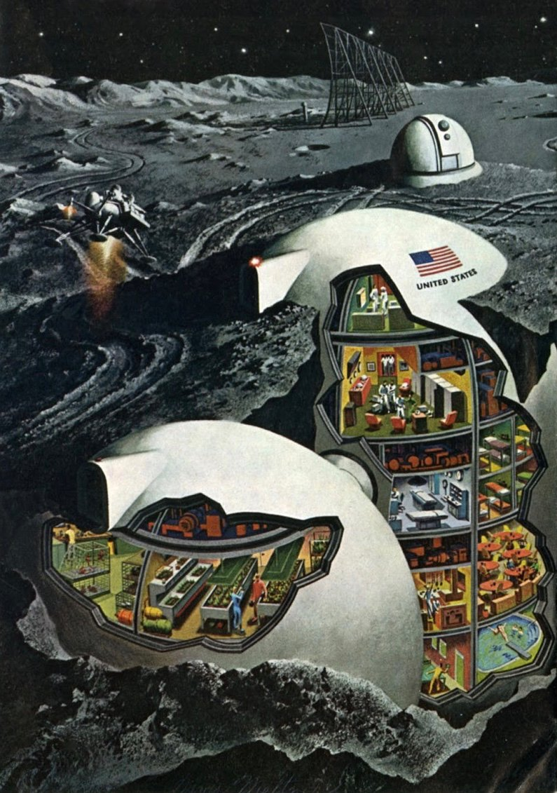
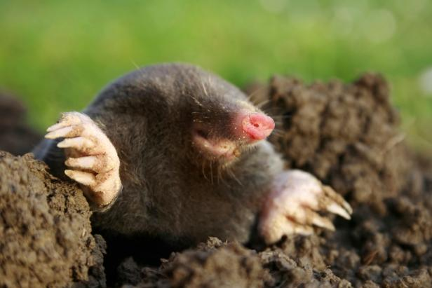
Lunar Bases Underground
A few concepts have explored underground lunar bases
More likely a temporary shelter.
Humans unlikely to prefer them as they are not ground moles!

Slide 15
First Phase – Exploration of Lunar Pits
We need to confirm all the hypothesis discussed earlier
Do so with the enabling low-cost technology from small satellites
Utilizing teams of robots, where even if one or a few are damaged or destroyed, mission continues.
Green exploration doctrine
The lava tubes are great natural monuments that needs to be well preserved, so no contact/tether grinding with side walls or mouth.

Slide 16
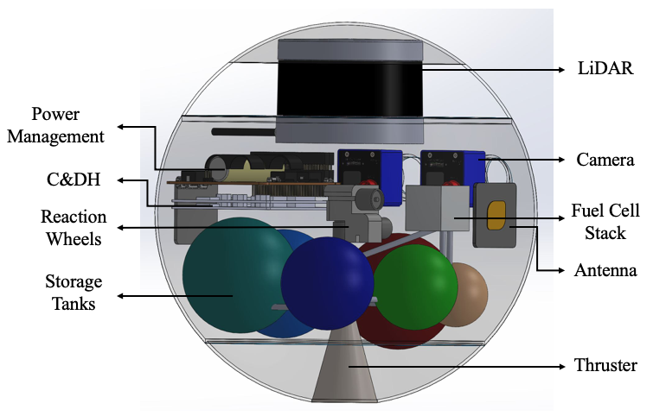
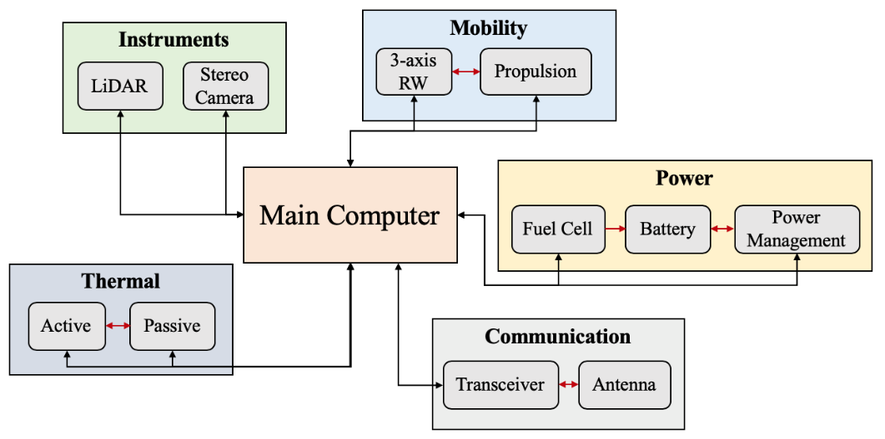
SphereX Robots for Lunar Pit Exploration
Small low-cost, modular spherical robot (SphereX)
  Mobility system for exploration
  Space-grade electronics
  Power system for power generation
  UHF/S-band antennas for communication
  Thermal and Shielding system for survival
  Outer shell for structural robustness
  Payload capacity for science instruments
Avoid damage of pit walls or entrances.
Credit: Rachel Moses

Slide 17

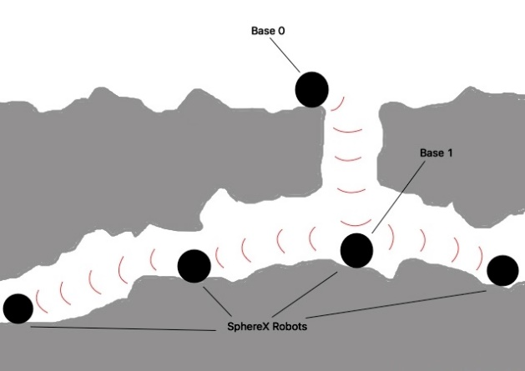
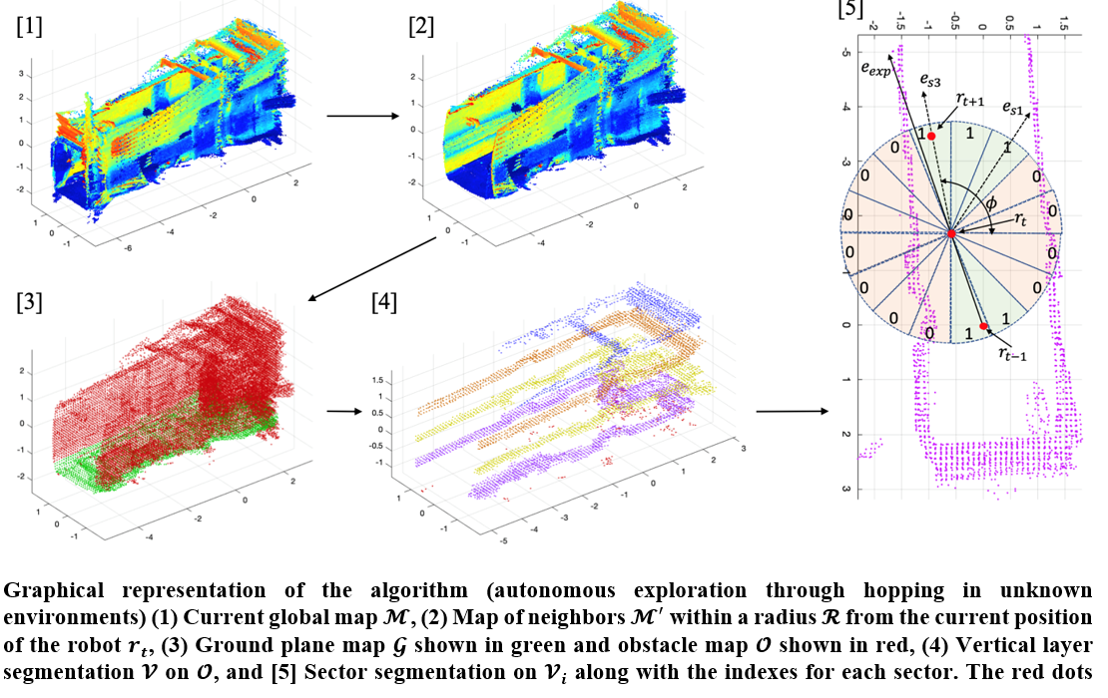
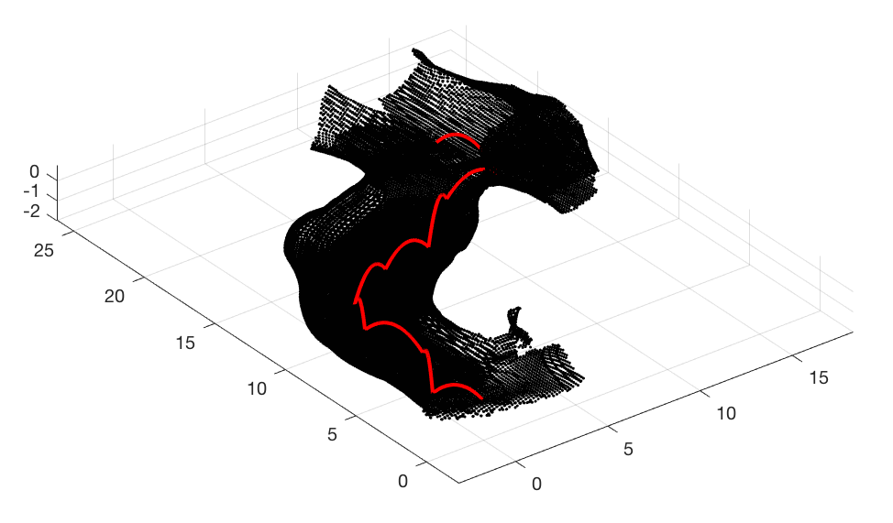
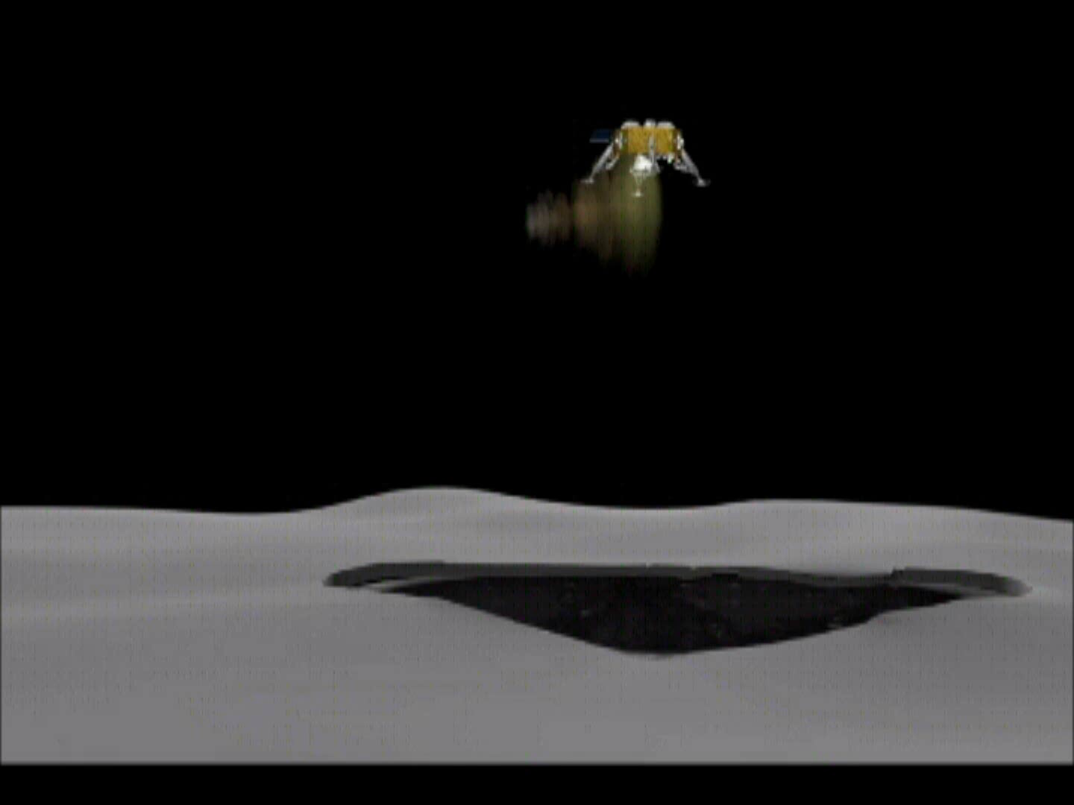
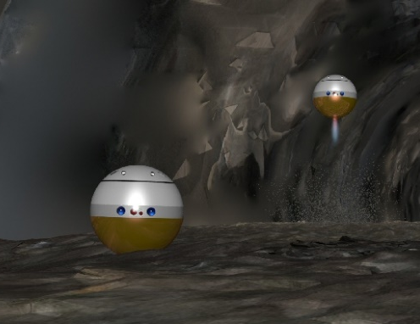
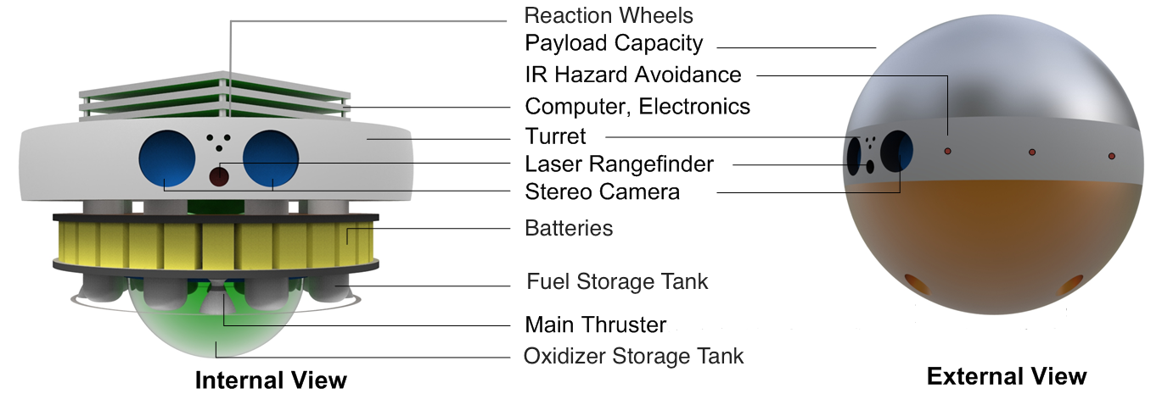

ARNE Mission Concept
[Jekan Thanga*, Mark Robinson, Wagner, 2015]
SphereX Platform
Explore caves, canyons and craters using swarms of flying/hopping robots.

Slide 18
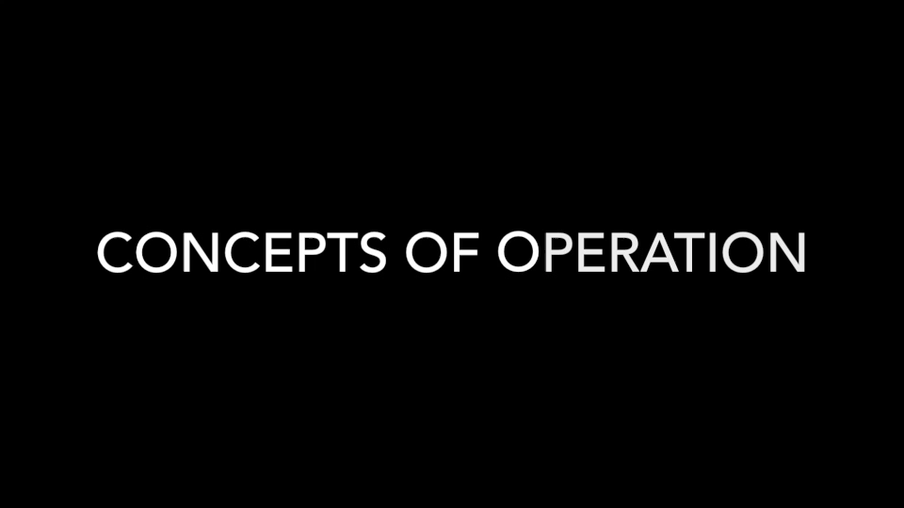
ARNE II Mission Concept
[Jekan Thanga*, H Kalita, Mark Robinson, 2018-]

Slide 19
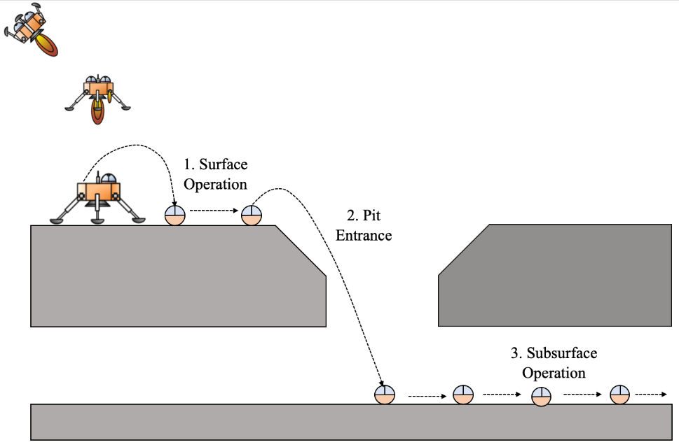
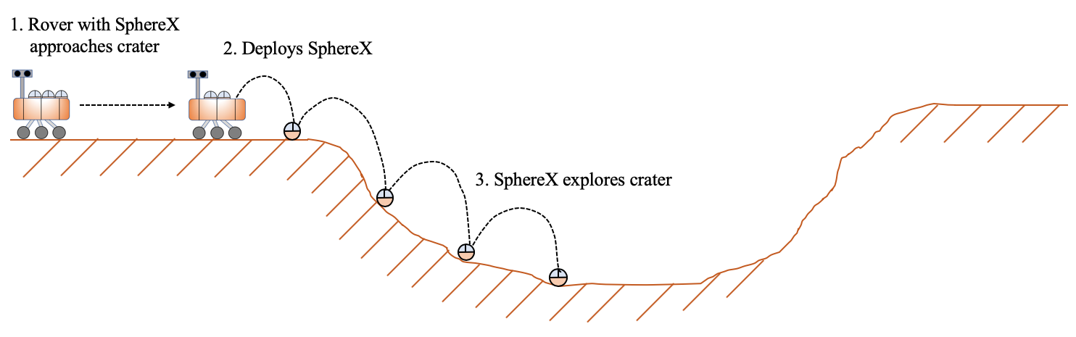
Exploration of Pits, Lava Tubes and Craters
Concept of Operations for exploring planetary pits/lava tubes
Concept of Operations for exploring planetary craters

Slide 20
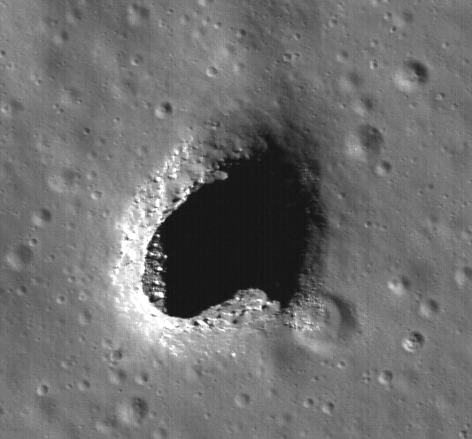
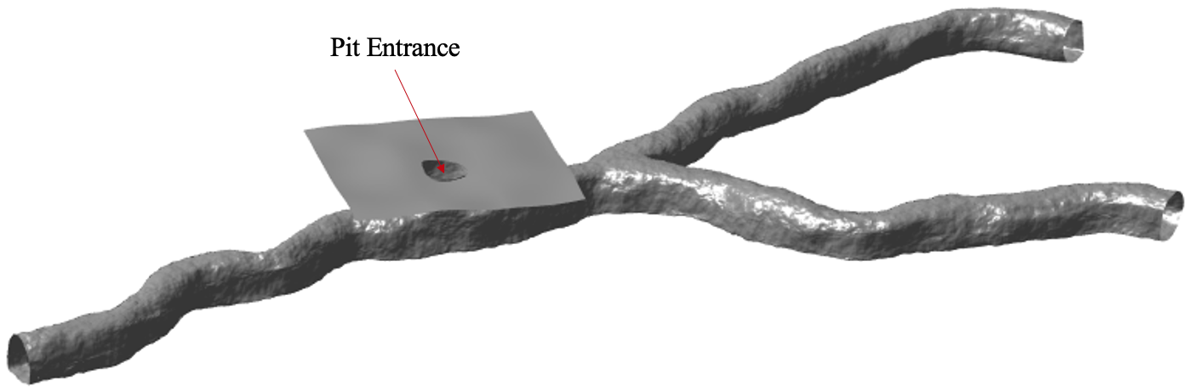
Lunar Pits
Recently discovered lunar mare “pits” are key science and exploration targets.
Ready made shelter for future lunar explorers, benign T (-25º C)
Pristine preservation
  Flow features
  Sublimate minerals
  Regolith? Water?
Mare Ingenni
Mare Tranquilitatis
Marius Hills
Test Model: modelled in Blender

Slide 21
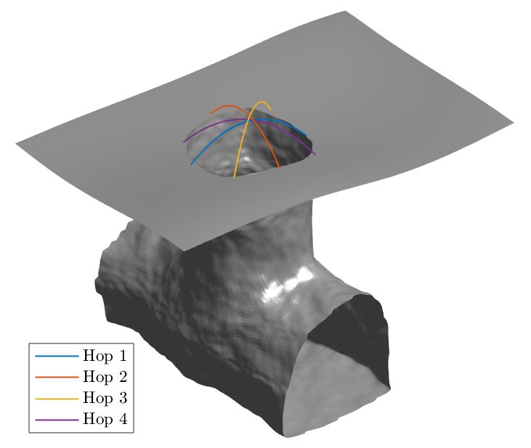
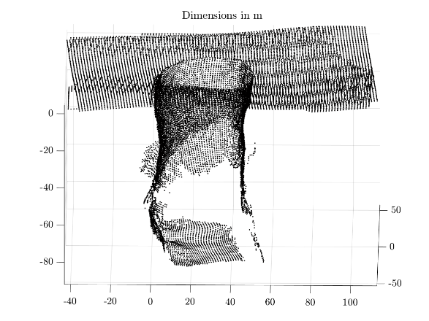




Pit Entrance Survey
Hop 1
Hop 2
Hop 3
Hop 4
Combined Map

Slide 22




Pit Entrance
Map Generated
Position Estimate
Orientation Estimate

Slide 23

Line-of-sight Analysis
Line-of-sight from pit surface to pit floor

Slide 24












Line-of-sight Analysis
$a=5$m
BW$=30°$
BW$=60°$
Laser
$a=10$m
BW$=30°$
BW$=60°$
Laser

Slide 25







Sensor Placement
$$ℙ_{cave}$$
$$ℙ_{obs}$$
Optimal Sensor Placement using RRT*

Slide 26


Sensor Placement
Optimal Sensor Placement using RRT* in an unknown cave through 5 successive Explore$→$Place sensor cycles

Slide 27




Multi-Robot Mapping
Robot 1
Robot 2
Robot 3
Master Map

Slide 28

Protecting Earth’s Endangered Species
Total Nearly: 6.7 million species need protection
  5.1 million Fungi
  0.3 million Plants
  1.3 million Animals
Seed, sperms, eggs, DNA could be stored for hundreds of years at cryo-conditions.

Slide 29

Where to Get Started
Replicate Svalbard Seed Vault on the moon.
Second mission would be to carry 12U CubeSat canisters containing seeds and store them in a lava tube.
Estimates show 15 launches of SpaceX Falcon Heavy.
Svalbard Seed Vault

Slide 30

Seeds to be Stored
Based on the Svalbard experience seeds would be stored in foil bags and sealed (500 per species).
Depending on amount of background radiation from granite, will need additional protection.
Store 1 million seeds.

Slide 31

Seed Ark vs Full Ark
International Space Station took 40 launches. Lunar Seed Ark can be started now without breaking the bank!

Slide 32

A Modern Lunar Ark
Modular robotic base inside lava tube powered using renewable energy.

Slide 33


Lunar Ark Modules
Modules would be pre-fabricated and transported from Earth
Envision using SpaceX Falcon Heavy or SLS to do the heavy lifting.
Current numbers show
need for 250 Falcon Heavy
launches!
Design optimization – next step

Slide 34

Lunar Ark
Shafts for base expansion and preserve transport
Preserves held cryo-modules

Slide 35

Cryo-Module Cross Section
Cryo-module hold preserves in cassettes stored at -180 ºC to 196 ºC
Floating 7-DOF robot manipulator retrieves preserve

Slide 36
Structures & Thermal Insulation
Material | Thermal expansion coefficient | Thickness (mm)
Ortho-fabric (outer) | 1.2 × 10⁻⁴ | 4
Aluminized mylar | 1.7 × 10⁻⁵ | 6
Goretex Pressure Garment | -1.0 × 10⁻⁵ | 3
Bladder (coolant) | 2.4 × 10⁻⁴ | 4
Nylon Ripstop | 8.0 × 10⁻⁵ | 3
Ortho-fabric (inner) | 1.2 × 10⁻⁴ | 3
Aluminum | 2.3 × 10⁻⁵ | 20
Multiple layers, consisting of inflatable bladder, pressure garments, nylon ripstop, with AL 6065 backing

Slide 37

Lunar Ark and Logistics Base

Slide 38

Power Needs – Lunar Full Ark
Total Subsurface Cryo-modules: 5 Needed
For modules at -180 ºC:
  2.3 kW
For modules at -196 ºC
  3.8 kW
Cryo-modules total: 23 kW
More work needs to be done to figure out if 5 cryo-modules enough or more needed.

Slide 39
Power for Lunar Ark
Power to be generated using PV cells located on surface operating over lunar day.
Ark needs 11,000 kWh for lunar day.
Total needs: 28,500 kWh (including margins)
Solar Panels: 191 m², 3TJ, 30% efficiency

Slide 40
Lunar Seed Ark
Refrigeration power needs is zero.
Still will need small amount of power for lighting. (500 W) and controlled access.
Laser power beaming from surface could be sufficient.
Simple elevator shaft placed at center of pit with “T” support structure anchoring surface.
Lunar seeds placed in stacked 12U cannisters, no need for building complex structure to house them.

Slide 41
Conclusions
Proposed a Seed Lunar Ark as first step before trying to protect all major animals, plants, fungi.
Would store 1 million seed packets
Need 15 launches (SpaceX Falcon Heavy)
Material needs to be preserved at -18 C
Technology exist to do this now (within 5 years)

Slide 42






Authors
Alvaro Diaz-Flores
Claire Pedersen
Yinan Xu
Lindsey Williams
Prof. Cholik Chan
Prof. Jekan Thanga

Slide 43

Thank You!

Slide 44
Questions ?

