Slide 1


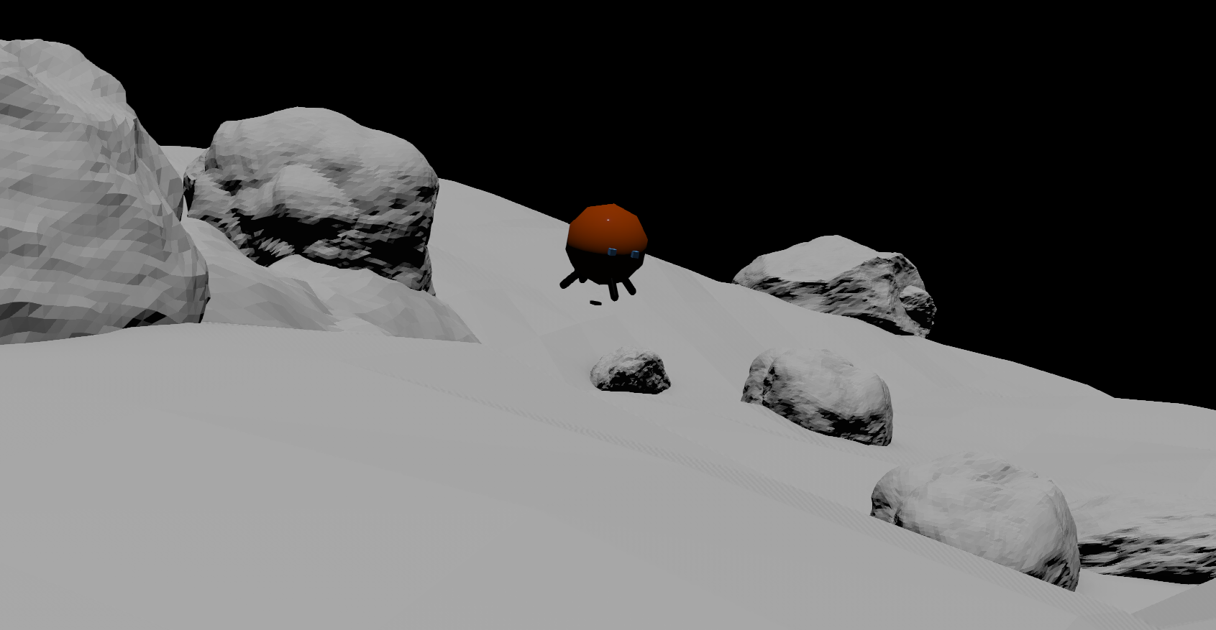
Simulation and Evaluation of a Mechanical Hopping Mechanism for Robotic Small Body Surface Exploration
Kevin May
Dr. Jekan Thanga, Himangshu Kalita, Dr. Stephen R. Schwartz
University of Arizona ASTEROIDS Laboratory
Interplanetary Small Satellite Conference (ISSC) 2021
May 3-4, 2021

Slide 2
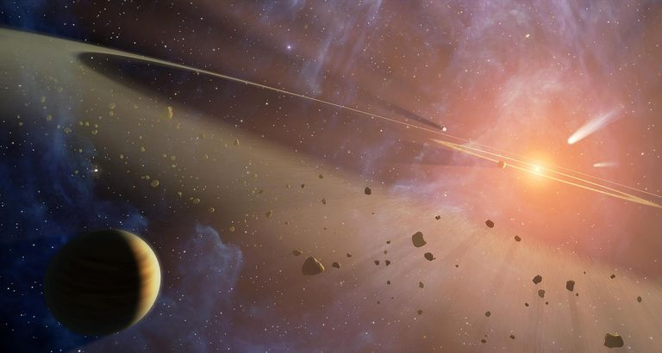
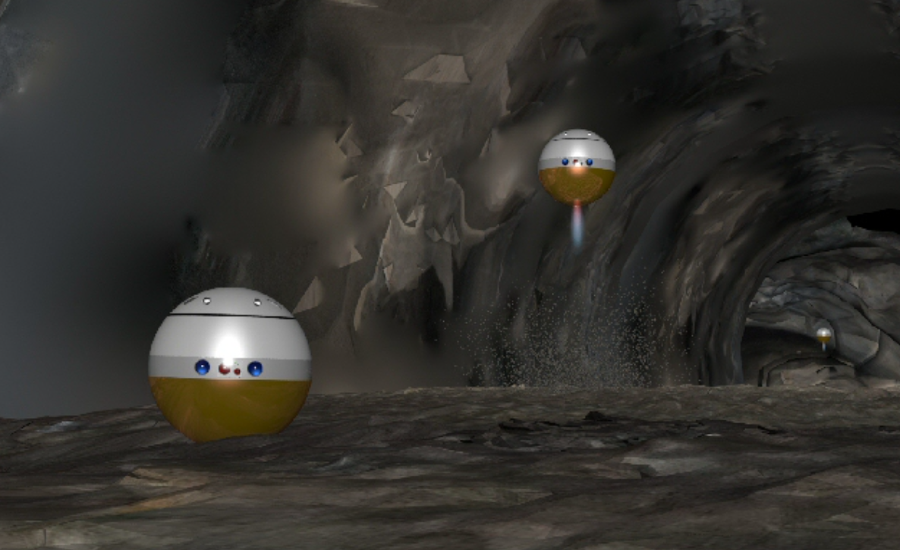
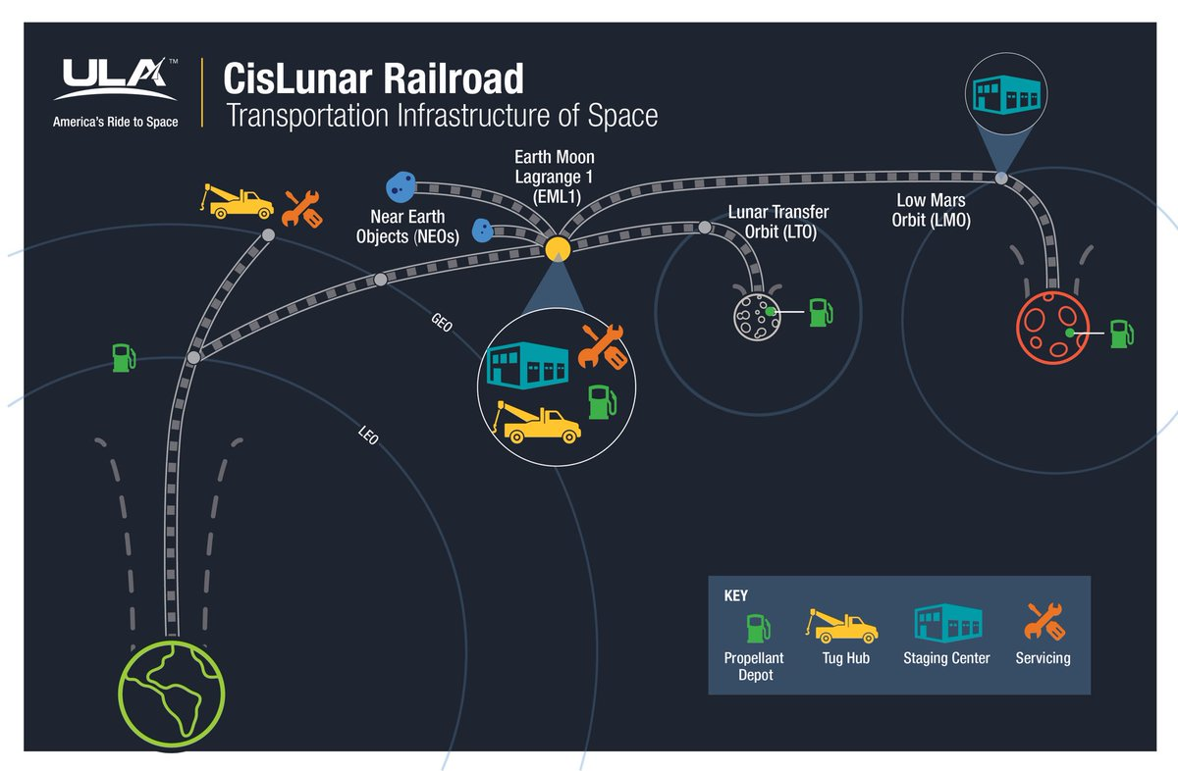
Motivation
Origins of our Solar System
Cost-Effective Exploration
NASA/JPL-Caltech
SpaceTREx
Interplanetary Species
ULA

Slide 3
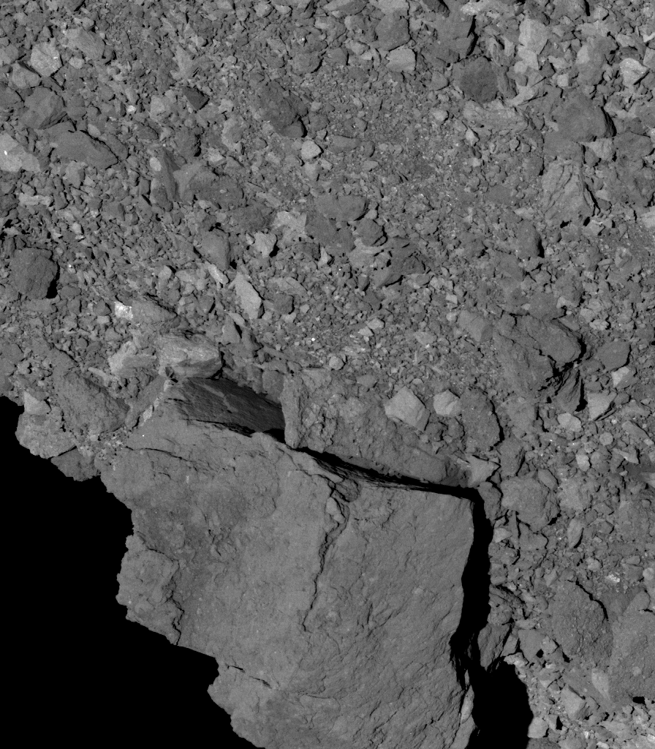
Challenges with Small Body Exploration
Rough terrain with obstacles
Extremely low gravity
  Complex surface interactions
  Low escape velocity
NASA/Goddard/University of Arizona

Slide 4
Objective
Simulate the movement and interactions of small hopping robots within a realistic small-body environment
  Develop and implement a more realistic asteroid model on local scale (e.g., Bennu, Deimos)
  Design a small surface robot with hopping capabilities (SphereX) and control in simulated environment
  Model and analyze the complex surface interactions between the hopping system and rubble-pile regolith

Slide 5
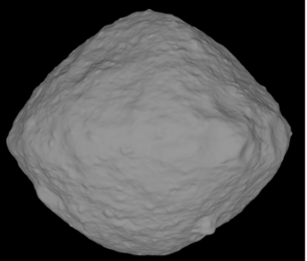
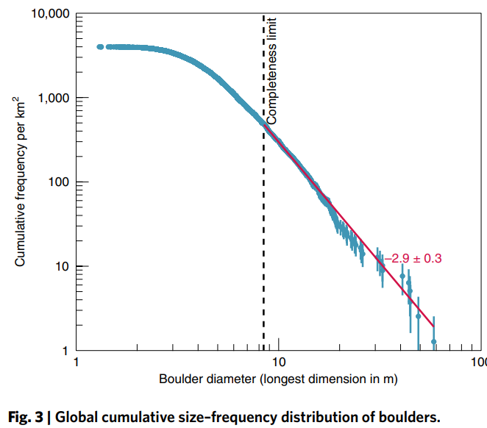
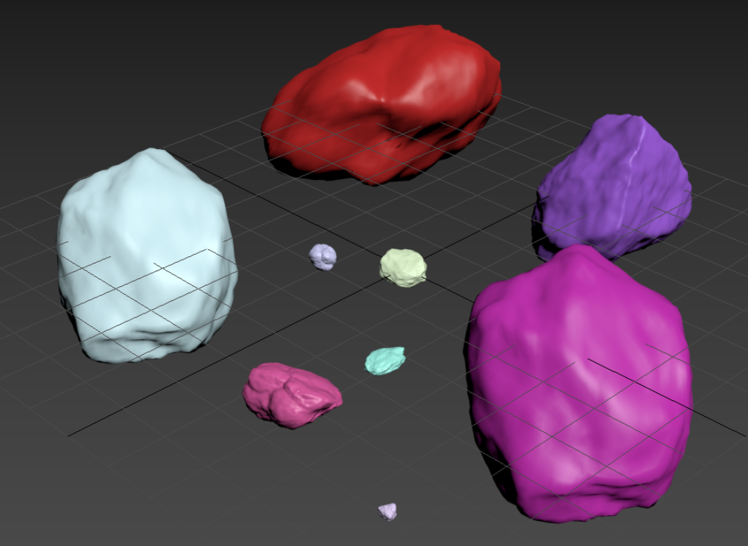
Approach – Small Body Environment
Bennu shape model
Relatively accurate local boulder distribution
  RStones script, 3ds Max
NASA/Goddard/University of Arizona
DellaGuistina et al., 2019

Slide 6
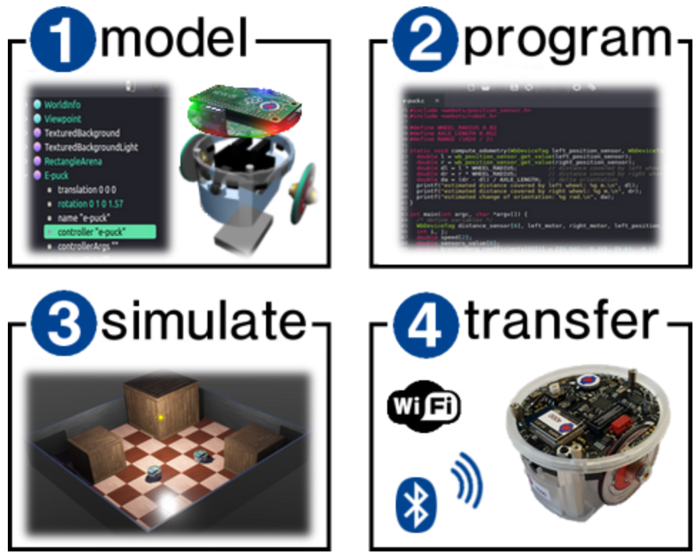
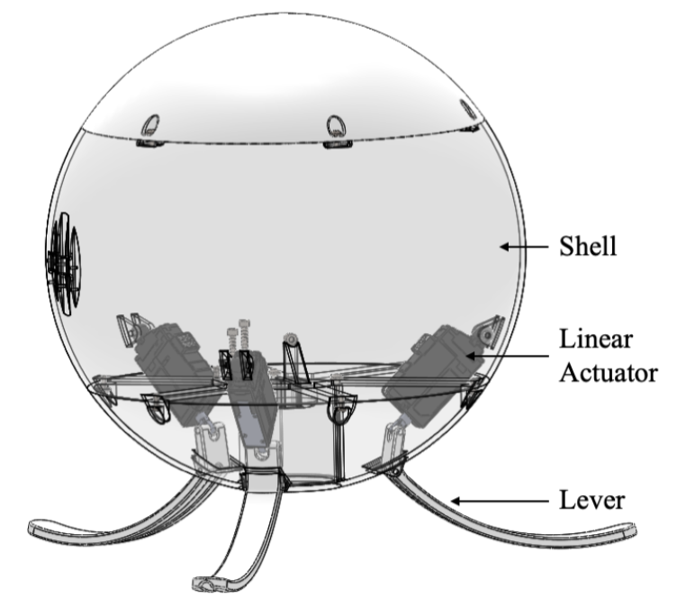
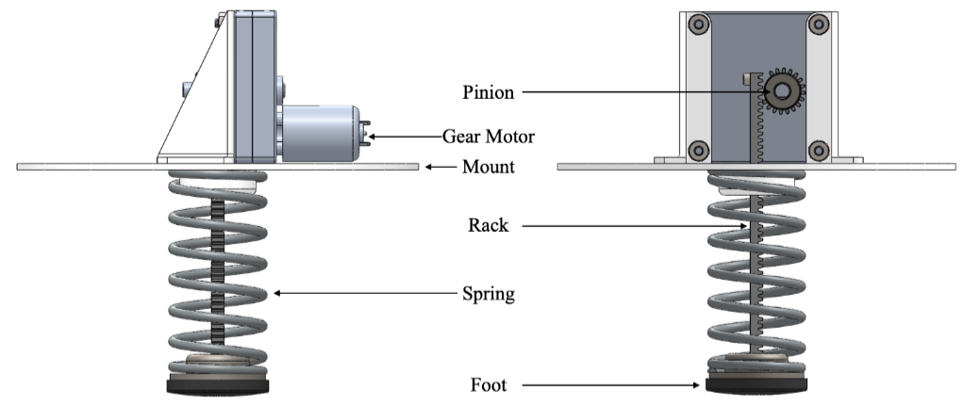
Approach – Webots
Webots – robot simulation software
  Environment – physics, surfaces, solids…
  Robot(s) – solids, motors, cameras, controllers…
SphereX mechanics
Kalita et al. 2019

Slide 7
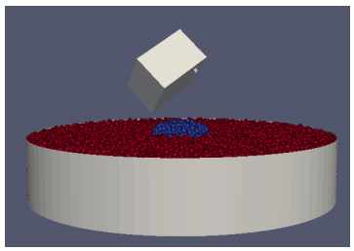
Approach – pkdgrav
n-body code adapted to compute granular dynamics for planetary science*
  Develop regolith bed similar to rubble-pile asteroid surface
  Simulate and observe interactions between hopper foot and regolith (various shapes, sizes, velocities, etc.)
MASCOT Lander (Thuillet et al. 2019)
* Stadel 2001; Richardson et al. 2000; Schwartz et al. 2012

Slide 8
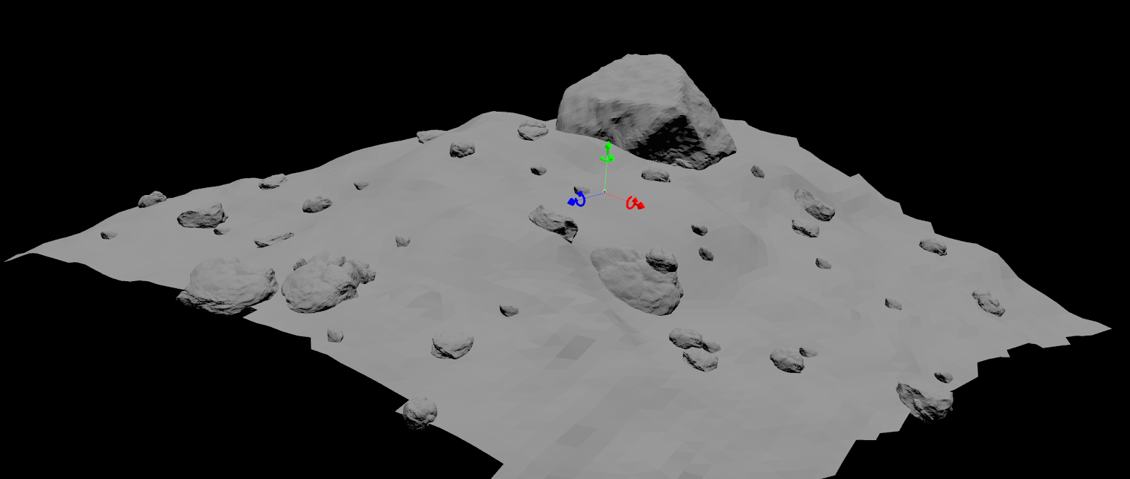
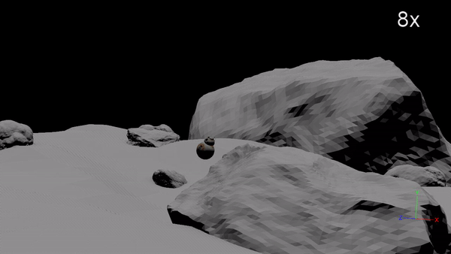
Results – Environment
Boulder distribution across local “chunk”
  Global cumulative size-frequency distribution
  Randomized scatter
Bounded solid object interaction (robot + surface)

Slide 9
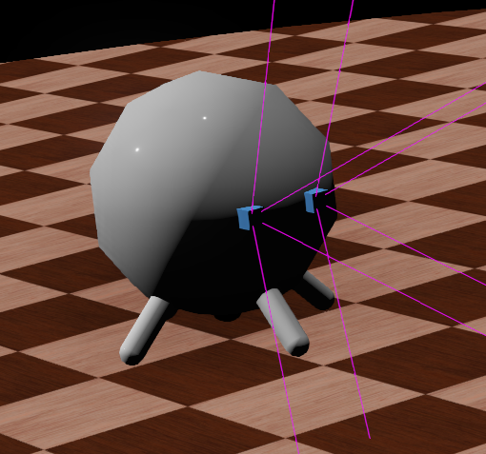
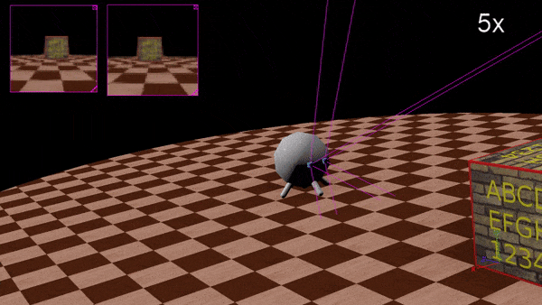
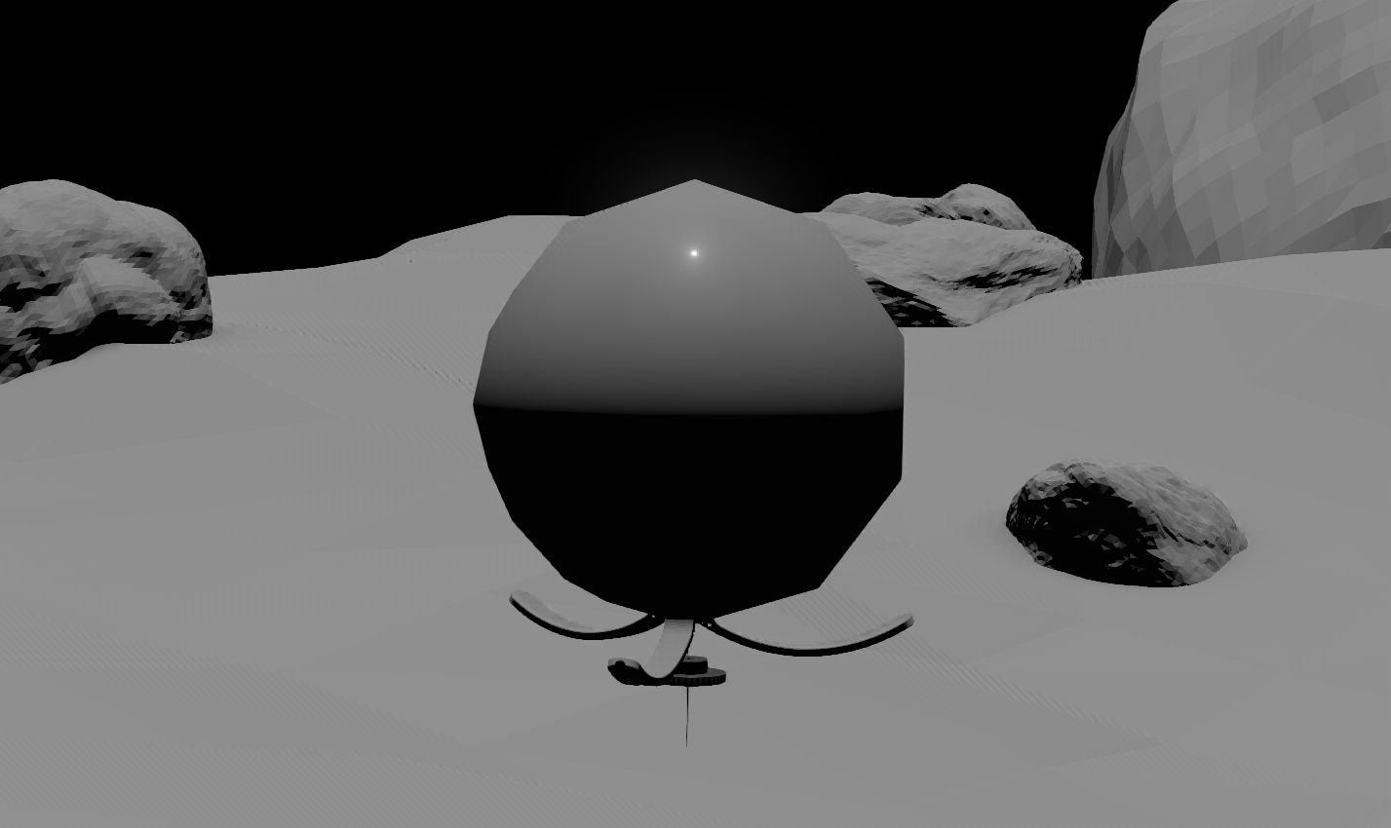
Progress – Robot
SphereX-like robot
  Solid model
  Linear motors
  Camera system
  Controller vs. manual
Solid, spherical body
Dual cameras
Spring/foot (linear motor)
Levers (linear motors)

Slide 10
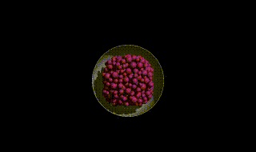
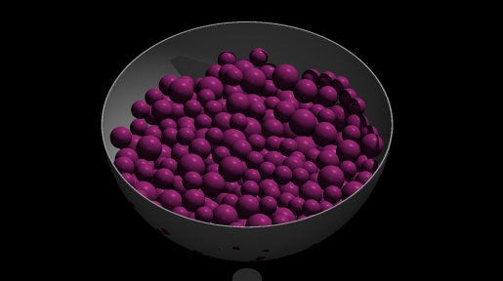
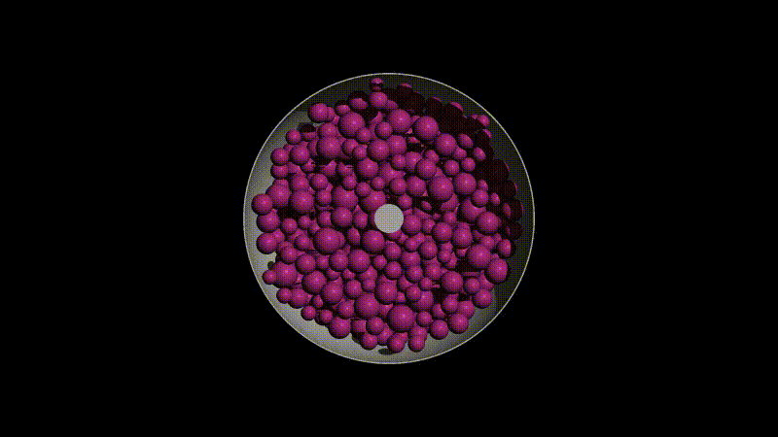

Progress – pkdgrav

Slide 11
Significance / Future Work
Robotic simulation
  Controlling hops to take desired path
  Obstacle awareness in developed environment, intelligent path planning (machine learning)
  Transfer controller to real robots
Surface granular dynamic interactions
  Evaluate foot design for optimal normal force, low regolith dispersion
  Can be applied to various surface robots / sample acquisition mechanisms

Slide 12
Acknowledgements
ASTEROIDS Laboratory
  Dr. Jekan Thanga
  Himangshu Kalita
  Dr. Stephen R. Schwartz
NASA MIRO
Arizona/NASA Space Grant Consortium
Interplanetary Small Satellite Conference

Slide 13
References
DellaGiustina, Dani & Emery, Joshua & Golish, D. & Rozitis, B. & Bennett, C. & Burke, K. & Ballouz, Ron & Becker, K. & Christensen, P. & Drouet d'Aubigny, Christian & Hamilton, V. & Reuter, Dennis & Rizk, B. & Simon, Amy & Asphaug, E. & Bandfield, J. & Barnouin, O. & Barucci, Maria & Bierhaus, E. & Bernacki, Marc. (2019). Properties of rubble-pile asteroid (101955) Bennu from OSIRIS-REx imaging and thermal analysis. Nature Astronomy. 3. 1. 10.1038/s41550-019-0731-1.
Derek C. Richardson, Thomas Quinn, Joachim Stadel, George Lake. (2000). Direct Large-Scale N-Body Simulations of Planetesimal Dynamics. Icarus. 143. 1. 45-59. 10.1006/icar.1999.6243.
Kalita, Himangshu & Jameson, Troy & Stancu, George & Thangavelautham, Jekan. (2019). Design and Analysis of a Mechanical Hopping Mechanism Suited for Exploring Low-gravity Environments. IEEE Aerospace Conference Proceedings.
Michel, Olivier. (2004). WebotsTM: Professional Mobile Robot Simulation. International Journal of Advanced Robotic Systems. 1. 10.5772/5618.
Schwartz, S.R., Richardson, D.C. & Michel, P. (2012). An implementation of the soft-sphere discrete element method in a high-performance parallel gravity tree-code. Granular Matter. 14. 363–380. 10.1007/s10035-012-0346-z
Stadel, Joachim. (2001). Cosmological N-body simulations and their analysis. Cosmological N-body Simulations and Their Analysis.

Slide 14
Thank You
Asteroid Science, Technology and Exploration Research Organized by Inclusive eDucation System (ASTEROIDS) Center
* Center Designation Application in Progress

