Slide 1


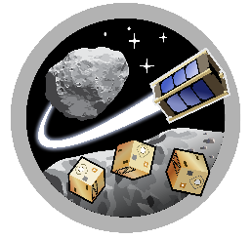

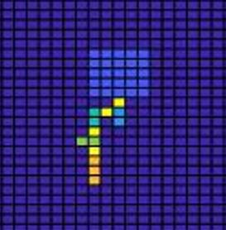
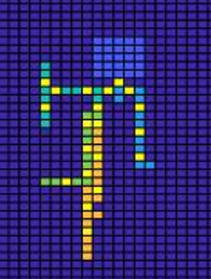
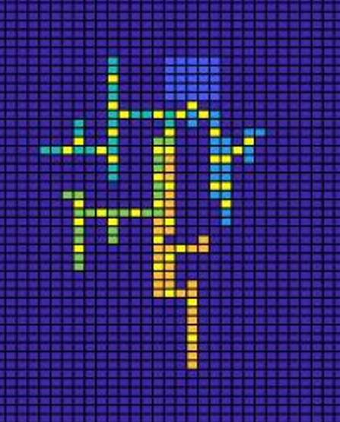
MIRO
ASTEROIDS
Automated Design of Off-world Multi-Robot Mining Base Using L-Systems/Bio-inspired Methods
Charles Penny
Asteroid Science, Technology and Exploration Research Organized
by Inclusive eDucation System (ASTEROIDS) Center
University of Arizona

Slide 2
Outline
Project Background/Motivation
Project Objective
Methodology
Challenges
Results
Discussion
Conclusion

Slide 3
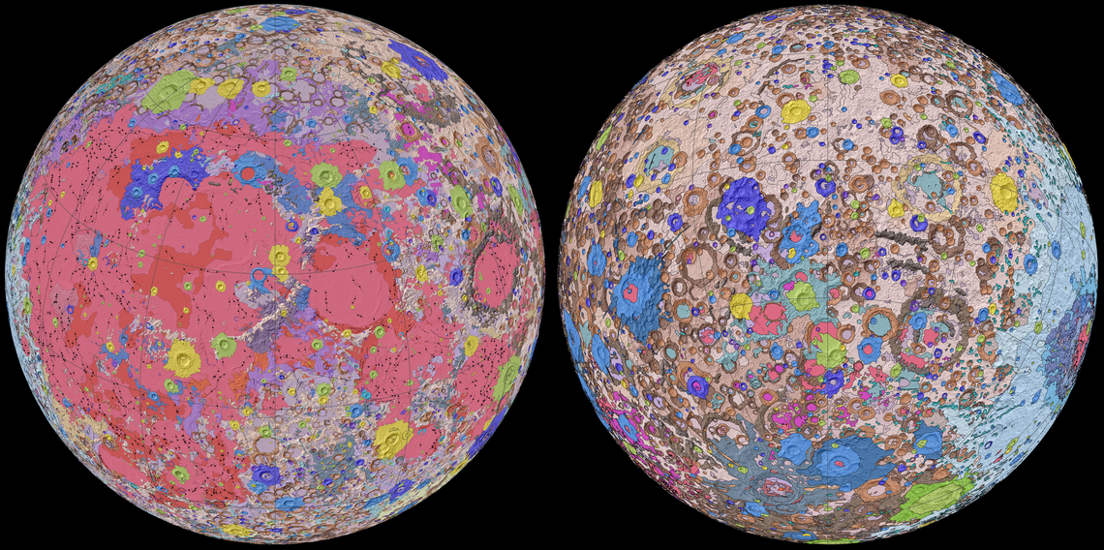
Motivations
Resources worth hundreds of billions (JPL estimate)
  In-Situ Construction Applications
  Cis-Lunar Fueling Applications
  Possible Earth Applications
Lunar Geological Map, USGS

Slide 4
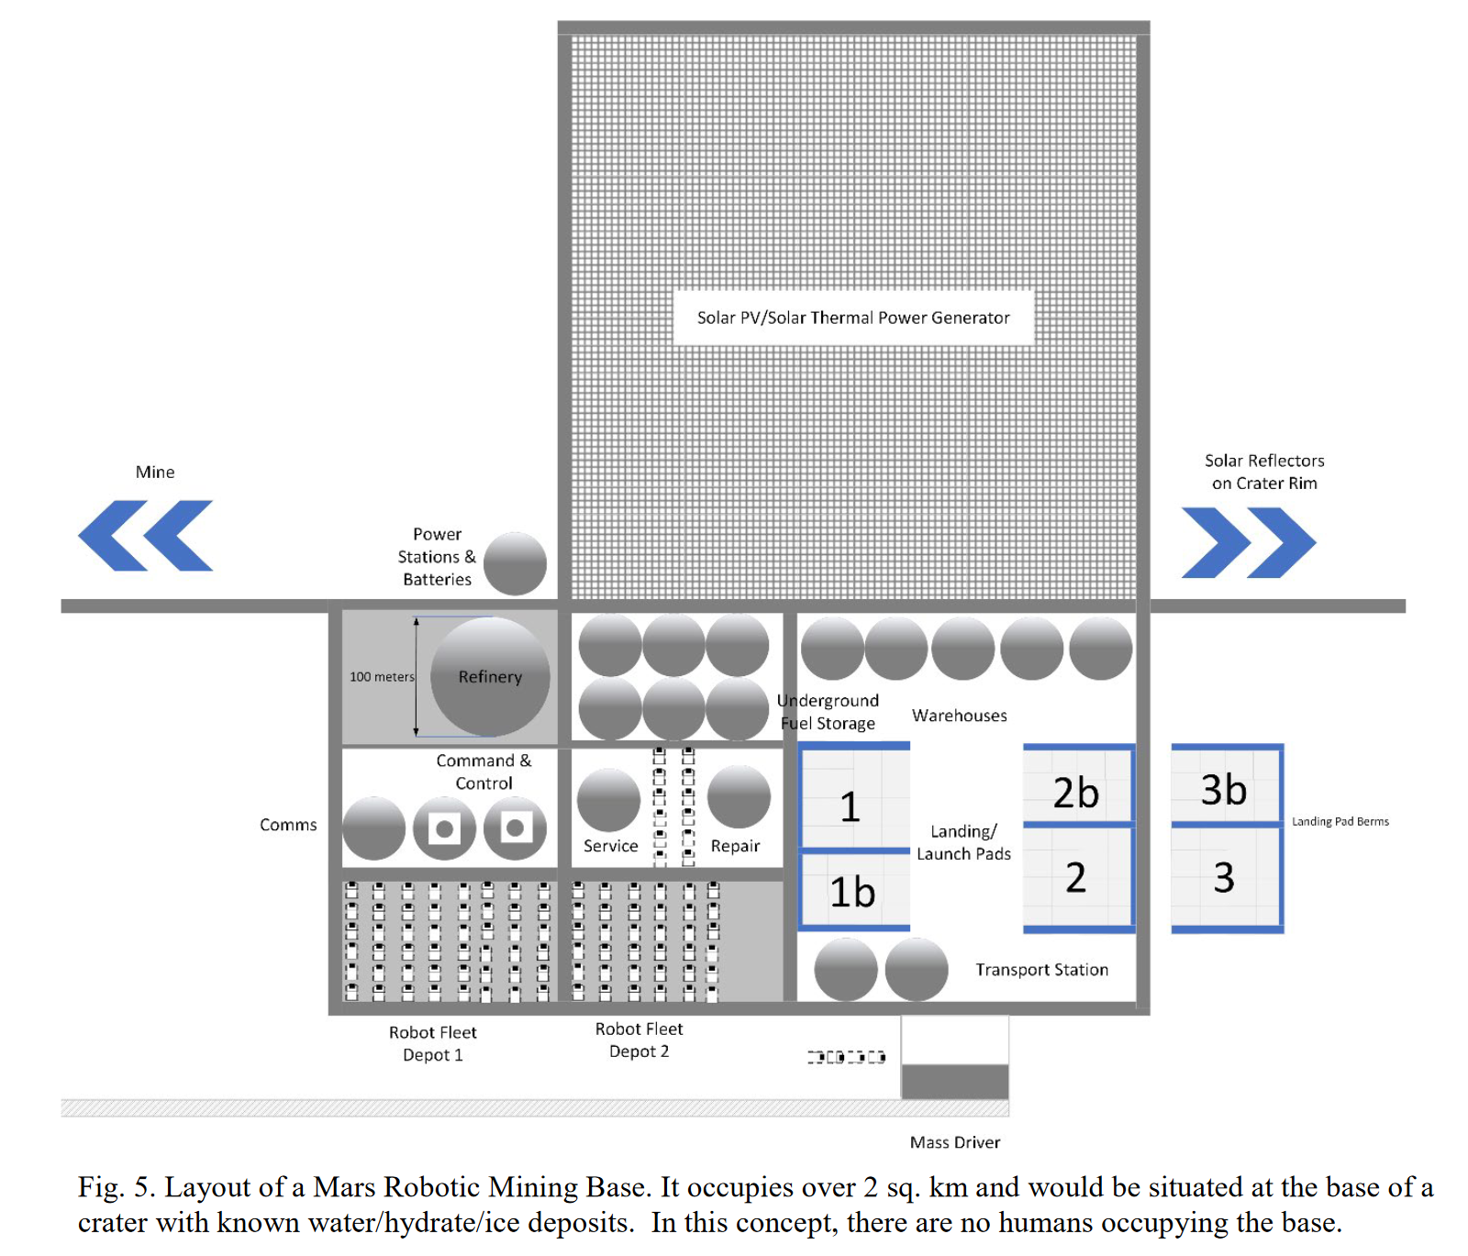
Current Research
Potential of multi-robot mining
  Removes human presence
  Operates efficiently and adaptably
J. Thangavelautham, A. Chandra, E. Jensen, “Autonomous Multirobot Technologies for Mars Mining Base Construction and Operation” IAC, 2019

Slide 5
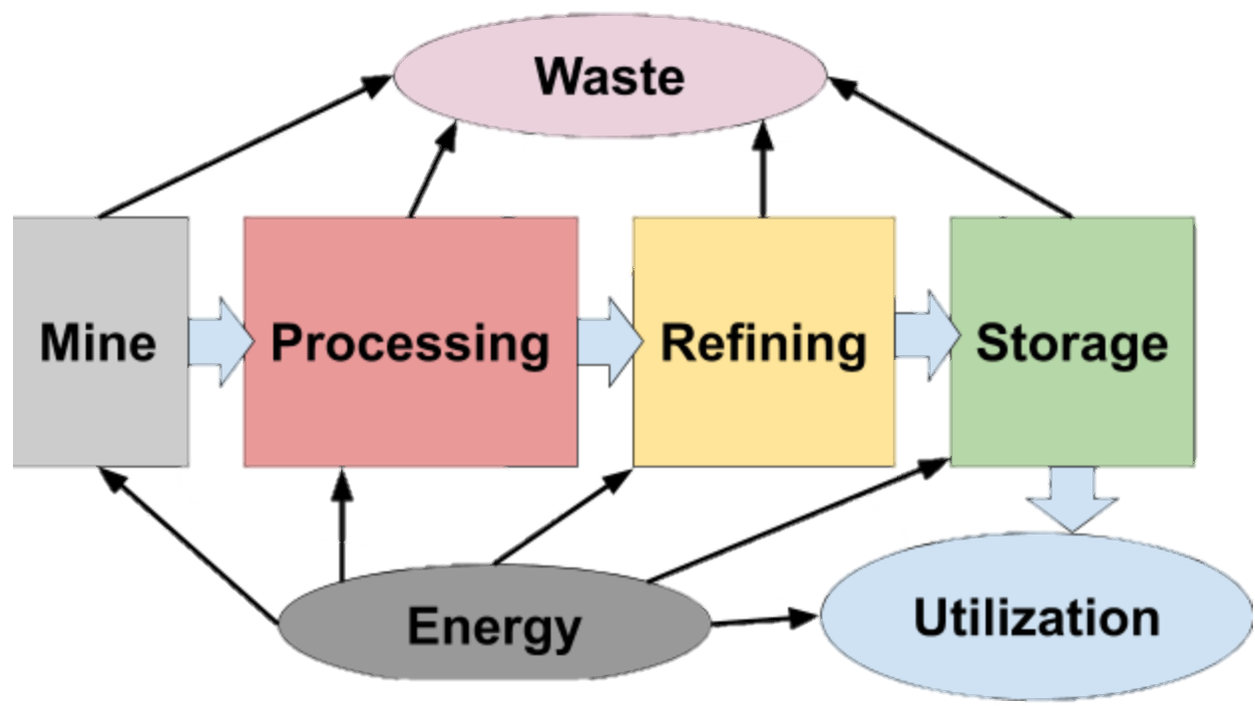
Objective
Automate the design of a mining base
  Design to be hardy
  Design to be efficiently placed
  Design to access resources

Slide 6
Challenges
Equipment needs to be specialized
  size and mass constraints
  limited in-situ deployment
  Processing/ crushing equipment may be reusable
Refining A
Refining B
Refining C
Processing
A-Rich Deposit
B-Rich Deposit
C-Rich Deposit

Slide 7
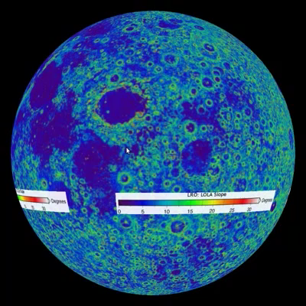
Method
Import terrain data
Extrapolate ore concentration data
Use L-systems to generate layout
  Inspired by plant root growth
Score results
Lunar Reconnaissance Orbiter Slope Data, NASA/Washington University
Notes:
Ore concentration data extrapolated from information made available by the Center for Lunar Science and Exploration. The ejecta blankets on the edges of craters offer the greatest regolith concentration of REMs. So the slope/ elevation data from the Lunar Reconnaissance Orbiter can be used to make guesses where higher ore concentrations might be found. Since I do not know exactly how accurate/consistent this would be, I added an element of randomization

Slide 8
Scoring
Redundancy
  If a piece of equipment fails, how far is the next usable piece of equipment?
Cost
  How rough is the terrain?
Mining Access
  What is the richness of the ore reached?
Spread
  How far apart are the furthest points
Sustainability
  How accessible is the staging area?
Notes:
Briefly mention scoring – this is important!

Slide 9
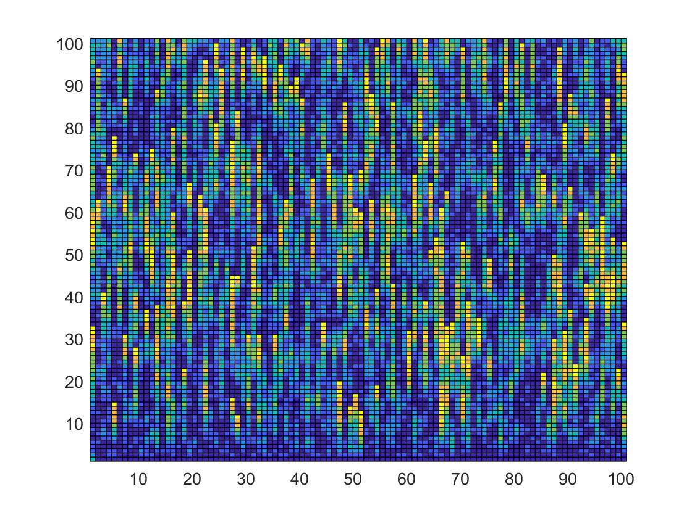
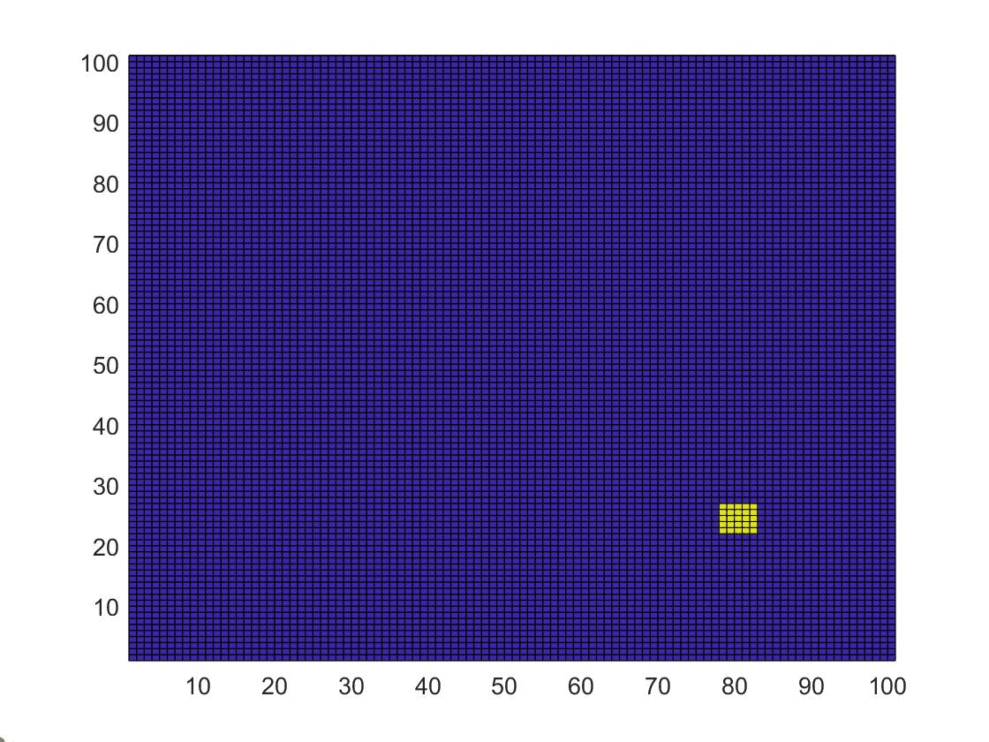
Results
Roughness heatmap from data
Algorithmic initial positioning
Notes:
This particular map was generated from an “ejecta blanket” area,

Slide 10
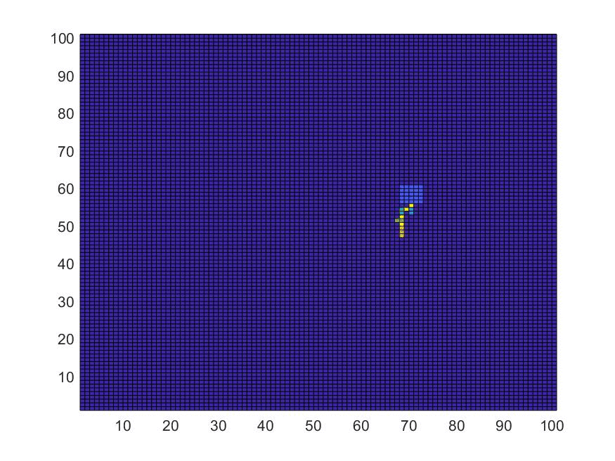
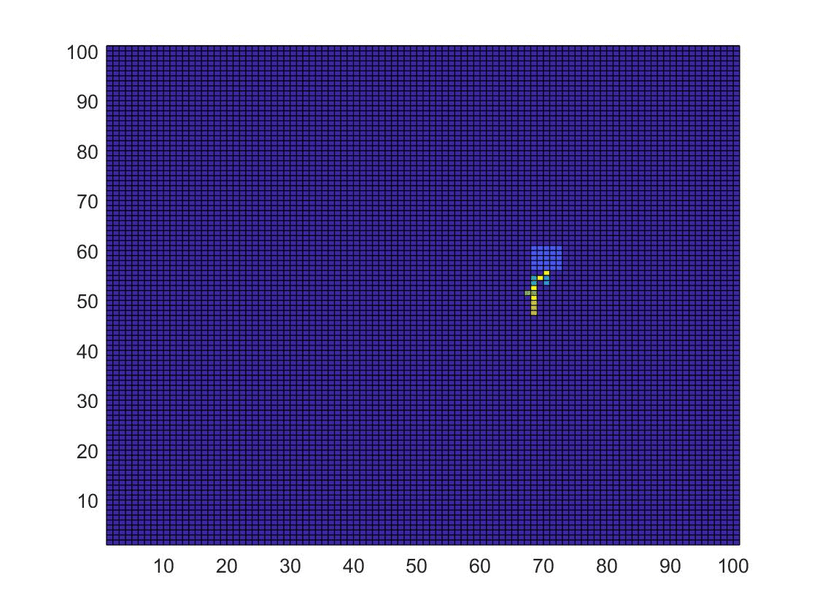

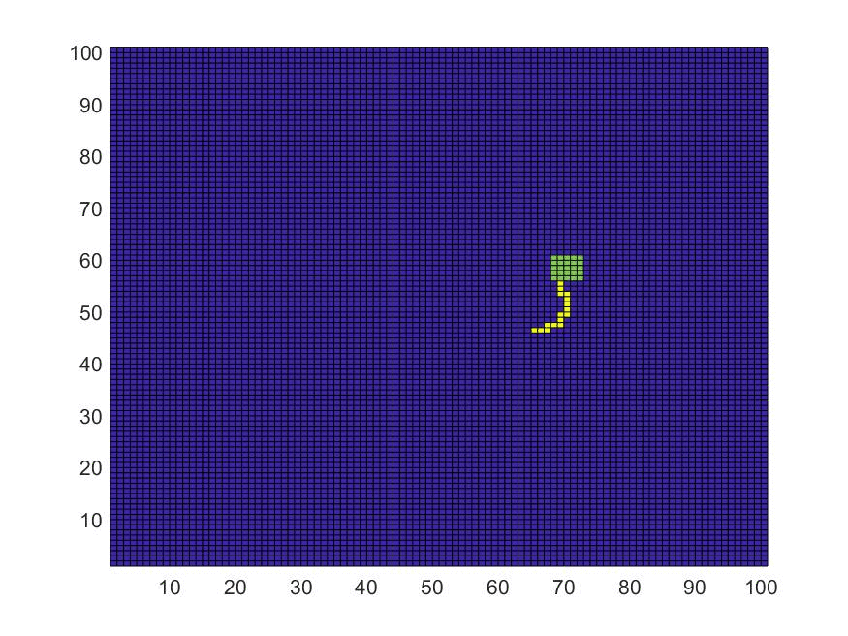
Results
Breakoff
Sprawl
Minor Variation in L-Systems
Hybrid
Central

Slide 11
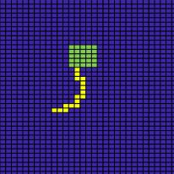
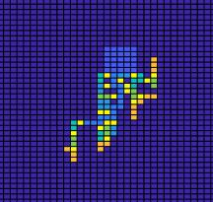
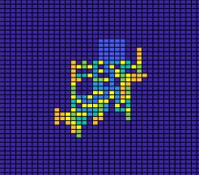
Analysis
Central L-System won out overall
  Efficient placement
  Good mining access
  High redundancy

Slide 12
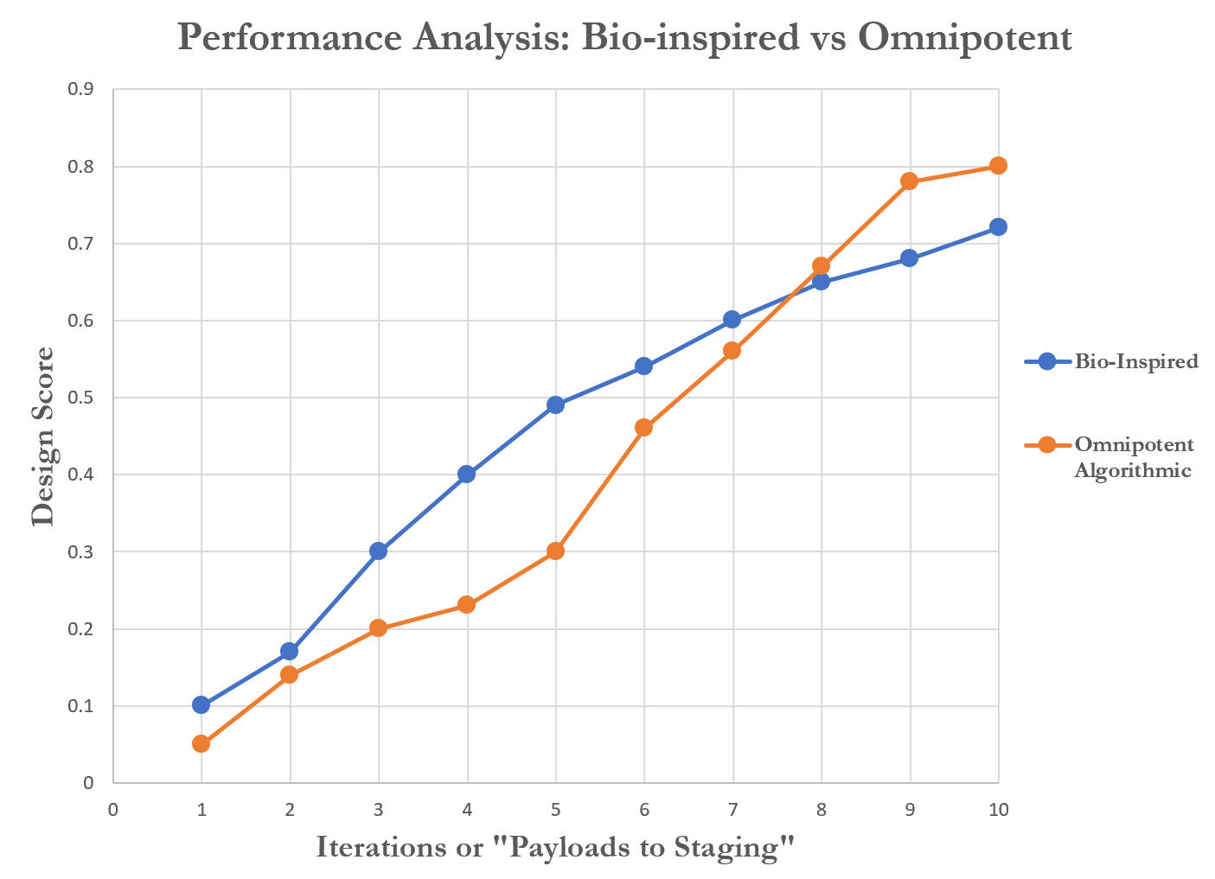
Conclusion

Slide 13
Moving Forward
Work out specifics better
  A base for producing fuel is going to be much different from a REM mining base
  How small can processing and refining equipment be to still be viable?
Incorporate multi-robot system path planning

Slide 14
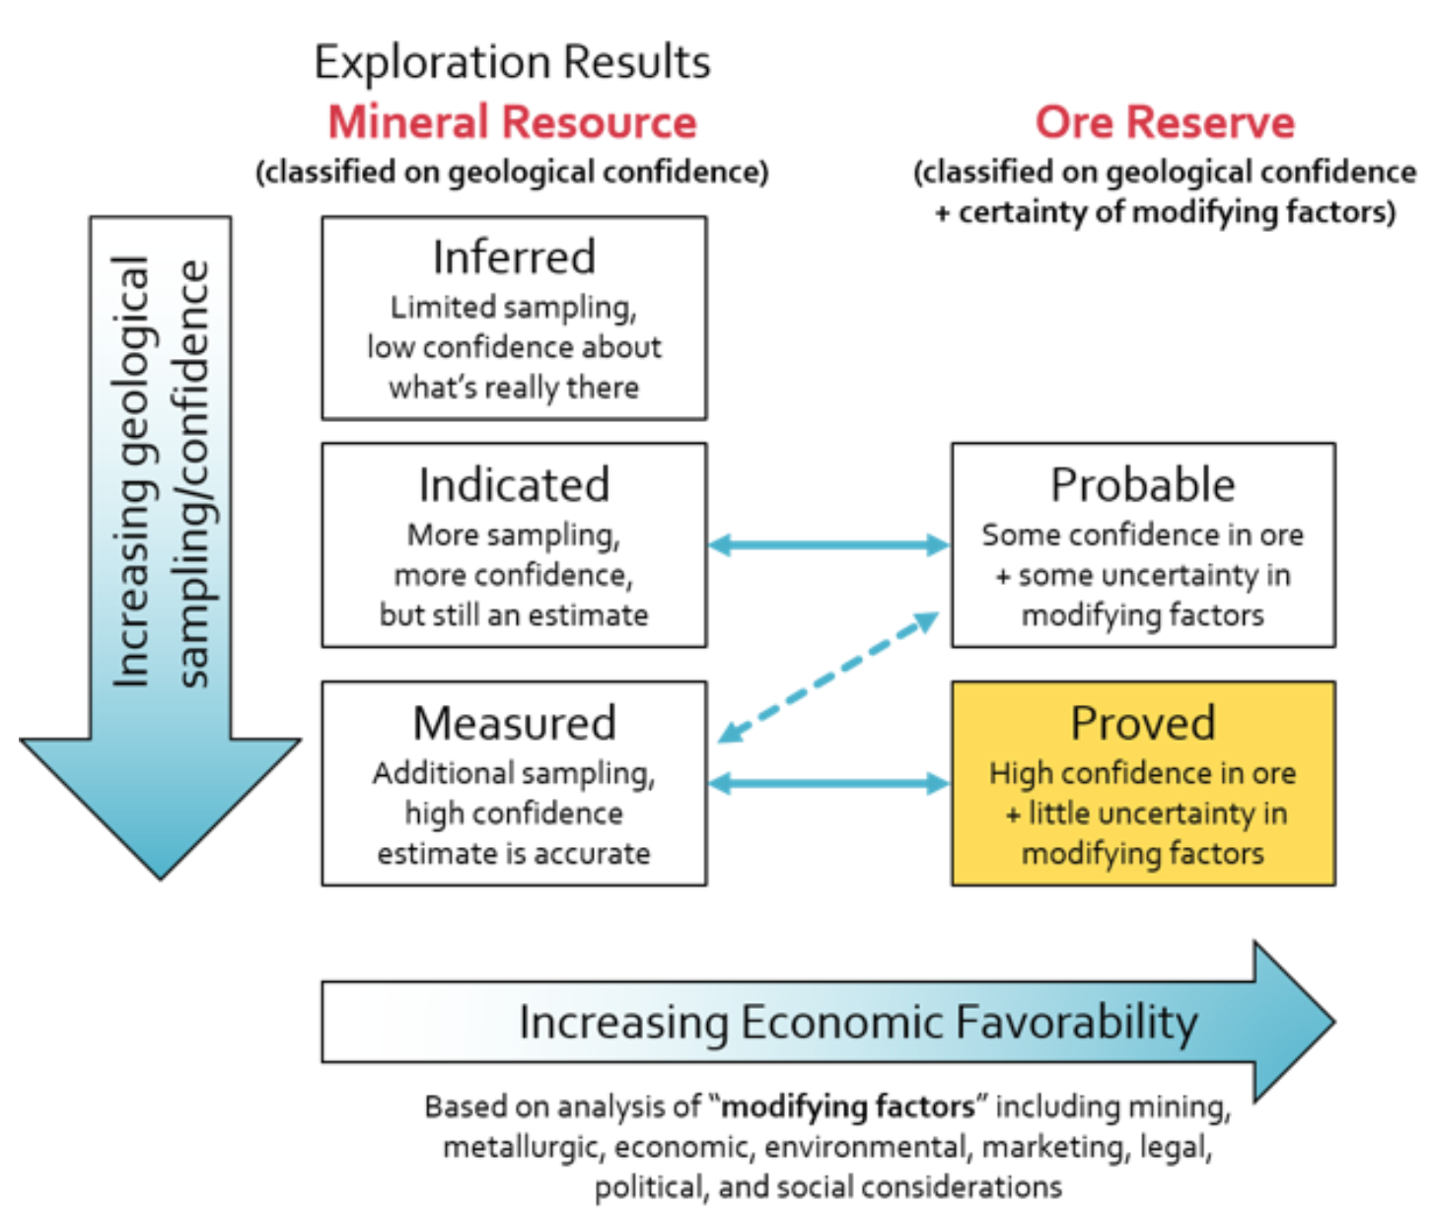
International Cost Estimating and Analysis Association (ICEAA), Cost and Market Modeling for Lunar Mining and Drilling, 2019

Slide 15

Asteroid Science, Technology and Exploration Research Organized
by Inclusive eDucation System (ASTEROIDS) Center
* Center Designation Application in Progress

Slide 16
http://www.iceaaonline.com/ready/wp-content/uploads/2020/01/Blair-Cost-and-Market-Modeling.pdf
https://www.lpi.usra.edu/exploration/education/hsResearch/crateringLab/lab/part2/background/

