Slide 1


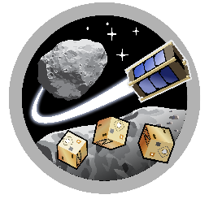
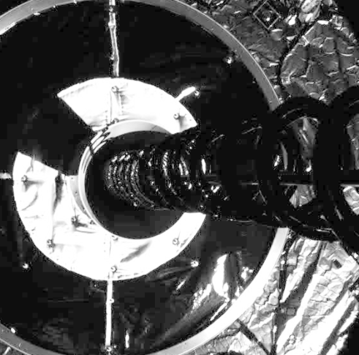
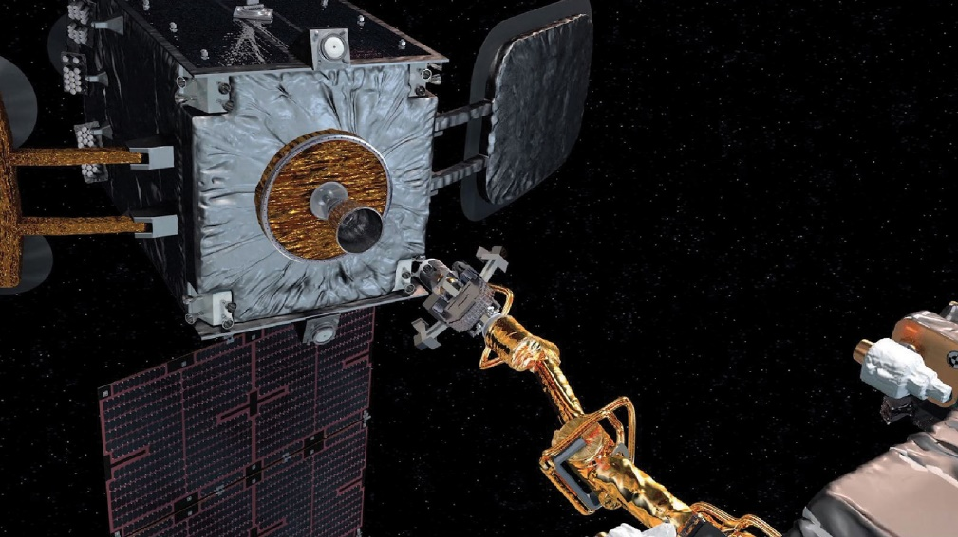
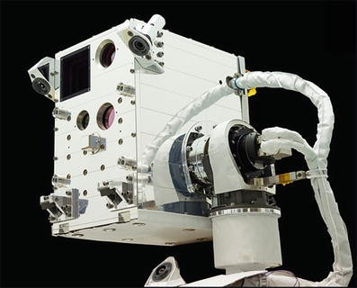
ASTEROIDS
Design of Two-Stage Docking System for Autonomous Micro-Aerobots & CubeSats
Kairav Kukkala
Space and Terrestrial Robotic Exploration (SpaceTREx) Laboratory
Aerospace and Mechanical Engineering Department
University of Arizona

Slide 2
Outline
Motivation
Current Research Focus/Related Works
Project Objective
Challenges
Concept of Operations
Design Discussion
Results
Conclusion
Future Work
Acknowledgements

Slide 3

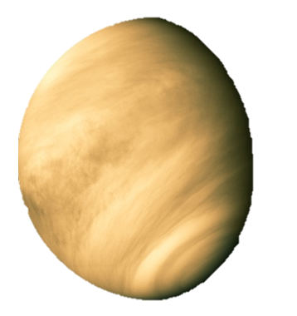
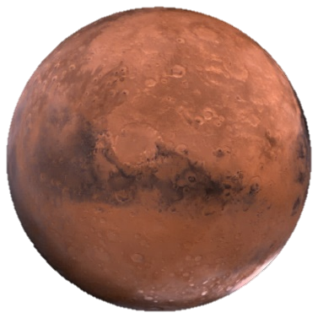
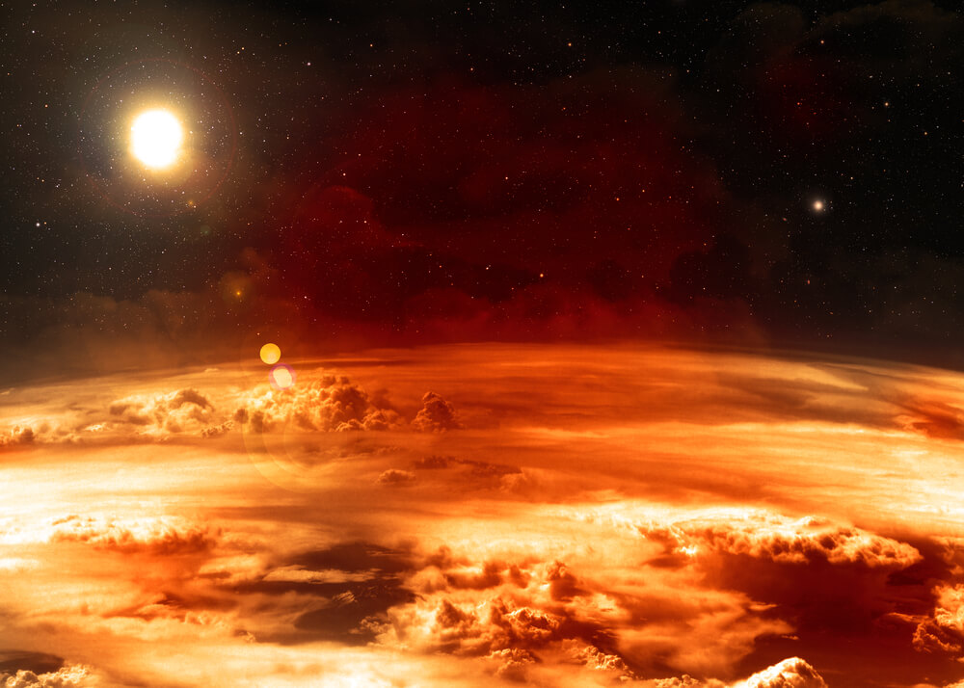
Motivation
Extend atmospheric exploration range and life
Transfer Data & Power
Connectivity to Form Larger Exploratory Vehicles
Mars
Venus

Slide 4
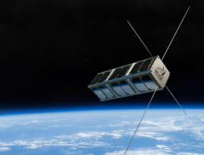
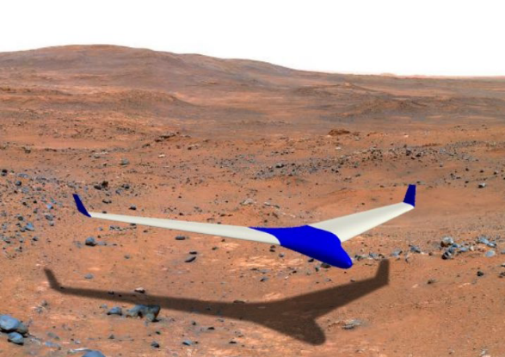
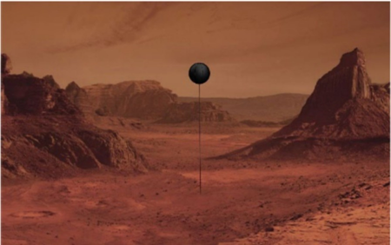
Current Research Focus/Related Work
Mars Exploratory Balloon (MEB)
Secondary Vehicle (e.g., Sailplane)
Large Spacecrafts Docking Systems
Docking between Small Spacecraft
  CubeSat Docking Types

Slide 5
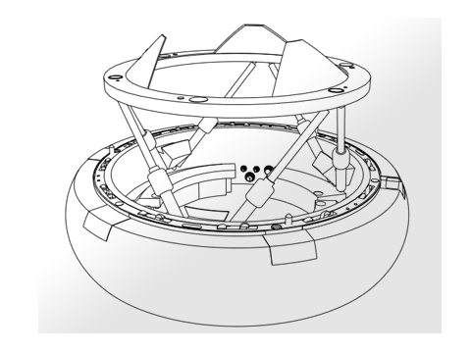
Project Objective
Dock & Release Micro-Aerobots & Small Satellites
Universal Two-Stage Docking System
  Magnetic Soft Capture & Spring-Loaded Hard Capture

Slide 6
Challenges
Small Vehicle Docking
Mid-Flight Docking
Precise Alignment between Two Small Vehicles
  Lack of Geo-Spatial Coordinates
  Current Designs are for Large Systems
Suitable Hard Capture/Release Mechanism
  Weight, Temperature Constraints
  Energy Efficiency

Slide 7
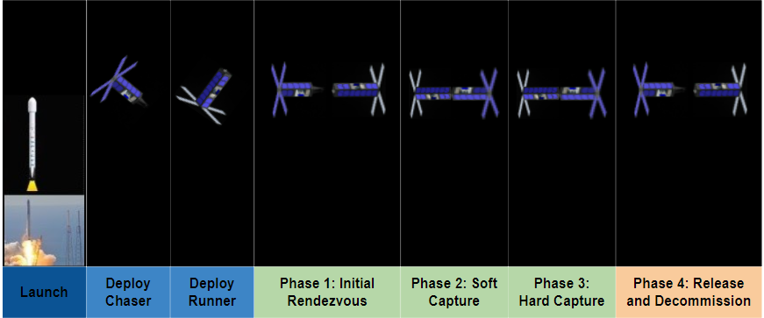
Concept of Operations - Applied to CubeSats

Slide 8
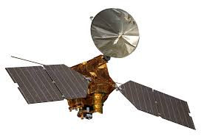
Design Discussion
Initial Rendezvous
Far-Range Rendezvous
  Communication with Larger Satellites (e.g. MRO)
Close-Range Rendezvous
  Communication between Aerobots through Zigbee Radios
  Lighting Cues

Slide 9
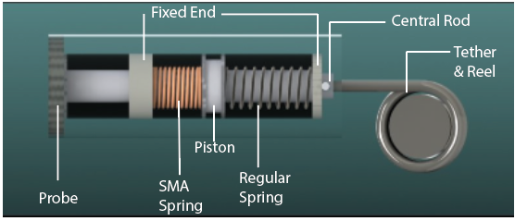
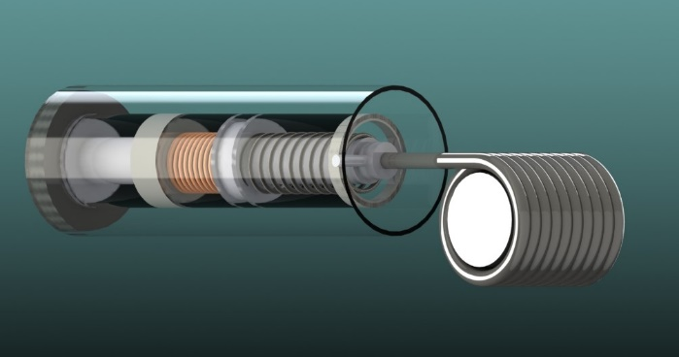
Soft Capture
Electromagnetic Tethered Probe
  SMA-based Probe Ejection Spring System
  Magnetic Mating & Tether Retraction

Slide 10
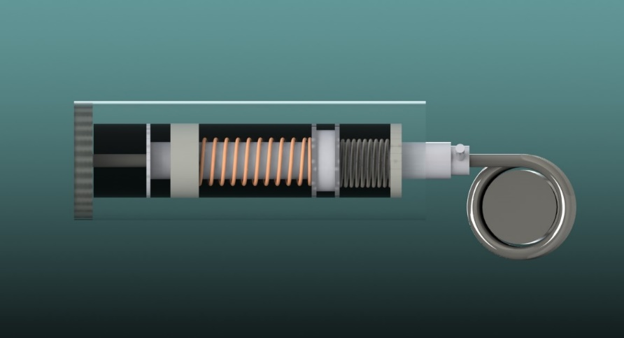
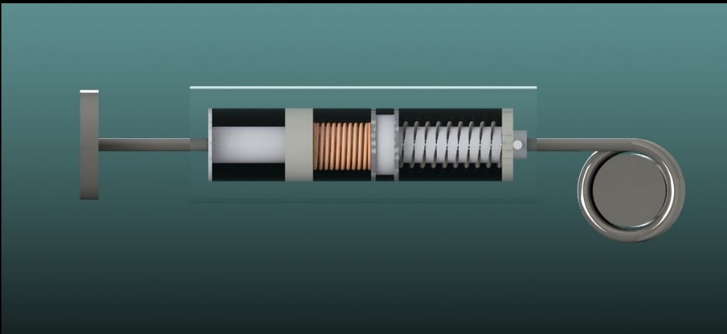
Soft Capture
  Mid-Dock Stage:
  SMA Spring heated to expand, compressing the Regular Spring
  Full Dock Stage:
  Regular Spring unloads, propelling probe forward

Slide 11
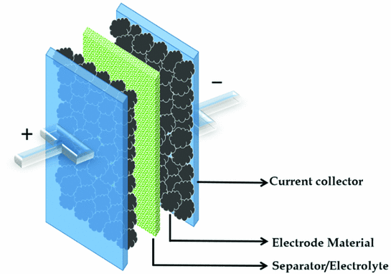
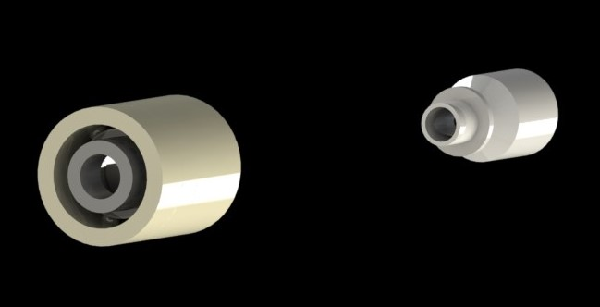
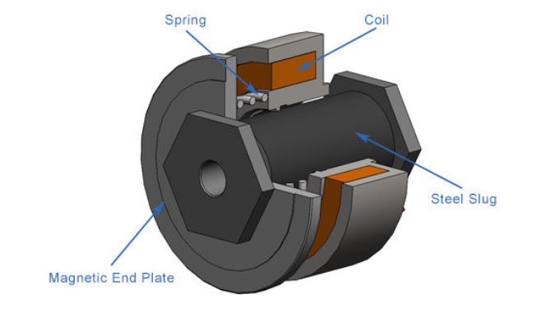
Hard Capture & Release
Spring-Loaded Lock & Release Mechanism
  Feature Recognition Alignment using geometry
  Pressurized Quick Connection Coupling System
  Supercapacitor-based Solenoid Assembly

Slide 12
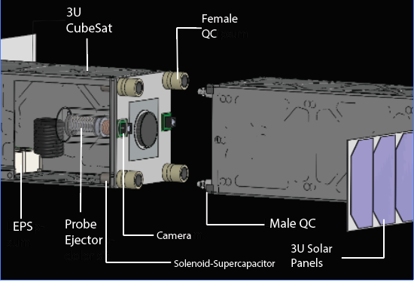
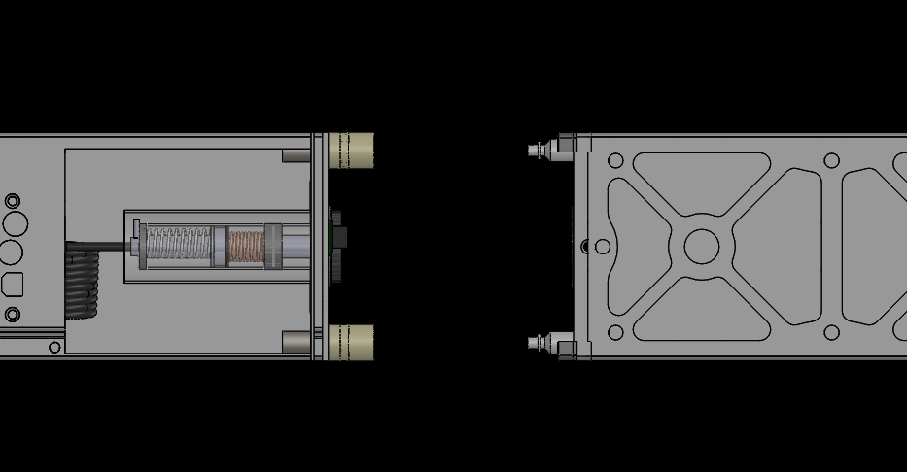
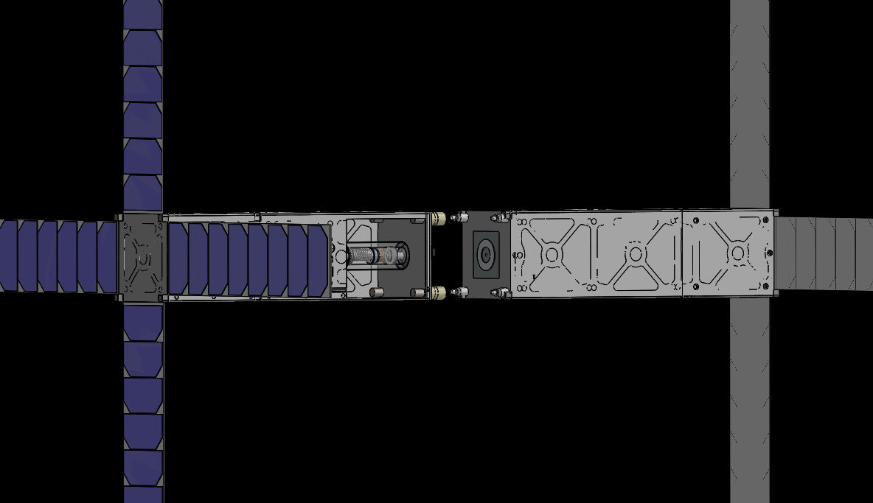
Results
Docking System Design applied to 3U CubeSat

Slide 13
Conclusion
Precise alignment through feature recognition necessary for micro-aerobot docking due to small tolerances & lack of geo-spatial coordinates
Design uses combination of magnetic forces, image recognition, and novel energy efficient capture/release mechanism
  Electromagnetic tether ejector utilizes SMA & energy efficient spring series to soft dock
  Quick Connection Couplers paired with Solenoid-Supercapacitor assembly allows for power & size efficient hard docking

Slide 14
Future Work
Manufacturing of soft and hard capture components
Hardware selection
Construction of prototype to be tested in frictionless space environment, 3D simulations

Slide 15
Acknowledgements
Dr. Jekan Thanga, SpaceTREx Lab
Athip Thirupathi Raj, SpaceTREx Lab
Harsh Bansal, SpaceTREx Lab
Connor Sturgeon, SpaceTREx Lab

Slide 16

Asteroid Science, Technology and Exploration Research Organized
by Inclusive eDucation System (ASTEROIDS) Center
* Center Designation Application in Progress

