Slide 1
Charge Dissipating Conformal Coating for ESD Protection of Electronics
Overview: Implement a charge dissipating conformal coating to enable greater radiation hardening and electrostatic discharge (ESD) mitigation for mission-critical electronics.
Adam Goff
Senior Research Scientist
Luna Innovations Inc.
goffa@lunainc.com, 434-220-2513
Interplanetary Small Satellite Conference ISSC 2021

Slide 2
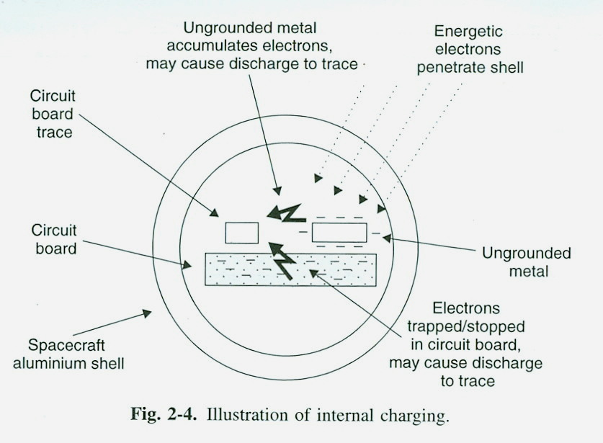
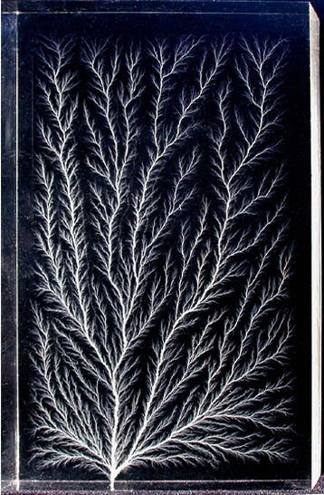
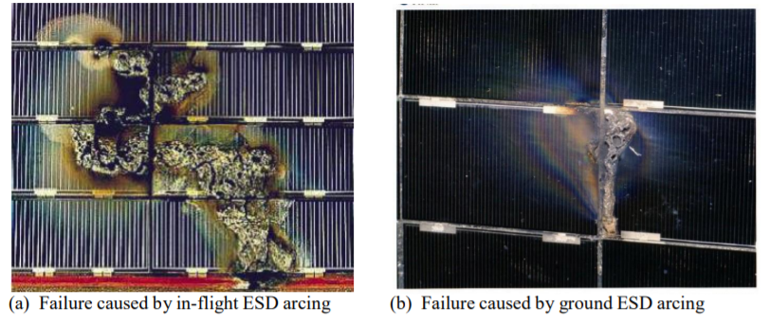
The Problem
Unwanted electrical discharge events can occur on critical spacecraft electronics owing to charged radiation orbits, solar flares, micrometeoroid impacts, proximity to RTG fuel source, etc.
  Relevant to all spacecraft and electrical systems that exist in these environments
  Currently in a solar minimum but projected to be at solar maximum in ~ 5 years
  Even if an ESD event does not occur, unwanted charging can lead to excessive EMI noise that conflicts with electrical systems
“Guide to Mitigating Spacecraft Charging Effects”
Hank Garrett and Albert Whittlesey
Lichtenberg discharge pattern
(4.5 MeV electrons in Lucite)
Examples of solar array arcing from NASA-HDBK-4002A

Slide 3
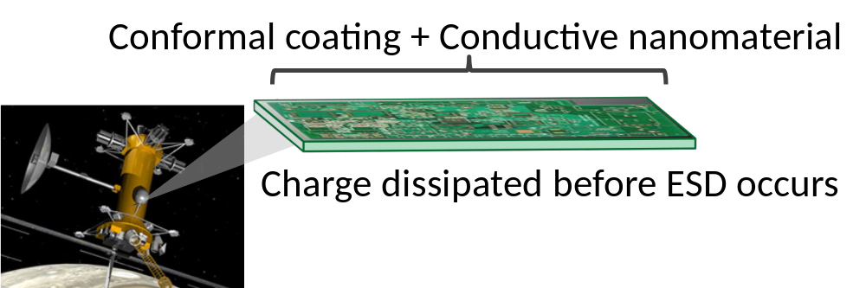
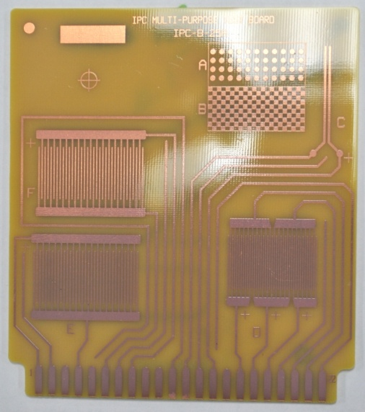
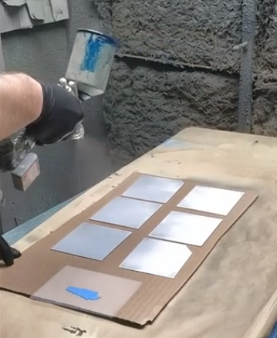
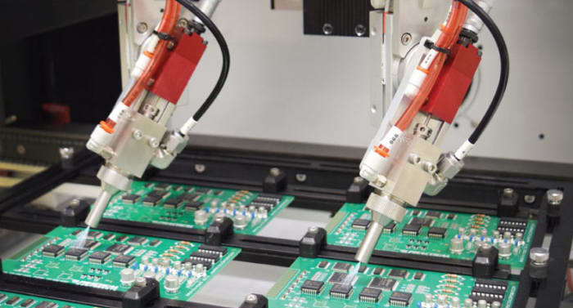
Luna’s Solution and Key Benefits
Solution: Luna’s XP-CD Charge Dissipation Coating
  Can be used to prevent damaging charge dissipation events on electrical components like circuit boards
  Applied like traditional polymer conformal coatings
  Conductive enough to leak charge to ground to prevent discharge
Benefits:
  Helps ensure spacecraft operational readiness in harsh electrical environments
  Drop-in ready solution for numerous applications
  Protection in a single conformal coating solution, reducing complexity, added weight and cost
  Applies and handles just like a traditional conformal coating
  Electrical properties are tailorable depending on mission need
  Synergistic with other radiation protection technologies
Luna’s XP-CD coating is transparent, and easy to apply and inspect
XP-CD application to coupons for electrical resistivity testing
Credit: Aerospace & Defense Technology

Slide 4
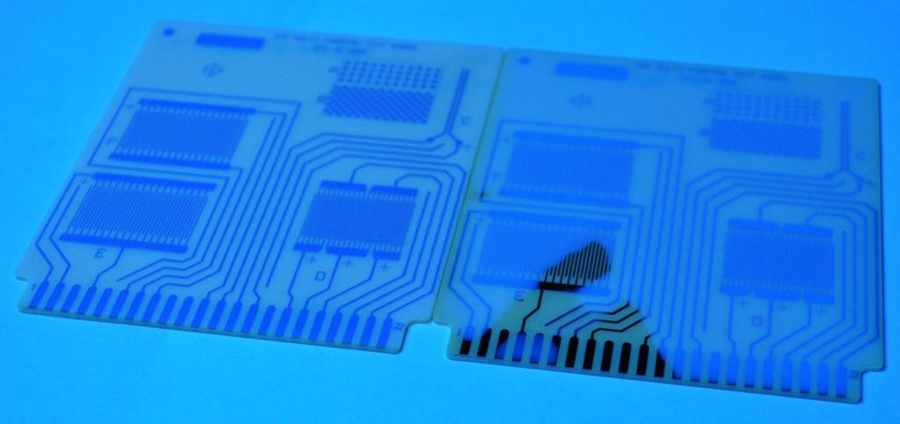
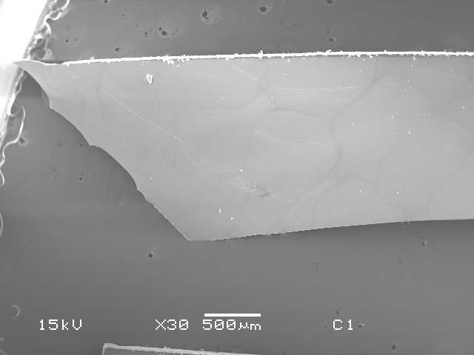
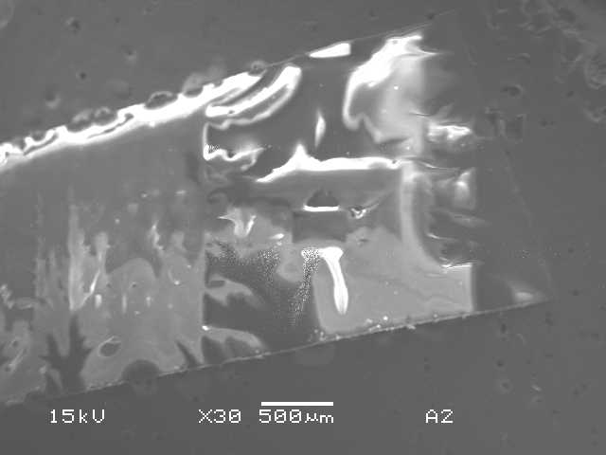

Performance Attributes
A single-component acrylic coating formulation
Transparent, uniform appearance that is easily inspected under UV lamp like traditional conformal coatings
Volume electrical resistivity between 10⁹ to 10¹¹ ohm-cm
  Leaks charge to ground during charge storage testing
  Passes IPC-CC-830 dielectric withstanding voltage test
XP-CD applied with intentional poor coverage; easy to see with UV lamp
Wide temperature use range from -50°C up to +70°C
  Passes IPC-CC-830 thermal cycling/shock testing
Excellent adhesion and flexibility applied to common hardware materials
  ASTM D3359 and D522 top ratings
Low outgassing per ASTM E595
Ambient and elevated temperature curable
XP-CD does not charge
Bright spots indicate charging
XP-CD does not charge under SEM, unlike most polymers
COTS conformal coatings charge under SEM

Slide 5
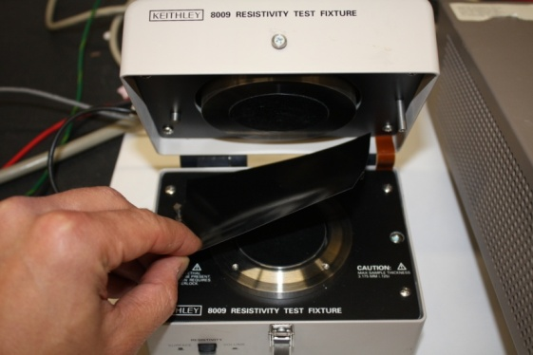
Electrical Performance - Resistivity
Surface and Volume Resistivity measured on free standing films by Aerospace Corp using ASTM D 257 and ANSI/ESD STM11.11-2006 methods
  Keithley Model 8009 test fixture and Model 6517A Electrometer/High Resistance Meter were used
  Model 6524 High Resistance Measurement Software used to:
    Take resistivity measurements using the alternating polarity method
    Analyze sample current in response to a voltage step (used for determining the appropriate measure time or electrification time for the resistance measurement)
  Experimental conditions (nominal):
    Measurement (electrification) time = 30 sec.
    Alternating voltage applied = 100 V
    Readings taken per sample = 30
    Current range set to auto range (reading micro amps)
    External temperature = RT or - 30 ± 1°C
      Cryo testing performed by placing 8009 fixture in environmental chamber – fixture temp limit was ~ -30°C
        Measurement started upon reaching stable temp
Notes:
ASTM approved model can handle volume resistivity range of 10³ to 10¹⁸ Ohm-cm and surface resistivity range of 10³ to 10¹⁷ Ohm/square

Slide 6
Volume Resistivity and Outgas Results
Sample | Average Volume Resistivity at RT (Ohm-cm) After bake out* | Average Volume Resistivity at -30°C (Ohm-cm) After bake-out* | *ASTM E595 Outgas Test – Average TML / Average CVCM
Base Coating | 1.46 x 10¹⁶ | 2.76 x 10¹⁵ | ---
XP-CD | 4.86 x 10⁹ | 4.65 x 10⁹ | 1.25% 0.02%
* Bake out conditions:
Heated to 40°C for 20 min.
Vacuum pressure = 29.3 in. Hg
Bake out schedule can be optimized in the future for maximum volatile removal.

Slide 7
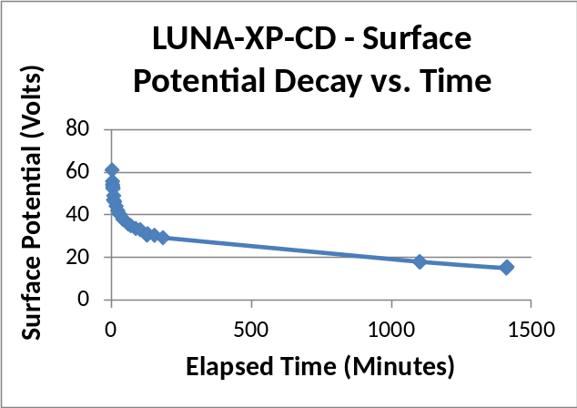
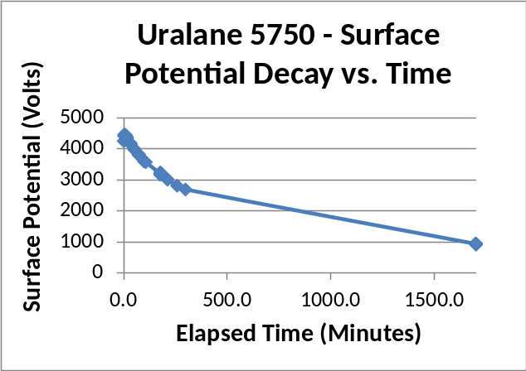
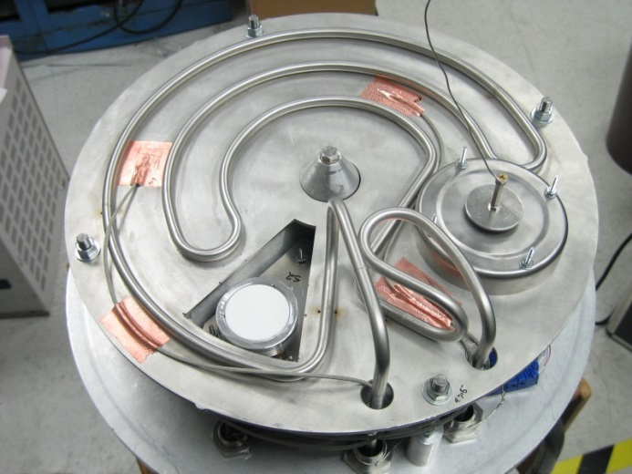
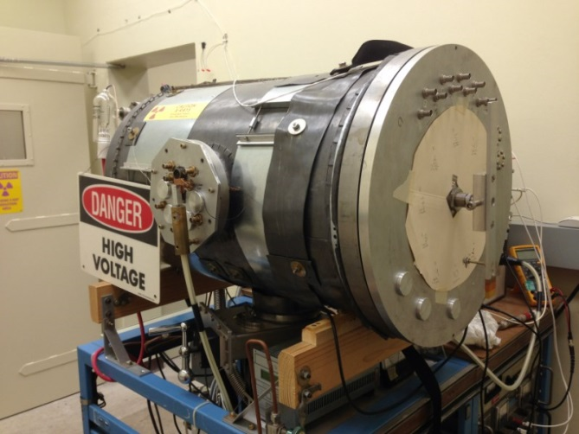
Charge Storage Testing
Electron gun chamber – Completed at the NASA Jet Propulsion Lab
  Measures ESD events and surface potentials at room temperature
  Energies 6-100 keV, current densities 0.1-100 nA/cm²
  Coatings were subjected to 30 keV electrons and 2 nA/cm²
  Luna XP-CD potential decays two orders of magnitude faster than COTS coating
    Determined by NASA as “showing adequate dissipation of charge to ground” for spacecraft applications
Coated coupon holder
Luna’s XP-CD
A common space-qualified COTS coating

Slide 8
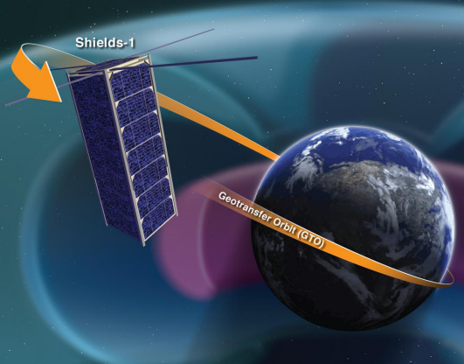
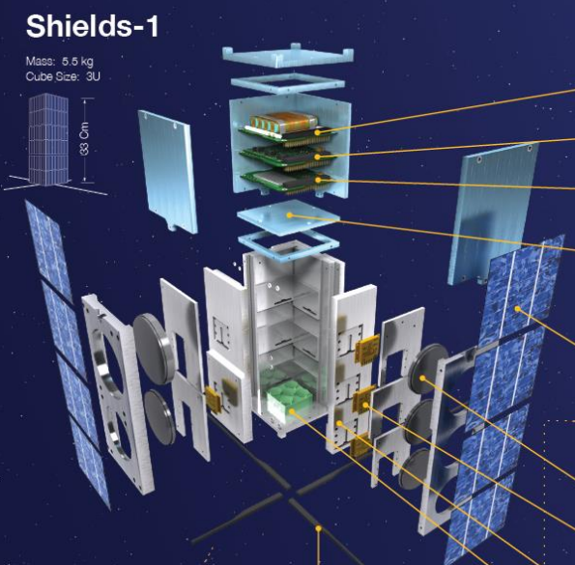
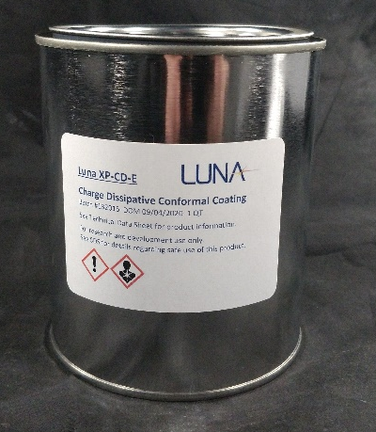
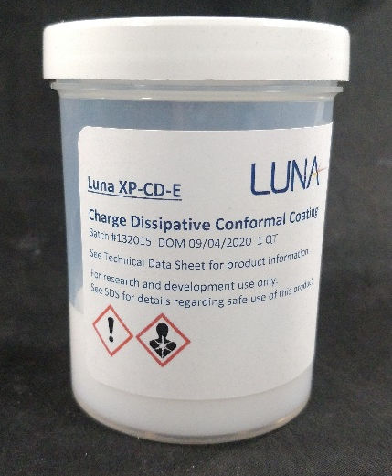
XP-CD is Presently Flying in Space
XP-CD coating initially developed under NASA STTR funding for use in charged environments
  Currently flying on Shields-1 CubeSat
    Objective to demonstrate new radiation shielding technologies that enhance mission lifetime and lower risk
    XP-CD coating resistance measured consistently throughout mission, at varying temperature and charged particle fluence
Flown on the Materials International Space Station Experiment (MISSE)-9
Luna is currently producing a finished product with commercial sales to multiple companies for use in satellite applications
“Shields-1, A SmallSat Radiation Shielding Technology Demonstration”
Dr. Laurence Thomsen III, NASA Langley

Slide 9
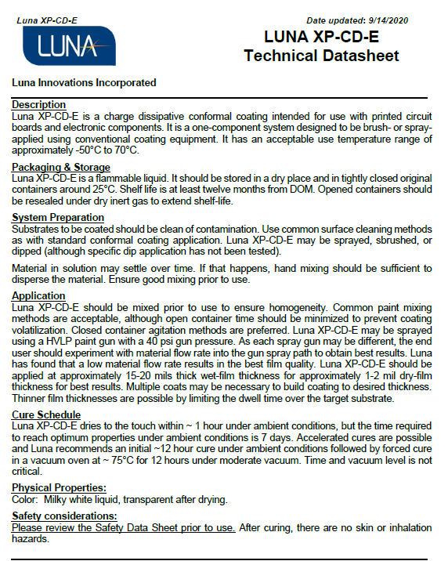
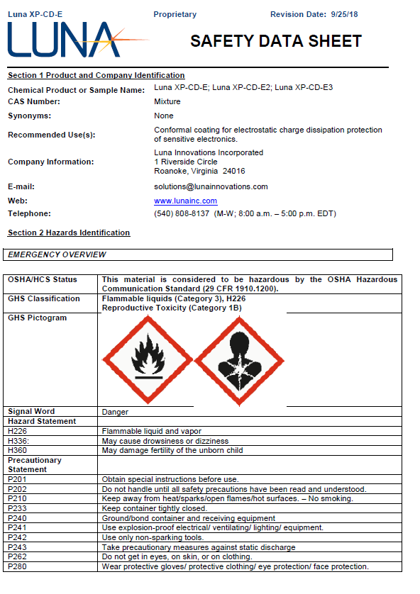
XP-CD Coating Development History
NASA Langley Research Center Phase I STTR project – 2011 (contract # NNX11CI29P)
NASA JPL Purchase Order – 2014
NASA Langley Research Center Phase III SBIR – 2015
In-space demonstration evaluation
  MISSE-9 experiment – 2017
  Shields-1 CubeSat demonstration integration, Launched 2018
    Current TRL 7, TRL 8 in 2022 Q4 with flight testing
Regulatory and SDS/TDS completed 2016

Slide 10
Conclusions and Summary
A charge dissipating conformal coating has been developed with demonstrated performance suitable for application to electronic components
Luna’s coating formulation approach is tailorable to other coating types and chemistries and is robust enough to enable formulation tweaking to specific performance levels
We are open to a wide array of options ranging from direct product sales for tech demonstration, tech licensure to suppliers or end users, and/or new coating formulation development
Thank you for your attention!

