Slide 1


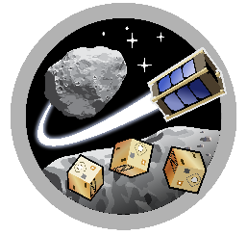

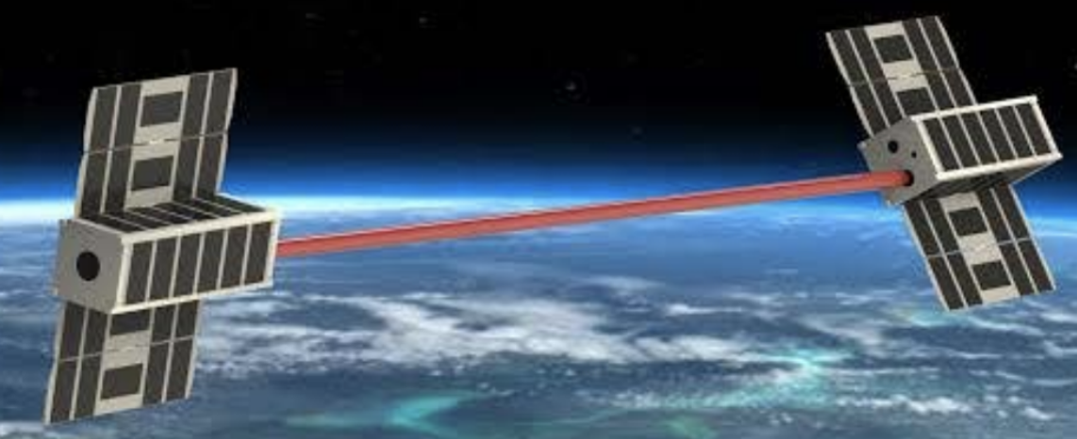
MIRO
ASTEROIDS
Laser Communication Components of a Nano-Satellite Network
Jaxon Richards
Space and Terrestrial Robotic Exploration (SpaceTREx) Laboratory
Aerospace and Mechanical Engineering Department
University of Arizona

Slide 2
Outline
Why Nano-Satellite Communication?
State of the Technology
Challenges
Project Objective
Methodology
Results
Future Work
Conclusion

Slide 3
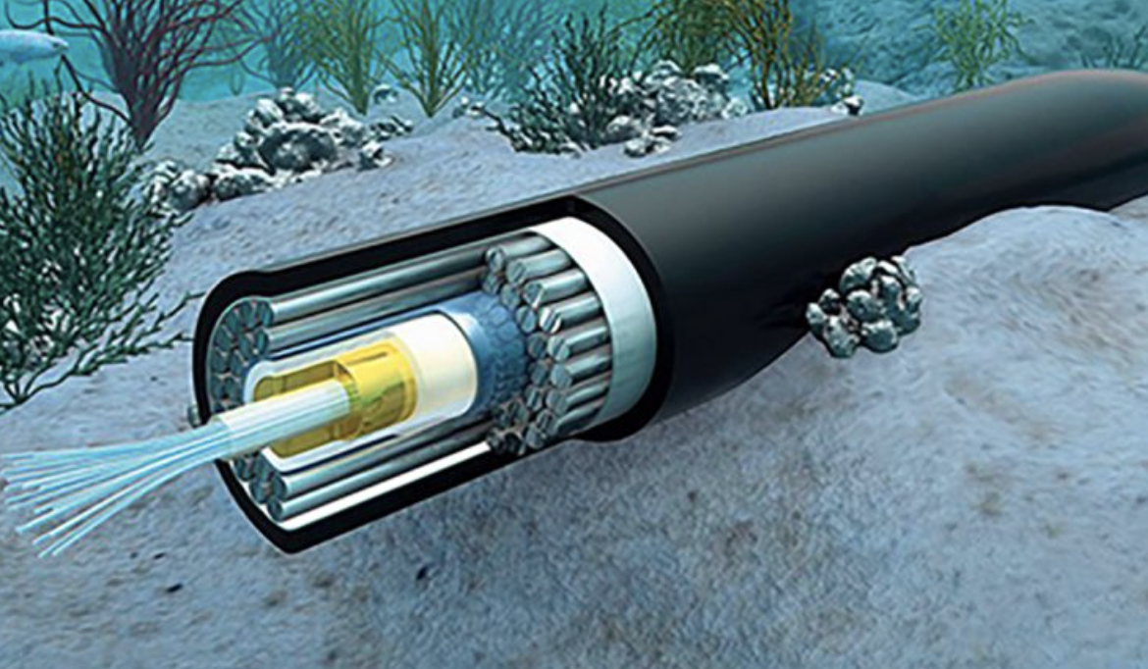
Motivating Nano-Satellite Communication
Gbit/s Data Transfer Speeds
Expendable and cheap
Low cost and efficient launches
RF space becoming crowded
Difficult to detect and intercept information
RF Beam Divergence
Laser Beam Divergence
Underwater Fiber Optic Cable
Generalized comparison of RF and laser divergence

Slide 4


Current Research
SpaceTREx Laboratories
CubeSat Cluster Laser COMM System in development
Research is tied to this project
Star Link (SpaceX)
Satellites are about the size of a table making them easier to detect
Massachusetts Institute of Technology (MIT)
Focusing on the downlink
Pairs of satellites rather than crosslinked clusters

Slide 5
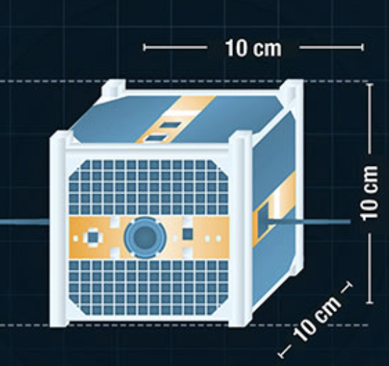
Implementation Challenges
Design frame of a nanosatellite is restricting
High magnification power (MP) needed
Large distance to maintain collimated beam
Power limitations
Staying below budget

Slide 6

Implementation Challenges
Lack of optical engineering experience
Lack of optics table
Iterating Designs are expensive, and shipping take time
Testing with high powered lasers is dangerous
Lab time was scarce at first

Slide 7
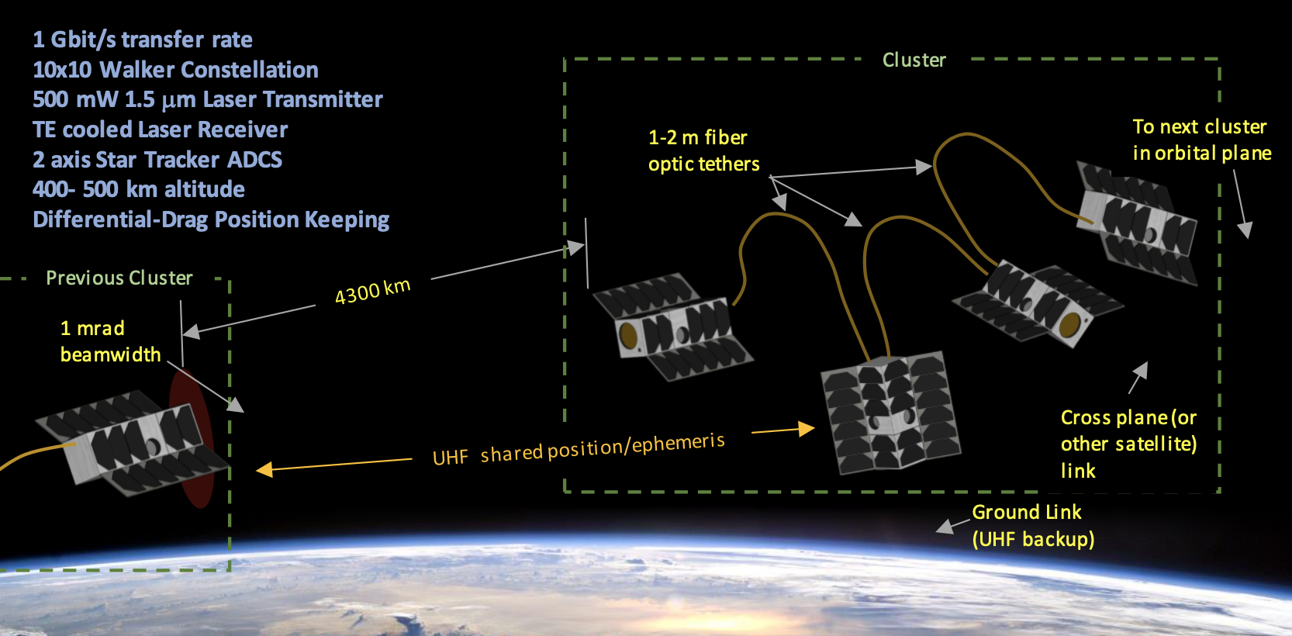
Project Objective
Design and build an optical system for transmitting and receiving a laser signal across space
Includes optical components, electronics and housing of the system
System will fit inside a 10x10x10 cm CubeSat block (1U)
Vance, Leonard and Thangavelautham, Jekan 2019. Nanosatellite Based Global Laser Communications Network IARPA 19-05

Slide 8
Method
Calculating and testing optical components needed
Establishing basic laser-based communication
Measure photons/sec on the receiving end
Starting with loose design restrictions and narrowing from there

Slide 9
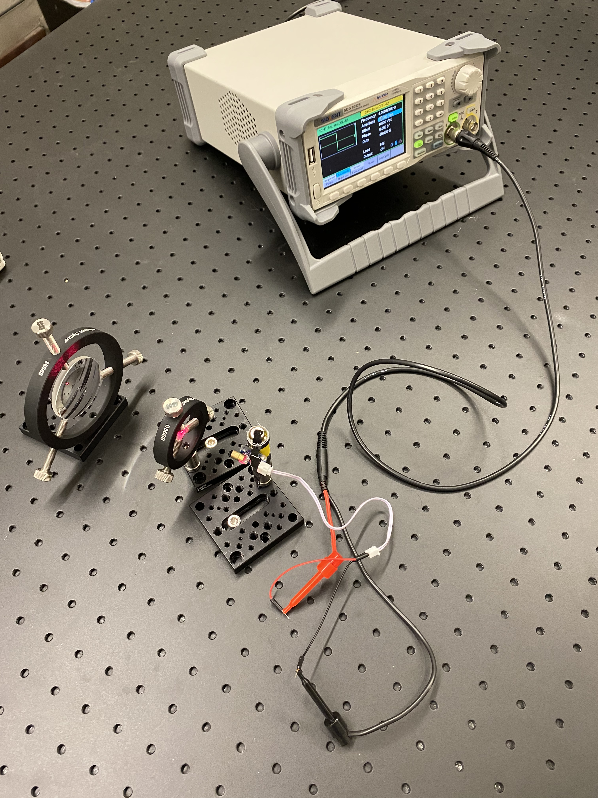

Optical System
Transmitter optics for a 25 cm design frame
Expansion and collimation lenses implemented
Optical table contains experimental setup
Primary Lens Supplier
Optical System Setup

Slide 10
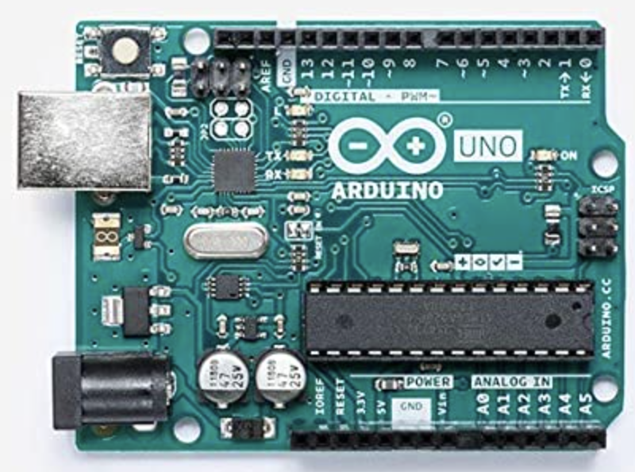
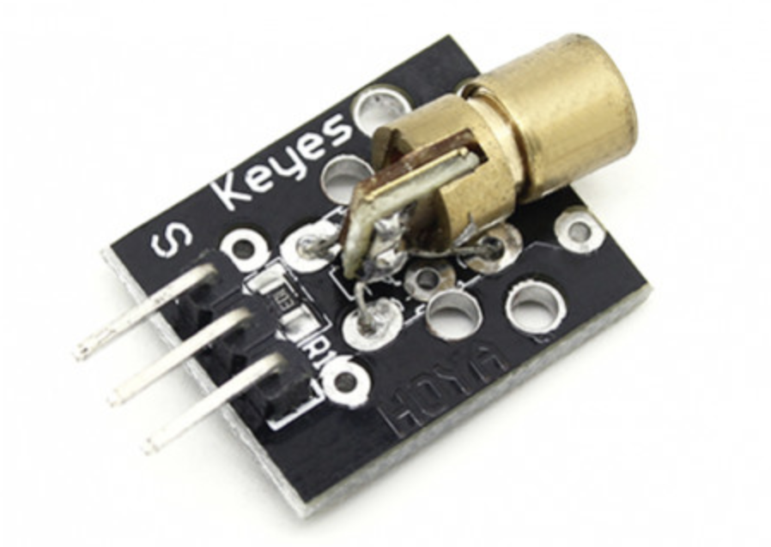
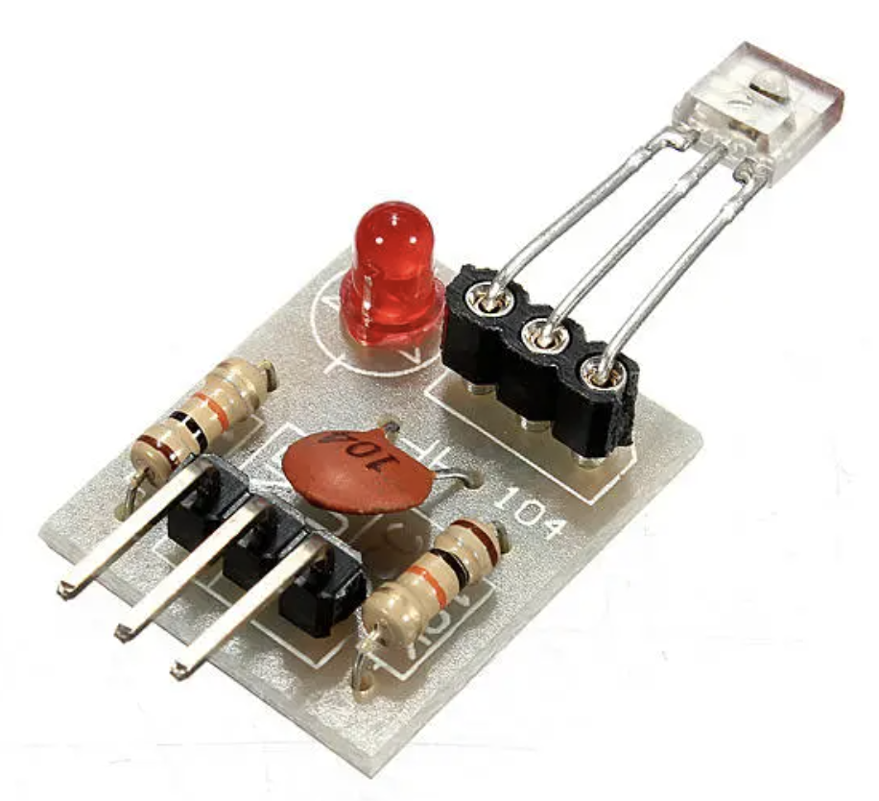
Optical System
Arduino Uno for photon counting and other electronics testing
Shift to oscilloscope for signal processing
Function Generator for signal testing
Arduino Uno
Laser Diode
Slow Laser Receiver

Slide 11
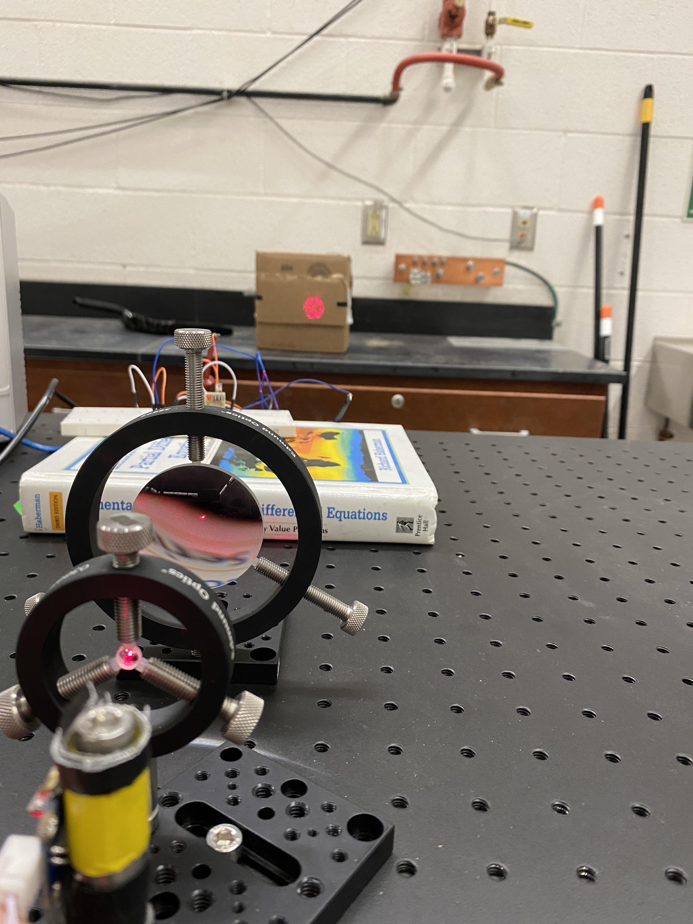
Results
Base optics system is built and being tested
A well collimated beam achieved
Transmission parameters are more defined
Photo of beam collimation

Slide 12
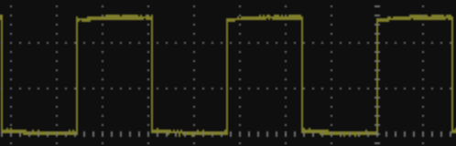
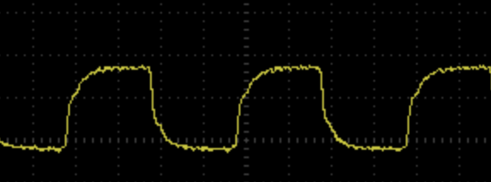
Results
Basic signal transmission has been achieved up to 500 kHz
Square wave begins to delay past 500 kHz
Oscilloscope Reading < 500kHz
Oscilloscope Reading > 500 kHz

Slide 13
Future Work
Continuing system assembly and testing
Want a steady signal of at least 1 GHz
Photon and power measurements
Design alterations
CAD drawings of system housing and system as a whole
Communication efficiency tests

Slide 14
Conclusion
Optics System is a missing piece of proposed nanosatellite laser communication network
Main optics system is being tested and optimized
Once a suitable receiver is purchased progress should follow rapidly

Slide 15
Acknowledgements
Leonard Vance
Dr. Jekan Thangavelautham

Slide 16
Thank you!

