Slide 1
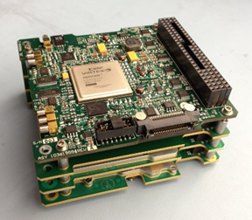
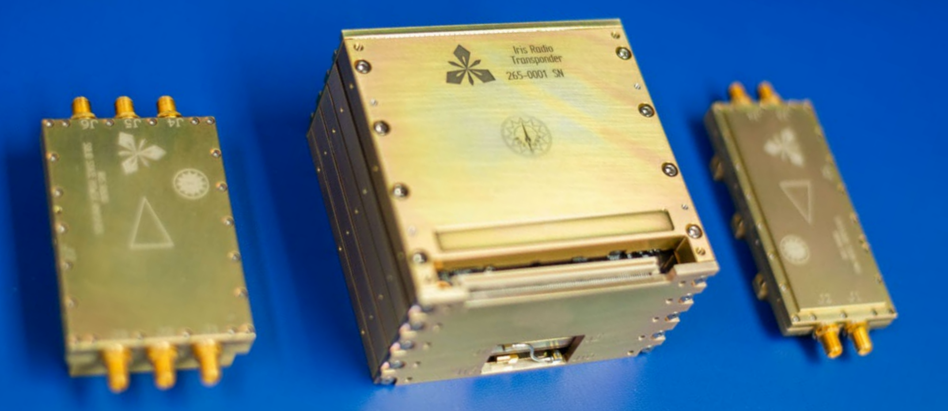
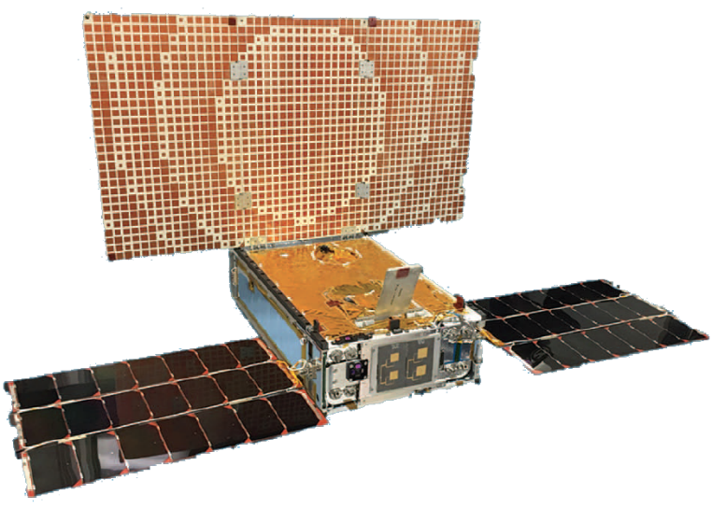
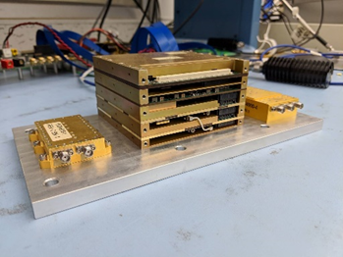
Inter-Planetary Small Satellite Conference
Pasadena, California
3-4 May 2020
Recent Features Added to the Iris Deep-Space Transponder
Presenter: Zaid Towfic
M. Shihabi*, C. Duncan*, Z. Towfic*, B. Burgett*, M. Chase*, S. Clancy*, S. Holmes*, and D. Sorensen^
*Jet Propulsion Laboratory, California Institute of Technology ^Space Dynamics Lab, Utah State University

Slide 2
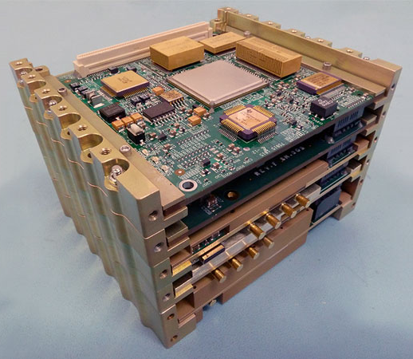
The Iris Transponder
Iris is a CubeSat/SmallSat compatible transponder developed by the National Aeronautics and Space Administration’s (NASA’s) Jet Propulsion Laboratory (JPL) as a low volume and mass, lower power and cost, software/ firmware defined telecommunications subsystem for deep space. Iris is manufactured and fabricated by Space Dynamics Laboratory.
Iris is a deep-space transponder targeted for NPR 7120.8 technology demonstrations and Class-D space flight projects, utilizing COTS-grade components.
Iris’ features include ~0.5 U volume, 0.86 kg mass, 35 W DC power consumption when fully transponding at 3.8 W radio frequency output (12.6 W DC input for receive only), and interoperability with NASA’s Deep Space Network (DSN) at X-Band frequencies (7.2 GHz uplink, 8.4 GHz downlink) for command, telemetry, and navigation.
Iris V2.1 is designed with an environmentally robust architecture including radiation tolerant parts needed for deep space missions with durations of a few years and thermal management needed for navigation tracking sessions of several hours.

Slide 3
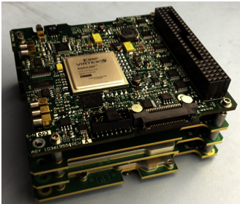
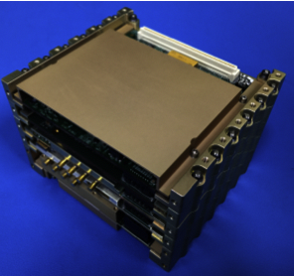
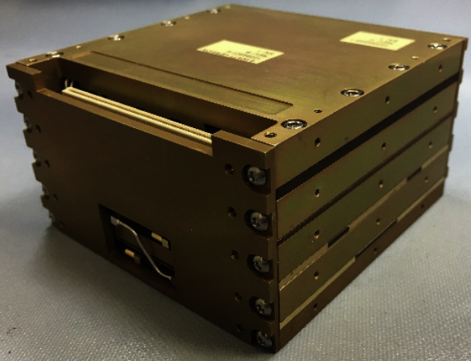
Iris Transponder Evolution History
10.1 x 10.1 x 4.5 cm
Iris V1.0: To extend CubeSat/SmallSat deep space capability, JPL introduced the Interplanetary NanoSpacecraft Pathfinder In Relevant Environment (INSPIRE) mission¹, coupled with the first-generation of Iris deep-space transponder². Modular Design (4-slices)
Iris V2.0: The radio was further developed, matured, and in 2018 successfully flown onboard Mars Cube One (MarCO), to support InSight’s Mars Entry, Descent, and Landing (EDL)³. Five slices (including an UHF receive slice). The mass of Iris V2.0 (with this additional slice) is 1.2 kg.
Iris V2.1: The latest version of Iris includes design updates that support Artemis-1 CubeSats missions⁴.
Iris V1.0 Stack
10.1 x 10.1 x 7.5 cm
Iris V2.0 Stack
10.1 x 10.1 x 5.6 cm
¹ A. Klesh et al., “INSPIRE: Interplanetary NanoSpacecraft Pathfinder In Relevant Environment,” in AIAA SPACE Conf. and Expo., San Diego, CA, 2013.
² C. B. Duncan et al., “Iris Transponder – Communications and Navigation for Deep Space”, in Small Satellite Conf., Logan, UT, 2014.
³ A. Klesh et al., “MarCO: Early Operations of the First CubeSats to Mars,” in Small Satellite Conf., Logan, UT, 2018.
⁴ M. M. Kobayashi et al., “Iris Deep-Space Transponder for SLS EM-1 CubeSat Secondary Payloads”, IEEE Aerospace and Electronic Systems Magazine, Volume 34, Issue 9, pp 34-44, September 1, 2019.

Slide 4
Artemis-1 Iris
The only small deep space transponder that is compatible with the NASA standard deep space signal and protocol stack.
Four slices:
  Digital: Virtex 6 (Defense-grade) with embedded CPU (SPARC V8: LEON3-FT softcore) running at 50 MHz
  Power Supply Board
  X-Band Exciter
  X-Band Receiver
1 MHz SPI Interface
2-ch LNA: 7 x 4.8 x 1.3 = 44 cc
3-ch SSPA: 8.7 x 4.3 x 1.8 = 68 cc
Receiver Noise Figure: 3.5 dB
62.5 bps to 6.25 Mbps telemetry symbol rates, CCSDS Deep Space
62.5 bps to 1.024 Mbps command symbol rates, CCSDS Deep Space
Doppler, Seq. Ranging, Regen. Ranging, Delta DOR, PN Delta DOR
Radiation Tolerance: 23 krads TID
Licensed to Space Dynamics Laboratory (SDL) for manufacturing and sale.
Digital
Triple
SSPA
Power
Dual
LNA
5.6
cm
Exciter
10.1 cm
Receiver
10.1 cm
10.1 x 10.1 x 5.6 cm = 0.57 U, 0.86 kg,
28 - 34 W DC (Tx/Rx), 5W RF Output

Slide 5
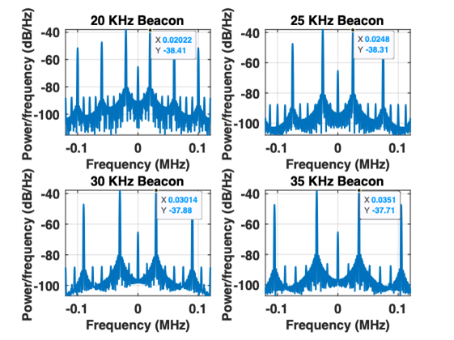
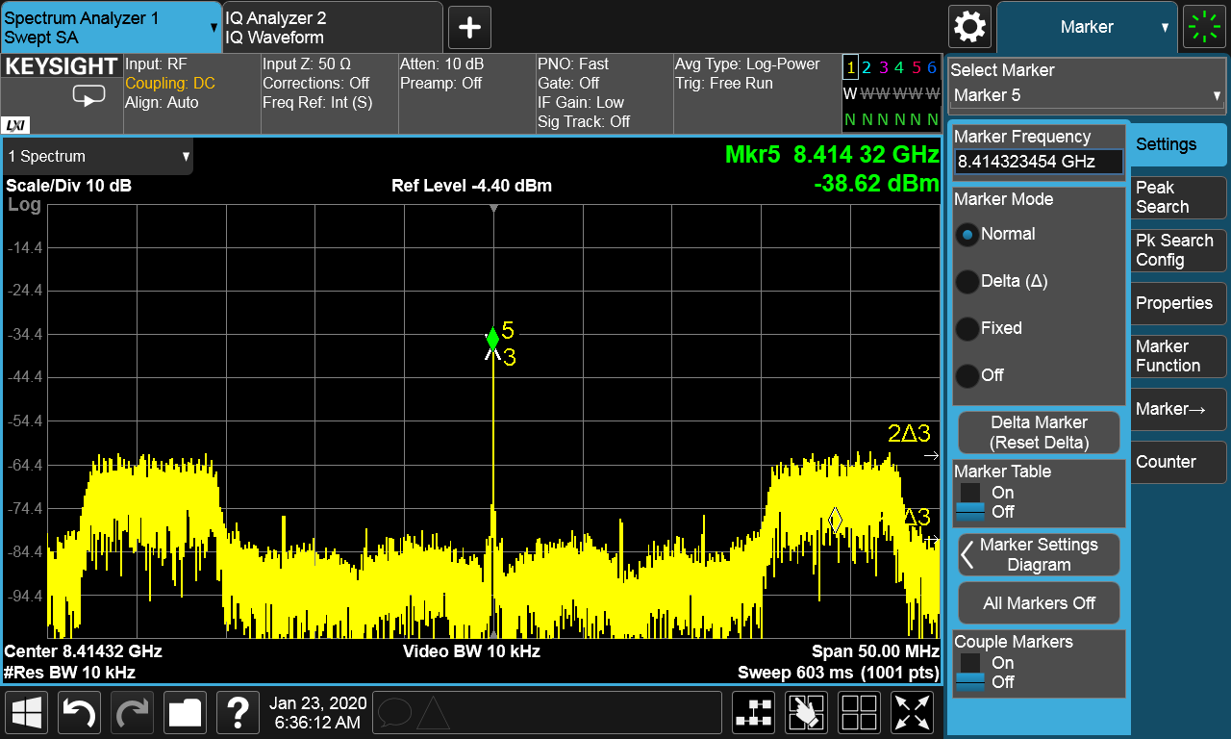
Newly Verified Capabilities
The following capabilities have now been fully verified at DTF-21:
  Beacon Mode
  PN Delta DOR
  PN Regenerative Ranging
  Over the Air Software/Firmware Update
  High rate downlink and uplinks.

Slide 6
Newly Implemented Iris Capabilities
LDPC Coding (DTF-21 Verified):
  LDPC rates 1/2, 2/3, 4/5, 7/8.
  LDPC block sizes 1024, 4096, or 7136 bits.
MUPA-ready:
  Third-order CTL implemented for high dynamics environments (DTF-21 verified).
  Iris can sweep and find the uplink carrier automatically without need for sweep from the ground station (DTF-21 verified).
  FFT-search for the carrier implemented (not yet DTF-21 verified).
  SCID verified on uplinks (DTF-21 verified).
  Programmable turn-around ratio

Slide 7
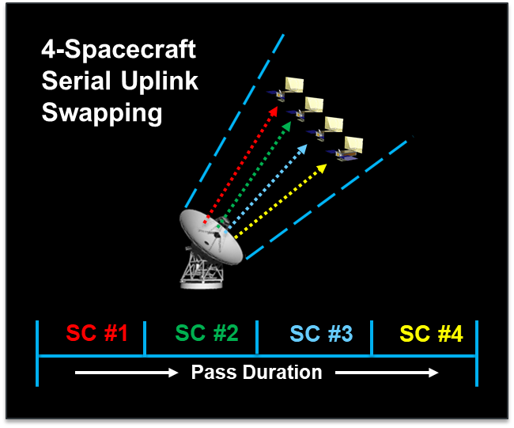
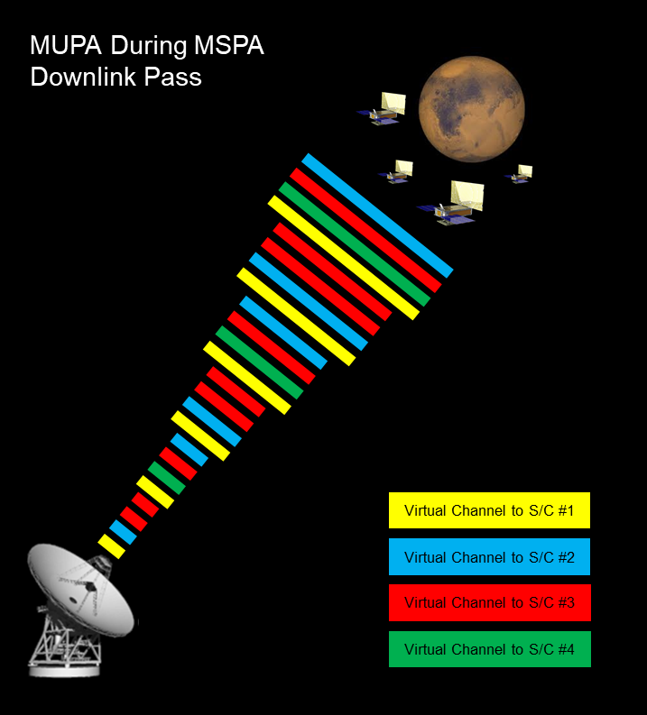
MUPA: Multiple Uplinks per Antenna
Today:
During MSPA (Multiple Spacecraft per Antenna), simultaneously downlinking, in-beam spacecraft have to share the uplink one at a time (serial uplink swapping).
For those spacecraft waiting their turn, no 2-way Doppler and no commanding can occur.
10-30 minutes calibration time between each successive spacecraft.
Future:
MUPA: Commands to multiple, in-beam spacecraft time-multiplexed on a single uplink frequency with each spacecraft differentiating its commands by spacecraft ID.
2-way Doppler and commanding available to all in-beam spacecraft all of the time.
Key Enablers: (1) Onboard Doppler-shift compensation for acquisition of the single frequency uplink; (2) Variable turnaround ratios on the radio; (3) Frequency Carrier Search.
Courtesy of Douglas Abraham.

Slide 8
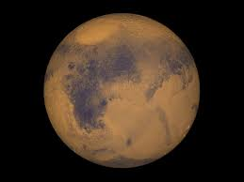
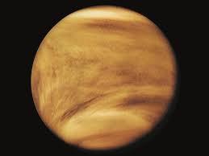
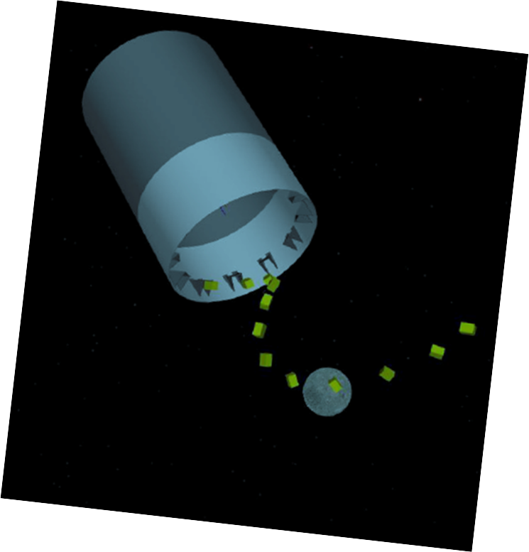
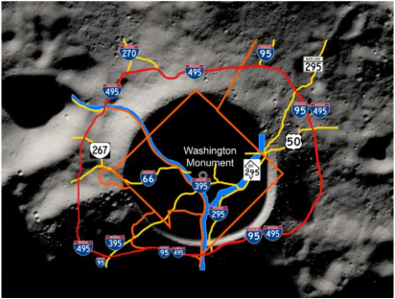
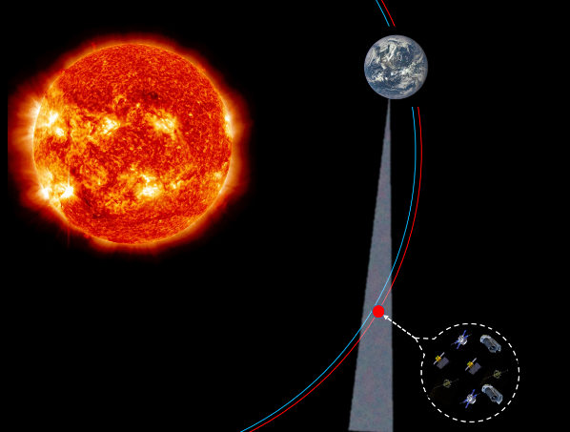
Situations Where MUPA Would Be Particularly Useful
Spacecraft at Mars or Venus are always in the beam of some other spacecraft with a scheduled comm. link to Earth.
Multiple exploration elements within a particular area on the lunar surface, such as the lunar South Pole’s Shackleton Crater.
A constellation or “flotilla” of spacecraft with inter-spacecraft separation distances sized to fit within a 34m antenna beam-width over a given set of range distances.
Multiple CubeSats deploying from a launch vehicle upper stage, such as the DSN-supported CubeSats deploying from the upcoming Artemis-1 mission.
Courtesy of Douglas Abraham.

Slide 9
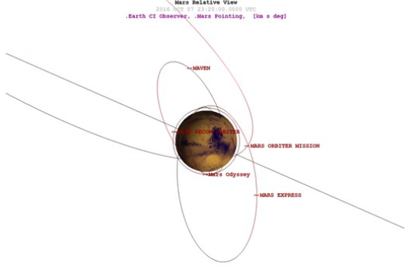
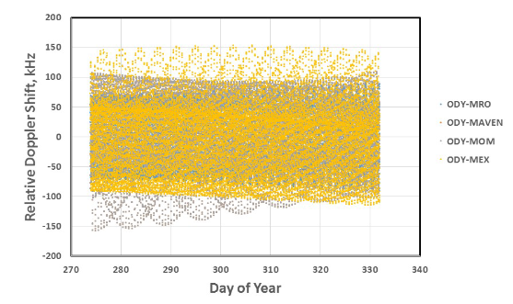
Enabling MUPA at the Spacecraft
DSN can no longer address specific spacecraft Doppler shifts through use of spacecraft specific predicts.
  Relative to orbiting spacecraft around Mars, the single frequency uplink from Earth will be significantly Doppler shifted and changing in frequency as a function of where each spacecraft is in its own particular orbit.
    Expected Doppler shifts of + or – 150 kHz.
  The DSN ground station can no longer sweep the carrier for the spacecraft to lock onto.
Solution: Let the spacecraft perform the frequency sweep, use trajectory-aided tuning of the uplink signal, and/or use FFT-based carrier acquisition.
Iris has implemented frequency sweep capability with programmable limits, sweep rate, and center frequency. This capability has been tested at DTF-21. FFT-based acquisition is also implemented, not yet tested at DTF-21.
Dave Morabito, 2018
Current Sweep Region
FFT-determined Sweep Region
Power
True Carrier Frequency Location
Frequency

Slide 10
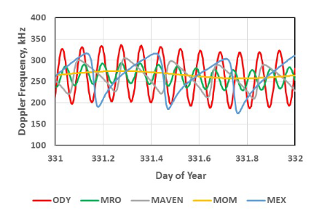
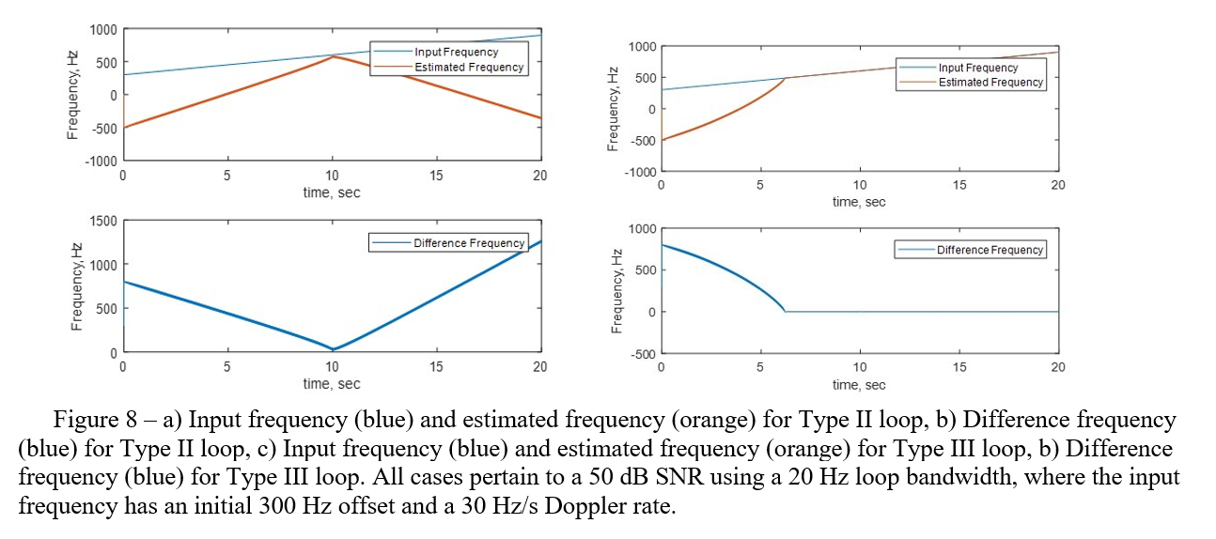
Enabling MUPA at the Spacecraft
Additionally, Doppler rates (Hz/s) may be significant.
Solution: Implement type-3 loop on the spacecraft carrier tracking loop. A type-3 loop can track:
  Constant carrier phase
  Linearly-changing carrier phase (i.e., constant frequency offset).
  Linearly-changing carrier frequency (i.e., constant frequency velocity)
  The potentially high Doppler dynamics relative to a single-frequency uplink carrier during a MUPA session suggest the need for a Type-III loop.
Iris has implemented type-3 loop on the carrier tracking loop. The capability is configurable to arbitrary loop bandwidths. This capability has been tested at DTF-21. This capability can be used independently of Iris’ carrier search capability.
Dave Morabito, 2018

Slide 11
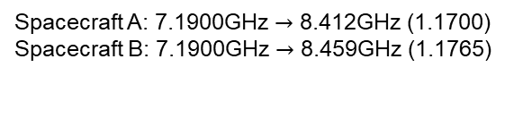
Enabling MUPA at the Spacecraft
DSN most likely will have to use the same TLM line coding, symbol rate, etc. for all spacecraft (lowest common denominator).
  Spacecraft must filter the uplink commands to keep its own commands.
Solution: SCID Filter.
Iris has now implemented an SCID filter that rejects commands not utilizing the particular radio’s SCID.
When performing 2-way passes, the spacecraft must use a non-standard turn-around ratio to achieve the right channel on the downlink.
Solution: Implement variable turn-around ratios.
Iris already has the capability to modify its turn-around ratio during flight.
Default Turnaround ratio: 880/749 ~ 1.1749.
Spacecraft | Uplink Frequency | Downlink Frequency
A | 7.160GHz | 8.412GHz
B | 7.200GHz | 8.459GHz
Spacecraft A: 7.1900GHz $→$ 8.412GHz (1.1700)
Spacecraft B: 7.1900GHz $→$ 8.459GHz (1.1765)

Slide 12
MUPA
Currently, we believe that missions that take the newest firmware build of Iris will be able to utilize MUPA.
However, the ground side of MUPA is not yet ready for utilization. Work is ongoing to enable the multiplexing of command streams from different spacecraft MOCs onto the same frequency uplink.
We hope that by enabling the spacecraft side of the equation for MUPA, that adoption of the technique is accelerated. Similar to our implementation of beacon mode on the Iris, even though the ground side is not yet ready.

Slide 13
Features in Development
Arbitrary Spectrum Filtering
1-Way Ranging
Automatic Anomaly/Interference Detection
SpaceWire interface for high-rate data transfers to S/C C&DH unit

Slide 14
Acknowledgements
For the recent Iris update: Acknowledge the support of:
  JPL Solar System Exploration Directorate: John Baker
  JPL Interplanetary Network Directorate: Douglas Abraham, Faramaz Davarian, and Steve Townes.
Previous Iris technical development team: JPL Division 33 (Communications, Tracking, and Radar) – Too many individuals to list: M. Kobayashi, F. Aguirre, J. Lux, L. McNally, D. Heyer, A. Smith, E. Satorius, D. Bell, J. Chen, H. Mojaradi, K. Larsen, D. Wang, T. Doberva, I. Kuperman, M. Kilzer.

