Slide 1
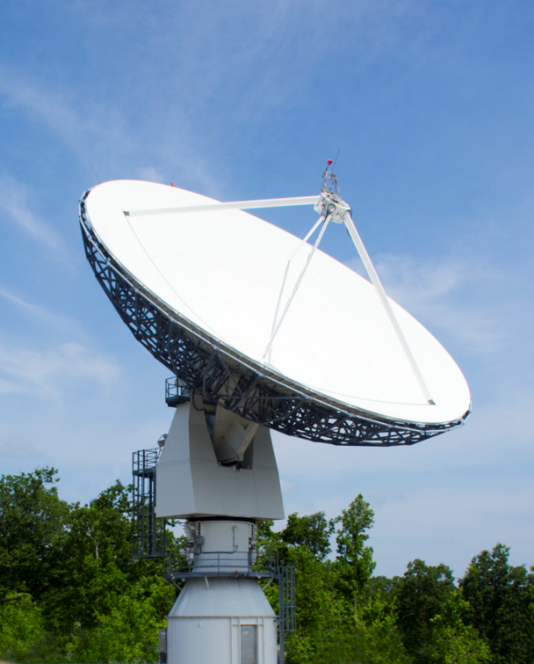
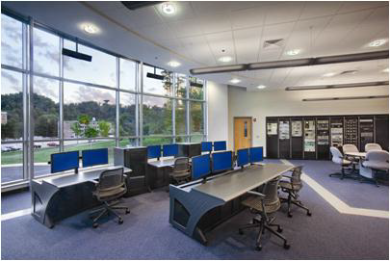
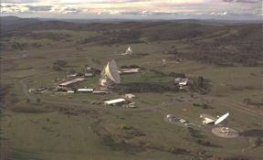
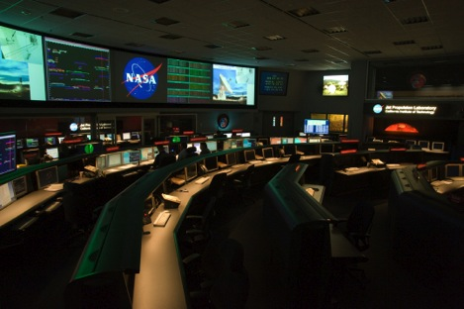
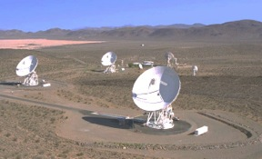
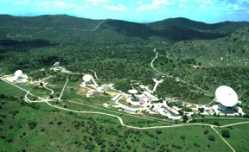


Deep Space Station-17
A University-Operated Affiliated Node on the NASA Deep Space Network- Preparing for Operational Readiness
Briefing for the Interplanetary Smallsat Conference
May 3, 2021
Tim Pham, Jay Wyatt (JPL)
Ben Malphrus, Jeff Kruth (MSU)
In Partnership with

Slide 2
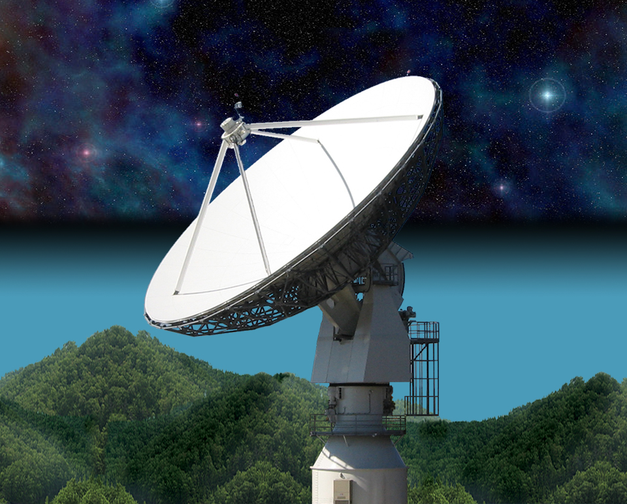
21 Meter Space Tracking Antenna
at Morehead State University
Specifications by MSU faculty with NASA assistance
Dual Purpose Instrument
  Ground Station for Smallsats
  Radio Telescope for Astronomy Research
Built and Installed by VertexRSI (General Dynamics)
Operational in 2006
Program Funded by AES in 2016 to Upgrade for DSN Compatibility

Slide 3

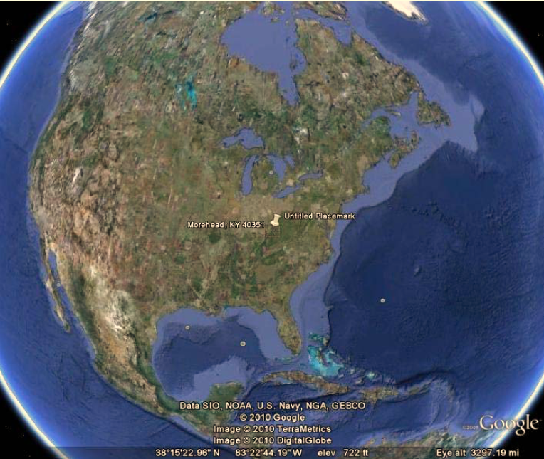
The Morehead State University Ground Station
Relatively Quiet RFI Environment in Eastern Kentucky
21 m Ground Station (few in the US large enough for DSN Work)
Staff Experienced in Mission Operations
Caveats:
There is weather in Kentucky!
University-based Asset- with Single String Instrumentation

Slide 4
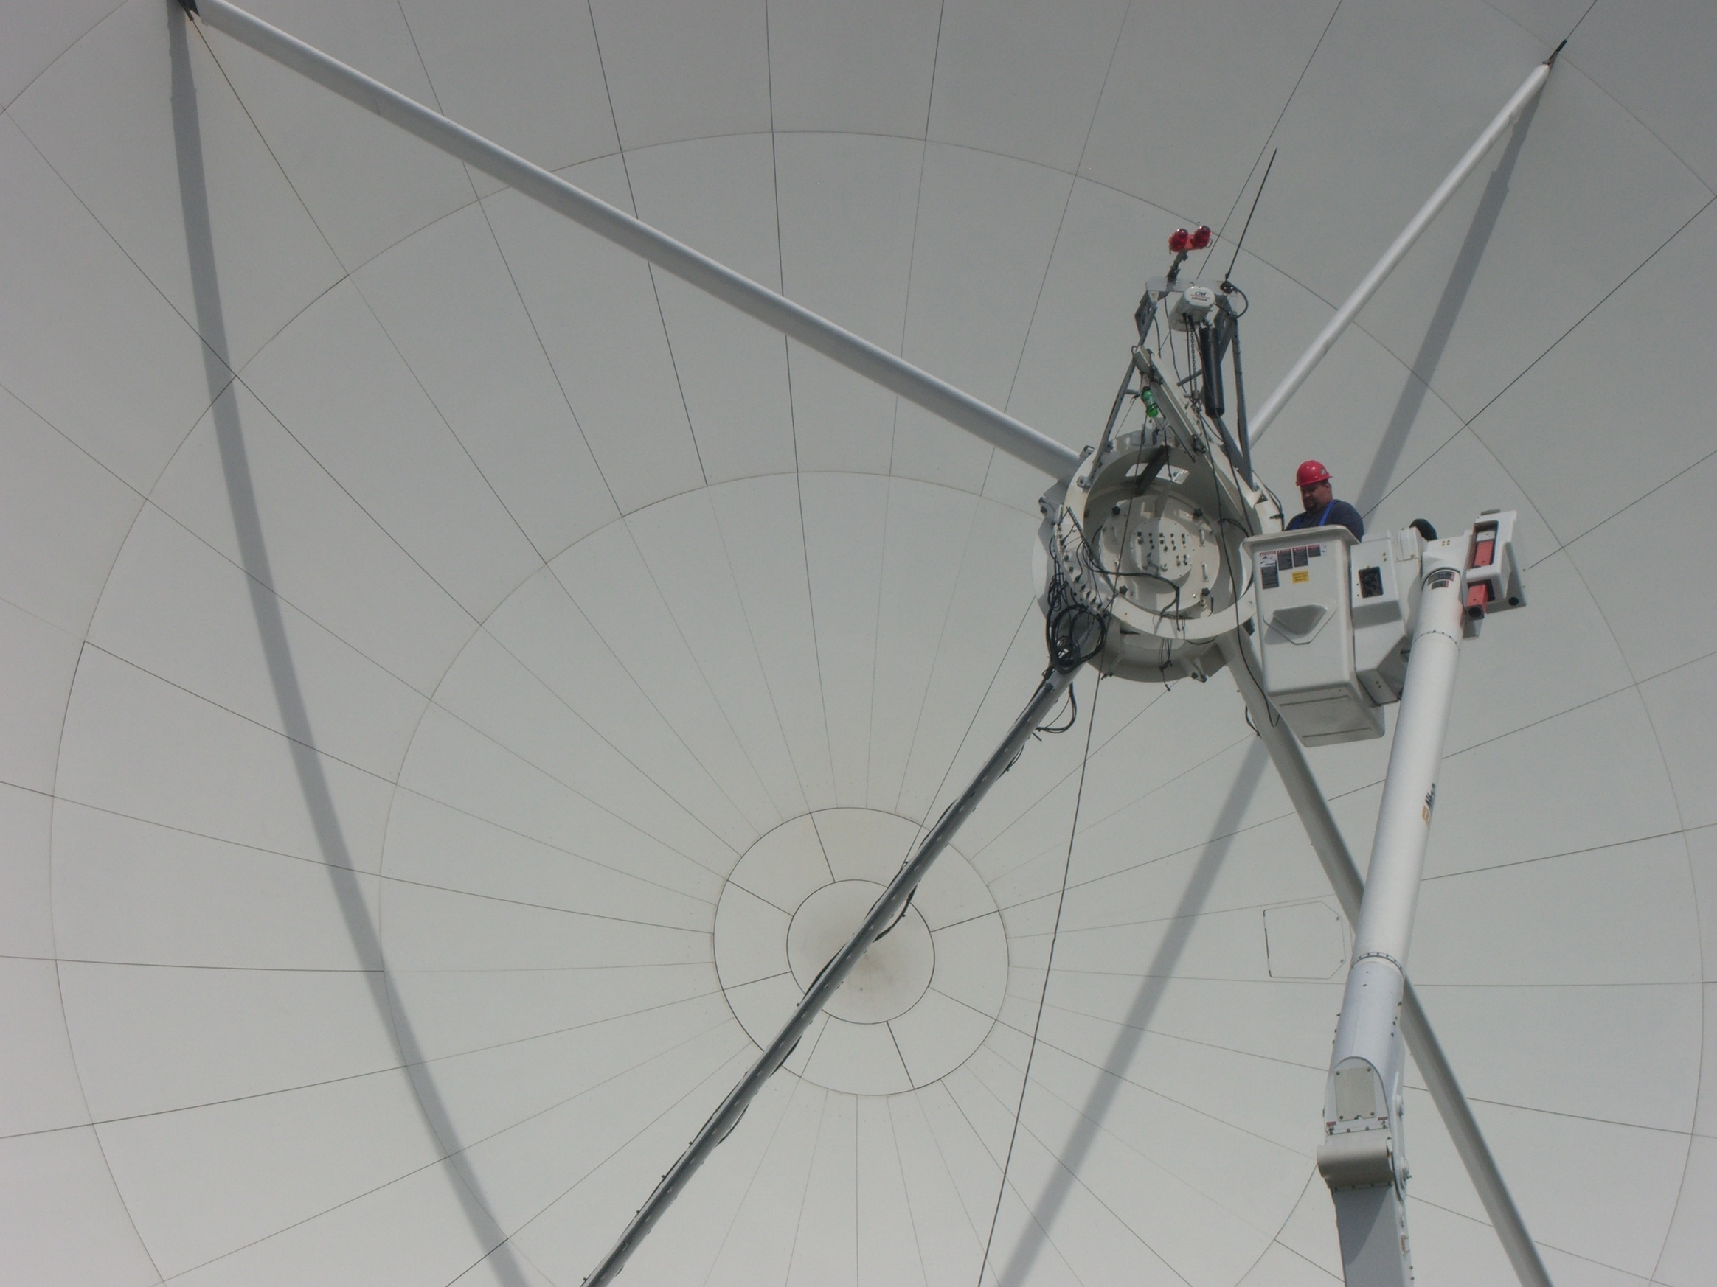
21 M Operations
Satellite Ground Station for Morehead State SmallSat Missions and Others
JPL ASTERIA Ground Station
Radio Telescope Mode for Research in Astrophysics
Test-Bed for Experimental Communication Systems and Processes- DTN, Autonomous Ops, OMSPA

Slide 5



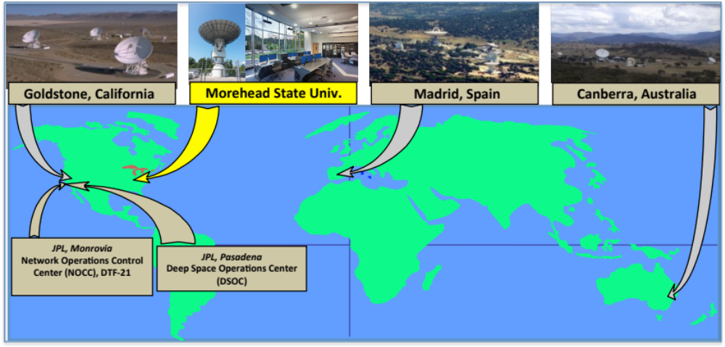
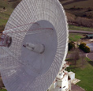

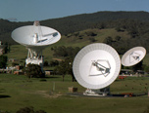
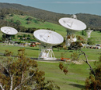
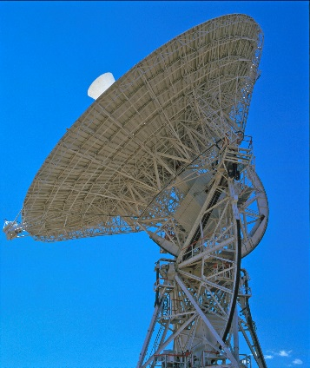
DSS-17 Affiliated Station
Fig. 1: LH2 Tank Installed at Test Site
Fig. 3new: C&C Trailer
Notes:
5

Slide 6

AES Program: Evolving 21 m DSN Station into DSS-17
Project Description and Objectives Demonstrate a cost-effective process for expanding DSN capabilities by utilizing non-NASA assets to provide communication and navigation services to small spacecraft missions to the Moon and inner solar system, thereby enabling interplanetary research with small spacecraft platforms.
Technical Approach Develop and implement a strategy to transfer Deep Space Network (DSN) processes and protocols to the MSU 21 m antenna system to enable integration into the DSN as an auxiliary station to support small spacecraft missions. Implement deep space communications, tracking and navigation techniques as well as adoption of CCSDS standards. Implement systems upgrades, conduct tests/demonstrations, and transition to an operational capability.
Benefits Serves as a test-case for other non-NASA ground stations to provide auxiliary deep space navigation and tracking support for small spacecraft missions. Develops an operational capability to support EM-1 CubeSat missions in the 2021 timeframe Transparent to Missions Being Supported | Targets Full DSN Compatibility Scheduled by DSN Support CCSDS-SLE DSN Tracking and Ranging Support Lunar, NEA, Lagrange Point Missions at 64-128 kbps (or higher, subject to link margin)

Slide 7
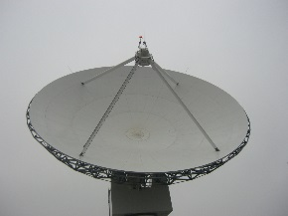
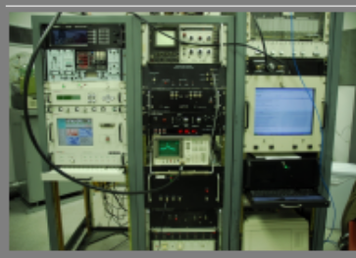
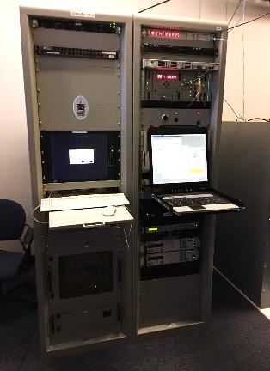
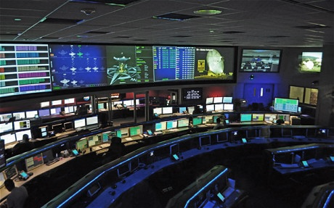
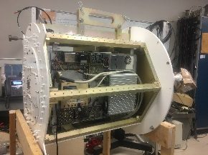
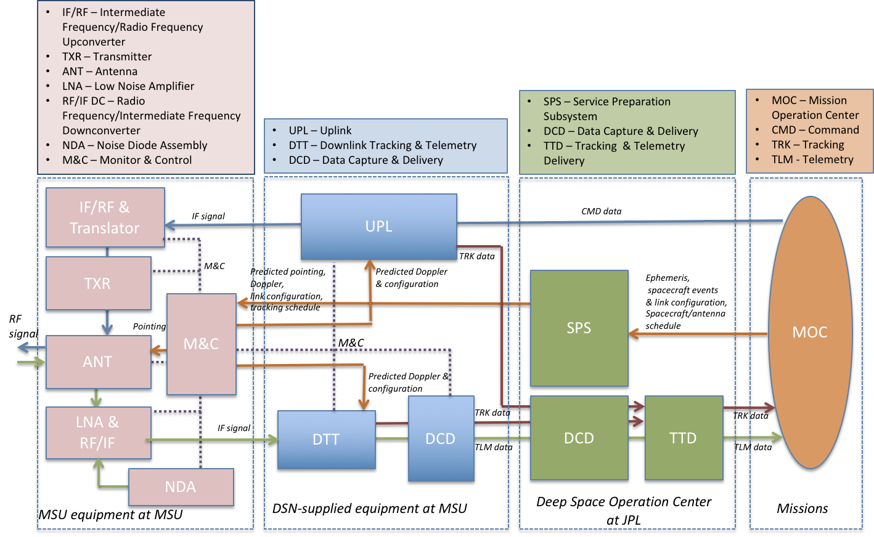
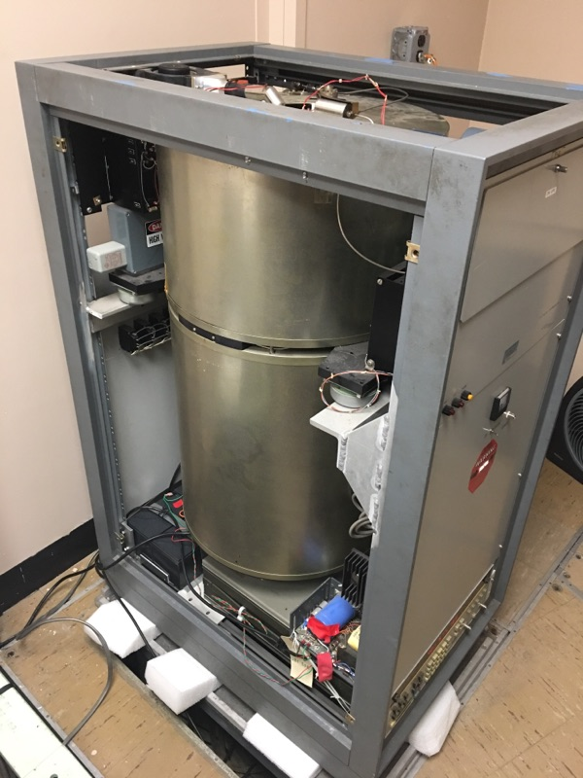

DSS-17 System Architecture
“Lite” Version of DSN Block 6 Exciter System Developed for Morehead State
Morehead State 21 m Antenna System
21 m Antenna Control System
Deep Space Operation Center- JPL Mission Control
Updated Cryogenic X-Band Feed
H- MASER
Morehead State University Mission Operations Center

Slide 8


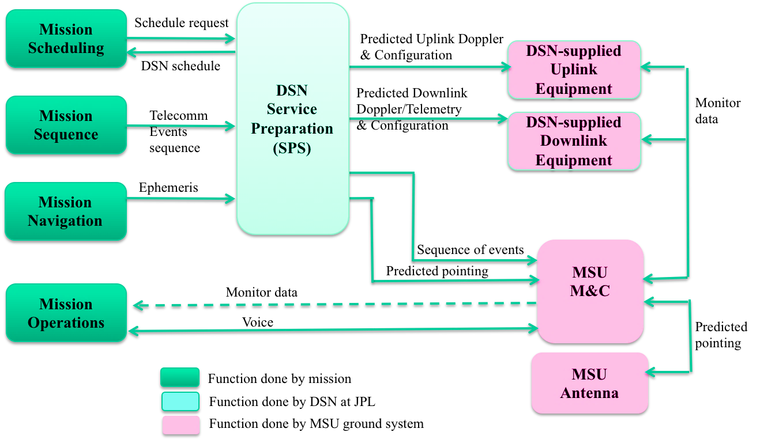
Service Management Data Flow
For NASA Missions

Slide 9
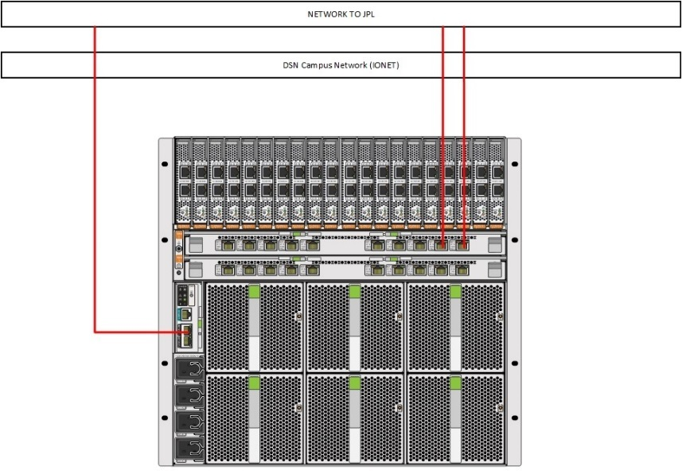
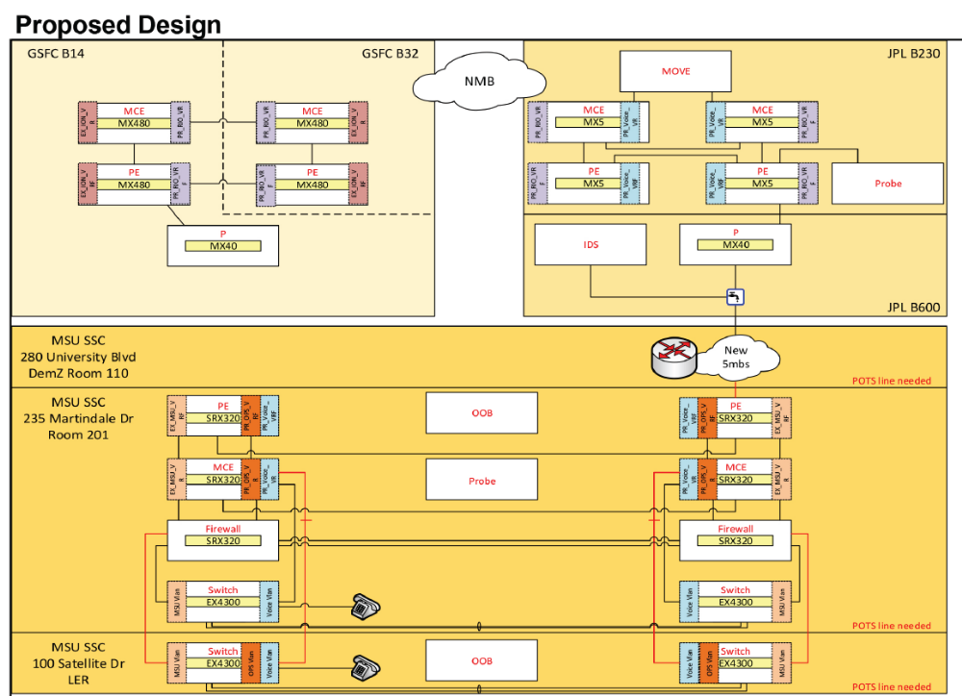
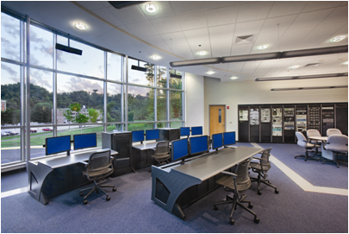
IT Security and NMB Connection
IT Security and Network Connection Required
  LAN Independent of University Network
  Architecture Designed with JPL and CSO
  Behind NASA Firewall
  Designed by NASA JPL and CSO
  Direct Connection to the NASA NMB

Slide 10
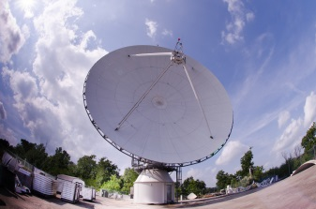
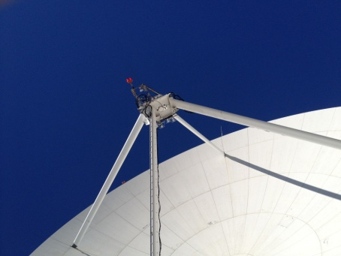
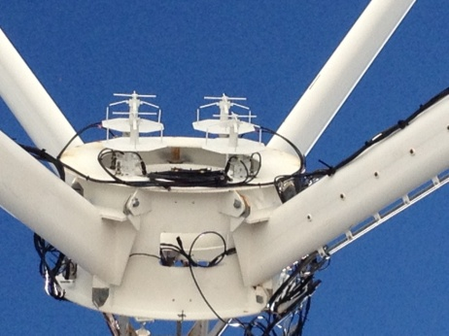
DSS-17 Performance
Parameter | Measured Values
Axis Slew Velocity
Azimuth | > 3.0 º/sec minimum
Elevation | > 1.6 º/sec minimum
Polarization | > 0.7 º/sec minimum
Axis Acceleration
Azimuth | 1.0 º/sec²
Elevation | 0.6 º/sec²
Travel Range
Azimuth | ± 269.8º
Elevation | 1.0º to 90.3º
Polarization Range | ± 90º
Pointing Accuracy | 0.005º RMS
Tracking Accuracy | 0.0004º RMS
Aperture Efficiency, η (L/Ku) | 0.653/0.563
Surface Tolerance @ 35 mph wind | < 0.020” RMS
Performance Measure | DSS-17 Performance Metric
X-Band Frequency Range | 7.0 – 8.5 GHz
LNA Temperature | < 20 K
System Noise Temperature | <100 K
Antenna Gain | 62.7 dBi (@8.4 GHz)
System Noise Spectral Density | <-178 dBm/Hz
G/T at 5° Elevation | 40.4 dB/K
Time Standard | Hydrogen maser (1 ns/day)
EIRP | 93.7 dBW
HPBW | 0.115 deg
SLE Compliance | Yes
CCSDS Compliance | Yes
Forward Error Coding | Reed Solomon/Convolutional, Turbo, Low Density Parity Check
Radiometric | Angle, Doppler, Ranging

Slide 11
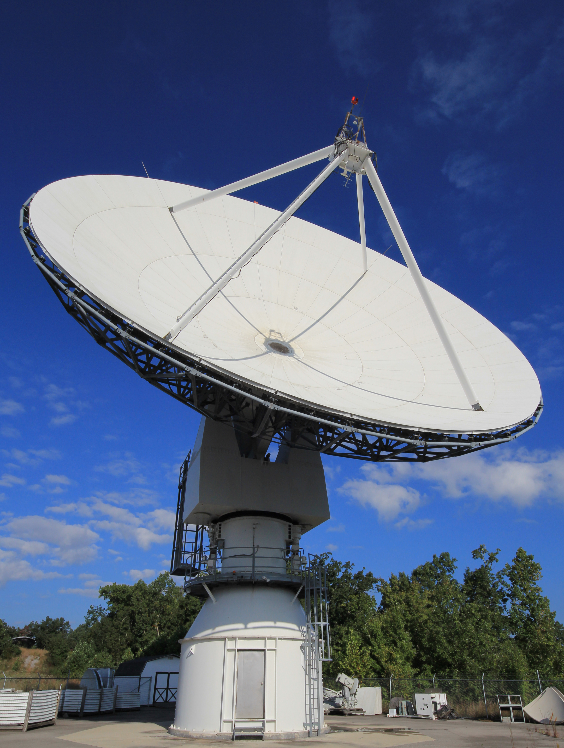
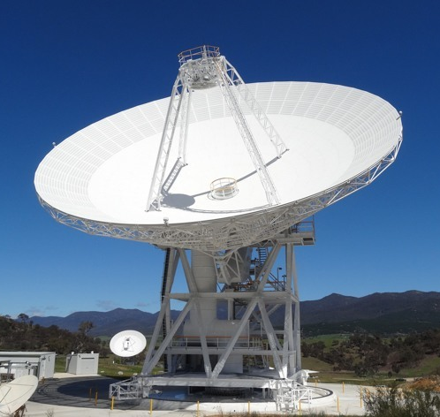
COMPARISON to 34m BWG
G/T: 10 dB less (~ 5 dB less Gain, 5 dB higher noise temperature)
EIRP: 92.7 dBW vs. 110 dBW (1 kW PA vs 20 kW PA)
Ranging Accuracy: 1 m (1 sigma accuracy) vs 1 m (1 sigma accuracy)

Slide 12
Performance Tests
The Morehead State University and DSN/JPL teams performed the following set of tests to empirically determine the performance of DSS-17:
G/T as a function of elevation (from 0° to 90° in 5° intervals)
SNT as a function of elevation (from 0° to 90° in 5° intervals)
EIRP
Pointing and Tracking Error Measurements
Telemetry Tracking of S/C: Chart that includes Coding and Modulation Tests- examples from Missions; Telemetry Data Capability (Capture Rates and grades)
Commanding (DTT locks to carrier and sub-carrier, measure variations, command verification. Confirm that USG generates signals of X, at a bit rate of Y)
Radiometric Measurements- Ranging Data- loop back test with command
Stability of Ranging Measurements - STEREO A 3-Way
Doppler Noise
8) Horizon Mask
9) Operational Tests (retrieval of predicts, achieving carrier and symbol lock, etc.) Reference 4 and 6, Spacecraft Tracks (SNR, data rates, modulation schemes, etc.)

Slide 13
G/T Empirical Measurements

Slide 14
Radiometric Measurements
Ranging Data- loop back test with Command
Stability of Ranging Measurements - STEREO A 3-Way (STA)
Two –Way (Local)*
Two-Way over Air (LIC)*
Doppler Noise
*Two-Way Ranging Measurements have not been possible to make without an existing spacecraft willing to participate in the measurements
*CAPSTONE will provide operational measurements of the two-way ranging capabilities

Slide 15
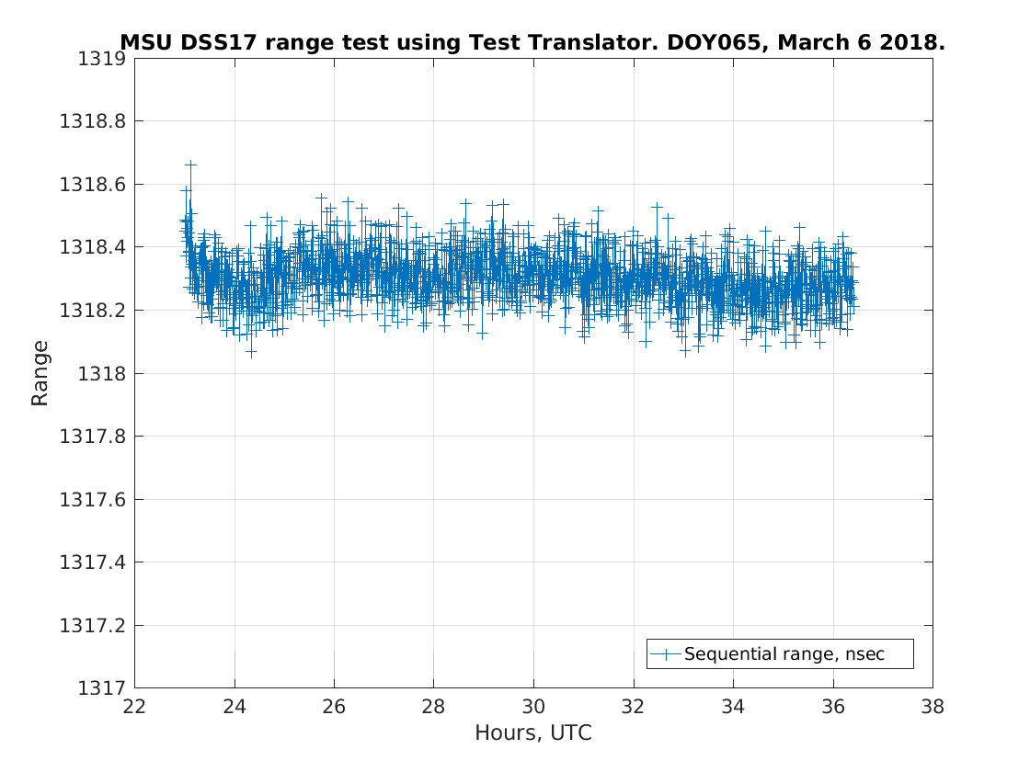
Overnight Range Test Shows Stable Result

Slide 16
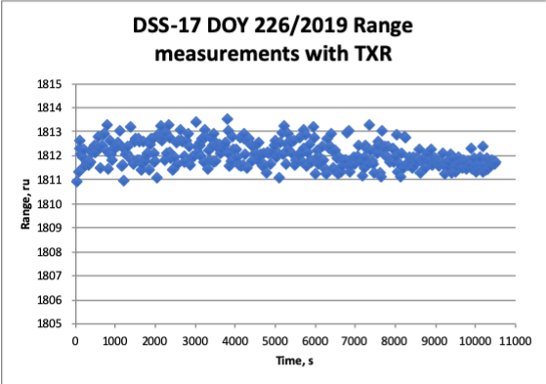
Ranging Accuracy Measurements
DSS-17 Ranging Results (Tx Stability)- precision within +/-1 range unit (0.94 ns). Implies 1 meter accuracy ranging at the Moon Lab Test

Slide 17
Doppler Accuracy Measurements
DSS-17 3-Way Ranging Results with STA imply 0.56 cm/sec standard deviation residual (Test Results from 3/18/2021)

Slide 18
Pre-Operational Tests
Pre-Operational Tests involved testing all aspects of an operational track:​
Retrieval of Predicts and Configuration Files from the SPS Server ​
Achieving carrier lock, Frame lock and Symbol lock​
Reference Telemetry Tracking​
Radiometric Measurements​
Flowing Data and Telemetry to DSOC​
Flowing Radiometric Data to FDF​
Testing Uplink (Unable to Complete- did not receive Mission Permission)​
​
Additional Tests involved Shadow DSN tracking of missions with sufficient SNR (>10 dB link margin)​
Hayabusa2​
Osiris-Rex​
Maven​
STEREOA​
​

Slide 19
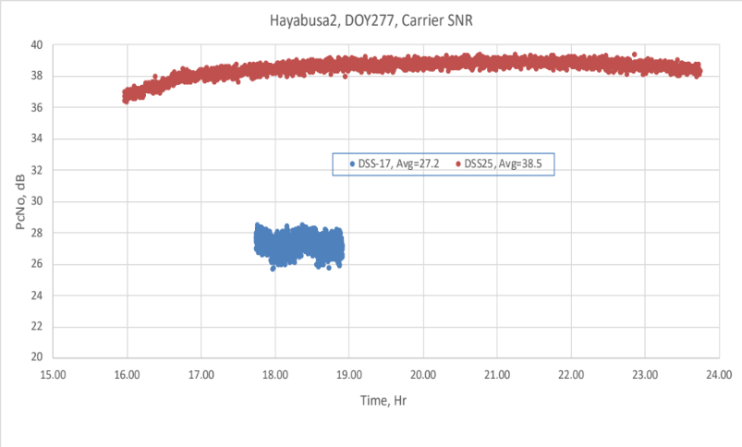
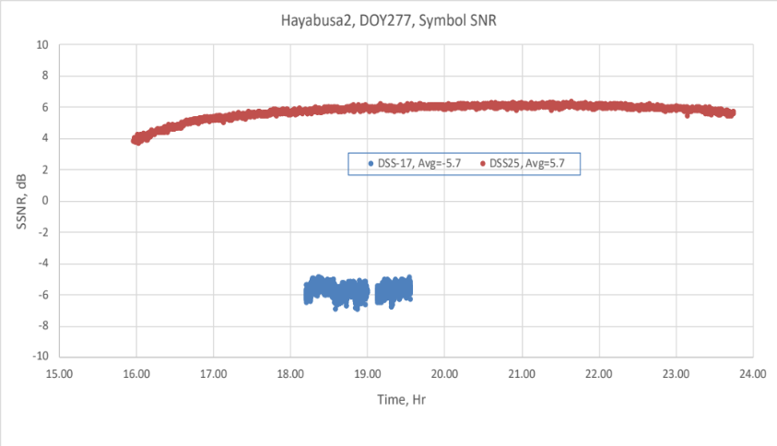
Results from Hayabusa2 Tracks
Expected signal strong enough for carrier, subcarrier and symbol locks
  Not strong enough for telemetry decoded
Observed 11.3 dB difference between MSU and DSN antennas, based on carrier SNR and symbol SNR
  Within bounds of 10 dB expectation

Slide 20
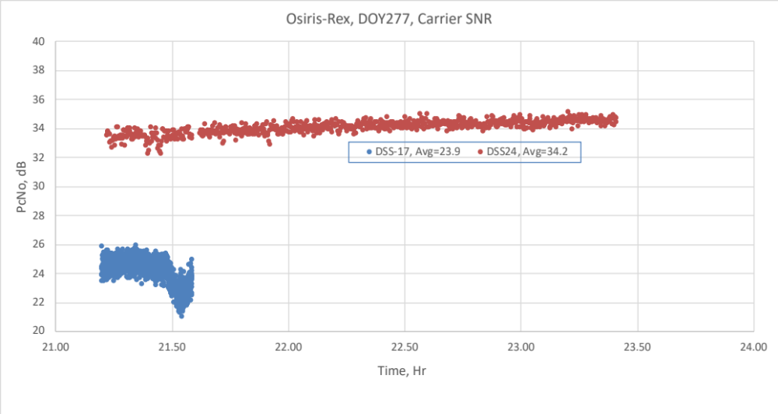
Results from Osiris-Rex Tracks
Expected signal strong enough for carrier, subcarrier and symbol locks
  Insufficient bit SNR (Eb/No) for telemetry frame decoding
  Achieved carrier lock, but not subcarrier nor symbol locks
    10.3 dB difference between MSU and DSN antennas
    Consistent with expectation

Slide 21
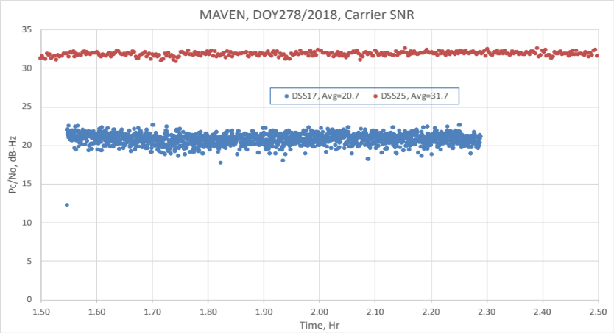
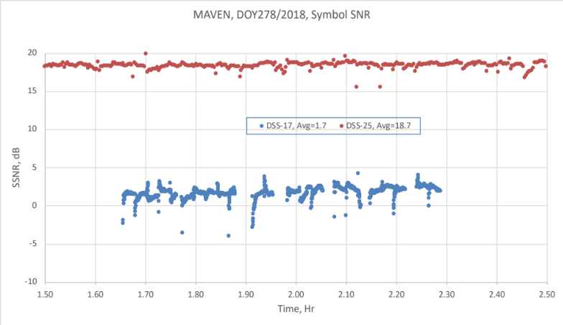
Results with MAVEN
Expected signal strong enough for carrier, subcarrier and symbol locks
Observed
  Carrier lock - 11.0 dB difference between MSU and DSN antennas
  Subcarrier lock – Not achieved
  Symbol lock – 17 dB difference, due to lack of subcarrier lock
  Telemetry decode – Not achieved, due to lack of subcarrier lock

Slide 22
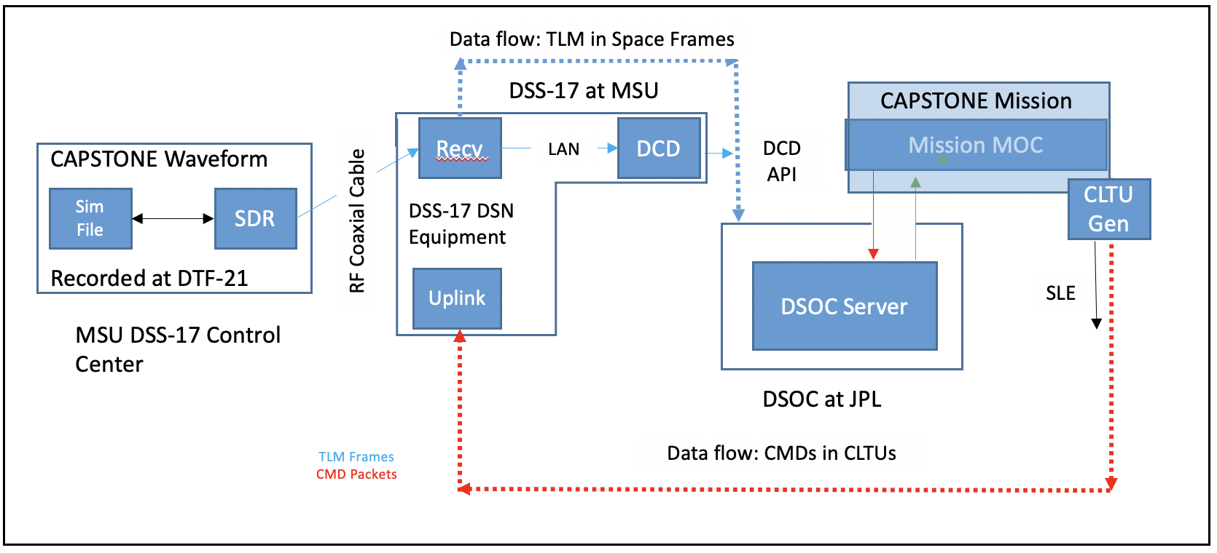
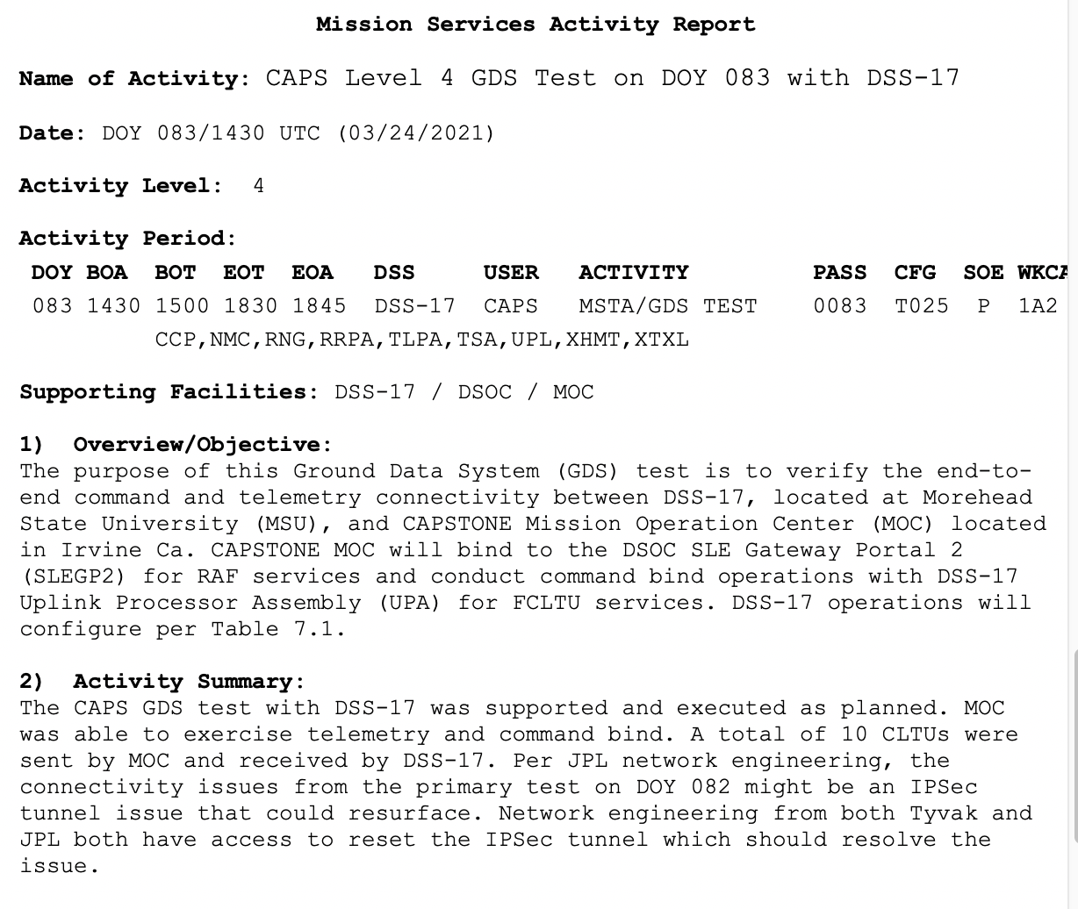
Results with CAPSTONE GDS Test
Successful command and telemetry data flows between DSS-17 and CAPSTONE MOC established on Mar. 24, 2021
NOTE: DSS-17 is Prepared to Support GDS Testing with All Artemis 1 Missions for which Tracking Services are being Provided

Slide 23
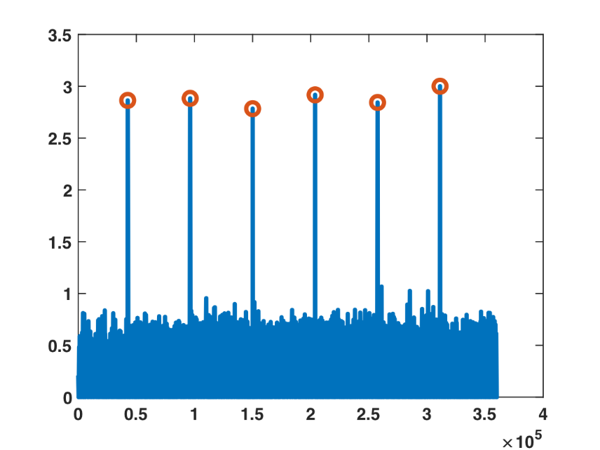
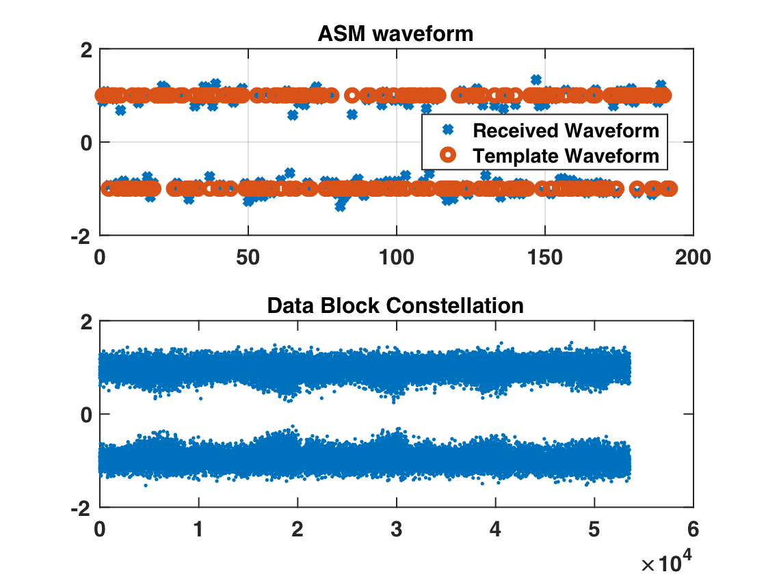
MarCO Demonstration Results
From DSS-17 at Morehead State
MarCO launched on May 5, 2018, Subsequent Demonstrations were Undertaken:
  Downlink Using X-Band Feed and DSN Equipment
    Carrier Lock, Working on Symbol Lock
  Downlink Using X-Band Feed and MarCO Receiver System
    >250 frames decoded
    OMSPA Using X-Band Feed and Custom SDR-based Multiple Receiver System
    First OMSPA Demonstration with a CubeSat
First 5 Demodulated Frames from MarCO OMSPA Demonstration on May 6, 2018 from DSS-17, D. Abraham, Z. Towfic, S. Finley (JPL)
C. Conner, M. Stratton, R. Kroll (Morehead State)

Slide 24
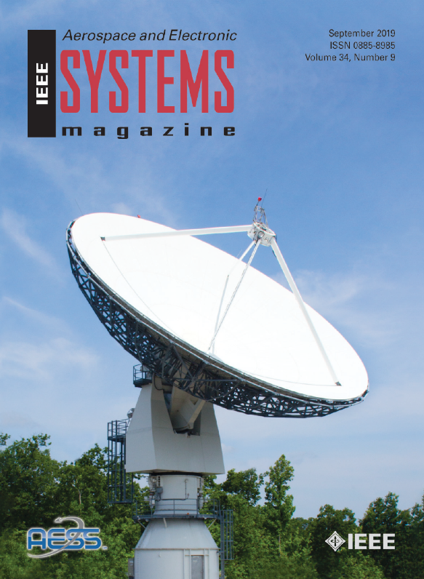
DSS-17 Milestones and Timeline
X-Band Downlink Capability Developed and Tested with Real Spacecraft, including Stereo, Osiris Rex, and MAVEN
Telemetry connection to JPL over NASA Mission Backbone Network Operational
  Enables telemetry and commanding in the same manner as other DSN antennas
X-band Transmit and Ranging
  Ranging Measurements Successful
    Results imply 1m ranging accuracy at the Moon
Conducted Series of DTN Demonstrations Using Lunar IceCube (LIC), DSS-17 and LIC Ground Data System
Conducted first OMSPA Demonstration with a CubeSat using the X-band Feed and custom SDR-based Multiple Receiver System
Successfully conducted approximately 1,000 S-band ASTERIA Mission passes
  Enabled staff and students to obtain significant operational experience
DSS-17 on the Cover of the IEEE Aerospace and Electronic Systems Magazine Special Issue on Artemis 1 (September 2019)
Critical Milestones
ΔSRR | NMB Connection | Downlink Demo | OMSPA Demo | Uplink/Ranging Demo | ORR | Operational | EM-1 Mission Ops | Mission Duration | Future Interplanetary Smallsats
01/15/2016 | 6/15/2018 | 5/5/2018 | 5/15/2018 | N/A | 06/15/2021 | 08/15/2021 | Oct 2021 | Artemis 1 CubeSat Mission Duration | Beyond EM-1
ISEE-3 Carrier During Lunar Fly-by Sept 2014
© 2020. All Rights Reserved

Slide 25
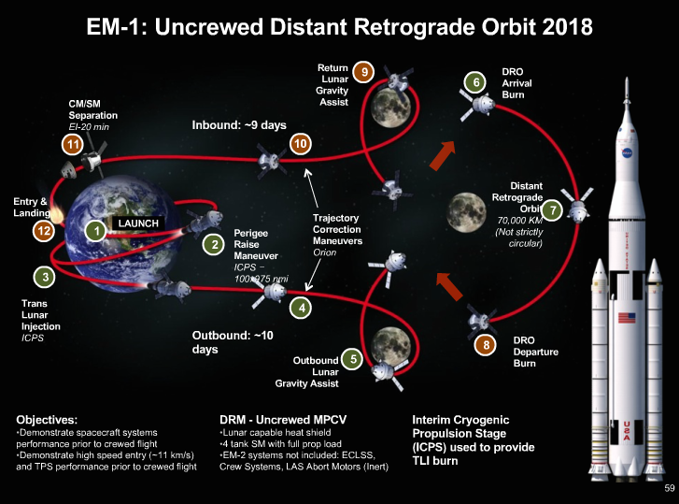
On Target for Operational Readiness for Artemis-1
Prepared to Provide Support for NASA EM-1 CubeSats
Lunar IceCube NEA Scout LunaH- Map
Lunar Flashlight

Slide 26
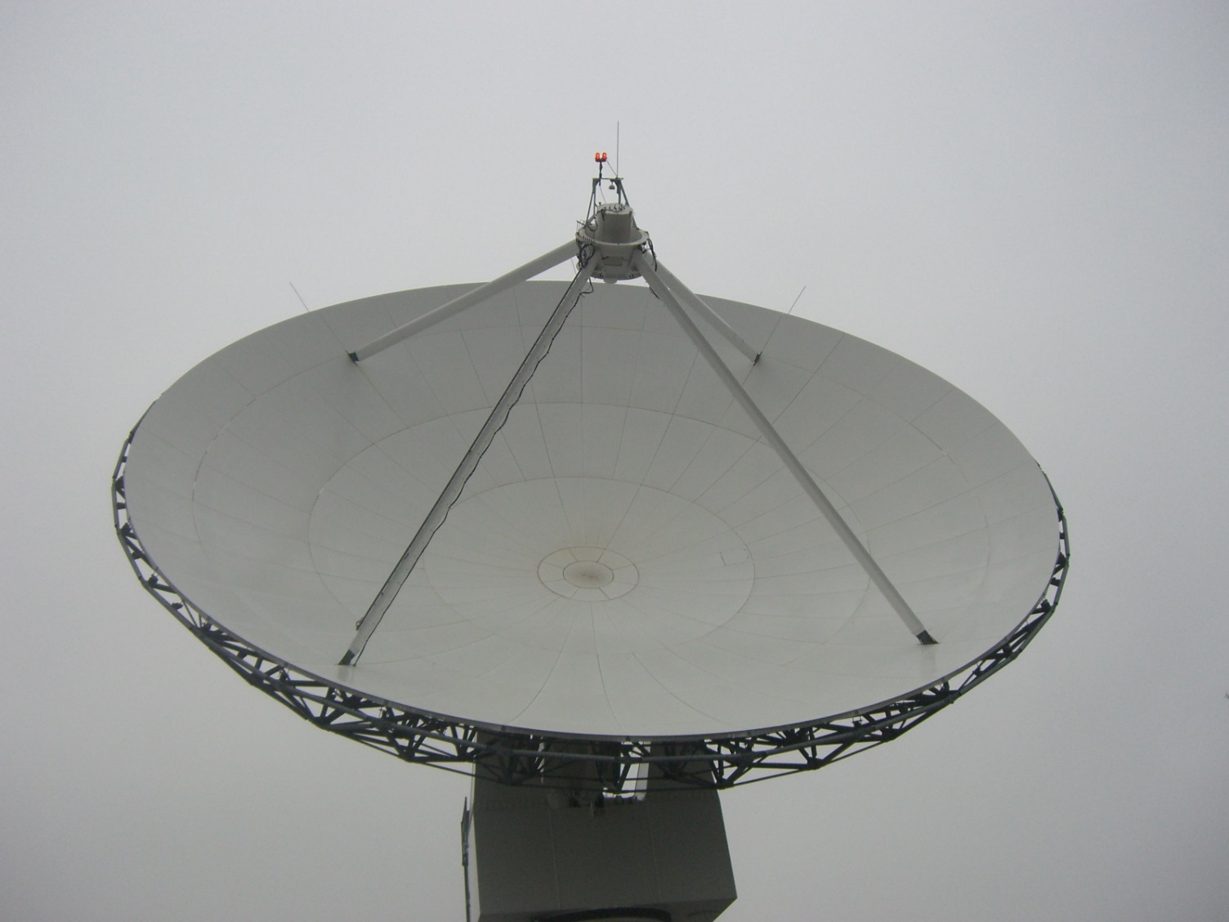
Questions at Q&A Session

