Slide 1
2020 IEEE Aerospace Conference
Data Mules on Cycler Orbits for High-Latency, Planetary-Scale Data Transfers
Marc Sanchez-Net
Etienne Pellegrini
Joshua Vander Hook

Slide 2
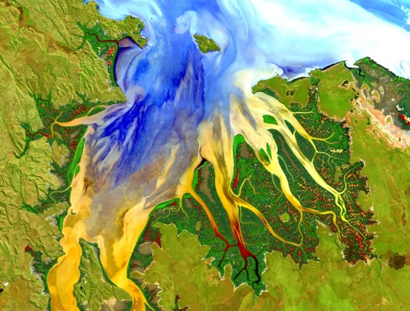
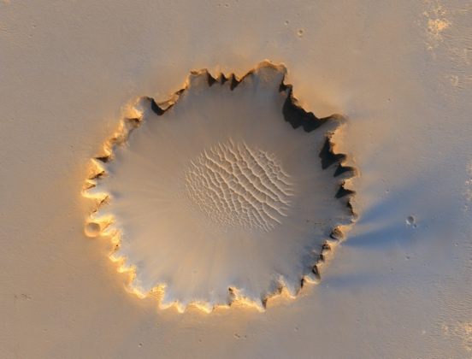
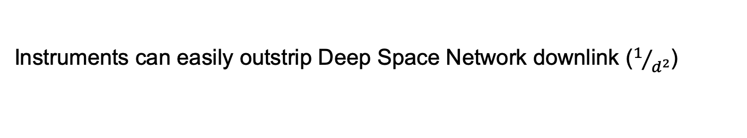
Motivating Problem
Instruments can easily outstrip Deep Space Network downlink ($1/{d^{2}}$)
Example / Reference | Coverage | Resolution | Bands | Volume | Cadence | Rate (Kbps)
HiRise | 4% | 1m / pixel | 3 | 268 Tb | 15 years | 556
CRISM (targeted) | ~1% | 15 m / pixel | ~100 | 7 Tb | 15 years | 14
CRISM (untargeted) | ~100% | 100m / pixel | <50 | 10 Tb | 15 years | 21
What we want! | Coverage | Resolution | Bands | Volume | Cadence | Rate (Kbps)
Imaging Spectrometer | 100% | 30m / pixel | 200 | 2,000 Tb | 4x / year | >253,000
Visible Imager | 100% | 1m / pixel | 3 | 6,700 Tb | 1x / year | >212,000

Slide 3
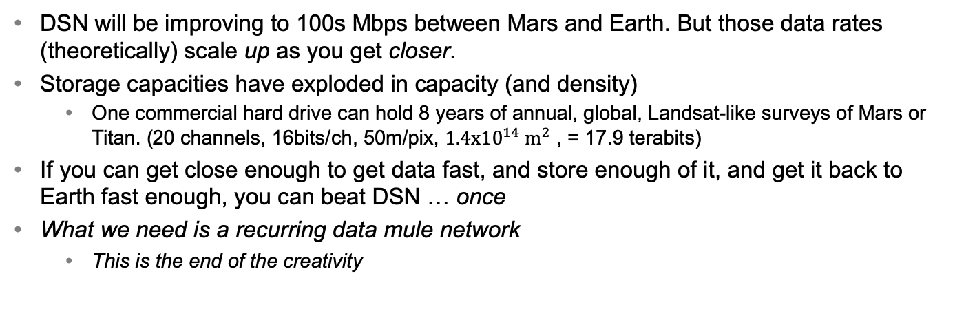
Motivating Problem
DSN will be improving to 100s Mbps between Mars and Earth. But those data rates (theoretically) scale up as you get closer.
Storage capacities have exploded in capacity (and density)
  One commercial hard drive can hold 8 years of annual, global, Landsat-like surveys of Mars or Titan. (20 channels, 16bits/ch, 50m/pix, $1.4x{10}^{14} m^{2}$ , = 17.9 terabits)
If you can get close enough to get data fast, and store enough of it, and get it back to Earth fast enough, you can beat DSN … once
What we need is a recurring data mule network
  This is the end of the creativity
“Never underestimate the bandwidth of a station wagon full of tapes hurtling down the highway.” – Andrew Tanenbaum Computer Networks, 3rd ed., p. 83

Slide 4
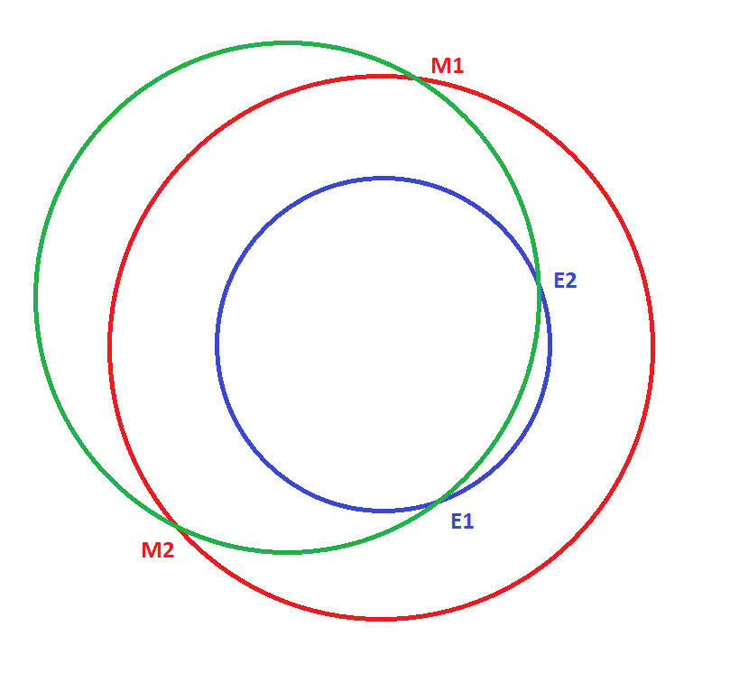
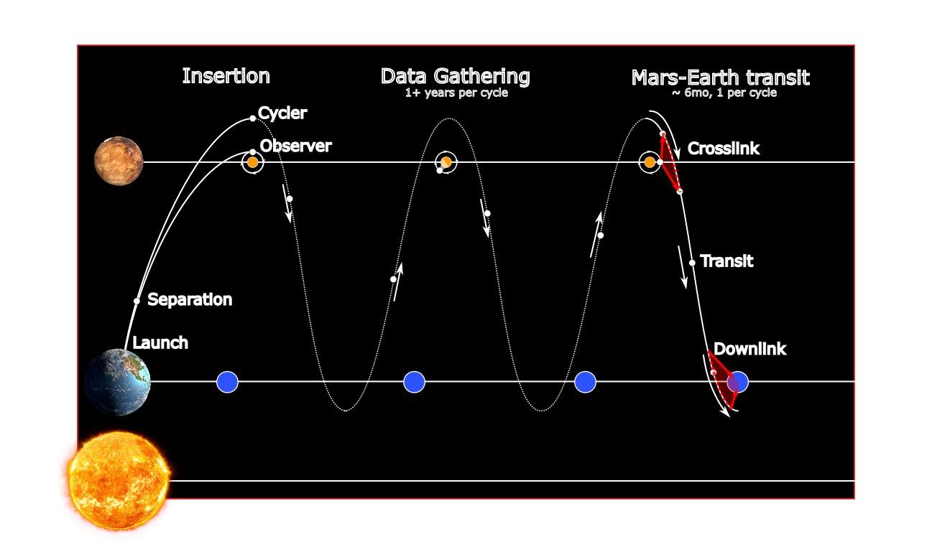
Solution we investigated
Use cycler orbits to re-use data mules with little / no propulsion
One cycler achieves a ME transfer every 2-4 years
“Staggering” cyclers can achieve > 1 ME transfer / year
Limited effect on DSN, since crosslink takes a few hours
Launch a bundle of couriers
Problem: Not “enough” cyclers in literature (also timing … )

Slide 5
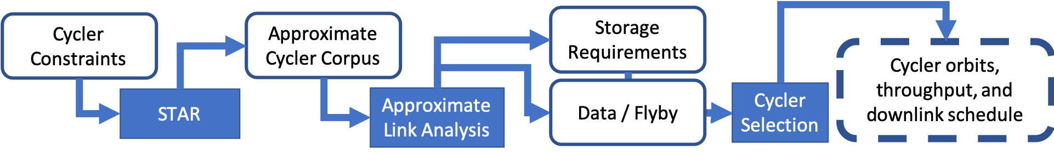
This work
(mostly) automated enumeration and selection of complementary cyclers
(approximate) calculation of crosslink data volumes per Mars flyby

Slide 6
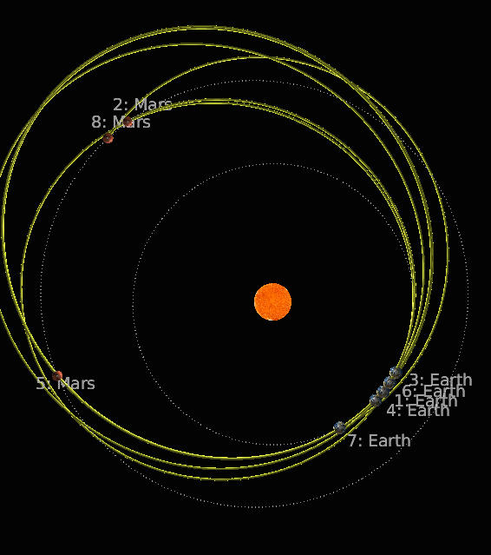
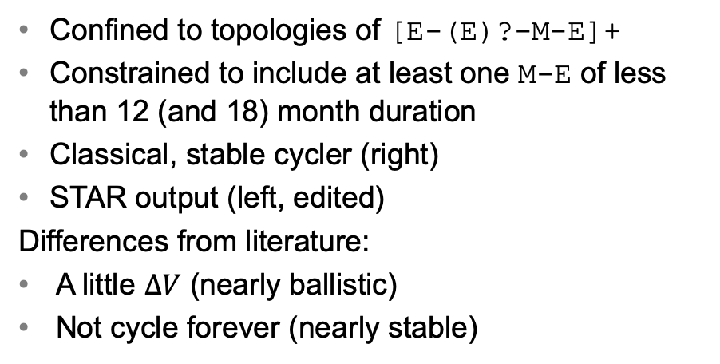
Cycler Generation
Confined to topologies of [E-(E)?-M-E]+
Constrained to include at least one M-E of less than 12 (and 18) month duration
Classical, stable cycler (right)
STAR output (left, edited)
Differences from literature:
A little $ΔV$ (nearly ballistic)
Not cycle forever (nearly stable)
E-M-E2-M-E2-M
Etienne.Pellegrini@jpl.nasa.gov

Slide 7
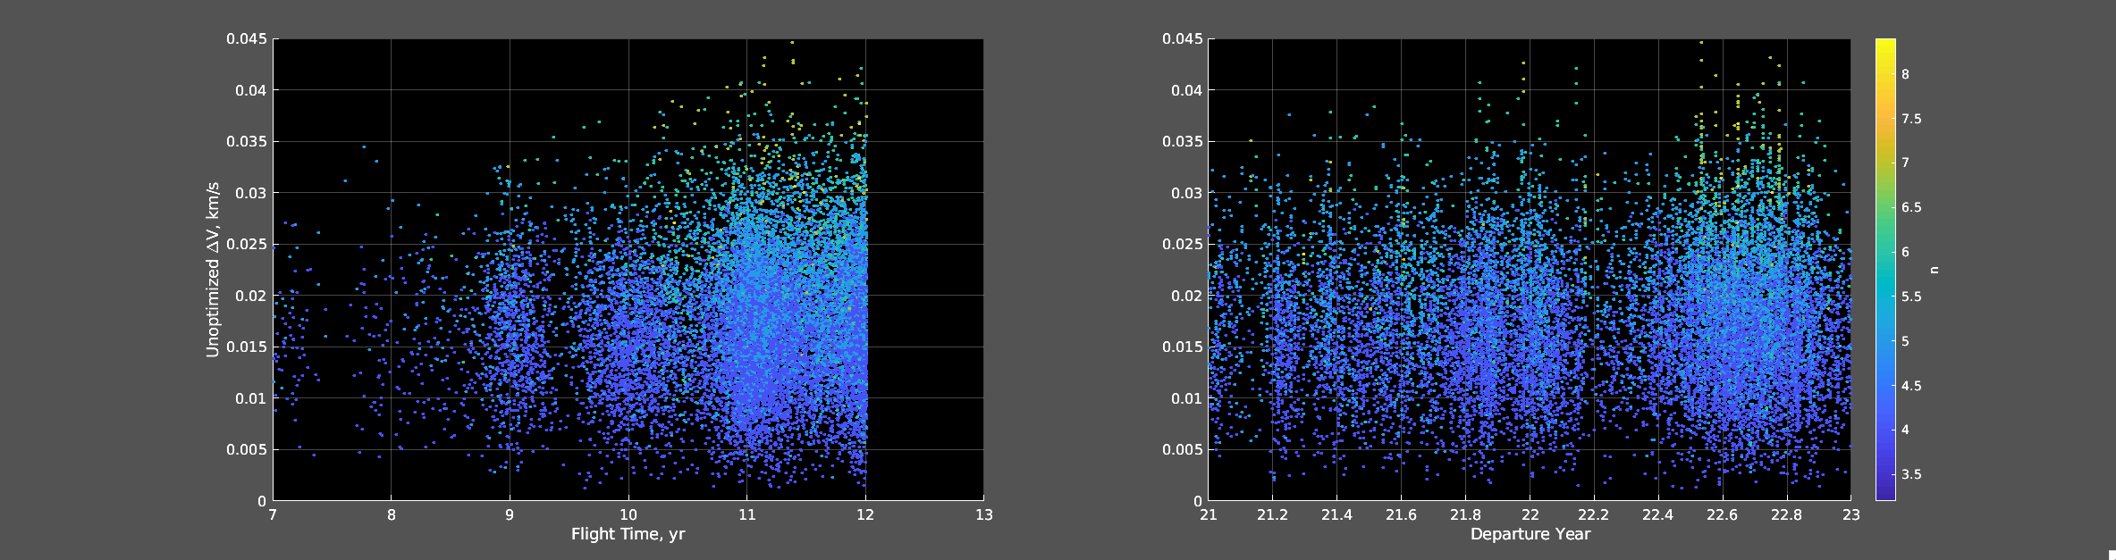
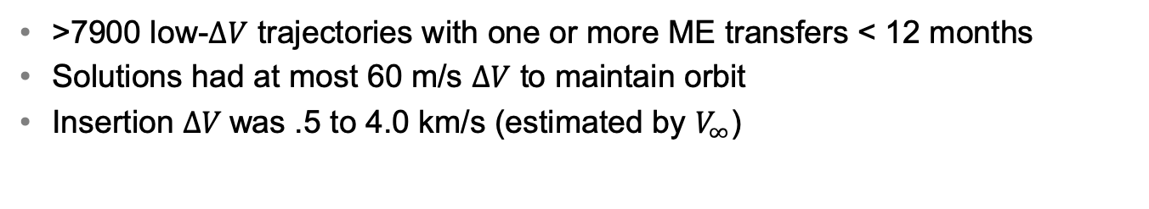
Cycler Generation
>7900 low-$ΔV$ trajectories with one or more ME transfers < 12 months
Solutions had at most 60 m/s $ΔV$ to maintain orbit
Insertion $ΔV$was .5 to 4.0 km/s (estimated by $V_{∞}$)
Etienne.Pellegrini@jpl.nasa.gov

Slide 8
Cycler Dataset Caveats
For a given window size, not every window had a ME transfer
Toy example: “Does cycler i have a M-E transit in year j”
 | Year 1 | Year 2
Cycler 1
Cycler 2
Cycler 3
Union

Slide 9
Cycler Dataset Caveats
For a given window size, not every window had a M-E transfer
 | Q1 | Q2 | Q3 | Q4 | Q5 | Q6 | Q7 | Q8
Cycler 1
Cycler 2
Cycler 3
Union
Gaps

Slide 10
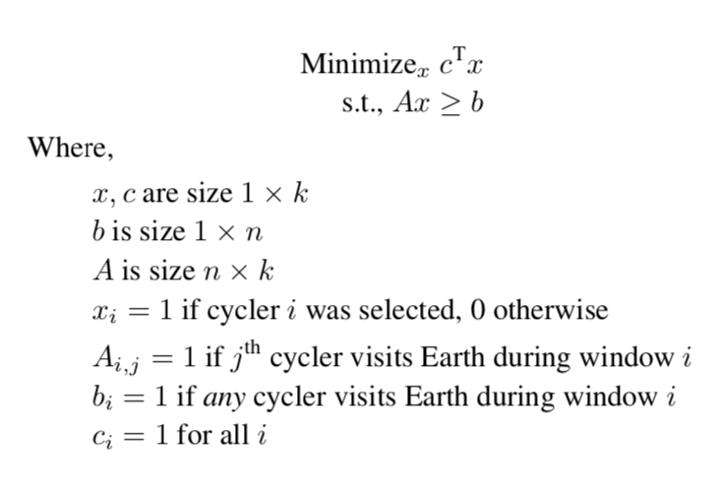
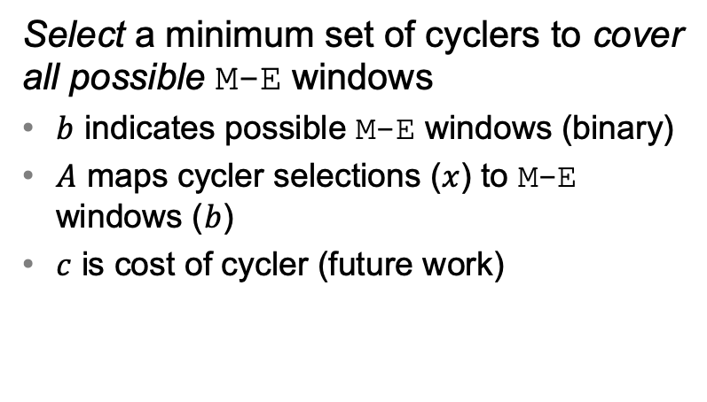
Cycler Selection
Set Cover formulation, Integer Programming implementation
Select a minimum set of cyclers to cover all possible M-E windows
$b$ indicates possible M-E windows (binary)
$A$ maps cycler selections ($x$) to M-E windows ($b$)
$c$ is cost of cycler (future work)
hook@jpl.nasa.gov

Slide 11
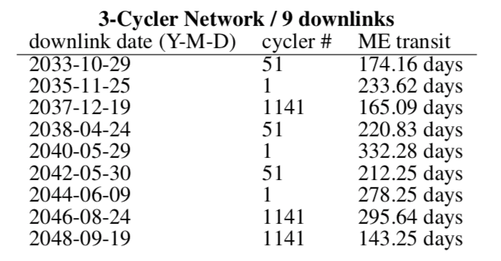
Covering Set Example (2030 launch)
Gaps
Good spacing
<12 month M-E transit
Small # couriers
So, how much data can we get per flyby at Mars?

Slide 12
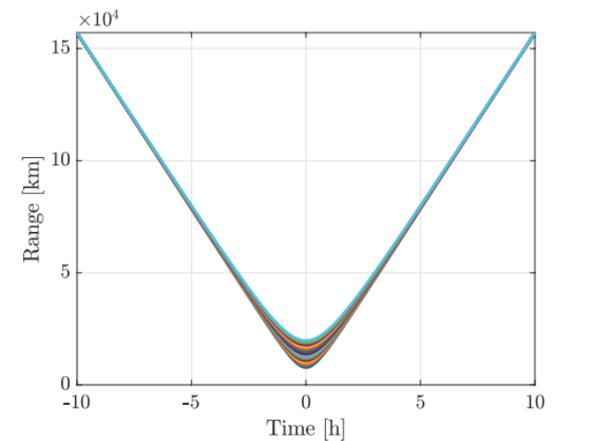
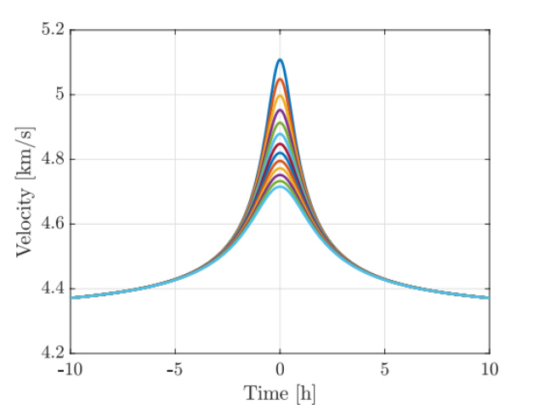
Mars Flyby (Observer / Courier geometry)
Range and relative velocity over time
Test “representative” cyclers from STAR output ephemeris
Propagate near Mars for range / relative velocity of observer and data mule
Marc.Sanchez.Net@jpl.nasa.gov

Slide 13
Mars Flyby (Observer / Courier geometry)
Range and relative velocity over time
Test “representative” cyclers from STAR output ephemeris
Propagate near Mars for range / relative velocity of observer and data mule
Assume 2.5 hours of transmission*
  (*fairly restrictive assumption)
Marc.Sanchez.Net@jpl.nasa.gov

Slide 14
Link Budget Assumptions
 | Both | Courier-specific |  | Observer-specific
 | Electronics | Terminal (cm) | Laser (W) | Terminal (cm) | Laser (W)
T1 | ~10 Gbps | 0.10 | 0.5 | 0.10 | 0.5
T2 | ~100 Gbps | 0.10 | 0.5 | 0.22 | 0.5
T3 | ~1000 Gbps | 0.22 | 0.5 | 0.22 | 1.0
Terminal capabilities based on [1]
DPSK for transmission
1. J. Breidenthal, H. Xie, C.-W. Lau, and B. MacNeal, “Space and earth terminal sizing for future mars missions,” in 2018 SpaceOps Conference, 2018, p. 2426.

Slide 15
Link Budget Assumptions
 | Both | Courier-specific |  | Observer-specific
 | Electronics | Terminal (cm) | Laser (W) | Terminal (cm) | Laser (W)
T1 | ~10 Gbps | 0.10 | 0.5 | 0.10 | 0.5
T2 | ~100 Gbps | 0.10 | 0.5 | 0.22 | 0.5
T3 | ~1000 Gbps* | 0.22 | 0.5 | 0.22 | 1.0
Terminal capabilities based on [1]
DPSK for transmission
*Fairly liberal assumption
(NVMe, DMA ~ 100s Gbps, ~ 40 Tbps serial fiberoptic)
1. J. Breidenthal, H. Xie, C.-W. Lau, and B. MacNeal, “Space and earth terminal sizing for future mars missions,” in 2018 SpaceOps Conference, 2018, p. 2426.

Slide 16
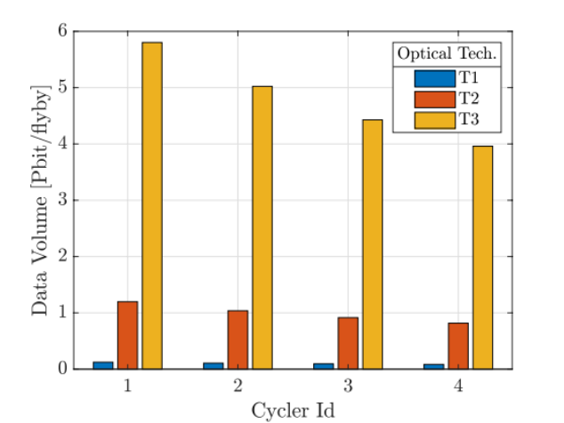
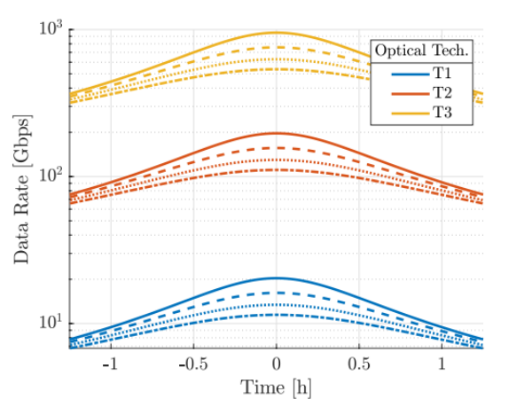
Data Rate and Volume per Flyby
Range over time from STAR
Scales peak rate from technology assumptions
Integrated for total data volume per flyby
Marc.Sanchez.Net@jpl.nasa.gov

Slide 17
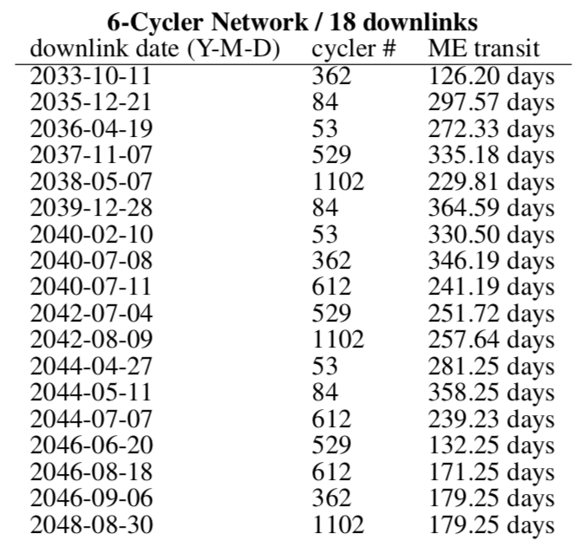
Example Total Data Volume and Rate from Single Launch
(probably quite optimistic)
90 Pbits / 15 Years
(220 Mbps)
X
=
>1000x the last 15 years
Comparable to DSN in 2030-2040 optimistic peak rate
2-3x better than DSN amortized rate in most projections
Requires <1% of DSN time, so >100x more efficient by time
See paper for more DSN projections to compare against (Thanks reviewers)

Slide 18
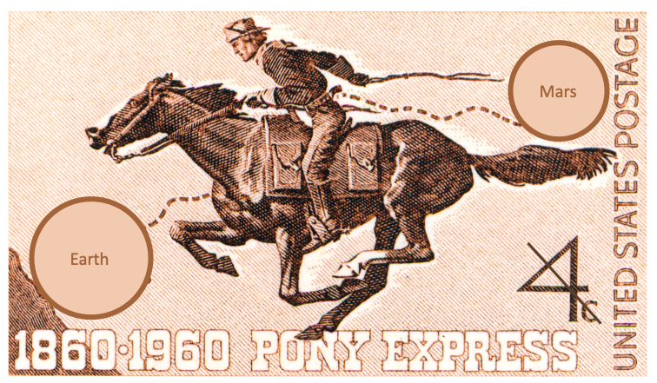
Work to do
Reduce data rate w/ longer comms window
Expand to Venus (should be better)
Trajectories instead of patched conics
Insertion for 6+ couriers to 6+ cycler orbits from single launch (Very Hard?)
Size, Weight, Power (ESPA~= 6x180kg)

