Slide 1


Solar-powered Outer Solar System SmallSat
(OS4) Architecture and Technologies
Interplanetary Small Satellite Conference (ISSC-virtual), Pasadena, California
2021 May 3
© 2021 All rights reserved; Government sponsorship acknowledged.
Robert L. Staehle, Alessandra Babuscia, Yuri Beregovski, Nacer Chahat, Steve Chien, Corey Cochrane, Courtney Duncan, Henry Garrett, Damon Landau, Paulett Liewer, Pantazis Mouroulis, Neil Murphy, Adrian Tang, Team Xc
Jet Propulsion Laboratory, California Institute of Technology
Jordi Puig-Suari, John Bellardo, Cole Gillespie, Nick Bonafede, Michael Fernandez, Maya Gordon, Cassandra Kraver, Daniel Leon, Liam Mages, Aviv Maish, Lucas Martos-Repath, Sydney Retzlaff, Zachary Stednitz
California Polytechnic University – San Luis Obispo
Kian Crowley/Crowley Aerospace Consulting
Jekan Thangavelautham/University of Arizona
Pre-Decisional Information -- For Planning and Discussion Purposes Only

Slide 2
How can we explore differently, to the orbit of Neptune+?
Classical approach, with very sophisticated, high-yield missions with broad objectives
New Horizons, Voyager 1 & 2, and Pioneer 10 & 11 are the only spacecraft to venture beyond Saturn’s orbit. 5 missions in 5 decades (1970 – 2020)
Each weighed >250 kg (some >>250 kg),
Cost >FY19US$300 M (most >>$300 M,
Operations teams with 10s of people (100s at peak).
Radioisotope power.
Focused SmallSat approach, very specific objectives
Launched as secondary payloads along with primary missions to the Outer Solar System,
Solar powered,
Inspired by the CubeSat/SmallSat revolution in small, low power electronics and miniature instruments,
1/10th the cost* and mass,
1% of the equivalent continuous power level and
1 - 10% operations staffing of such missions today.
Use Jupiter swingbys to target different sectors of the outer Solar System.
*Cost information contained in this document is of a budgetary and planning nature and is intended for informational purposes only. It does not constitute a commitment on the part of JPL and/or Caltech.
Pre-Decisional Information -- For Planning and Discussion Purposes Only

Slide 3
Big challenges
Getting to the inner Edgeworth-Kuiper Belt without radioisotopes for power or heat today is impossible (at least if you want to do anything useful and send a signal back…)
At 30 AU, sunlight’s power density per unit area is 1/900th of the level at Earth.
It may be impossible for the next ten years, but we have an approach may work
  For spacecraft <250 kg
  With simple, pre-programmed measurements
  Very limited maneuvers beyond Jupiter
  Capture and store energy from ambient sunlight
  Almost everything “off” almost all the time
  All equipment able to run cold, e.g., -40 C (-40 F), some colder
Pre-Decisional Information -- For Planning and Discussion Purposes Only

Slide 4
Enabled by inflatable dual function solar concentrator/high gain antenna
Concept Drawing
Pre-Decisional Information -- For Planning and Discussion Purposes Only

Slide 5
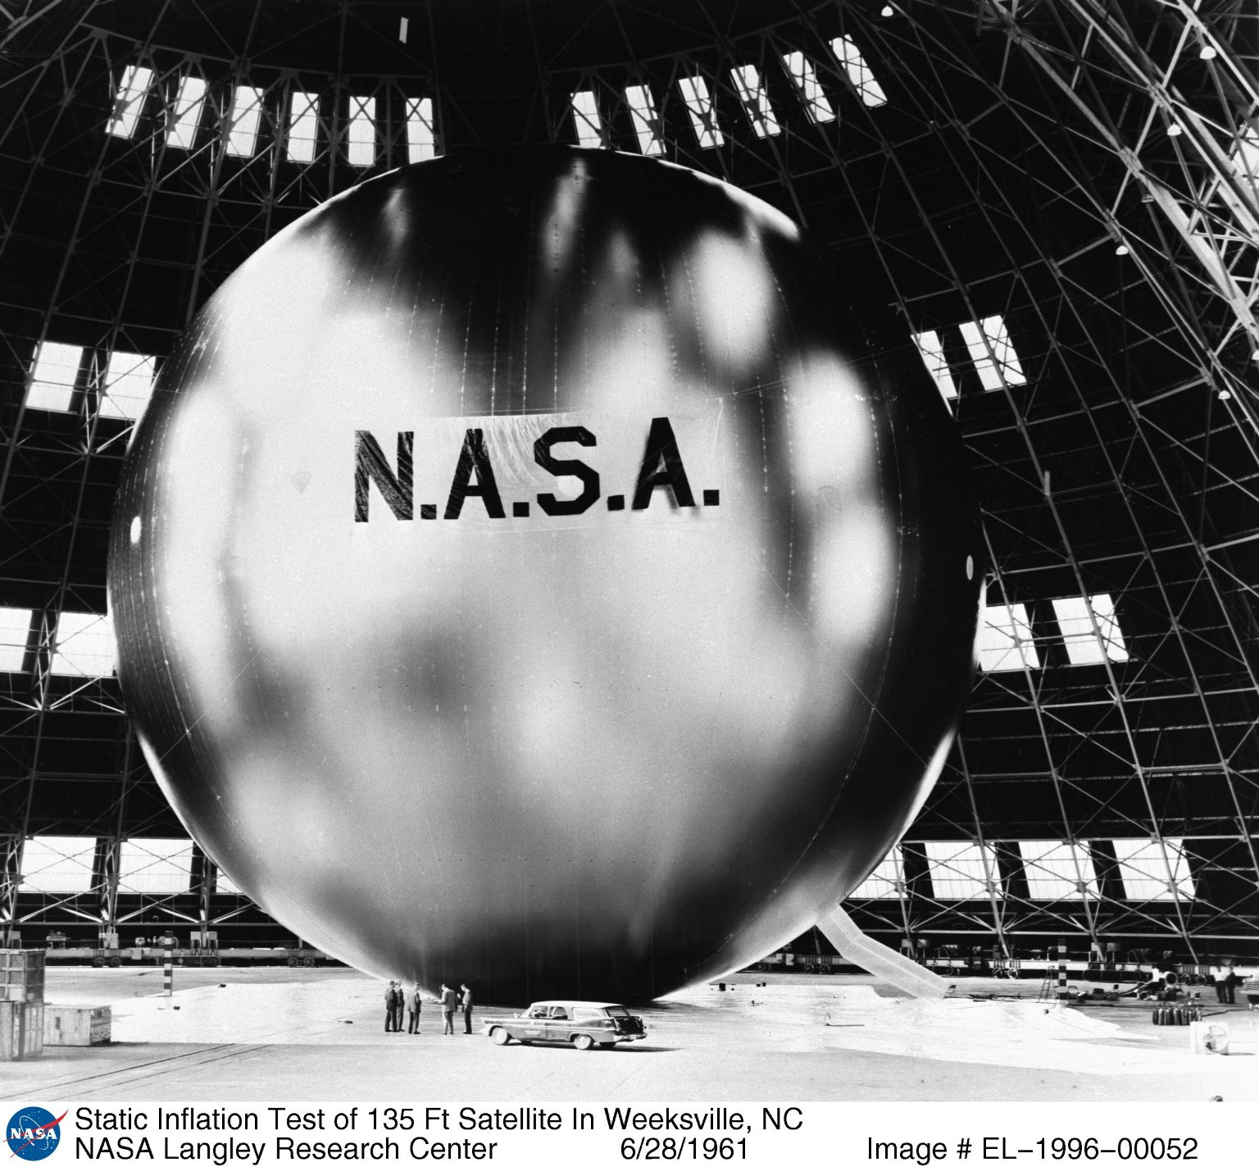
Big inflatable spheres have been in space before:
Echo 1A, 1961
30.5 m diameter
0.2 um (0.5 mil) thick Mylar
71 kg, incl inflation gas

Slide 6
Inflatables demonstrated for another application
~5 m
14 m
NASA/JPL/L’Garde 1997 in orbit
Pre-Decisional Information -- For Planning and Discussion Purposes Only

Slide 7
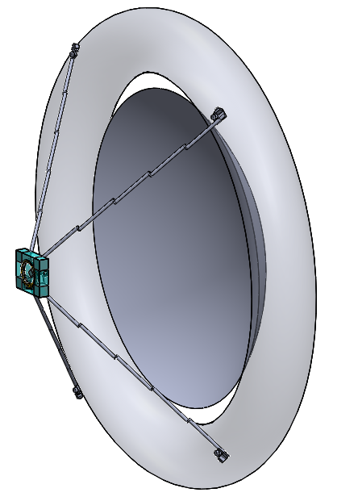
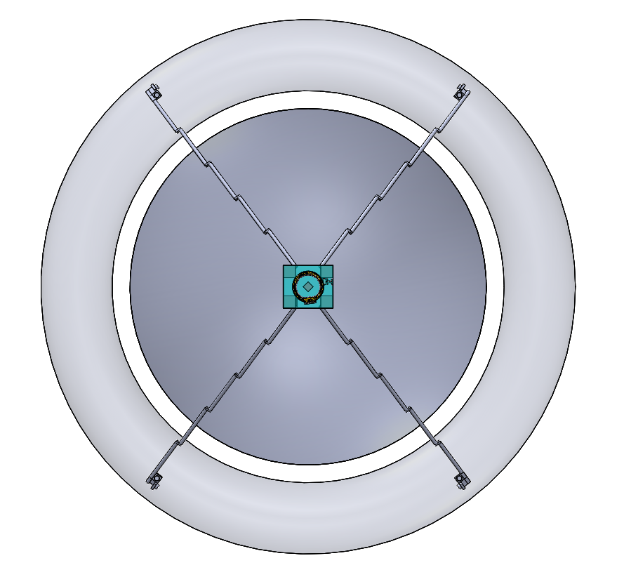
Deployed Parabolic Metalized Membrane Reflector, Torus, and OS4 Hub
5 m
Concept Drawing
Nicholas Bonafede/CalPoly-SLO, 2020/1
Pre-Decisional Information -- For Planning and Discussion Purposes Only

Slide 8
Concept Drawing
Pre-Decisional Information -- For Planning and Discussion Purposes Only

Slide 9
Fresnel Element separates incident sunlight from telecommunications energy...
Concept Drawing
Pre-Decisional Information -- For Planning and Discussion Purposes Only

Slide 10
Concept Drawing
Pre-Decisional Information -- For Planning and Discussion Purposes Only

Slide 11
Different thermal architectures yield different maximum solar distance capabilities...
Pre-Decisional Information -- For Planning and Discussion Purposes Only

Slide 12
Some modern low-power electronics
Ultra Low Power IoT Microcontroller Families
Series | Vendor | Grade | Architecture | Sleep Power (mW) | Active Power (mW) | min temp active ºC | max temp active ºC
PIC32MX2 | Microchip Technologies | Commerical | RISC_V-32 | 0.297 | 165 | -40 | 85
AtmegaS128 | Atmel | Space Grade | AV-RISC-32 | 0.0825 | 36.3 | -55 | 125
SAM L11 | Microchip Technologies | Commerical | ARM/Cortex | 0.00165 | 2.64 | -40 | 125
Atmega328P | Atmel | Automotive | AV-RISC-32 | 0.00495 | 6.6 | -55 | 125
SAM D | Microchip Technologies | Commerical | ARM/Cortex | 0.14256 | 14.19 | -40 | 125
Adrian Tang/386 2019/9/14
Pre-Decisional Information -- For Planning and Discussion Purposes Only

Slide 13
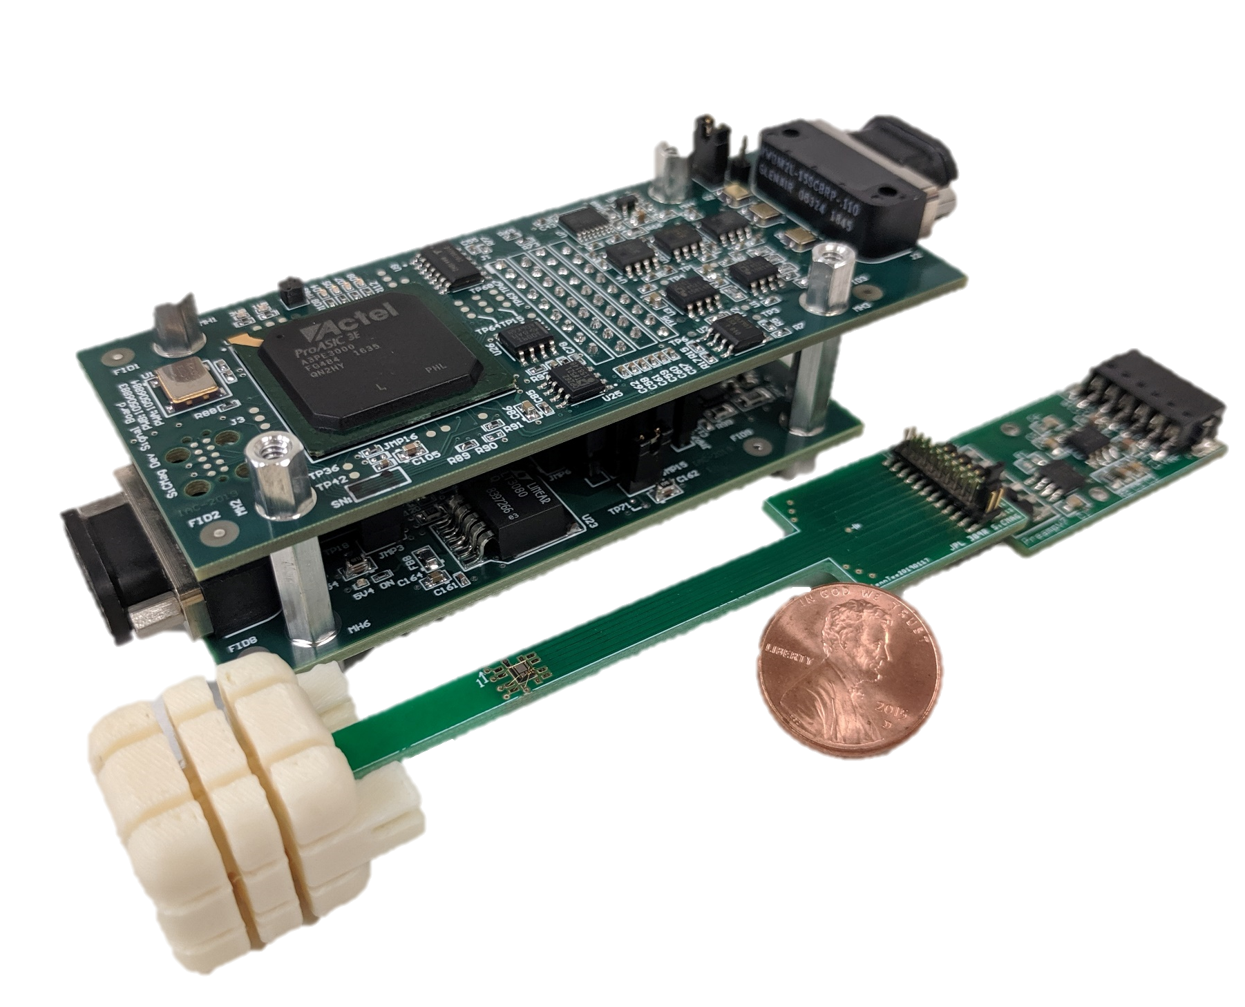
Magnetometer & Plasma Sensors
SwRI Solar Wind Ion & Electron Sensor (IES)
(Mihir Desai, et al./SwRI)
(Rosetta heritage sensor, re-done electronics w/ modern components) [see next slide for placement]
Miniaturized Electron and Ion
Telescope (MeRIT)
(Mihir Desai, et al./SwRI)
(CuSP & CeRES heritage)
SiC Solid-State Quantum Magnetometer
(Corey Cochrane/JPL)
Electronics to be miniaturized to ASIC/SoC
Pre-Decisional Information -- For Planning and Discussion Purposes Only
Notes:
IES placement: The red torus in the picture is the instrument entrance aperture. The instrument has a pancake field of view. In the part of the s/c closest to the Sun, and not shaded from the Sun, this toroidal aperture should be placed such that the s/c spin axis, which is to be pointed within a small angular distance of the Sun (for the outer Solar System part of the mission) is parallel to a diameter across the toroid. Thus, the Sun is located with in the pancake field of view, and the pancake is rotating end-over-end about the axis roughly defined by a line from the Sun to the spacecraft, or more precisely defined by the s/c spin axis, or a line parallel and close to the s/c spin axis.
The anti-Sun 90 degree segment of the pancake FOV is to be blocked, that is, +/-45 deg from the anti-Sun direction, to avoid light reflected back from the solar concentrator, and/or blockage by the s/c. No part of the remaining 270 deg FOV should be blocked by any part of the s/c.
A second IES should be similarly placed, with its pancake rotated ~90 deg from the first, also with the Sun always in view, and the anti-Sun 270 deg of its aperture blocked.
MeRIT placement: The axis of the centerline of MeRIT aperture and the cylinder behind it should point perpendicular to the s/c spin axis, and be clear of any view of elements of the s/c +/- ~20 deg on either side of this axis. Thus MeRIT scans 360 deg with every rotation of the s/c about its spin axis. A second MeRIT should be similarly placed, viewing perpendicular to the s/c spin axis, >=45 from the first.
Magnetometer placement: assume that the electronics package show as the upper assembly of the two shown will shrink dramatically, to fit as two more boards stacked on the one that is the wider part of the right-hand portion of the lower assembly (we’ll postulate that we move to an ASIC or SoC). The actual sensor is the white cube to the left of the lower assembly. The distance between the left and right portions should be maintained for now, for magnetic cleanliness.
Six identical magnetometers can be placed in dispersed locations

Slide 14
Cameras for Measuring Holes in Reflector Created by Dust and Taking Periodic Portraits of the Solar System
Mars2020 NavCam
Mars2020 EECAM Camera Specifications
Sensor Capabilities
Type | 20M Pixel CMOS Image Sensor
Array Size | 5120 x 3840
Pixel Size and Pitch | 6.4um2 on 6.4um Pitch
Full well charge | 15ke-
Pixel Dark Noise | 8e- RMS
Windowing | Yes
Shutter | Global
Color | Bayer RGB Color
Pixel Quantization | 12bit
Electrical Interface
Commanding & Data | LVDS
Protocol | MER/MSL/Mars2020 NVMCAM
Power Input | +5.5V (+/- 0.4V)
Power | < 3 W
Memory | 1Gbit SDRAM
FPGA | MicroSemi Rad-Tolerant ProASIC3
Camera Specifications
Mass (CBE, no optics) | < 425g
Volume (CBE, no optics) | 65 mm x 75 mm x 55 mm
Operating Temperature Range | -55C to +50C
Survival Temperature Range | -135C to +70C
Optics Configurations
Navigation Camera | 95°X 71°(H x V), f/12, iFOV < 0.32 mrad/pix
Hazard Camera | 134°X 110°(H x V), f/12, iFOV < 0.46 mrad/pix
Sample Caching System Camera | 0.49 magnification, 130mm stop to plane-of- focus, +/- 5mm Depth of Field
65 x 74 mm at base x 90 mm along optical axis. 700 g
Christophe Basset, Colin McKinney, Mark Schwochert, Justin Boland/JPL, 2017
Pre-Decisional Information -- For Planning and Discussion Purposes Only
Notes:
Solar System Portrait Camera placement: somewhere on the sunward side of the Hub, with boresight approximately along the spin axis, pointing in the sunward direction. A small part of the s/c may be in the FOV. The second camera should be similarly positioned, but with boresighted ~45 deg off the spin axis.
Dust Camera placement: on the anti-Sun side of the spacecraft, looking back in the sunward direction at a swath of the aluminized reflector. Its data is a count of the holes, position and intensity of light showing through each hole, and how the hole population increases over time, e.g., from one month to the next.

Slide 15
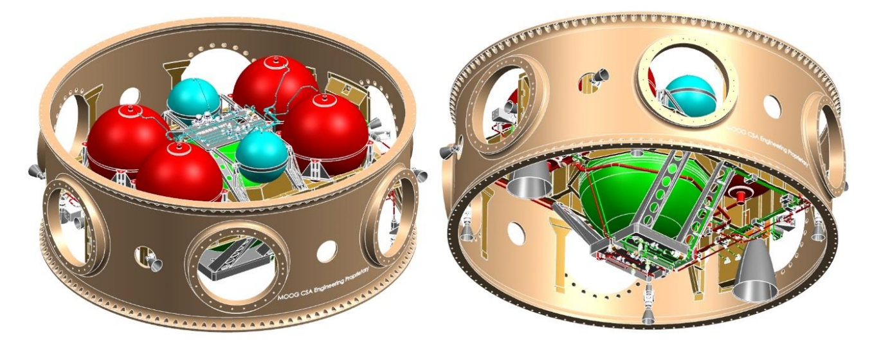
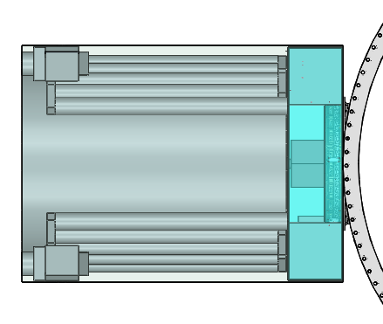
OS4 Hub, Stowed Parabolic Metalized Membrane Reflector, and ESPA Ring
(Inner Solar System Solar Panels not shown)
Moog: used with permission
CAD Illustration
Marc Lane/Team Xc
2020/1/24
Pre-Decisional Information -- For Planning and Discussion Purposes Only

Slide 16
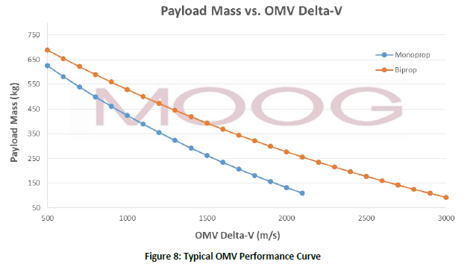
Rideshare and deployment
Propulsive ESPA Ring could perform the 200-1000 m/s trajectory correction burn in the first 30 days of the mission.
Propulsive ESPA would be more than capable of providing the necessary delta-V for OS4 (estimated at 217kg).
OS4 would separate from Propulsive ESPA after final Jupiter targeting maneuver.
Images from “Extending Rideshare: Mission Case Studies Using Propulsive ESPA”
By Marissa Stender, Chris Loghry, Chris Pearson, Eric Anderson, and Joseph Maly of MOOG, April 12, 2015
https://www.spacesymposium.org/wp-content/uploads/2017/10/C.Pearson_31st_Space_Symposium_Tech_Track_paper.pdf
Pre-Decisional Information -- For Planning and Discussion Purposes Only

Slide 17
Selected Primary Mission Trajectory examples on which rideshare
to escape might be utilized...
Pre-Decisional Information -- For Planning and Discussion Purposes Only

Slide 18
11 Years to Orbit of Neptune
50 years to Heliopause
Pre-Decisional Information -- For Planning and Discussion Purposes Only

Slide 19
Required Technologies Include:
Cold-tolerant equipment (enabling: -40 C and below, but without rapid cycling)
  Electronics
  Instruments
  Pulsed plasma thrusters & propellant
Inflatables (enabling)
  Venous Web
  UV-rigidizing liquid
  Folding, storage, and deployment over time
Clear Canopy Jettison (enhancing)
  Cut away, jettison, or “disperse” (sublimate?)
Attitude Sensing (enhancing)
  Spin rate-sensitive; or 3-axis stabilization
Pre-Decisional Information -- For Planning and Discussion Purposes Only

Slide 20
Who can do this?
Launch requires rideshare arrangement on a primary mission already going to outer Solar System
Technology development within range of select universities and small businesses
Science leadership available for heliophysics, planetary, and small body science
Students already engaged, via CalPoly-San Luis Obispo
Many organizations can engage the public
Pre-Decisional Information -- For Planning and Discussion Purposes Only

Slide 21
?Can we Affordably explore the outer Solar System with SmallSats?
Thank you!
Full report available from NASA server: https://www.nasa.gov/sites/default/files/atoms/files/niac_2019_phi_staehle_os4_tagged.pdf
Summary report in Journal of Small Satellites (JOSS Online)
https://jossonline.com/wp-content/uploads/2020/10/Final-Staehle-LtE-A-Solar-powered-Outer-Solar-System-SmallSat-OS4-Architecture-Defined.pdf
Robert Staehle, Asteroid3875Rob@gmail.com, gaboon@sbcglobal.net
+1 626 798-3235
Pre-Decisional Information -- For Planning and Discussion Purposes Only

