Slide 1

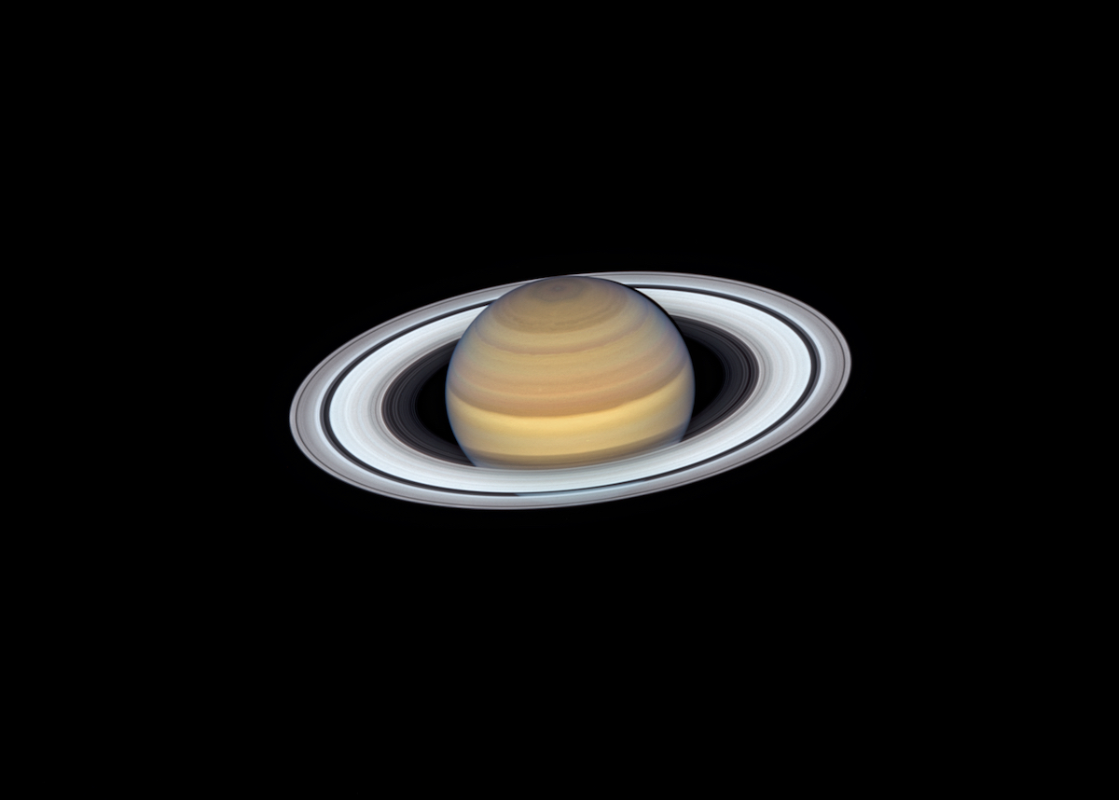
May 3-4, 2021
Deep Dive:
A Saturn Probe with In-Situ Power
Geoffrey A. Landis
NASA Glenn Research Center, Cleveland, OH, 44135
Notes:
Saturn image from NASA Gallery: https://solarsystem.nasa.gov/planets/saturn/galleries/

Slide 2
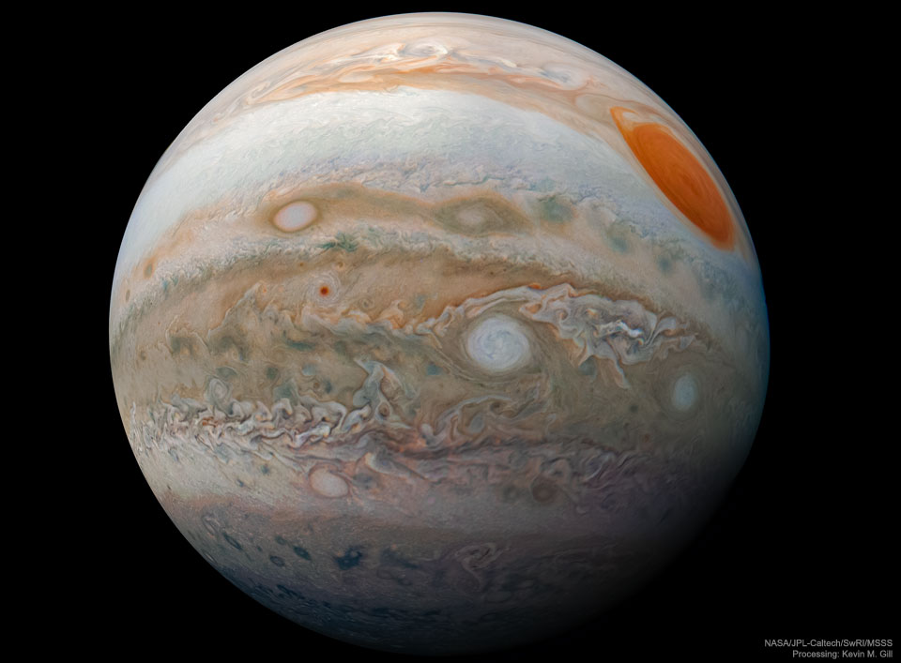
Introduction
Left: Jupiter from the Juno mission
Right: Hubble view of Saturn
What is inside the gas giant planets? The gas giants, Jupiter and Saturn, comprise most of the mass of the sun’s planetary system, but our knowledge of their interiors consists of models and guesswork based mostly on viewing them from outside.

Slide 3
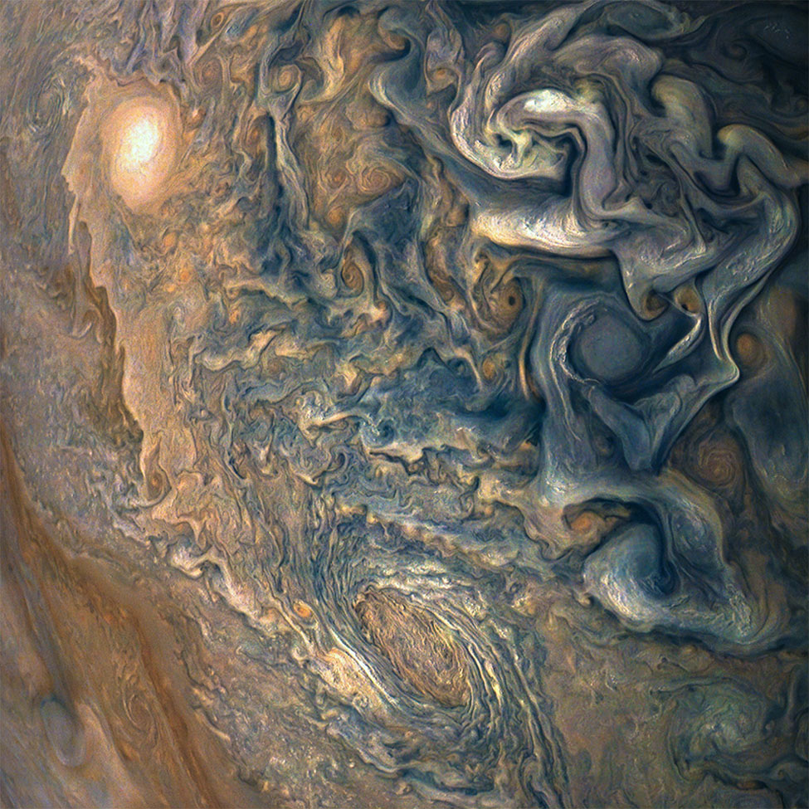
Jupiter and Saturn have complex and interesting atmospheres
The atmospheres are extensively three-dimensional
the full atmosphere depth, measured from the cloudtops to the metallic hydrogen that makes up the interior, is 15,000 km
the atmosphere of Jupiter, viewed from above by the Juno mission.

Slide 4
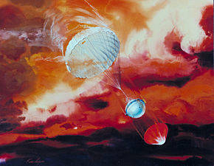
Previous mission: Galileo
Only one probe has entered the atmosphere of any gas giant: the Galileo Jupiter atmospheric probe.
This vehicle penetrated to a depth of 134 km below the 1-bar level, failing at a pressure of 22.7 atmospheres, when the probe reached a temperature of 152°C
the probe’s traverse covered less than 5% of the thickness of the wind layer of the atmosphere; not even one percent of the total depth of the atmosphere above the metallic hydrogen core.
Notes:
NASA Image https://www.nasa.gov/feature/30-years-ago-galileo-off-to-orbit-jupiter

Slide 5
Objective: deep dive into gas giant atmosphere
To penetrate farther into the atmosphere of a gas giant, the significant challenges are:
  temperature
  pressure
  atmospheric entry
Baseline mission objective: design a probe to penetrate at least 10 times deeper into a gas giant’s interior than achieved by the Galileo atmospheric probe

Slide 6
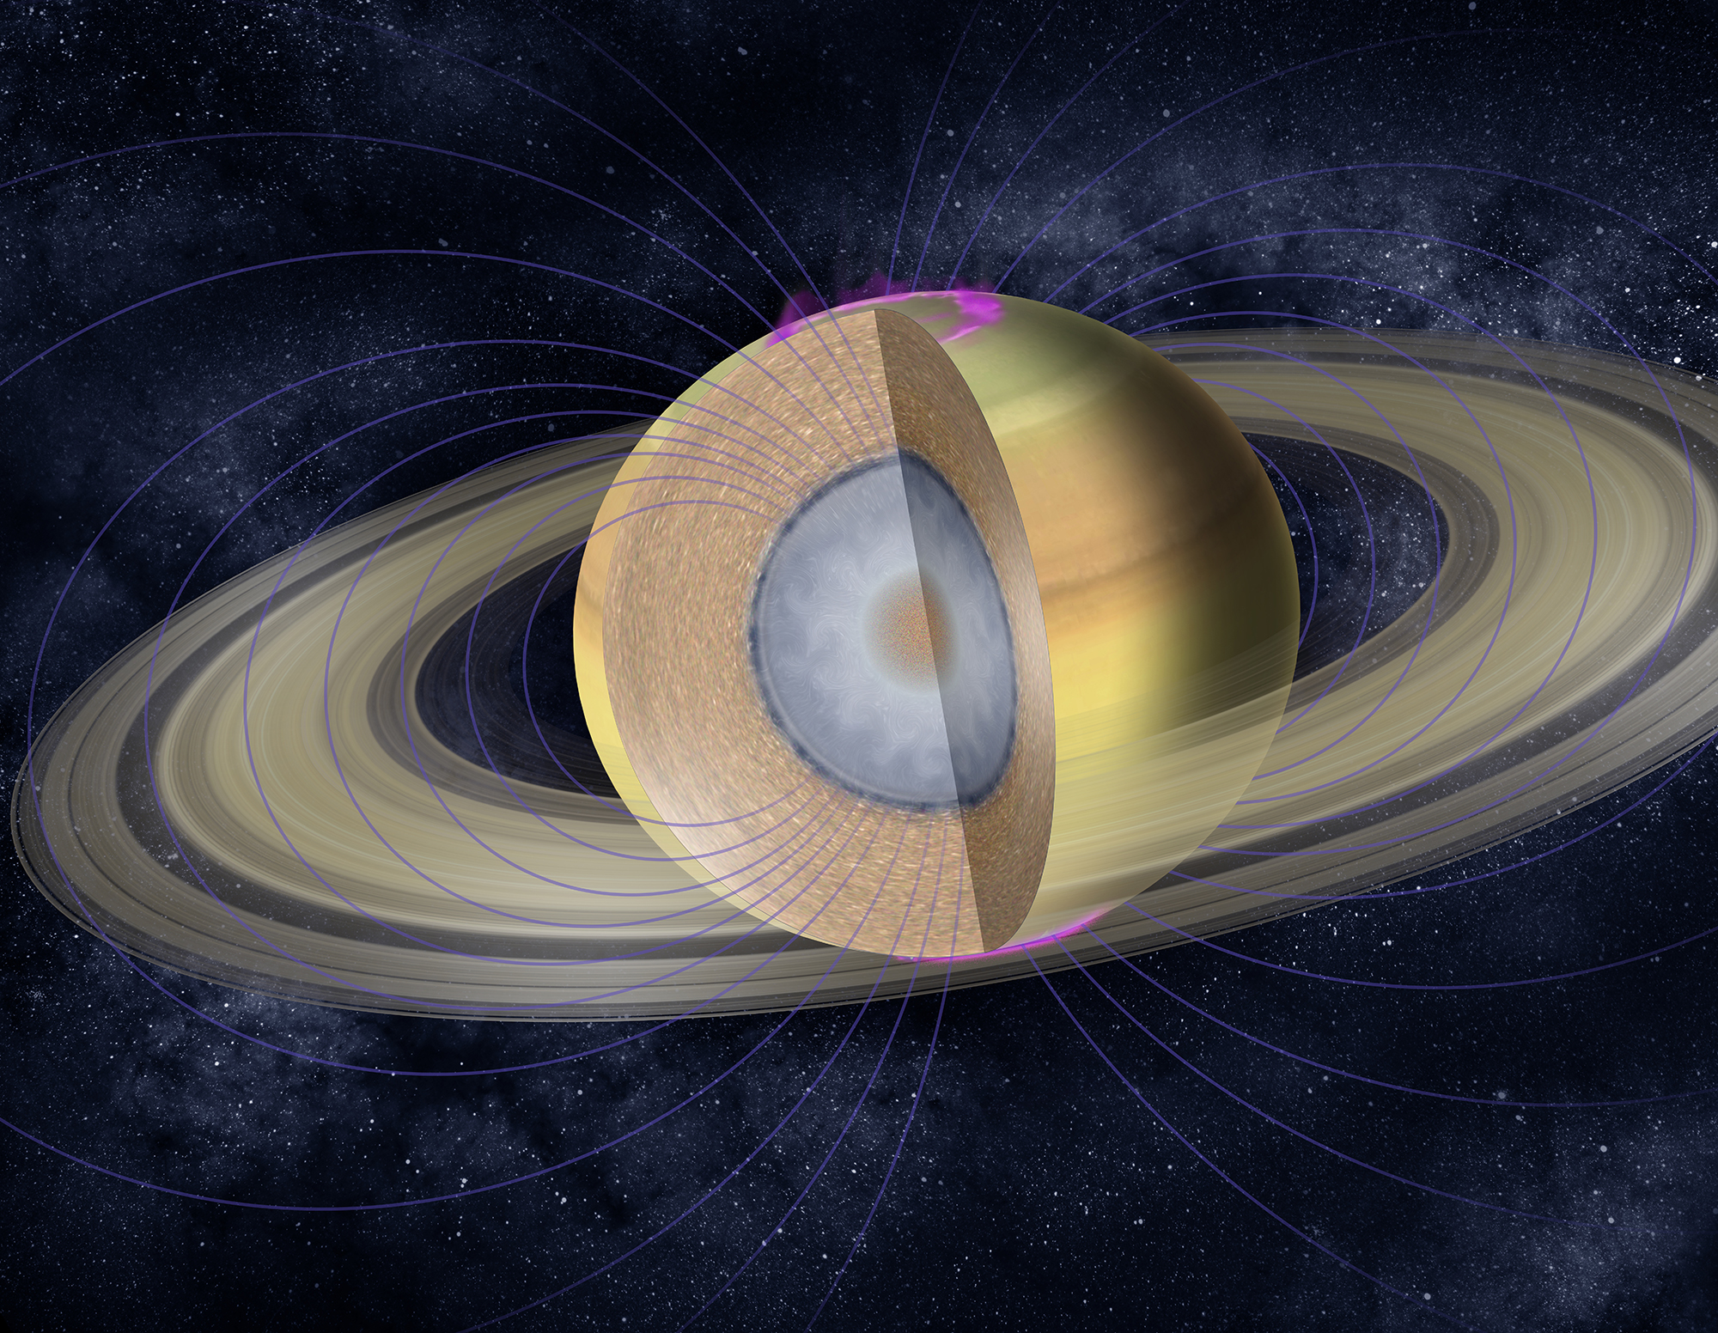
Target:
Saturn atmospheric Probe
Why Saturn?
  Saturn less well probed and less well understood than Jupiter, yet has significant science mysteries
  Saturn atmosphere was one of the five top priorities for a medium-sized planetary mission in the previous NASA Planetary Science Decadal survey

Slide 7
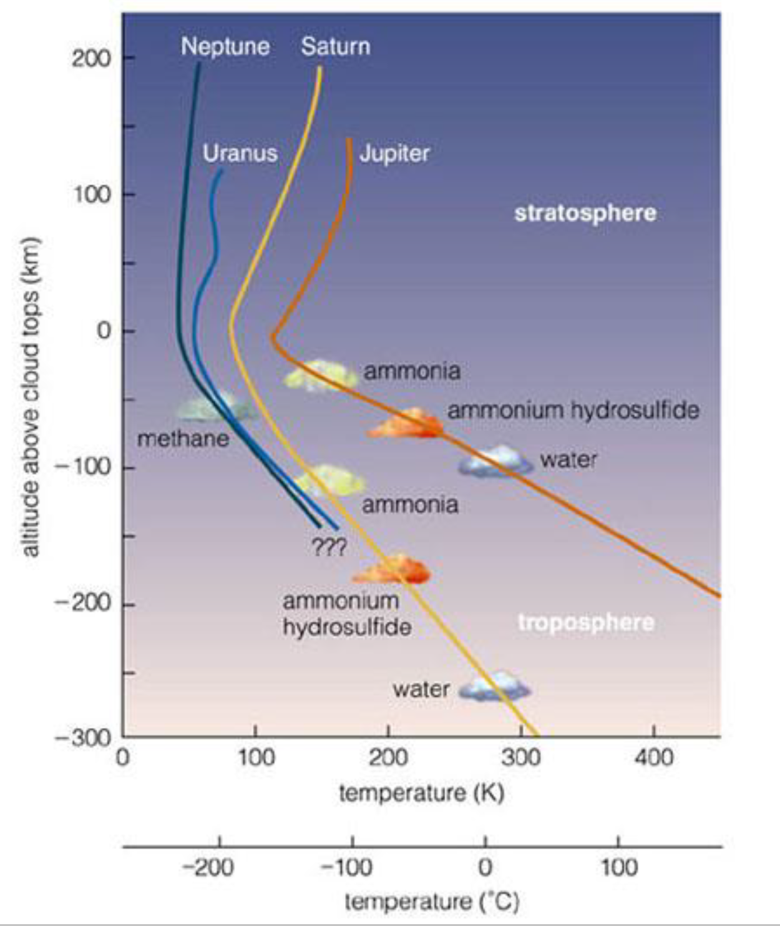
Saturn compared to Jupiter
lower adiabatic lapse rate (about 0.8 K/km at the 1.3 bar level, compared to ~1.8 K/km) for Jupiter
Cooler cloud top temperature
lower escape velocity allows simpler atmospheric entry
Notes:
Adiabatic lapse comparison image: https://trs.jpl.nasa.gov/bitstream/handle/2014/48679/CL%2317-5215.pdf

Slide 8
Deep Dive Saturn: what we want
Metallic hydrogen
Metallic hydrogen:
Depth 30,000 km
Temperature 8,000 K
Pressure 3 million atmospheres
→ Not even remotely possible
What we want:
Dive to the metallic hydrogen core of Saturn!
Source of Saturn’s magnetic field
Unique to gas giant planets
State unlike anything ever seen on Earth
Image: NASA/JPL-Caltech
So, we can’t get that. What can we get?
Notes:
https://solarsystem.nasa.gov/resources/17631/saturn-interior-cutaway-illustration/

Slide 9
Deep Dive Saturn: what we target
The baseline mission is to Saturn, but the same technologies will be useful for a Jupiter probe, as well as for probes into Uranus and Neptune
Image: NASA/JPL-Caltech
Baseline mission: target 1500 km below the 1-bar level
  Radius of Saturn is 58,000 km: so this is less than 3% of the way to the center.
Notes:
https://solarsystem.nasa.gov/resources/17631/saturn-interior-cutaway-illustration/

Slide 10
Saturn compared to Jupiter
lower adiabatic lapse rate (about 0.8 K/km at the 1.3 bar level, compared to ~1.8 K/km) for Jupiter
Cooler cloud top temperature
lower escape velocity allows simpler atmospheric entry
These factors allow deeper depth to be achieved.
objective: 10 times greater depth than the Galileo atmospheric probe
Baseline mission: target 1500 km below the 1-bar level (compared to 134 km for the Galileo probe)
Notes:
Adiabatic lapse comparison image: https://trs.jpl.nasa.gov/bitstream/handle/2014/48679/CL%2317-5215.pdf

Slide 11
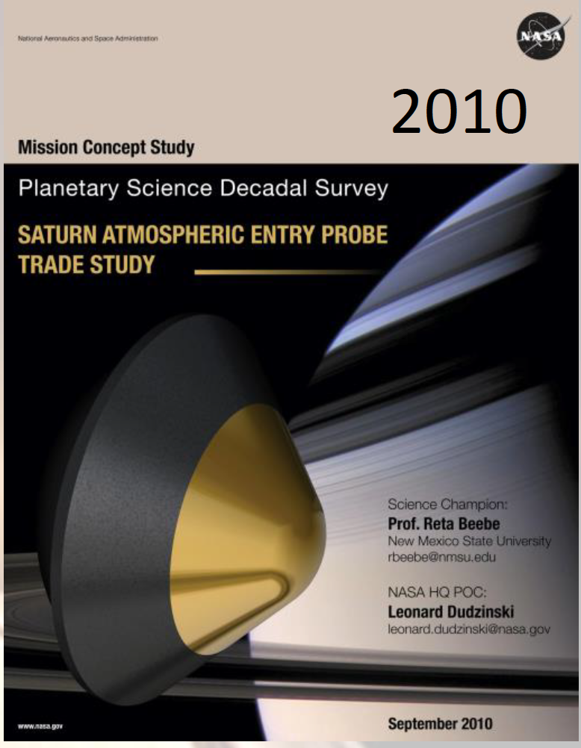
Comparison to other proposed Saturn probes
the Saturn Atmospheric Entry Probe trade study for the NASA Decadal survey proposed an entry probe to reach the 5-bar level, about 125 km below the 1-bar level.
the Decadal survey SPRITE mission and proposed ESA Hera Saturn Entry Probe mission target nominal end of mission at the 10 bar level.
Our probe will target ten times deeper.
NASA, Saturn Atmospheric Entry Probe Trade Study (R. Beebe, Science Champion), Planetary Decadal Survey report, Sept. 2010.
Atkinson, D. H., et al., “The New Frontiers Saturn PRobe Interior and aTmosphere Explorer (SPRITE) Mission Proposal,” European Planetary Science Congress, vol. 11. 2017.
Mousis, O., et al., “The Hera Saturn Entry Probe Mission”, Planetary and Space Science, Vol. 130, Oct. 2016, pp. 80-103. doi: 10.1016/j.pss.2015.06.020.

Slide 12
Challenges: deep dive into gas giant atmosphere
To penetrate farther into the atmosphere of a gas giant, the significant challenges are:
  temperature
  pressure
  atmospheric entry
Temperature is the driving factor in achievable depth.
Pressure increases the difficulty because insulating against high temperature becomes increasingly difficult at high pressure
Deal with high temperature by two approaches:
next-generation high-temperature electronic components being developed for Venus surface applications
increasing descent rate to slow heating rate
See: https://www1.grc.nasa.gov/space/pesto/space-vehicle-technologies-current/high-operating-temperature-technology-hottech/

Slide 13
High temperature power system
Battery power
Radioisotope Thermal Generator
Betavoltaic or alphavoltaic
Power from descent energy

Slide 14
High temperature power system
Battery power
  Advantages: simple
  High temperature batteries being developed for Venus
  Disadvantages: need to shift from low temperature battery to high temperature battery with descent
  Limited lifetime: power is proportional to mass
Radioisotope Thermal Generator
Betavoltaic or alphavoltaic
Power from descent energy

Slide 15
High temperature power system
Battery power
Radioisotope Thermal Generator
  Advantages: well developed technology for outer planets
  Disadvantages: needs heat rejection
  Relatively low specific power
Betavoltaic or alphavoltaic
Power from descent energy

Slide 16
High temperature power system
Battery power
Radioisotope Thermal Generator
Betavoltaic or alphavoltaic
  Advantages: all solid state, completely pressure independent
  Disadvantages: not yet demonstrated for high temperature
  Very low power devices: current devices are at most milliwatts
Power from descent energy

Slide 17
High temperature power system
Battery power
Radioisotope Thermal Generator
Betavoltaic or alphavoltaic
Power from descent energy
  New concept: can we transform some of our own descent energy into power?
  Advantage: not mass limited; continues to generate power as long as probe descends

Slide 18
Probe with counterrotating propeller power source
propellers
generator
payload
The probe generates power from its own descent by use of counter-rotating propellers turning the armature of an electrical generator
Notes:
Image from https://www.kisspng.com/png-counter-rotating-propellers-aircraft-contra-rotati-3605775/preview.html and https://www.kisspng.com/png-ufo-outer-space-icon-ufo-440540/
labelled “Free & unlimited download”

Slide 19
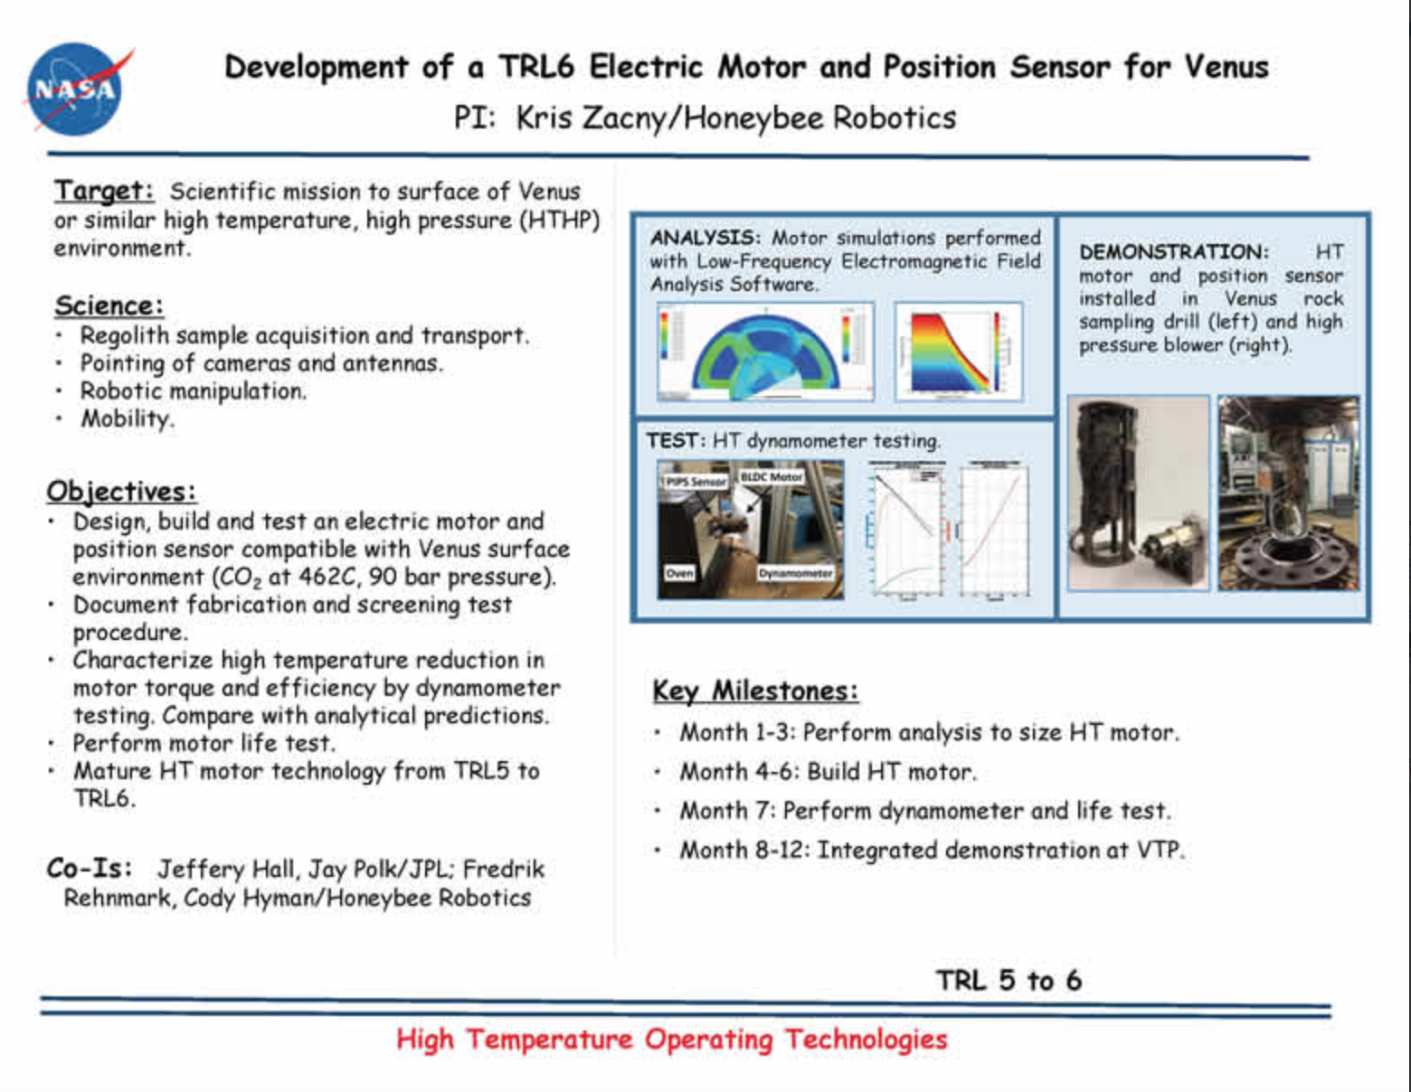
Requires high-temperature generator
Generators are same as motors
High temperature motors have been demonstrated, and TRL improvement activities are ongoing for Venus applications
generator
https://www1.grc.nasa.gov/space/pesto/space-vehicle-technologies-current/high-operating-temperature-technology-hottech/

Slide 20
Power from Descent Energy
Power generated is calculated from the descent rate. From E = mgh, the power
P_{descent} = dE/dt = mgV (1)
where m is the mass of the descending object, g is gravitational constant, and V is the descent velocity.
Saturn’s gravity g=10.44 m/s²
Thus:
  P_{descent}/m = 10.44V W/kg (2)
(for V in meters per second)

Slide 21
Power from Descent Energy (2)
Assuming propeller efficiency 0.85, generator efficiency of 0.9, and other efficiency losses of 14%, in a more realistic case the power generated will be
P/m = 7.5V watts/kg (3)
  For an example case, a 1 kg mass descending at 50 m/s can generate 375 watts.
  Since a larger propeller reduces descent speed, this leads to the counterintuitive result that larger propellers produce less power.
  This is the maximum possible power, assuming all the descent energy is converted to useable energy. It is easy to produce less power

Slide 22
Power from Descent Energy (3)
The power available from the atmosphere passing through the disk of the propeller, P_{air}, is:
P_{air} = ρ(πd²/4)V³ (4)
where ρ is the atmospheric density and d is the diameter of the propeller (in meters, assuming MKS units).
The Betz limit says that the maximum amount of power that can be extracted from this is 59.3%. Thus
P_{gen} = 0.593 (ρ πd²/4)V³ (5)

Slide 23
Power from Descent Energy (4)
Setting generated energy equal to the power of descent:
0.148 ρπd²V³ = mgV (6)
Thus
V² = mg/(0.148 ρπd²) (7)
Substituting g=10.44 m/s² for Saturn:
V = 4.6(m/ρ)^{½}/d (8)

Slide 24
Atmosphere of Saturn
The atmosphere of Saturn is predominantly hydrogen
(plus small amount of helium)
Density increases with depth due to pressure
Density decreases with depth due to temperature
  density ρ=0.19 kg/m³ at the 1-bar level
  Atmospheric scale height for Saturn is ~59.5 km

Slide 25
Example calculation:
1-bar level on Saturn
For the atmosphere of Saturn ρ=0.19 kg/m³ at the 1-bar level
V= 10.6 m^{½}/d m/s (9)
  velocity scales inversely with the propeller radius (for given mass)
  Velocity scales as the square root of mass (given propeller radius).
Required propeller diameter as a function of desired velocity:
d (m)= 10.6 m^{½}/V(m/s) (10)
For a 50 m/s descent velocity, propeller diameter = 0.2√m
  →2 meter rotor for a 100 kg probe

Slide 26
Effect of altitude variation
Density of atmosphere ρ ~ ρ_{o} e^{(H/H}o⁾
  where H_{o} ~ 60 km
  This approximation is reasonable for the upper part of the descent, but becomes increasingly inaccurate at high pressures (~ 1000 bar and above), where the density is no longer linear in the pressure, and numerical modelling using the correct hydrogen equation of state becomes necessary. At these pressures, the hydrogen is supercritical, and density starts to level off. Above about 100 kg/m³, additional pressure does not significantly increase density.

Slide 27
Effect of altitude variation
For constant descent velocity, we need to adjust the lift produced by the propeller as the density increases
  → straightforward to do this by adjusting blade pitch
  This is identical to the adjustment of a wind turbine blades to account for varying wind velocity, except in this case the velocity is constant and the density is changing.
  → as probe descends further, reduce propeller disk area
  Multiple blades: jettison blades successively as the probe descends.
  → at the lowest part of the descent, allow descent rate to decrease
  In the high-density region, the drag of the probe body dominates the descent rate.

Slide 28
Conclusions
We are analyzing a probe into the atmosphere of a gas giant planet, in which we will use advanced thermal design and high-temperature electronics to maximize the depth into the atmosphere we can achieve
A new power system is proposed, in which power is generated from the probe’s motion through the atmosphere

