Slide 1
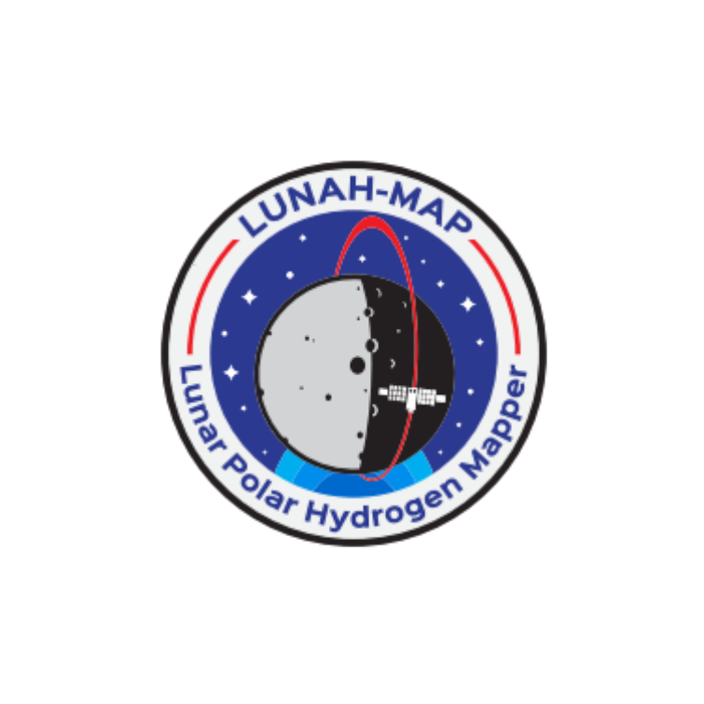
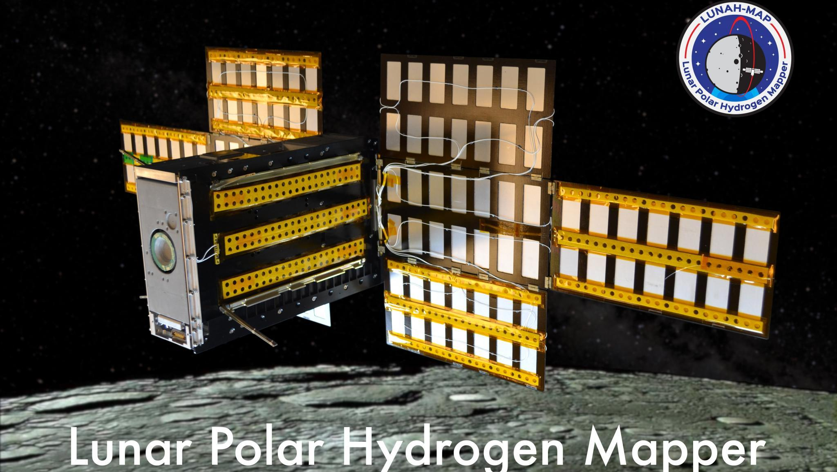

Lunar Polar Hydrogen Mapper (LunaH-Map) Mission Update Craig Hardgrove
LunaH-Map Principal Investigator – Assistant Professor, School of Earth and Space Exploration, ASU

Slide 2
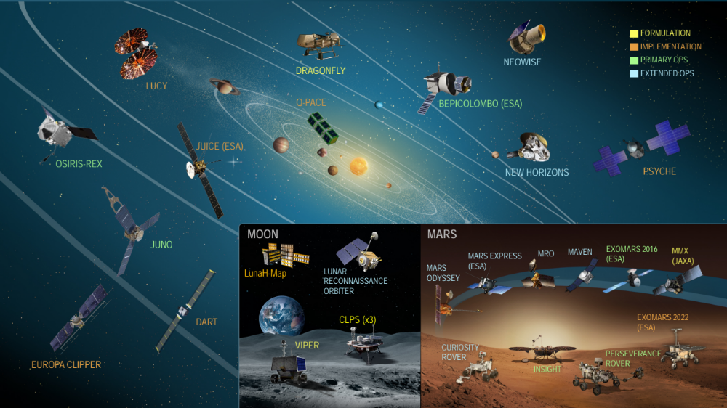
NASA Science Mission Directorate “Fleet Chart”
Image: NASA (2020)

Slide 3
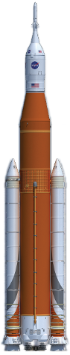
LunaH-Map Mission Overview
NASA SMD SIMPLEx 2015 mission led by ASU
6U+ CubeSat form factor to launch on SLS EM-1
Science Objective: Map hydrogen enrichments within PSRs at the lunar south pole at spatial scales <20 km²
Tech Objectives: Deep space navigation and operations using ion propulsion on a small sat

Slide 4
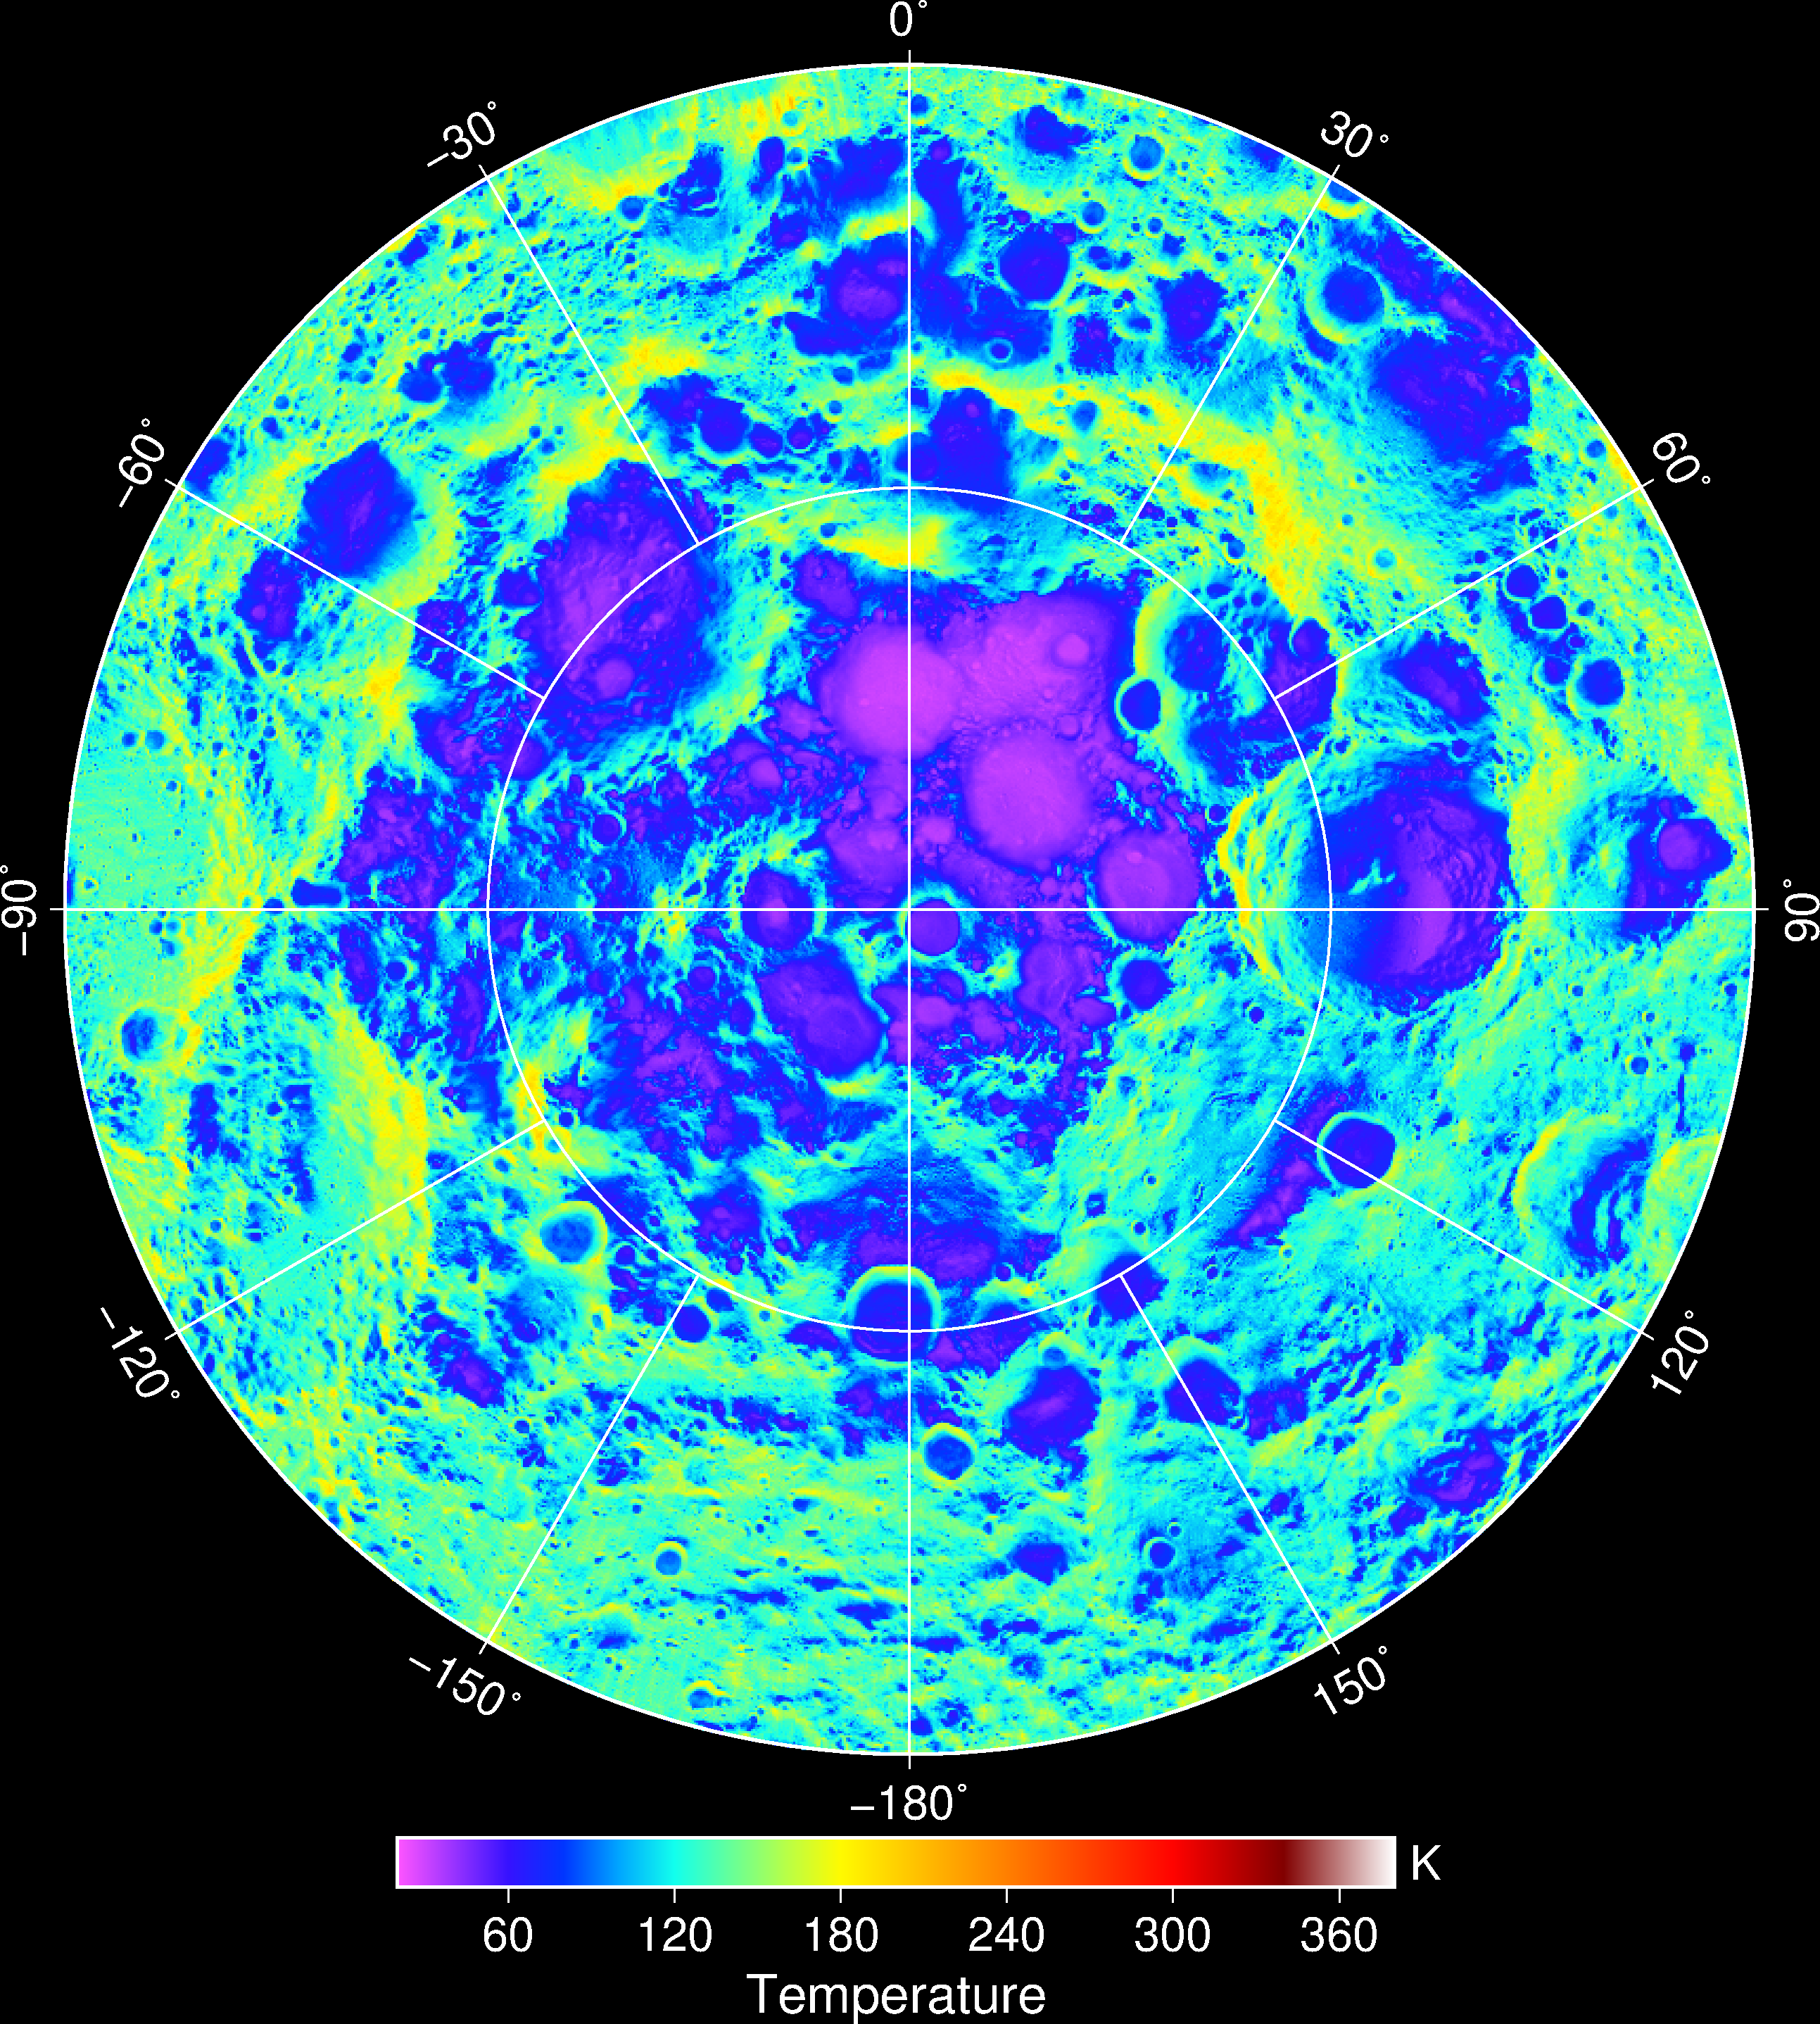
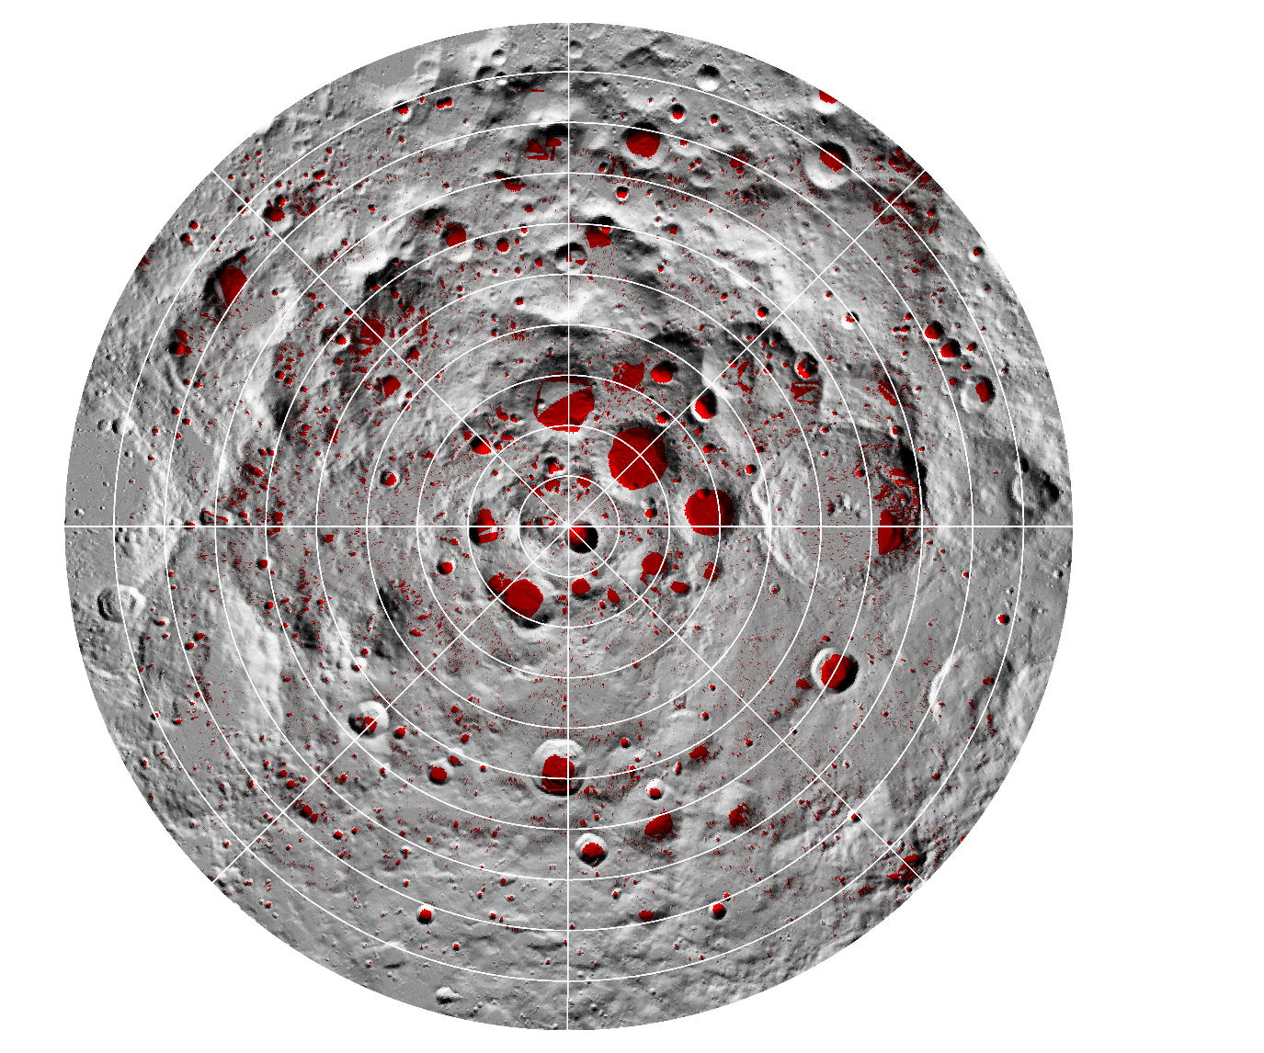
Lunar south pole – thermal environment
LRO/Diviner
(Winter
average)
PSRs are cold traps for volatiles
Possible sources include:
Delivery by water-rich asteroids and comets (e.g. Rubanenko et al., 2019)
Migration of H-species formed by chemical sputtering of H implanted by the solar wind - Crider & Vondrak (2002)
Williams, J.-P. et al. (2019) JGR

Slide 5
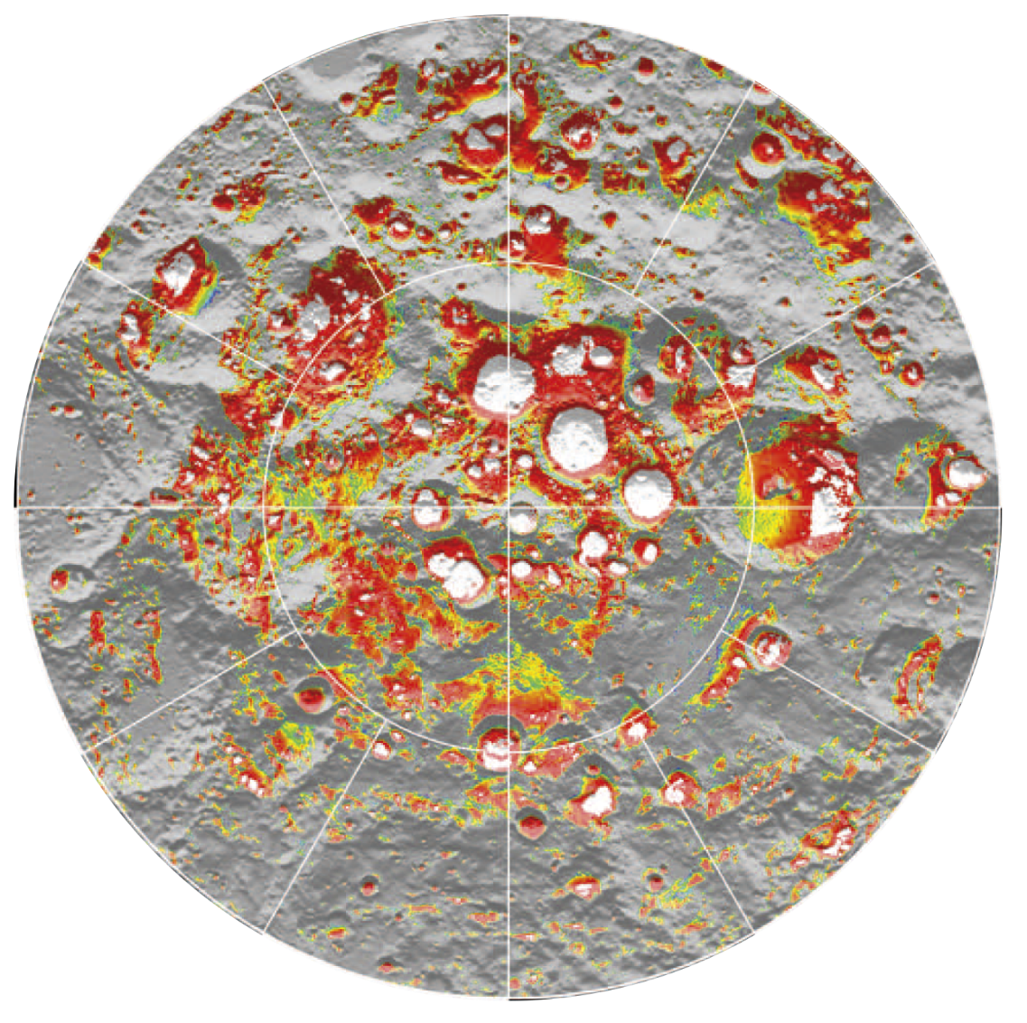
Lunar south pole – thermal environment
0E
Ice can be cold trapped on the surface in craters with PSRs.
The permafrost boundary is within a meter of the surface in many locations.
270E
90E
180E
0
Depth (m)
1
Paige, D. A. et al. (2010) Science
Notes:
Model-calculated depths at which water ice would be lost to sublimation at a rate of less than 1 kg m−2 per billion years. The white regions define the locations where water ice can currently be cold trapped on the surface, the colored regions define the upper surface of the lunar ice permafrost boundary, and the gray regions define locations where subsurface temperatures are too warm to permit the cold-trapping of water ice within 1m of the surface. High-resolution images are available in the SOM.

Slide 6

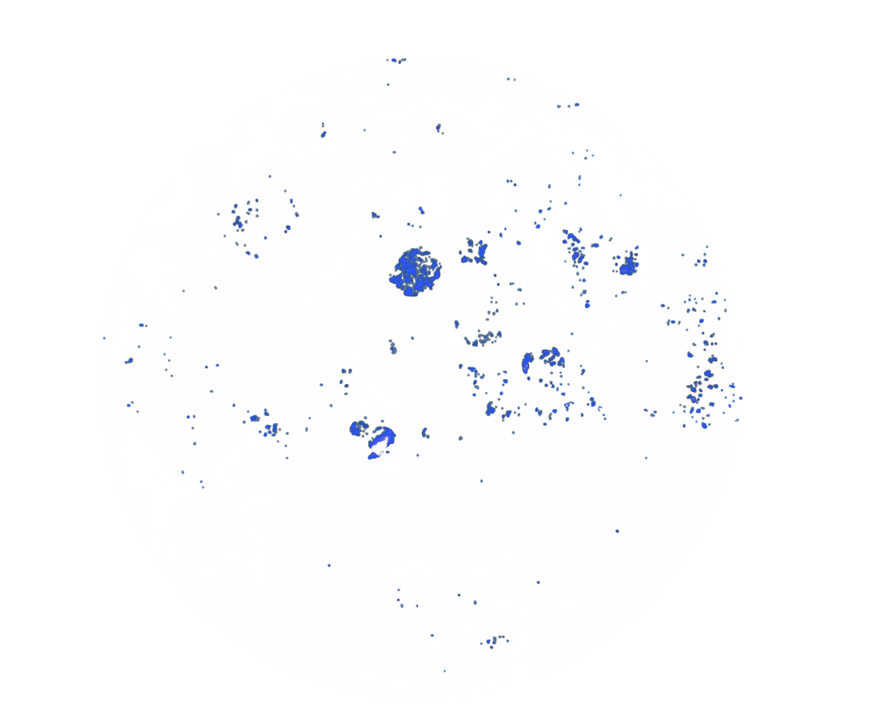
Lunar south pole – water ice?
0E
LRO/LAMP UV spectral features consistent with surface frost in some regions with temperatures <110 K.
270E
90E
Surface frost
Hayne, P. O. et al. (2015) Icarus
cf. LOLA-reflectance/Diviner analyses by Fisher et al. (2017) Icarus
& M³/LOLA/Diviner/LAMP analyses by Li et al. (2018) PNAS
180E
Notes:
We utilize surface temperature measurements and ultraviolet albedo spectra from the Lunar Reconnaissance Orbiter to test the hypothesis that exposed water frost exists within the Moon’s shadowed polar craters, and that temperature controls its concentration and spatial distribution. For locations with annual maximum temperatures Tmax greater than the H2O sublimation temperature of 110 K, we find no evidence for exposed water frost, based on the LAMP UV spectra. However, we observe a strong change in spectral behavior at locations perennially below 110 K, consistent with cold-trapped ice on the surface. In addition to the temperature association, spectral evidence for water frost comes from the following spectral features: (a) decreasing Lyman-a albedo, (b) decreasing ‘‘on-band’’ (129.57– 155.57 nm) albedo, and (c) increasing ‘‘off-band’’ (155.57–189.57 nm) albedo. All of these features are consistent with the UV spectrum of water ice, and are expected for water ice layers >100 nm in thickness. High regolith porosity, which would darken the surface at all wavelengths, cannot alone explain the observed spectral changes at low temperatures. Given the observed LAMP off-band/on-band albedo ratios at a spatial scale of 250 m, the range of water ice concentrations within the cold traps with Tmax < 110 K is 0.1–2.0% by mass, if the ice is intimately mixed with dry regolith. If pure water ice is exposed instead, then up to 10% of the surface area on the 250-m scale of the measurements may be ice-covered. The observed distribution of exposed water ice is highly heterogeneous, with some cold traps <110 K having little to no apparent water frost, and others with a significant amount of water frost. As noted by Gladstone et al. (Gladstone, G.R. et al. [2012]. J. Geophys. Res.: Planets 117(E12)), this heterogeneity may be a consequence of the fact that the net supply rate ofH2O molecules to the lunar poles is very similar to the net destruction rate within the cold traps. However, an observed increase in apparent H2O abundance with decreasing temperature from 110 K to 65 K suggests that destruction of surface frosts by impact gardening and space weathering is spatially heterogeneous. We find a loosely bimodal distribution of apparent ice concentrations with temperature, possibly due to competition between vertical mixing by impact gardening and resupply of H2O by vapor diffusion at sites 110 K. Finally, we cannot rule out the possibility that the colder population of ice deposits is in fact primarily carbon dioxide ice, although peak temperatures of 65 K are slightly higher than the usual CO2 sublimation temperature of 60 K.

Slide 7
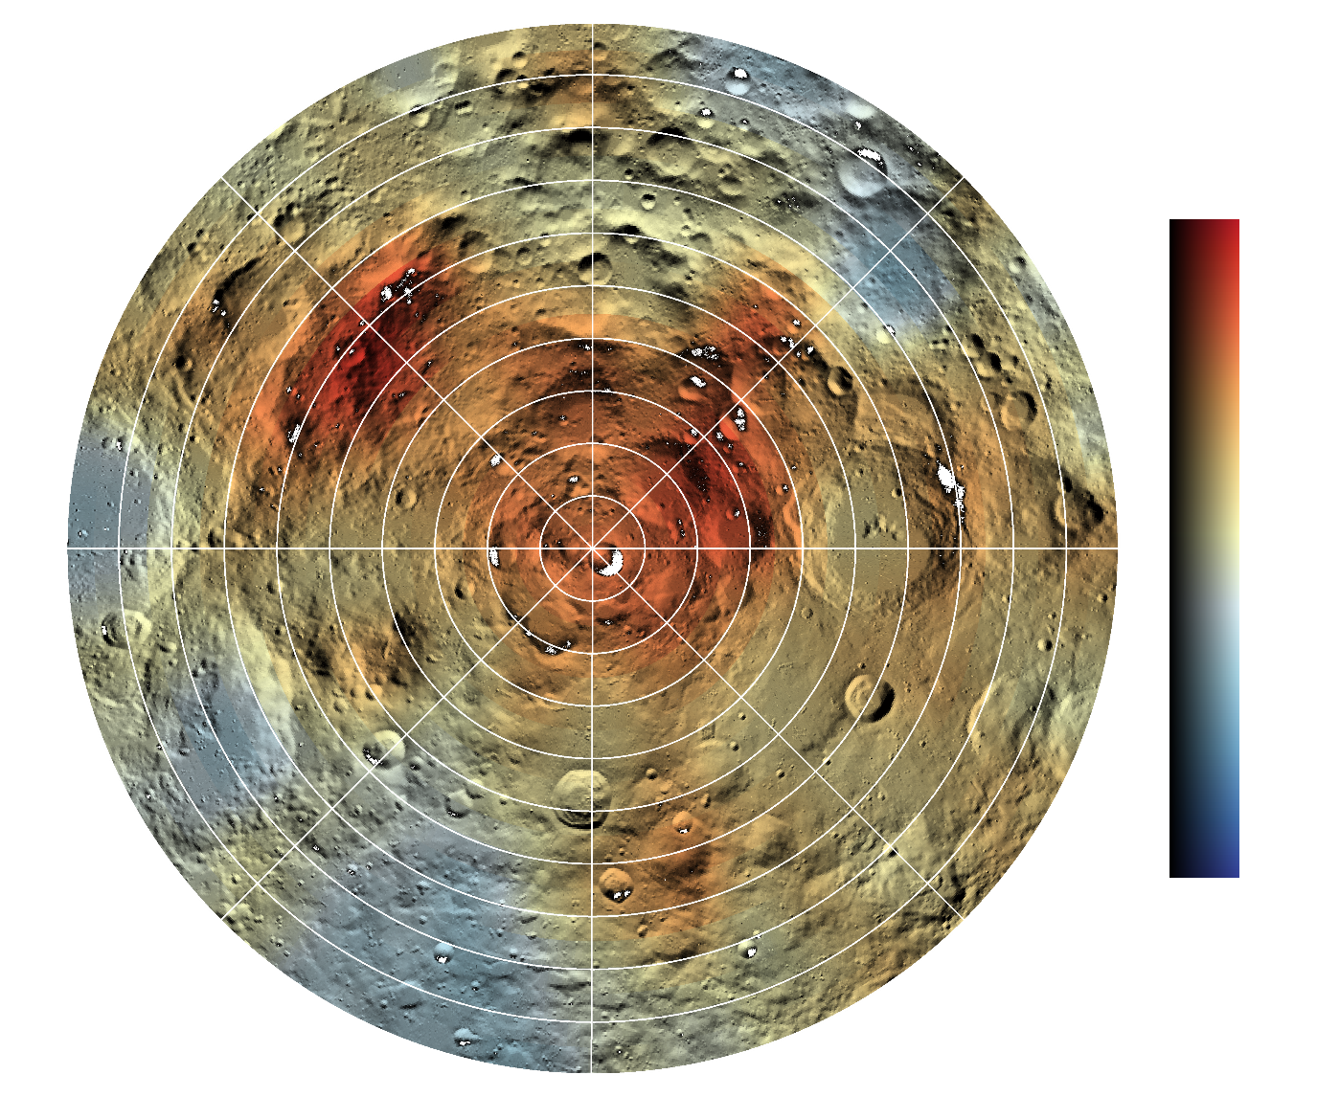
Hydrogen Distributions from Neutron Spectroscopy
~150 km² pixels
0E
0E
Haworth
Cabeus
Shoemaker
Faustini
[H] μg/g
LCROSS
200
Amundsen
270E
90E
270E
90E
30 km/°
0
Sverdrup
PSR
180E
180E
*Feldman et al., Science, 281, 1496, 1998
Based on LOLA shape models by Mazarico, E. et al. (2011), Icarus; see also NAC data, Cisneros, E. et al., LPS 48.
Notes:
LP – launch 1998, 30/100 km, 19 mos (12 @ 100, 7 @ 30)
LRO – launch 2009, 50/100km as low as 30

Slide 8
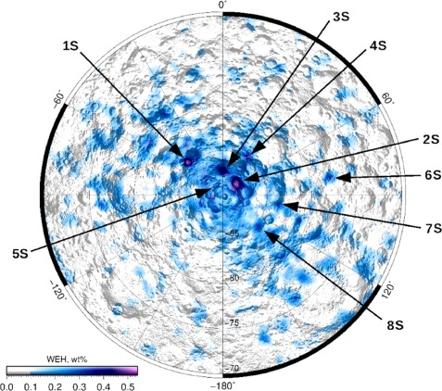
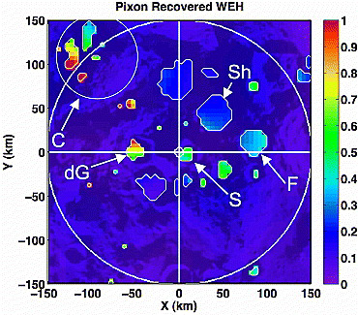
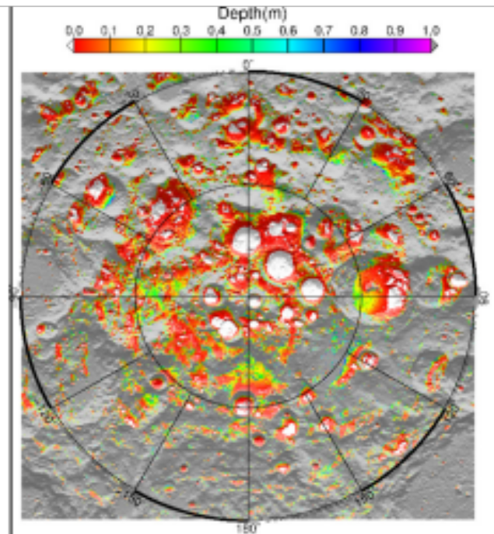
Lunar South Pole Water Distribution
Analysis of LEND data (Sanin et al 2017) reveals higher WEH abundances (~0.5 wt%) in south polar craters Shoemaker, Haworth, and Faustini
Pixon-based reconstruction of LPNS data (Elphic et al 2007) reveals high WEH abundances in Cabeus (near 1 wt%) and lower abundances in Shoemaker, Haworth, and Faustini (~0.3 wt%)
Map of current day ice stability depth from Siegler et al [2015] as used in constraint map development
Notes:
LP – launch 1998, 30/100 km, 19 mos (12 @ 100, 7 @ 30)
LRO – launch 2009, 50/100km as low as 30

Slide 9
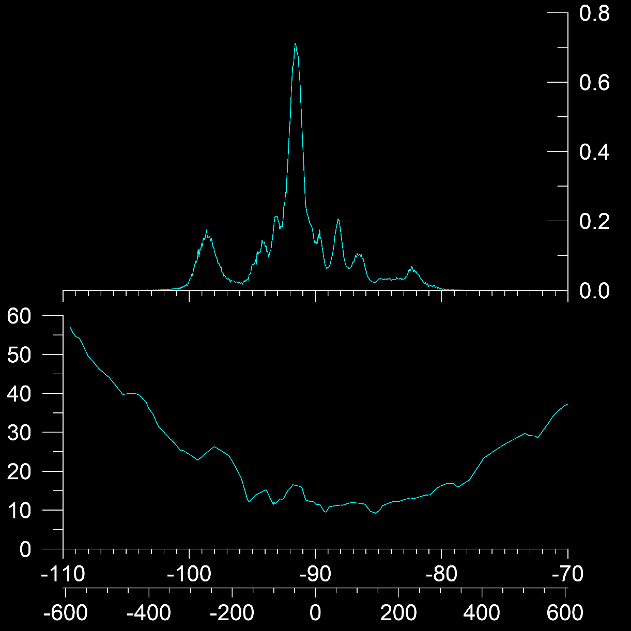
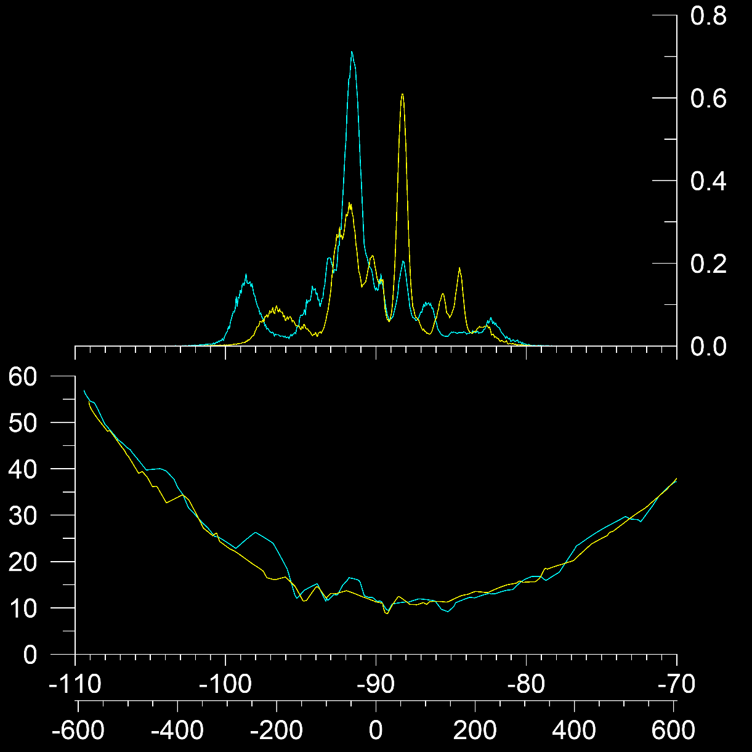

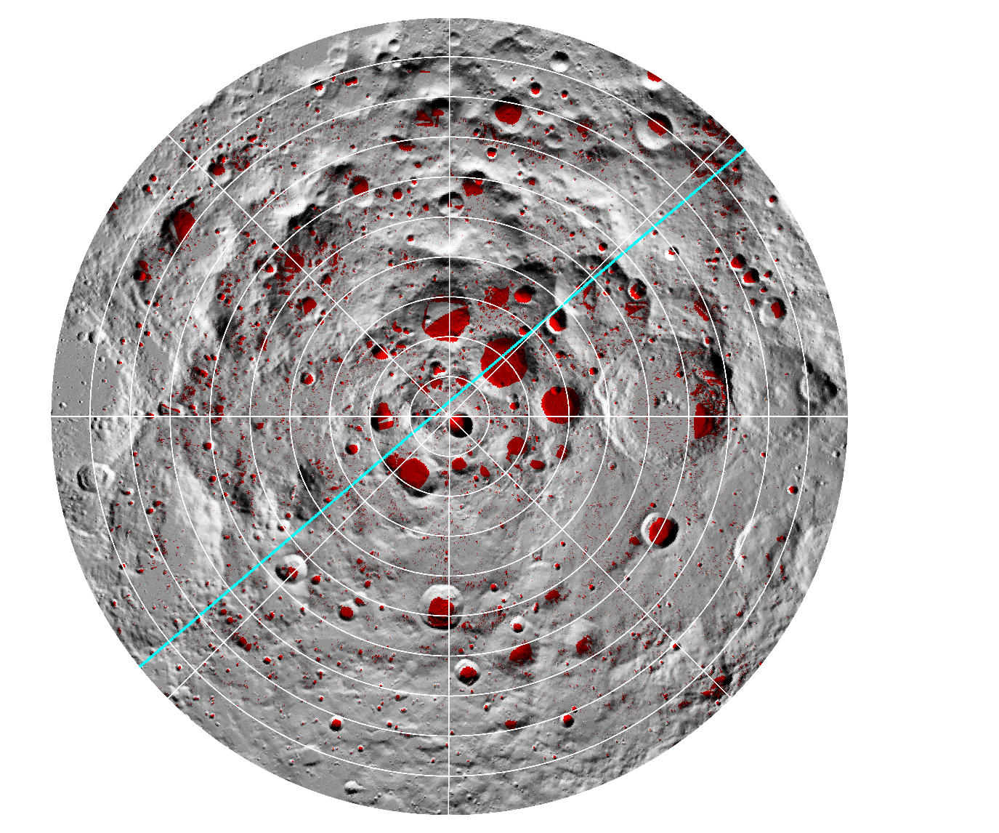
LunaH-Map: Example orbits
15- × 3150-km eccentric orbits
4.7h orbit
0E
Shoemaker
PSR contribution
Shoemaker
270E
90E
5 min poleward 80S
Altitude (km)
-70
-80
(Latitude)
180E
LOLA PSRs
(Mazarico et al., 2011)
Distance along ground track (km)

Slide 10
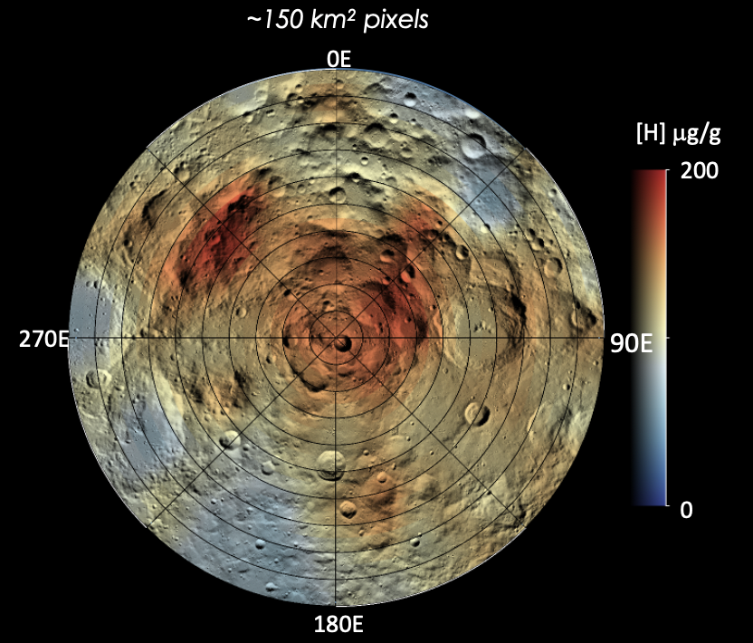
Lunar south pole: LunaH-Map regions of interest
Cisneros, E.
Cisneros, E.
0E
Haworth
Cabeus
Shoemaker
Faustini
LCROSS
Amundsen
270E
90E
30 km/°
Sverdrup
PSR
180E
Based on LOLA shape models by Mazarico, E. et al. (2011), Icarus; see also NAC data, Cisneros, E. et al., LPS 48.

Slide 11
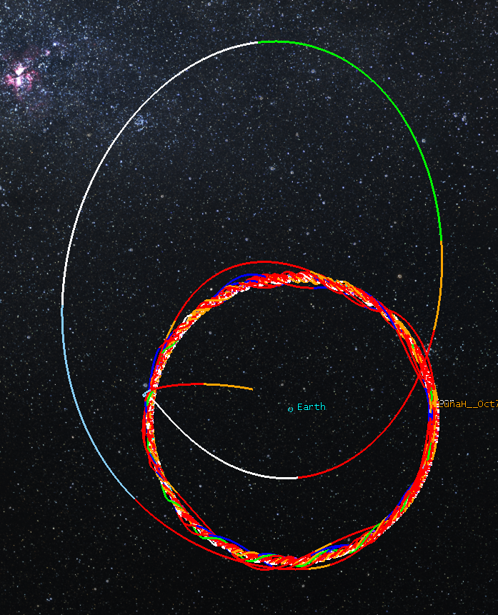
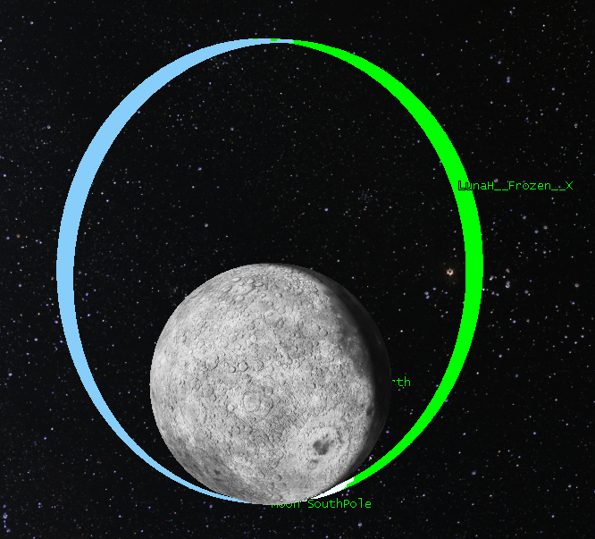
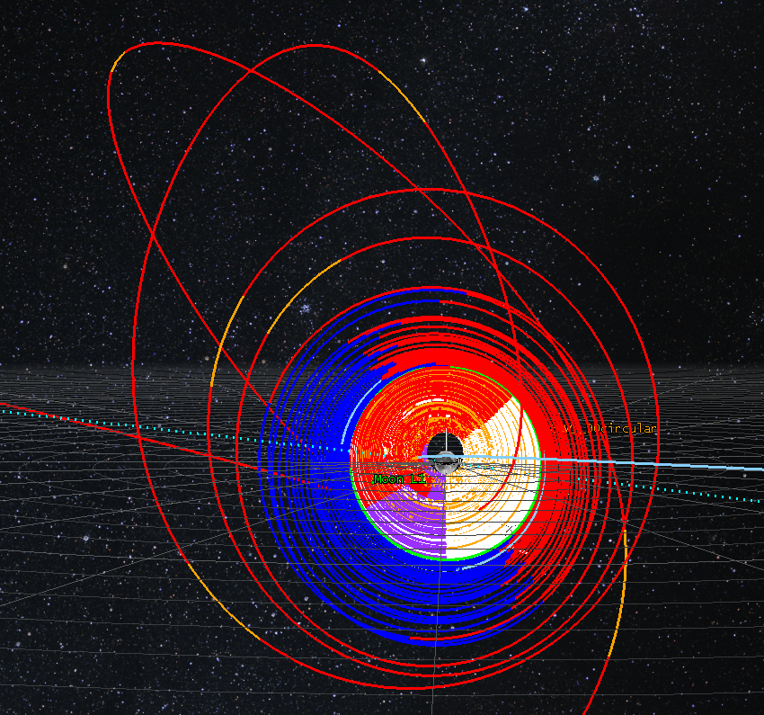
LunaH-Map Navigation and Trajectory Design
1
3
Period | 4.76 hour
Aposelene Altitude | 3150 km
Periselene Altitude | RAAN dependent 15-25 km
Inclination | 90°
Argument of Periselene | 273.5°
2
Genova, A. L. and Dunham, D. W. (2017) 27th AAS/AIAA Space Flight Mechanics Meeting 17-456.

Slide 12
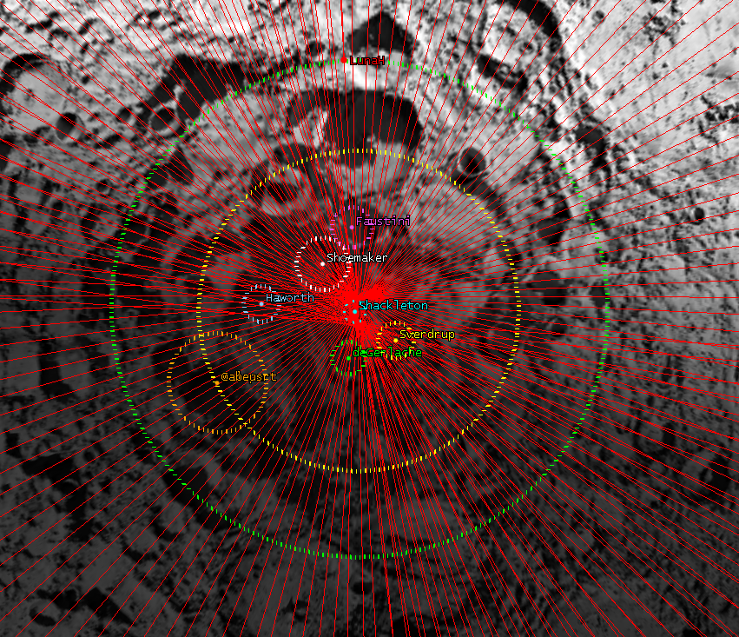
LunaH-Map Ground Tracks
Period | 4.76 hour
Aposelene Altitude | 3150 km
Periselene Altitude | RAAN dependent 15-25 km
Inclination | 90°
Argument of Periselene | 273.5°
Genova, A. L. and Dunham, D. W. (2017) 27th AAS/AIAA Space Flight Mechanics Meeting 17-456.

Slide 13
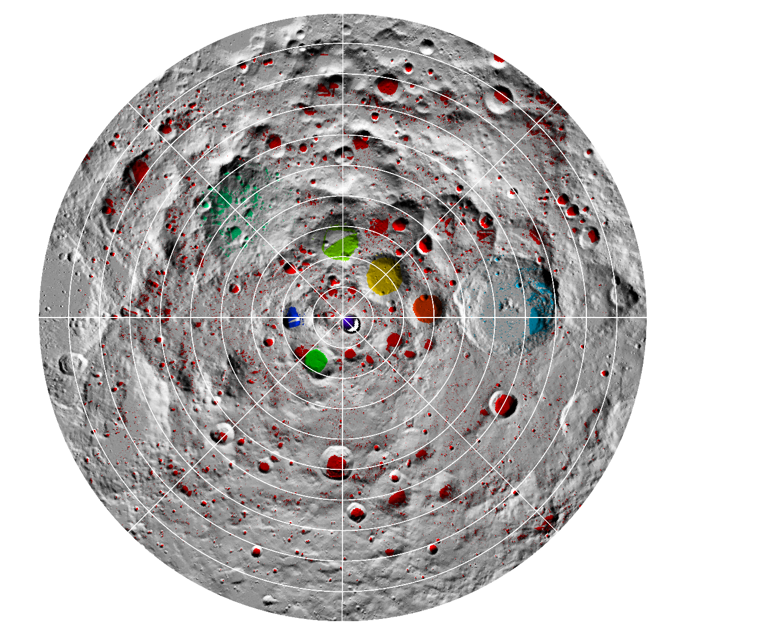
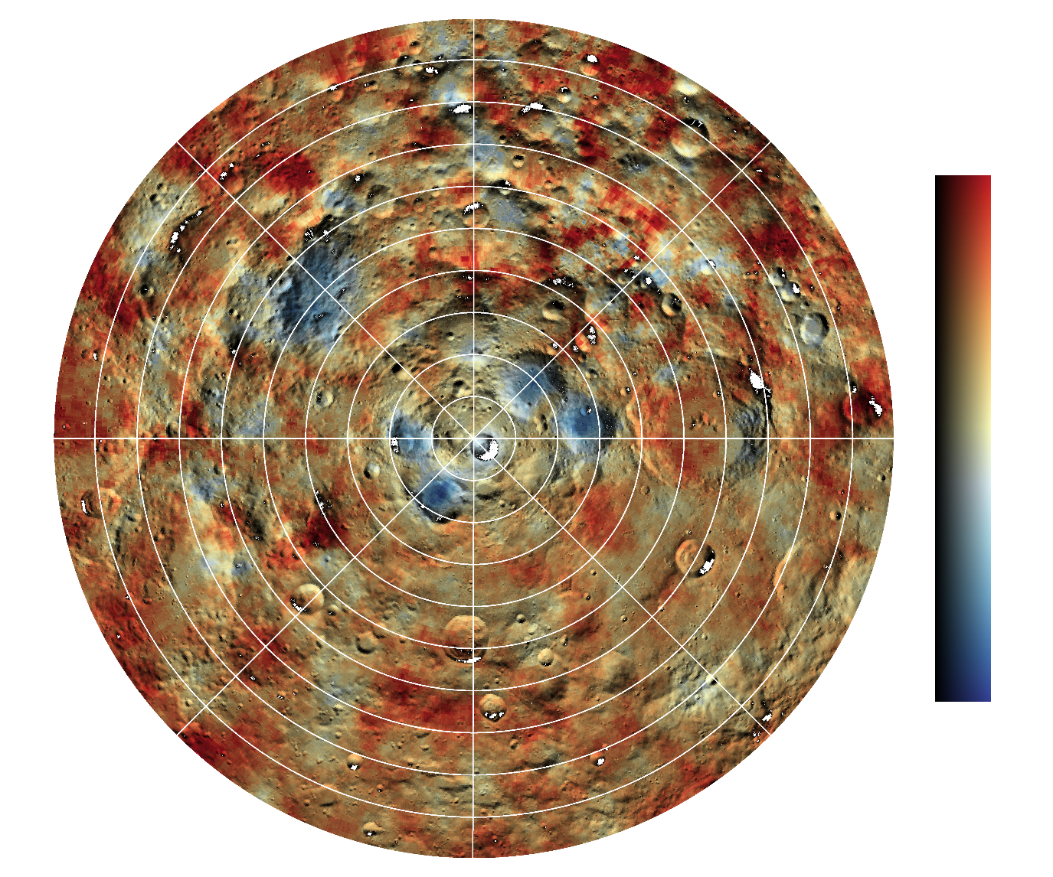
LunaH-Map: Simulated counting data
0E
Added noise
56 day mission
(282 orbits)
Epithermal counts (relative)
1
B 50 μg/g
P 200 μg/g
H 250 μg/g
Sh 256 μg/g
A 300 μg/g
F 378 μg/g
S 556 μg/g
Sv 667 μg/g
C 778 μg/g
dG 800 μg/g
C
H
Sh
270E
dG
S
F
90E
0.95
A
Sv
P
0.9
B
0-220 μg/g H
180E

Slide 14
LunaH-Map Science Objectives
Paige, D. A. et al. (2010) Science
Thick, subsurface ice deposits may be pervasive at high latitudes (e.g. delivery by comets, subsequent burial & gardening)
Indicated by morphology (shallowing) of simple craters (Rubanenko et al., 2019)
If so, then impact gardening could vertically redistribute the ice, bringing ice closer than expected based on stability models
Shallow ice (i.e. frost) locations are not consistent with bulk (i.e. buried) hydrogen distributions (Hayne et al., 2015; Sanin et al., 2016)
Tests for LunaH-Map:
Is the distribution of H determined by LunaH-Map consistent with expected permafrost depths and frost distributions?
Is H enhanced in >1 m depth regions?
0E
270E
90E
180E
0
Depth (m)
1

Slide 15
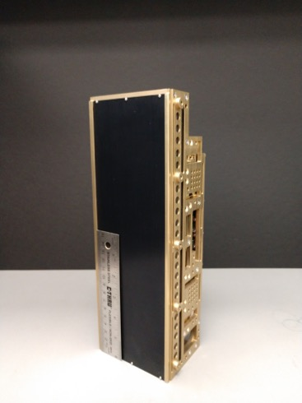
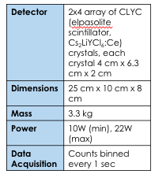
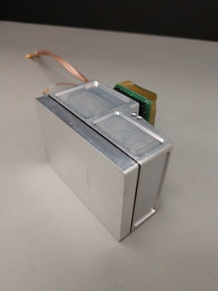

Miniature Neutron Spectrometer for CubeSats and SmallSats
Mini-NS Flight Unit delivered and calibrated at Los Alamos National Lab Neutron Free In-Air (NFIA) facility in late Fall 2018
Notes:
Yes add graphic

Slide 16
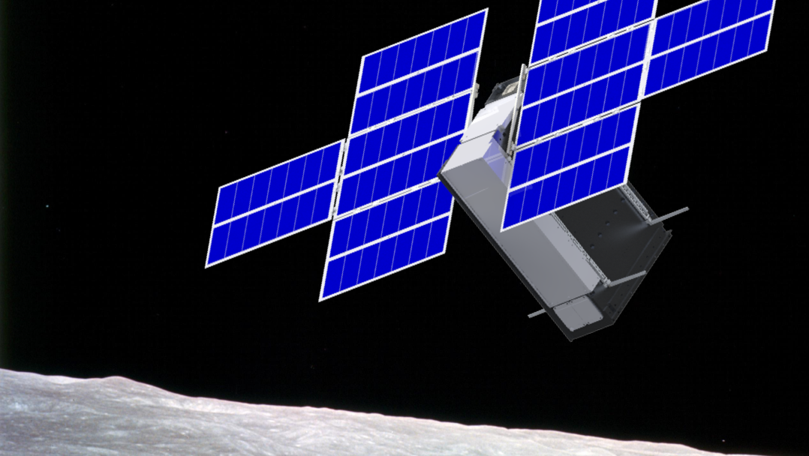
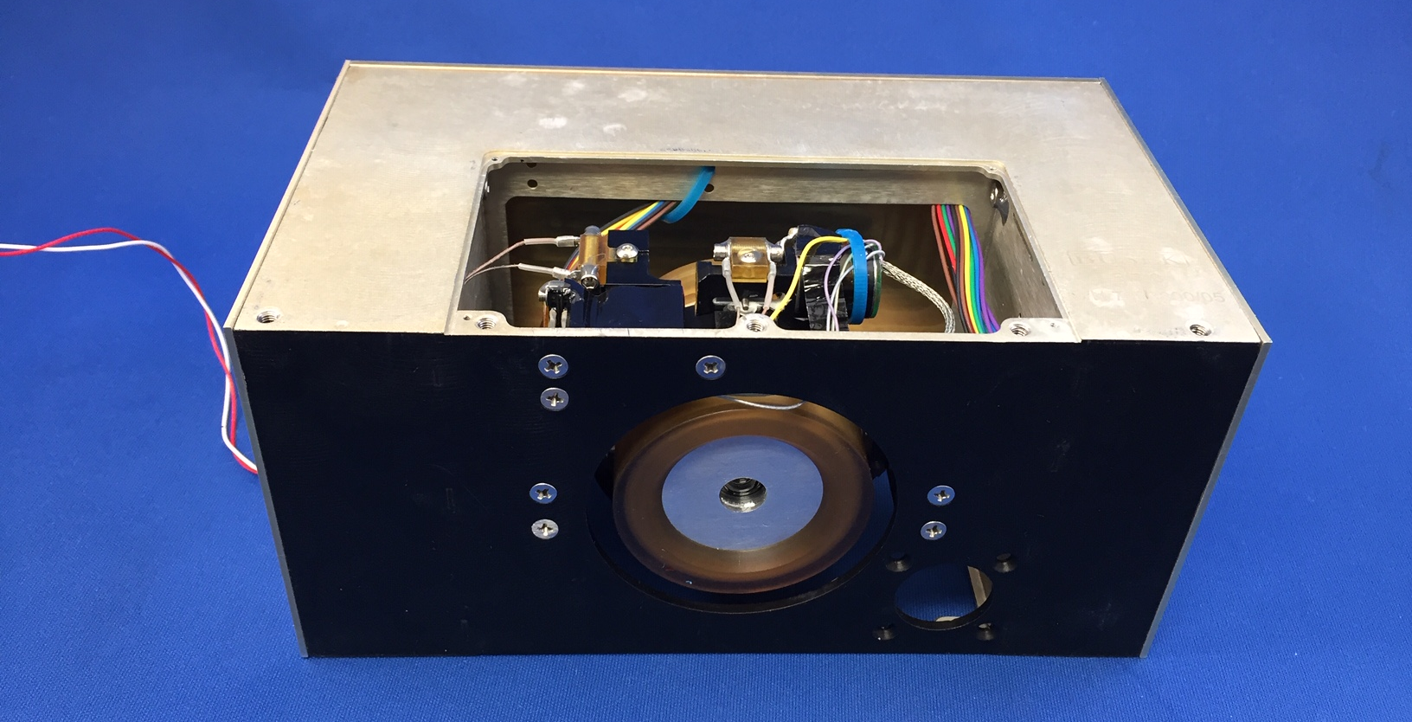
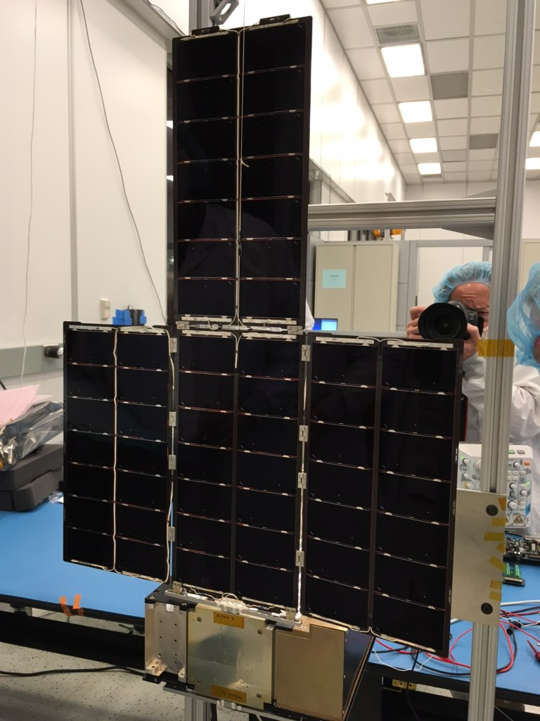
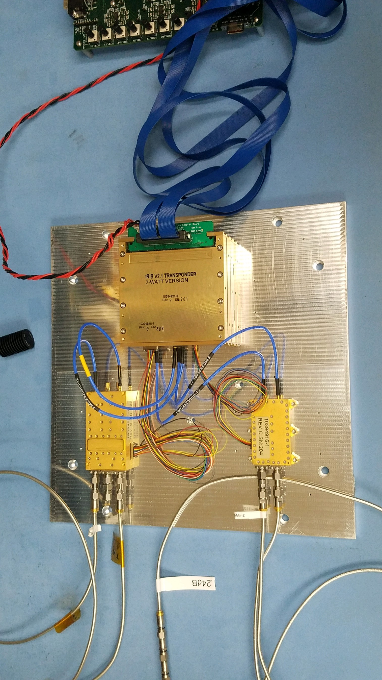





Flight BIT-3 propulsion system – Delivered December 2019
Flight eHawk+ Solar Arrays – Delivered February 2019
Flight Iris radio – Delivered February 2019
Flight XB1-50, XEPS delivered September 2019

Slide 17
LunaH-Map Path to Delivery

Slide 18
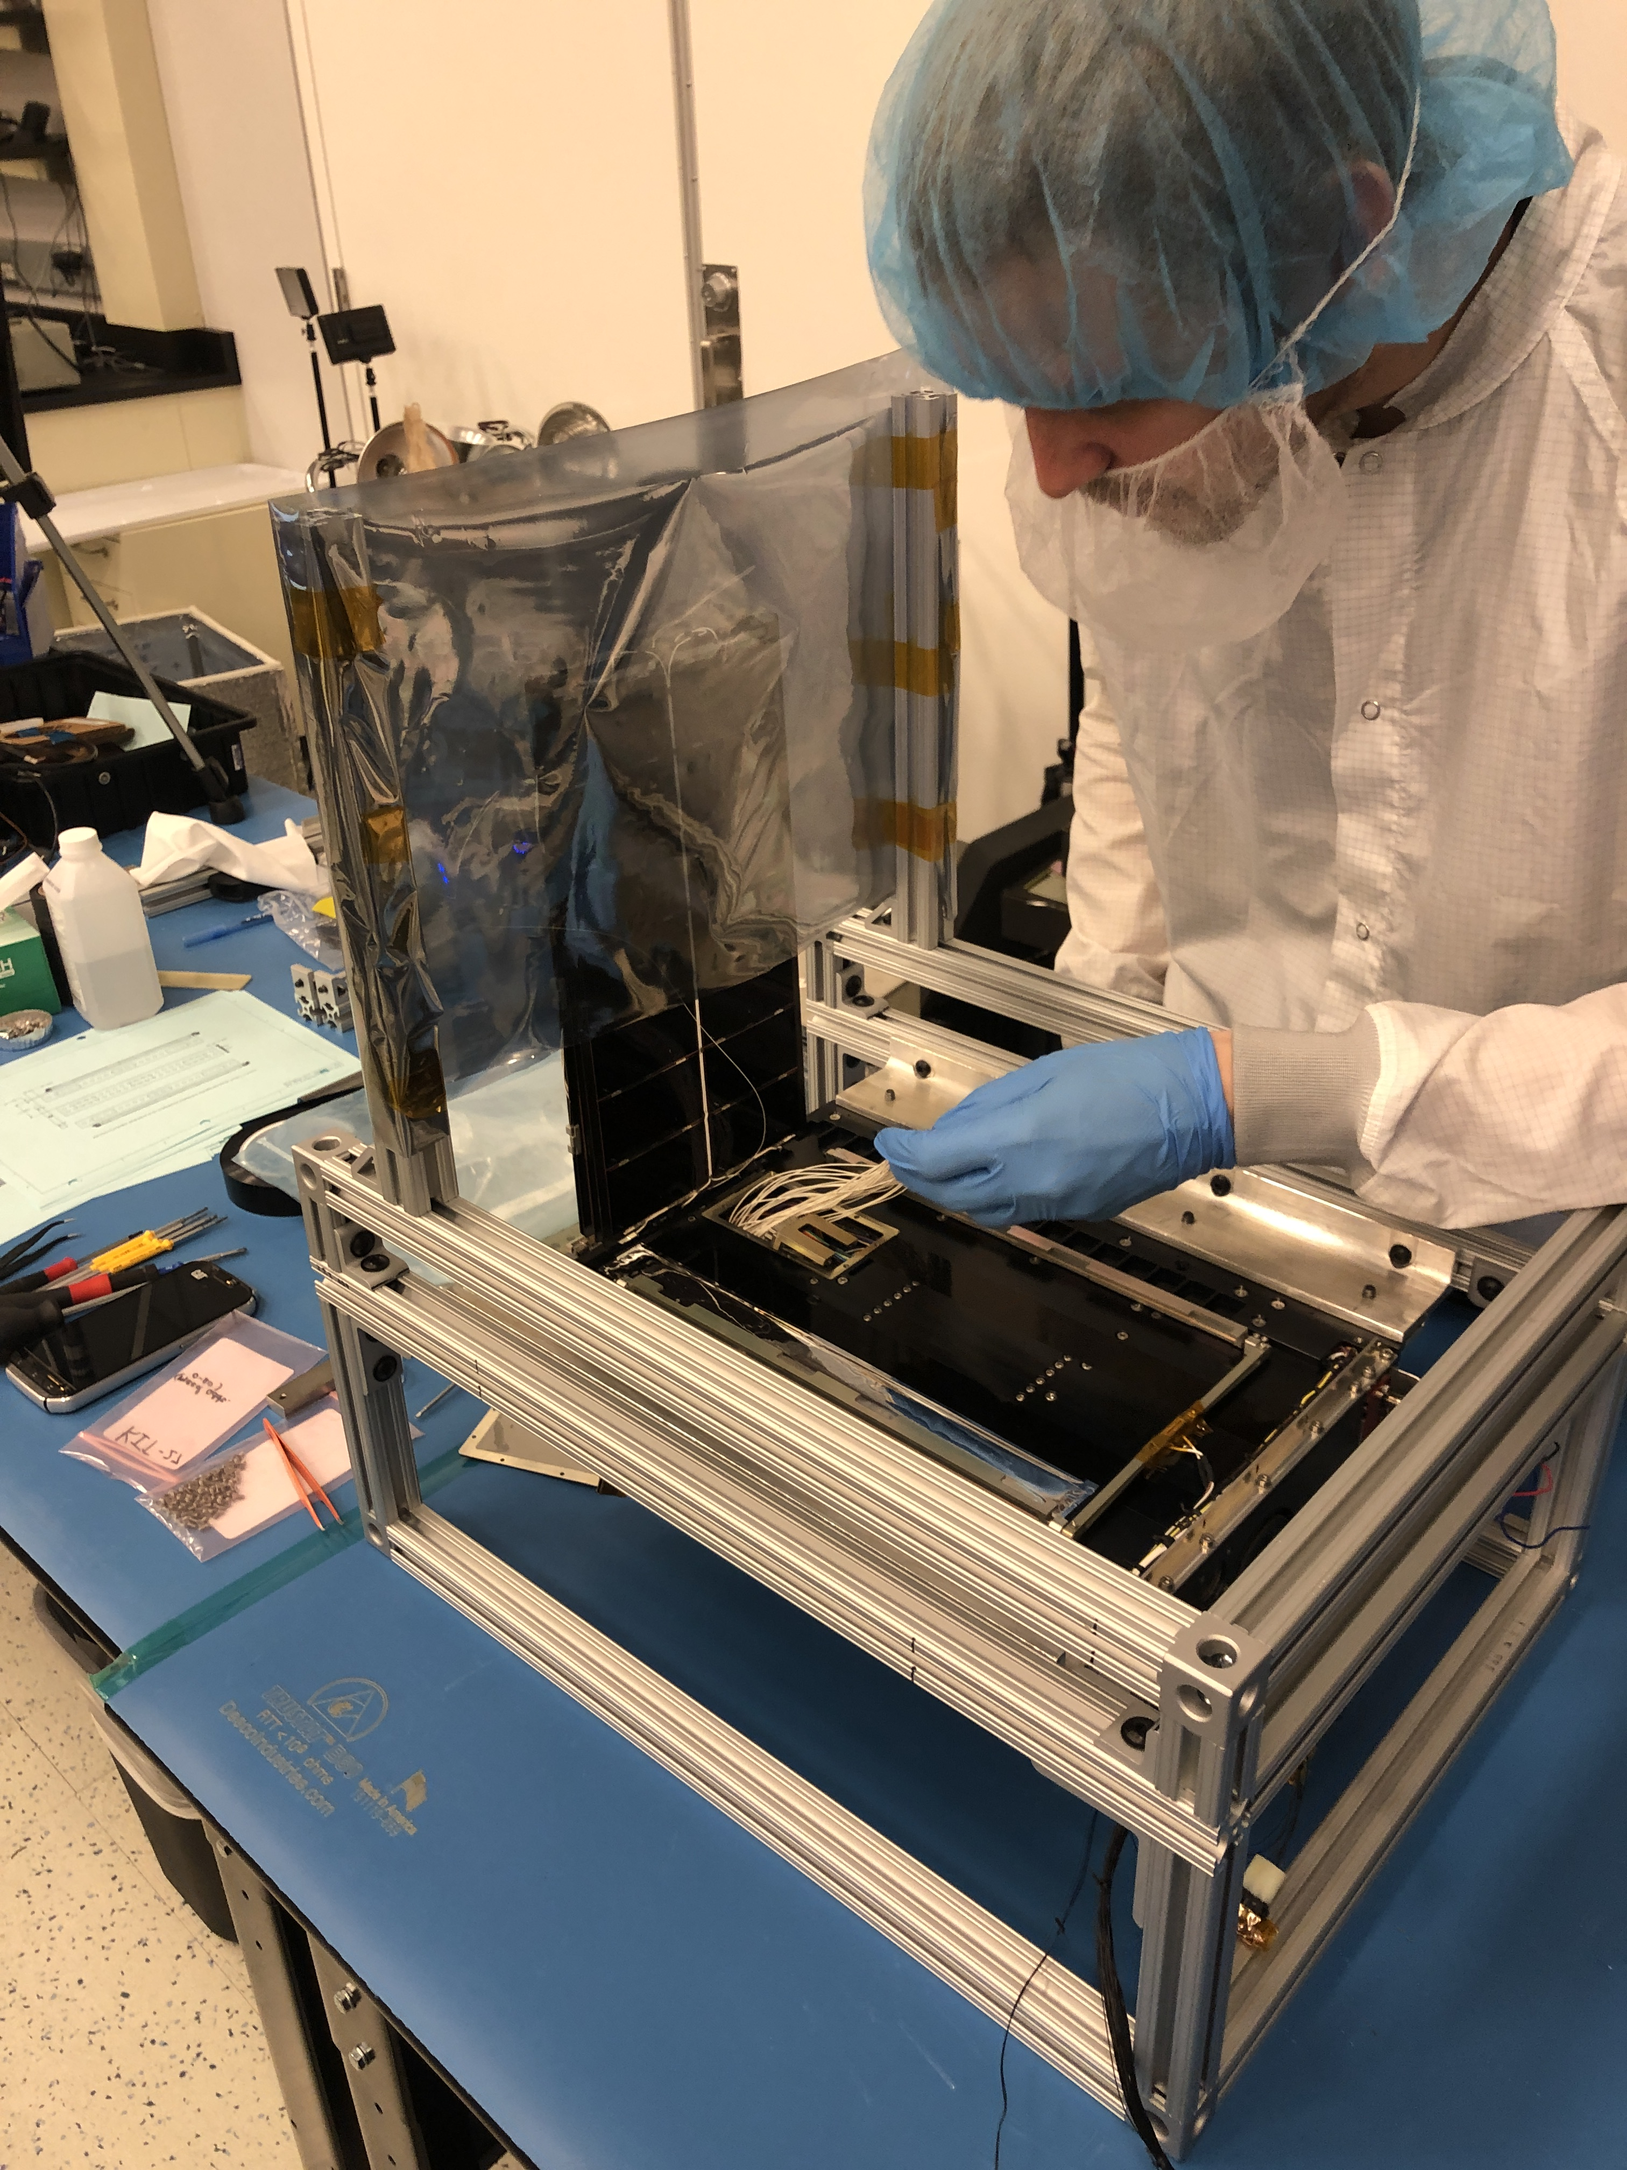
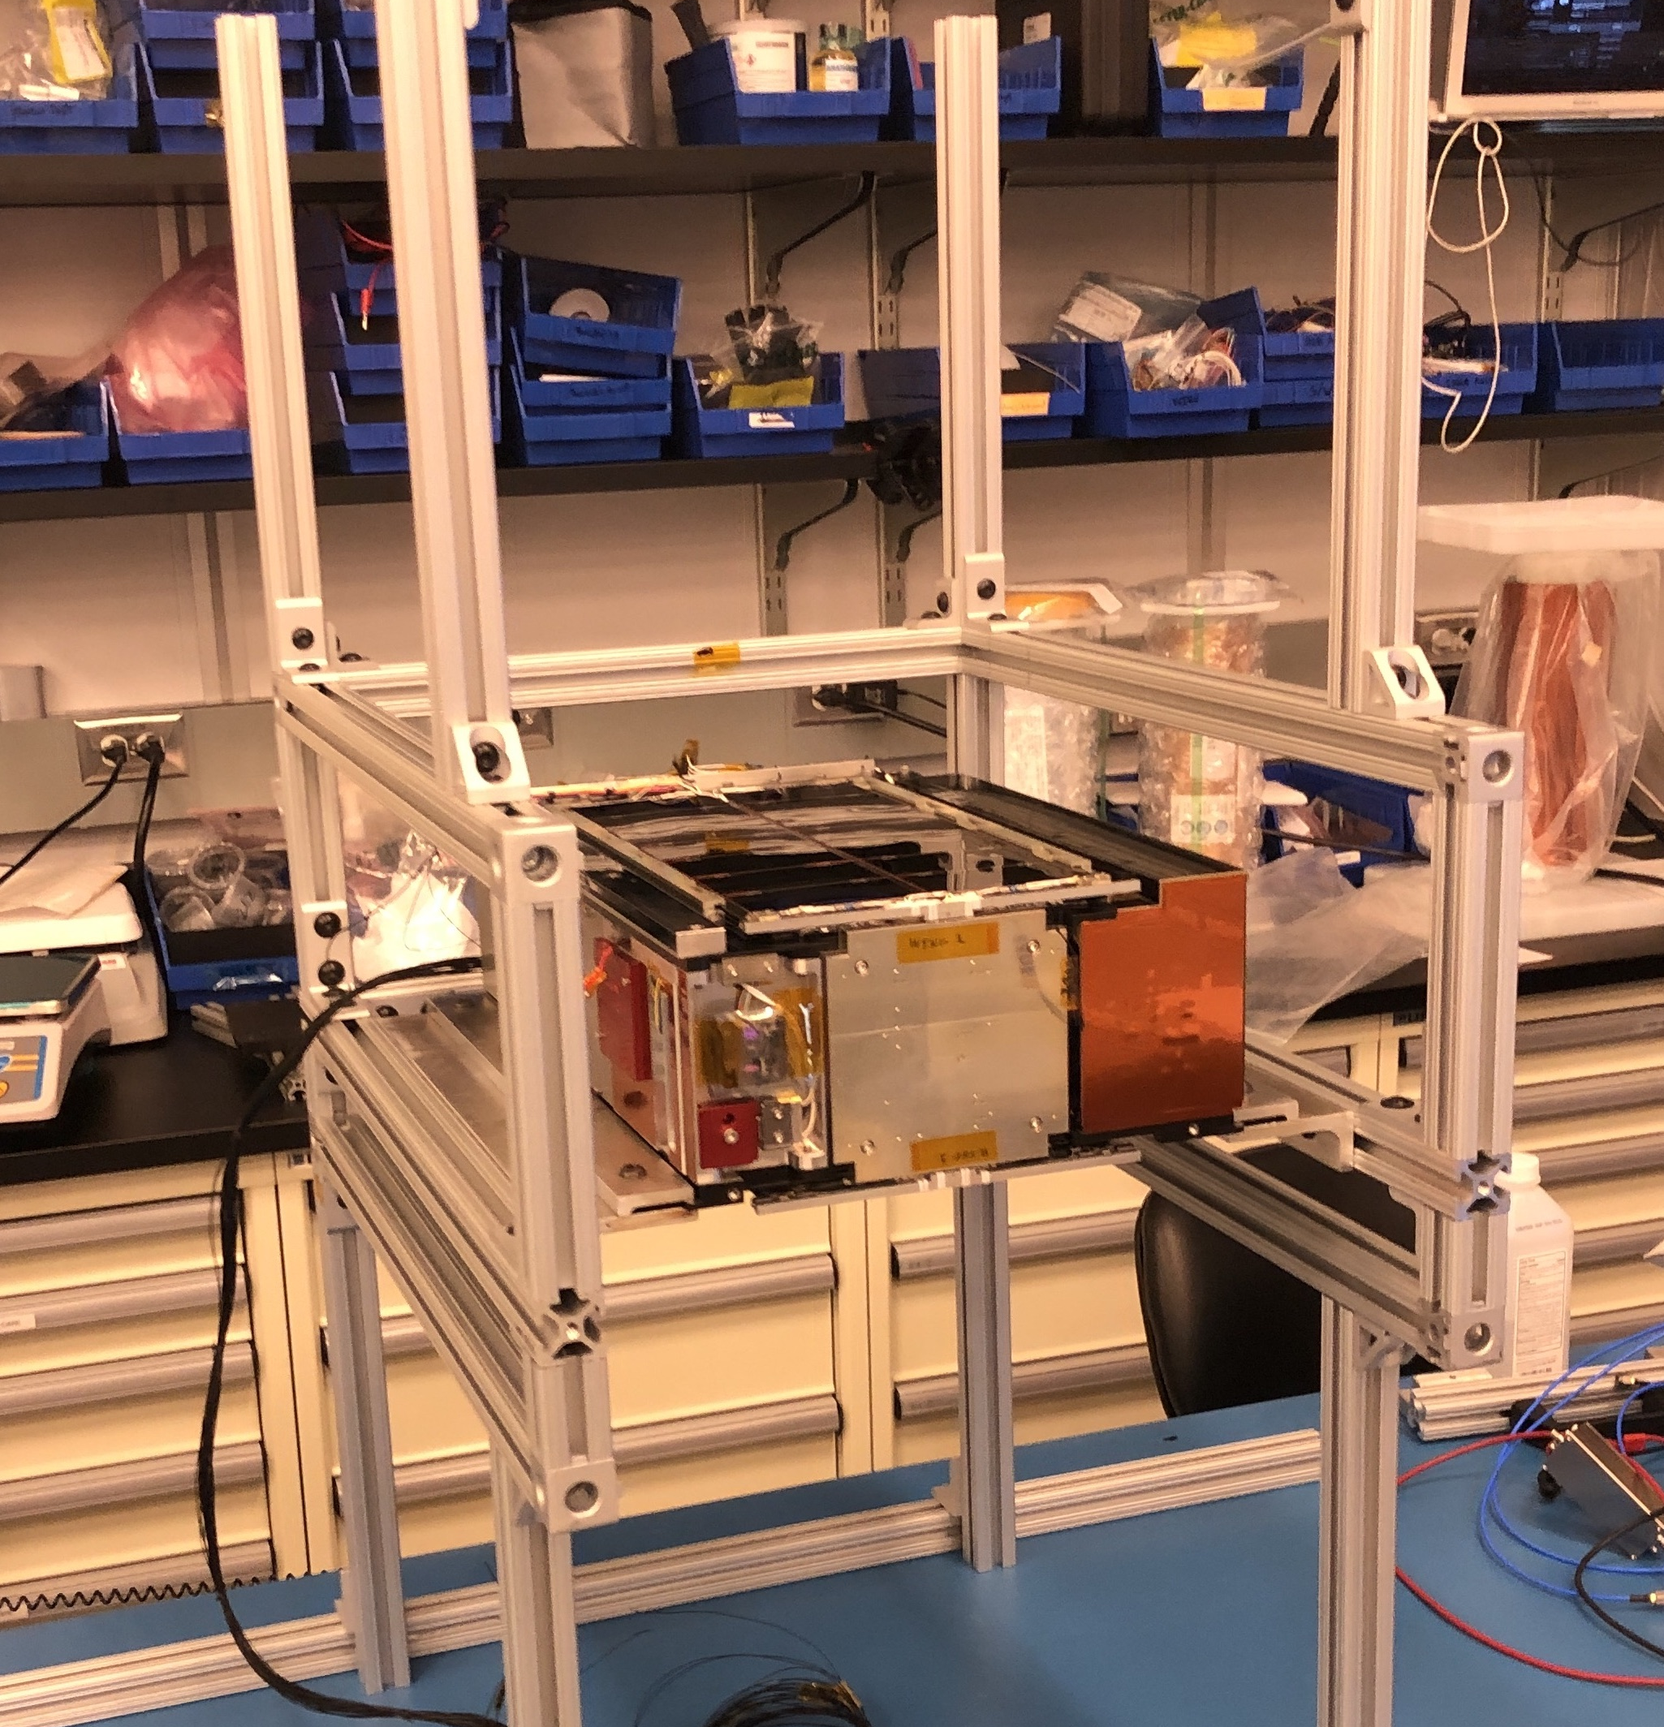
Flight Spacecraft Solar Array Integration
April 2020
LunaH-Map Flight Spacecraft Assembled
May 2020
Notes:
Fix solar panels
Add more reviews
- past (IAA, SRR, PDR, I-PDR)
- future (AITRR, FRR, etc.)

Slide 19
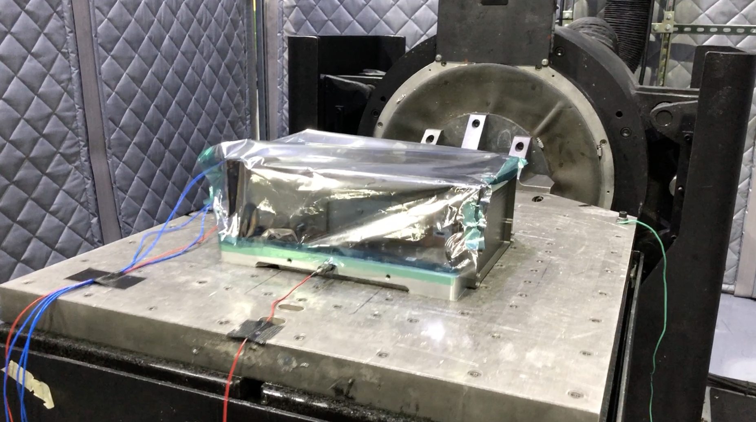
LMAP Vibe May 2020

Slide 20
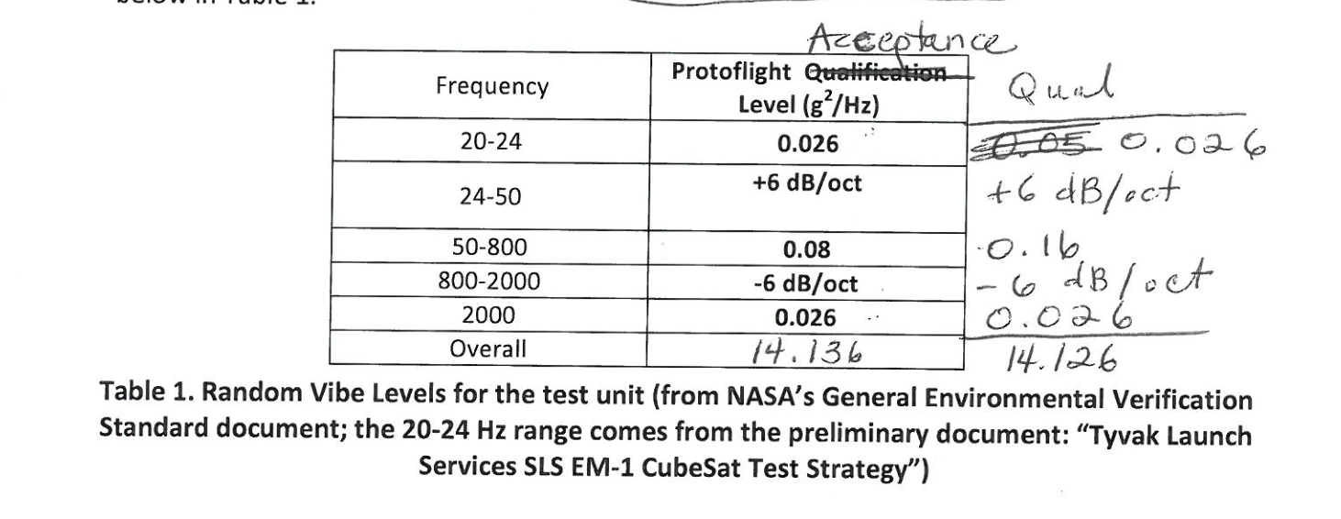
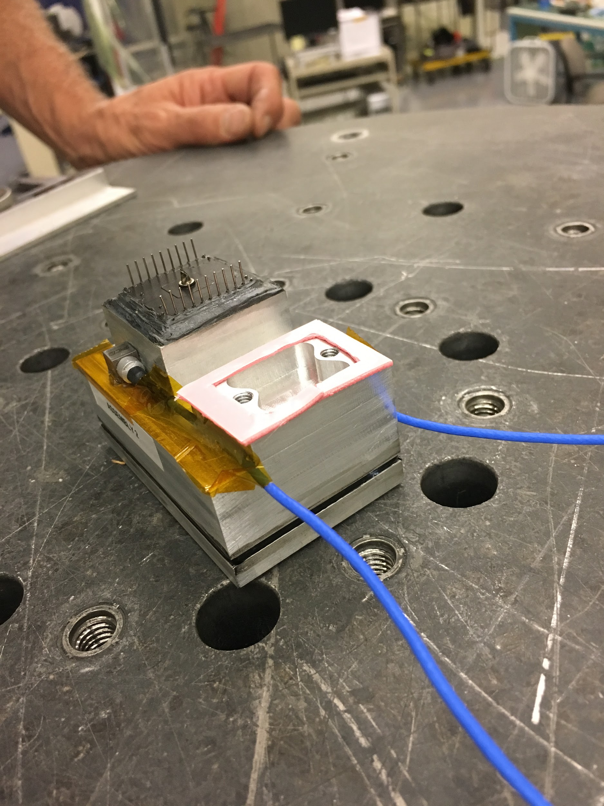
Early Module Testing
Module + PMT vibe testing in 2017
Should Be: 10.7 Grms
In the region of most of our modes the module was tested at 4X SC levels

Slide 21
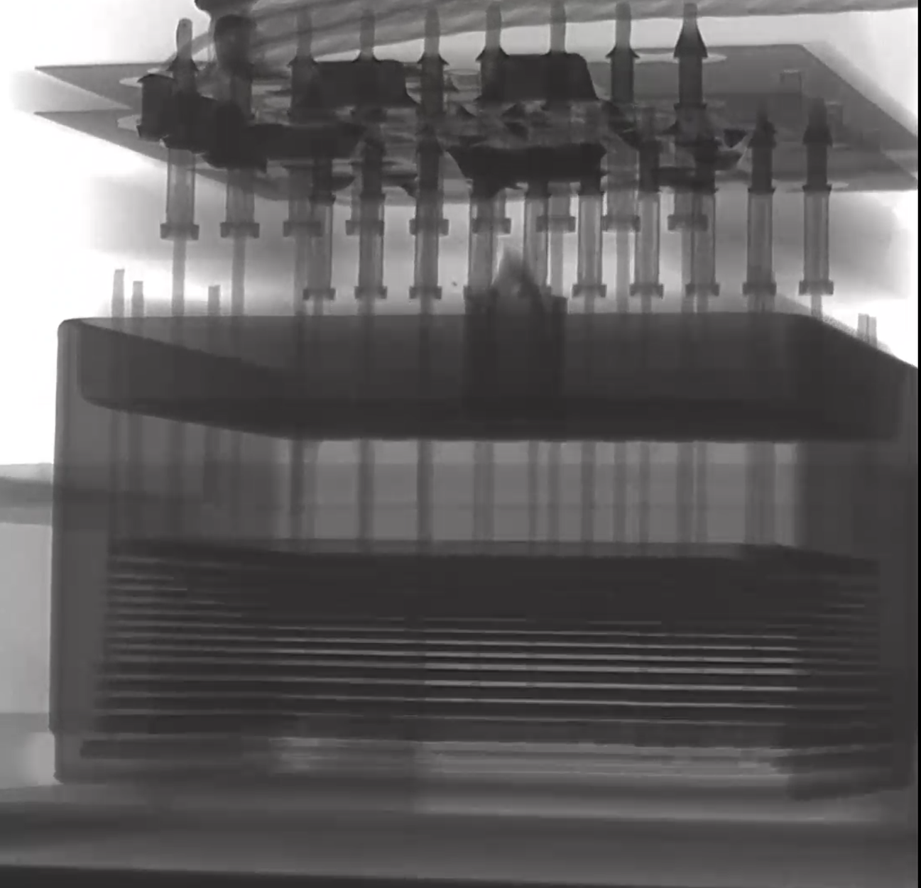
Post Vibe
X-ray analysis
Pins are difficult to see against the grids
Short
{
Short
{

Slide 22
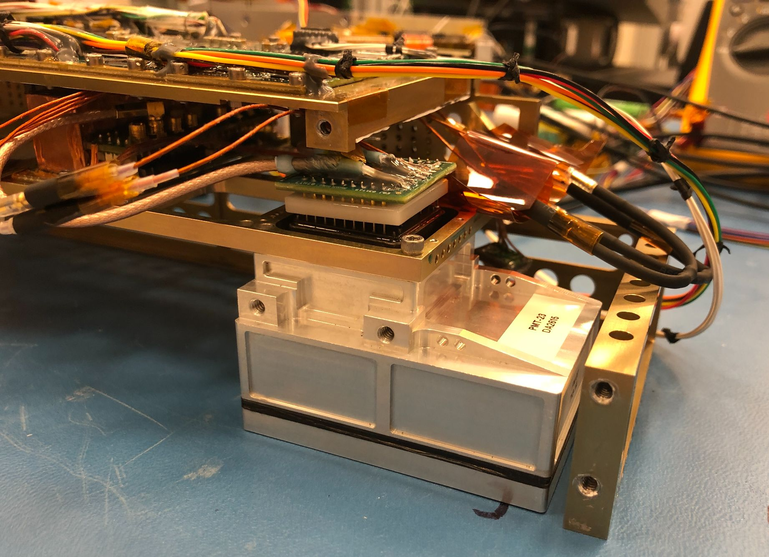
Disassembly Shows VDN Tilted

Slide 23
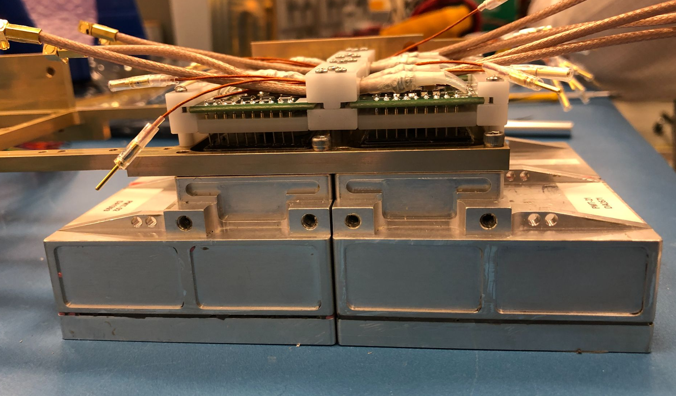
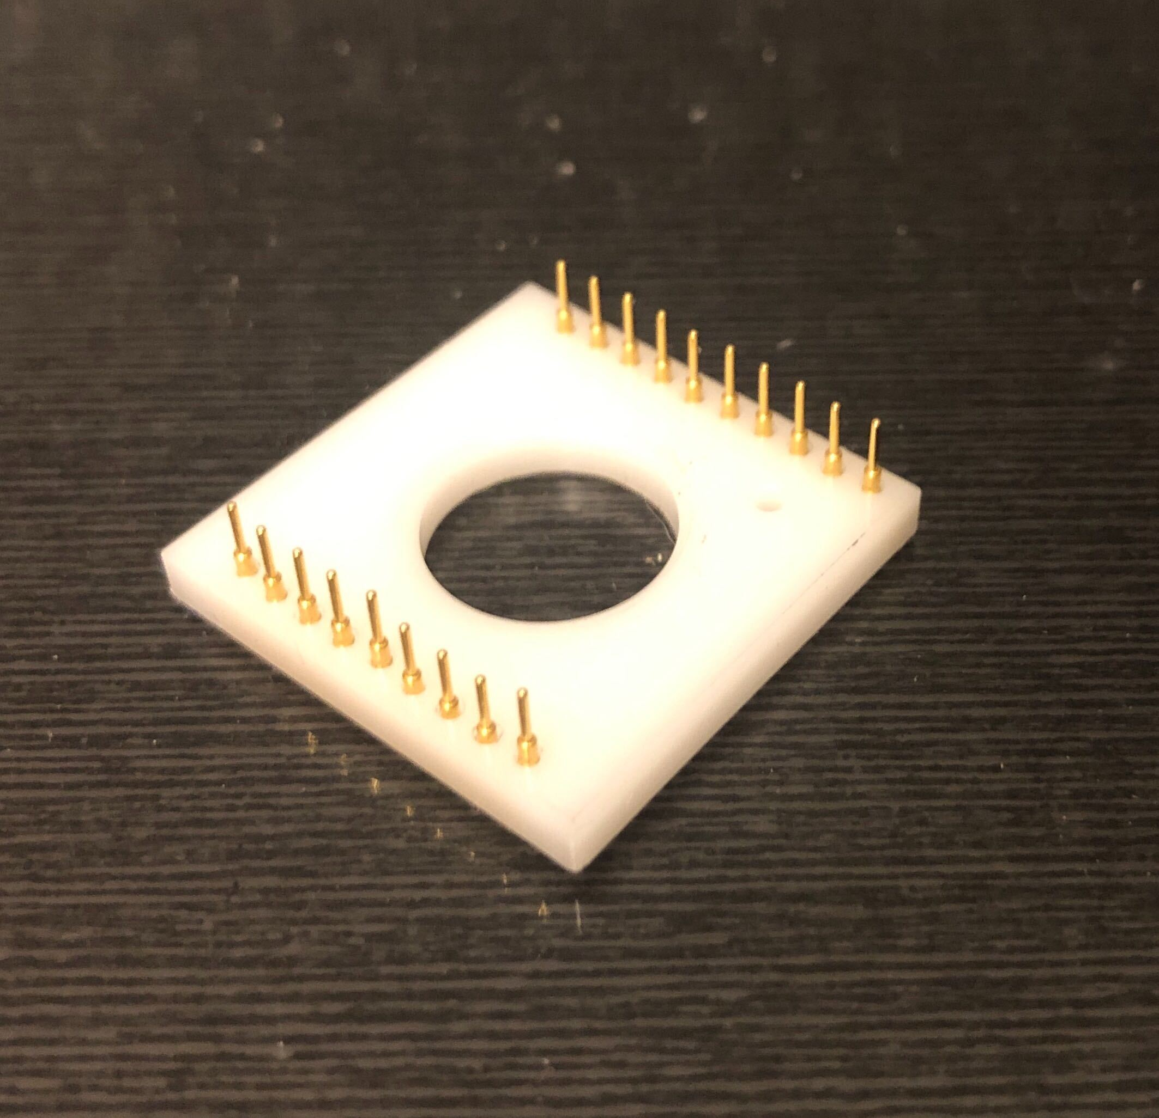
The New Clips Secure the VDN Boards and Cables
ASU PMT Sockets

Slide 24
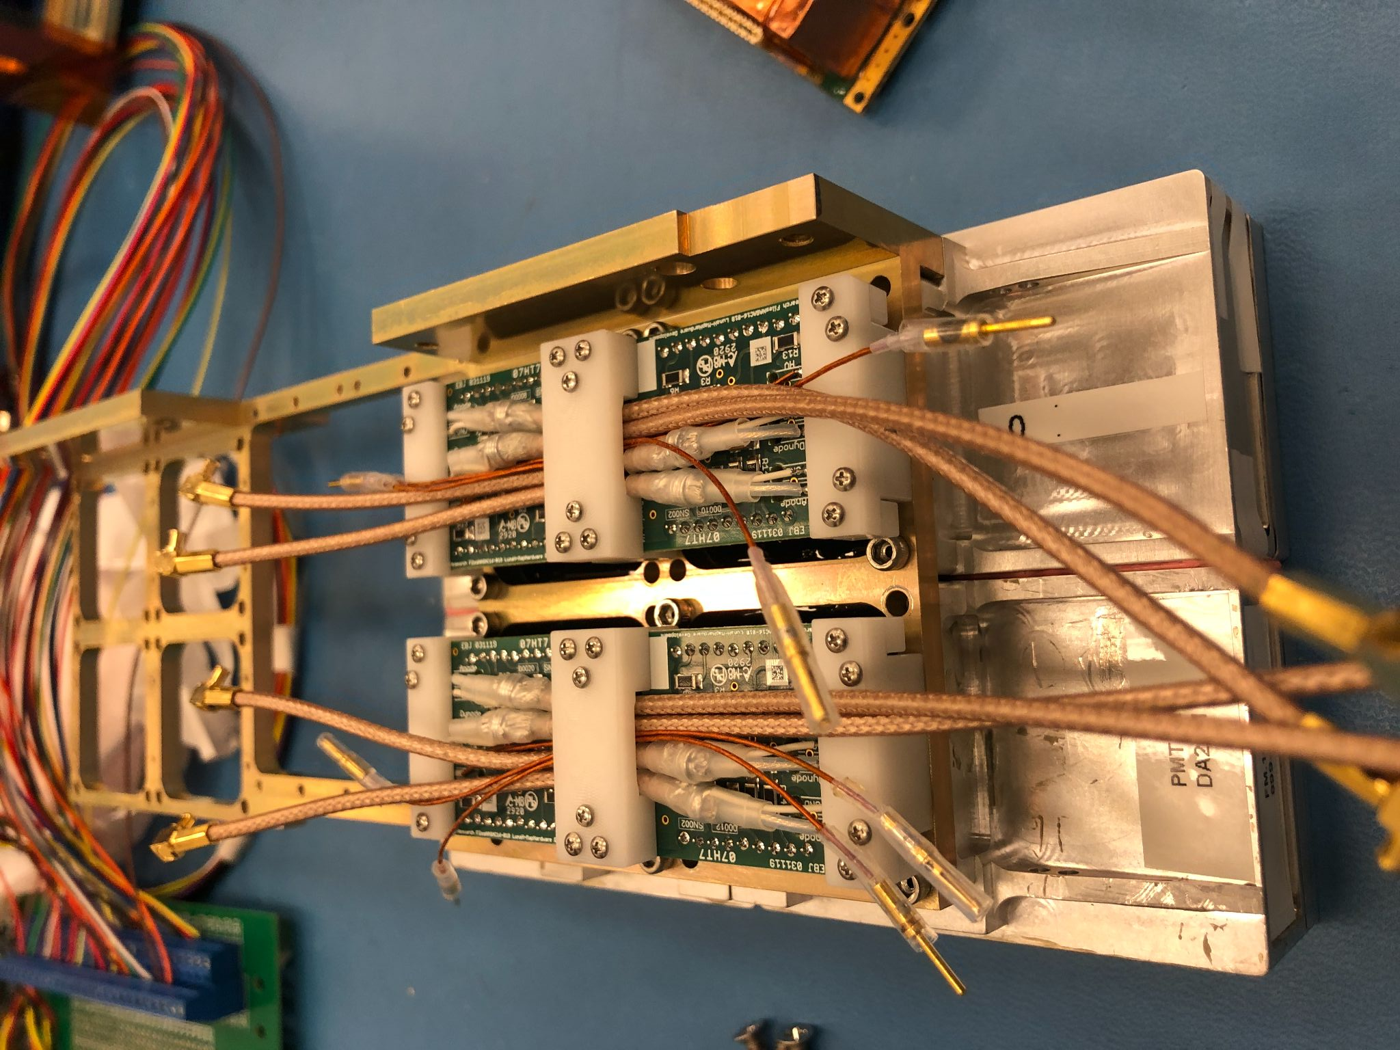
The New Clips Secure the VDN Boards and Cables
Re-vibe November 2020 at instrument level & S/C level
Both passed!

Slide 25
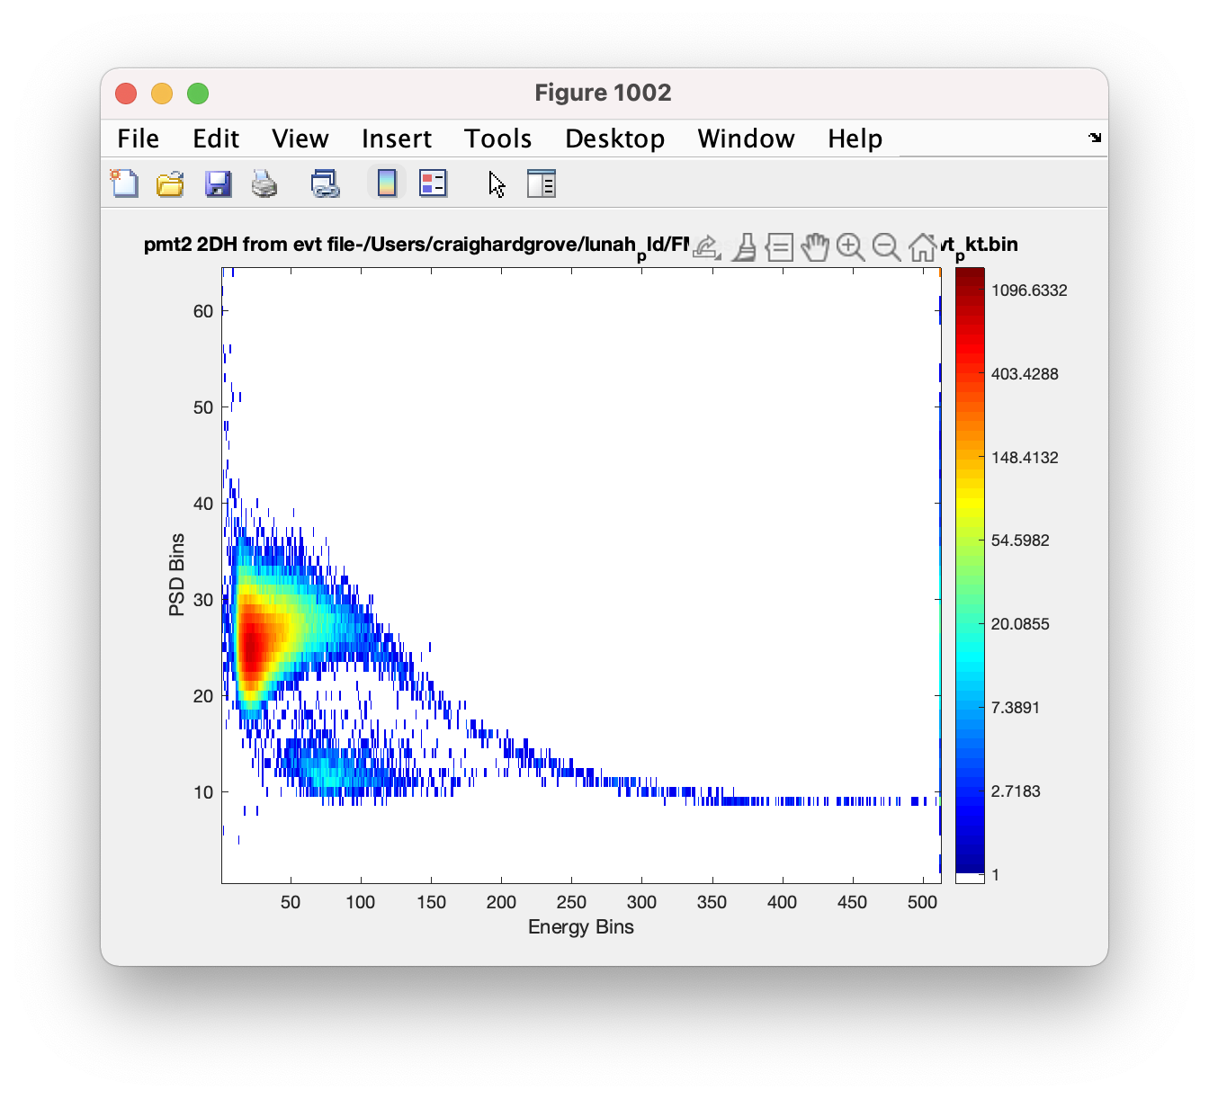
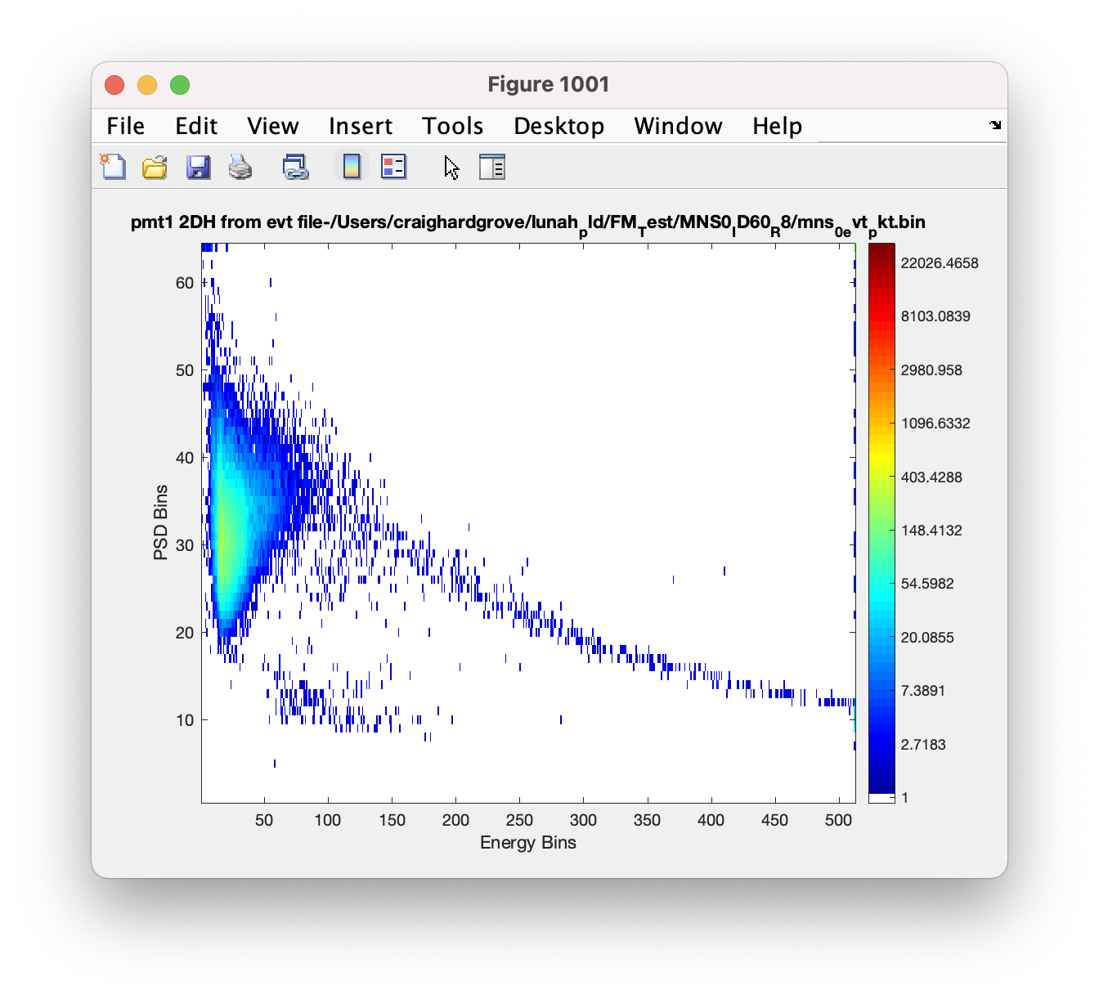
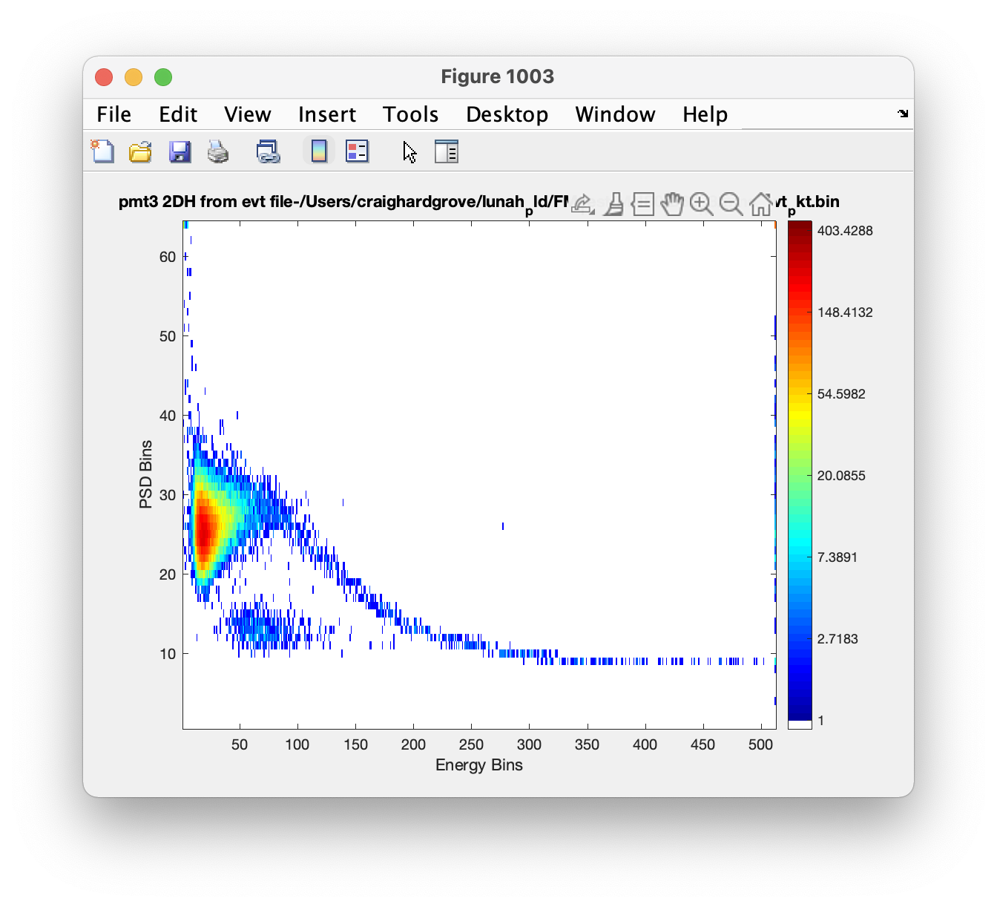
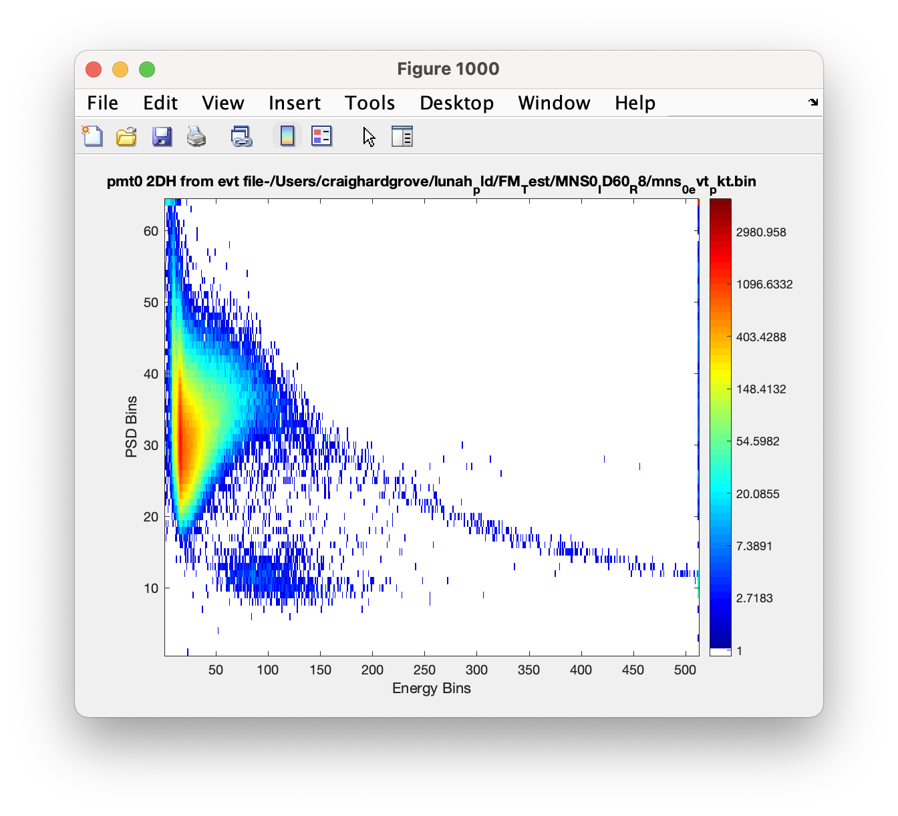
Mini-NS Post-Vibe Data
D0
TVAC @0C
Dec 19th 2020

Slide 26
Mini-NS Post-Vibe Data
D0
TVAC @0C
Dec 19th 2020
D0 neutrons

Slide 27
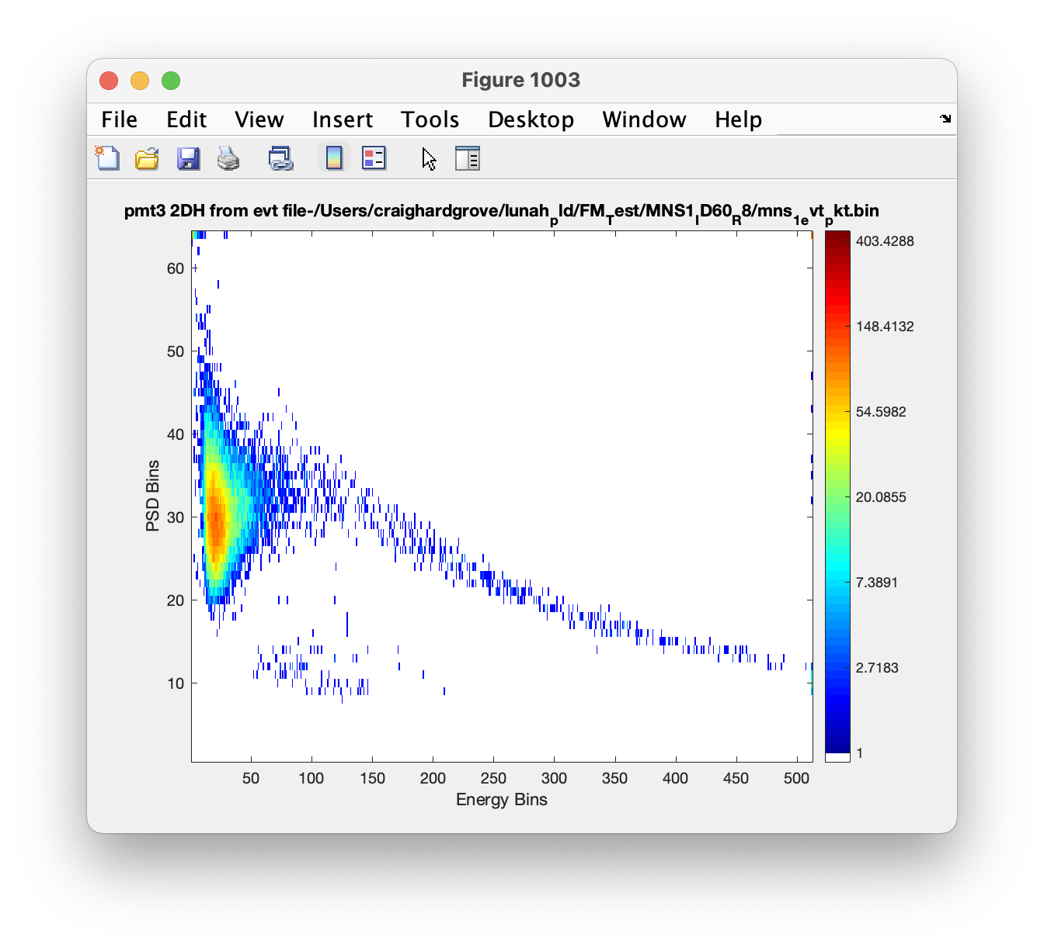
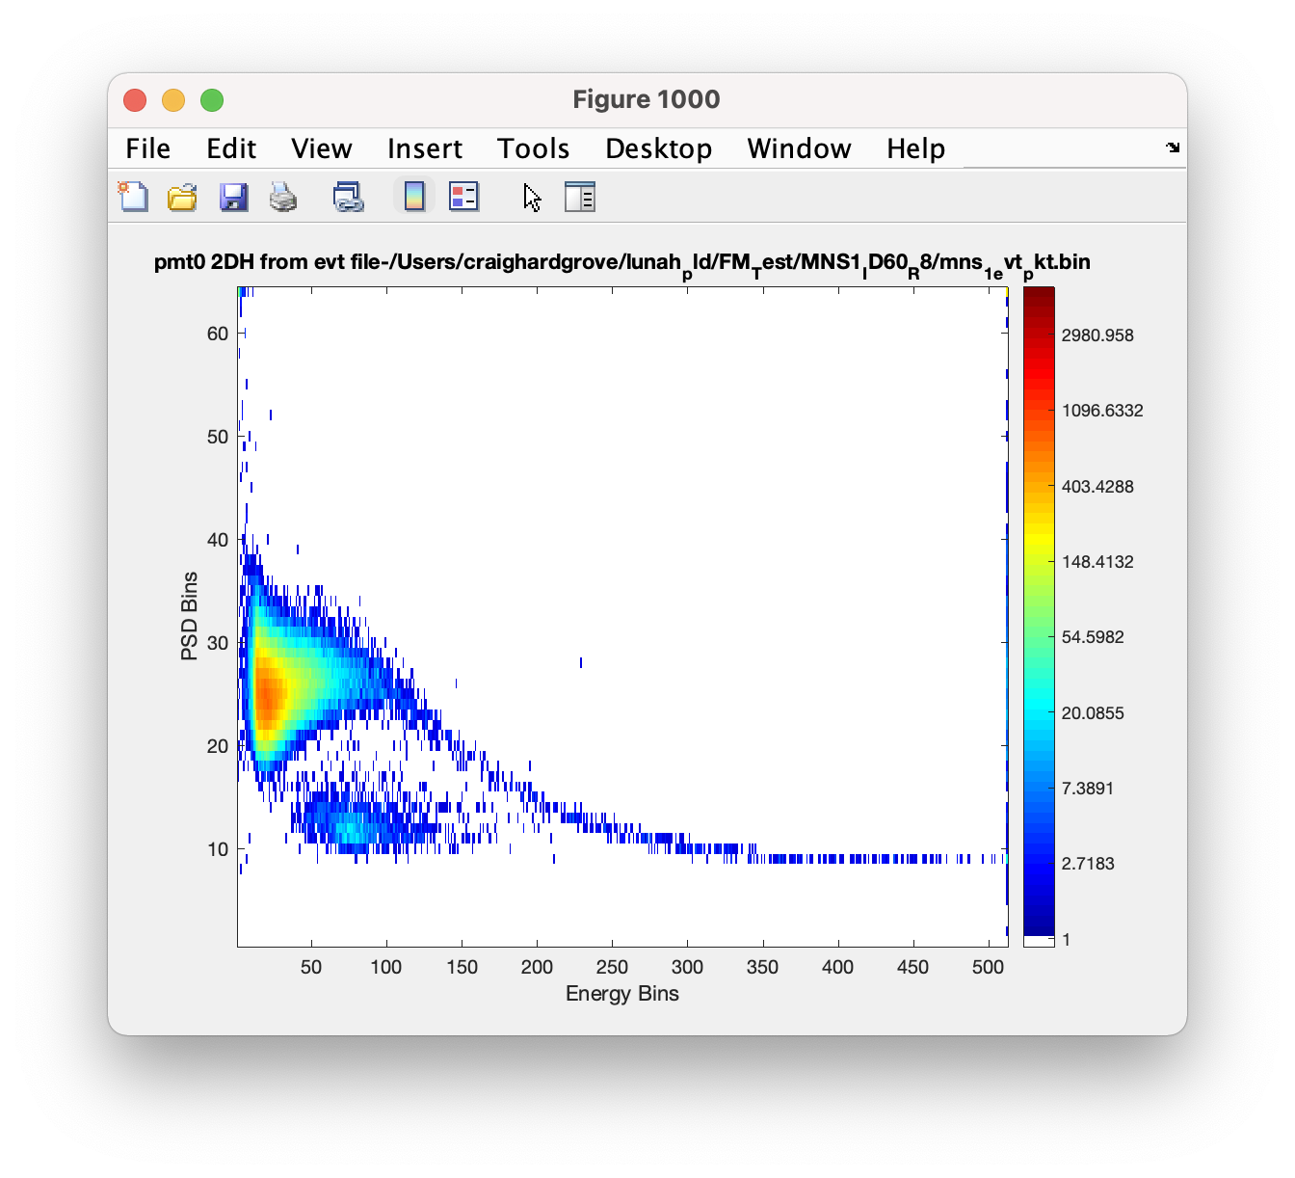
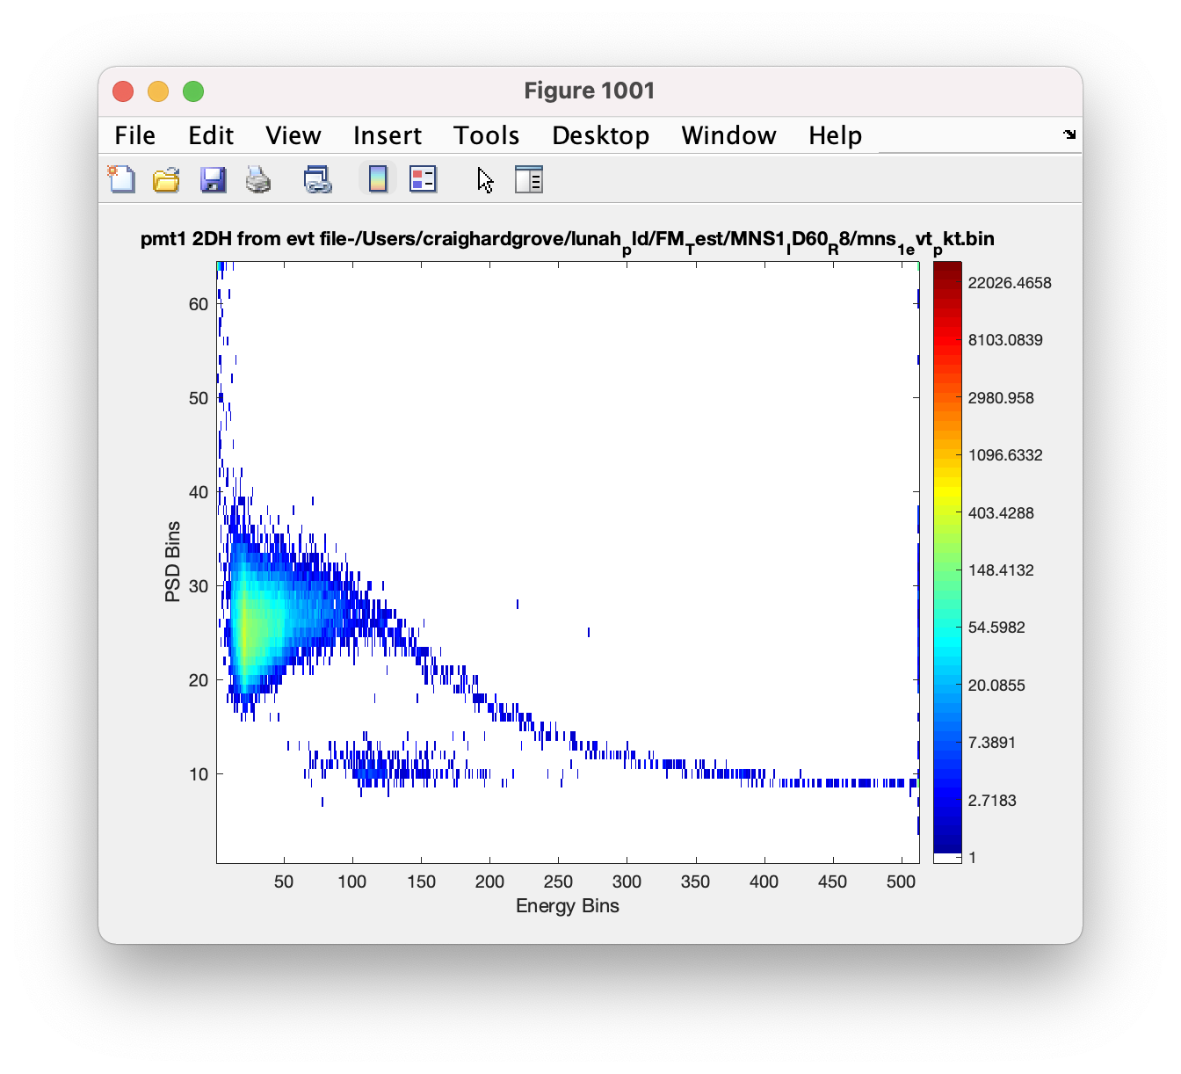
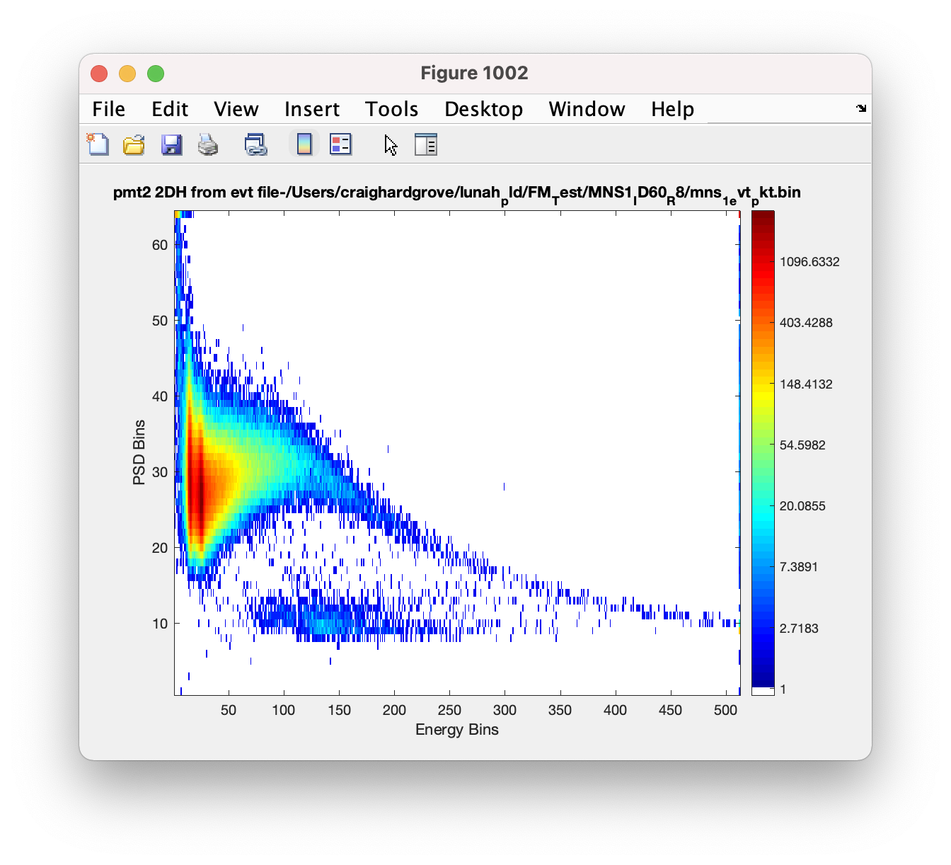
Mini-NS Post Vibe Data
D1
TVAC @0C
Dec 19th 2020
D1 neutrons

Slide 28
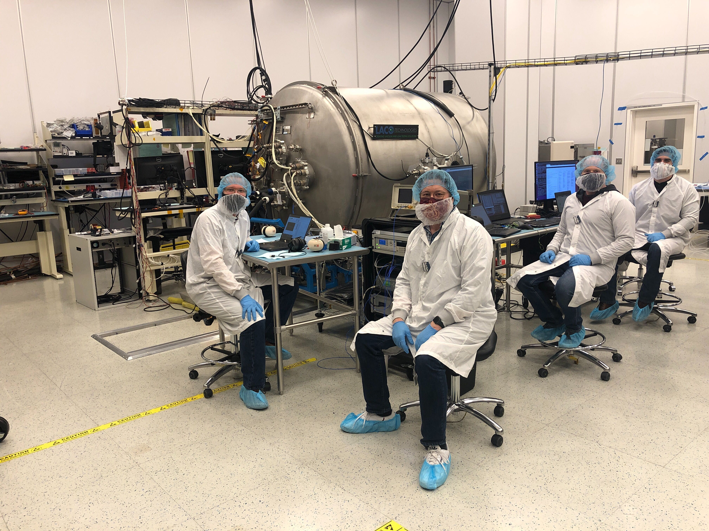
LMAP TVAC December 2020

Slide 29
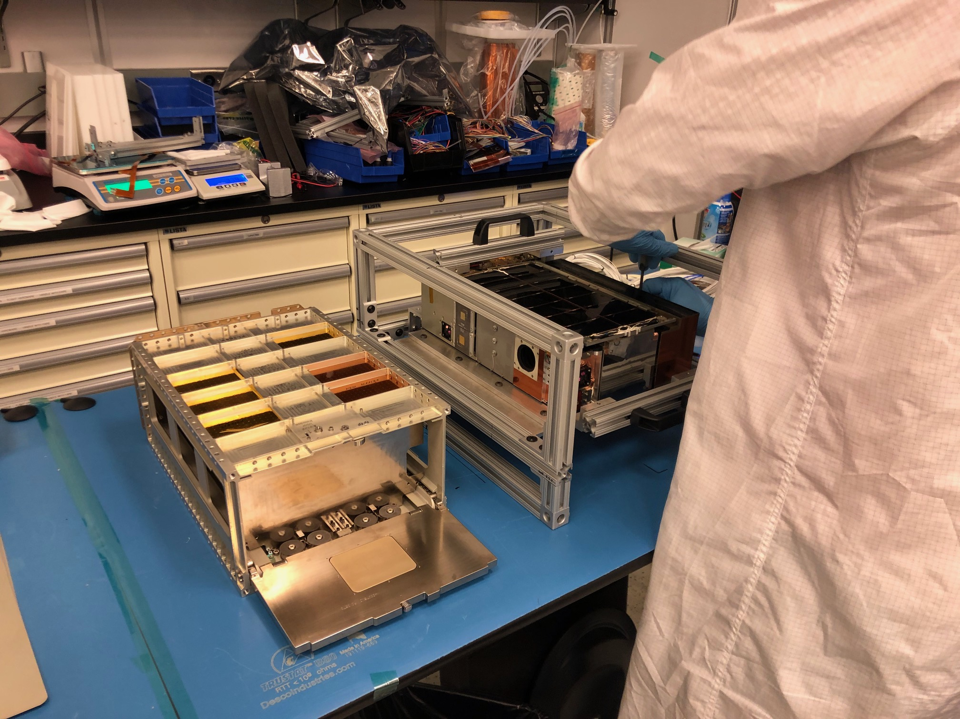
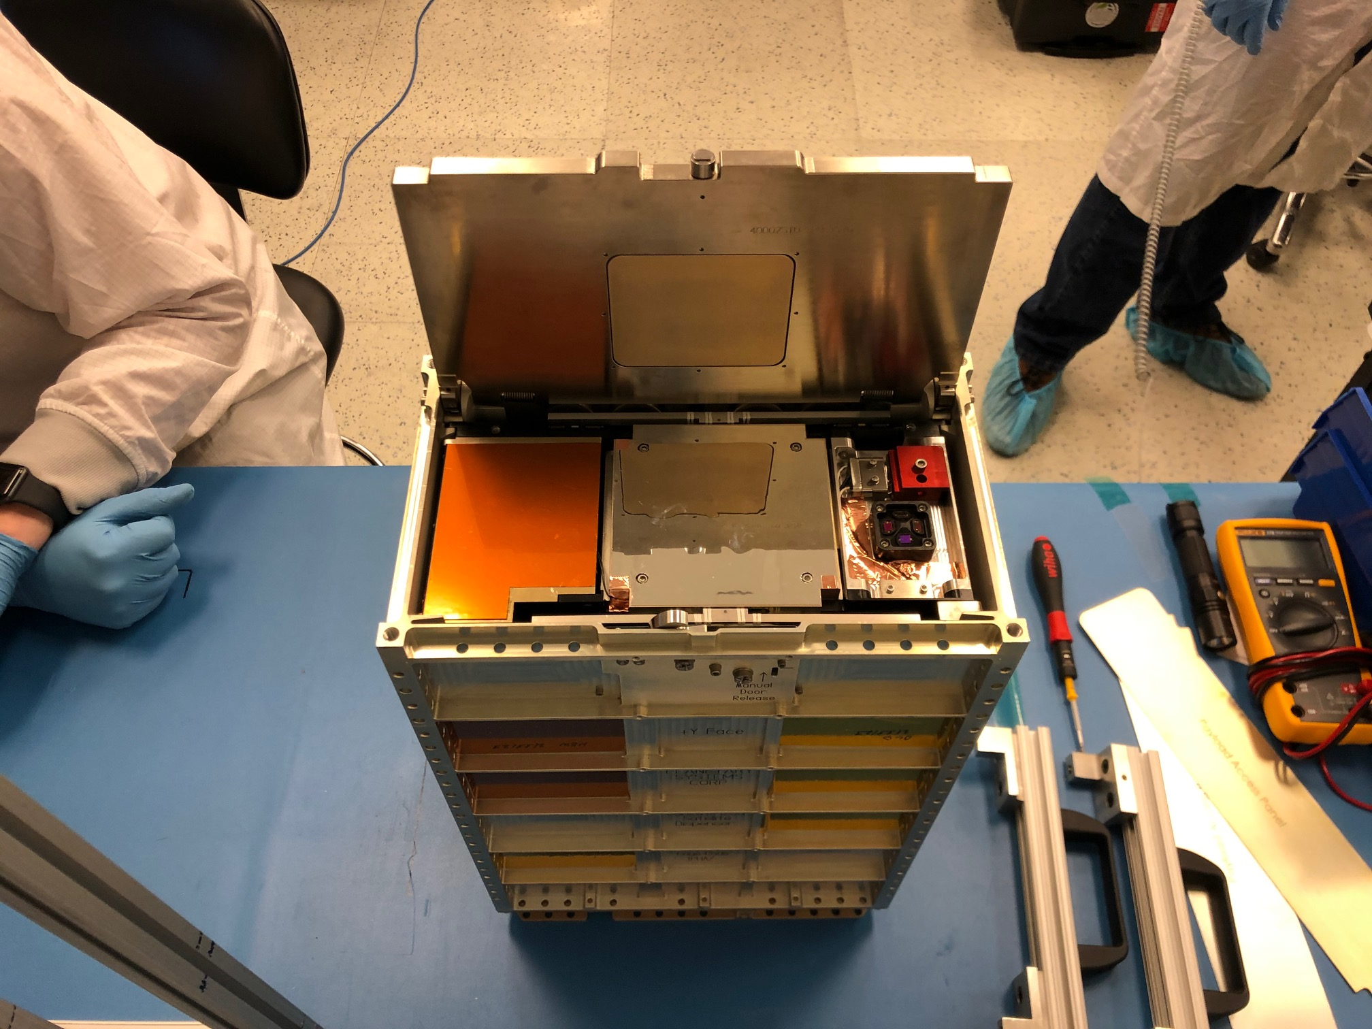
Dispenser Fit Check
March 2021

Slide 30


Dispenser Fit Check
March 2021

Slide 31


Mini-NS Characterization
Temperature characterization
Live time characterization
Day-in-the-life testing
Over 100 hours of collection time (>100% of mission requirement)
500+ data collections and power cycles >200% mission requirement)

Slide 32
Remaining Tests and Delivery
Iris over-the-air test
Final tests of deployment and initial acquisition activities
Delivery to NASA early/mid-June 2021

