Slide 1
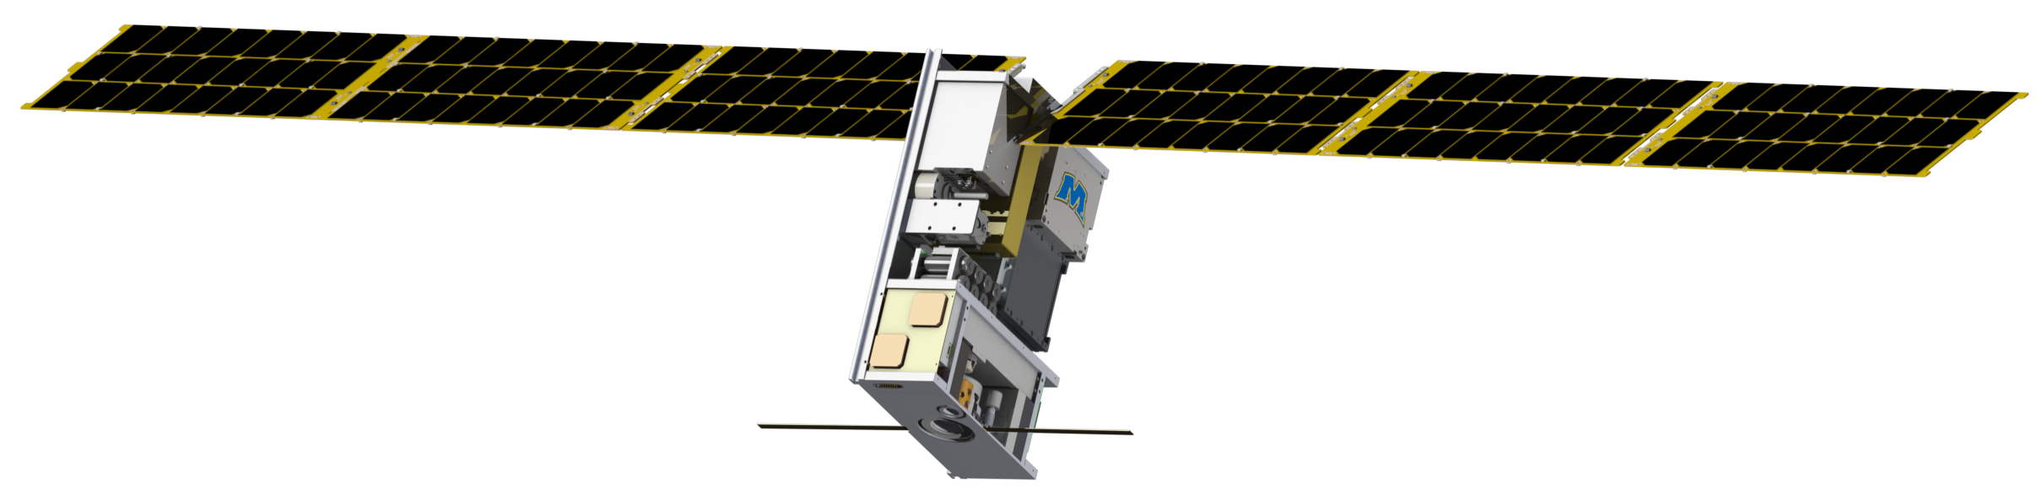
Lunar Ice Cube: Ongoing Development of First Generation Deep Space CubeSat Mission with Compact broadband IR Spectrometer
P.E. Clark (Science PI) (CalTech/JPL),
B.Malphrus (PI), N. Fite (SE), S. McNeil, C. Smith, B. Micula (Morehead State U),
C. Brambora, G. Young, N. Gorius, T. Hewagama, D. Patel, T. Hurford, D. Folta, P. Mason (NASA/GSFC)
and members of the Lunar ICe Cube Team
National Aeronautics and Space Administration
Jet Propulsion Laboratory
California Institute of Technology
Pasadena, California
www.nasa.gov
© 2021. All rights reserved.
Government sponsorship acknowledged.
Jet Propulsion Laboratory
California Institute of Technology

Slide 2
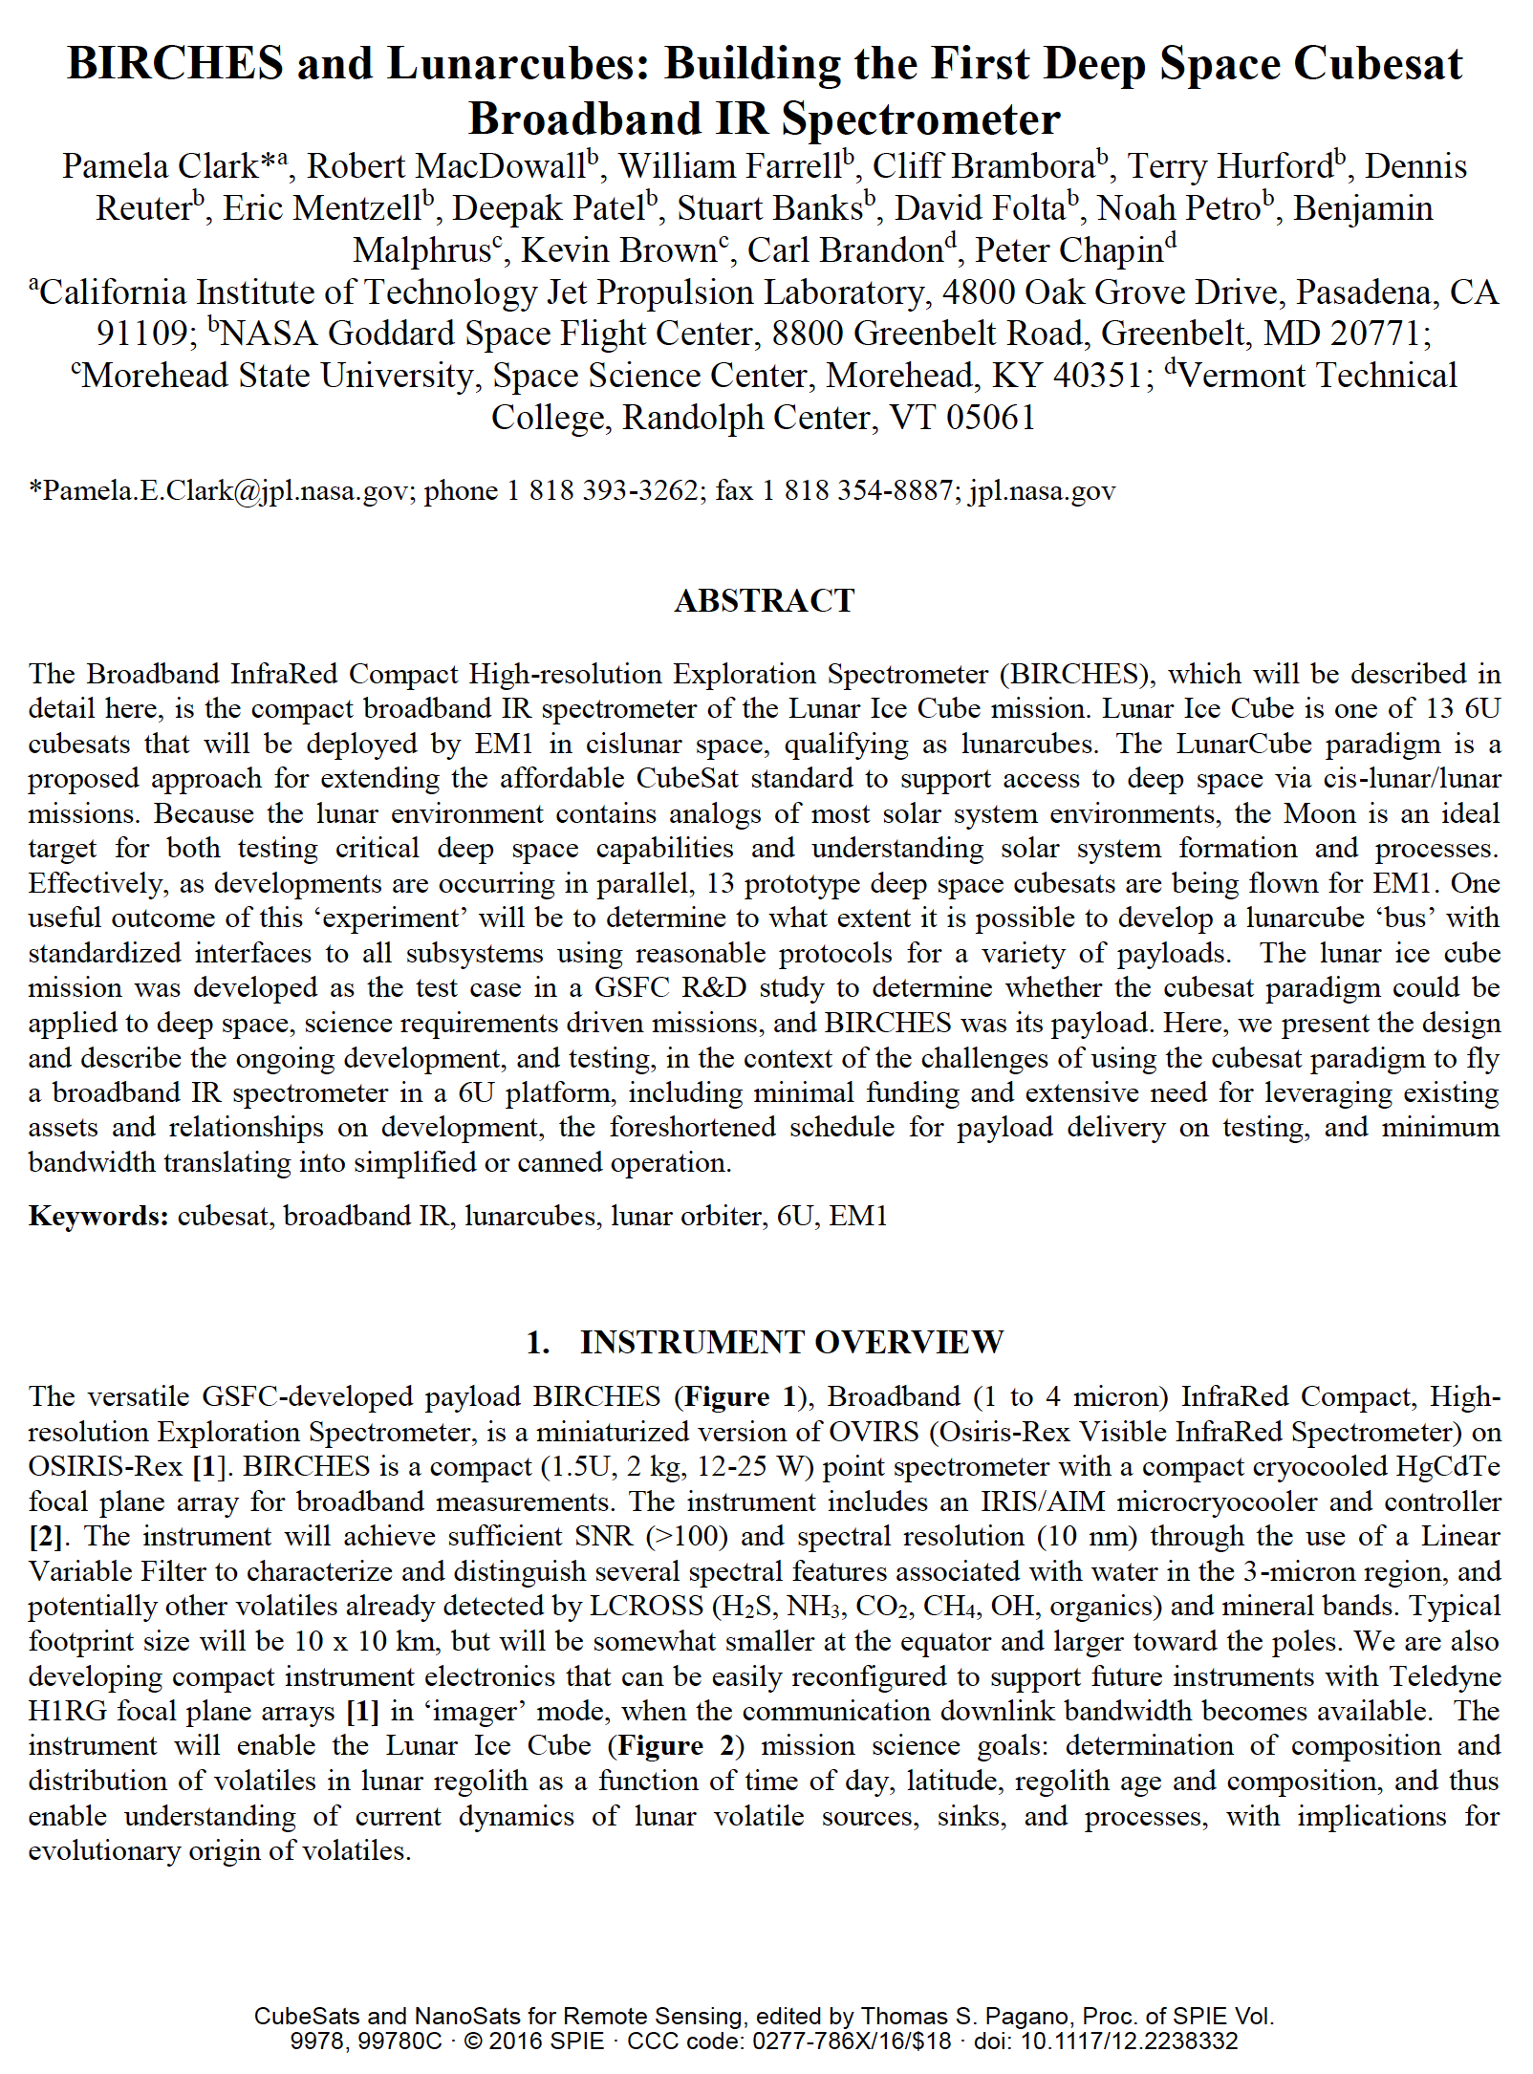
Current Status
Shutdown delay.
EM1 Launch now late 2021.
Publications (Source): Online Presentations, Short papers from 2015 at LPSC, LEAG, CDW, and ISSC. Papers, Clark et al, 2016, 2018, 2019, 2021 SPIE Optics; 2018 Small Satellite Conference.
BIRCHES and S/C now undergoing TVPM and troubleshooting detector cooling issues in preparation for optical, digital, and radiometric calibration in simulated environment.
FlatSat with emulators tested all subsystems
End to End tests for S/C successful.
Software for Level 0 and Level 1a Calibration and Flight data production Written. Critical Flight Calibration real time analysis software written.

Slide 3
Significance of Water
Relevance to NASA | Growing Evidence for Global Distribution
HEOMD Strategic Knowledge Gaps: 1) Temporal Variability and Movement Dynamics of Surface-Correlated OH and H2O deposits toward permanently shadowed area retention (Lunar Ice Cube) 2) Composition, Form and Distribution of Polar Volatiles (Lunar Flashlight, LunaH Map) 3)Quality/quantity/distribution/form of H species and other volatiles in mare and highlands regolith (Lunar Ice Cube) at >30 degrees latitude SMD Decadal Survey: understanding solar system formation, and evolution of the lunar surface and atmosphere by further establishing the role of surface volatiles SMD Scientific Context for Exploration of the Moon: Using the Moon to study regolith, exosphere (including water vapor) processes on airless bodies | Evidence for surface ice near both poles (cold traps). Evidence for bound water in surface volcanic deposits. Evidence for surface hydroxyl (OH) and water varying as function of of temperature (local time of day) and illumination (slope orientation) in 100's of PPM range. Evidence for polar region bulk water down to 1 meter depth 100 PPM range, unknown distribution

Slide 4
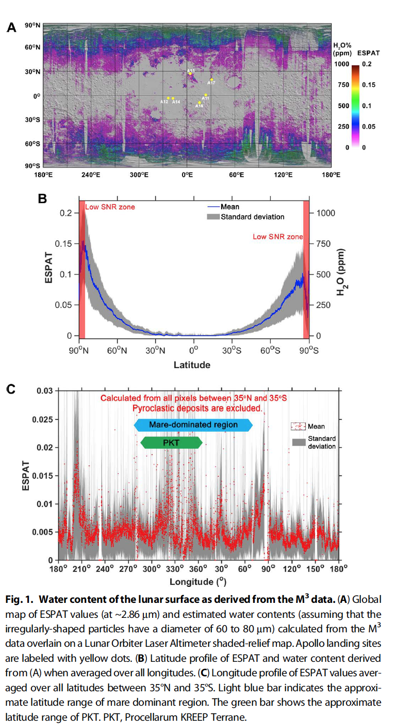
Further Evidence for Water
Map of 2.85 u Effective Single Particle Absorption Thickness (ESPAT) derived from M3 at low lunar latitudes. Features apparently associated with pyroclastic deposits, lending credence to hypothesis of volatile-rich (hundreds ppm) sources in mantle. A aristarchus; O orientale, RB Rima Bode, SG Sulpicius Gallus, TL Taur-Littrow. Milliken and Li, 2017.
M3 calculated ESPAT estimated water content (Apollo landing sites in yellow) map (A), all longitude-averaged latitude profile (B), and +/- 35 degree latitude-averaged longitude profile (C). Li and Milliken, 2017.
M3 calculated ESPAT estimated water content (Apollo landing sites in yellow) map (A), all longitude-averaged latitude profile (B), and +/- 35 degree latitude-averaged longitude profile (C). Li and Milliken, 2017.

Slide 5
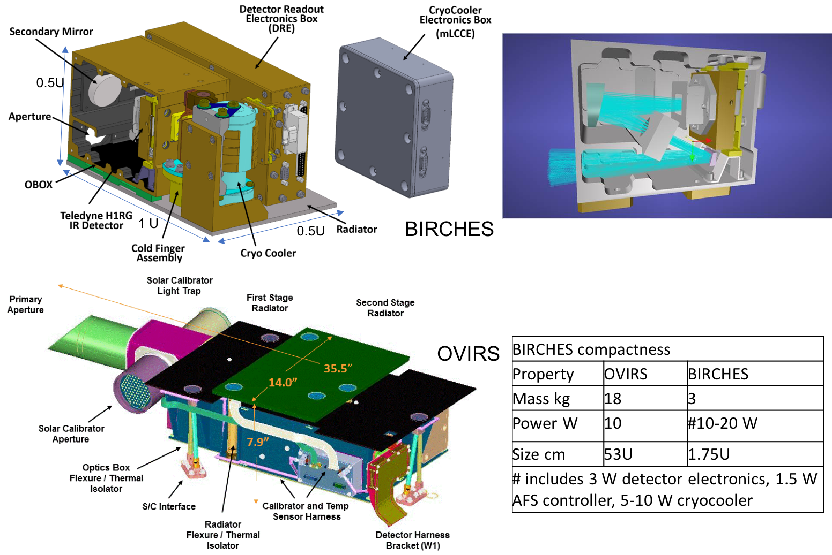
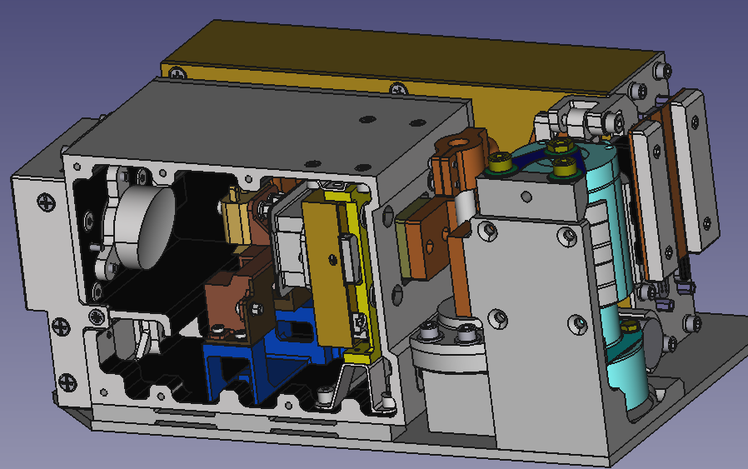
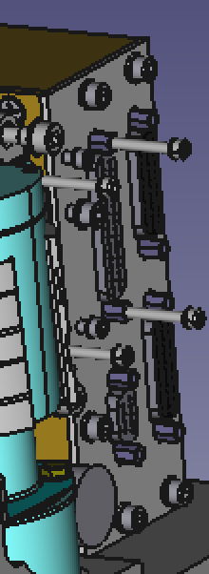
BIRCHES IR Spectrometer HW Architecture
OBOX (<200 K)
Detector Readout
Electronics (DRE) (~300 Kelvin)
Secondary
Mirror
Outer Door
Adjustable
Field
Stop
(AFS)
Cryo Cooler Electronics
Optical Input
Cryo Cooler
Teledyne H1RG
IR Detector (~120 K)
G10 Spacers
Primary Mirror
(Obscured)
Cold Finger
Assembly
DRE and Cryo-Cooler
Radiator 274K – 289K

Slide 6
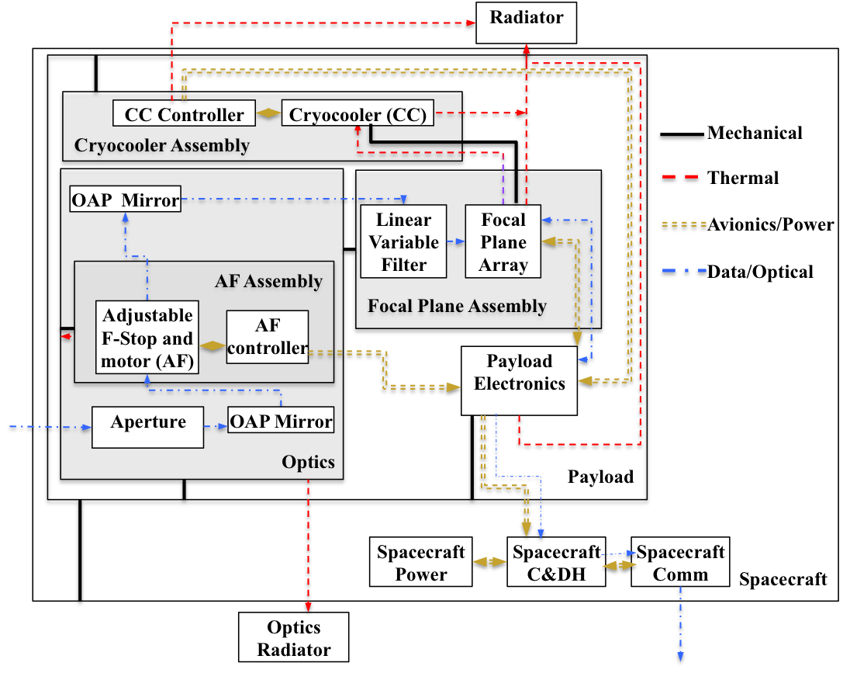
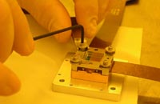
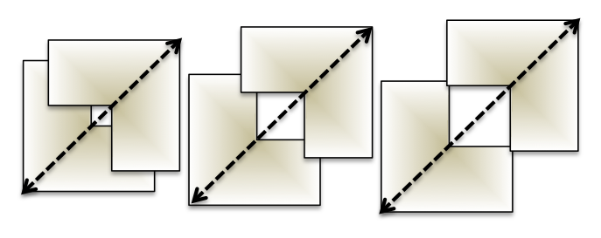
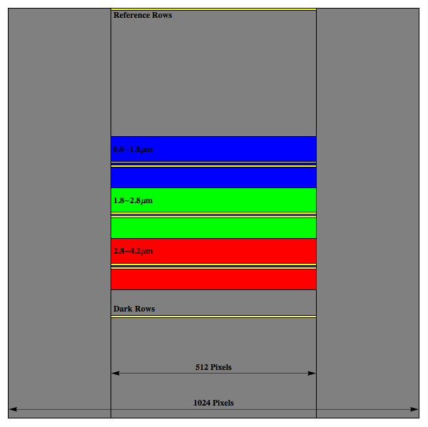
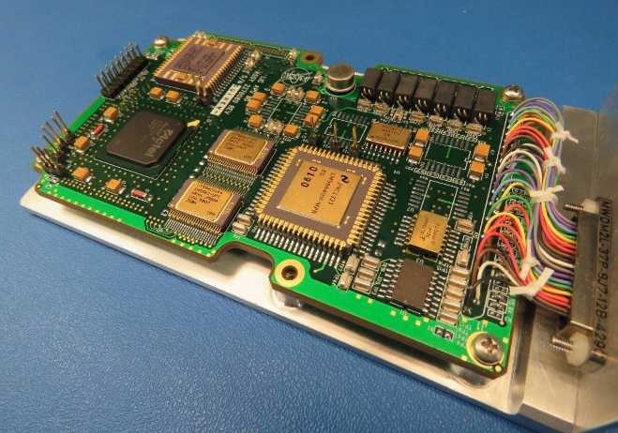
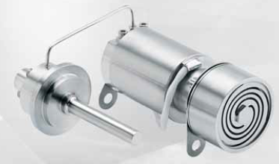
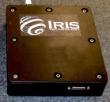
Spectrometer Schematic and Components
BIRCHES utilizes a compact Teledyne H1RG HgCdTe Focal Plane Array and JDSU linear variable filter leveraging OSIRIS REx OVIRS.
Adjustable Iris maintains footprint size at 10 km by varying FOV regardless of altitude
Linear Variable Filter Segments over H1RG focal plane array with reference, dark, segment 1, segment 2, and segment 3 rows (yellow lines) superposed.
BIRCHES Analog Processing Unit (APU) (top)
COTS AFRL developed AIM SX030 microcryocooler with cold finger to maintain detector at ≤115K and iris controller

Slide 7
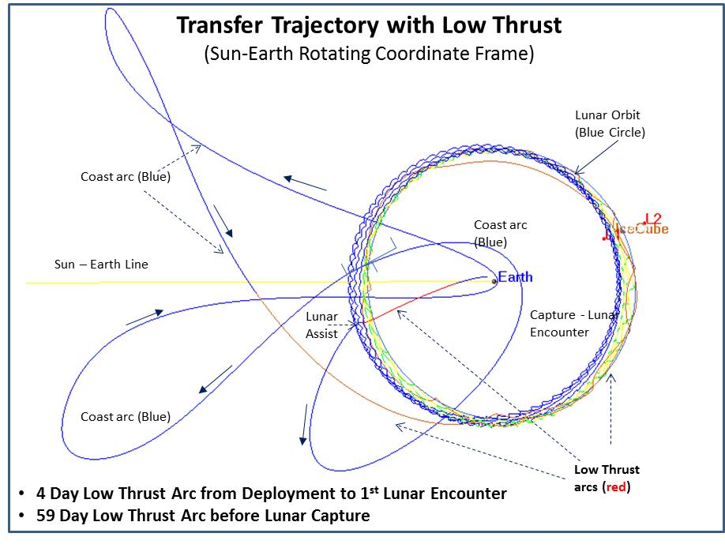
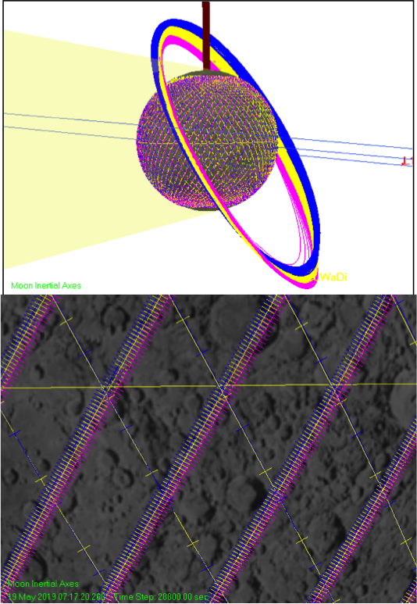
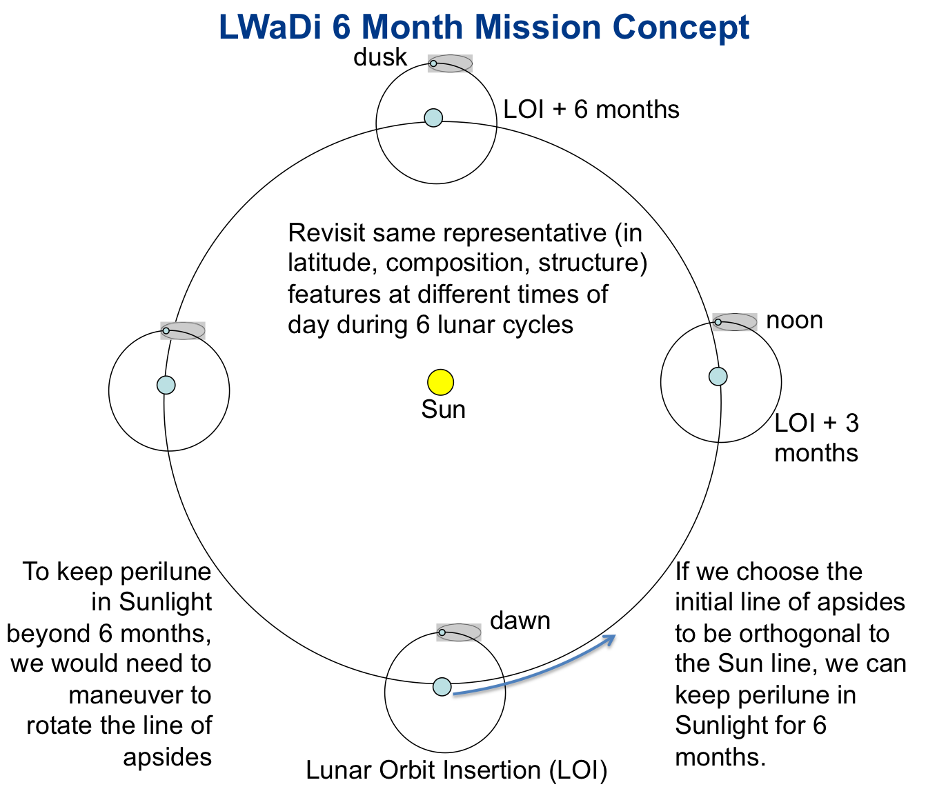
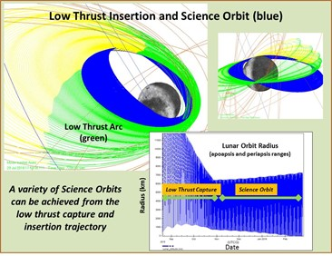
Lunar Ice Cube MIssion Concept

Slide 8
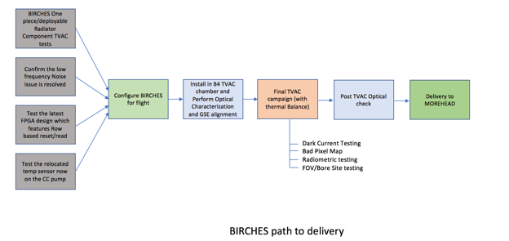
BIRCHES Testing and Calibration Plan
Figure 1-1 BIRCHES Testing and Delivery Path

Slide 9
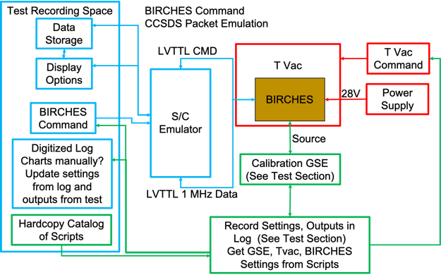
Top Level ground test configuration for all tests as described in text.

Slide 10
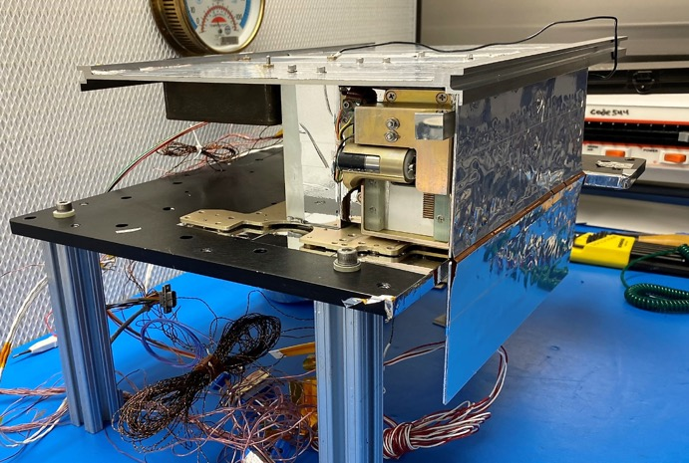
–Y Radiator
(0ºC)
MLCCE
Double
O-box
Radiators
(98K)
+ Y Radiator
(50ºC)
Figure 5-2 BIRCHES Integrated Test Configuration

Slide 11
Instrument Calibration Tests (as function of environmental temperature (TVac chamber), instrument component (including detector) temperatures (T sensors), source)
Functional Tests
Optical alignment and Boresight Tests (pre and post integration)
Other optics tests Scatter, Stray light, Uniformity Test
Detector Characterization/Radiometry
Establish Gain and Voltage settings
Establish Physical Locations of LVF Segments
Determine noise, stability, linearity of pixel response
Select readout rows (2 sets of 4 adjacent rows for each segment) on basis of bad pixel analysis.
Verify linearity of integration times
Radiometric Scaling (conversion from counts)
Spectrometry
Pixel Wavelength Map (Central Wavelength of each pixel)
Spectral resolution (spectral shape)
In and out of band responses

Slide 12
GSE Calibration
Control (Functional, T Balance, T Noise)
Day in the Life Test
GSE Commands
BIRCHES Command
Radiometry
NB Transmissions Filters
Fiber
OAP
BIRCHES
Blackbody Thermal Source
Theodolite/
Hexapod
BIRCHES Output
ZnSe
Optical/Spatial
Monochrometer
Fiber
OAP
Spectrometry
TVAC Chamber
Manual Command aligned with GSE
Settings for Rotational Stage (Hexapod) and Alignment Template for Metrology (add table)
NIST Calibrated Power Meters
Monochrometer with new Gratings, Collimator and Optical Fiber Alignment (add table)
Cleanroom

Slide 13
Challenges Summary
Challenges and Mitigations
Thermal design (on-orbit heat removal an issue for 6U, and on-surface heat retention during lunar night an issue if minimum resource (including cost) solutions sought: In future, take advantage of High performance thermal solutions now being developed. Additional work (remove some stand offs, modify detector surfaces, add small dedicated deployable radiator, variable thickness radiator) to reduce heat transfer to detector to reduce pixel saturation without increasing mass.
Development process: version controlled design and interface control documentation, and scheduled essential reviews and deliverables. Learning curve for 'first deep space qualification'. Define 'threshold' early and go to threshold as cost cap issues arise.
Team membership: high turn over and no guaranteed backups for student team. In future, would appoint staff mission operations and ground data system managers.
Non-scalable (in cost and schedule) development and operation: Support and utilize design, subsystem simulation and driver tools, operating systems, operations facilities, and data delivery pipeline tools already developed or under development for cubesats.

Slide 14
Conclusions
Lunar Ice Cube is the most operationally complex cubesat to date.
Lunar Ice Cube goal to provide measurements from which liquid water, ice, OH distribution across the lunar surface can be derived to understand function of time of day (temperature and illumination) at a variety of representative locations.
Regardless of the degree of overlap with other missions (LunaH-Map and Lunar Ice Cube) in space or time, these measurements when combined will provide far more systematic understanding of the water cycle, and the accessibility of water as a resource on the Moon.
We are doing what cubesats are supposed to do: creating an innovative and tailored solution with a standard platform.
Serious challenges for thermal design in deep space 6U volume must be addressed for next round of deep space opportunities.
pamela.e.clark@jpl.nasa.gov

Slide 15
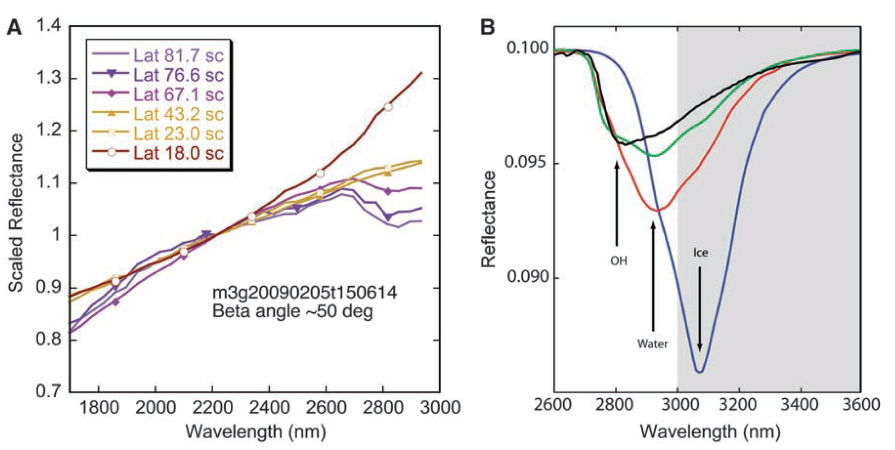
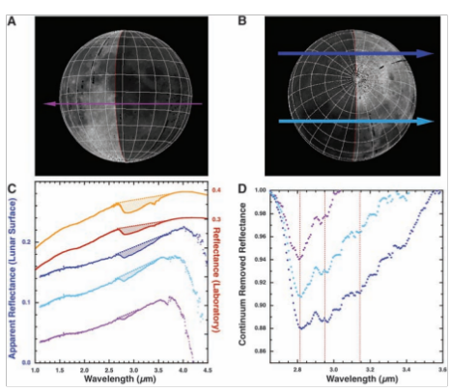
Evidence for Water
Reflectance spectra showing water and hydroxyl aborption features (near 3 microns) depth as a function of latitude. Chandrayaan M3, Pieters et al 2009
Water and Hydroxyl on Moon. Combined Red (Pyroxene), Green (Reflectance continuum), Blue (water and hydroxyl absorption) bands. Blue, Cyan, Magenta, Pink water indicators. Chandrayaan M3, Pieters et al 2009
Reflectance spectra with absorption feature strength correlated with time of day. Deep Impact Epoxi. Sunshine et al 2009

Slide 16
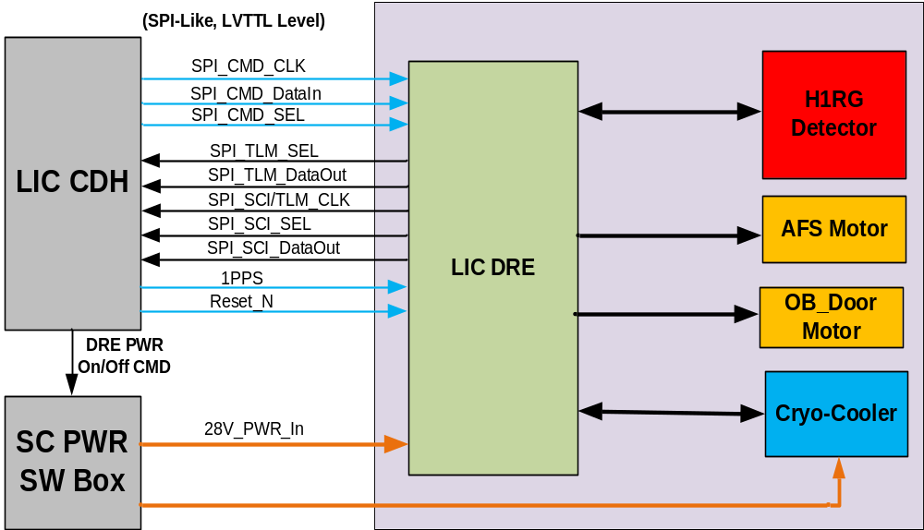
BIRCHES Functional Block Diagram
Digital Readout Interface
W1
W2
W2
W3

Slide 17
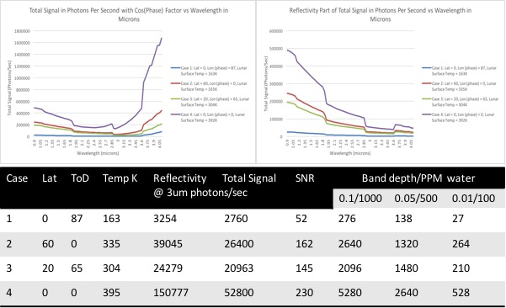

Slide 18
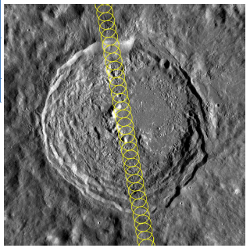
Because of the adjustable field stop, BIRCHES, with its 6 degree FOV, is capable of maintaining at 10 x 10 km footprint over the range of predicted altitudes (100 to 1000 km).
At 100 km altitude, observations, taken every second, are separated by ~2.5 km, allowing alongtrack overlap and oversampling.
Near the poles, the effective SNR is also intrinsically lower, but consecutive orbits overlap. The combination of the adjustable field stop sized to increase the effective FOV and the orbital overlap allow improved statistics through ‘sliding averages’ as well as continuous coverage in an area where water-related features are anticipated to be relatively abundant.
BIRCHES overlapping along-track observations with 10 km footprint maintained by AFS over Vasilov Crater (100 km diameter).

Slide 19
Figure 5-1 is the Building 4 Test Facility floor plan. The chamber is in a Class 10K clean room. Desk 2 has a laptop running NTGSE software and a power supply (remoting out with cable) and TVS unit (S/C emulator interface which includes data/telemetry and command interfaces). Desk 1 has the chamber controls and display (labview). The plan is to add desk 3 with laptop linked to Desk 2 for test data ‘visualization’

Slide 20
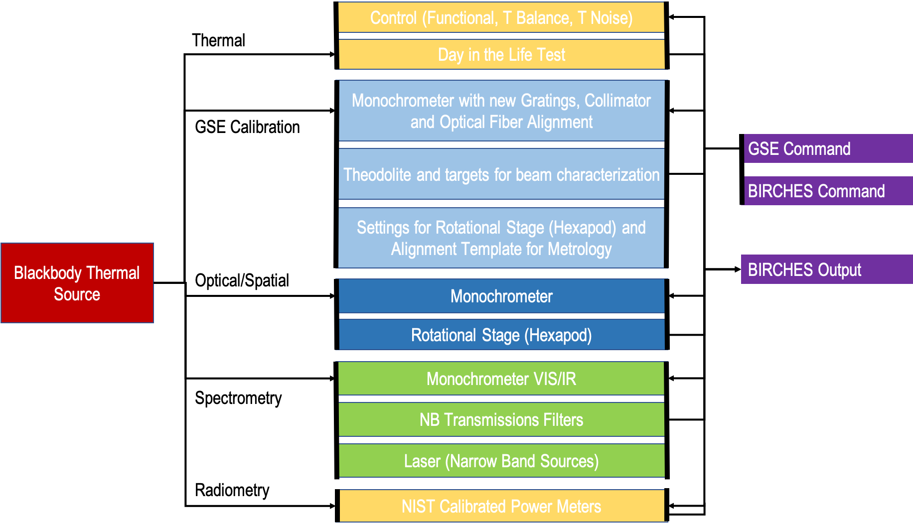
Figure 5.6 BIRCHES GSE Configuration for Pre Calibration and Calibration Tests. Most tests use Blackbody Source.

